Slide 1
VIIRS TPW Status report
Eva Borbas (PI), Zhenglong Li, Paul Menzel, and Laura Dobor
CIMSS/SSEC
University of Wisconsin-Madison
MODIS Science Team Meeting, 6-10 June, 2016

Slide 2
Overview
Validation for 2012-2015 with TPW from ground-based GPS network, MWR, and RAOB (poster)
VIIRS TPW L2 algorithm/products based on 6 min granules
Hole filling
Smoothing
Algorithm delivered
Granule and one day global validation using MYD07
Ready for comprehensive validation
Working on L3 algorithm as well as ATBD

Slide 3
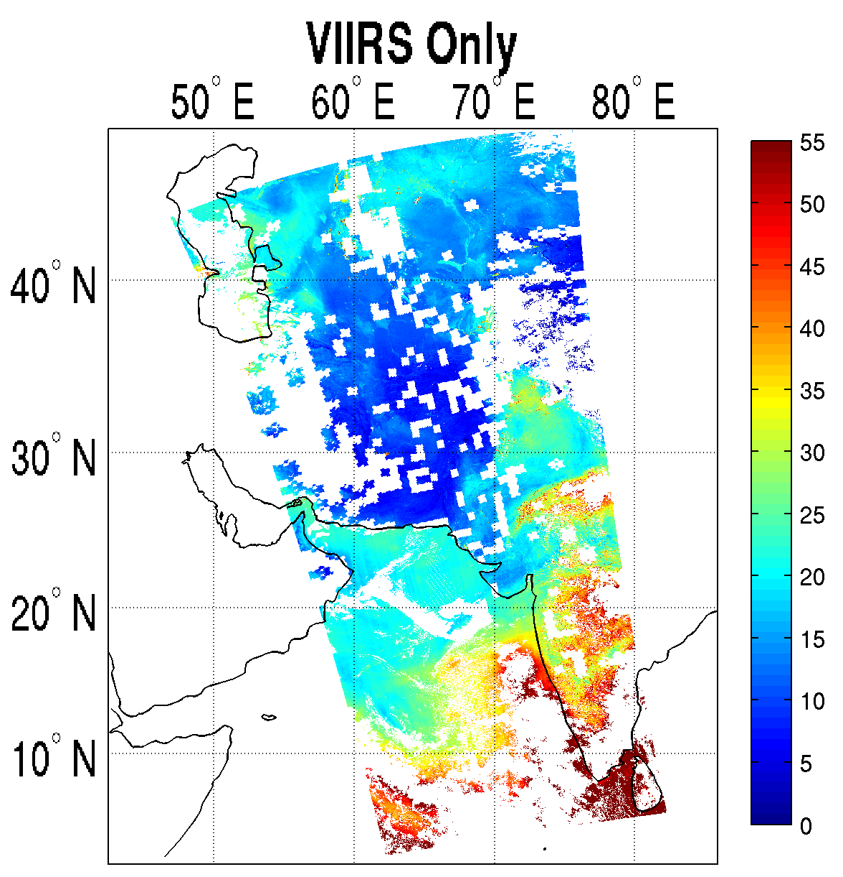
Retrieval comparison
Unit: mm
Retrieval Comparison
0842~0854 UTC
10/15/2014
NUCAPS

Slide 4
Difference Images
Unit: mm

Slide 5
Retrieval comparison
Retrieval Comparison
Unit: mm
Radius of 60 is used!
0842~0854 UTC
10/15/2014
20141015 09:20 UTC
NUCAPS MYD07

Slide 6
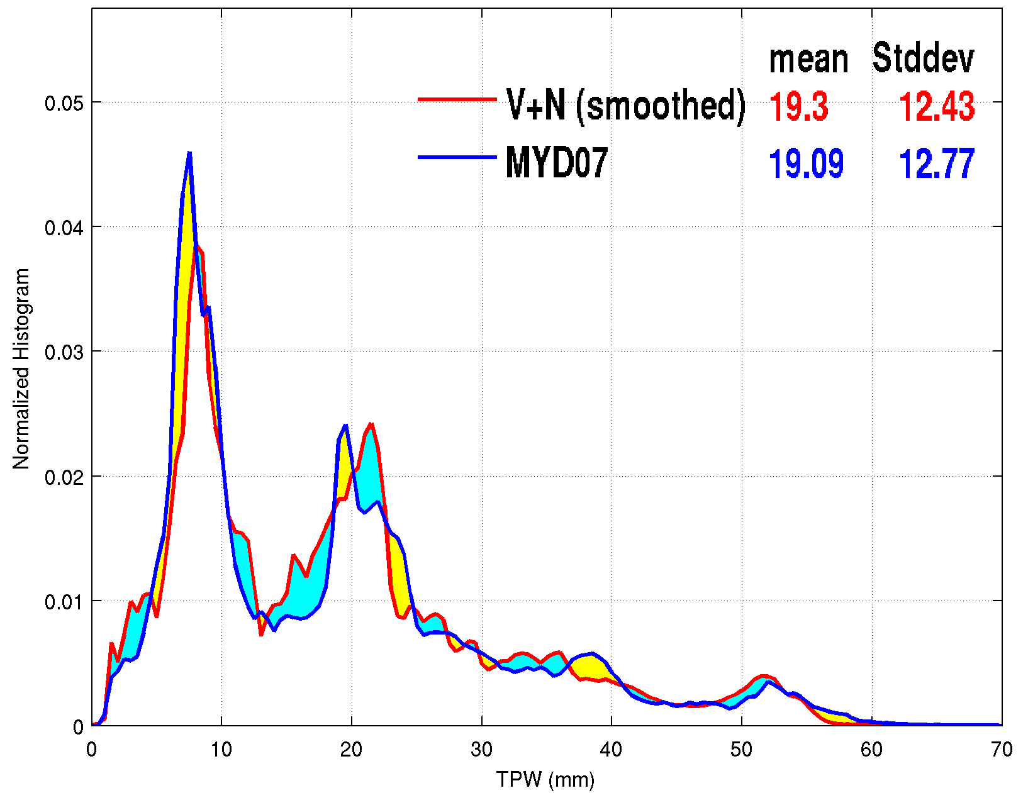
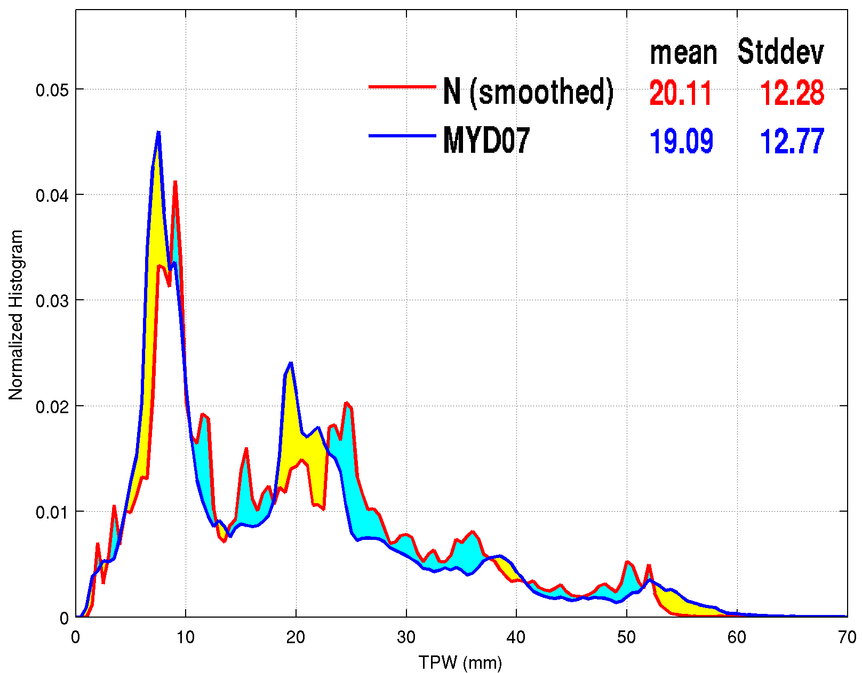
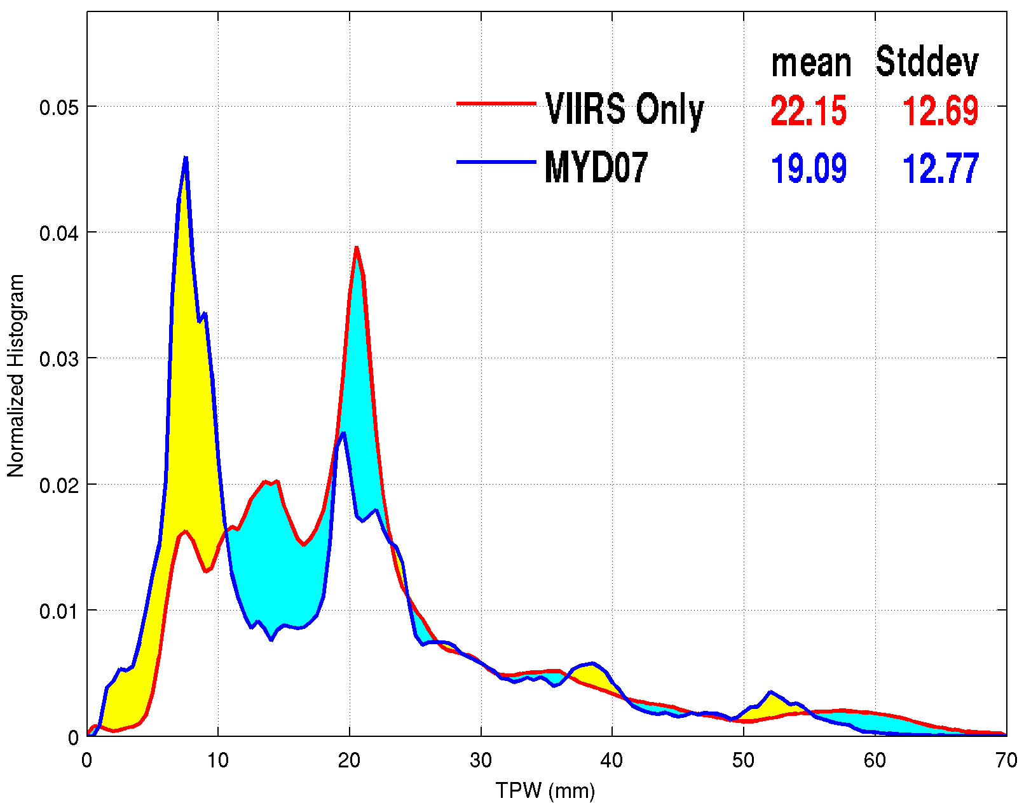
Histograms (smoothed)
VIIRS+NUCAPS
NUCAPS only VIIRS only

Slide 7
Summary
L2 algorithm/products based on 6 min granules
NUCAPS holes filled and smoothed;
VIIRS+NUCAPS adjusts both NUCAPS alone and VIIRS alone, information from both is a better product
VIIRS+NUCAPS less affected by cloud and surface features
Apply STG software to build the global daily, and monthly VIIRS/NUCAPS L3 gridded TPW products
Compare VIIRS/NUCAPS TPW L3 global products to MOD07 L3, AIRS L3, and SSMI
Finalize ATBDs

