Slide 1

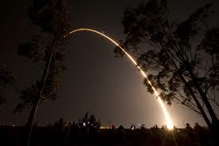



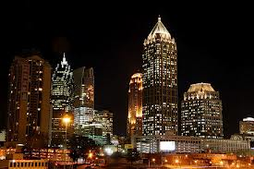


Application of DNB for air quality and fire monitoring
Jun Wang
Yun Yue, Xiaoguang Xu
Yang Liu
Robert Levy
James J. Szykman
In collaboration with
Suomi-NPP launch
28 Oct. 2011
Lina Balluz
Chaoyang Li
Robert Holz

Slide 2
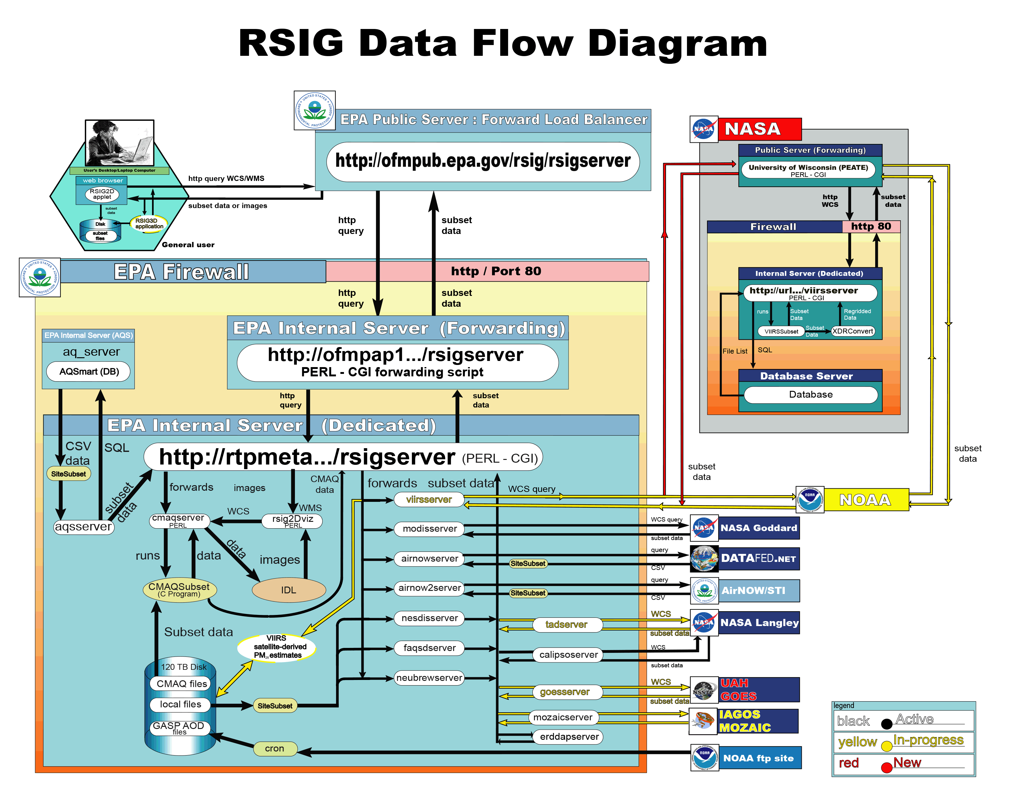
Use of EPA Remote Sensing Information Gateway to deliver VIIRS AOD/PM_{2.5} data products
Current satellite WCS:
  MODIS C6 (10 km, 3 km, DB)
  CALIOP, GASP (GOES AOD)
  Prototype NOAA-VIIRS
Establish OGC compliant Web Coverage Service (WCS ) between PEATE and RSIG to add NASA- VIIRS data (This project). --- Done !!!
GEOS-Chem scaling factors used to create a daily Look-Up-Table (LUT) of the spatial varying relation of AOD and PM_{2.5} (van Donkelaar et. al., 2012, ES&T) .
Prototype use of AOD-to-PM2.5 scaling factors via regional models (WRF-CMAQ & WRF-CHEM) and explore ensemble type approach (This project).
http://ofmpub.epa.gov/rsig/rsigserver?index.html

Slide 3
Summary
  Data flow from UW-SIPS (Science Investigator Processing System) to EPA’s RSIG is implemented, tested, and successful. ARL4->ARL-7
  Evaluation of ensemble approach for surface PM2.5 estimates from VIIRS and other satellite projects is conducted for June 2012. This would provide insight on the selection and improvement of operation approach for remote sensing of surface PM_{2.5}. ARL2->ARL3
  Refinement of Hierarchical Autoregressive Model has started in EPA site. ARL5->ARL7

Slide 4
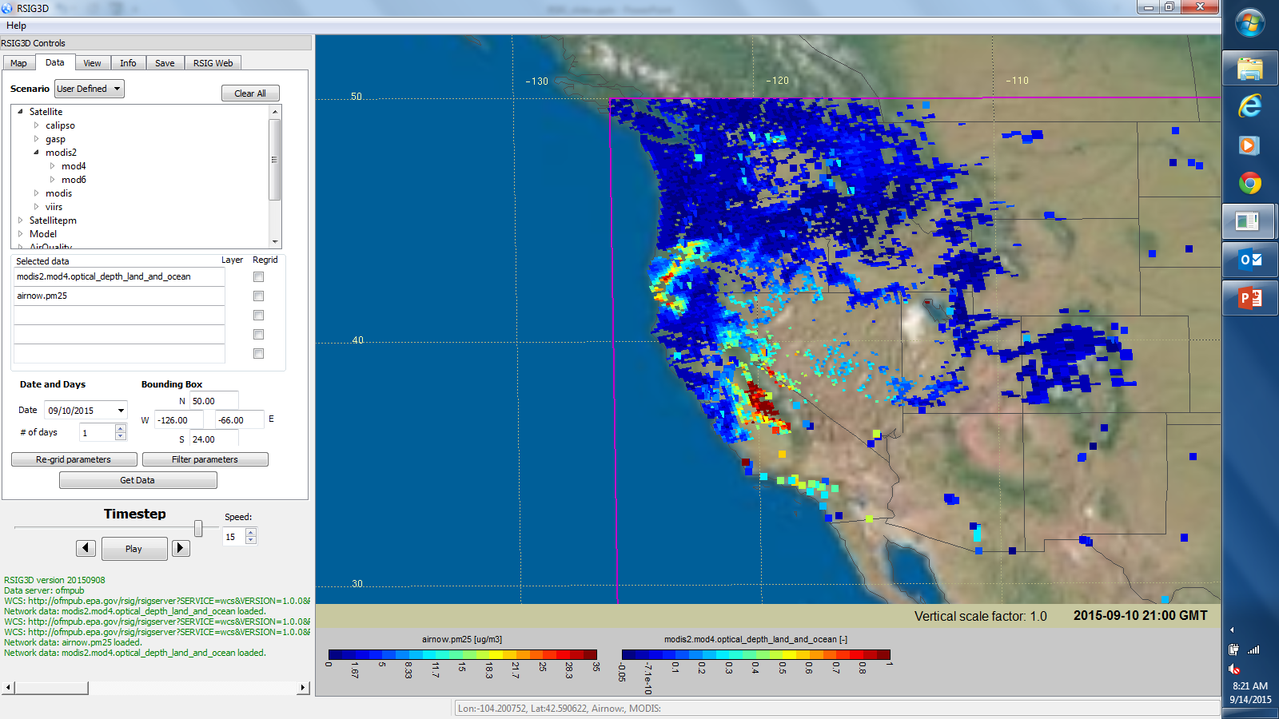
Developed and implemented operational PEATE-RSIG WCS using MOD04; to be switched to VIIRS data products when final file format implemented on PEATE
MODIS2 data selection - Operational PEATE-RSIG WCS for using MOD04

Slide 5
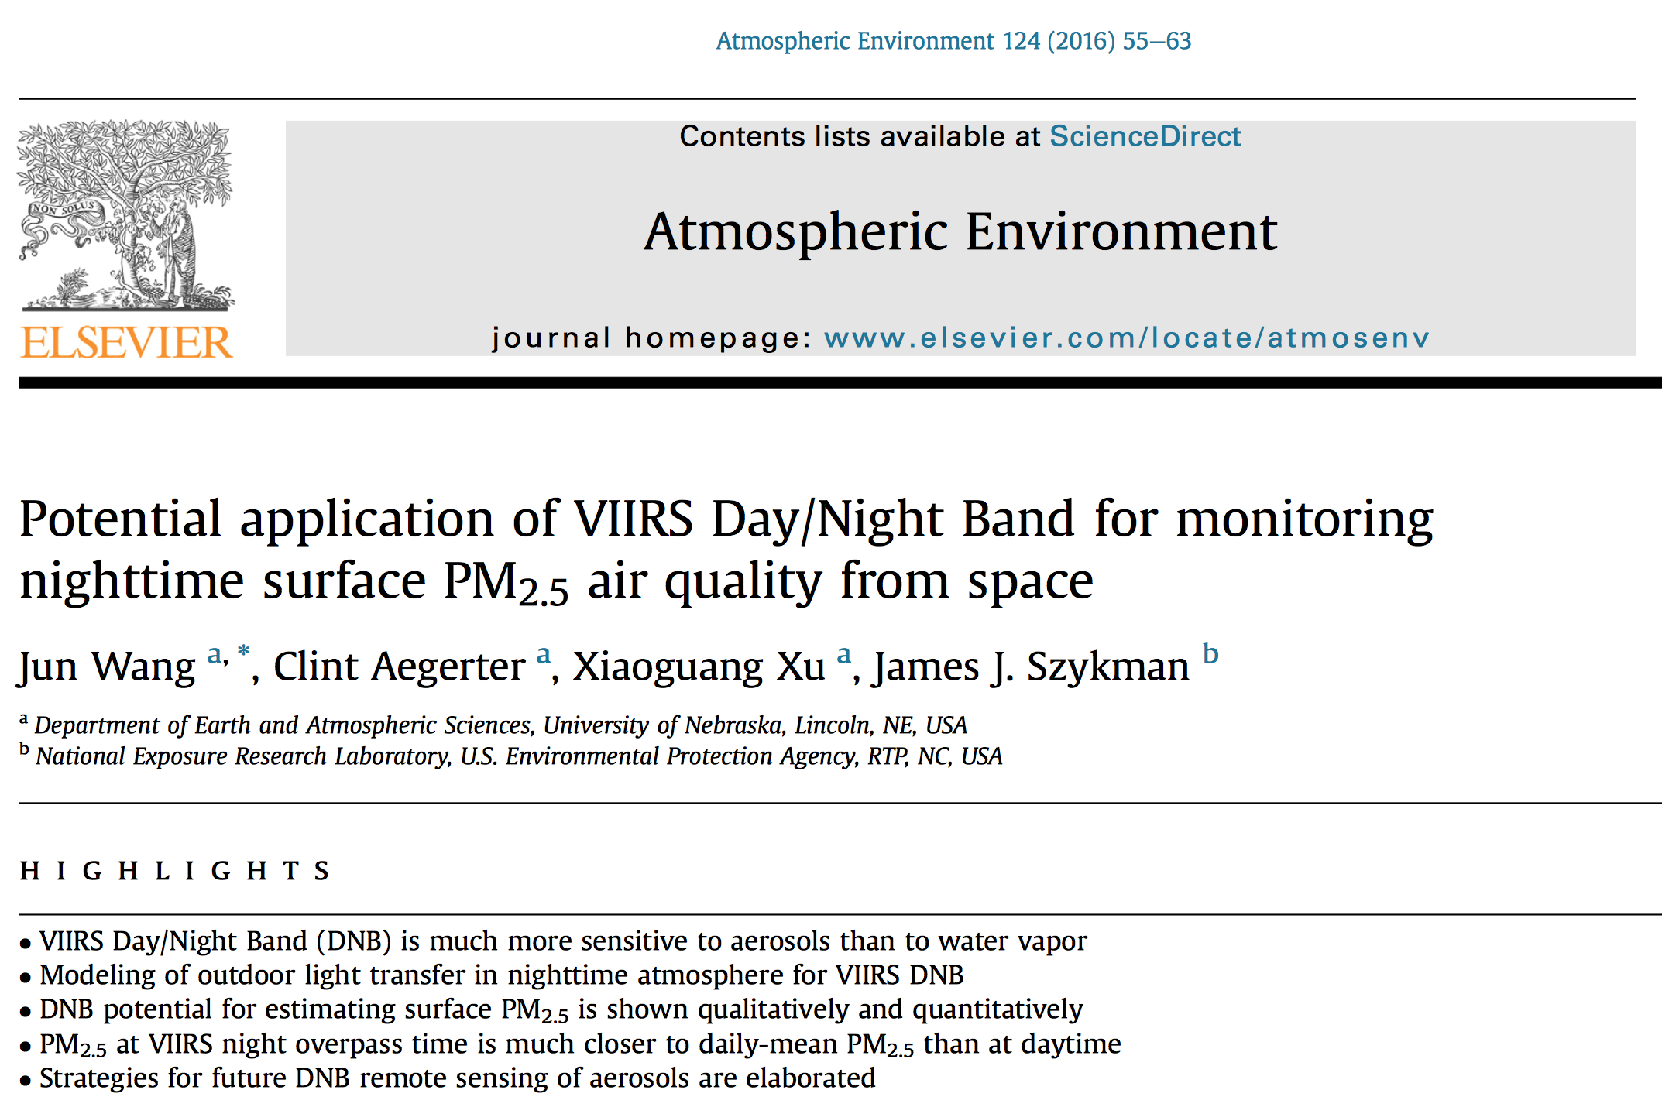

Slide 6
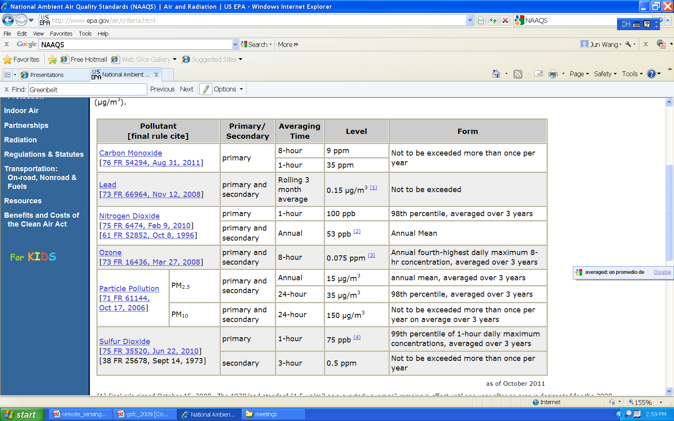
National Ambient Air Quality Standards
12 μg/m³,
FR, 15 Jan. 2013
Notes:
Final rule signed October 15, 2008. The 1978 lead standard (1.5 µg/m3 as a quarterly average) remains in effect until one year after an area is designated for the 2008 standard, except that in areas designated nonattainment for the 1978, the 1978 standard remains in effect until implementation plans to attain or maintain the 2008 standard are approved.
(2) The official level of the annual NO2 standard is 0.053 ppm, equal to 53 ppb, which is shown here for the purpose of clearer comparison to the 1-hour standard.
(3) Final rule signed March 12, 2008. The 1997 ozone standard (0.08 ppm, annual fourth-highest daily maximum 8-hour concentration, averaged over 3 years) and related implementation rules remain in place. In 1997, EPA revoked the 1-hour ozone standard (0.12 ppm, not to be exceeded more than once per year) in all areas, although some areas have continued obligations under that standard (“anti-backsliding”). The 1-hour ozone standard is attained when the expected number of days per calendar year with maximum hourly average concentrations above 0.12 ppm is less than or equal to 1.
(4) Final rule signed June 2, 2010. The 1971 annual and 24-hour SO2 standards were revoked in that same rulemaking. However, these standards remain in effect until one year after an area is designated for the 2010 standard, except in areas designated nonattainment for the 1971 standards, where the 1971 standards remain in effect until implementation plans to attain or maintain the 2010 standard are approved.

Slide 7
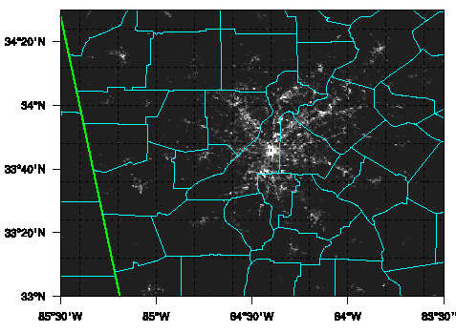

NAAQS uses daily and annual averages of PM_{2.5}
Can we use DNB to estimate surface PM_{2.5} at night?
At night, aerosols are often mixed in a shallow nocturnal boundary layer.
Retrieval of AOD from DNB is still in its infancy; preliminary work include Zhang et al. (2008) and Johnson et al. (2013).
We like to make a first attempt to apply DNB for night time PM_{2.5} air quality.
Aug – Oct 2012. Focus area: Atlanta
PM_{2.5}: 5 ug/m³
PM_{2.5}: 13 ug/m³
VIIRS DNB, 7 Sep. 2012
VIIRS DNB, 8 Sep. 2012

Slide 8
Is DNB sensitive to aerosol, water vapor, & O₂ absorption ?
Miller et al., 2013
H₂O
H₂O
O₂-B
O₂-A
Wang et al., 2014
µm

Slide 9
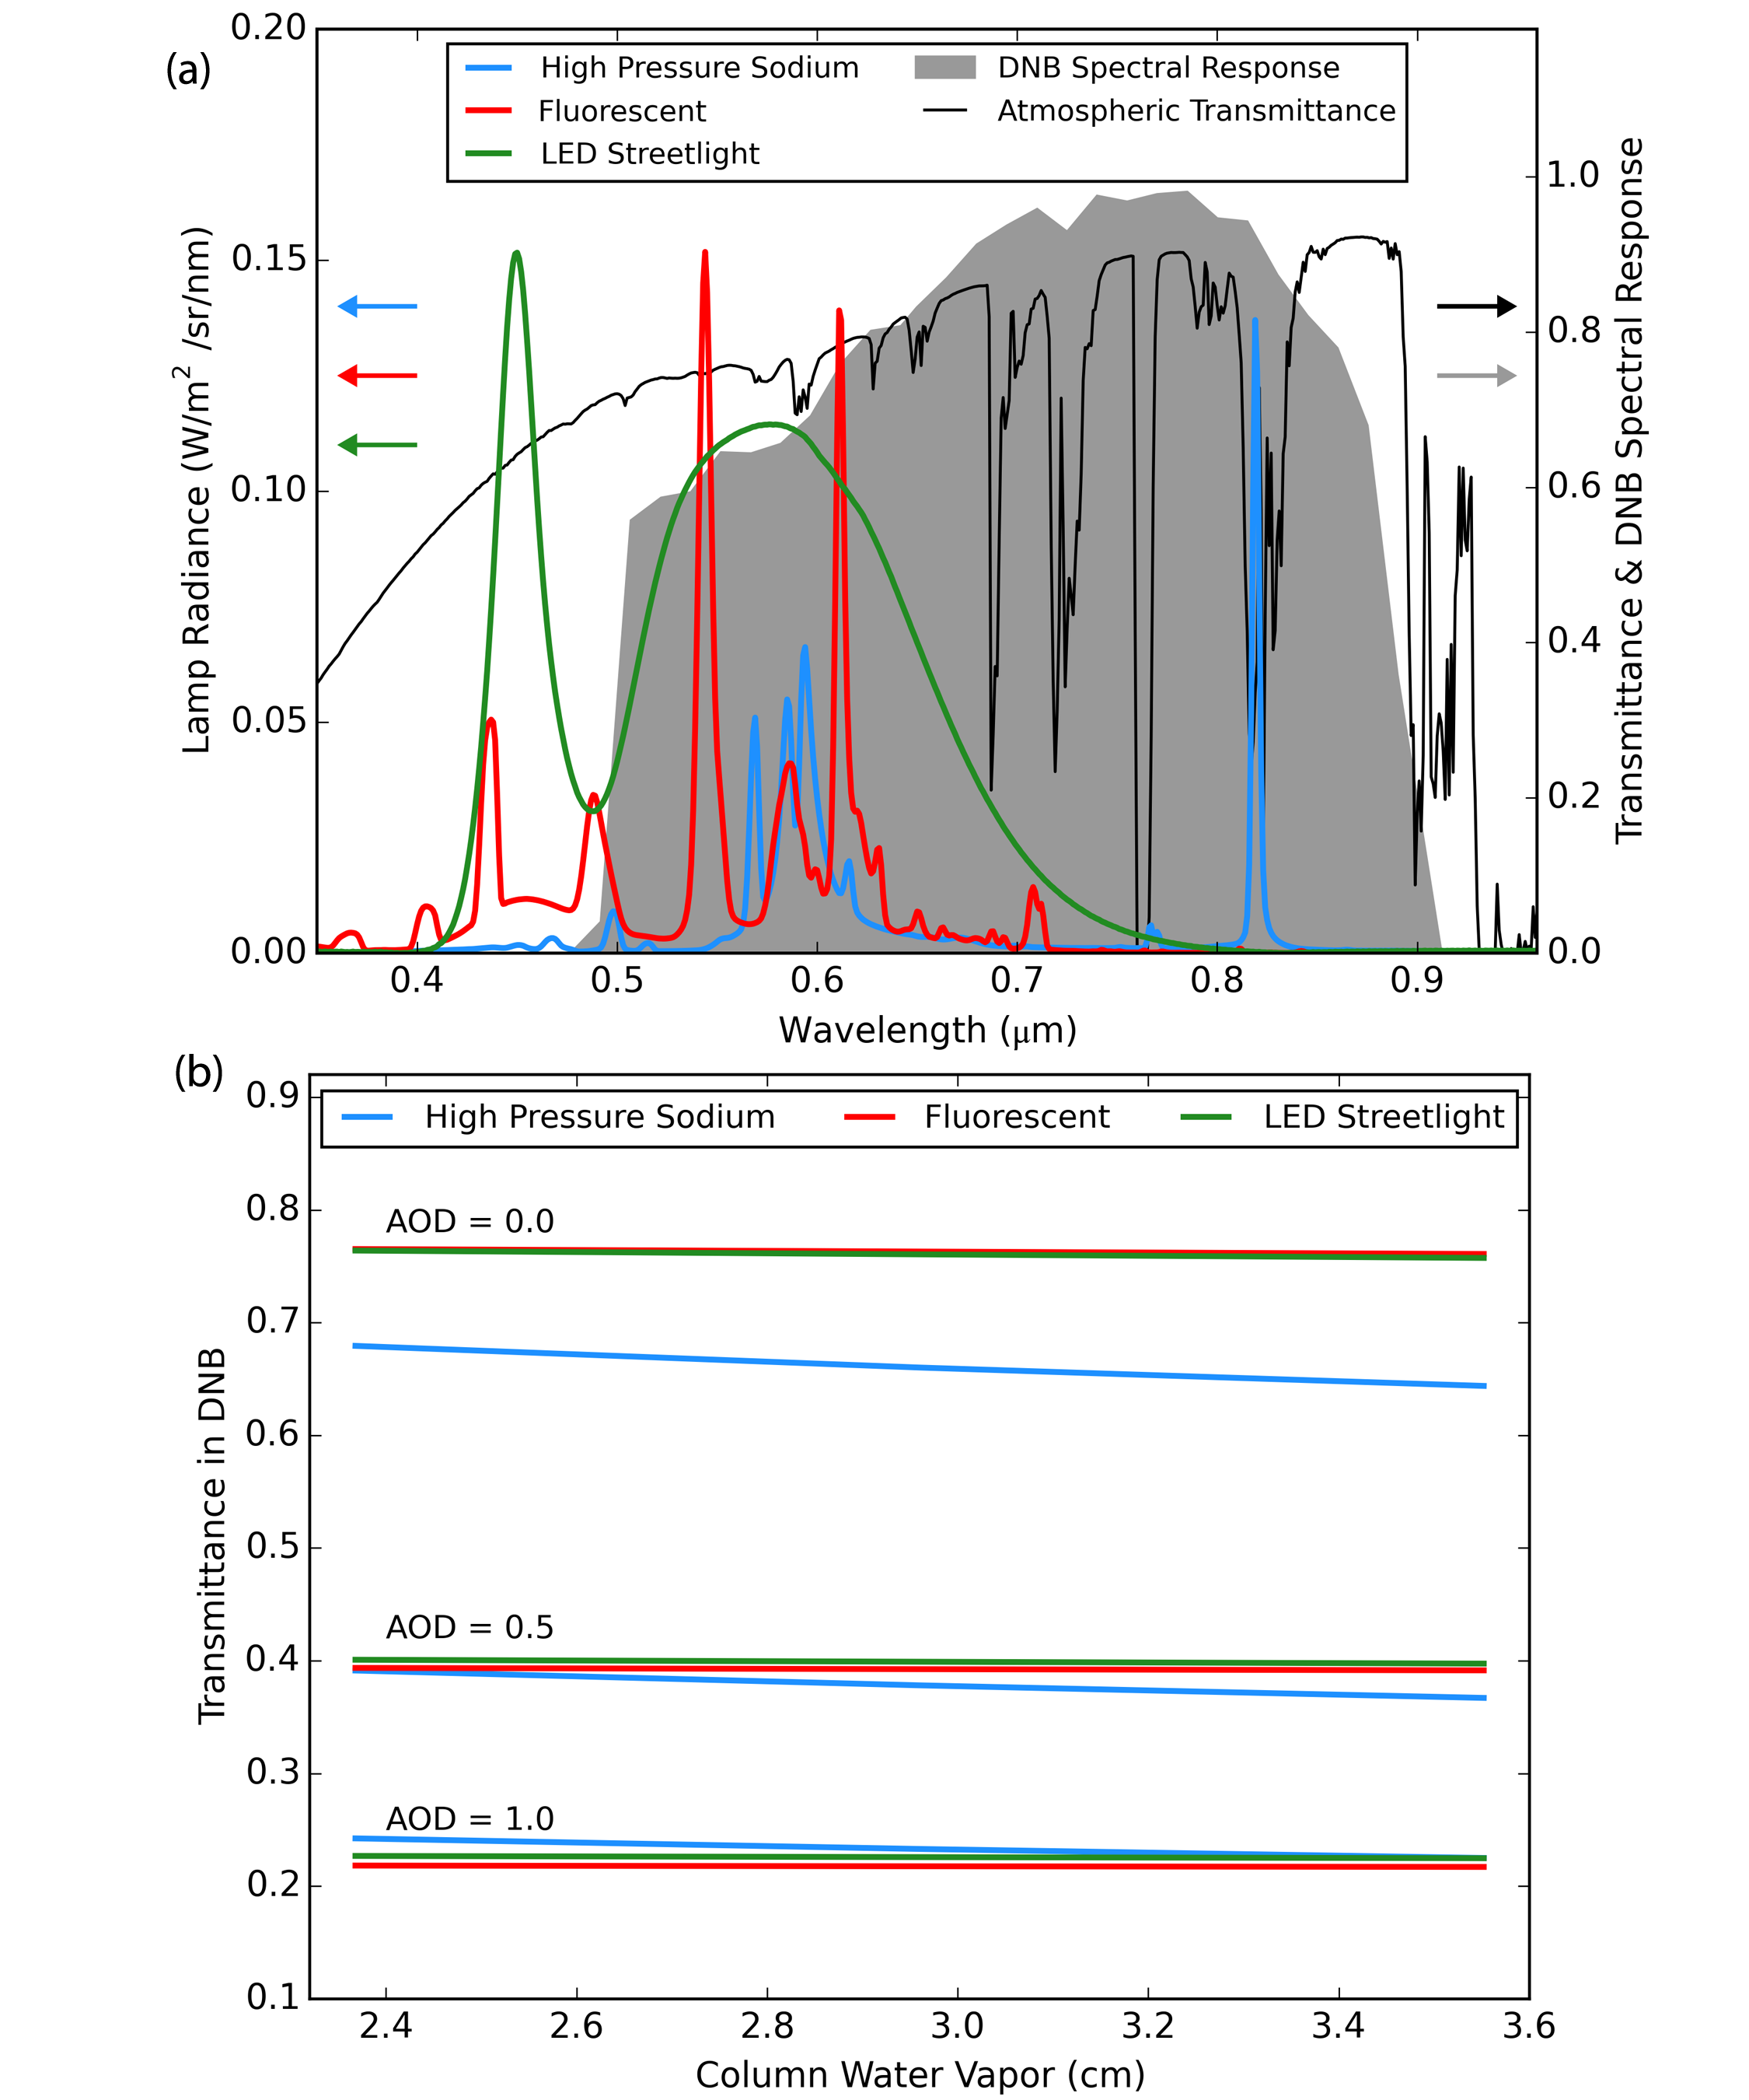
DNB is most sensitive to change of AOD but, water vapor effect is also not negligible
The database of spectral intensity emitted from HPS, fluorescent, and LED bulbs are from Elvidge et al., (2010).
In the U.S., high- pressure sodium lamps (HPS) are the most common type of light source used for outdoor applications (Rea et al., 2009)

Slide 10
PM_{2.5} at VIIRS night overpass time is more representative daily-mean PM_{2.5} than at noon time (VIIRS daytime overpass)

Slide 11
Regression analysis
Among surface wind speed, surface pressure, and columnar water vapor amount) that are routinely measured at the surface, the DNB light intensity is the only variable that shows either the largest or second largest correlation with surface PM2.5.

Slide 12
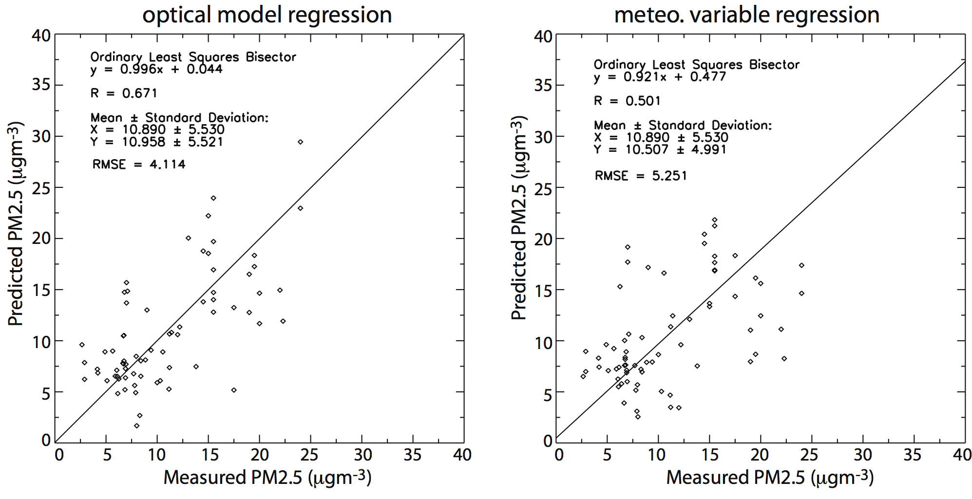
Leave-one-out cross validation of regression model
$$\frac{{PM}_{2.5}f\left(rh\right)}{μ}=a_{0}−a_{I}ln\left(I\right)−a_{r}×W−a_{p}×P_{s}$$
$${PM}_{2.5}=f(W, Ps, U, V)$$
VIIRS-based optical model gives better estimate of surface PM_{2.5} than meteorology-based regression.

Slide 13
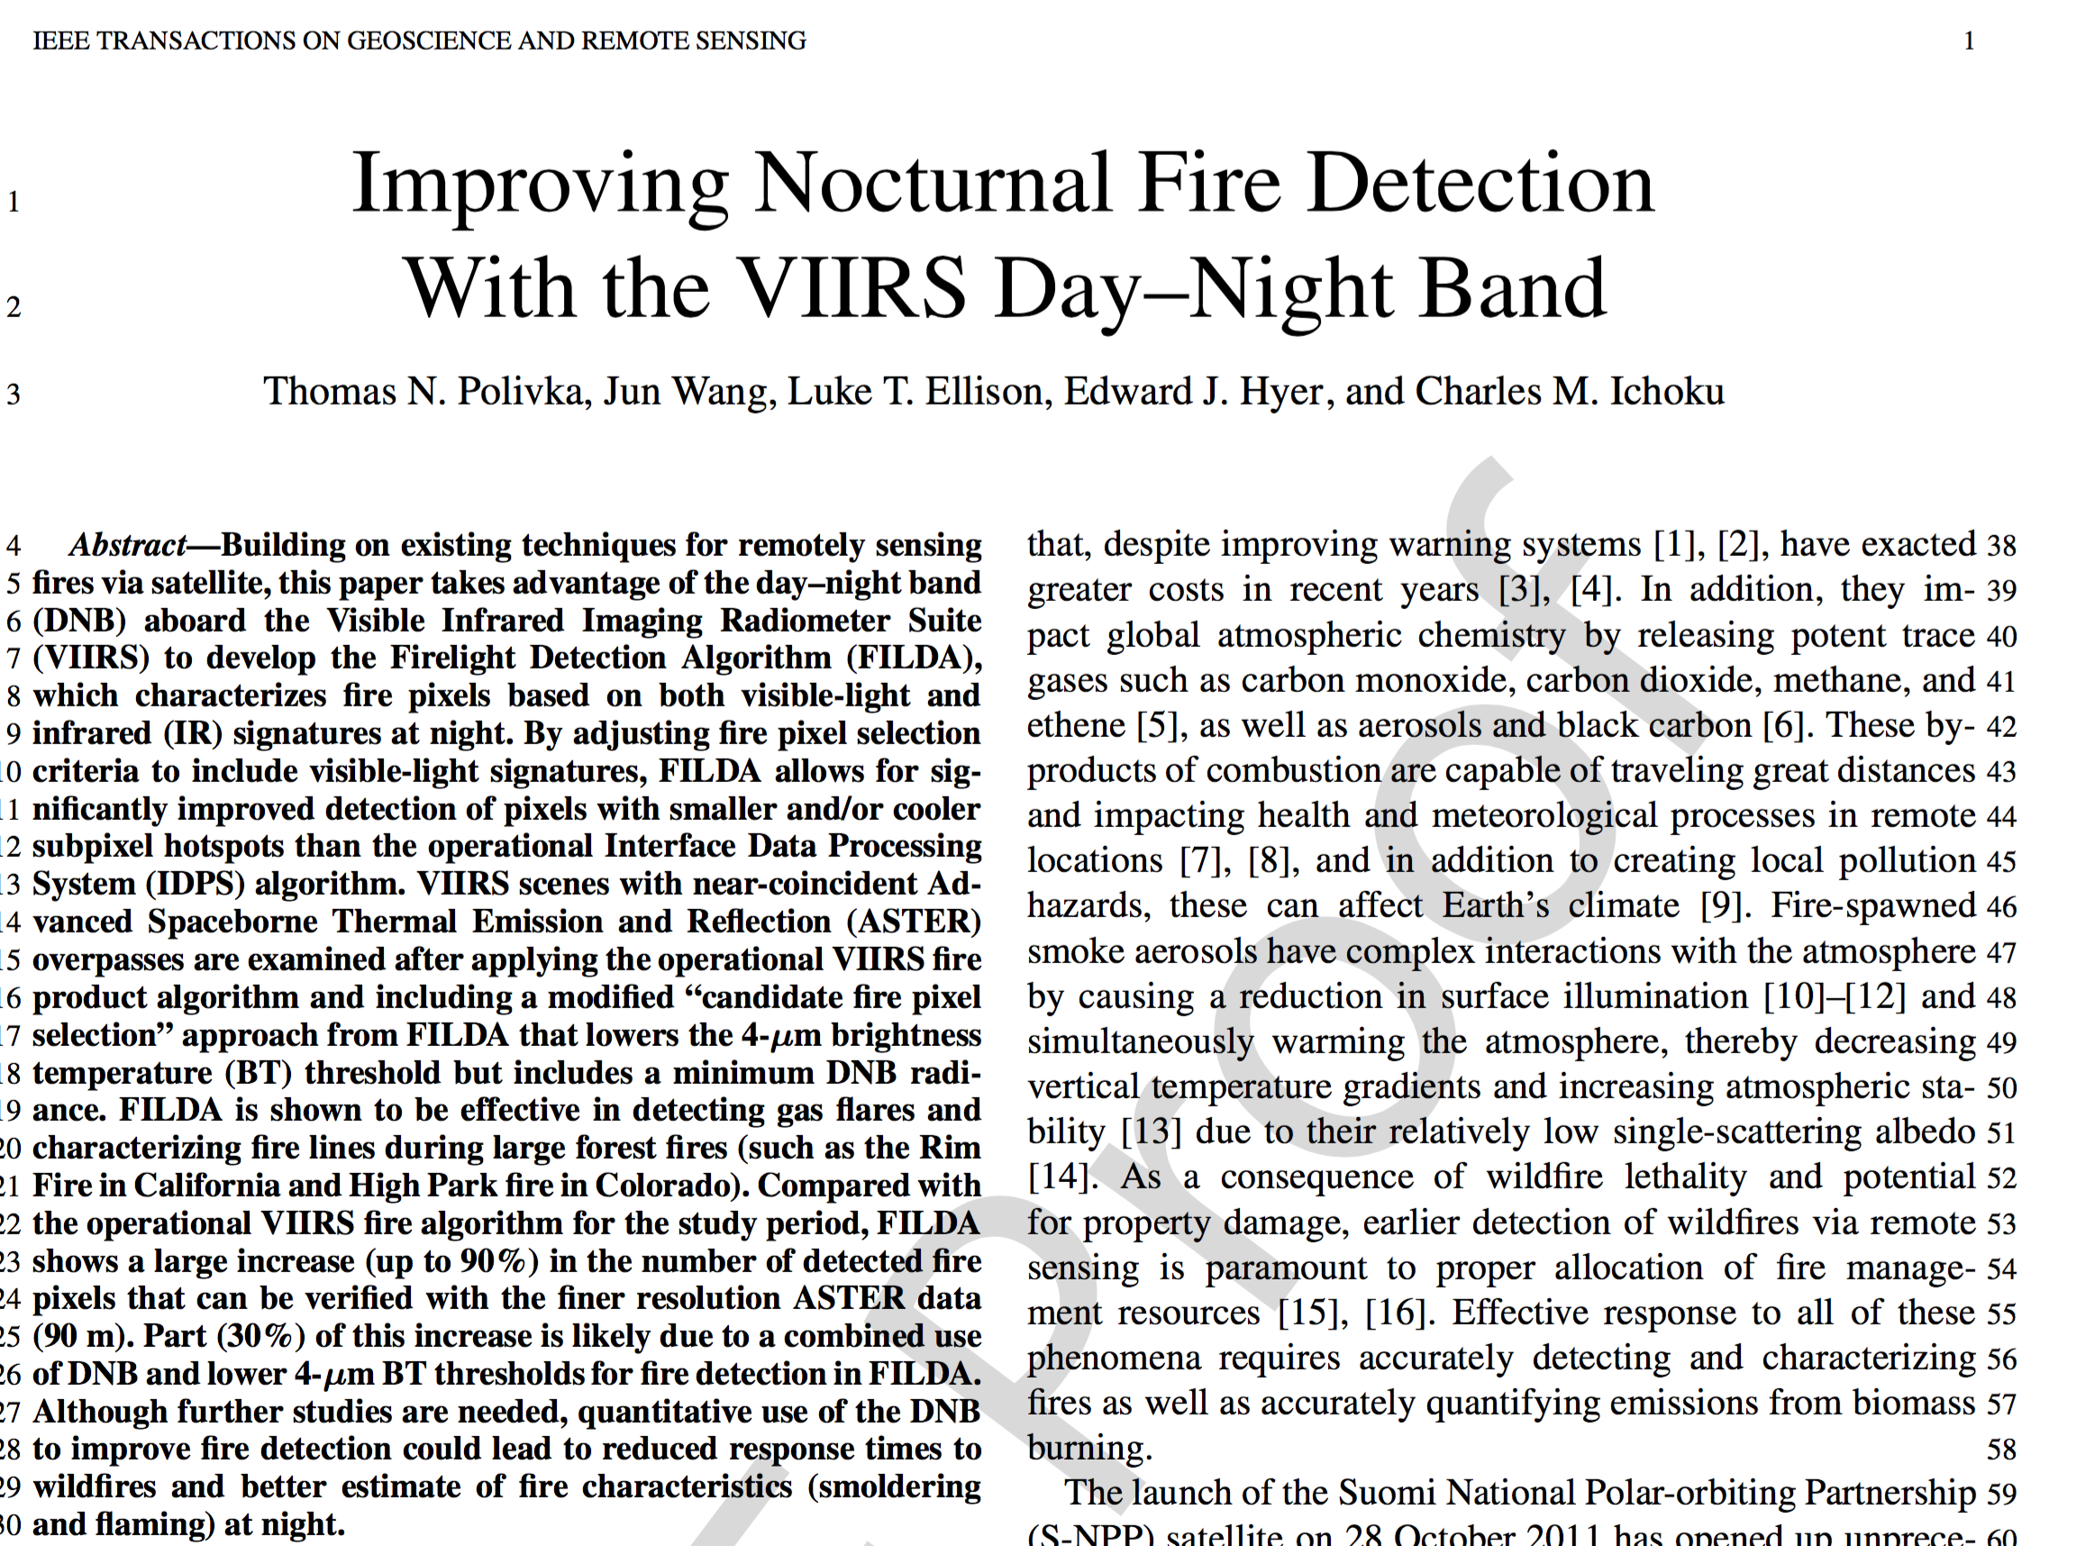

Slide 14
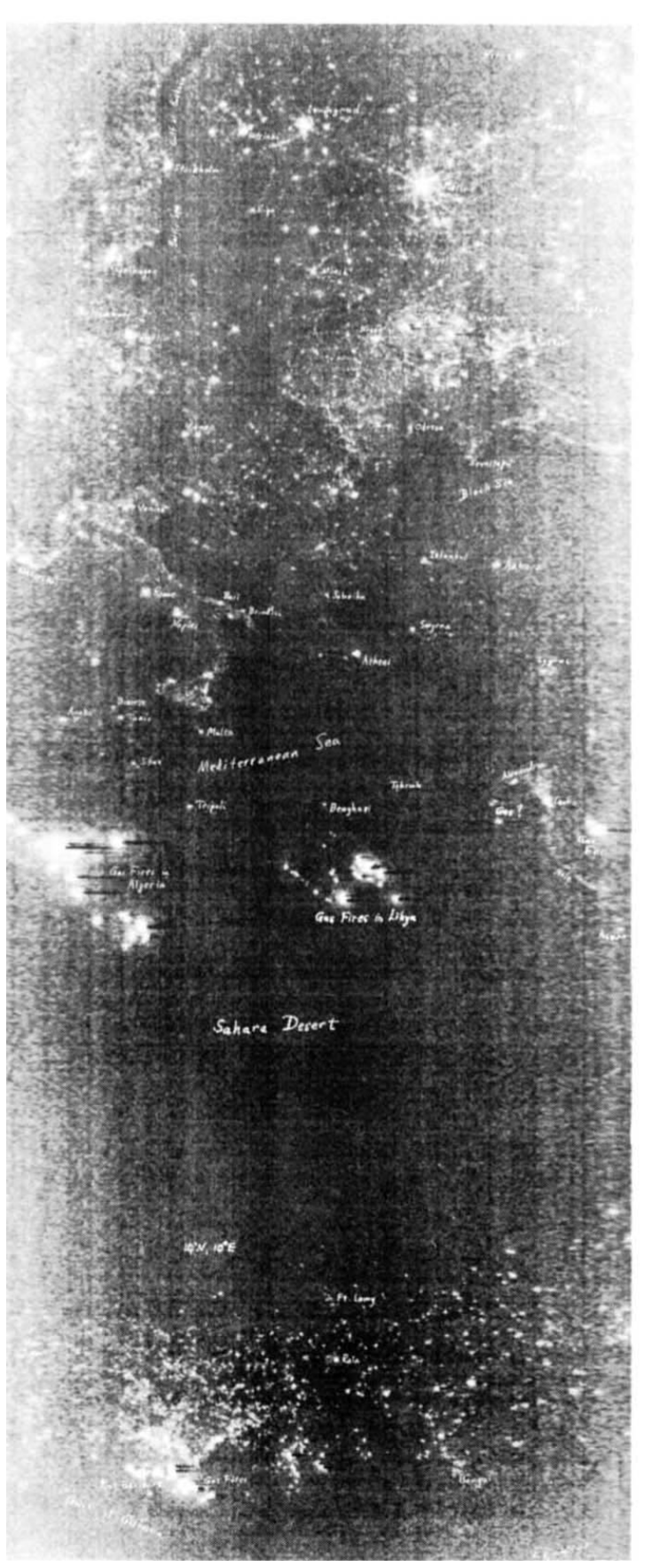
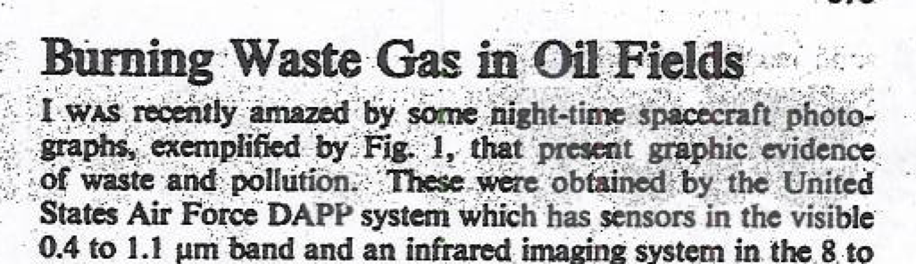
First fire detection from space was from visible light at night…
T. A. Croft, Nature, 1973.
Such agricultural “Fires, invisible by day, are seen ranging all around … at night (when) we were literally surrounded by them; some smouldering, … others fitfully bursting forth, whilst others again stalked along with a steadily increasing and enlarging flame…” Hooker (in 1846), cited by Croft, 1973.

Slide 15
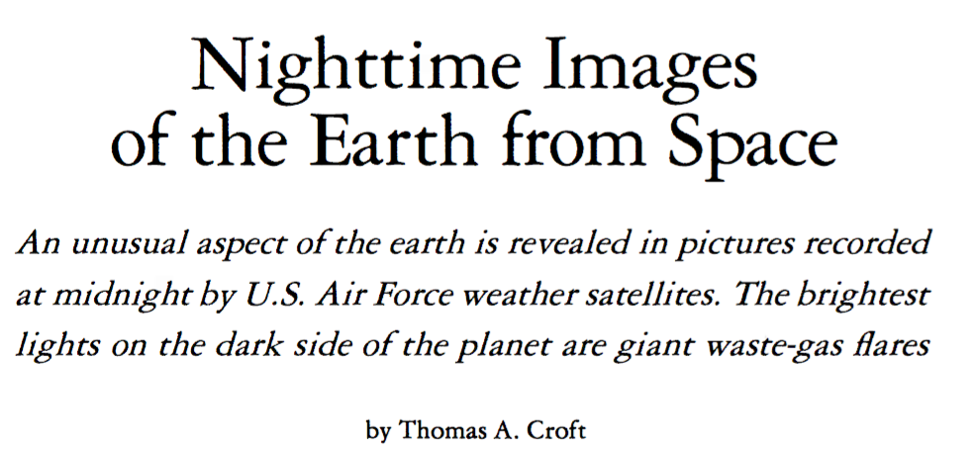
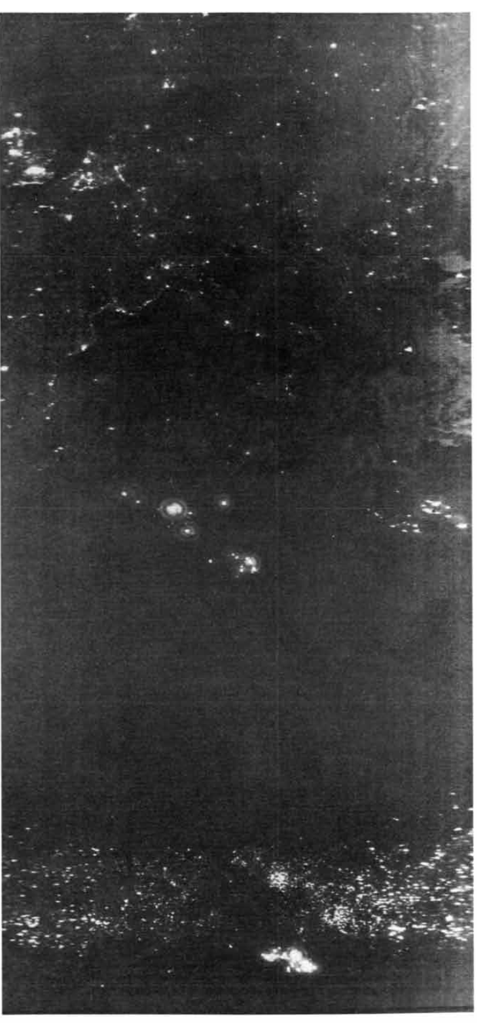
THREE MAJOR LIGHT SOURCES associ­ated with human activities are visible in this nighttime satellite image …
the upper third of this picture are the city lights of Europe.
The larger isolated lights near the middle and bot­tom arise from gas flares at oil fields in Al­geria, Libya and Nigeria.
The uniform band of smaller lights scattered across Africa south of the Sahara appears to originate with agricultural and pastoral fires.
Scientific America, 1978.

Slide 16
Recent work of using shortwave IR (1.6 um) for night fire detection
C. D. Elvidge, M. Zhizhin, F.-C. Hsu, and K. E. Baugh, “VIIRS nightfire: 1333 Satellite pyrometry at night,” Remote Sens., vol. 5, no. 9, pp. 4423–4449, 1334 Sep. 2013, doi: 10.3390/rs5094423.
W. Schroeder, P. Oliva, L. Giglio, and I. A. Csiszar, “The new VIIRS 375 m active fire detection data product: Algorithm description and initial assessment,” Remote Sens. Environ., vol. 143, pp. 85–96, Mar. 5, 2014, doi: 10.1016/j.rse.2013.12.008.

Slide 17
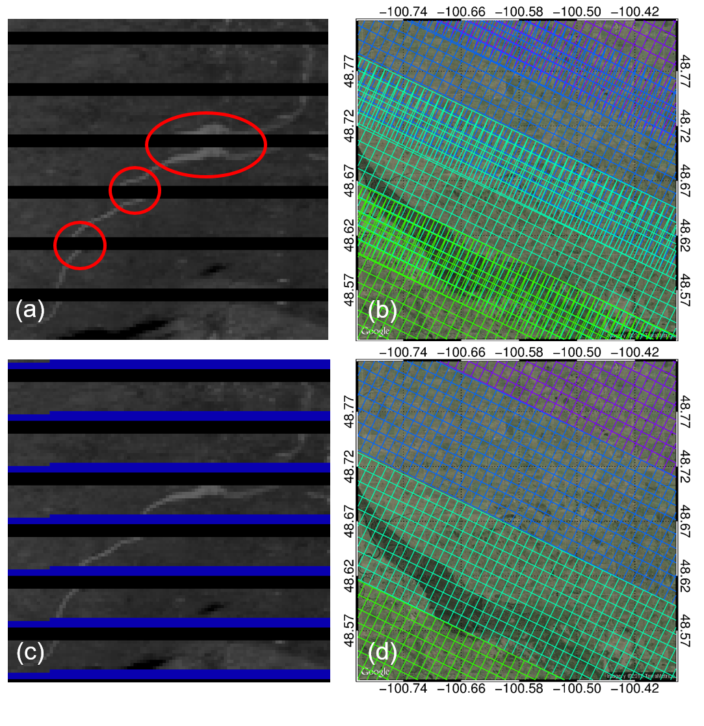
Correction of pixel overlaps
M13

Slide 18
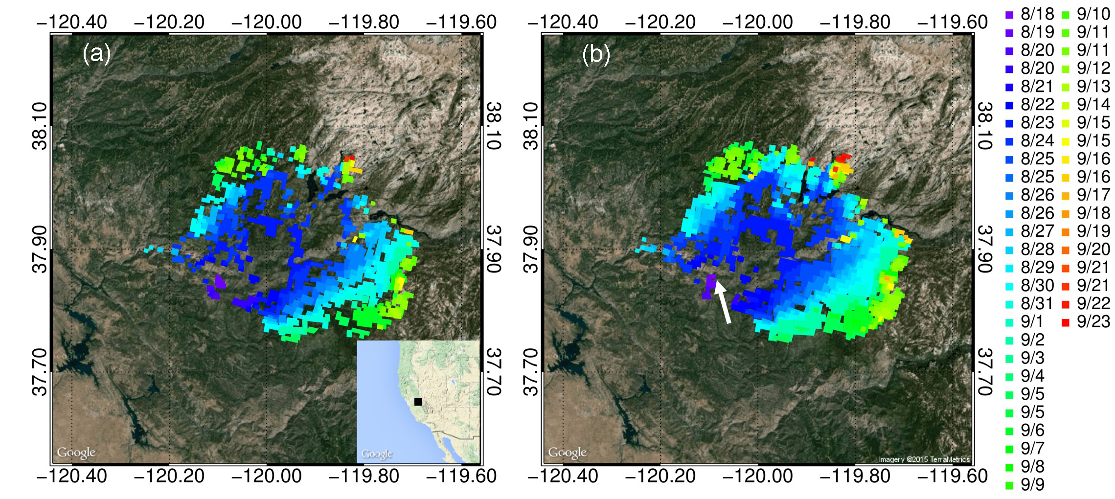
Firelight Detection Algorithm (FILDA)
Combined use of Vis + NIR + IR to detect fires
IDPS AFARP
Active Fire Application Related Product
BT₄ > 320 K
FILDA
Dynamic threshold of BT₄
& DNB threshold
Notes:
Good for detecting small sub-pixel fires;
Visible light is much less attenuated and interfered than IR in the atmosphere

Slide 19
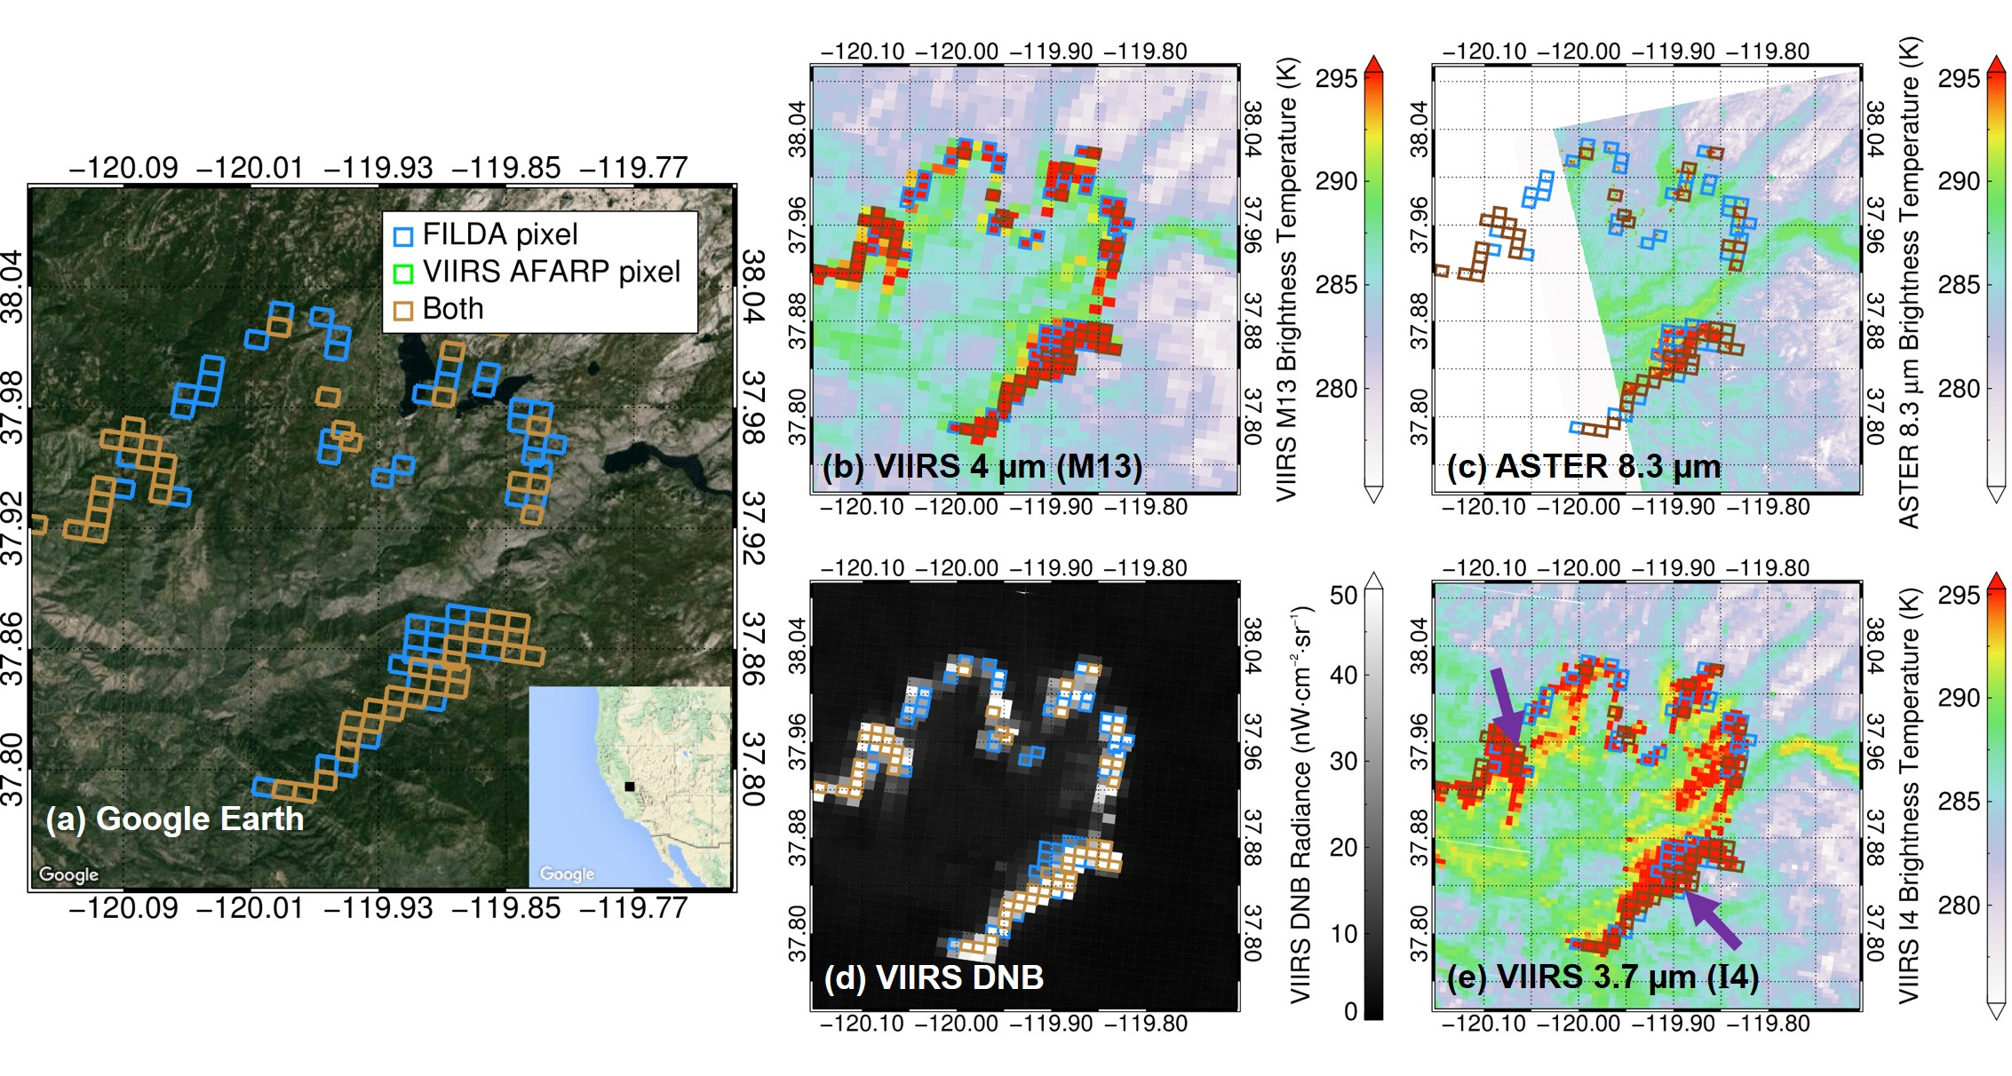
Evaluation with ASTER
Multiband/sensor view of the Rim Fire taken at 2:29 AM PDT, 24 August 2013

Slide 20
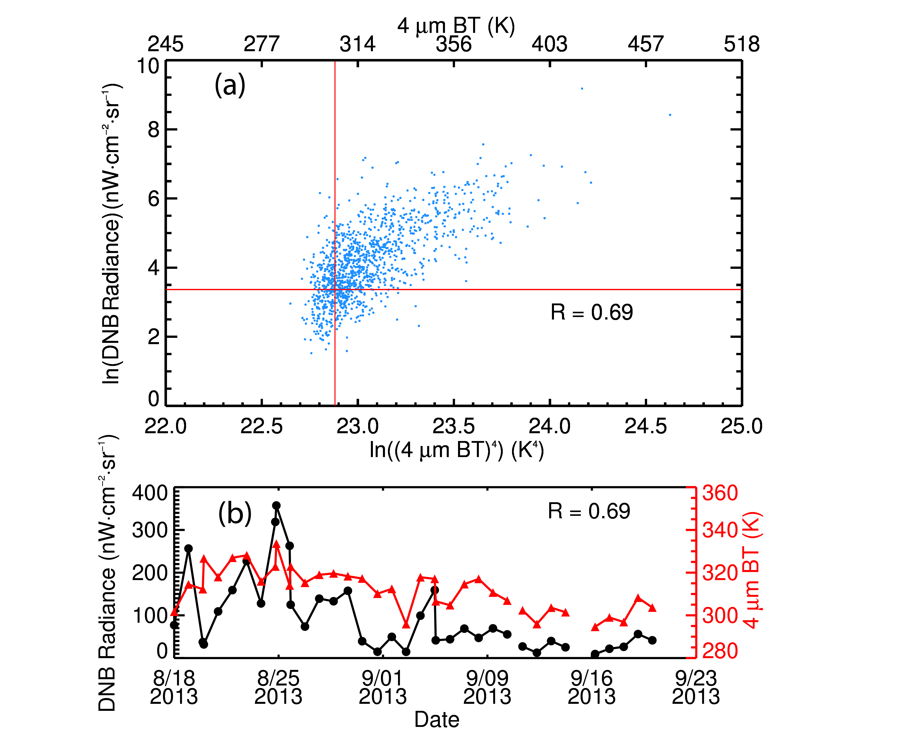
Potential characterization of smoldering vs. flaming
flaming
smoldering

Slide 21
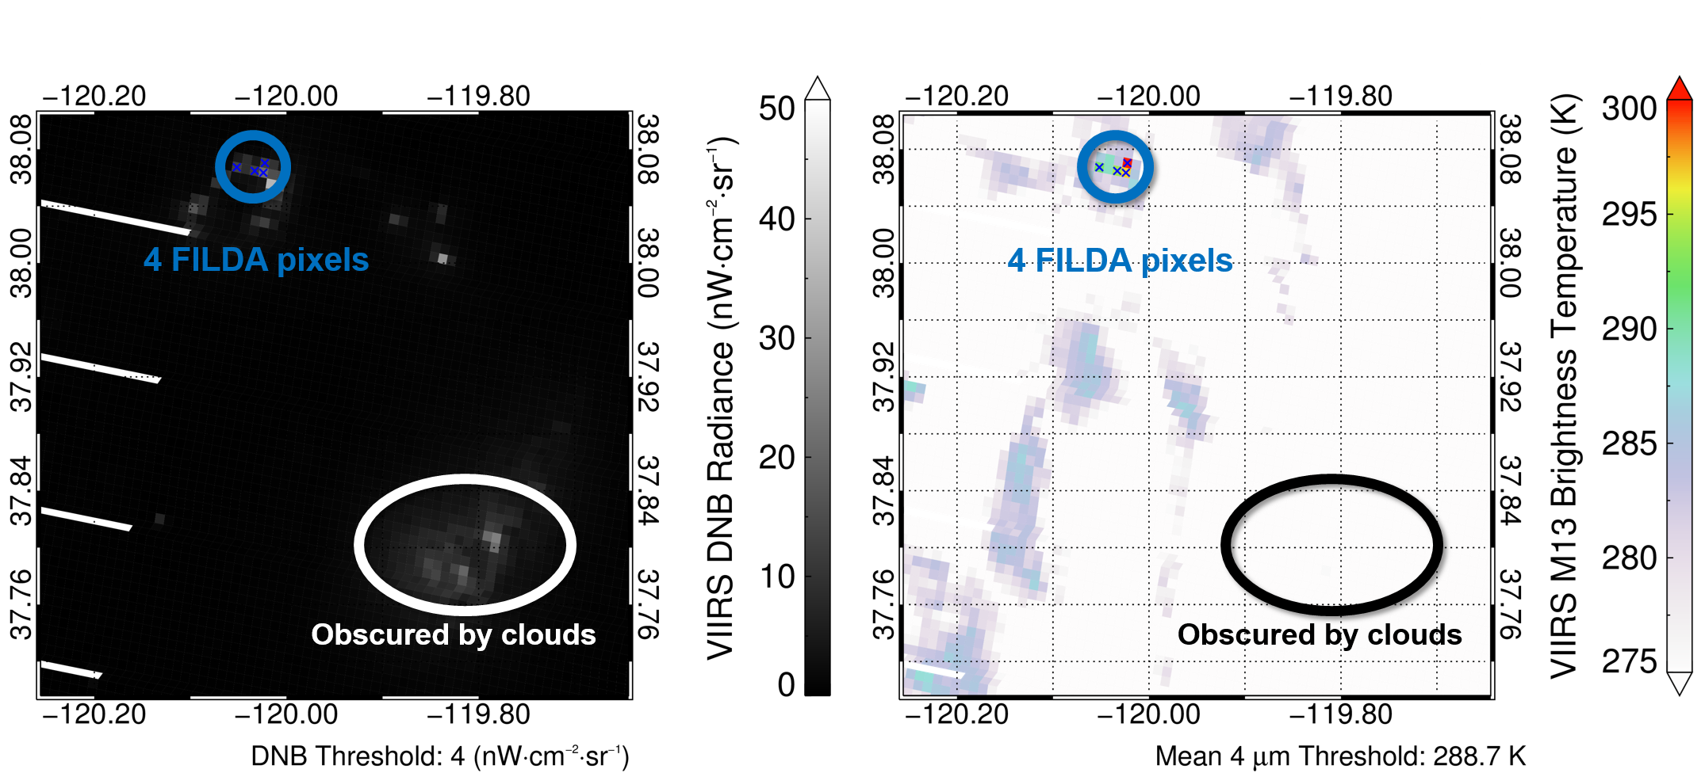
Potential to detect fires through clouds

Slide 22

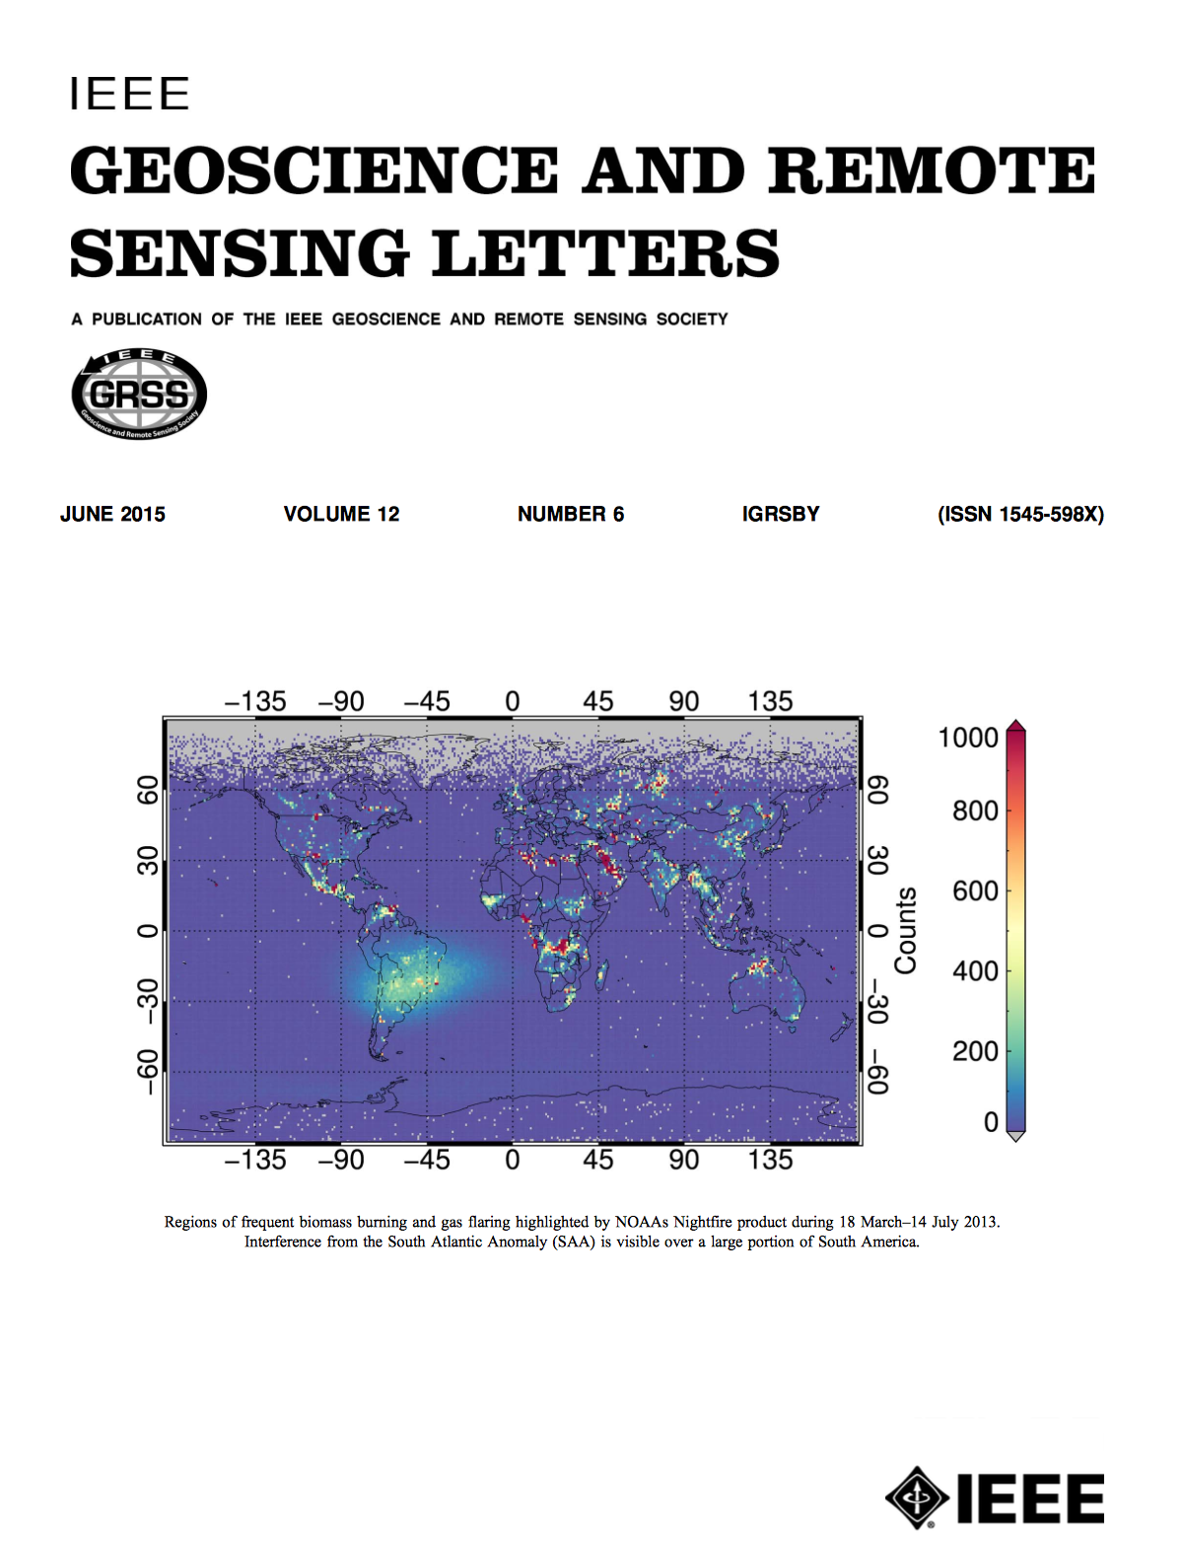
Thank you !
Acknowledgement:
NASA Suomi-NPP program & NASA Applied Science program.
Polivka, T., J. Wang, L. Ellison, E. Hyer, and C. Ichoku, Improving Nocturnal Fire Detection with the VIIRS Day-Night Band, IEEE Transactions on Geoscience & Remote Sensing, in press, 2016.
Wang, J., Clint Aegerter, Xiaoguang Xu, and J. J. Szykman, Potential application of VIIRS Day/Night Band for monitoring nighttime surface PM2.5 air quality from space, Atmospheric Environment, 124, 55–63, doi:10.1016/j.atmosenv.2015.11.013, 2016.
Polivka, T., E. Hyer, J. Wang , and D. Peterson, First global analysis of saturation artifacts in the VIIRS infrared channels and the effects of sample aggregation, IEEE Geoscience and Remote Sensing Letters, 1262-1266, 2015, (journal cover article).

Slide 24
Case Analysis
Moon Nights
Moonless Nights
Low PM_{2.5}
Large VZA →
High PM_{2.5}
Nadir view →

Slide 25
City lights enhance the signal for detecting PM_{2.5} changes.
Using moonlight alone to detect PM2.5 appears very challenging.

