Slide 1

MAIAC Status
Alexei Lyapustin, GSFC, code 613
Y. Wang (UMBC), S. Korkin (USRA)
MODIS STM
Silver Spring, June 8, 2016

Slide 2
MAIAC: General Information
Status:
  MAIAC is at MODAPS for C6+ re-processing of MODIS (MCD19)
Products (gridded):
  Atmosphere: WV, CM, AOT, SSA, aerosol type (background/smoke/dust), FMF (over water) @1km resolution;
  Land Surface: spectral BRDF (RTLS model, naturally gap-filled), BRF (surface reflectance) @1km and 500m, albedo;
  Detected Snow: snow grain size, and sub-pixel snow fraction (1km);
  Last-minute changes to algorithm while it is under testing in MODAPS. ATBD in preparation.
  As MODIS algorithm is fixed, VIIRS code will be delivered in 2-3 weeks.

Slide 3
Multi-Angle Implementation of Atmospheric Correction (MAIAC)
Features
Grid TOA L1B data to 1km fixed grid – work with polar-orbit data as “geostationary-like”;
Sliding window algorithm – store 4-16 last days of measurements in memory;
RT with fully coupled BRDF model;
Accumulate surface-related information for each grid cell (spectral BRDF, BT-contrasts etc.)
Main Results
Advanced cloud (snow) detection – particular improvements over tropics and at northern lat. (vegetation analysis);
AOD data globally over dark and bright land surface;
Aerosol at 1km resolution & low urban bias – strong interest from AQ community;
AC at AOT_{0.47}<1.5, RTLS retrievals at AOT_{0.47}<0.6

Slide 4
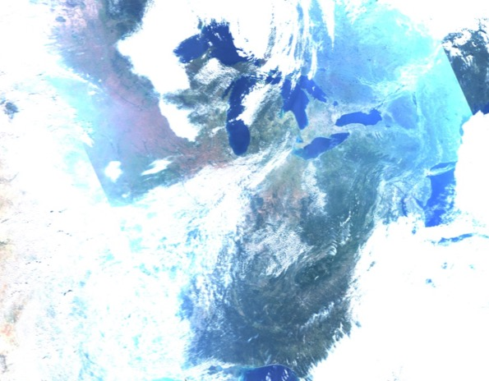
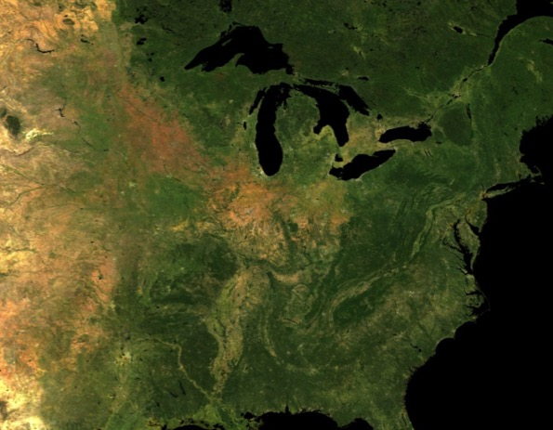
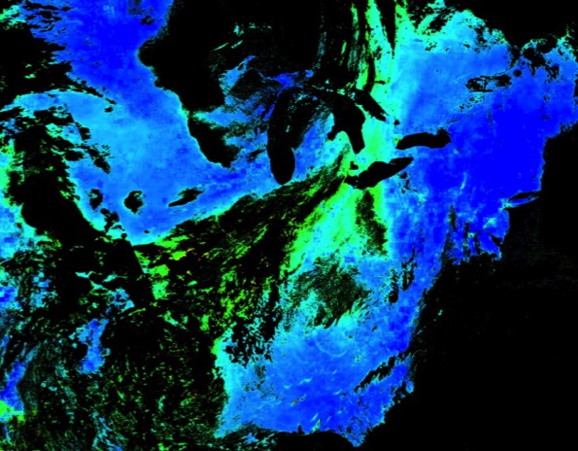
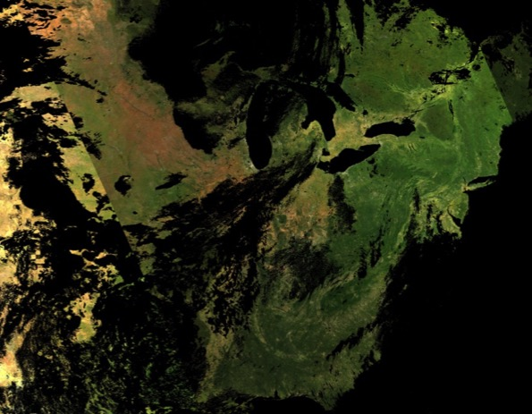
MAIAC = Time Series + Spatial Analysis
MODIS, TOA RGB
NBRF
AOT
BRF

Slide 5
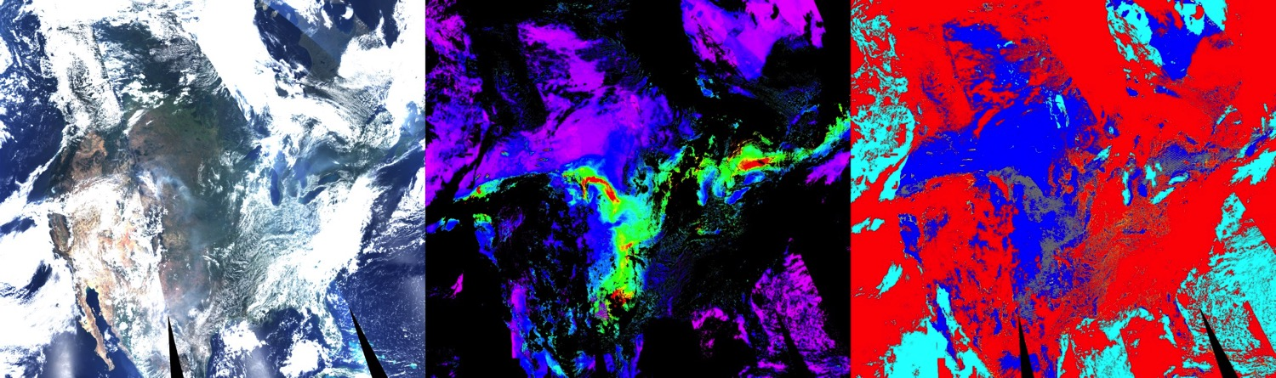
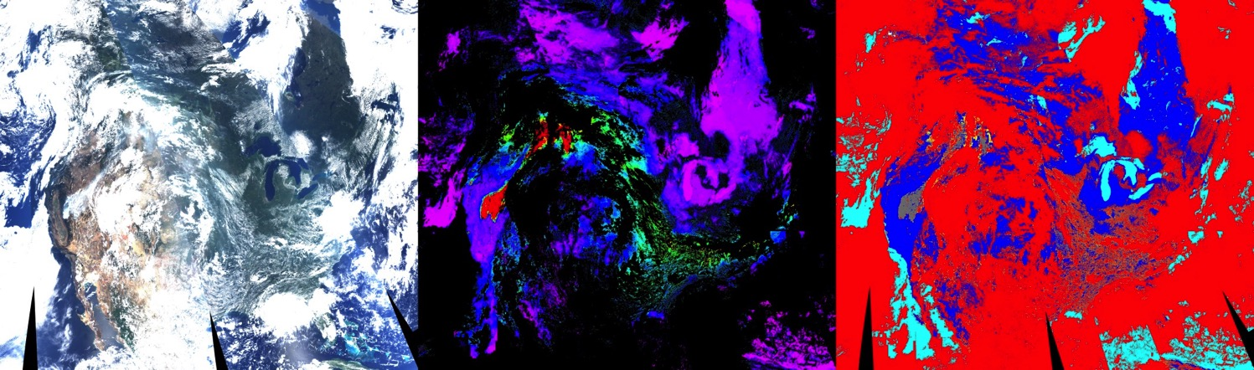

Idaho/Wyoming – Yosemite Fires (08-2013)
TOA RGB
MAIAC AOT(0.47)
MAIAC CM:
Red – Clouds;
Grey – Smoke;
231
235
2
1
3

Slide 6
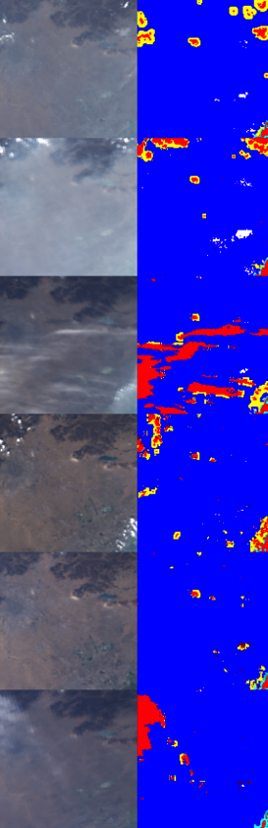
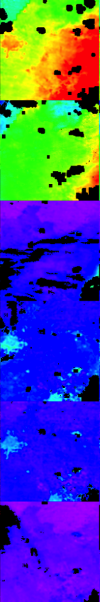
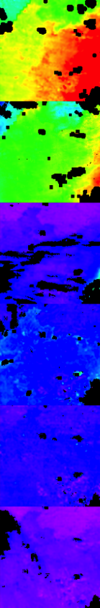
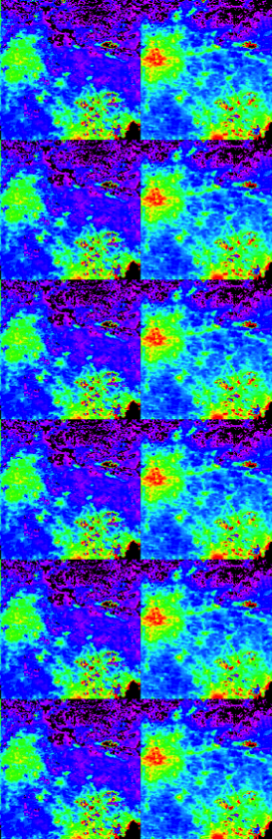
Urban Bias: Xianghe
TOA CM AOT AOT SRC
RGB DT C5 MAIAC FS BS
ρ_{0.47}= SRC×ρ _{2.1}
BRDF shape is not spectrally-invariant
AOT
0 0.5 1.0 1.5 2.0
DT bias over urban areas where C5 parameterization does not work

Slide 7
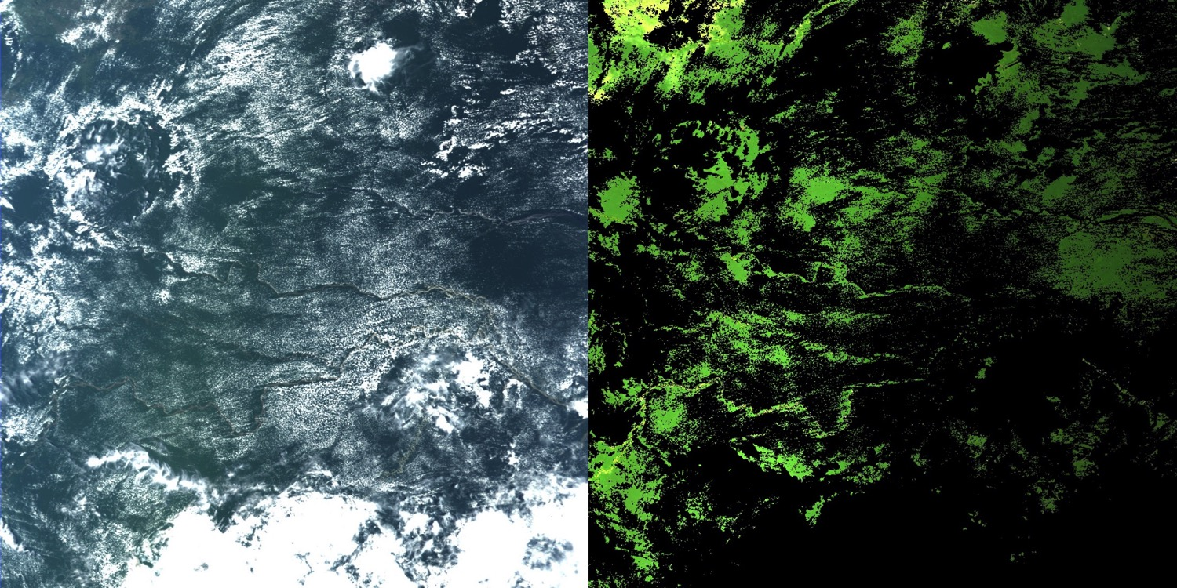
Quality of Atmospheric Correction …
TOA RGB
BRF RGB
1200 km
Decreasing brightness – moving from backscattering towards forward scattering

Slide 8
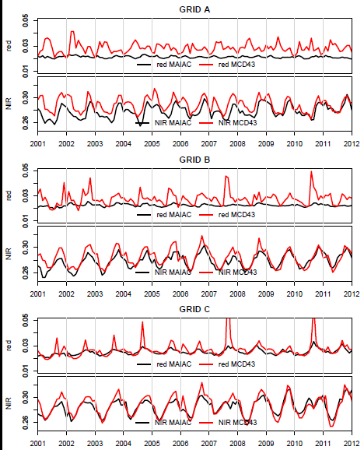
Quality of Atmospheric Correction
Maeda, E., Mendes Moura, Y., Wagner, F., Hilker, T., Lyapustin, A.I., Wang, Y., Mõttus,M., Aragão, L., Shimabukuro Y. Consistency of vegetation index seasonality across the Amazon rainforest (in press).

Slide 9
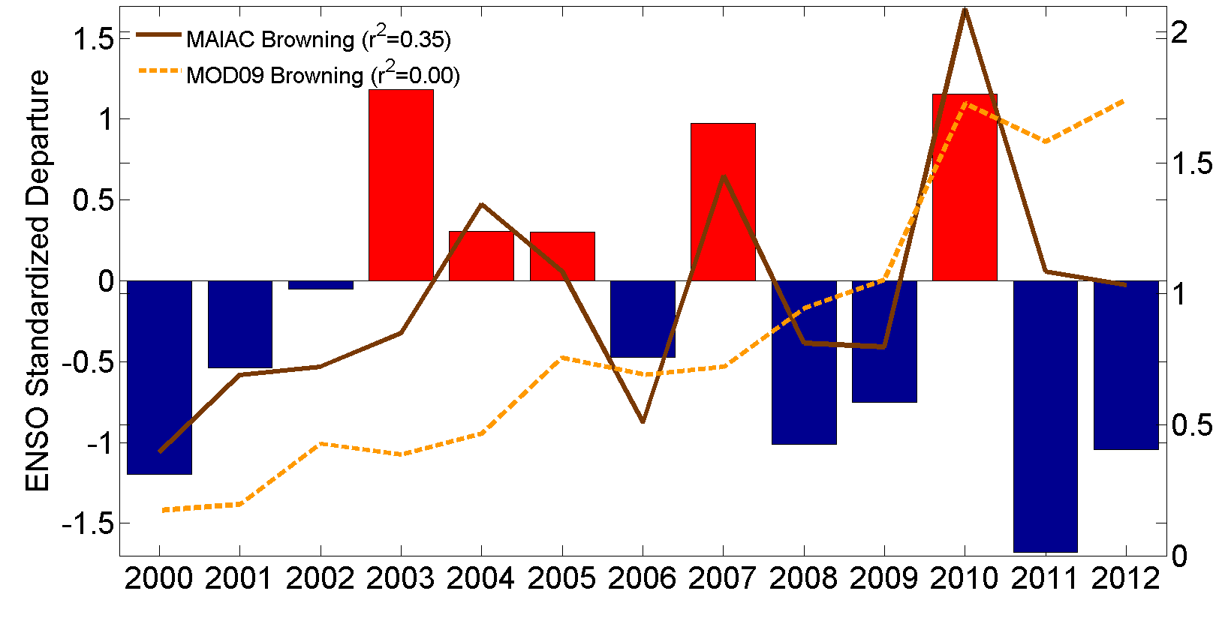
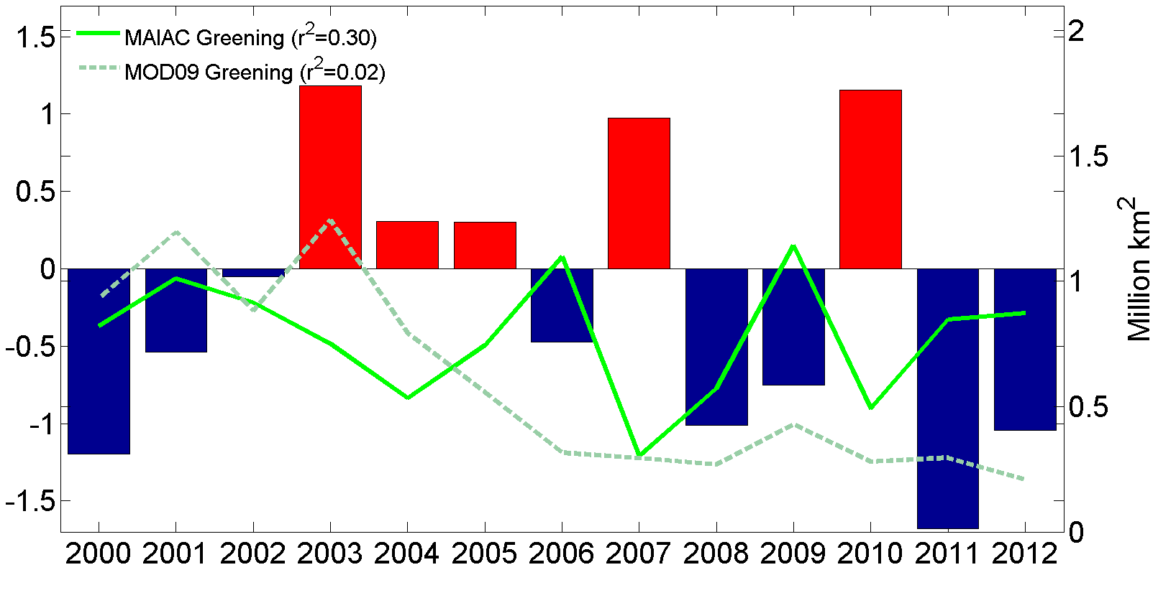
Interannual Variability
Hilker, T., A. I. Lyapustin, C. J. Tucker, F. G. Hall, R. B. Myneni, Y. Wang, J. Bi, Y. M. de Moura, P. J. Sellers (2014), Vegetation dynamics and rainfall sensitivity of the Amazon, PNAS, 111 (45), 16041-16046.
El Ninõ
Amazon Browning and Greening Anomalies from MOD09 C5 (dashed) and MAIAC C6 L1B data (solid).
Anomaly Analysis – Myneni & Jian (BU)
Correlation with MEI – Hilker & Lyapustin
La Ninã
Significant interannual variability in MAIAC B/G anomalies and expected physical correlation with the short-term climate variations.
Anomaly:

Slide 10
Interannual Variability
Bi, J., R. Myneni, A. Lyapustin, Y. Wang, T. Park, C. Chen, K. Yan, Y. Knyazikhin, Amazon forests’ response to droughts: a perspective from the MAIAC product, Remote Sens., 2016.
Amazon basin Greening and Browning area from MAIAC and MOD09 C5 and C6
Standardized anomalies for 2010 drought for MAIAC and MOD09 C5 and C6 NDVI, EVI

Slide 11
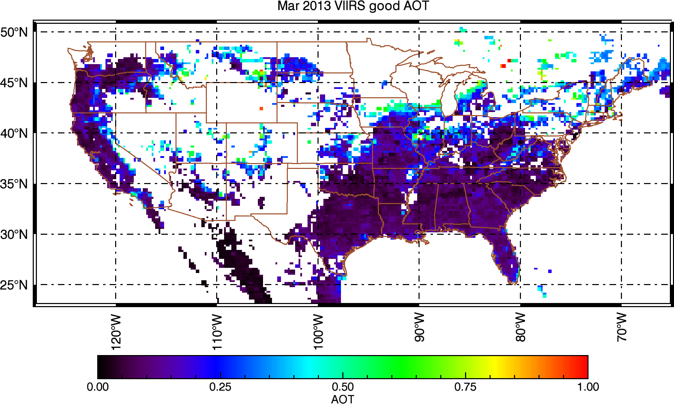
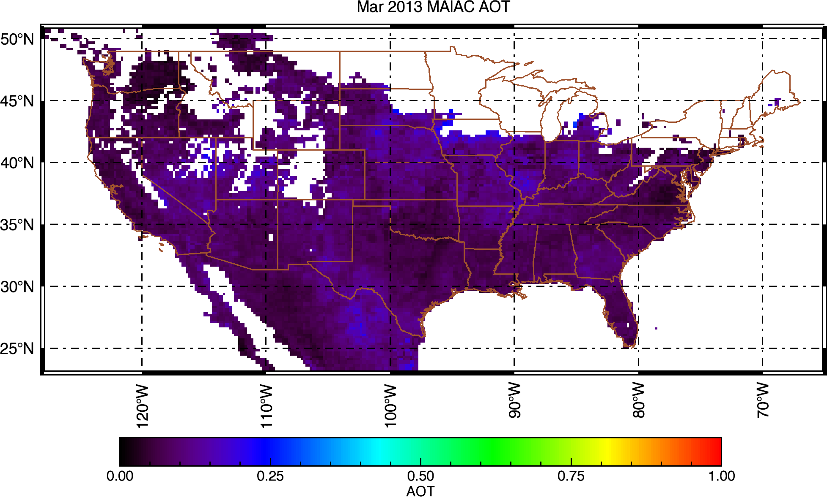
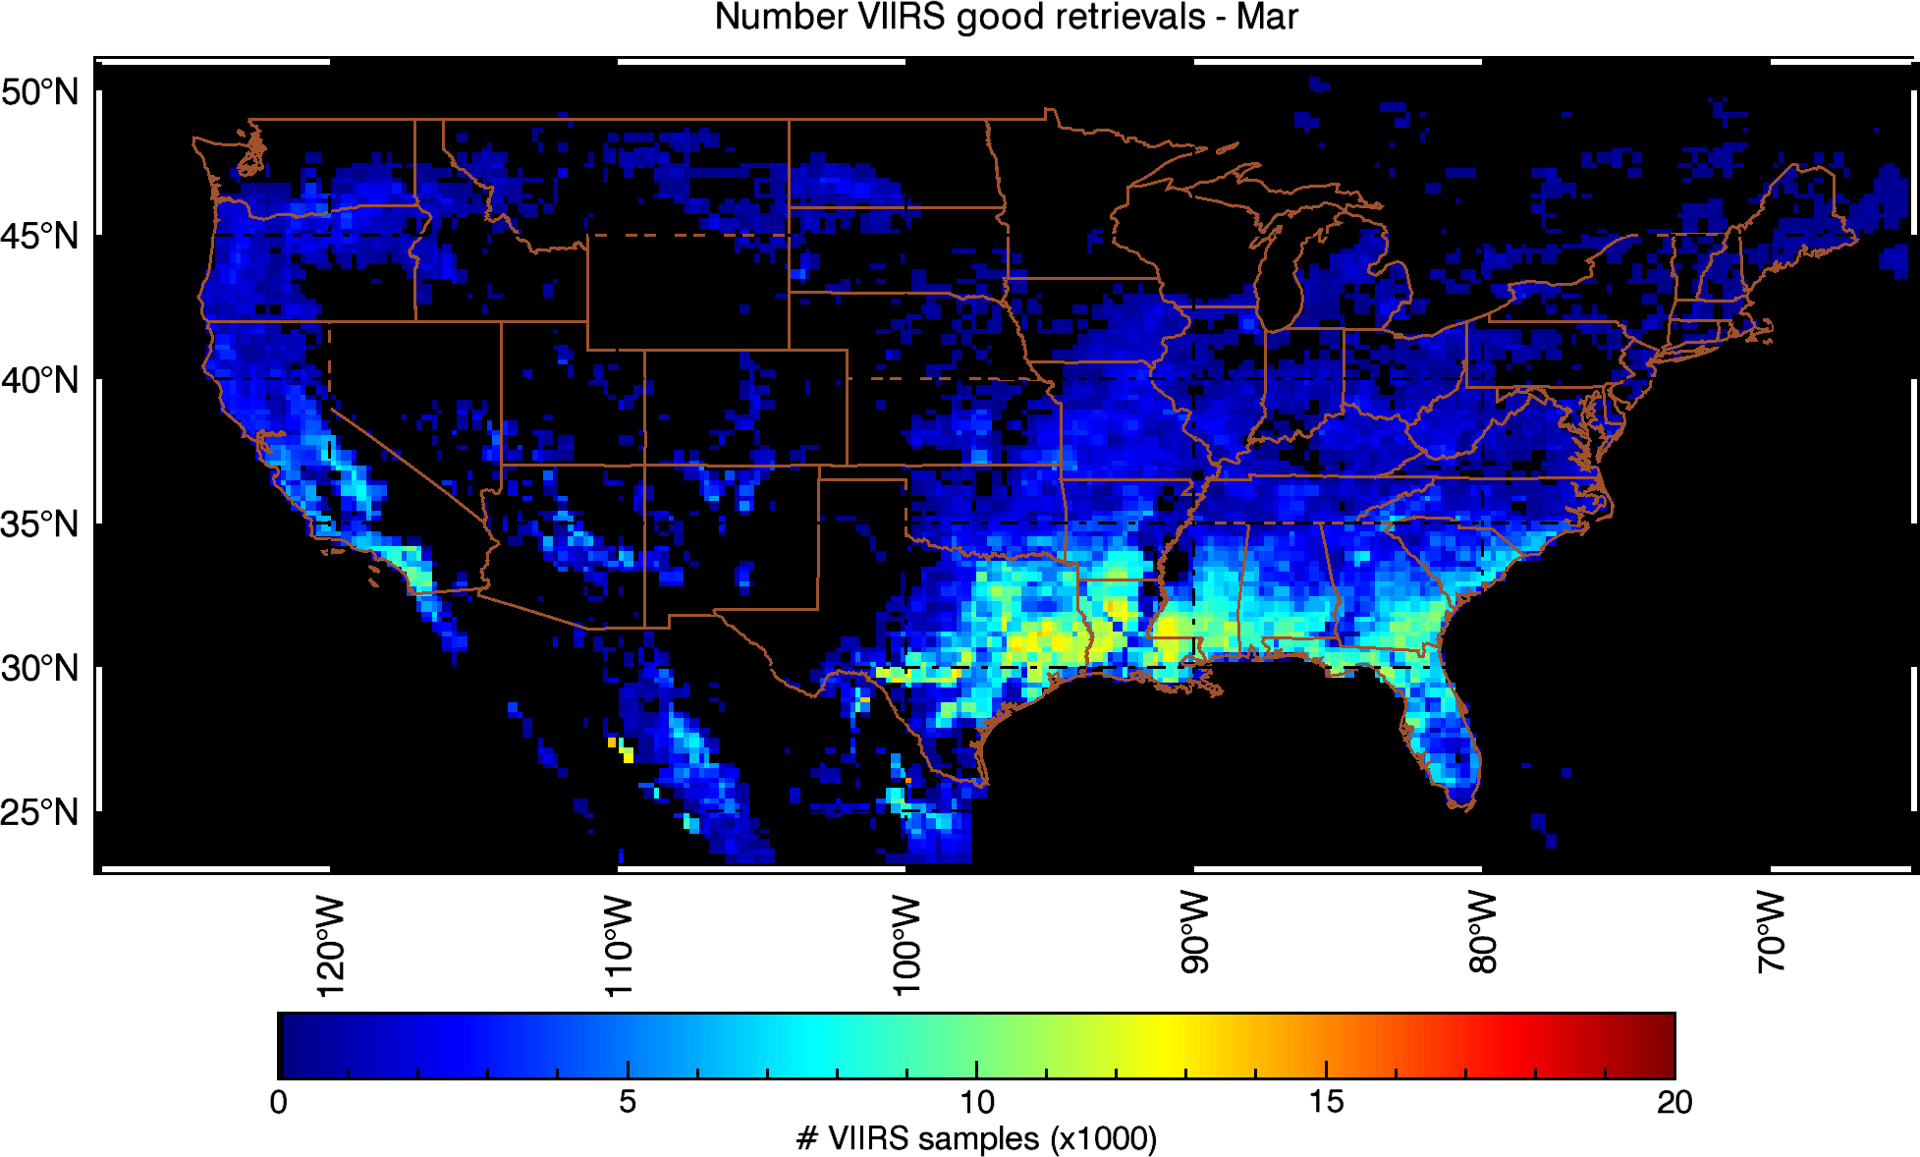
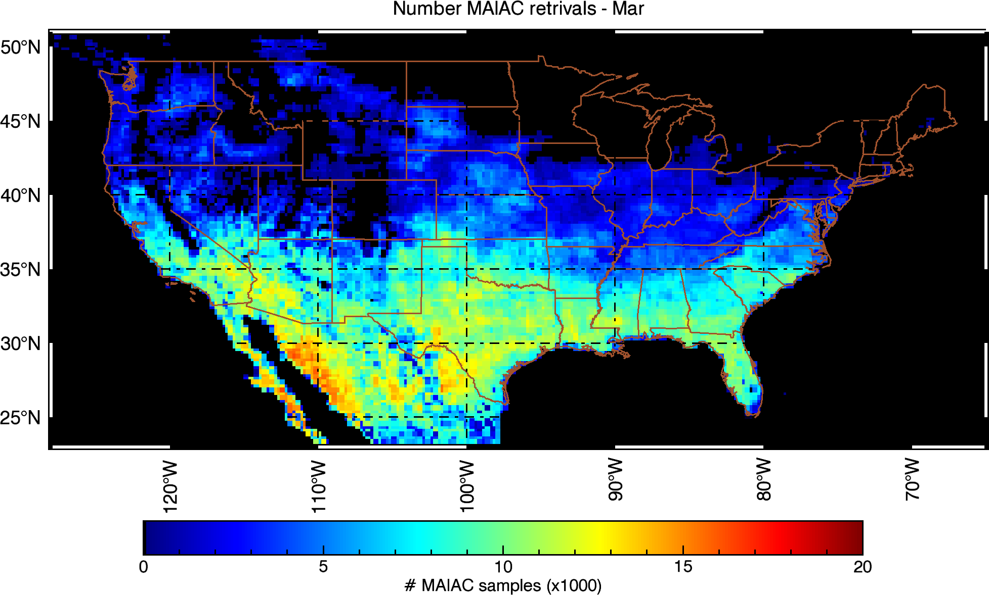
VIIRS AOT IP vs MODIS MAIAC (25km)
Superczynski, Kondragunta et al., to be subm., 2016)
NOAA VIIRS
MAIAC MODIS

Slide 12
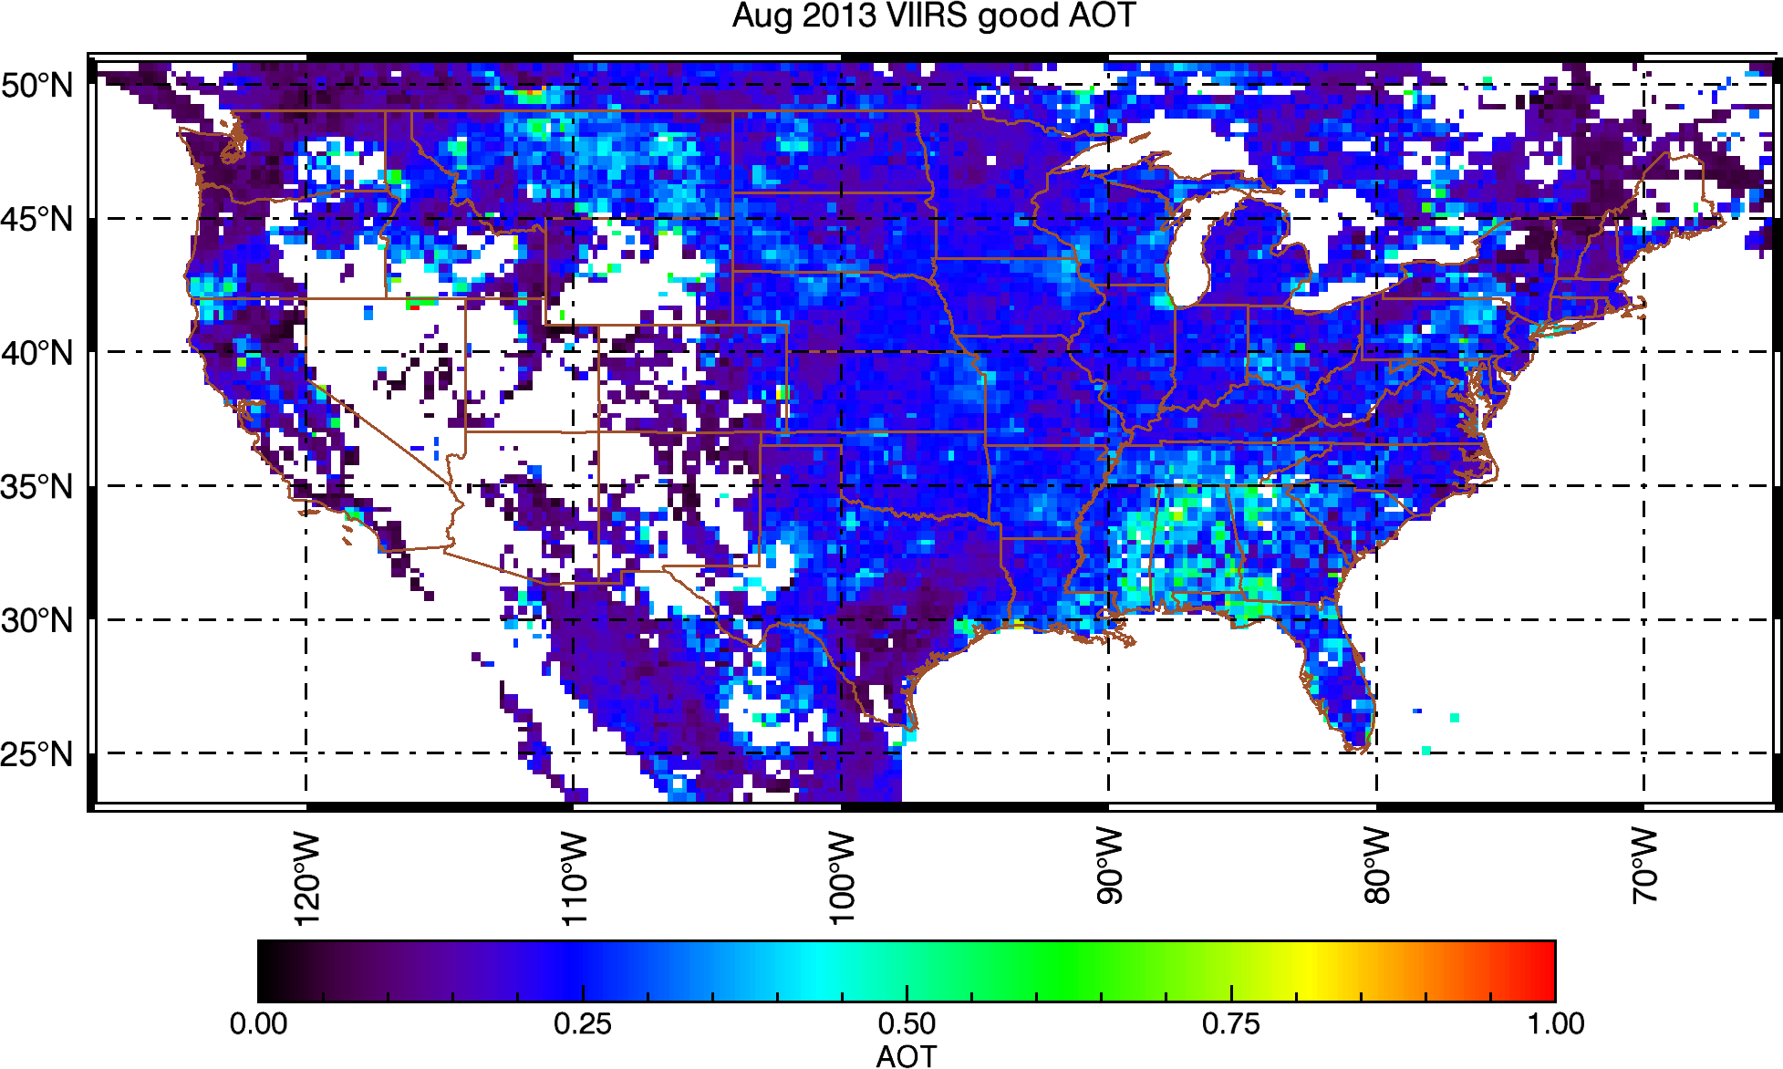
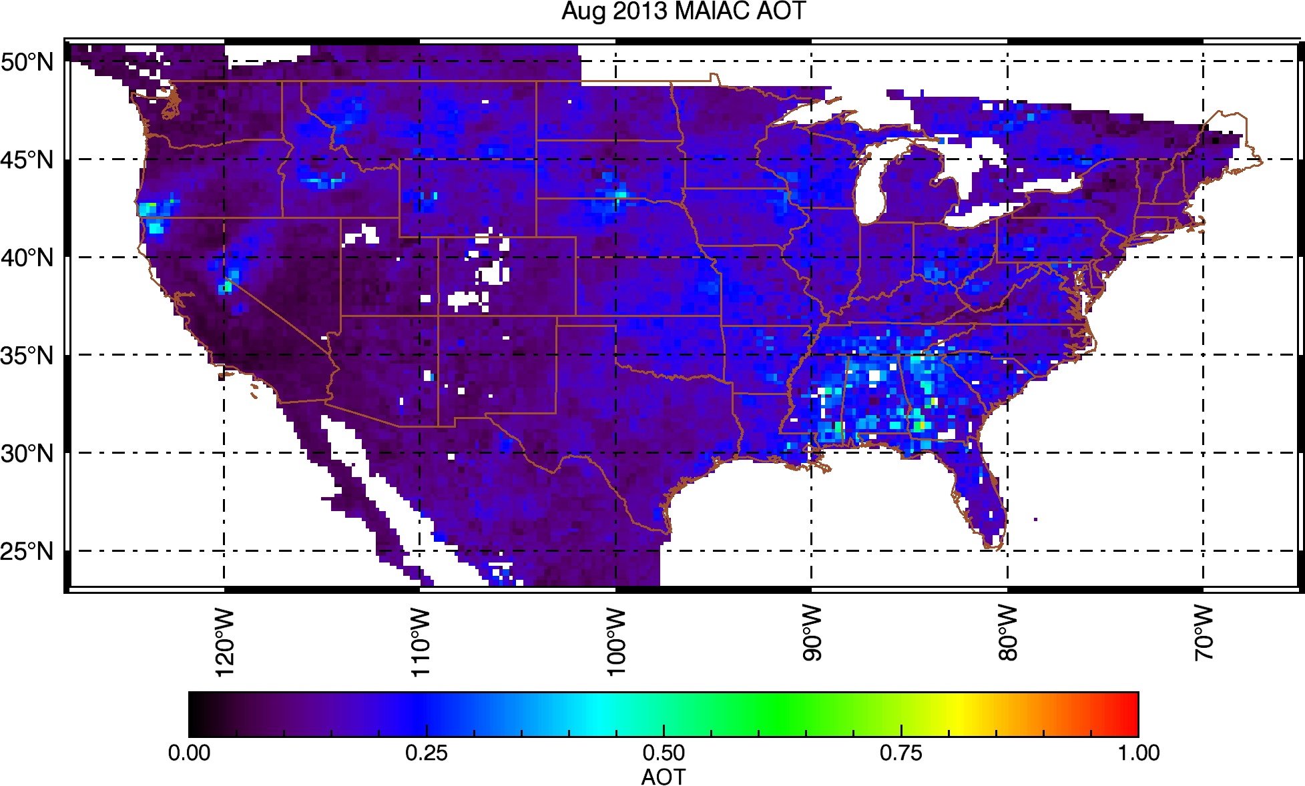
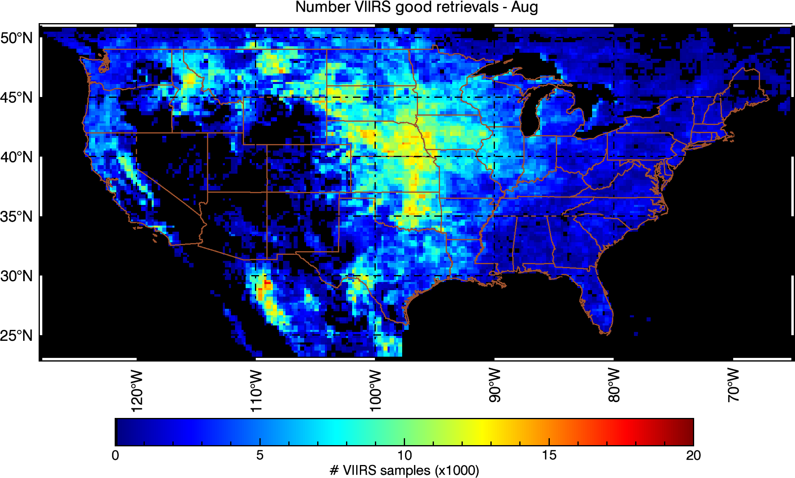
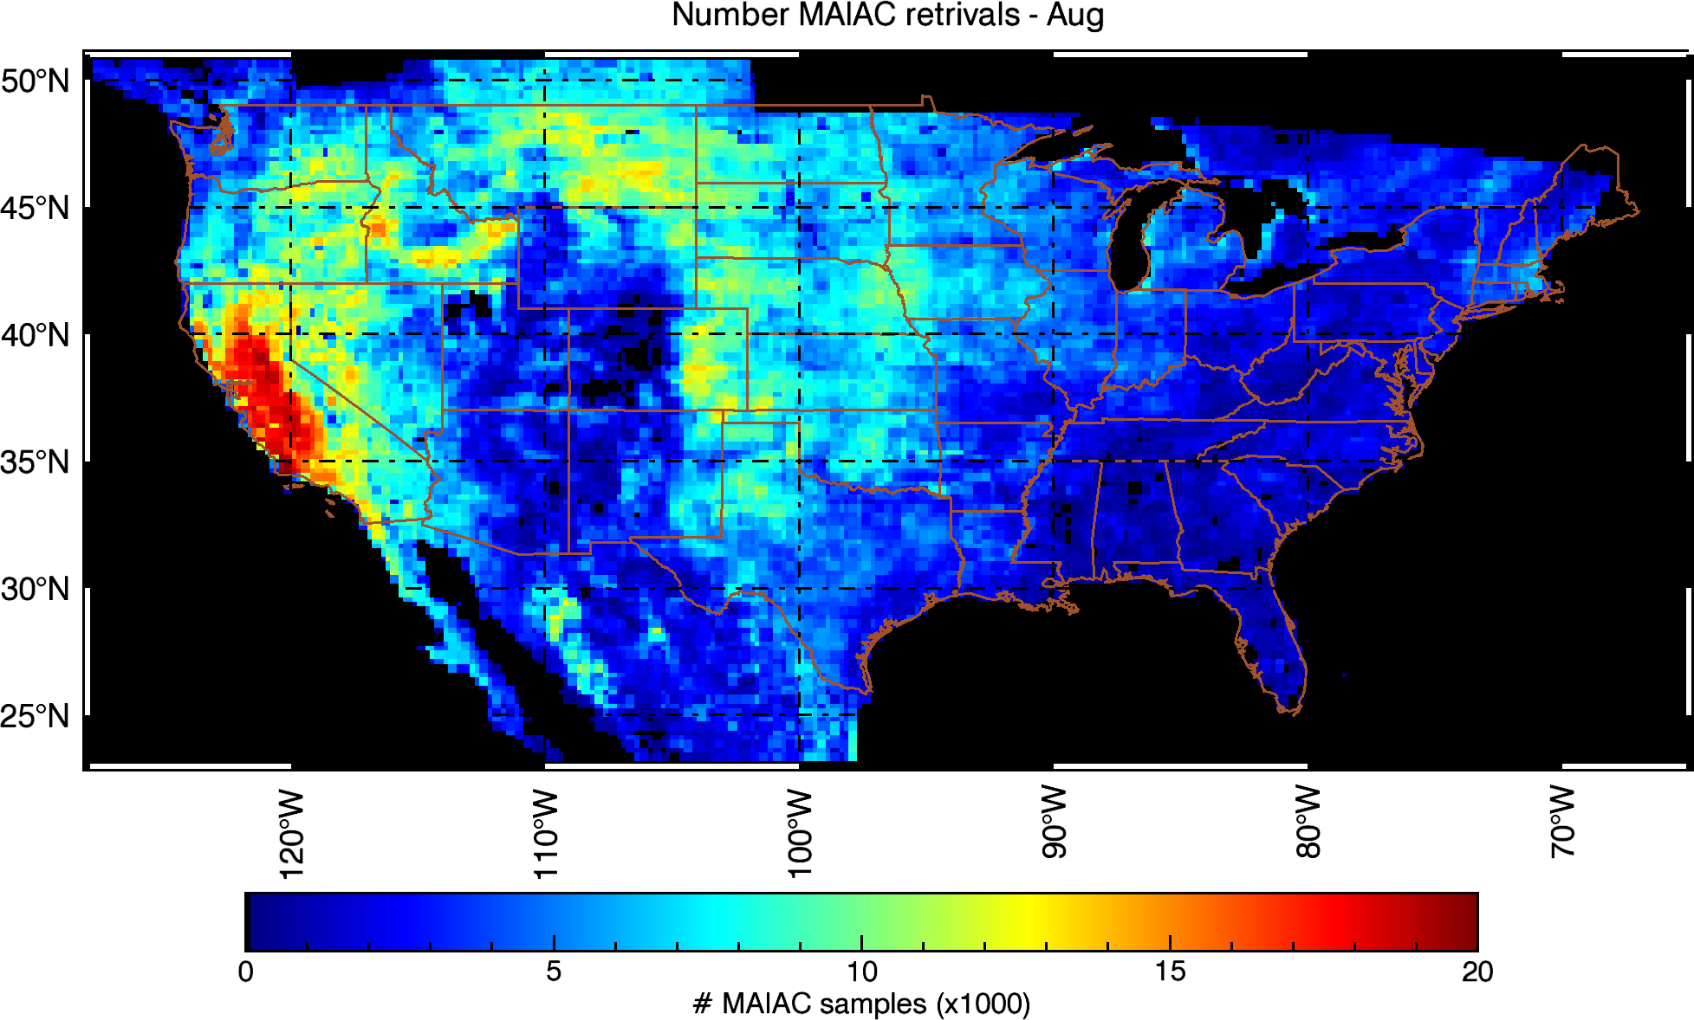
VIIRS AOT IP vs MODIS MAIAC (25km)
(S. Kondragunta, S. Superczynski (NOAA), study for NASA GeoCAPE project)

Slide 13
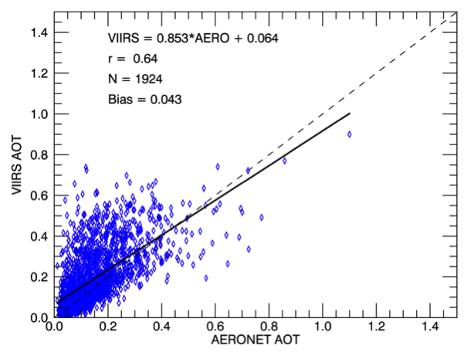
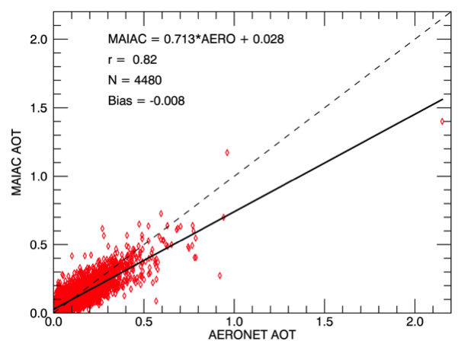
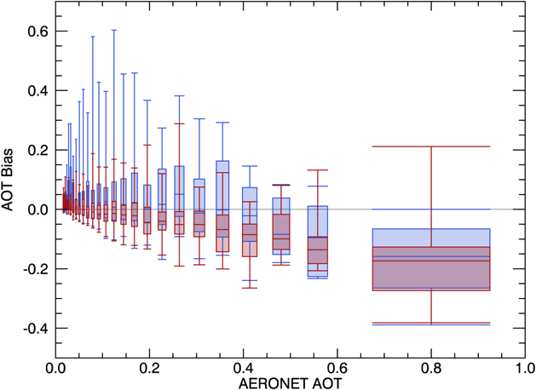
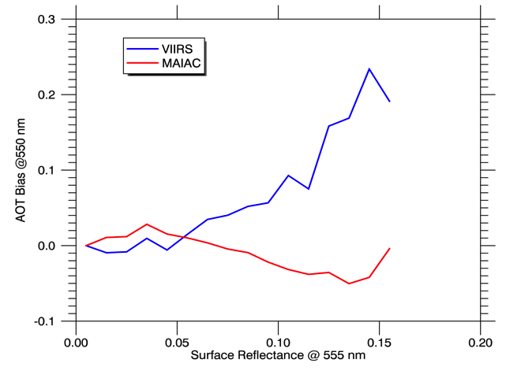
VIIRS AOT IP vs MODIS MAIAC (25km)
(S. Kondragunta, S. Superczynski (NOAA), study for NASA GeoCAPE project)
Bias vs AOT
Bias vs SR

Slide 14
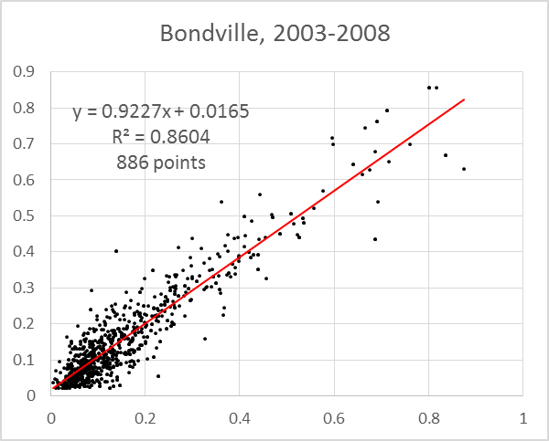
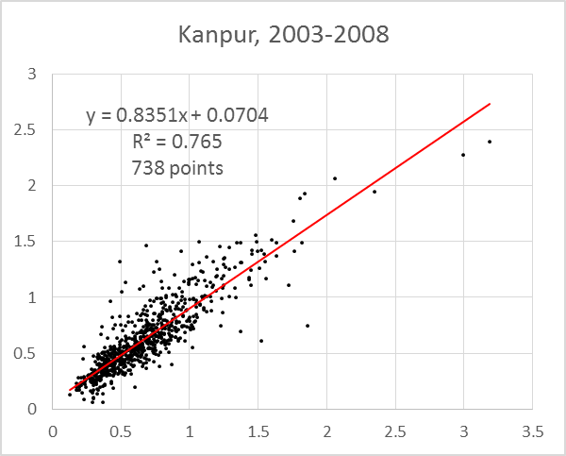
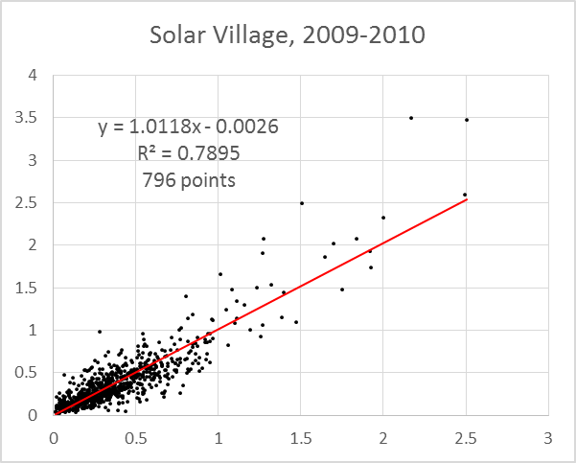
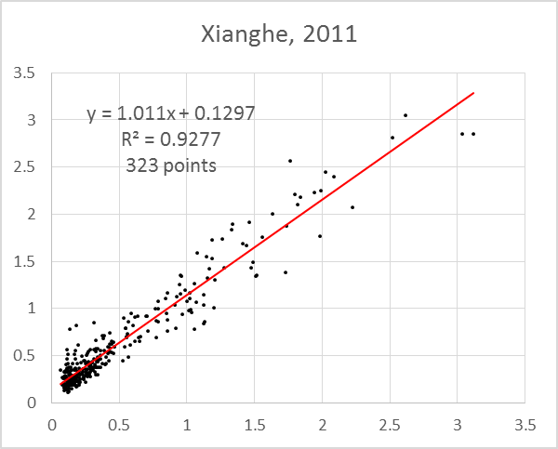
AERONET Validation
Strong seasonal surface dynamics
Surface dynamics, variable aerosol type
Bright surface

Slide 15
MODIS De-Trending and X-Cal
New MCST RVS characterization for Aqua → new OBPG Terra Polarization Correction (PC) coefficients → MODAPS generated 50km L1B subsets for CEOS desert cal. sites;
Method: a) run MAIAC retrievals (AOT, BRDF etc.); 2) compute TOA reflectance (R_{n}) for fixed geometry (VZA=0°, SZA=45°) and evaluate trends in both Terra and Aqua; 3) Apply de-trending and compute T-A X-calibration factor (gain correction for T)
Lyapustin, A., Y. Wang, X. Xiong, G. Meister, S. Platnick, R. Levy et al, Science Impact of MODIS C5 Calibration Degradation and C6+ Improvements, AMT, 7, 7281-7319, 2014.
Average trend/year/unit_refl.
 | Δ_{Terra} | σ_{Terra} | Δ_{Aqua} | σ_{Aqua}
TOA_B01 | -1.6884E-03 | 2.6114E-04 | 1.5848E-06 | 3.9377E-04
TOA_B02 | 7.7780E-04 | 2.4303E-04 | -6.5120E-05 | 3.5583E-04
TOA_B03 | -8.8922E-04 | 4.5314E-04 | -3.1763E-04 | 2.8486E-04
TOA_B04 | -5.6629E-04 | 3.2829E-04 | -3.9831E-05 | 5.0202E-04
TOA_B05 | 1.9477E-04 | 3.3019E-04 | 4.5784E-06 | 3.3528E-04
TOA_B06 | -3.9516E-04 | 3.0211E-04 | -3.1194E-04 | 2.8191E-04
TOA_B07 | 2.0259E-04 | 2.4491E-04 | -5.8419E-04 | 3.2705E-04
TOA_B08 | -1.2627E-03 | 1.0018E-03 | -5.5178E-04 | 1.0915E-04
TOA_B09 | -3.9874E-04 | 5.2176E-04 | 1.3724E-04 | 2.1120E-04
TOA_B10 | -7.2800E-04 | 8.2601E-04 | -3.0632E-04 | 7.1498E-04

Slide 16
Terra-Aqua X-Calibration
After MCST RVS de-trending for Aqua, we see trend reduction (a factor of 12 in B1 and a factor of 2 in B3) compared to our previous analysis.
Average X-gain for Terra
 | Average | Stdev
TOA_B01 | 1.018776 | 0.000949
TOA_B02 | 1.000523 | 0.001054
TOA_B03 | 0.989436 | 0.001268
TOA_B04 | 1.00109 | 0.001448
TOA_B05 | 0.98862 | 0.001855
TOA_B06 | 0.997128 | 0.000898
TOA_B07 | 0.999368 | 0.000373
TOA_B08 | 1.003774 | 0.000948
TOA_B09 | 1.0014 | 0.001488
TOA_B10 | 1.014141 | 0.002077

