Slide 1
CEOS Land Product Validation Update
(and other housekeeping items…)
Miguel Román, Pierre Guillevic, Jaime Nickeson, Zhuosen Wang
with contributions from the CEOS-LPV Focus Area Leads
MODIS/VIIRS Science Team Meeting: June 6-10, 2016

Slide 2
CEOS > WGCV > LPV
CEOS - Committee on Earth Observation Satellites
  31 CEOS Members (e.g. space agencies, research centers)
  24 Associate Members (e.g., UNEP, WMO, GCOS)
CEOS coordinates civil space-based EO to benefit society
The Working Group on Calibration and Validation (WGCV) is one of 5 CEOS working groups.
  Land Product Validation (LPV) is one of 6 WGCV subgroups
Current LPV Officers:
Chair Miguel Román NASA GFSC
Vice-Chair Fernando Camacho EOLAB/U. of Valencia
Secretariat Jaime Nickeson SSAI/NASA GSFC
Protocol Dev. Pierre Guillevic UMD/NASA GSFC
LPCS Liaison Zhuosen Wang ESSIC/ NASA GSFC
+ 11 Focus Areas with ~2 co-leads each
Notes:
International associates include intergovernmental groups like GCOS, GEO, UN systems
WGCV subgroups Terrain Mapping, IR Visible Optical Sensors, SAR, Microwave, Atmospheric Composition

Slide 3
LPV Focus Areas and Co-leaders
*ECV
Snow Cover*, Sea Ice | Thomas Nagler (ENVEO, Austria) | Tao Che (Chinese Academy of Sciences)
Surface Radiation (Reflectance, BRDF, Albedo*) | Crystal Schaaf (U Mass Boston) | Alessio Lattanzio (EUMETSAT)
Land Cover * and Land Use Change | Pontus Olofsson (Boston University) | Martin Herold (Wageningen University, NL)
Biomass* | Vacant | Vacant
FAPAR* | Arturo Sanchez (University of Alberta) | Nadine Gobron (JRC, IT)
Leaf Area Index* | Oliver Sonnentag (University of Montreal) | Stephen Plummer (Harwell, UK)
Fire* (Active Fire, Burned Area) | Luigi Boschetti (University of Idaho) | Kevin Tansey (University of Leicester, UK)
Land Surface Temperature* (LST and Emissivity) | Simon Hook (NASA JPL) | Jose Sobrino (University of Valencia, SP)
Soil Moisture* | Tom Jackson (USDA ARS) | Wolfgang Wagner (Vienna Univ of Technology, AT)
Land Surface Phenology | Matt Jones (Oregon State University) | Jadu Dash U Southhampton
Vegetation Index | Tomoaki Miura and Marco Vargas (University of Hawaii / NOAA/STAR) | Vacant
Notes:
Restructured a few years ago, now following essential climate variables. Several focus area co-leads presenting variable-specific results.

Slide 4









LPV’s Core Mission
CEOS Member Agencies and Affiliates
Discipline Teams
Instrument Teams
To integrate across LPV Focus Areas, CEOS Space Agencies, and the Land Discipline & Instrument Teams.

Slide 5
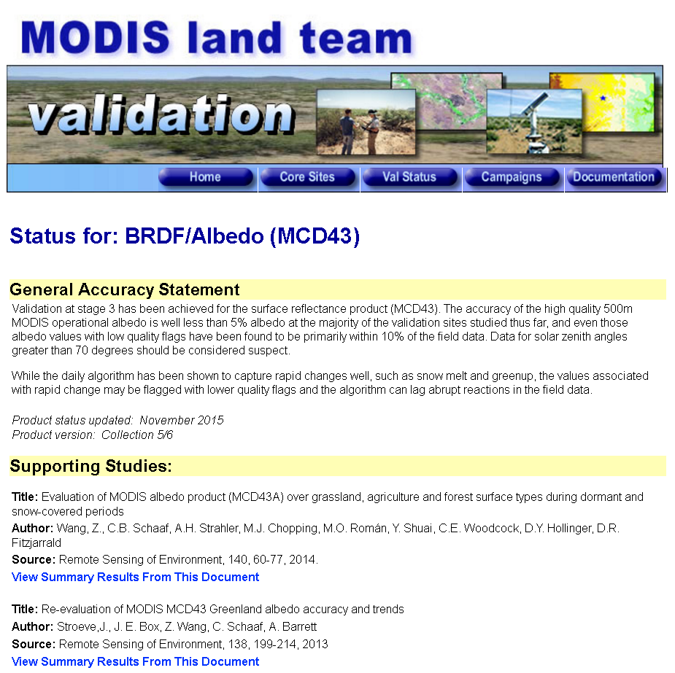
MODIS Maintenance PIs:
Need to keep your
val status pages updated!!

Slide 6
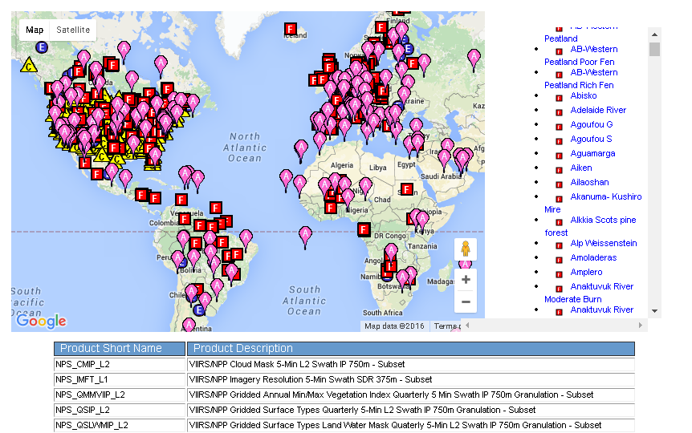
MODIS/VIIRS Subsets FTP Access Page
Used by multiple teams (VIIRS ST, VCST, LPDAAC, ORNL, NOAA/STAR)

Slide 7
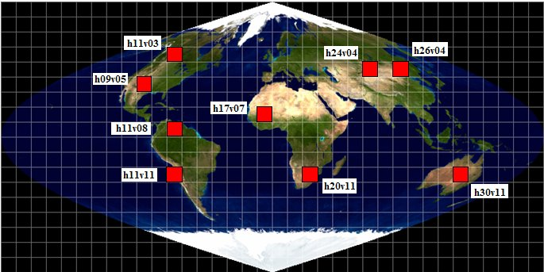
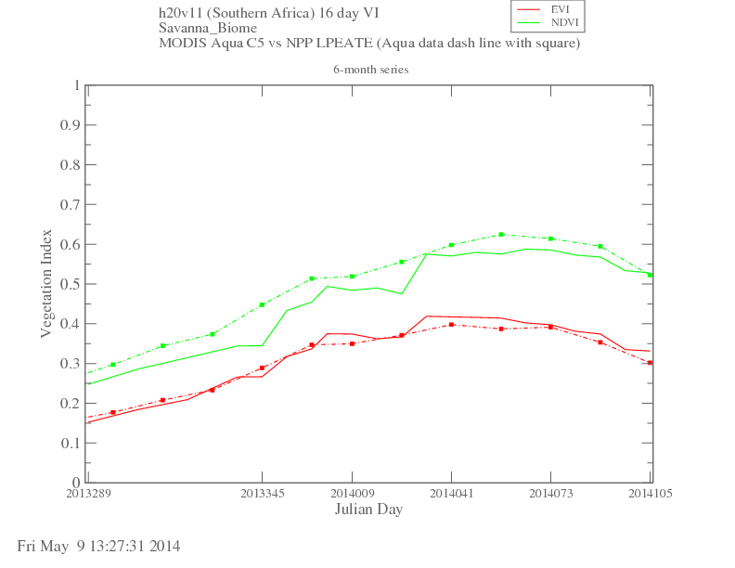
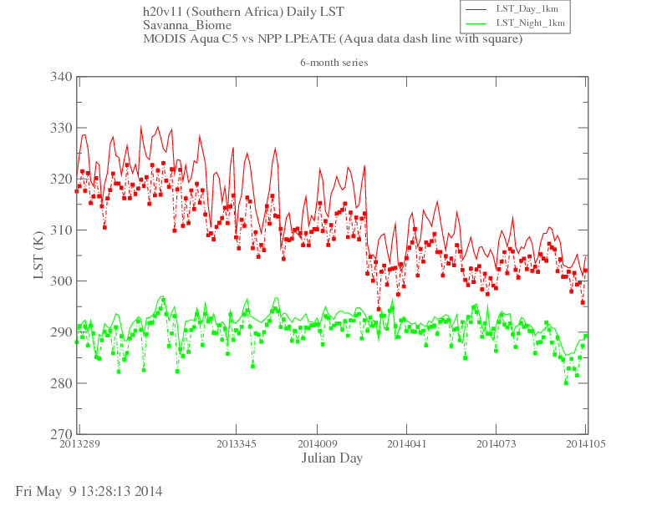
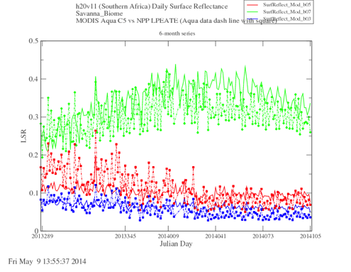
Land Product Quality Assessment
Golden Tile Time Series
Approach: Summary statistics for (10° X 10°) SIN golden tiles.
Early VIIRS (solid lines) vs. Aqua MODIS C6 (dashed-dot lines) Vegetation Index (left), LST (center), and Surface Reflectance (right). 6-month trending shown for observations from savanna class (tile h20v11).

Slide 8
CEOS Member Agencies and Affiliates
Discipline Teams
Instrument Teams
http://ceos.org/about-ceos/agencies/

Slide 9
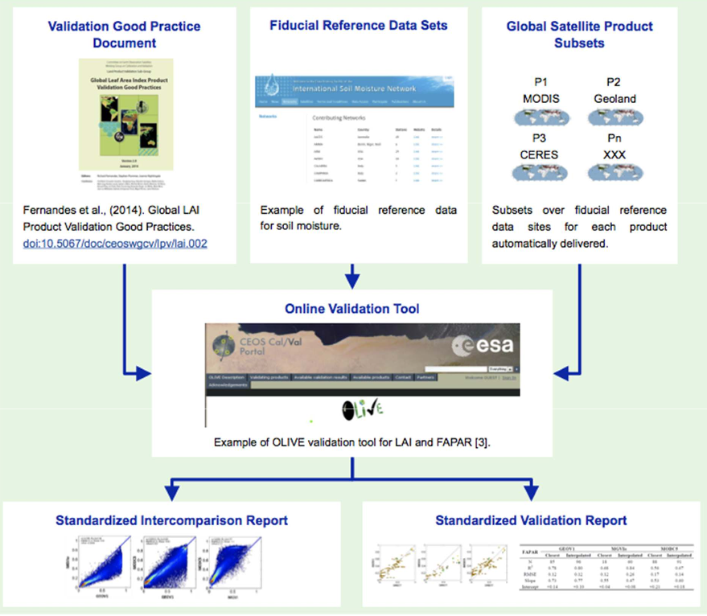
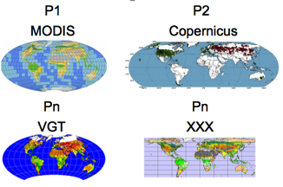
The LPV Validation Framework
Lead Coordinating
Agency: NASA
Lead Agencies: Various
Lead Agency:
NASA
Lead Agencies:
USGS/NOAA
Lead Agency: ESA
Lead Agency: ESA

Slide 10





















CEOS-LPV 5-Year Roadmap
<2016 2017 2018 2019 >2020
Vision
Operational Validation Framework: Land Product Characterization System (Lead Agencies: USGS/NOAA)
  All missions support validation & validation is on-going
  Uncertainty information determined through standard practices & protocols
  Algorithms are iteratively improved based on validation results
Albedo, Burned Area, & LST Protocols
Phenology, ET, & Soil Moisture Protocols (Lead Agency: NASA)
CEOS Carbon Actions 7/8 (NASA CMS Program)
Biomass Protocol (Lead Agencies: NASA/ESA)
ECV protocols and procedures for Snow ECV (Lead Agency: ESA)
WGCV Atmospheric Correction Intercomparison Exercise (Lead Agency: ESA)
Atmospheric Correction and VI Protocols (Lead Agencies: ESA/NOAA)
Field Campaigns and IOPs
New Missions
Biomass
Sustained Missions
a/b
A
/ 1b
b
Morning
c
Landsat 9
Afternoon
Terra/Aqua/S-NPP
JPSS-1
JPSS-2

Slide 11

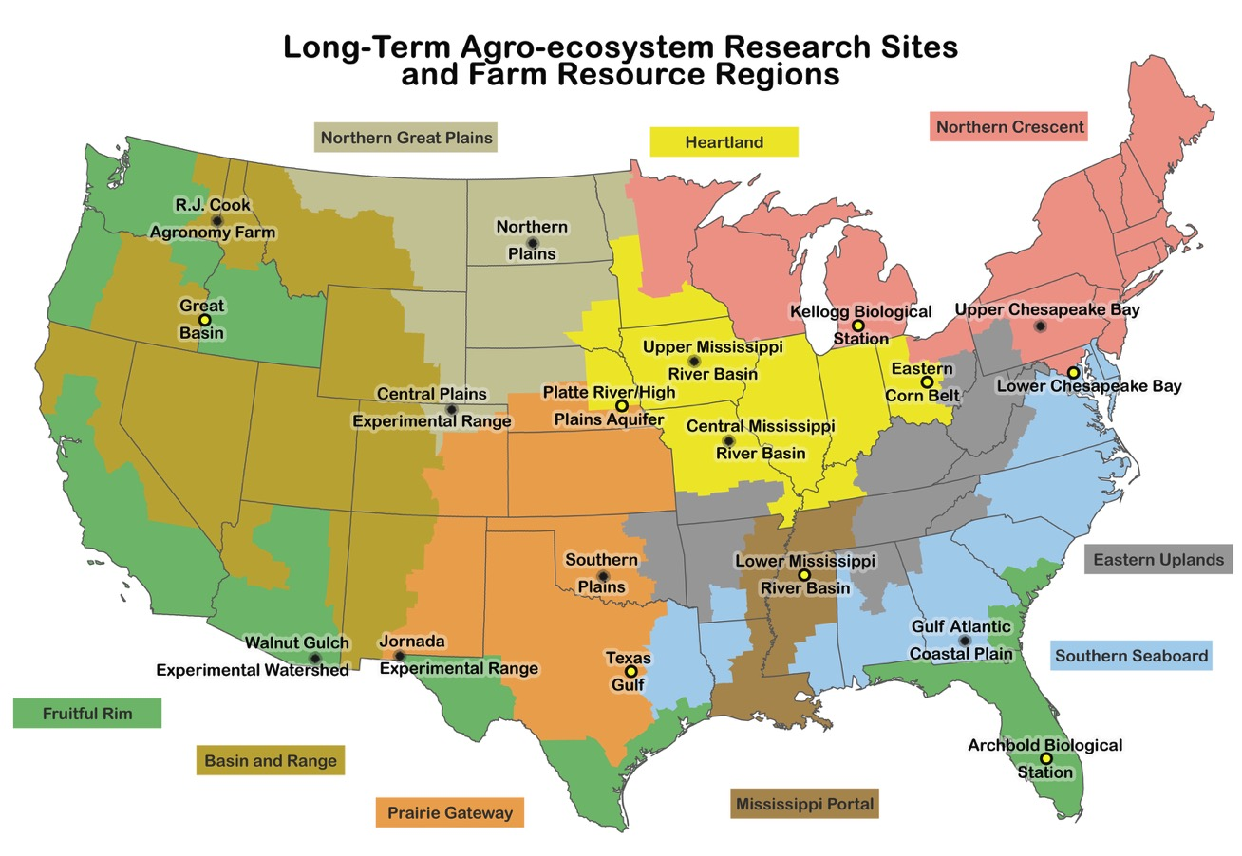
Fiducial Reference Data Sets: Key Players
NASA POCs (Pierre Guillevic, Brad Doorn, Chris Justice)
Full List of Organizations: http://www.ars.usda.gov/SP2UserFiles/Program/211/LTAR%20Collaborators%20alphbetical%20FINAL.pdf
Notes:
A small subset of networks lpv uses for develop their in situ datasets
Sometimes the networks don’t exist or are insufficient - LC developed their own, GOFC/GOLD with BU and USGS developed a set of 500 global sites that covered all biomes where they produced a detailed LC classification using commercial high resolution data
But mostly we rely on existing networks, but they need to be checked for spatial representativeness and they need quality checking, so even though the networks are providing the basic data, a lot of effort goes in to make sure the data are suitable for validation.

Slide 12

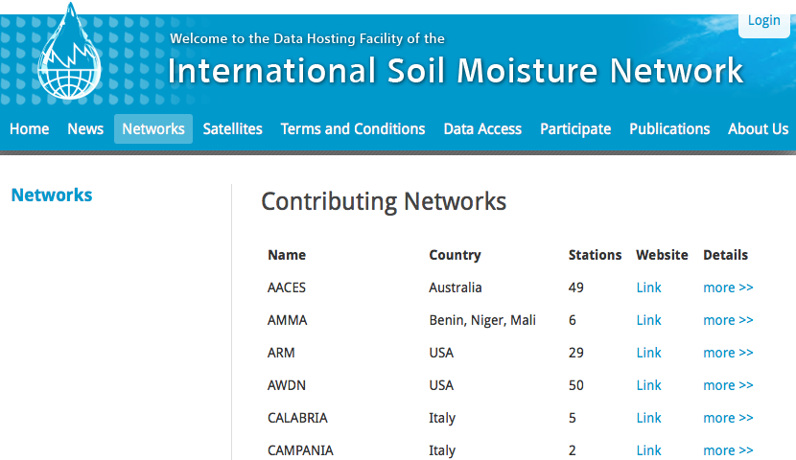
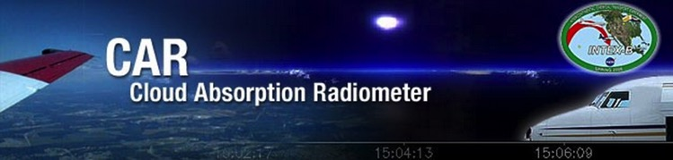





Fiducial Reference Data Sets
Notes:
A small subset of networks lpv uses for develop their in situ datasets
Sometimes the networks don’t exist or are insufficient - LC developed their own, GOFC/GOLD with BU and USGS developed a set of 500 global sites that covered all biomes where they produced a detailed LC classification using commercial high resolution data
But mostly we rely on existing networks, but they need to be checked for spatial representativeness and they need quality checking, so even though the networks are providing the basic data, a lot of effort goes in to make sure the data are suitable for validation.

Slide 13
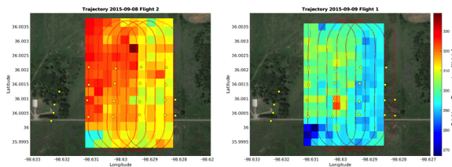


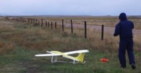
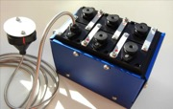
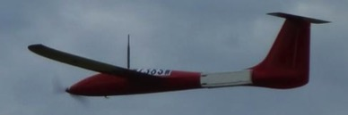
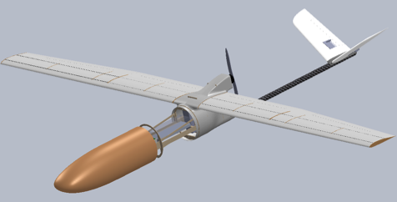

NASA small-UAS Partnerships:
GSFC, ARC and BlackSwift Technologies LLC
Two Instrument Systems
  Soil Moisture (w/ L-Band Radiometer - SBIR)
  MultiAngle, MultiSpectral Imagers (Román, et al - IRAD)
Two Types of s-UAS
  Tempest (Established Platform)
  SuperSwift (New, GeoScience Tailored Platform)
Electric s-UAS (both):
Max Wt. ~15 lbs
P/L Wt. ~5 lbs
Endurance~1 Hr

Slide 14
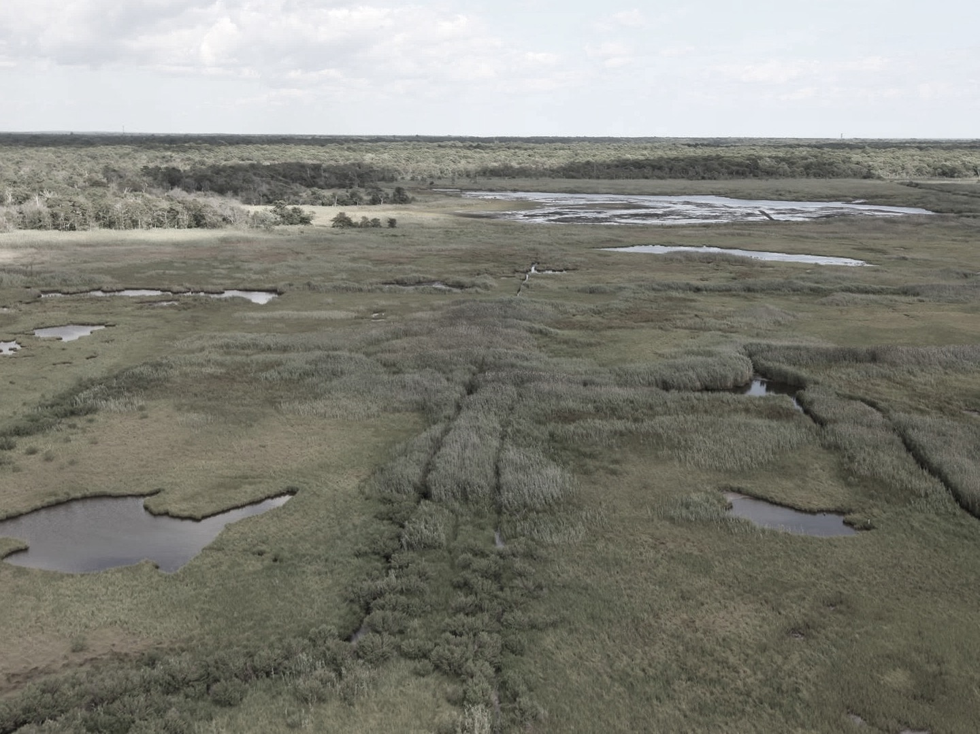
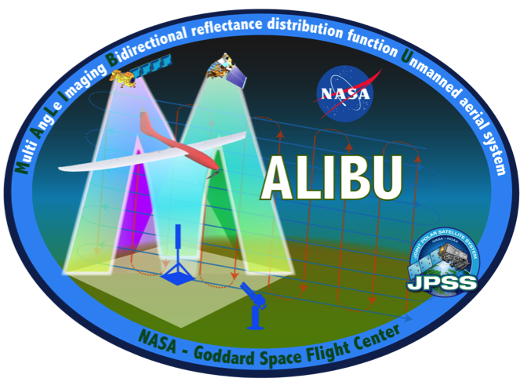
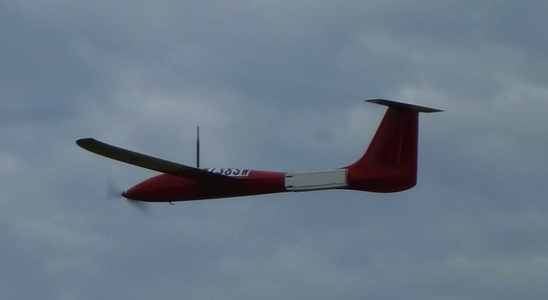
MALIBU (Multi AngLe Imaging Bidirectional
Reflectance Distribution Function sUAS)
MALIBU is a pathfinder concept funded through NASA’s Internal Research and Development Program (IRAD) to develop a multi-angle remote sensing technique using small Unmanned Aircraft Systems (sUAS).
The instrument package includes two multispectral imagers, oriented at two different viewing angles, to capture key surface radiation and biophysical parameters.
GSFC instrument system is packaged in a Black Swift Technologies LLC Tempest aircraft (seen deployed here).

Slide 15
MALIBU Spectral Response
The MALIBU instrument design includes two Tetracam optical units matching the optical Land channels of key Land sensors such as Landsat-8 OLI, Sentinel-2 MSI, Terra/Aqua MODIS, Terra MISR, and Suomi-NPP/JPSS VIIRS.

Slide 16
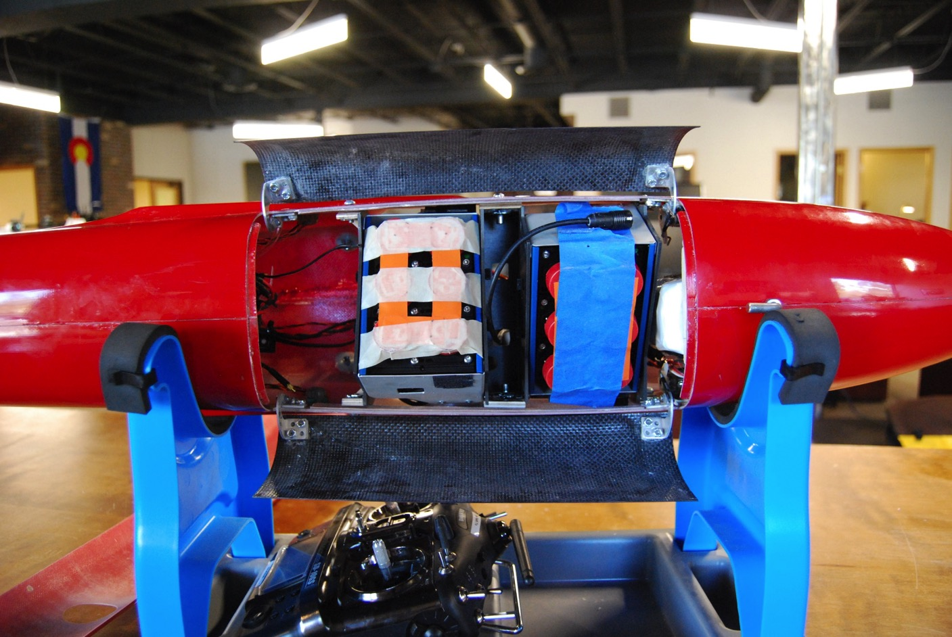

Slide 17
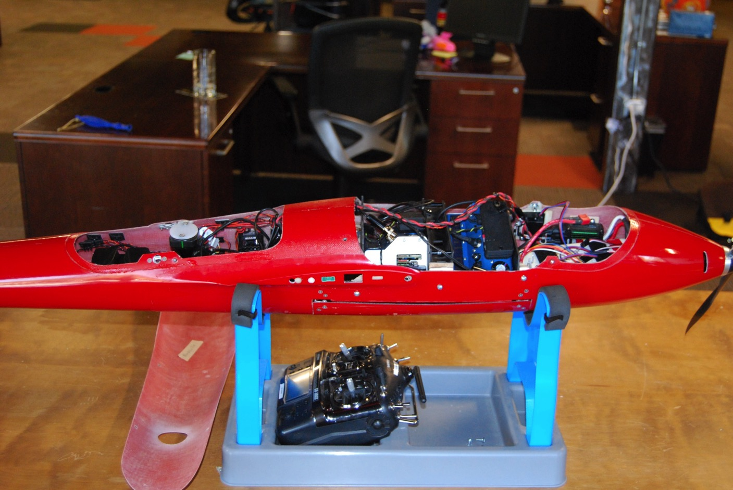

Slide 18
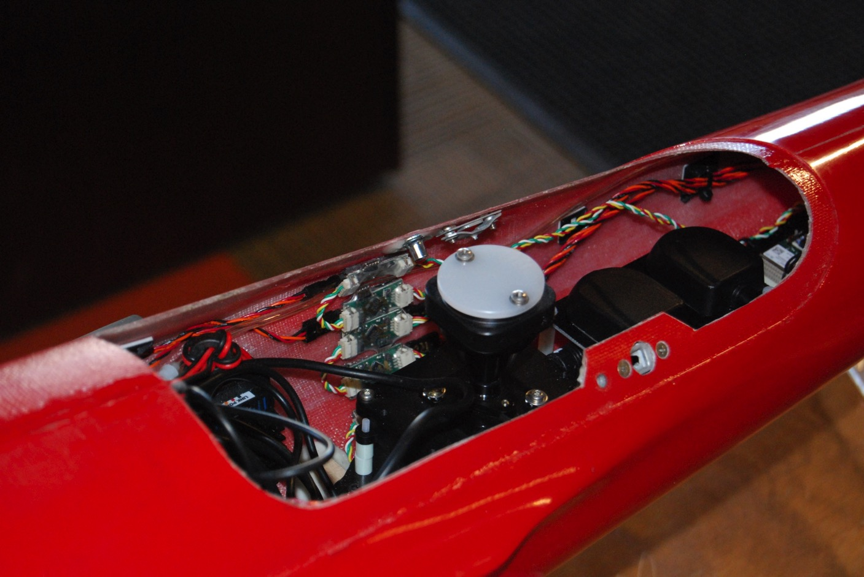

Slide 19
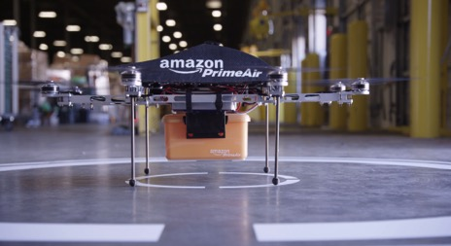

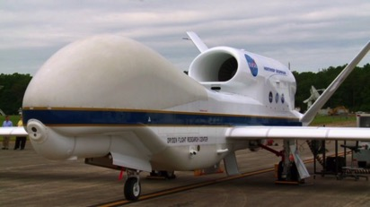
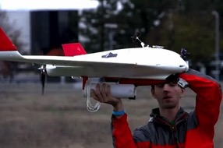
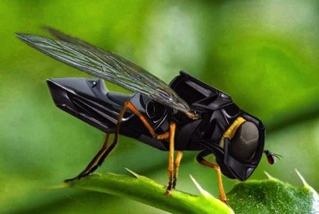
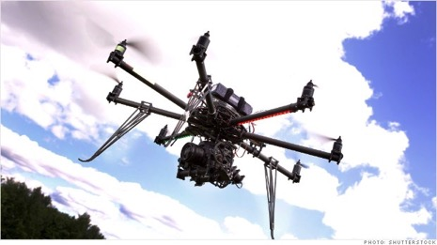
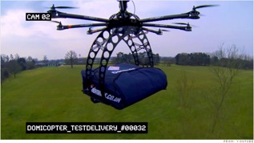
Six types of drone concepts ‘crazier’ than MALIBU…
Package Delivery
IED Detection
Hurricane Drone
Food Delivery
Pollinating Drone
Wildfire Drone

Slide 20
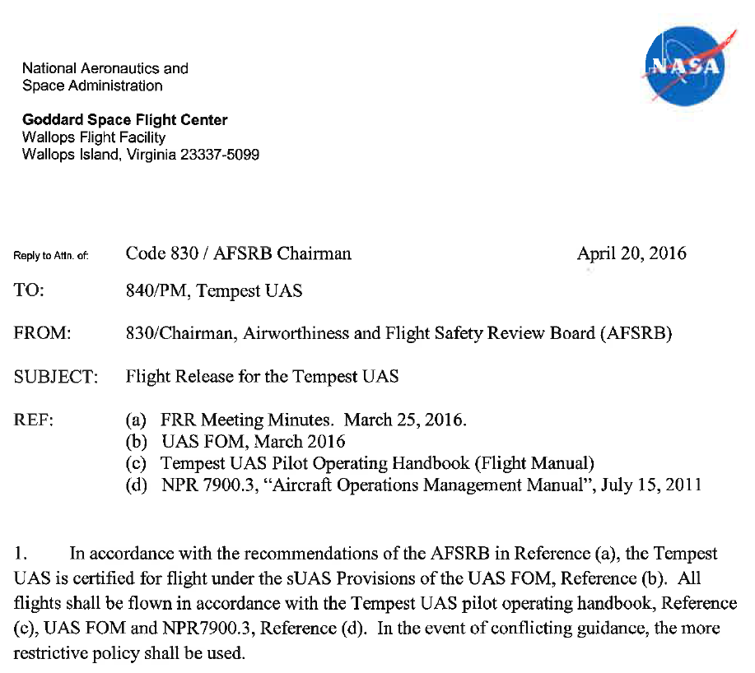
NASA Flight Readiness Review Approval
COA-Gov’t

Slide 21
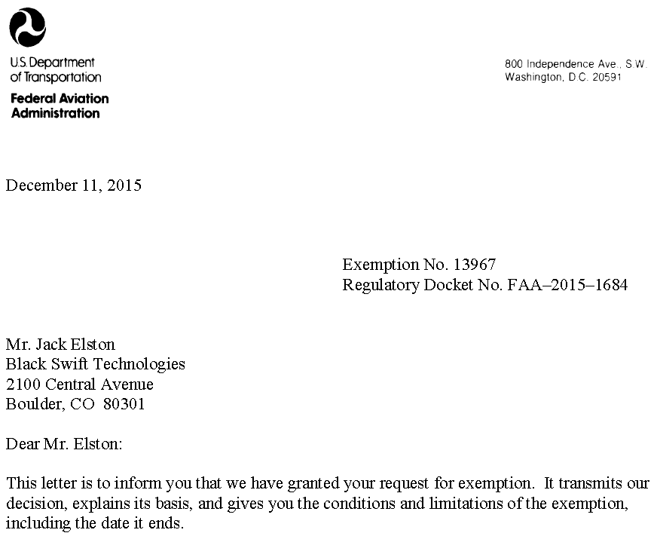
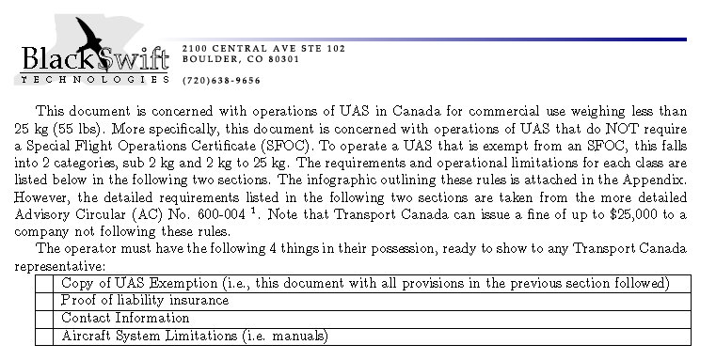
FAA Section 333 and Transport Canada Full Blanket Exemptions

Slide 22
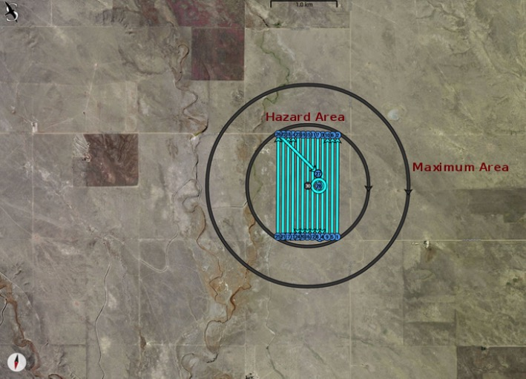
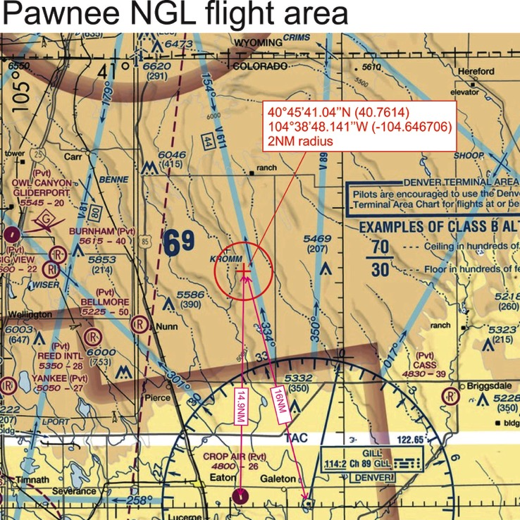
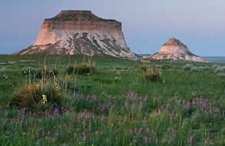
MALIBU Test Flight – (6/28/16 – 7/1/16)
(Pawnee National Grasslands, CO)

Slide 23
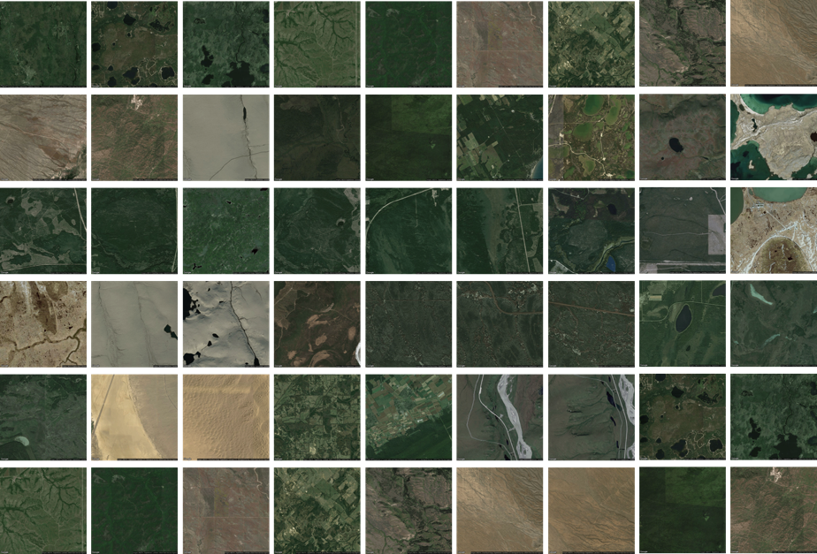
NASA-FAA Approved MALIBU Sites
MODIS/VIIRS Team Member Discount! ~$350/flight hour
Meeting COA-Gov’t and FAA Section 333 requirements

Slide 24
CEOS Working Groups and Associates
Discipline Teams
Instrument Teams

Slide 25
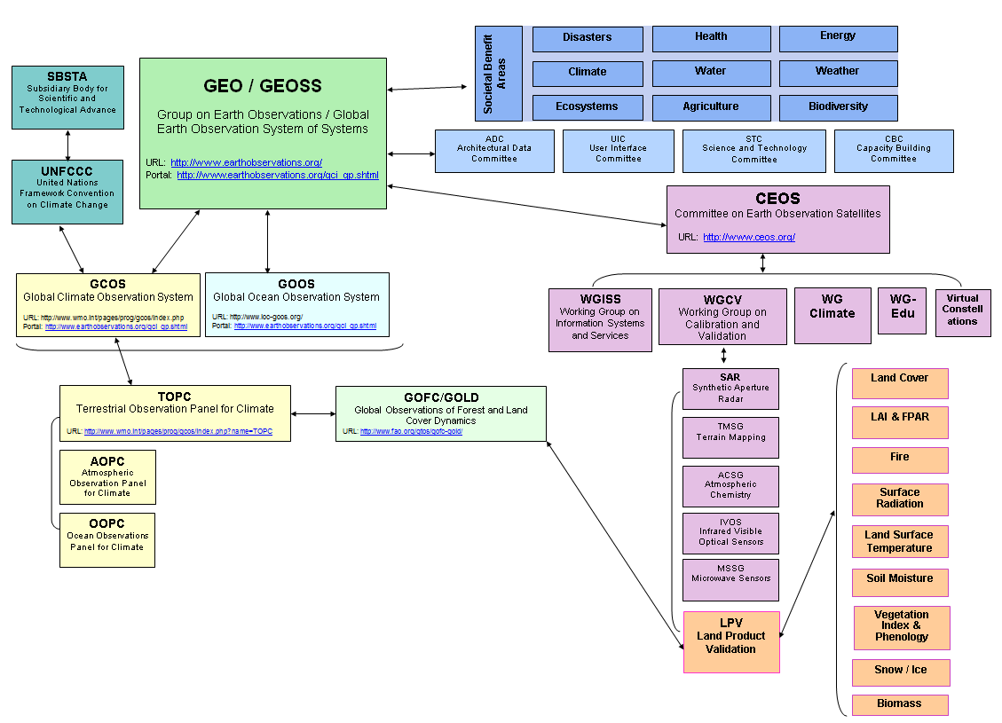
International Programs concerned with
Terrestrial Earth Observations
www.ceos.org
25
Notes:
Some of you may be familiar with CEOS; it is basically the space component of the Global Earth Observation System of Systems; for the Group on Earth Observations. Our NASA team leads are active members of the Working group on Calibration and Validation and we basically exist to help science teams and the wide user community to make better use of validation data; so it’s a manner of facilitating the data access and encouraging widespread use of validation data. This helps us to move toward standardized approaches to global land product validation. With the high cost of in-situ data collection, the potential benefits from international cooperation are considerable and obvious.

Slide 26

CEOS Carbon Activity:
History and Background
GEO Carbon Report developed in June 2010.
CEOS Strategy for Carbon Observations from Space – written in response to above, completed in March 2014 – Wickland et al.
42 Actions identified in the report for specific response– first discussed at SIT Technical Workshop in September 2013
April 2014: Proposed establishment of a study team to take forward the Actions and also identify formal CEOS mechanism to manage Actions.
Mark Dowell (EC-JRC)
mark.dowell@jrc.ec.europa.eu
Stephen Plummer (ESA)
stephen.plummer@esa.int

Slide 27
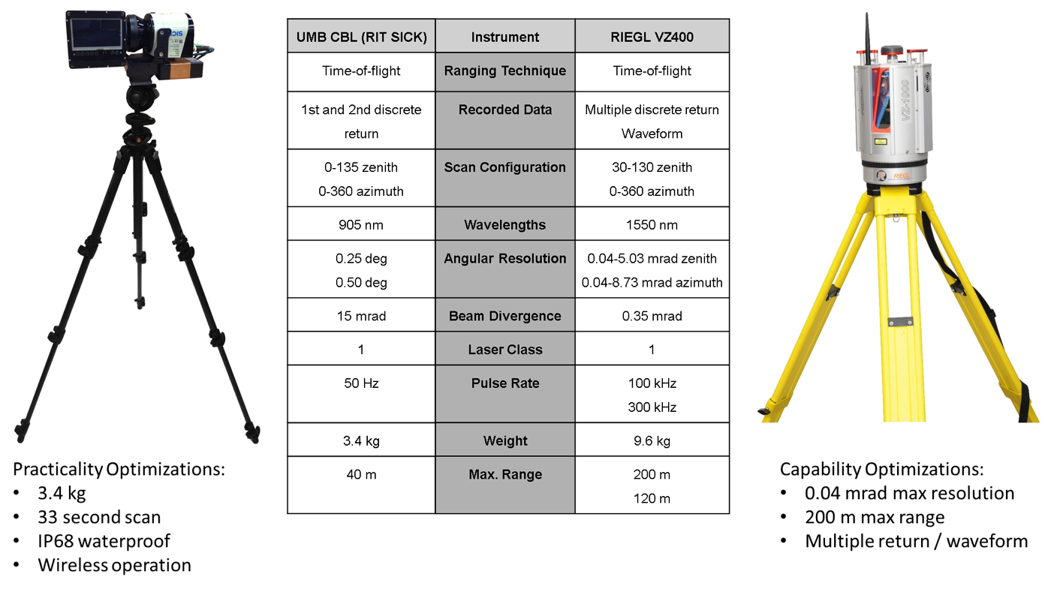
LPV Biomass Focus Area Goals:
Validation protocols focusing on core site selection, field sampling using Terrestrial and Airborne LIDAR Systems, and spatial representativeness and uncertainty quantification of in situ measurements.

Slide 28
International Programs concerned with
Terrestrial Earth Observations
www.ceos.org
28
Notes:
Some of you may be familiar with CEOS; it is basically the space component of the Global Earth Observation System of Systems; for the Group on Earth Observations. Our NASA team leads are active members of the Working group on Calibration and Validation and we basically exist to help science teams and the wide user community to make better use of validation data; so it’s a manner of facilitating the data access and encouraging widespread use of validation data. This helps us to move toward standardized approaches to global land product validation. With the high cost of in-situ data collection, the potential benefits from international cooperation are considerable and obvious.

Slide 29

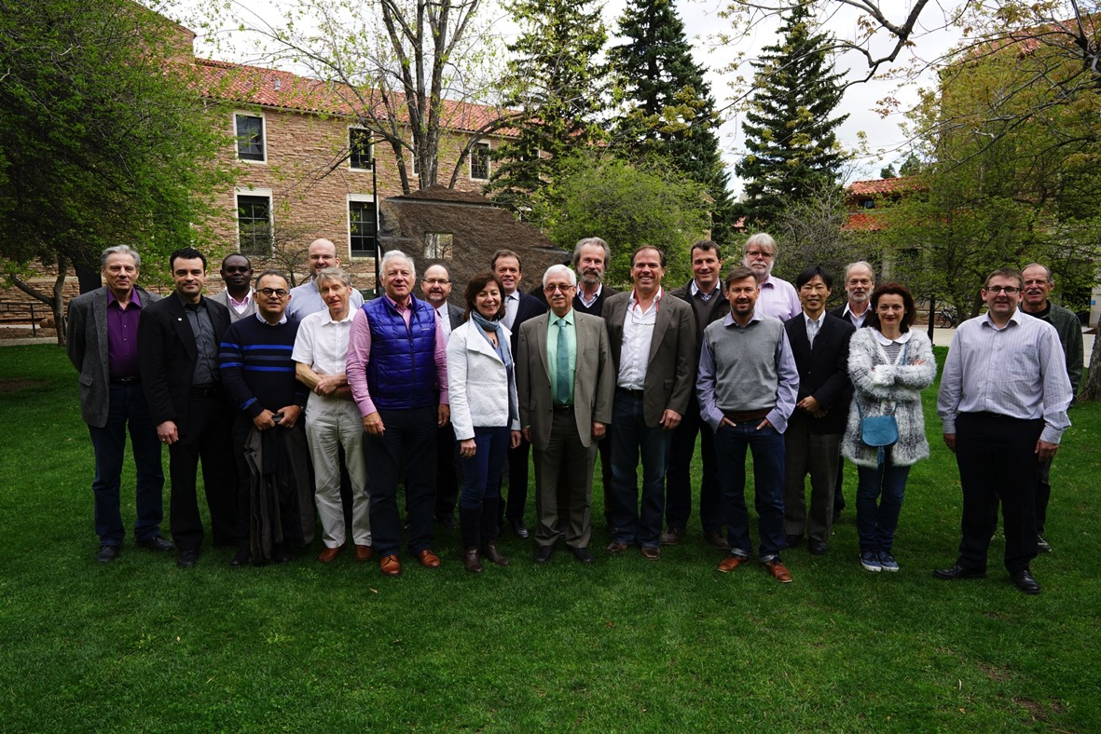
TOPC-18 Panel & Experts
TOPC/USA Delegation
Miguel Román (CEOS/NASA)
Sassan Saatchi (JPL)
Tom Painter (JPL)
Jeff Key (NOAA)

Slide 30
GCOS Land Surface Temperature (LST) Status
LST to become ECV!!
(Just in time for inclusion in the new GCOS-IP due for UNFCCC COP 22.)
Process took years since initial inquires. LPV LST & Emissivity focus area leads first made a strong case for inclusion and pushed the case forward.
Key players (Hook, Sobrino, Hulley, Guillevic, Warren, Remedios) iterated on variable definitions, requirements for satellite/reference/climate, and completed a Draft IP section: Not easy!
Proposal presented by the CEOS-LPV Chair (Román) and endorsed by the TOPC-18 Panel in April, 2017.
Notes:
LST approved by TOPC 3 weeks ago!
GCOS requirements for accuracy stability and feasibility

Slide 31
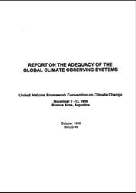
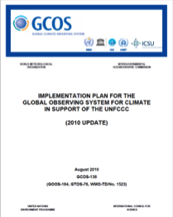

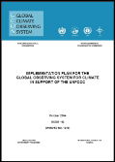

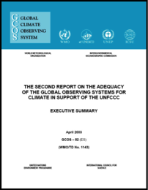

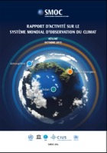

Driving the Global Climate Observation Agenda
Identify/Review Essential Climate Variables (ECVs) through science panels
Regular review of how these ECV are observed
Develop plans to ensure continuity and improvement of observations
GCOS follows a 3 phase approach driven by users
2015 Status Report started the 3rd assessment cycle with a new Implementation Plan due in 2016 for UNFCCC COP 22
(1st cycle:
1995-1998)
(2nd cycle:
2003-2004-2010)
(3rd cycle: 2015-2016)

Slide 32
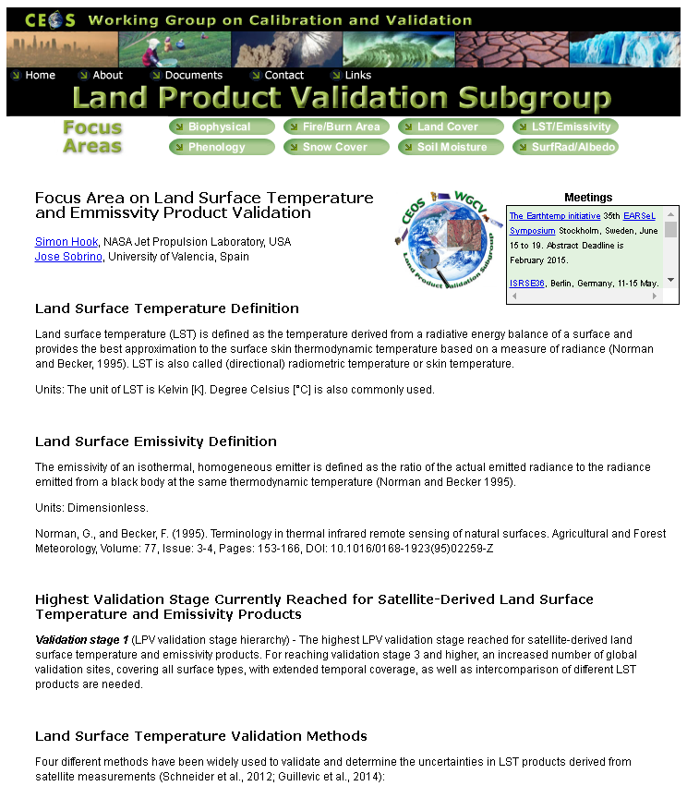






Factors that helped ‘seal the deal’ for LST at TOPC-18:
-- Community Consensus
-- Housekeeping of LPV LST&E Section!
Notes:
LST approved by TOPC 3 weeks ago!
GCOS requirements for accuracy stability and feasibility

Slide 33
19 Essential Climate Variables
Current focus of TOPC is to identify measurable terrestrial key variables that control the physical, biological and chemical processes affecting climate and are indicators of climate change.
Biological/Ecological (6)
Land cover and Land Use Change
FAPAR
Leaf area index
Above ground biomass
Soil carbon
Fire disturbance
Hydrological (5)
River discharge
Water use
Ground water
Lakes
Soil moisture
Cryospheric (4)
Snow cover
Glaciers and ice caps
Ice sheets and ice shelves
Permafrost
Surface Properties (4)
Albedo
Land surface temperature
Energy fluxes
Anthropogenic greenhouse gases
New, Revised, and Proposed
11 ECVs are directly linked to MODIS/VIIRS Land Products
Notes:
The summary of the EVC’s discussed in TOPC – the terrestrial parameters. One exception is the albedo which has not a fixed home

Slide 34

http://lpvs.gsfc.nasa.gov

