Slide 1
Development and Validation of a Land Surface Phenology Product from VIIRS
2016 MODIS/VIIRS Science Meeting, June 6-10
Xiaoyang Zhang¹, Mark Friedl², Geoffrey Henebry¹, Senthilnath Jayavelu¹, Joshua Gray², Yan Liu³, Crystal Schaaf³, Jianmin Wang¹
¹Geospatial Sciences Center of Excellence, South Dakota State University, Brookings, SD
²Department of Earth and Environment, Boston University, Boston MA
³School for the Environment, University of Massachusetts Boston, Boston MA
Xiaoyang.Zhang@sdstate.edu

Slide 2
Outline
Algorithm of detecting land surface phenology from VIIRS
Comparison of VIIRS phenology with MODIS phenology
Validation of VIIRS phenology using PhenoCam and Landsat observations
Summary
Notes:
In the presentation, I would like to talk about the following objectives.

Slide 3
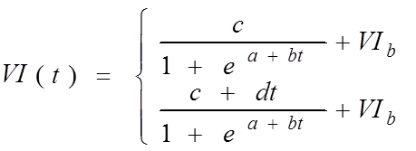
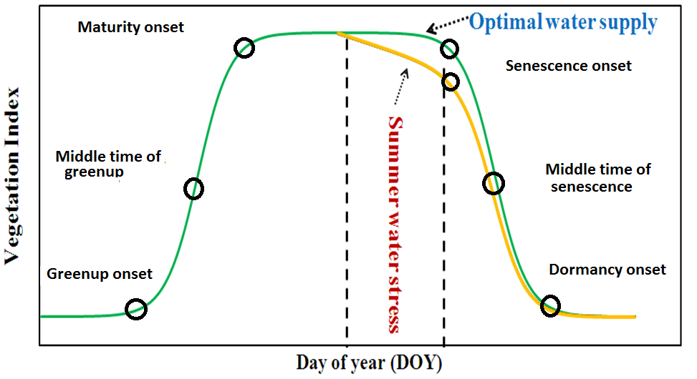
Hybrid Piecewise Logistic Model for Simulating Temporal Vegetative Trajectory
Favorable growth condition
Vegetative stress condition
t is time in days
VI_{(t)} is the VI value at time t
VI_{v} is the VI value in vegetation growth
a and b are vegetation growth parameters
d stress parameter
c+VI_{b} is the maximum VI value
VI_{b} is the background VI value

Slide 4
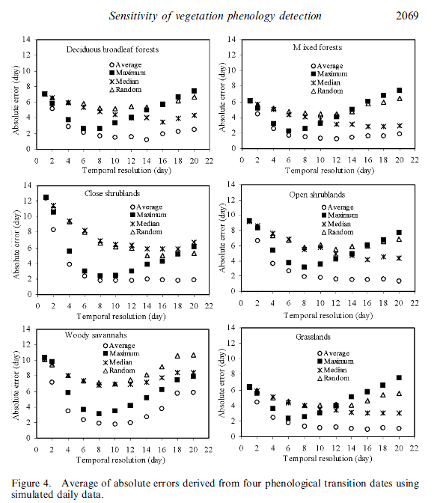
Assessment of Good Quality Observations During Vegetation Growing Season
Proportion of good quality observations (PGQ) during a growing season:
PGQ=N_{qa0}/T
T is the total number of VI during a growing season
N_{qa0}is the moving-window of good quality observation within a growing season.
If there is one or more good VI values within a 9-day moving window, then it counts as one good observation.
Zhang et al. 2009

Slide 5
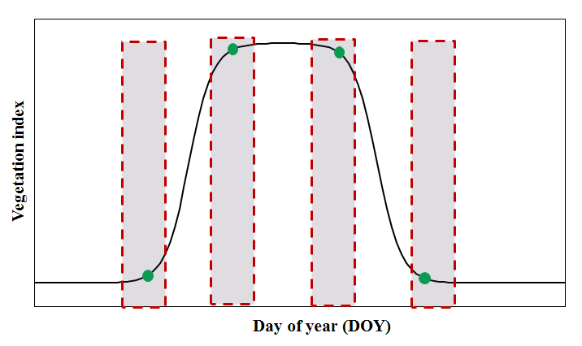
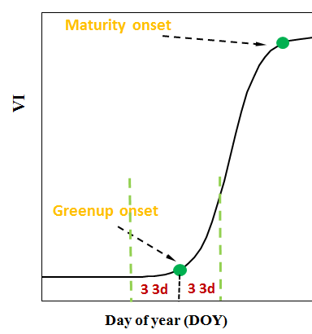
Qualifications of Good Observations Around Phenological Events
QA in the detection of greenup onset (QAgin):
QAgin=100*Ngin/6
Ngin is the number of good quality obs during three 3-day periods before and after the detected timing of greenup onset
QA in maturity onset: QAgma=100*Ngma/6
QA in senescence onset: QAgde=100*Ngde/6
QA in dormancy onset: QAgmi=100*Ngmi/6

Slide 6
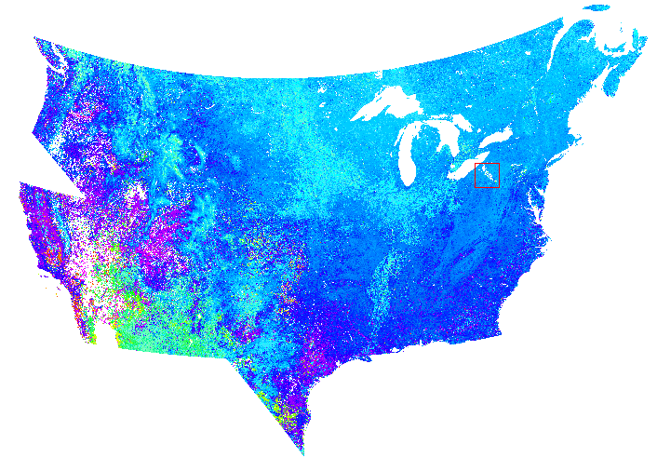
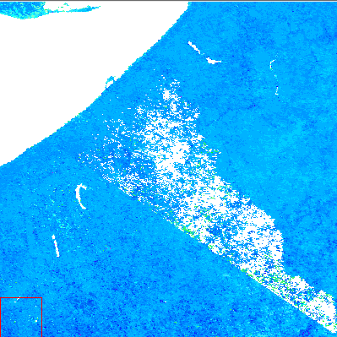
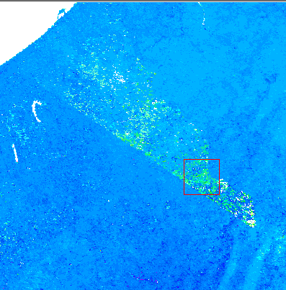
Phenology Detected from Daily VIIRS NBAR (500m)
2014
2014
2013
DOY

Slide 7
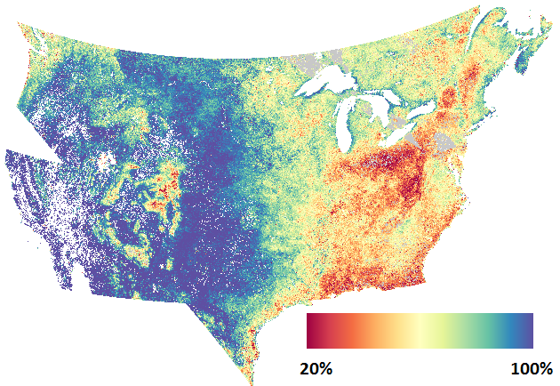
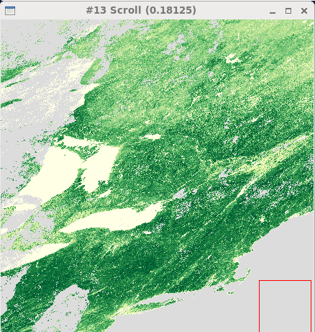
Quality of Time Series of VIIRS Data
Proportion of Good Observations (PGQ) During a Growing Season (2014)
EVI2 in DOY 166, 2014

Slide 8
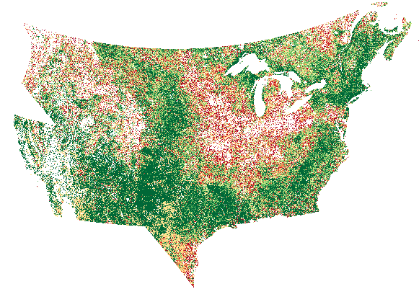
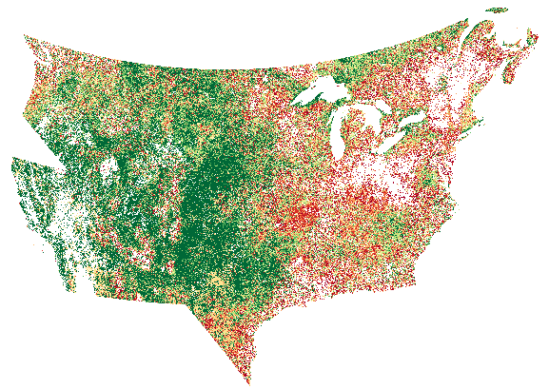
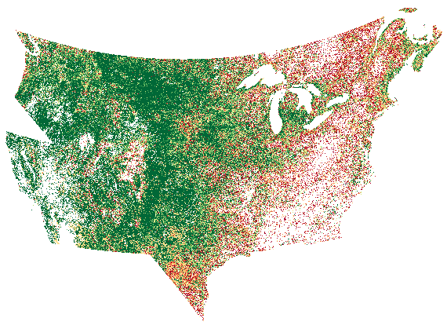
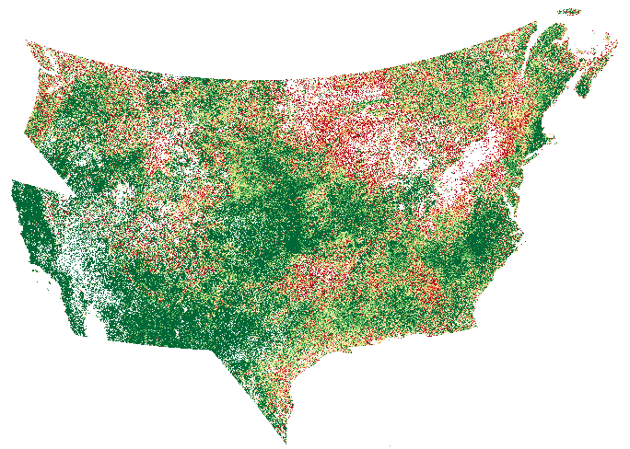
Quality of Time Series of VIIRS Data
Proportion of Good Observations around Each Phenological Event (2013)
Greenup onset
Maturity onset
Senescence onset
Dormancy onset
<20% 100%

Slide 9
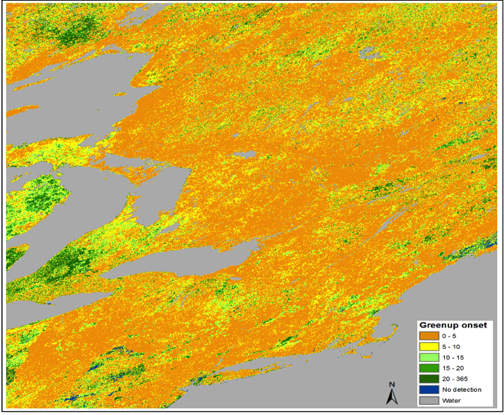
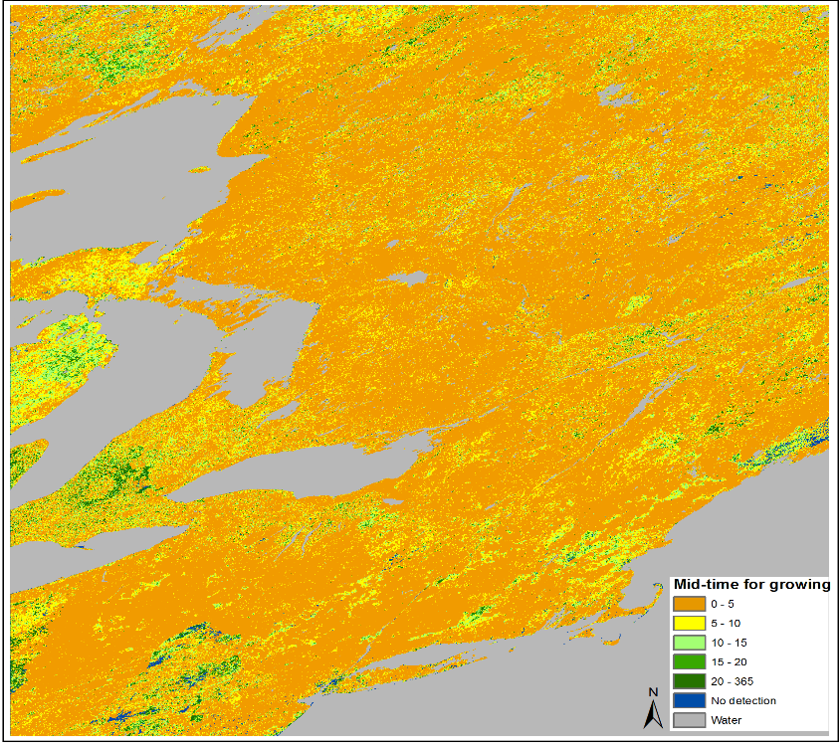
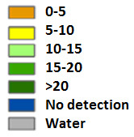
Comparison of Phenological Dates between MODIS and VIIRS NBAR Detections in Eastern US
Middle date of grow up phase
Greenup onset

Slide 10
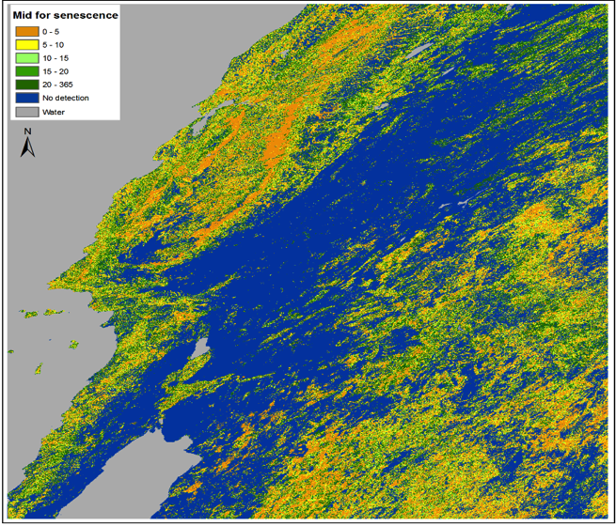
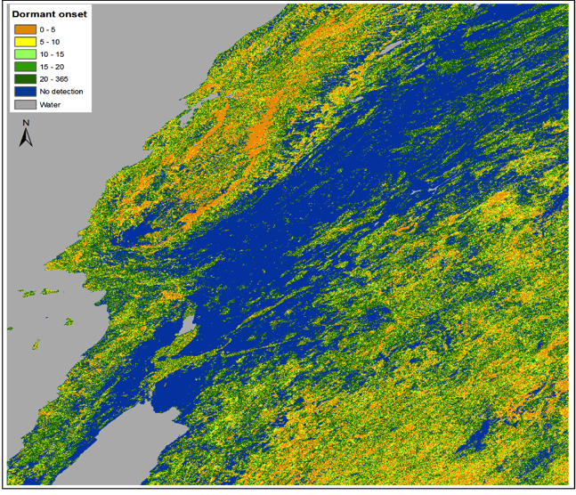
Comparison of Phenological Dates between MODIS and VIIRS NBAR Detections in western US
Middle date of senescent phase
Dormancy onset

Slide 11
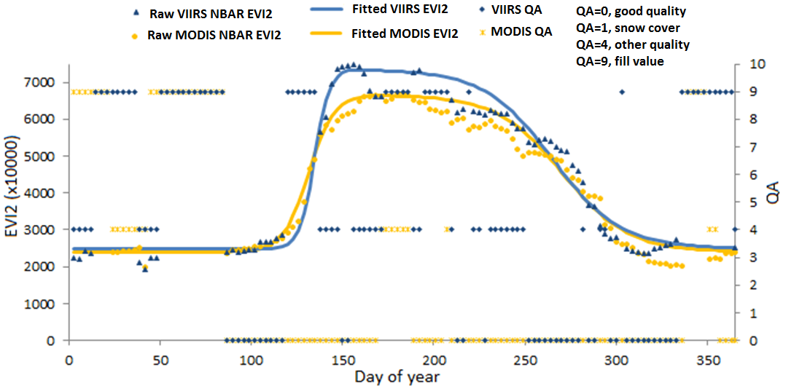
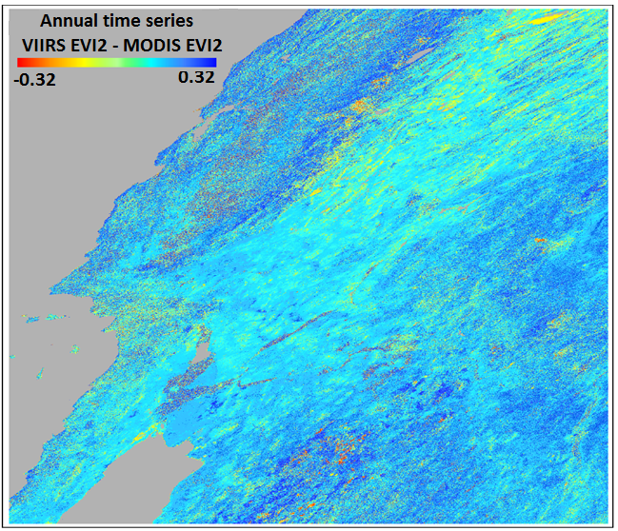
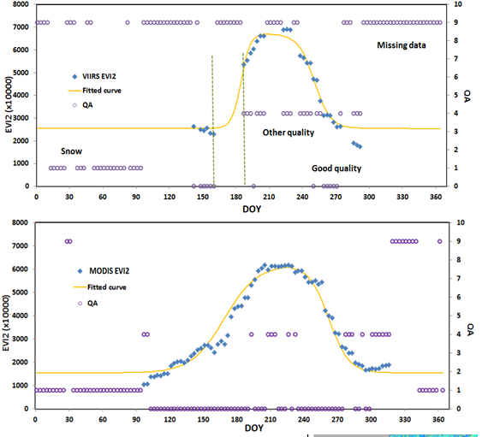
Difference of Temporal EVI2 trajectory between VIIRS NBAR and MODIS NBAR Data
Case 1
Case 2

Slide 12
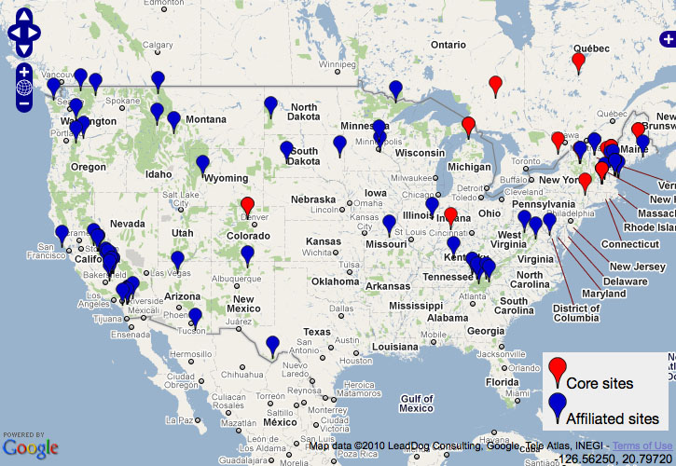
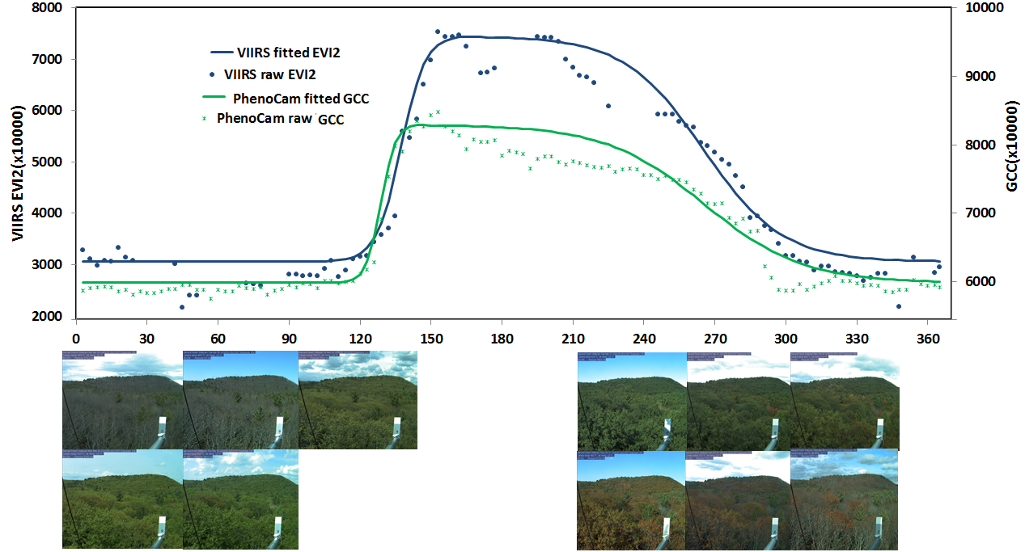
Validation of VIIRS Phenology Using Phenocam Data
Green chromatic coordinate (GCC):
Vegetation contrast index (VCI) :
http://richardsonlab.fas.harvard.edu/

Slide 13
Comparison of phenology transition dates between PhenoCam and VIIRS observations
 |  | Greenup onset | Mid-greenup | Maturity onset | Senescent onset | Mid-senescence | Dormant onset
2013 (100 sites) | AAD | 6.5 ± 6.2 | 9.4 ± 6.3 | 11.4 ± 7.9 | 14.9 ±11.4 | 11.8±10.9 | 11.2±8.6
 | Bias | -1 | -2 | -3 | 0 | -3 | -2
 | RMSD | 9.00 | 10.05 | 12.20 | 17.41 | 12.35 | 11.40
 | R² | 0.87 | 0.85 | 0.79 | 0.75 | 0.68 | 0.54
2014 (95 sites) | AAD | 7.3±5.8 | 7.1±5.1 | 10.7±6.6 | 16.7±10.9 | 12.8± 9.3 | 13.6±10.0
 | Bias | 0 | -2 | -5 | -3 | -4 | -3
 | RMSD | 9.15 | 8.12 | 10.27 | 19.28 | 14.10 | 15.23
 | R² | 0.88 | 0.88 | 0.83 | 0.74 | 0.87 | 0.78
AAD- Average absolute difference
RMSD-Root mean square difference

Slide 14
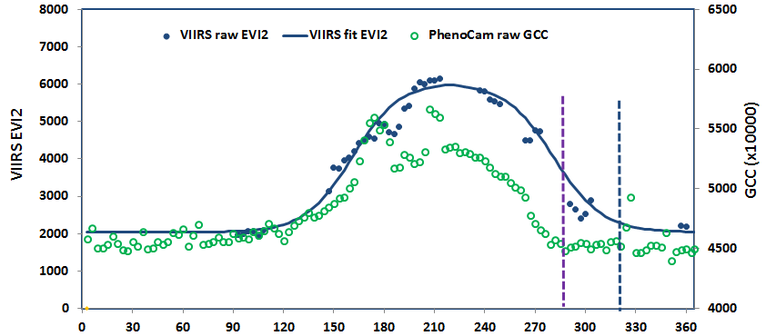
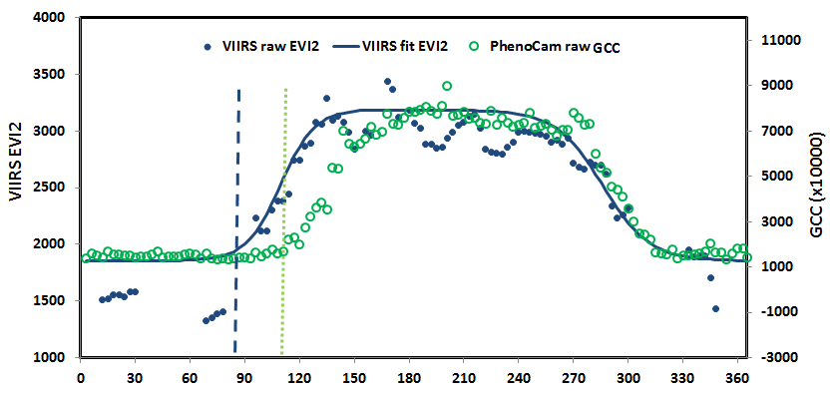
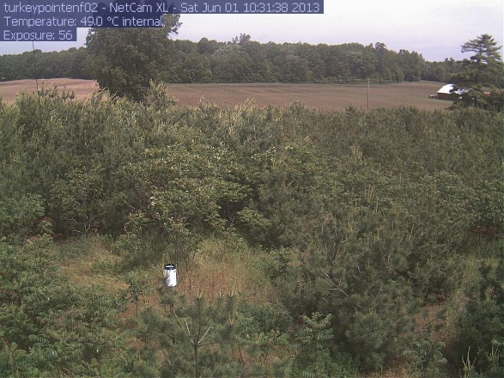
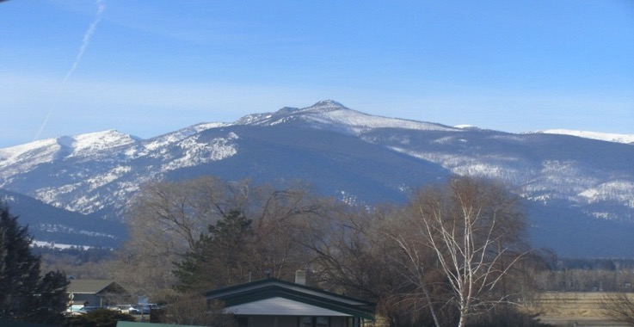
Difference Between Temporal VIIRS EVI2 and PhenoCam Data in Heterogeneous Sites

Slide 15
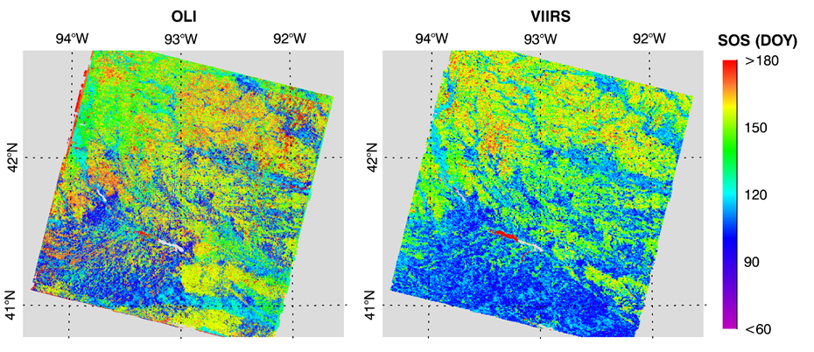
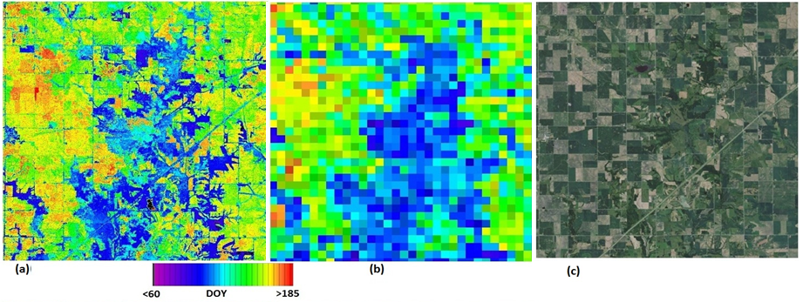
Validation of VIIRS Phenology Detections (500) Using Time Series
Fused from MODIS and Landsat OLI Data (30m)
IOWA
Limited Landsat observations
Google Earth map in June 2012
Time Series of fused data from MODIS and Landsat are provided by Dr Feng Gao

Slide 16
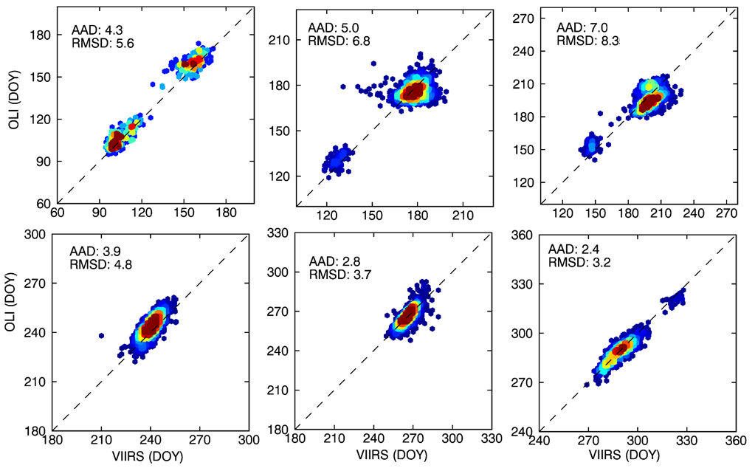
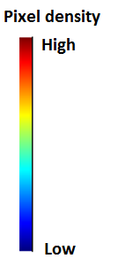
VIIRS Phenology (500m) vs Fused-Landsat Phenology (30m) in 20% of the most homogeneous pixels (2013)
Greenup onset
Middle date of greenup phase
Maturity onset
Middle date of senescent phase
Senescent onset
Dormancy onset
AAD = average absolute difference (day)
RMSD = root mean squared difference (day)

Slide 17
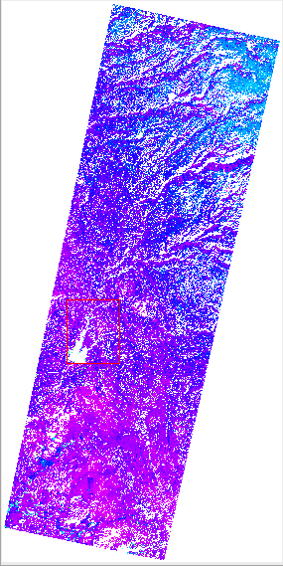
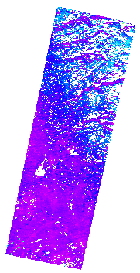
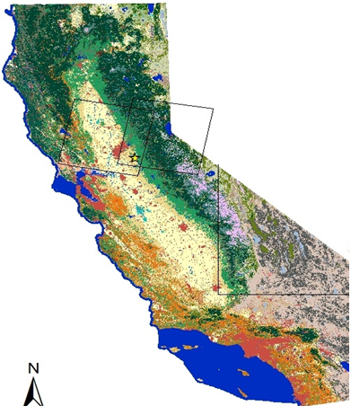
Validation of VIIRS Phenology Using Landsat Data in the Overlap Zone
VIIRS
Landsat OLI
SOS in 2014

Slide 18
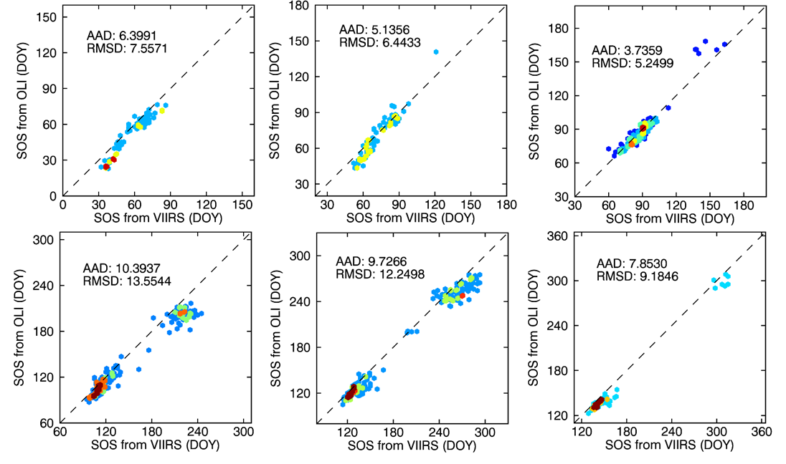
VIIRS Phenology (500m) vs Landsat SOS (30m) in 20% of the most homogeneous pixels (2014)
Greenup onset
Middle date of greenup phase
Maturity onset
Middle date of senescent phase
Senescent onset
Dormancy onset
AAD = average absolute difference (day)
RMSD = root mean squared difference (day)

Slide 19
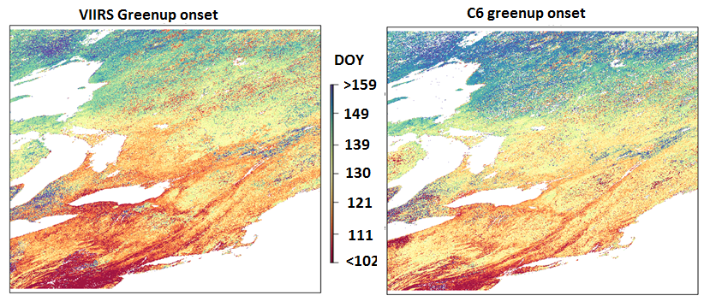
Comparison Between MODIS Collection 6 and VIIRS Phenology
C6 – 20% threshold in spline
VIIRS – Inflection points in hybrid piecewise logical models
Phenometric | H12V04 Mean Difference
Greenup onset | C6 is 4.2 days later
Middle date in greenup phase | C6 is 1.7 days later
Middle date in senescence phase | C6 is 4.7 days earlier
Dormancy onset | C6 is 7.4 days earlier

Slide 20
Conclusions
VIIRS NABR Time Series has fewer good quality observations than MODIS NBAR (Terra+Aqua). Artifacts in VIIRS data may exist in some areas.
VIIRS phenology is comparable with MODIS phenology, if the same algorithm is used.
VIIRS phenology is similar to the results calculated from PhenoCam data, particularly during greenup phases.
VIIRS and Landsat phenology detections are identical in relatively homogeneous regions. However, the difference can be large in heterogeneous regions.
VIIRS phenology is generally comparable with MODIS Collection 6 detections.

Slide 21
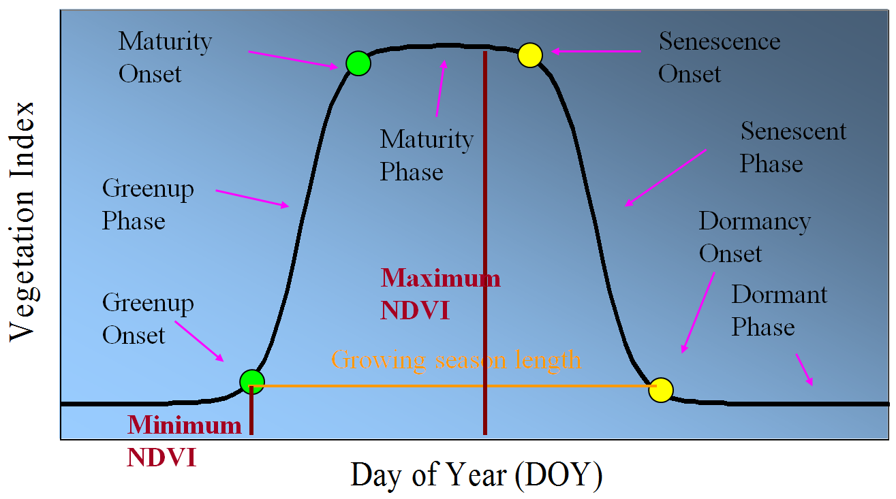
Metrics of Land Surface Phenology
Timing:
1. Onset of greenness increase
2. Onset of greenness maximum
3. Onset of greenness decrease
4. Onset of greenness minimum
5. Middle date of grow up phase
6. Middle date of senescent phase
7. Onset of fall foliage low coloration
8. Onset of fall foliage moderate coloration
9. Onset of fall foliage near peak coloration
10. Onset of fall foliage peak coloration
11. Onset of fall foliage post peak coloration
Put one figure here
Magnitudes
12. Growing season VI minimum
13. Growing season VI maximum
14. Summation of VI for growing season length
15. Rate of change in greenness increase
16. Rate of change in greenness decrease
Notes:
Ideally, vegetation growth experiences 4 phases. During winter, vegetation is at dormant phase, and VI is minimum. it starts growing during spring called greenup phase. It reaches maximum during summer called maturity phase, and vegetation leaf starts changing color in autumn, called senescent phase. These four phases can be separated by 4 phenological transition dates. After we have the seasonal variation of vegetation index, we can extract various phenological metrics…

Slide 22
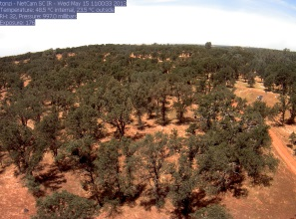
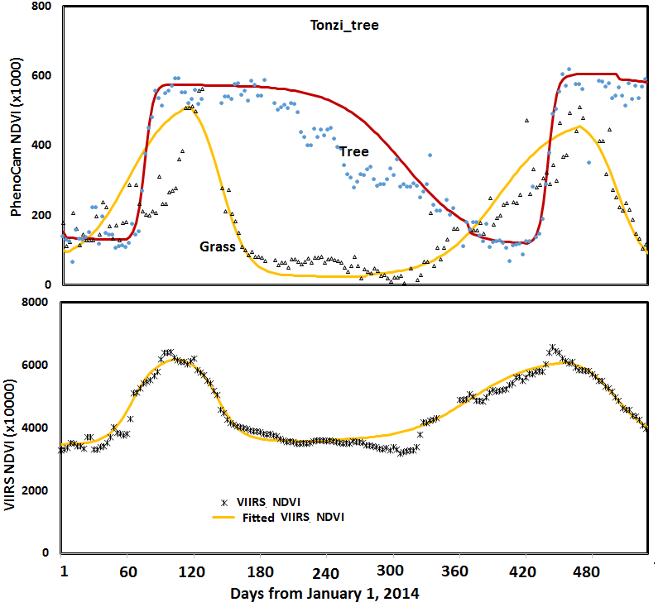
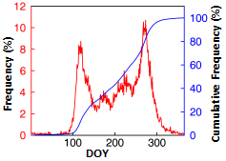
Challenge of the Validation of VIIRS Phenology in Savannas
Frequency of Landsat EOS within a VIIRS pixel

