Slide 1
Ocean break-out Current advances (and challenges) with the PIC algorithm
William M. Balch, Catherine Mitchell, Chuanmin Hu, Bruce Bowler
Bigelow Laboratory for Ocean Sciences
E. Boothbay, ME 04544

Slide 2
Current status of the 2-band/3-band PIC algorithm
PIC retrievals by VIIRS and MODIS are similar, except VIIRS has not been validated in any large, high concentration blooms
Latest processing, incorporating 2015 cruises…algorithm coefficients are further refined but change is incremental

Slide 3
PIC by VIIRS and MODIS

Slide 4
The relation between chl and acid-labile b_{bp531}

Slide 5
A differencing algorithm for PIC

Slide 6
Overview
A new method for estimating particulate inorganic carbon (PIC) concentrations from remote sensing reflectance has been developed.
Using an extensive global dataset of PIC, the reflectance difference approach of Hu et al. (2012) was applied to derive a relationship between PIC and the color-index (CI), hereafter referred to as the PIC_{CI} algorithm
The wavelengths used here in deriving the color-index differ from those used in the Hu et al. (2012) chlorophyll (Chl) algorithm to limit the affect of Chl and CDOM:
$$CI=R_{rs}\left(λ_{2}\right) − \left[R_{rs}\left(λ_{1}\right)+ \frac{λ_{2}−λ_{1}}{λ_{3}−λ_{1}}\left(R_{rs}\left(λ_{3}\right) −R_{rs}\left(λ_{1}\right)\right)\right]$$
Hu et al | 443 | 547 | 667
This study | 547 | 667 | 869

Slide 8
Color Index algorithm for PIC: Proof of concept
Differing PIC concentrations
Differing CHL concentrations
Low Chl
Low PIC
$$R_{rs} : {sr}^{−1}$$
$$R_{rs} : {sr}^{−1}$$
High Chl
High PIC
CI
CI
Wavelength : nm
Wavelength : nm
547
667
748
869
547
667
748
869
Patagonian Shelf, January 2008
Mitchell et al. in prep
Notes:
Remote sensing reflectance spectra from MODIS Aqua matched to field measurements of PIC and particulate absorption in the South Atlantic and on the Patagonian shelf, showing CI is sensitive to PIC but not to CHL (i.e. particulate absorption)

Slide 9
The data set, 15 cruises
N=2,022
Notes:
Fig. 1- Cruise tracks of 16 ocean expeditions used in tis analysis. Cruises include: 8 Atlantic Meridional Transect cruises 15-22, Patagonia Shelf (COPAS’08), Equatorial Pacific Biocomplexity (‘2004-5), Great Belt cruises 1 & 2 (MV1101 and RR1202, respectively, Arabian Sea (JGOFSP4), Western Arctic (HLY1101) and SW Pacific on Tangaroa (Tan1109).

Slide 10
Relationship between PIC and color index
r² = 0.804
Relationship between field measurements of PIC and CI derived from MODIS Aqua $R_{rs}$ data, shown on both a linear (left hand plot) and logarithmic scale (right hand plot)
Mitchell et al. in prep

Slide 11
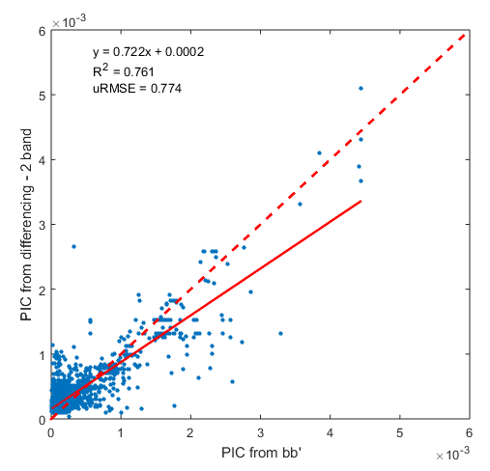
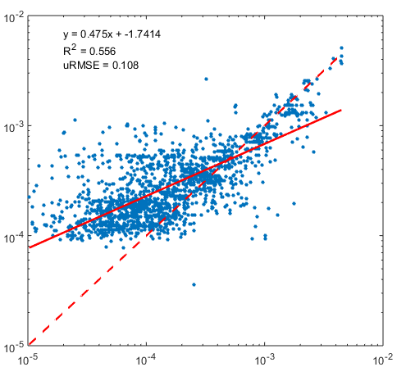
Validation of PIC_{CI} algorithm
a) PIC_{CI} algorithm
b) Current merged two and three band algorithm
r²=0.761
RMSE=0.774
r²=0.627
RMSE=0.930
PIC_{CI} : ${mol m}^{−3}$
PIC from two/three band algorithm : ${mol m}^{−3}$
r²=0.556
RMSE=0.108
r²=0.462
RMSE=0.132
PIC from field measurements : ${mol m}^{−3}$
PIC from field measurements : ${mol m}^{−3}$
Performance of (a) the PIC_{CI} algorithm and (b) the current merged two and three band PIC algorithm (Balch et al., 2005 & Gordon et al., 2001), shown in both linear and logarithmic scales
Mitchell et al. in prep

Slide 12
Let’s compare three CI-style algorithms: 2-band (547, 667) , 3-band (547, 667, 869) and alternate 3-band (547, 667, 748nm)
CI-2 (547,667)
CI-3 (547,667,869)
r² =0.842
r² =0.848
r² =0.851
CI-3 (547,667,748)

Slide 13
Application to MODIS Aqua data
a) PIC from PIC_{CI} algorithm
b) PIC from current merged two and three band algorithm
A
B
C
c)
current algorithm
(a) and (b) Global maps of the average PIC concentration for December 2015 (A and B) and (C) the distribution of the PIC concentration in each of the maps
PIC_{CI}
2B/3B
PIC_{CI}
Mitchell et al. in prep

Slide 14
Application to MODIS Aqua data
quasi-true color
PIC from PIC_{CI} algorithm
PIC from current algorithm
# valid pixels:
176,061
# valid pixels:
173,898
The Patagonian Shelf, 10th December 2008, with two regions of interest (ROI) highlighted. Both ROIs show areas where the PIC_{CI} algorithm is more resistant to atmospheric effects than the current algorithm, with less speckling evident in the rectangular ROI and more data recovered in the circular ROI for the PIC_{CI} algorithm.

Slide 15
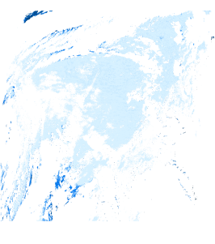
Application to MODIS Aqua data
quasi-true color
PIC from PIC_{CI} algorithm
PIC from 2B/3B algorithm
# valid pixels:
341,207
# valid pixels:
404,012
negative PIC
The low CHL Atlantic gyre, 3rd October 2011. The highlighted region shows how more detail is obtained at lower PIC levels with the PIC_{CI} algorithm. The yellow region in the PIC_{CI} algorithm image is where PIC was calculated to be negative.

Slide 16
Conclusions/Summary
In very clear waters with low R_{rs} signals, PIC from the PIC_{CI} algorithm can be negative, resulting in a reduced number of retrievals.
There is no hard cut off using the PIC_{CI} algorithm (compared to current algorithm), resulting in a natural lognormal distribution of PIC across the globe, with slightly higher mean value of PIC.
The PIC_{CI} algorithm is more resistant to atmospheric effects (as evidenced by (i) less speckling and (ii) more data in regions were the 2B/3B algorithm fails).
Thank you!

