Slide 1
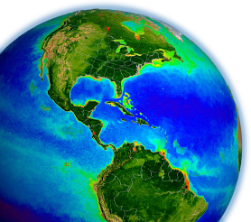
MODIS & VIIRS
Ocean Science Team Break-out
MODIS/VIIRS Science Team Meeting
6-10 June 2016, Silver Spring, MD

Slide 2
Contents
Overview
Instrument Status
Processing Status
OC Time-series Consistency
OC Product Validation
OC Climate Data Record

Slide 3
Ocean Break-out Agenda
June 8

Slide 4
Ocean Break-out Agenda
June 8

Slide 5
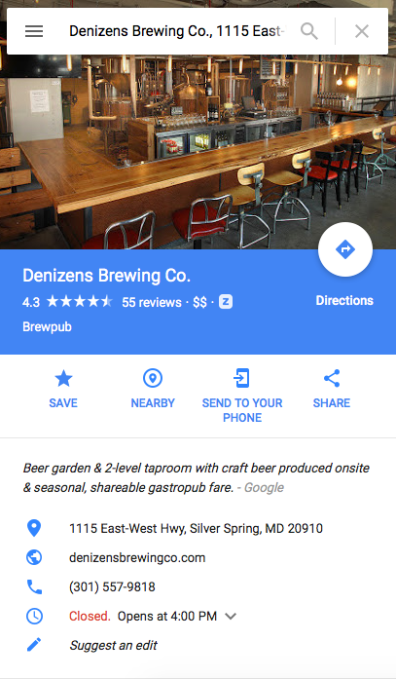
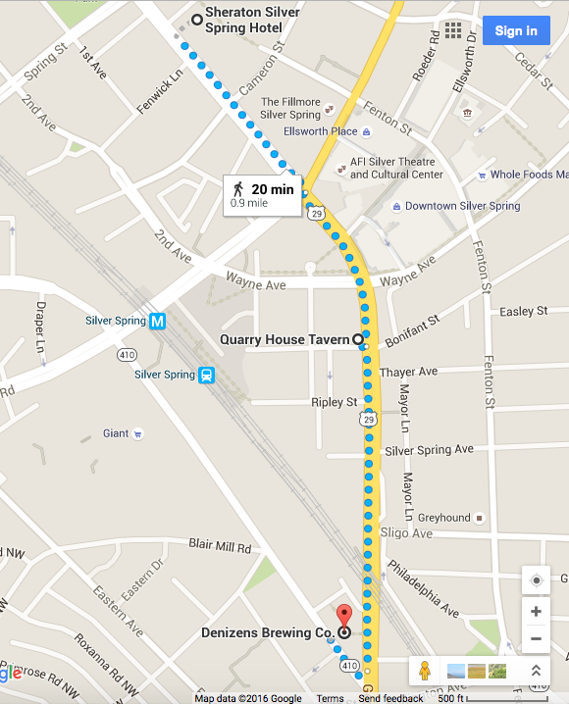
Follow-up Discussions (5:30, Denizens)

Slide 6
A.28 The Science of Terra and Aqua
A.46 Terra and Aqua – Algorithms – Existing Data Products
A.29 Suomi National Polar-orbiting Partnership Science Team
MODIS and VIIRS Ocean Science Team
26 Selected Proposals
16 Unique PIs
Notes:
6 of 9 VIIRS PIs also MODIS PIs

Slide 7
Science Team Organization
Program Scientist (S-NPP & MODIS, etc., etc.)
Paula Bontempi
Science Team Leaders
Michael King (MODIS)
Jim Gleason (VIIRS, S-NPP Project Scientist)
Science Team Ocean Discipline Leaders
Bryan Franz (MODIS)
Carlos Del Castillo (VIIRS)
Ocean SIPS (MODIS & VIIRS, Implementation and Processing)
Gene Feldman & Bryan Franz
DAAC (MODIS & VIIRS, Archive and Distribution)
OB.DAAC (Gene Feldman & Sean Bailey, Ocean Color)
PO.DAAC (Robert Toaz & Ed Armstrong, SST)

Slide 8
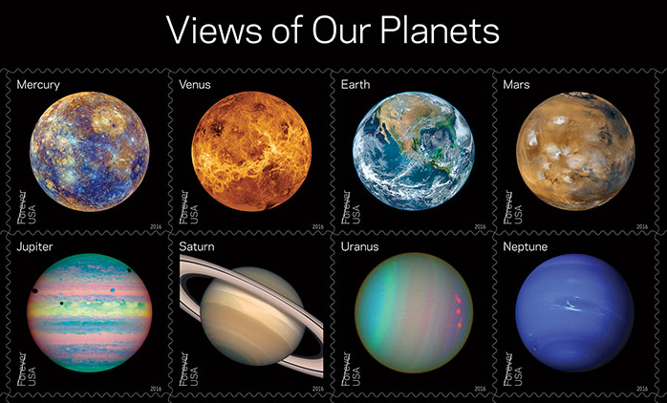
Views of Our Planets” Forever stamps featuring iconic images of the planets in our solar system, including the well-known “Blue Marble” image of Earth. New “Pluto Explored”
Views of Our Planets” Forever stamps featuring iconic images of the planets in our solar system,
including the well-known “Blue Marble” image of Earth” were released on 31 May 2016 at the
World Stamp Show in New York City, an international gathering of stamp collectors that occurs
only once each decade in the U.S. with more than 250,000 visitors attending.

Slide 9
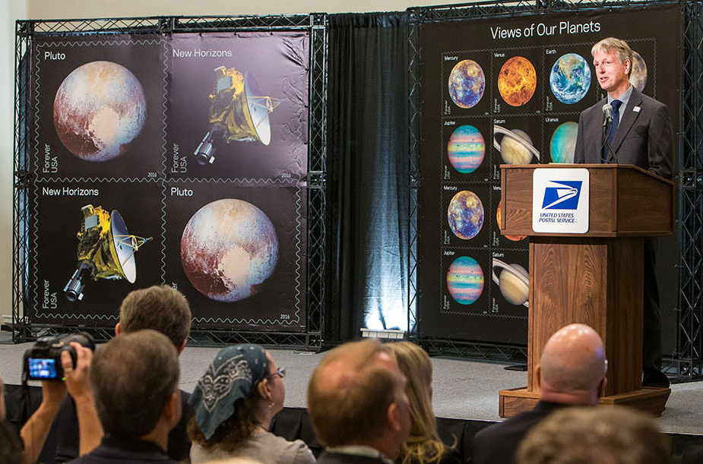
Norman
Norman Kuring of the OBPG created the new “Blue Marble” using data taken by VIIRS on the
NOAA/NASA Suomi NPP satellite soon after it began orbiting our home planet in 2011.

Slide 10
Instrument Status

Slide 11
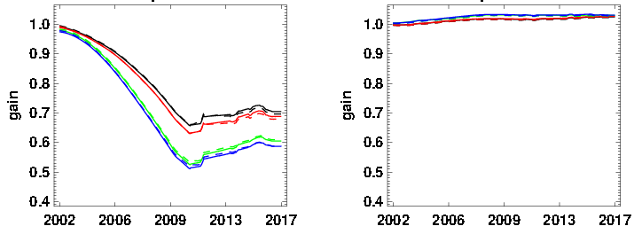
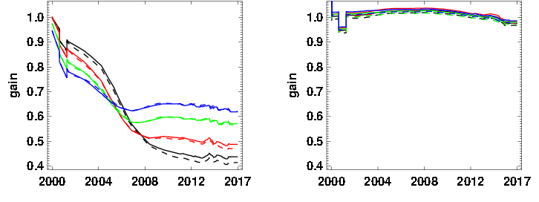
MODIS Sensor Degradation
412nm
869nm
MODIS
Aqua
Solar
Lunar
MODIS
Terra
Lunar
Solar

Slide 12
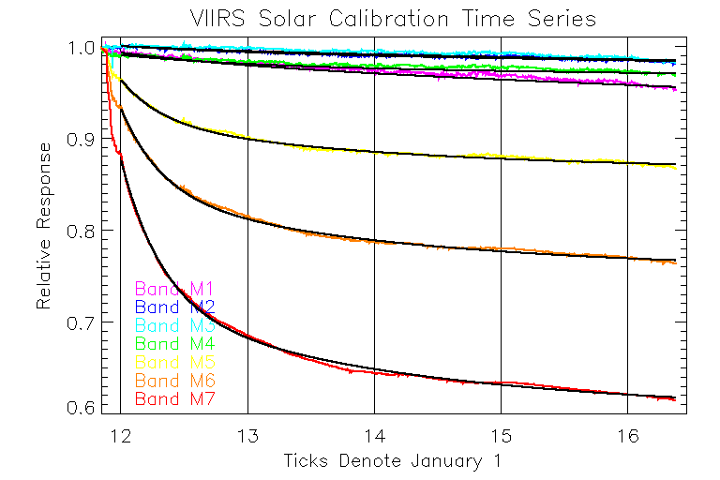
VIIRS Sensor Degradation
Lunar-corrected Solar Calibration Time-Series
671nm
745nm
862nm
Years

Slide 13
Processing Status

Slide 14
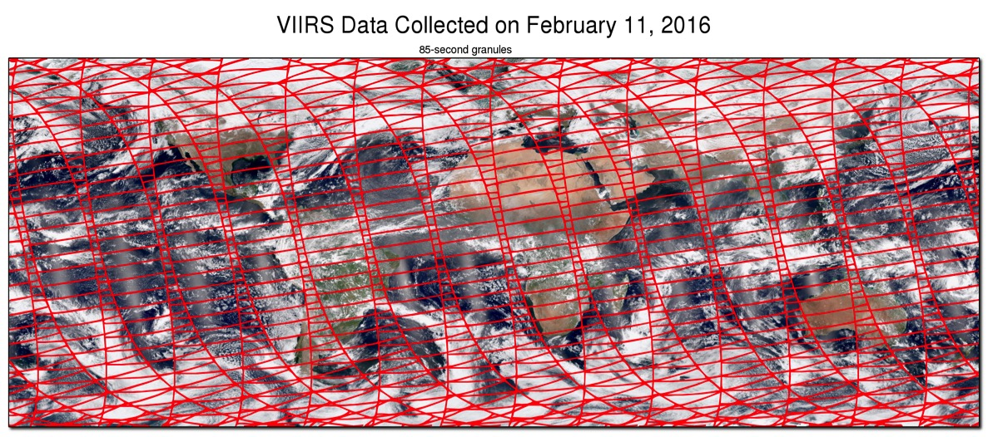
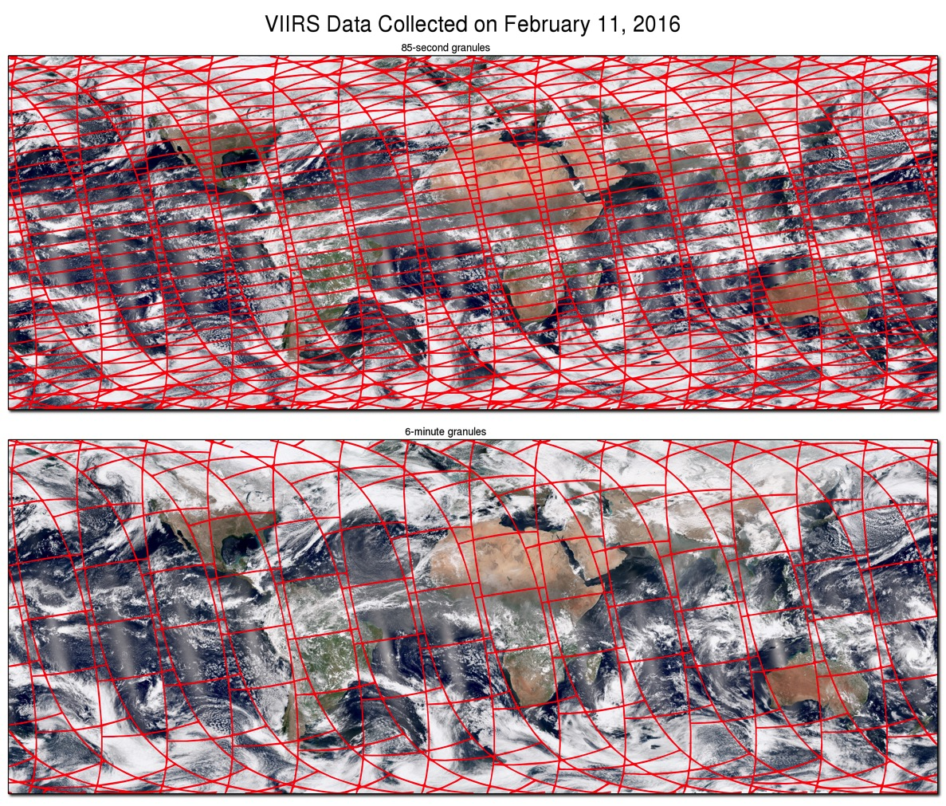
VIIRS Level-1 Redevelopment

Slide 15
VIIRS Level-1 Redevelopment
Why did we do this?
L1 algorithms, software and product formats under NASA control.
6-minute granules instead of 85 seconds.
Daily calibrated data files reduced from 22,000 SDRs to 720 L1Bs.
Significantly improved support for reprocessing.
Permanent archive of L1A and geolocation products.
Simplify calibration updates and algorithm tests.
Support for subscene extraction (match-up)
Raw data feed via NASA (EDOS).
What have we accomplished?
V1.0 of VIIRS L1 software released in October 2015.
IDPS raw data feed ended March 2016.
All VIIRS OC products regenerated April 2016 (version R2014.0.2).

Slide 16
MODIS and VIIRS SST Status
All three missions have been reprocessed:
MODIS/Aqua R2014.0, May 2015
MODIS/Terra R2014.0, May 2015
VIIRS/SNPP R2016.0, May 2016
Level-2 and Level-3 format changed to CF-compliant netCDF-4
A minor issue was identified in the cloud masking decision tree for the MODIS sensors. An update to the code was put in production in the forward stream in March 2016.
VIIRS implemented a new decision-tree process. MODIS will likely be reprocessed again this year, for consistency (R2016.0).
RSMAS and SeaBASS team implementing improved in situ match-up process, which will provide an online accessible SST validation data set similar to the ocean color validation data set.

Slide 17
R2014.0 Multi-Mission Ocean Color Reprocessing
Scope
CZCS, OCTS, SeaWiFS, MERIS, MODIS(A/T), and VIIRS
Motivation
improve interoperability and sustainability of the product suite by adopting modern data formats, standards, and conventions (netCDF4, CF and ISO conventions, etc.)
incorporate knowledge gained in instrument-specific radiometric calibration and updates to vicarious calibration
incorporate algorithm updates and advances from community and Mission Science Teams
Status
CZCS, OCTS, VIIRS, MODISA, MODIST, SeaWiFS (& GOCI) done
MERIS in progress

Slide 18
R2014.0 Ocean Color Product and Algorithm Changes
R_{rs}(λ) | calibration updates, ancillary data updates, improved land/water masking, terrain height, other minor fixes
Ångstrom
AOT
Chlorophyll a | standard chlor_a product now OCI algorithm (Hu et al. 2012) original OC3/OC4 product still being distributed as chl_ocx
K_{d}(490) | no change
POC | no change
PIC | updated algorithm and LUT
CDOM_index | remove product (redundant with new IOP suite)
PAR | consolidated algorithm, minor fixes
iPAR | MODIS-only, no change
nFLH | MODIS-only, flagging changes (allow negatives)
IOPs | added suite of inherent optical properties (Werdell et al. 2013)

Slide 19
IOP Product Suite
Products
a(λ) total absorption at all visible wavelengths
bb(λ) total backscatter at all visible wavelengths
aph(λ) absorption due to phytoplankton
adg(443) absorption due to gelb. & detritus at 443nm
Sdg exponential spectral slope for adg
bbp(443) particle backscattering at 443nm
Sbp power-law spectral slope for bbp
uncertainties uncertainties in adg, aph, bbp at 443nm
Rationale
provides sufficient information to compute full spectral component absorption and scattering coefficients and uncertainties
SeaWiFS λ = 412, 443, 490, 510, 555, 670
MODIS λ = 412, 443, 469, 488, 531, 547, 555, 645, 667, 678
VIIRS λ = 410, 443, 486, 551, 671

Slide 20
Action for Team Members
Algorithm POCs please review and revise existing algorithm description documents for all current standard products.
http://oceancolor.gsfc.nasa.gov/cms/atbd
R_{rs}(λ) | Franz
Chlorophyll a | Werdell, Hu
K_{d}(490) | Werdell
POC | Stramski (Franz)
PIC | Balch
PAR | Frouin
iPAR | Bailey (Franz)
nFLH | Westberry
IOPs | Werdell
SST (11um) | Minnett (Kilpatrick)
SST (4um) | Minnett (Kilpatrick)

Slide 21
R2014.0 Instrument VNIR Calibration Changes
SeaWiFS | correcting dark offset changes at the sub-count level correction for time-dependent change in system spectral response Patt et al. (in prep), Eplee et al. (in prep)
MODISA | updated temporal calibration from MCST (V6.1.35.17_OC2) updated temporal corrections to response versus scan angle Meister and Franz 2014.
MODIST | updated temporal calibration from MCST (V6.1.20.16) updated temporal corrections for response versus scan angle and polarization sensitivity (crosscal to SeaWiFS and MODISA)
VIIRS | first use of lunar calibration trends to track temporal degradation of VIIRS (lunar calibration is used to correct more frequent but more uncertain solar calibration trends). correction of the lunar calibration trends for time-dependent changes in spectral response of the primary mirror. correction of solar calibration trends for a solar unit vector error in the source data used for solar calibration analysis, and improved solar diffuser stability corrections. additional statistical correction for detector striping. Eplee et al. 2015

Slide 22
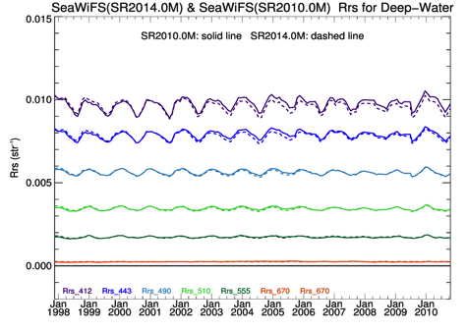
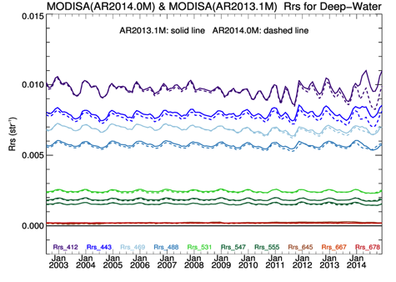
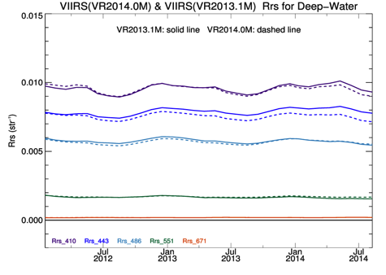
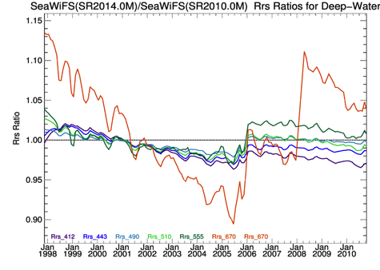
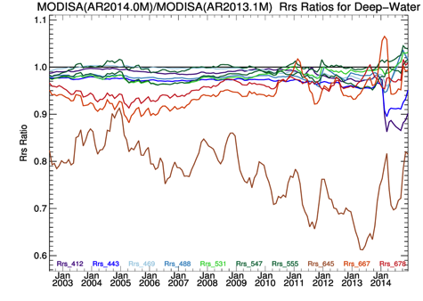
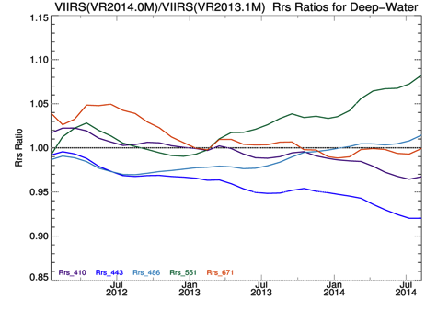
Reprocessing Impact on OC Time-Series
SeaWiFS
MODISA
VIIRS
Rrs (λ; sr⁻¹)
Rrs (λ) Ratio
Time
Rrs time-series comparison for global mean deep-water (> 1000m) between previous reprocessing (solid lines) and R2014.0 reprocessing (dashed lines). Bottom row shows Rrs ratio of like bands. Changes to the trends are significant for all sensors.

Slide 23
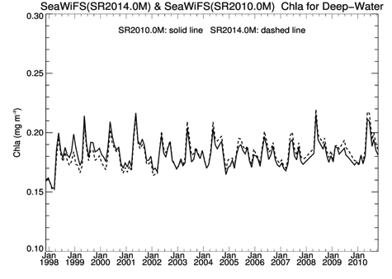
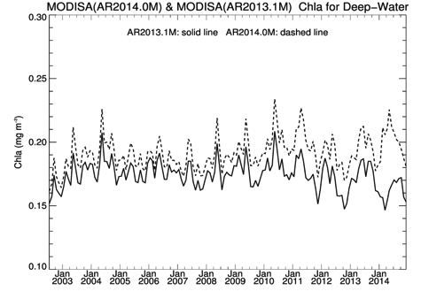
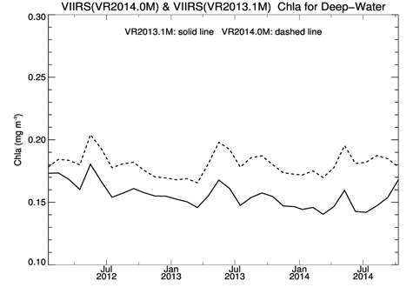
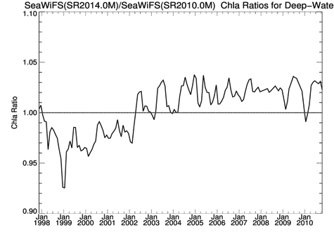
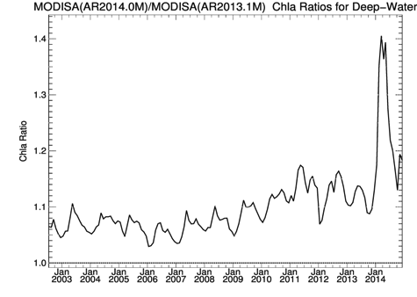
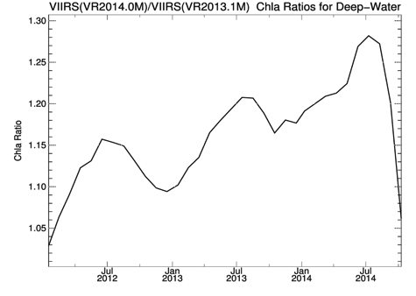
Reprocessing Impact on OC Time-Series
SeaWiFS
MODISA
VIIRS
Chla (mg m⁻³)
+40%
+5%
+30%
+20%
Chla Ratio
+20%
-5%
+10%
+10%
Time
Chla time-series comparison for global mean deep-water between previous reprocessing (solid lines) and R2014.0 reprocessing (dashed lines). Bottom row shows Chla ratio. Impact of the reprocessing is significant for all sensors.

Slide 24
OC Product Consistency

Slide 25
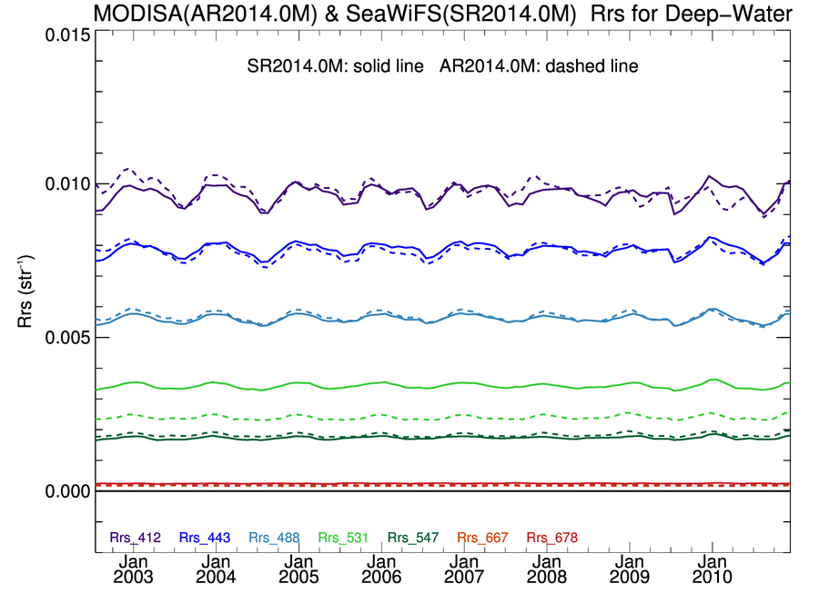
SeaWiFS & MODISA Rrs(λ) Deep-Water Time-Series showing good agreement
R2014.0
SeaWiFS = solid line
MODISA = dashed line
Mean
Ratio
412
1.01
443
0.99
490-488
1.01
547-555

Slide 26
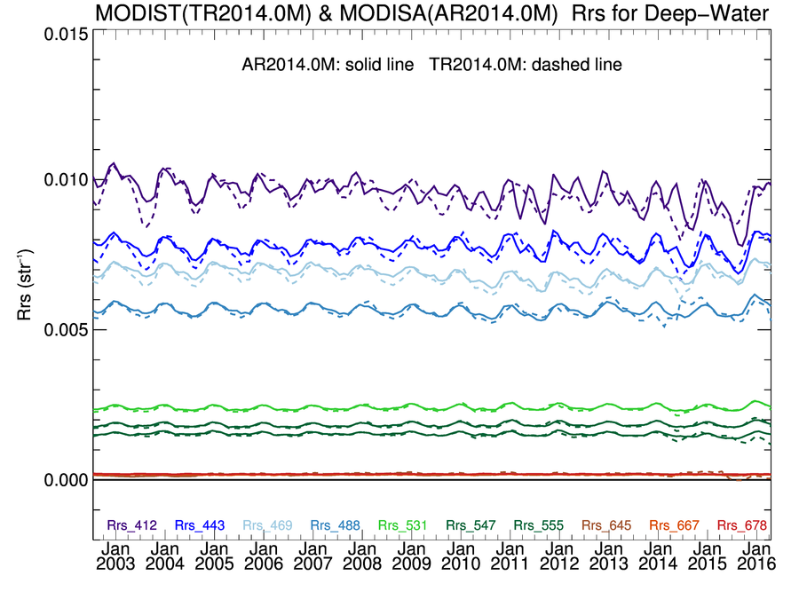
MODIST & MODISA Rrs(λ) Deep-Water Time-Series showing “mostly” good agreement
R2014.0
MODISA = solid line
MODIST = dashed line
Mean
Ratio
412
0.99
443
0.99
488
0.99
531

Slide 27
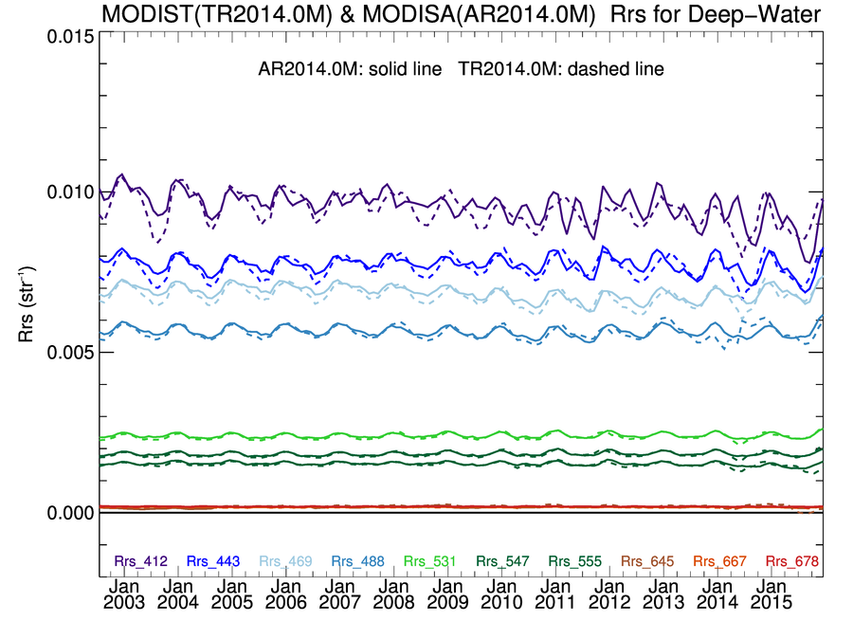
MODIST & MODISA Rrs(λ) Deep-Water Time-Series showing “mostly” good agreement
R2014.0
MODISA = solid line
MODIST = dashed line
Mean
Ratio
412
0.98
443
0.98
488
0.99
531

Slide 28
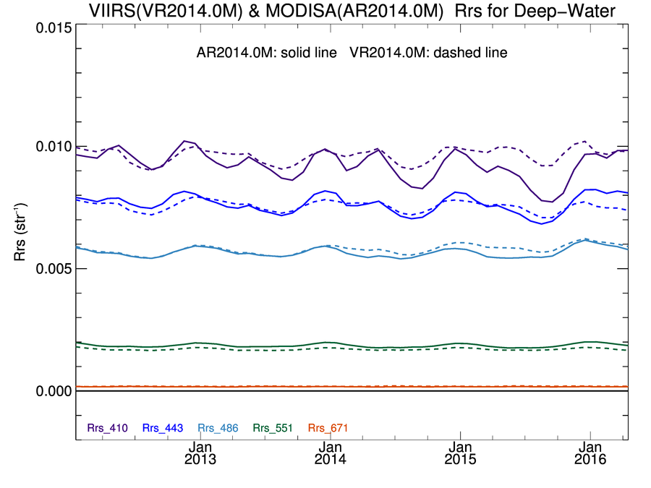
MODISA & VIIRS Rrs(λ) Deep-Water Time-Series showing “good” agreement
R2014.0
MODISA = solid line
VIIRSN = dashed line
Mean
Ratio
410-412
suspect decline in MODISA Rrs(412)
1.04
443
0.99
486-488
1.02
547-551

Slide 29
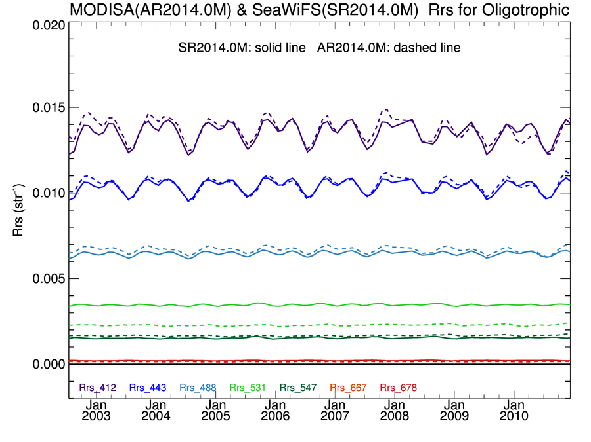
SeaWiFS & MODISA Rrs(λ) Clear-Water Time-Series showing “good” agreement
R2014.0
SeaWiFS = solid line
MODISA = dashed line
Mean
Ratio
412
1.01
443
1.01
490-488
1.03
547-555

Slide 30
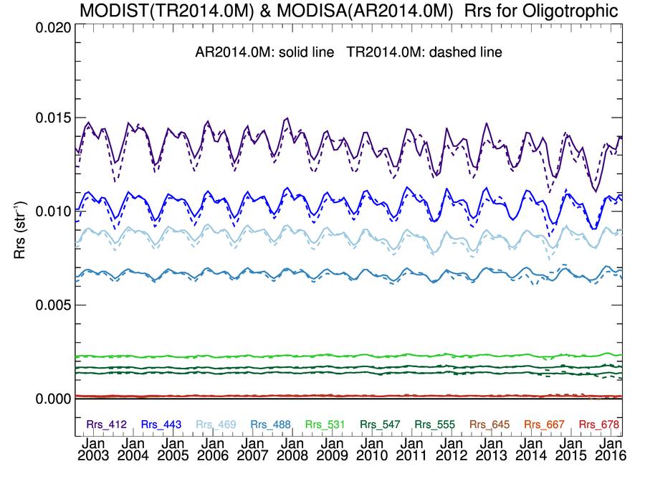
MODIST & MODISA Rrs(λ) Clear-Water Time-Series showing “good” agreement
R2014.0
MODISA = solid line
MODIST = dashed line
Mean
Ratio
412
0.98
443
0.98
488
0.99
531

Slide 31
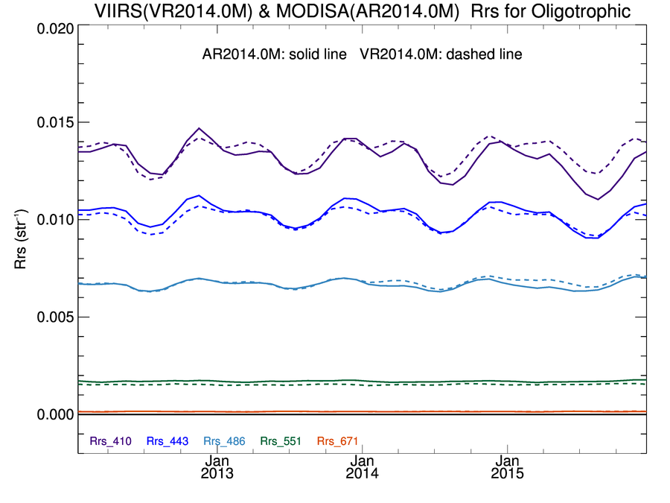
MODISA & VIIRS Rrs(λ) Clear-Water Time-Series showing “good” agreement
R2014.0
MODISA = solid line
VIIRSN = dashed line
Mean
Ratio
412
1.03
443
0.98
486-488
1.02
547-551

Slide 32
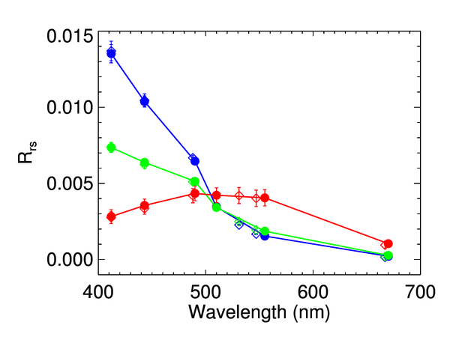
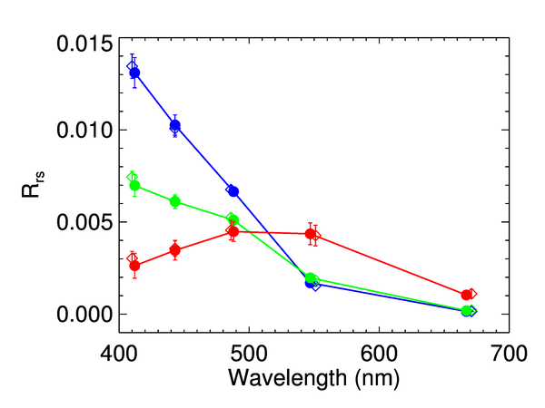
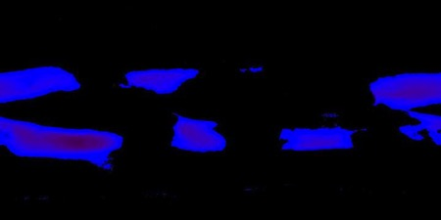
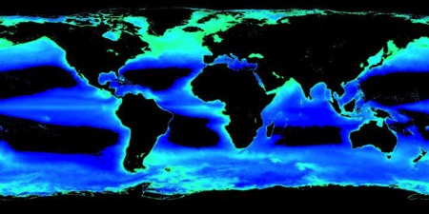
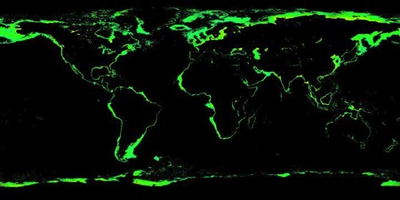
Rrs(λ) Spectral Comparison common mission mean by water type
SeaWiFS and MODISA
MODISA and VIIRS
SeaWiFS = filled circle
MODISA = diamond
MODISA = filled circle
VIIRSN = diamond
Oligotrophic
Mesotrophic
Eutrophic

Slide 33
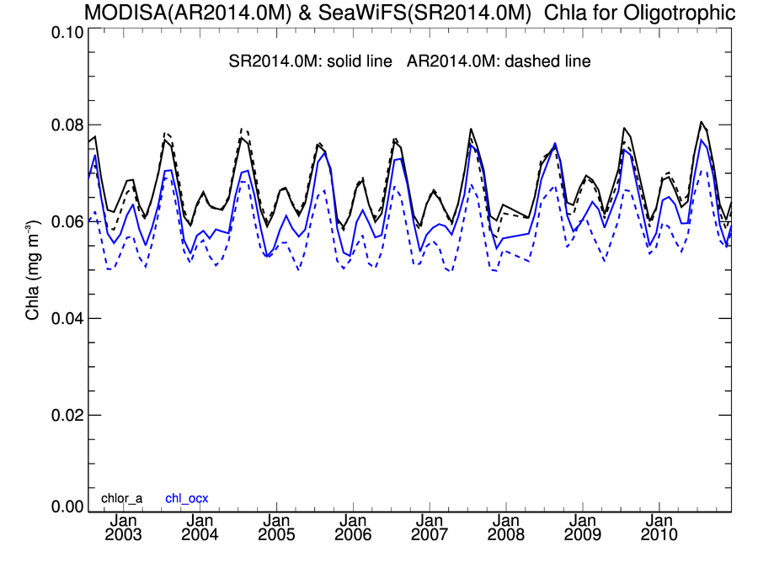
SeaWiFS and MODISA R2014.0 Chlorophyll Clear-Water Time-Series
OCI algorithm yields higher values of chlorophyll in clear water relative to OCx (+0.005 to 0.01 mg m⁻³), with improved consistency between sensors.
OCI
OCx
 | Mean | Stdv
MODISA | 0.067 | 0.006 | mg m⁻³
SeaWiFS | 0.067 | 0.006 | mg m⁻³
MODIS/SeaWiFS | 0.992 | 0.025

Slide 34
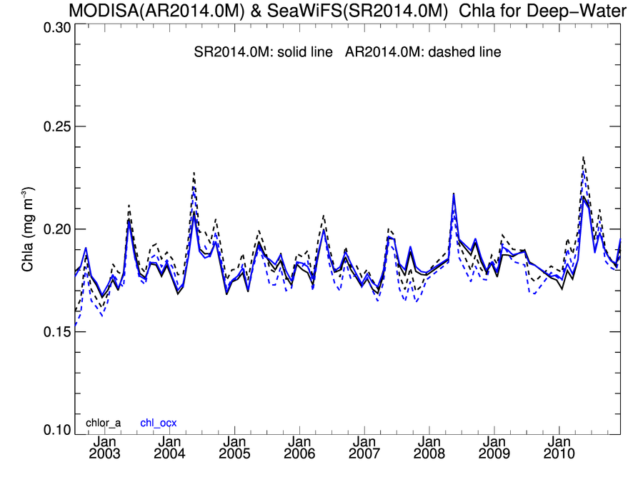
SeaWiFS and MODISA R2014.0 Chlorophyll Deep-Water Time-Series
 | Mean | Stdv
SeaWiFS | 0.183 | 0.010 | mg m⁻³
MODISA | 0.186 | 0.013 | mg m⁻³
MODIS/SeaWiFS | 1.017 | 0.036
MODISA = solid line
VIIRSN = dashed line
Black = OCI algorithm
Blue = OCx algorithm

Slide 35
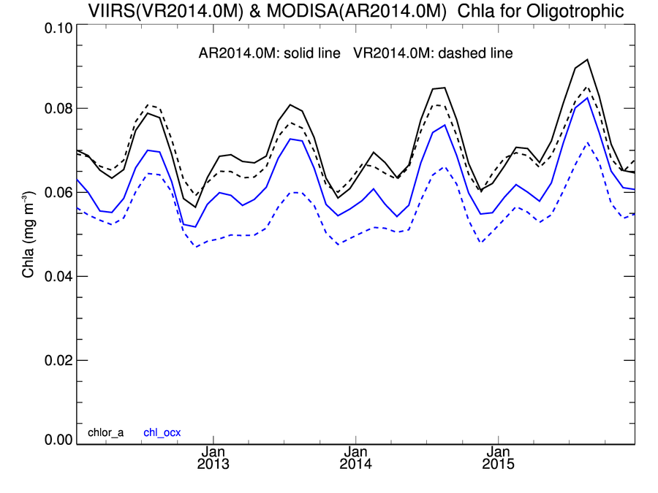
MODISA and VIIRS R2014.0 Chlorophyll Clear-Water Time-Series
OCI algorithm yields higher values of chlorophyll in clear water relative to OCx (+0.01 to 0.015 mg m⁻³), with improved consistency between sensors.
OCI
OCx
 | Mean | Stdv
MODISA | 0.070 | 0.008 | mg m⁻³
VIIRS | 0.069 | 0.007 | mg m⁻³
VIIRS/MODISA | 0.98 | 0.04

Slide 36
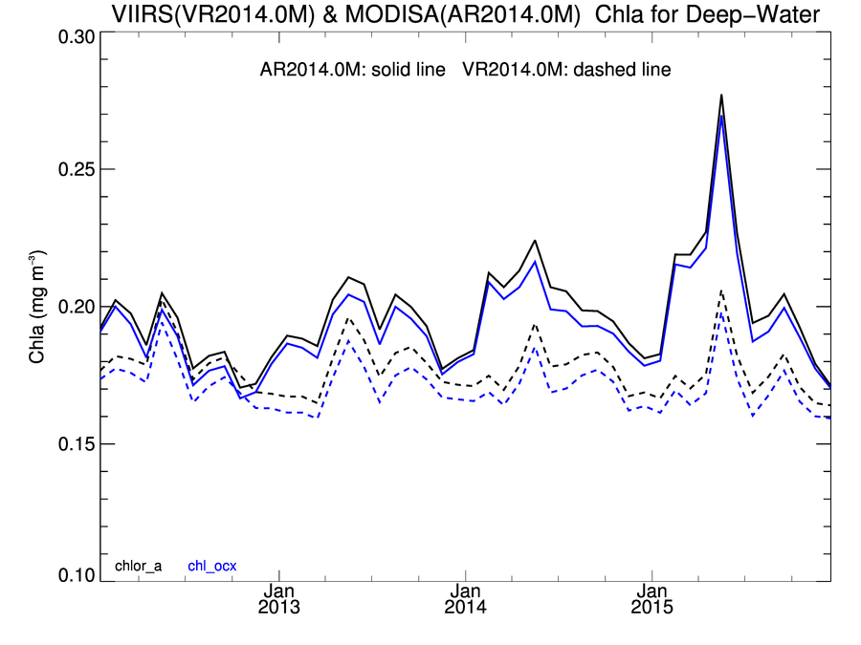
MODISA and VIIRS R2014.0 Chlorophyll Deep-Water Time-Series
 | Mean | Stdv
MODISA | 0.197 | 0.019 | mg m⁻³
VIIRS | 0.177 | 0.009 | mg m⁻³
VIIRS/MODISA | 0.90 | 0.06
MODISA
VIIRS
degraded confidence
in MODISA trends

Slide 37
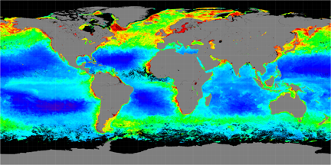
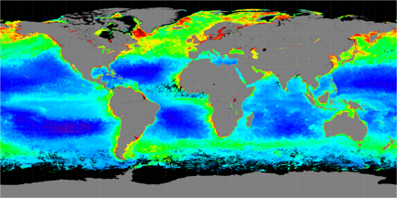
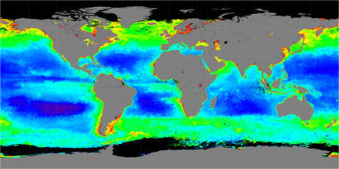
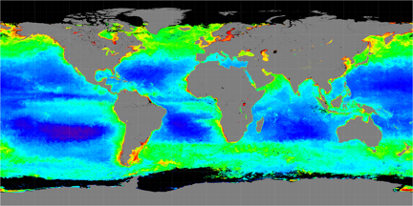
Seasonal Chlorophyll Comparison (2015)
MODISA
VIIRS
Spring
Fall

Slide 38
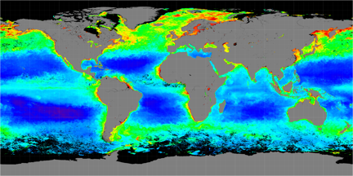
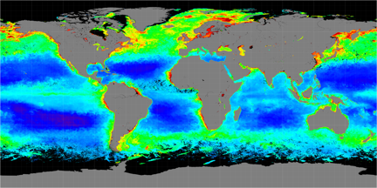
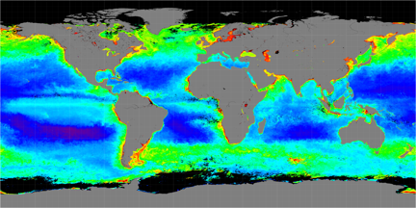
Seasonal Chlorophyll Comparison (2005)
SeaWiFS
MODISA
Spring
Fall

Slide 39
OC Product Validation

Slide 40
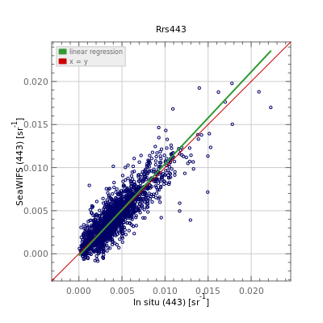
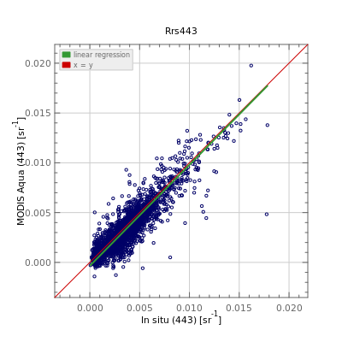
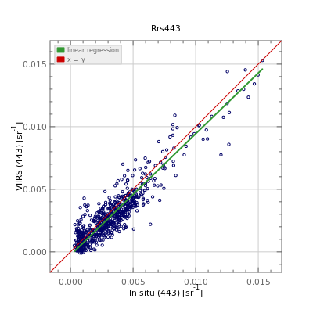
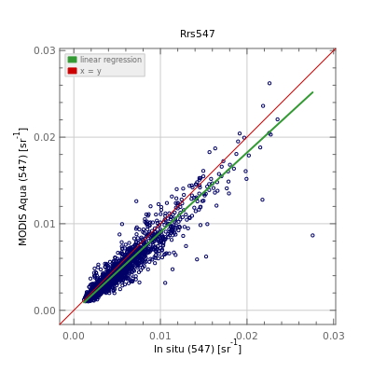
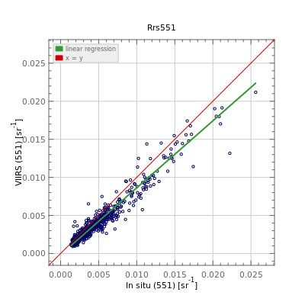
SeaWiFS
MODISA
VIIRS
Satellite Rrs (443; sr⁻¹)
Satellite Rrs (55x; sr⁻¹)
In situ Rrs(λ)
Comparison between R2014.0 satellite retrievals and in situ measurements for Rrs at 443nm and near 550nm. Match-up is for all available in situ data from SeaBASS and AERONET-OC.

Slide 41
PRODUCT | COUNT | SLOPE | INT (sr⁻¹) | R² | MED RATIO | APD (%) | RMSE (sr⁻¹)
Rrs 412 | 1681 | 1.10 | -0.00067 | 0.74 | 0.92 | 28.0 | 0.00170
Rrs 443 | 1930 | 1.07 | -0.00024 | 0.77 | 1.00 | 20.2 | 0.00134
Rrs 490 | 1534 | 0.91 | 0.00003 | 0.82 | 0.92 | 15.9 | 0.00122
Rrs 510 | 785 | 0.95 | -0.00004 | 0.84 | 0.93 | 16.0 | 0.00102
Rrs 555 | 1684 | 0.92 | 0.00002 | 0.86 | 0.92 | 15.0 | 0.00128
Rrs 670 | 1288 | 0.97 | -0.00009 | 0.76 | 0.86 | 31.7 | 0.00050
Rrs 412 | 2189 | 1.02 | -0.00077 | 0.69 | 0.79 | 37.4 | 0.00163
Rrs 443 | 2350 | 1.01 | -0.00035 | 0.81 | 0.92 | 19.6 | 0.00117
Rrs 488 | 1987 | 0.89 | -0.00021 | 0.89 | 0.85 | 18.7 | 0.00129
Rrs 531 | 780 | 0.90 | -0.00022 | 0.88 | 0.87 | 16.7 | 0.00146
Rrs 547 | 1959 | 0.92 | -0.00016 | 0.89 | 0.89 | 14.2 | 0.00128
Rrs 667 | 1789 | 0.99 | -0.00017 | 0.79 | 0.78 | 33.0 | 0.00049
Rrs 678 | 465 | 1.16 | -0.00034 | 0.82 | 0.76 | 34.1 | 0.00046
Rrs 410 | 693 | 0.96 | -0.00044 | 0.71 | 0.76 | 38.9 | 0.00134
Rrs 443 | 697 | 0.97 | -0.00026 | 0.85 | 0.85 | 26.5 | 0.00100
Rrs 486 | 697 | 0.87 | -0.00019 | 0.93 | 0.81 | 23.5 | 0.00120
Rrs 551 | 692 | 0.88 | -0.00016 | 0.94 | 0.84 | 18.6 | 0.00119
Rrs 671 | 693 | 0.96 | -0.00019 | 0.85 | 0.76 | 30.6 | 0.00048
SeaWiFS
MODISA
VIIRS
Statistical analysis of Rrs(λ) match-ups between R2014.0 satellite retrievals and in situ measurements, for all available in situ match-ups from SeaBASS and AERONET-OC.

Slide 42
PRODUCT | COUNT | SLOPE | INT (sr⁻¹) | R² | MED RATIO | APD (%) | RMSE (sr⁻¹)
Rrs 412 | 241 | 0.99 | 0.00007 | 0.83 | 1.00 | 14.9 | 0.00167
Rrs 443 | 418 | 0.98 | 0.00010 | 0.79 | 1.01 | 14.5 | 0.00124
Rrs 490 | 427 | 0.97 | -0.00004 | 0.63 | 0.97 | 12.3 | 0.00091
Rrs 510 | 322 | 0.99 | -0.00010 | 0.26 | 0.96 | 12.8 | 0.00066
Rrs 555 | 245 | 0.90 | 0.00017 | 0.38 | 1.00 | 14.5 | 0.00048
Rrs 670 | 89 | 0.91 | 0.00007 | 0.24 | 1.34 | 47.3 | 0.00015
Rrs 412 | 154 | 1.01 | -0.00037 | 0.86 | 0.97 | 12.0 | 0.00145
Rrs 443 | 291 | 0.99 | -0.00010 | 0.81 | 0.99 | 11.8 | 0.00107
Rrs 488 | 304 | 0.99 | -0.00026 | 0.65 | 0.96 | 9.3 | 0.00086
Rrs 531 | 41 | 0.69 | 0.00060 | 0.38 | 0.96 | 8.6 | 0.00069
Rrs 547 | 3 | 1.21 | -0.00006 | 0.82 | 1.15 | 13.5 | 0.00035
Rrs 667 | 239 | 1.53 | -0.00008 | 0.05 | 0.97 | 37.5 | 0.00011
Rrs 678 | 2 | -0.04 | 0.00046 | 1.00 | 1.53 | 37.6 | 0.00016
Rrs 410 | 5 | 1.13 | -0.00117 | 0.70 | 0.89 | 17.1 | 0.00192
Rrs 443 | 5 | 1.00 | 0.00001 | 0.72 | 0.90 | 12.8 | 0.00127
Rrs 486 | 5 | 1.17 | -0.00090 | 0.39 | 0.97 | 13.8 | 0.00089
Rrs 551 | 0
Rrs 671 | 3 | 0.97 | -0.00016 | 0.58 | 0.56 | 57.0 | 0.00017
SeaWiFS
MODISA
VIIRS
Statistical analysis of Rrs(λ) match-ups between R2014.0 satellite retrievals and in situ measurements, for all available in situ match-ups from SeaBASS, restricted to deep-water (> 1000m).

Slide 43
SeaWiFS
MODISA
VIIRS
Satellite Chla (mg m⁻³)
In situ Chla
PRODUCT | COUNT | SLOPE | INT (mg m⁻³) | R² | MED RATIO | APD (%) | RMSE (mg m⁻³)
SeaWiFS | 1739 | 0.92 | 0.02513 | 0.83 | 1.07 | 37.3 | 0.29030
MODISA | 653 | 1.04 | 0.07814 | 0.80 | 1.19 | 40.7 | 0.30814
VIIRS | 21 | 0.63 | -0.27375 | 0.27 | 0.86 | 34.9 | 0.27166
SeaWiFS | 363 | 0.83 | -0.09787 | 0.74 | 1.01 | 32.4 | 0.24365
MODISA | 113 | 0.87 | -0.10674 | 0.85 | 0.97 | 22.5 | 0.19605
VIIRS | 17 | 0.50 | -0.37107 | 0.30 | 0.79 | 40.9 | 0.29676
All
Chlorophyll a
Deep

Slide 44
Long-term (18-year) record of phytoplankton chlorophyll a for mid-latitude oceans (± 40⁰), constructed from R2014.0
Chla (mg m⁻³)
Chla (%)
SeaWiFS
MODISA
VIIRS
Multivariate Enso Index (MEI)
Chla Anomaly (mg m⁻³)
Chla Anomaly (%)
SeaWiFS
MODISA
VIIRS

Slide 46
Ocean Break-out Agenda
June 8

Slide 47
New Products

Slide 48
Standard, Evaluation, and Test Products
a standard product is one that the SIPS is committed to maintain, and the DAAC is committed to archive and distribute, at the ultimate discretion of Program Management
an evaluation product is one that the SIPS/DAAC may produce and distribute, if resources allow, to support community assessment of a new product or alternative product algorithm
a test product is one that the SIPS may produce to support the algorithm PI in implementation verification and product testing
in practice, OC standard products are made at Level-2 and Level-3, while
eval products are made only at Level-3 (usually from Level-3 Rrs dailies).

Slide 49
Current Evaluation Products
GSM IOP Algorithm
Chlorophyll, bbp(443), adg(443)
QAA IOP Algorithm
a(443), adg(443), aph(443), bbp(443)
Lee Euphotic depth
based on QAA IOPs

Slide 50
Product Lifecycle from concept to standard product
PI develops new algorithm or modification, demonstrates feasibility, perhaps publishes results.
If PI and Ocean Team Leader agree, PI works with SIPS to implement in NASA processing code and to develop a test plan for verification and large-scale testing.
If PI is satisfied with implementation tests, and SIPS confirms that required computing resources are available, evaluation products and documentation will be produced and distributed, and the algorithm will be incorporated into SeaDAS.
PI works with SIPS to develop or update the Product Description Document (to be hosted under “evaluation products”).
SIPS/DAAC begins production and distribution of product
PI performs assessment of results (validation, global dist., trends)
Before the next mission reprocessing opportunity, PI/SIPS/DAAC and Program Management review the performance evaluation, documentation, and appropriateness for standard production.

Slide 51
Uncertainties

Slide 52
Rrs(λ) Uncertainty
Using instrument noise model propagated through atmospheric correction
via Monte Carlo simulation (SeaWiFS 4-day period shown, 1000 iterations)
Erdem Karakoylu

Slide 53
Rrs(λ) Uncertainty
Using instrument noise model propagated through atmospheric correction
via Monte Carlo simulation (SeaWiFS 4-day period shown, 1000 iterations)
Erdem Karakoylu

Slide 54
Developing per-pixel Rrs(λ) uncertainty estimates
instrument noise propagated through atmospheric correction via Monte Carlo simulation (MODIS-Aqua Ches. Bay, 1000 iterations)
Rrs(443)
Uncertainty
Rrs(547)
Uncertainty

Slide 55
Developing per-pixel chlorophyll uncertainty
Chlorophyll Uncertainty
Chlorophyll
Chlorophyll
Uncertainty

Slide 56
Product Documentation

Slide 57
Product Documentation
MODIS has historically required that every standard product have associated with it an Algorithm Theoretical Basis Document (ATBD)
The original MODIS ATBDs are extremely out of date and in many cases they are not relevant to current standard products
This is largely due to the fact that the MODIS processing was awarded to the NASA OBPG in 2004 with the mandate to adopt the SeaWiFS heritage processing, as documented in SeaWiFS TMs
It is also the case that the ocean algorithms are predominantly sensor-independent, evolved from broad community contributions
To satisfy NASA Program Management and better serve the research community, we need to establish a new set of product documentation for the current standard product suite of MODIS & VIIRS, and maintain that level of documentation going forward
To that end, Ocean SIPS is developing a set of online documents that can be easily updated and will include dynamic links to ensure that implementation and validation information remains current

Slide 58
Product and Algorithm Description Document standardized elements
Product Summary
defines what it is and what it’s for
Algorithm Description
as detailed as necessary to ensure full traceability to algorithm basis and heritage (e.g., links to published literature)
if applicable to multiple sensors, include any sensor-specific modifications required (e.g., adjustments for band passes)
algorithm failure conditions and associated product flags
Implementation
how is the product distributed (product suite, file-types, encoding)
direct links to source code and/or software flow charts

Slide 59
Product and Algorithm Description Document standardized elements
Assessment
validation analyses (e.g., direct link to dynamic match-ups)
uncertainties
References
links to previous ATBD(s) or TM(s), if relevant
links to published literature (DOIs)
Product History
document version (date)
product change log

Slide 60
Product Description Documents

Slide 61
Algorithm Description

Slide 62
Implementation Details

Slide 63
Assessment

Slide 64
Action for Team Members
Algorithm POCs please review and revise existing algorithm description documents for all current standard products.
http://oceancolor.gsfc.nasa.gov/cms/atbd
R_{rs}(λ) | Franz
Chlorophyll a | Werdell, Hu
K_{d}(490) | Werdell
POC | Stramski (Franz)
PIC | Balch
PAR | Frouin
iPAR | Bailey (Franz)
nFLH | Westberry
IOPs | Werdell
SST (11um) | Minnett (Kilpatrick)
SST (4um) | Minnett (Kilpatrick)

Slide 65
Instruments and Calibration

Slide 66
R2014.0 SeaWiFS Calibration Changes
enhanced tracking of dark offset changes (now tracking at the sub-count level, using per detector measurements from intergain cal).
correction for time-dependent change in system spectral response due to spectral dependence of long-term responsivity change (>20% in NIR, 3% in blue). Largest impact at 865nm (0.6% life of mission).
updated correction for differences in degradation of the lunar and earth-view commanded gain for the 765nm channel.
865nm Dark Offsets
median
Offset (Counts)
median

Slide 67
SeaWiFS R2010.0 Radiometric Instability Issue
determined to be due to 1-count shift in avg dark offset
Angstrom
Chlorophyll
global mean clear-water anomaly trends
Rrs(555)
Rrs(443)
+3e-4
+3e-4
-3e-4
-3e-4
Time
Time

Slide 68
SeaWiFS R2014.0 Recalibration (1) sub-count dark-offset changes determined from intergain cal
Angstrom
Chlorophyll
global mean clear-water anomaly trends
Rrs(555)
Rrs(443)
+3e-4
+3e-4
-3e-4
-3e-4
Time
Time
Notes:
changes on the order of 10^-4, 10^-5 in 555 in Rrs

Slide 69
SeaWiFS R2014.0 Recalibration (2) correct for effect of changing system spectral response
Angstrom
Chlorophyll
global mean clear-water anomaly trends
Rrs(555)
Rrs(443)
+3e-4
+3e-4
-3e-4
-3e-4
Time
Time
Notes:
changes on the order of 10^-4, 10^-5 in 555 in Rrs

Slide 70
MODIS calibration: Aqua and Terra
OBPG uses MCST calibration as starting point for MODIS Aqua, then applies minor corrections derived from a cross-calibration of MODIS Aqua to its own Level-3.
MODIS Terra calibration difficult due to extreme degradation (primary mirror and solar diffuser)
OBPG uses MCST calibration as starting point for MODIS Terra, then overwrites it with cross-calibration to SeaWiFS (up to Jan. 2004) and MODIS Aqua afterwards. A temporally changing polarization correction is derived and applied as well. Only correction to NIR bands is striping reduction.

Slide 71
MODIS calibration: Aqua trends
412nm
869nm
MODIS Aqua gain trends for the short wavelengths vary strongly with scan angle, mirror sides are similar
MCST uses lunar measurements and desert sites for gain trending of 412-443nm bands
NIR gain trending (with solar diffuser) is less of a concern
Cross-calibration correction is plotted (dashed), but small

Slide 72
MODIS calibration: Terra trends
412nm
869nm
Dashed lines include crosscalibration correction
MODIS Terra gain trends for the short wavelengths vary strongly with scan angle and mirror side
NIR gain trending (with solar diffuser) is less of a concern

Slide 73
MODISA temporal correction to response versus scan derived through flat-fielding calibration
412 nm (ms1, det1)
443 nm (ms1, det1)
2016
2016
2002
2002
Gain (M11)
547 nm (ms1, det1)
667 nm (ms1, det1)
scan pixel number

Slide 74
MODIST correction to RVS and polarization sensitivity derived through cross-calibration
M11 (412 nm)
m12 (412 nm)
mside 1
mside 2
m13 (412 nm)
Time (Years)
Temporal trend at Solar Diffuser AOI
Time (Years)

Slide 75
VIIRS R2014.0 calibration
Significantly improved instrument calibration developed for ocean color through re-analysis of VIIRS prelaunch and on-orbit calibration.
Based on solar calibration, corrected with lunar calibration.
Incorporating advancements in solar and lunar calibrator knowledge (solar diffuser stability, solar unit vector fix, lunar libration corrections, etc.).
implemented as a continuous calibration model that allows for extrapolation into the future (improved NRT calibration quality).
Including corrections for relative detector and mirror-side calibration to reduce image striping artifacts.
Robert E. Eplee, Kevin R. Turpie, Gerhard Meister, Frederick S. Patt, Bryan A. Franz, and Sean W. Bailey, "On-orbit calibration of the Suomi National Polar-Orbiting Partnership Visible Infrared Imaging Radiometer Suite for ocean color applications," Appl. Opt. 54, 1984-2006 (2015)
Notes:
lunar-based
exponential model allows forward-stream extrapolation
relatively accurate NRT retrievals
destriping

Slide 76
VIIRS Band M5-M7 Calibration Time Series
Notes:
76
76

Slide 77
VIIRS Band M1-M4 Calibration Time Series
Notes:
77
77
Plot for bands M1-M4 lunar data should have same y-range as plots for solar data.

Slide 78
VIIRS Clear-Water Rrs Anomaly Trends
Before Reprocessing
R2013.1
Rrs(443)
Chlorophyll
Rrs(551)

Slide 79
VIIRS Clear-Water Rrs Anomaly Trends
After Reprocessing
R2014.0
Rrs(443)
Chlorophyll
Rrs(551)

