Slide 1
Updates on the OCI Chl algorithm
Chuanmin Hu¹, Lian Feng¹, Zhongping Lee², Bryan Franz³
¹University of South Florida
²University of Massachusetts Boston
³NASA OBPG
Funding provided by NASA OBB program
MODIS/VIIRS Science Team meeting, 6 – 10 June 2016, Silver Spring, MD

Slide 2
A new concept to derive Chl…
CI = Rrs₅₅₅ – [Rrs₄₄₃ + (555-443)/(670-443)*(Rrs₆₇₀-Rrs₄₄₃)]

Slide 3
A new concept to derive Chl…
CI = Rrs₅₅₅ – [Rrs₄₄₃ + (555-443)/(670-443)*(Rrs₆₇₀-Rrs₄₄₃)]

Slide 4
A new concept to derive Chl…
From: NOMAD dataset
Hu et al. (2012, JGR)
CI = Rrs₅₅₅ – [Rrs₄₄₃ + (555-443)/(670-443)*(Rrs₆₇₀-Rrs₄₄₃)]
Chl_{CI} = 10^{-0.4909 + 191.6590 * CI} [CI ≤ -0.0005 sr⁻¹]
Chl_{OCI}= Chl_{CI} [for Chl_{CI} ≤ 0.25 mg m-³]
Chl_{OC4} [for Chl_{CI} > 0.30 mg m⁻³]
α×Chl_{OC4} + β× Chl_{CI} [for 0.25 < Chl_{CI} ≤ 0.30 mg m⁻³],
α = (Chl_{CI} - 0.25)/(0.3 -0.25), β = (0.3 - Chl_{CI})/(0.3 - 0.25)
Notes:
Global seawifs data 2000-2004, monthly statistics: 5.06+-0.43% of ocean area is between 0.25 and 0.3.

Slide 5
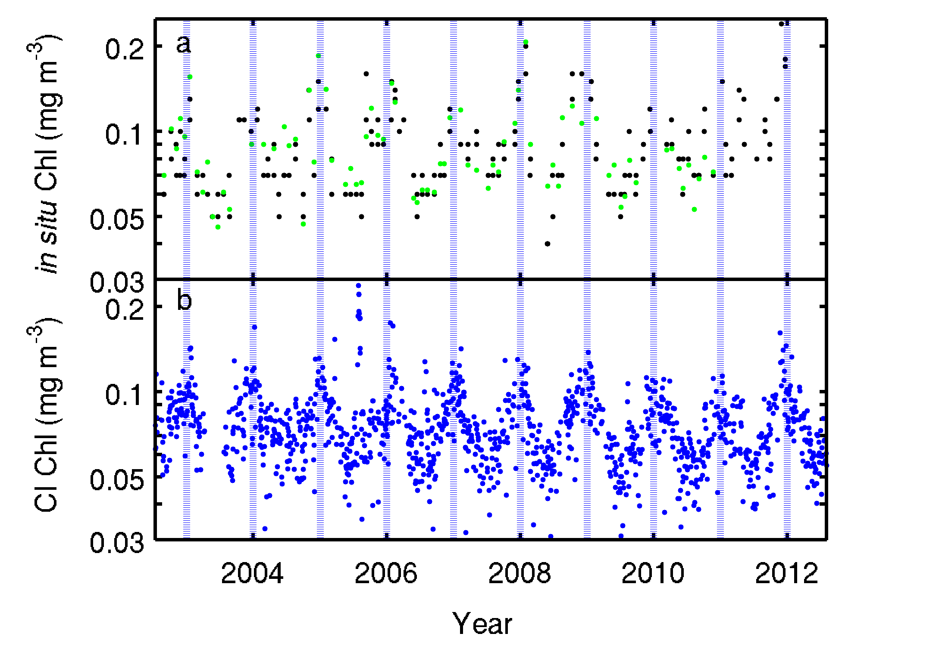
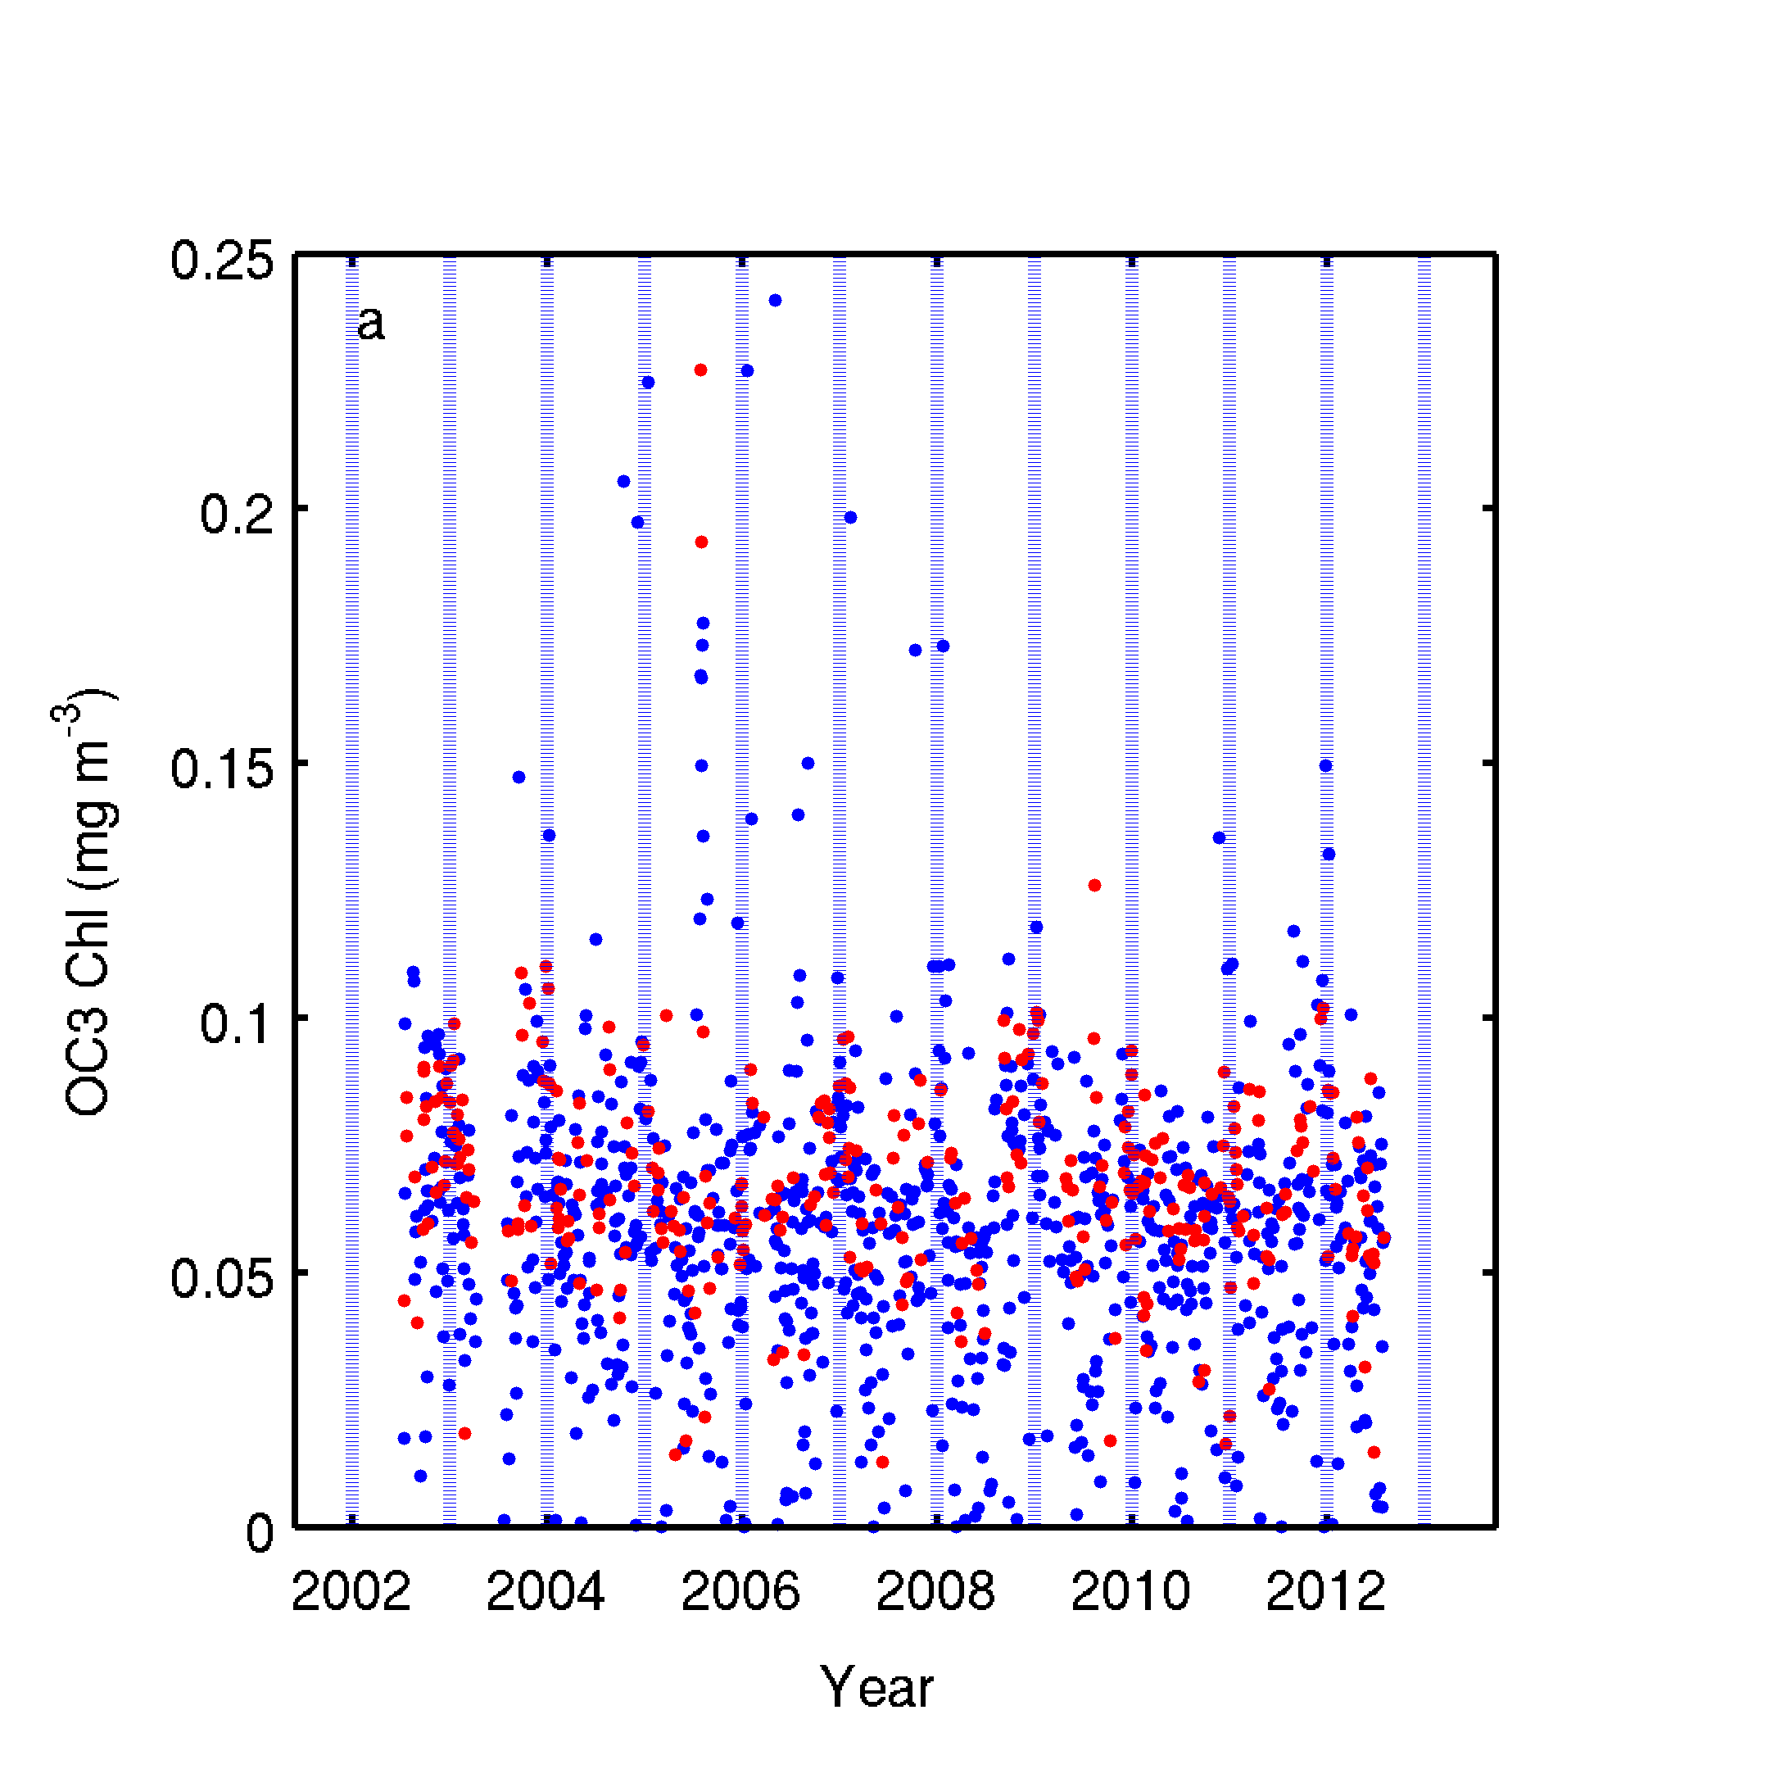
MODIS comparison with HOTS measurements
in situ HPLC fluorometric
satellite
no flags (n=1171)
standard flags (n=319)
Slide from Jasmine Nahorniak, Oregon State Univ.

Slide 6
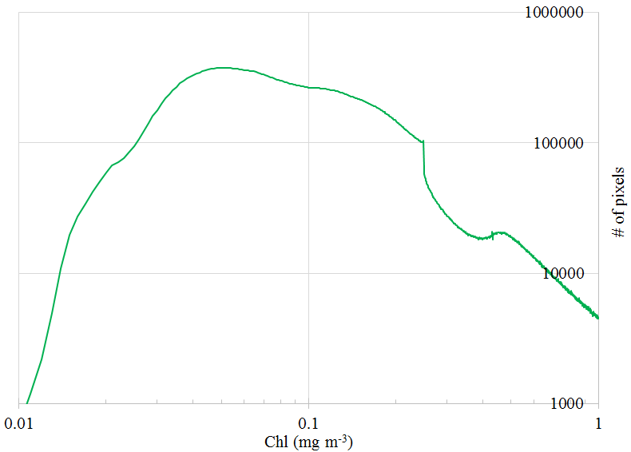
What’s the problem?
Only 50 HPLC data points from NOMAD were used to
relate to Chl for Chl<0.25 mg m⁻³
Discontinuity in the algorithm
transition zone
Uncertainties in gyres (<0.05 mg m-³)
Temporary solution
Instead of using the 0.25 – 0.30 mg m⁻³ transition zone,
use 0.175 – 0.25 transition zone. Results are good (see Franz report), but the full-advantage of band subtraction is compromised.

Slide 7
What’s the approach?
Revisit regressions
Develop a sensor-independent OCI algorithm with more data and fine-tuned regression coefficients;
Raise the algorithm transition zone and to take full advantage of the band-subtraction design

Slide 8
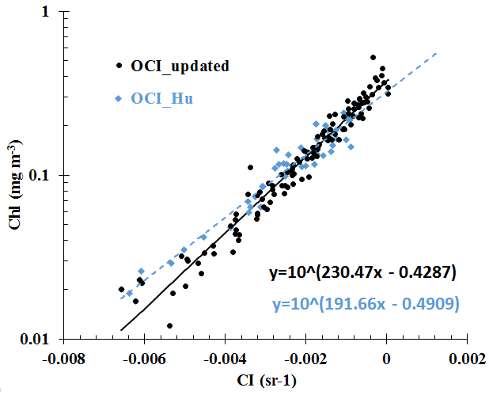
Data and Method
Dataset
Fluorometric and HPLC of NOMAD
Region: [60S~60N]
Methods
Criteria: Valid Rrs at 443, 490, 510 and 555 nm
Chl < 0.4 mg m⁻³ (1051 points)
Valid in situ points were gridded into log space for both maximum ratio and Chl
Merge zone: 0.25~0.4 mg m⁻³

Slide 9
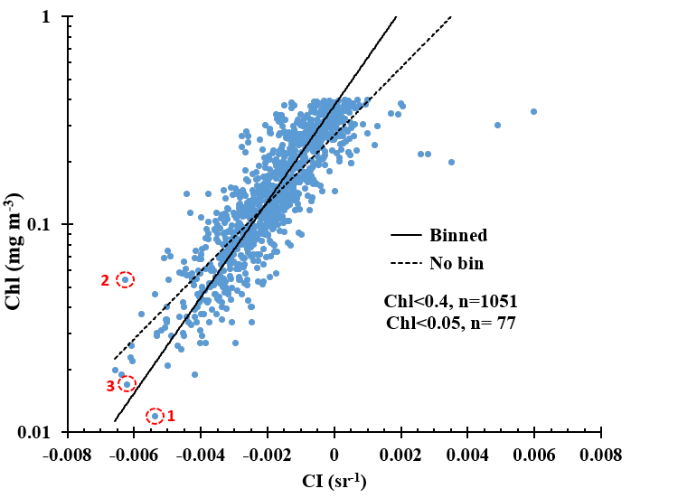
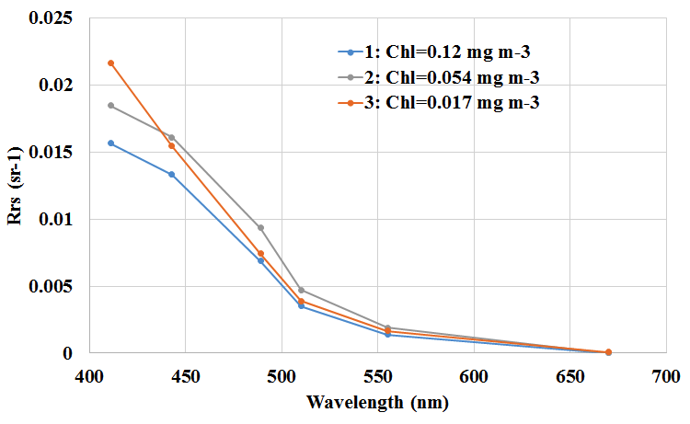
Data and Method
Are all these field data valid, even outliers?

Slide 10
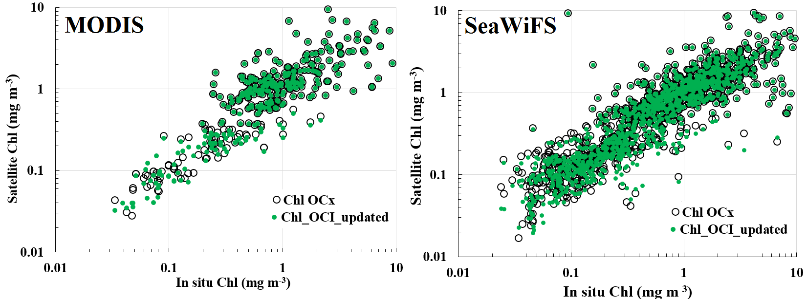
Results SeaBASS VALIDATION
MODIS | RMSE | URMSE | Mean Ratio | Median ratio | MRE | R2 | logR2 | N
OCX | 77.70% | 44.20% | 1.24 | 1.05 | 32.00% | 0.42 | 0.66 | 63
OCI_hu | 43.90% | 32.70% | 1.15 | 1.04 | 25.40% | 0.62 | 0.71 | 63
OCI_new | 51.20% | 37.60% | 1.12 | 0.94 | 35.20% | 0.59 | 0.71 | 63
SeaWiFS | RMSE | URMSE | Mean Ratio | Median ratio | MRE | R2 | logR2 | N
OCX | 535.80% | 54.20% | 1.79 | 1.19 | 41.50% | 0.01 | 0.33 | 357
OCI_hu | 91.80% | 47.20% | 1.4 | 1.16 | 36.80% | 0.31 | 0.39 | 357
OCI_new | 102.00% | 49.60% | 1.38 | 1.14 | 39.40% | 0.28 | 0.39 | 357

Slide 11
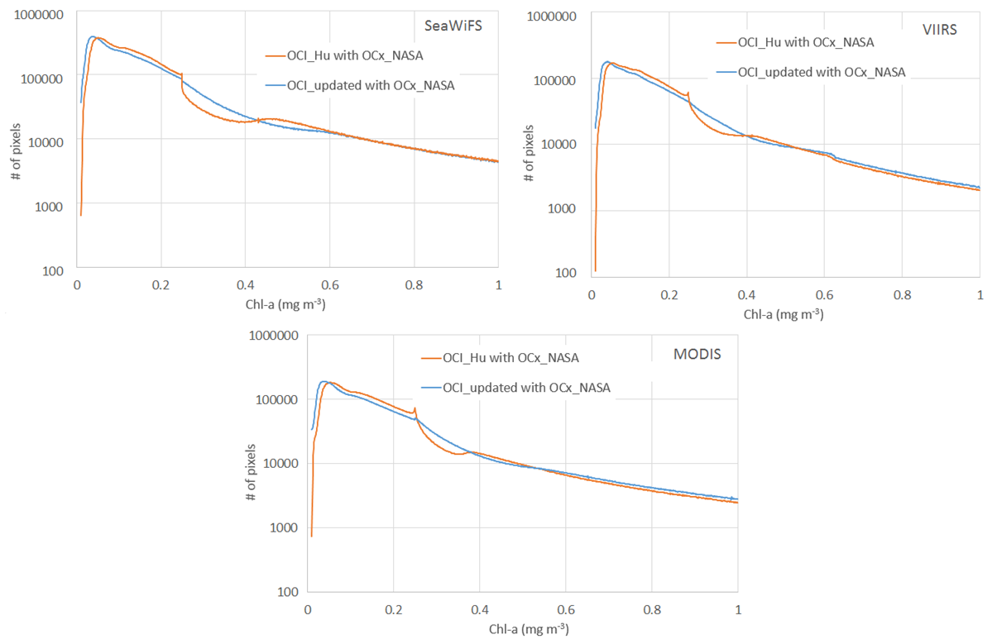
Results Improvement in transition zone

Slide 12
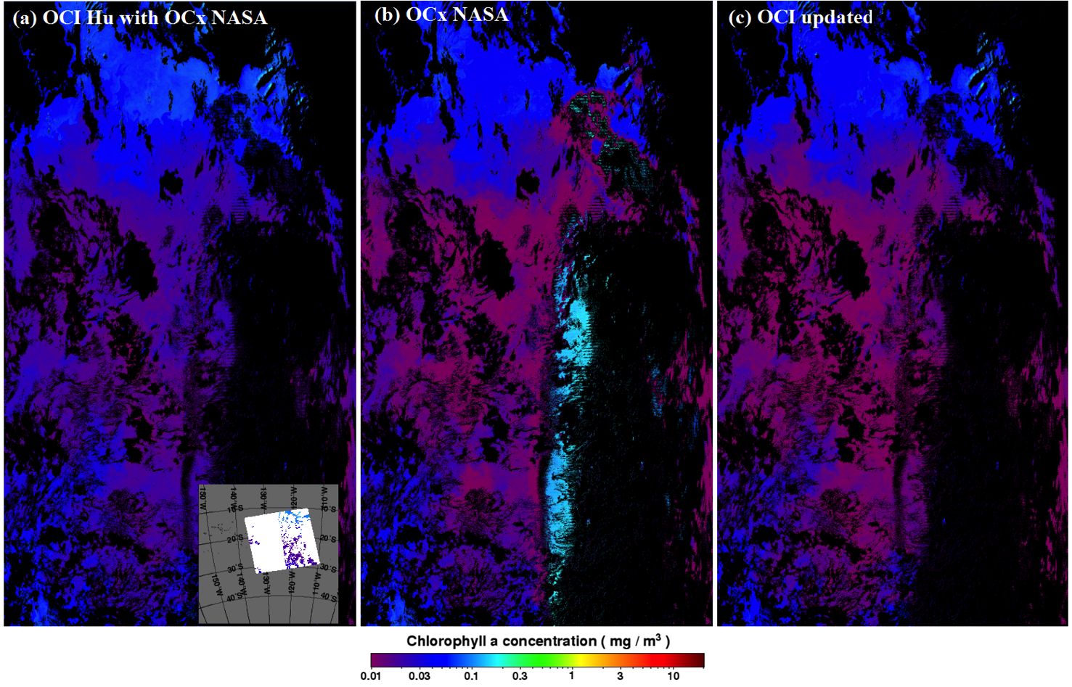
Results Single image comparison (MODISA 10/24/2004)
Notes:
ME effects are clearly revealed in the up scan directions in two MODIS sensors

Slide 13
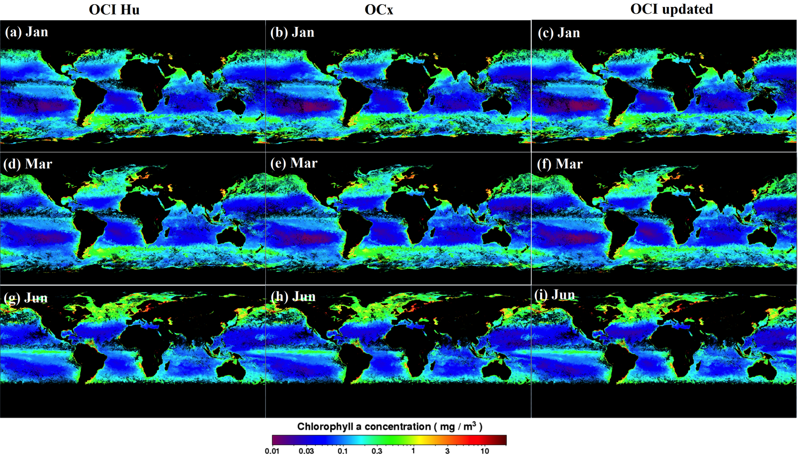
Results Global comparison (MODISA in 2010)
Notes:
ME effects are clearly revealed in the up scan directions in two MODIS sensors

Slide 14
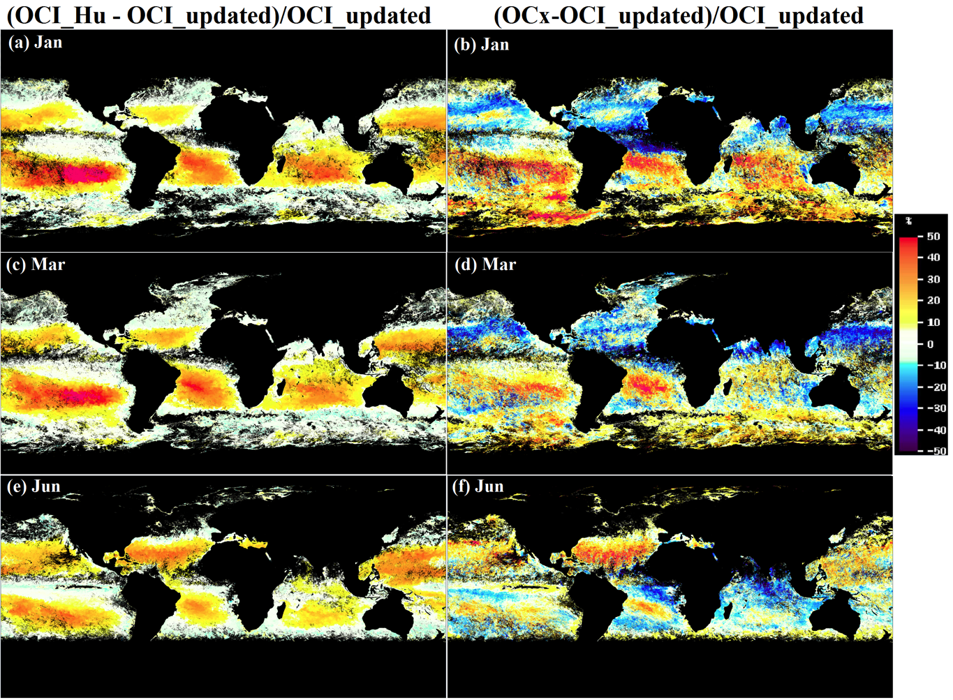
Results Global comparison (MODISA in 2010)

Slide 15
Results Cross-sensor consistency
aqua seawifs: http://oceancolor.gsfc.nasa.gov/ANALYSIS/PROCTEST/aOCI2m_sOCI2m/ viirs aqua: http://oceancolor.gsfc.nasa.gov/ANALYSIS/PROCTEST/vOCI2m_aOCI2m/

Slide 16
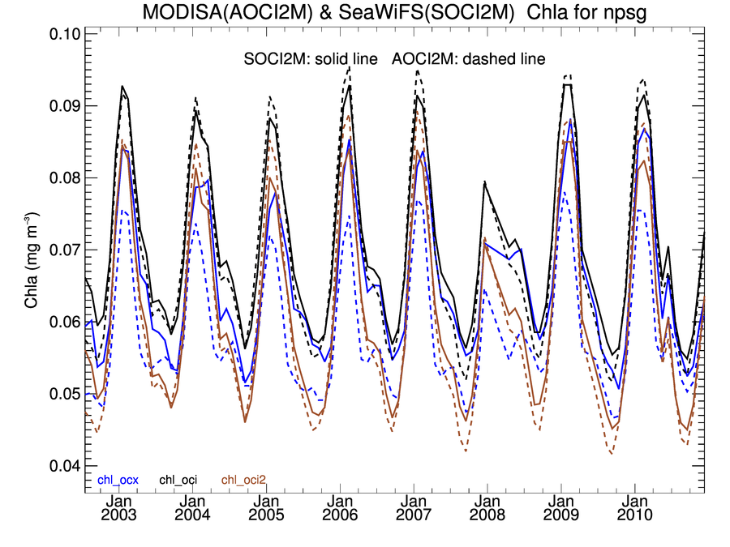
Results Cross-sensor consistency

Slide 17
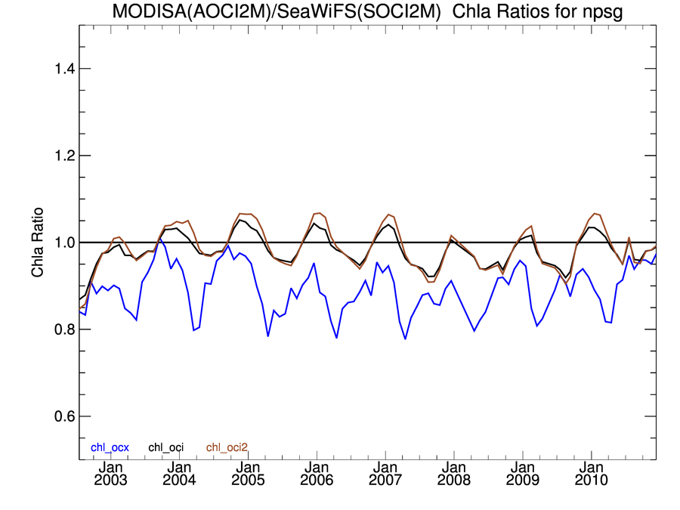
Results Cross-sensor consistency

Slide 18
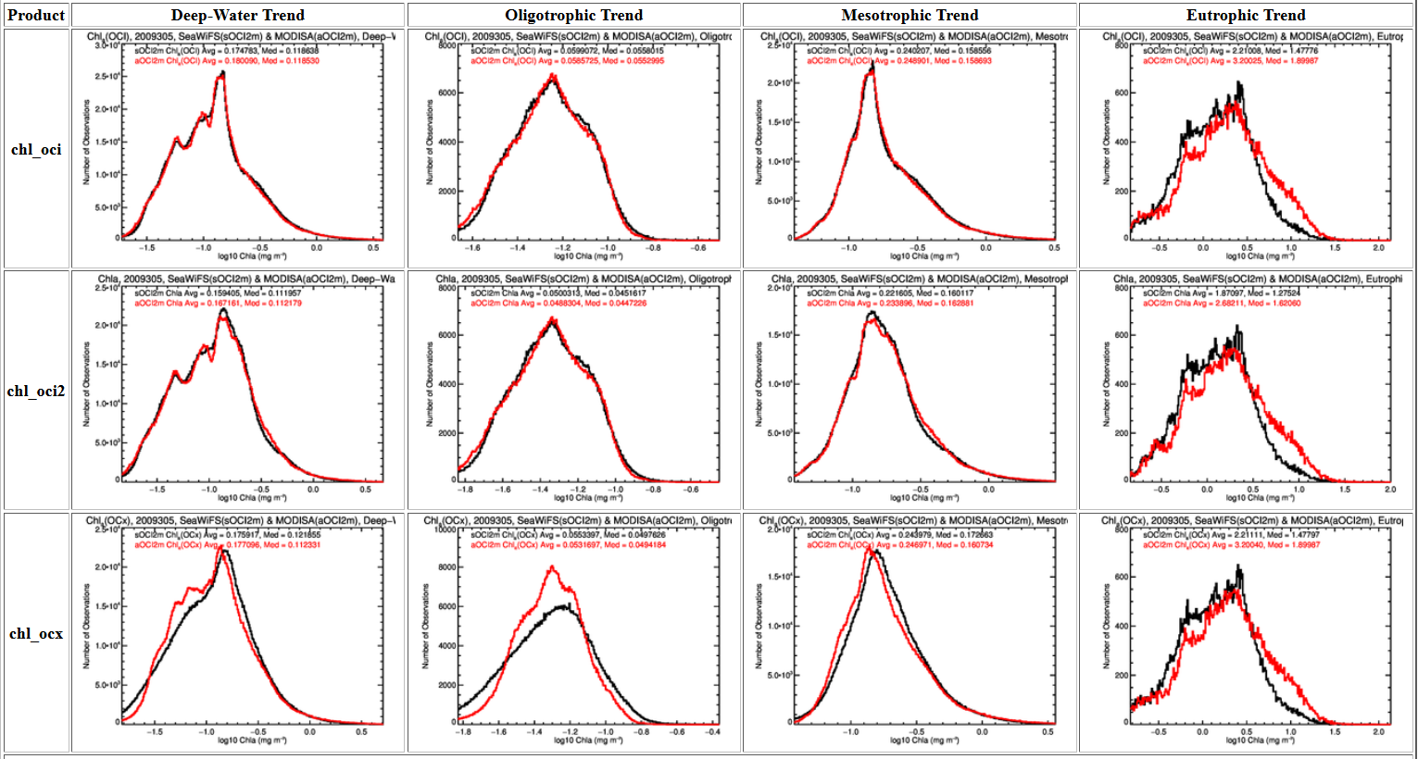
Results Cross-sensor consistency
2010305

Slide 19
Conclusion
OCI2 nearly as good as OCI
Transition zone from 0.175 – 0.25 to 0.25 – 0.4
OCI2 almost 0.01 lower than OCI in ocean gyres
- which is right?
Need high-quality data for Chl < 0.05, especially between 0.01 – 0.03

Slide 20
Motivations
3. OCI does not differentiate the various in-water constituents, then
how to reduce such CDOM impacts on OCI retrievals?

Slide 21
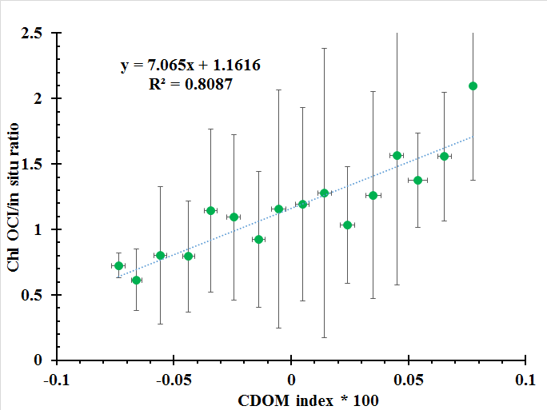
CDI index proposed to reduce CDOM impacts

Slide 22
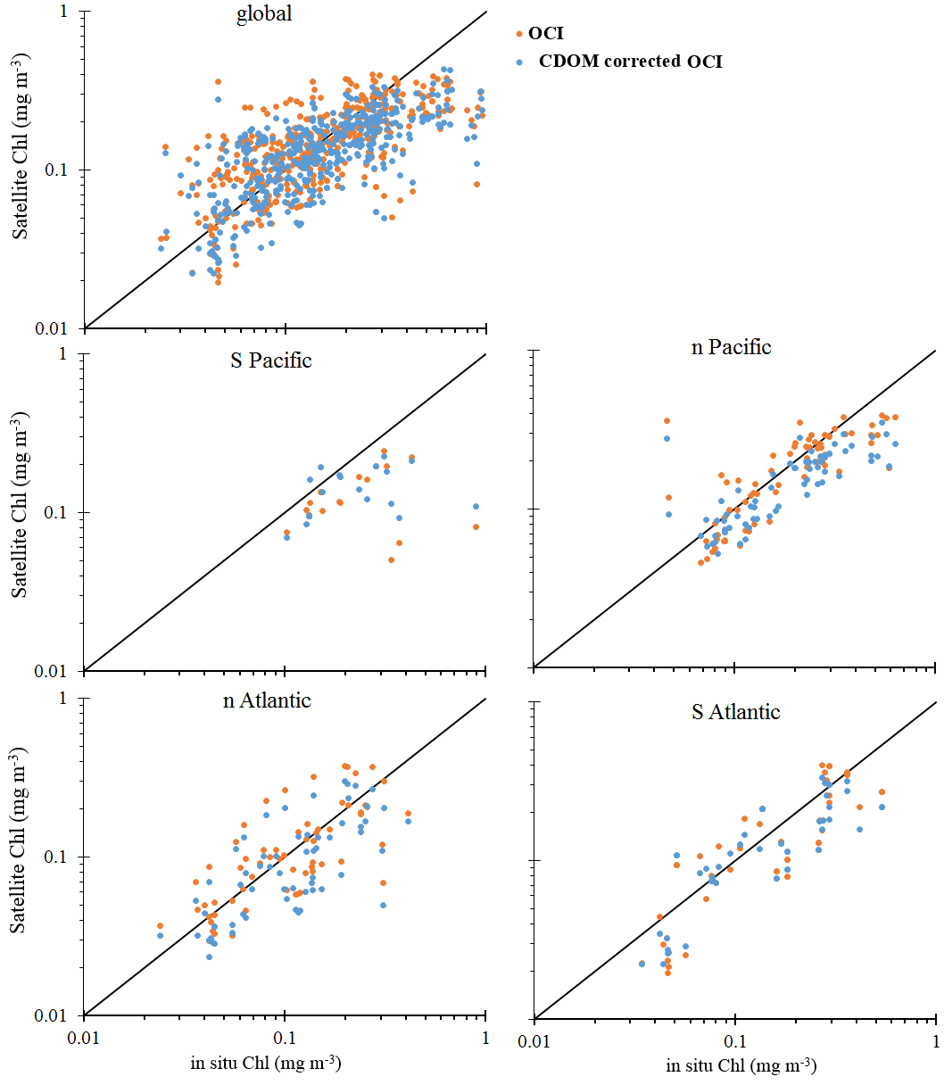
Results Performances of CDI
 |  | Chl satellite/in situ
Area | N_Points | OCI | CDOM corrected
global | 450 | 1.13 ± 0.76 | 0.99 ± 0.64
s_pacific | 21 | 0.63 ± 0.22 | 0.68 ± 0.28
n_pacific | 70 | 1.02 ± 0.9 | 0.85 ± 0.68
n_atlantic | 63 | 1.15 ± 0.65 | 0.94 ± 0.54
s_atlantic | 48 | 0.92 ± 0.42 | 0.86 ± 0.41
Others | 248 | 1.09 ± 0.68 | 1.25 ± 0.79
CDI is not satisfactory way to reduce CDOM effects on Chl OCI

Slide 23
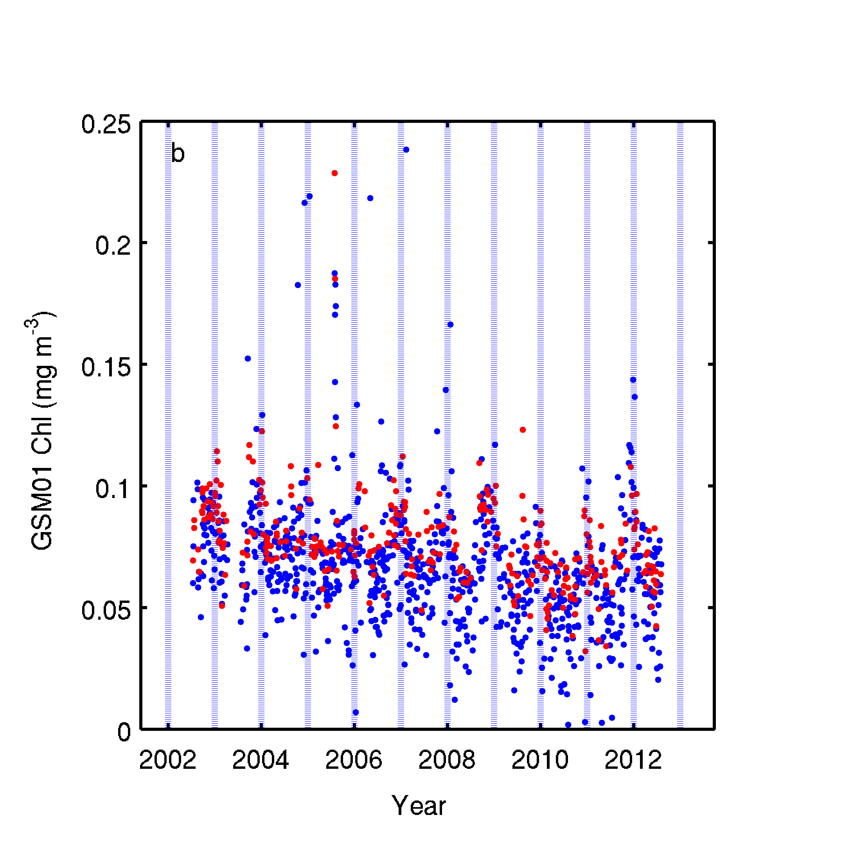
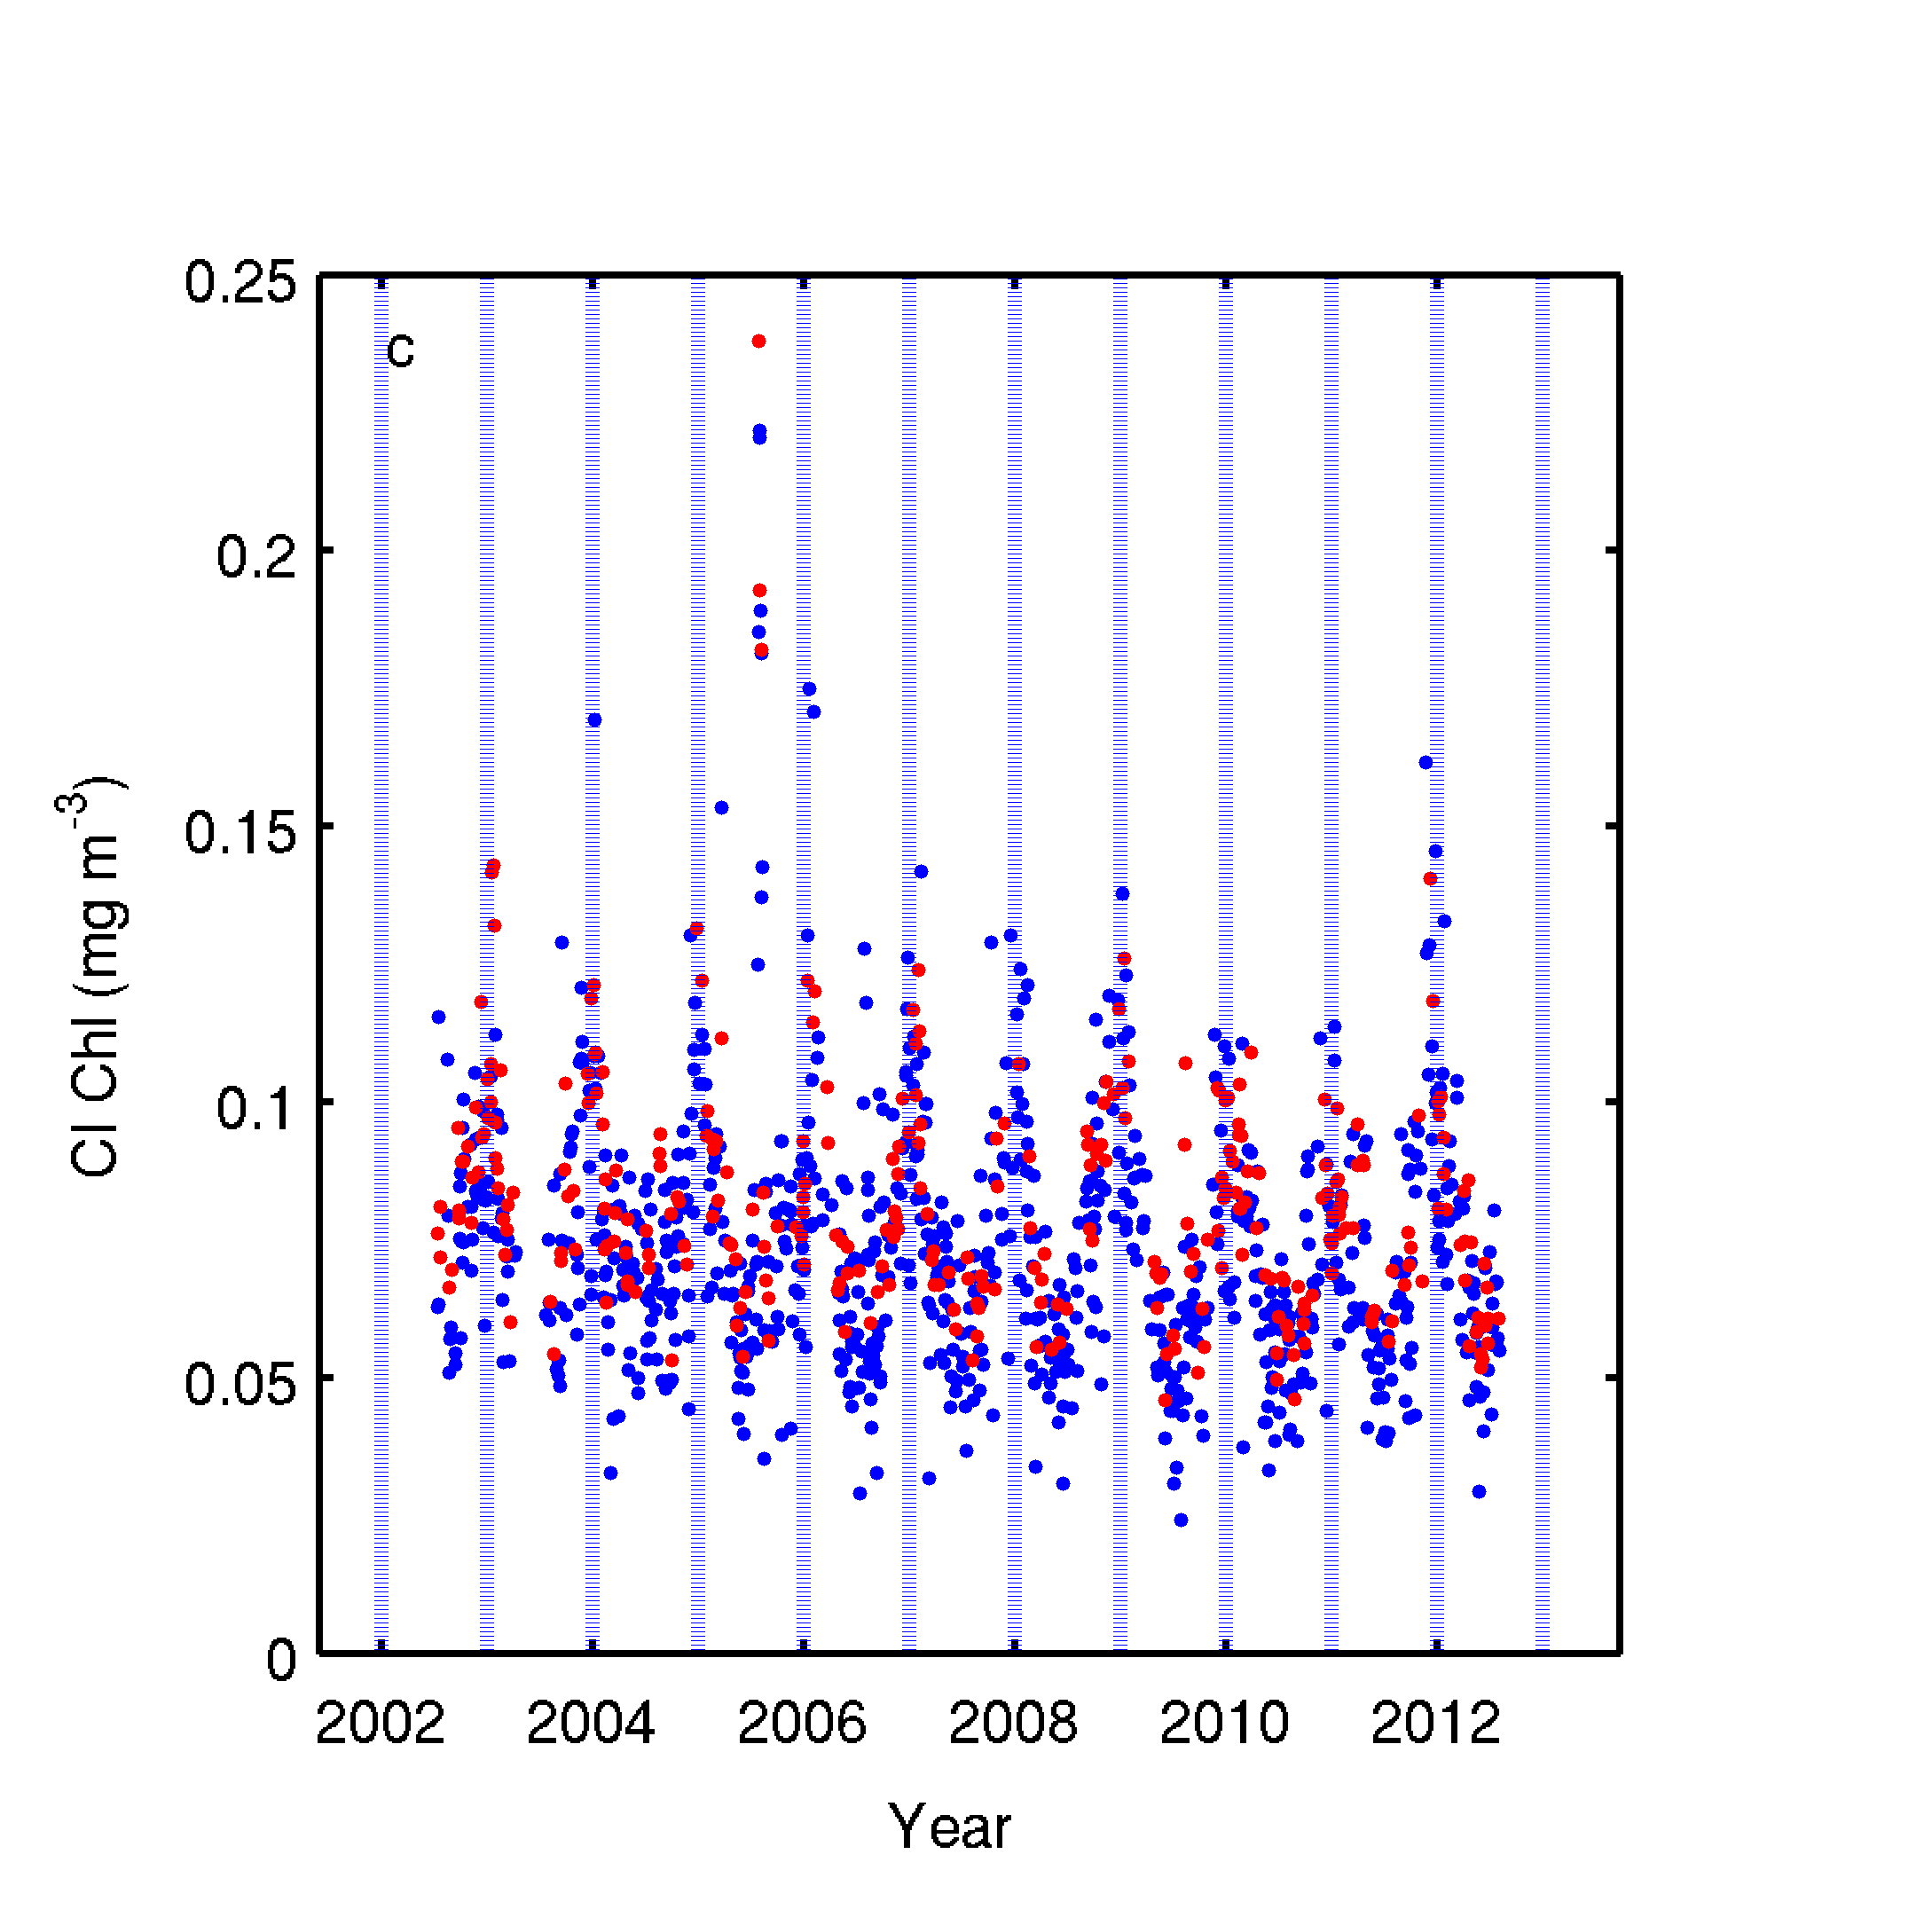
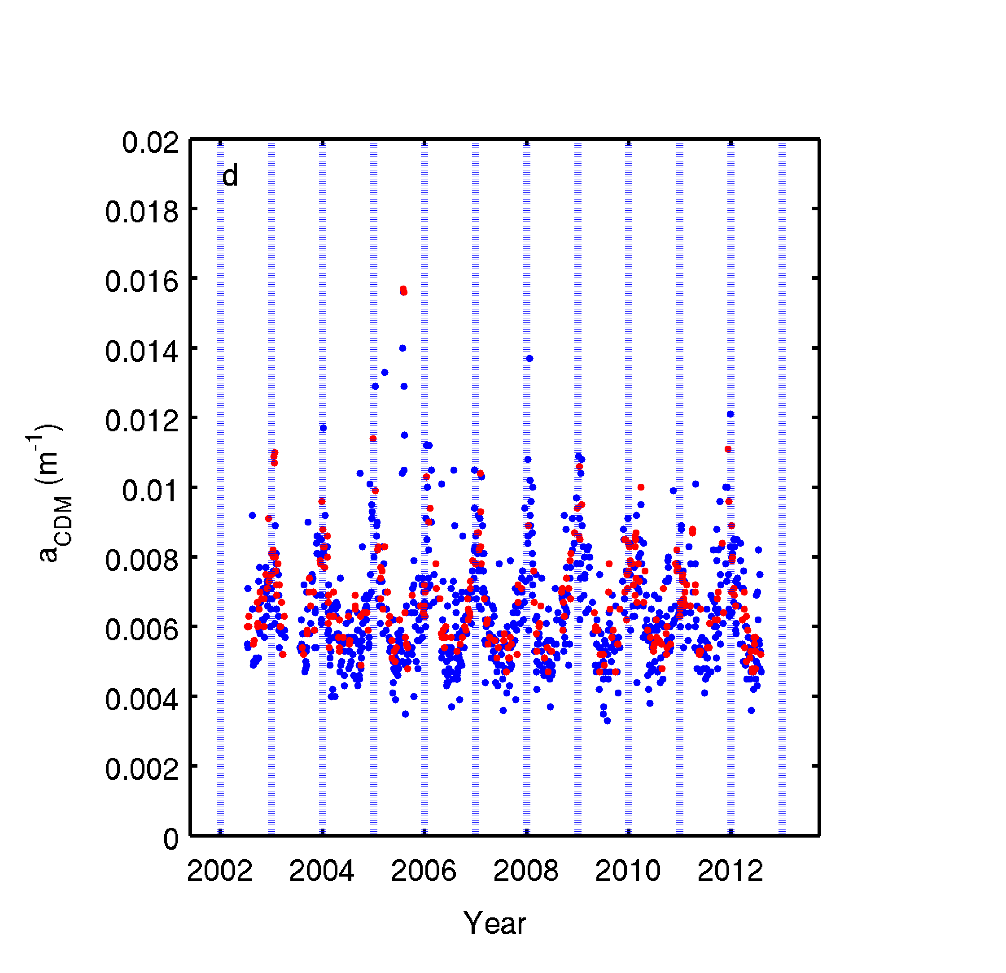
Time Series with and without standard flags
in situ HPLC fluorometric
satellite
no flags (n=1171)
standard flags (n=319)
n_{total}=3133

Slide 24
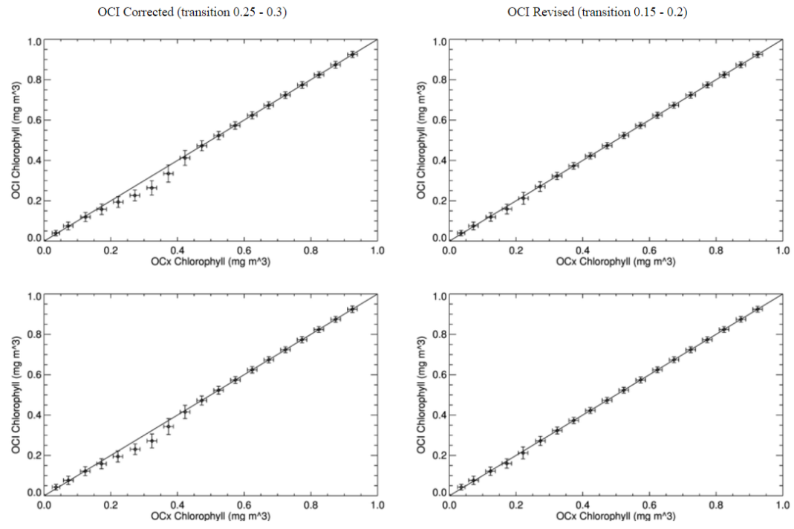
Motivations
2. Discontinuity in histogram (transition 0.25-0.3)

