Slide 1
Chl-specific flag?
Chuanmin Hu¹, Lian Feng¹, Zhongping Lee²
¹University of South Florida
²University of Massachusetts Boston
Funding provided by NASA OBB program
MODIS/VIIRS Science Team meeting, 6 – 10 June 2016, Silver Spring, MD

Slide 2
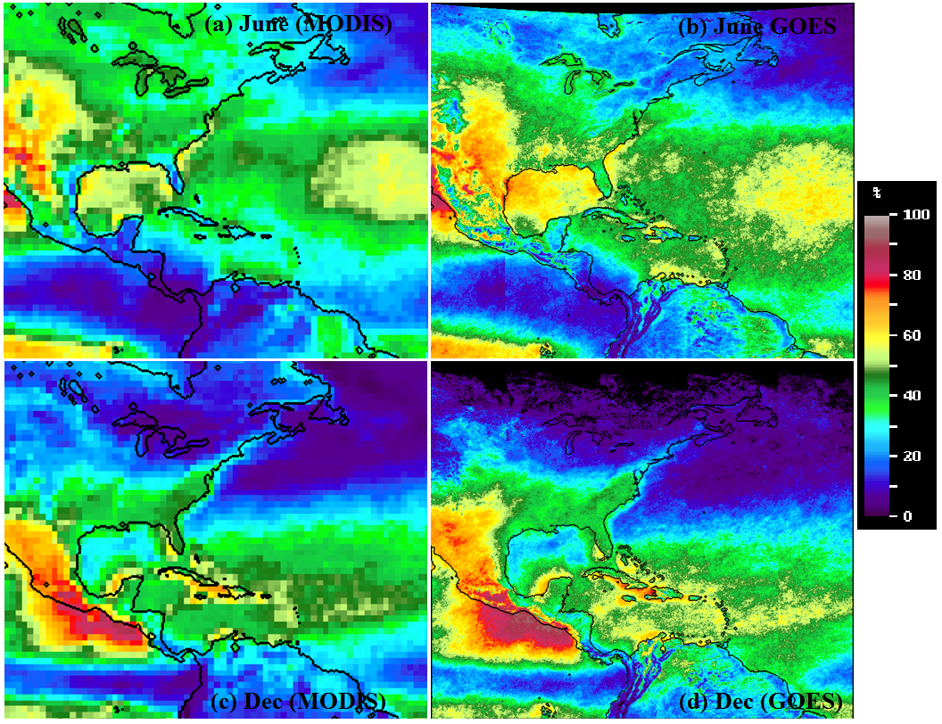
Rule of Thumb: more is better
MODIS and GOES cloud-free probability (Feng et al., submitted)
Notes:
MODIS is from MOD35 1-km data but binned to 1degree. GOES is from 4-km data but resampled to 0.1degree.

Slide 3
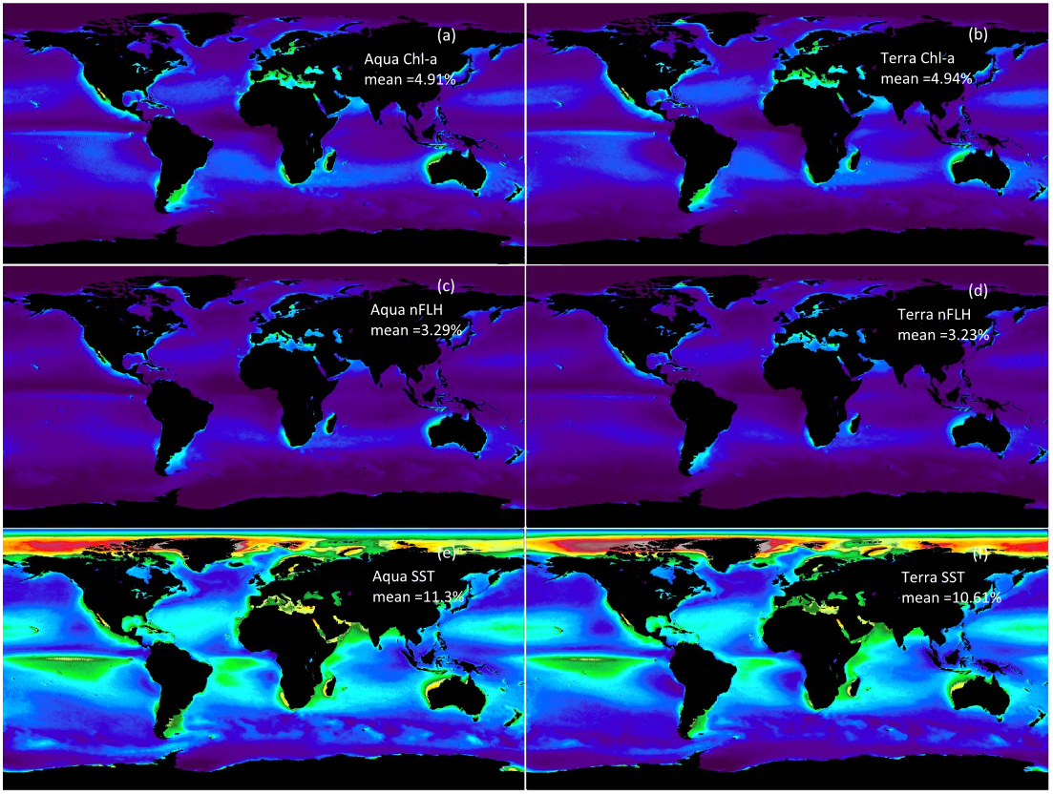
The Reality
Daily percentage valid data from Aqua and Terra 2003 – 2014 (Feng and Hu, 2016a)
Chl
nFLH
SST

Slide 4
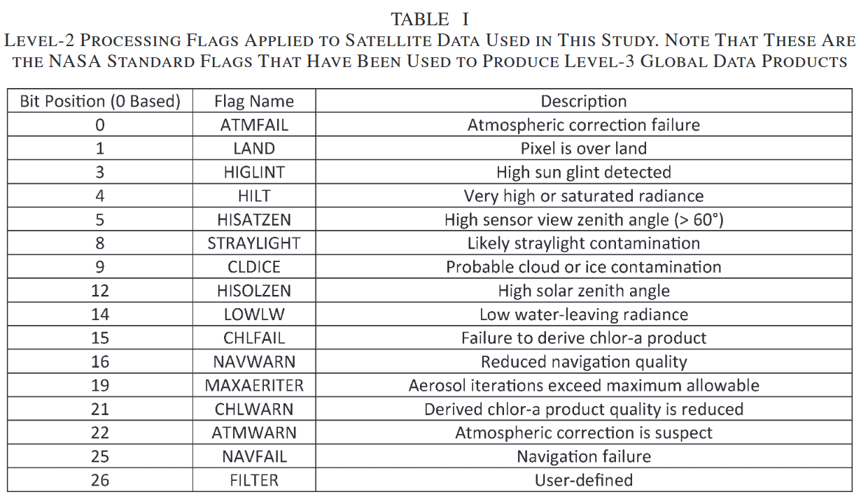
Default Chl flags
Global composite data is always a trade between quality and quantity

Slide 5
Lack of coverage is NOT always due to clouds
Notes:
5

Slide 6
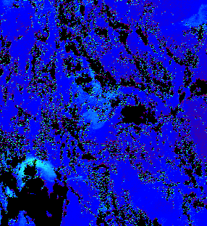
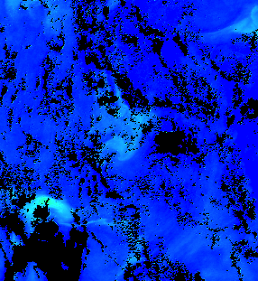
Relax Chl flag around cloud edges?
Chl Ocx Chl OCI
Notes:
6

Slide 7
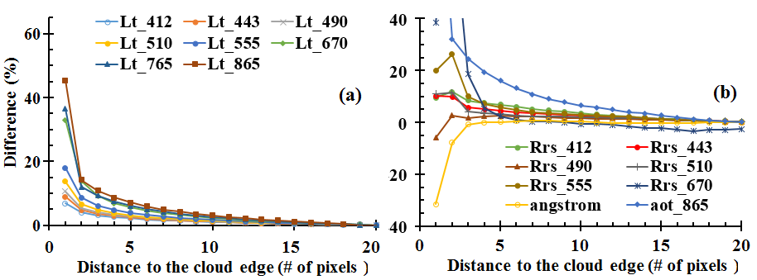
Effects of cloud adjacency ME-free direction (Feng and Hu, 2016b)
SeaWiFS

Slide 8
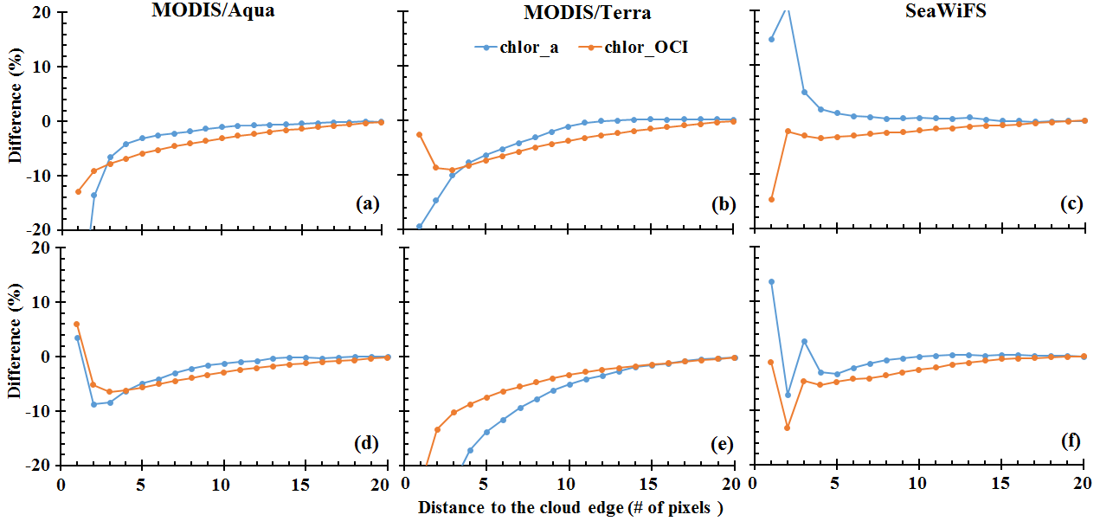
Effects of cloud adjacency ME-free and ME-containing directions (Feng and Hu, 2016b)

Slide 9
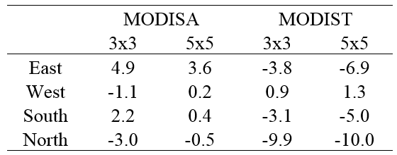
OCI Chl-a “immune to” cloud adjacency
?
The SeaDAS operational masking window (7x5) could be changed to 3x3 with the OCI Chl-a algorithm, without losing confidence for the remaining data
Notes:
Table lists the differences (in %) of AE between using two smaller window sizes (3x3 and 5x5) with Chl_{OCI} and the current operational mask method (eg. 5x7 window size) with Chl_{OCX}
The values are estimated between the Chl_{OCI} AE and Chl_{OCX} AE (both in absolute values) of the pixels just outside of their own masks. Specifically, the AE of Chl_{OCX} in the calculations are fixed at the fourth pixel of along scan direction and the third pixel of along track direction respectively. In contrast, the AE of Chl_{OCI} selected the second (third) pixel for all the directions when window size of 3x3 (5x5) was used.

Slide 10
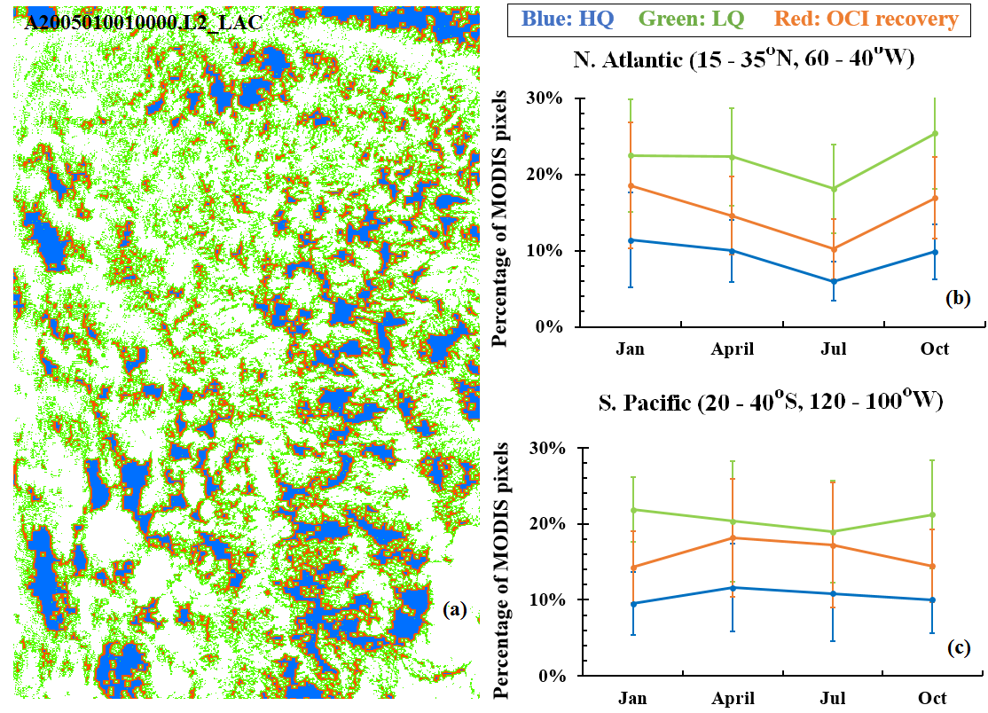
Chl-specific L2 Flag for 3x3 stray light?
Unfortunately, of the entire global data and SeaBASS archive, we could not find any field measurement just in the “recovered” pixels for validation
Notes:
a large amount of data (>40%) have been recovered for any given months of the two regions.

Slide 11
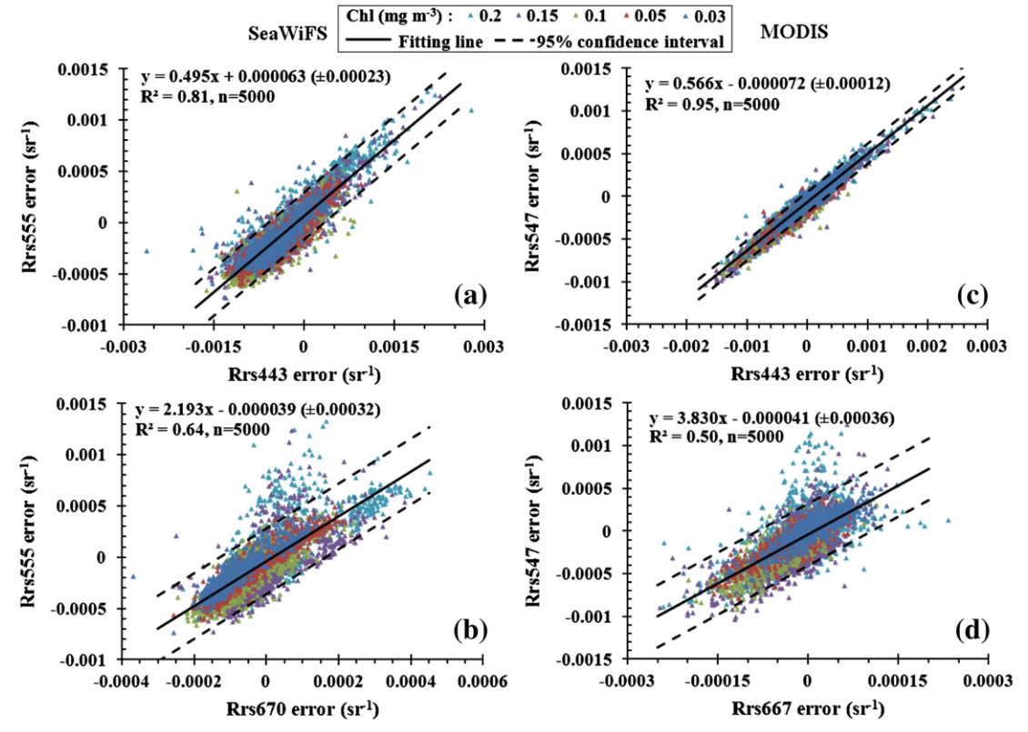
Rrs recovery?
Rrs errors are NOT spectrally independent (Hu et al., 2013)

Slide 12
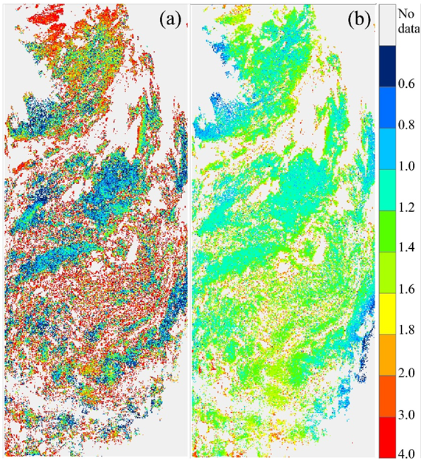
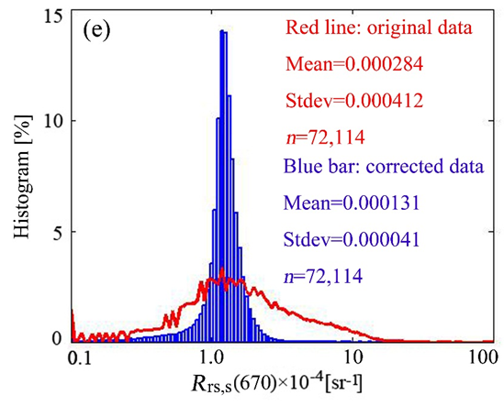
Rrs recovery?
Neural-net QAA relatively immune to input Rrs errors, therefore can be used to derive IOPs and “corrected” Rrs simultaneously (Chen et al., 2016, JGR). The scheme is applied to all non-zero Rrs pixels
SeaWiFS Rrs670 over N Atlantic on 2/20/1998, original and recovered

Slide 13
Conclusions
OCI is nearly immune to perturbations including cloud adjacency
7x5 stray light flag may be relaxed to 3x3 for low-Chl waters without losing quality
The result will be >40% valid data volume for low-Chl waters
The difficulty of lack of field validation from the “recovered” pixels may be circumvented from global statistics
How to implement for low-Chl waters only?

