Slide 1
VIIRS Land Discipline Report-back
Chris Justice/Miguel Roman (VIIRS)
Instrument Discipline Leads

Slide 2
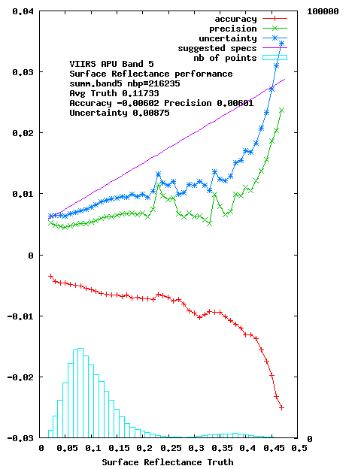
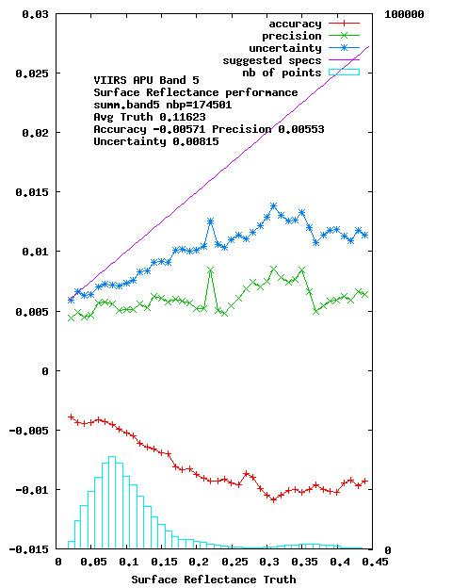
Testing of MODIS Collection 6 implementation for VIIRS Surface Reflectance (coming up in AS 5000)
Performance of the VIIRS Surface Reflectance in the red band derived over AERONET sites for 2012 (Left side)and 2013 (right side).
Vermote et al
Notes:
Surface reflectance (SR) algorithm is mature and pathway toward validation and automated QA is clearly identified.
Algorithm is generic and tied to documented validated radiative transfer code so the accuracy is traceable enabling error budget.
The use of BRDF correction enables easy cross-comparison of different sensors (MODIS,VIIRS,AVHRR, LDCM, Landsat, Sentinel 2 ,Sentinel 3…)
AERONET is central to SR validation and a “standard” protocol for its use to be defined (CEOS CVWG initiative)

Slide 3
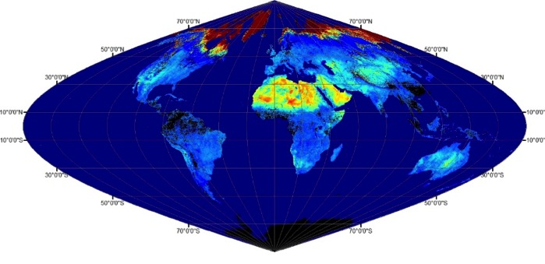
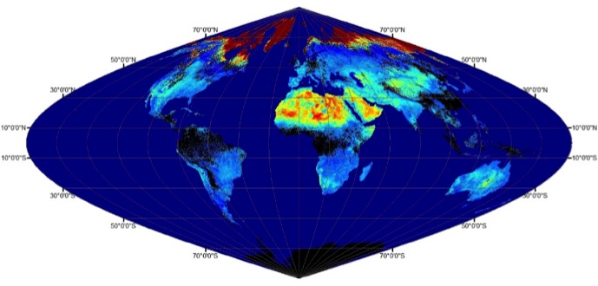
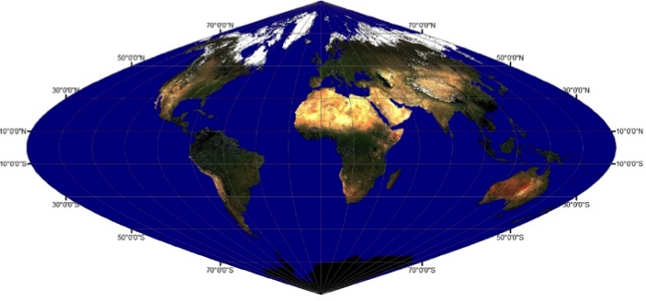
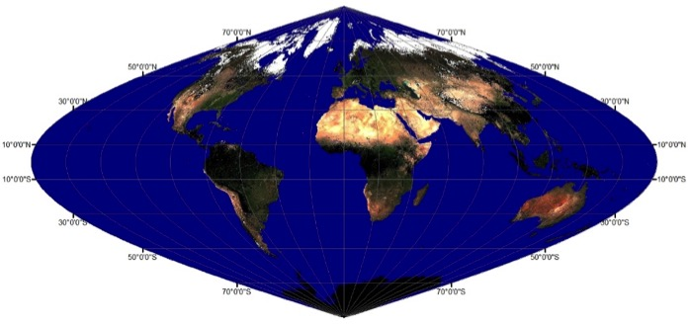
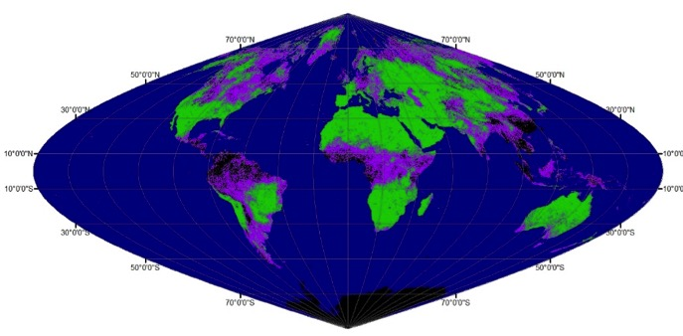
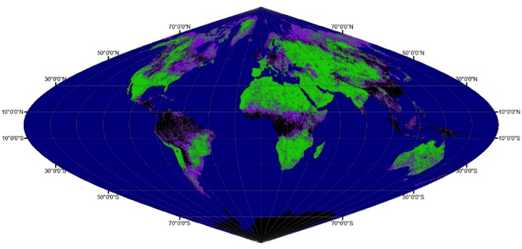
BRDF, ALBEDO, NBAR Continuity
MODIS
VIIRS
12 May 2014 (DOY 132)
WSAlbedo
0 0.6
NBAR
M5-Red(0-0.3)
M4-Green (0-0.3)
M3-Blue(0-0.3)
Quality
No Data
High Quality
Poor Quality (Backup Alg)
Schaaf et al
Notes:
MODIS
Collection V006 reprocessing up to DOY 56 2015
Excellent evaluations over representative tower sites
VIIRS
Just received latest VNP09 (HDF5) to evaluate
Excellent initial evaluations over representative sites
Comparable to MODIS (long term continuity)

Slide 4
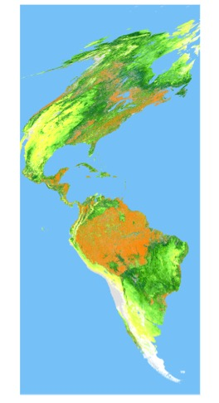
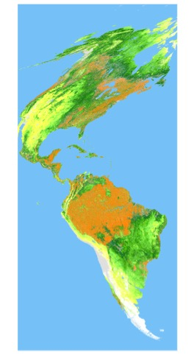
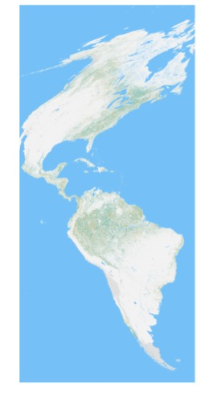
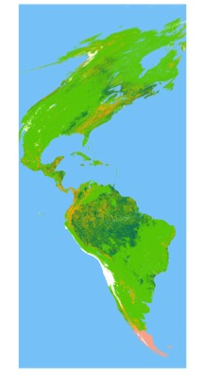
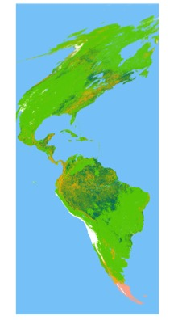
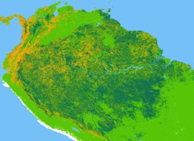
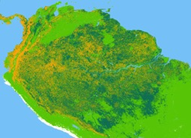
MODISLAI & FPAR – 2016 UPDATE
Global scale LAI/FPAR comparison between optimized VIIRS & MODIS C6
Overall, comparable spatial distribution of LAI/FPAR & spatial coverage
Larger discrepancies are mostly induced by algorithm path mismatch (i.e., Main vs. Backup)
Relatively higher uncertainty in dense forest can be another causal factor (i.e., saturation)
MODIS Aqua C6
VIIRS Prototype
Difference
(VIIRS-MODIS)
MODIS Aqua C6
VIIRS Prototype
3.0<
2.5
2.0
1.5
1.0
0.5
-0.5
-1.0
-1.5
-2.0
-2.5
-3.0>
Algorithm Quality Control (QC)
Water
Non-Veg
Main
Main-S
Leaf Area Index (LAI)
No-Data
BackUp-G
BackUp-O
Not-Retrieved
4
Water
0.0
0.1
0.3
0.5
0.8
1.2
1.6
2.1
2.8
3.4
4.4
5.4
7.0
4
Non-Veg
Myneni et al

Slide 5
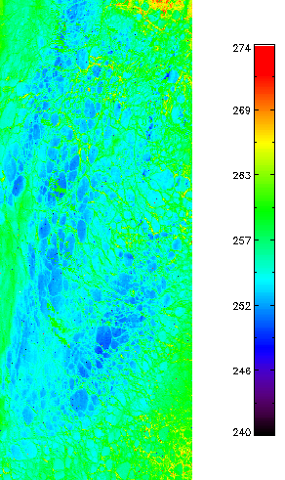
NASA VIIRS Ice Surface Temp
Initial code generated from MODIS code by NASA’s Land Science Investigator-led Processing System (LSIPS)
Code being updated for VIIRS (calibration coefficients, etc.)
New Quality Flags to be added
Inter-comparison: MODIS, NCEP
Validation: IceBridge, buoys
First draft of ATBD delivered Jan. 2016
Left: VIIRS IST (K) from the NASA VIIRS IST product
uses new calibration coefficients from J. Key
Sept 12, 2014, 21:10 UTC
Beaufort Sea, AK

Slide 6
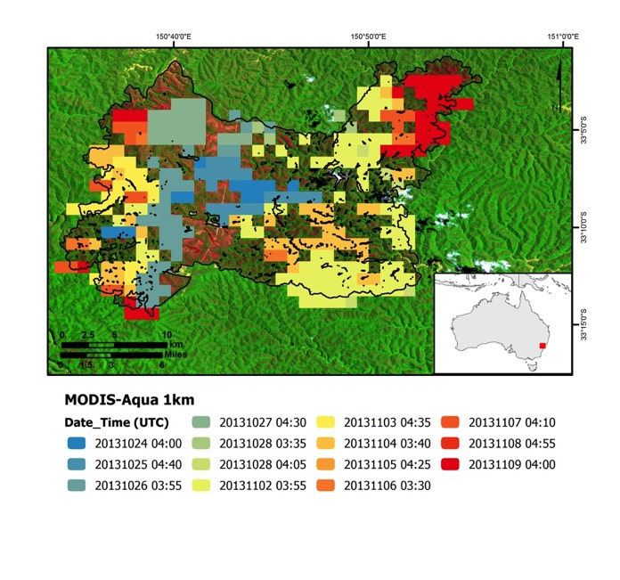
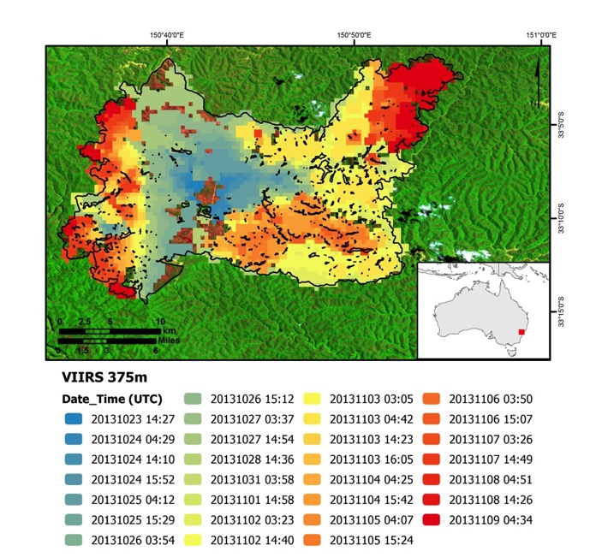
Improved Satellite Mapping of Active Fires Using VIIRS 375m Data
Aqua/MODIS 1km
S-NPP/VIIRS 375m
Schroeder et al

Slide 7
VIIRS
Product Maturity Slide
Schedule
Most products still in HDF 4
Need to transition to HDF 5 - Conversion may cause c. 6 week delay in BRDF Suite and LAI /FPAR – land team working together through the conversion issues
Land DAAC provided overguide to convert to HDF 5 compatible tools to minimize user impact

Slide 8
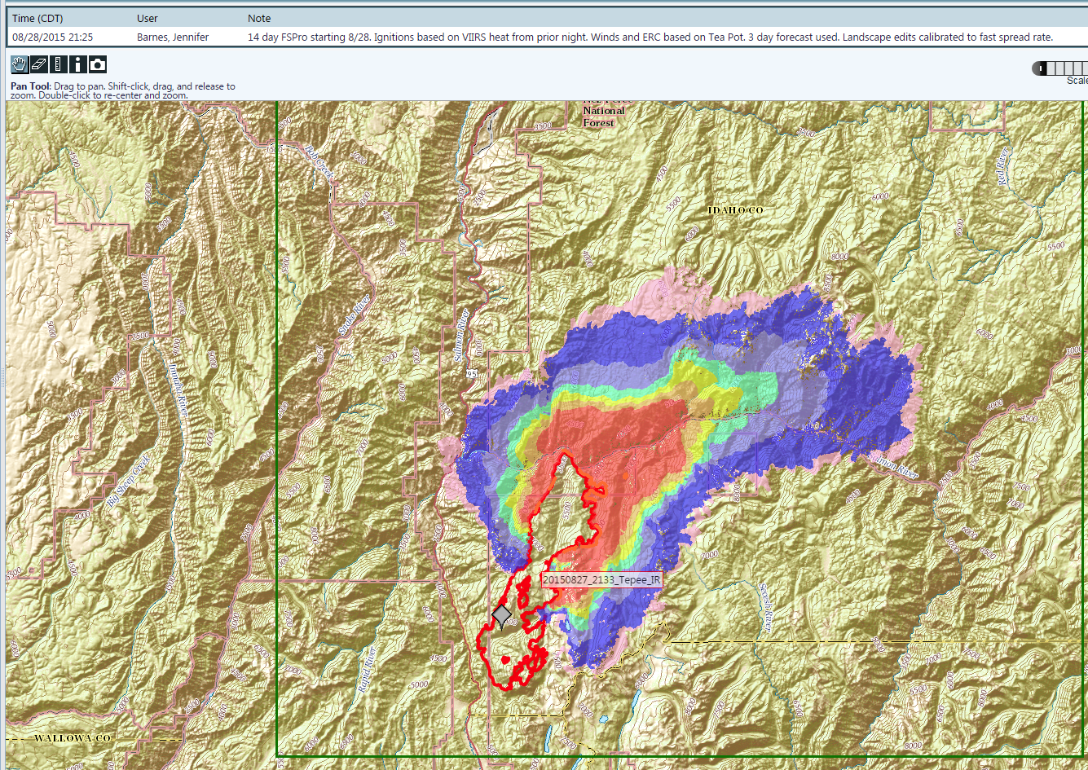
Example Operational Application – WFDSS (http://wfdss.usgs.gov)
Wildland Fire Decision Support System (WFDSS)
Computes probability of maximum fire spread from a known ignition point/perimeter under various scenarios
Help managers determine an “Appropriate Management Response” to fires from a strategic and tactical stand point and prescribe adequate resources for fire containment.
Fire spread probability output using extent of VIIRS 375m active fire detections to initialize fire spread probability model.
Output represents the probability of fire spread over 14 days.
Notes:
MODIS and VIIRS active fire detection data are used in decision support applications used for fire management.
WFDSS uses Fire Spread Probability (FSPro) to calculate the probability of fire spread from a know origin point or current fire perimeter.
Current and forecasted weather, fuel conditions and topography are used in the modelling to estimate the probability of fire spread, typically in the absence of fire suppression actions.
These results used in the context of values at risk (structures, special designated areas, etc.) guide fire suppression decision making and prioritize resources.
Active fire detection data provides consistently derived and reliable data for use in WFDSS scenarios.

Slide 9
Land Product Validation
General decrease in NASA Land Validation funding since EOS
Land Strategy to leverage international efforts – coordination through CEOS LPV (Roman - chair)
Also important for equivalent international land products to be validated
Use the same protocols and reporting (RS community agenda)
CEOS LPV adoption of MODIS Validation Terminology
Developing Joint Agency approaches
MODIS Validation has had significant funding over the years
All products at Stage 2 - Some products at or near Stage 3 (SR, Fire, ....... )
Web sites are being brought up to date
NOAA VIIRS Products undergo validation - linked to their operational status
NASA VIIRS Validation (focus on major uncertainties)
Community expectation of Stage 2 Validation
Working with NOAA VIIRS Validation efforts as appropriate
Interacting with national/international networks (e.g. via LPV) – BSRN, NEON, NPN
GSFC sUAS

Slide 10
Considering Changing Projection ?
Sinusoidal (equal area) adopted by MODLAND in the late 1990’s
CMG format offers alternative at e.g. 30 Arc Sec grid
Sinusoidal is problematic in terms of resampling particularly at high latitudes
Up sampling might present an option
Evaluating changing to Geographic (or other) Projection from Sinusoidal
Pahlevan comparative analysis showed little radiometric impact
Seeking User guidance from the Land DAAC UWG
Suggestion to consider compatibility with the global Landsat projection solution (USGS/Landsat Science team) – Fall reprocessing schedule
Discussion on-going

Slide 11
VIIRS Land Cover Issue
NASA LC Product missing from the current VIIRS product suite
Some higher level land products are dependent on land cover
Current Approach:
Use MODIS Land Cover Product
Work with NOAA Annual Surface Type team to evaluate whether the product is sufficient

Slide 12
NOAA Operational VIIRS Land Product Status
All remaining land / cryosphere products are being migrated to NOAA’s Enterprise system using improved algorithms
Suomi NPP Data Exploitation (NDE)
Green Vegetation Fraction, Vegetation Health, Active Fire already in NDE
Phased implementation following product dependencies
follows “Risk Reduction” package: clouds, aerosol, cryosphere etc.
Surface reflectance ~ February 2017; LST, Albedo, VI ~Aug 2017
Annual Surface Type generated by STAR / UMD team
Long-term quality monitoring ongoing
IDPS production, long-term monitoring and maintenance continues until all downstream products are migrated into NDE/ NOAA ESPC Enterprise system
Preparations for NPP reprocessing and J1 production ongoing
CEOS protocols used for product validation
NOAA JPSS Science Team meeting Aug 8 – 12th 2016 (College Park)
http://www.star.nesdis.noaa.gov/star/meeting_2016JPSSAnnual.php

Slide 13
Documentation and User Community Guidance
ATBD/Data Product Documentation and Reviews:
Documentation on web sites lacking for Sensor/Team/ATBDs/Data – new (and existing?) users (especially in the applied/operational world) need to find the details
We could envision something like this on line:
MODIS PRODUCT / CORRESPONDING VIIRS PRODUCT / COMMENTS / NASA funded & RELATED RESEARCH / REFERENCES”
Focus currently on getting the VIIRS Land Products ready for release
Recognize that Attention is Needed to User-oriented Documentation re. Data Continuity (this coming year)
Prior to re-competition documentation should be complete

Slide 14
A Land Climate Data Record
Multi instrument/Multi sensor Science Quality Data Records used to quantify trends and changes
81
82
83
84
85
86
87
88
89
90
91
92
93
94
95
96
97
98
99
00
01
02
03
04
05
06
07
08
09
10
11 12 13 14 15 16 17
N16
N17
AVHRR
N07
N09
N11
N09
N14
METOP
N16
SPOT VEGETATION
Terra
MODIS
Aqua
AVHRR (GAC) 1982-1999 + 2003-2006
MODIS (MO(Y)D09 CMG) 2000-present
VIIRS 2011 – 2025
SPOT VEGETATION 1999-2000
Sentinel 3 2014
NPP
VIIRS
JPSS 1
Sentinel 3
We are trusting that JPSS-1 will be added to the NASA Climate Data Record
– with funding for 1) Inst. Cal, 2) Data processing, 3) Product continuity 4) Science

Slide 15
The strength of the MODIS AM/PM Combination
MODIS Terra is degrading
In the next two years we we will potentially have 3 satellites with similar overpass times (Aqua, SNPP, JPSS1)
SNPP and JPSS1 is planned ‘operational’ redundancy
3 satellites would be excessive redundancy
For the land community, AM and PM provides several improved science algorithms (cloud cover)
Explore moving Aqua to AM overpass
As Aqua degrades SNPP will become the cal. gold standard
Question of fuel use (lifetime reduction) to change orbit
Are there any other discipline objections ?

Slide 16
This Meeting Format
Benefit for all to hear the calibration presentations and the HQ perspectives
Some good multi-instrument science presentations
Not much inter-disciplinary communication or cross fertilization
Algorithm maintenance product status not so interesting across disciplines
For VIIRS Land we could have benefited from a two-day ‘working meeting’ developing the production
Suggestion – one large meeting after selection – then devolve to discipline/instrument meetings – perhaps one overall science meeting at the end of the funding cycle to show results
5 days !

