Slide 1
PIC of the ‘Lith-er…PIC/Coccolith Algorithm Advances for MODIS and VIIRS for Evaluating the Global Ocean Carbonate Budget: Three Vignettes
William M. Balch, Jason Hopkins, Catherine Mitchell, Bruce Bowler, Chuanmin Hu
Bigelow Laboratory for Ocean Sciences
E. Boothbay, ME 04544

Slide 2
Coccolithophores are strong drivers of ocean biogeochemistry and optics
Emiliania huxleyi
Ophiaster sp.
Emiliania huxleyi
Papposphaera sp.
Calcidiscus leptoporous
2014, MODIS AQUA
Great Calcite Belt
Notes:
(Left) 2014 PIC average image (Right)
a (upper left) Most ubiquitous species, Emiliania huxleyi; this and Gephyrocapsa oceanica have been cultured extensively and their life-cycle is well worked out (Klaveness 1972, Green et al 1996, Houdan et al. in press). The dominant phase is diploid, non-motile and usually heterococcolith-bearing (= C-cells), although naked mutants often occur in culture (= N-cells). The alternate phase is haploid, scale-bearing and motile (= S-cells). There is no holococcolith stage.
Coccolith structure: Coccoliths are placoliths with Emiliania-type structure,
b (upper right) Ophiaster sp. Appendages formed from strings of highly modified antapical coccoliths (osteoliths). The appendages have some similarity to those of Michaelsarsia but are formed antapically rather than apically, there are no whorl coccoliths and the body coccoliths are smaller and simpler.
C (lower left) Papposphaera lepida or P. obpyrimidalis: Family PAPPOSPHAERACEAE Jordan & Young 1990; Minute (cells typically 4-6 μm), lightly-calcified coccolithophores. Mainly recorded from high-latitudes (Arctic and Antarctic), but many additional undescribed low-latitude spp occur (Thomsen & Buck 1998; Østergaard & Thomsen in prep.; Cros & Fortuño 2002; our obs.).
D (lower right) Calcidiscus leptoporous coccolith- One of larger species, important in sediments; Calcidiscacae; Holococcolith form (Syracolithus quadriperforatus)

Slide 3
PIC by VIIRS and MODIS

Slide 4
Vignette #1: Scaling from Surface Satellite Measurements of PIC to Integrated Euphotic Estimates over the Global Ocean: Do Vertical Profiles of Coccolithophores Look Like Vertical Profiles of Chlorophyll?

Slide 5
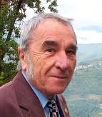
Set the scene…
Deep chlorophyll maxima are the norm… causes are variable (Cullen, 1982; Can. J. Fish. Aquat. Sci. 39:791-803).
Others parameterized integrated chlorophyll based on remote sensing measurements from the top optical depth (e.g. Morel et al., 1988; J. Geophys. Res. 93:10749-68).
PROBLEM: Little known about vertical distributions of other significant biogeochemical variables, to apply to space-based ocean color measurements from the top optical depth.

Slide 6
The data set, 15 cruises
N=2,022
Notes:
Fig. 1- Cruise tracks of 16 ocean expeditions used in tis analysis. Cruises include: 8 Atlantic Meridional Transect cruises 15-22, Patagonia Shelf (COPAS’08), Equatorial Pacific Biocomplexity (‘2004-5), Great Belt cruises 1 & 2 (MV1101 and RR1202, respectively, Arabian Sea (JGOFSP4), Western Arctic (HLY1101) and SW Pacific on Tangaroa (Tan1109).

Slide 7
Balch et al. in prep

Slide 8
Deep-dwelling coccolithophores
Balch et al. in prep
Notes:
A) Conceptual view showing the homogeneous distribution assumption (points within 10% of dashed line with 100:1 slope), points above line (tendency to a subsurface max) or below line (tendency to a surface maximum).

Slide 9
Example- 3 profiles w/ same integral
Homogeneous
Surface Max
Deep Max
Balch et al. in prep
Notes:
Hypothetical profiles of the concentration of a biogeochemical variable, all with the same integral concentration, but one has a subsurface max (red), one has a surface max (blue) and one is homogeneous. (black dash). Top optical depth visible to satellite noted.

Slide 10
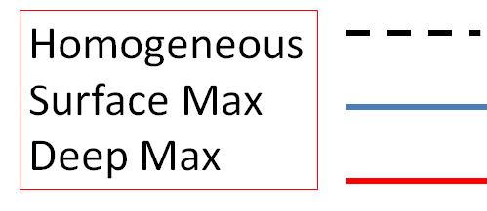
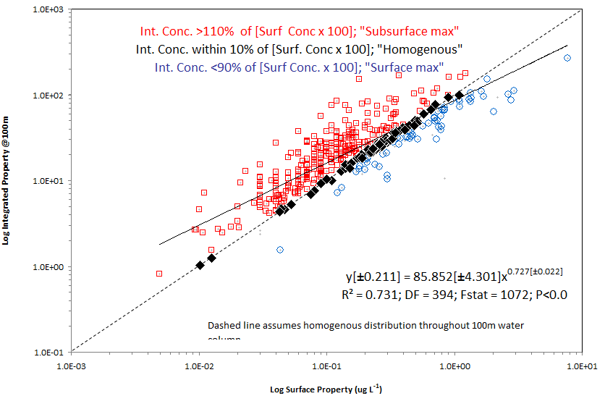
Example
10³
10²
10¹
10⁰
10⁻¹
100m Integrated Property (g m⁻²)
10⁻³ 10⁻² 10⁻¹ 10⁰ 10⁺¹
Surface Property (g m⁻³)
Balch et al. in prep
Oligo. Eutro.
Notes:
Hypothetical profiles of the concentration of a biogeochemical variable, all with the same integral concentration, but one has a subsurface max (red), one has a surface max (blue) and one is homogeneous. (black dash). Top optical depth visible to satellite noted.

Slide 11
Chlorophyll
10³
10²
10¹
10⁰
10⁻¹
Int. Chl. Conc. over 100m (mg m⁻²)
Exp = 0.727±0.022; r² =0.731; P<0.001
10⁻³ 10⁻² 10⁻¹ 10⁰ 10⁺¹
Surf. Chl. Conc (mg m⁻³)
Balch et al. in prep
Oligo. Eutro.

Slide 12
PIC
10³
10²
10¹
10⁰
10⁻¹
Int. PIC Conc. over 100m (mmol m⁻²)
Exp = 0.560±0.025; r² =0.482; P<0.001
10⁻³ 10⁻² 10⁻¹ 10⁰ 10⁺¹
Surf. PIC Conc (mmol m⁻³)
Balch et al. in prep
Oligo. Eutro.

Slide 13
Abundance of plated coccolithophores
10⁵
10⁴
10³
10²
Int. Cocco Conc. over 100m (x10⁶ cells m⁻²)
Balch et al. in prep
Exp = 0.708±0.028; r² =0.675; P<0.001
10⁻¹ 10⁰ 10¹ 10² 10³ 10⁴
Surf. Cocco. Conc (x10⁶ cells m⁻³)
Oligo. Eutro.

Slide 14
Vignette 2: Global PIC trends based on the 2-band/3-band algorithm
Post-doc Jason Hopkins

Slide 15
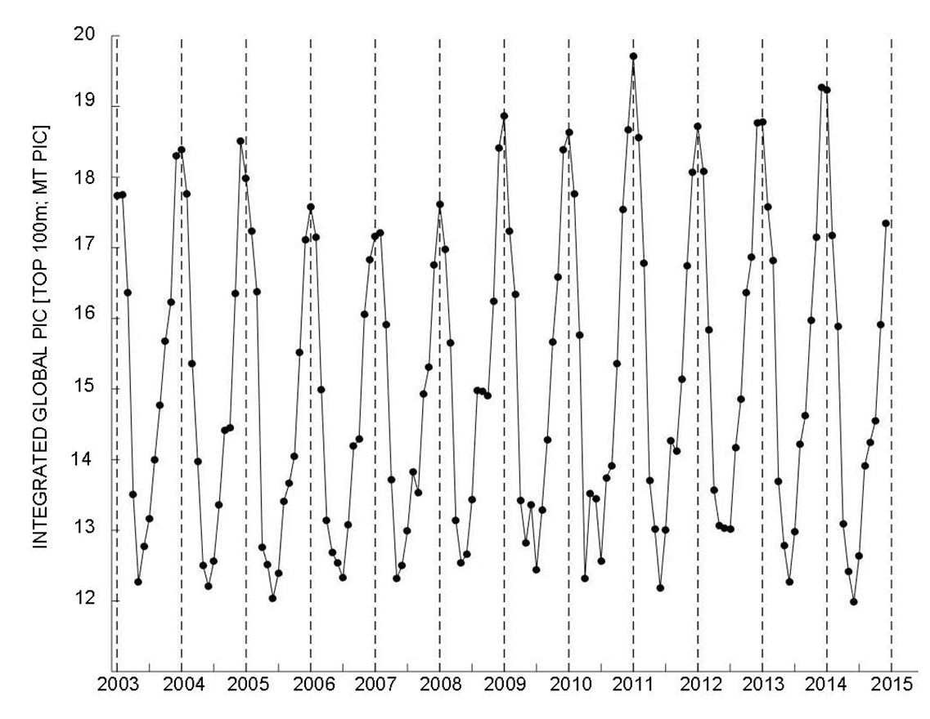
PIC standing stock
Using global PIC production of 1.6GT/y (Balch et al., 2007), avg TO of PIC is 4.6d!
Mean =
15.08±2.14 MT
Over top 100m
Time series of monthly average global PIC standing stock.
Hopkins et al. in prep
Notes:
Monthly global averages Based on M-Aqua 2014 reprocessing; Using an average global calcification rate of 1.6 GT PIC yr-1 (Balch et al, 2007) and a PIC export flux of 0.4 GT yr (Honjo, 2008) that equates to a turnover time of 4.6 days (cf. Balch et al. (2005) estimate of 6.86 days). 1.6GT =1600MT 1600-400=1200MT/y 1200/12 = 100MT/mon 15.08 M/T/ 100MT/mon = 4.6d

Slide 16
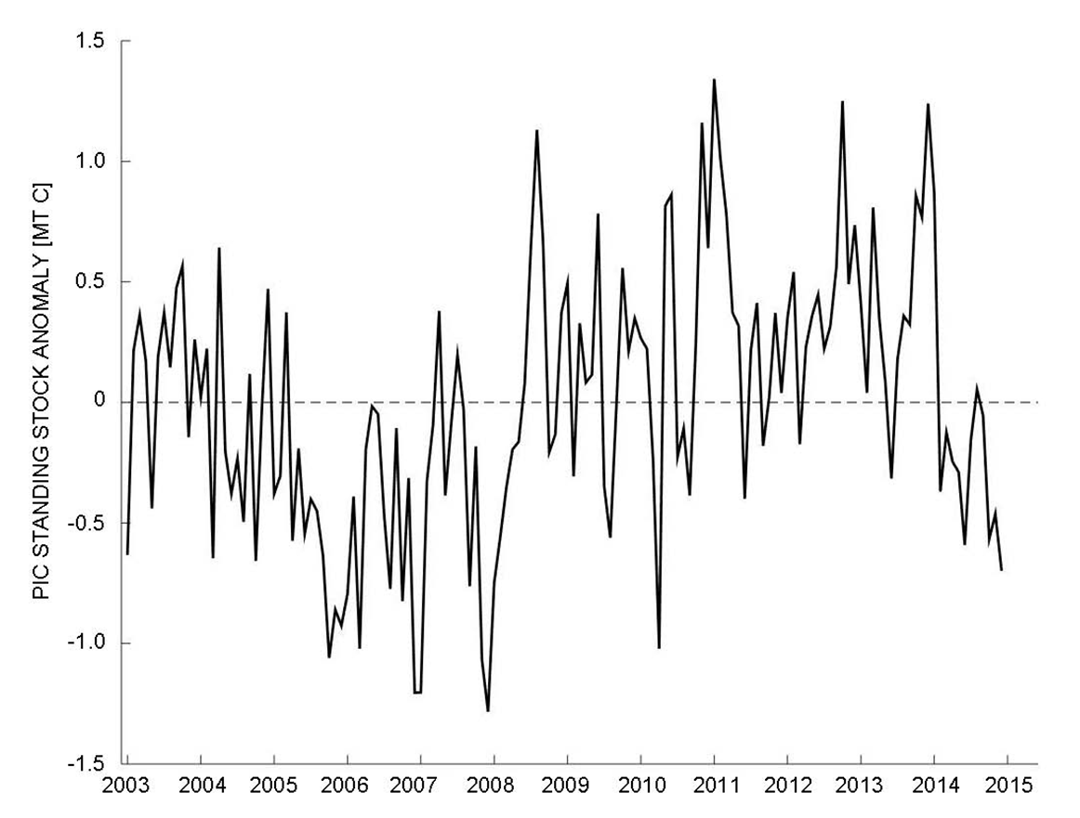
PIC standing stock
Global inter-annual variability in average monthly PIC standing stock
Hopkins et al. in prep
Notes:
Subtracting the observed monthly – climatological monthly for ‘03-’15. No correlation with NAO, ENSO, PDO, SOI. No single index explains significant variance. Might have expected since SO is driving global variability then the SOI might have been expected to show correlation with the global anomaly, but this was not the case.

Slide 17
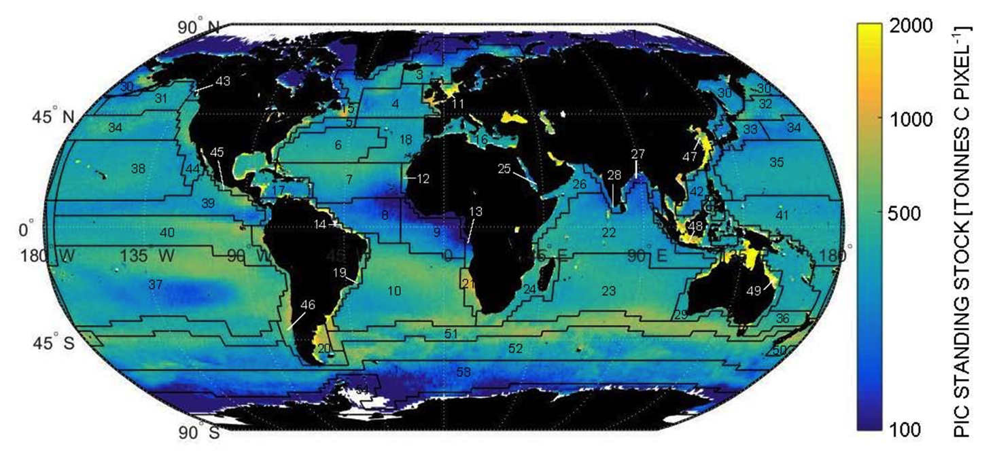
PIC standing stock
PIC Standing Stock
[metric tonne C per 1° x 1° area, top 100m]
Weighted, monthly PIC standing stock climatology
(2003-2014; all months averaged)
Hopkins et al. in prep
Notes:
Avg weighted monthly standing stock (avg annual/12) with a std dev of &&&&. Also weighted by # of observations. Multiply by 12 to get avg annual PIC standing stock to 100m

Slide 18
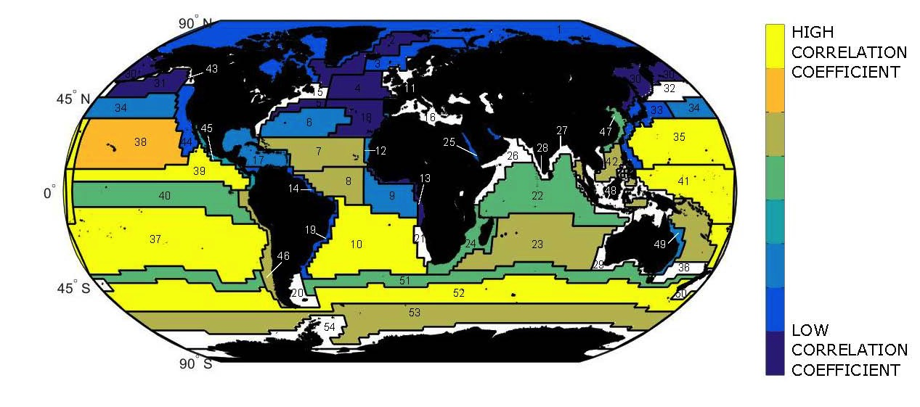
PIC standing stock and correlations to global PIC trends…
R² = 0.55
Southern Ocean and Subtropical gyres drive the global PIC cycle
R² = 0.15
Hopkins et al. in prep
Notes:
Take annual anomaly (global PIC anomaly), break into Longhurst provinces, calc ann anomaly per province. Then do correlation between 12 year global anomaly and 12y province anomaly, regress one against other to get correlation coefficient . Question about which provinces influence the global anomaly the most. SO, Southern Sub tropical gyres, highest correlation. White areas have nonsignificant correlation.

Slide 19
Do current velocities in the Southern Ocean relate to the Great Calcite Belt?
Balch et al., Global Biogeochemical Cycles, in press
Notes:
OSCAR Current velocities
The OSCAR product is a direct computation of global surface currents using satellite sea surface height, wind, and temperature. Currents are calculated using a quasi-steady geostrophic model together with an eddy viscosity based wind-driven ageostrophic component and a thermal wind adjustment. The model calculates a surface current averaged over the top 30m of the upper ocean.

Slide 20
Vignette #3: A new PIC algorithm based on a differencing approach
Post-doc Catherine Mitchell

Slide 21
The CI algorithm reduces atmospheric errors/ improves accuracy, especially at low chlorophyll concentrations

Slide 22
Color Index algorithm for PIC: Proof of concept
Differing PIC concentrations
Differing CHL concentrations
High PIC
Low Chl
$$R_{rs} : {sr}^{−1}$$
$$R_{rs} : {sr}^{−1}$$
High Chl
Low PIC
CI
CI
Wavelength : nm
Wavelength : nm
547
667
748
869
547
667
748
869
Patagonian Shelf, January 2008
Mitchell et al. in prep
Notes:
Remote sensing reflectance spectra from MODIS Aqua matched to field measurements of PIC and particulate absorption in the South Atlantic and on the Patagonian shelf, showing CI is sensitive to PIC but not to CHL (i.e. particulate absorption)

Slide 23
Relationship between PIC and color index
r² = 0.804
Relationship between field measurements of PIC and CI derived from MODIS Aqua $R_{rs}$ data, shown on both a linear (left hand plot) and logarithmic scale (right hand plot)
Mitchell et al. in prep

Slide 24
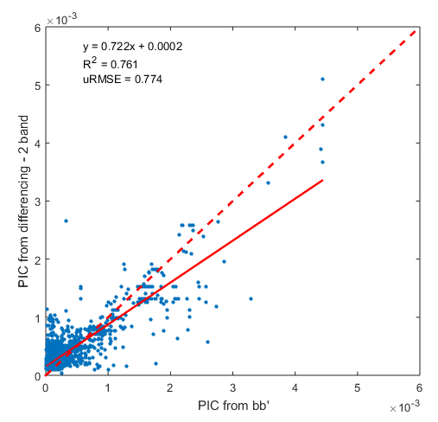
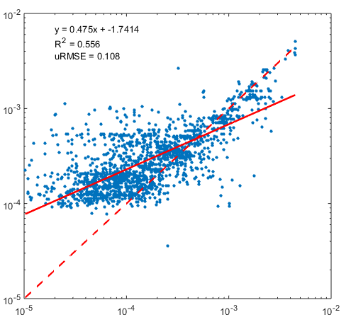
Validation of PIC_{CI} algorithm
a) PIC_{CI} algorithm
b) Current merged two and three band algorithm
r²=0.761
RMSE=0.774
r²=0.627
RMSE=0.930
PIC_{CI} : ${mol m}^{−3}$
PIC from two/three band algorithm : ${mol m}^{−3}$
r²=0.556
RMSE=0.108
r²=0.462
RMSE=0.132
PIC from field measurements : ${mol m}^{−3}$
PIC from field measurements : ${mol m}^{−3}$
Mitchell et al. in prep
Notes:
Performance of (a) the PIC_{CI} algorithm and (b) the current merged two and three band PIC algorithm (Balch et al., 2005 & Gordon et al., 2001), shown in both linear and logarithmic scales

Slide 25
Let’s compare three CI-style algorithms: 2-band (547, 667) , 3-band (547, 667, 869) and alternate 3-band (547, 667, 748nm)
CI-2 (547,667)
CI-3 (547,667,869)
r² =0.842
r² =0.848
r² =0.851
CI-3 (547,667,748)

Slide 26
Application to MODIS Aqua data
a) PIC from PIC_{CI} algorithm
b) PIC from current merged two and three band algorithm
A
B
C
c)
current algorithm
(a) and (b) Global maps of the average PIC concentration for December 2015 (A and B) and (C) the distribution of the PIC concentration in each of the maps
PIC_{CI}
2B/3B
PIC_{CI}
Mitchell et al. in prep

Slide 27
Summary
Performance of MODIS-A, MODIS-T and VIIRS for PIC all similar.
We can now statistically account for sub-surface PIC for global imagery, applicable across all levels of productivity
A new analysis of global PIC shows mean PIC standing stocks of 15.08+/- 2M tons. Anomolies show coherent change but not correlated to NAO, ENSO, PDO, SOI; Southern ocean drives the global trend in PIC
PIC concentrations in Great Calcite Belt correlated to altimetry-based current velocities
New two-band CI algorithm for PIC shows good promise, with improved explained variance and accuracy

Slide 28
The future?
Folks, we’re going to make the ocean great again!s

Slide 29
The Future?
Prospects for doing BGC from space are good when we can account for 56-86% of variance of 100m integrated property based on surface measurements in top optical depth. Challenge remains to relate the global variability to global climatological cycles
Encouraging for NASA EXPORTS program!
New differencing algorithm for PIC needs to be applied as an experimental product
Thank you!

Slide 30
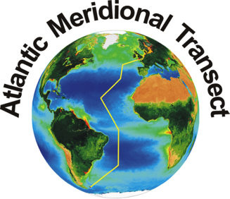
Acknowledgments
A. Wyeth, Bigelow Laboratory-
AMT24 SEMs
Atlantic Meridional Transect
Phil Boyd, Univ. Tasmania-
R/V Tangaroa 1109
NASA- Funding, cruises
NSF- Funding, cruises

Slide 32
Vignette #4: Using MISR to estimate PIC
Using MODIS Atmospheric correction
Propagated to MISR nLw (NADIR only)
Apply to 2-band PIC algo.
Higher resolution (275m)

Slide 33
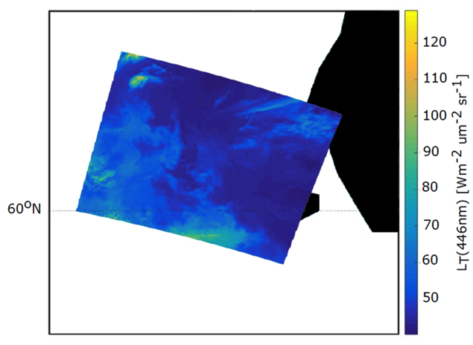
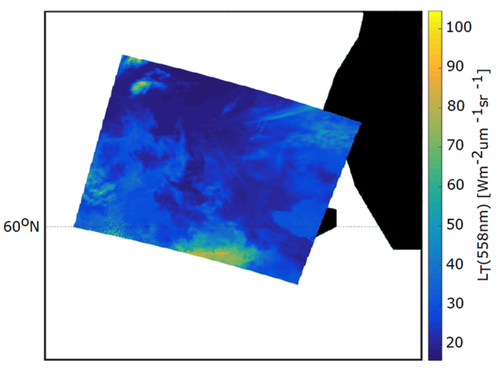
MISR 446nm
MISR 558nm
a
b
MISR L_{T} from September 2014 in the Bering Sea (a) 446 nm; (b) 558 nm (Nadir TOA)
Hopkins et al. in prep
Notes:
Images from two blocks, stitched together using spline average (which blurs. At native resolution)

Slide 34
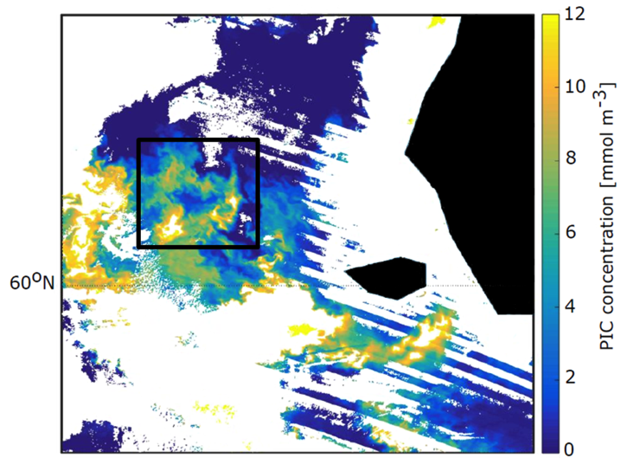
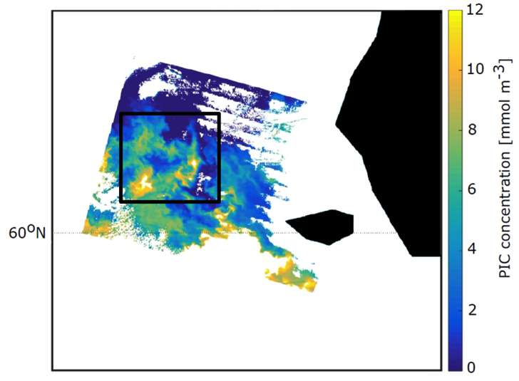
MODIS
1km resolution
MISR
275m resolution
a
b
(a) MODIS PIC from September 2014 in the Bering Sea (b) MISR PIC derived using co-located MODIS atmospheric correction parameters
Hopkins et al. in prep
Notes:
MODIS in SEADAS from L1B to L2-> to get atmos parameters which then applied to standard eqn for Lw from MISR Lt, propagated to MISR nLw (NADIR only) then applie to 2-band PIC algo. Note, MODIS 1km atmos correction applied to 4x275m MISR pixels equally.

Slide 35
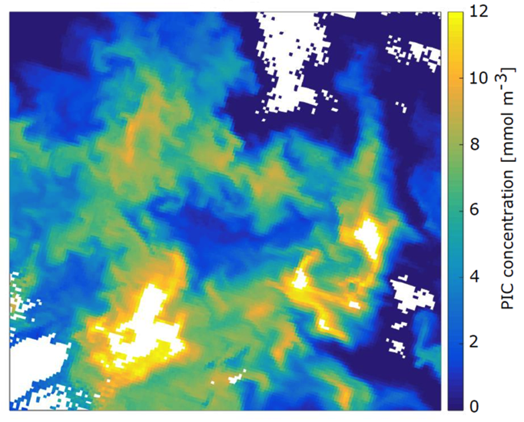
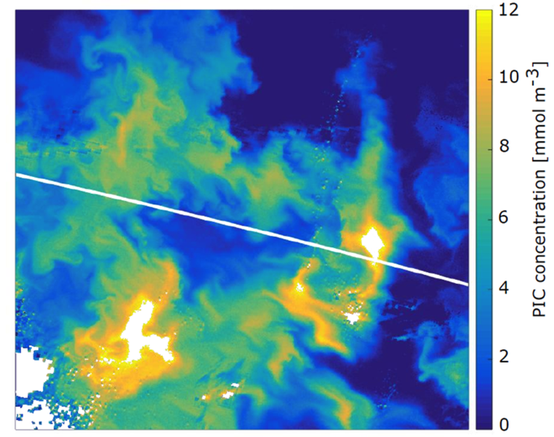
MODIS PIC
1km resolution
MISR PIC
275m resolution
a
b
Detail from boxed area in previous figure (a) 1 km MODIS PIC pixels (b) 275 m MISR PIC pixels (line is boundary of MISR “blocks”)
Hopkins et al. in prep
Notes:
MODIS is 2B/3B No spline used in MISR to avoid blurring at high res (which shows line demarcation between two blocks

Slide 36
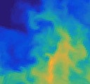
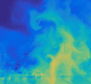
MODIS
1km resolution
MISR
275m resolution
a
b
Detail from boxed area in previous figure (a) 1 km MODIS PIC pixels (b) 275 m MISR PIC pixels (line is boundary of MISR blocks)
Hopkins et al. in prep
Notes:
MODIS is 2B/3B No spline used in MISR to avoid blurring at high res (which shows line demarcation between two blocks

Slide 37
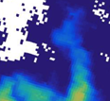
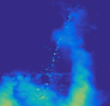
MODIS
1km resolution
MISR
275m resolution
a
b
Detail from boxed area in previous figure (a) 1 km MODIS PIC pixels (b) 275 m MISR PIC pixels (line is boundary of MISR blocks)
Hopkins et al. in prep
Notes:
MODIS is 2B/3B No spline used in MISR to avoid blurring at high res (which shows line demarcation between two blocks

Slide 38
POC
POC
10⁴
10³
10²
10¹
Int. POC Conc. over 100m (mmol m⁻²)
Exp = 0.617±0.028; r² =0.588; P<0.001
10⁻¹ 10⁰ 10¹ 10²
Surf. POC Conc (mmol m⁻³)
Oligo. Eutro.

Slide 39
Biogenic Silica
10⁵
10⁴
10³
10²
10⁺¹
10⁰
10⁻¹
10⁻²
10⁻³
Int. BSi Conc. over 100m (mmol m⁻²)
Exp = 0.863±0.015; r² =0.848; P<0.001
10⁻⁵ 10⁻⁴ 10⁻³ 10⁻² 10⁻¹ 10⁰ 10¹ 10² 10³
Surf. BSi Conc (mmol m⁻³)
Oligo. Eutro.

Slide 40
Top Optical Depth/100m Integral
Variance Explained from Top Optical Depth
Balch et al. in prep

Slide 41
Overview
A new method for estimating particulate inorganic carbon (PIC) concentrations from remote sensing reflectance has been developed.
Using an extensive global dataset of PIC, the reflectance difference approach of Hu et al. (2012) was applied to derive a relationship between PIC and the color-index (CI), hereafter referred to as the PIC_{CI} algorithm
The wavelengths used here in deriving the color-index differ from those used in the Hu et al. (2012) chlorophyll (Chl) algorithm to limit the affect of Chl and CDOM:
$$CI=R_{rs}\left(λ_{2}\right) − \left[R_{rs}\left(λ_{1}\right)+ \frac{λ_{2}−λ_{1}}{λ_{3}−λ_{1}}\left(R_{rs}\left(λ_{3}\right) −R_{rs}\left(λ_{1}\right)\right)\right]$$
Hu et al | 443 | 547 | 667
This study | 547 | 667 | 869

Slide 42
Summary on vertical distributions…
Statistical distributions of Biogenic Silica, PIC, coccolithophore concentration, POC and chlorophyll are characterized over the top 100m:
subsurface maxima, in oligotrophic waters,
relatively more homogeneous distributions in mesotrophic waters
surface maxima in eutrophic waters.
Greater exponent-> greater variance explained… Future???

