Slide 1
Cloud Top Properties: Challenges in Extending
MODIS to VIIRS
Bryan A. Baum¹, W. Paul Menzel¹, Ray Garcia¹, Eva Schiffer¹
Irina Gladkova² and Fazlul Shahriar²
Andrew Heidinger³
¹Space Science and Engineering Center, University of Wisconsin-Madison
²City College of New York
³NOAA/NESDIS/STAR, UW-Madison
Main topics:
Brief report on 1ST International Cloud Working Group
Construction of 13.3-µm channel based on VIIRS & CrIS data fusion
Development & application of new Level-3 gridding software
Cloud top heights derived with/without fusion channel
Joint MODIS-Suomi NPP Science Team Meeting
June 2016

Slide 2
The 1st International Cloud Working Group
Hosted by Jerome Riedi in Lille, France in May 2016
http://www-loa.univ-lille1.fr/workshops/ICWG2016
Topical Groups
Severe weather & nowcasting applications
Cloud and aerosol masking
Cloud models for remote sensing
Assessment of cloud climate data records
Retrieval uncertainties
Intercomparison of Level-2 cloud parameters
Critical contribution of spaceborne active sensors for validation
Cloud parameter comparison effort is important and needs agency attention
2nd GEWEX cloud climatology assessment is being initiated

Slide 3
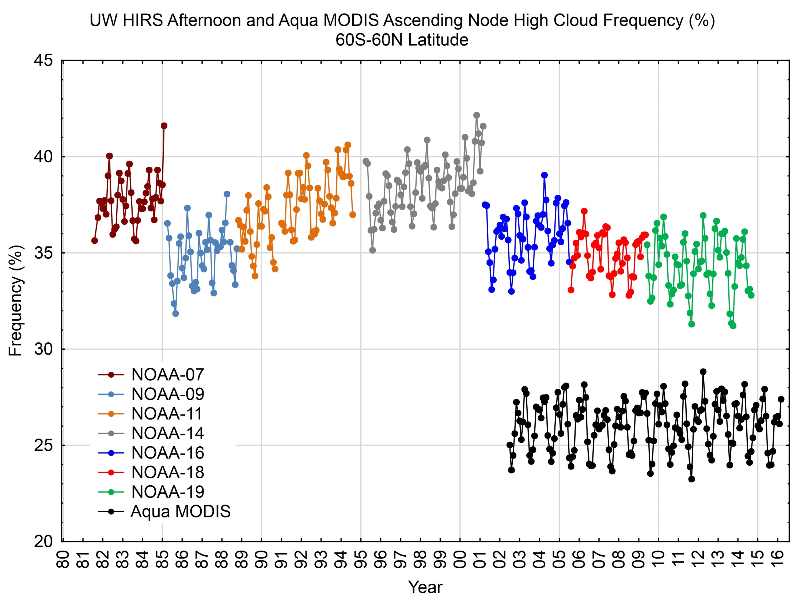

Slide 4
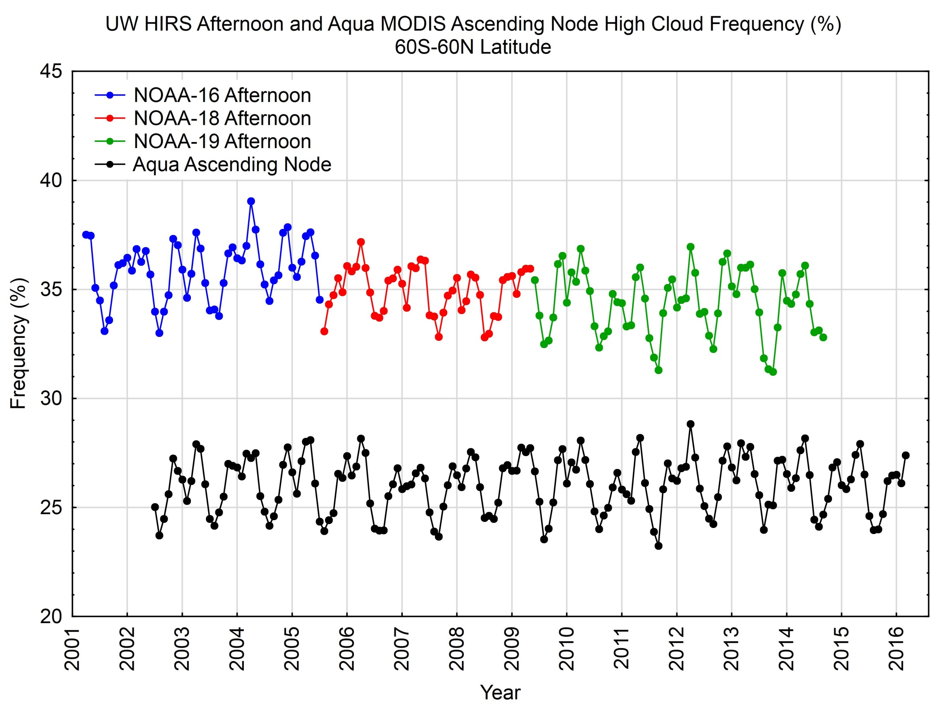

Slide 5
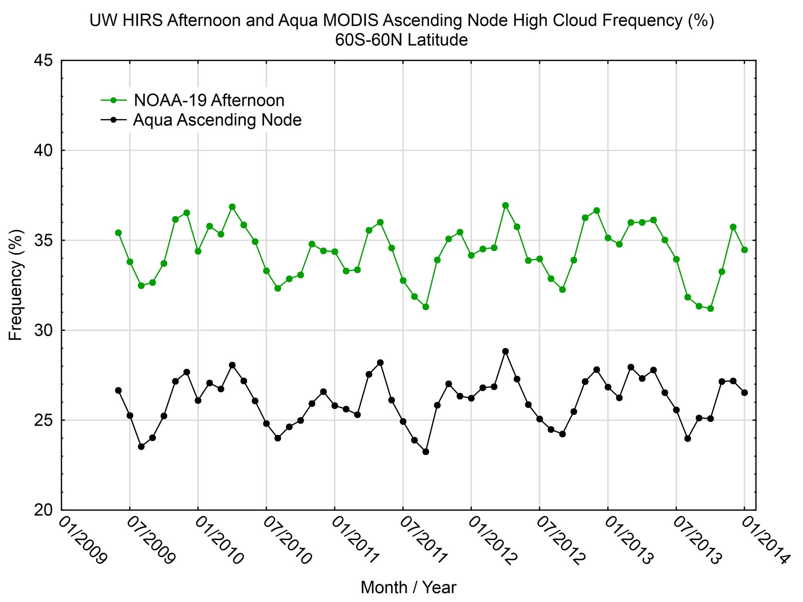

Slide 6
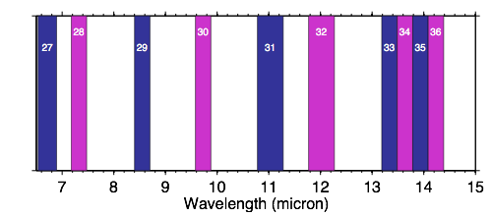
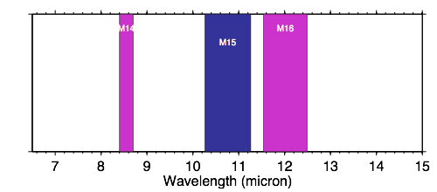
VIIRS and MODIS IR spectral bands
MODIS
VIIRS: M bands
Notes:
Most noticeable is the lack of absorbing (WV or CO2) channels on VIIRS. Because these are used in cloud top height and effective emissivity retrievals, bringing in CrIS data will be essential. The impacts in subtle spectral response differences for the 8.5, 11, and 12 micron channels will need to be modeled and looked at.

Slide 7
Different Approaches to Linking Imager and Sounder
Approach 1: Perform analysis for sounder FOV as first step
Use CTP from sounder as first guess for imager-based optimal estimation
Approach 2: Data fusion statistical approach to construct 13.3 µm at imager resolution
Use combination of IR window and 13.3-µm channels in optimal estimation
Potential application to other polar-orbiting platforms
Sensor | Swath Width (km)
AVHRR | 2800
HIRS | 2200
MODIS | 2330
AIRS | 1650
VIIRS | 3040
CrIS | 2200
AVHRR | 2800
HIRS/IASI | 2200
❯
NOAA
❯
Aqua
❯
S-NPP
❯
Metop-A/B

Slide 8
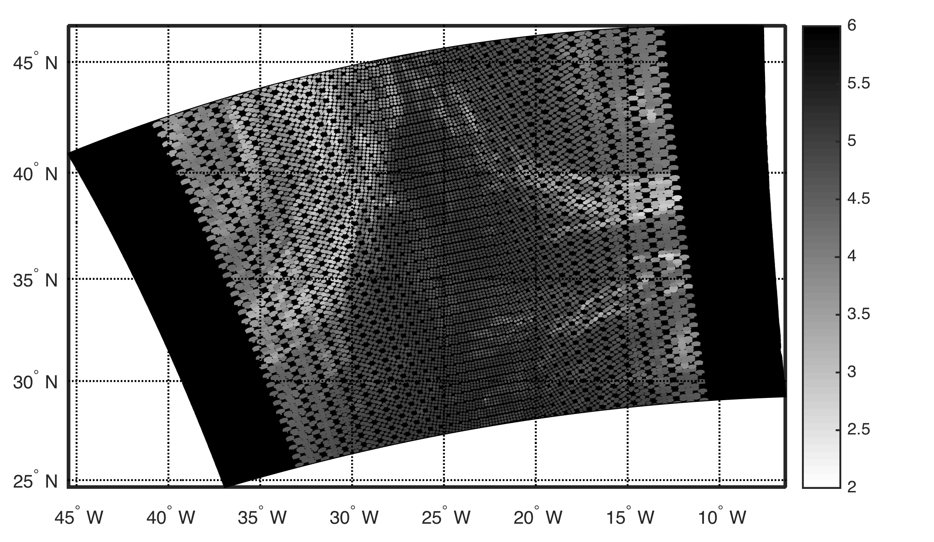
CrIS FOVs Superimposed on VIIRS Swath
W m⁻² str⁻¹ µm⁻¹
Scene over eastern Atlantic Ocean on April 17, 2015 at 1440 UTC
Notes:
28 Aug 2012 over Korea
8

Slide 9
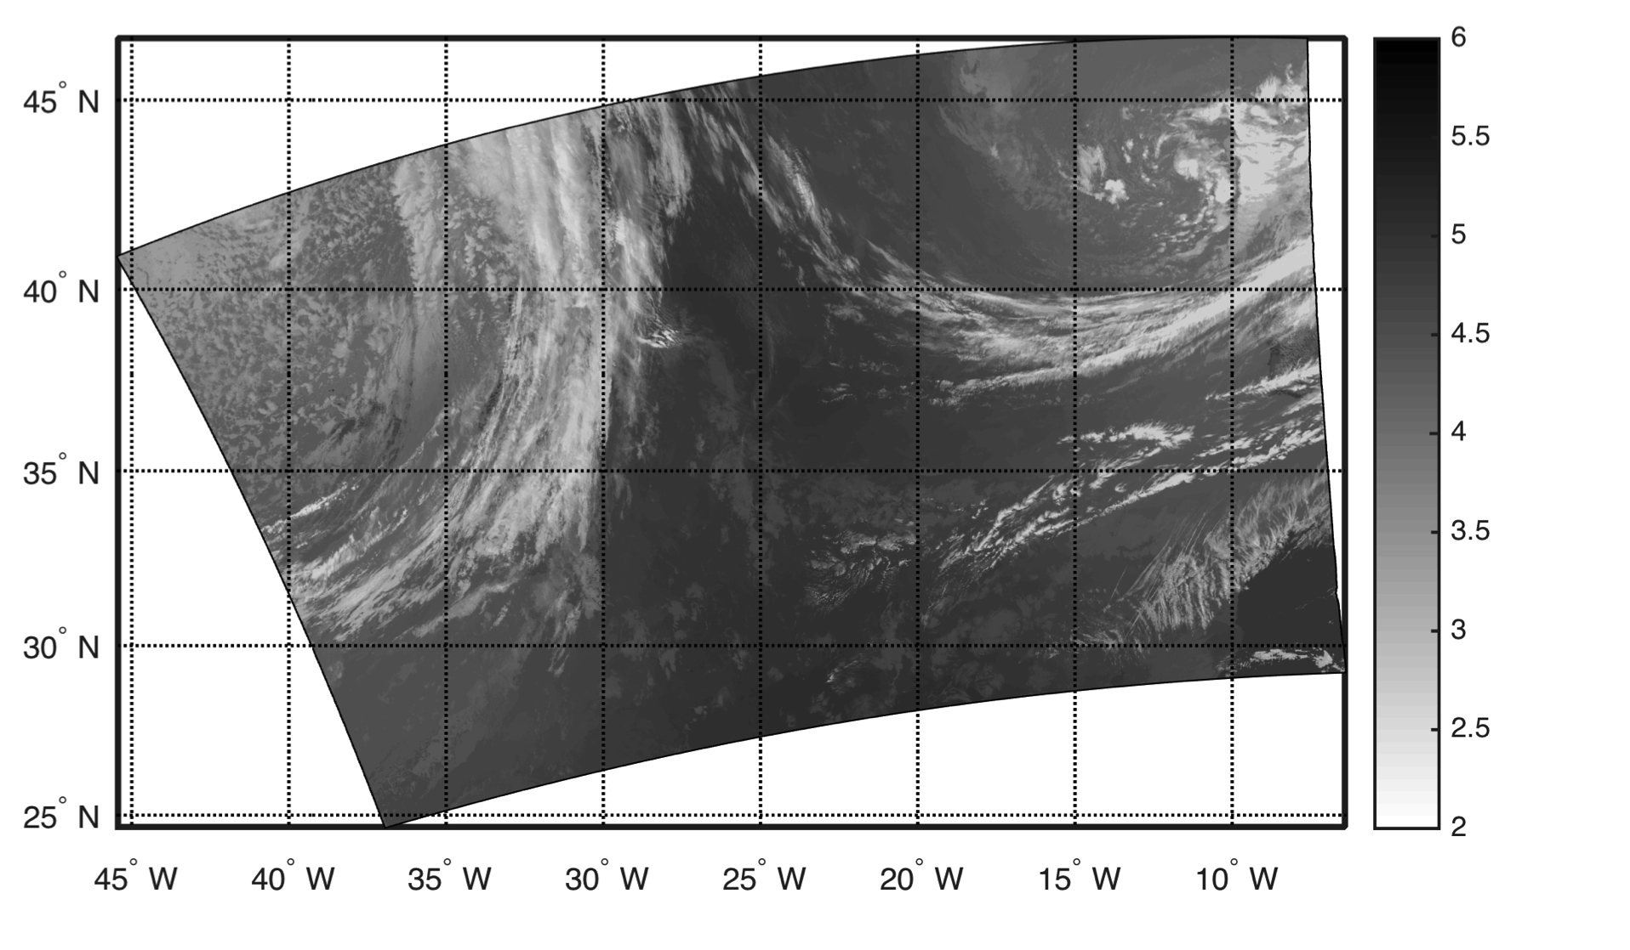
VIIRS Constructed 13.3-µm Channel
W m⁻² str⁻¹ µm⁻¹
Notes:
28 Aug 2012 over Korea
9

Slide 10
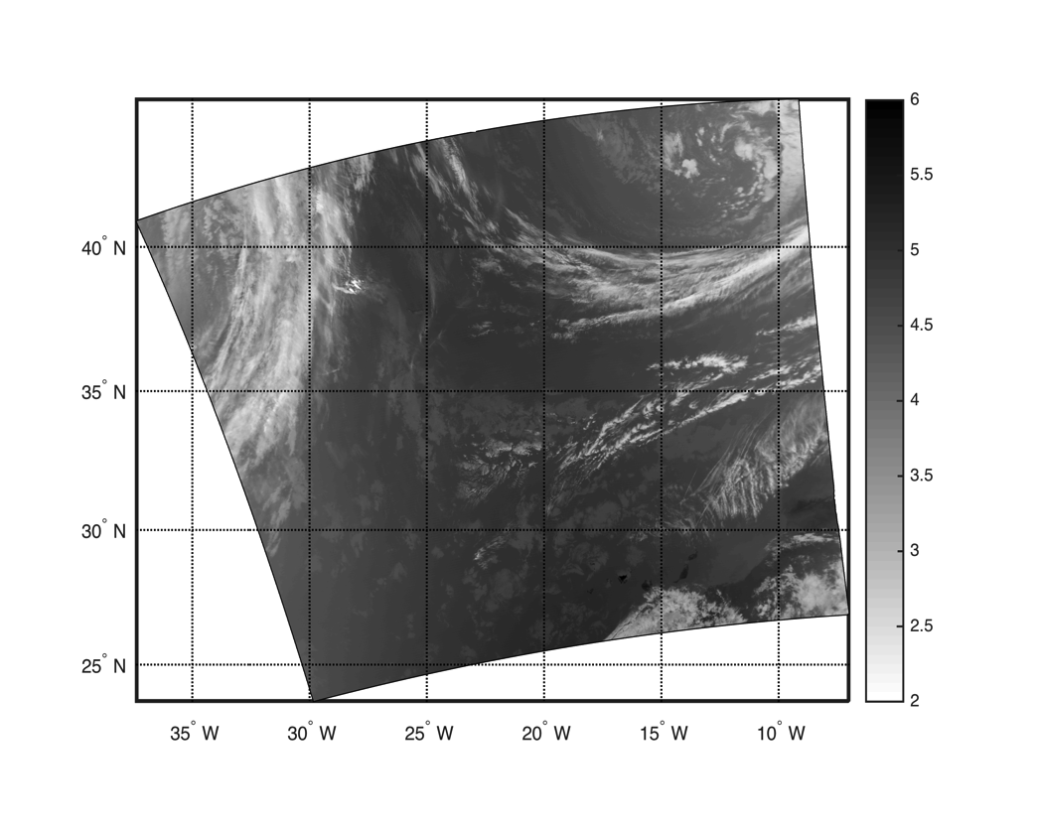
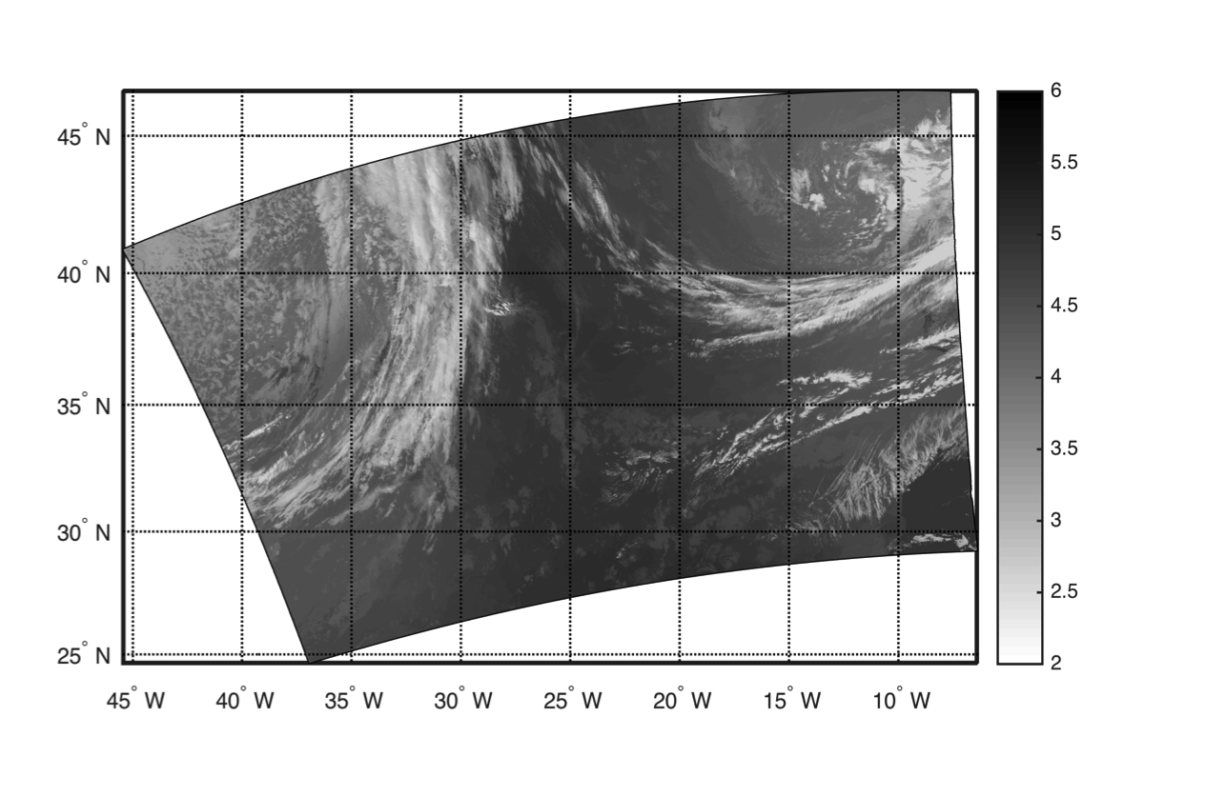
Comparison of MODIS to VIIRS 13.3-µm Radiances
April 17, 2015
MODIS
VIIRS
W m⁻² str⁻¹ µm⁻¹
W m⁻² str⁻¹ µm⁻¹
1435 UTC
1440 UTC
Notes:
28 Aug 2012 over Korea
10

Slide 11
About the statistical construction approach
Pros:
No striping, noise, or other artifacts
Response function same as for MODIS-Aqua
Hyperspectral IR data are well calibrated
Do not have to account for gaps between sounder FOVs
Cons:
Radiance differences increase outside of sounder swath
Requires aligning imager and sounder granules
Radiance differences are about 1-2% of the total (~1˚K/typical scene)
Note: this approach works only for the 13.3-µm channel – it can not be used to construct any of the IR water vapor channels or a different 15-µm CO₂ channel.
Question: how does this approach work with global MODIS data?
Notes:
28 Aug 2012 over Korea
11

Slide 12
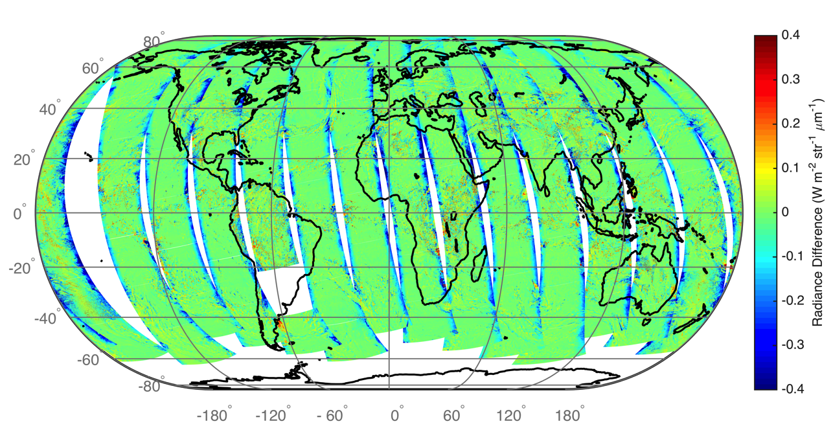
Daytime for April 17, 2015
(Real-Constructed) MODIS 13.3-µm Radiance Differences
Over all Scan Angles

Slide 13
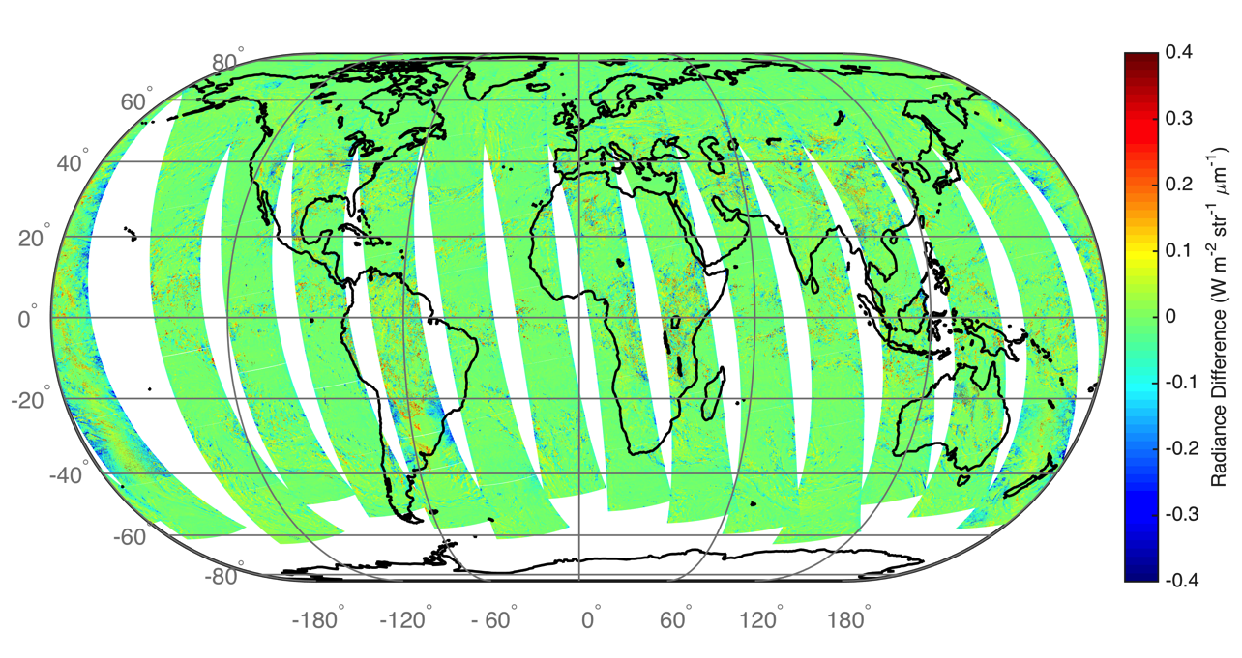
Daytime for April 17, 2015
(Real-Constructed) MODIS 13.3-µm Radiance Differences
Swath limited to Sensor Zenith Angle ≤ 58˚

Slide 14
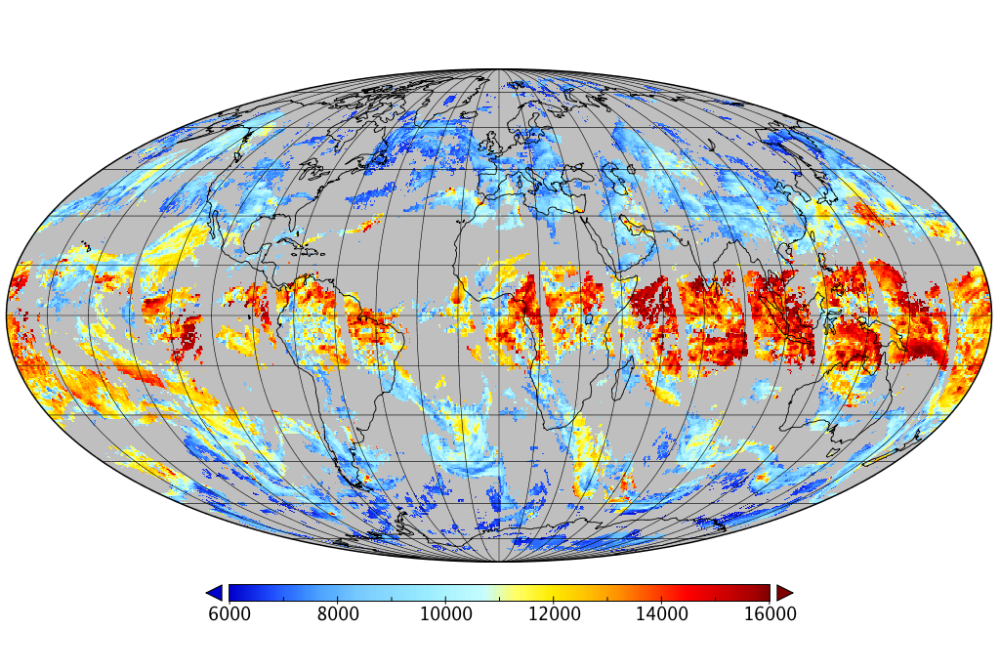
MODIS C6 High-cloud-only Heights for March 29, 2013
Meters

Slide 15
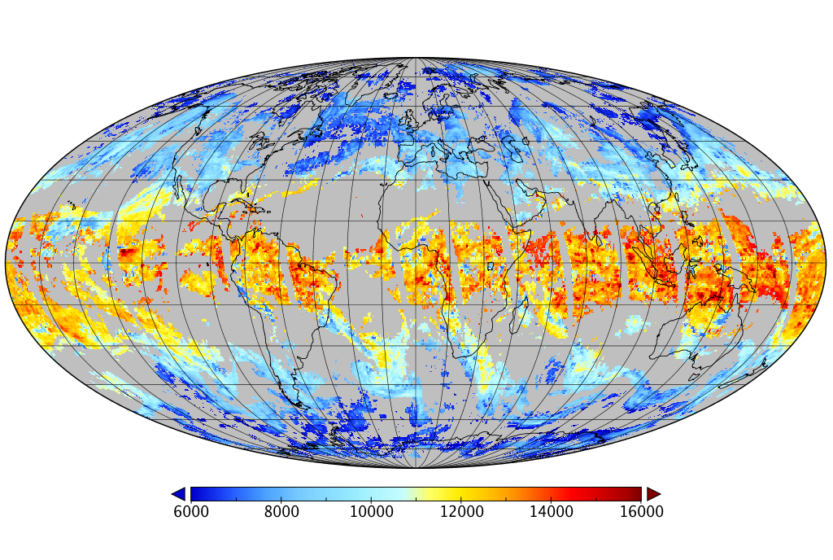
ACHA applied to MODIS
OE based on 11/12/13.3-µm bands
Meters

Slide 16
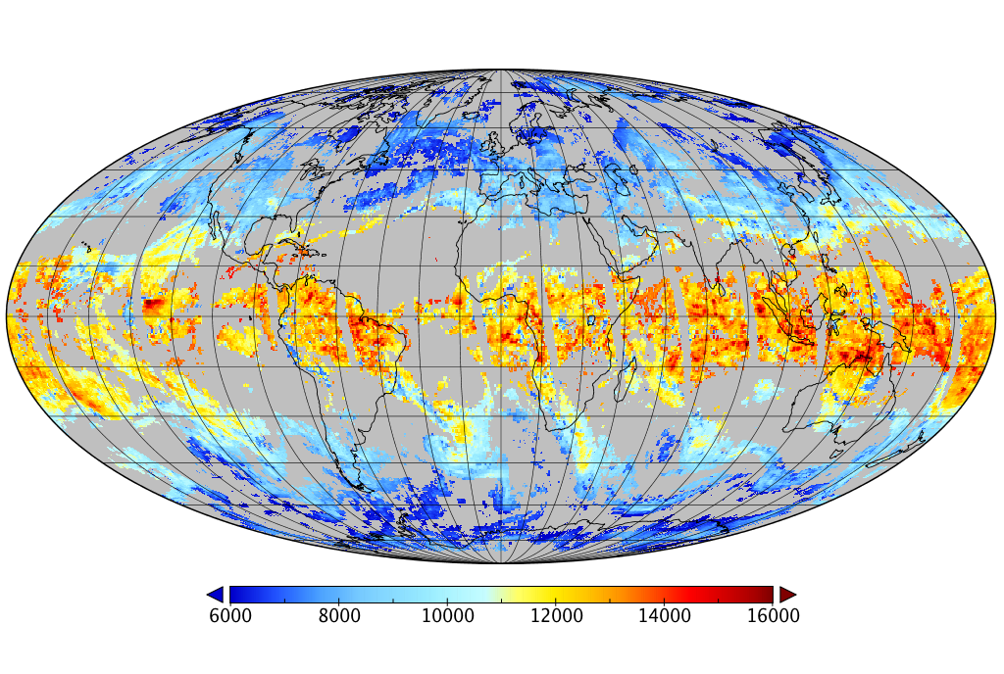
ACHA applied to MODIS
OE based on 11 &12-µm bands
Meters

Slide 17
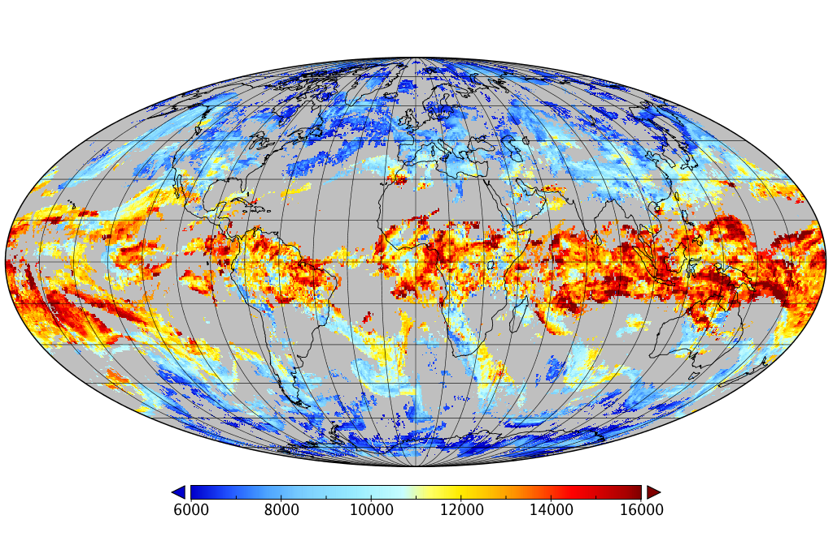
ACHA applied to VIIRS
OE based on 11 &12-µm bands
Meters

Slide 18
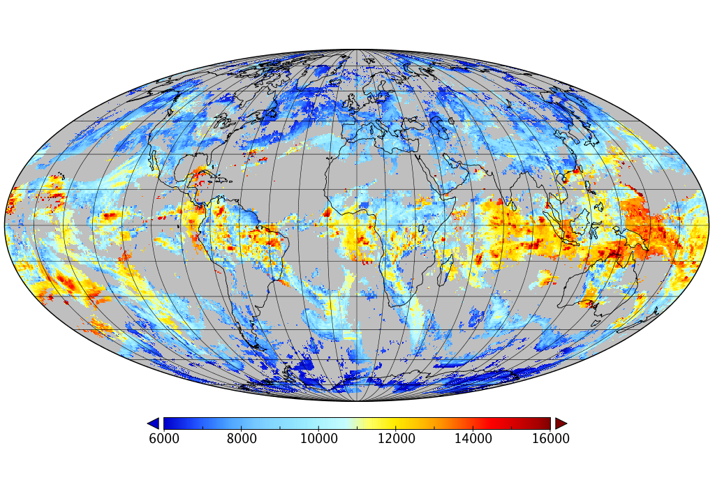
ACHA applied to VIIRS
OE based on 11/12/13.3-µm bands and Aggregate Ice Particle
Meters

Slide 19
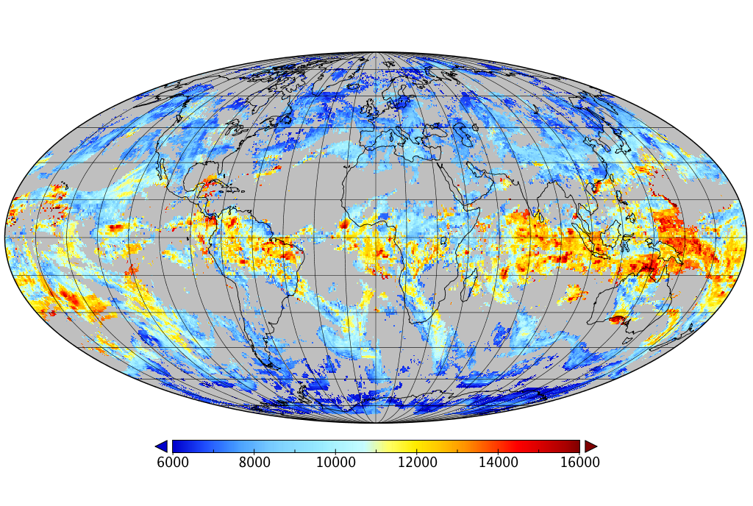
ACHA applied to VIIRS
OE based on 11/12/13.3-µm bands and Empirical Ice Model
Meters

Slide 20
ACHA applied to MODIS
OE based on 11/12/13.3-µm bands
Meters

Slide 21
In summary
Cloud product continuity assumes the ability to demonstrate that there is consistency over space and time in products from different sensors and teams…even between different versions by the same team. Several issues in the cloud climate record are highlighted by the ICWG for mitigation.
Our approach fuses data from two sensors (imager + sounder) to build a high spatial resolution 13.3-µm band.
There are differences between MODIS C6 (physical retrieval) and OE CTHs, and also between VIIRS OE and MODIS OE – time to roll up our shirtsleeves.
Suggest applying eventual VIIRS OE approach to the MODIS Terra/Aqua record to arrive at a continuity CTH product. Note that this would likely be a separate effort from the current Collection process.

Slide 22
Atmosphere Team Breakout Session
Atmosphere SIPS summary
Several PI talks
PI summaries
Discussion of issues (we’ll get through as many as possible)
a. request for product descriptions
b. develop VIIRS L1B analog of the MYD02SSH (5-km sub-sampled data)
c. MODIS Atmosphere 6.1 reprocessing discussion (impact of L1B changes, etc)
d. VIIRS and CrIS 6-min Level 1b concerns
e. missing or additional ancillary data requests
f. Level 3 plans
g. ATBD documentation
h. process for SIPS product transfer to LAADS
i. product validation

