Slide 2
VIIRS Atmosphere Team
Aerosols
  Deep Blue and Dark Target teams are making good progress and are on target for product generation this year
  Products will be similar to those from MODIS
Clouds
  MVCM: MODIS-VIIRS Cloud Mask needs to become a beta product for testing by entire team
  Cloud product will be quite similar to MOD06 with exception of cloud-top property algorithm (two parallel investigations, teams working together)
  Gridded cloud product “baseline” will be similar to MOD08 (offering to do for other MODIS-like products)
  Discussion of entire cloud team moving to GEOS product (moving away from GDAS)

Slide 3
VIIRS TPW Status Report
Eva Borbas (PI), Zhenglong Li, Paul Menzel, and Laura Dobor
University of Wisconsin-Madison
Validation for 2012-2015 with TPW from ground-based GPS network, MWR, and RAOBs
VIIRS TPW L2 algorithm/products based on 6 min granules
  Hole filling
  Smoothing
  Algorithm delivered
Granule and one day global validation using MYD07
Integrated at SIPS for global processing
Working on L3 algorithm as well as ATBD

Slide 4
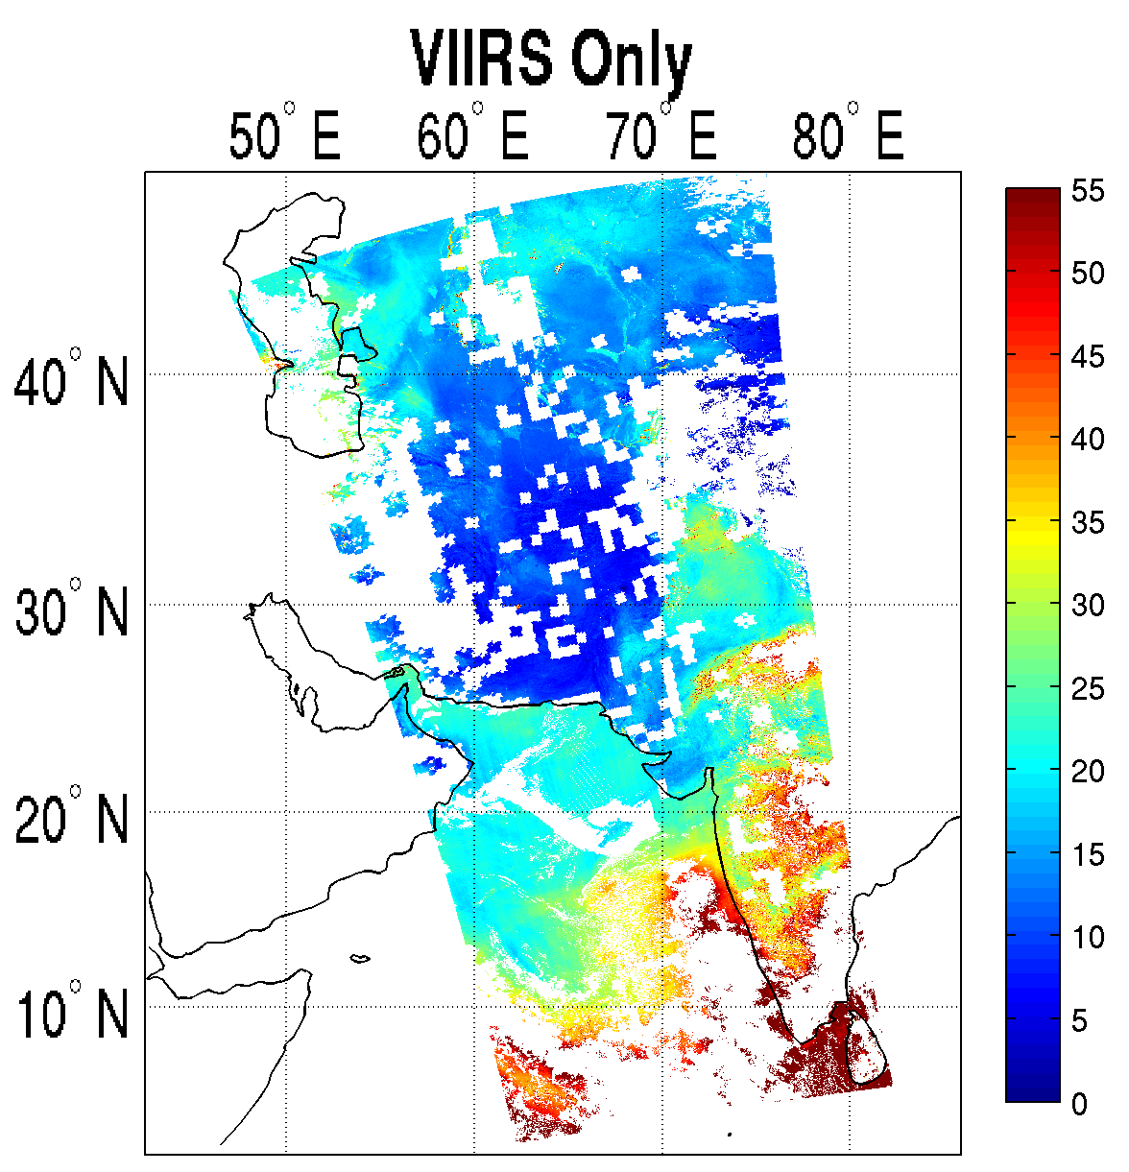
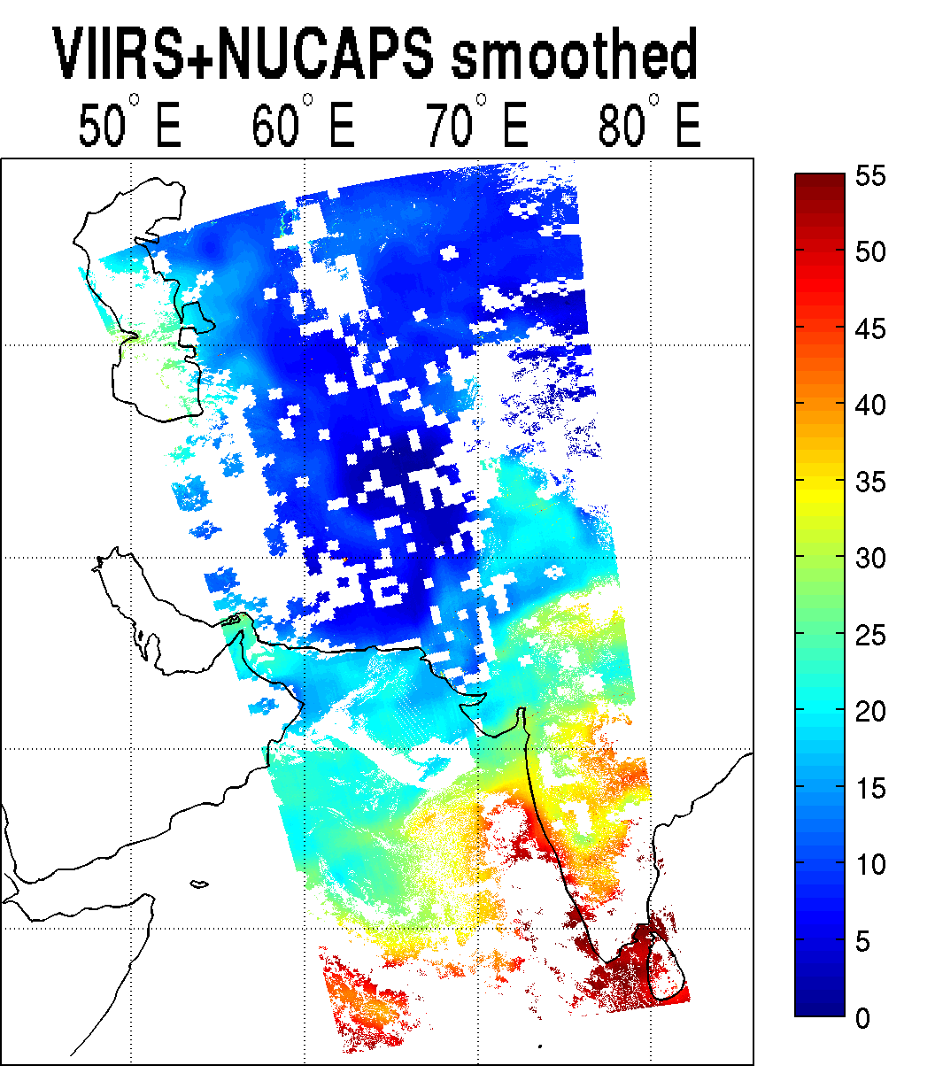
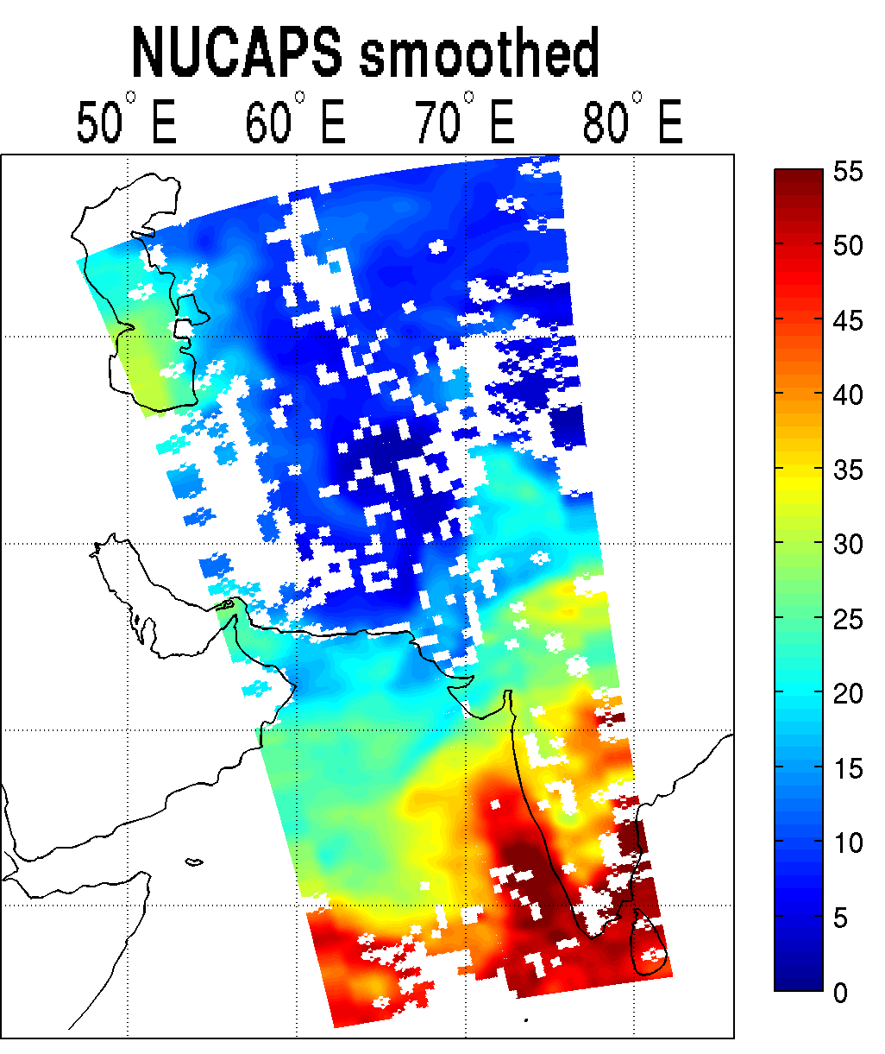
Retrieval comparison
Unit: mm
Retrieval Comparison
0842~0854 UTC
10/15/2014
NUCAPS

Slide 5
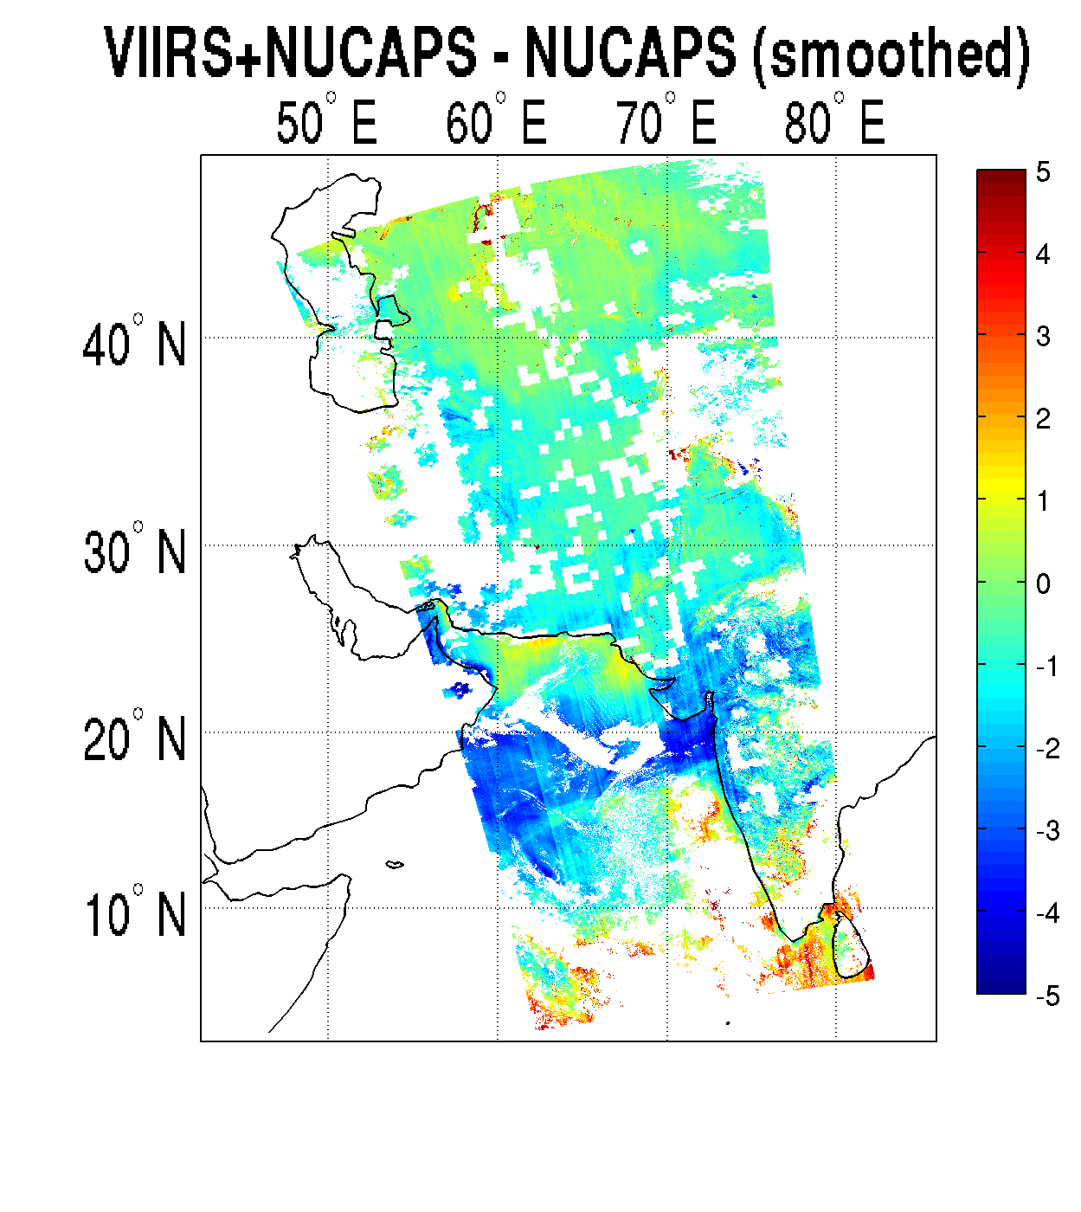
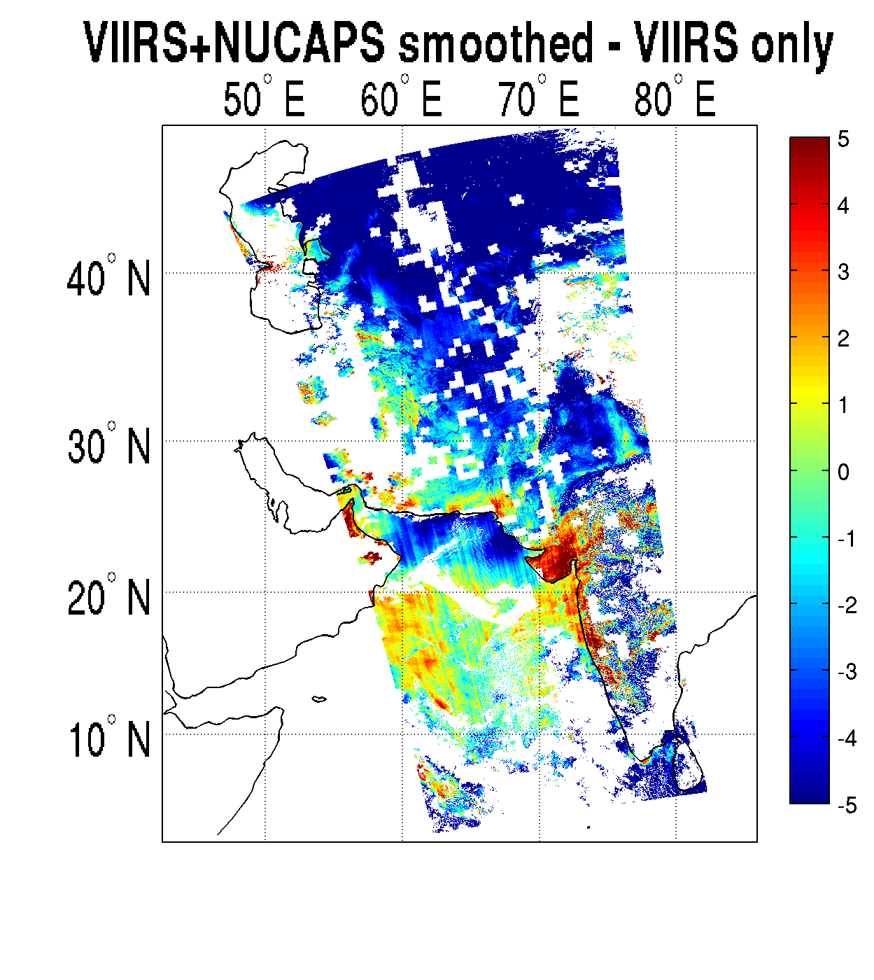
Difference Images
Unit: mm

Slide 6
VIIRS Nighttime Lights Development Update
Kim Baugh and Chris Elvidge (NOAA)
A nighttime lights composite is made to serve as a baseline of persistent light sources.
Composites are made as an average of the highest quality nighttime lights imagery over desired time period – usually monthly or annually.
“Stable Lights” composites have ephemeral light sources and non-light (background) areas are removed from a composite.
EOG group is producing current monthly cloud-free/no-moon DNB nighttime lights composites and is doing algorithm development to turn these in to Stable Lights composites.
Products still generated using IDPS VIIRS granules; need to switch to NASA 6-min granules
Products are distributed by NOAA

Slide 7
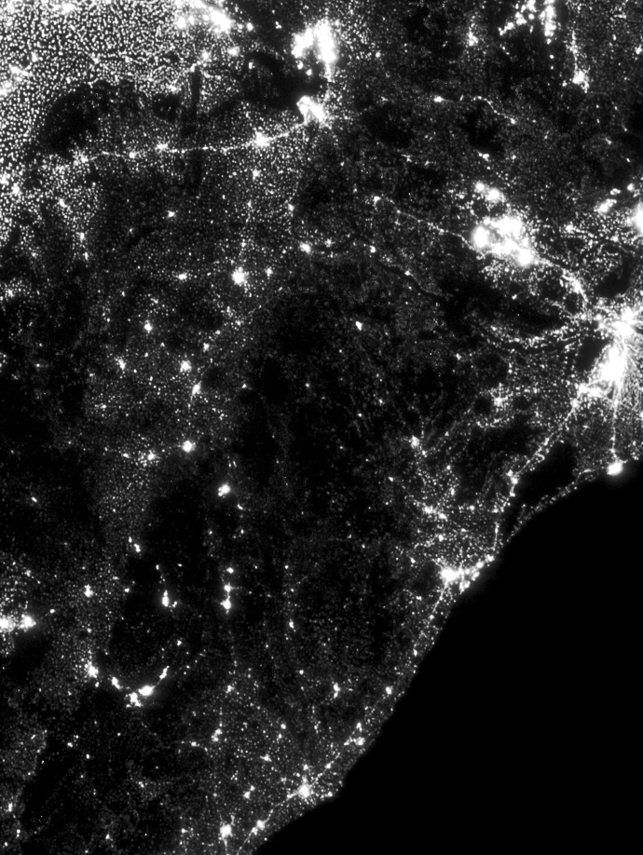
DNB Ephemeral Lights: Before Outlier Removal
In this example there are regions with fire activity

Slide 8
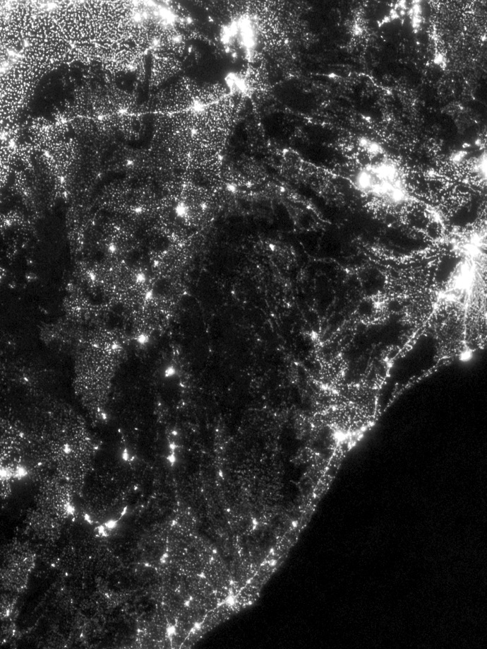
DNB Ephemeral Lights: After Outlier Removal
Notice how regions with fire activity return to background radiance levels after outlier removal

Slide 9
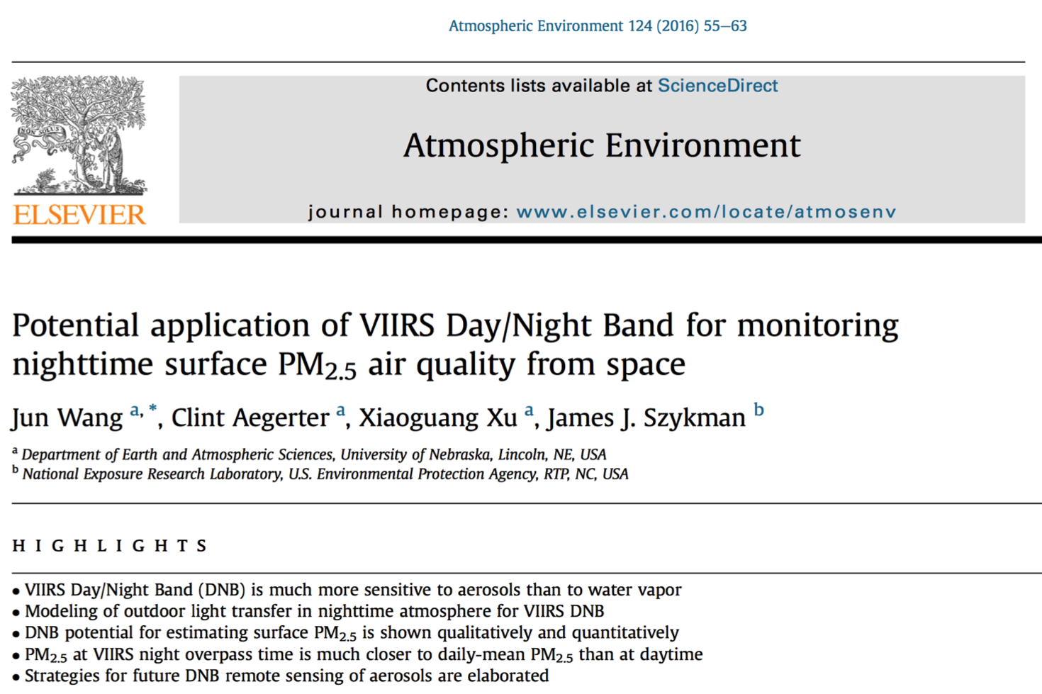
Application of DNB for air quality and fire monitoring
Jun Wang and colleagues

Slide 10
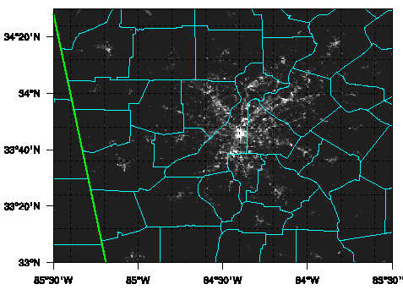

NAAQS uses daily and annual averages of PM_{2.5}
Can we use DNB to estimate surface PM_{2.5} at night?
At night, aerosols are often mixed in a shallow nocturnal boundary layer.
Retrieval of AOD from DNB is still in its infancy; preliminary work include Zhang et al. (2008) and Johnson et al. (2013).
We like to make a first attempt to apply DNB for night time PM_{2.5} air quality.
Aug – Oct 2012. Focus area: Atlanta
PM_{2.5}: 5 ug/m³
PM_{2.5}: 13 ug/m³
VIIRS DNB, 7 Sep. 2012
VIIRS DNB, 8 Sep. 2012

Slide 11
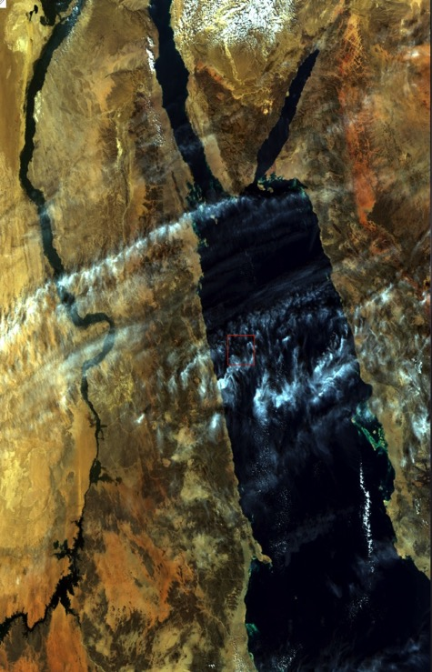
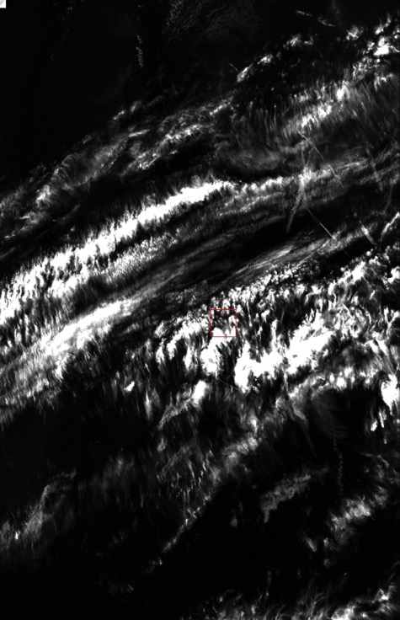
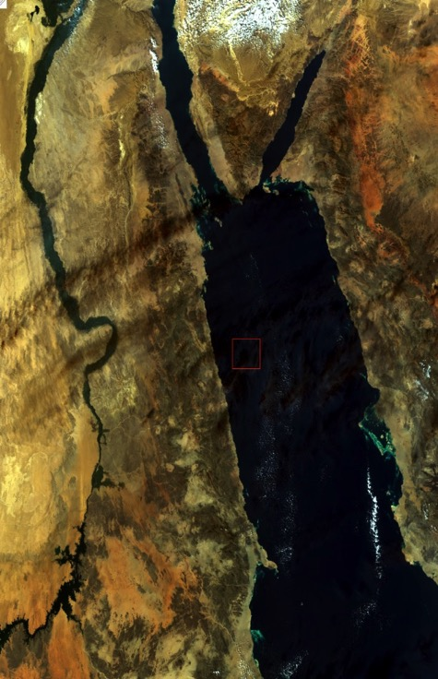
Example of VIIRS Cirrus Detection & Cirrus Removal Over the Red Sea
Bo-Cai Gao and Rong-Rong Li
VIIRS RGB Image
Cirrus Reflectance Image
Cirrus-Removed RGB Image
No horizontal striping effects are introduced in the cirrus-corrected RGB image.

Slide 13
Process for Level-2 metadata generation
This was a rather onerous process for MODIS cloud/aerosol products back in the day
Liam Gumley (Atmosphere SIPS) presented an approach to easing this process for algorithm developers
    Approach is to build a template with the necessary global and scan-line specific attributes; then fill in the necessary arrays during product generation
Aerosol teams (Deep Blue followed by Dark Target) will be the first to try out this process

Slide 14
Develop subsampled Products – Level 1B and L2
Analog to MYD02SSH and MYDATML2
Provides a lower volume when you need to process the entire data stream repeatedly
Platnick team will develop analog to MODIS ATML subsampled Level-2 product and will need to work with SIPS on this process. Need to ensure that the ATML subsampled product is based on the same pixels chosen for the subsampled L1B product.
  Subsample issues: Inclusion of Bowtie Deleted pixels in SIPS IFF files, 4x4 sampling for VIIRS (vs. 5x5 for MODIS)

Slide 15
Discussion of calibration impacts
As noted during plenary talks by aerosol and cloud teams, MODIS and MODIS-VIIRS relative calibration issues are becoming more apparent. This involves both mitigation of solar and IR channels as well as issues after safe hold (see following slides for refresher).
  MODIS Terra: b27, b29 (pre- and post-safe hold) impacts on cloud mask => CTP, COP
  MODIS Aqua: concern about some shortwave degradation
  VIIRS vs. MODIS: compromising data/instrument continuity
Discussion revolved about how to fix the broken cloud mask and downstream product records

Slide 16
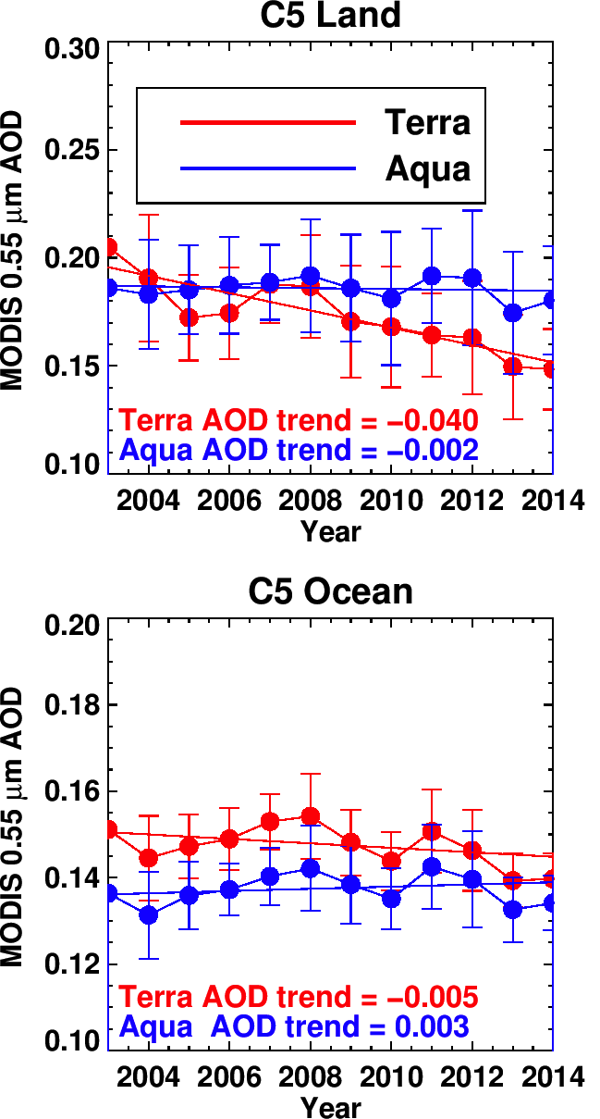
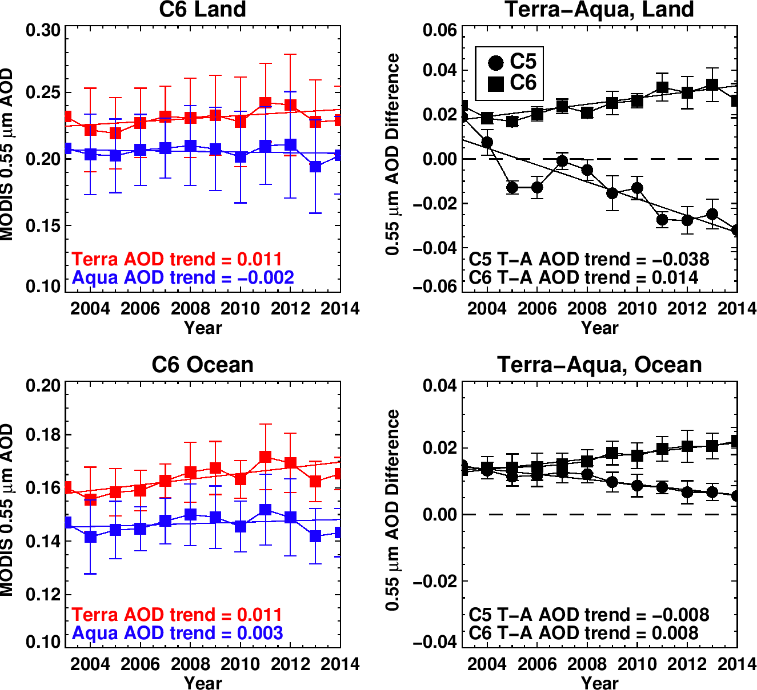
Time series of MODIS-derived AOD
Dt = Terra - Aqua
LAND
C5
C6
OCEAN
Good news: Strong Dt negative “trending” is reduced in C6
Bad news: 1) Dt offset increases, and 2) there is now a positive trend

Slide 17
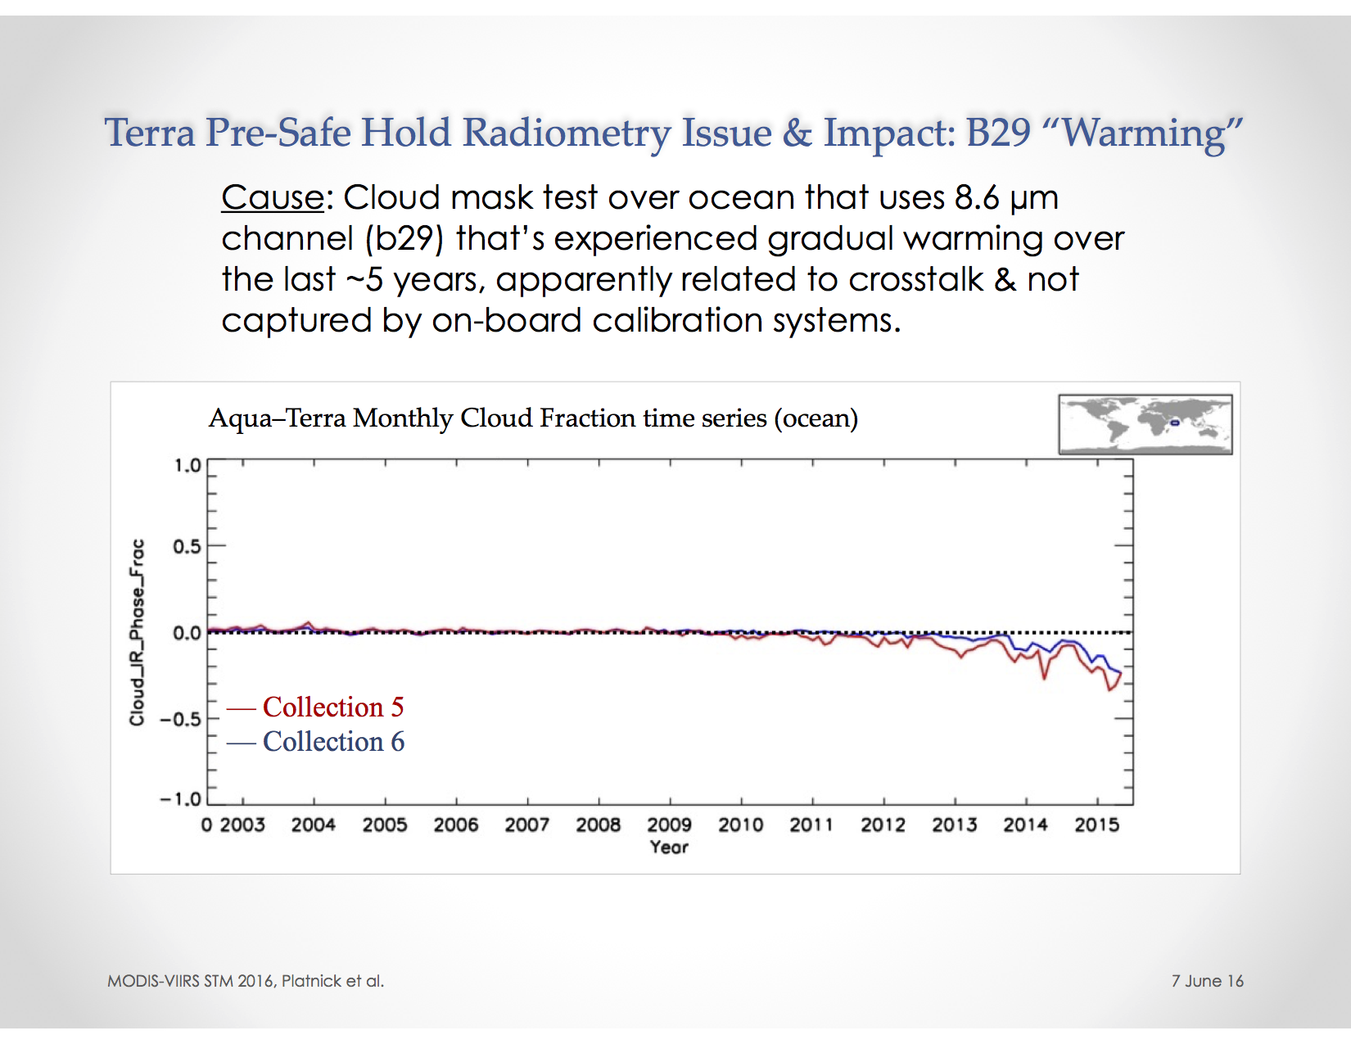

Slide 18
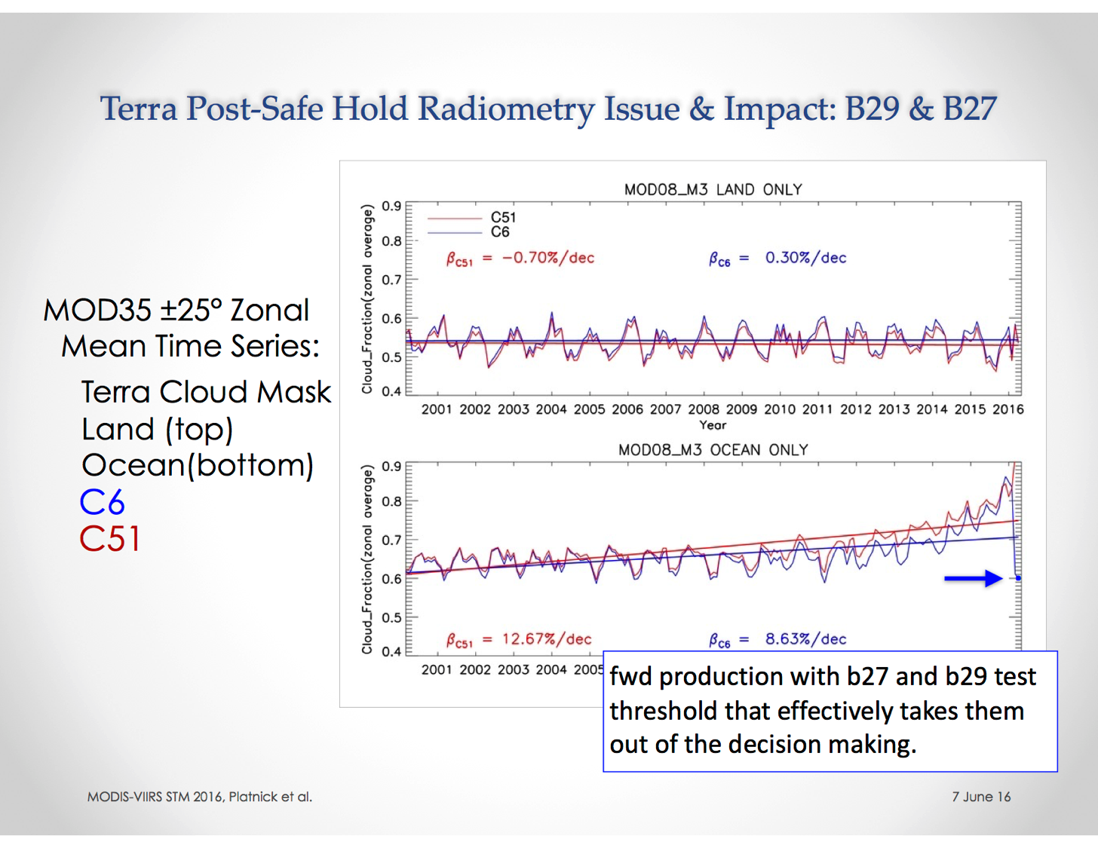

Slide 19
MODIS-VIIRS Continuity
  Discussion of approach taken to generating MODIS Aqua/Terra and VIIRS continuity cloud products, i.e., using same channel set and algorithms for MODIS as for VIIRS (MODAWG).
  Issue for future solicitations/Senior Review is in how to balance resources associated with potential MODIS streams (Collection 6.1and C7 activity) vs. generation and validation of MODIS-VIIRS continuity product.
  Future plans for product generation for VIIRS JPSS-x?

