Slide 1
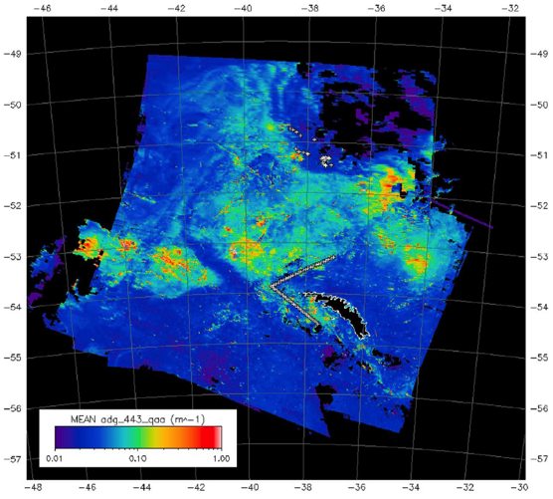
Using MODIS Ocean Color Data and Numerical Models to Understand the Distribution of Colored Dissolved Organic Matter in the Southern Ocean
C. E. Del Castillo^{1,3}, S. Dwivedi², and T. W. N. Haine³
¹Ocean Ecology Laboratory, National Aeronautics and Space Administration, Goddard Space Flight Center, Greenbelt, MD 20771, USA
²Department of Atmospheric and Ocean Sciences, University of Allahabad, Allahabad, UP 211002, INDIA
³Department of Earth and Planetary Sciences, Johns Hopkins University, Baltimore, MD 21218, USA
MODIS/VIIRS Science Team Meeting, Sheraton Silver Spring Hotel June 9, 2016

Slide 2
Goals:
1-To estimate the three- dimensional time evolving distribution of CDOM during the Southern Ocean Gas Exchange Experiment (SO_GasEx).
2-To diagnose the physical processes controlling CDOM distribution. Ultimately we want to model evolution of a_{g}ʎ (and other IOPs) to fill gaps in satellite coverage over periods of weeks.
Hypotheses:
1- That CDOM distribution in the Southern Ocean in time scales of ~weeks is controlled by physical processes. Biological processes are negligible.
2- That data assimilation of remote sensing and field data can produce IOP fields. Modeled products can compensate for lack of imagery in cloudy environments.

Slide 3
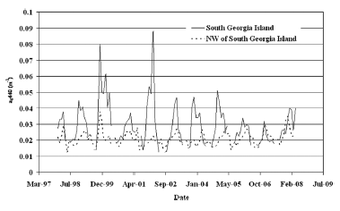
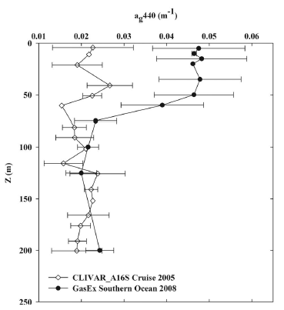
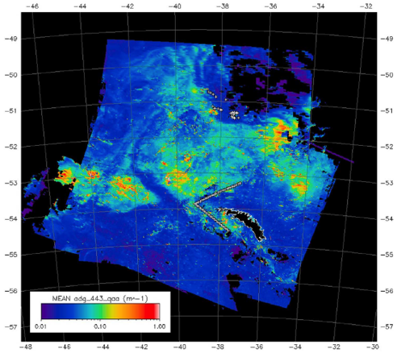
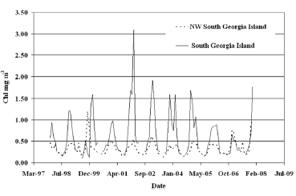
Background:
Seasonal changes in CDOM can be explained by bacterial production and photodegradation (Nelson et al., 2004).

Slide 4
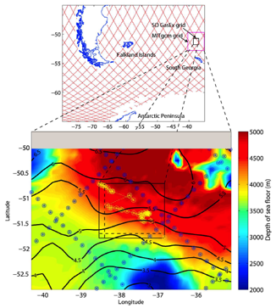
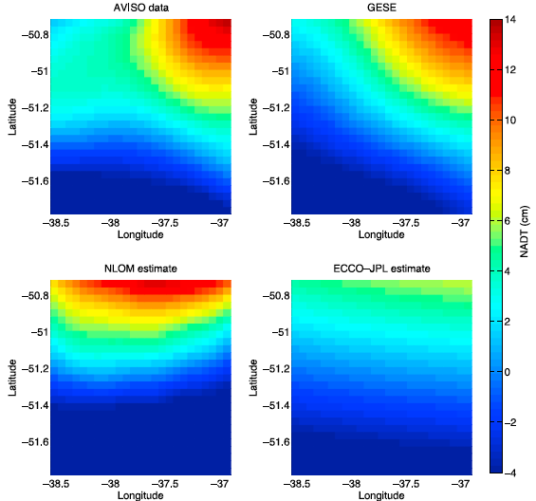
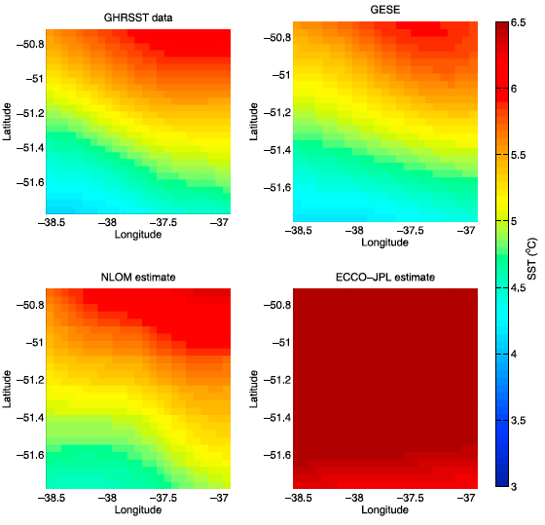
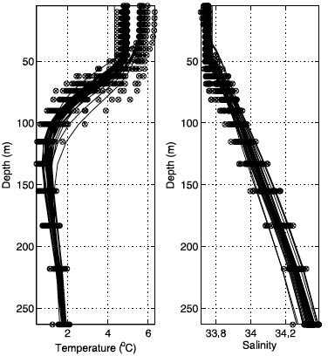
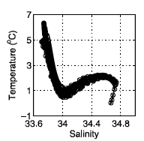
Background:
Our GESE estate estimation showed considerable skill in modeling upper ocean physical variables along the spatial and temporal domains of the SO GASEX

Slide 5
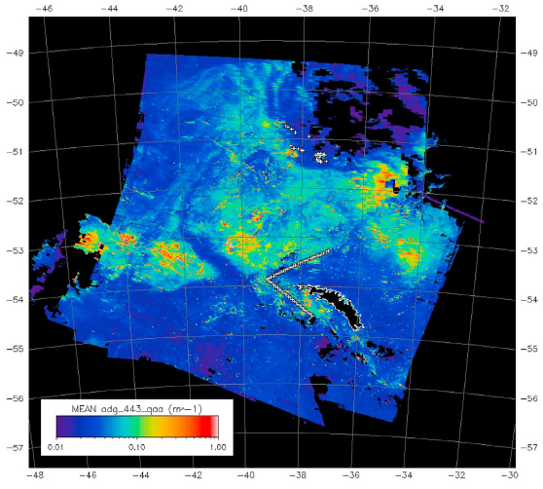
Issues:
1- We had poor match-ups. However, CDOM retrievals using QAA where in family with the field samples.
2- Don’t have photodegradation parameters for the SO, assume that marine CDOM is similar everywhere.

Slide 6
Methods:
We developed a package for MITgcm to simulate advection and diffusion of CDOM at multiple wavelengths. We treated the CDOM absorption coefficients as passive tracers with time and space-varying sources and sinks. The absorption of light by CDOM and the associated photobleaching (photolysis) acted as the main sink. Following Del Vecchio and Blough [2002], the CDOM absorption coefficient a_{CDOM} after illumination for a short time Δt is
a_{CDOM} (λ, z) = a_{CDOM} (λ) e ^{–f (λ, z) Δt},
where f (λ, z) is the photobleaching rate at wavelength λ and depth z. It is given by
f (λ, z) = σ_{P} (λ) E(λ) e ^{–k (λ, z) z}
where σ_{P} (λ) is the photobleaching cross-section, E(λ) is the solar irradiance at wavelength λ transmitted through the sea surface, and k(λ, z) is the vertical attenuation coefficient which is approximated as (4/3) a_{CDOM} (λ, z).
The CDOM model was run for three different wavelengths 350 nm, 380 nm, and 400 nm using the hourly surface solar irradiance obtained from the OASIM radiative transfer model (Gregg and Casey [2009]) .

Slide 7
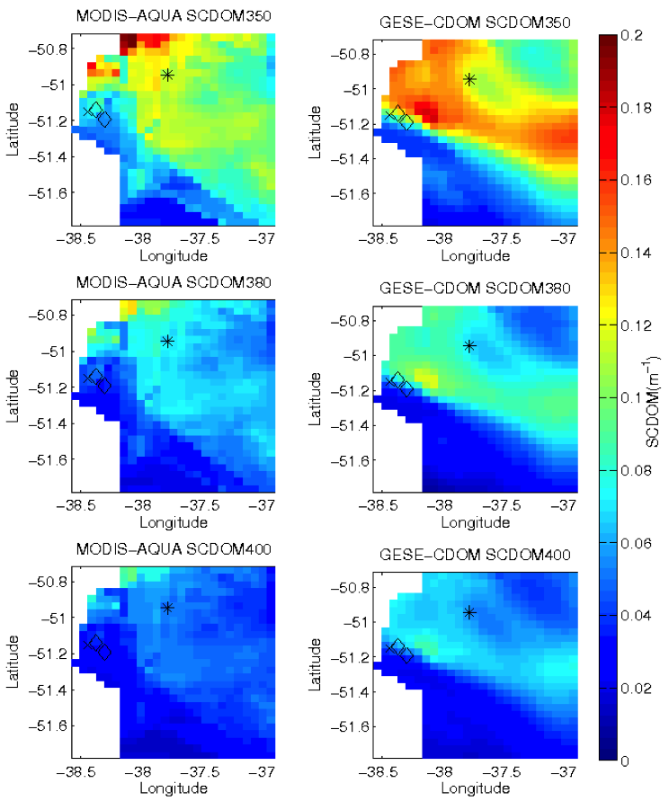
Comparison of the time averaged MODIS-AQUA derived SCDOM field at 350 nm (upper panel), 380 nm (middle panel) and, 400 nm (lower panel) with the corresponding GESE-CDOM SCDOM fields for the SO GasEx domain. The time average is over 21, 22, 24, and 27 March 2008 (the dates of the satellite data). The star and diamonds show the SO GasEx cruise station on 20th March and 22nd March, respectively.
Why the mismatches?
~1. We are measuring remotely at 440 nm and extrapolating to shorter wavelengths using the S parameter.
~2. Can the model resolve better the first optical depth?
~3. This is a poor
match up.

Slide 8
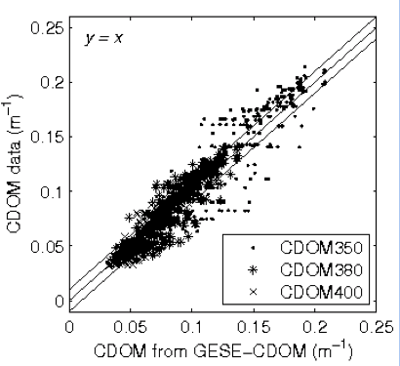
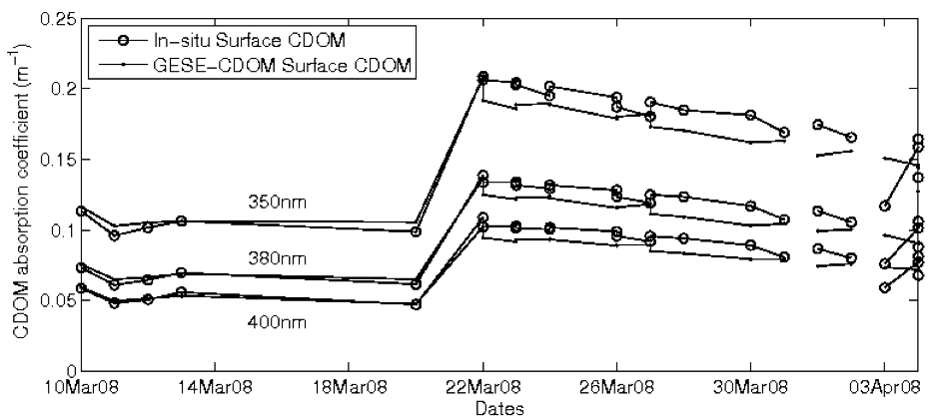
Comparison between field data (all CTD samples and modeled CDOM)
Comparison of the time series of SO GasEx in-situ surface CDOM (circles) at 350nm, 380nm, and 400nm with the corresponding GESE-CDOM surface CDOM values (dots). The samples are from surface CTD stations.

Slide 9
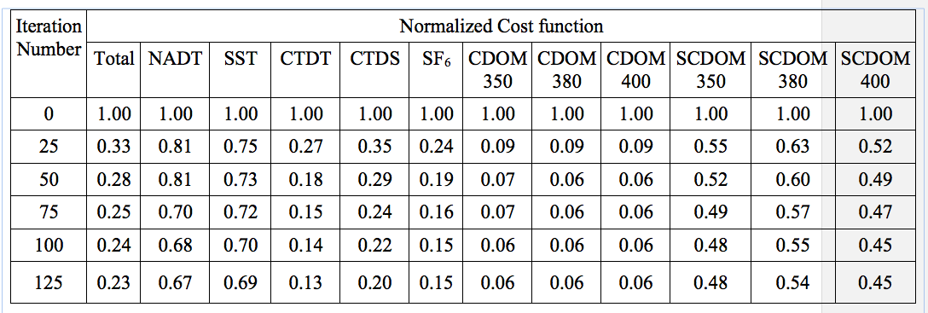
I know that this is a horrible slide….
…...sorry......

Slide 10
Conclusions:
1- CDOM distribution in the Southern Ocean in time scales of < weeks is controlled by physical processes. Biological processes are negligible.
2- Data assimilation of remote sensing and field data can produce IOP fields –at least CDOM. Modeled products can compensate for lack of imagery in cloudy environments.

Slide 11
?

