Slide 1
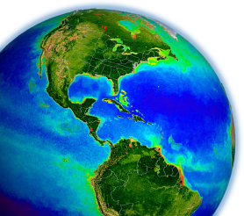
Remote Sensing Reflectance and Derived Products: MODIS & VIIRS
Bryan Franz
Ocean Ecology Laboratory
NASA Goddard Space Flight Center
MODIS/VIIRS Science Team Meeting
6-10 June 2016, Silver Spring, MD

Slide 2
Definition
Remote Sensing Reflectance, Rrs(λ; sr⁻¹), is water-leaving radiance, Lw(λ), corrected for bidirectional effects of the air-sea interface and sub-surface light field, and normalized by downwelling solar irradiance, Ed(λ), just above the sea surface.
Rrs(λ) is the fundamental measurement from which ocean color (OC) products such as phytoplankton chlorophyll concentration and marine inherent optical properties are derived.
Primary purpose of our work is to develop a stable and consistent, long-term OC time-series spanning multiple mission lifetimes to support global change research and applications.

Slide 3
Proposal Team: MODIS & VIIRS
Team Member | Primary Role
Bryan Franz | project lead & quality assessment
Zia Ahmad | atmospheric correction
Sean Bailey | vicarious calibration & software
Gene Eplee | VIIRS calibration
Gerhard Meister | MODIS calibration
Chris Proctor | in situ validation
Kevin Turpie | VIIRS prelaunch
Jeremy Werdell | bio-optical algorithms
and the Ocean Biology Processing Group ...

Slide 4
Contents
MODIS & VIIRS OC Reprocessing Overview
Multi-mission OC Time-series Consistency
Product Validation and Uncertainties
Chlorophyll Climate Data Record
Summary

Slide 5
R2014.0 Multi-Mission Ocean Color Reprocessing
Scope
CZCS, OCTS, SeaWiFS, MERIS, MODIS(A/T), and VIIRS
Motivation
improve interoperability and sustainability of the product suite by adopting modern data formats, standards, and conventions (netCDF4, CF and ISO conventions, etc.)
incorporate algorithm updates and advances from community and science teams
incorporate knowledge gained in instrument-specific radiometric calibration and updates to vicarious calibration
Status
CZCS, OCTS, VIIRS, MODISA, MODIST, SeaWiFS (& GOCI) done
MERIS in progress

Slide 6
PRODUCT AND ALGORITHM CHANGES
R_{rs}(λ) | calibration updates, ancillary data updates, improved land/water masking, terrain height, other minor fixes
Ångstrom
AOT
Chlorophyll a | standard chlor_a product now OCI algorithm (Hu et al. 2012) original OC3/OC4 product still being distributed as chl_ocx
K_{d}(490) | no change
POC | no change
PIC | updated algorithm and LUT
CDOM_index | remove product (redundant with new IOP suite)
PAR | consolidated algorithm, minor fixes
iPAR | MODIS-only, no change
nFLH | MODIS-only, flagging changes (allow negatives)
IOPs | added suite of inherent optical properties (Werdell et al. 2013)

Slide 7
INSTRUMENT CALIBRATION CHANGES
SeaWiFS | correcting dark offset changes at the sub-count level correction for time-dependent change in system spectral response Patt et al. (in prep), Eplee et al. (in prep)
MODISA | updated temporal calibration from MCST (V6.1.35.17_OC2) updated temporal corrections to response versus scan angle Meister and Franz 2014.
MODIST | updated temporal calibration from MCST (V6.1.20.16) updated temporal corrections for response versus scan angle and polarization sensitivity (crosscal to SeaWiFS and MODISA)
VIIRS | first use of lunar calibration trends to track temporal degradation of VIIRS (lunar calibration is used to correct more frequent but more uncertain solar calibration trends). correction of the lunar calibration trends for time-dependent changes in spectral response of the primary mirror. correction of solar calibration trends for a solar unit vector error in the source data used for solar calibration analysis, and improved solar diffuser stability corrections. additional statistical correction for detector striping. Eplee et al. 2015
Reprocessed to utilize new NASA-developed 6-minute Level-1A and Level-1B granule format and calibration code. (R2014.0.2)

Slide 8
Contents
MODIS & VIIRS OC Reprocessing Overview
Multi-mission OC Time-series Consistency
Product Validation and Uncertainties
Chlorophyll Climate Data Record and Application
Summary

Slide 9
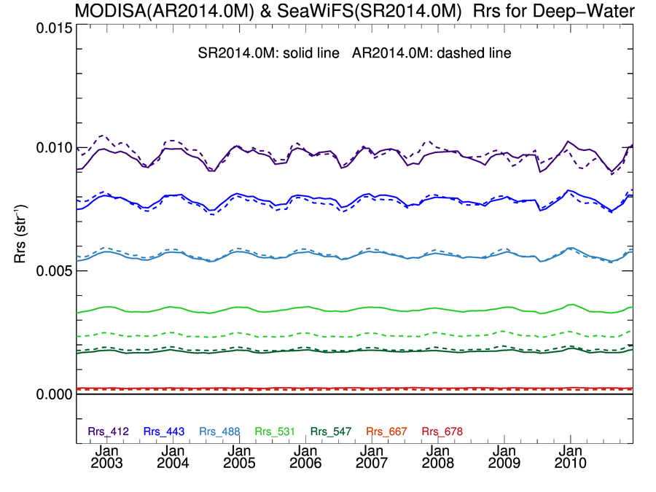
SeaWiFS & MODISA Rrs(λ) Deep-Water Time-Series showing good agreement
R2014.0
SeaWiFS = solid line
MODISA = dashed line
Mean
Ratio
412
1.01
443
0.99
490-488
1.01
547-555

Slide 10
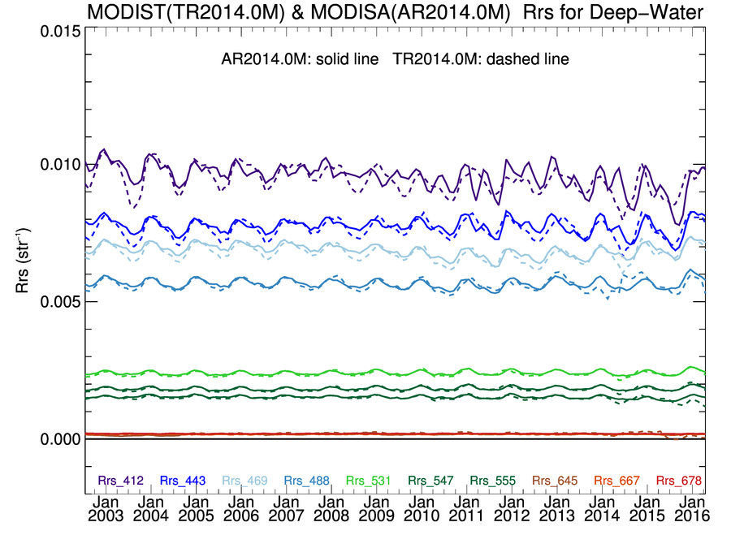
MODIST & MODISA Rrs(λ) Deep-Water Time-Series showing “mostly” good agreement
R2014.0
MODISA = solid line
MODIST = dashed line
Mean
Ratio
412
0.99
443
0.99
488
0.99
531

Slide 11
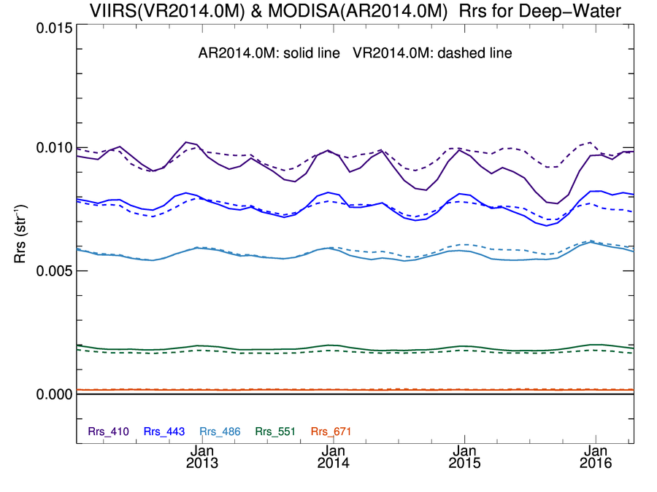
MODISA & VIIRS Rrs(λ) Deep-Water Time-Series showing “mostly” good agreement
R2014.0
MODISA = solid line
VIIRSN = dashed line
Mean
Ratio
410-412
suspect decline in MODISA Rrs(412)
1.04
443
0.99
486-488
1.02
547-551

Slide 12
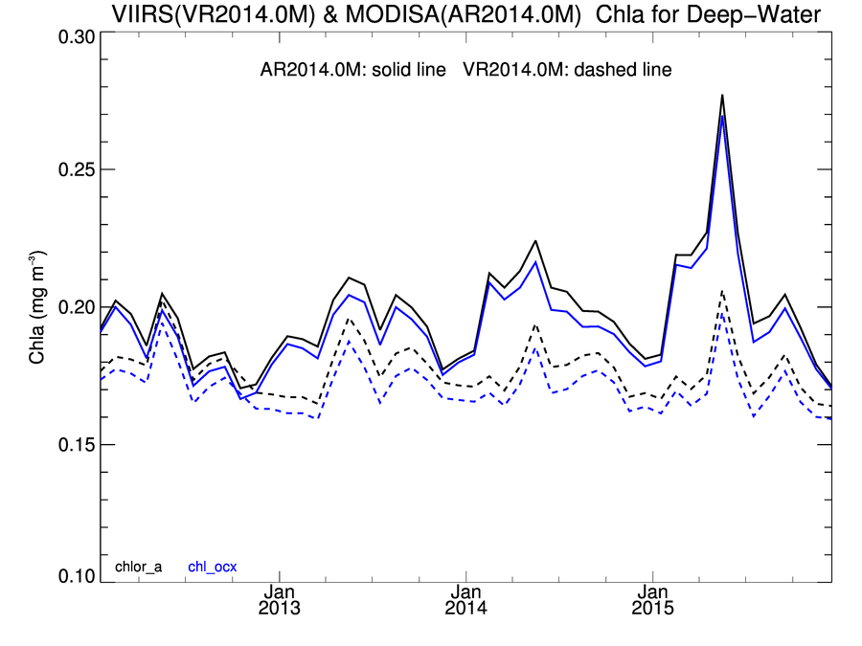
MODISA and VIIRS R2014.0
Chlorophyll Deep-Water Time-Series
 | Mean | Stdv
MODISA | 0.197 | 0.019 | mg m⁻³
VIIRS | 0.177 | 0.009 | mg m⁻³
VIIRS/MODISA | 0.90 | 0.06
MODISA
VIIRS
degraded confidence
in MODISA trends

Slide 13
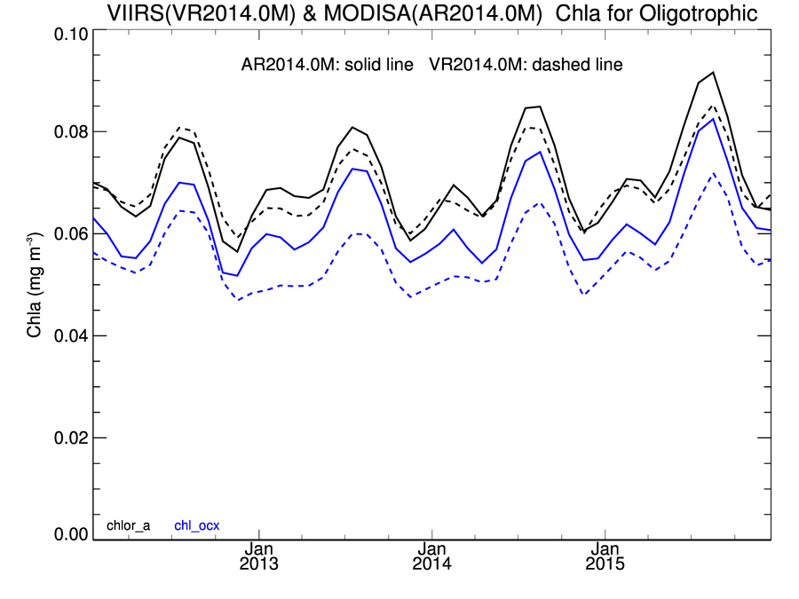
MODISA and VIIRS R2014.0
Chlorophyll Clear-Water Time-Series
OCI algorithm yields higher values of chlorophyll in clear water relative to OCx (+0.01 to 0.015 mg m⁻³), with much improved consistency between sensors.
OCI
OCx
 | Mean | Stdv
MODISA | 0.070 | 0.008 | mg m⁻³
VIIRS | 0.069 | 0.007 | mg m⁻³
VIIRS/MODISA | 0.98 | 0.04

Slide 14
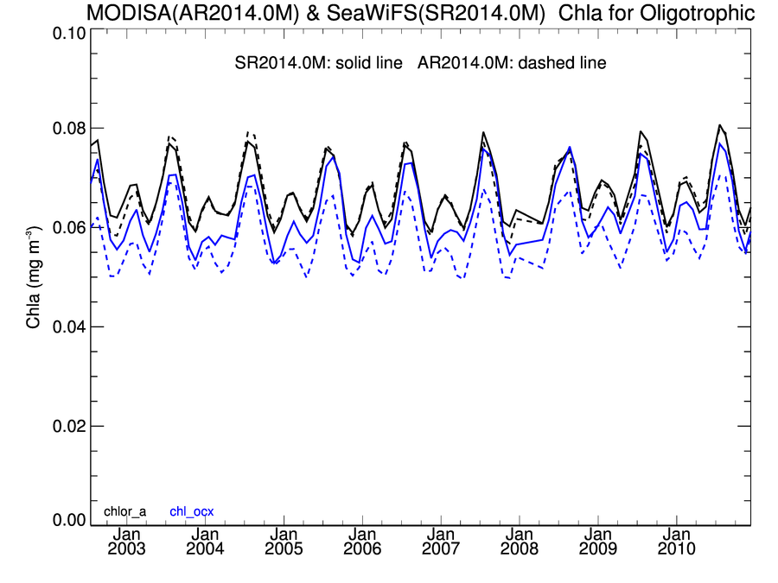
SeaWiFS and MODISA R2014.0
Chlorophyll Clear-Water Time-Series
OCI algorithm yields higher values of chlorophyll in clear water relative to OCx (+0.005 to 0.01 mg m⁻³), with improved consistency between sensors.
OCI
OCx
 | Mean | Stdv
MODISA | 0.067 | 0.006 | mg m⁻³
SeaWiFS | 0.067 | 0.006 | mg m⁻³
MODIS/SeaWiFS | 0.992 | 0.025

Slide 15
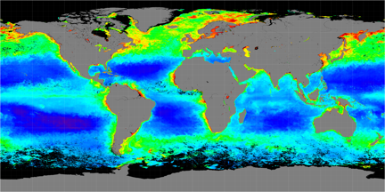
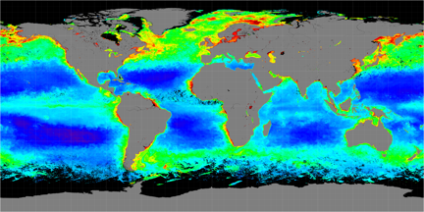
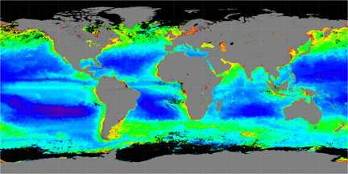
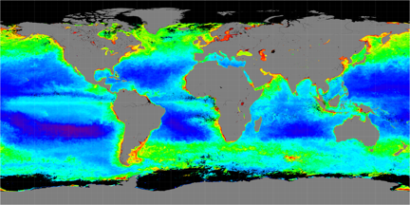
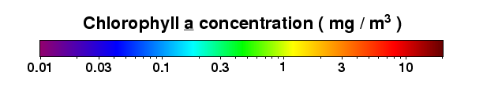
Seasonal Chlorophyll Comparison (2005)
SeaWiFS
MODISA
Spring
Fall

Slide 16
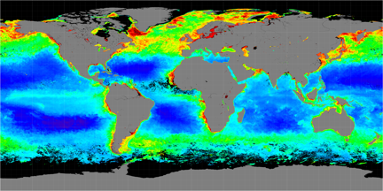
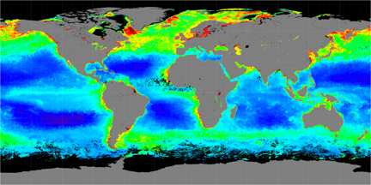

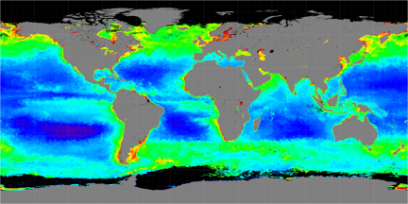
Seasonal Chlorophyll Comparison (2015)
MODISA
VIIRS
Spring
Fall

Slide 17
Contents
MODIS & VIIRS OC Reprocessing Overview
Multi-mission OC Time-series Consistency
Product Validation and Uncertainties
Chlorophyll Climate Data Record and Application
Summary

Slide 18
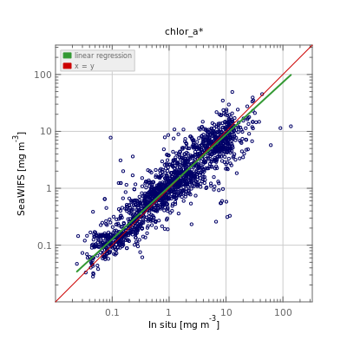
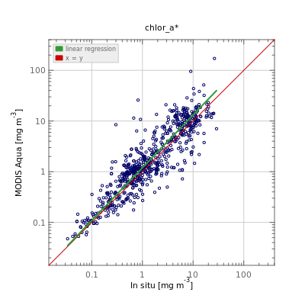
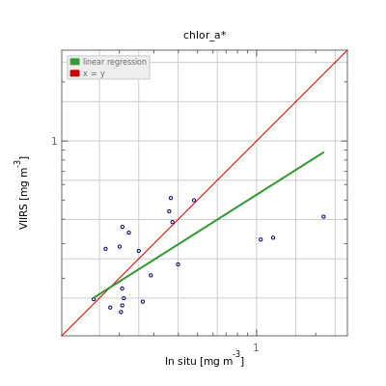
SeaWiFS
MODISA
VIIRS
Satellite Chla (mg m⁻³)
In situ Chla
PRODUCT | COUNT | SLOPE | INT (mg m⁻³) | R² | MED RATIO | APD (%) | RMSE (mg m⁻³)
SeaWiFS | 1739 | 0.92 | 0.02513 | 0.83 | 1.07 | 37.3 | 0.29030
MODISA | 653 | 1.04 | 0.07814 | 0.80 | 1.19 | 40.7 | 0.30814
VIIRS | 21 | 0.63 | -0.27375 | 0.27 | 0.86 | 34.9 | 0.27166
SeaWiFS | 363 | 0.83 | -0.09787 | 0.74 | 1.01 | 32.4 | 0.24365
MODISA | 113 | 0.87 | -0.10674 | 0.85 | 0.97 | 22.5 | 0.19605
VIIRS | 17 | 0.50 | -0.37107 | 0.30 | 0.79 | 40.9 | 0.29676
All
Chlorophyll a
Deep

Slide 19
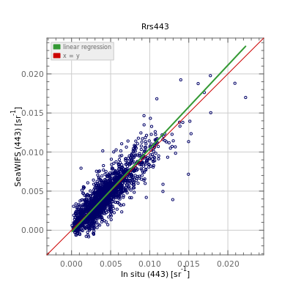
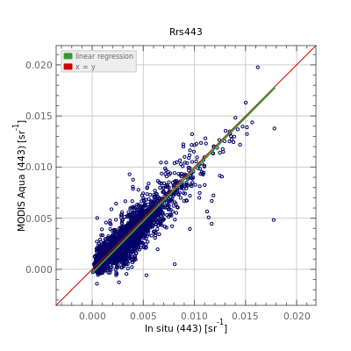
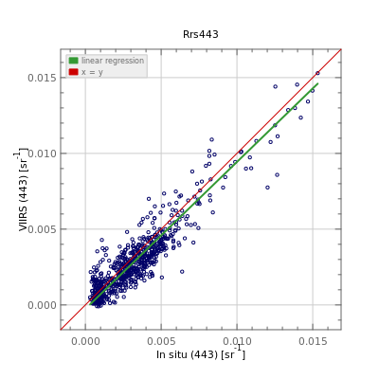

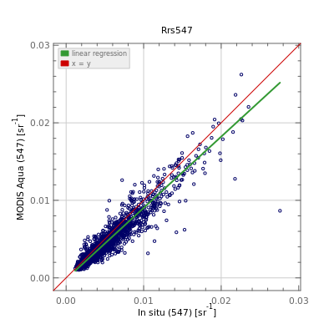
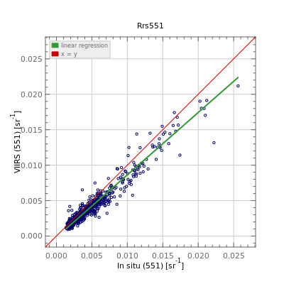
SeaWiFS
MODISA
VIIRS
Satellite Rrs (443; sr⁻¹)
Satellite Rrs (55x; sr⁻¹)
In situ Rrs(λ)
Comparison between R2014.0 satellite retrievals and in situ measurements for Rrs at 443nm and near 550nm. Match-up is for all available in situ data from SeaBASS and AERONET-OC.

Slide 20
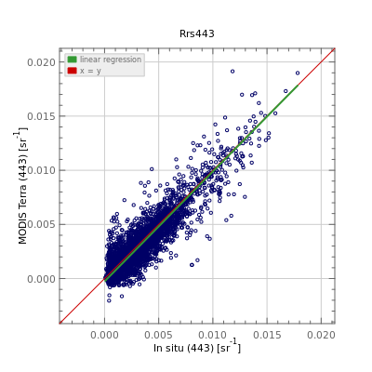
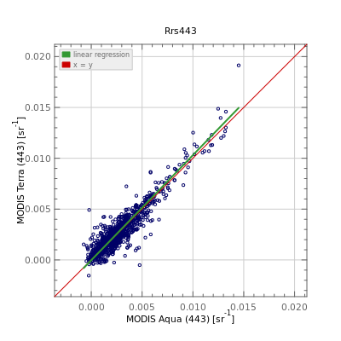
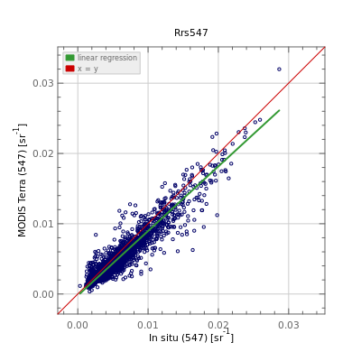
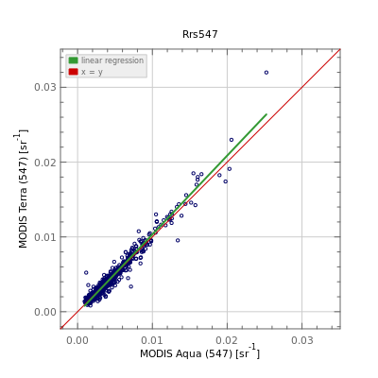
MODIST
MODISA
MODIST vs MODISA
Satellite Rrs (443; sr⁻¹)
MODIST Rrs(443)
Satellite Rrs (547; sr⁻¹)
MODIST Rrs(547)
In situ Rrs(λ)
MODISA Rrs(λ)
Comparison between R2014.0 satellite retrievals and in situ measurements for Rrs at 443nm and near 547nm. Match-up is for all available in situ data from SeaBASS and AERONET-OC.

Slide 21
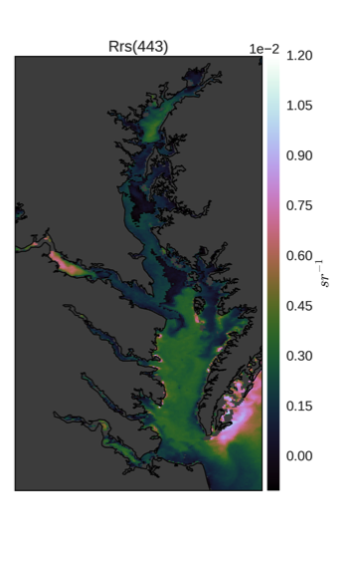
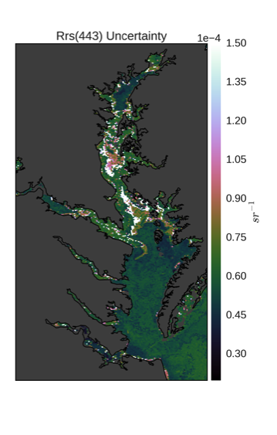
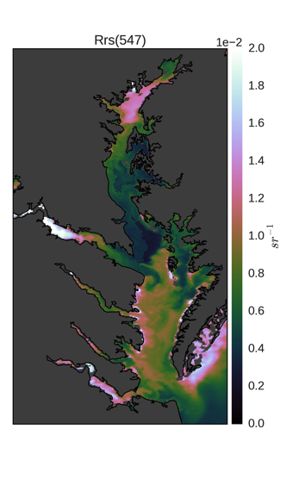
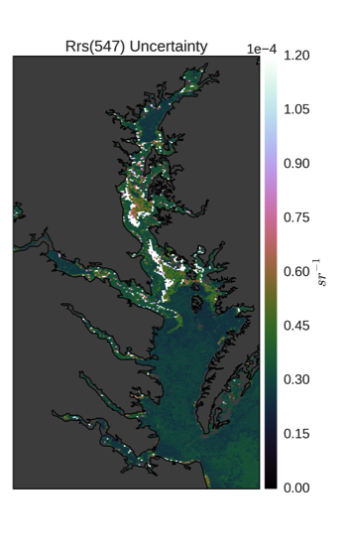
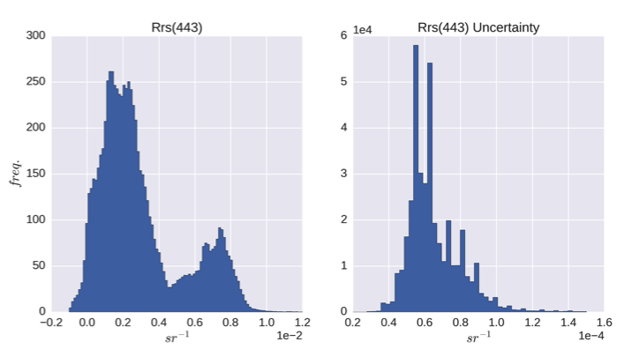
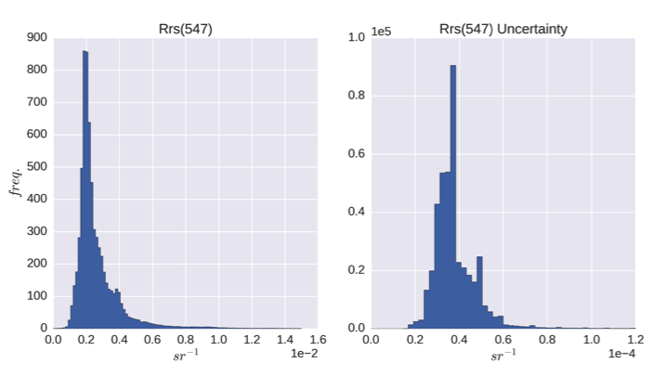
Developing per-pixel Rrs(λ) uncertainty estimates
instrument noise propagated through atmospheric correction via Monte Carlo simulation (MODIS-Aqua Ches. Bay, 1000 iterations)
Rrs(443)
Uncertainty
Rrs(547)
Uncertainty

Slide 22
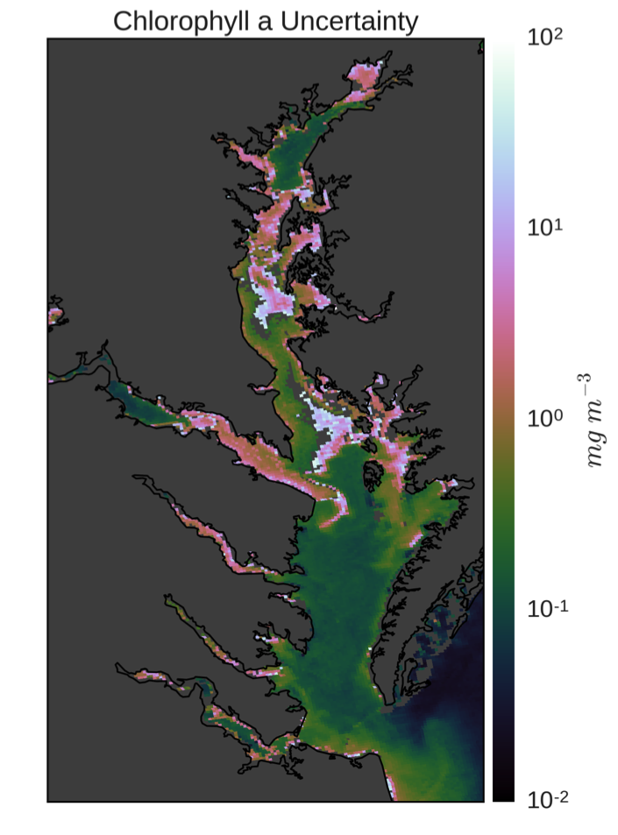
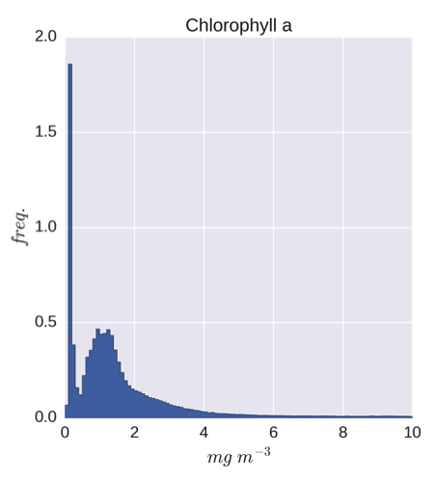
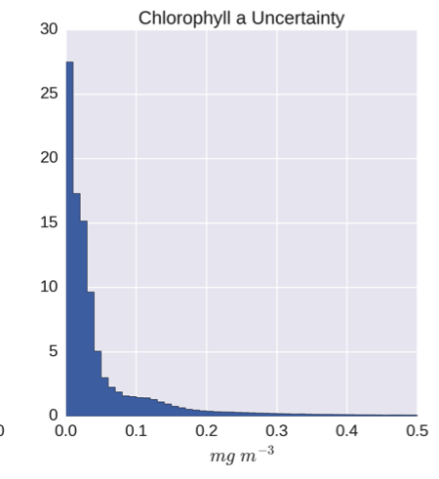
Developing per-pixel chlorophyll uncertainty
Chlorophyll Uncertainty
Chlorophyll
Chlorophyll
Uncertainty

Slide 23
Contents
MODIS & VIIRS OC Reprocessing Overview
Multi-mission OC Time-series Consistency
Product Validation and Uncertainties
Chlorophyll Climate Data Record and Application
Summary

Slide 24
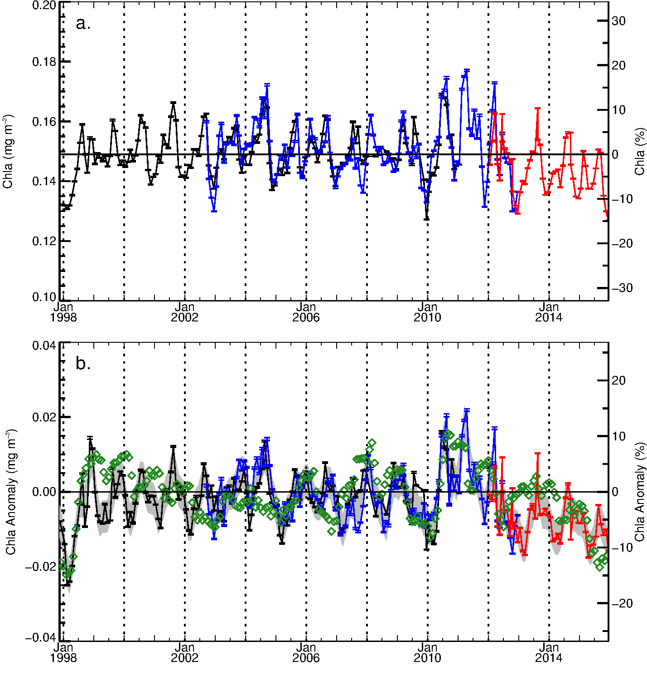
Long-term (18-year) record of phytoplankton chlorophyll a for mid-latitude oceans (± 40⁰), constructed from R2014.0
Chla (mg m⁻³)
Chla (%)
SeaWiFS
MODISA
VIIRS
Multivariate Enso Index (MEI)
Chla Anomaly (mg m⁻³)
Chla Anomaly (%)
SeaWiFS
MODISA
VIIRS

Slide 25
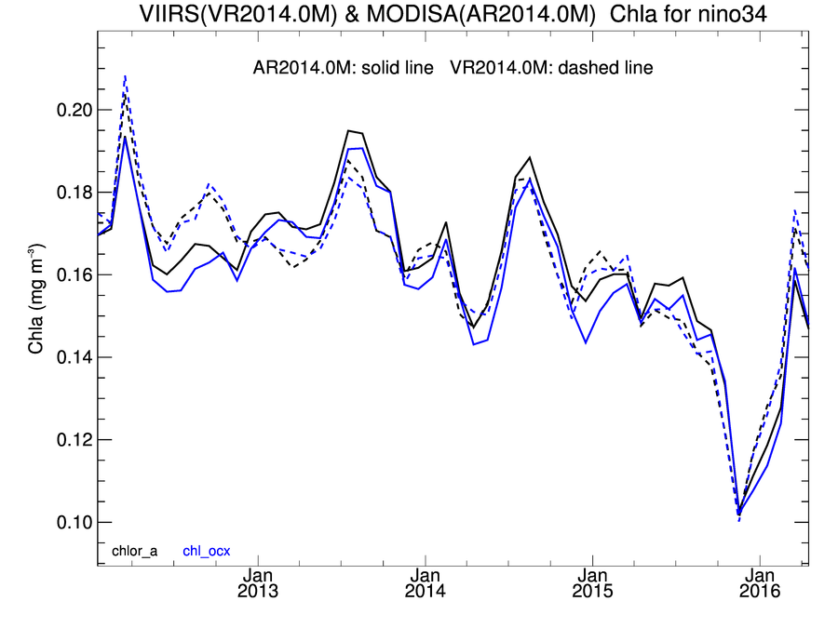
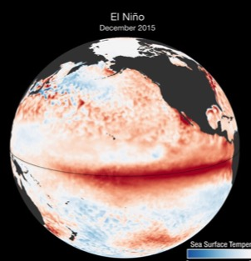
Phytoplankton Chlorophyll decline in the Niño 3.4 Region
~40% drop by December 2015
Solid lines MODIS/Aqua, dashed lines VIIRS/S-NPP, colors indicate different chlorophyll retrieval algorithms.
NASA Ocean Biology Processing Group

Slide 26
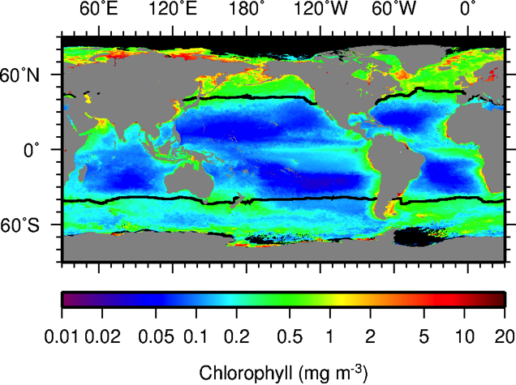
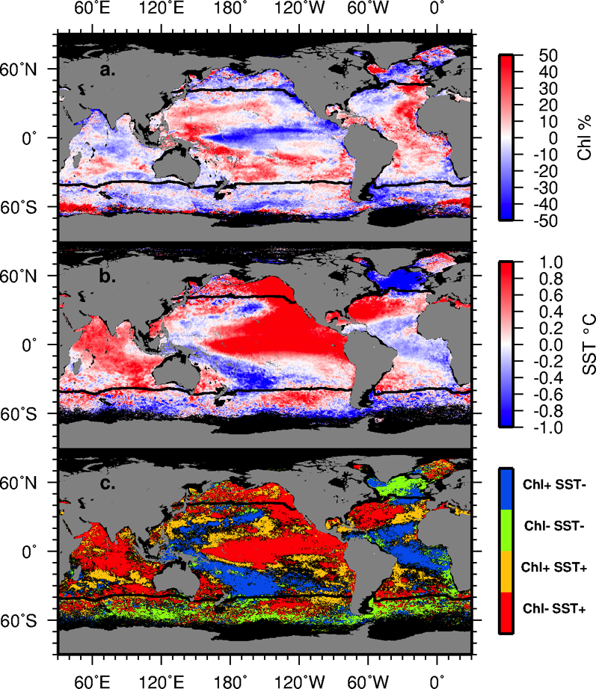
2015 El Niño Anomaly (VIIRS)
Image above shows mean phytoplankton chlorophyll distribution for 2015, from VIIRS processed by NASA. Images to right show change in chlorophyll in 2015 relative to the climatological norm, and correlated changes in sea surface temperature from MODIS on Aqua.

Slide 27
Summary
R2014.0 multi-mission ocean color reprocessing completed for VIIRS, MODIS/Aqua, and MODIS/Terra (& CZCS, OCTS, SeaWIFS).
High degree of mission-to-mission consistency achieved for Rrs, with some exceptions in the blue (412nm).
New OCI algorithm contributes to significant improvement in consistency of chlorophyll time-series for clearest ocean waters.
Validation of Rrs and Chl retrievals against in situ measurements shows equivalent performance for SeaWiFS, MODIS, and VIIRS.
We have produced a long-term ocean color time-series of sufficient length (18 years), continuity, and consistency to assess climate-driven trends in ocean biology.

Slide 28
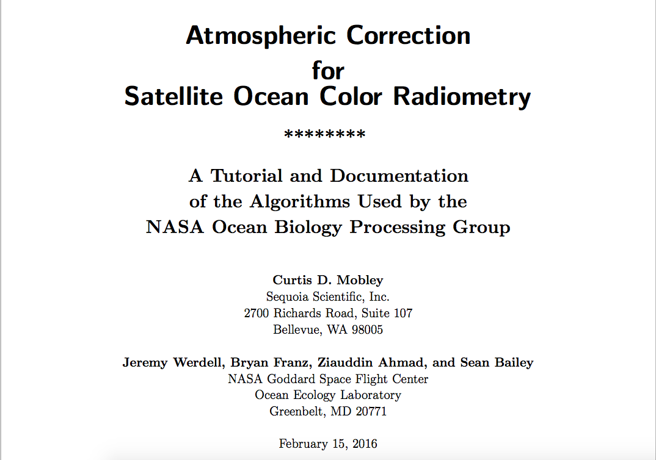
http://soap.siteturbine.com/webbook/file.php?id=345

Slide 29
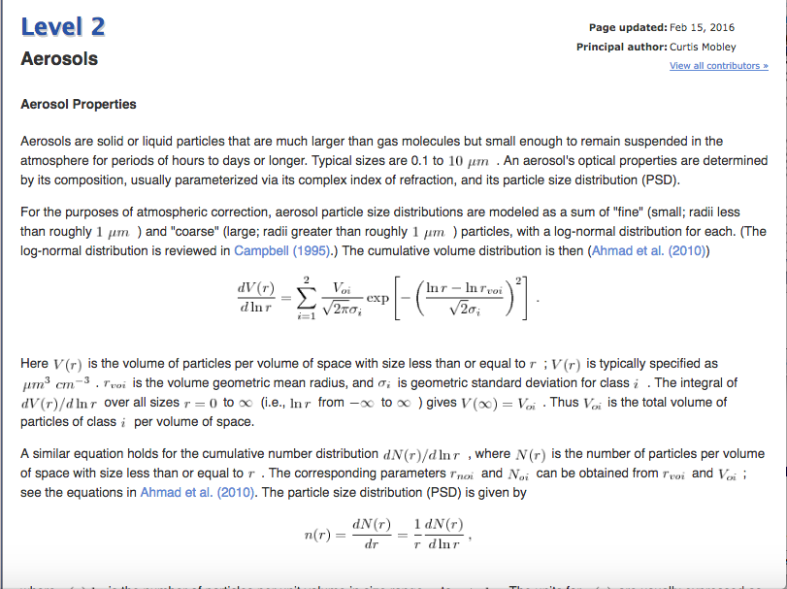
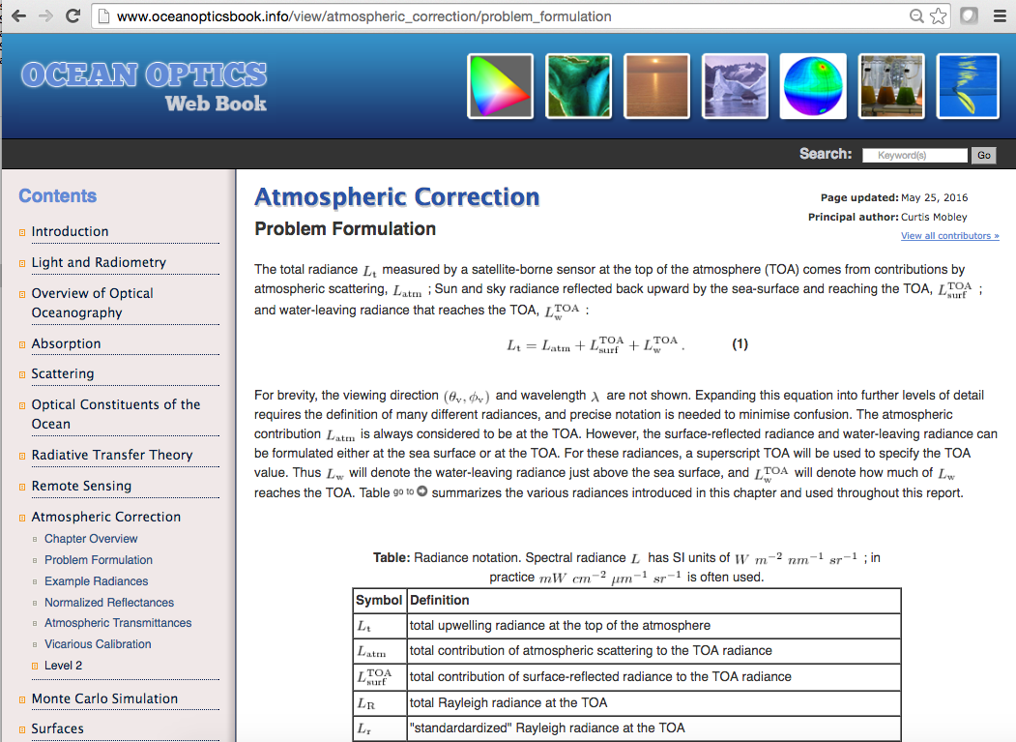
New on-line book: NASA Standard Atmospheric Correction Algorithm for Ocean Color Retrieval
www.oceanopticsbook.info

Slide 30
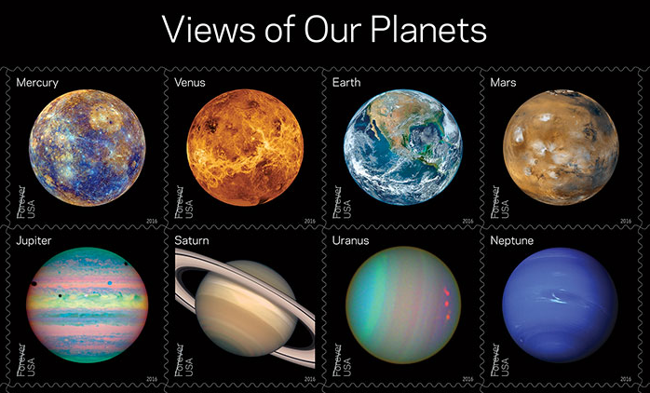
Views of Our Planets” Forever stamps featuring iconic images of the planets in our solar system, including the well-known “Blue Marble” image of Earth. New “Pluto Explored”
Views of Our Planets” Forever stamps featuring iconic images of the planets in our solar system,
including the well-known “Blue Marble” image of Earth” were released on 31 May 2016 at the
World Stamp Show in New York City, an international gathering of stamp collectors that occurs
only once each decade in the U.S. with more than 250,000 visitors attending.

Slide 31
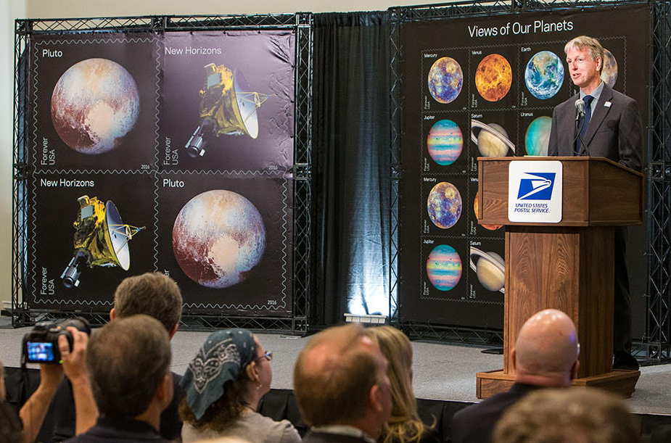
Norman
Norman Kuring of the OBPG created the new “Blue Marble” using data taken by VIIRS on the
NOAA/NASA Suomi NPP satellite soon after it began orbiting our home planet in 2011.

Slide 32
Questions?

Slide 33
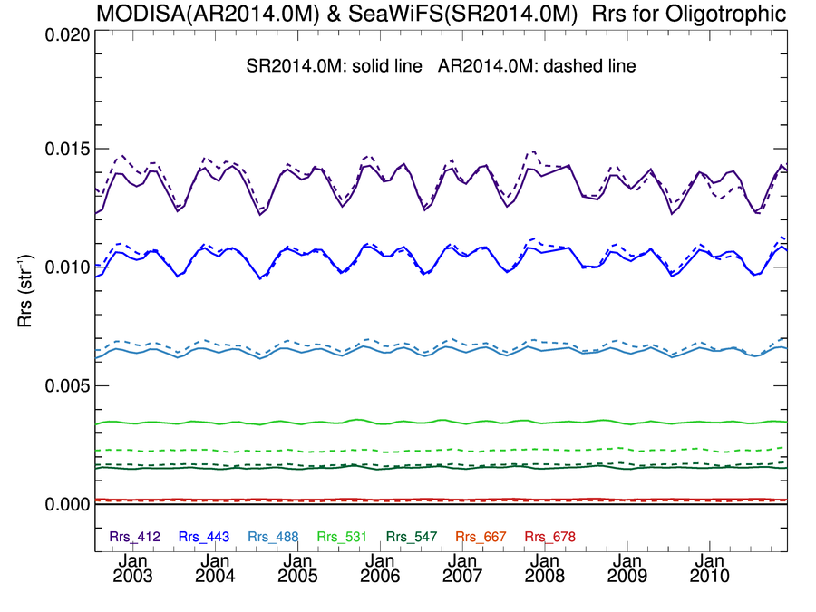
MODISA & SeaWiFS Rrs(λ) Clear-Water Time-Series showing “good” agreement
R2014.0
SeaWiFS = solid line
MODISA = dashed line
Mean
Ratio
412
1.01
443
1.01
490-488
1.03
547-555

Slide 34
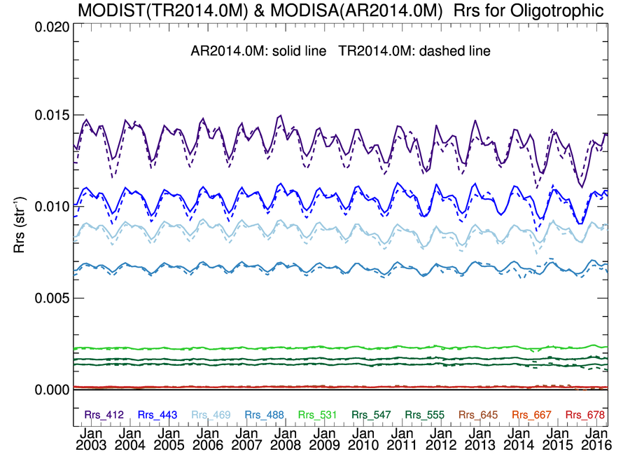
MODIST & MODISA Rrs(λ) Clear-Water Time-Series showing “good” agreement
R2014.0
MODISA = solid line
MODIST = dashed line
Mean
Ratio
412
0.98
443
0.98
488
0.99
531

Slide 35
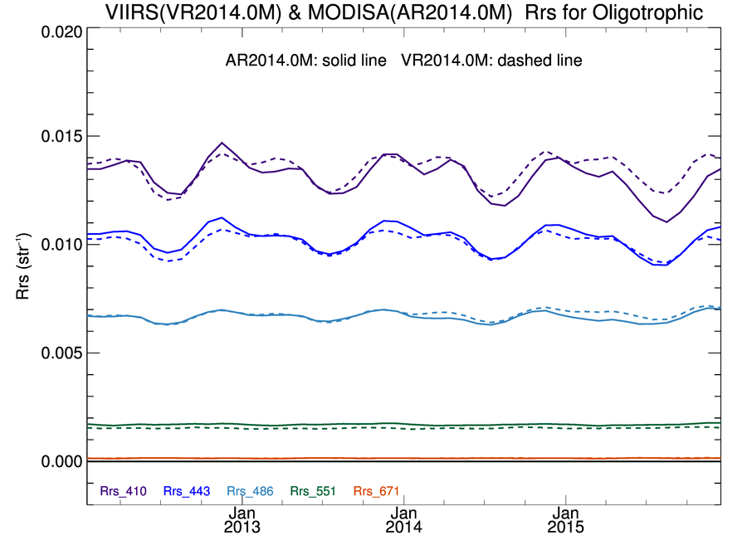
MODISA & VIIRS Rrs(λ) Clear-Water Time-Series showing “good” agreement
R2014.0
MODISA = solid line
VIIRSN = dashed line
Mean
Ratio
412
1.03
443
0.98
486-488
1.02
547-551

Slide 36
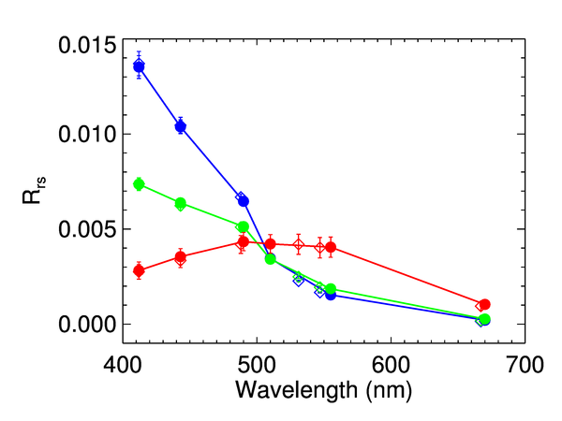




Rrs(λ) Spectral Comparison common mission mean by water type
SeaWiFS and MODISA
MODISA and VIIRS
SeaWiFS = filled circle
MODISA = diamond
MODISA = filled circle
VIIRSN = diamond
Oligotrophic
Mesotrophic
Eutrophic

Slide 37

SeaWiFS and MODISA R2014.0
Chlorophyll Deep-Water Time-Series
 | Mean | Stdv
SeaWiFS | 0.183 | 0.010 | mg m⁻³
MODISA | 0.186 | 0.013 | mg m⁻³
MODIS/SeaWiFS | 1.017 | 0.036
MODISA = solid line
VIIRSN = dashed line
Black = OCI algorithm
Blue = OCx algorithm
Notes:
MODIS biased high with elevated variability
upward trend in late mission SeaWiFS reflected in MODIS

Slide 38
Algorithm

Slide 39
Remote Sensing Reflectance (Rrs; sr⁻¹)
Rrs is the ratio of upwelling “water-leaving” radiance to downwelling irradiance, just above the sea surface
Rrs is the fundamental remote sensing quantity from which most ocean color products are derived (e.g., chlorophyll, particulate organic and inorganic carbon, inherent optical properties)
foam & whitecaps
water-leaving
aerosol + Ray-aer
Sun glint
observed TOA
Rayleigh
Atmospheric Correction

Slide 40
determining aerosol contribution
assume L_{w}(λ) = 0 at two NIR (or SWIR) bands, or that it can be estimated with sufficient accuracy.
retrieve aerosol reflectance in each NIR band as
use spectral dependence of retrieved NIR aerosol reflectance (ε) to select the most appropriate aerosol model from a suite of pre-computed models
use NIR aerosol reflectance and selected aerosol model to extrapolate aerosol reflectance to visible wavelengths
known

Slide 41


aerosol model tables
Fine Mode Albedo
vector RT code (Ahmad-Fraser)
based on AERONET size distributions & albedos
80 models (10 size fractions within 8 humidities)
  100% coarse mode to 95% fine mode
  non- or weakly absorbing
LUT: extinction, albedo, phase function, ss->ms, t_{d}
  function of path geometry (or scattering angle)
model selection discriminated by relative humidity
Typical Size Distributions
Mean AERONET Fine & Coarse Modal Radii
Rh r_{vf} σ_{f} r_{vc} σ_{c} r_{vf}/r_{ovf} r_{vc}/r_{ovc}
0.30 0.150 0.437 2.441 0.672 1.006 1.009
0.50 0.152 0.437 2.477 0.672 1.019 1.024
0.70 0.158 0.437 2.927 0.672 1.063 1.210
0.75 0.167 0.437 3.481 0.672 1.118 1.439
0.80 0.187 0.437 3.966 0.672 1.255 1.639
0.85 0.204 0.437 4.243 0.672 1.371 1.753
0.90 0.221 0.437 4.638 0.672 1.486 1.917
0.95 0.246 0.437 5.549 0.672 1.648 2.293
Ahmad et al. 2010, Appl. Opt.

Slide 42
aerosol model selection & application
select the two sets of 10 models (10 size fractions) with relative humidity (RH) that
bound the RH of the observation.
find the two models that bound the observed epsilon within each RH model family.
*
model epsilon
use model epsilon to extrapolate to visible.
compute weighted average, , between
models within each RH family, and then again between bounding RH solutions.
*actually done in single scattering space and transformed to multi-scattering

Slide 43
we estimate L_{w}(NIR) using a bio-optical model
guess
L_{w}(670) = 0
  1) convert L_{w}(670) to b_{b}/(a+b_{b})
  via Morel f/Q and retrieved Chl_{a}
  2) estimate a(670) = a_{w}(670) + a_{pg}(670)
  via NOMAD empirical relationship
  3) estimate b_{bp}(NIR) = b_{bp}(670) (λ/670)^{η}
  via Lee et al. 2002
  4) assume a(NIR) = a_{w}(NIR)
  5) estimate L_{w}(NIR) from b_{b}/(a+b_{b})
  via Morel f/Q and retrieved Chl_{a}
model
L_{w}(NIR) = func L_{w}(670)
correct
L'_{a}(NIR) = L_{a}(NIR) – t L_{w}(NIR)
retrieve
L^{i}_{w}(670)
test
|L_{w}^{i+1} (670) - L^{i}_{w}(670)|
< 2%
no
done
Bailey et al., Optics Express, 2010

Slide 44
brdf correction
to account for shape of sub-surface light-field due to position of the
Sun and optical properties of the water column.
based on pre-computed look-up tables from hydrolight simulations of
Morel et al. 2002, Appl. Opt.
given radiant path geometry (θ₀,θ,Δϕ), windspeed (w) and Chl
Chl = f (R’_{rs}(λ))
f_{b}(λ,θ₀,θ,Δϕ,Chl,w) = (R₀ f₀/Q₀) / (R f/Q)
f/Q relates subsurface irradiance reflectance to radiance reflectance
R includes all reflection/refraction effects of the air-sea interface
θ₀=0, θ=0,Δϕ=0
iteration
R_{rs}(λ) = R’_{rs}(λ) f_{b}(λ,θ₀,θ,Δϕ,Chl,w)
Chl = f (R_{rs}(λ))
Notes:
may not want to apply brdf for IOP retrieval

Slide 45
adaptation to VIIRS
standard MODIS atmospheric correction software was modified (previous S-NPP science team) to also process VIIRS
starts from VIIRS pseudo Level-1A, and applies instrument calibration in Level-1A to Level-2
  Level-1A developed by multi-disciplinary NASA team
  instrument calibration developed by OBPG (Eplee et al. 2015)
algorithm modifications limited to adjustment for sensor-specific spectral band centers and relative spectral responses
same Ahmad-Fraser vector radiative transfer code used to derive MODIS & VIIRS-specific Rayleigh and aerosol model tables
bands used for aerosol determination
  MODIS: 748 & 869 nm
  VIIRS: 745 & 862 nm

