Slide 1
MODIS and Suomi NPP Discipline Summary Report
By
Bryan A. Franz and Carlos E. Del Castillo
June 10, 2016

Slide 2
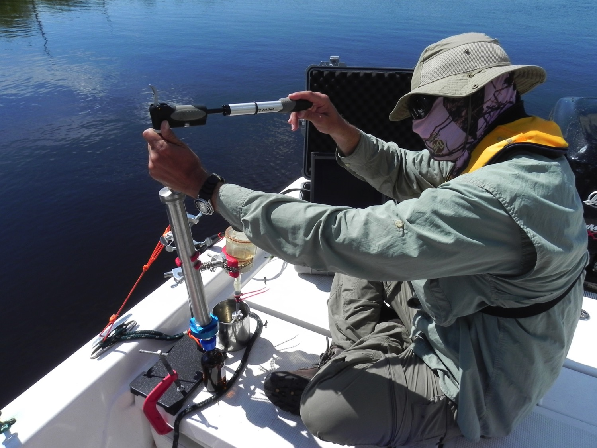

Slide 3
Some Salient Points:
Validation OC
Small number of matchups for VIIRS
In pixel variability
Validation SST
What are the issues???
Do we need to develop new instrumentation?
In water instrumentation?
In pixel variability?
Data Assimilation
Increase temporal and spatial product coverage
Autonomous profilers
Resolve vertical structure.

Slide 4
Some thoughts on this meeting
Data providers
Data users
State of the data records
Feedback on data formats
Data quality issues
Feedback on data quality
What needs improvement?
Requests for the community for cal/val data
Where do we need more cal/val
Etc…
2-3 days every 18 months? + random web meeting.

