Slide 1
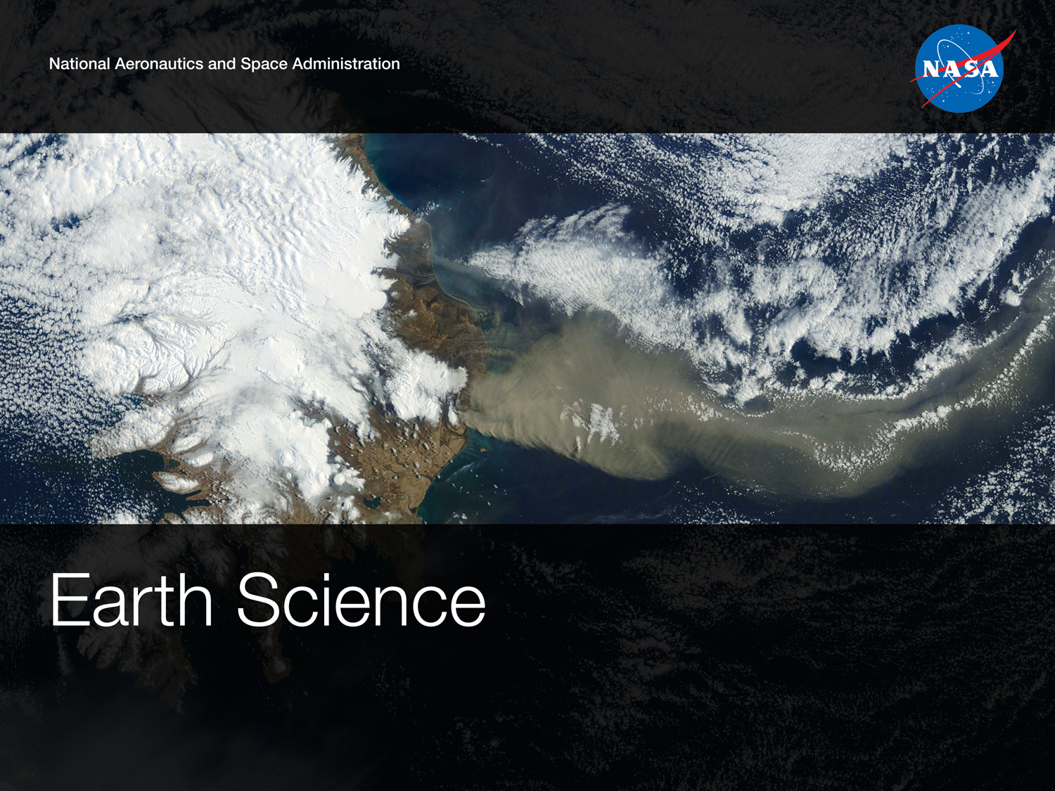
FY16-17 Overview/Summary
MODIS Science Team Meeting
June 2016

Slide 2
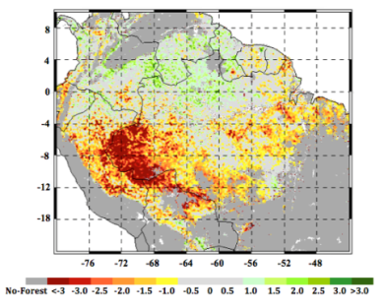
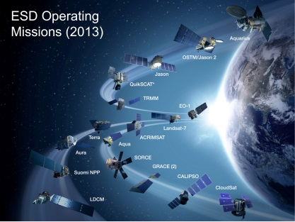
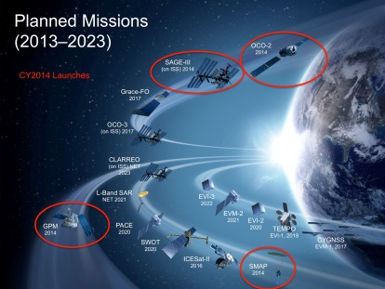
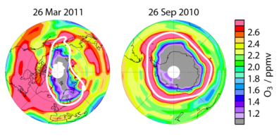
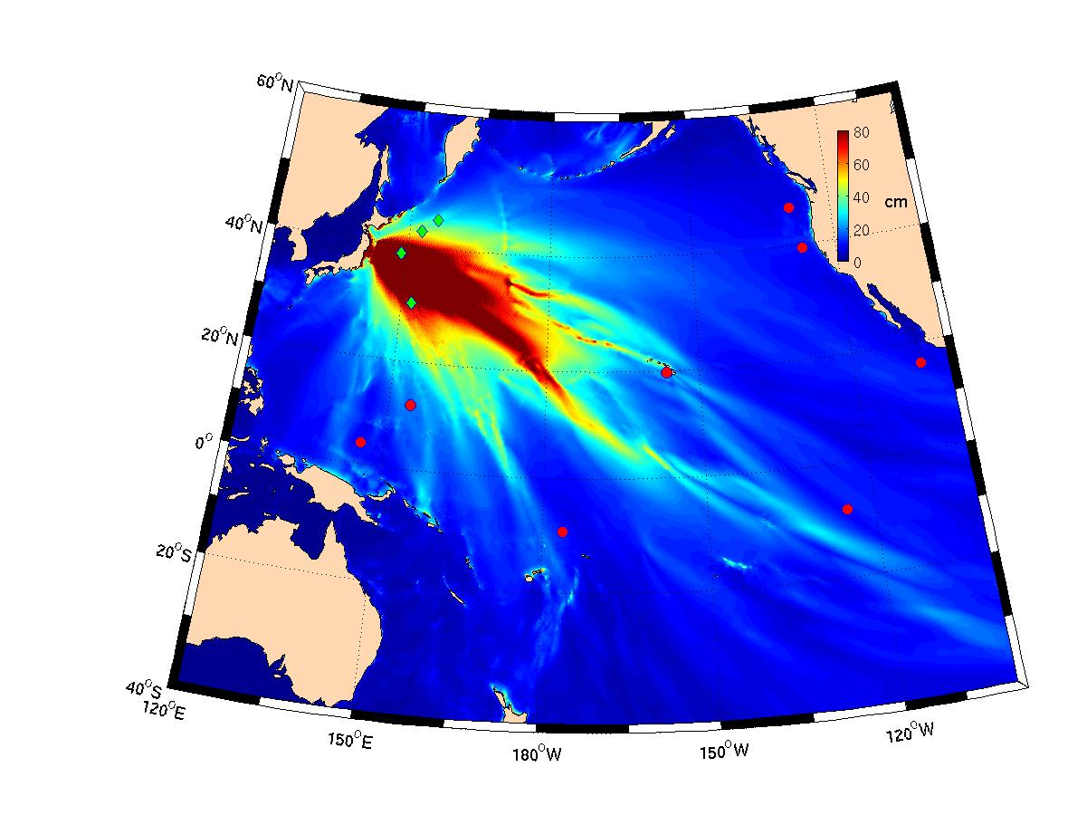
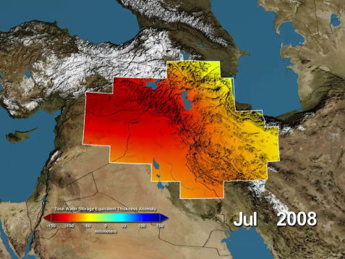
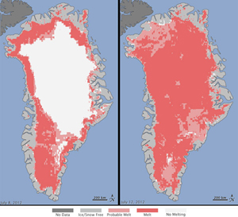
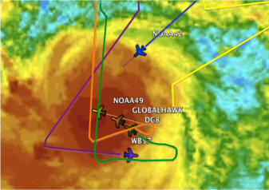
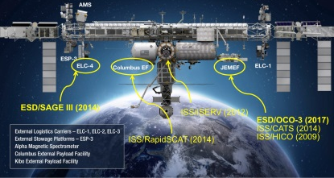
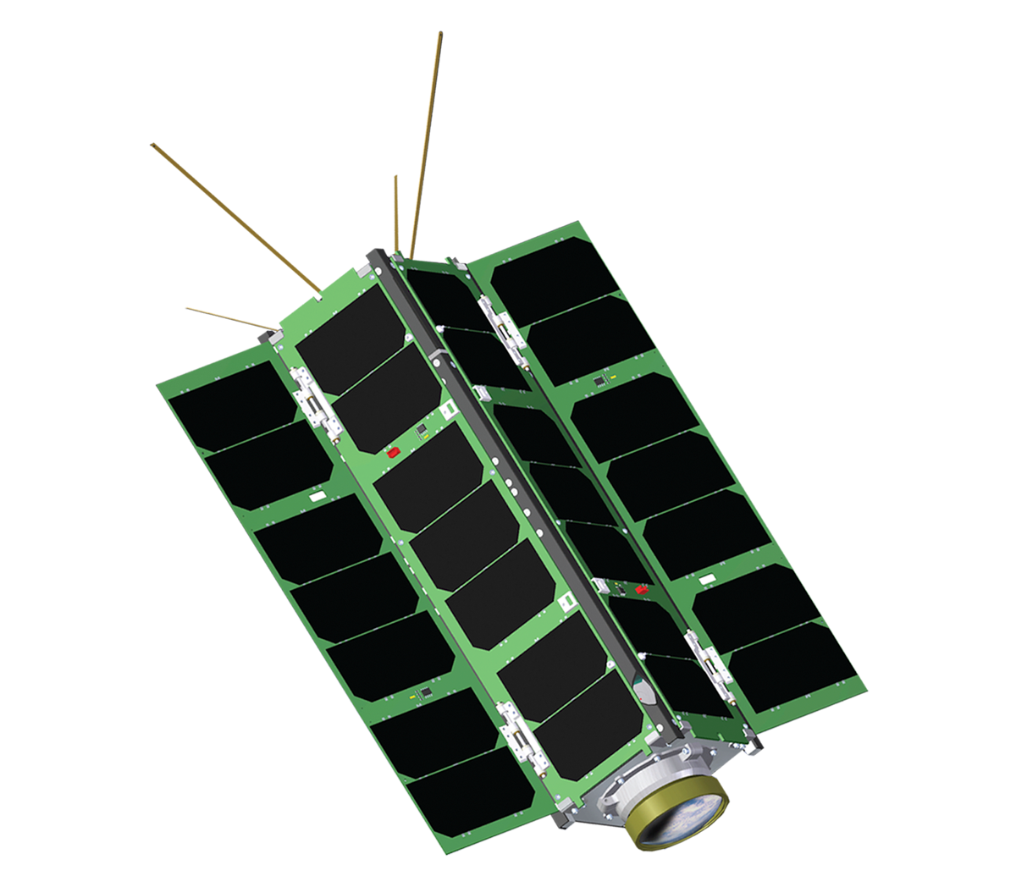


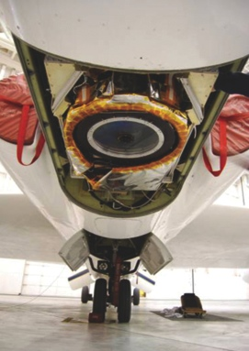
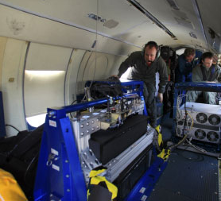
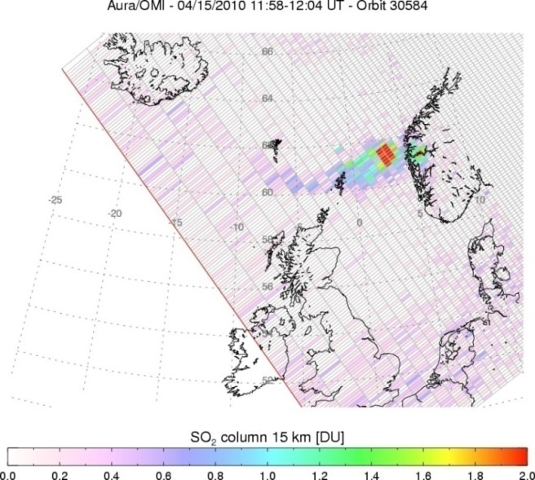



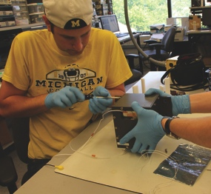
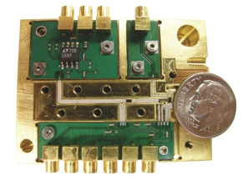
NASA’s Earth Science Division
Research
Flight
Applied Sciences
Technology
Notes:
2

Slide 3
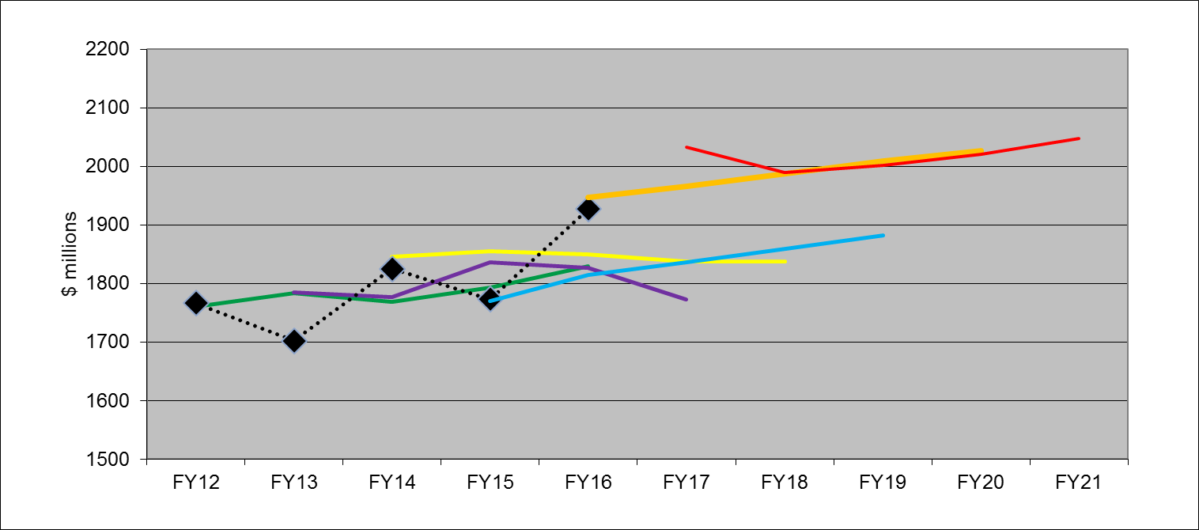
ESD Budget: FY17 Request/Appropriation
  ESD budget jumps significantly in FY17 – then becomes
  consistent with FY16 President’s Budget Request for the
  out-years
FY17
request
FY14
request
FY16 request
FY12
request
FY15
request
FY13
request
Appropriation

Slide 4



























(Pre)Formulation
Implementation
MAIA (~2021)
TROPICS (~2021)
EVM-2 (~2021)
Primary Ops
Landsat 9
(2020)
Extended Ops
PACE (2022)
NI-SAR (2022)
SWOT (2021)
TEMPO (2018)
JPSS-2 (NOAA)
RBI, OMPS-Limb (2018)
Sentinel-6A/B (2020, 2025)
GRACE-FO (2) (2017)
ICESat-2 (2017)
Earth Science Instruments on ISS:
RapidScat, (2017)
CATS, (2020)
LIS, (2016)
SAGE III, (2016)
TSIS-1, (2018)
ECOSTRESS, (2017)
GEDI, (2018)
OCO-3, (2018)
CLARREO-PF, (2020)
TSIS-2 (2020)
CYGNSS (2016)
ISS
SORCE, (2017)
TCTE (NOAA)
NISTAR, EPIC (2019)
(NOAA’S DSCOVR)
QuikSCAT (2017)
Landsat 7
(USGS)
(~2022)
EO-1 (2017)
SMAP (>2022)
Terra
(>2021)
Suomi NPP (NOAA) (>2022)
Aqua(>2022)
Landsat 8
(USGS) (>2022)
CloudSat (~2018)
CALIPSO (>2022)
GPM (>2022)
Aura (>2022)
GRACE (2)
(2018)
OSTM/Jason 2 (>2022)
(NOAA)
OCO-2 (>2022)
Notes:
Fleet - Earth Science Division - Missions (with color key; editable)
Dec. 15, 2015
Credit: NASA/J. Mottar
------------------------------
SLIDE INFO
CORRECTION DENNING PER RIVERA Feb 18, 2016
Changed misspelling of “Sentinal” to “Sentinel”
UPDATE DENNING PER FREILICH DECISIONS FEB 12, 2016
Changed OCO-3 to Formulation color and moved lower in list
Changed RBI to Formulation color
Changed GEDI to Implementation color and moved to line above it
Added TSIS-2 in Formulation color
UPDATE DENNING PER FREILICH DECISIONS FEB 4, 2016
Changed “Altimetry FO (Formulation in FY16) to “Sentinal-6A/B”
On Landsat 9, removed comma and TIRFF
Change I was going to make – “NISTAR, EPIC (NOAA’s DSCOVR) to green primary ops was already corrected
Dec. 15, 2015 – Updated: TEMPO changed to Implementation phase; NISTAR, EPIC changed to Primary Ops phase; ; OCO-3 and ECOSTRESS changed to Implementation phase; Aquarius removed; slide now fully editable. JMottar
May 18, 2015 – Added to SMD Multimedia Library.
May 18, 2015 – Updated the outdated 2014 version: TRMM was removed; NISTAR, EPIC (NOAA's DSCOVR) were added; SMAP icon was updated; moon at top left was removed; color key moved to top left.-JMottar
ID: I-EA-15-0040 (image)
ID: SL-EA-15-0068 (slide)

Slide 5
ESM and ESSP Program Overviews
The Earth Systematic Missions (ESM) development missions in this period include:
  ICESat-2, SAGE III, GRACE-FO, SWOT, Landsat-9, RBI, TSIS-1 and -2, OMPS-Limb, NISAR, PACE, Sentinel 6A and -B, CLARREO Pathfinder
The Earth Systematic Missions (ESM) on-orbit* missions include:
  SMAP (>2022), DSCOVR (2019), S-NPP (>2022), GPM (>2022), LDCM (>2022), Terra (>2022), Aqua (>2022), Aura (>2022), OSTM (>2022), QuikScat (2017), SORCE (2017), and EO-1 (2017); also RapidScat (2017) and CATS (2020)
The Earth System Science Pathfinder (ESSP) development missions in this period include:
  OCO-3, CYGNSS, TEMPO, GEDI, ECOSTRESS, MAIA, TROPICS
  EVS-2 and -3 and Venture Technology selections (GrAOWL, Tempest), EVM-2 & 3, EVI-4,5,6,7,8
The Earth System Science Pathfinder (ESSP) on-orbit missions include:
  OCO-2 (>2022), GRACE (2018), CALIPSO (>2022), CloudSat (2018)
*On-orbit dates correspond to end-of-mission assumptions, consistent with 2015 Sr. Review
Notes:
Missions in operation:
2013 – ACRIMSAT, Terra, Aqua, Aura, Jason, OSTM/Jason-2, EO-1, QuikScat, TRMM,
LDCM/Landsat-8, Landsat-7, SORCE, GRACE, CALIPSO, CloudSat, Aquarius, S-NPP
2019 – add GPM, SMAP, ICESat-2, GRACE FO, OCO-2, SAGE III, CYGNSS, OCO-3, TEMPO and subtract TRMM, EO-1 for sure. Others are maybe
Missions in formulation/development:
2013 – SMAP, OCO-2, GPM, SAGE III, OCO-3, ICESat-2, GRACE FO, TEMPO, CYGNSS, SWOT
2019 – add PACE, L-Band SAR, EVI1a, EVI-2/3/4/5, EVM-2, and possibly 2 more (if smaller EVI’s are selected; subtract all but SWOT from 2013 list

Slide 6
Venture Class Selections/Solicitations
EVS-1: CARVE, ATTREX, DISCOVER-AQ, AirMOSS, HS-3
EVM-1: CYGNSS (10/2016 LRD)
EVI-1: TEMPO (2019-; 2017 instrument delivery)
EVI-2: GEDI (2019; 2018 del.); ECOSTRESS (10/2017; 5/2017 del.)
EVS-2: ATom, NAAMES, OMG, ORACLES, ACT-America, CORAL
EVI-3: MAIA, TROPICS
EVM-2: Selection(s) likely by end of FY2016
Notes:
TJF 3/27/15: removed second page number.

Slide 7
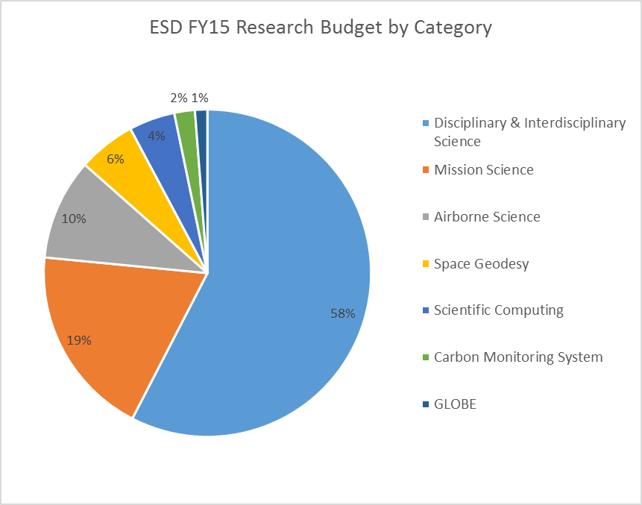
Earth Science Research
Focus Areas
Carbon cycle and Ecosystems
Climate Variability and Change
Atmospheric Composition
Global Water and Energy Cycle
Earth Surface and Interior
Weather

Slide 8
Mission | Location(s) | Date(s) | Platform(s) | Summary of Mission
Aviris NG India | Hyderabad India | Dec 15 – Spring 16 | B200 (ISRO aircraft) | Imaging spectroscopy science and application investigation over Indian territory
AfriSAR/G-TEC | Gabon Africa | Feb – Mar 16 | B200, C20A | NASA/ESA collaboration on algorithm development and future mission cal/val activities for above-ground biomass and ecosystem structure and dynamics usint radar and lidar.
Korus-AQ | Korea | Spring 16 | DC8, B200 | Study sources of pollution in atmosphere over Korea and Western Pacific region using a mix of in situ and remote sensing capability while enhancing understanding of future geostationary atmospheric composition observations
Atmospheric Carbon and Transport – America | Eastern and Midwestern US | Summer 16, Spring 17, Fall 17, Summer 18 | B200, C-130 | Quantify the sources of regional carbon dioxide, methane and other gases, and document how weather systems transport these gases in the atmosphere; improve identification and predictions of carbon dioxide and methane sources and sinks over the eastern US
North Atlantic Aerosols and Marine Ecosystems Study (NAAMES) | Atlantic Ocean, flown from Canada | Sep 17, Mar/Apr 18, | C-130, Ship ((UNOLS) research vessel) | Environmental and ecological controls on plankton communities in the North Atlantic Ocean
Coral Reef Airborne Laboratory (CORAL) | FL, HI, Mariana Is., Palau, Australia | Apr 16 – Jan 17 | Contracted GIV | Provide critical data and new models needed to analyze the status of coral reefs and to predict their future
ObseRvations of Aerosols Above Clouds and Their IntEractionS (ORACLES) | Namibia, Africa | Aug/Sep 16, Jul/Aug 17, Sep/Oct 18 | P-3, ER-2 | Investigate how smoke particles from massive biomass burning in Africa influences cloud cover over the Atlantic.
Oceans Melting Greenland (OMG) | Greenland | Sep/Oct 16 - + multiple till Sept/Oct 2019 | Contracted Twin Otter, GIII, Ship (MV Cape Race) | investigate the role of warmer saltier Atlantic subsurface waters in Greenland glacier melting. The study will help pave the way for improved estimates of future sea level rise.
Atmospheric Tomography Experiment (ATom) | Around the Globe | Aug 16, Jan/Feb 17, Sep/Oct 17, Apr/May 18 | DC-8 | Study the impact of human-produced air pollution on multiple greenhouse gases, addressing transformation of various air pollutants, especially methane and ozone.
O2/N2 Ratio and CO2 Airborne Southern Ocean (ORCAS) | Southern Ocean | Jan/Feb 16 | GV (NSF) | NASA brings remote sensing (PRISM) capability to NSF-led mission to Investigate the large-scale tropospheric distributions, gradients, and fluxes of O2 and CO2 over Southern Ocean.
HyspIRI | Hawaii | Summer 16 | ER-2 | Study the optical characteristics of coral reef and volcanic systems in and around Hawaii using MASTER and AVIRIS to assess value of HysPIRI-like observations
Operation IceBridge | Alaska, Greenland, Antarctica | Mar – May, Oct/Nov – FY16,17,18,19 | P-3, DC-8 | Study ice sheet thickness, sea ice distributions, and related parameters over Arctic and Antarctic to bridge gap between ICESat-1 and ICESat-2, complement lidar observations with those using related techniques (e.g., radar) and obtain coincident data with ESA CryoSat-2
UAVSAR | Various US and South America | Year round | C-20 | Radar data collected for multiple NASA focus areas (Earth Surface and Interior, Carbon Cycle and Ecosystems, Global Water and Energy Cycle, Climate Variability and Change) and for Applications Uses (e.g., levee monitoring)
SPURS II | Eastern Sub-Tropical Pacific Ocean | Starting spring 2016, multiple sailings covering 18 month period | Schooner Lady Amber plus in-water observations (e.g., gliders, drifters, buoys) | Study processes that control sea surface salinity in higher salinity region than that sampled in SPURS I (sub-tropical North Atlantic)
ABoVE | Alaska, NW Canada | Beginning 2016, continuing | Surface measurements; airborne to follow | Study vulnerability and resilience of Arctic ecosystems to environmental change in the Arctic and boreal region of western North America

Slide 9

SMD Earth Science Division
Applied Sciences Program
Applications
Health & Air Quality
Ecological Forecasting
Water Resources
Disaster Applications & Response Team
Wildfires (through FY17)
Capacity Building
SERVIR (joint with USAID)
ARSET, Applied Remote Sensing Training
DEVELOP
Satellite Mission Planning
Early Adopters, Apps. Workshops
Program-wide
Socioeconomic Impact Analyses
Community Utilities (ESIP, NEX, etc.)
Communications
GEO and USGEO Support
President’s FY17 Budget Request
Re-establishes funds for full SERVIR Applied Sciences Team FY16-18; expands Team in FY19-21 for increase to 6 SERVIR hubs by 2018
Increases funding for Applications Areas (via internal re-allocation)
Implements Snow & Water Availability focused activity for Western States
Implements Food Security Consortium
Implements Disaster Response Plan for increased preparation-based approach
Continues activities to develop techniques to quantify social and economic benefits from Earth science applications

Slide 10

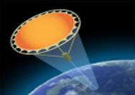
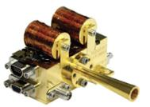
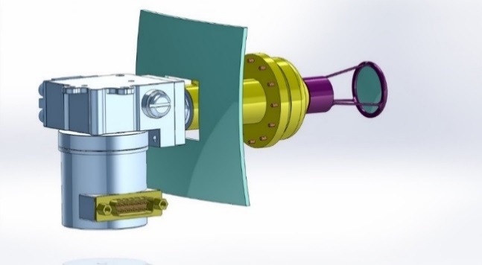
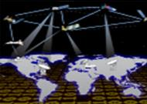
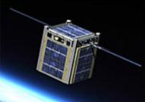
Earth Science Technology Office
Instrument Incubator Program (IIP)
robust new instruments and measurement techniques
17 new projects added in FY14 (total funding ~$71M over 3 years)
Advanced Component Technologies (ACT)
critical components and subsystems for instruments and platforms
11 new projects added in FY14 (total funding ~$13M over 3 years)
Observation
Sustainable Land Imaging-Technology (SLI-T); Managed by ESTO, funded from SLI
new technologies and reduced costs for future land imaging (Landsat) measurements
First solicitation released in FY16 (total funding ~$29M over 5 years from SLI budget – investigations managed by ESTO)
Advanced Information Systems Technology (AIST)
innovative on-orbit and ground capabilities for communication, processing, and
management of remotely sensed data and the efficient generation of data products
24 new projects added in FY15 (total funding ~$25M over 2 years)
Information
In-Space Validation of Earth Science Technologies (InVEST)
on-orbit technology validation and risk reduction for small instruments and instrument systems that could not otherwise be fully tested on the ground or airborne systems 4 new projects added in FY15 (total funding ~$21M over 3 years)
Validation

