Slide 1
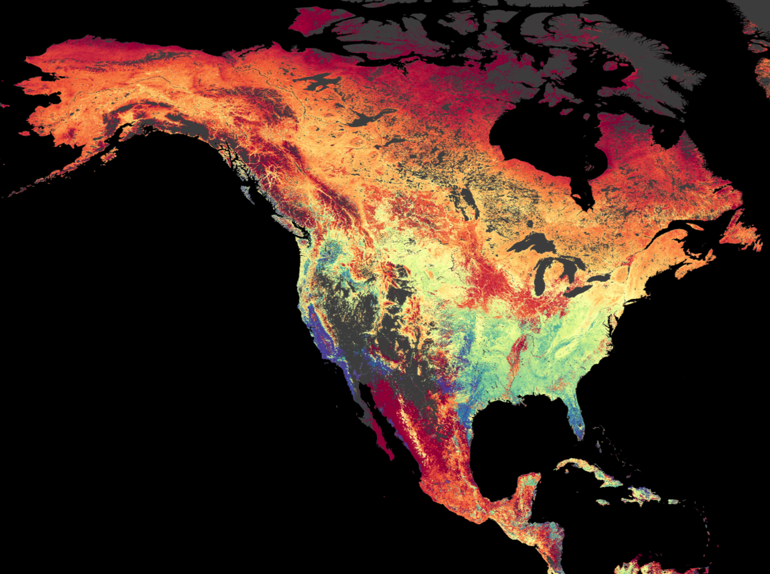
MODIS Collection 6 Land Cover & Land Cover Dynamics
MODIS Science Team Meeting 2016
Josh Gray, Damien Sulla-Menashe, Mark Friedl

Slide 2
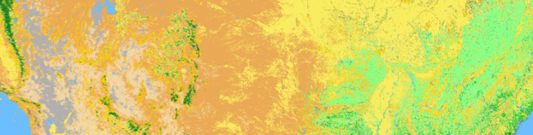
The MCD12 Products
Primary inputs are MCD43A4/2 products
MCD12Q1 and MCD12C1
  Global, annual land cover at 500 m and 0.05°
  6 Types: IGBP, UMD, LAI/fPAR, NPP/BGC, PFT, LCCS
MCD12Q2
  Global, annual land surface phenology at 500 m
  Start and end of season, integrated greenness

Slide 3
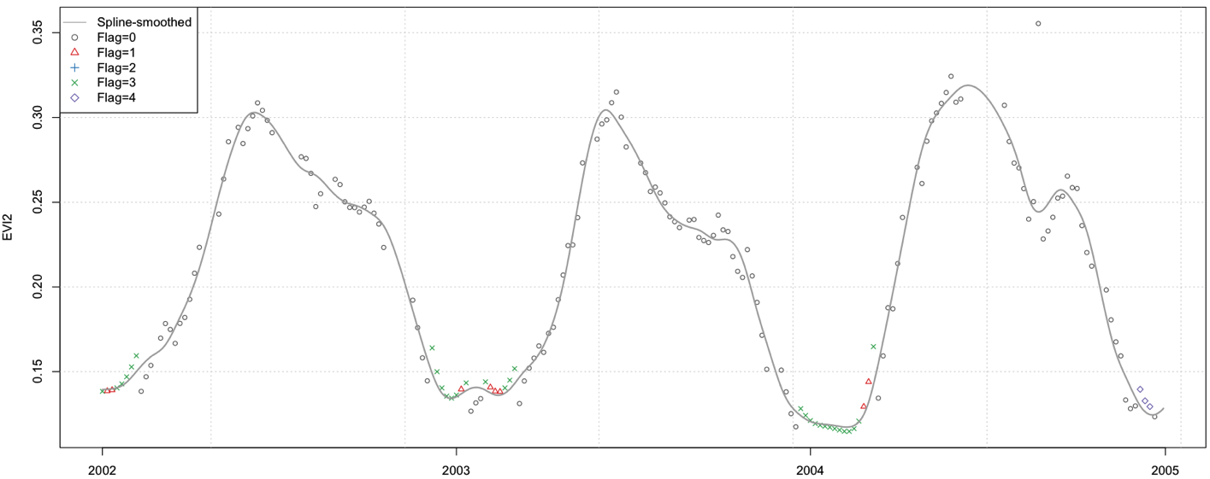
MCD12 Collection 6
MCD12Q1/C1 and MCD12Q2 both use:
  Daily Collection 6 NBARs
  Spline smoothing of band time series
  Snow screening and filling

Slide 4
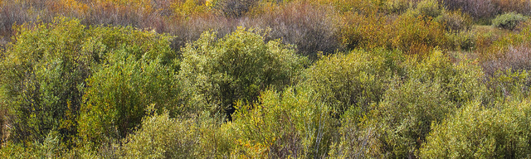
MCD12Q1 Improvements
Hierarchical classification approach
RandomForest instead of C4.5
Improved training data (STEP)
Improved feature set
Hidden Markov model (Abercrombie and Friedl, 2016 IEEE TGARS)

Slide 5
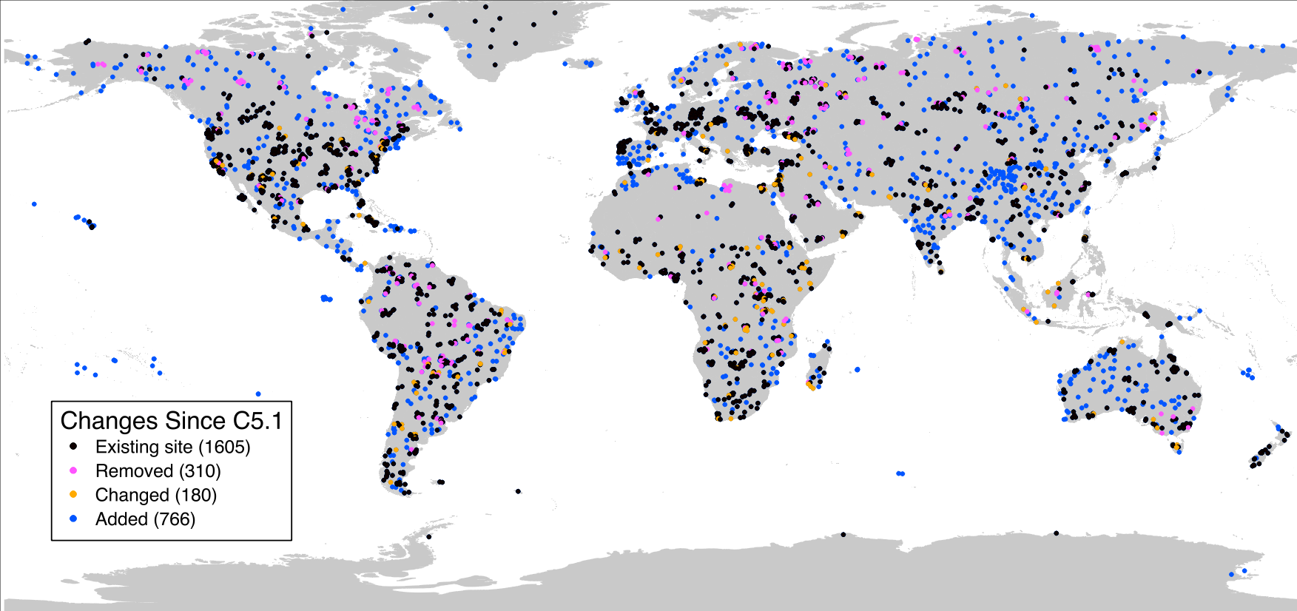
STEP Changes
47% more STEP sites
31% of sites modified or removed

Slide 6
Improved Algorithm and Classification Inputs
 | V5 | V6
Feature Set | Monthly NBAR (7 bands), EVI, and LST. Annual metrics (min, max, mean) for each feature. | Annual metrics for growing season: from NBARs (7 bands) and vegetation indices (EVI2, NDII1, NDII2, NDWI, NDSI)
Classifier | C4.5 Decision Tree | RandomForest Classifier
Ancillary Data | MODIS V5 land-water mask V5 urban layer Prior probability layers based on Collection 4 data with agriculture intensity data | MODIS V6 land-water mask at 250-m Updated V6 urban layer Prior probability layers based on: New agriculture intensity data Climate-based classifications MODIS Vegetation Continuous Fields product

Slide 7
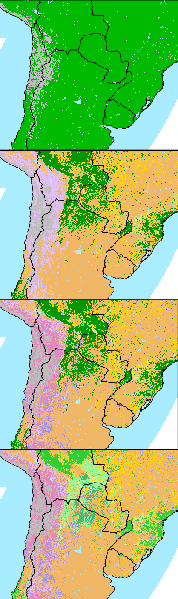
New LCCS Layer
All Data
Vegetated and Nonvegetated Layer
Vegetated
Barren
Permanent Snow/Ice
Water
Canopy and Understory Layer
Closed Tree Canopy
Open Tree Canopy
Sparse Tree Canopy
Dense Understory
Sparse Understory
Dense Shrub
Shrub /Herbaceous Mix
Dense Herbaceous
Sparse Shrub
Sparse Herbaceous
Perennial and Annual Layer
Leaf Type and Phenology Layer
Evergreen Needleleaf
Evergreen Broadleaf
Deciduous Needleleaf
Deciduous Broadleaf
Mixed

Slide 8
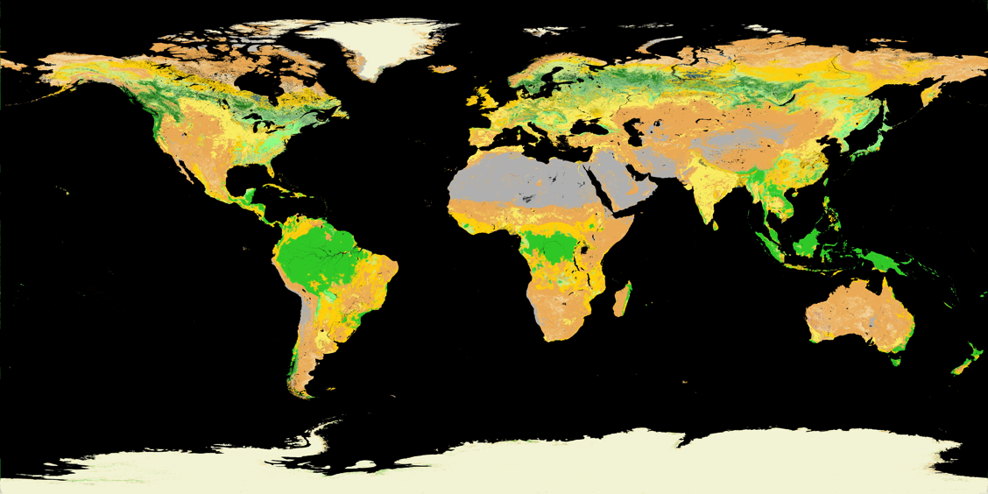
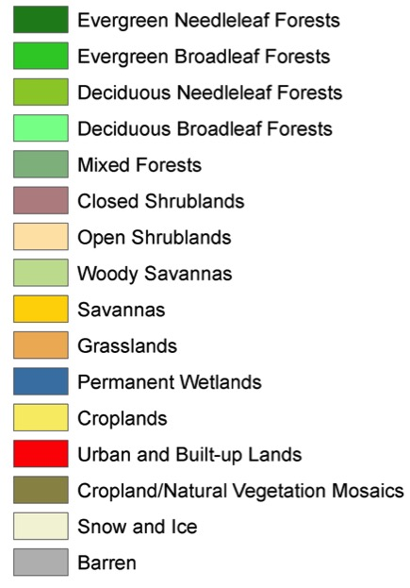
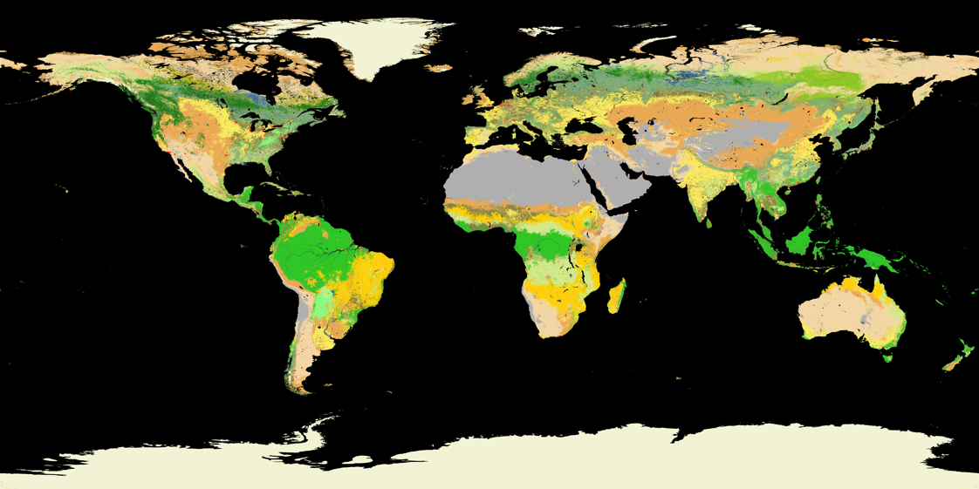
C6
C5

Slide 9
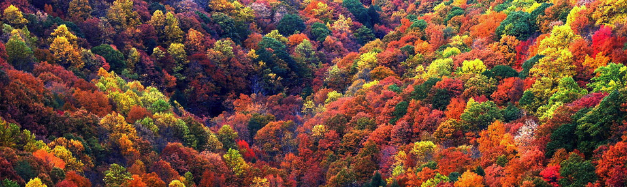
MCD12Q2
What’s new in C6?
  Relative thresholds of splined NBAR-EVI2 rather than inversions of piecewise logistic functions
  New SDS: peak, midpoint of GUP/GDOWN
  Improved QA: QA value for each phenometric; weighted sum of missing data in vicinity of phenometric and spline goodness of fit

Slide 10

2003 Mid-Greenup DOY

Slide 11
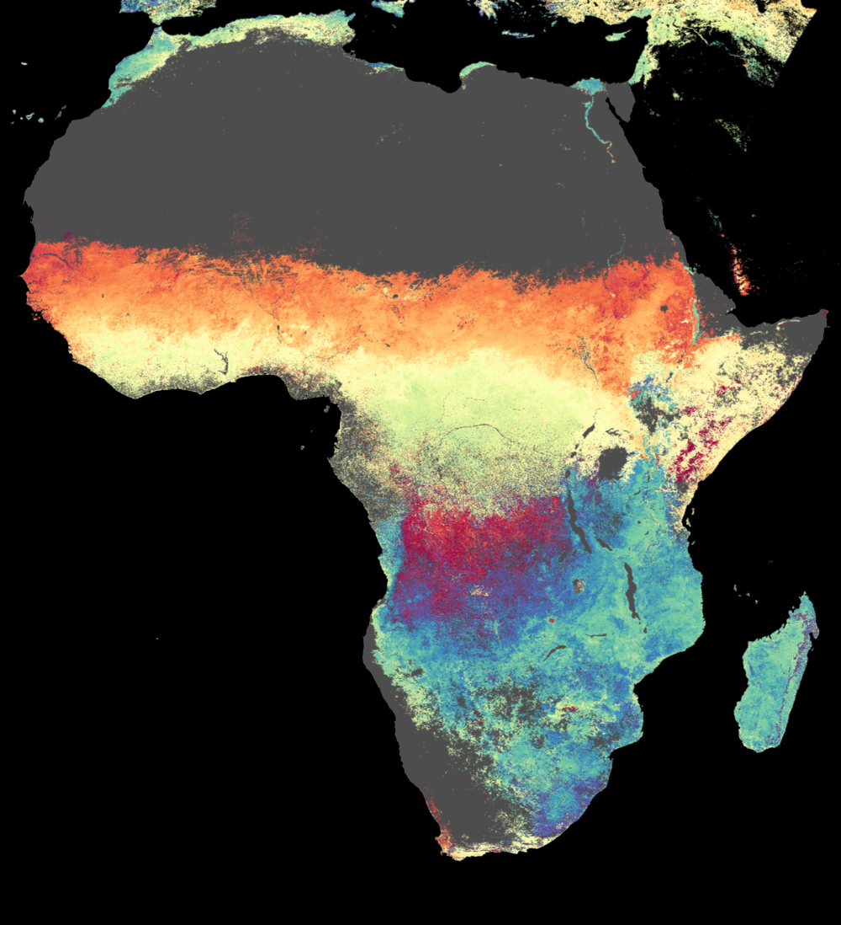
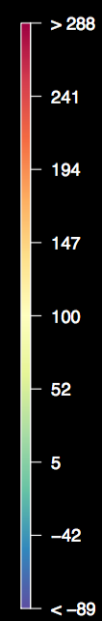

Slide 12
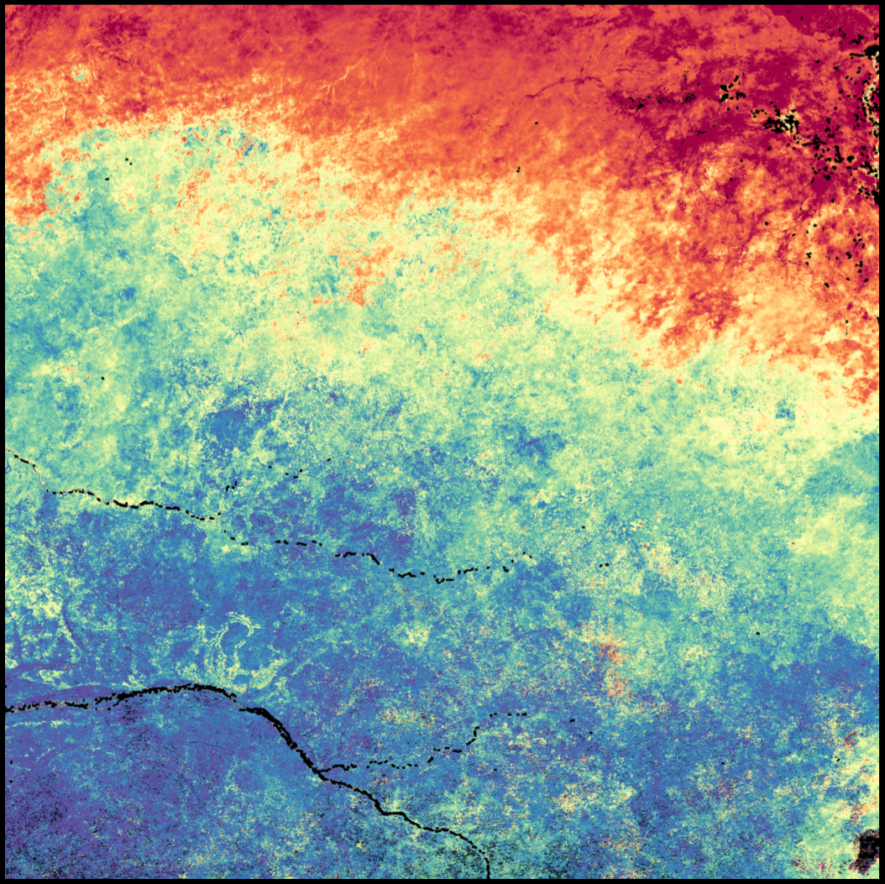
h20v08 midgup 2003

Slide 13
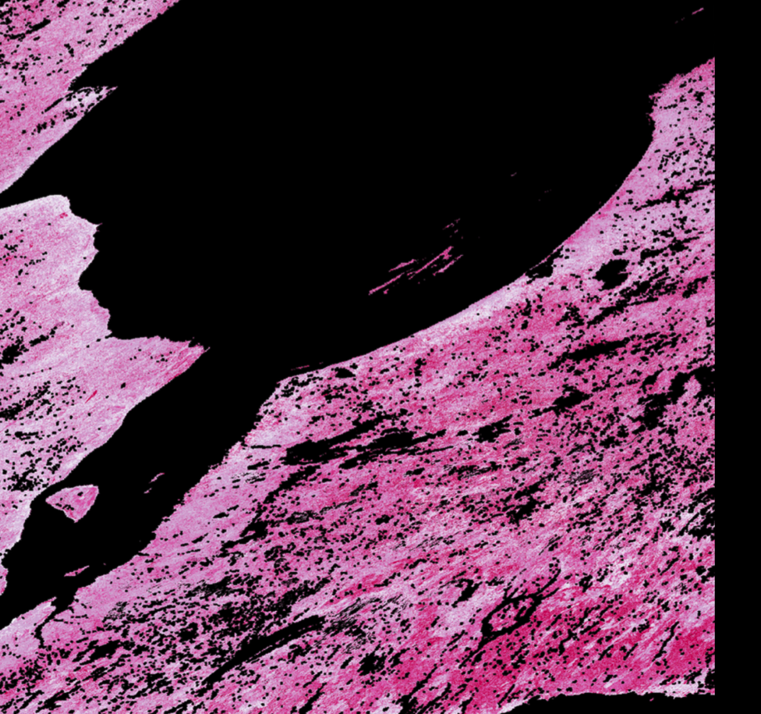
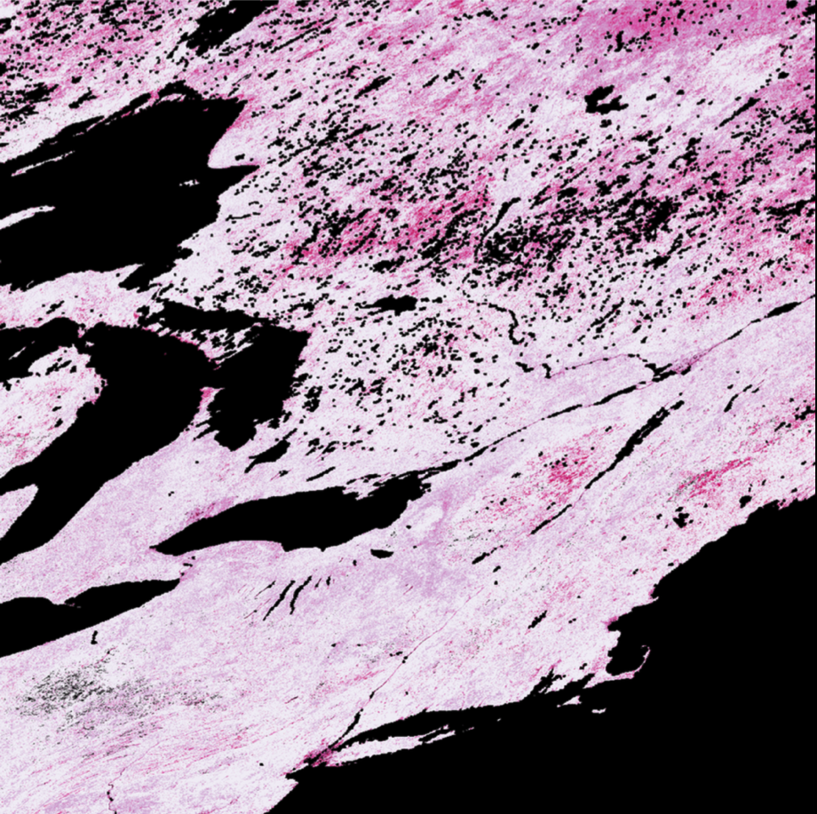
Phenometric-specific QA
Best
Good
h13v03 2003 onset greenness increase quality
Fair
Marginal
QA score is weighted sum of fraction missing in month centered on phenometric and spline R^2 (80% and 20%, resp.)
Continuous scores collapsed to 1-4 qualitative score
h12v04 2003 onset greenness increase quality

Slide 14
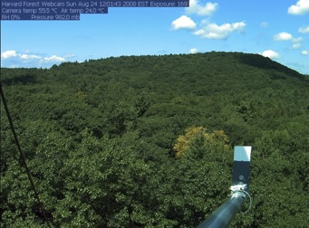
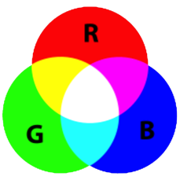

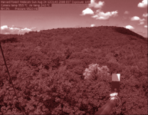
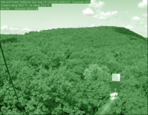
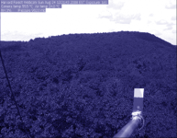

Extracting Phenology Data From Webcam Images
RGB Triplet:
RGB Color Model
Canopy “Greenness” (GCC)
Canopy “Greenness”
Richardson et al. (2013) in Schwartz (ed.)

Slide 15
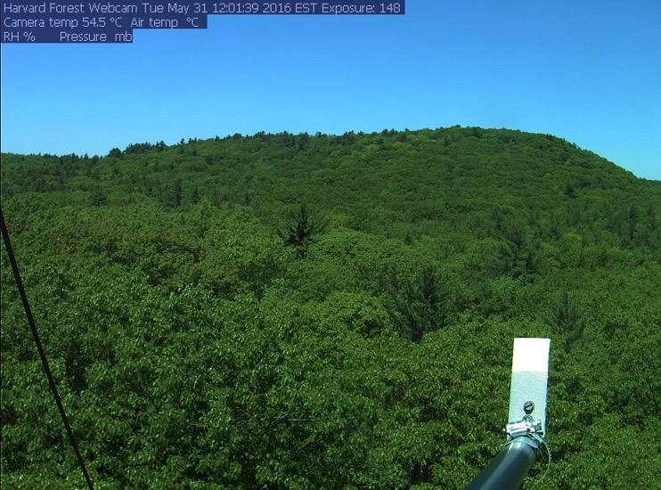
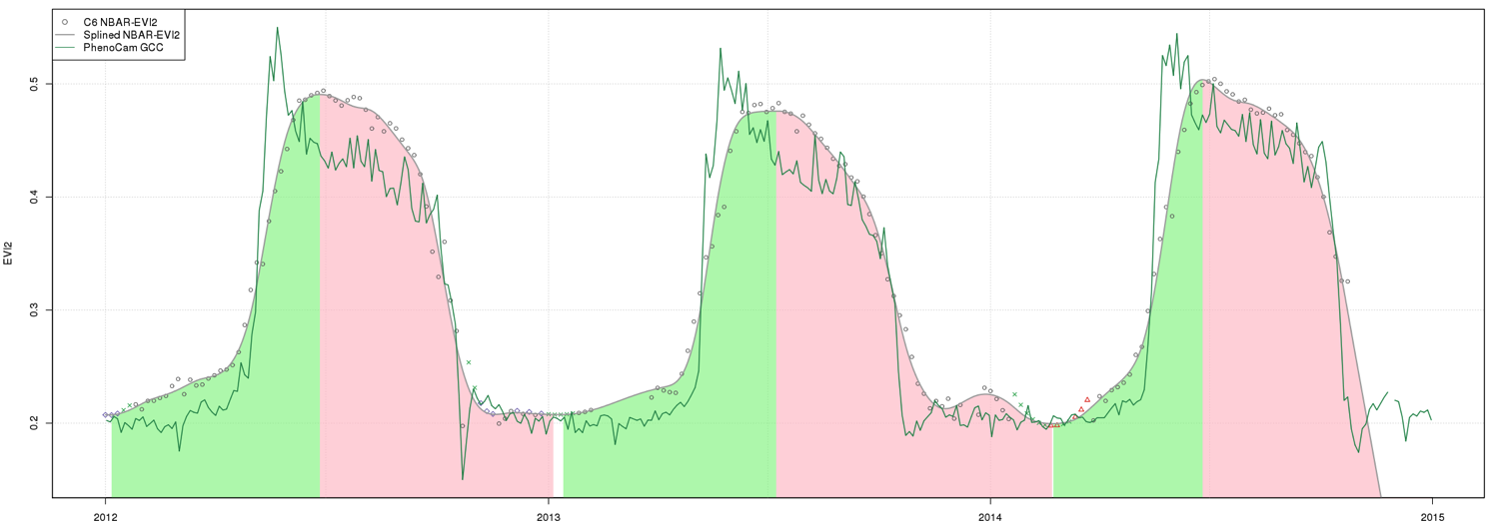
Harvard Forest Phenocam, MA

Slide 16
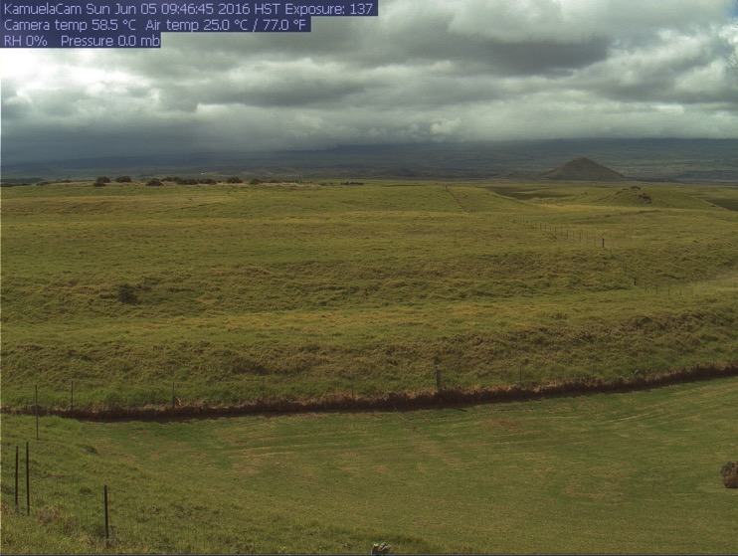
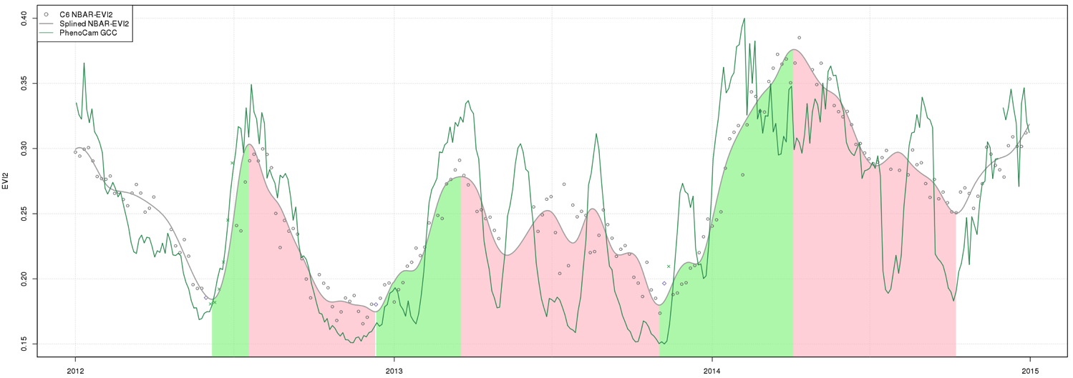
Kamuela Phenocam
Waimea, HI

Slide 17
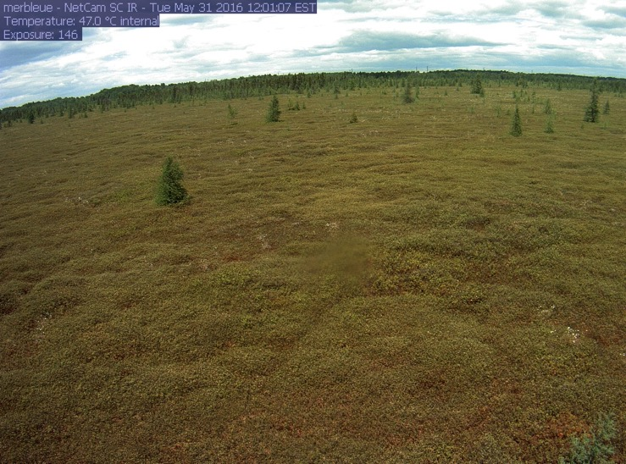
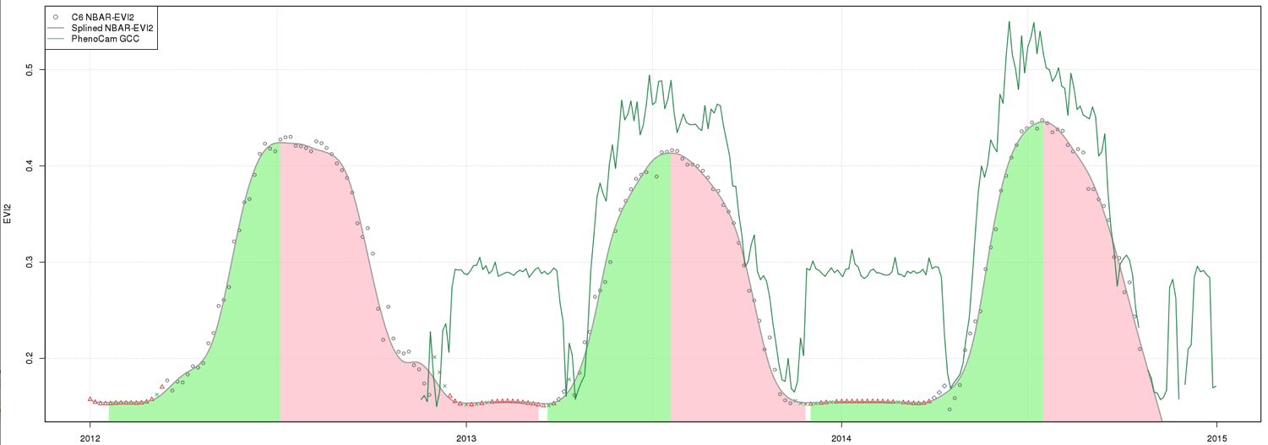
Mer Bleue Phenocam, Ontario

Slide 18
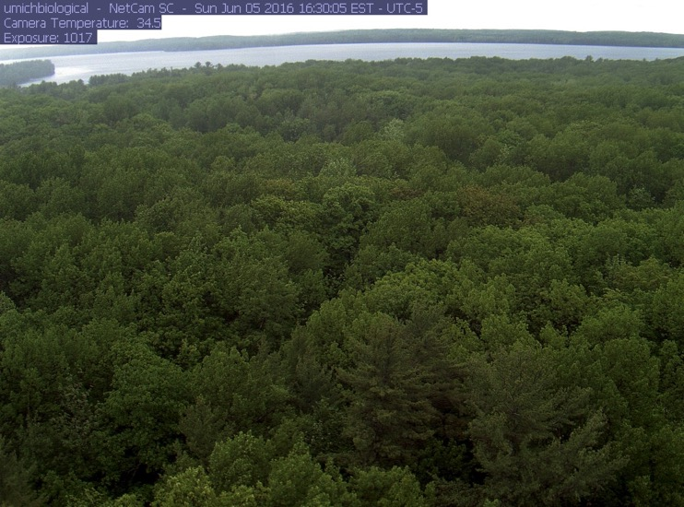
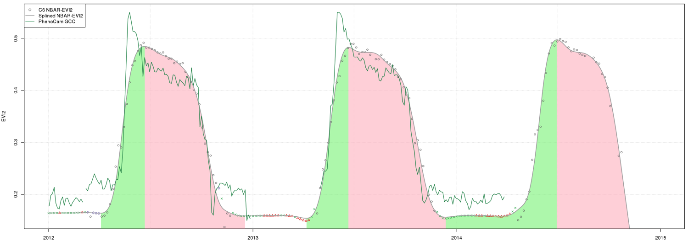
U. Michigan Biological Station

Slide 19
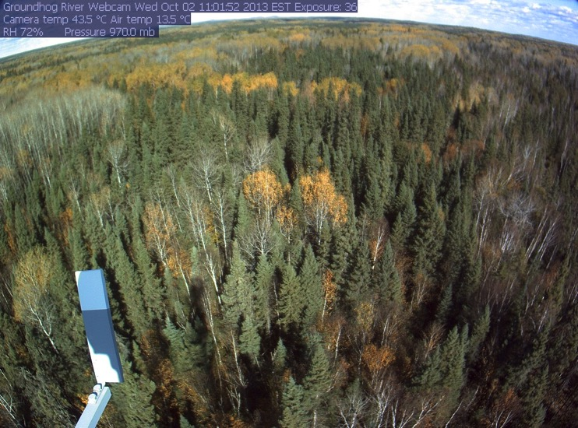
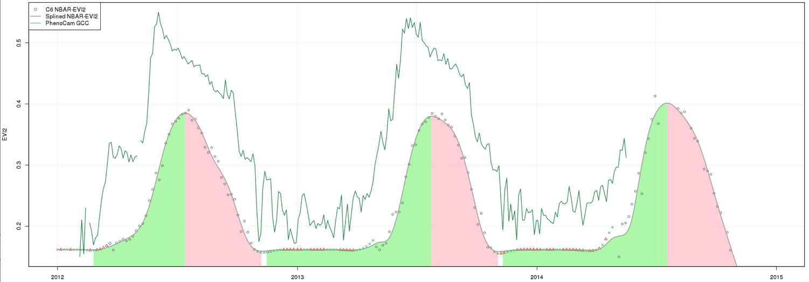
Groundhog River Phenocam, Ontario

Slide 21
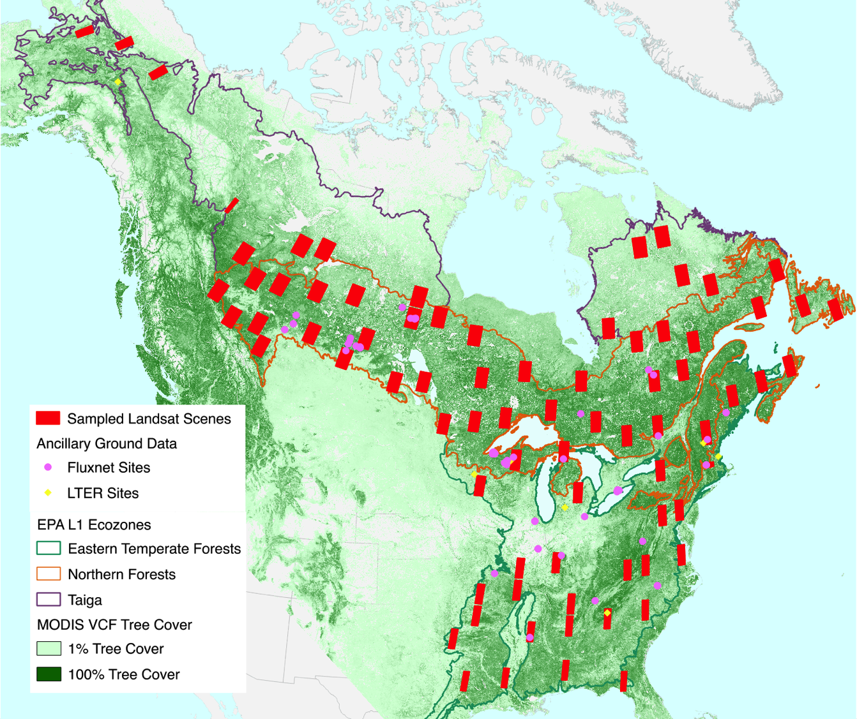
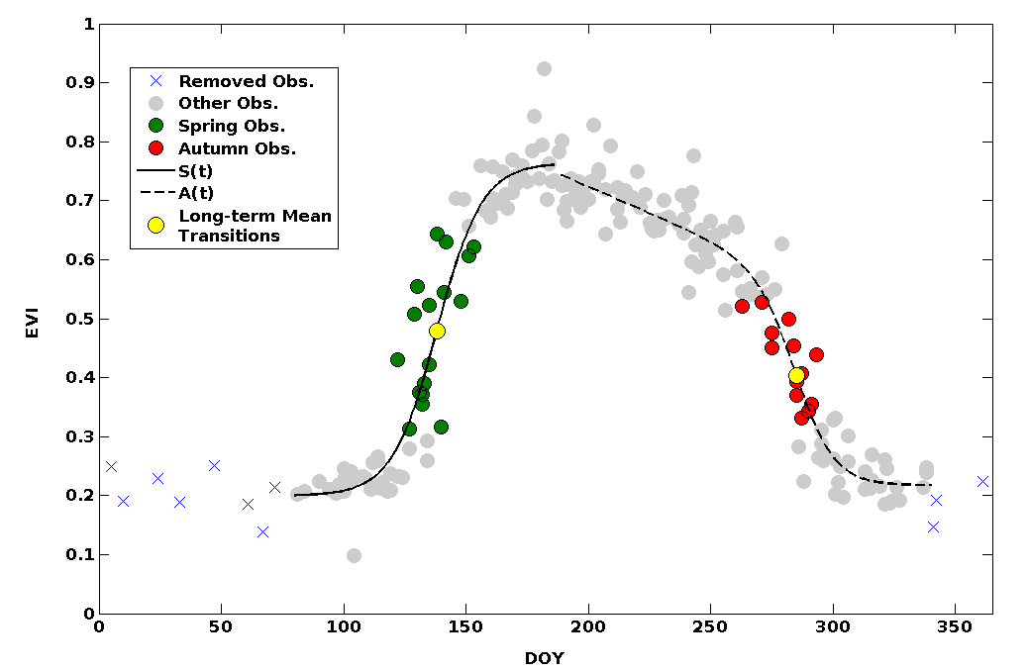
Melaas, Friedl, and Zhu. 2013. RSE

Slide 22
50% Greenup Assessment with Melaas et al. Landsat method 2001-2014
Bars are standard errors across pixels within site

Slide 23
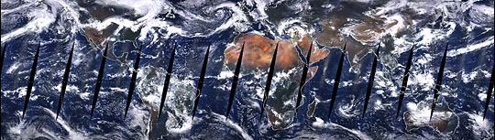
Moving Forward
Code migration to Goddard, will be processed on the PEATE like most other products
Ongoing assessment and refinement
Working with XYZ for VIIRS continuity

Slide 24
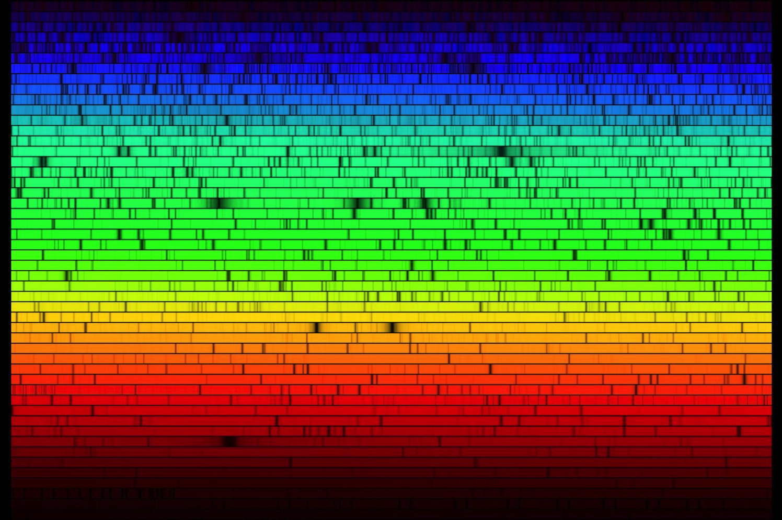
Questions?

