Slide 1
Multi-Sensor Analysis of Global Daytime and Nighttime Urban Heat Islands
Steve Frolking¹, Leah Cheek², Mark Friedl²
Annemarie Schneider³, Tom Milliman¹, Jingfeng Xiao¹
1. University of New Hampshire, Durham
2. Boston University
3. University of Wisconsin, Madison
Outline:
Mapping urban expansion globally, 2000-2010.
Landsat spectral mixture analysis (SMA) and Boston urban heat island.
Testing of project central hypothesis.

Slide 2
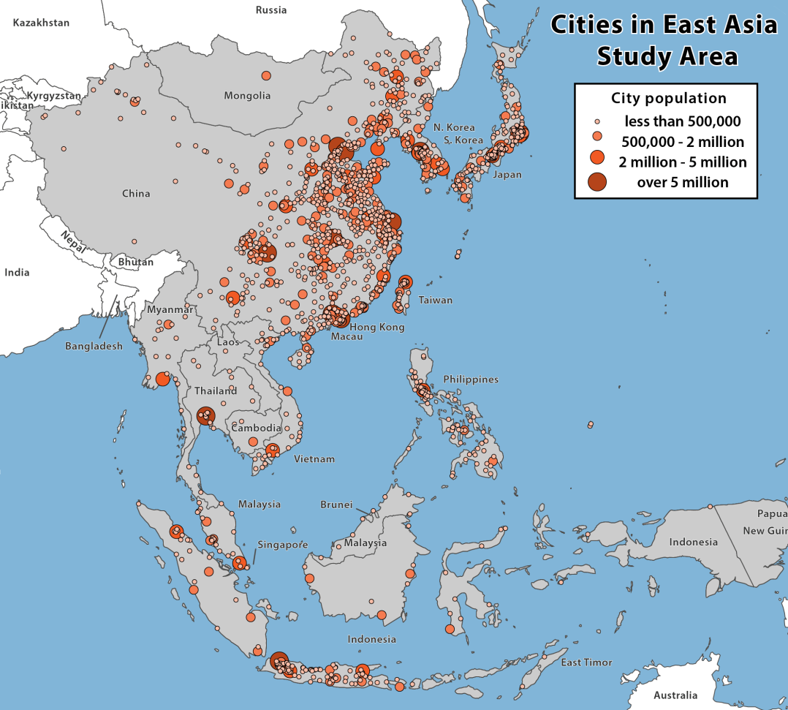
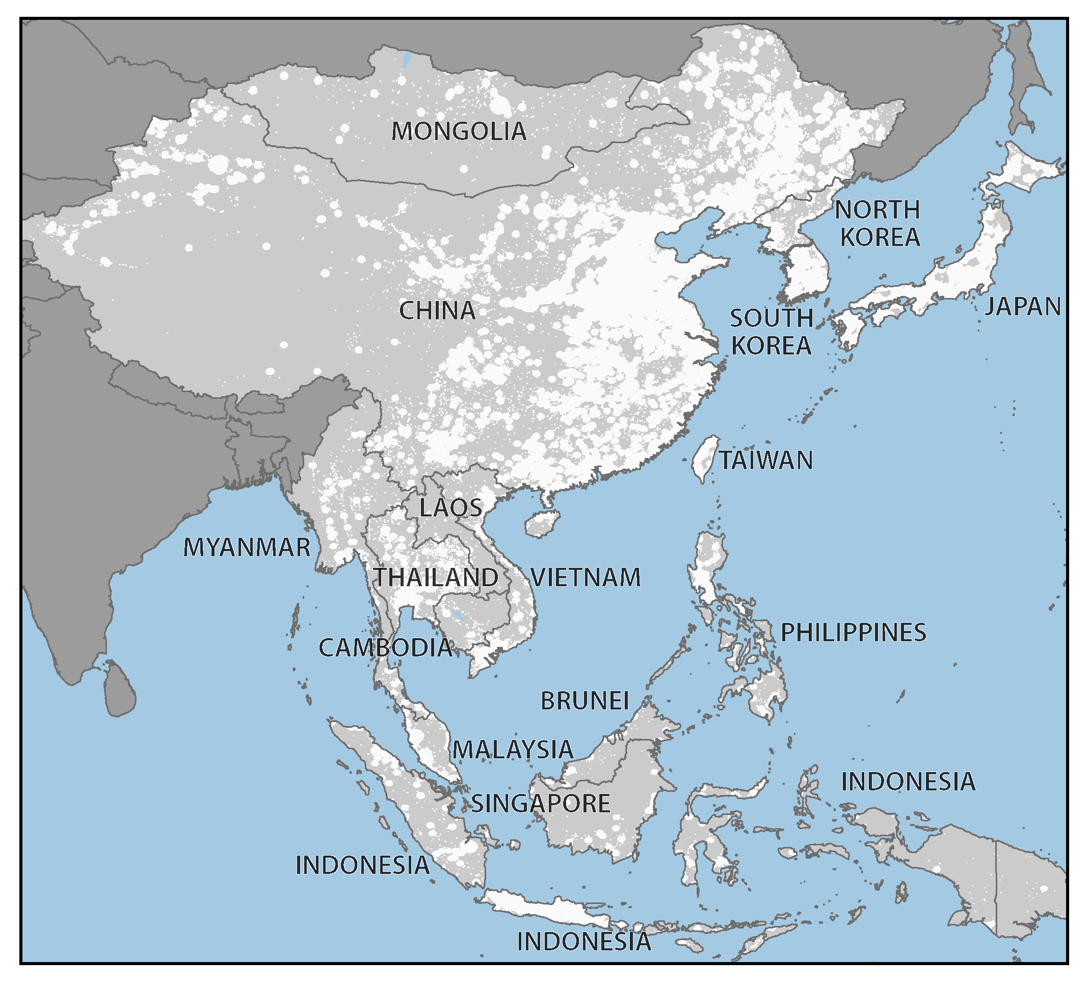
Methods
1. Mapping urban expansion globally: Methods/results for
North America and East Asia, 2000-10
Step 1:
Delineate study area extent
    Merge 2001 MODIS map of urban extent with all point datasets on cities (GRUMP, UN, etc.)
    Buffer by urban patch size
A. Schneider et al., UW
Notes:
Map of the East Asia region illustrating the study area extent defined by known locations of urban land
Merge c 2001 MODIS map of global urban extent with all available global- and country-level point datasets on cities and metropolitan areas (GRUMP, UN, etc.)

Slide 3
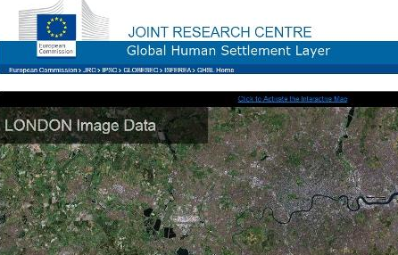
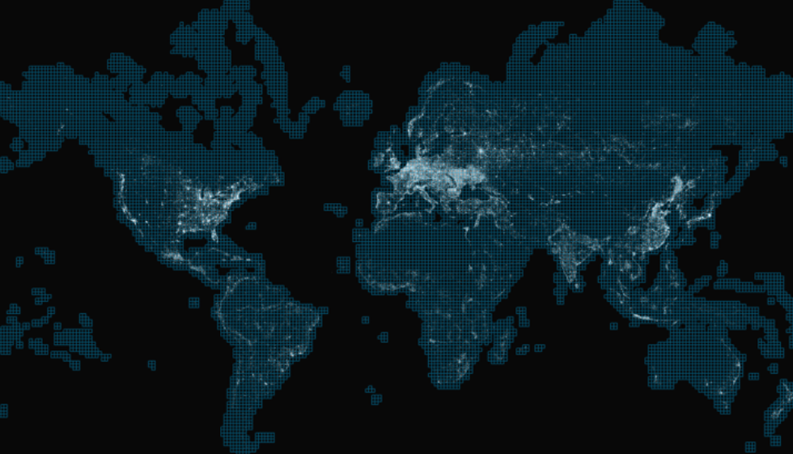
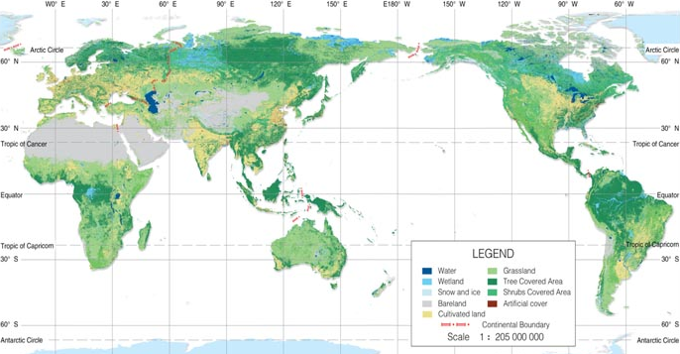

Methods
Step 2:
Characterize urban extent, c. 2010
    Synthesize new global urban maps (Landsat scale) – Globeland30, Global Human Settlement Layer, DLR urban extent map – to create urban probability surface at 500m resolution.
    Merge with MODIS 500m decision tree classification of urban land, using Bayes Rule (Mertz et al., 2015).
A. Schneider et al., UW
Notes:
shorten?
Decision trees, known for their efficacy in handling complex landscapes and noisy or missing data (Friedl & Brodley, 1997), have been widely used in remote sensing in recent decades, especially in large area mapping of land cover (Friedl et al., 2002; Hansen et al., 2005) and urban areas (Schneider et al., 2003; 2009, 2010).
Decision tree construction involves the recursive partitioning of a set of training data into increasingly homogeneous subsets based on statistical tests applied to the feature values from the training data. Once the decision tree has been estimated, these rules are then applied to the entire image to produce a classified map. Boosting, an ensemble classification technique that improves class discrimination by estimating multiple classifiers while systematically varying the training sample (Quinlan, 1996), is used to improve map accuracy. Boosting has been shown to be equivalent to a

Slide 4
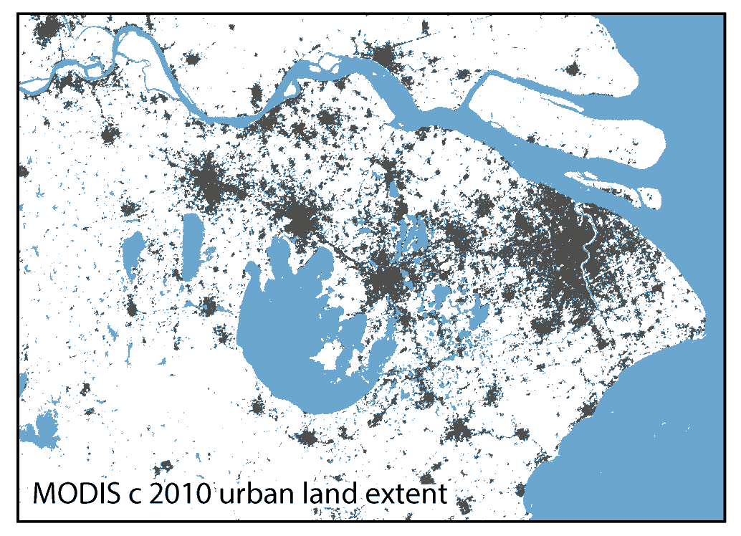
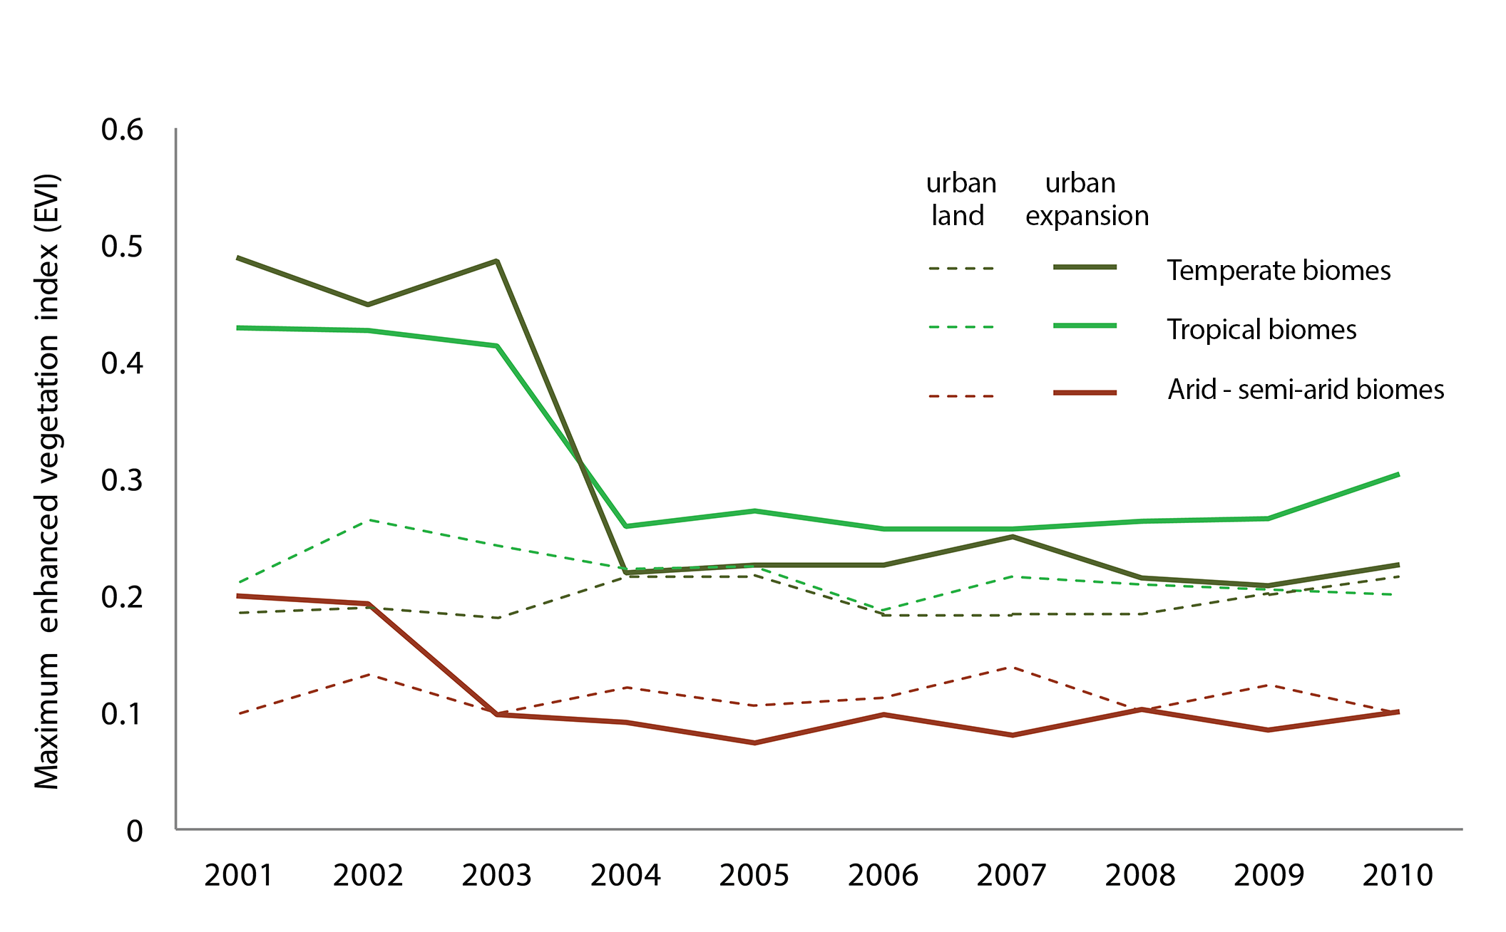
Methods
Step 3:
Change detection
  Work backwards – were 2010 urban areas built-up in 2000, or did they become urban between 2000 and 2010?
  10 years growing season max EVI data from MODIS (2001-2011).
  Supervised boosted decision tree algorithm
  Training data:
  (1) stable urban areas (2) areas that became urbanized, 2000-2010
  Output probabilities iteratively thresholded, compared to c2010 Google Earth imagery.
Maximum EVI trajectories over time
A. Schneider et al., UW
Notes:
to choose breakpoints for urban change and stable urban classes
Capitalizing on our assumption that urban land does not become ‘undeveloped’, the 2010 urban extent map was used to spatially constrain the change detection process. The change detection method used ten years of growing season maximum EVI data (2001-2010) as input to a boosted decision tree algorithm (C4.5) to classify circa 2010 urban extent as: (1) urban areas built up in 2000 that remained built‐up throughout the period; and (2) areas that belonged to a non-urban land cover class in 2000 (e.g., agriculture, grassland, forest) that became urbanized during the 2000‐2010 period. The pixel-based training data collected for the logistic regression (Figure 3c) were revisited, and all urban sites were labeled as existent urban land, or newly developed urban land, 2000-2010 (Figure 3d).
This approach relies on the observed relationship between maximum EVI and urban areas described above: any conversion from a non-urban land cover to developed land is detectable through changes in vegetation content. The premise is similar to that of EVI trajectory analysis that has been widely employed for change detection (Kennedy et al., 2007; Verbesslt et al., 2010, Clark et al., 2013). Here, the use of growing season metrics and supervised multi-date composite classification of changed areas help address the challenges associated with the large amount of cloud-contaminated data in East Asia. Similar to the procedure used for the 2010 urban extent map, the decision tree output probabilities for the urban expansion class were iteratively thresholded and compared to c 2010 Google Earth VHR imagery on a regional basis to choose breakpoints for the urban change and stable urban classes.
(Figure 5).

Slide 5
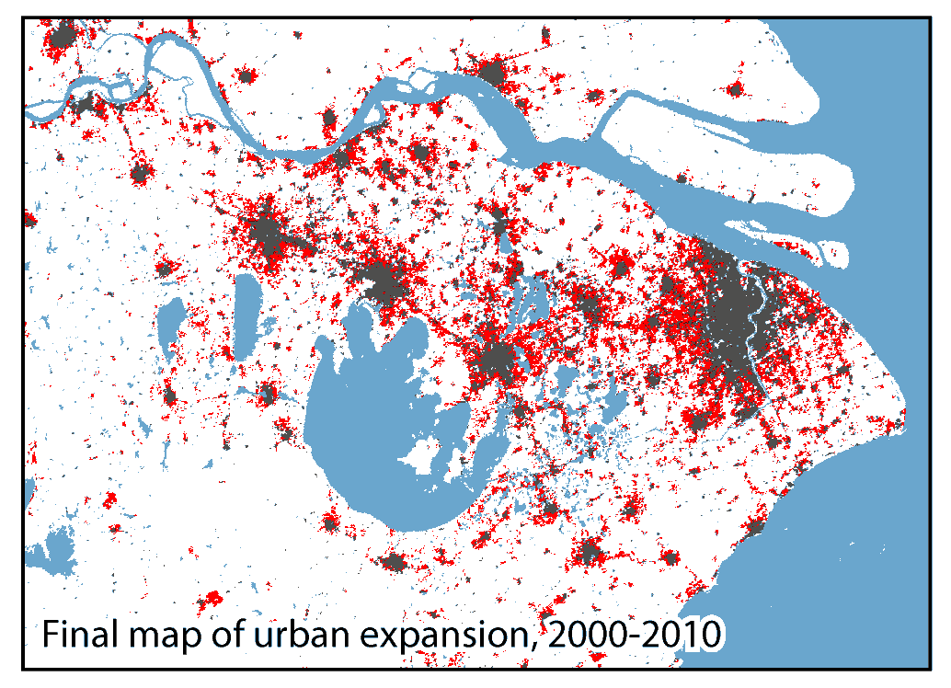
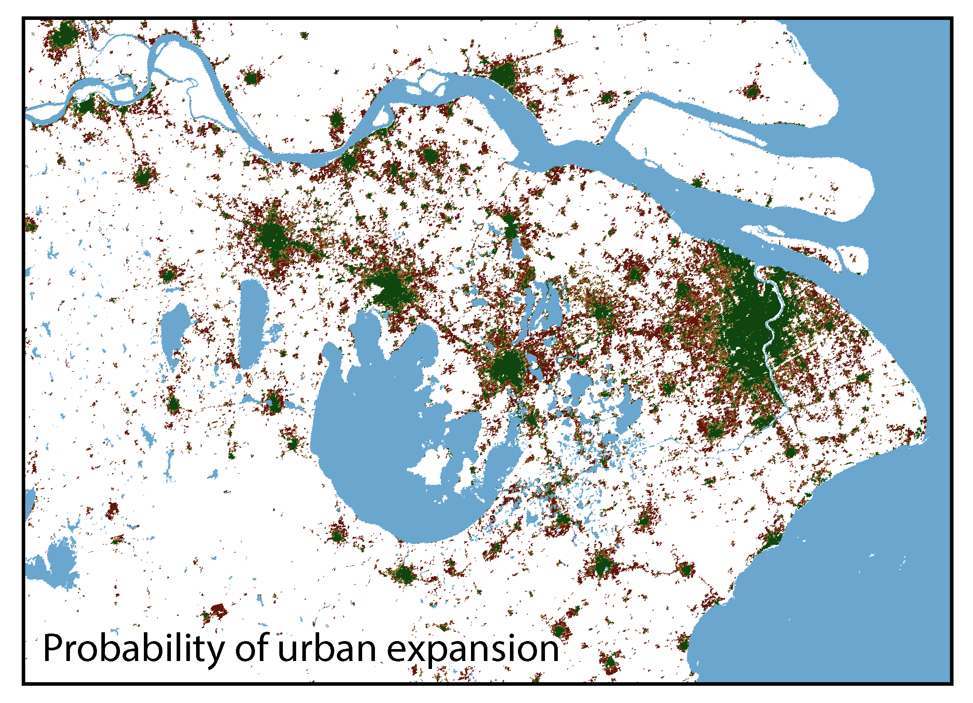
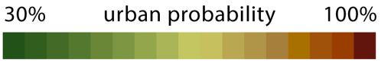
Methods
Step 3:
Change detection
  Work backwards – were 2010 urban areas built-up in 2000, or did they become urban between 2000 and 2010?
  10 years growing season max EVI data from MODIS (2001-2011).
  Supervised boosted decision tree algorithm
  Training data:
  (1) stable urban areas (2) areas that became urbanized, 2000-2010
  Output probabilities iteratively thresholded, compared to c2010 Google Earth imagery.
A. Schneider et al., UW
Notes:
to choose breakpoints for urban change and stable urban classes
Capitalizing on our assumption that urban land does not become ‘undeveloped’, the 2010 urban extent map was used to spatially constrain the change detection process. The change detection method used ten years of growing season maximum EVI data (2001-2010) as input to a boosted decision tree algorithm (C4.5) to classify circa 2010 urban extent as: (1) urban areas built up in 2000 that remained built‐up throughout the period; and (2) areas that belonged to a non-urban land cover class in 2000 (e.g., agriculture, grassland, forest) that became urbanized during the 2000‐2010 period. The pixel-based training data collected for the logistic regression (Figure 3c) were revisited, and all urban sites were labeled as existent urban land, or newly developed urban land, 2000-2010 (Figure 3d).
This approach relies on the observed relationship between maximum EVI and urban areas described above: any conversion from a non-urban land cover to developed land is detectable through changes in vegetation content. The premise is similar to that of EVI trajectory analysis that has been widely employed for change detection (Kennedy et al., 2007; Verbesslt et al., 2010, Clark et al., 2013). Here, the use of growing season metrics and supervised multi-date composite classification of changed areas help address the challenges associated with the large amount of cloud-contaminated data in East Asia. Similar to the procedure used for the 2010 urban extent map, the decision tree output probabilities for the urban expansion class were iteratively thresholded and compared to c 2010 Google Earth VHR imagery on a regional basis to choose breakpoints for the urban change and stable urban classes.
(Figure 5).

Slide 6
Methods
Step 3:
Change detection
  Work backwards – were 2010 urban areas built-up in 2000, or did they become urban between 2000 and 2010?
  10 years growing season max EVI data from MODIS (2001-2011).
  Supervised boosted decision tree algorithm
  Training data:
  (1) stable urban areas (2) areas that became urbanized, 2000-2010
  Output probabilities iteratively thresholded, compared to c2010 Google Earth imagery.
A. Schneider et al., UW
Notes:
to choose breakpoints for urban change and stable urban classes
Capitalizing on our assumption that urban land does not become ‘undeveloped’, the 2010 urban extent map was used to spatially constrain the change detection process. The change detection method used ten years of growing season maximum EVI data (2001-2010) as input to a boosted decision tree algorithm (C4.5) to classify circa 2010 urban extent as: (1) urban areas built up in 2000 that remained built‐up throughout the period; and (2) areas that belonged to a non-urban land cover class in 2000 (e.g., agriculture, grassland, forest) that became urbanized during the 2000‐2010 period. The pixel-based training data collected for the logistic regression (Figure 3c) were revisited, and all urban sites were labeled as existent urban land, or newly developed urban land, 2000-2010 (Figure 3d).
This approach relies on the observed relationship between maximum EVI and urban areas described above: any conversion from a non-urban land cover to developed land is detectable through changes in vegetation content. The premise is similar to that of EVI trajectory analysis that has been widely employed for change detection (Kennedy et al., 2007; Verbesslt et al., 2010, Clark et al., 2013). Here, the use of growing season metrics and supervised multi-date composite classification of changed areas help address the challenges associated with the large amount of cloud-contaminated data in East Asia. Similar to the procedure used for the 2010 urban extent map, the decision tree output probabilities for the urban expansion class were iteratively thresholded and compared to c 2010 Google Earth VHR imagery on a regional basis to choose breakpoints for the urban change and stable urban classes.
(Figure 5).

Slide 7
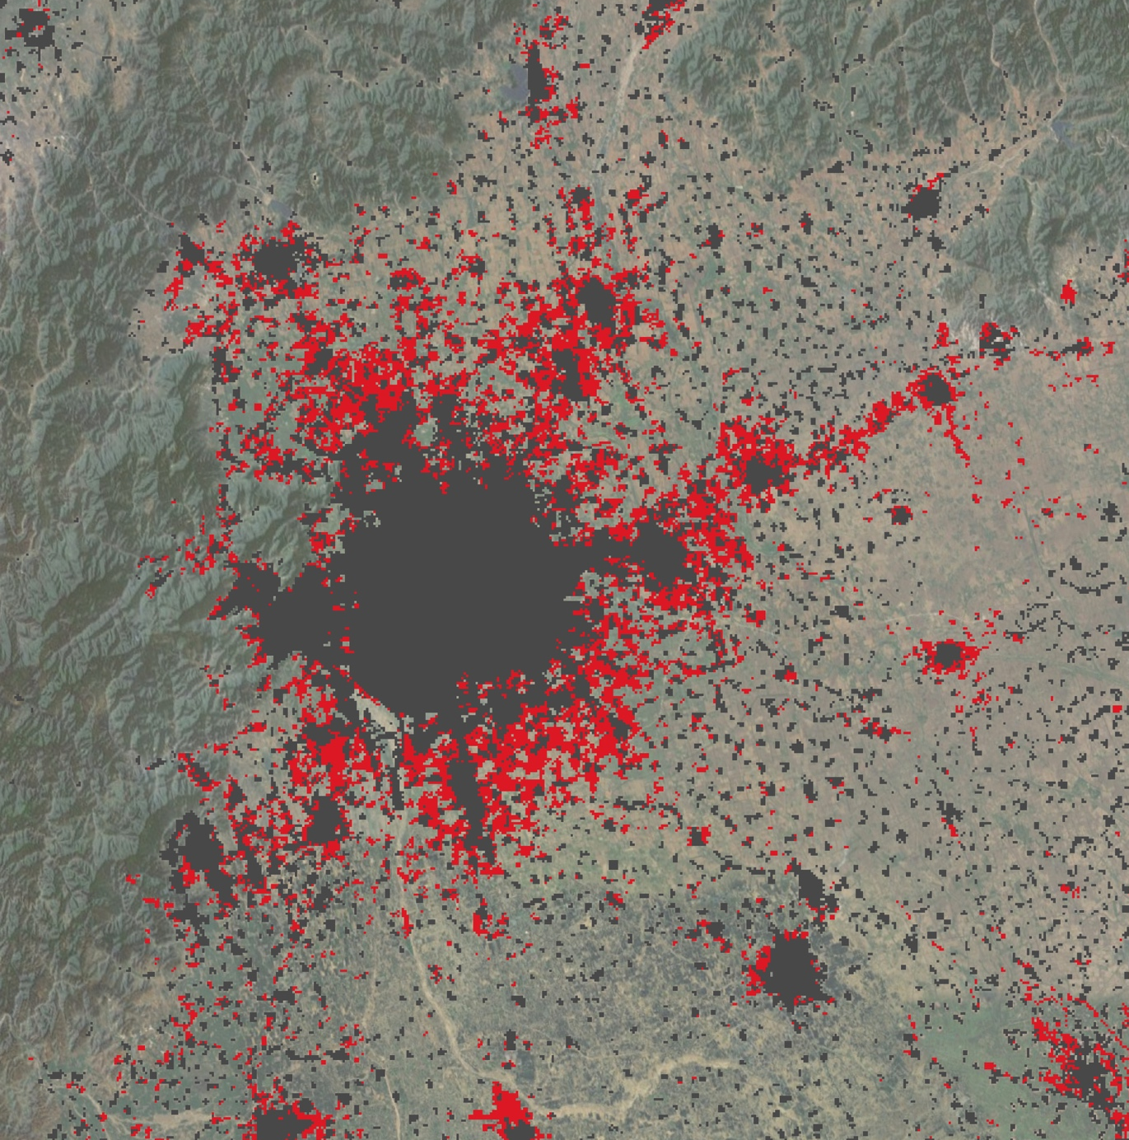
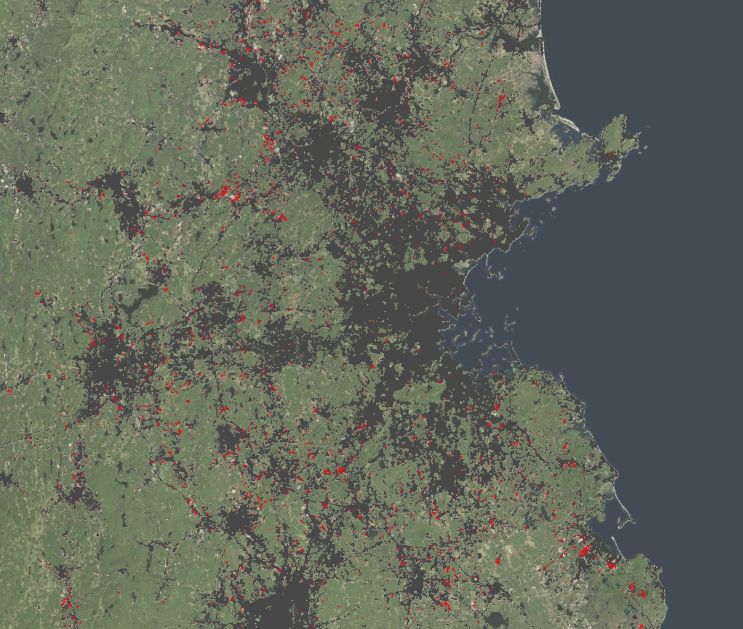
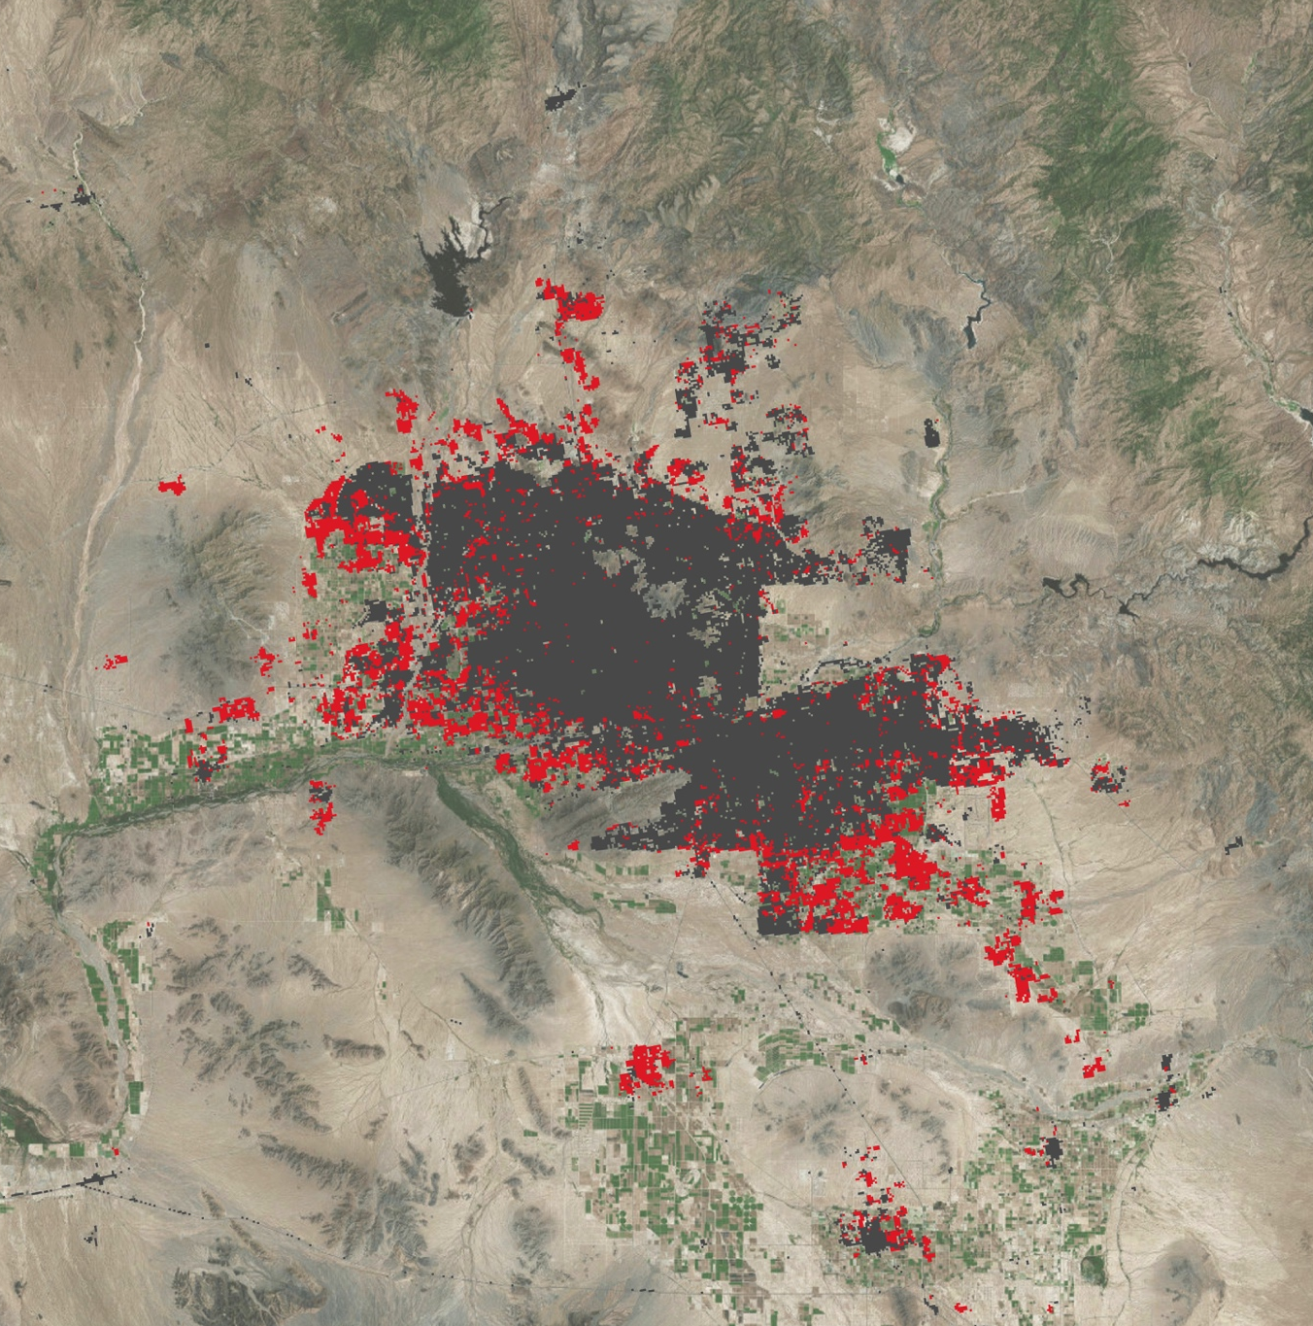
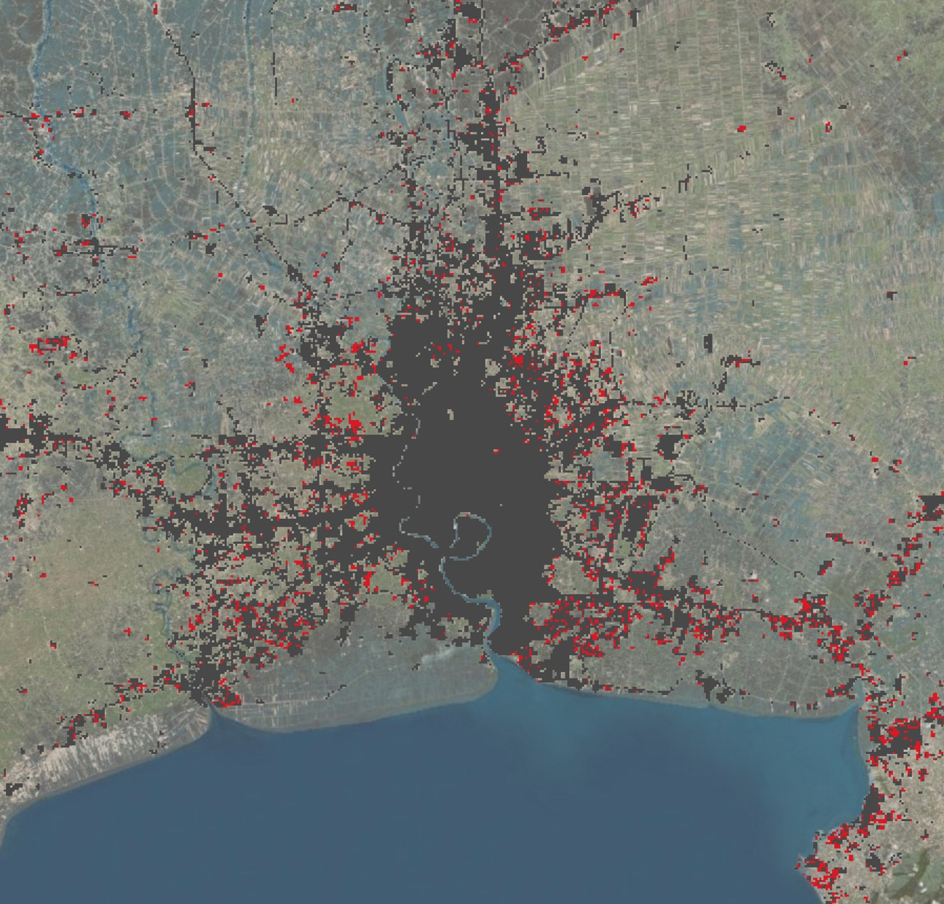
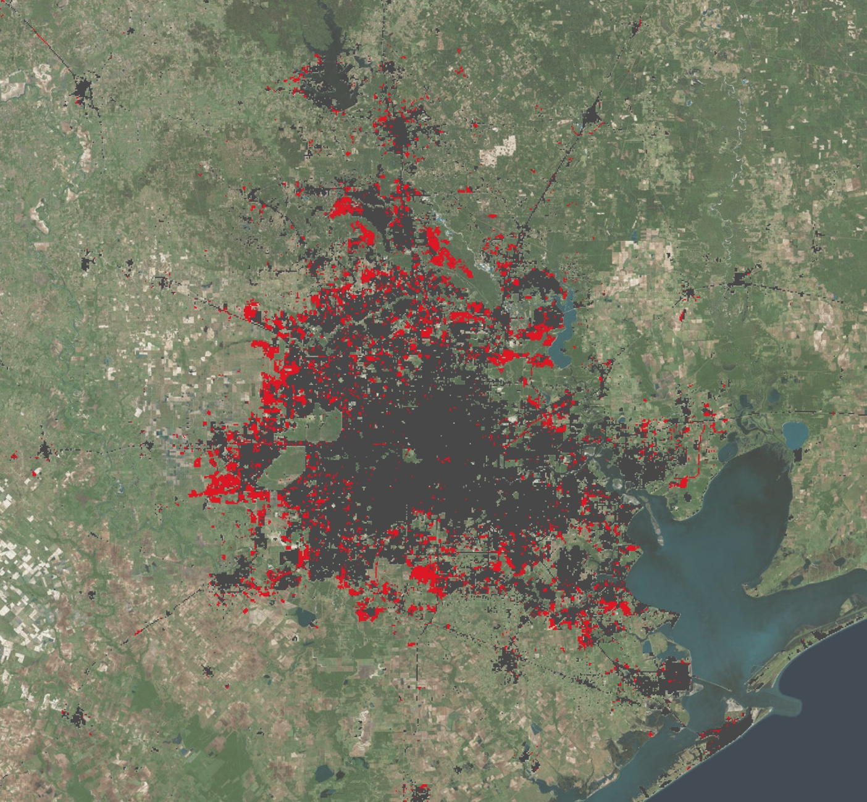
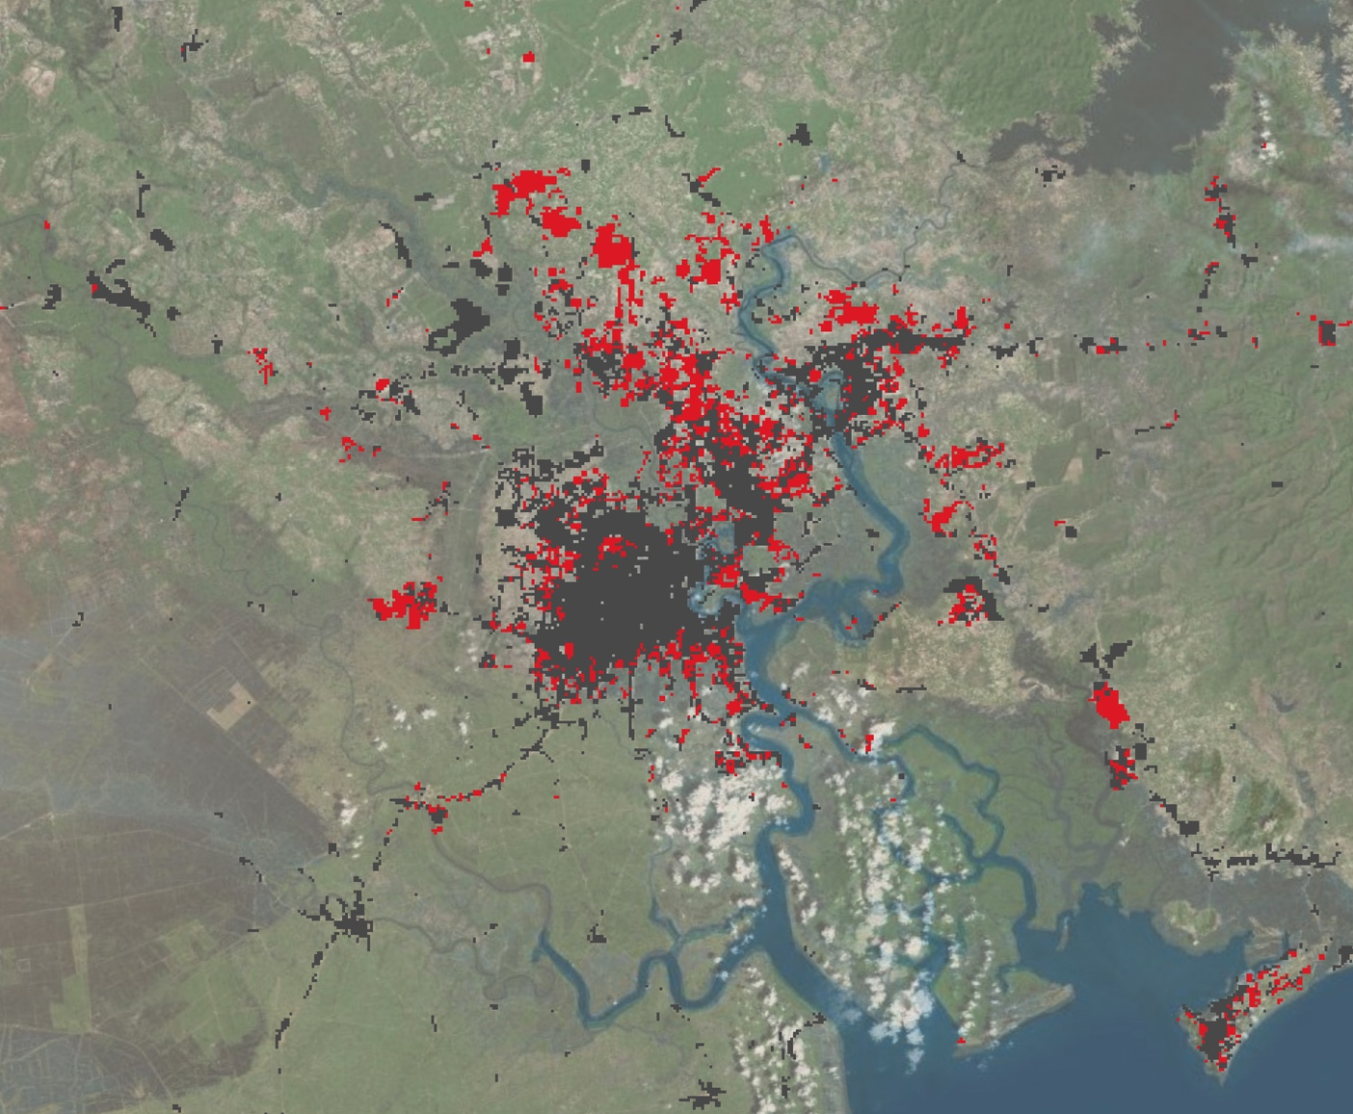
Urban land 2000
Urban expansion, 2000-2010
Phoenix, USA
Step 4:
Accuracy assessment
Boston, USA
Beijing, China
Bangkok, Thailand
20 km
Houston, USA
Ho Chi Minh City, Vietnam
A. Schneider et al., UW
Notes:
all maps are the same scale, 1:750,000 – they can be compared directly to one another

Slide 8
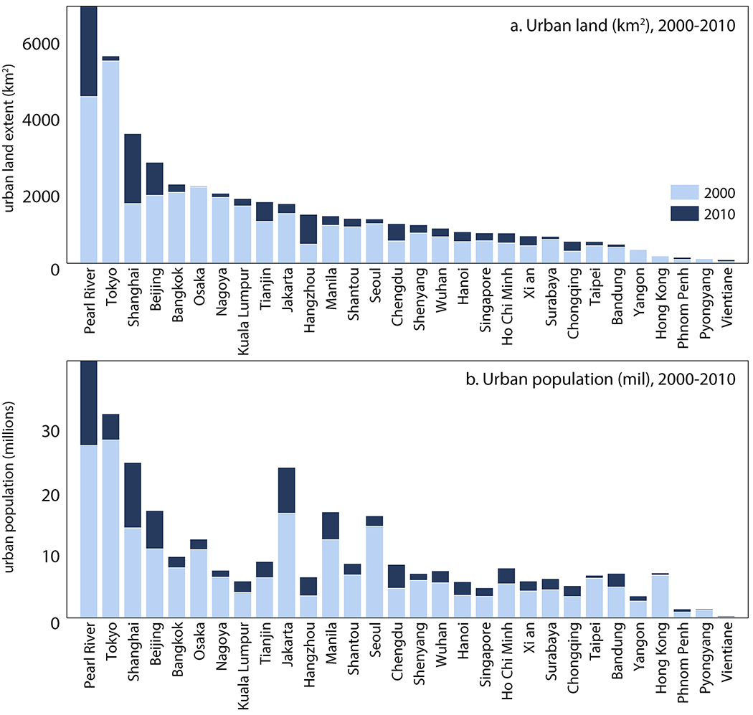
Mapping urban expansion
City-level results for top 30 urban agglomerations in East Asia.
Progress and next steps
    Mapping c. 2010 global urban land extent to be completed in 2016.
    Change detection work ongoing; maps released as completed.
    Robust, two-tier accuracy assessment using stratified random sample of sites labeled by multiple analysts, double-blind procedure.
Urban land (km²) 2000-2010
Urban pop. (10⁶) 2000-2010
A. Schneider et al., UW
Notes:
shorten?
Decision trees, known for their efficacy in handling complex landscapes and noisy or missing data (Friedl & Brodley, 1997), have been widely used in remote sensing in recent decades, especially in large area mapping of land cover (Friedl et al., 2002; Hansen et al., 2005) and urban areas (Schneider et al., 2003; 2009, 2010).
Decision tree construction involves the recursive partitioning of a set of training data into increasingly homogeneous subsets based on statistical tests applied to the feature values from the training data. Once the decision tree has been estimated, these rules are then applied to the entire image to produce a classified map. Boosting, an ensemble classification technique that improves class discrimination by estimating multiple classifiers while systematically varying the training sample (Quinlan, 1996), is used to improve map accuracy. Boosting has been shown to be equivalent to a

Slide 9
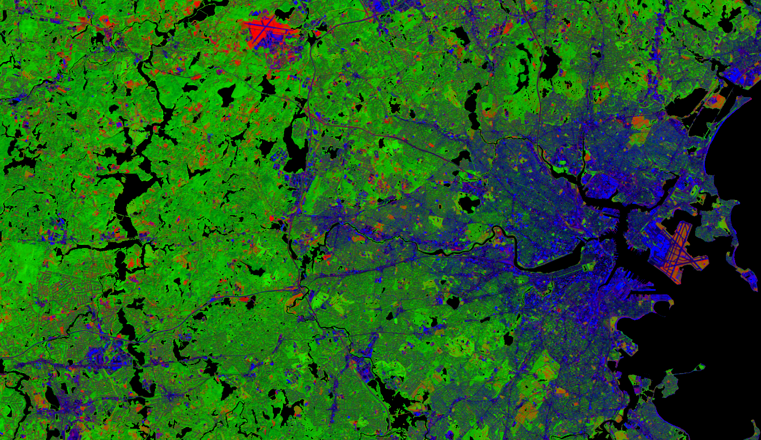
2. Boston MA – Urban Heat Island
Landsat Spectral Mixture Analysis
August, 2010
R: Substrate
G: Green Vegetation
B: Urban
4th end-member (not included): Shade
Notes:
Using the same endmembers you can track drastic temporal change.
Going from spring to summer, the amount of vegetation mapped in these pixels increases substantially.
Aug has less overall heterogeneity.
Substrate is now restricted to isolated patches of soil.
Urban doesn’t change substantially, mostly the reference area, which controls UHI.

Slide 10
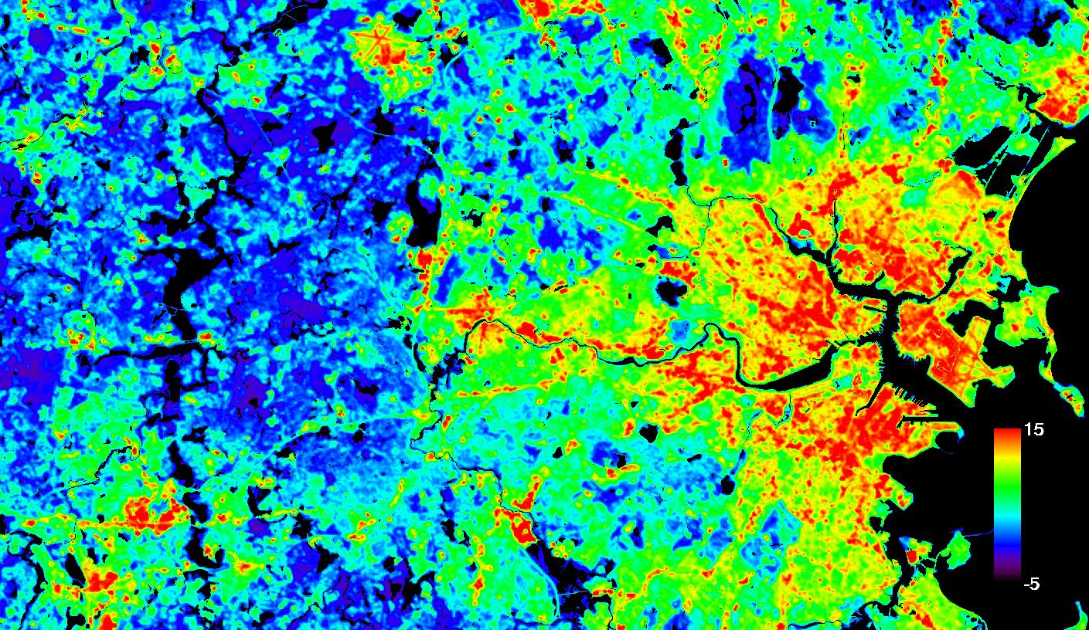
Defining Urban Heat Island: daytime ΔT
Land Surface Temperature Clusters
Urban Heat Island, August 2010
ΔT
ΔT
T_{ref}
Notes:
Previous: Getting land cover (continuous) for Landsat scenes.
Now: Getting UHI
One of the challenges in understanding the UHI is that you have to choose some sort of reference T relative to which you measure the enhancement in urban T. There are lots of different ways people have done this.
We’ve approached this purely from a temperature perspective. Rather than choosing some geographic cutoff to define urban and non-urban, we have simply looked at the distribution in LST values
Cluster LST into 6 groups, choose the median of the lowest T group to represent the reference temperature.
Define UHI as the difference between LST and this reference value for each pixel
Data: Clusters on 40,000 point sample of the full 30m dataset, downselected to include only rows with all good data

Slide 11
Spectral Mixture Analysis
Relative fractions of four endmembers vary across scene and through year.
1. green vegetation,
2. urban (built),
3. substrate (e.g., dirt, dead grass & leaves, leafless trees),
4. shade (dark).
Notes:
Can easily characterize temporal change in the different components.
We are missing September here because of clouds, but otherwise span March to Oct
Note the strong seasonal change in shading
Data: averaged over the full images. Fractions have not been normalized.

Slide 12
Urban Heat Island ~ Spectral Mixture Analysis
ΔT increases in summer and with urban fraction;
ΔT decreases with green vegetation fraction.
August
August
ΔT (°C)
ΔT (°C)
March
March

Slide 13
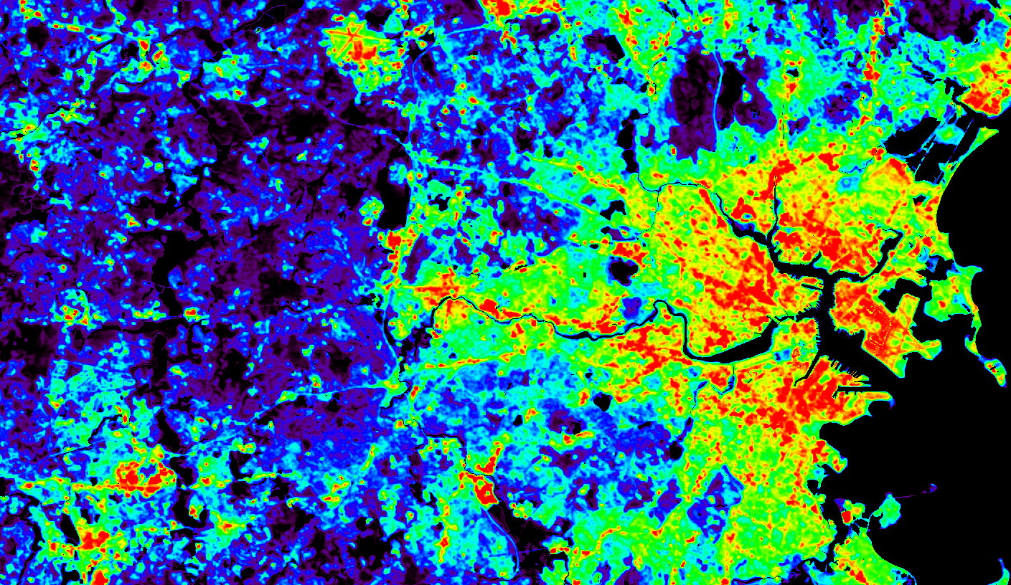
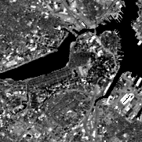
Urban Heat Island
ΔT high in downtown Boston, but there are cooler spaces.
°C
2 km
Blue: ΔT <10°C
Urban Heat Island
August, 2010
Notes:
To DO:
Scale bars
The city is generally enhanced in UHI, obviously, but there are a few cool spaces.
We expect the cool spaces to be vegetated. This is generally true, ie the common.
Next: closer look at the cool spaces. This relationship breaks down in one interesting place

Slide 14
Urban Cool Islands
Low ΔT

Slide 15
Urban Cool Islands – Vegetation
non-vegetated cool pixels
Green/Red: Low ΔT with high green vegetation.
White: low ΔT with 0% vegetation.
Colors
Vegetation fraction

Slide 16
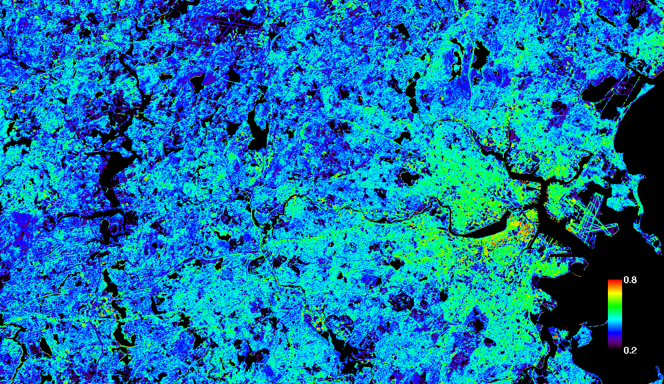
Urban Cool Islands – Shade
Shade fraction
Red/Orange: low ΔT that has abundant shade.
White: low ΔT with <20% shade.

Slide 17

Urban Cool Islands – Shade
Shade fraction
Red/Orange: low ΔT that has abundant shade.
White: low ΔT with <20% shade.
Shade fraction
Urban cool islands: Boston’s urban core includes cooler areas
arising not only from vegetation, but also from shading.

Slide 18
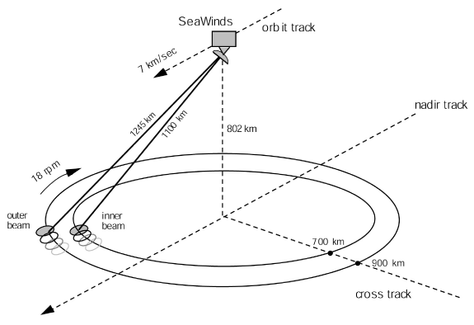
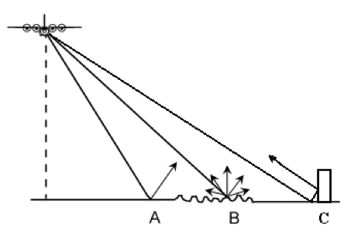
3. Hypothesis – Urban core development impacts urban heat island
Ku-band
microwave
scatterometer
surface scattering
Seoul
A – specular reflection
B – diffuse scattering
C – corner reflector
Tokyo
Big cities have strong backscatter.

Slide 19
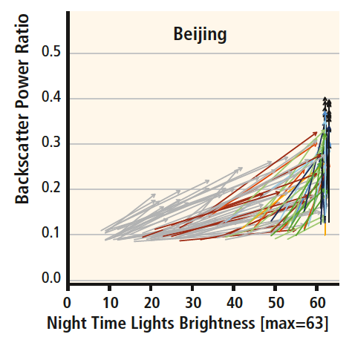
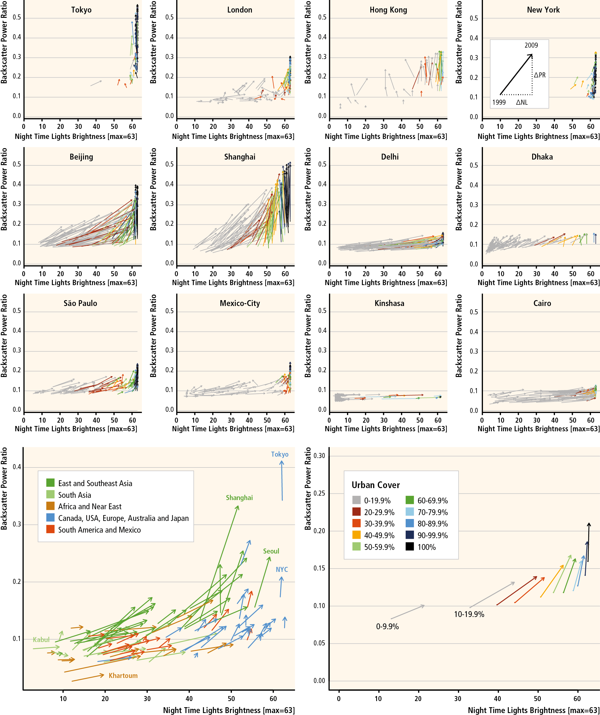
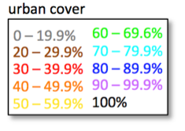
1999-2009 change in night time lights and microwave backscatter
SeaWinds power return (PR = 10^(σ⁰/10)
DMSP/OLS night time lights (NL; max. = 63)
• 11 x 11 grid (0.05°) centered on each city.
• summer mean backscatter; annual mean night time lights.
• arrows point from NL and PR in 1999 to NL and PR in 2009.
• urban fraction (arrow color) from MODIS land cover product.
• water grid cells masked out.
Frolking et al. 2013 ERL

Slide 20
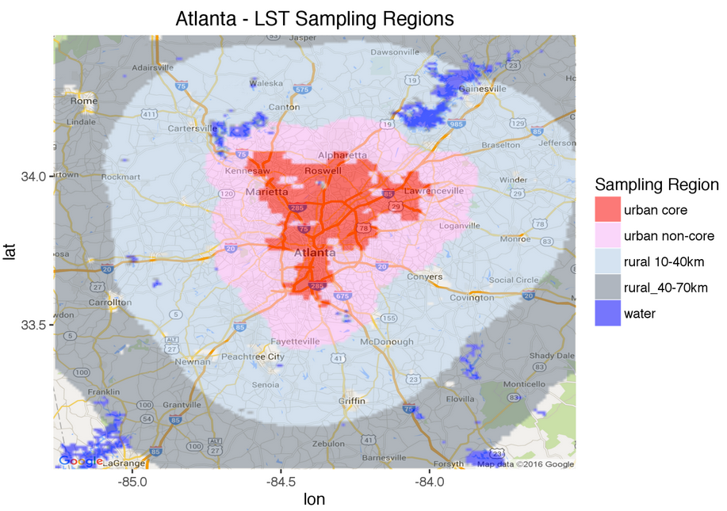
A central hypothesis of the project:
rapid growth in the urban core built environment (as quantified by Quikscat) will have an observable impact on the urban core temperature relative to surrounding rural areas that are not experiencing rapid building growth, and thus on the urban heat island.
Method:
Target large cities – 30 in East Asia (rapid growth) and North America (slower growth).
Dissaggregate into urban core, urban non-core, near rural (10-40 km), far rural (40-70 km).
Assemble data, including:
• MODIS AQUA & TERRA LST (day & night);
• MODIS EVI
• Quikscat;
• DMSP/OLS stable lights.
4. Evaluate UHI and trends across samples.
Atlanta urban-rural sampling regions

Slide 21
Seasonal time series data
Beijing
Boston
Quikscat
backscatter
MODIS Terra
Daytime - LST
MODIS Terra
Nighttime - LST
2000
2005
2010
2015
2000
2005
2010
2015
Hypothesis (trend in Quikscat → trend in LST) not supported.

Slide 22
30 large cities in East/SouthEast Asia and North America
Mean urban core backscatter
vs mean TERRA UHI ΔT
urban core minus rural 10-40 km
Seasonal mean, 2000-09, urban core
diurnal LST range (day minus night)
summer (JJA)
winter (DJF)
summer (JJA)
winter (DJF)
TERRA
TERRA
day
day
TERRA UHI ΔT (°C)
AQUA UHI ΔT (°C)
AQUA
AQUA
night
night
Qscat (backscatter power ratio)
Qscat (backscatter power ratio)
Hypothesis (trend in Quikscat → trend in LST) not supported.

Slide 23
30 large cities in East/SouthEast Asia and North America
Mean urban core backscatter
vs mean TERRA UHI ΔT
urban core minus rural 10-40 km
Rate of backscatter increase, 2000-09,
vs rate of increase in AQUA LST UHI ΔT,
urban core minus rural 10-40 km
summer (JJA)
winter (DJF)
summer (JJA)
winter (DJF)
day
day
day
day
TERRA UHI ΔT (°C)
AQUA UHI ΔT (°C/yr)
night
night
night
night
Qscat (backscatter power ratio)
ΔQscat (backscatter power ratio)
Hypothesis (trend in Quikscat → trend in LST) not supported.

Slide 24
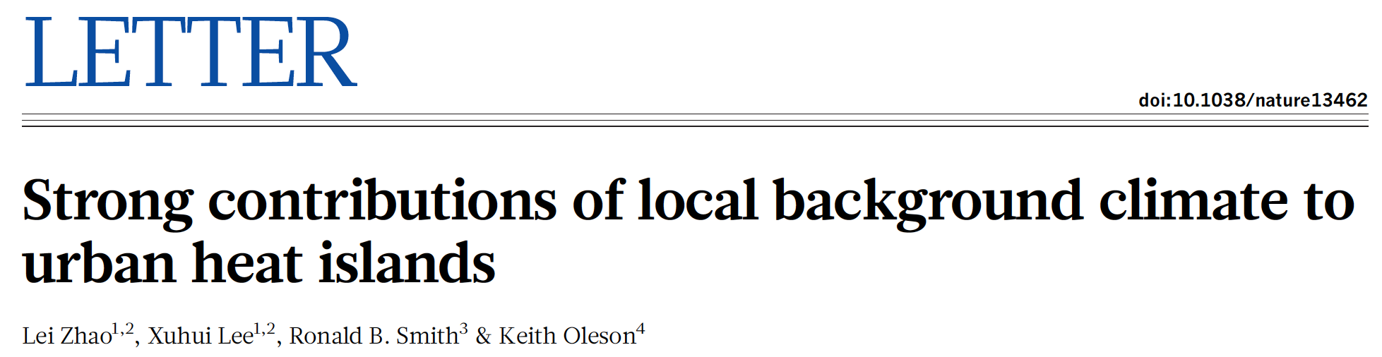
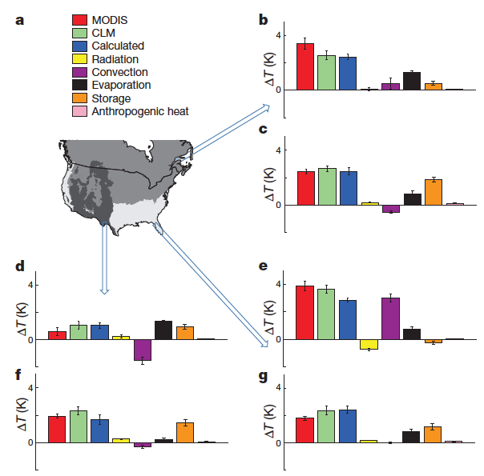
CLM dominant terms in simulated UHI:
• evaporation – daytime > nighttime.
• thermal storage – nighttime > daytime.
• convection – mixed geographic results.
Nature, 2014
daytime
evaporation
energy
balance
terms
nighttime
storage
daytime
convection
daytime
nighttime
nighttime

Slide 25
CLM dominant terms in simulated UHI:
• evaporation – daytime > nighttime.
• thermal storage – nighttime > daytime.
• convection – mixed geographic results.
Nature, 2014
“Managing the convection efficiency or heat storage of urban land does not seem viable, even though these are large contributors to ΔT [UHI], because it would require fundamental changes to the urban morphology, such as a city-wide increase in building height.” [p. 219]
daytime
evaporation
energy
balance
terms
nighttime
storage
daytime
convection
daytime
nighttime
nighttime

Slide 26
CLM dominant terms in simulated UHI:
• evaporation – daytime > nighttime.
• thermal storage – nighttime > daytime.
• convection – mixed geographic results.
Nature, 2014
“Managing the convection efficiency or heat storage of urban land does not seem viable, even though these are large contributors to ΔT [UHI], because it would require fundamental changes to the urban morphology, such as a city-wide increase in building height.” [p. 219]
daytime
evaporation
energy
balance
terms
nighttime
storage
daytime
convection
daytime
nighttime
nighttime

Slide 27
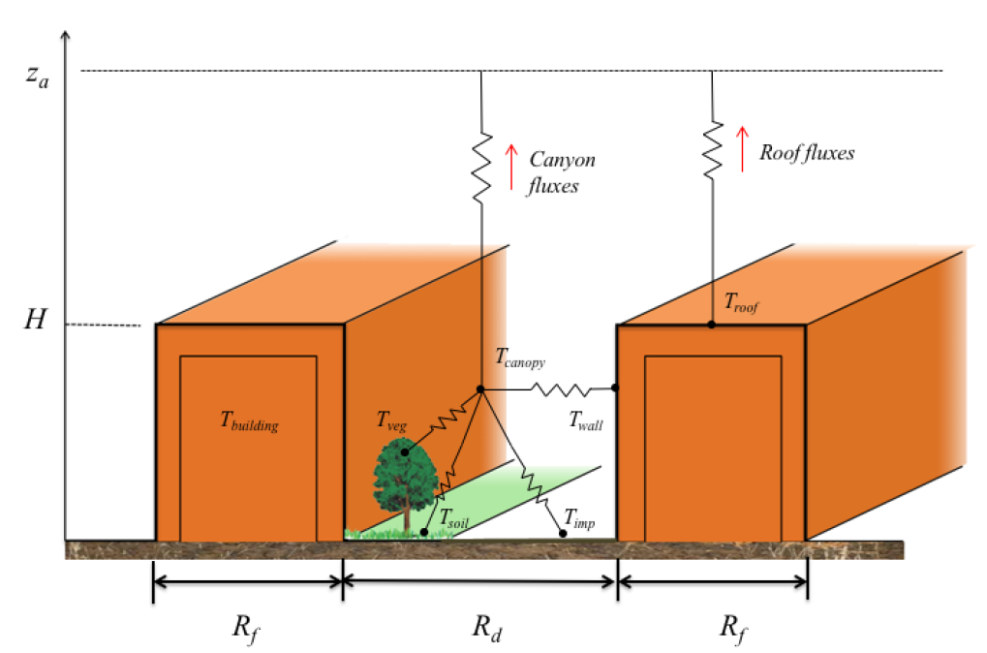
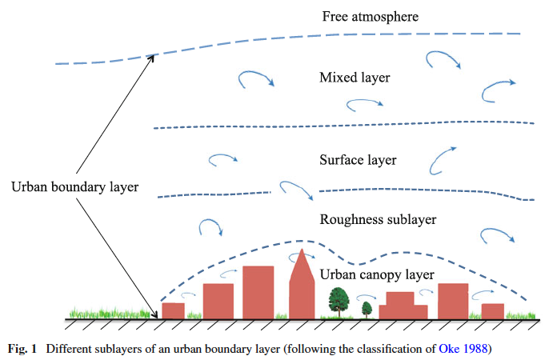
We will work with Dan Li, urban climate modeler at BU, on sensitivity of urban climate to building boom in Beijing.
Schematic of GFDL LM3 urban canopy model.
Li, et al. 2016. J Adv Model Earth Sys
Wang, Li, et al. 2013. Boundary-Layer Meterol.
What is impact on modeled urban temperatures (air and radiative; day and night) of building height changes in central Beijing during 2000-2010?

Slide 28
Conclusions
• Ongoing mapping of global urban expansion 2000-2010.
• Daytime cooler areas in urban core can occur not only with
high vegetation cover, but also with structure-derived
shading.
• Rapid building development in urban core of large cities
does not lead to changes in MODIS LST (day or night,
TERRA or AQUA).

Slide 29
Extra slides

Slide 30
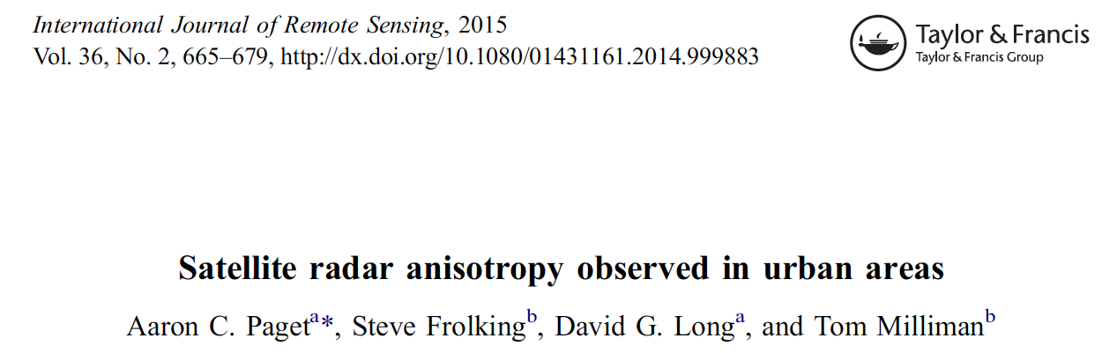
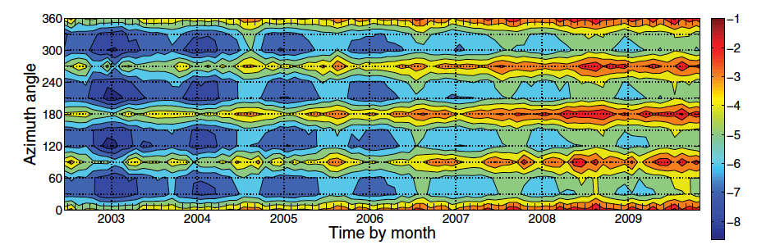
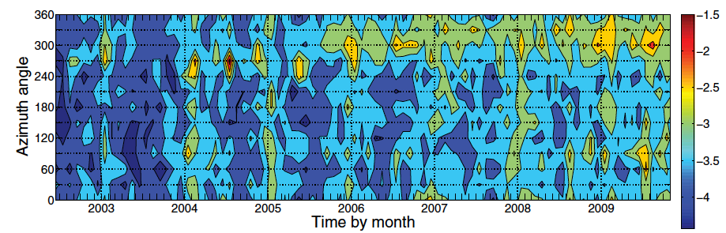
Hovmöller diagrams of time series of monthly mean (x-axis) of the 30° binned (y-axis) QuikSCAT Level 1B σ⁰ HH data (in dB).
Beijing, China
Beijing:
• strong increase over time.
• strong azimuthal asymmetry.
São Paulo, Brazil
São Paulo:
• weaker increase over time.
• weak azimuthal asymmetry.

Slide 31
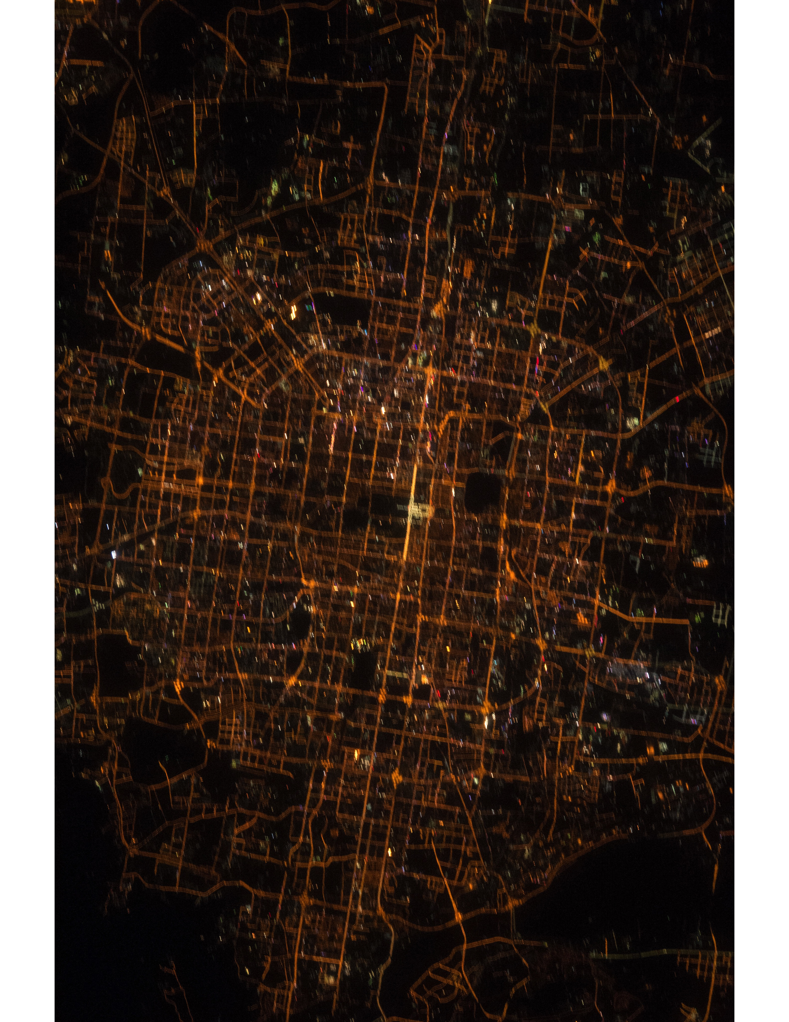
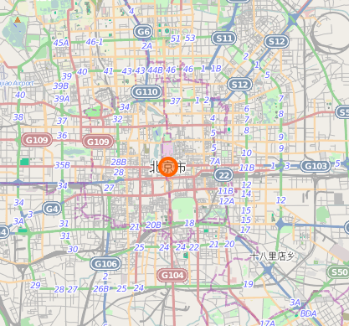
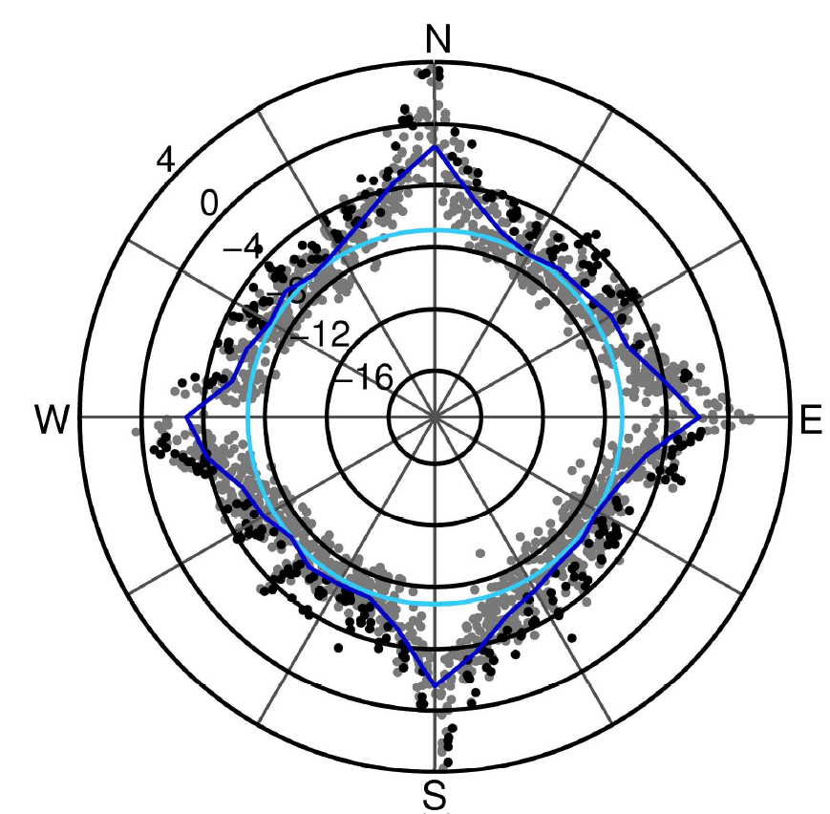

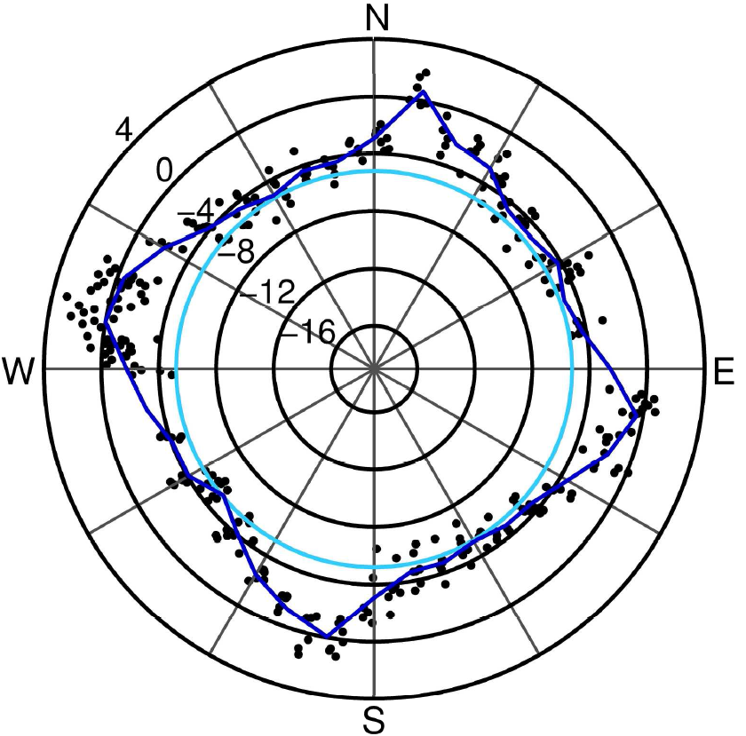

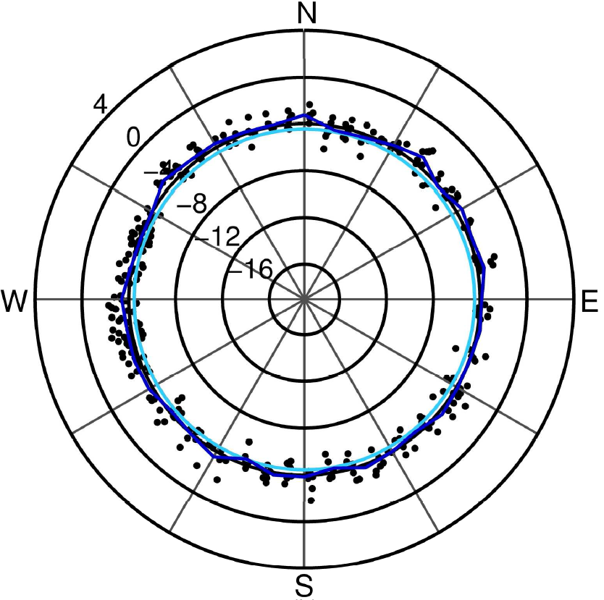
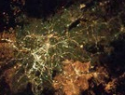
Beijing
Quikscat level 1b backscatter
Azimuthal dependence of individual backscatter returns vary by city (high to none).
Seems to be strongly correlated with orientation of major urban road networks.
Averaging over one or more months fully samples azimuthal range.
Beijing, China
Mexico City
photos from ISS
www.OpenStreetMap.org
São Paulo
São Paulo, Brazil
floor
mean by angle
Paget et al. 2015 IJRS

Slide 32
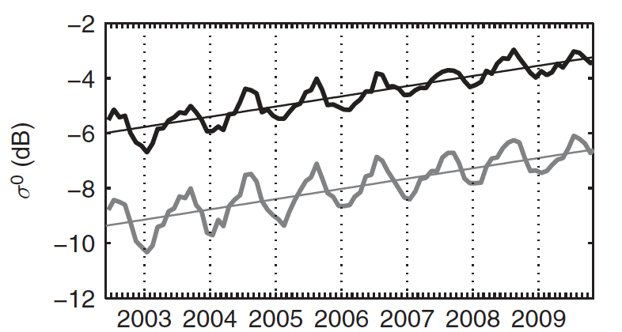
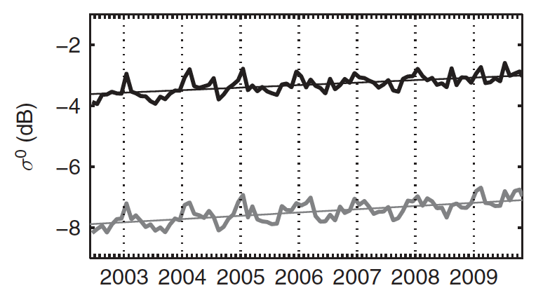
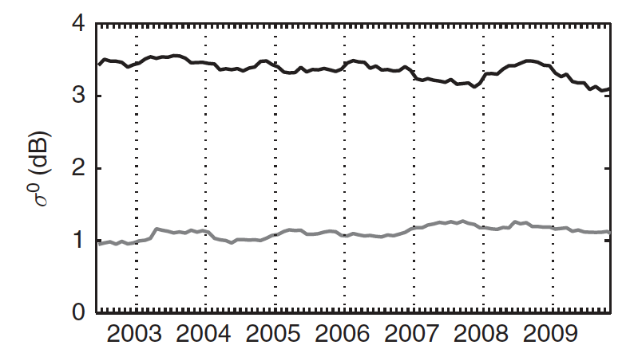
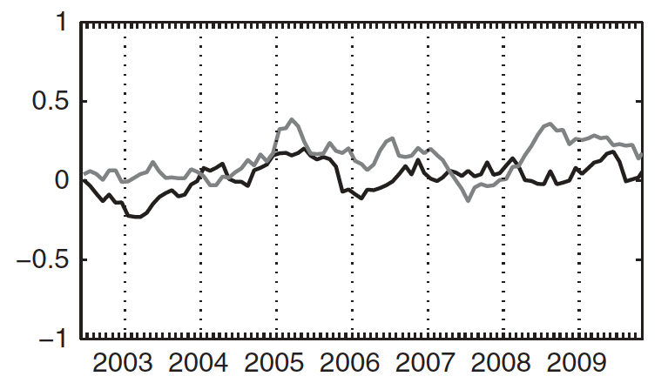
Although urban backscatter magnitude changed over 1999-2009, there was no trend in azimuthal dependence for several large cities we sampled.
Beijing
São Paulo
backscatter
backscatter
HH
HH
VV
VV
backscatter anisotropy index
backscatter anisotropy index
HH
VV
HH
VV
Paget et al. 2015 IJRS

Slide 33
Urban Heat Island ~ Spectral Mixture Analysis
Seasonality of ΔT increases as pixel fraction of green vegetation decreases.
little green veg. &
high seasonal ΔT
deciduous veg. &
low seasonal ΔT
Notes:
The variation in UHI over the season is correlated with large change in vegetation (ie, correspond to deciduous forests that have strong vegetation phenology).
For each in a sample of 3000 pixels (500 from each LST cluster), the variance in green vegetation (across the 7 observations, March – October) vs. the variance in UHI.
The points are colored according to July UHI magnitude (red = ~ 20 degrees; blue = ~5 degrees) as a quick proxy for peak UHI.
The points spanning the x axis have low UHI variance, and these are the pixels that reach high Green Vegetation abundance and have generally low peak UHI (are blue).
The points reaching the highest UHI variance (most change over the course of the year) have almost no green vegetation, and have high peak UHI.

Slide 35
Night lights & backscatter – different urban characteristics.
2009
Night lights
Backscatter power
40.4°N
Beijing
39.6°N
116.8°E
116.0°E
29.0°N
Delhi
28.2°N
76.8°E
77.6°E
0
NTL
63
0
PR
0.6
Plan view: 21x21 grid cells (0.05°)
Frolking et al. 2013 ERL

Slide 36
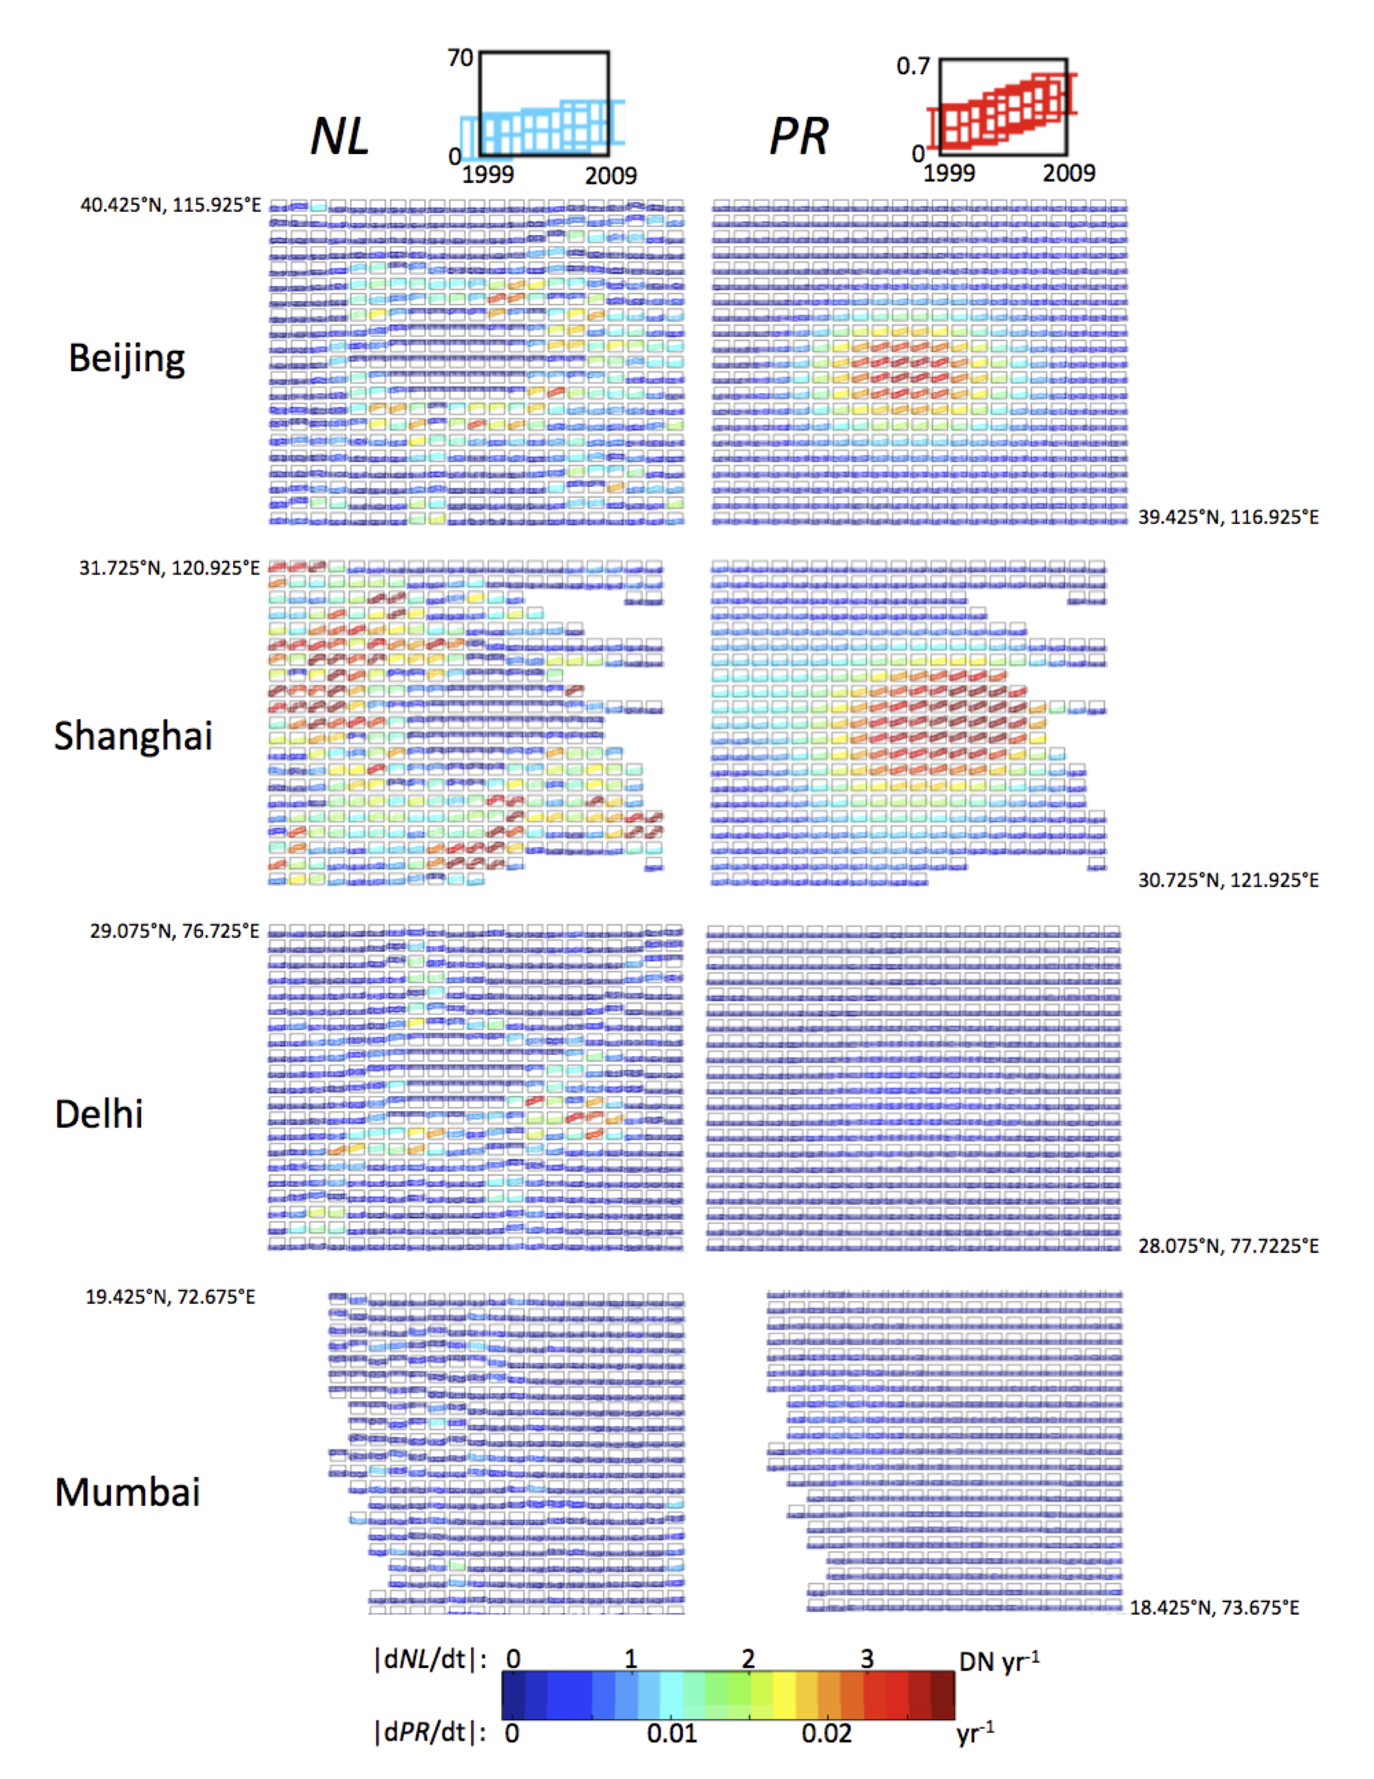
Night lights & backscatter – different urban characteristics & modes of change.
2009
Night lights
Backscatter power
40.4°N
Beijing
39.6°N
116.8°E
116.0°E
29.0°N
Delhi
28.2°N
76.8°E
77.6°E
0
NTL
63
0
PR
0.6
Plan view: 21x21 grid cells (0.05°)
Frolking et al. 2013 ERL

Slide 37
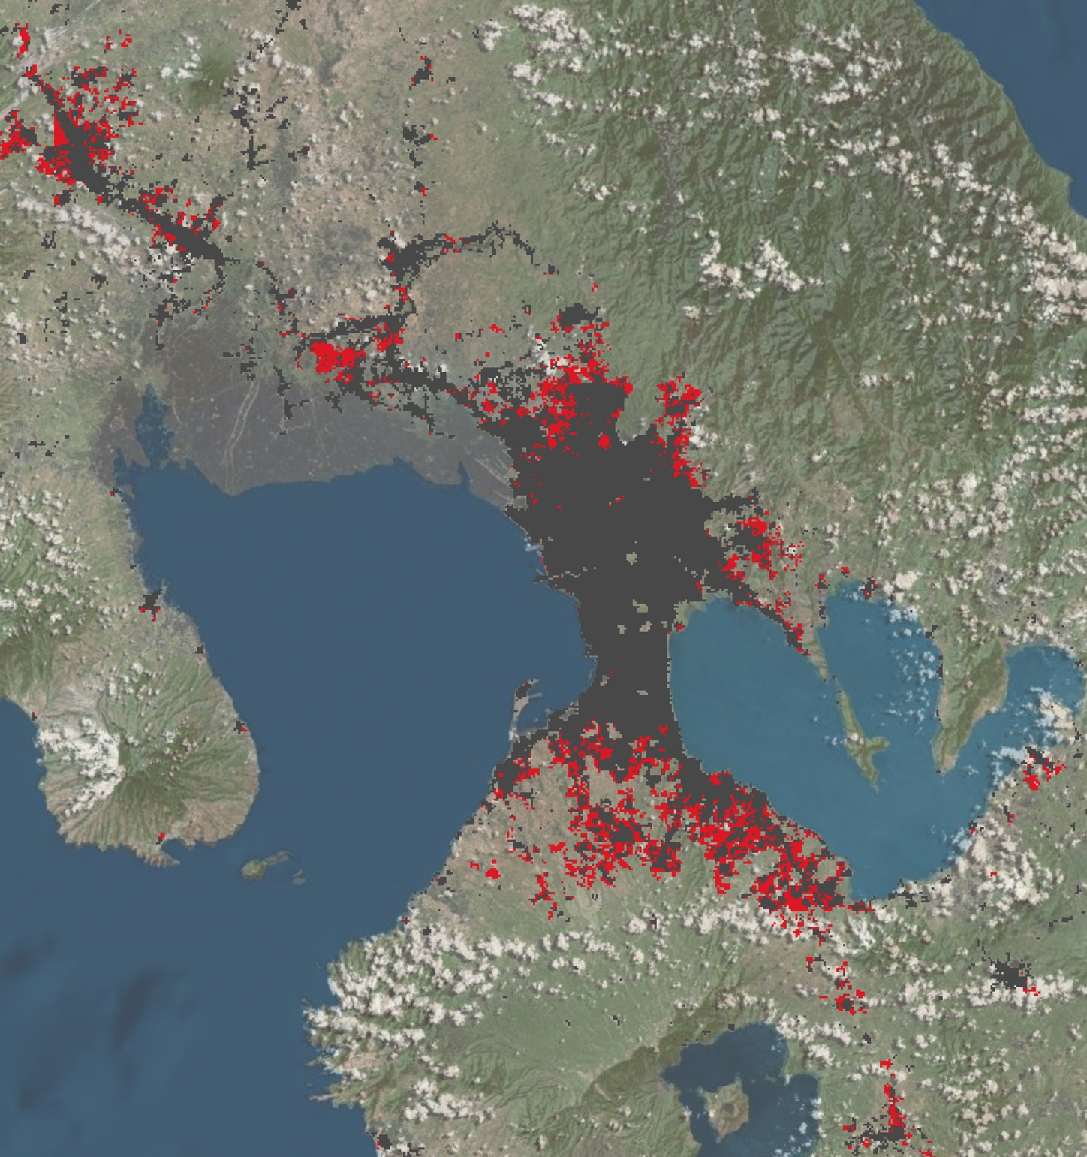
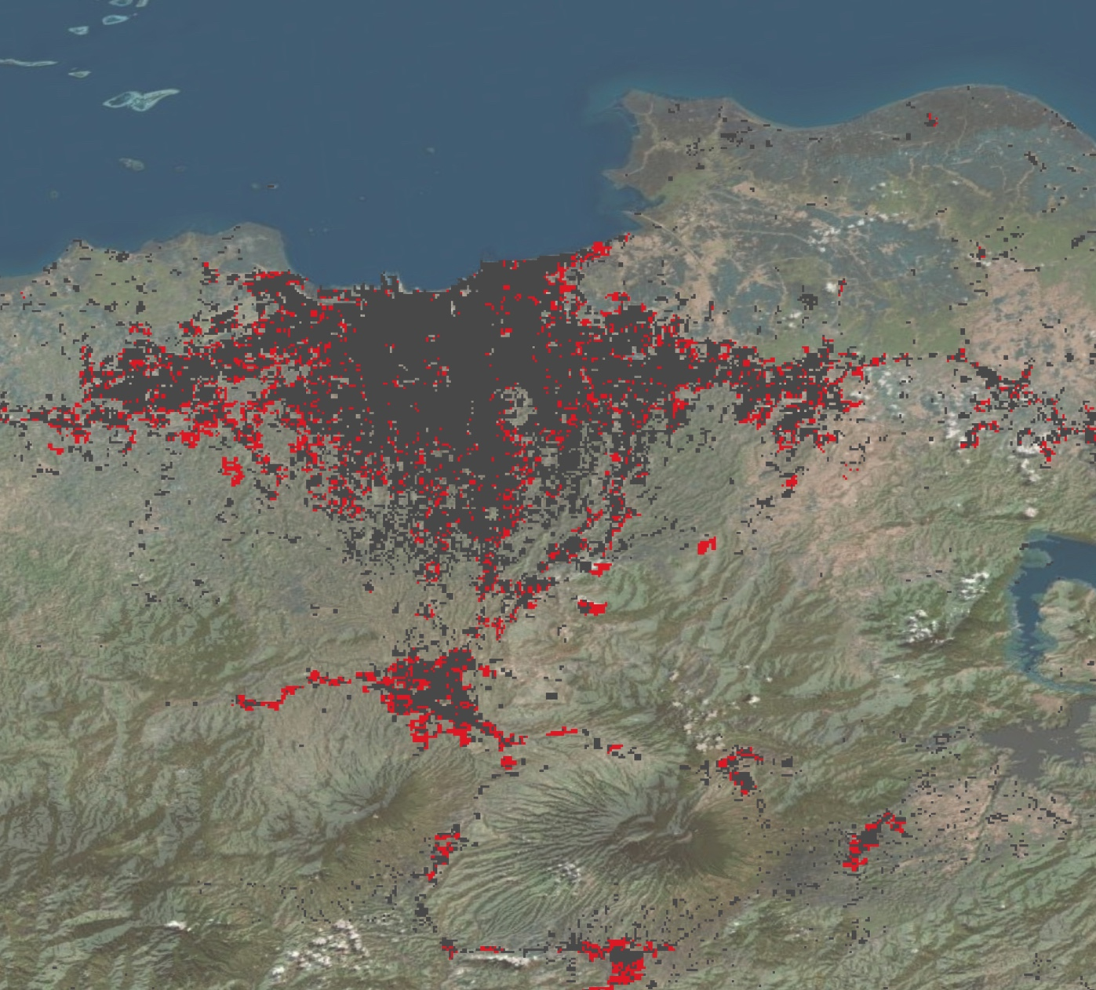
Jakarta, Indonesia
Manila, Philippines

Slide 38
Beijing 2002-2009:
monthly data trends
Quikscat
backscatter
Seasonal Decomposition
of Time Series by Loess
in R (‘stl’)
daytime urban core –
rural UHI (ΔT in °C)
Strong trend in QScat
Weak trends in UHI
nighttime urban core –
rural UHI (ΔT in °C)
Hypothesis not supported.

