Slide 1

VIIRS Issues and Perspectives
VIIRS Blue Marble Stamp
June 2016
Jim Gleason
Suomi Project Scientist
June 6, 2016

Slide 2
Suomi NPP Status
Suomi NPP Instrument Status
  CrIS, OMPS CERES; all nominal
  ATMS; known bearing degradation issue
    Change in con-ops; revealed FSW error
    Reverse motor direction once-per-day
  VIIRS; Nominal
    HAM-sync error; periodic short term (90s) loss of data
    SEU-caused computer lock-up aka petulant mode
      Std reset procedure (1-2 orbits lost)
    Tungsten-oxide mirror contamination
      Following thin-film model
      Will meet requirements at EOL

Slide 3
JPSS Status
  JPSS-1 Launch: January 2016
  All Instruments Complete
  All Instruments Integrated on Spacecraft
  Observatory in Environmental Testing
    Currently in EMI/EMC testing
    Observatory T/V in July-September 2016
  J1 VIIRS is an excellent, well characterized instrument.
    Nine M-band waivers
    Two DNB waivers
    All performance data is available to interested parties

Slide 4
J1 VIIRS Performance Waivers
The joint NASA/NOAA Performance Waiver WG discussed and deemed acceptable the following waivers on science performance:
  Spatial resolution – better than allowed by spec established after NPP
  Dynamic Range – several bands saturate before spec Lmax, similar to NPP but exacerbated by somewhat higher optical throughput achieved on J1
  Near-Field Response – better than NPP but worst-case contamination at end-of-life still violates spec requirements
  Crosstalk – much better than NPP but still non-compliant to the specification
  Band-to-Band registration – overall better than NPP, but different in details (VIIRS J1 misregistration largely in track vs. mix of scan and track on NPP)
  Emissive Band Radiometric Calibration – similar to NPP, concerns on J1 mostly have to do with response uniformity and the potential for striping
  Reflective band radiometric calibration – dominated by SWIR low radiance non-linearity (new for NPP) which could impact processing approaches
  Relative Spectral Response – similar to NPP, and T-SIRCUS at Raytheon
  Polarization – non-compliance not seen on NPP but acceptable on J1 based on more extensive characterization testing, modeling, and model validation
  DNB Stray Light – similar to NPP, mitigated by correction in ground system
  DNB non-linearity – new for NPP, non-compliant at low light levels in modes baselined for edge-of-scan. Mitigation for J1 substitutes compliant modes.

Slide 5
JPSS -2,-3,-4
JPSS-2 VIIRS – Complete
Almost ready for ambient testing
Launch July 2021 (notional)
JPSS-3 VIIRS and JPSS-4 VIIRS
Raytheon under contract
No significant performance changes planned
JPSS-3: Launch Date July 2026 (notional)
JPSS-4: Launch Date July 2031 (notional)

Slide 6
Ground System Updates
Level 0
New Data path for SNPP and JPSS data
EDOS network till Fall 2016
JSH in Suitland Fall 2016 – end of JPSS Program
EDOS L0 format
Level 1
NASA VIIRS L1 algorithm complete
L1A format for easier reprocessing

Slide 7



SDS SNPP Data Acquisition
(Operational)
SvalSat
Svalbard
FCDAS
Gilmore Creek
(contingency only)
EDOS
HRDFEP
NASA
SIPS
EDOS
HRDFEP
via DREN
at ASF
Sounder
CrIS/ATMS
VIIRS
Atmosphere/
Land/Ocean
Closed
EBnet
EDOS
LZPF
Ozone
OMPS
Internet 2
Open
EBnet
CERES
Level 0 NASA EDOS network
NASA EDOS format (not NOAA C3S/IDPS)
New Data path for SNPP and JPSS data till Block 2.0

Slide 8
SDS Data Flow in Block 2.0
SNPP and JPSS
EDOS
formats
JSH
in Suitland
NOAA Networks
To Suitland

Slide 9
Summary
SNPP VIIRS
Performance nominal
New L0 data path using known EDOS L0 format
NASA L1 algorithm complete
JPSS-1 VIIRS, Complete
JPSS-2 VIIRS, Assembly in progress, ready for test
JPSS-3,-4 VIIRS, Under contract
VIIRS data record begins in 2012 and will end beyond 2036
Opportunity for 40 year combined MODIS-VIIRS data sets

Slide 10


Questions?

Slide 11
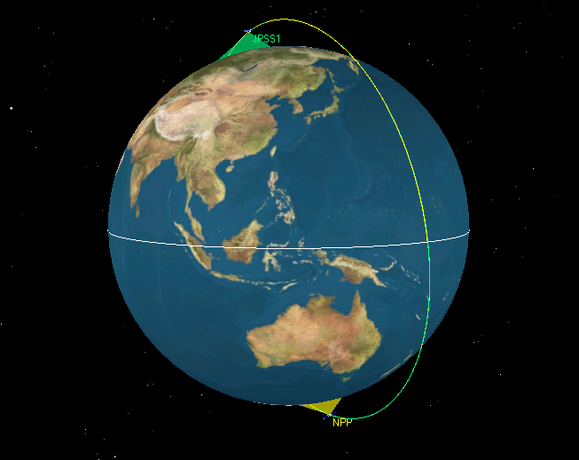
S-NPP & JPSS-1 Mission Orbit View
(1325 LTAN/824 km orbit)
½ orbit along-track separation

Slide 12
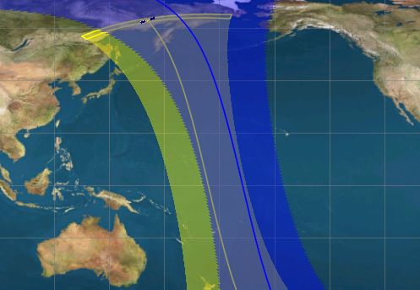
S-NPP & JPSS-1 Sensor Overlap
(1325 LTAN/824 km orbit)
NPP
JPSS1 (not on map)
Sensor swath overlap
Spacecraft Follow Different Ground Tracks
Based On ½ Orbit Along-Track Separation

Slide 13
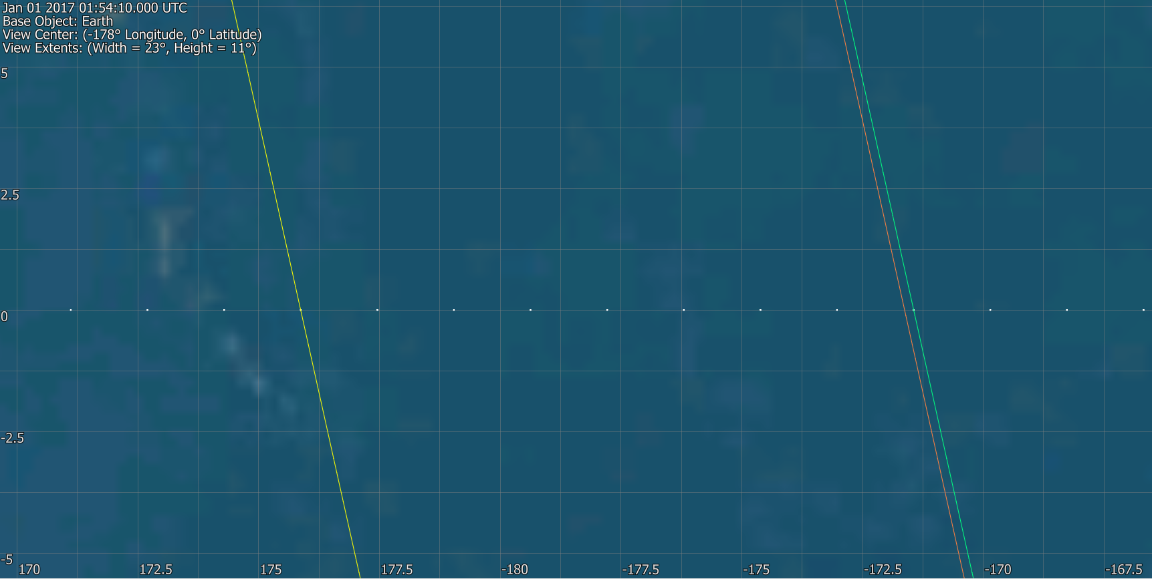
JPSS-1 wrt S-NPP
(1/2 orbit along-track separation)
Ascending Node Crossing
JPSS1 ½ orbit lead
SNPP
JPSS1 50 min lead
Ground track path centers
Earth rotation
Order of equator crossing: JPSS1; JPSS1 45 seconds later; SNPP 50:45 later (1/2 orbit is ≈50:45)
JPSS1 and SNPP cross through center of ground track 8 paths apart.
JPSS1 crosses ≈21 km to the “west” of the center of the ground track

Slide 14
Questions?
Backup

Slide 15
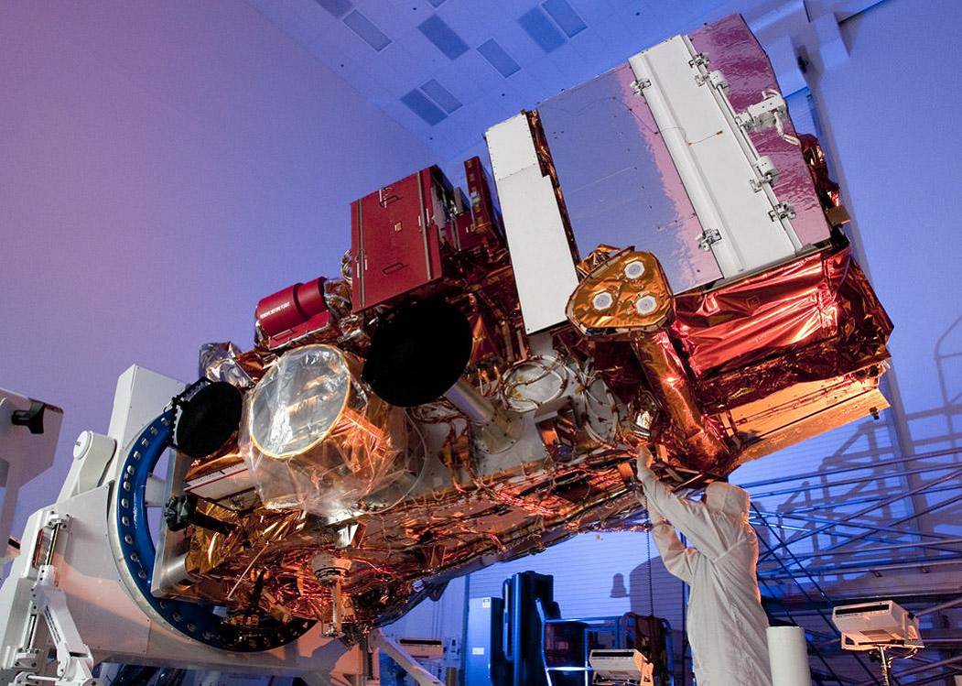
S-NPP & JPSS-1 with 5 instruments
13.2 ft long
8.5 ft wide
4,500 lbs
VIIRS
CrIS
ATMS
OMPS
CERES

Slide 16
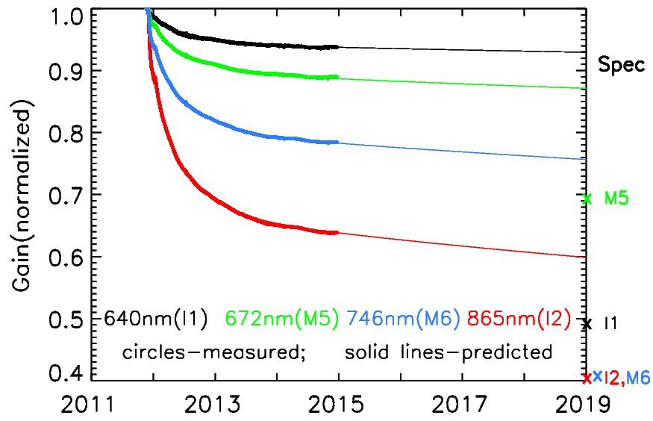
Suomi NPP VIIRS Degradation Analysis and Prediction
V15 data up to Dec 19, 2014
Ref: Lei, et al, SPIE Proceeding, Vol 8533, paper 19 (2012)
Lei, et al, IEEE Trans. Geosci. Remote Sens., Vol 53, pp 1565-1573, (2015)
4-mirror thin-layer model

Slide 17
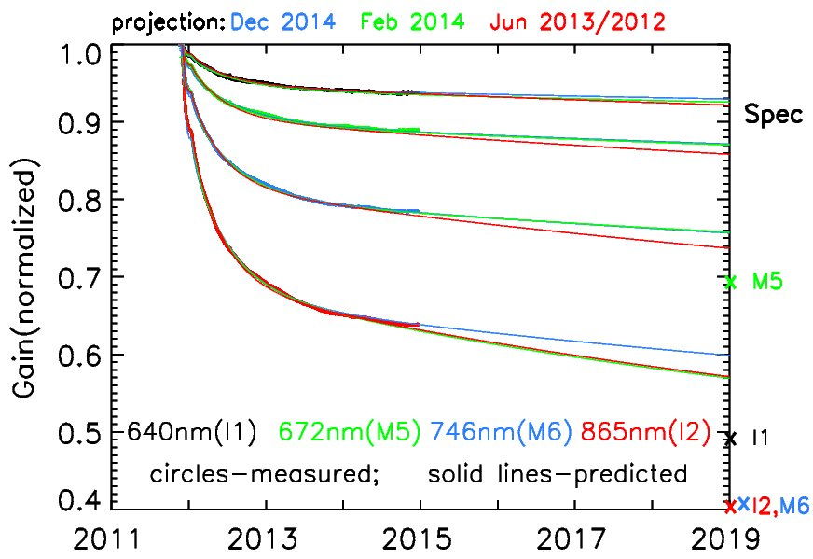
Suomi NPP VIIRS Degradation Analysis and Prediction
V15 data up to Dec 19, 2014
Ref: Lei, et al, SPIE Proceeding, Vol 8533, paper 19 (2012)
Lei, et al, IEEE Trans. Geosci. Remote Sens., Vol 53, pp 1565-1573, (2015)
I1
M5
M6
I2
4-mirror thin-layer model

Slide 18
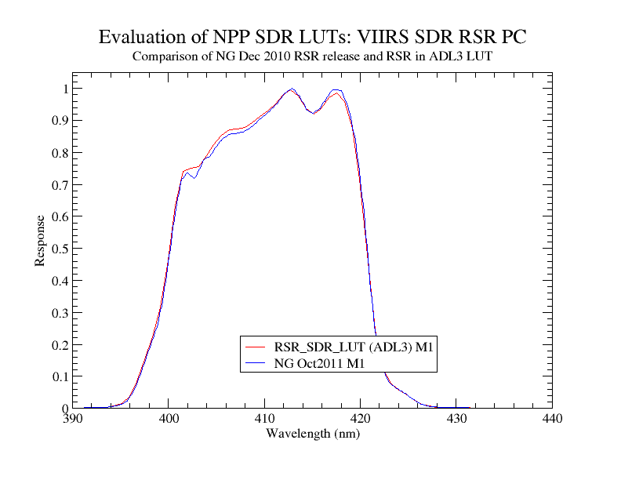
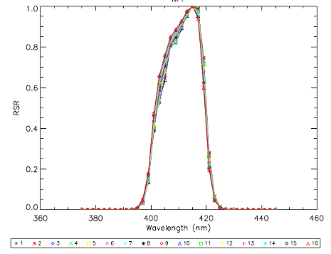
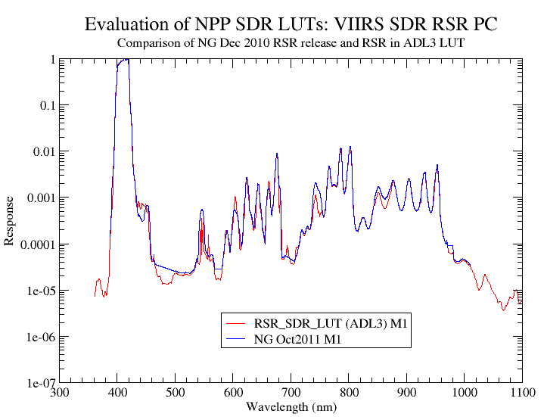
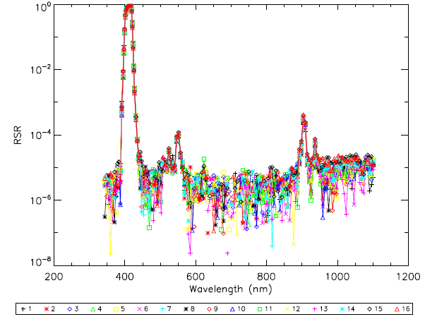
VIIRS Spectral Response Example; M1 412 nm
Suomi NPP VIIRS
JPSS 1 VIIRS

Slide 19
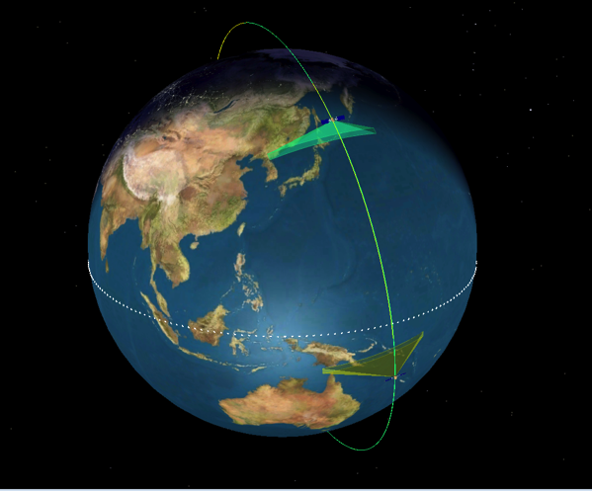
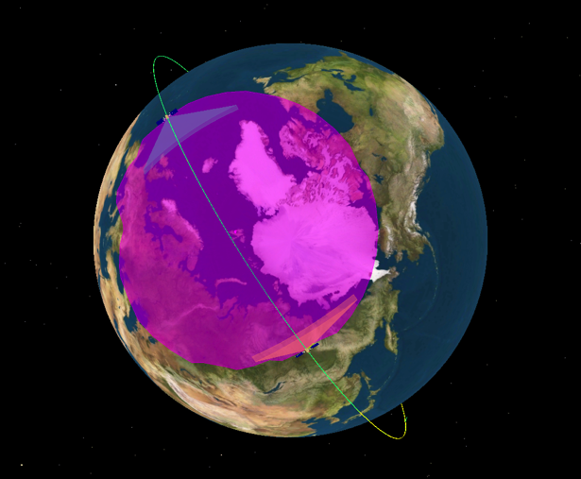
JPSS-1 Orbit and Constellation View
Part of JPSS satellite constellation at 824 km and 1330 LTAN, polar sun-synchronous orbit
16 day repeat cycle like S-NPP
JPSS-1 leads S-NPP with a minimum of 20 min orbital separation
  Support instrument calibration using cross reference
  Avoid ground contact conflicts
  Working with GSFC A-train personnel and are preparing for meetings with JPSS Flight/LV to start coordination of mission orbit insertion
Cross different node at
same LTAN
JPSS-1
227 nodal crossings
JPSS-1
Svalbard
13:30
LTAN
S-NPP
S-NPP
Snapshot taken at time when both
spacecraft above Svalbard horizon
(magenta colored circle)

Slide 20
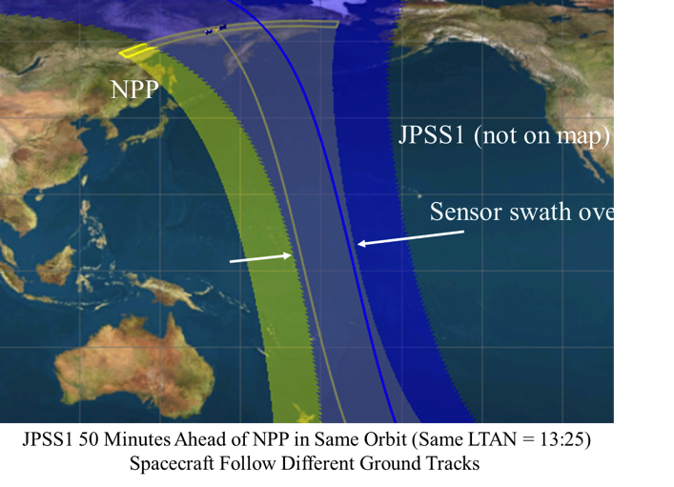
Mission Orbit Constellation Concept
Current Timeframe
  Program Science was asked to review/revisit the constellation concept (December 2014 timeframe) and responded with request to evaluate ½ orbit along-track separation concept (based on Eumetsat EPS-SG concept)
  PSE coordinated study involving science/flight/ground/mission ops to assess feasibility and impacts for changing the along-track separation
½ orbit along-track separation between JPSS-1 and S-NPP in the same mission orbit plane (824 km, 1325 LTAN)
Ground Track Diagram
Blue line/swath – JPSS-1; Yellow line/swath – S-NPP;
Grey swath – coverage overlap of JPSS-1 trailing edge with S-NPP leading edge; eliminates bow-tie effect
Diagrams/pictures based on analysis performed by Richard McIntosh/Dave Rohrbaugh (a.i. solutions)

Slide 21
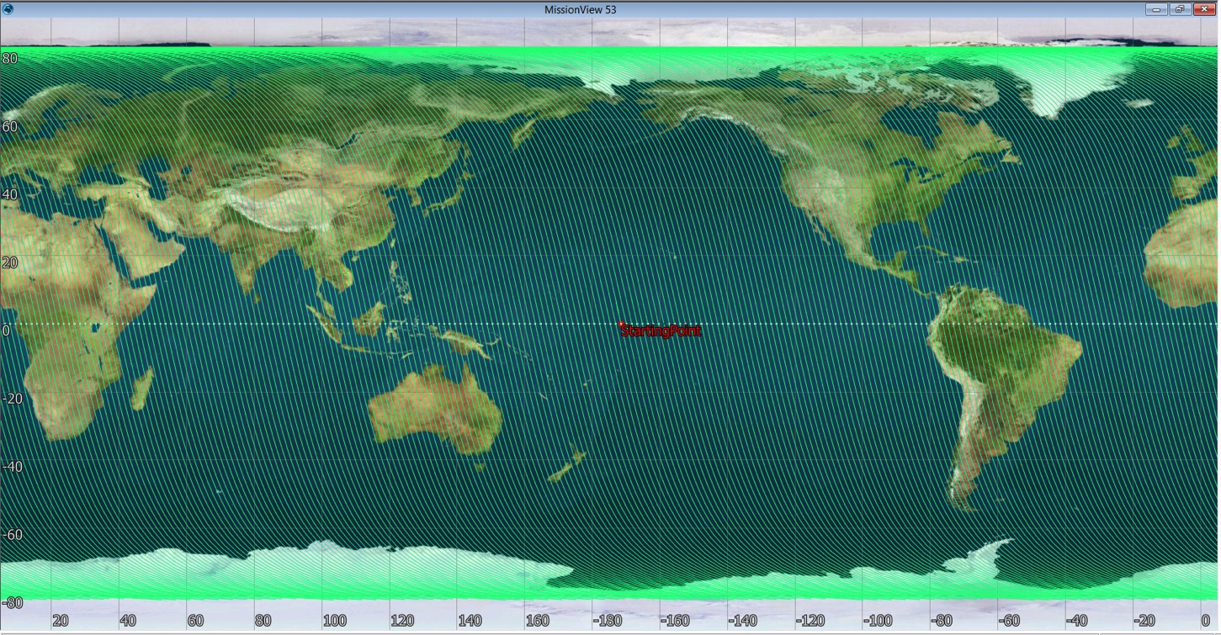
JPSS-1 Orbit Paths for 16 Days
Orbit grid for JPSS1 (ascending node paths shown) – there are 227 orbit paths for every 16-day cycle

Slide 22
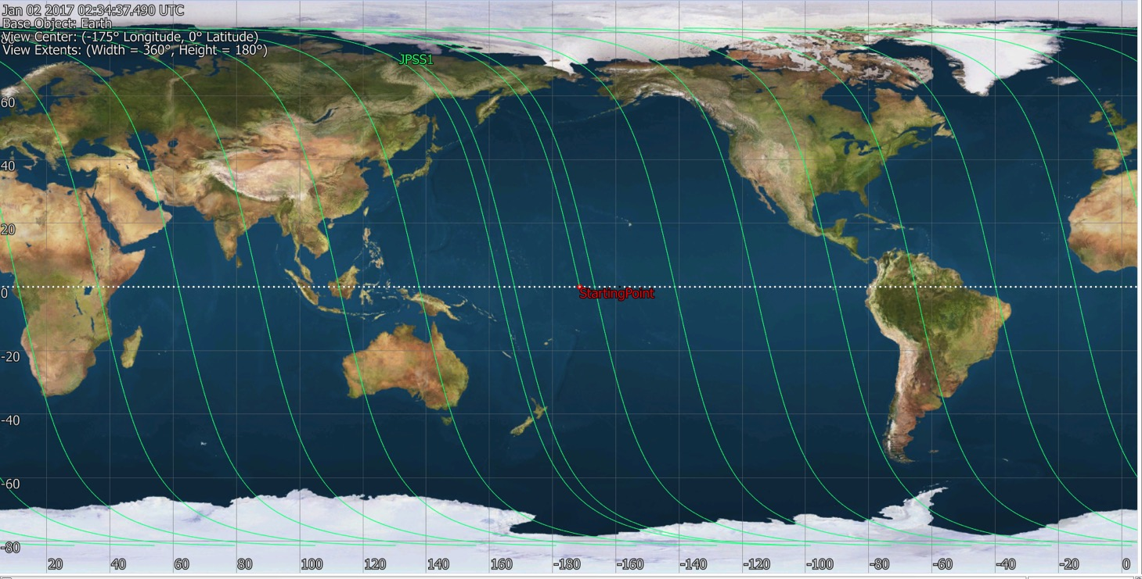
JPSS-1 Orbit Paths
Map shows orbit paths for slightly more than one day to see how the ground track is laid out
Consecutive orbits track 16 paths apart
Orbit 16
Orbit 15
Orbit 14
Orbit 13
Orbit 12
Orbit 11
Orbit 10
Orbit 9
Orbit 8
Orbit 7
Orbit 6
Orbit 5
Orbit 4
Orbit 3
Orbit 2
Orbit 1

Slide 23
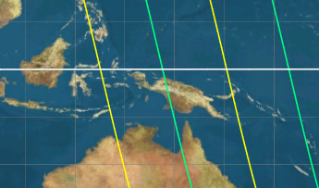
S-NPP & JPSS-1 Ground Track
(1325 LTAN/824 km orbit)
Equator
NPP
JPSS1
Spacecraft Follow Different Ground Tracks
Based On ½ Orbit Along-Track Separation

Slide 24
JPSS-1 wrt S-NPP
(1/2 orbit along-track separation)
Path 8
Path 7
Path 6
Path 5
Path 4
Path 3
Path 2
Path 1
176.542 km
21 km
50:45 minute Earth Rotation
(1/2 SNPP orbit)
JPSS1
50 min
ahead
SNPP
JPSS1
½ orbit
ahead
Note: Path numbers do not correspond to orbit numbers.

