Slide 1
A Deterministic Inverse Method for SST Retrieval from VIIRS: Incorporating Aerosol in the Retrieval Vector
Research: Prabhat Koner
PI: Andy Harris
CICS, ESSIC, University of Maryland
Notes:
Add the “title” of the product or service to the cover slide.
Add the project lead(s) name, office, and the date slides are submitted.
If this product/service development is stopping at the pre-operational phase, change the word “Operational” to “Pre-Operational”.

Slide 2
Physical Retrieval - Recap
Reduces the problem to a local linearization
Dependent on ancillary data (NWP) for an initial guess
More compute-intensive than regression – not an issue nowadays
Especially with fast RTM (e.g. CRTM)
Widely used for satellite sounding
More channels, generally fewer (larger) footprints
Initially, started with a simple reduced state vector
x = [SST, TCWV]^{T}
N.B. Implicitly assumes NWP profile shape is more or less correct
Selection of an appropriate inverse method
Ensure that satellite measurements are contributing to signal
Avoid excessive error propagation from measurement space to parameter space
If problem is ill-conditioned

Slide 3
History of Inverse Model
Forward model:
Simple Inverse: (measurement error)
Legendre (1805) Least Squares:
MTLS:
OEM:

Slide 4
Uncertainty Estimation
Physical retrieval
Normal LSQ Eqn: Δx = (K^{T}K)⁻¹K^{T}Δy [= GΔy]
MTLS modifies gain: G’ = (K^{T}K + λI)⁻¹K^{T}
Regularization strength: λ = (2 log(κ)/||Δy||)σ²_{end}
(σ²_{end} = lowest singular value of [K Δy])
Total Error
||e|| = ||(MRM – I)Δx|| + ||G’||⟨||(Δy - KΔx)||⟩
N.B. Includes TCWV as well as SST

Slide 5
DFS/DFR and Retrieval error
Retrieval error of OEM higher than LS
More than 75% OEM retrievals are degraded w.r.t. a priori error
DFR of MTLS is high when a priori error is high

Slide 6
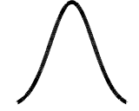
“Optimized” OE
[S_{e}], S_{a} =
Perform experiment – insert “true” SST error into S_{a}⁻¹
Can only be done when truth is known, e.g. with matchup data
0
σ² is an overestimate…
…or an underestimate
0

Slide 7
DFS/DFR and Retrieval error
Retrieval error of OEM higher than LS
More than 75% OEM retrievals are degraded w.r.t. a priori error
DFR of MTLS is high when a priori error is high
The retrieval error of OEM is good when a priori SST is perfectly known, but DFS of OEM is much lower than for MTLS

Slide 8
Improved cloud detection
Use a combination of spectral differences and RT
Envelope of physically reasonable clear-sky conditions
Spatial coherence (3×3)
Also check consistency of single-channel retrievals
Flag excessive TCWV adjustment & large MTLS error
Increased coverage w.r.t. GHRSST QL3+, but with reduced cloud leakage
Prabhat’s talk in yesterday’s Oceans Breakout
~50% increase in coverage & ~50% reduction in error

Slide 9
VIIRS Initial Results
Data are ordered according to MTLS error
Reliable guide for regression as well as MTLS
Trend of initial guess error is expected

Slide 10
MODIS experiments
Channel selection
Test various combinations and look at accuracy of retrieval
RTM may be inadequate for some channels ➔ bias
Channels 1, 3, & 13 are particularly useful

Slide 11
Addition of aerosol
Put aerosol information in the CRTM
NGAC profiles, multiple species (dust, salt, sulfate, soot)
Improve match of RTM to observation
Does this improve retrieval?
Put aerosol in the retrieval vector
Allow Total Column Aerosol to vary
x = [SST, WV, TCA]^{T}
Jacobian now includes ∂T/∂TCA for each channel
Does this improve retrieval?
MTLS developed for 2-parameter retrieval
Try different regularization operator since problem is now more ill-conditioned: Truncated Total Least Squares (TTLS)
|Δy| ≤ 1: λ = (σ_{end-1})² |Δy| > 1: λ = (σ_{end-1}/log(|Δy|))²

Slide 12
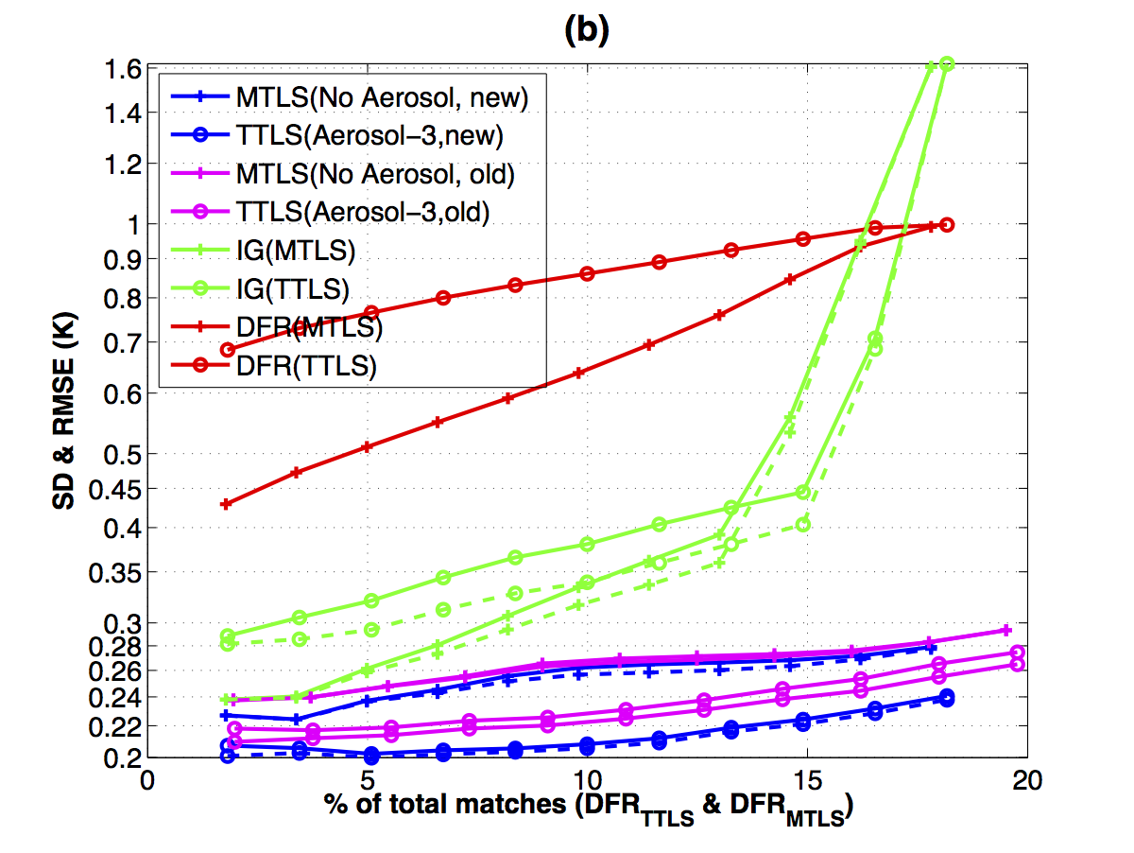
Inclusion of aerosol
Accuracy with TTLS & joint [SST, WV, TCA] ~0.2 K
Algorithm sensitivity is also improved cf. MTLS

Slide 13
Summary
Addition of aerosol has significant benefit
Most of all when included in retrieval vector as well as CRTM
Better partitioning of brightness temperature residuals
No longer forcing delta-BTs caused by aerosol into the SST and/or WV retrieval space
Also improves algorithm sensitivity to SST (better overall fit to model)
TTLS better choice for 3-parameter retrieval
Initial “tuning” with MODIS works well
Adaptation to VIIRS channels underway
Validation results are approaching buoy accuracy limit
Best ~50% of retrievals at 0.2 K
Implies actual retrieval accuracy is better than this
Need to consider what might be needed @SIPS
Full aerosol profiles as well as NWP

Slide 14
Backup slides

Slide 15
Improvements
It seems “obvious” that a sensitivity of 1 is desirable
E.g. if there is diurnal warming of 5 K, it will be observed in the data, and strong upwellings will be accurately observed, etc.
However, there is a penalty to be paid
Ill-conditioned problem ➔ noise propagates from measurement space to parameter space
Compromise is usually struck (e.g. minimum least squares result for training data in a regression algorithm)
Regression algorithms may have sensitivity <1 for large regions
E.g. daytime algorithms in the tropics (diurnal warming!)
Causes bias if local atmospheric conditions are different from the ensemble mean for the training data

Slide 16
MODIS Initial Results
Note improvement from discarding MTLS error “last bin”
Irrespective, MTLS is quite tolerant of cloud scheme
Recalculated SST4 coefficients produce quite good results

