Slide 1
Lake Water Temperature Trends from LST
Simon J. Hook (JPL)
N. Healey (JPL)
J. Lenters (LimnoTech, MI)
C. M. O’Reilly (Illinois State University)
Jet Propulsion Laboratory
California Institute of Technology
Pasadena, California, 91109
Contact: simon.j.hook@jpl.nasa.gov

Slide 2
Outline
Background and previous work
Data and Methods
California Case Study
Ecological consequences
Summary and Conclusions

Slide 3
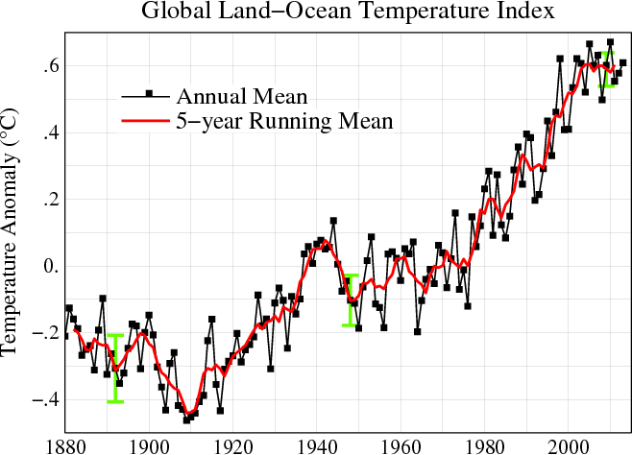
Background
Line plot of global mean land-ocean temperature index, 1880 to present, with the base period 1951-1980. The dotted black line is the annual mean and the solid red line is the five-year mean. The green bars show uncertainty estimates.
[This is an update of Fig. 1A in Hansen et al. (2006).]
Air temperature over land
Buoy and satellite retrievals over oceans

Slide 4
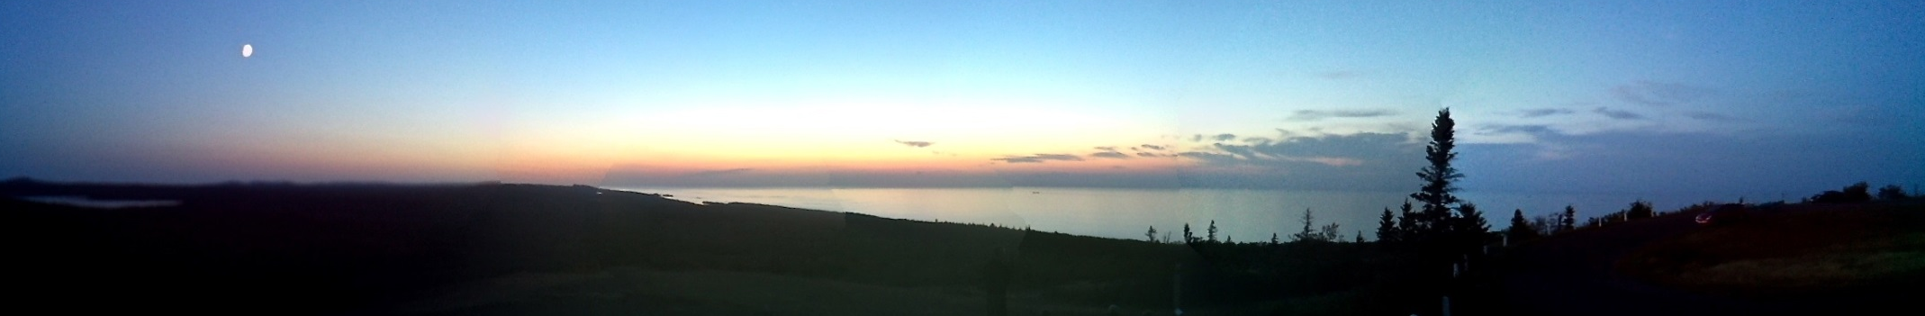

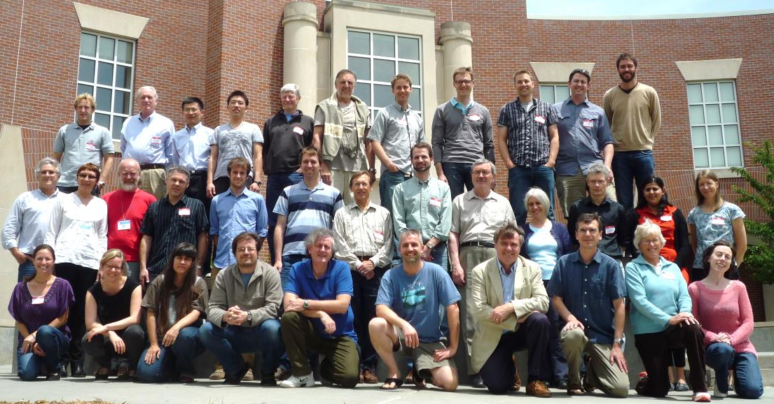
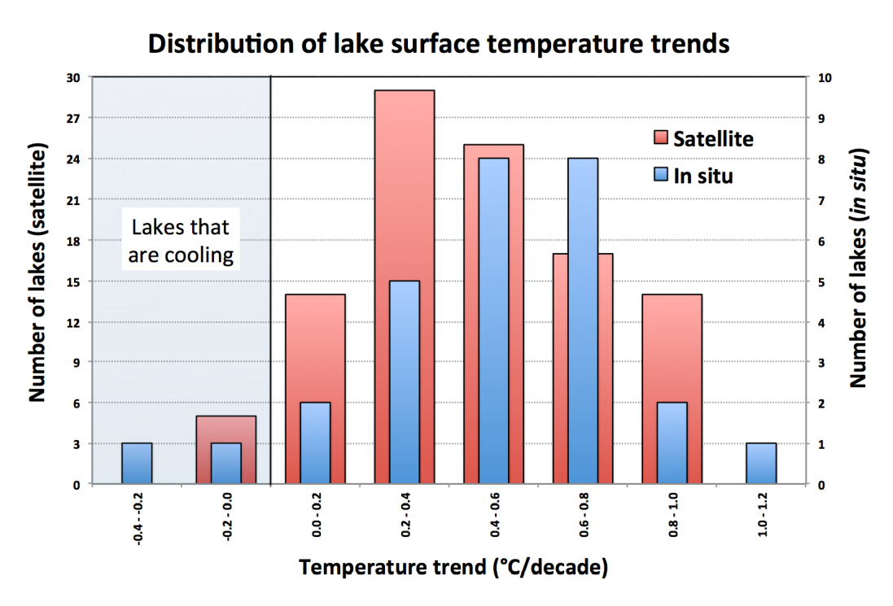
Previous Work
http://laketemperature.org/
Global Lake Temperature Collaboration (GLTC):
What are the patterns, mechanisms,
and impacts of global lake
warming / cooling?
Oreilly et al. 2015

Slide 5
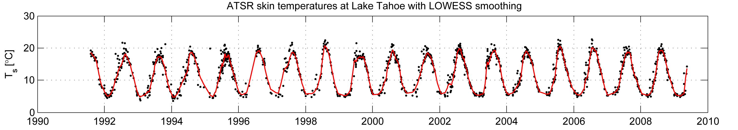
Data and Methods
Thermal infrared data from four sensor series
  Advanced Very High Resolution Radiometer (AVHRR) 1982-present
  Along-Track Scanning Radiometer (ATSRx) 1991-2011
  Moderate Resolution Imaging Spectroradiometer (MODIS) 1999-present
  Visible Infrared Imaging Radiometer Suite (VIIRS) 2011-present
Data extraction
Cloud masking
Atmospheric correction
Computation of summer time (JAS) means
Weighted linear regression analysis and uncertainty analysis

Slide 6
Processing Criteria for MODIS
(Terra & Aqua)
Location | 3 x 3 pixel window (1 km pixels)
Minimum points in JAS Range | 20
Smoothing | LOWESS interpolation
Image Time | Night
Range from Target Coordinates | < 1 km
Standard Deviation of Temperatures in 3 x 3 | < 0.5 K
Sensor Zenith Angle | < 45°
 | Cirrus Cloud Test
Cloud Masking | High Cloud Test
 | Thermal Test
Temperature Range | <= 308.15 and >= 237.15 K

Slide 7
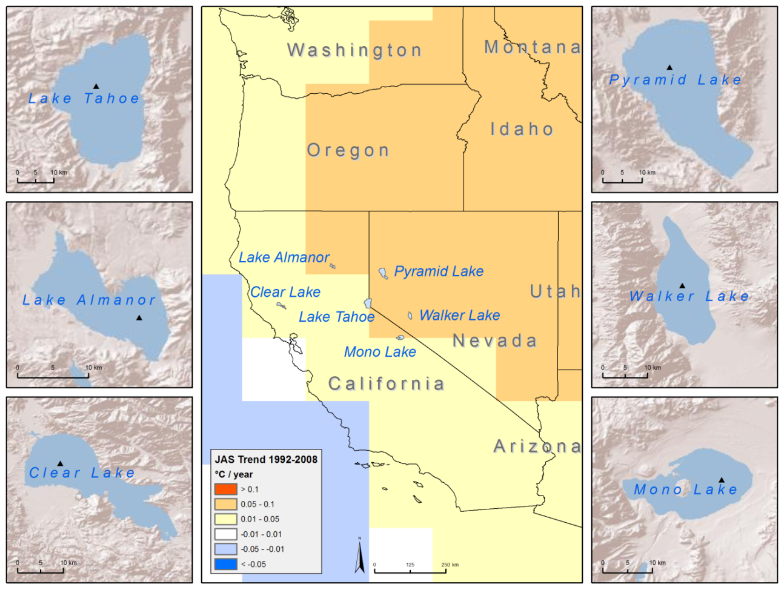
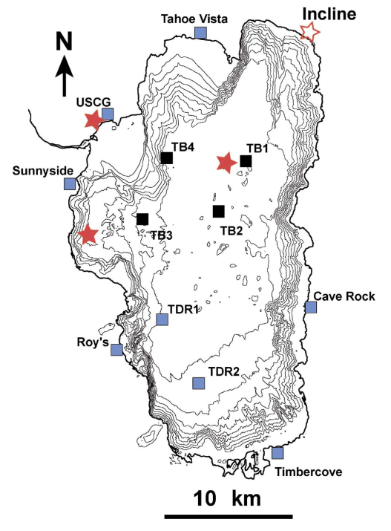
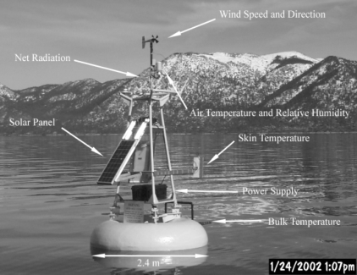
California/Nevada case study
In situ measurements at 4 buoys at Lake Tahoe were used to develop algorithms and validate the results
A preliminary case study was carried out for six lakes in California and Nevada. The center panel shows the lake locations and the GISTEMP (Hansen et al., 1999) summertime temperature change between 1991 and 2008.

Slide 8
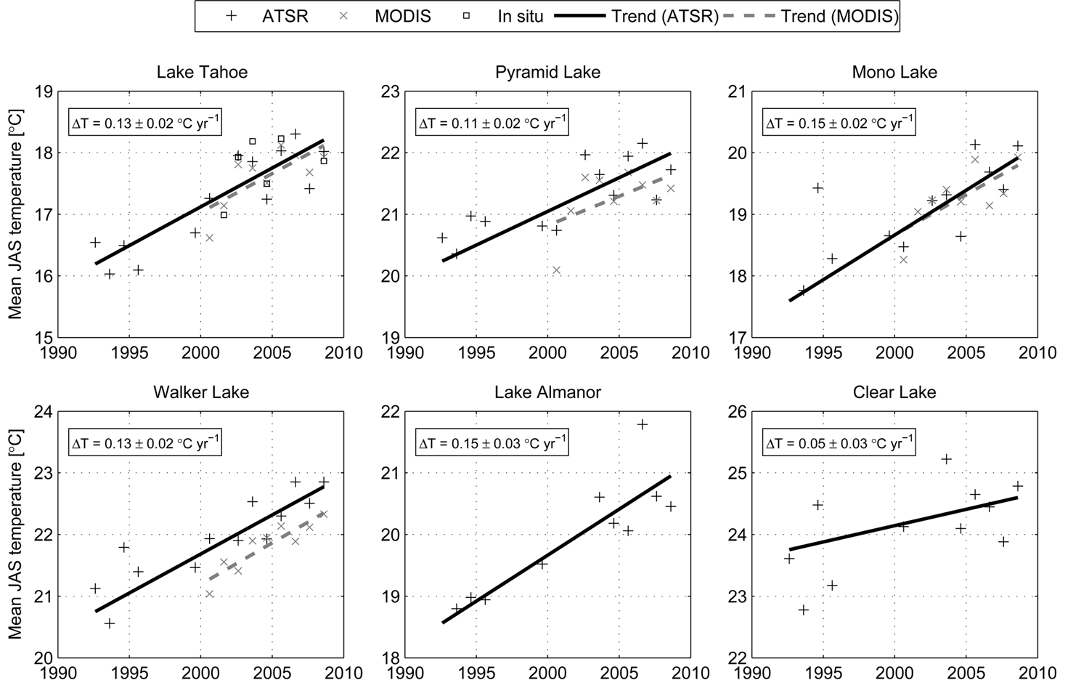
Summertime (JAS) trends since 1991-2008
Schneider et al. (2009). Satellite observations indicate rapid warming trend for lakes in California and Nevada. Geophysical Research Letters
Listed trends are derived from ATSR data (1991-2008)

Slide 9
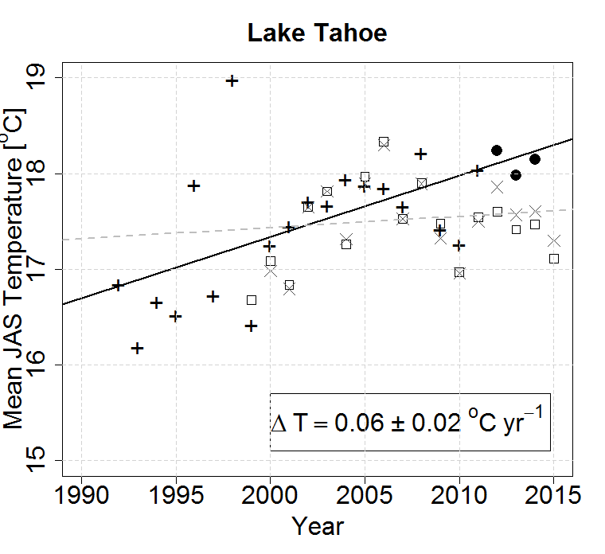
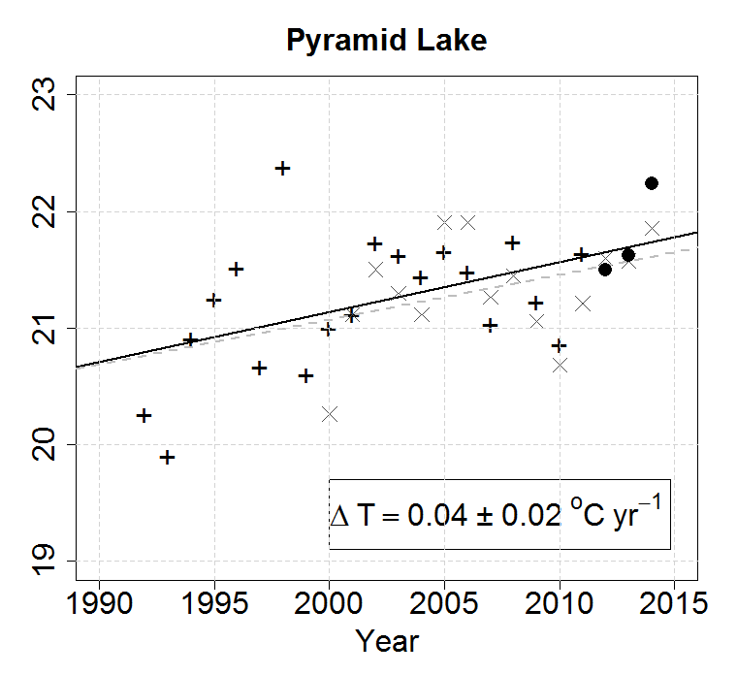
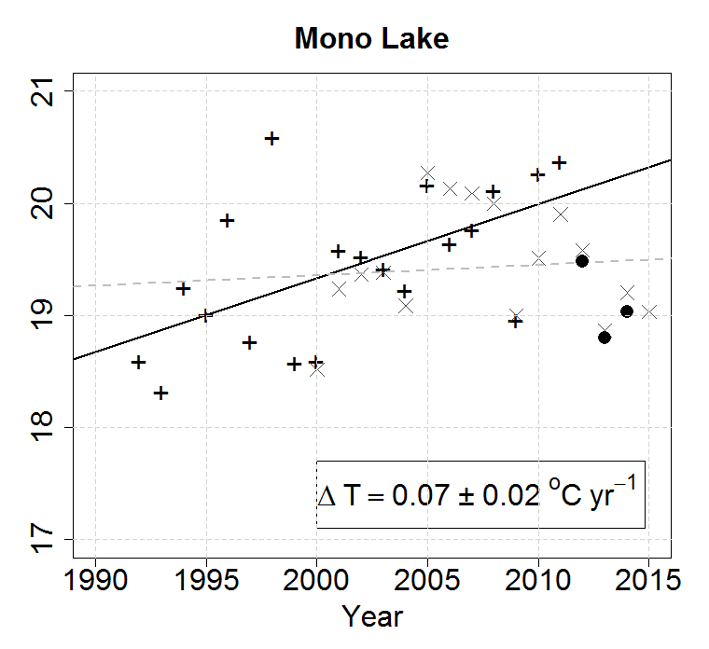

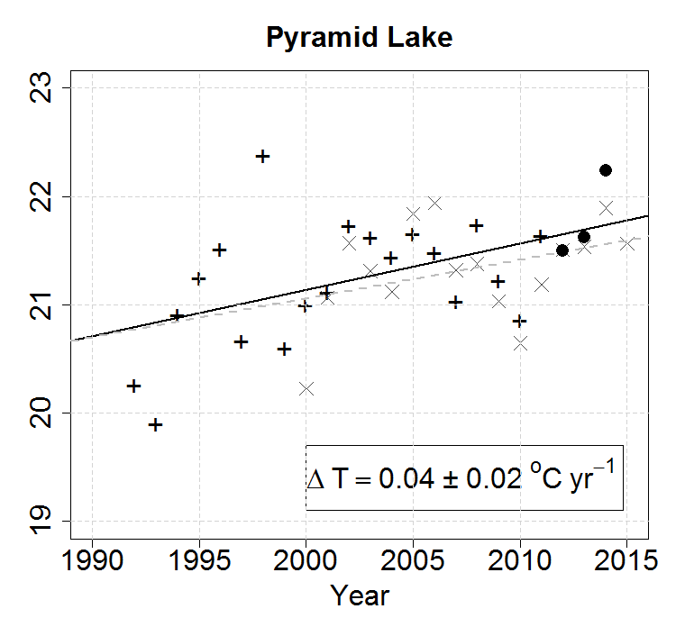

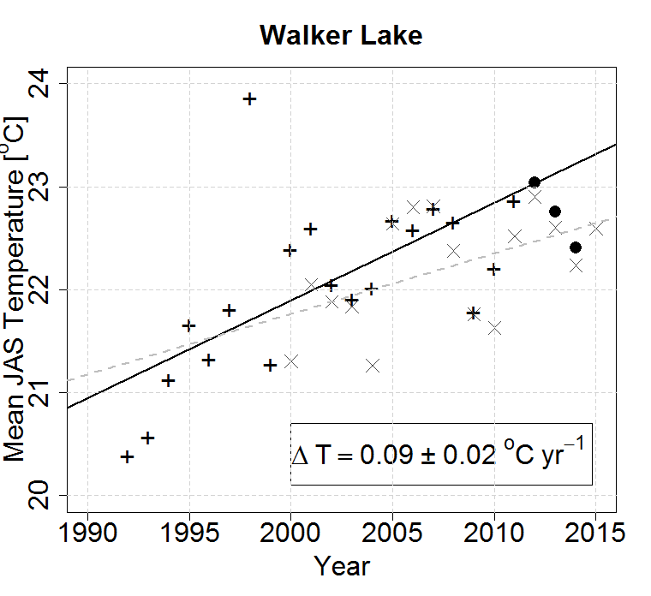
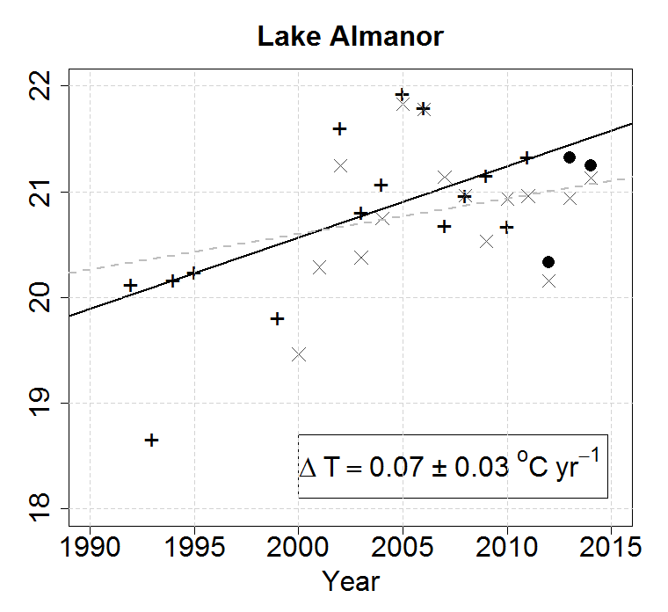
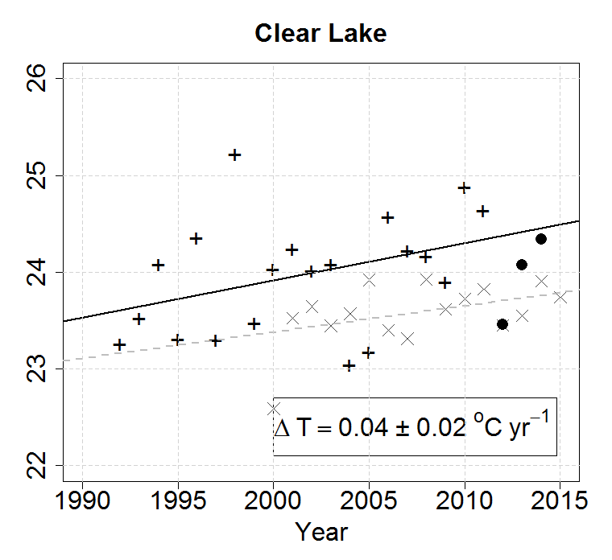
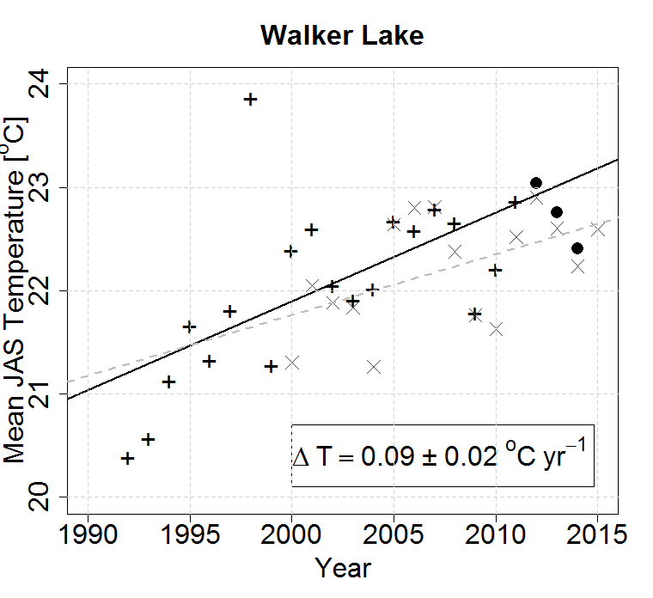

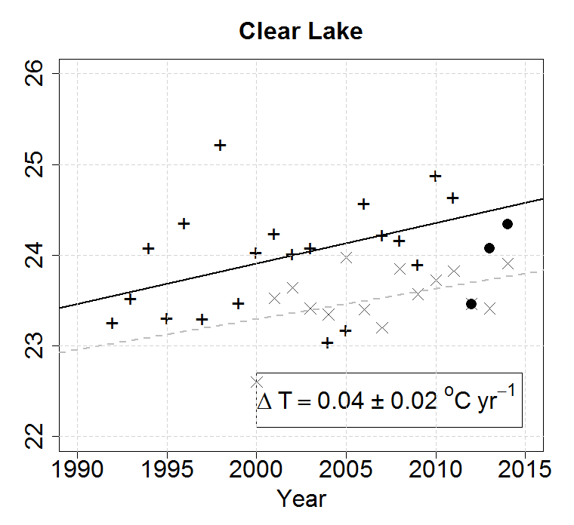

Summertime (JAS) trends since 1991-2015
ATSR
MODIS
VIIRS
In situ
Trend (ATSR)
Trend (MODIS)
Listed trends are derived from ATSR data (1991-2011)

Slide 10
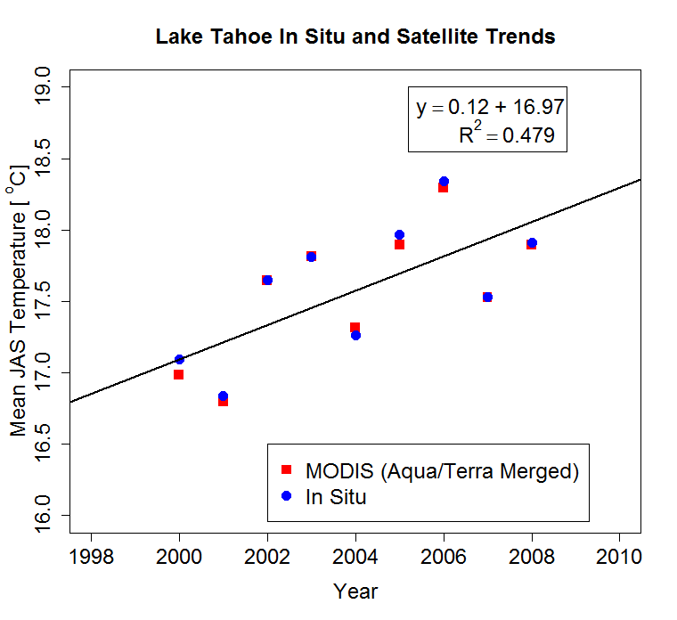
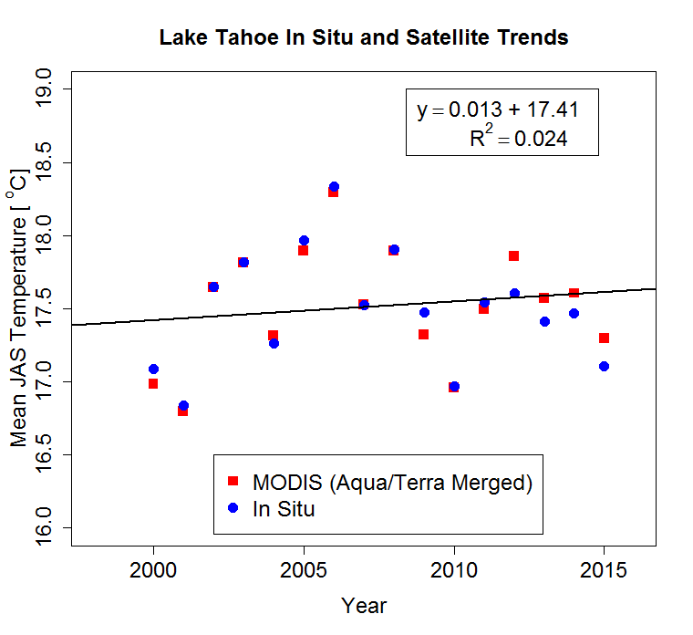
The Importance of Record Length

Slide 11
North American Lakes
MODIS (Aqua &Terra) Trends - Top Ten
2000-2008
2000-2015

Slide 12
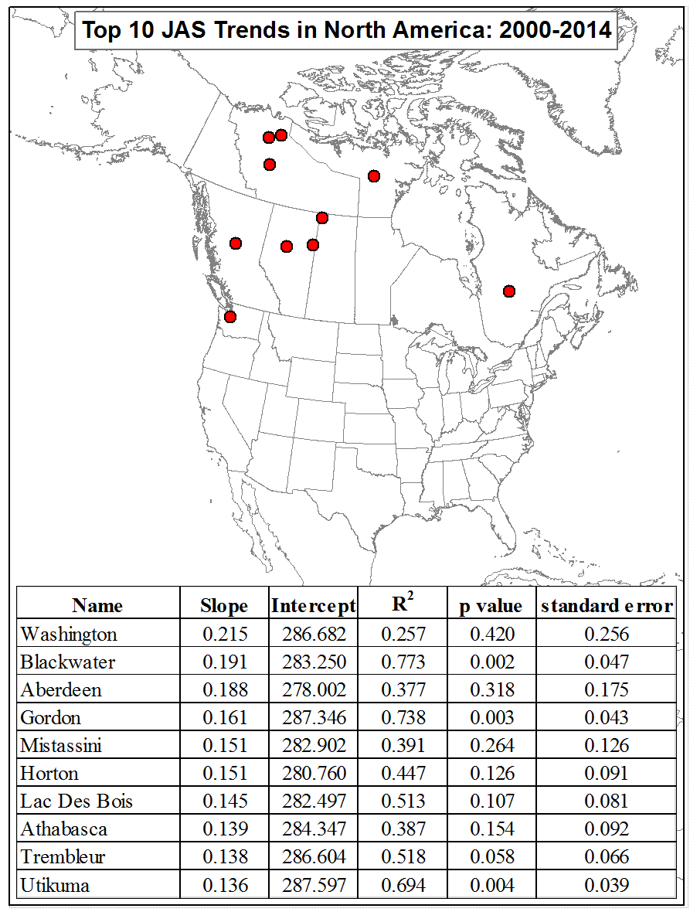
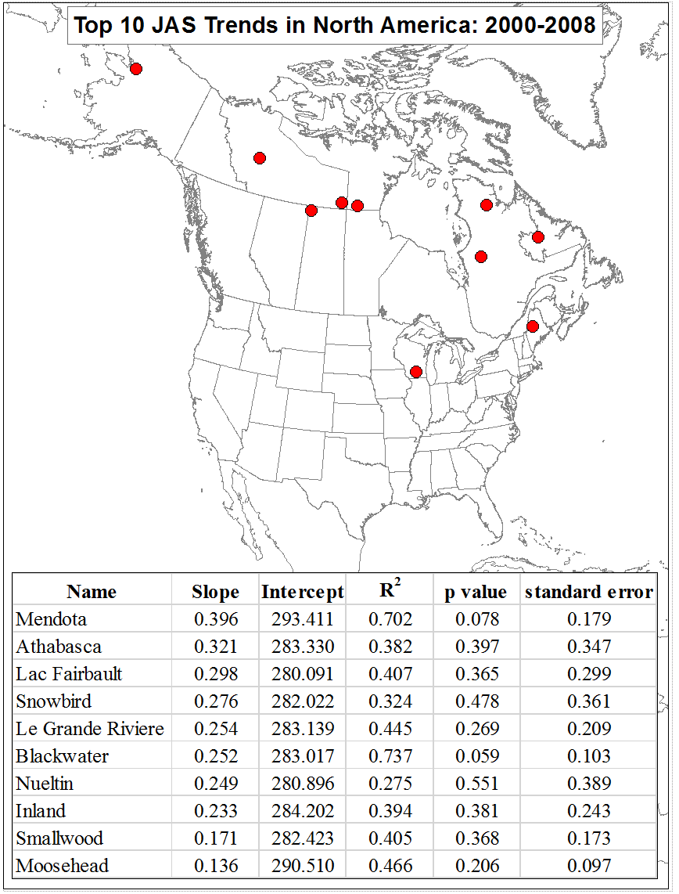
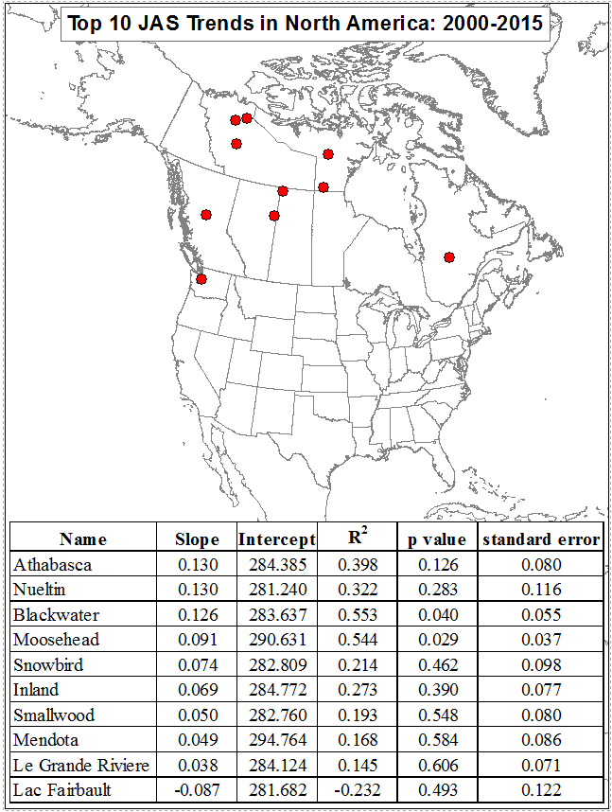
North American Lakes Trends - Top Ten
Previous study
Current study

Slide 13
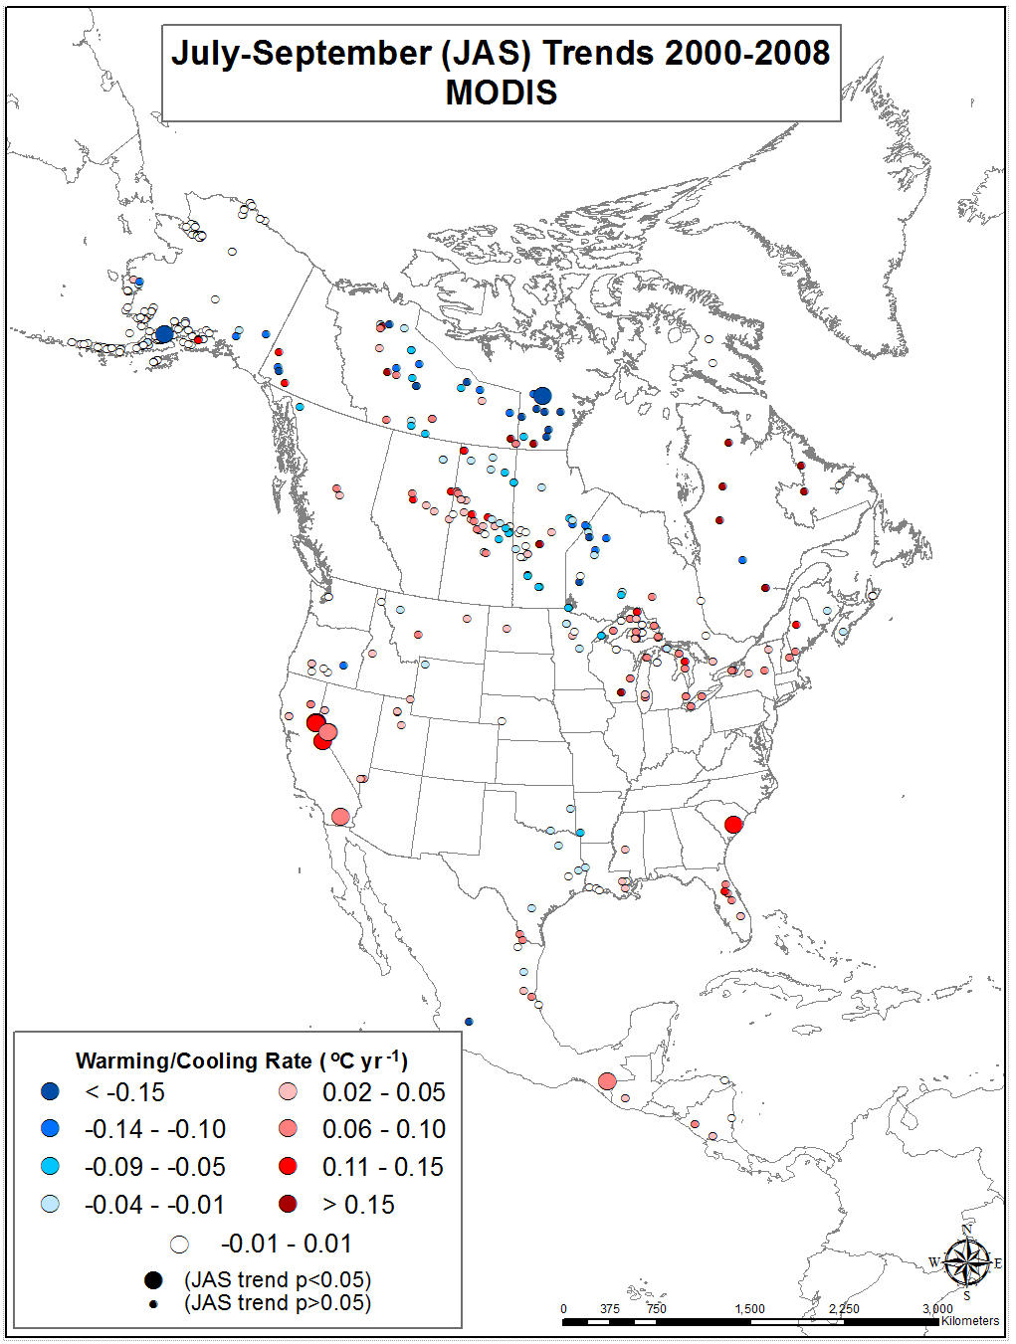
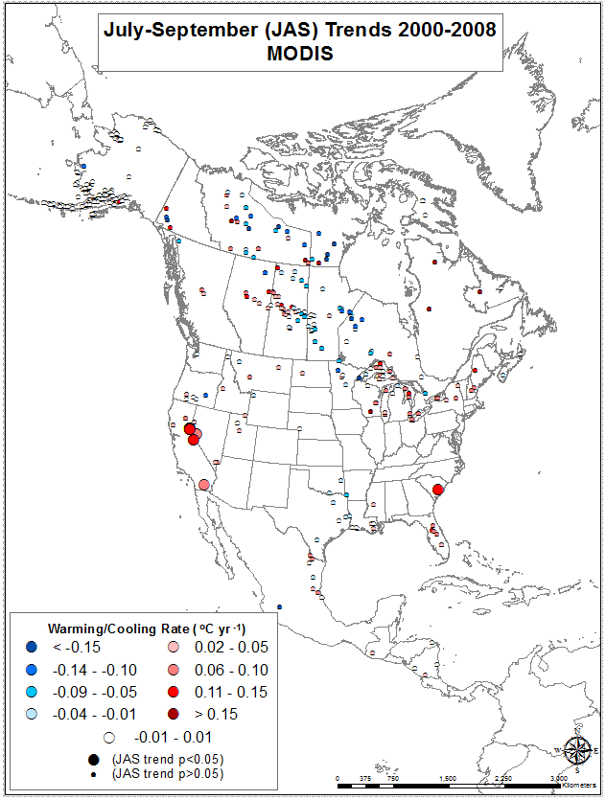
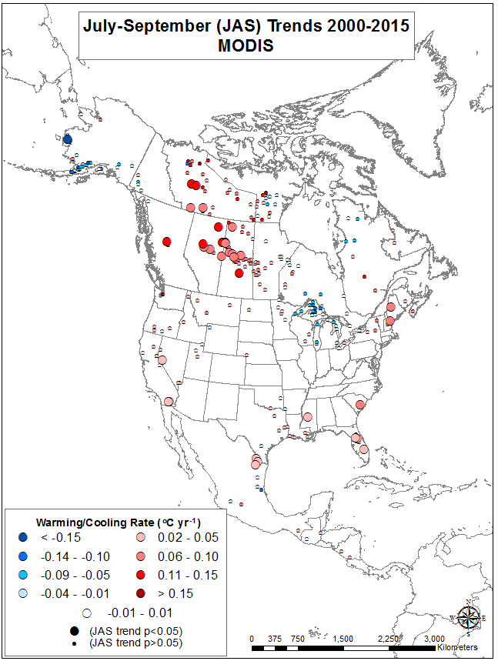
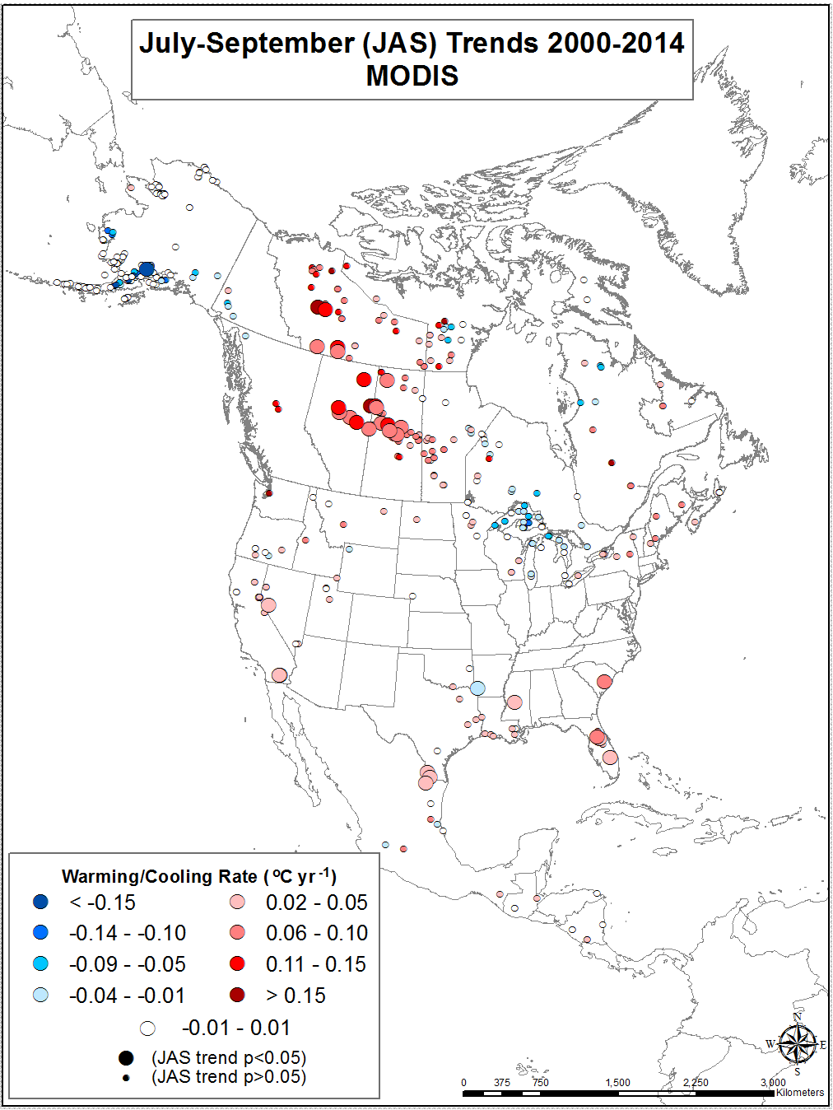
North American Lake Trends

Slide 14
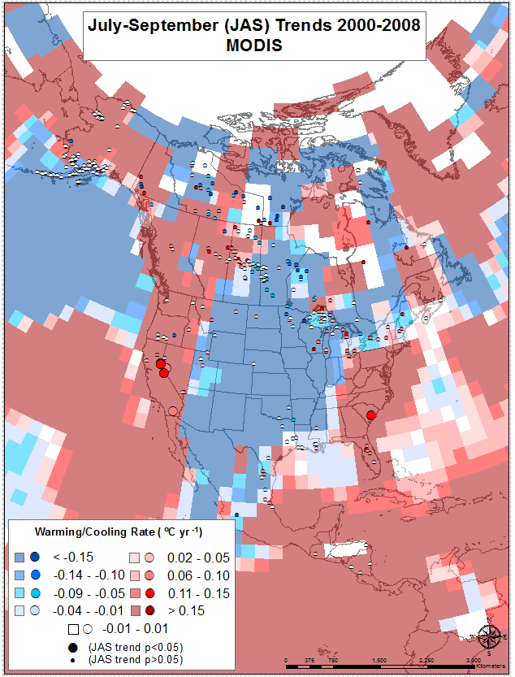
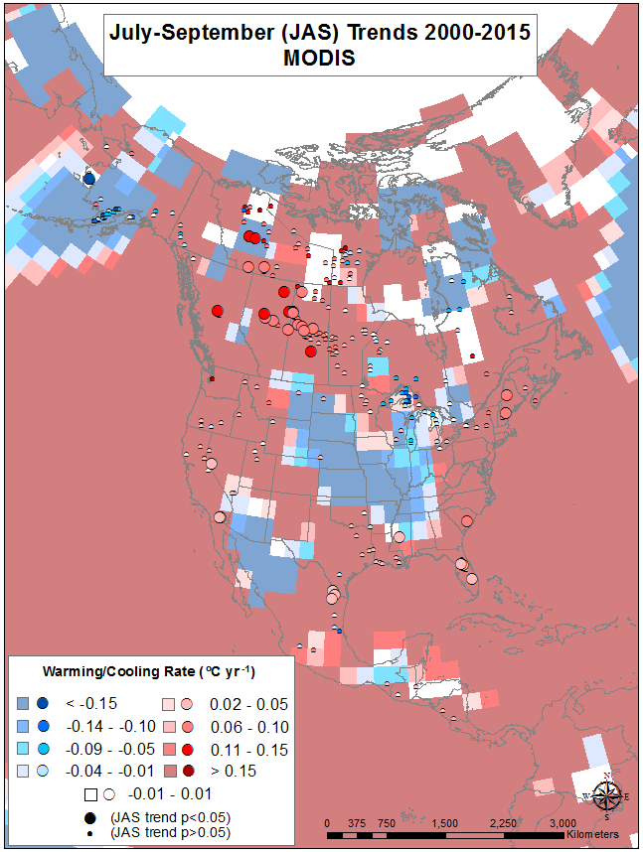
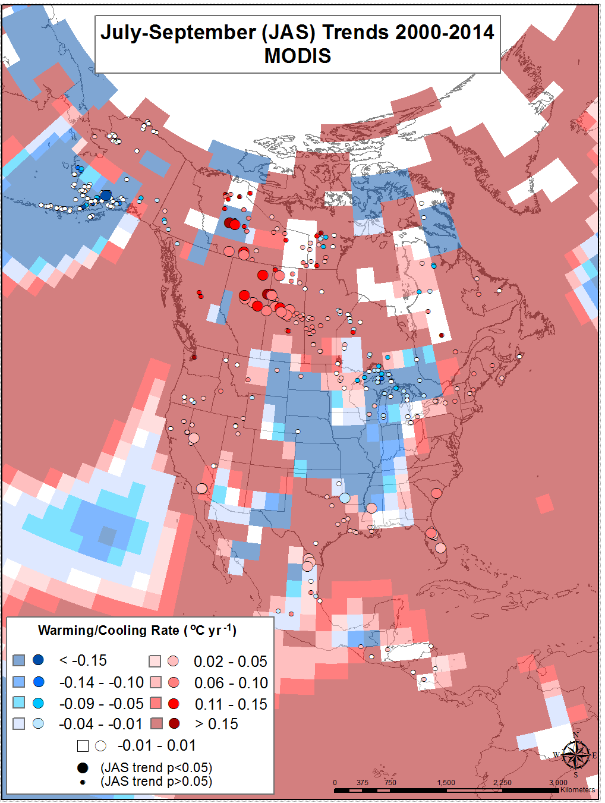
North American Lake and Air Temperature Trends
(GISTEMP Team, 2015;
Hansen et al., 2010)
(GISTEMP Team, 2015;
Hansen et al., 2010)

Slide 15
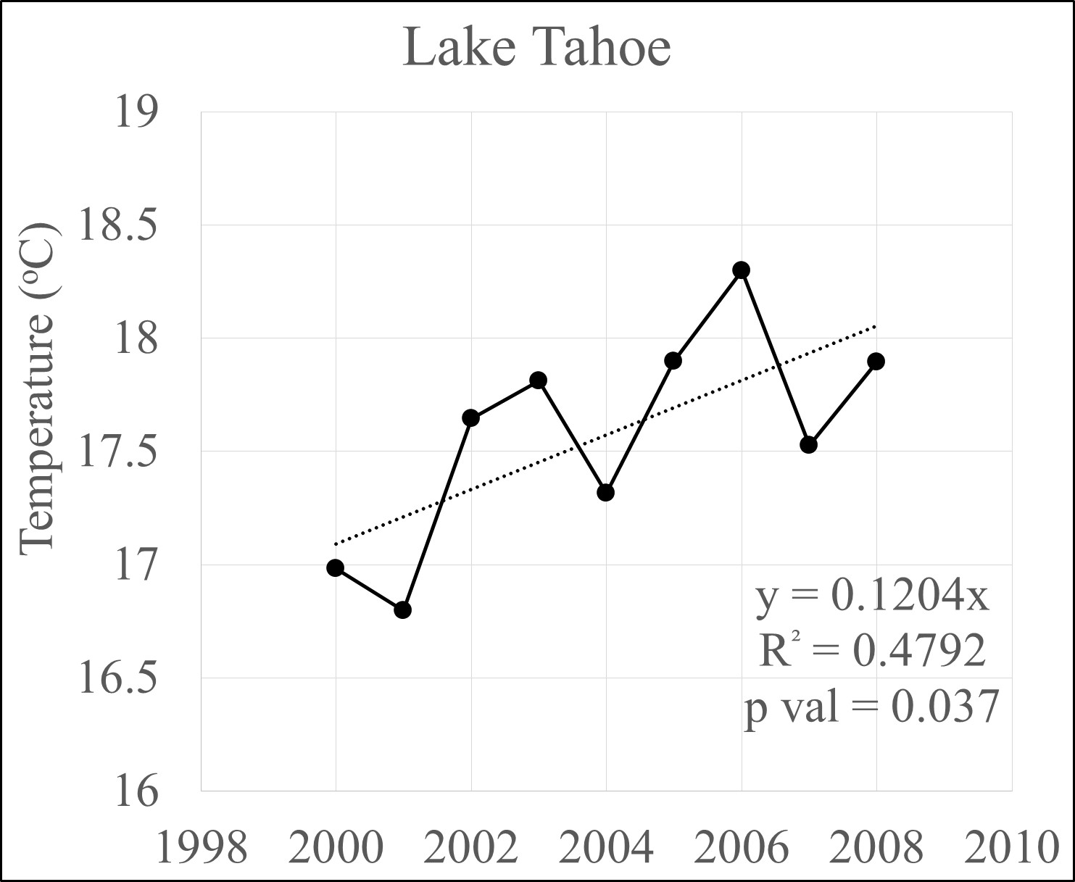
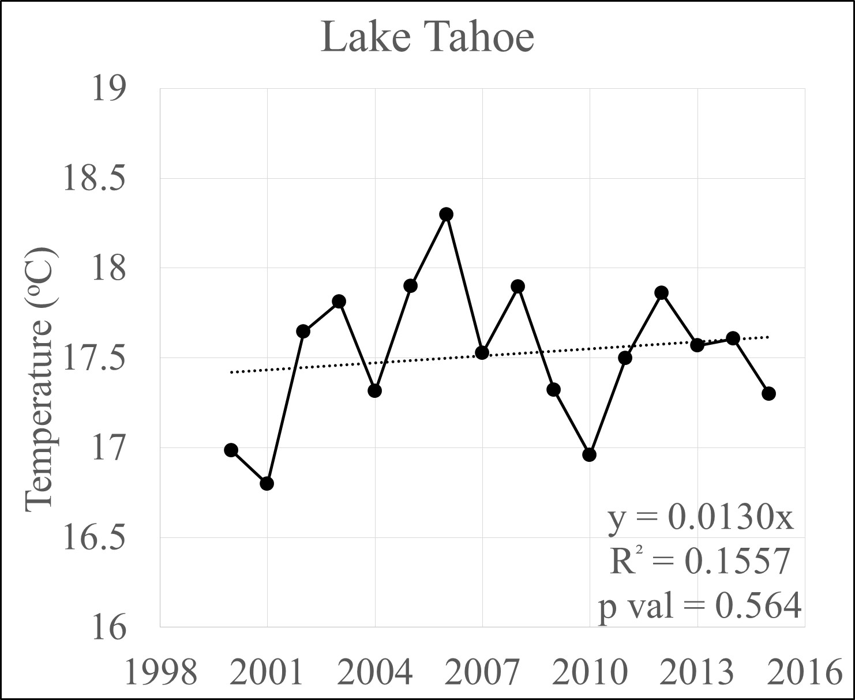
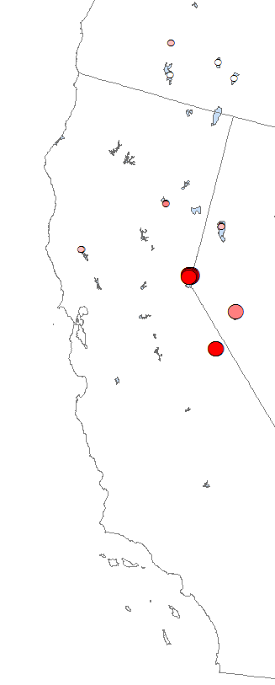
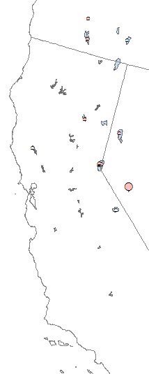
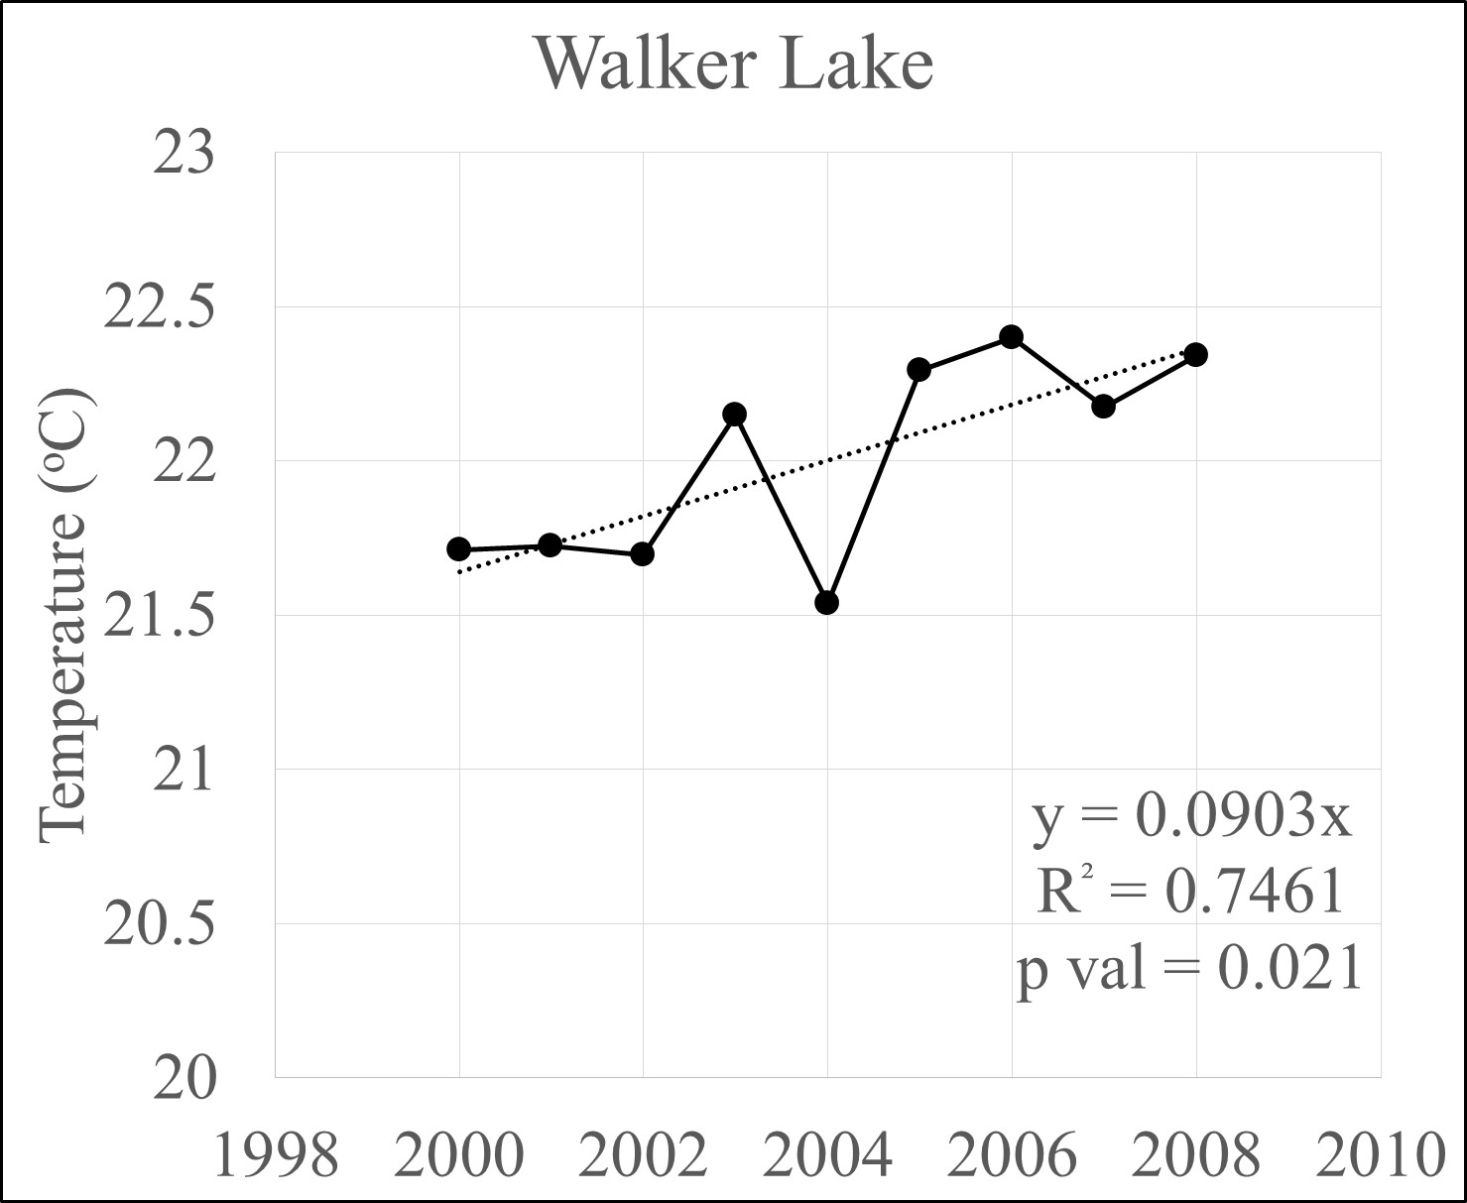
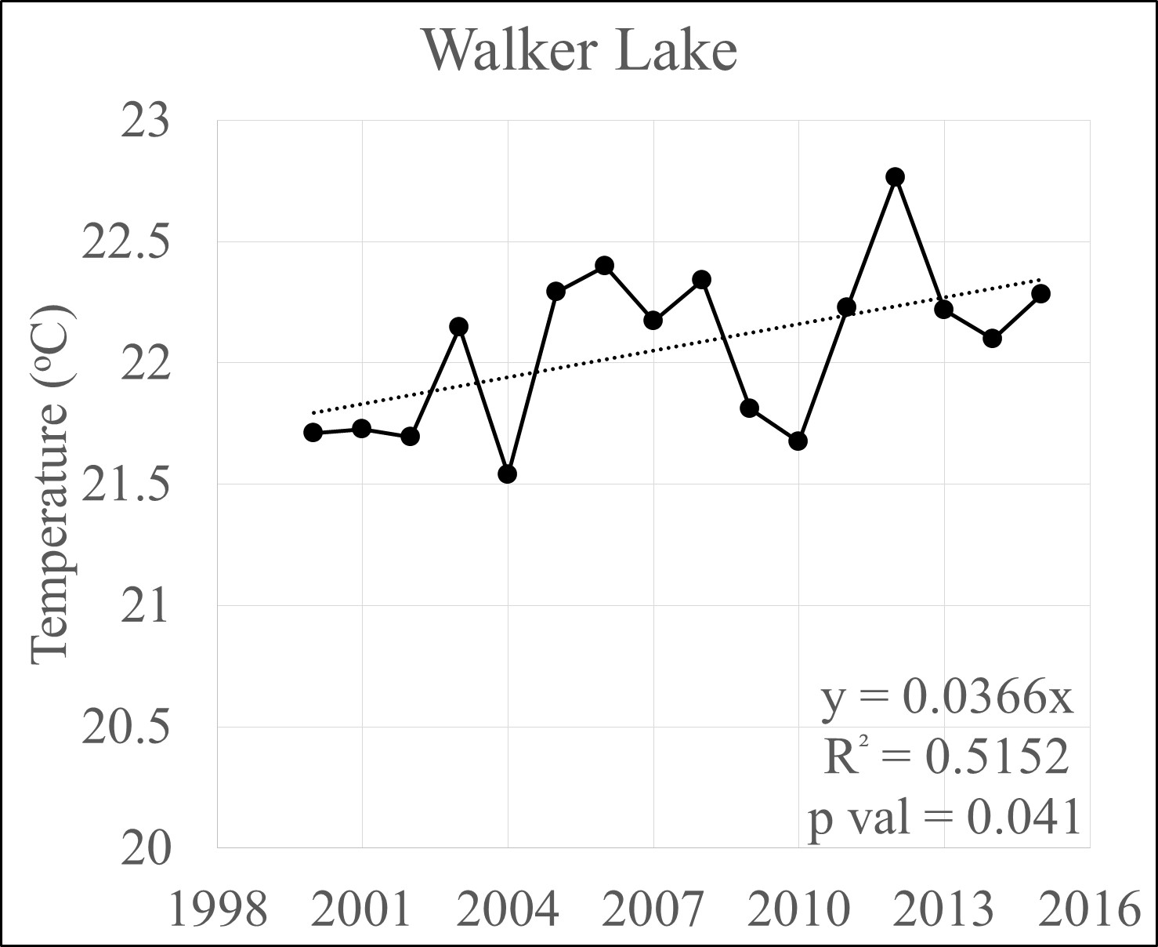
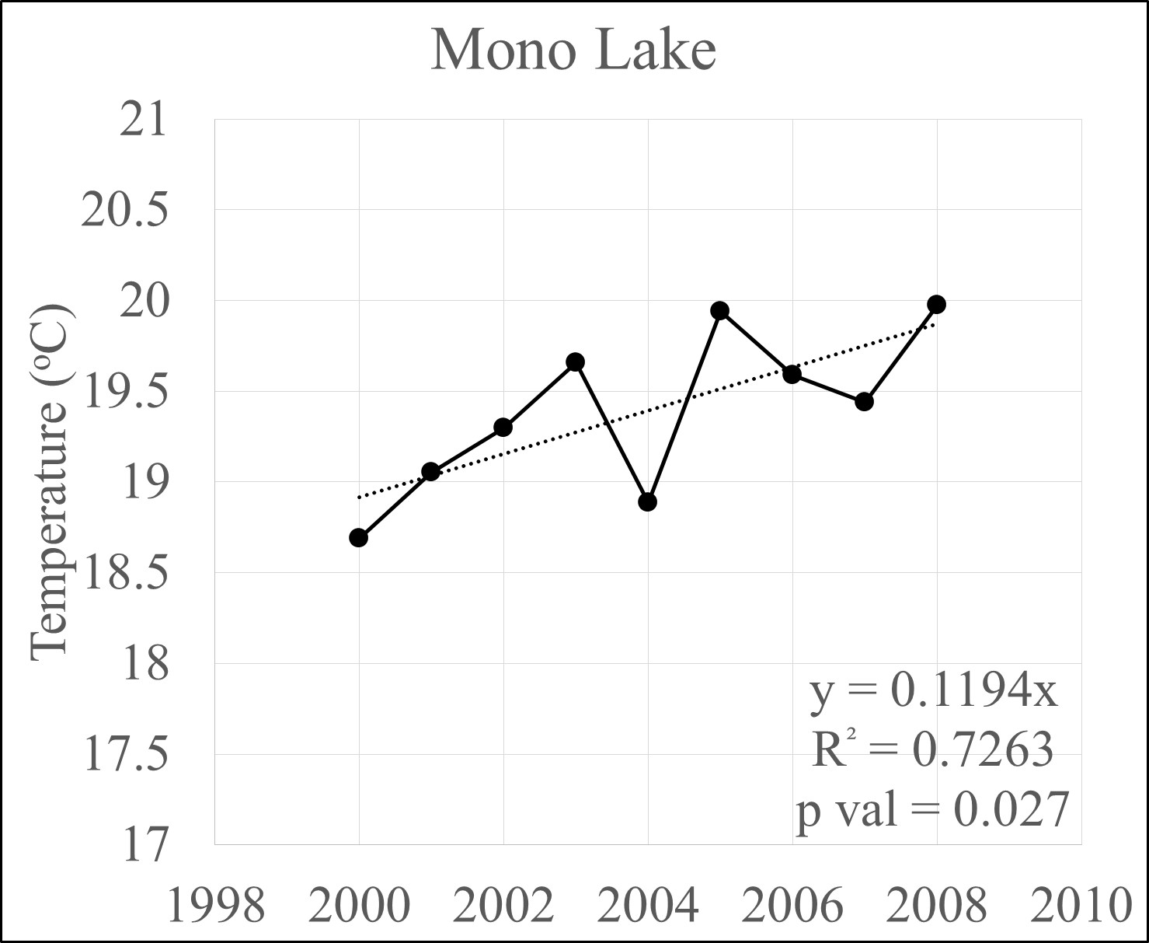
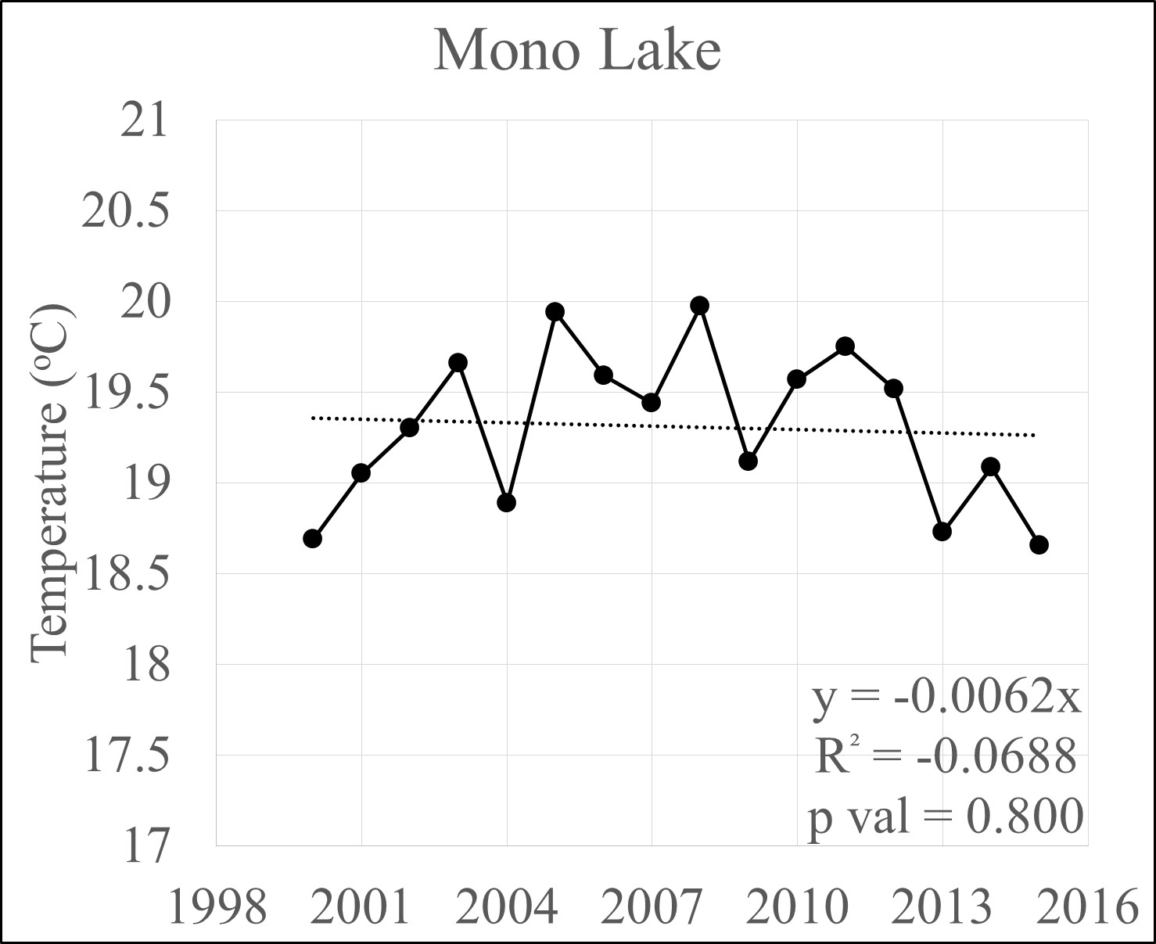
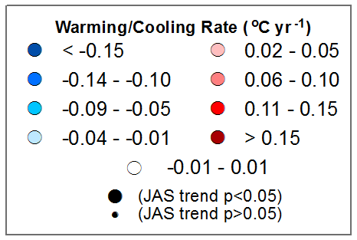
Latest Trends
2000 - 2008
2000 - 2015

Slide 16
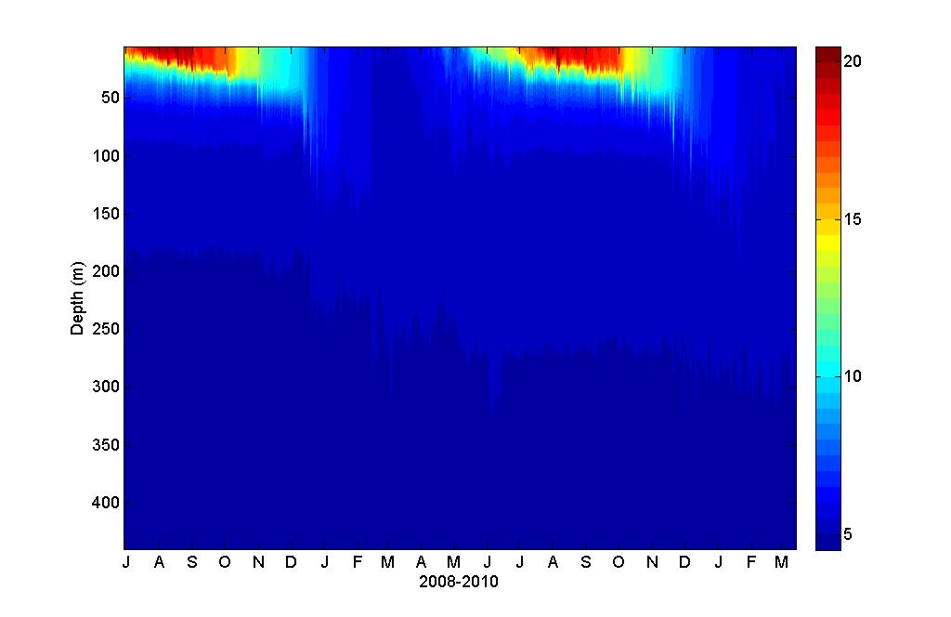
Typical Thermal Stratification Pattern
Deep mixing
DEEP MIXING
DEEP MIXING
Courtesy G. Schladow – UC Davis

Slide 17
Last 41 Years – Depth of Winter Mixing
Courtesy G. Schladow – UC Davis
Notes:
Depth of mixing (1973-2014)

Slide 18
Courtesy G. Schladow – UC Davis

Slide 19
DO in the Next 85 Years? Hypoxia at Lake Tahoe?
Courtesy G. Schladow – UC Davis
SOD 0.04 g-O₂ m⁻² d⁻¹ Marc Beutel

Slide 20
Summary and Conclusions
Satellite thermal data provides a rich record of changes in surface temperature since 1980.
Currently extending time series first created in 2009 to present day (AVHRR, ATSRx, MODIS, VIIRS).
In Western USA warming rates have been lower from 2009-present
Relating changes in the thermal behavior of the water bodies to changes in surface air temperature data.
Exploring ecologically consequences of warming

Slide 21
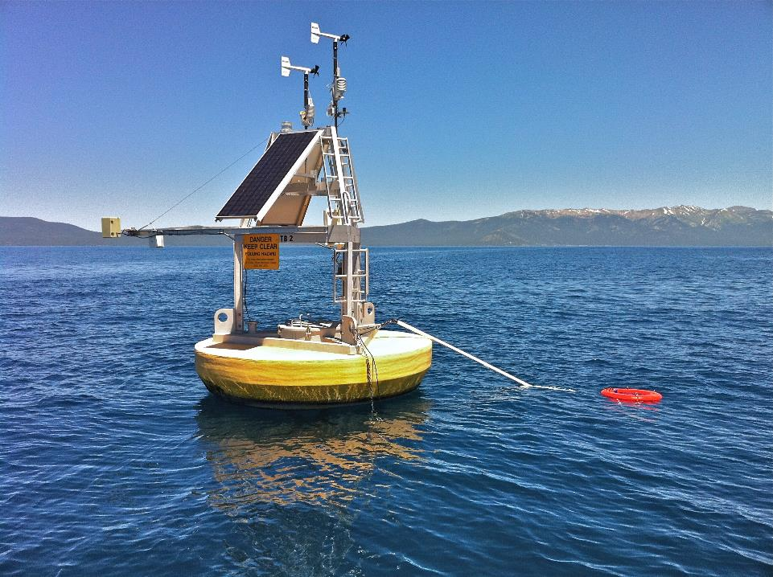
Comments?
Contact:
Simon.j.hook@jpl.nasa.gov
Questions?
Photo: John Lenters

