Slide 1
National Aeronautics and Space Administration
MODIS/VIIRS
Land Surface Temperature and Emissivity
Glynn Hulley, Nabin Malakar, Robert Freepartner, Tanvir Islam
Simon Hook, Pierre Guillevic
Jet Propulsion Laboratory, California Institute of Technology, Pasadena, CA
(c) 2016 California Institute of Technology. Government sponsorship acknowledged.
MODIS/VIIRS Science Team Meeting, Silver Spring, MD, June, 2016

Slide 2
Outline
Algorithm and product updates
Validation
Product unification
Continuity

Slide 3
Land Surface Temperature/Emissivity (LST&E)
LST&E are key variables for Earth Science:
Monitoring climate change
Land use/land cover change
Surface energy balance (e.g. ET)
Cryosphere
Push for better understanding and utilization:
EarthTemp, GlobTemperature, ILSTE-Working groups
LST recognized as Essential Climate Variable (ECV) by GCOS!
Requirements:
1 K accuracy LST, 1.5% accuracy emissivity
Global daily (LEO), and 30-min (GEO)
<1 km spatial resolution
Long term stability and uncertainty characterization
Notes:
No easy feat. Took a lot of persistence

Slide 4
LST&E Algorithm Updates
LST&E Product Characteristics | MODIS (MOD21) | VIIRS (VNP21)
Algorithm | Temperature Emissivity Separation (TES) | Temperature Emissivity Separation (TES)
Bands used | 29 (8.55 µm) 31 (11 µm) 32 (12 µm) | 14 (8.55 µm) 15 (10.76 µm) 16 (12 µm)
Radiative Transfer Model | RTTOV | RTTOV
Atmospheric Profiles (T, RH) | MERRA-2 | MERRA-2
Status | Complete: Tier-2 C6 (MODAPS) | Baselining in progress (LSIPS)
Data Product Types | L2, L2G Daily (1 km) L3 8-day, (1 km) | L2, L2G Daily (750 m) L3 8-day, (750 m)
Science Data Products | - LST - Emissivity (bands 29, 31, 32) | - LST - Emissivity (bands 14, 15, 16)

Slide 5
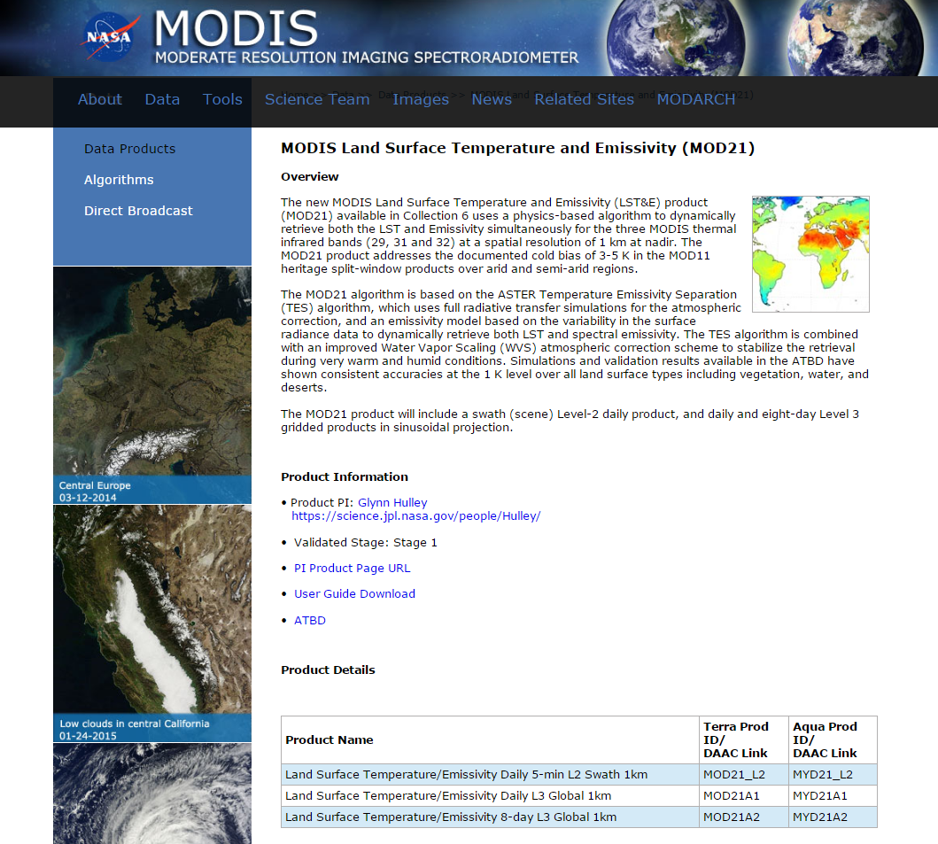

Slide 6
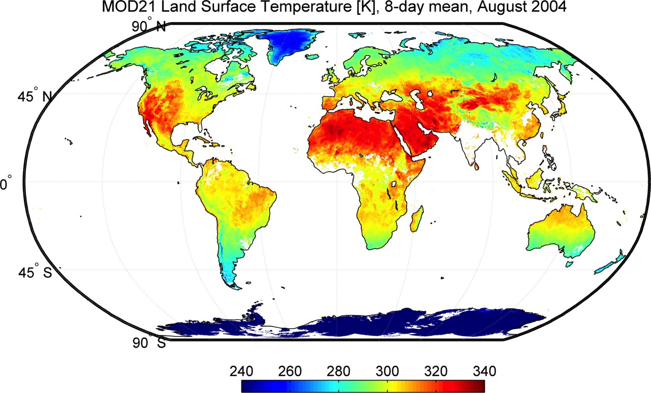
TERRA – 10:30 am
Mojave
Algerian desert
Lut Desert,
Rub
‘Al Khali
>70 C

Slide 7
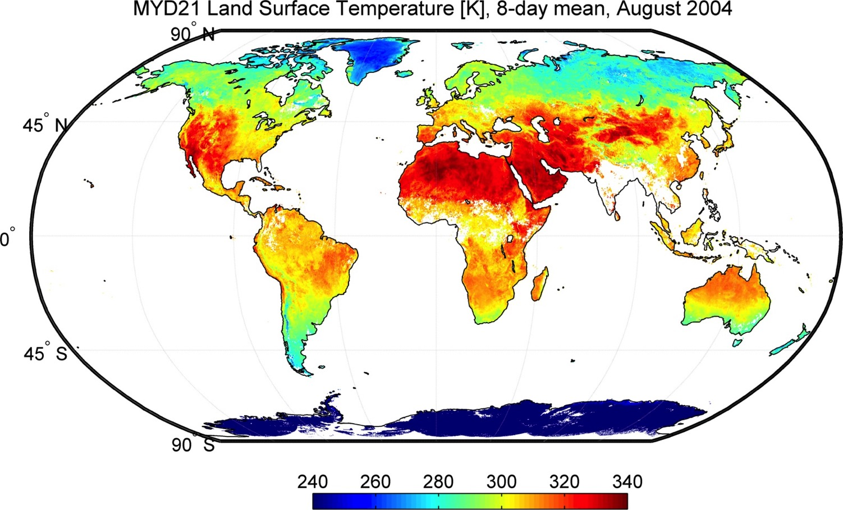
AQUA – 01:30 pm

Slide 8
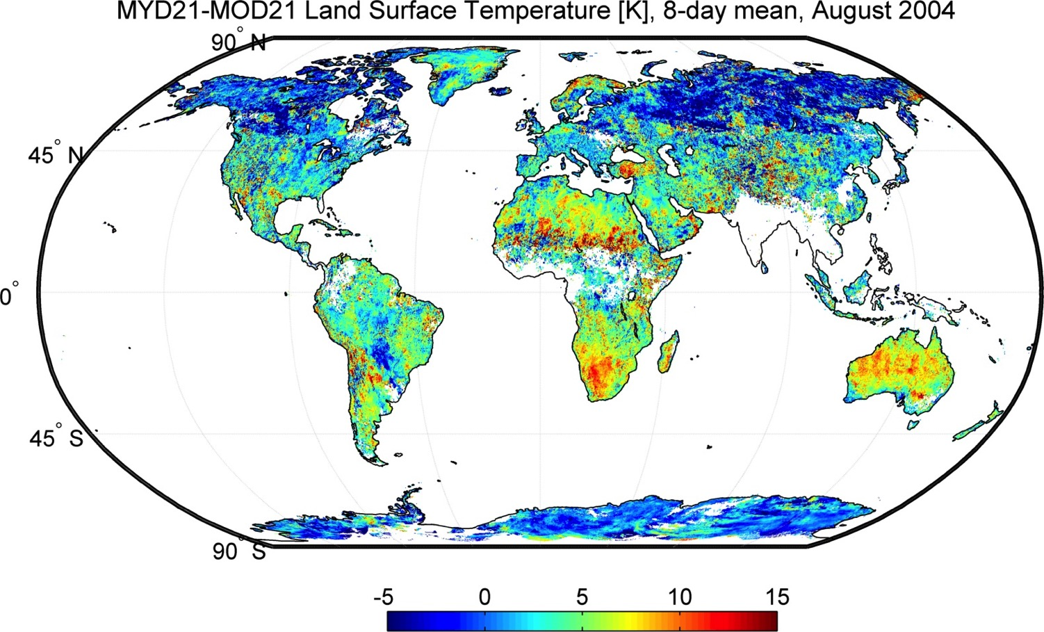

Slide 9
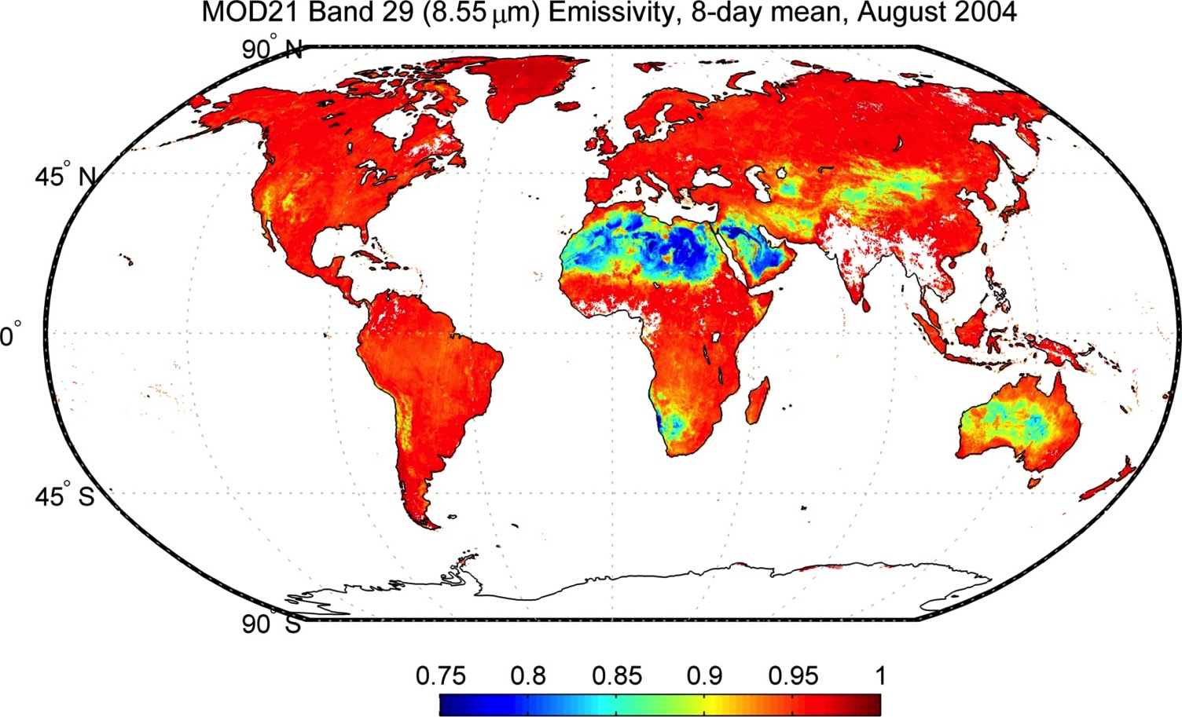
MOD21 Band 29 Emissivity – 1km
Generated using prototype MOD21 algorithm at MODAPS

Slide 10
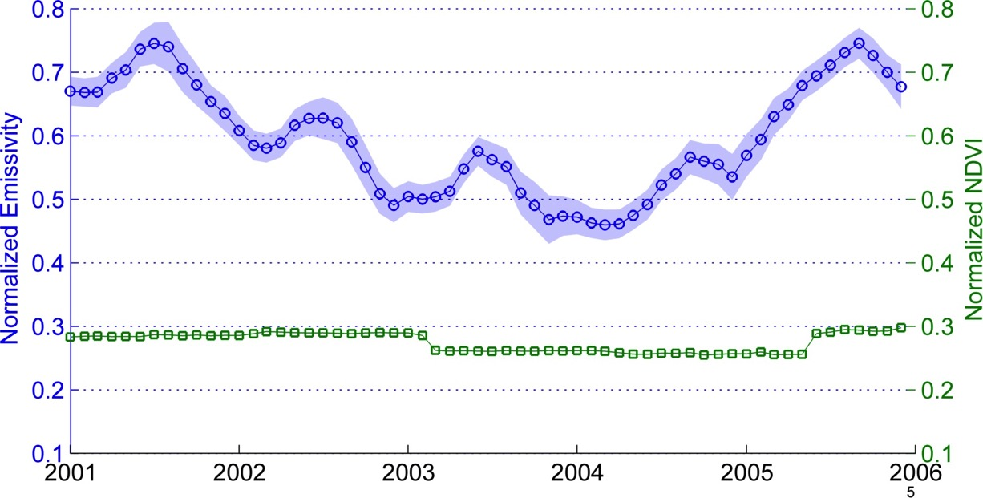
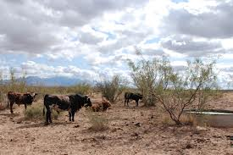
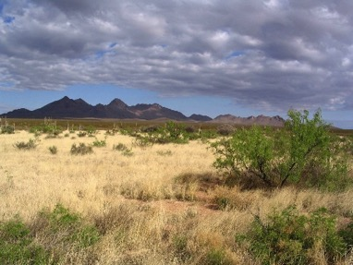
New thermal-based techniques for land cover change detection in climate sensitive zones Hulley et al. 2014
MOD21 Band 29 (8.55 µm) Emissivity, Jornada Experimental Range
Overgrazing
Recovery

Slide 11
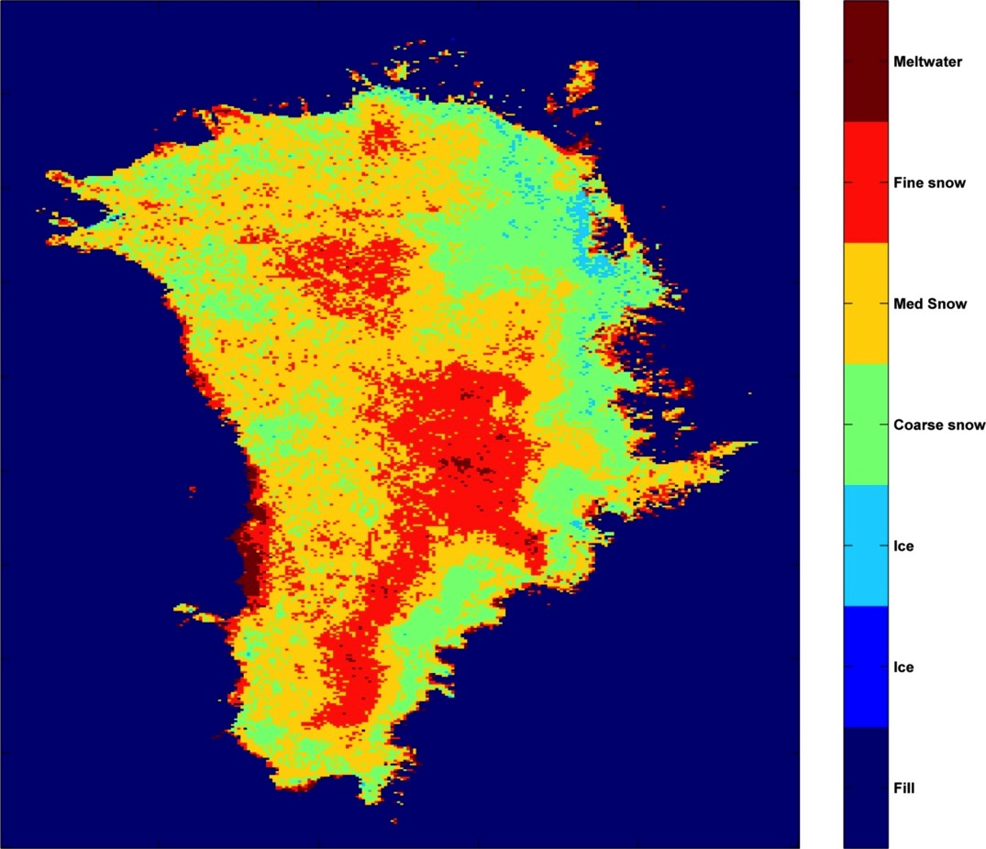
MOD21 Band 32 (12 µm) Emissivity, Greenland, August 2004
Extreme
Melt Zones
Incipient
Melt Zones

Slide 12
Outline
Algorithm and product updates
Validation
Product unification
Continuity

Slide 13
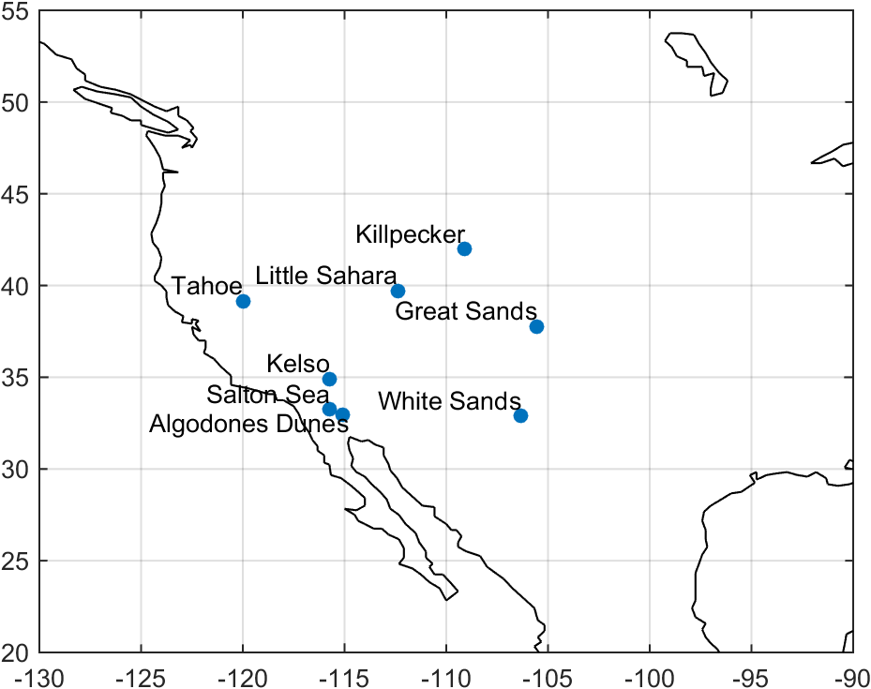
LST&E Validation Sites (Stage 1)
Redwood
Texas Grassland
Temperature-based and Radiance-based validation methods
(Wan et al. 2008, Guillevic et al. 2012, Schneider et al. 2013, Hulley et al. 2012, Hook et al. 2007)

Slide 14
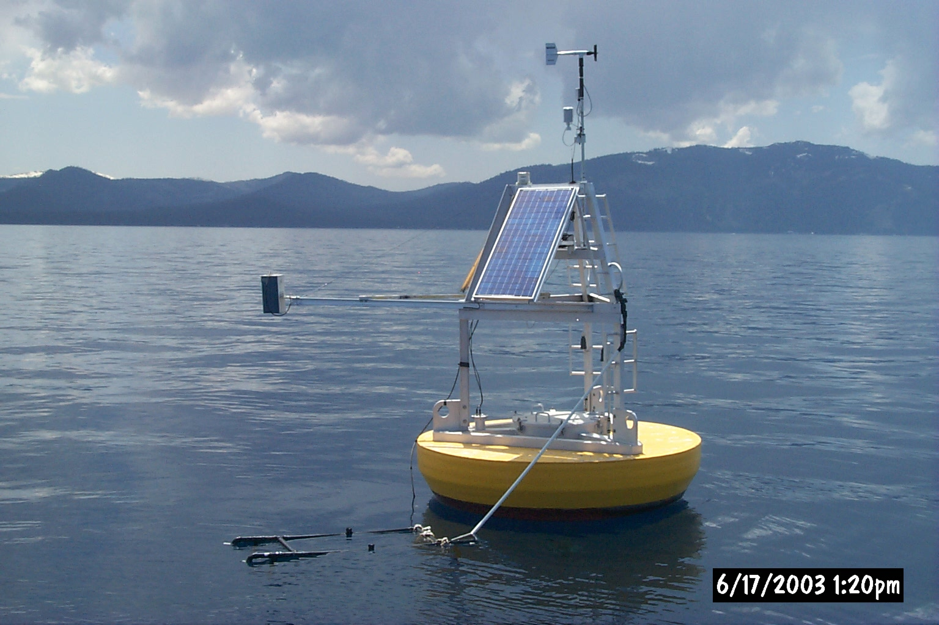
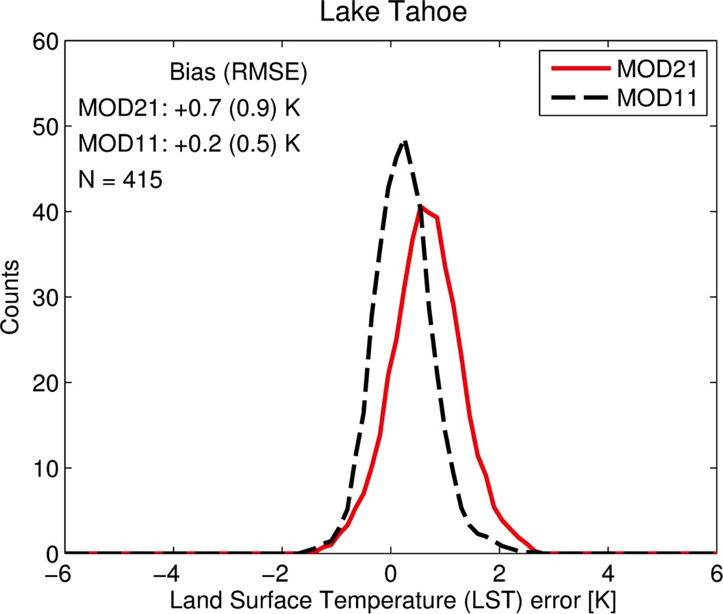
Lake Tahoe, CA (2003-2005)

Slide 15
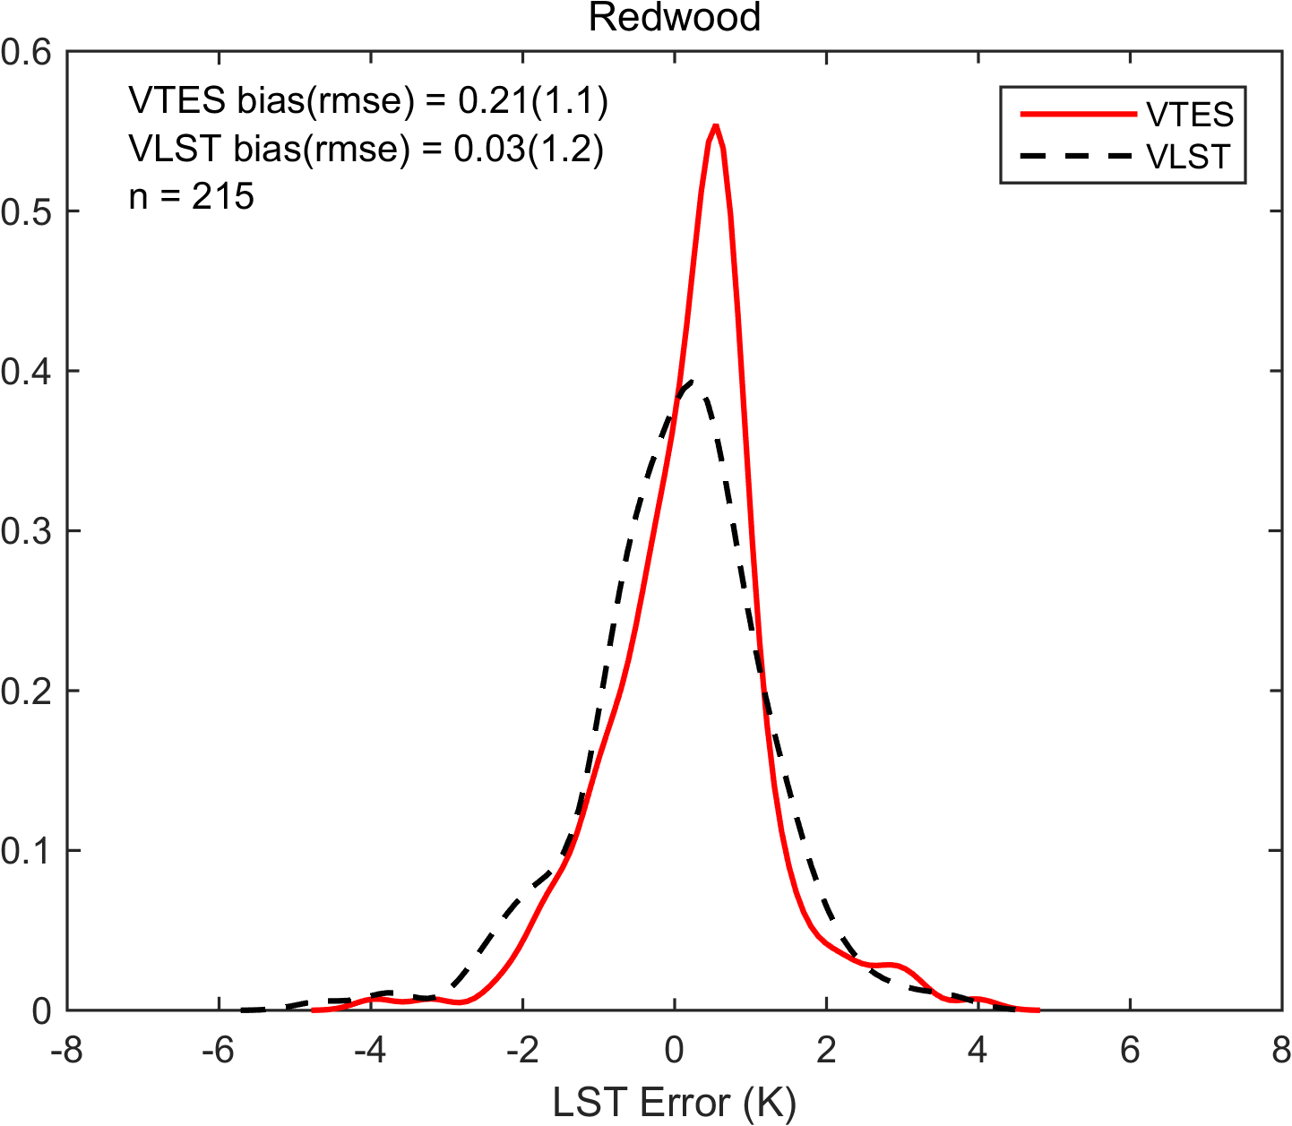
Lake Tahoe, CA (2003-2005)

Slide 16
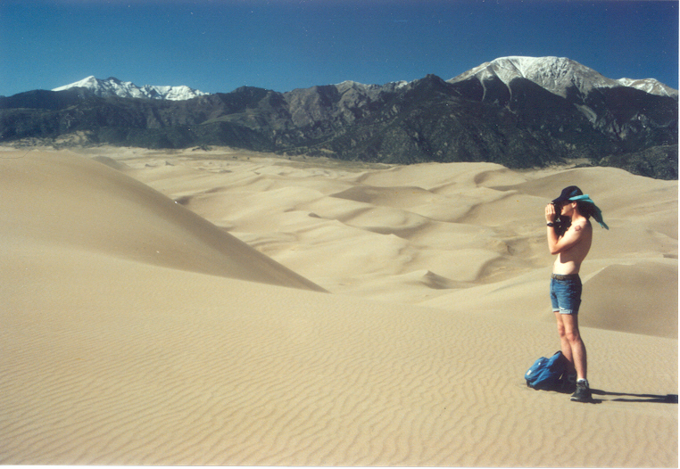
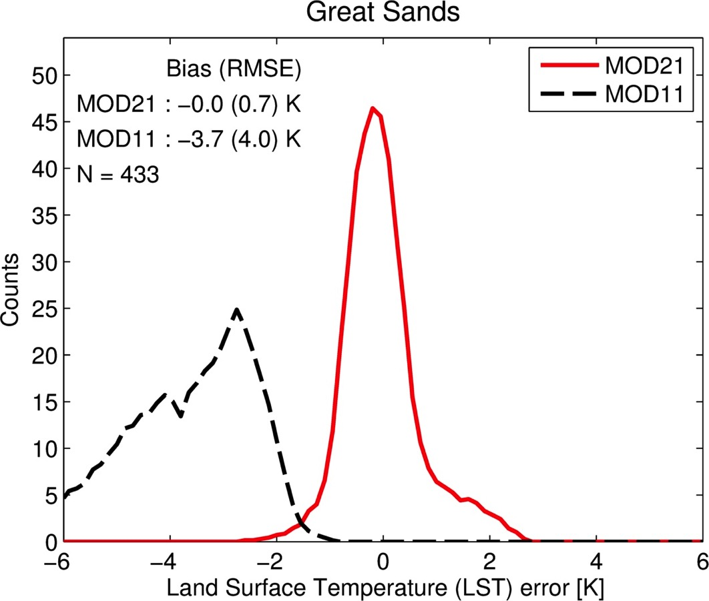
Great Sands, CO (2003-2005)

Slide 17
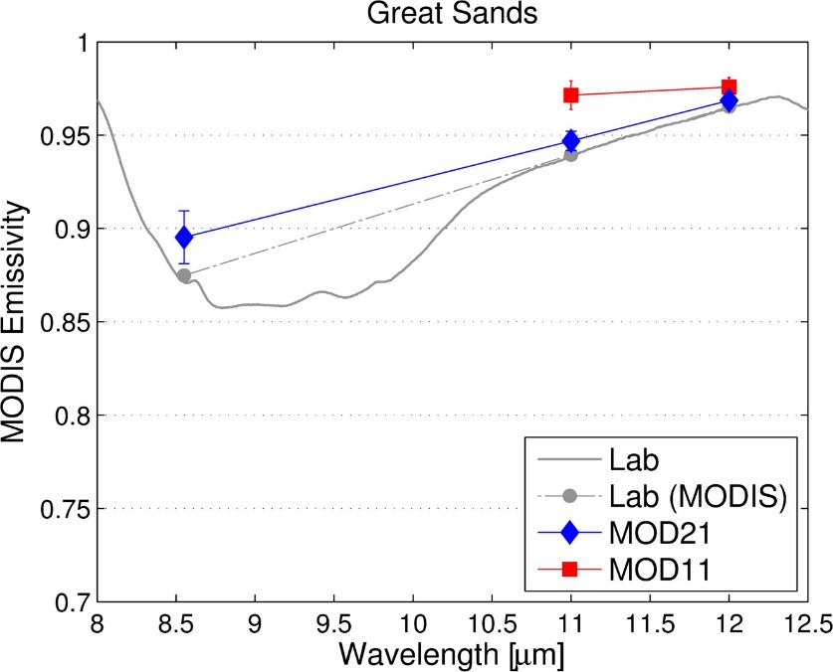
Great Sands, CO (2003-2005)
Quartz, magnetite, olivine

Slide 18
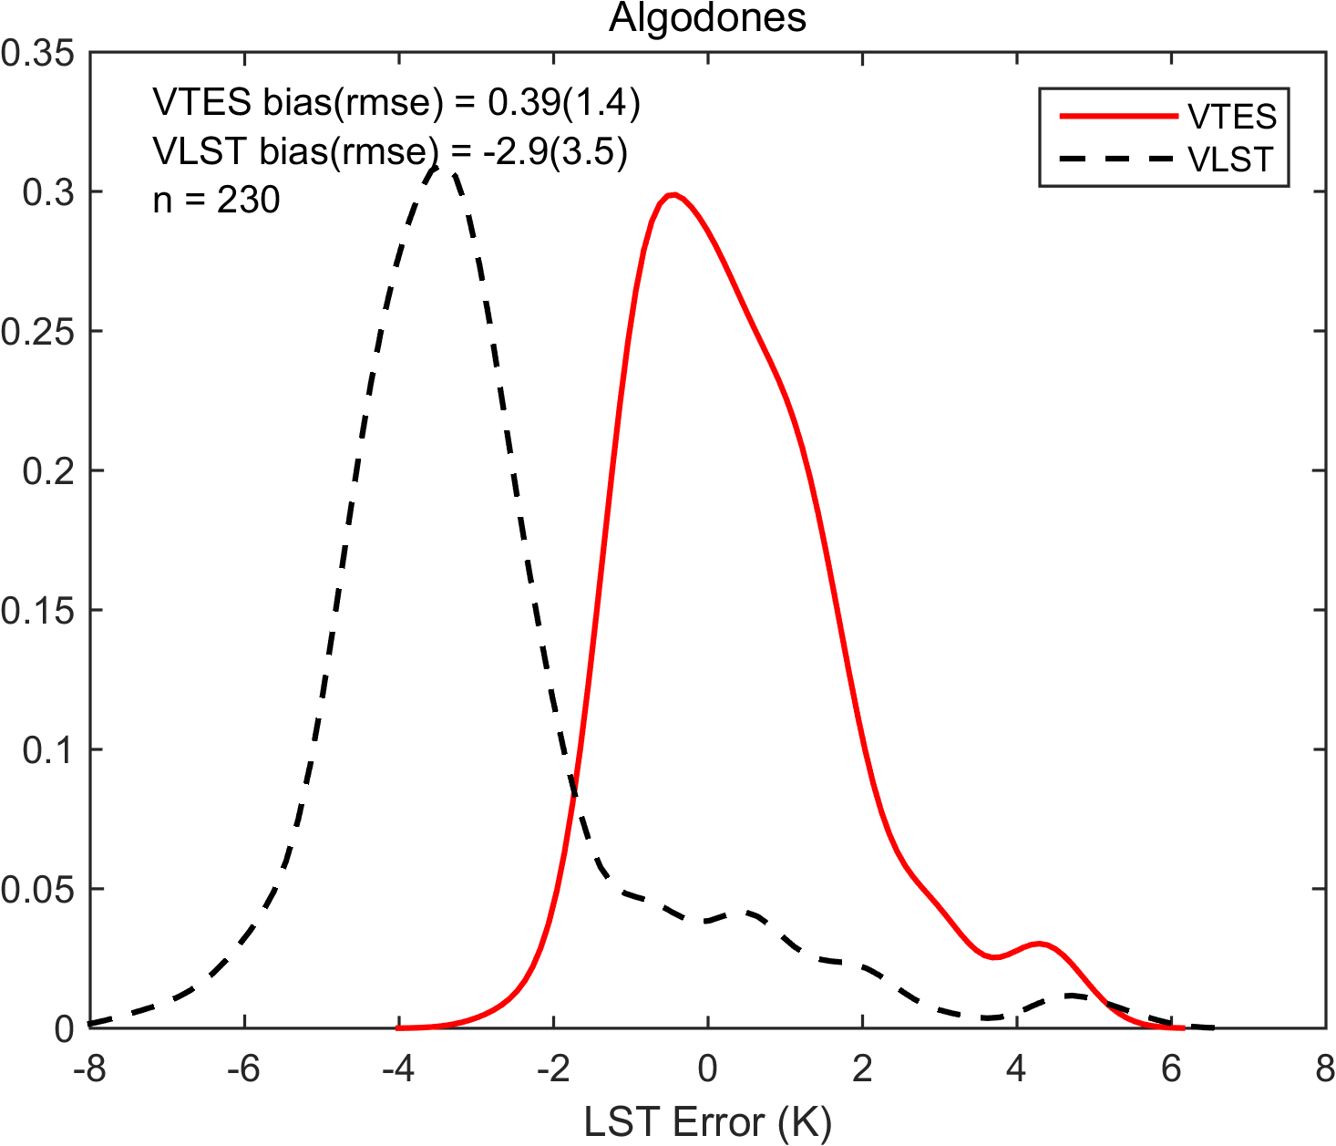
Great Sands, CO (2003-2005)

Slide 19
MODIS LST Validation Summary
MOD11 larger uncertainty over bare regions
(3-5 K)
MOD11 more stable over graybodies (higher precision)

Slide 20
Outline
Algorithm and product updates
Validation
Product unification (MOD11+MOD21)
Continuity

Slide 21
LST Uncertainty Model
Hulley et al. 2012
a_{i} = Regression coefficients dependent on surface type (gray, bare, transition)
SVA = Sensor view angle
TCW = Total column water estimate (cm), e.g. from MOD07, NCEP
Combined LST is weighted mean:
TCW

Slide 22
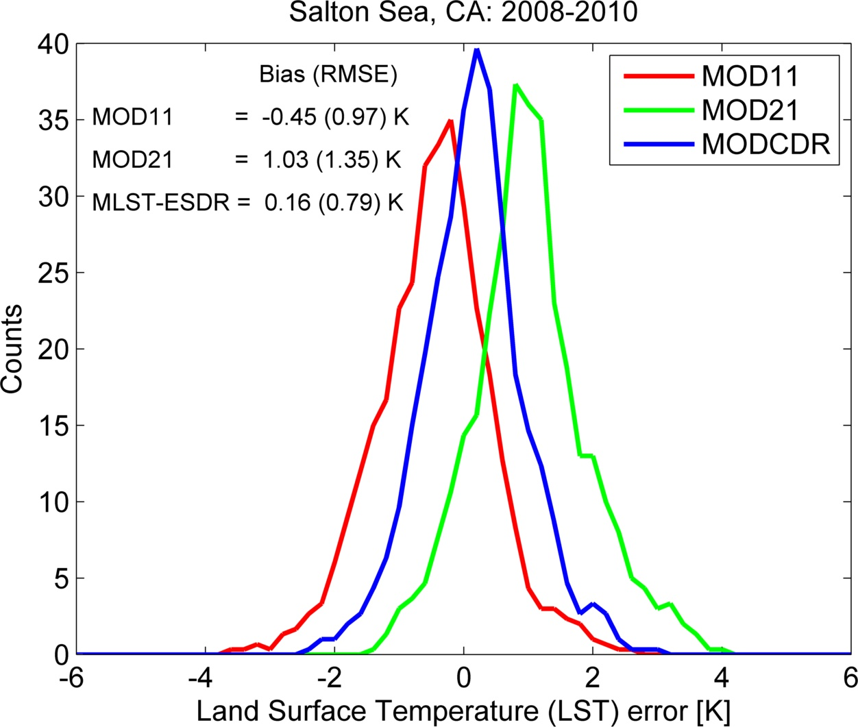
Tahoe, CA
MODx
MODx

Slide 23
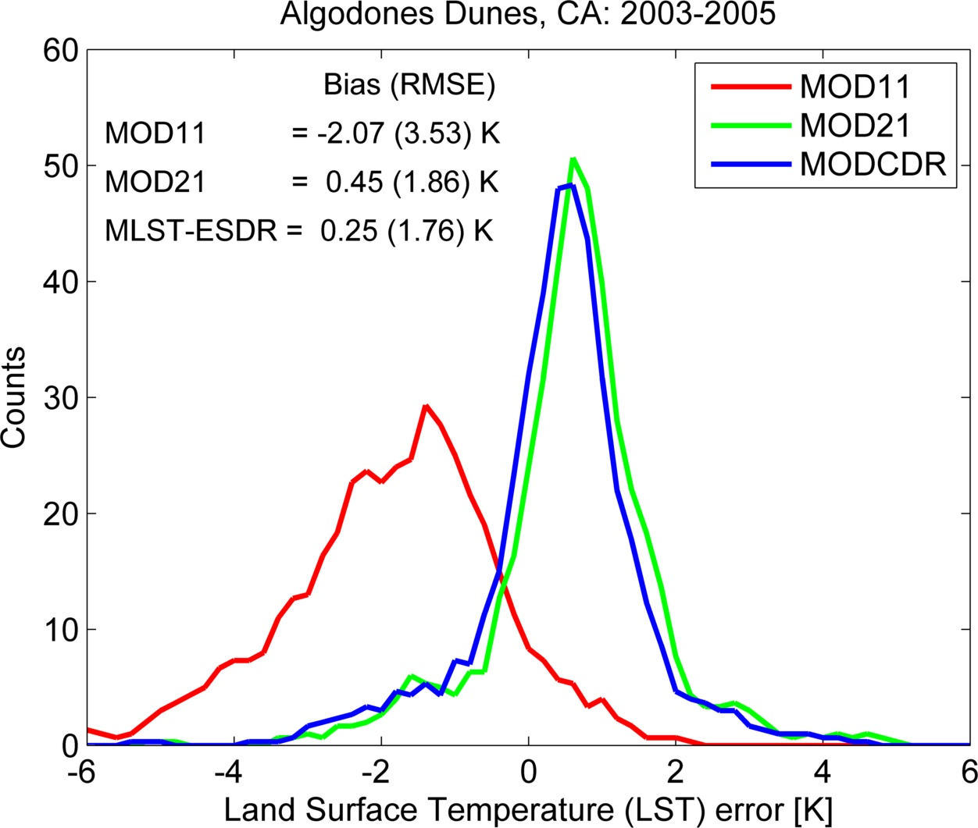
Great Sands, CO
MODx
MODx

Slide 24
Outline
Algorithm and product updates
Validation
Product unification
Continuity

Slide 25
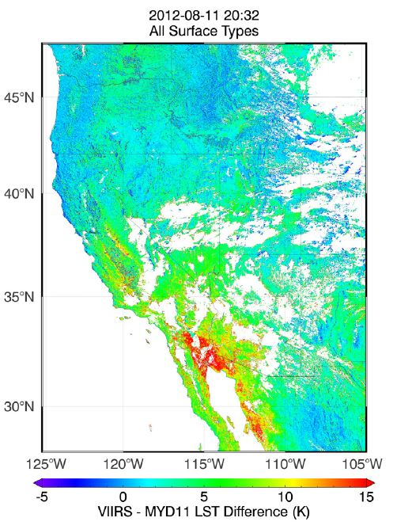
VLST – MOD11 C5 LST (08-11-2012, SNO)
Split-Window products
Criteria:
Time: <10 min
Angular separation: <2°
View angles < 10º
5-10 K
MOD11
VLST
(IDPS)
>15 K
Guillevic et al. 2014

Slide 26
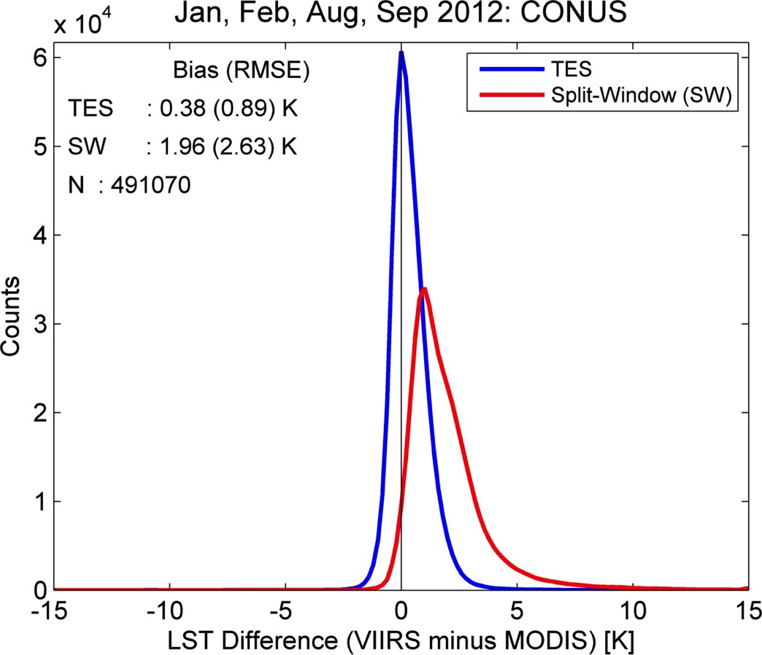
VIIRS – MODIS LST Difference
54 Granules
Jan, Feb, Aug, Sep
CONUS
2012
MOD21/VNP21
MOD11/VLST
Notes:
Then looked at seasonal differences

Slide 27
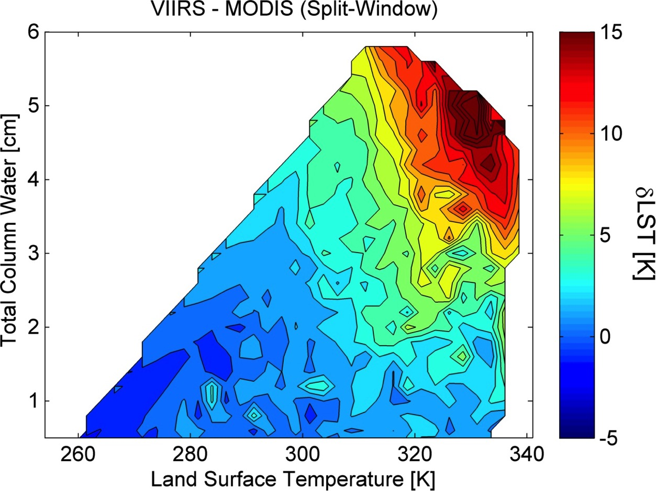
Split-Window Products (MOD11, VLST/IDPS)
K
54 Granules
Jan, Feb, Aug, Sep
CONUS
2012
Notes:
Regression coefficients computed using different range of atmospheric conditions.

Slide 28
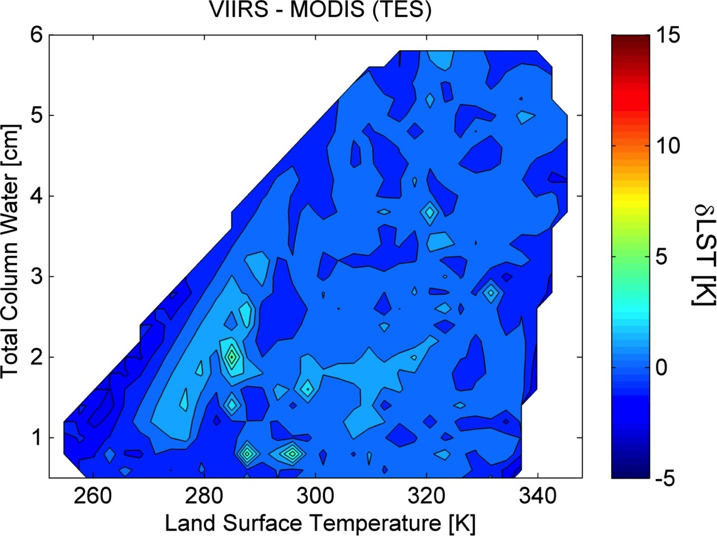
JPL TES Products (MOD21 and VNP21)
54 Granules
Jan, Feb, Aug, Sep
CONUS
2012
ΔT = ±1 K
Notes:
To be expected if using the same algorithm with well calibrated data – ensure continuity in the LST data record
Gives confidence that with the TES suite of products we will have a continuous data record

Slide 29
Summary
MXD21 and VNP21 algorithms implemented at MODAPS and Land-SIPS (mature)
Baselining and testing almost complete for MXD21
Baselining in progress for VNP21
MXD21/VNP21 uncertainties at ~1 K level for LST and ~1% for emissivity
MXD21/VNP21 continuity demonstrated at the ~0.5 K level (Climate enabling)
Future endeavor is to merge MXD21/MXD11 reduce uncertainty and overall number of LST products

Slide 30
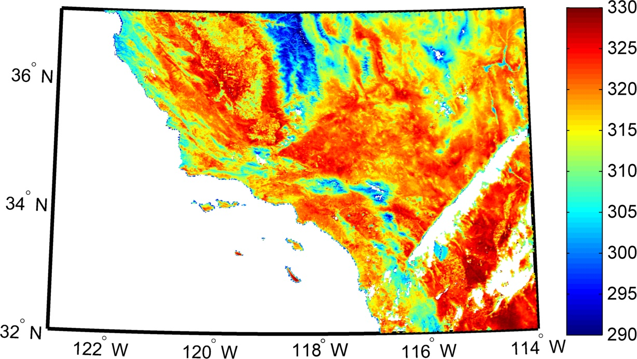
MODIS-TES (MOD21) Land Surface Temperature (K)
10 October 2015
Los Angeles Heatwave
9-11 October, 2015
320-330 K (~55 C, 130 F)
Notes:
Capture exteme events. Demonstrate anomalies between MODIS/VIIRS are consistent

Slide 31
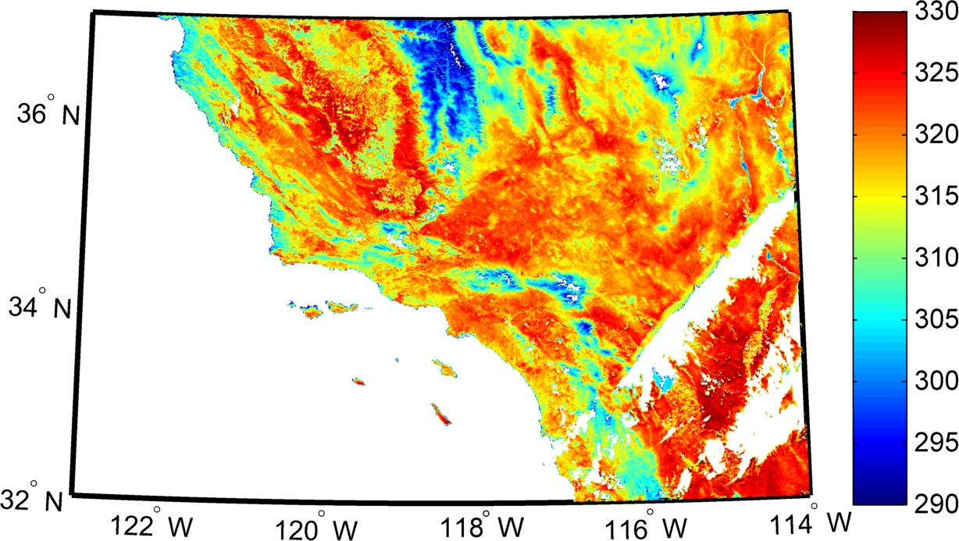
VIIRS-TES Land Surface Temperature (K)
10 October 2015

Slide 32
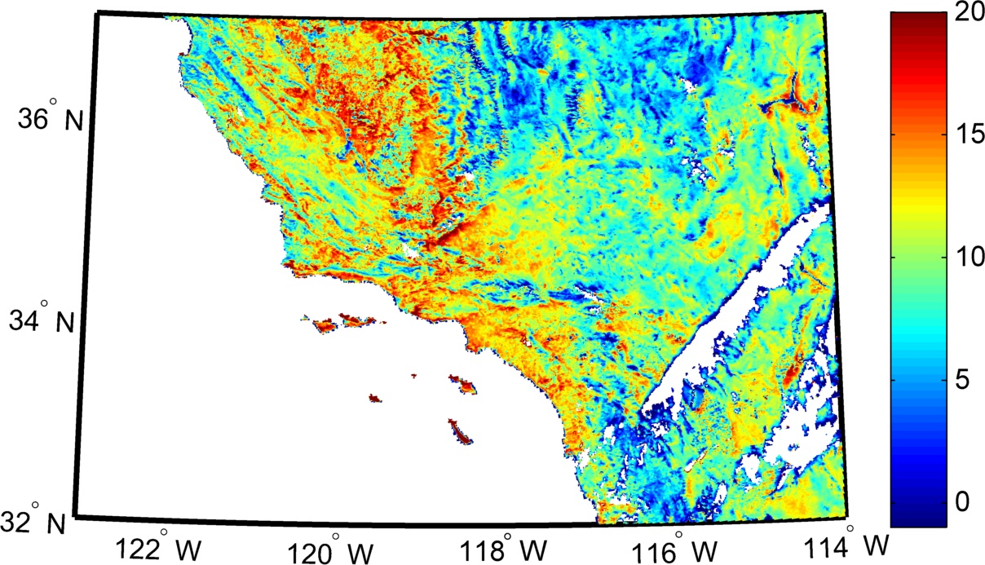
VIIRS-TES LST Anomaly
(2000-2014 October baseline)
Los Angeles Heatwave
9-11 October, 2015
20 degrees above normal!!

Slide 33
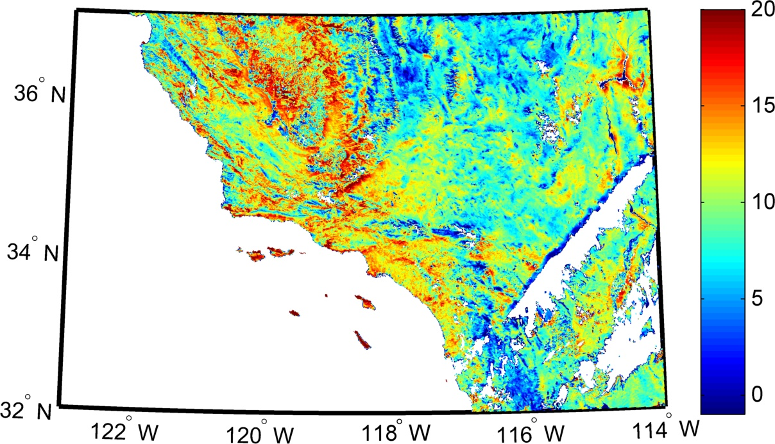
MODIS-TES LST Anomaly
(2000-2014 October baseline)

Slide 34
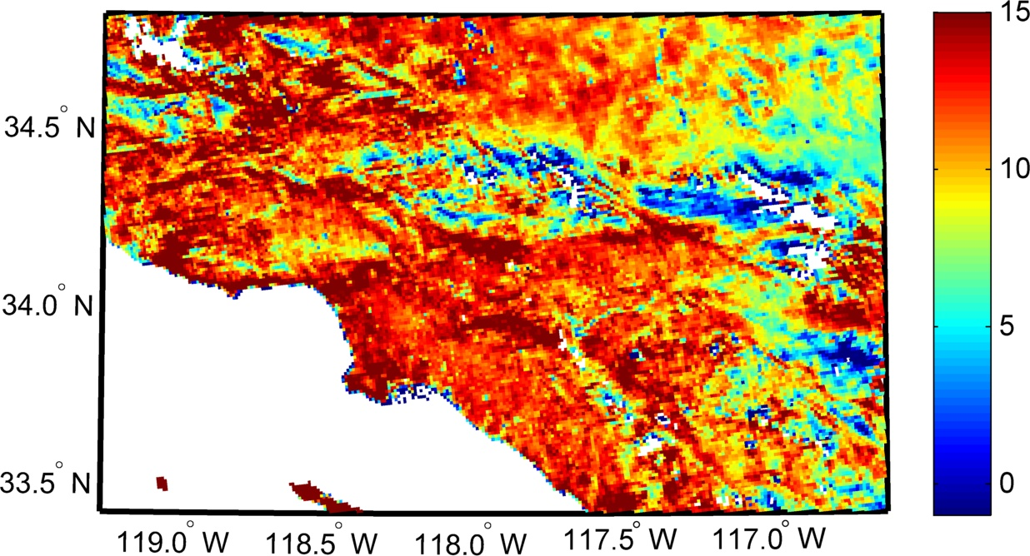

Slide 35
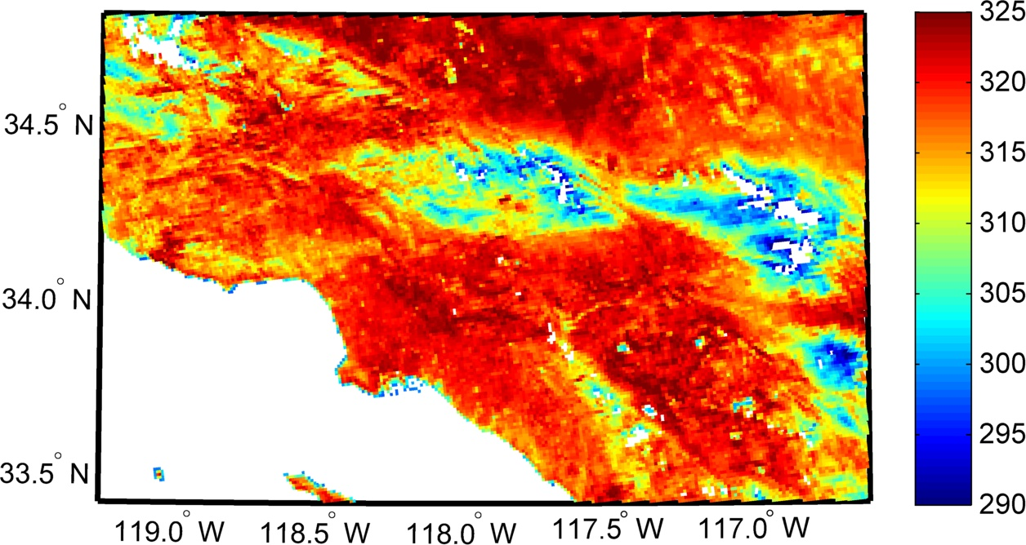

Slide 36
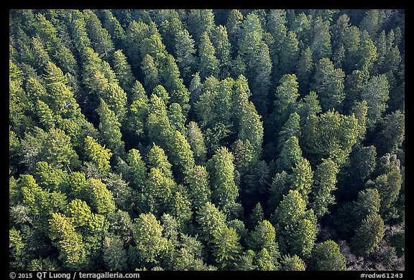
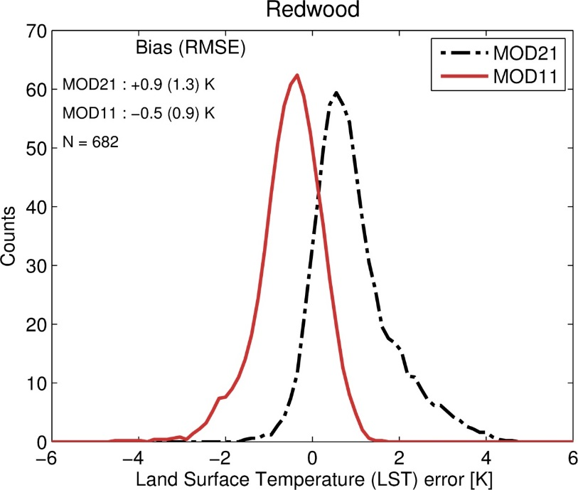
Redwood Forest, CA (2003-2005)

Slide 37
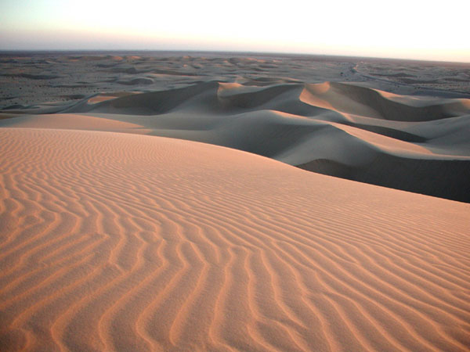
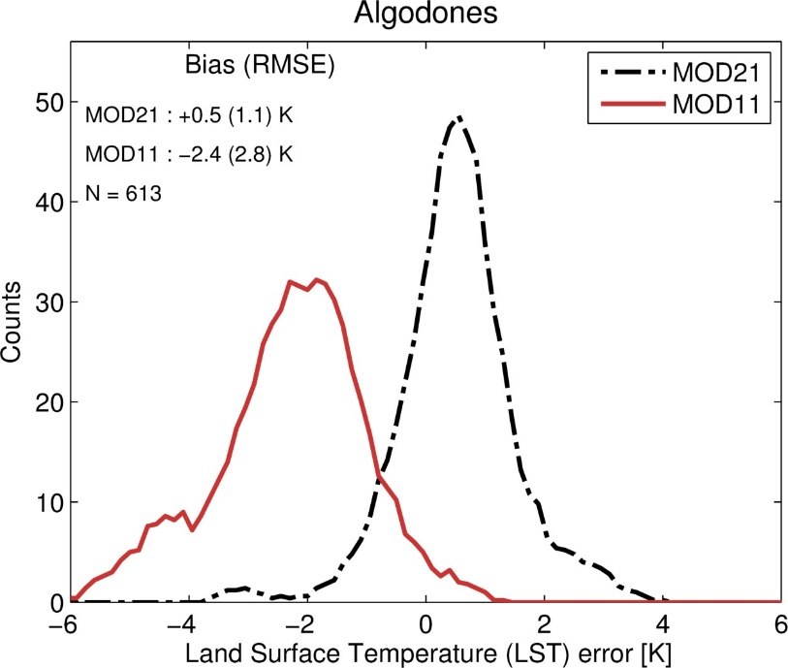
Algodones Dunes, CA (2003-2005)

Slide 38
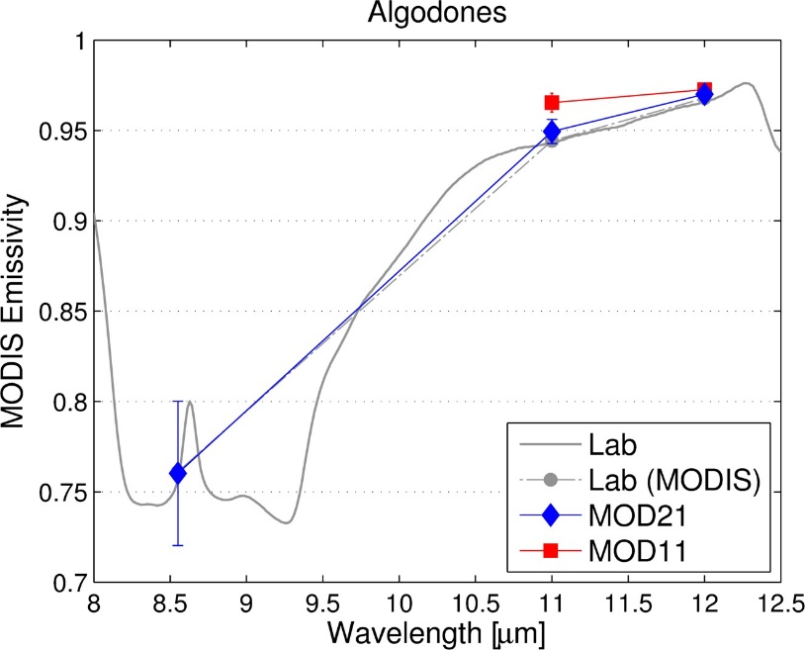
Algodones Dunes, CA (2003-2005)
Quartz

Slide 39
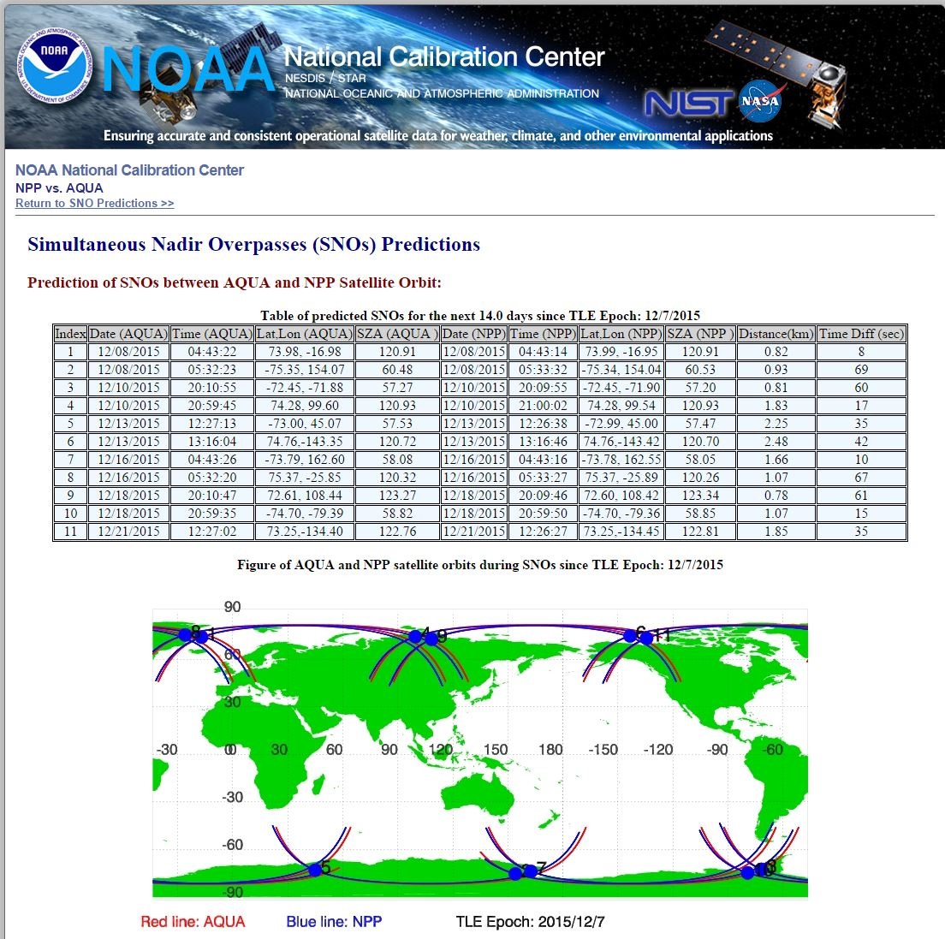
MODIS Aqua/VIIRS Matchups for 2012 over Contiguous US:
Winter (Jan, Feb): 24 granules
Summer (Aug, Sep): 30 granules
Observation Criteria:
Time: <10 min
Angular separation: <2°
View angles < 10º

