Slide 1
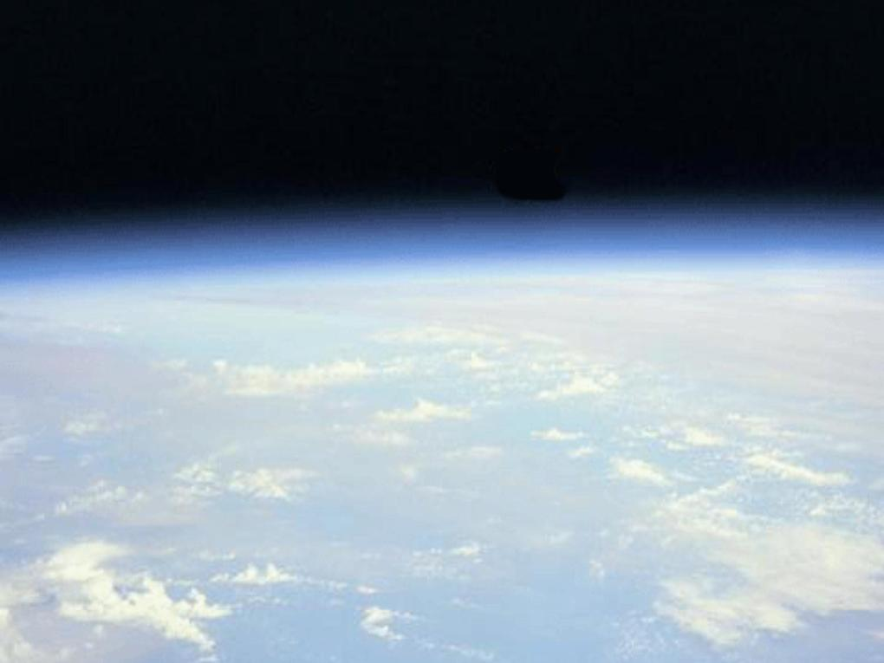


Spanning temporal scales:
An Evaluation of the Impacts of Aerosol Particles from Long-Term Climate Forcing Variation to Short-Term Weather Forecasts
Jianglong Zhang¹, Jeffrey S. Reid², Ricardo Alfaro-Contreras¹, Matthew Christensen¹, James Campbell², Angela Benedetti³ and Jared Marquis¹
¹ University of North Dakota, Dept. of Atmospheric Sciences
² Naval Research Laboratory, Marine Meteorology Division
³ European Centre for Medium-Range Weather Forecasts

Slide 2
Goals and Objectives / Opportunities
Initial Goal: Examine decadal trends in Terra and Aqua AOT and radiative forcing products from MODIS and CERES, by accounting for uncertainties and bias in the next generation of aerosol products.
Opportunities: With nearly 16 years of CERES and MODIS data and 10 years of CALIPSO data, it is possible to study the relatively long-term variation and radiative impact of aerosol vertical distribution. Now we can evaluate column-integrated AOT (e.g. MODIS and MISR), the aerosol vertical profile (e.g. CALIOP and OMI) and TOA SW aerosol-induced energy perturbations (TOA SW aerosol direct forcing, SWARF) simultaneously.
New opportunities: While the study of aerosol and aerosol forcing trends improves our understanding of climate variation, aerosol particles also likely affect daily surface temperature forecasts. This is particularly interesting as advances in aerosol satellite remote sensing and aerosol data assimilation have pushed this topic to the research forefront.

Slide 3
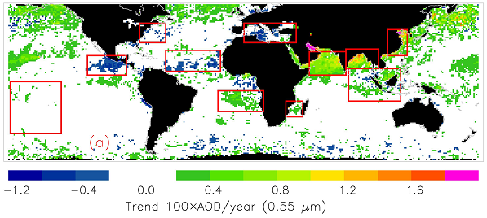
Inter-Comparison of Trend Analysis from C5 and C6 of Terra MODIS AOT datasets (2000-2009)
Regions | Corrected Slope AOD /decade (Terra)
 | C5 | C6
Global | 0.003 | 0.005
Africa (NW Coast) | -0.013 | -0.011
Bay of Bengal | 0.069 | 0.071
Coastal China | 0.062 | 0.068
Central America | -0.023 | -0.015
Arabian Sea | 0.058 | 0.069
Mediterranean Sea | -0.016 | -0.015
Africa (SW Coast) | 0.009 | 0.016
N. Amer. (E Coast) | -0.015 | -0.013
Africa (SE Coast) | 0.010 | 0.012
Southeast Asia | 0.007 | 0.014
-1.2 -0.4 0.0 0.4 0.8 1.2 1.6
Trend : 100×AOD/year (0.55 µm)
Zhang and Reid, 2010

Slide 4
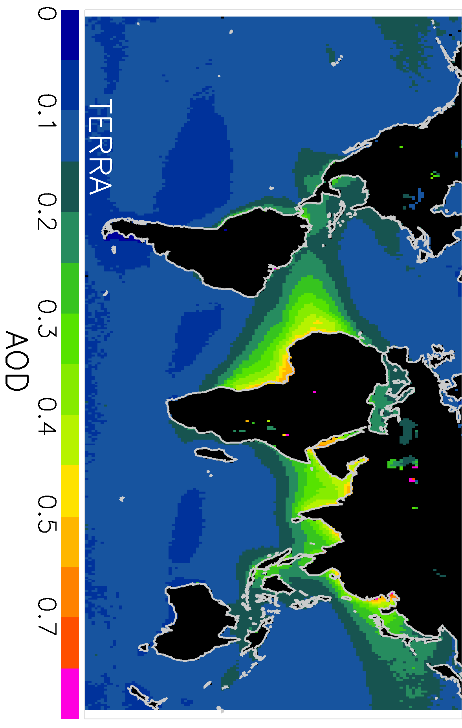
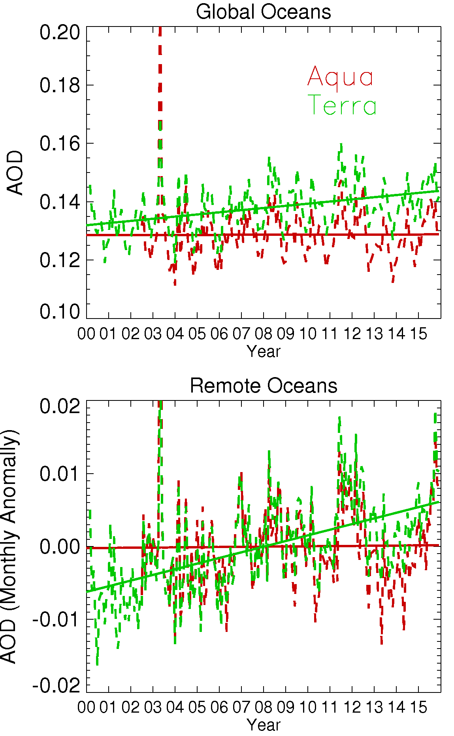
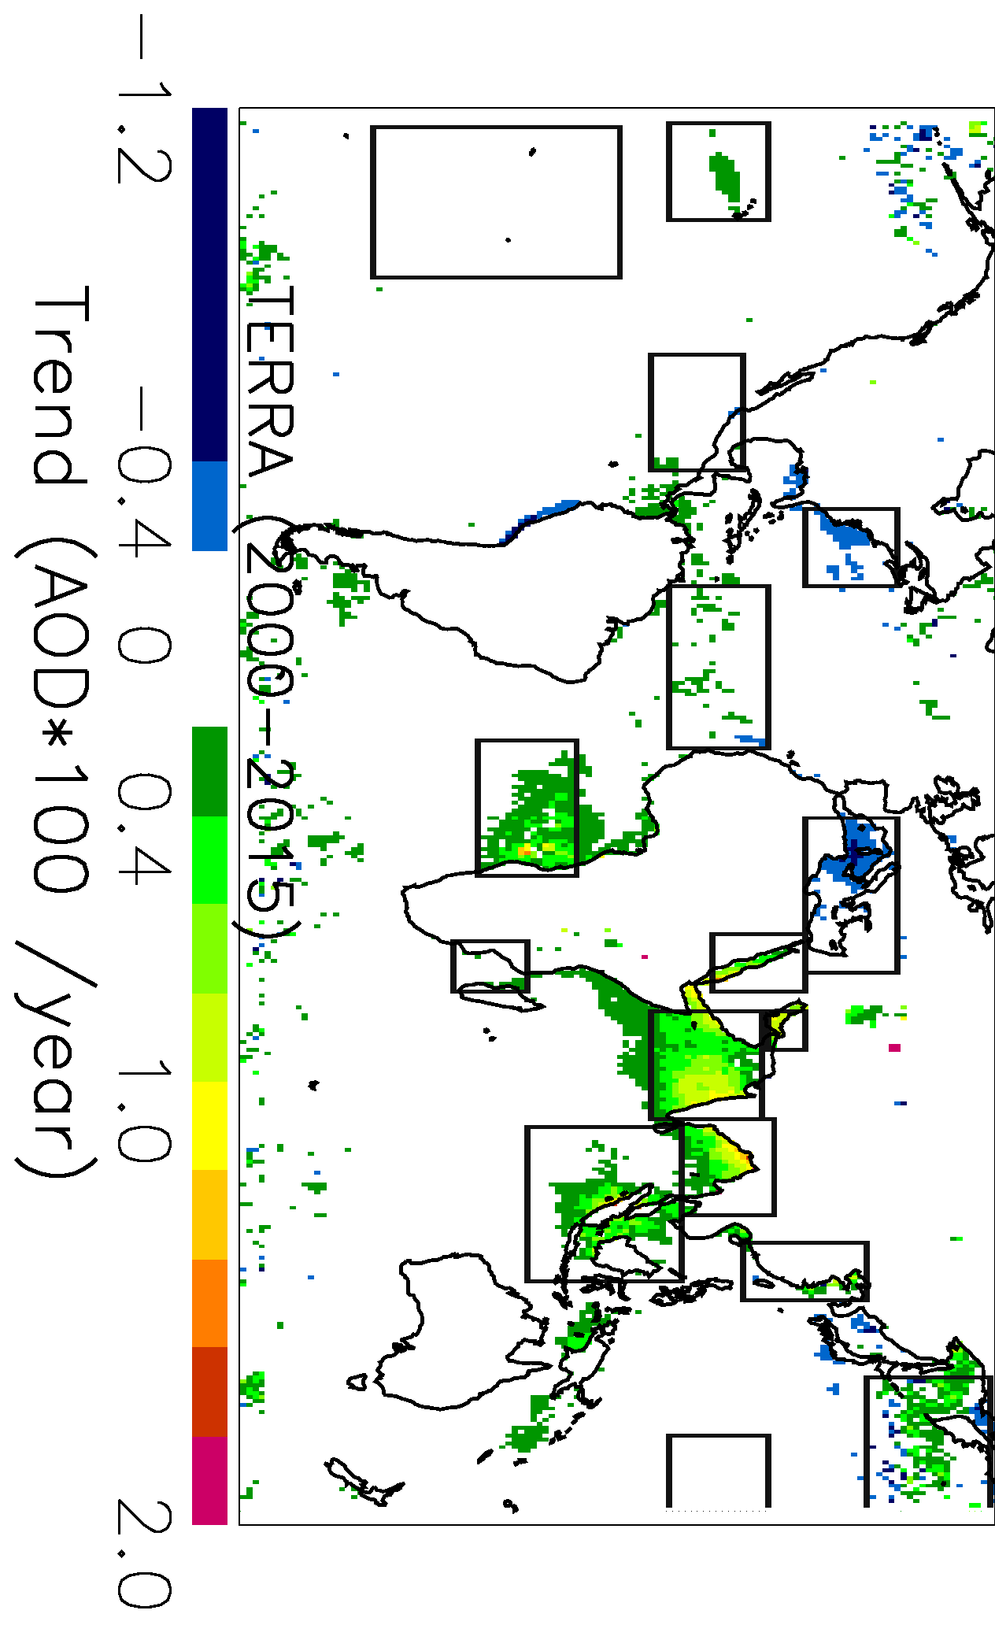
Extend the AOT Trend Analysis to 16 years
(2000-2015)
Alfaro-Contreras et al., et al., 2016 (in preparation)

Slide 5
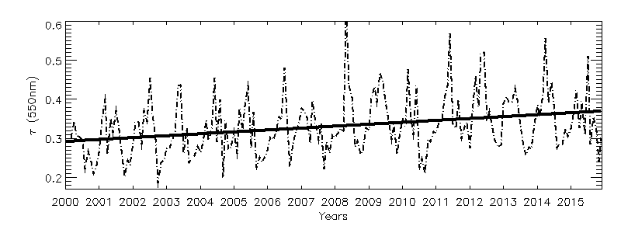
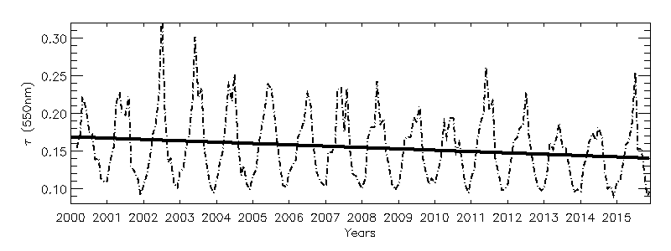
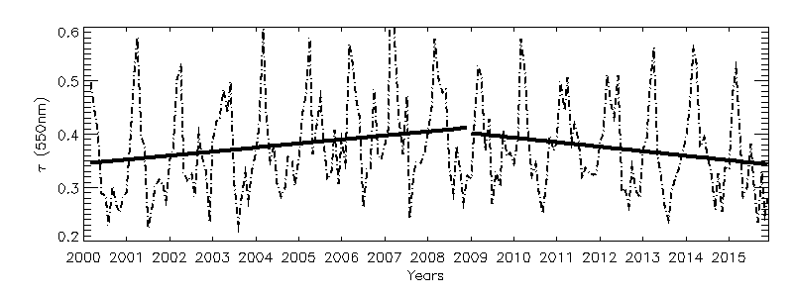
Regional-based Trend Analysis (Terra, 2000-2015)
0.6
0.4
0.2
Bay of Bengal
Operational DT MODIS
Regions | ΔAOD/ decade (Terra)
Global | 0.002
Coastal China | 0
Mediterranean Sea | -0.023
N. Amer. (E Coast) | -0.021
Bay of Bengal | 0.047
Arabian Sea | 0.048
Red Sea | 0.064
Persian Gulf | 0.072
0.3
0.2
0.1
East Coast US
AOT (550nm)
0.6
0.4
0.2
Coastal China
Alfaro-Contreras et al., et al., 2016 (in preparation)
2000 2002 2004 2006 2008 2010 2012 2014

Slide 6

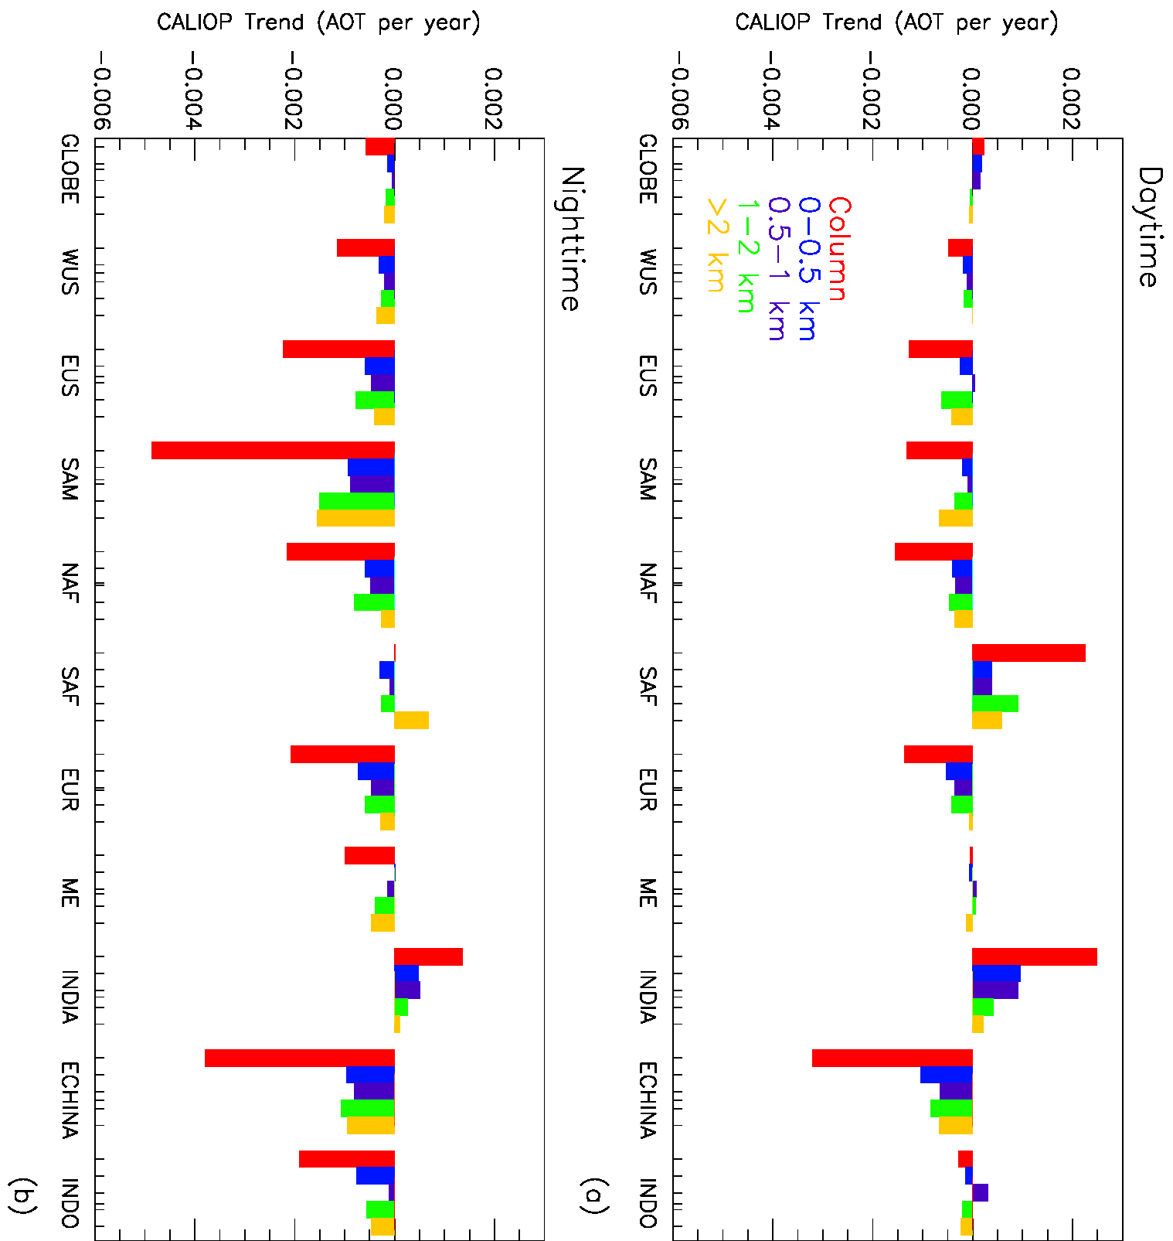

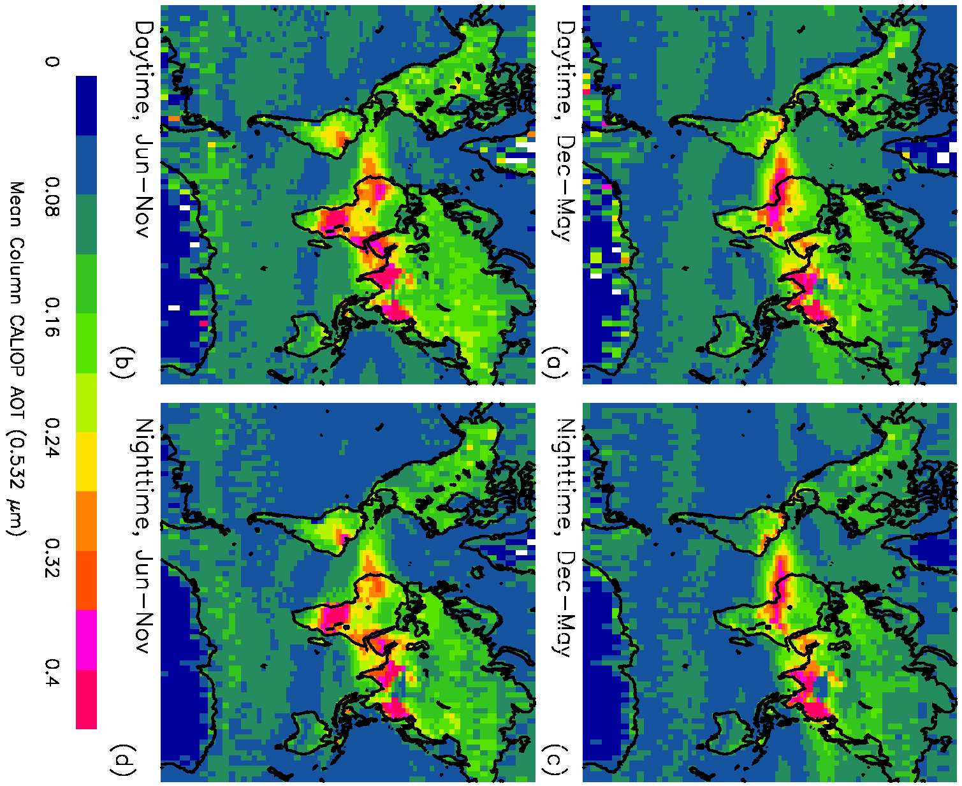
What do CALIOP Observations Tell Us About Vertical Trends? (2006-2014)
India
Eastern US
CALIOP Trend (AOT per year)
Eastern China
Daytime, Dec-May
Nighttime, Dec-May
CALIOP Trend (AOT per year)
Daytime, Jun-Nov
Nighttime, Jun-Nov
0 0.08 0.16 0.24 0.32 0.4
Mean Column CALIOP AOT (0.532 µm)
Toth et al., 2016 (submitted)

Slide 7
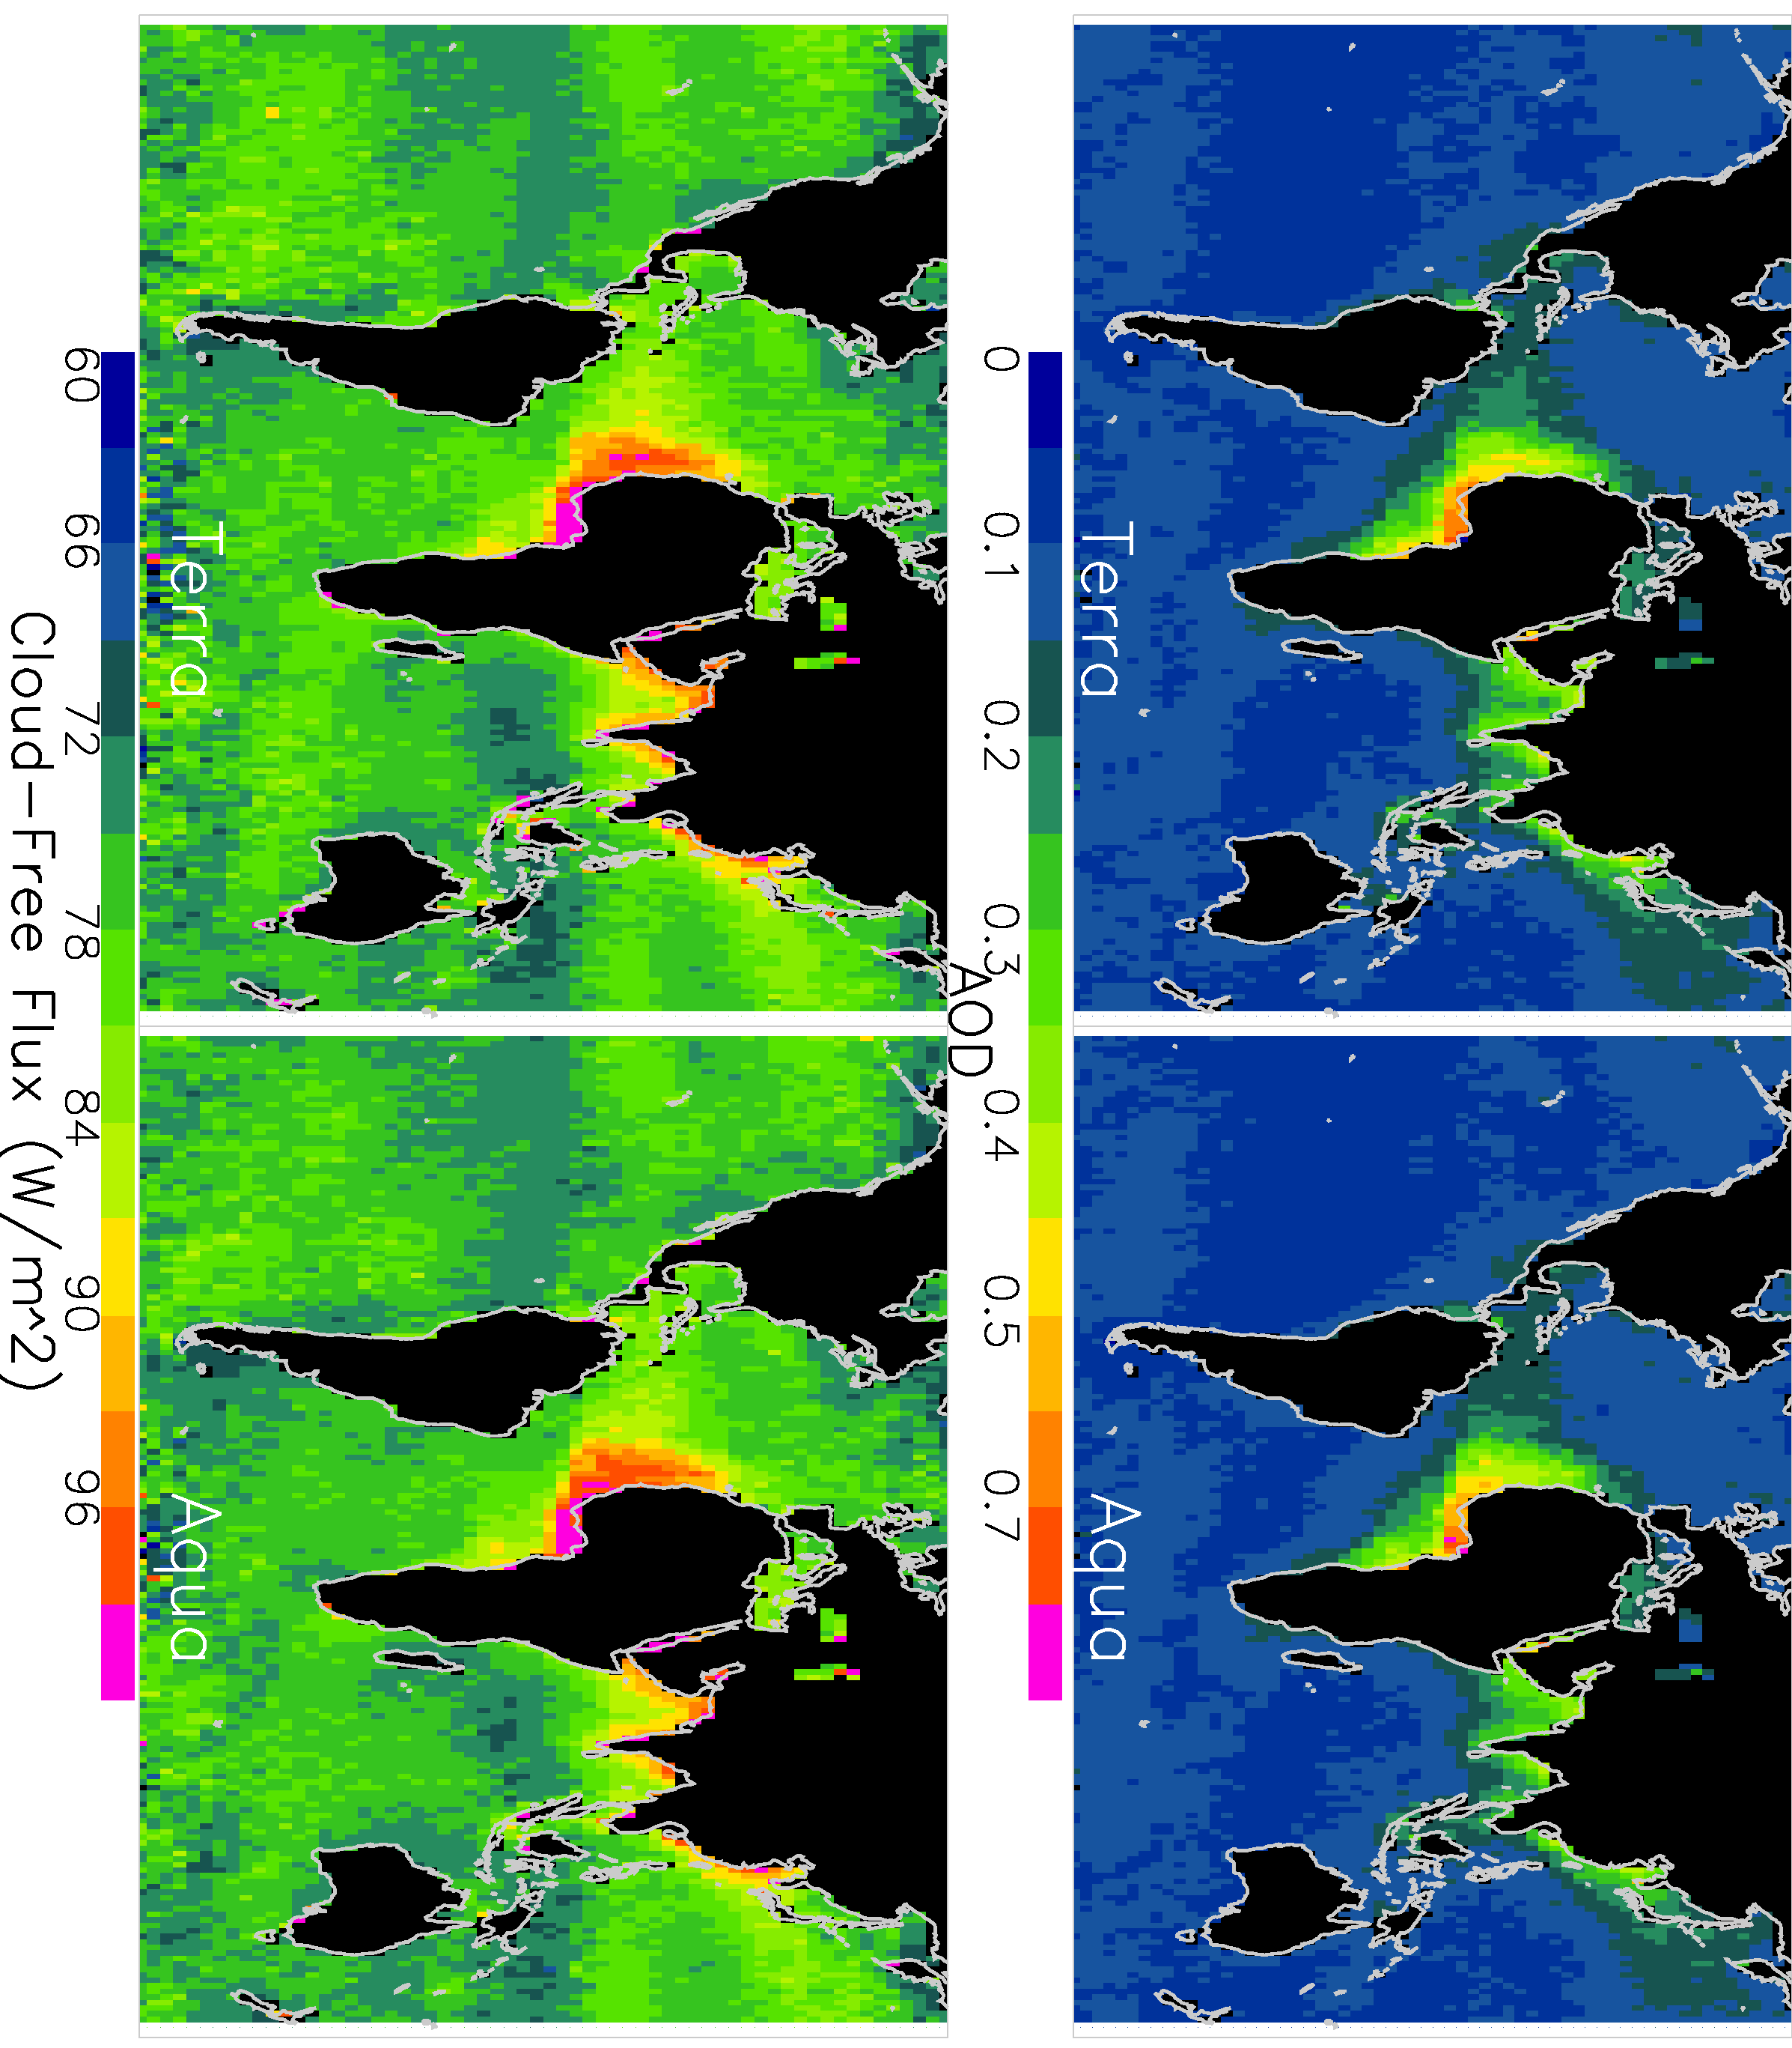
What do CERES Observations Tell Us About Trends in Aerosol Radiative Flux? (2000-2015)
Goal: Use collocated MODIS and CERES observations for estimating the trend in SW aerosol direct forcing
Collocated MODIS data are used for estimating cloud and aerosol status for CERES observations.
Here we assume that longer term variation in CERES cloud-free scenes (defined by MODIS) represent longer term variations in SWARF
Alfaro-Contreras et al., et al., 2016 (in prepare)

Slide 8
Aerosol-Induced TOA SW Perturbations from Collocated Terra MODIS and CERES data (2000-2015)
Calibration issue?
Regions | Corrected AOD / Decade (Terra) | Corrected Cloud-Free Flux W/m⁻²/decade (Terra)
Global | -0.0028 | -0.61
Bay of Bengal | 0.0560 | 3.17
Arabian Sea | 0.0510 | 3.60
Red Sea | 0.0530 | 3.40
Persian Gulf | 0.0682 | 3.48
Coastal China | -0.009 | -2.86
Cent. America | -0.010 | -0.91
Med. Sea | -0.011 | -1.48
N. America (East Coast) | -0.011 | -2.24
Global Oceans
Cloud Free Flux (De-seasonalized, Wm⁻²)
Remote Oceans

Slide 9
Can Similar Trends be Detected for Aerosol-Above-Cloud Events (CALIOP, 2006-2013)?
Alfaro-Contreras et al., 2015

Slide 10
What About the Direct Impact of
Aerosol Particles on Weather?
Climate is a scale composed by the long-term integration of weather phenomena. The impact of aerosol particles on climate is being extensively studied. However, the impact of aerosol particles on short-term weather scales is not well known.
In the past decade, breakthroughs have been made in both satellite remote sensing of aerosol properties and aerosol modeling through satellite data product assimilation.
Improvements in our ability to observe and model aerosol events have led to the coupling of prognostic aerosol fields into numerical weather models for advanced weather forecasts.
Is this initiative worth the time/computational effort?
Zhang et al., 2016

Slide 11
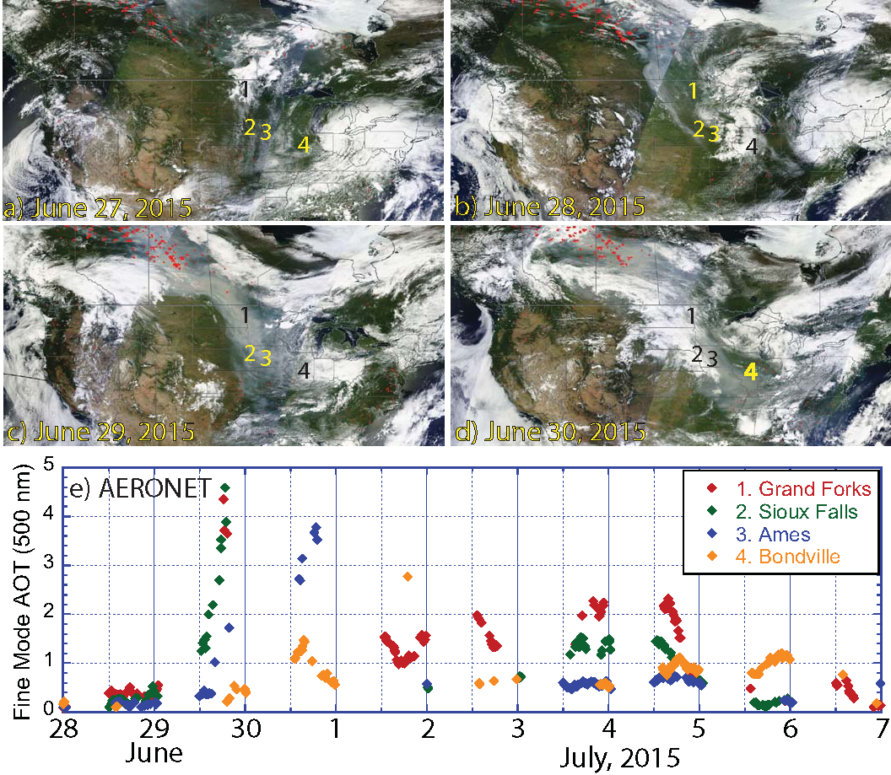
The 27-30 June 2015 Smoke Event of the Northern Great Plains

Slide 12
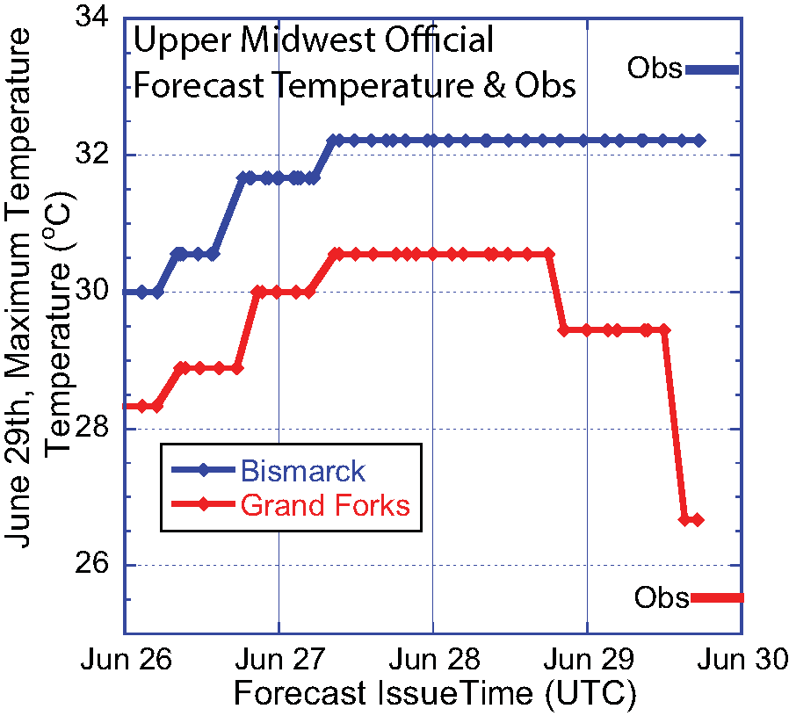
Weather Forecasts are Noticeably Affected by the Smoke Event
The forecast discussion issued by the Grand Forks NWS station at 10:00am CDT on June 29, stated:
“VERY THICK SMOKE TODAY WILL LIMIT TEMPERATURE RISE AT LEAST 2 TO 5 DEGREES...SO HAVE LOWERED TEMPS SOME AT LEAST. THIS IS VERY THICK SMOKE SO TEMPS COULD BE HELD DOWN INTO THE 70S...”
Zhang et al., 2016

Slide 13
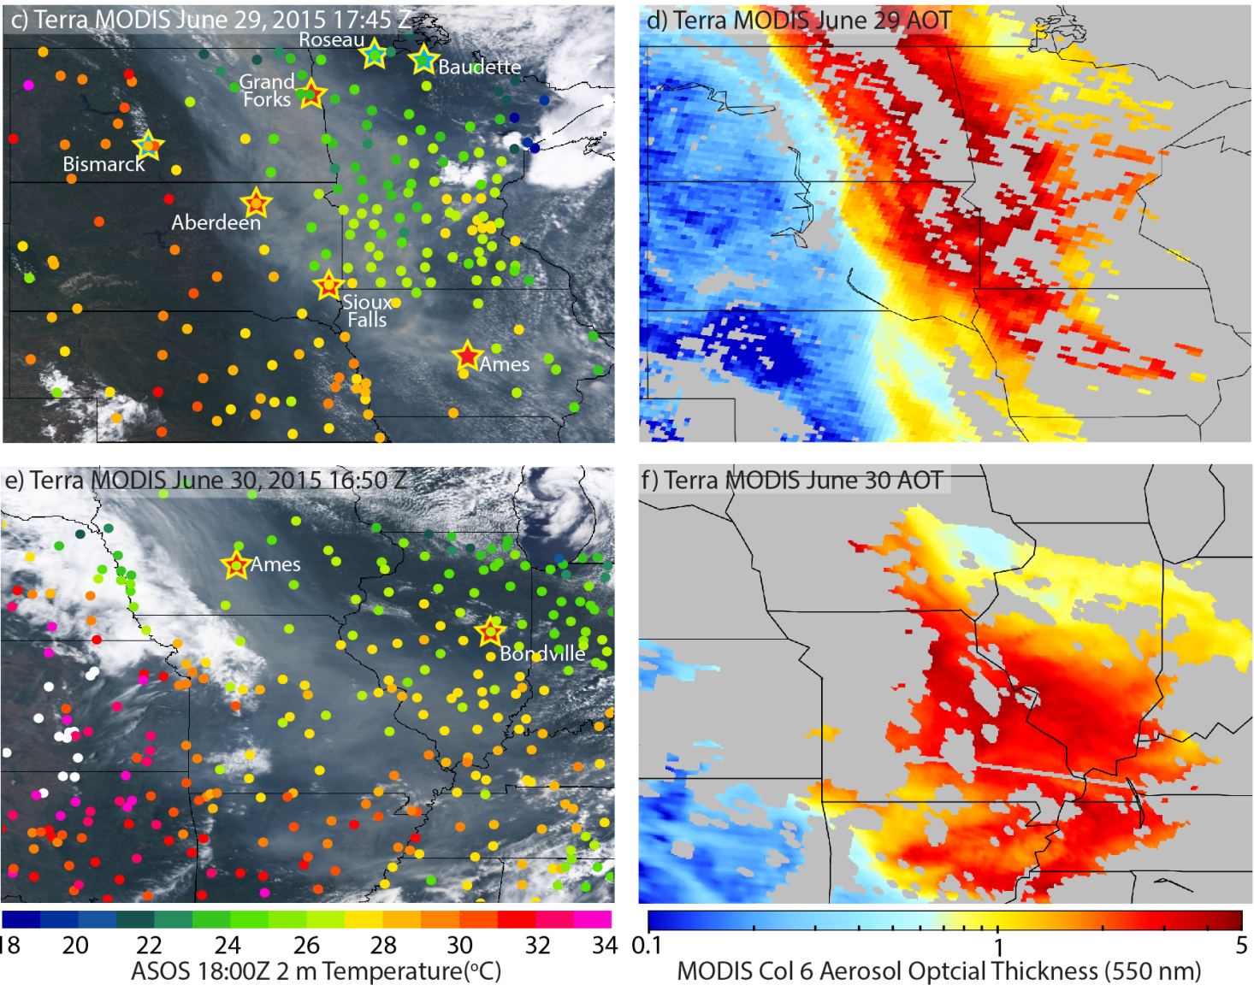
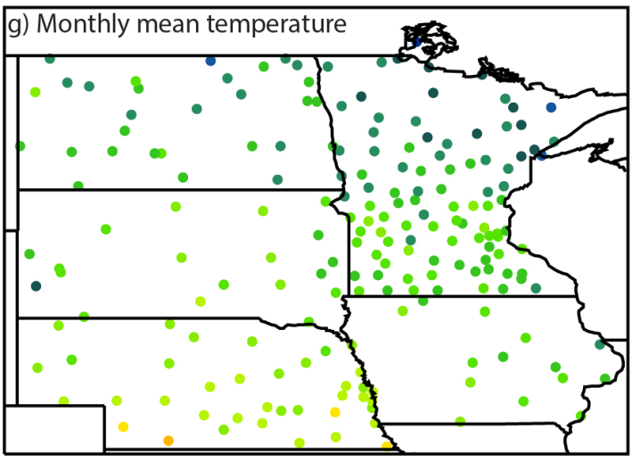
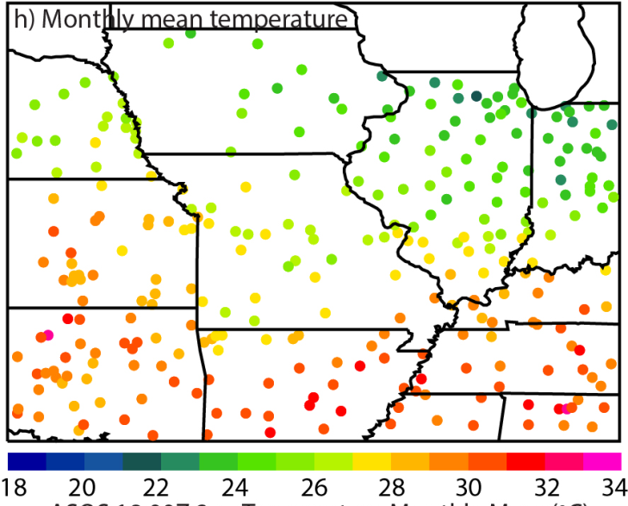
Aerosol Direct Cooling Effects can be
Observed from Surface Observations
June 29, 2015
June 30, 2015
ASOS 18:00Z 2 m Temperature (ºC)
MODIS DT C6 AOT (550nm)
ASOS 18:00Z 2 m monthly mean Temperature (ºC)
Zhang et al., 2016

Slide 14
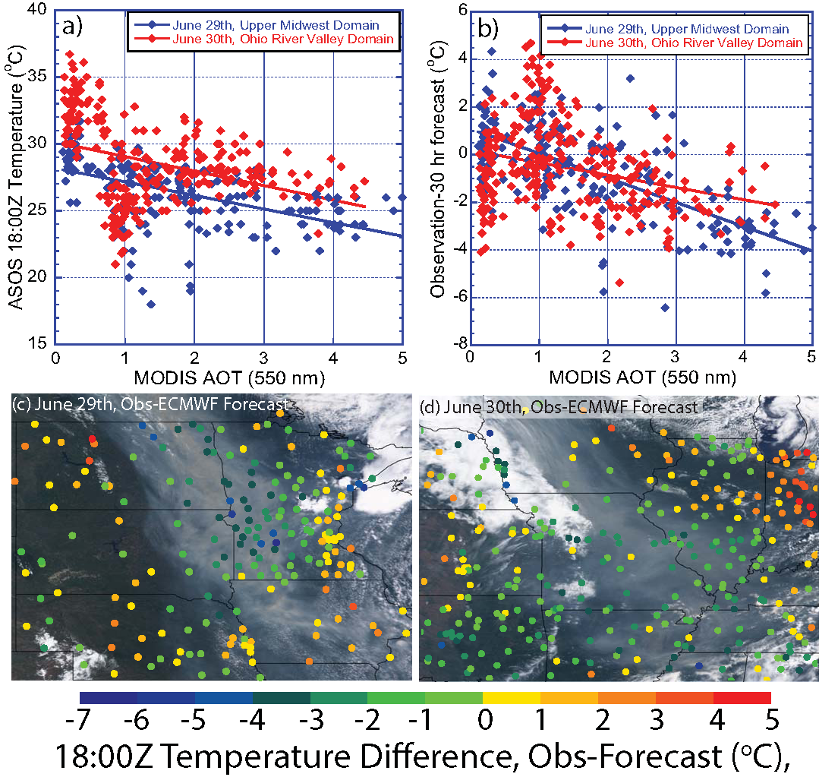
The Impact of Aerosol Particles on Near-Surface Temperature Forecasts is Distinguishable

Slide 15
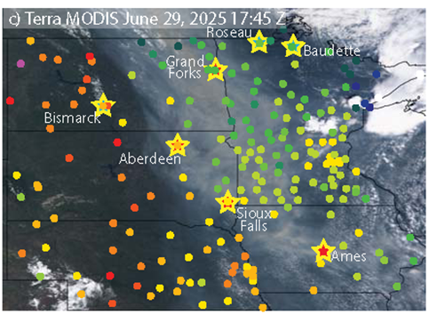
Estimate the Aerosol Direct Cooling Efficiency from Grand Forks and Bismarck Surface Observations
Terra MODIS June 29, 2015 17:45Z
The near-surface temperatures between Bismarck and Grand Forks share a high degree of correlation (0.9) with Bismarck is 1.0+-2.0 degree warmer for 15 June – 14 July 2015, excluding 29 June data.
An 8 degree temperature difference is found between Bismarck and Grand Forks on 29 June 2015.
AOT difference is ~3 - 4 for the two sites.
Aerosol direct cooling efficiency of ~
-1.5° C per 1.0 AOT (550nm, τ₅₅₀)
Zhang et al., 2016

Slide 16
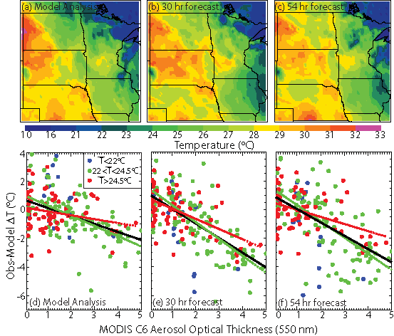
Aerosol Direct Cooling Efficiency Estimated from Model (ECMWF. UKMO and NCEP) Analysis and Forecasts (~ -0.25 - 1 °C per 1.0 τ₅₅₀)
ECMWF

Slide 17
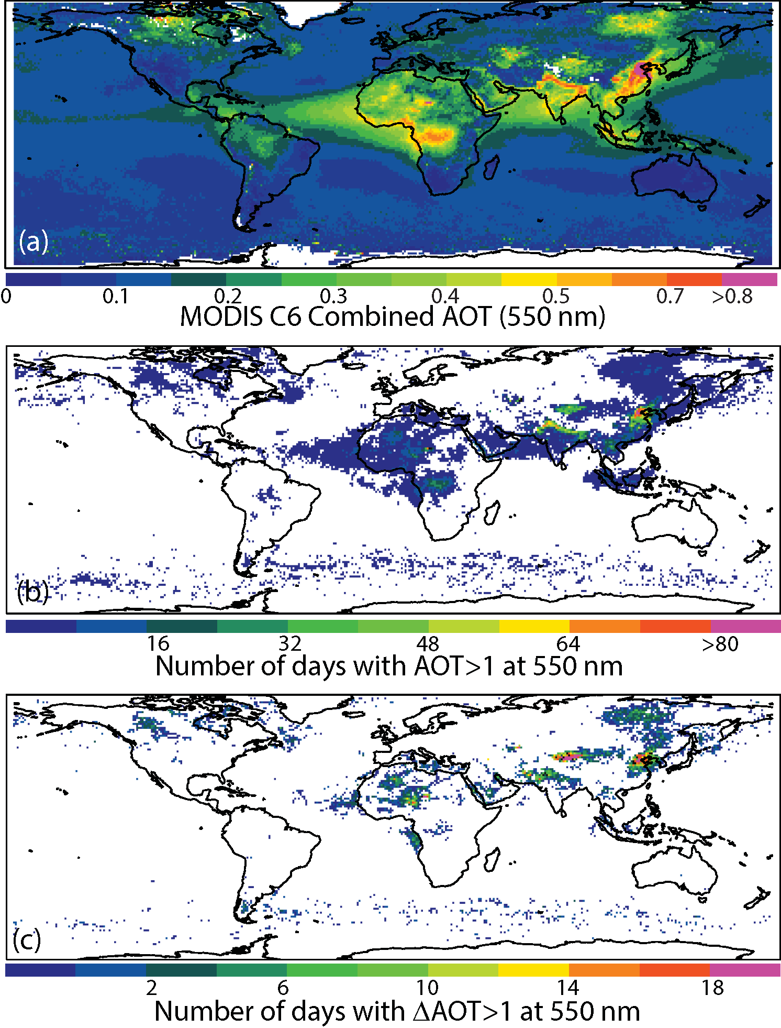
Issues?
Using one month of observed surface temperatures from the study region, baseline uncertainties for near-surface air temperatures from the 0-, 24(30)-, and 48(54)-hr forecasts (ECMWF, NCEP, UKMO models) are 1.3-2.3, 2.0-2.5 and 2.0-2.7°C, respectively.
Thus, for the aerosol-induced direct cooling effect to be observable from the 0-hr model forecasted near-surface air temperature fields, a daily change in τ₅₅₀ of ~1.0-1.5 (550nm) is needed, assuming the estimated daytime C_{τ} of ~ -1.5°C per unit τ₅₅₀ is applicable.
Not worth the clock time for now for surface temperature forecasts?

Slide 18
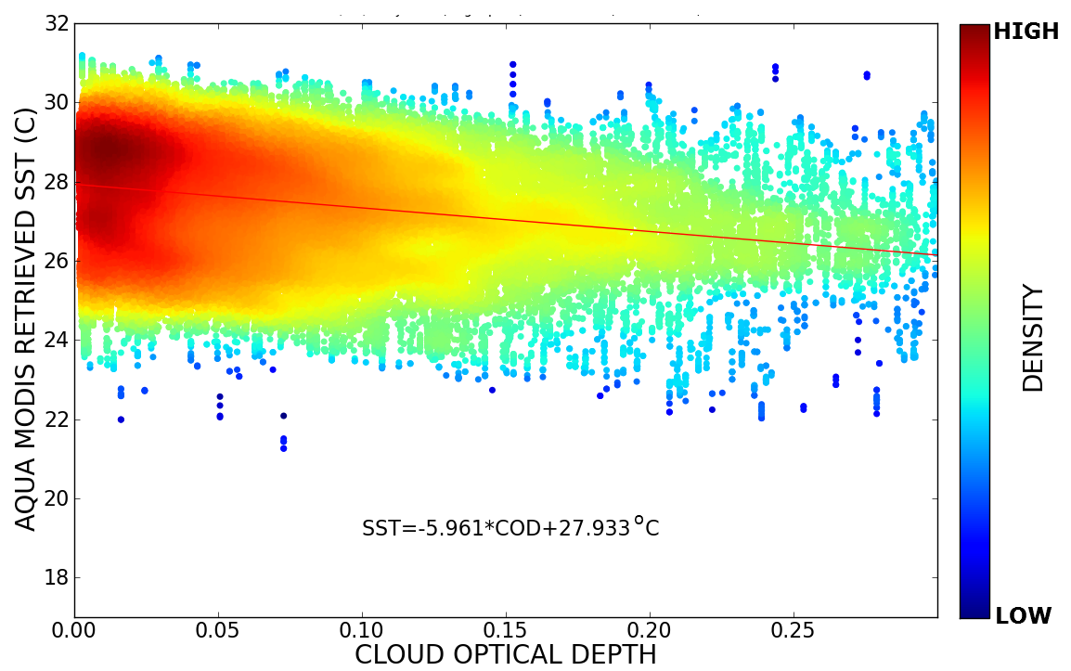
More Eye Candy – The Impact of Optically-Thin Cirrus Clouds On Operational SST Retrievals
We have estimated the impact of unscreened optically-thin cirrus clouds (OTC) on operational MODIS- AVHRR- and VIIRS-SST retrievals.
Passive radiometric sensors fail to screen OTC at cloud optical depths less than ~ 0.3.
Split-window relative OTC cold biases (single observation) range from 0.40°-0.49° C, with an absolute (bulk mean) bias between 0.10°-0.13° C.
Triple-window retrievals are more resilient, ranging from 0.03°-0.04° C relative and 0.11°-0.16° C absolute.
SST Cold Bias = -6°C/COD
CALIOP cloud optical depth versus Aqua-MODIS SST from OTC-contaminated retrievals for August-October 2012 over the Maritime Continent (75°W/15°S – 135°W/30°N).
Marquis et al., 2016 (submitted)

Slide 19
Conclusions
The study of longer-term changes of aerosol properties is necessary for our understanding of climate, but at the same there are NWP applications.
MODIS, OMI, CALIOP, CERES we now have column and vertical data
While consistent trends are found in India & Middle East (positive), Mediterranean Sea & Eastern US (negative), inconsistencies are found for regions such as Eastern China. Sampling?
Findings suggest an increase in coastal China from 2000-2008, followed by a negative trend after 2008. The reason for the change is not known, though we are beginning work on a new study pairing CALIOP with MODIS to understand trends in surface-based PM_{2.5}.
Moving to acute effects and NWP applications, a serendipitous boreal smoke event became an excellent natural laboratory.
Our study suggests that the smoke aerosol participles have an observable impact on near-surface temperature, with an estimated aerosol direct cooling efficiency ranging from – 0.25 to -1.5 °C per 1.0 AOT (550nm, τ₅₅₀) for AOT>1.

