Slide 1
MODIS and VIIRS
Sea-Surface Temperatures: Validation of continuity products
Kay Kilpatrick and Peter J Minnett
Susan Walsh, Elizabeth Williams, Goshka Szczodrak, Miguel Izaguirre
Rosenstiel School of Marine & Atmospheric Science
University of Miami

Slide 2
Outline
SST LWIR continuity algorithm
Sensor comparisons
New cloud mask methodology
Data availability
Future directions

Slide 3
SST continuity MODIS to VIIRS
The ROSES objective is to demonstrate compatibility between MODIS (Terra and Aqua) SST retrievals and those of S-NPP VIIRS for the production of a Consistent Data Record, and then to a Climate Data Record.
Consistency can be achieved by using comparable atmospheric correction algorithms, cloud-screening methods, and approaches to estimate errors and uncertainties.
Temperature Climate Data Records require SI traceability of calibration and validation. this requires measurements of skin SST by ship-board radiometers with calibration referenced to NIST, or NPL, standards.
SST CDR accuracy requirements are very stringent: absolute accuracy of 0.1K, and decadal stability of 0.04K¹

Slide 4
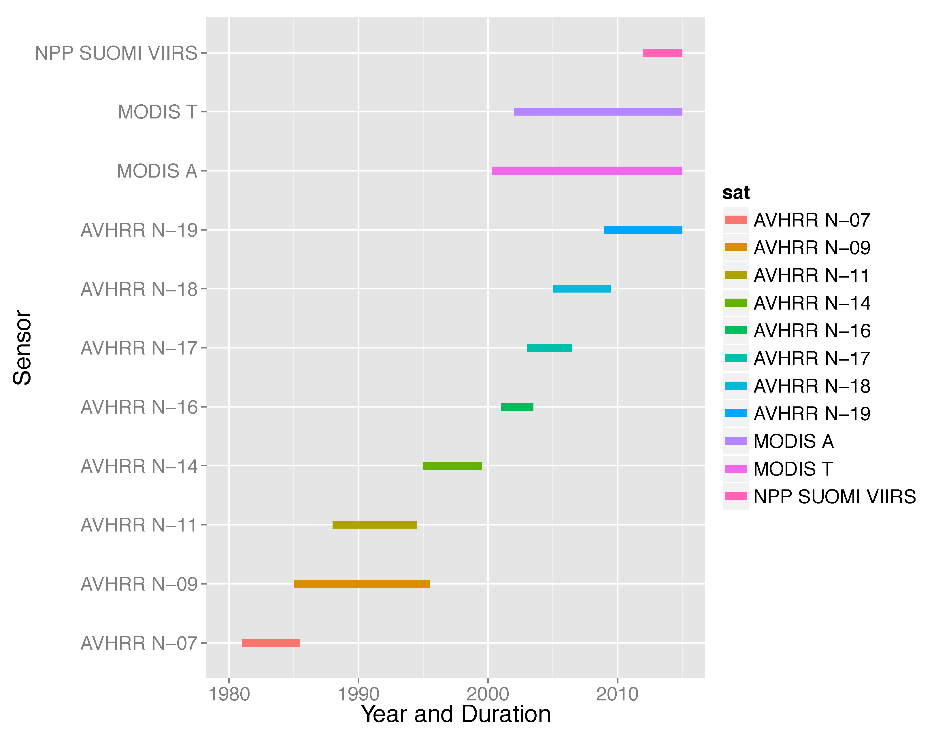
Time Series of Satellites

Slide 5
SST Retrieval Equation
Non-Linear LWIR SST algorithm (day and night, cloud and aerosol free):
SST = c₁+c₂ * T₁₁+ c₃ * (T₁₁-T₁₂) *T_{sfc}+c₄ * (sec (θ)-1 )* (T₁₁-T₁₂)
where T_{n} are brightness temperatures measured in the channels at n μm wavelength, T_{sfc} is a ‘climatological’ estimate of the SST in the area, and θ is the satellite zenith angle. For MODIS, T₁₁ from Band 31, T₁₂ from Band 32.
c_{i} are coefficients, not necessarily constant. There are uncertainties associated with their derivation – both for rte and matchups.
Applicable to cloud-free conditions only; residual effects from cloud screening and aerosol radiances add uncertainties….
Walton et al, (1998). The development and operational application of nonlinear algorithms for the measurement of sea surface temperatures with the NOAA polar-orbiting environmental satellites. Journal of Geophysical Research 103 27,999-28,012.

Slide 6
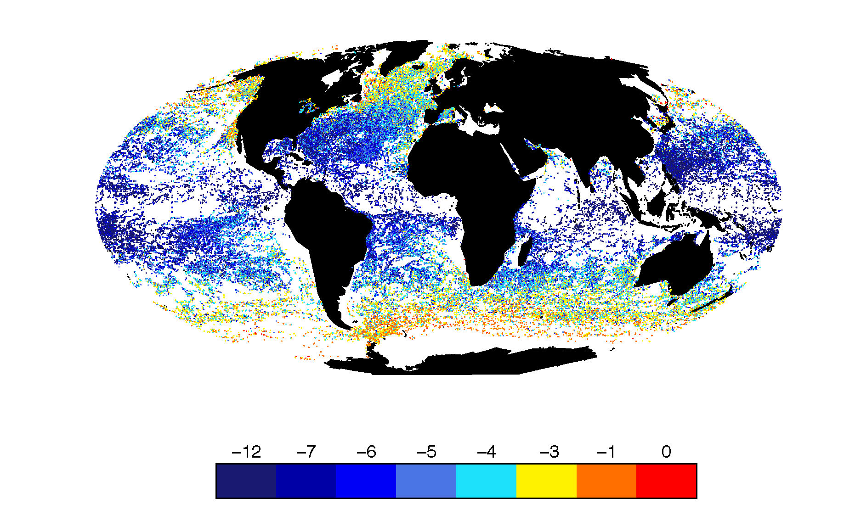
VIIRS Temperature deficit
BT11um – Buoy SST
0.25º grid (2012-2013)
Atmospheric correction
~ 12 months buoy obs
Notes:
2 years of buoy matchups in this case VIIRS SST Temp deficit TOA
Wet atmospheres of tropics and subtropics 4-8 degrees of correction
Drier high latitudes 0-1 degrees.
Algorithm correction is a function of the difference in the 11-12um bands

Slide 7
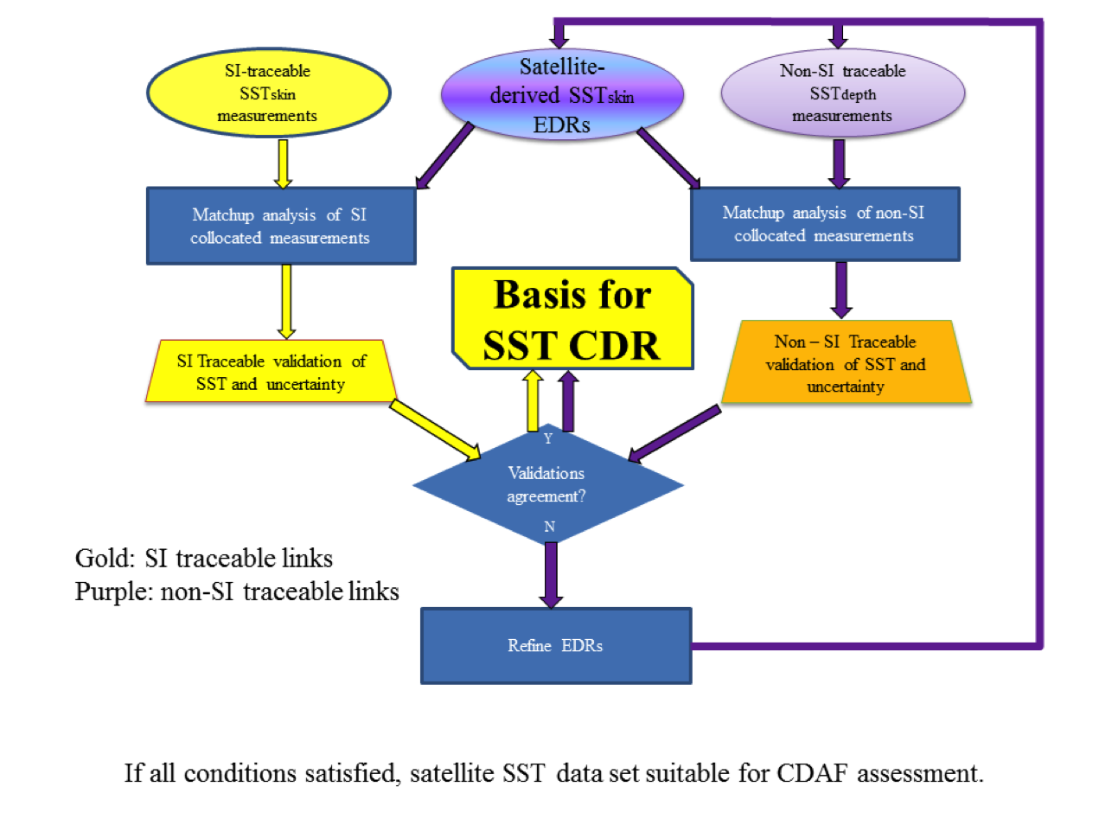
CDR Framework SI traceable
Skin SST
Ship radiometers
Sub surface SST
drifting and moored buoys

Slide 8
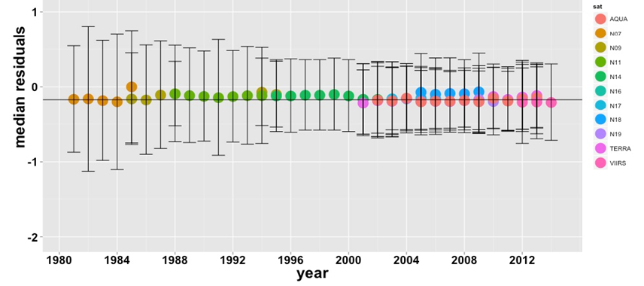
Consistent Data Record
Night time validation satellite IR skin SST
relative to sub-surface drifting and moored buoys

Slide 9
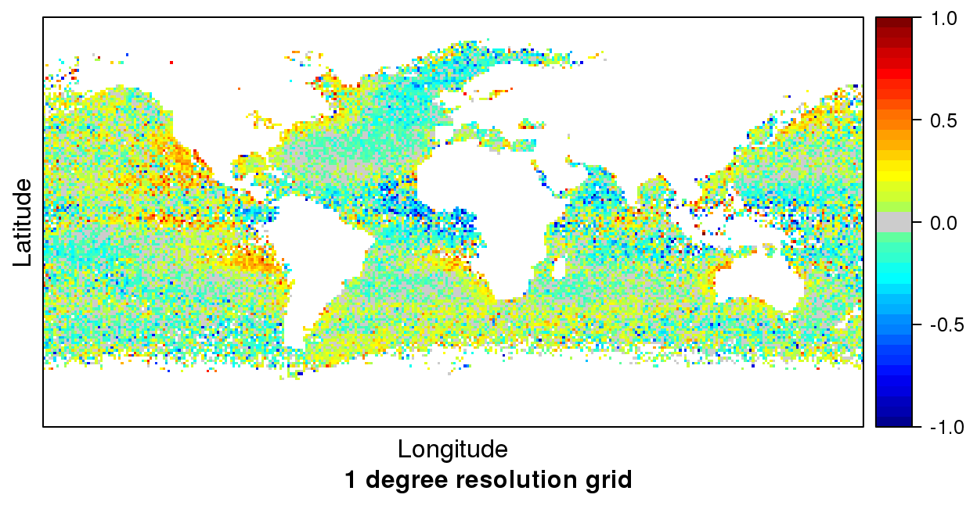
Regional versus global accuracy
TERRA 16 year median night SST bias -0.164K rsd 0.234
half a million sub-surface buoys observations
MODIS-T skin SST – buoy SST

Slide 10
Algorithm innovations
- Coefficients tuned to atmospheric conditions
AVHRR Pathfinder wet/dry atmospheres monthly
C6 MODIS/VIIRS – latitude and month of year
Extend retrievals towards edge of VIIRS & MODIS swaths
SST _{sat} = a₀ +a₁T₁₁ +a₂(T₁₁-T₁₂) T_{sfc}
+ a₃(sec(θ)-1)(T_{11μm}-T_{12μm})
+ a₄(mirror.side) +a₅(θ) +a₆(θ²)
Cloud/anomalous atmosphere detection

Slide 11
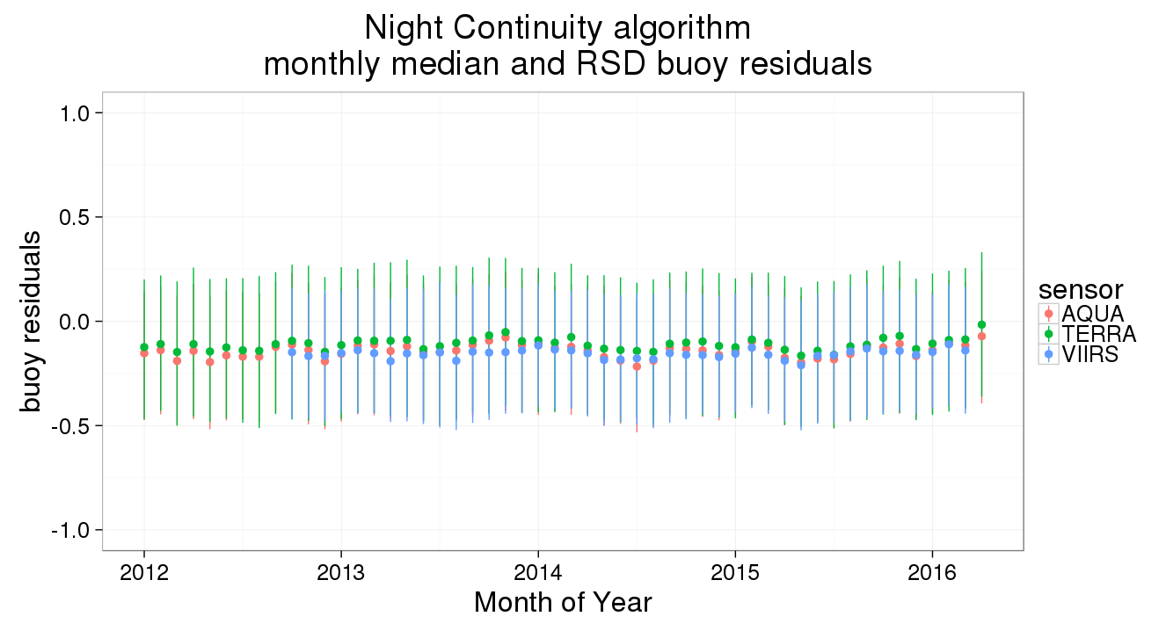
VIIRS and MODIS skin LWIR SST
compared to subsurface buoys

Slide 12
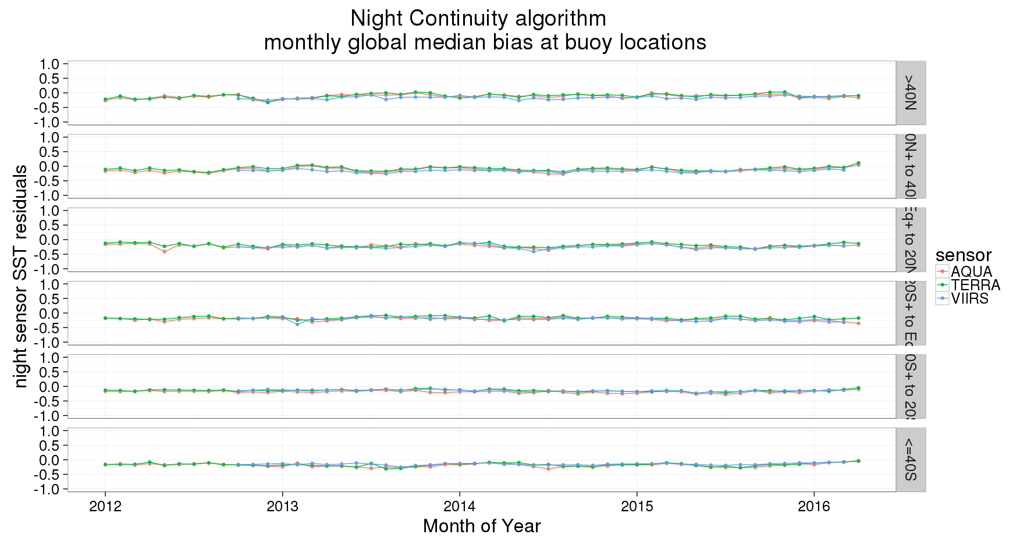
Stable residuals by latitude

Slide 13
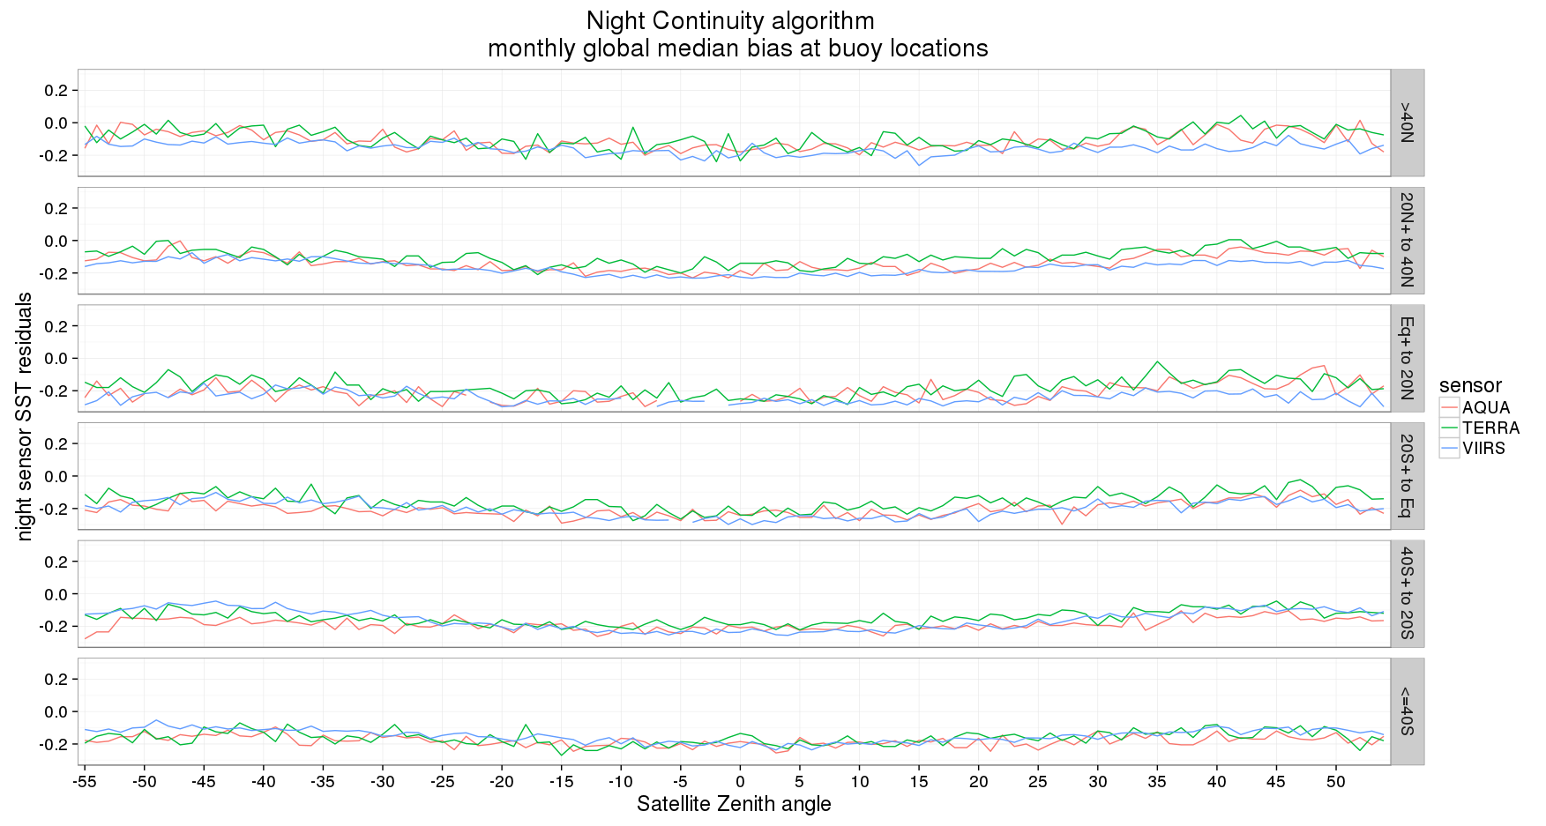
Satellite Zenith angle and latitude

Slide 14
Validation Buoy Matchups
Sensor | quality |  | mean | median | SD | RSD | Count
Residuals MODIS skin SST – sub-surface buoy SST
TERRA SST |  | ql0 | -0.166 | -0.150 | 0.442 | 0.319 | 538918
AQUA SST |  | ql0 | -0.185 | -0.170 | 0.423 | 0.305 | 508950
VIIRS SST |  | ql0 | -0.205 | -0.174 | 0.476 | 0.343 | 473498
TERRA SST |  | ql 1 | -0.424 | -0.395 | 0.641 | 0.462 | 252809
AQUA SST |  | ql1 | -0.424 | -0.380 | 0.620 | 0.447 | 267214
VIIRS SST |  | ql1 | -0.451 | -0.377 | 0.730 | 0.527 | 223565
TERRA SST4 |  | ql 0 | -0.164 | -0.145 | 0.325 | 0.234 | 5358234
AQUA SST4 |  | ql0 | -0.203 | -0.170 | 0.341 | 0.246 | 543139
VIIRS SST_Triple |  | ql0 | -0.151 | -0.147 | 0.346 | 0.250 | 356490
TERRA SST4 |  | ql 1 | -0.268 | -0.215 | 0.440 | 0.318 | 228143
AQUA SST4 |  | ql1 | -0.398 | -0.310 | 0.522 | 0.377 | 350790
VIIRS SST_Triple |  | ql1 | -0.254 | -0.223 | 0.495 | 0.357 | 256230
OB.DAAC
C6 MODIS v2014.0*
VIIRS v2016.0**
*OB.DAAC MUDB
**Miami MUDB

Slide 15
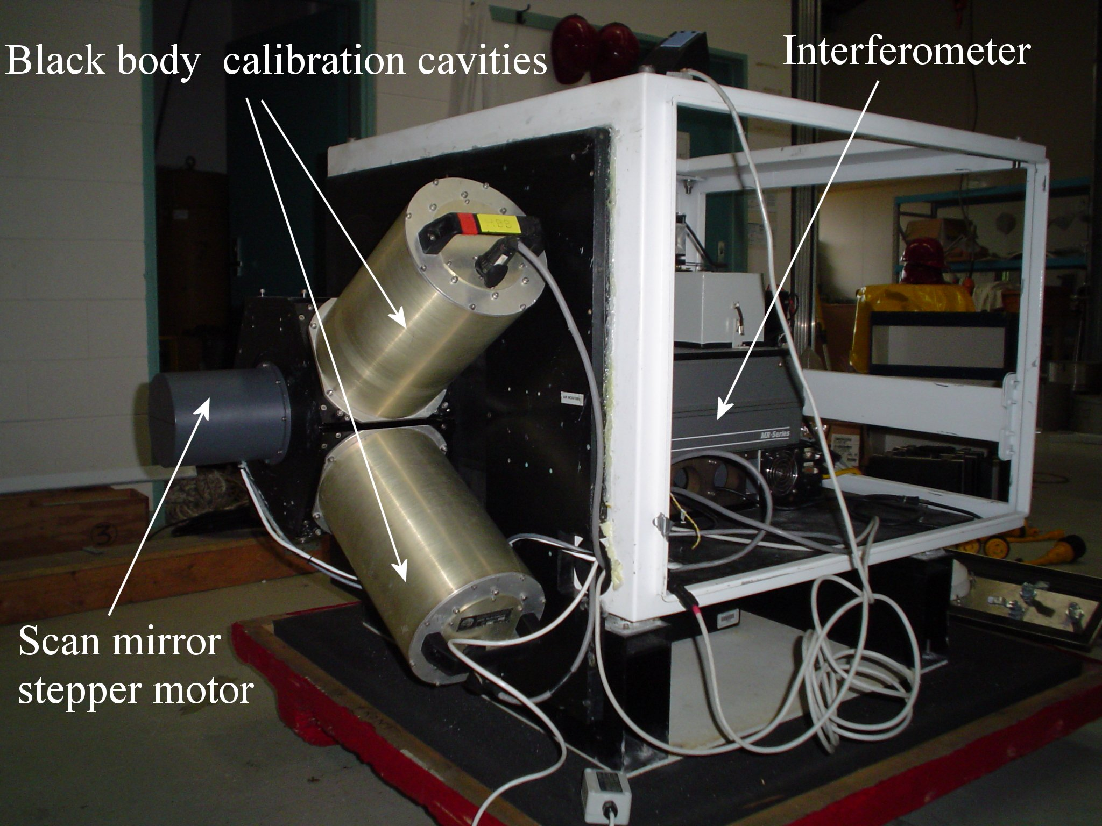
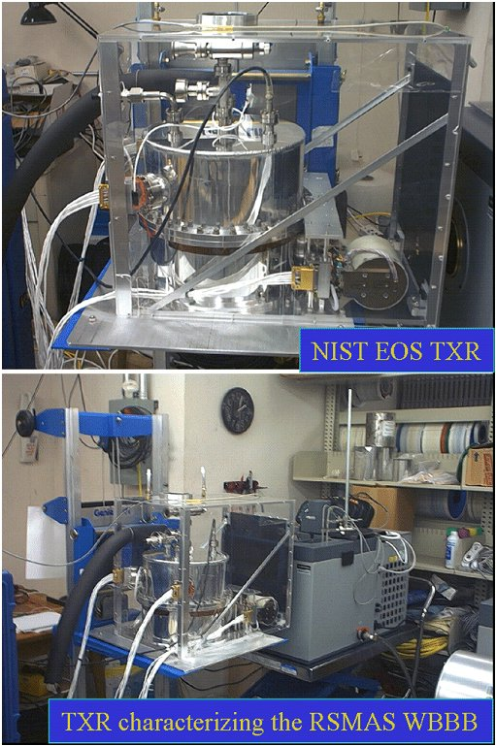
Marine-Atmospheric Emitted Radiance Interferometer
M-AERI is a very well-calibrated and stable sea-going Fourier Transform Infrared Interferometer.
At sea calibration by two internal blackbody cavities with thermometers with NIST-traceable calibration.
Calibration before and after deployments using NIST-designed water-bath blackbody calibration target at RSMAS. Uses NIST-traceable thermometers at mK accuracy.
Periodic radiometric characterization of RSMAS water-bath blackbody calibration target by NIST TXR.
GHRSST inter-calibration work shop will be next week in London at 2016.

Slide 16
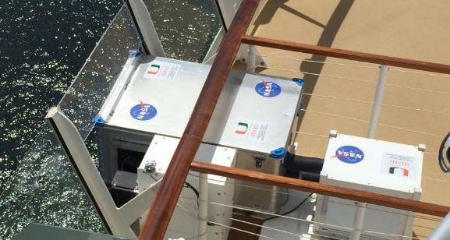
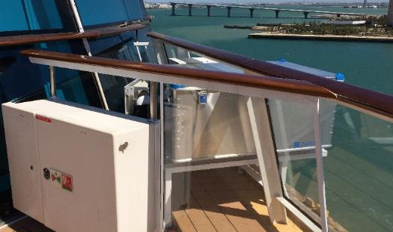
Current VOS deployments
Collaboration with Royal Caribbean Cruise Lines
Allure of the Seas
Celebrity Equinox
Celebrity Equinox

Slide 17
Validation Radiometer Matchups
Sensor | quality |  | mean | median | SD | RSD | Count
Residuals MODIS skin SST – skin radiometer SST
TERRA SST |  | ql0 | -0.0.58 | -0.052 | 0.481 | 0.347 | 3069
AQUA SST |  | ql0 | 0.042 | 0.0.040 | 0.494 | 0.347 | 2070
VIIRS SST |  | ql0 | 0.030 | 0.009 | 0.196 | 142 | 81
TERRA SST4 |  | ql 0 | 0.021 | 0.020 | 0.354 | 0.256 | 3065
AQUA SST4 |  | ql0 | 0.000 | 0.015 | 0.401 | 0.289 | 2194
VIIRS SST_Triple |  | ql0 | -0.076 | -0.04 | 0.179 | 0.129 | 73
OB.DAAC
C6 MODIS v2014.0*
VIIRS v2016.0**
*OB.DAAC MUDB
**Miami MUDB

Slide 18
New cloud/quality classification for VIIRS
Alternating Decision Trees ² are an ensemble collection both weak and strong classifiers with each binary decision nodes ending with a prediction node containing vote. Each vote is scaled to the predictive power of the test. The vote from all true nodes are summed and magnitude of the vote provides an indication of the confidence of the classification.
The combined vote from a collection of weak prediction nodes when voting together as a block can modify or over ride the vote of a single strong prediction node.
Combined with boosting algorithms a very accurate ensemble classification model can be developed.
2. Freund and Mason 1999, Pfahringer et. al . 200)

Slide 19
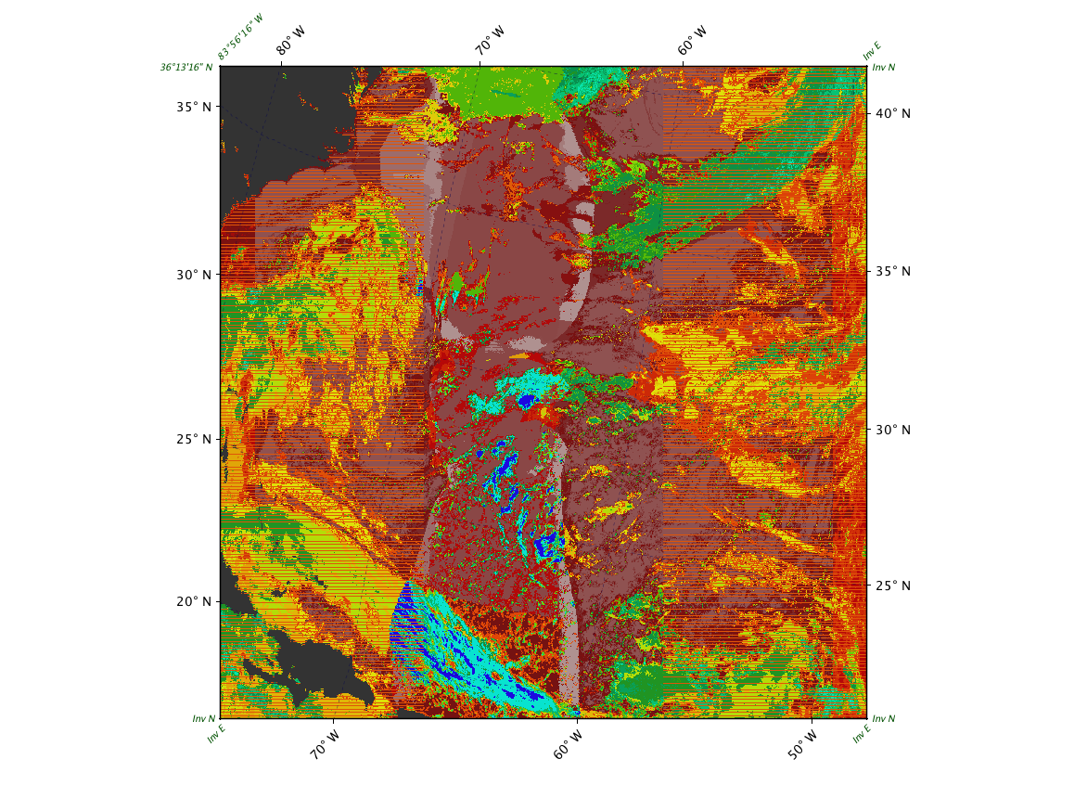
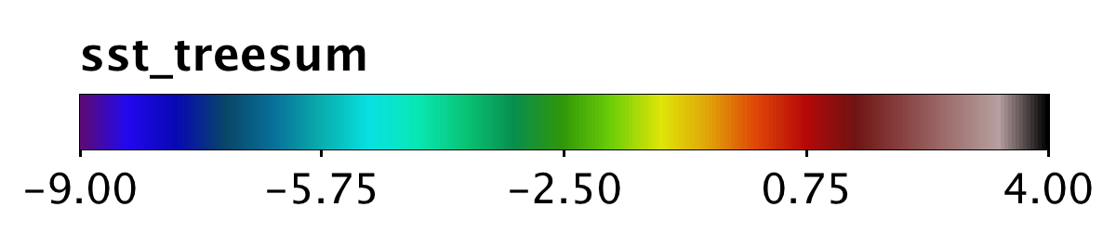
Classifier Ensemble Vote
An ensemble of 4 Alternating Decision Trees classifiers were trained to classify VIIRS SST retrievals as either clear or cloudy, using 10 fold-cross validation and boosting. The training sets consisted of a subset of randomly selected records in the VIIRS buoy Matchup Database (MUDB).
model cases:
Night
Day non glint
Day moderate glint
Day high glint
~ 30 nodes/leaves for each model
classification model validation data set:
Correctly Classified 29732 91.0015 %
Incorrectly Classified 2940 8.9985 %

Slide 20
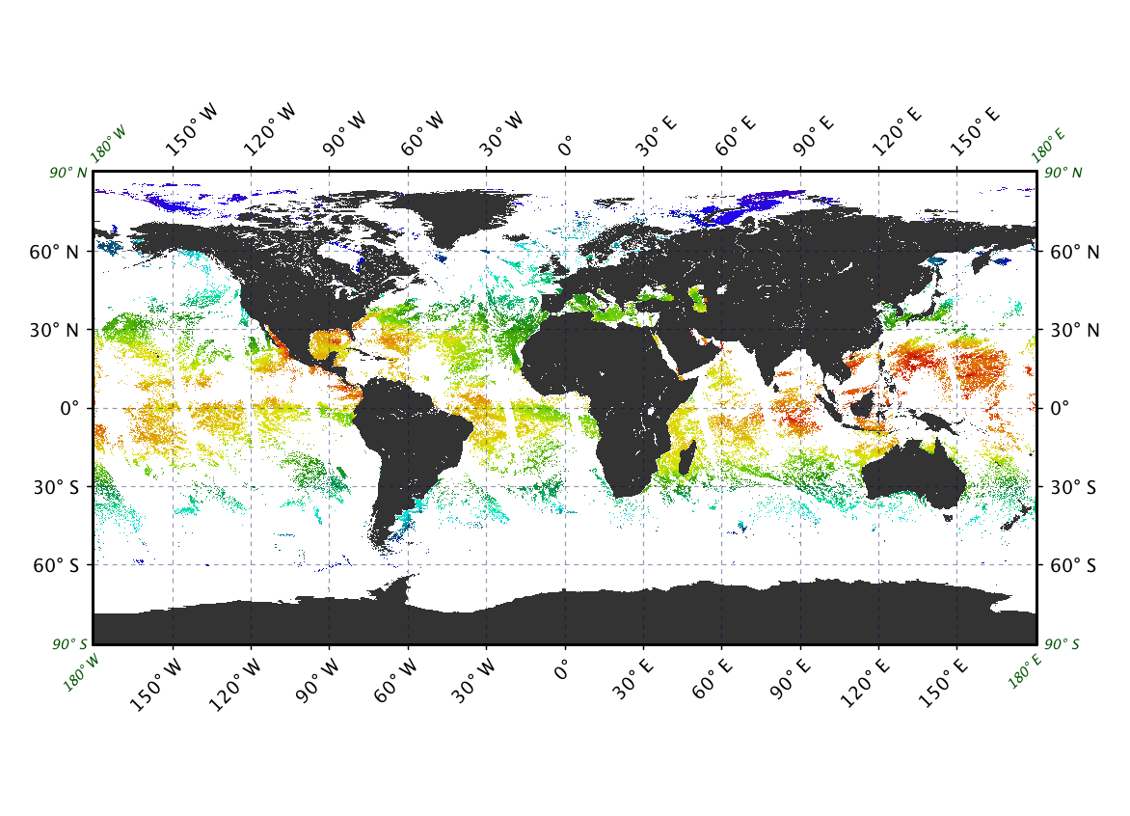
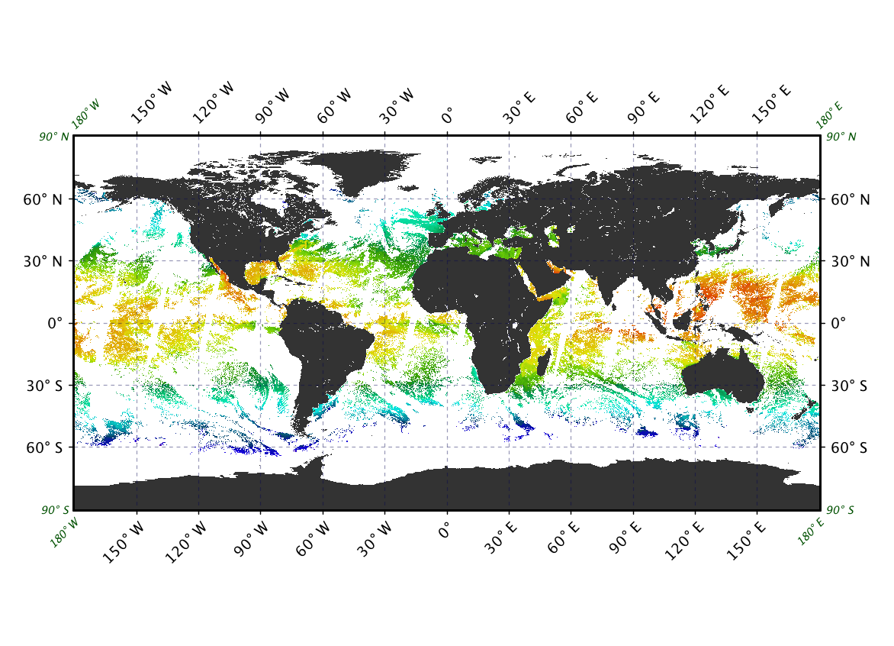
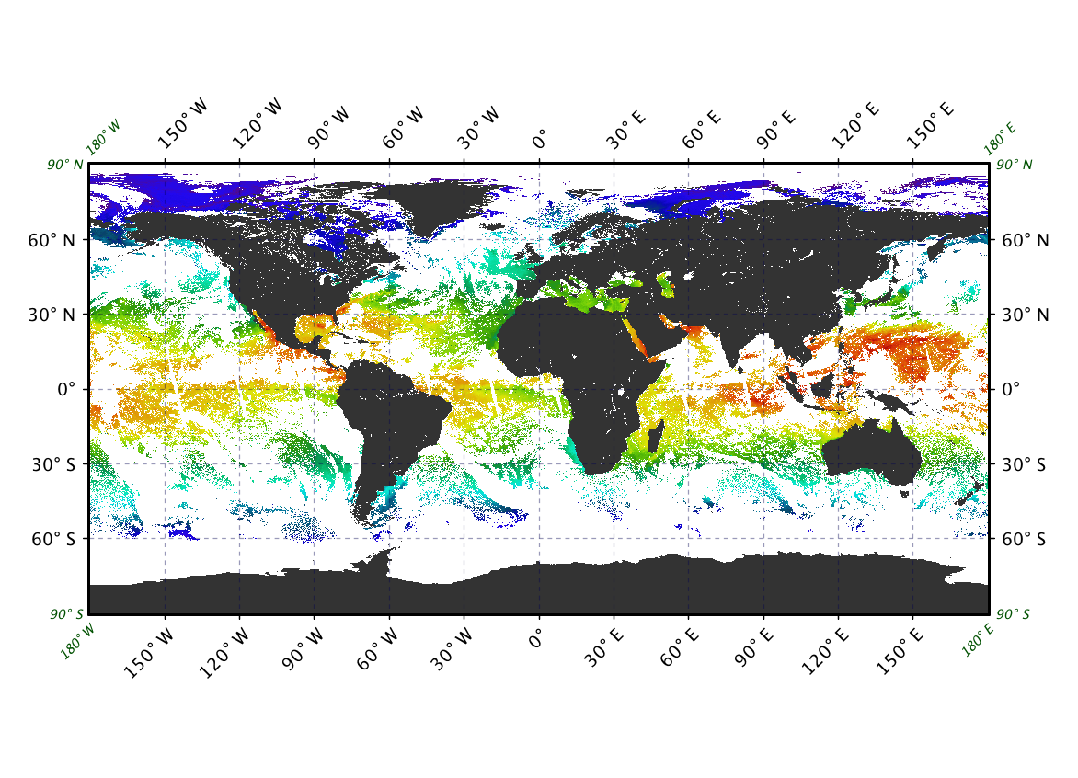
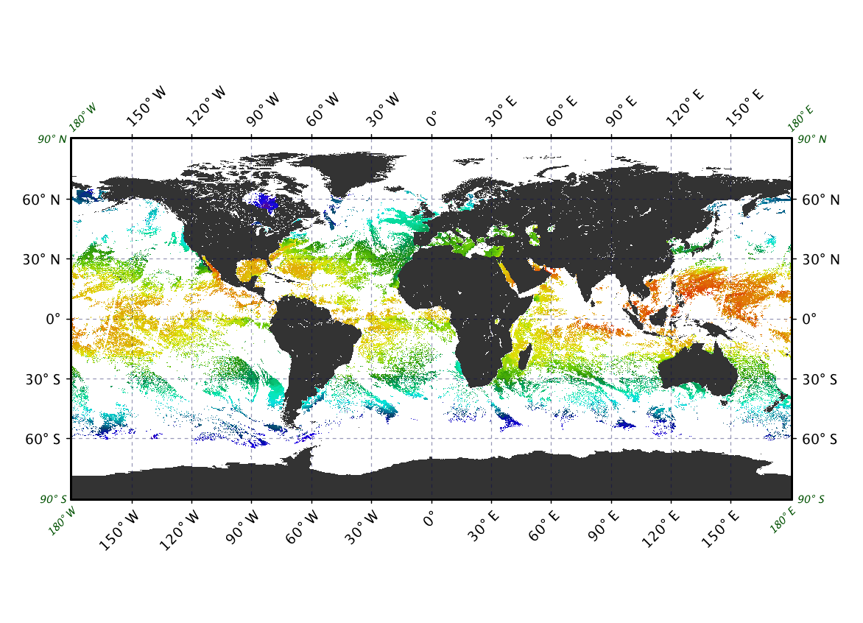
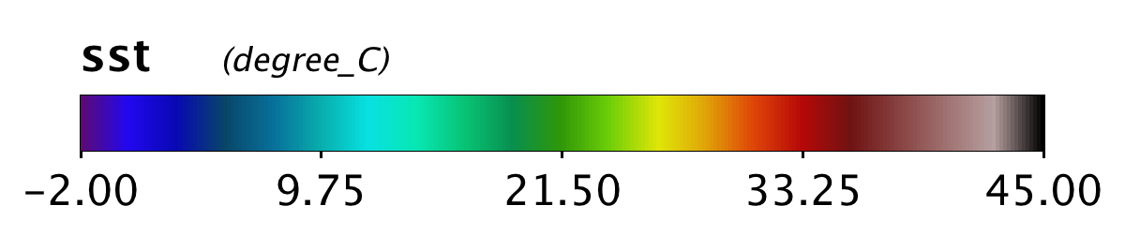
Ensemble ADTree classifier
Increase number of valid retrievals
MODIS-A
Day
Night
VIIRS
June 19 2014

Slide 21
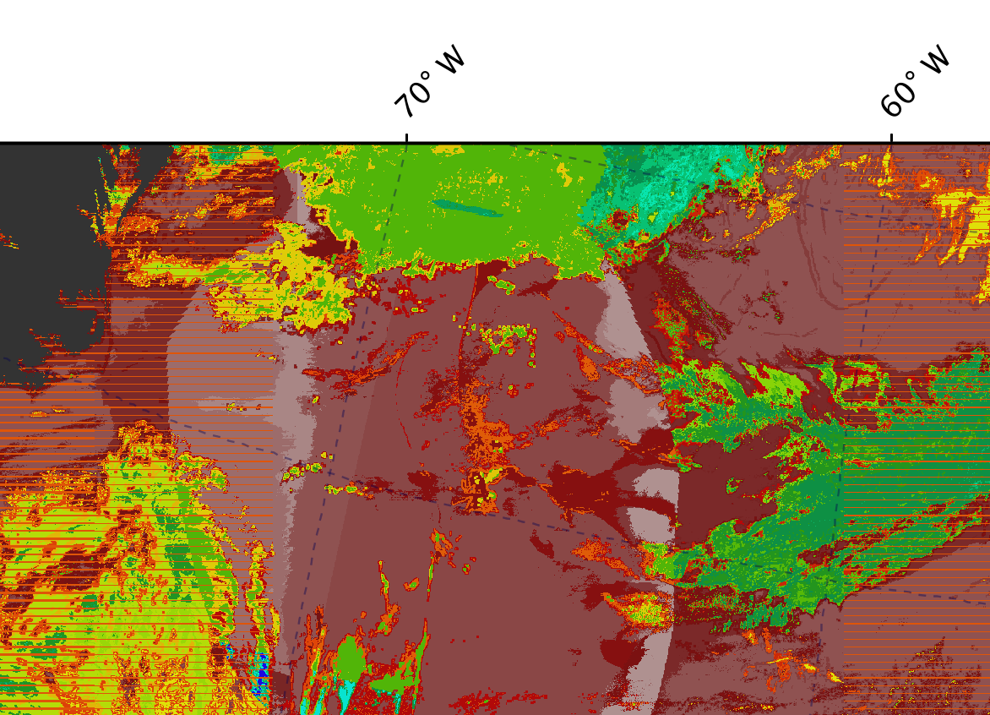
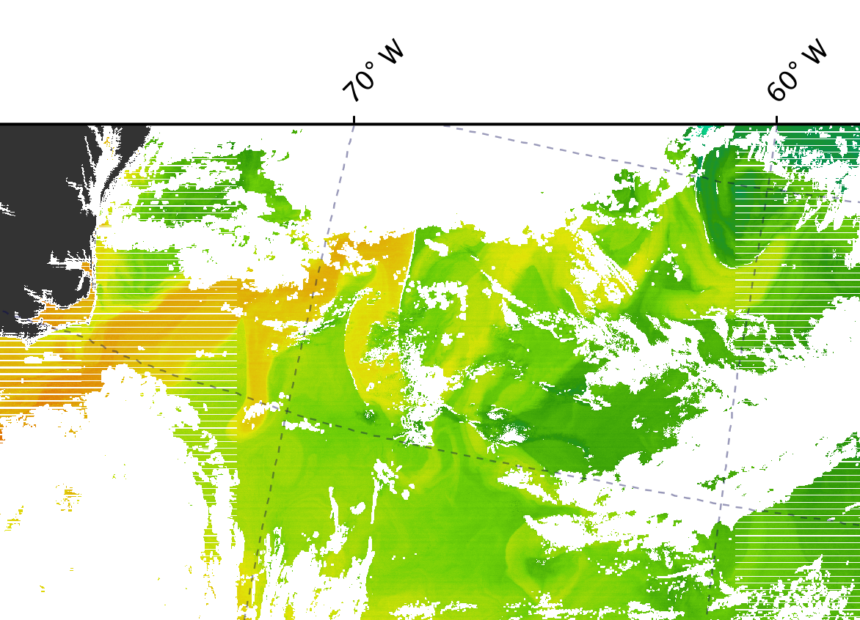
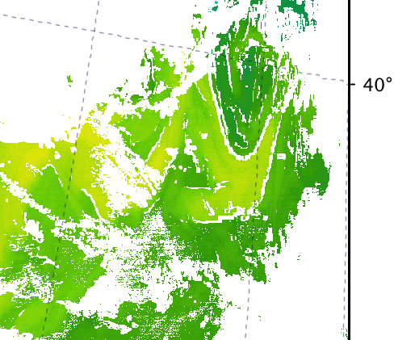
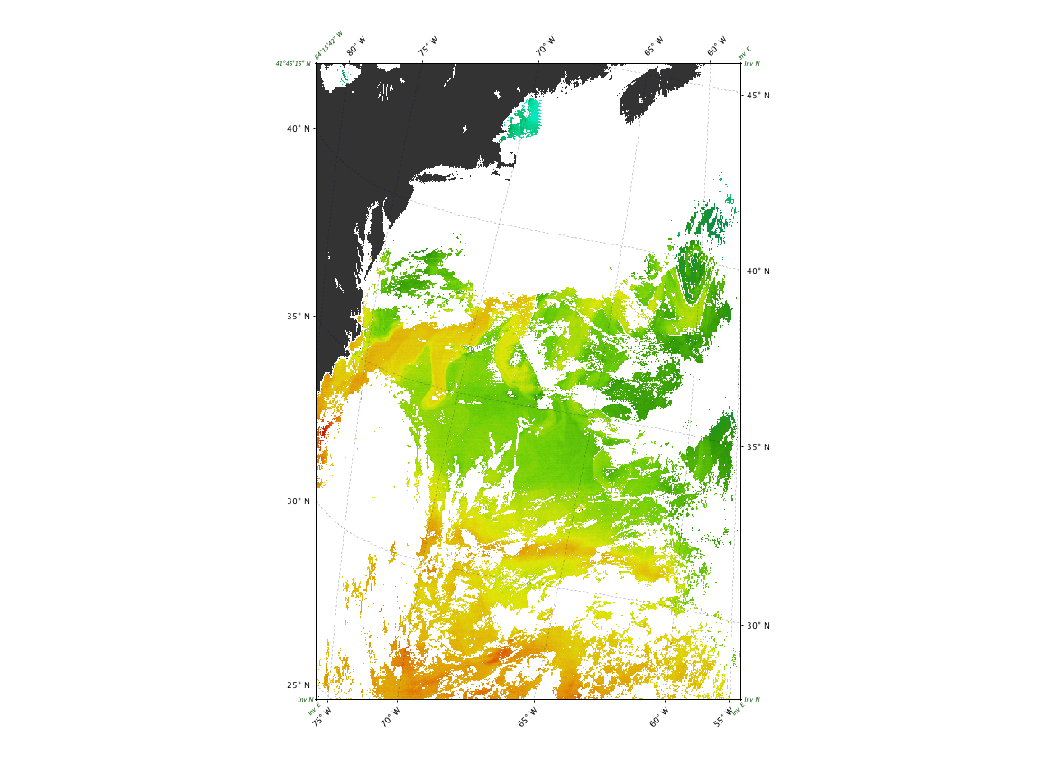
Ensemble of ADTree classifier improves retention of good quality pixels at frontal boundaries
MODIS –A SST
Standard decision tree
VIIRS SST
ADtree classifier
Adtree
Ensemble vote
June 19 2014 L2 over Gulf Stream

Slide 22
Data availability
C6 MODIS v2014.0 SSTs are available from NASA GSFC OB.DAAC as L2 and L3
NASA reprocessing of VIIRS SST v2016.0 is currently and should be complete by the end of June
JPL PO.DAAC reformatted into GDS 1.0 L2P
  note GDS 1.0 files are a mix of C5 and C6 MODIS SSTs
JPL PO.DAAC soon to release complete C6 MODIS SST GDS 2.0
MODIS and VIIRS MUDB s to be publically accessible and searchable through OB.DAAC SEABASS in situ archive late 2016 http://seabass.gsfc.nasa.gov

Slide 23
Summary
  The MODIS record remains very stable over the 16 year period ending May 2016. SI traceable to ship radiometer observations (0.02K bias relative to skin)
  Excellent agreement between VIIRS and both MODIS LWIR continuity SST algorithm based on L2 MUDB
  VIIRS Cloud mask using an ensemble of Alternating Decision Trees improves misclassification and increases number of valid retrievals
  Together NASA MODIS, VIIRS and NASA/NOAA PFSST produce 36 years of consistently processed SST

Slide 24
Looking forward
Improve MODIS cloud detection based on methods developed for VIIRS
Revise quality level definition and methodology of single sensor error statistics (SSES) for both MODIS and VIIRS
Comparisons L3 MODIS and VIIRS day ,month , year products at different resolutions
Reprocess in 4th quarter of 2016 based on analysis of the v2016.0 reprocessing and to add SSES L2p GDS2.0 compliance…..but the new V2 NASA VIIRS L1b may supersede the plan
Continue validation ship radiometers and buoys

Slide 25
Acknowledgements
Funding, primarily from NASA, MODIS project and the Physical Oceanography program. Also from NOAA/NESDIS/STAR.
Support of OB.DAAC
Support of MCST & VCST
Input from many students and colleagues.

Slide 26

Buoy SST accuracy characterization
Is the accuracy and stability of buoy SST measurements good enough for Satellite SST CDR validation?
  Study calibration drift and accuracy over a 1 to 2 year deployment in Bear cut
  1-2 years of monthly comparison to thermometers calibrated against the RSMAS black body
  12 moored buoys - 3 each of 4 designs
    3 designs SIO
    1 design NOAA/AOML

Slide 27
4km Mapped images
Pixel Quality level | MODIS A SST L3 4km count | VIIRS SST L3 4km count
Best Day Night | 2286952 2512379 | 3998602 3156603
Good Day Night | 1245048 975615 | 2711723 1589578

Slide 29
MODIS SST4 and VIIRS SST_Triple
Measurements in mid-IR atmospheric transmission windows have potential to provide better SSTs
MODIS:
SST4 = c₁+ c₂ * T_{3.9} + c₃ * (T_{3.9}−T_{4.0}) +
c₄ * (sec(θ)−1)
VIIRS multi-channel SST:
SST_Triple : c₁+ c₂ * T₁₁ + c₃ * (T_{3.7}−T₁₂) +
c₄ * (sec(θ)−1)
But can only be used confidently at night, due to reflection of solar radiation at the sea surface, and scattering from the atmosphere.

