Slide 1

MODIS/VIIRS LAI & FPAR – 2016 UPDATE
Yuri Knyazikhin
Taejin Park
Kai Yan
Chi Chen
Ranga B. Myneni
(rmyneni@bu.edu)

Slide 2

MODISLAI & FPAR – 2016 UPDATE
Analyzed C6 LAI/FPAR product
Results published in 2 papers
C6 LAI/FPAR “improved” relative to C5
Details in 2 posters @ this meeting
1. Yan et al., 2016. Evaluation of MODIS LAI/FPAR Product Collection 6.
Part 1: Consistency and Improvements, Remote Sensing, doi:10.3390/rs8050359
2. Yan et al., 2016. Evaluation of MODIS LAI/FPAR Product Collection 6.
Part 2: Validation and Intercomparison, Remote Sensing, doi:10.3390/rs8060460

Slide 3

MODISLAI & FPAR – 2016 UPDATE
Seasonal changes in leaf area of Amazonian rainforests and Drought impacts
Based on MAIAC reflectance products
Results published in 2 papers
1. Bi et al., 2016. Sunlight mediated seasonality in canopy structure and photosynthetic
activity of Amazonian rainforests. Environ. Res. Lett., doi: 10.1088/1748-9326/
10/6/064014.
2. Bi et al., 2016. Amazon Forests’ Response to Droughts: A Perspective from the
MAIAC Product, Remote Sensing, doi:10.3390/rs8040356

Slide 4

MODISLAI & FPAR – 2016 UPDATE
Developing prototype LAI/FPAR products from MAIAC reflectances
Focus on Amazonian rainforests
Results in 1 paper
Details in a poster @ this meeting
Chen et al., 2016. Development of a prototype LAI/FPAR products from MAIAC
reflectance product, (to be submitted by end-June-2016 to RS).

Slide 5

MODISLAI & FPAR – 2016 UPDATE
CO2 fertilization greening the Earth
Results published in 1 paper
Based on LAI data set developed from MODIS and AVHRR GIMMS NDVI3g
1. Zhu et al., 2016. Greening of the Earth and its Drivers. Nature Climate Change,
doi:10.1038/nclimate3004.

Slide 6
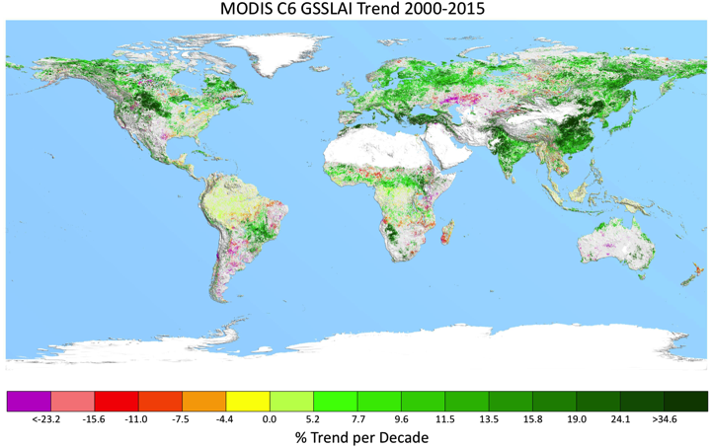
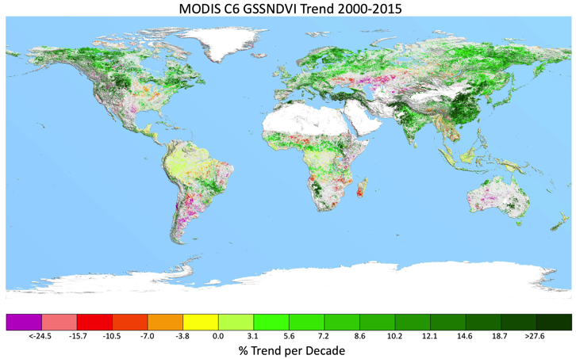
MODISLAI & FPAR – 2016 UPDATE
Does MODIS see a “greener Earth”?
Yes (25 -30% of vegetated area showing stat. sig. greening trends)
Work in progress – results in a poster @ this meeting

Slide 7
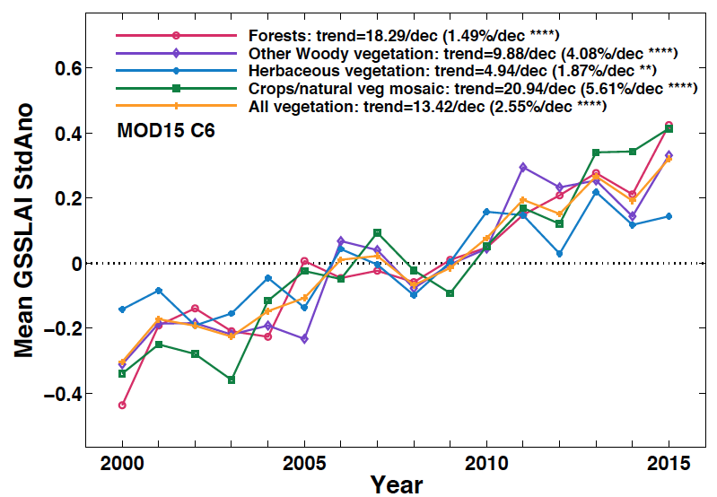
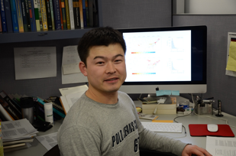
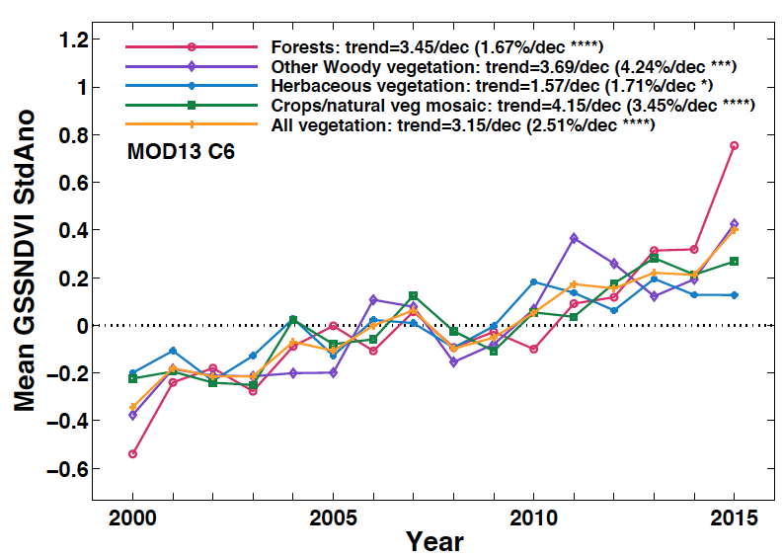
MODISLAI & FPAR – 2016 UPDATE
Does MODIS see a “greener Earth”?
Taejin Park
Kai Yan
Chi Chen

Slide 8

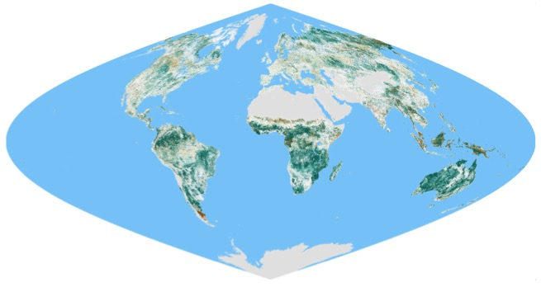

MODISLAI & FPAR – 2016 UPDATE
Evaluation of MODIS LUT based VIIRS Product
  Overestimations are observed relative to MODIS and field data
  Adjustments for VIIRS spectral band composition are needed
7
B8
6
B7
5
B6
4
B5
VIIRS C1.1 LAI
3
B4
2
B3
LAI Relative Difference (%)
B2
1
-5.0
10
20
40
50
-40
-30
-20
-10
5.0
30
B1
-50
0
0
1
2
3
4
5
6
7
8
Field LAI (55 LAI and 80 effective LAI)

Slide 9
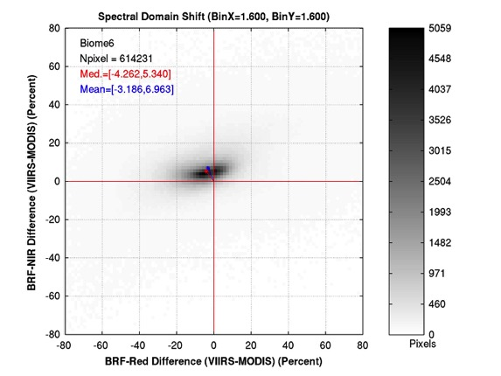
MODISLAI & FPAR – 2016 UPDATE
LUT adjustment for VIIRS spectral band composition
  Observed BRF spectral domain shift (Biome 6 as an example)
  All biomes show similar directional BRF shift (but magnitude varies)
  Optimizing VIIRS- and biome-specific configurable parameters
  Solution of problem - maximize RI (spatial coverage) & minimize RMSE
Optimal parameterization with minimizing RMSE and maximizing RI
BRF spectral domain shift inferred from observations
(Lower Red and Higher NIR)
Spectral space shift due to single scattering albedo modulation

Slide 10
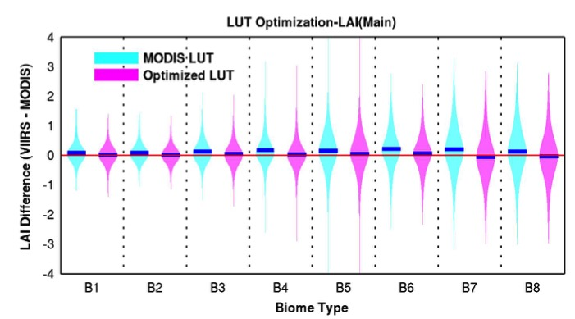
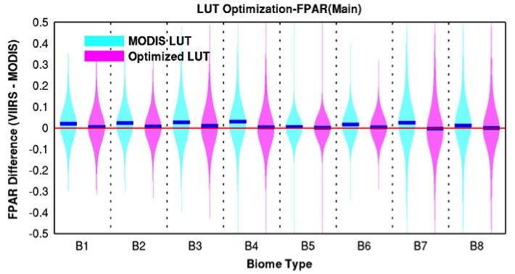
MODISLAI & FPAR – 2016 UPDATE
Global scale LAI/FPAR comparison between optimized VIIRS & MODIS C6
  Before adjustment, positive LAI biases are observed in all biomes (mean bias=+0.12)
  After adjustment, observed biases (mean bias=+0.02) in LAI are significantly reduced with better RMSE (=0.55)
  This improvement is also observed in FPAR case
10

Slide 11
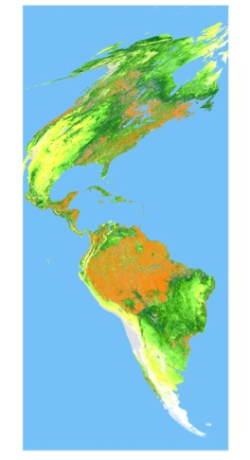
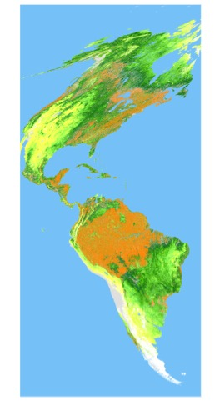
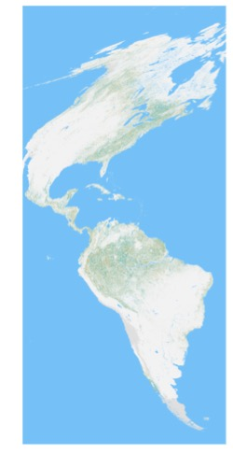
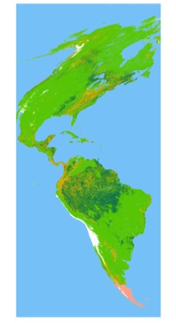
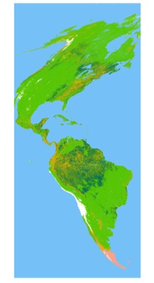
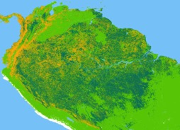

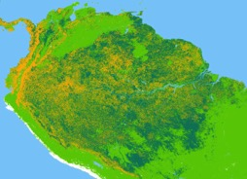
MODISLAI & FPAR – 2016 UPDATE
Global scale LAI/FPAR comparison between optimized VIIRS & MODIS C6
  Overall, comparable spatial distribution of LAI/FPAR & spatial coverage
  Larger discrepancies are mostly induced by algorithm path mismatch (i.e., Main vs. Backup)
  Relatively higher uncertainty in dense forest can be another causal factor (i.e., saturation)
MODIS Aqua C6
VIIRS Prototype
Difference
(VIIRS-MODIS)
MODIS Aqua C6
VIIRS Prototype
3.0<
2.5
2.0
1.5
1.0
0.5
-0.5
-1.0
-1.5
-2.0
-2.5
-3.0>
Algorithm Quality Control (QC)
Water
Non-Veg
Main
Main-S
Leaf Area Index (LAI)
No-Data
BackUp-G
BackUp-O
Not-Retrieved
11
Water
0.0
0.1
0.3
0.5
0.8
1.2
1.6
2.1
2.8
3.4
4.4
5.4
7.0
11
Non-Veg

Slide 12
MODISLAI & FPAR – 2016 UPDATE
More details in a poster @ this meeting
LUT submission end of summer 2016
ATBD and papers aim for submission end 2016
Lead work by Taejin Park (NASA Grad Fellow)

Slide 13
SUMMARY
MODIS: Exciting times
VIIRS: Two issues (a) HDF5 and (b) At least one more science test needed
THANK YOU!

