Slide 1
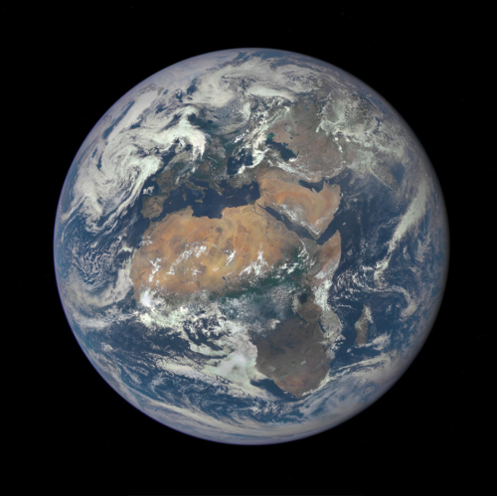

Eyes in the Sky: An Aqua-based Characterization of the Saharan Air Layer
Stephen D. Nicholls (JCET/GSFC)
Karen I. Mohr (GSFC)
MODIS/VIIRS Science Team meeting
7 June 2016

Slide 2
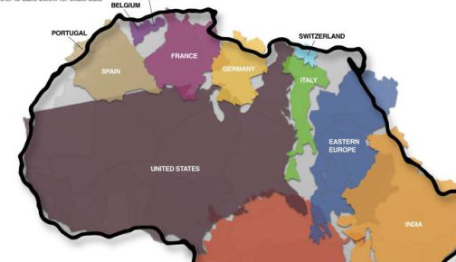
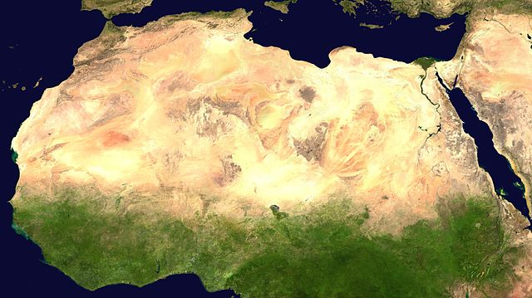
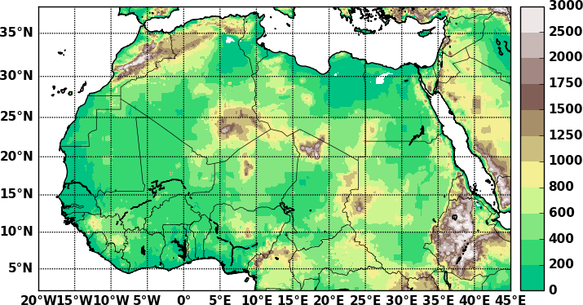
North Africa’s Complex Climate SYSTEM (1)
Vast piece of real estate
  Spans Equator to 39N, 20W to 50E
Diverse ecosystem
  Rainforests to savannas to Desert
  Sahara 9.4 million km² ~ US
Diverse topography (Sea-level to 3000m+)
Source: dailymail.co.uk
Messager et al. 2009

Slide 3
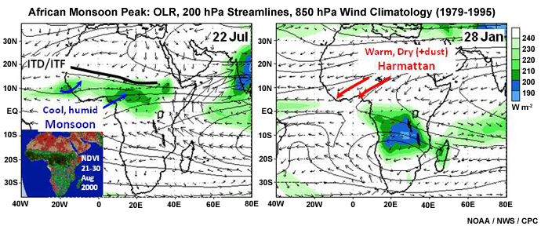
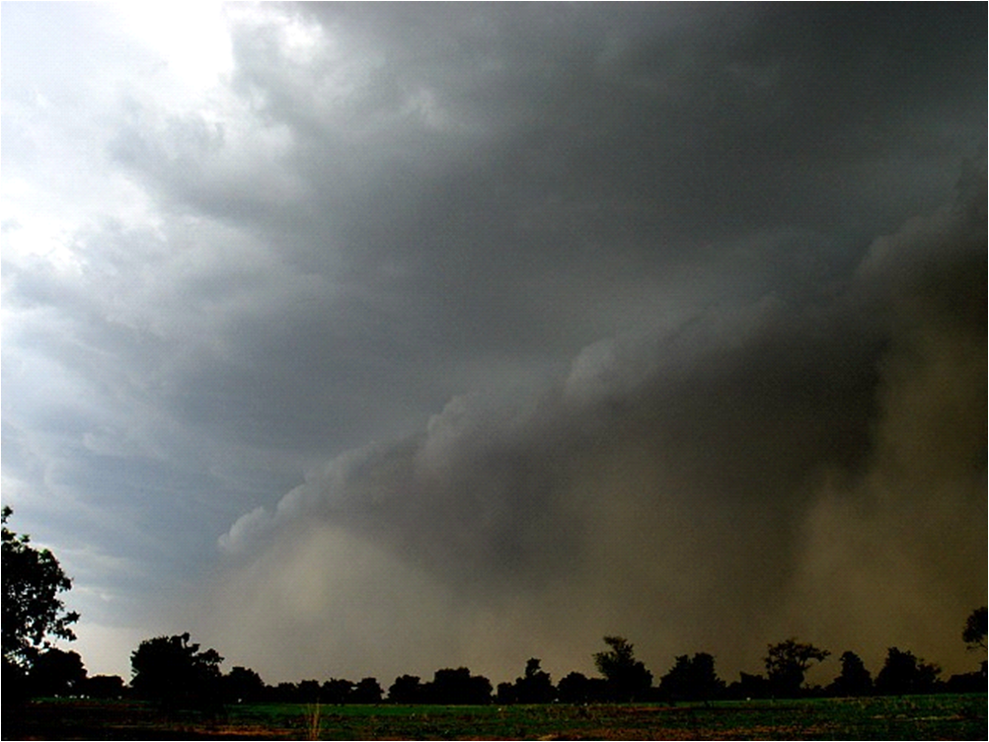
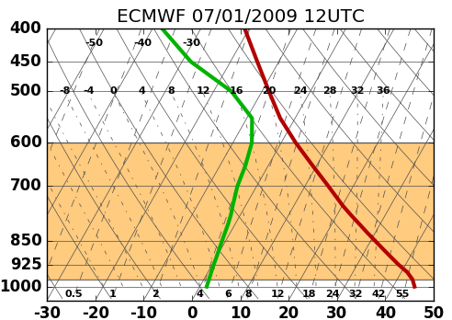
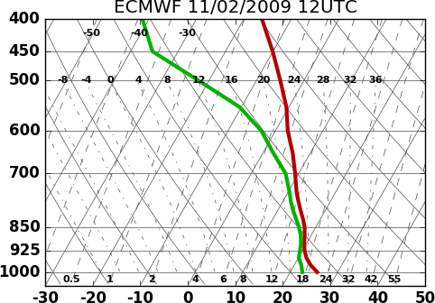
North Africa’s Complex Climate SYSTEM (2)
West African Monsoon
Monsoon (ITCZ)
Mid-latitude Systems
Strong Thermal Contrasts (AEJ)
Aerosol-cloud interaction
Thunderstorm in Burkina Faso
Sahara
Guinea Coast

Slide 4
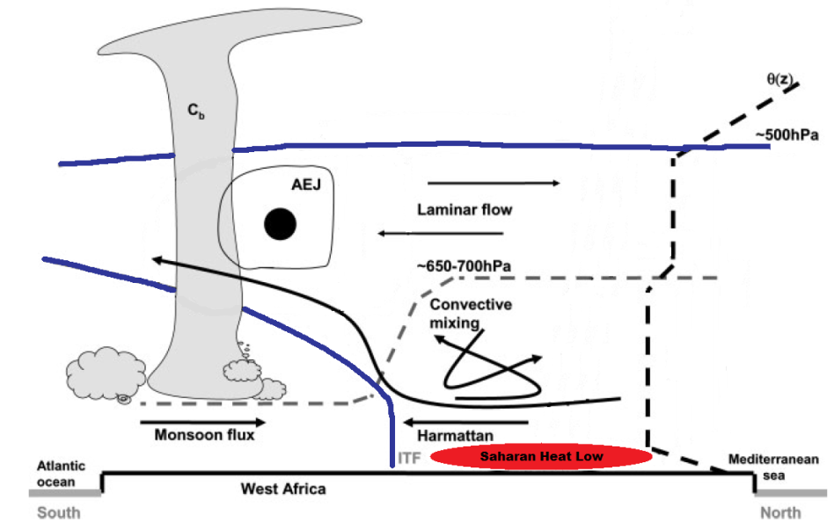
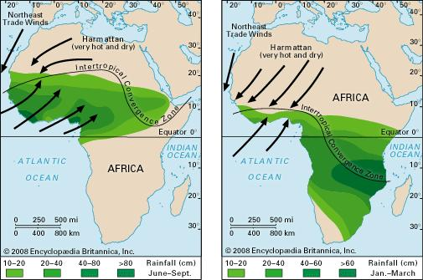
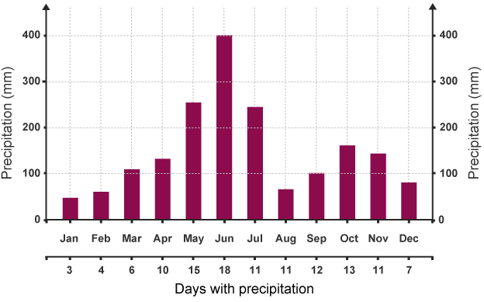
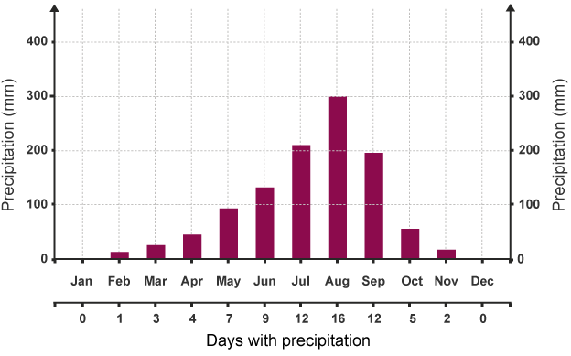
North Africa’s Complex Climate SYSTEM (3)
Annual precipitation pattern characteristics
Saharan heat low
Saharan Air Layer (SAL) - next
Abidjan, Ghana
Bamako, Mali

Slide 5
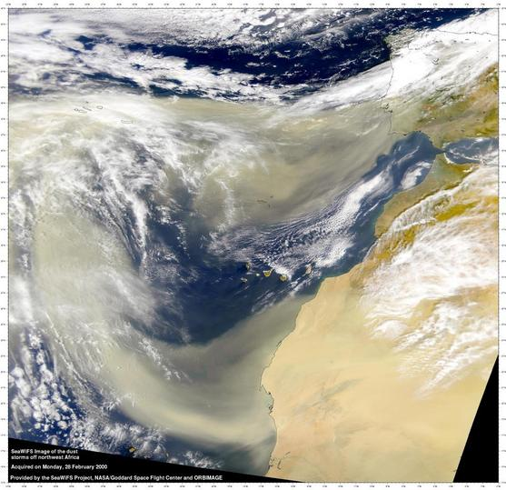
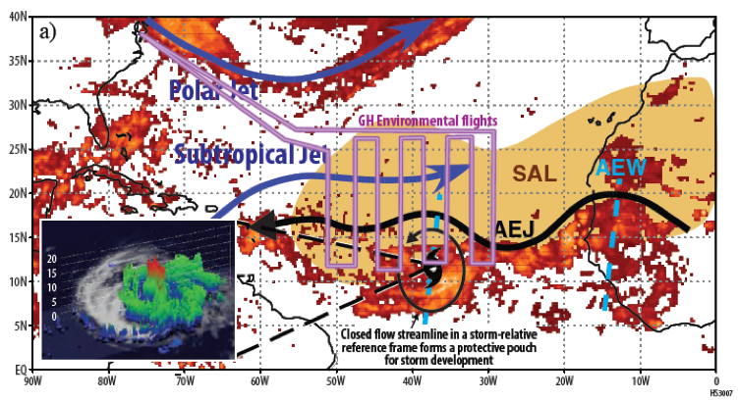
Saharan Air Layer (SAL)
  Well-mixed layer of warm, dry, and dusty air of nearly constant mixing ratio generated by the intense surface heating and strong, dry convection in the Sahara Desert
    M’bourou et al. 1997; Karyampudi et al. 1999
  Influence far and wide-ranging (Spanning Africa to Americas)
  Dust impact: Direct (solar rad), indirect (CCN)
Image from SeaWIFS, NASA GSFC
Image from NASA HS3 Website

Slide 6
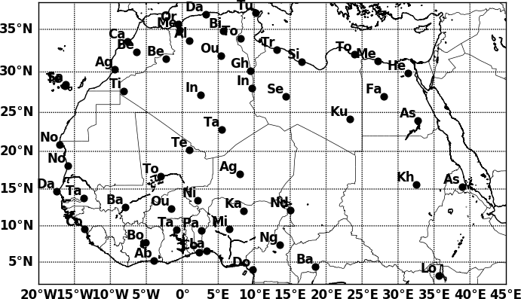
So What am I researching?
Hypothesis: NASA’s Atmosphere Infrared Sounder (AIRS) can detect well-mixed layers (WML’s) and SAL’s
Gain: Detection of SAL’s from space with regional coverage, consistent dataset quality
13 year period (2003-2015), 55 Stations
Data: L2 AIRS V6, L2 AIRS/AMSU V6, ECMWF-Interim, Rawinsondes
Rawinsonde Stations

Slide 7
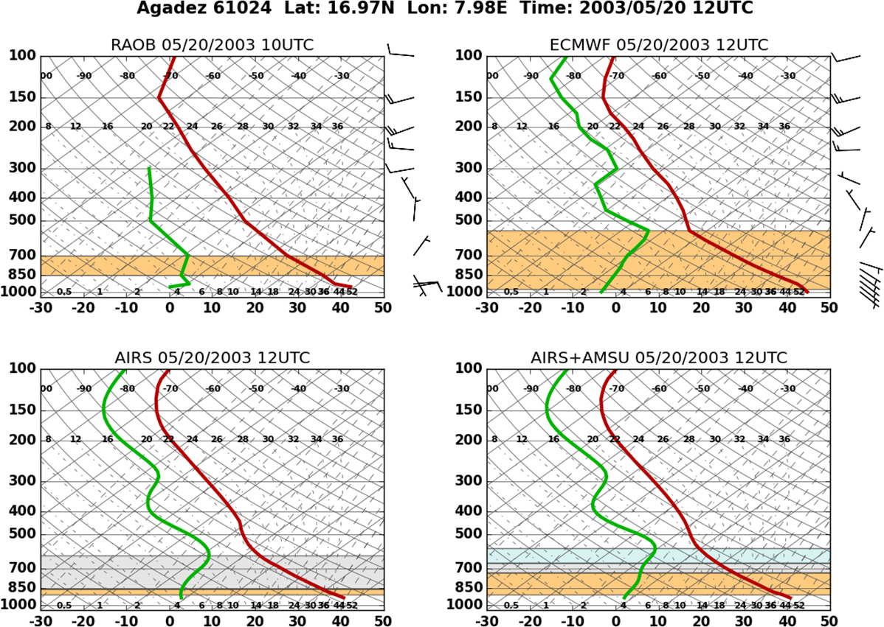
AIRS and well-mixed layer detection Algorithm(1)
Pressure: ≥ 500 hPa & Mixing ratio: ≤ 7 g kg⁻¹
Log decrease in allowable constant mixing ratio deviation with height: (starting: 0.95 g kg⁻¹ km⁻¹)
Two calculations (temps and mixing ratio):
  Bottom of layer (n_{o}) to current level (n)
  Level below (n-1) to current level (n)
If 1 and 2: same layer; if 2 only: new layer; otherwise: no layer

Slide 8
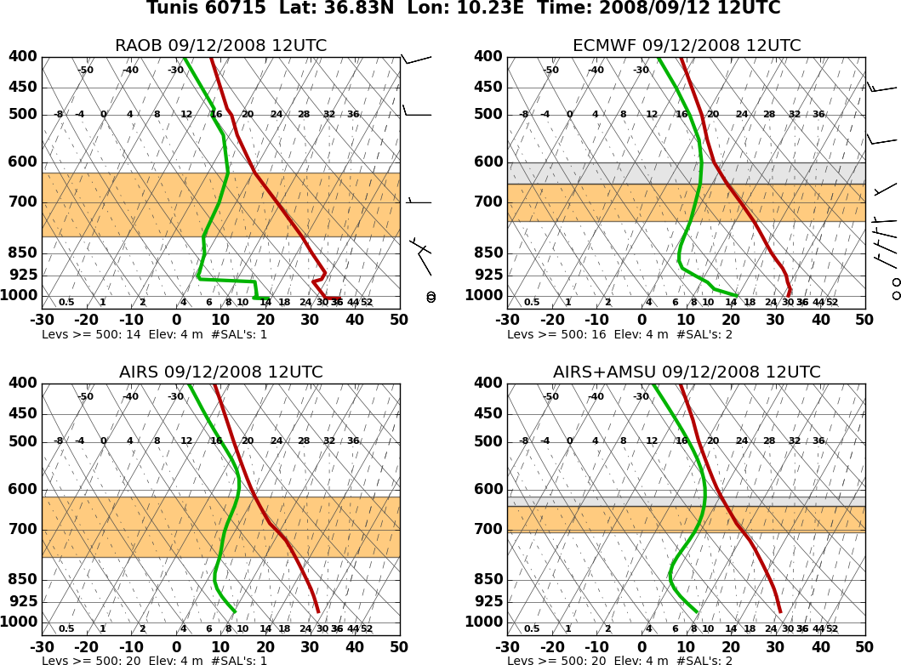
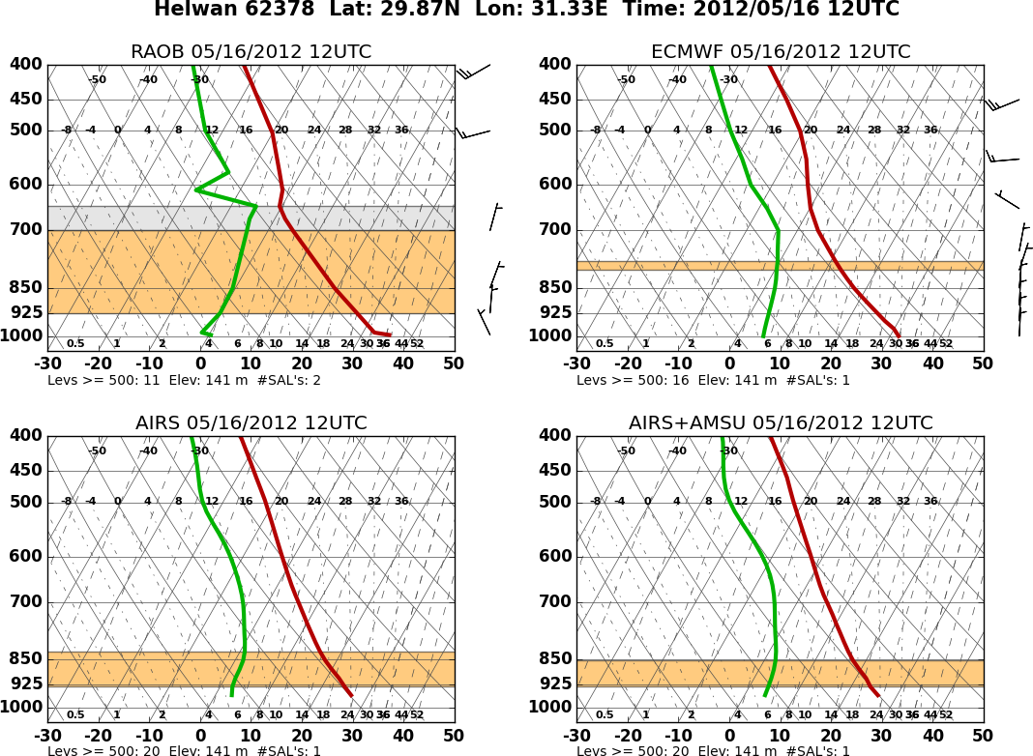
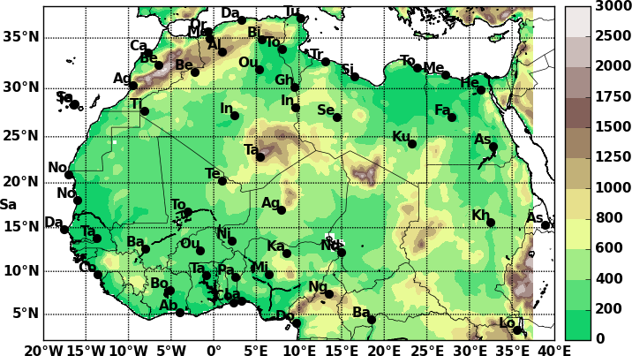
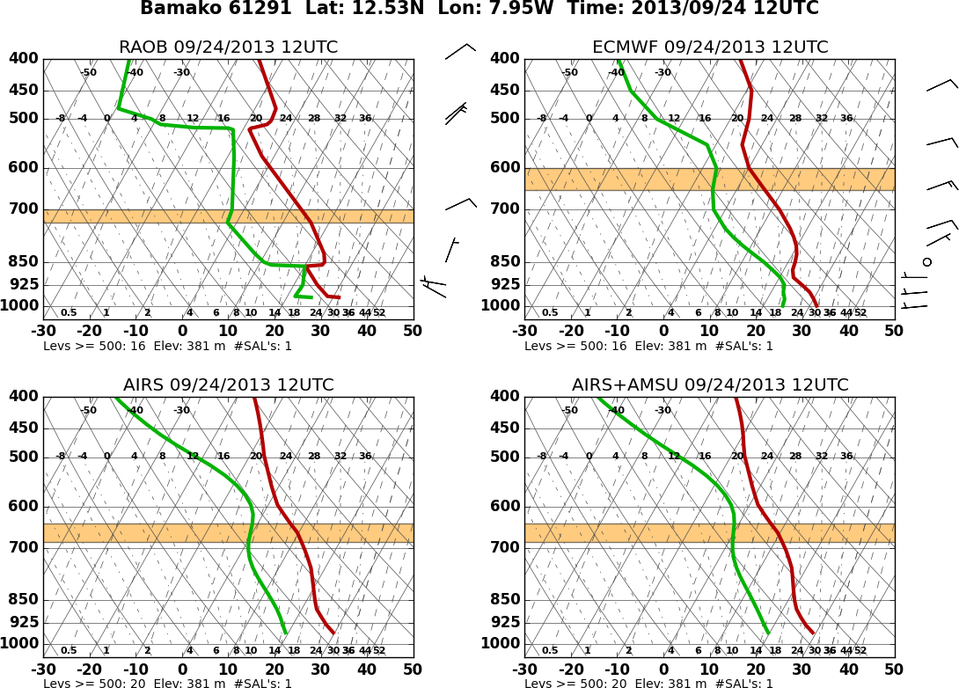
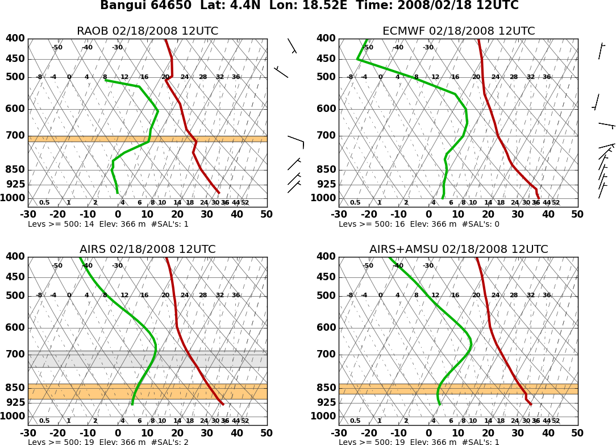
AIRS and well-mixed layer detection (2)
WML detection, not just Sahara
Unable to resolve truly “thin” WML (vertical resolution)
AIRS can sometimes best ECMWF
WML detection frequency higher in winter months

Slide 9
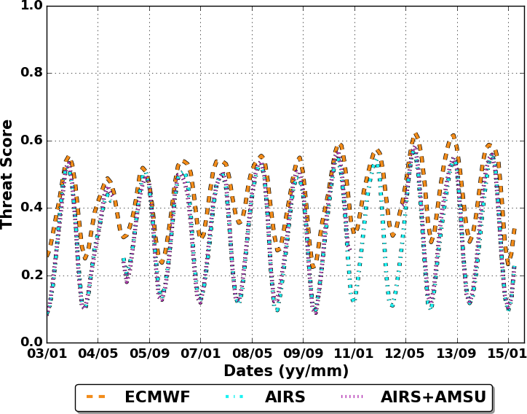
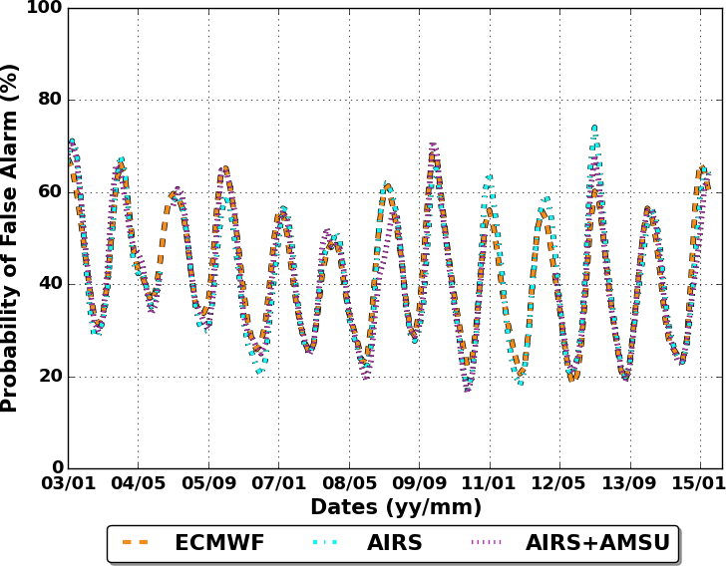
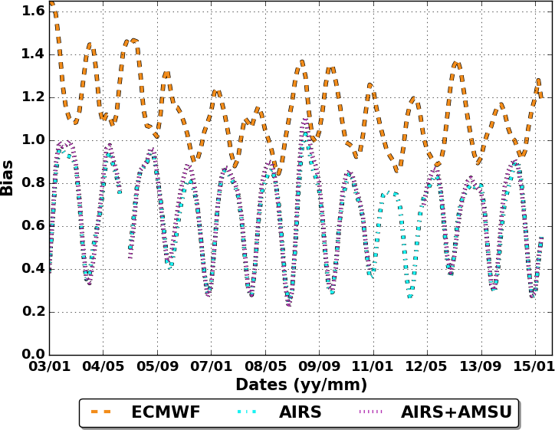
Well-mixed layer analysis (1): Detection
Statistics over all 55 Stations (2003-2015)
Strong seasonality (higher winter)
Threat Score (TS): 0.35 AIRS, 0.42 ECMWF. Highest Sahara, lowest coastal
FAR consistent between all data
ECMWF over-biased (Mean 1.1)
AIRS and AIRS+AMSU under-biased (0.6)
Saharan detection rates: AIRS (60%), ECMWF (80%)
Coastal detection rates: AIRS (20%), ECMWF (25%)
Threat Score
False Alarm Rate
Bias
TS
FAR
Bias

Slide 10
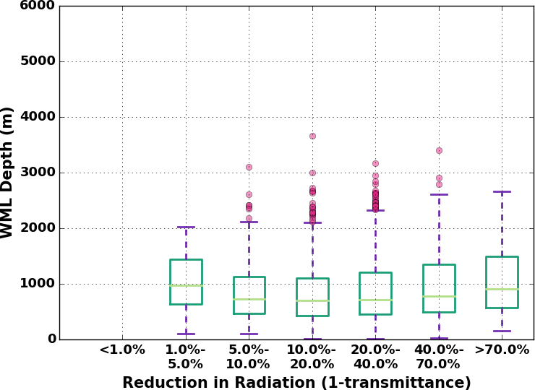
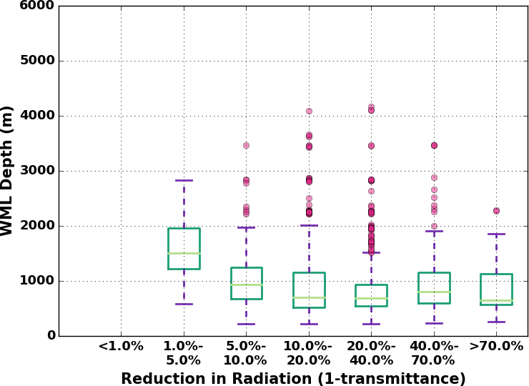
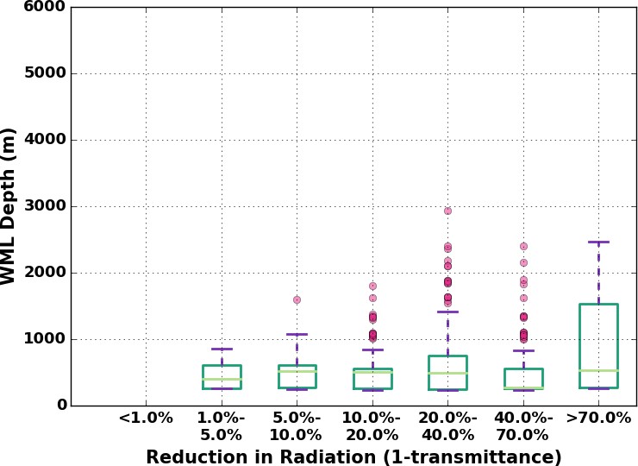
Well-mixed layer analysis (2): Thickness
WML Thickness (2003-2015)
Aqua AOD-based bins
WML thickness: < 50 m to > 3000 m
Thickness-Dust: limited dependence
ECMWF: Capture depth variance, under-biased
AIRS: More limited skill with depth variance, under-biased
Detection threshold: 300 m
Radiosondes
ECMWF
AIRS+AMSU
RAOB
ECMWF
AIRS+AMSU

Slide 11
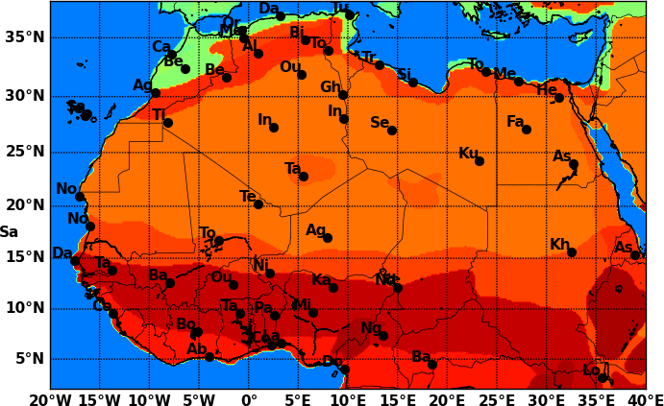
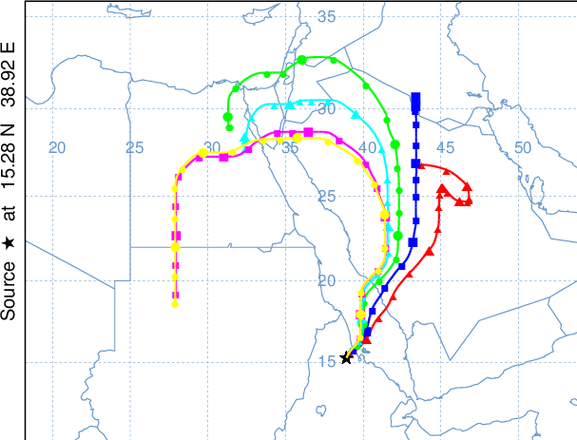
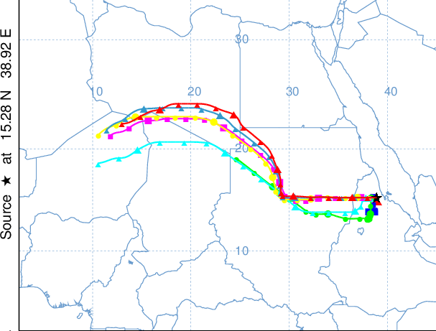
HYSPLIT
Hybrid Single Particle Lagrangian Integrated Trajectory Model (HYSPLIT)
  NOAA Air Resources Laboratory (ARL)
ECMWF Interim Analysis, 5-day backwards trajectories
Track parcels every 200 m in WML
SAL Classification Rules
1) Trajectory is Saharan:
  - 2 consecutive days in Sahara
  - 24 hours in Sahara within 72 hours of detection
2) WML is SAL: >50% of all trajectories are Saharan
Examples (see below)
Non-Saharan
Saharan

Slide 12
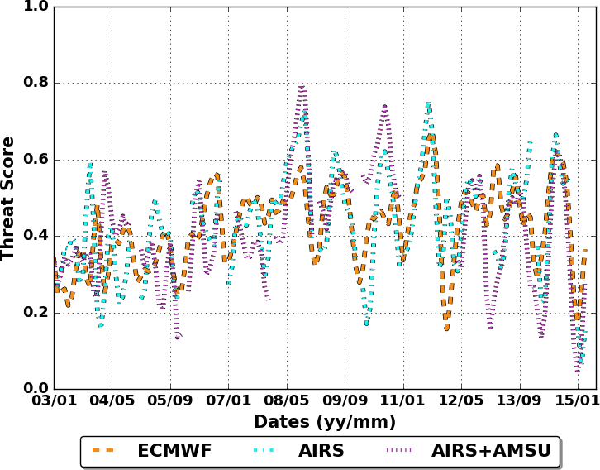
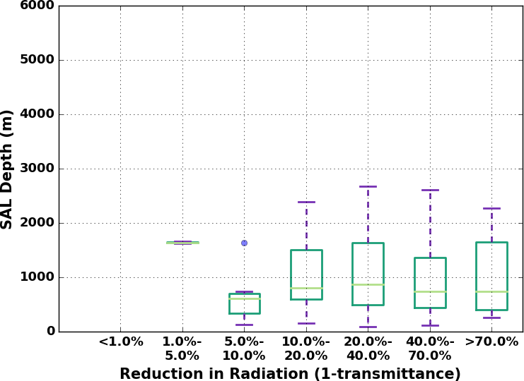
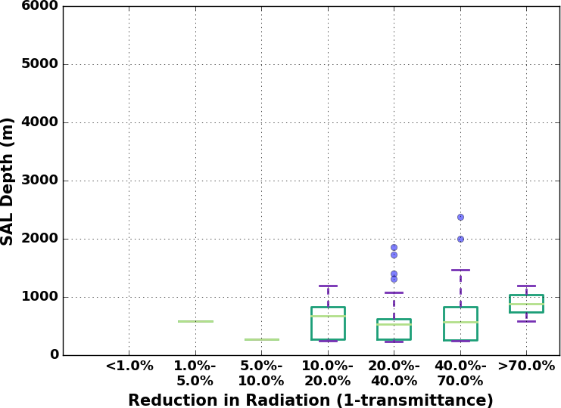
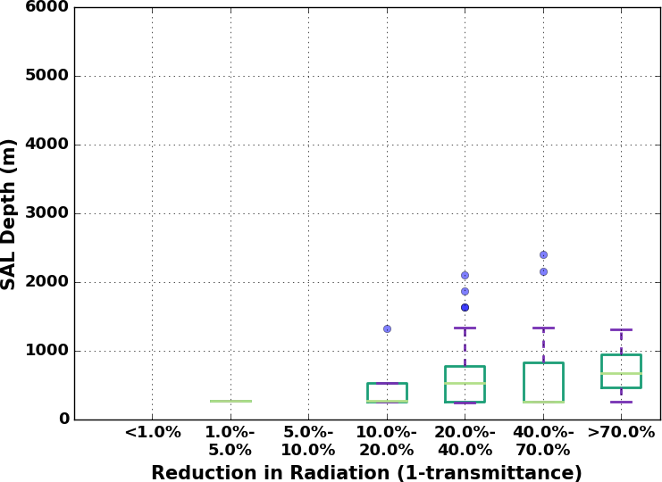
Saharan Air Layer analysis (1): Non-Saharan
Threat Score
Threat score (see right): Avg 0.4;
  General: AIRS > ECMWF, seasonal signal (dust extent)
SAL thicknesses (bottom)
  300 m detection threshold
  Limited dependence to dust (Aqua Deep Blue)
  ECMWF & AIRS: Similar thickness variance and IQR ranges
Radiosondes
ECMWF
AIRS+AMSU

Slide 13
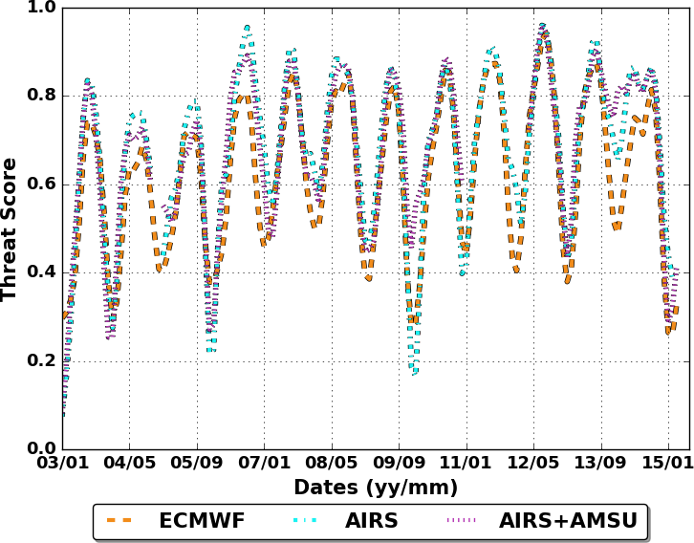
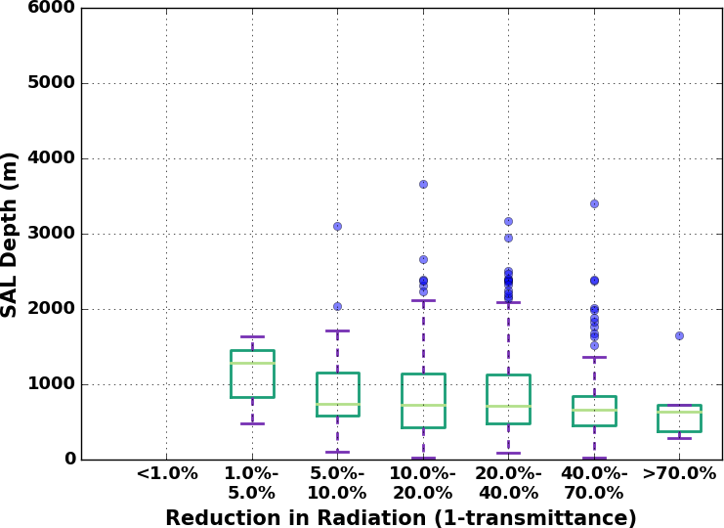
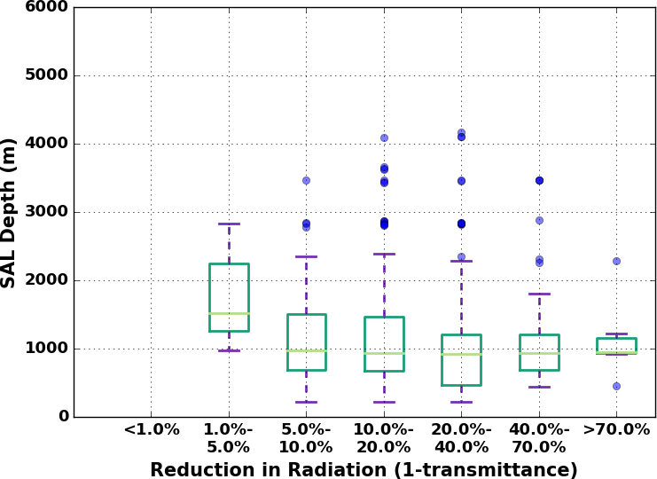
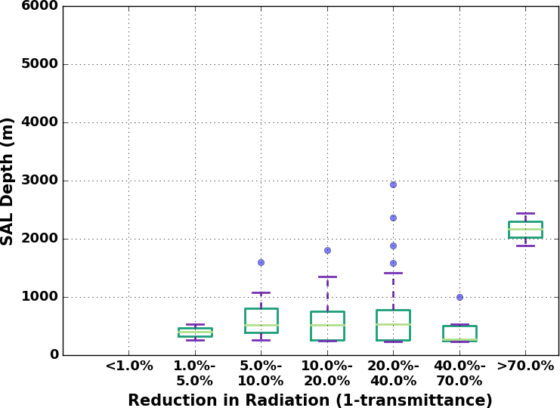
Saharan Air Layer analysis (2): Saharan
Threat score (see right): Avg 0.62;
  General: AIRS > ECMWF, stronger seasonal signal
SAL thicknesses (bottom)
  Same 300 m detection threshold as non-Saharan locations
  Limited dependence to dust (Aqua Deep Blue)
  ECMWF: Better captures variance & IQR ranges than AIRS
    Likely related to other data assimilated by ECMWF
    Hypothesis: Away from stations AIRS likely better (data consistency)
Threat Score
Radiosondes
ECMWF
AIRS+AMSU
TS
FAR
Bias

Slide 14
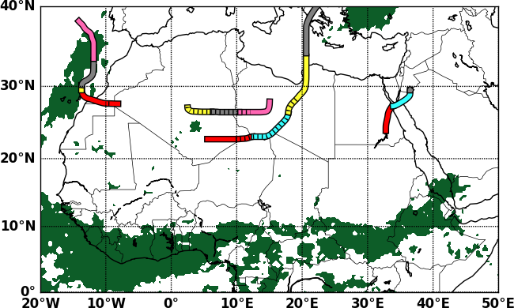
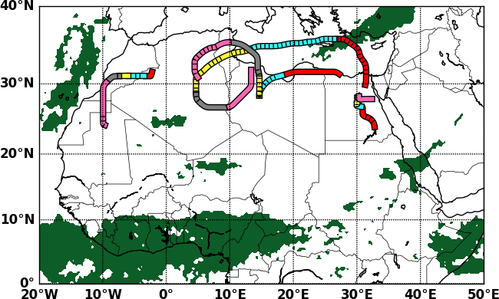
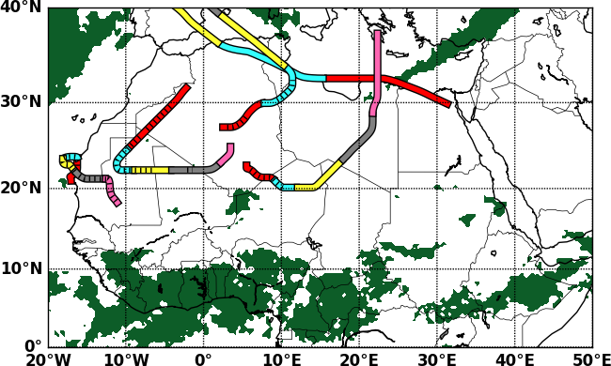
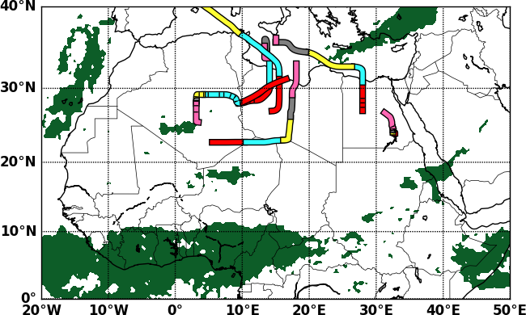
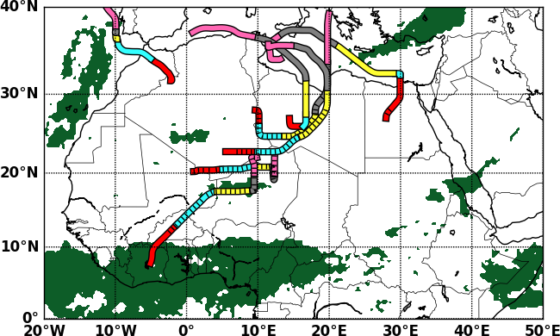
SAL Trajectories vs Aqua AOD vs TRMM 3B42 Precipitation
RAOB 11 July 2014
RAOB 12 July 2014
RAOB 13 July 2014
ECMWF 12 July 2014
AIRS+AMSU 12 July 2014
What is shown:
  Trajectories (24 hrs interval; colors, red most recent)
  TRMM 24-hr precipitation accumulation (green)
  Aerosol optical depth > 0.4 (hashed)
Differences between data sources
  Detected SAL or SAL heights
Trajectory origin points largely uncorrelated with precipitation

Slide 15
Summary
Evaluated AIRS SAL detection potential given porous radiosonde network
  55 Stations, 13 years of data (2003-2015)
  Detection of WML (constant Pot. T and mixing ratio), SAL (HYSPLIT)
WML: All data under-biased, ECMWF performance slightly better (T.S., range of thicknesses)
SAL detection at each station, 300 m detection threshold
  Threat score: AIRS slightly higher (0.6 vs 0.58) than ECMWF
  SAL Thickness: Detection rate over-bias, ECMWF better thickness
SAL trajectory origin points not well-correlated with precip.
AIRS results comparable or better than ECMWF at stations
  AIRS likely better outside radius of radiosonde influence

Slide 16
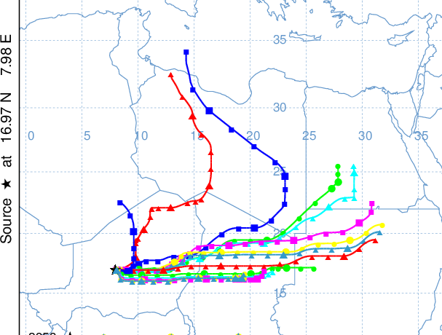
Thanks for your time and attention!!!
Image from SeaWIFS, NASA GSFC

Slide 18
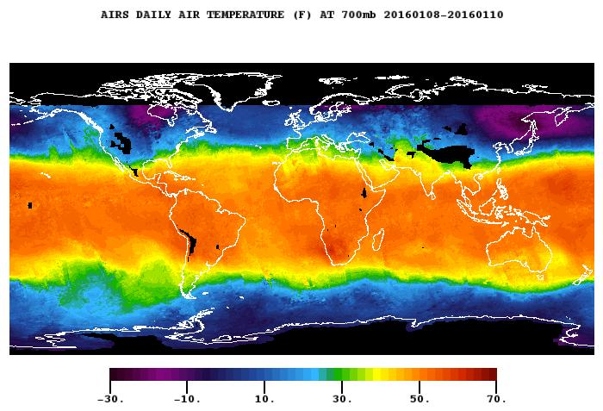
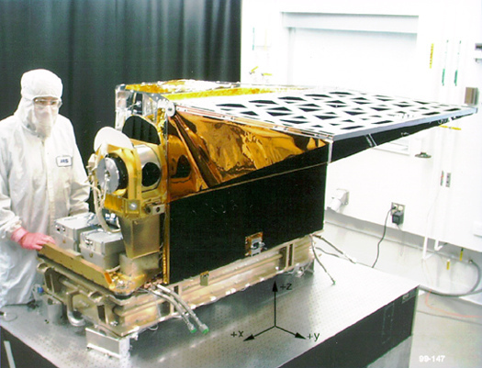
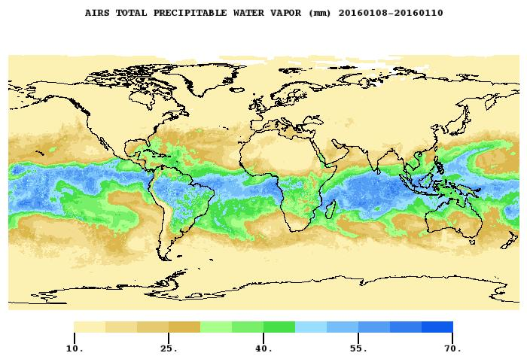
Atmospheric Infrared sounder (AIRS) Ver. 6
Passive infrared sounder
Resolution: 13.5 km at nadir, 41 km x 21.4 km at scan extremes
Operates in up to 90% cloudiness
Enhanced with Atmospheric Microwave Sounding Unit (AMSU data)
Global temperature and moisture data
Focus: 100-level support product (25 levels ≥ 500 hPa)
700-hPa Temperature (°C)
Total Precipitable Water (mm)
AIRS under construction
Images from AIRS JPL Webpage (http://airs.jpl.nasa.gov/)

Slide 19
Saharan Air Layer (SAL) [2]
Dust sources
  Dry convection (Saharan thermals)
  Gravity currents (i.e., storm outflow) -- (Flamant et al. 2007)
  African easterly wave forcing (Karyampudi
  et al. 1999)
  Mid-latitude, upper level troughs -- Jankowiak and Tanre, 1992)
Impacts to moist convection (Land and ocean)
  Direct: Scatter solar radiation
    Weaken: cools surface
  Indirect: Act as cloud condensation nuclei
    Strengthen: Decrease condensate loads aloft
Image from SeaWIFS, NASA GSFC

