Slide 1
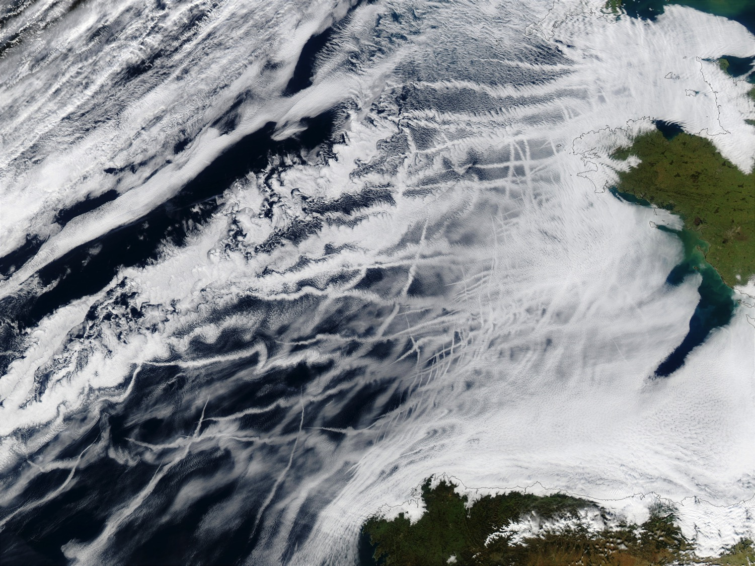
Radiative and Aerosol Indirect Effect Studies based on MODIS Cloud Regimes
Lazaros Oreopoulos (NASA-GSFC)
Nayeong Cho (USRA/NASA-GSFC)
Dongmin Lee (Morgan State/NASA-GSFC)
Acknowledgements: NASA’s “The Science of Aqua and Terra” program

Slide 2

Motivation
Need to understand effects of clouds on Earth’s Radiation Budget (ERB) – improve details of ERB-cloud coupling in GCMs
Need to understand effects of aerosols on clouds and precipitation and eventually on ERB (again with representation of processes in GCMs in mind)
  Problem poses obvious observational challenges
  How to separate aerosol from all other effects?
In both cases, breaking down the analysis by “regime” (groups of similar cloud conditions) may help
At scales O(100km)² likely to encounter cloud “mixtures” rather than isolated cloud “types”
  Regimes pose some constraint on environmental conditions (similar clouds ←→similar environment)
But how do we define regimes?
  Exploiting cloud appearance (from passive obs) is a good starting point
We adopt a “cloud regime” (CR) kind based on CTP-TAU joint histograms
  Our CRs are based on MODIS (you may also know ISCCP “Weather States”)

Slide 3

Datasets
12 years of Aqua-Terra L-3 daily (D3) 1° data
  Collection 6
Joint histograms of CTP-TAU
  MODIS CRs from k-means clustering
Other cloud variables: CF, CTP, TAU, REFF
Dark Target AOD (and MERRA-2 AOD, 3-hr, not shown)
CERES SYN1deg daily
TMPA-3B42 surface precipitation (3-hr, 0.25°)
  50°S-50°N
Collocated CloudSat-CALIPSO products

Slide 4
MODIS CRs

Slide 5
Global MODIS C6 CRs

Slide 6
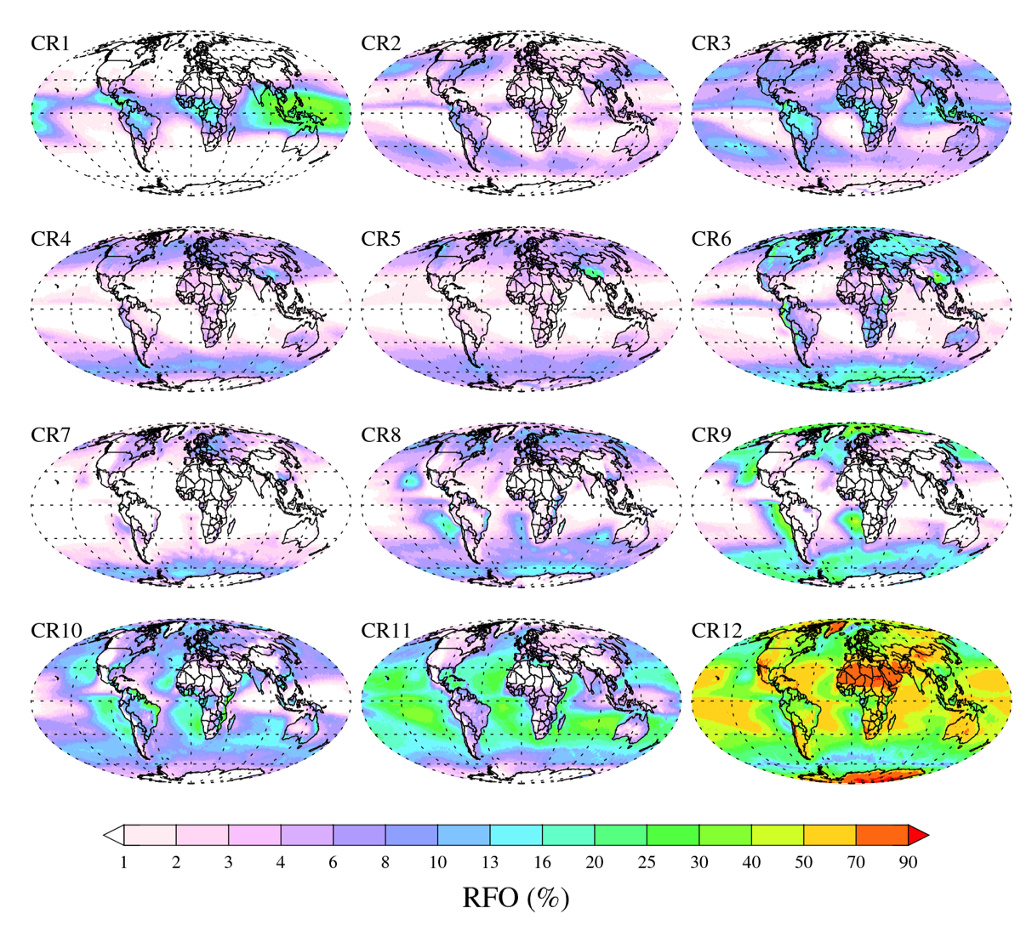
Where the CRs occur

Slide 7
(Aqua) CR cloud type breakdown per CloudSat

Slide 8
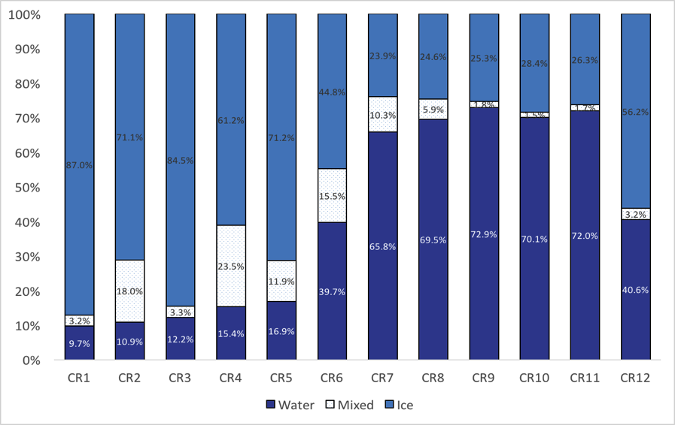
MODIS CF
CR thermodynamic phase
2B-CLDCLASS-LIDAR
* Cloud phase

Slide 9
Radiative Effects by CR
CRE = F_{all-sky}-F_{clr} = CF(F_{ovc}-F_{clr})
  F is net=down-up flux

Slide 10
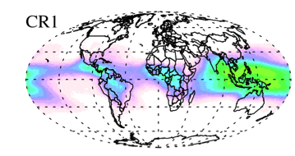
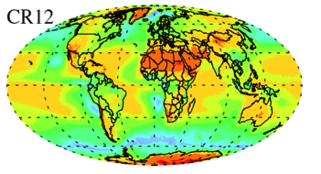
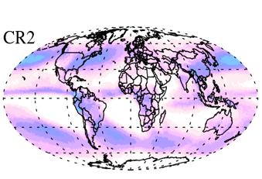
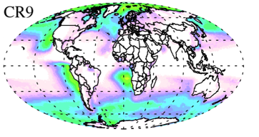
CRE from CERES SYN1deg-daily (CR_{Terra}=CR_{Aqua})

Slide 11
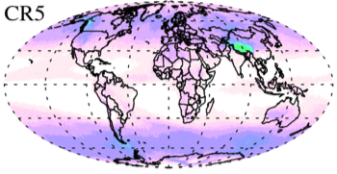
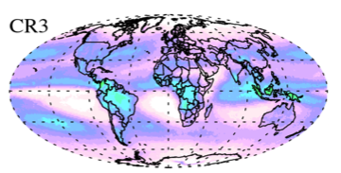
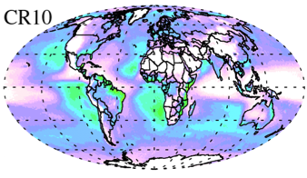
LW cooling or warming of atmospheric column
radiative coolers
radiative warmers

Slide 12

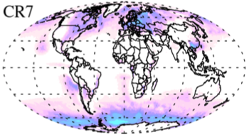
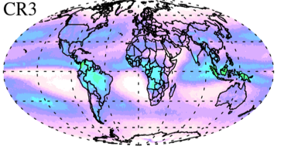
Vertical distribution of cooling and warming (LW and SW, Aqua CRs)
CloudSat-CALIPSO
(2B-FLXHR-LIDAR)

Slide 13
Summary and thoughts on CRE analysis
CRs help us understand the contributions of the various prevailing cloud systems to the Earth Radiation budget
Coherent picture between interpretation of the makeup (as viewed from passive or active) of the CRs and their radiative character
CRs good framework to:
  recognize cloud systems that provide radiative cooling or warming of the atmosphere
  resolve vertical distribution of cloud cooling/warming radiative contributions
  identify cloud systems contributing most to enhanced reflected solar and reduced emitted thermal infrared radiation to space
Oreopoulos et al. JGR 2016

Slide 14
Aerosol Indirect Effects by CR

Slide 15
Methodology
Daily MODIS aerosol AOD defined for each gridcell from Terra and Aqua (when needed use immediate neighbor gridcells)
Examine Precip, CF, CTP, TAU, REFF vs collocated aerosol
  Relative AOD value; position within distribution (percentile) for that location and season
Composite by CR (generally one Terra and one Aqua CR occurrence per day per gridcell)
  Pick the appropriate 3-hr TMPA value

Slide 16
What are we searching for?
Invigoration for (mostly) ice and mixed phase CRs
  Precipitation increase with AOD (what about scavenging?)
  CTP decrease with AOD
  TAU increase with AOD (?)
First indirect effect for (mostly) liquid CRs
  TAU increase with AOD
  REFF decrease with AOD
Second indirect effect for (mostly) liquid CRs
  Precipitation decrease with AOD
  CF increase with AOD

Slide 17

Are there land/ocean differences of precip vs aerosol?
TMPA (P > 0)
Ocean
Land

Slide 18
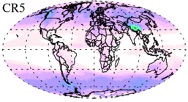
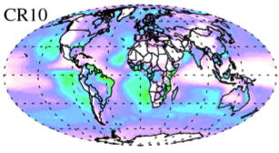
CF vs AOD percentile
Ocean
Land

Slide 19
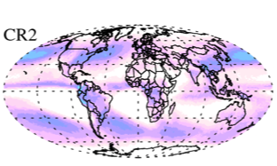
Cloud Top Pressure vs AOD percentile
Ocean
Land

Slide 20
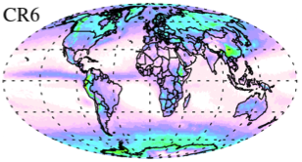
Cloud Optical Thickness vs AOD percentile
Ocean
Land

Slide 21
Cloud Effective Radius vs AOD percentile
Ocean
Land

Slide 22
Ice regime : CR1- CR3
Liquid regime : CR6 – CR11
Mix regime : CR4 – CR5
CR12
MODIS AOD distribution
MERRA AOD distribution
 | ICE |  | LIQ |  | MIX |  | CR12
 | Land | Ocean | Land | Ocean | Land | Ocean | Land | Ocean
P>0 | - |  | ⇑ | - | - | ⇓ | ⇑
CF | ⇑ |  | ⇑ |  | - |  | ⇑
CTH | ⇑ |  | ⇑ |  | ⇓ | ⇑ | ⇑
COT | ⇑ | - | ⇑ |  | ⇑ | ⇓ | ⇑
CER | ⇓ | - | ⇓ |  | - |  | -
P≥0 | - |  | - | ⇑ | - | ⇓ | ⇑
 | ICE |  | LIQ |  | MIX |  | CR12
 | Land | Ocean | Land | Ocean | Land | Ocean | Land | Ocean
P>0 | - | ⇓ | ⇑ | ⇑ | - | ⇓ | ⇑
CF | - |  | ⇑ |  | - |  | ⇑
CTH | ⇓ |  | ⇑ |  | ⇓ |  | ⇑
COT | - |  | ⇑ |  | ⇑ |  | ⇑
CER | ⇓ |  | ⇓ |  | - |  | -
P≥0 | ⇓ |  | ⇑ |  | - |  | ⇑
red arrow: consistent with invigoration; blue arrow: consistent with 1st and 2nd indirect effect

Slide 23
Summary and thoughts about IAE analysis
A regime-based approach is suitable for studying aerosol-cloud-precipitation interactions
Precipitation and cloud property variability with AOD seems very systematic (”good looking” curves)
  No clear sign of invigoration (scavenging interferes?)
  Aerosol indirect effects (increased CF, REFF) in liquid CRs
  Cloud tops always rise with aerosol over ocean
  TAU always increases with aerosol over land
  Land-ocean contrasts are substantial
  Low CF CR exhibits consistent behavior worth exploring further
Results should be interpreted with sampling and retrieval quality issues in mind. Is re-analysis AOD more appropriate?
Other co-variations (non-aerosol), e.g., meteorology cannot be excluded (working on that right now!).

Slide 24
Additional Slides

Slide 25
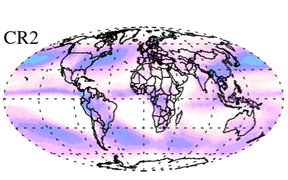
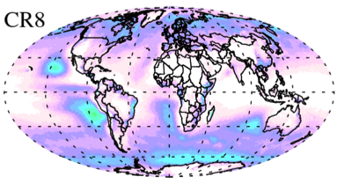
CRs and large-scale vertical motion

Slide 27
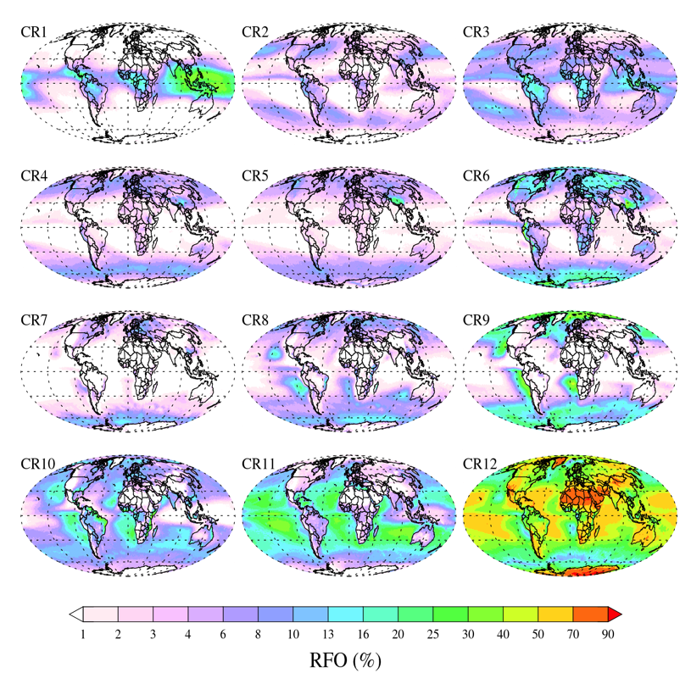
The full picture

Slide 28
AOD Determination
1)
AOD = (Aqua AOD + Terra AOD) / 2.
2)
AOD = Aqua AOD OR AOD = Terra AOD
3)
AOD = (Aqua_AOD_1+Aqua_AOD_2+Terra_AOD_1) / 3.
 | Aqua CRX
 | Terra CRY
 | Aqua AOD
 | Terra AOD
 | Aqua CRX
 | Terra CRY
 | Aqua AOD
 | Nan
 | Aqua CRX
 | Terra CRY
 | Nan
 | Terra AOD
 | Aqua CRX
 | Terra CRY
 | AquaAOD_1
 | Nan
Aqua AOD_2
Terra AOD_1 | Nan

Slide 29
Analysis permutations
Aerosol “low” vs high”: absolute/relative
Aerosol from MODIS C6 or MERRA-2
For precip: Ignore or not non-precipitating gridcells
Global vs land/ocean breakdown
For cloud properties: Separate by phase
I won’t show all results!

Slide 30

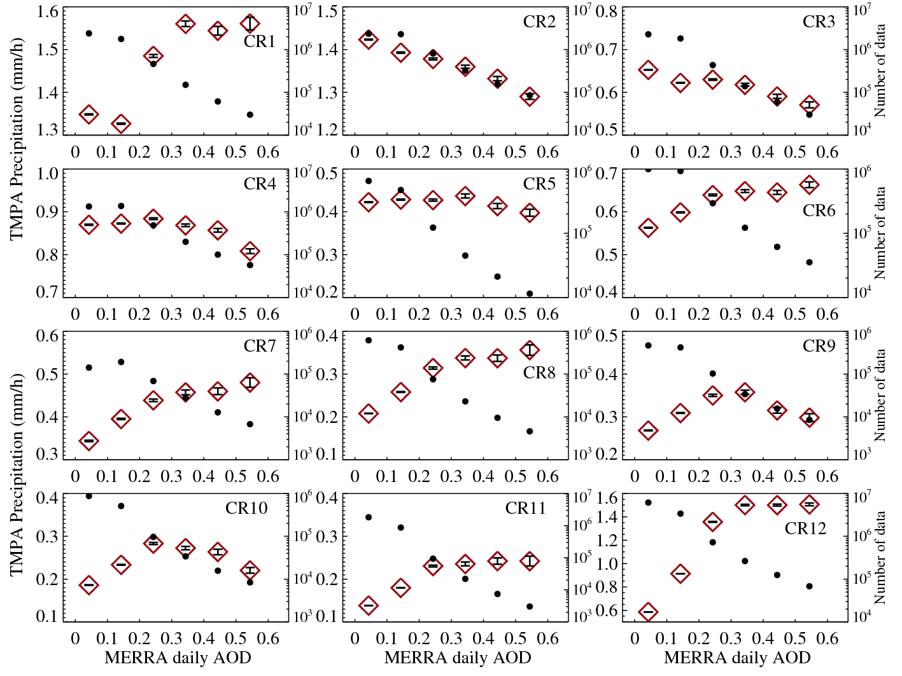
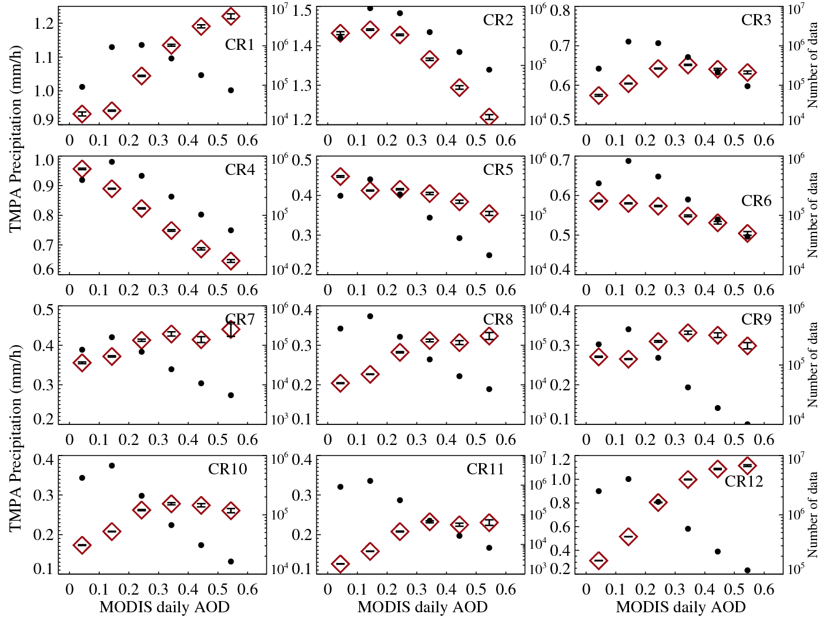
Does the AOD dataset matter?
TMPA (P > 0)
AOD data from Merra-2
AOD data from MODIS

Slide 31
Does the AOD dataset matter?
AOD data from Merra-2
TMPA (P > 0)
AOD data from MODIS

Slide 32
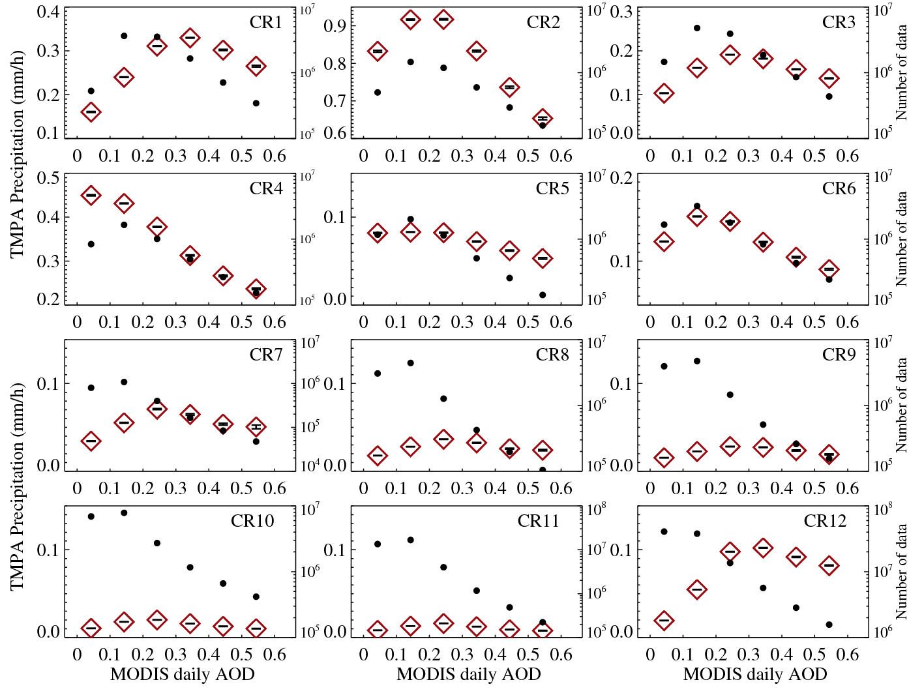
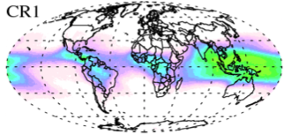
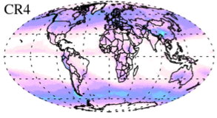
Does inclusion of non-precipitating matter?
TMPA (P ≥ 0)
AOD data from MODIS
TMPA (P > 0)

Slide 33
Does inclusion of non-precipitating matter?
TMPA (P ≥ 0)
AOD data from MODIS
TMPA (P > 0)

Slide 34
Ice regime : CR1- CR3
Liquid regime : CR6 – CR11
Mix regime : CR4 – CR5
CR12
MODIS AOD absolute values
MERRA AOD absolute values
 | ICE |  | LIQ |  | MIX |  | CR12
 | Land | Ocean | Land | Ocean | Land | Ocean | Land | Ocean
P>0 | - |  | ⇑ |  | ⇓ |  | ⇑
CF | ⇑ |  | ⇑ |  | - |  | -
CTH | ⇑ |  | ⇑ |  | ⇑ |  | ⇑ | -
COT | - |  | - |  | ⇓ |  | ⇑
CER | - |  | ⇓ |  | - |  | ⇓
P≥0 | ⇑ |  | ⇑ |  | ⇓ |  | ⇑
 | ICE |  | LIQ |  | MIX |  | CR12
 | Land | Ocean | Land | Ocean | Land | Ocean | Land | Ocean
P>0 | - |  | ⇑ |  | - |  | ⇑
CF | - |  | ⇑ |  | - |  | -
CTH | ⇓ |  | ⇑ |  | ⇓ | - | ⇑
COT | - |  | ⇑ |  | - |  | ⇑
CER | ⇓ |  | ⇓ |  | - |  | -
P≥0 | ⇓ |  | ⇑ |  | - |  | ⇑
red arrow: consistent with invigoration; blue arrow: consistent with 1st and 2nd indirect effect

Slide 35
Comparison of MERRA-2AOD to MODIS daily AOD over MODIS the spatial-temporal matching for 12-years.
MODIS daily AOD - MERRA2AOD aqua passing time
MODIS daily AOD - MERRA2 AOD terra passing time

Slide 36
Comparison of MERRA-2 daily AOD to MODIS daily AOD over MODIS the spatial-temporal matching for 12-years.
MODIS daily AOD - MERRA2 daily AOD
::: MERRA-2 daily AOD = (MERRA-2 MYD AOD + MERRA-2 MOD AOD ) / 2.

Slide 37
AOD data from Merra-2
TMPA (P ≥ 0)
TMPA (P > 0)

Slide 38
AOD data from Merra-2
TMPA (P ≥ 0)
TMPA (P > 0)

Slide 39
TMPA (P ≥ 0)
Ocean
Land
TMPA Precipitation (mm/h) as a function of AOD distribution(per grid per season). The horizontal dashed line is mean TMPA precipitation of each CR. The dots indicate mean AOD within their AOD distribution ranges.
Minimum and maximum values of Y-axis(for TMPA) are different to each CR, but their interval is same.

Slide 40
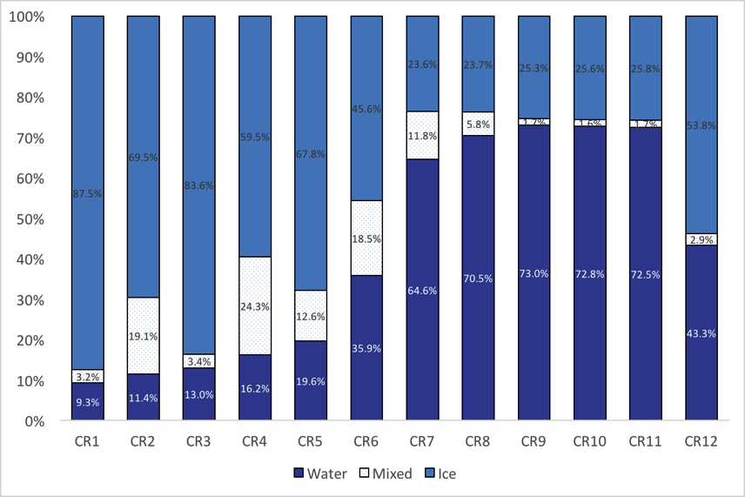
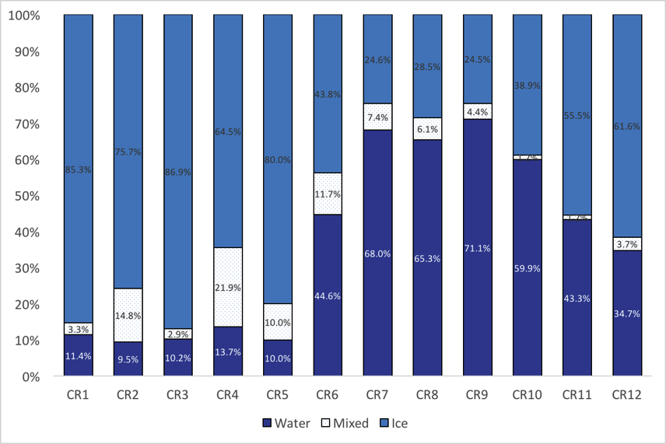
2B-CLDCLASS-LIDAR
* Cloud phase
Ocean
Land

Slide 41
Aerosol-Cloud(CR)-Precipitation
Ocean/ Land
As a function of MODIS aod relative distribution

Slide 42
TMPA (P > 0)
Ocean
Land
TMPA Precipitation (mm/h) as a function of AOD distribution(per grid per season). The horizontal dashed line is mean TMPA precipitation of each CR. The dots indicate mean AOD within their AOD distribution ranges.
Minimum and maximum values of Y-axis(for TMPA) are different to each CR, but their interval is same (max – min = 0.5) except CR12.

Slide 43
Cloud fraction
Ocean
Land
Cloud fraction as a function of AOD distribution(per grid per season). The horizontal dashed line is mean cloud fraction of each CR.
Minimum and maximum values of Y-axis are different to each CR.

Slide 44
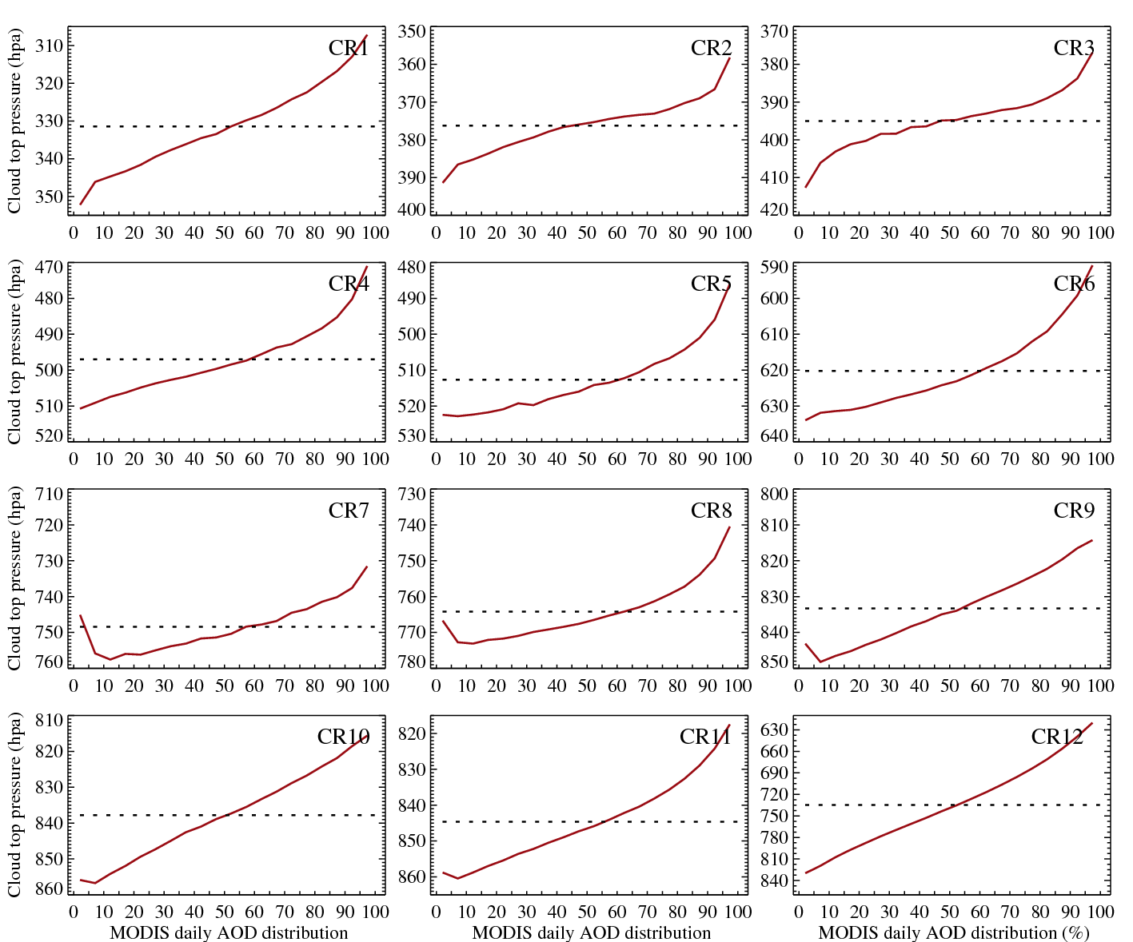
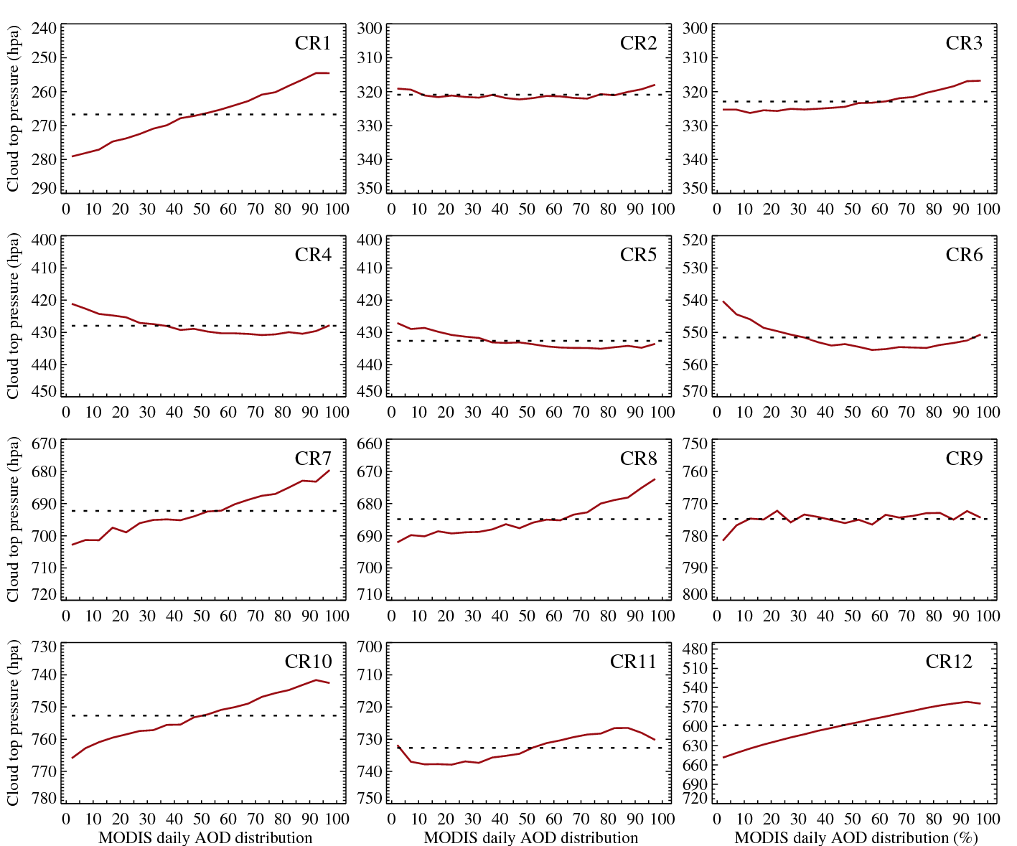
Cloud top pressure
Ocean
Land
Cloud top pressure as a function of AOD distribution(per grid per season). The horizontal dashed line is mean cloud top pressure of each CR. Minimum and maximum values of Y-axis are different to each CR, but their interval are same except CR12.

Slide 45
Cloud optical thickness
Ocean
Land
Cloud optical thickness as a function of AOD distribution(per grid per season). The horizontal dashed line is cloud optical thickness of each CR.
Minimum and maximum values of Y-axis are different to each CR.

Slide 46
Cloud effective radius (μm)
Ocean
Land
Cloud effective radius as a function of AOD distribution(per grid per season). The horizontal dashed line is cloud effective radius of each CR.

Slide 47
TMPA (P ≥ 0)
Ocean
Land
TMPA Precipitation (mm/h) as a function of AOD distribution(per grid per season). The horizontal dashed line is mean TMPA precipitation of each CR. The dots indicate mean AOD within their AOD distribution ranges.
Minimum and maximum values of Y-axis(for TMPA) are different to each CR, but their interval is same.

Slide 48
Aerosol-Cloud(CR)-Precipitation
Ocean/ Land
As a function of daily MODIS absolute values.

Slide 49
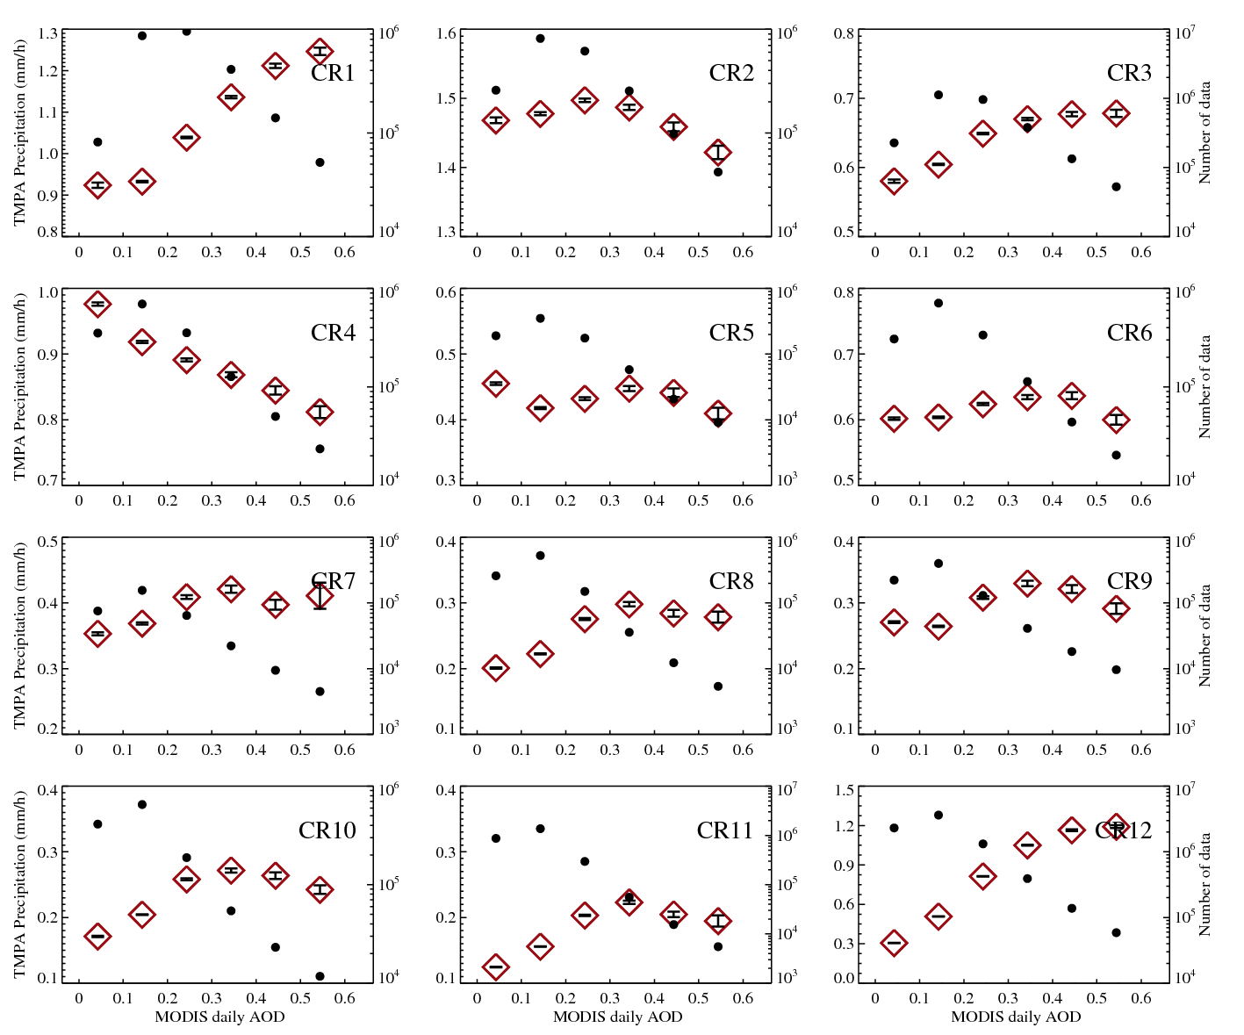
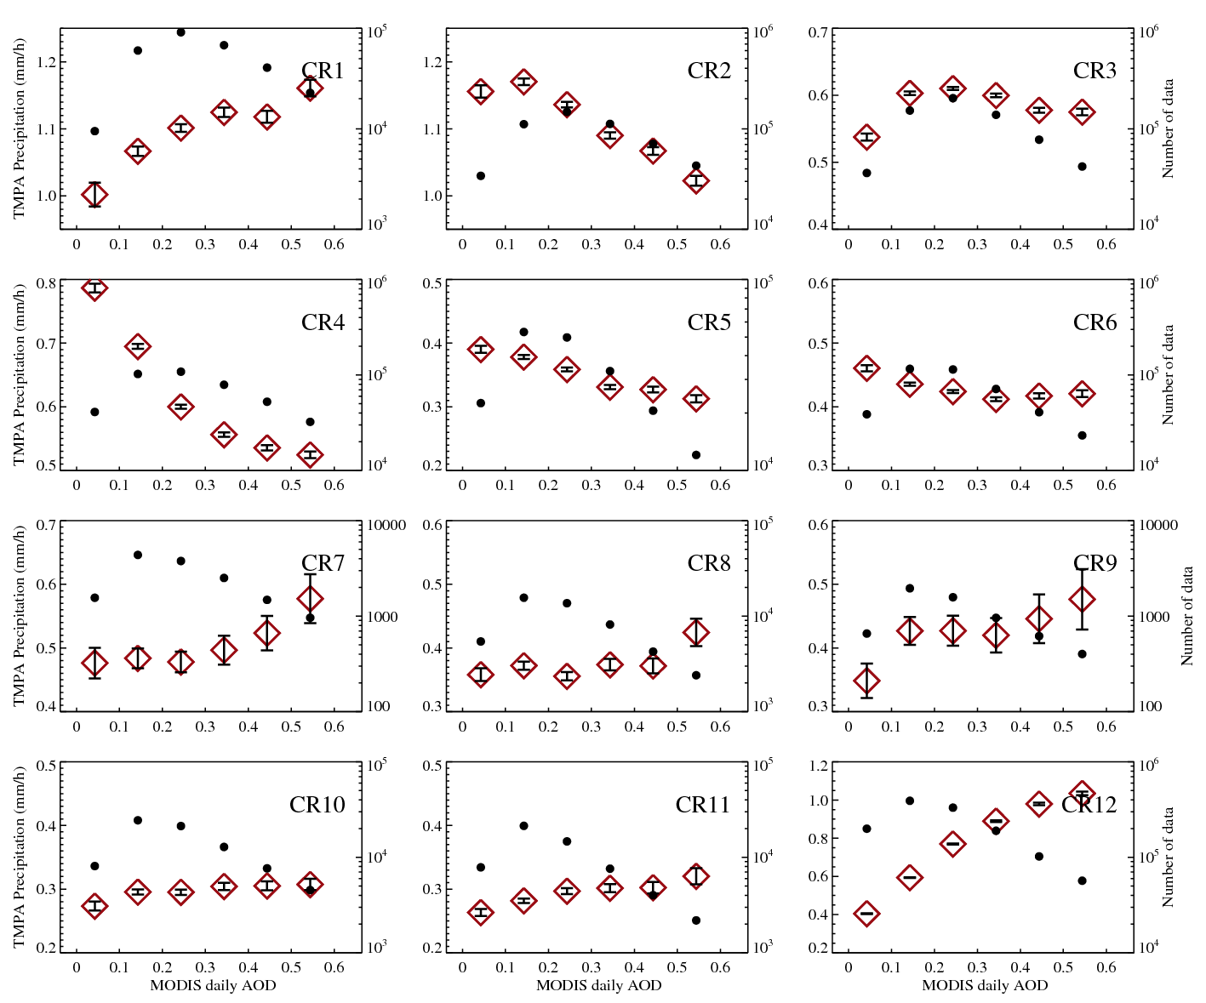
TMPA (P > 0)
Ocean
Land
TMPA Precipitation (mm/h) as a function of MODIS daily AOD. Black dots mean number of data. The error bars indicate the standard error (SE) given by the standard deviation of the data divided by the square root of number of data.

Slide 50
Cloud fraction
Ocean
Land
Cloud fraction as a function of daily MODIS AOD.

Slide 51
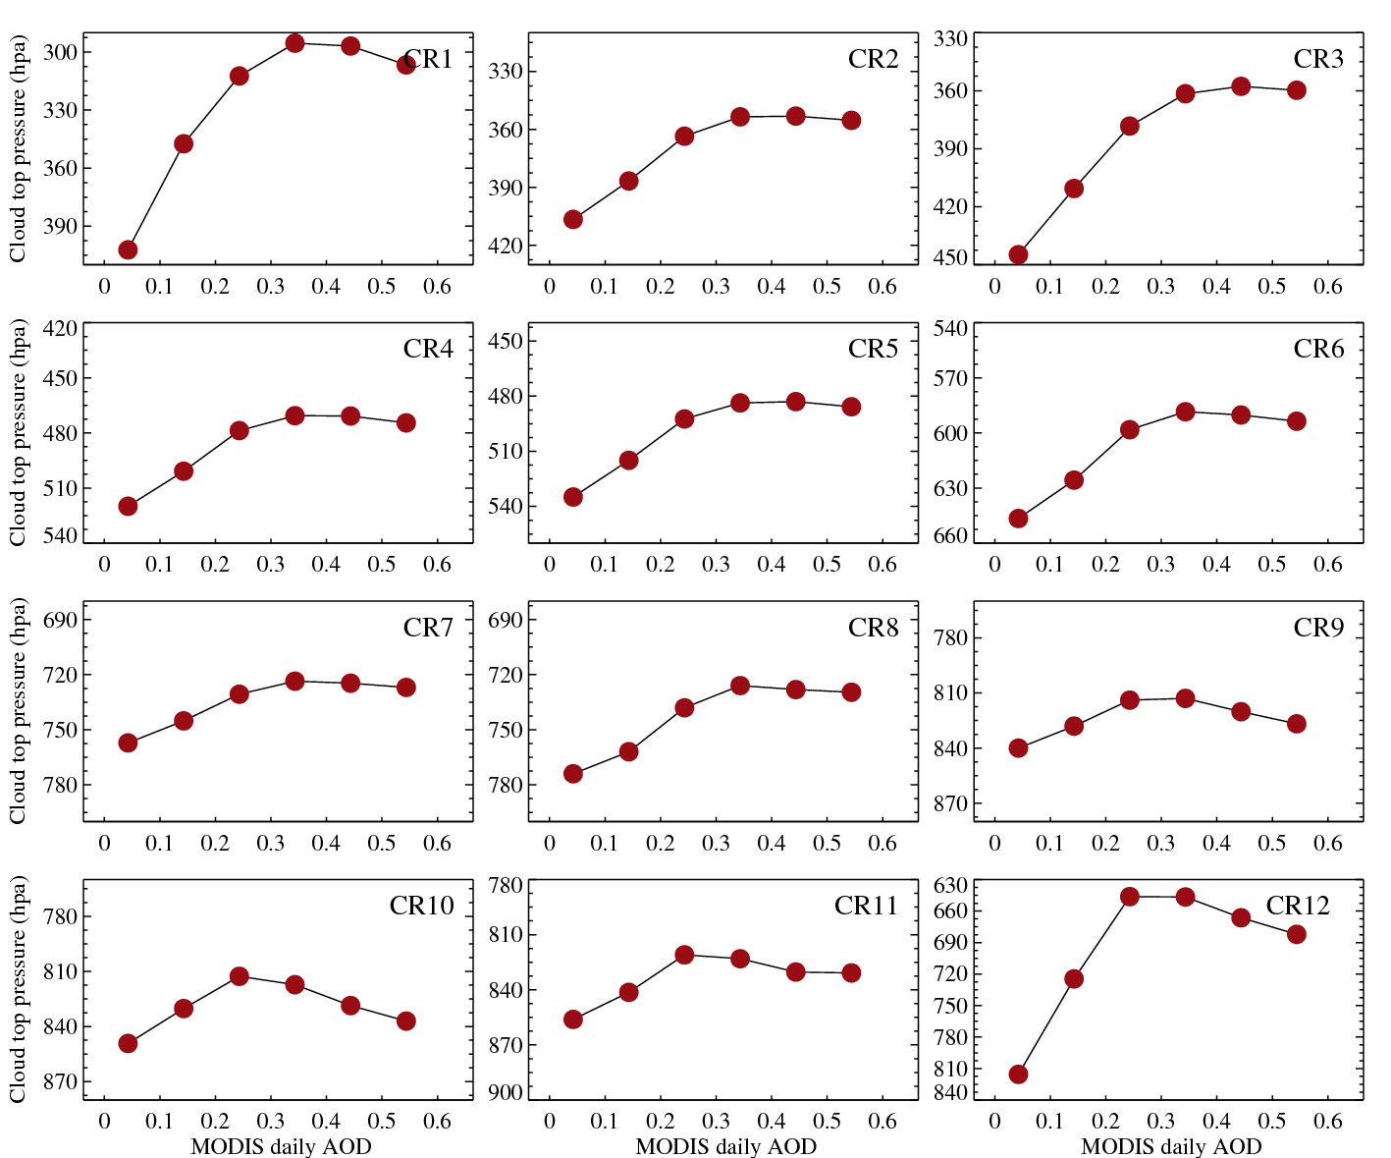
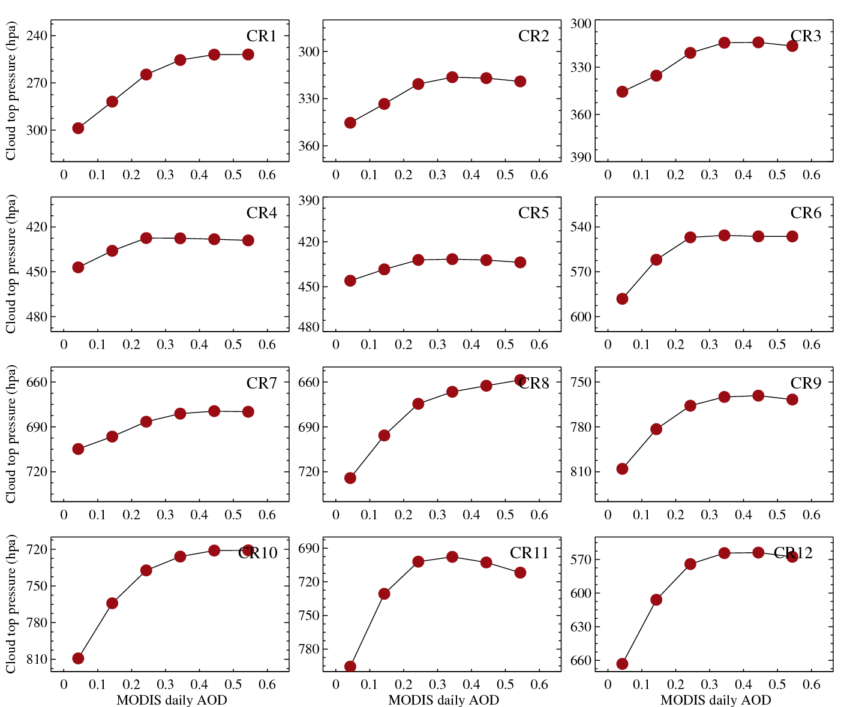
Cloud top pressure
Ocean
Land
Cloud top pressure as a function of MODIS daily AOD.

Slide 52
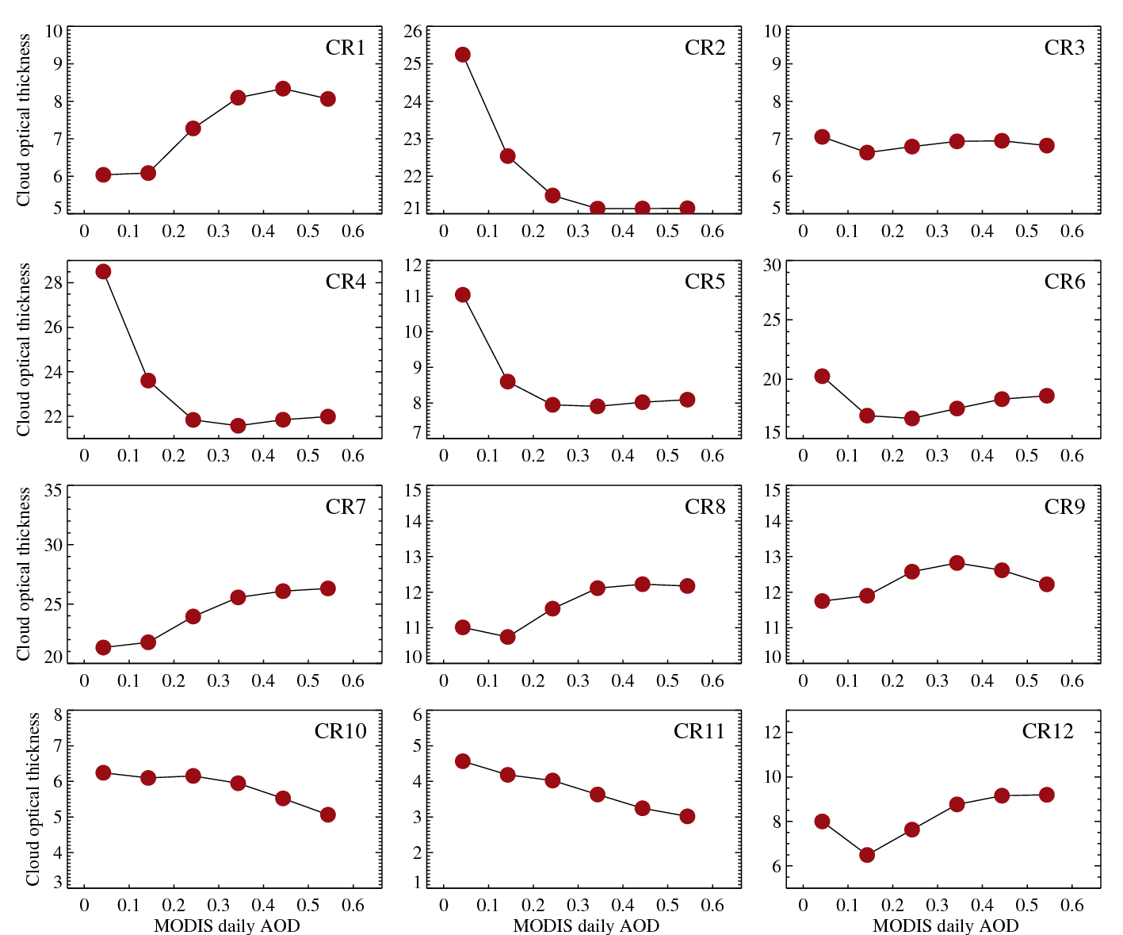
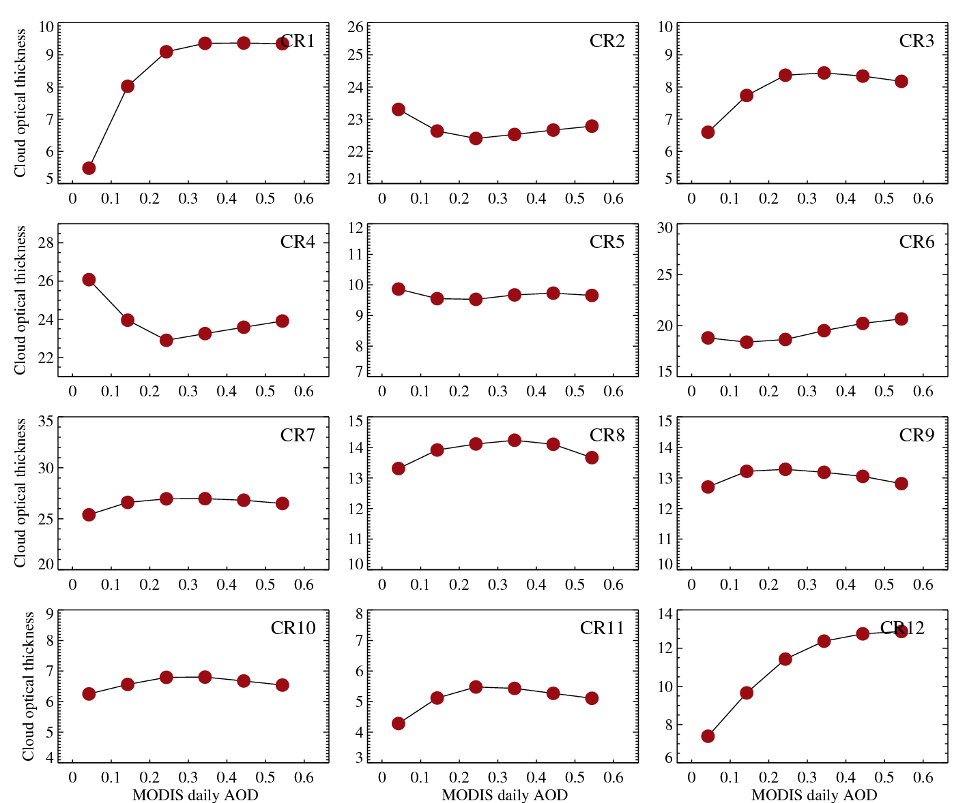
Cloud optical thickness
Ocean
Land
Cloud optical thickness as a function of MODIS daily AOD.

Slide 53
Cloud effective radius (μm)
Ocean
Land
Cloud effective radius as a function of MODIS daily AOD.

Slide 54
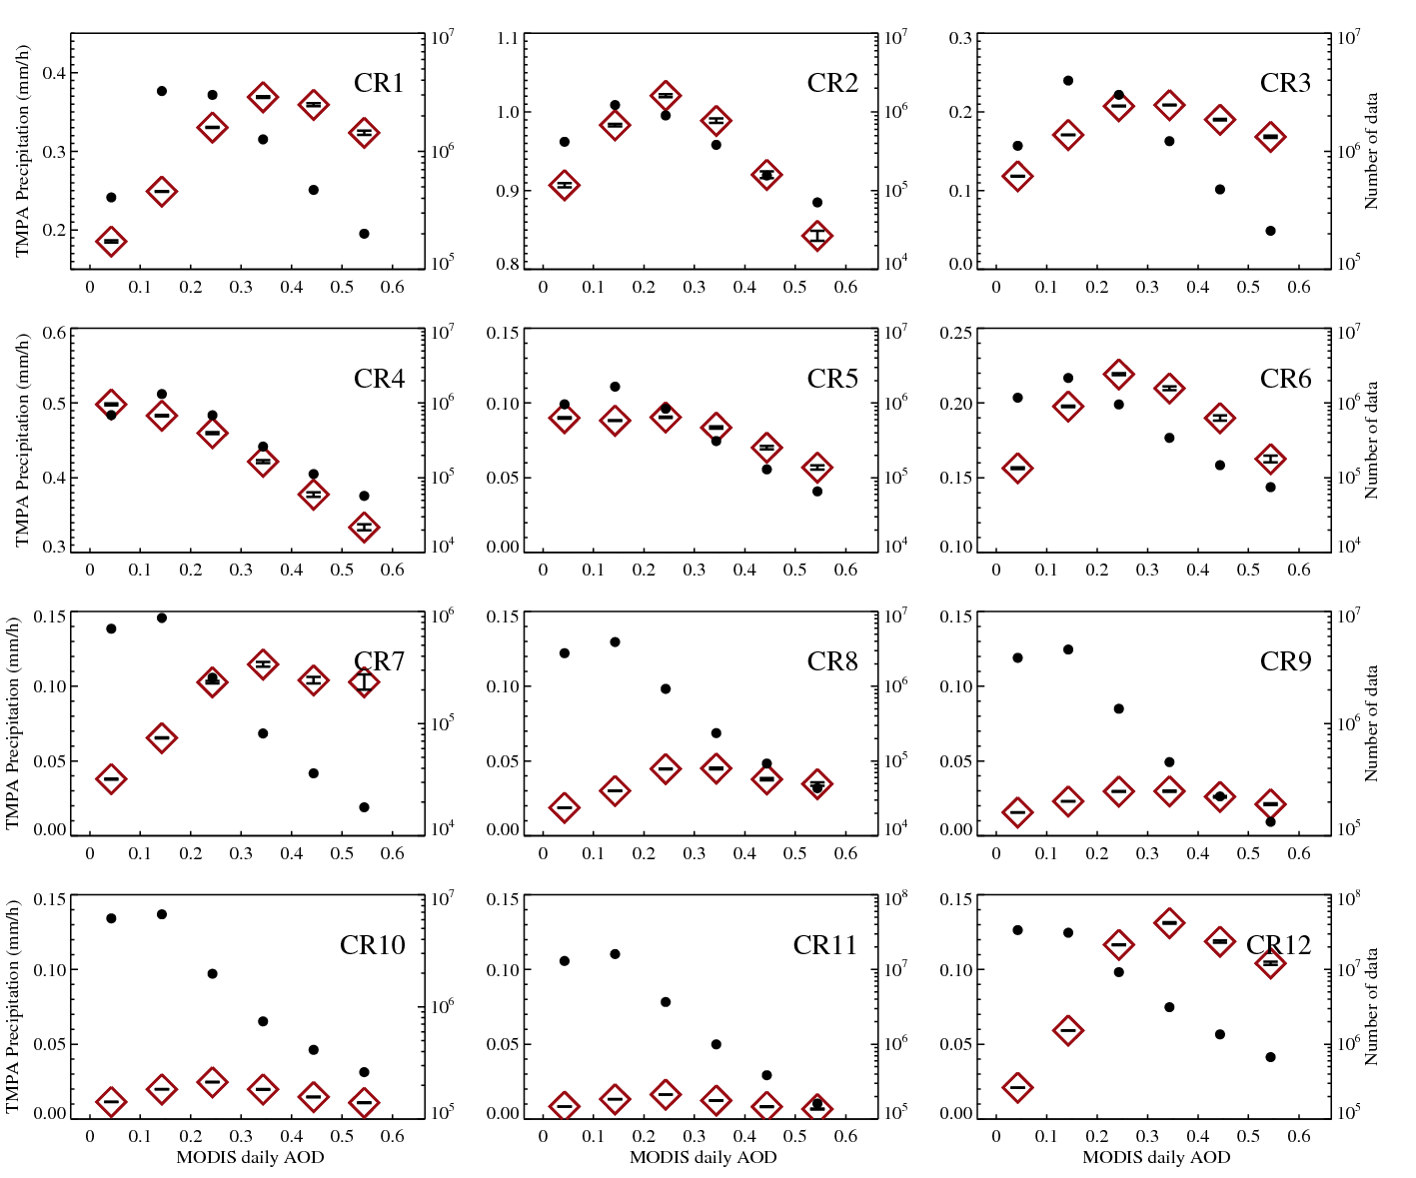
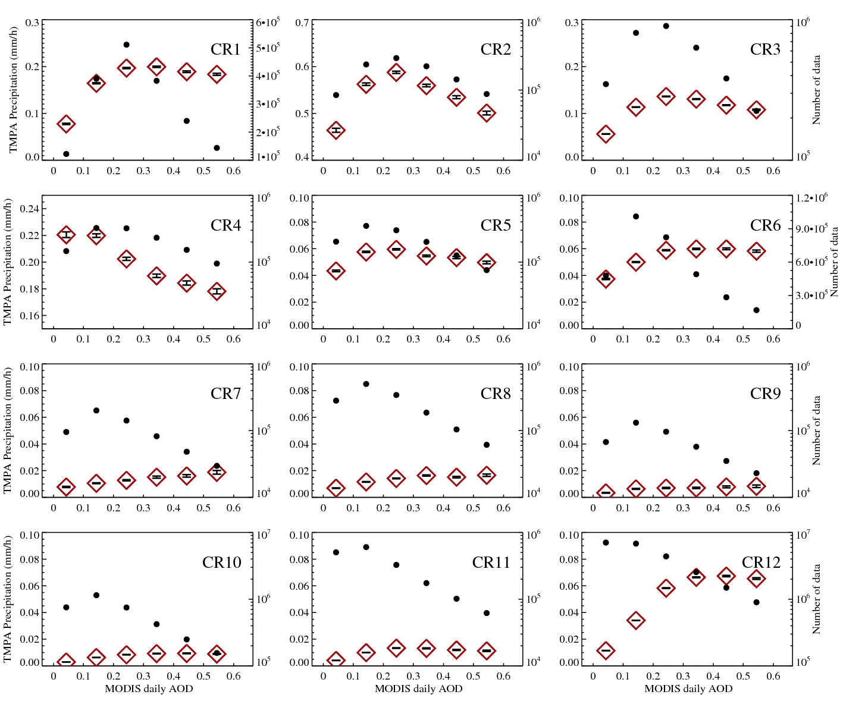
TMPA (P ≥ 0)
Ocean
Land
TMPA Precipitation (mm/h) as a function of MODIS daily AOD. Black dots mean number of data. The error bars indicate the standard error (SE) given by the standard deviation of the data divided by the square root of number of data.

Slide 55
Aerosol-Cloud(CR)-Precipitation
Ocean/ Land
As a function of daily MERRA aod relative distribution

Slide 56
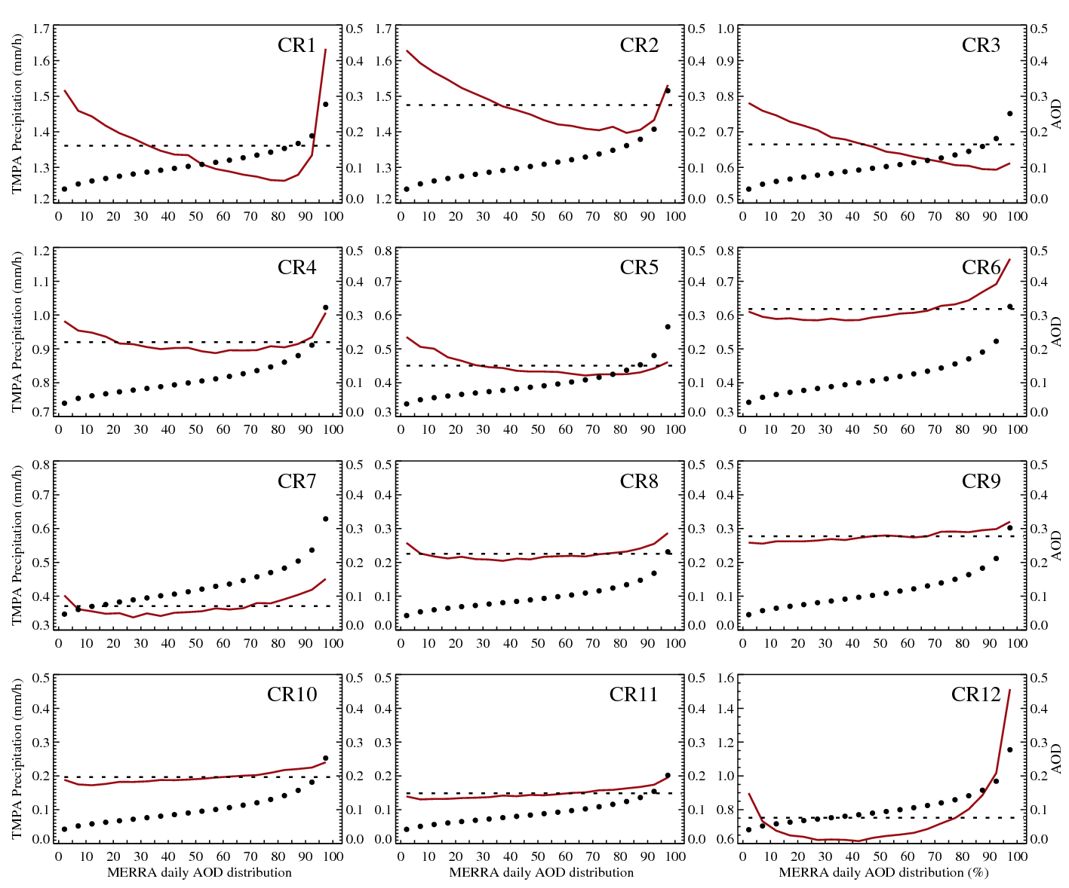
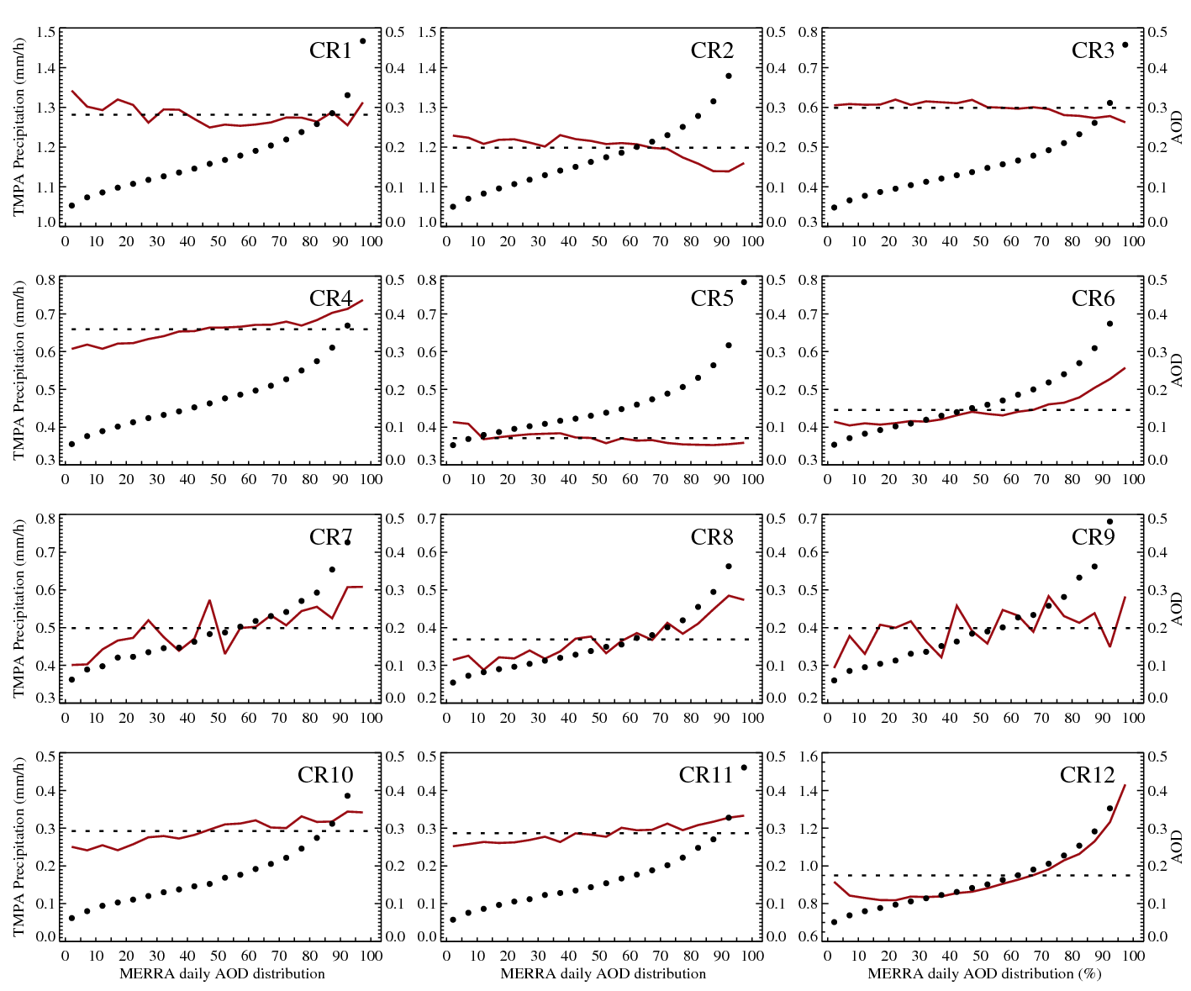
TMPA (P > 0)
Ocean
Land
TMPA Precipitation (mm/h) as a function of AOD distribution(per grid per season). The horizontal dashed line is mean TMPA precipitation of each CR. The dots indicate mean AOD within their AOD distribution ranges.
Minimum and maximum values of Y-axis(for TMPA) are different to each CR, but their interval is same (max – min = 0.5) except CR12.

Slide 57
Cloud fraction
Ocean
Land
Cloud fraction as a function of AOD distribution(per grid per season). The horizontal dashed line is mean cloud fraction of each CR.
Minimum and maximum values of Y-axis are different to each CR.

Slide 58
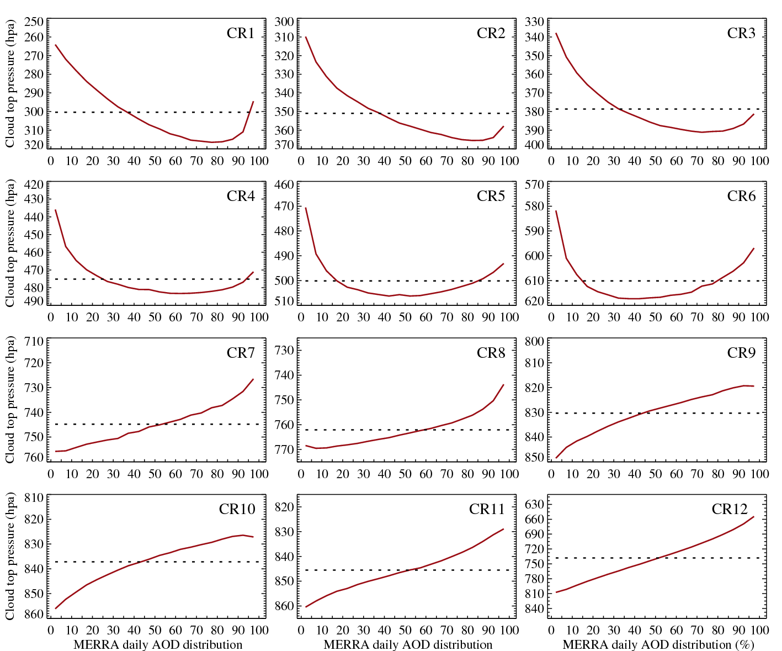
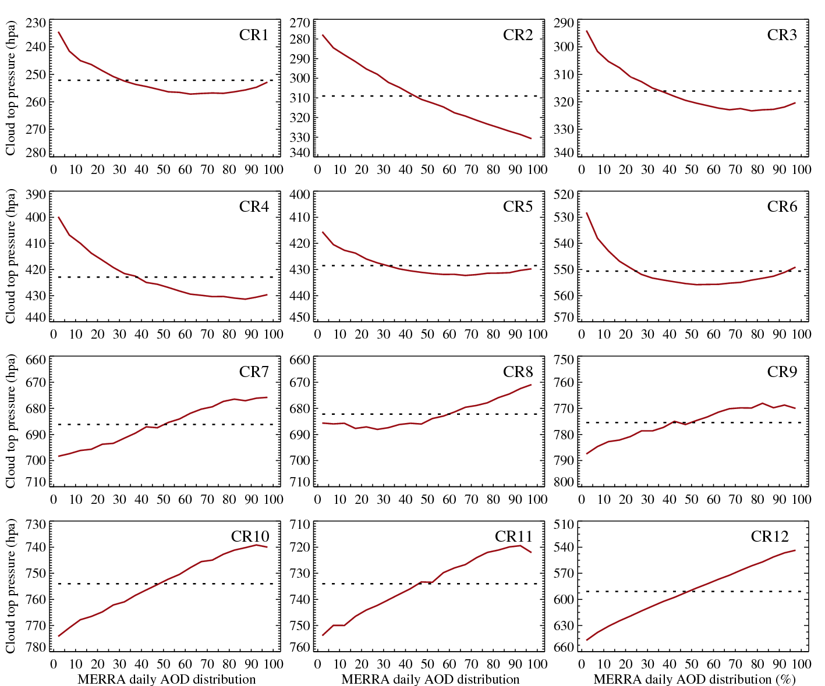
Cloud top pressure
Ocean
Land
Cloud top pressure as a function of AOD distribution(per grid per season). The horizontal dashed line is mean cloud top pressure of each CR.

Slide 59
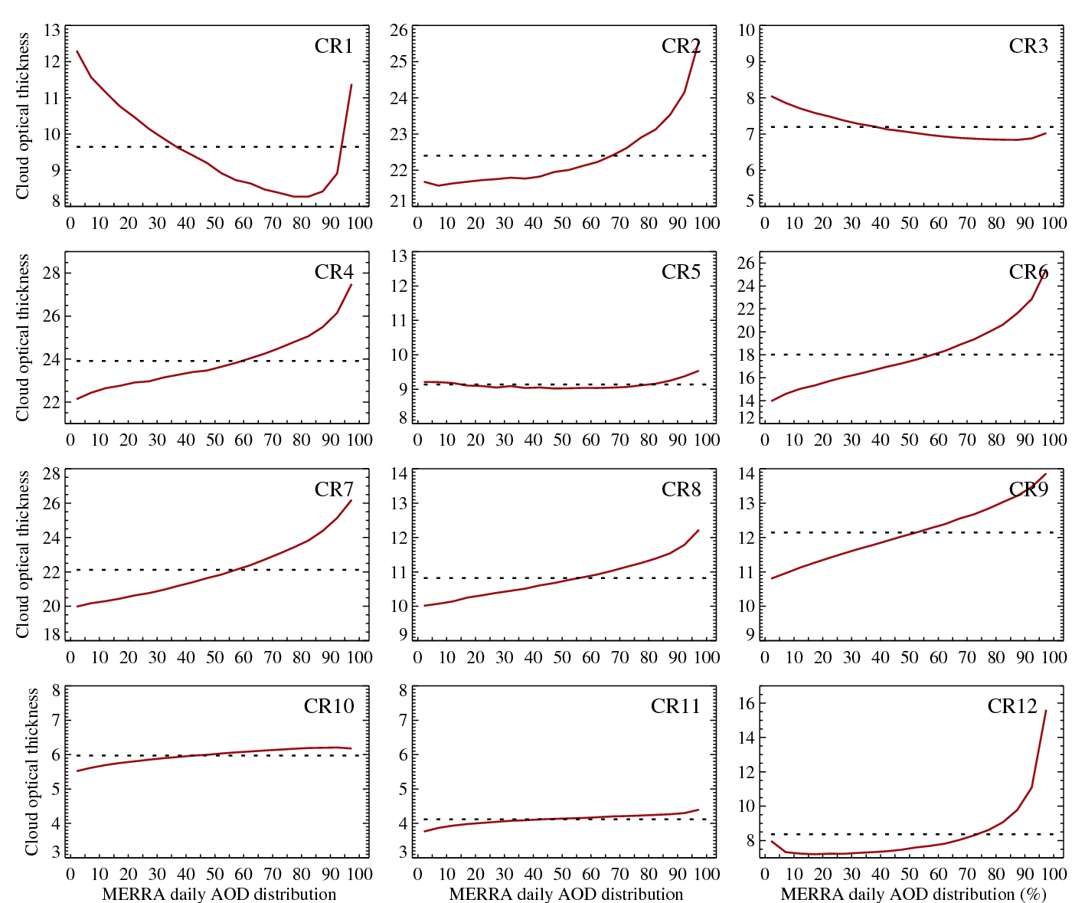
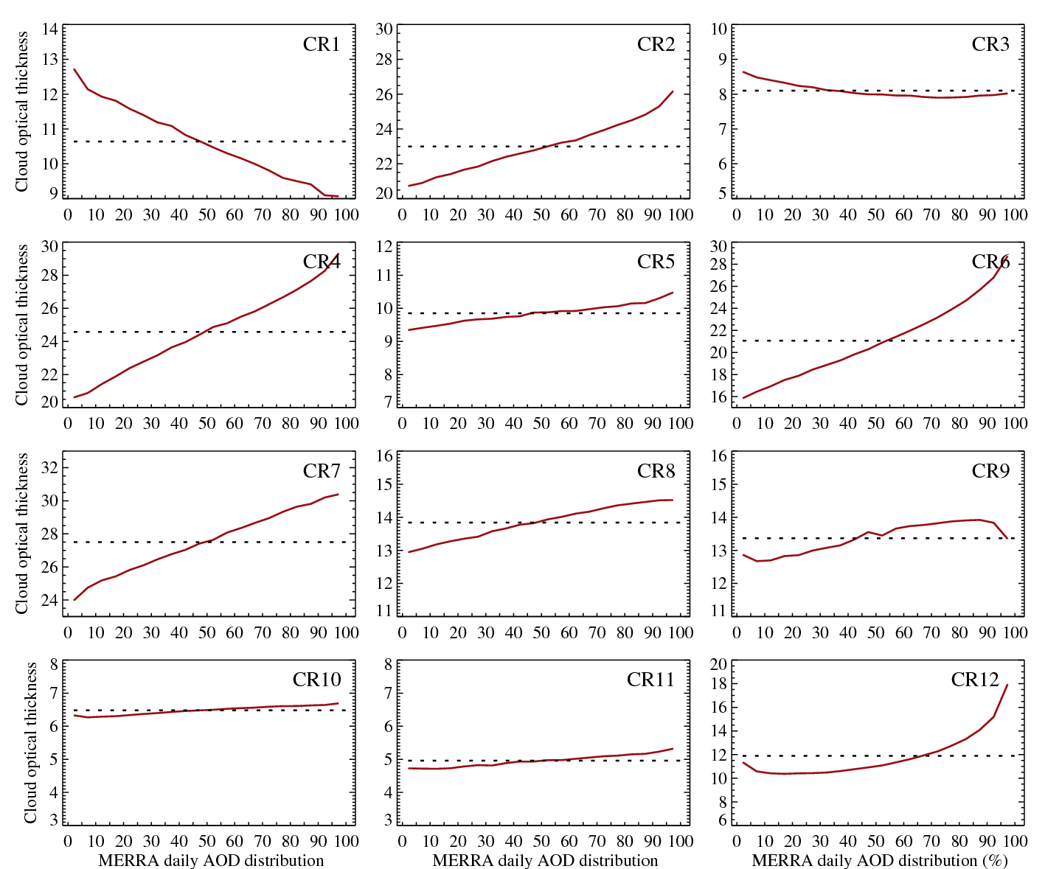
Cloud optical thickness
Ocean
Land
Cloud optical thickness as a function of AOD distribution(per grid per season). The horizontal dashed line is cloud optical thickness of each CR.

Slide 60
Cloud effective radius (μm)
Ocean
Land
Cloud effective radius as a function of AOD distribution(per grid per season). The horizontal dashed line is cloud effective radius of each CR.

Slide 61
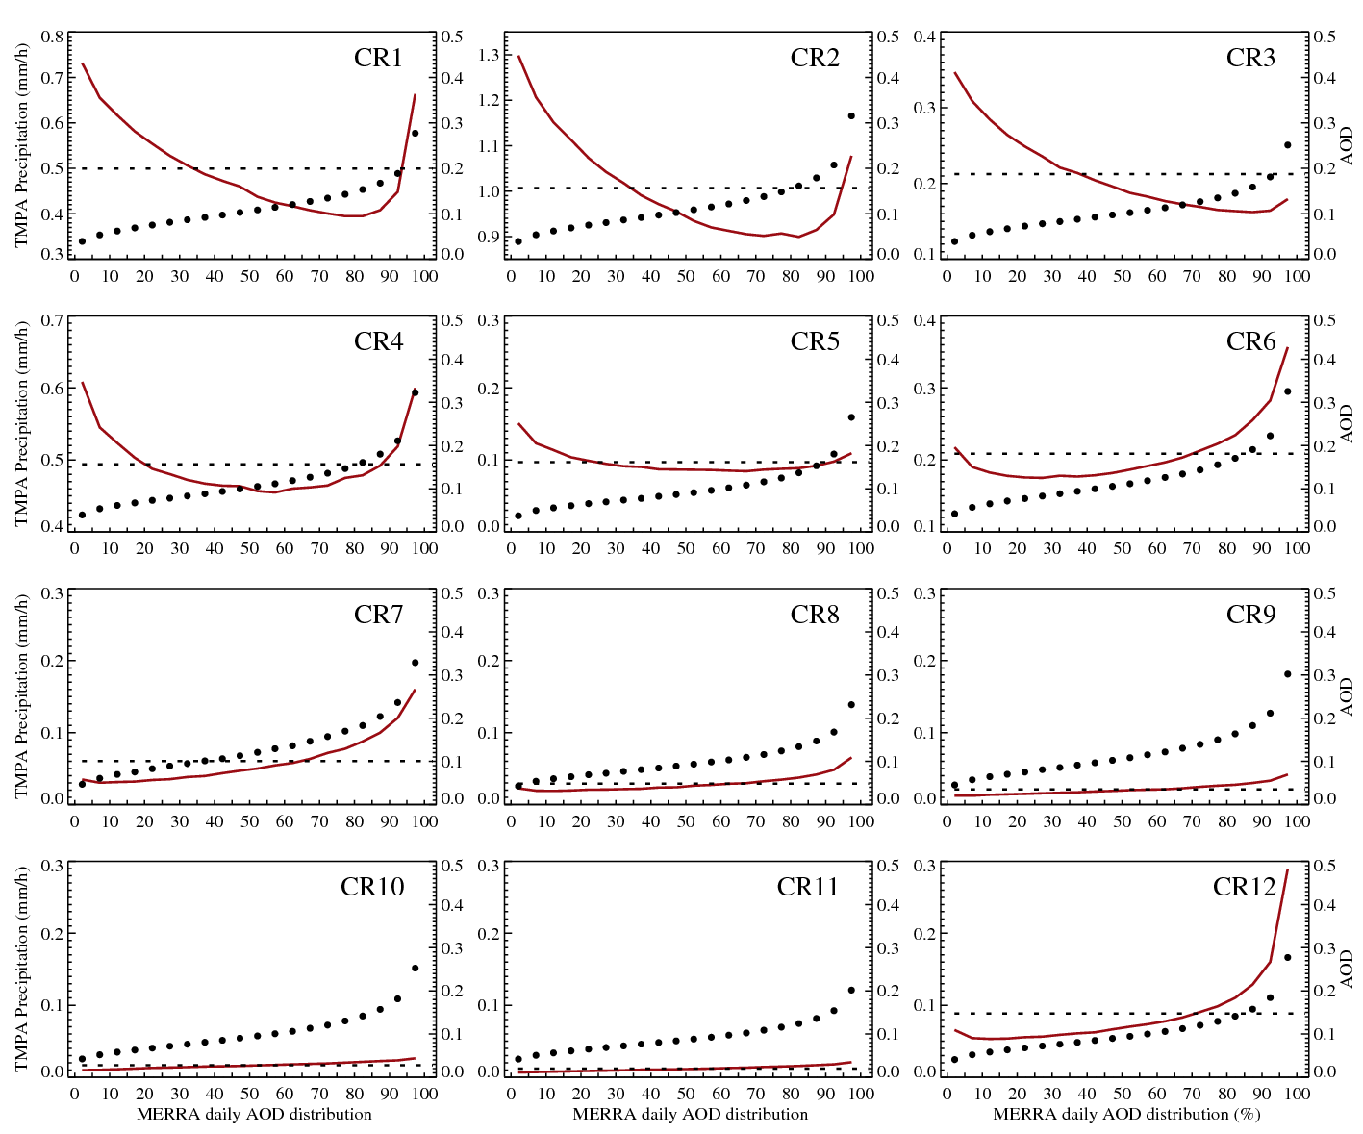
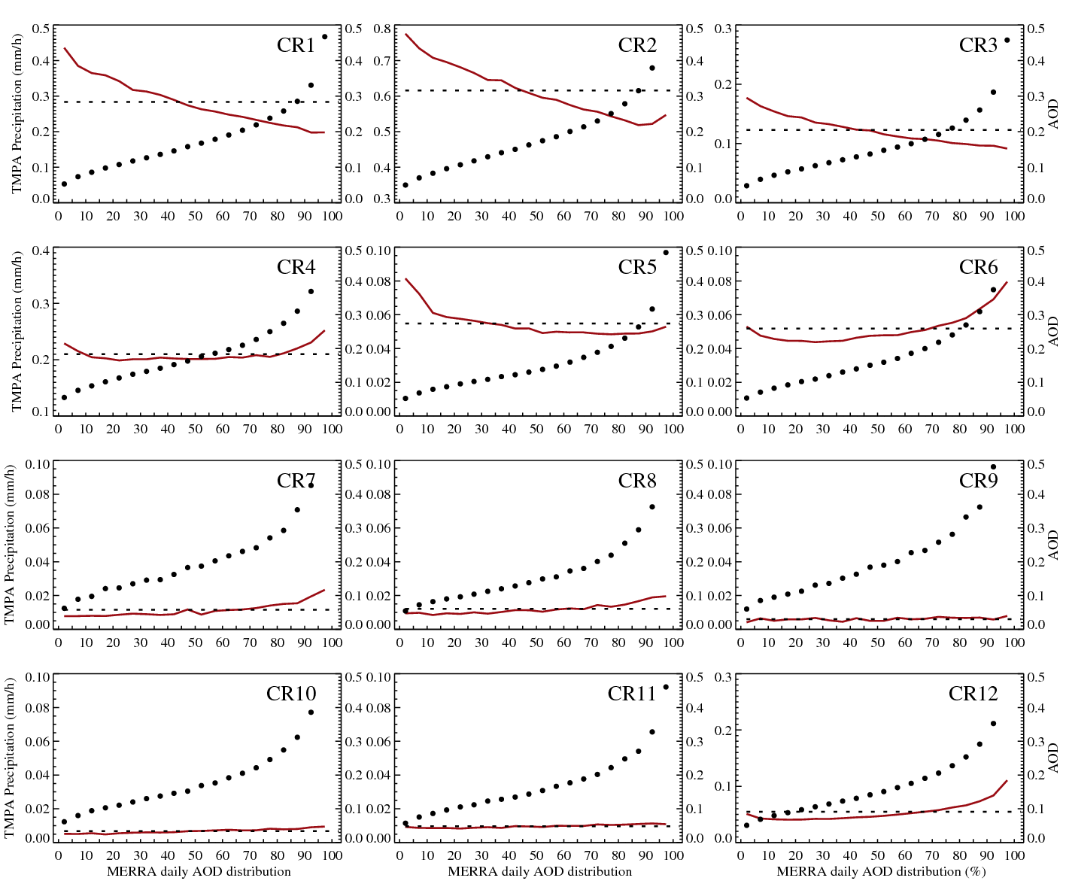
TMPA (P ≥ 0)
Ocean
Land
TMPA Precipitation (mm/h) as a function of AOD distribution(per grid per season). The horizontal dashed line is mean TMPA precipitation of each CR. The dots indicate mean AOD within their AOD distribution ranges.
Minimum and maximum values of Y-axis(for TMPA) are different to each CR, but their interval is same.

Slide 62
Aerosol-Cloud(CR)-Precipitation
Ocean/ Land
As a function of daily MERRA absolute values.

Slide 63
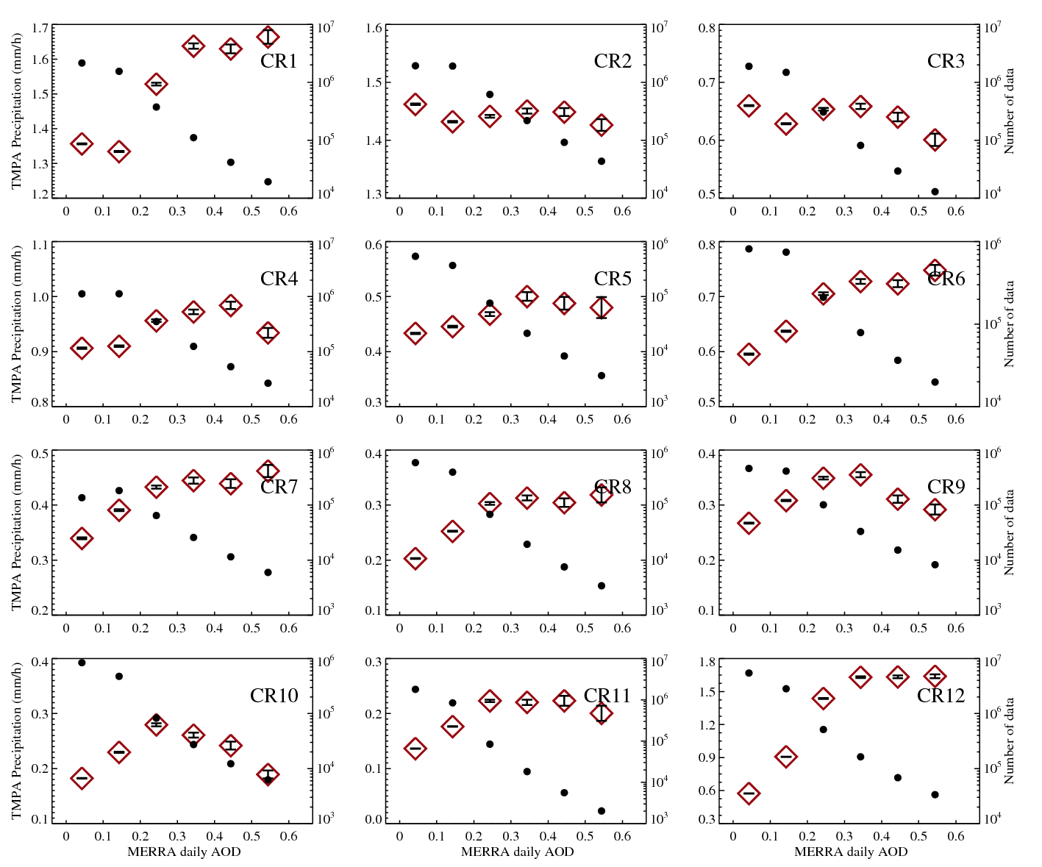
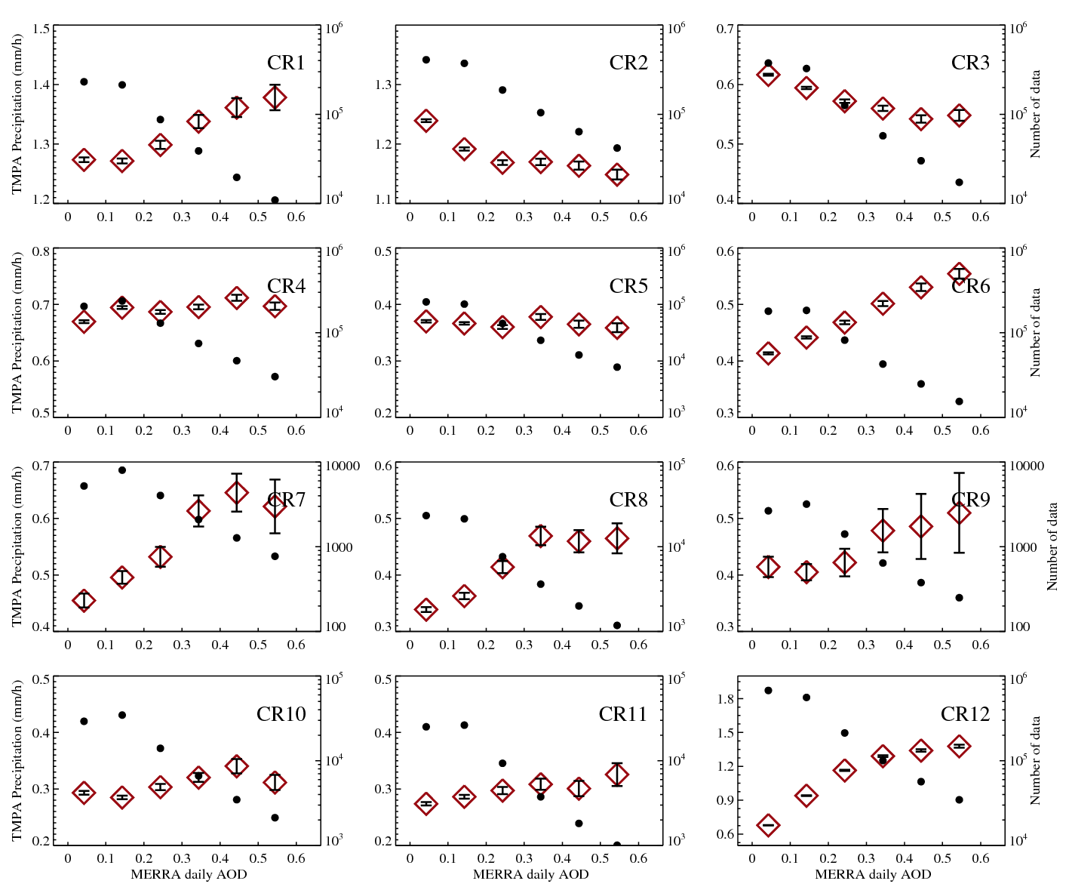
TMPA (P > 0)
Ocean
Land
TMPA Precipitation (mm/h) as a function of AOD distribution(per grid per season). The horizontal dashed line is mean TMPA precipitation of each CR. The dots indicate mean AOD within their AOD distribution ranges.
Minimum and maximum values of Y-axis(for TMPA) are different to each CR, but their interval is same (max – min = 0.5) except CR12.

Slide 64
Cloud fraction
Ocean
Land
Cloud fraction as a function of AOD distribution(per grid per season). The horizontal dashed line is mean cloud fraction of each CR.
Minimum and maximum values of Y-axis are different to each CR.

Slide 65
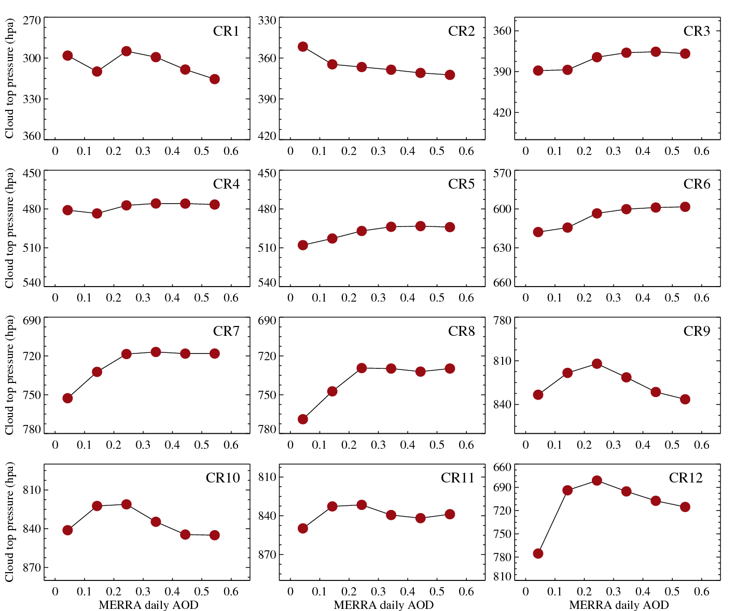
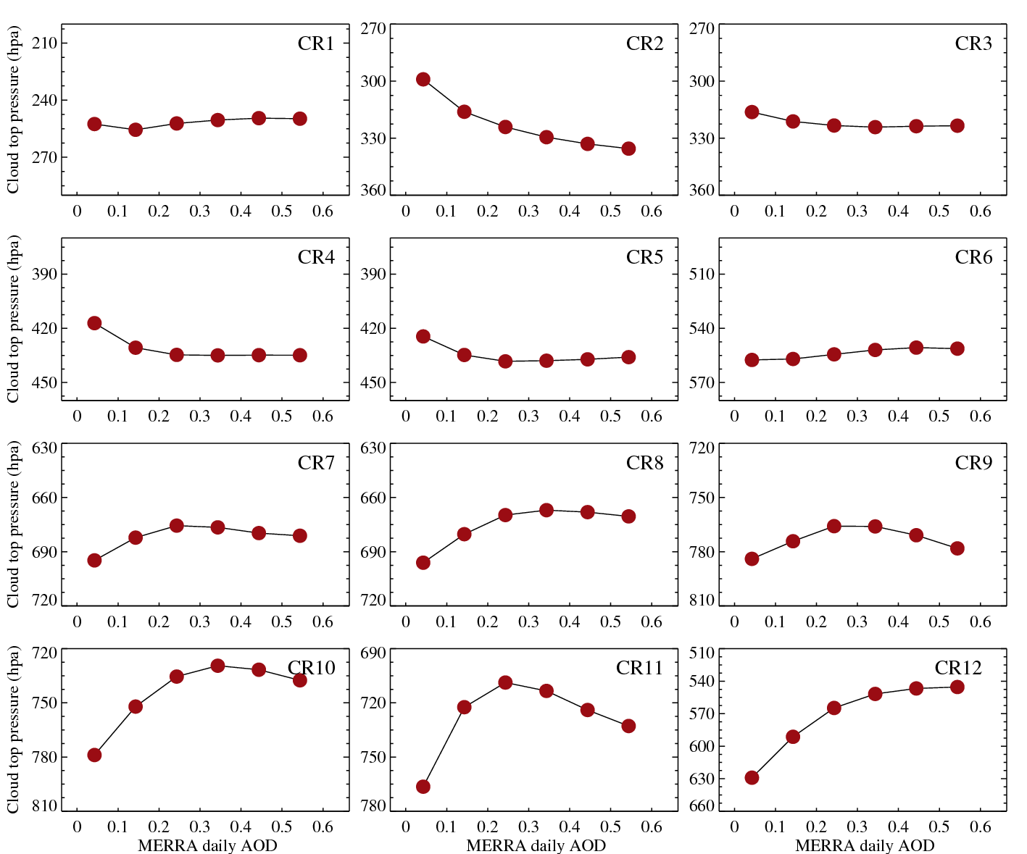
Cloud top pressure
Ocean
Land
Cloud top pressure as a function of AOD distribution(per grid per season). The horizontal dashed line is mean cloud top pressure of each CR. Minimum and maximum values of Y-axis are different to each CR, but their interval are same except CR12.

Slide 66
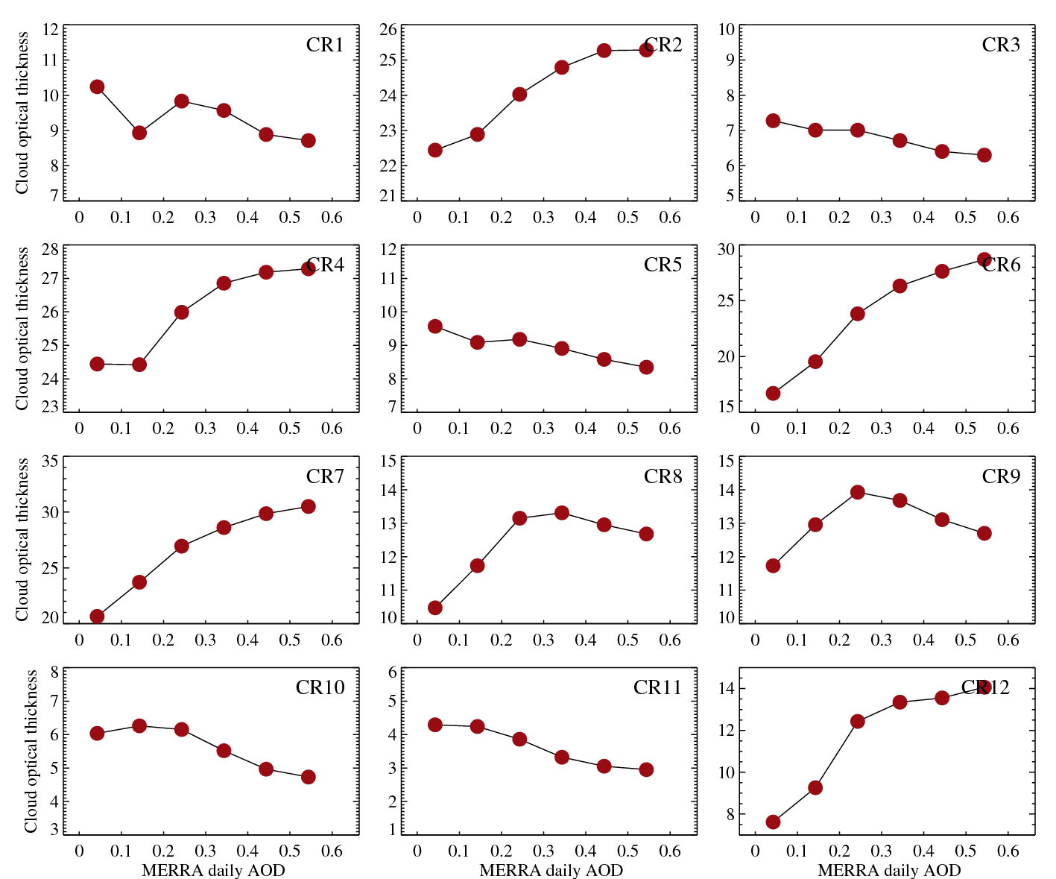
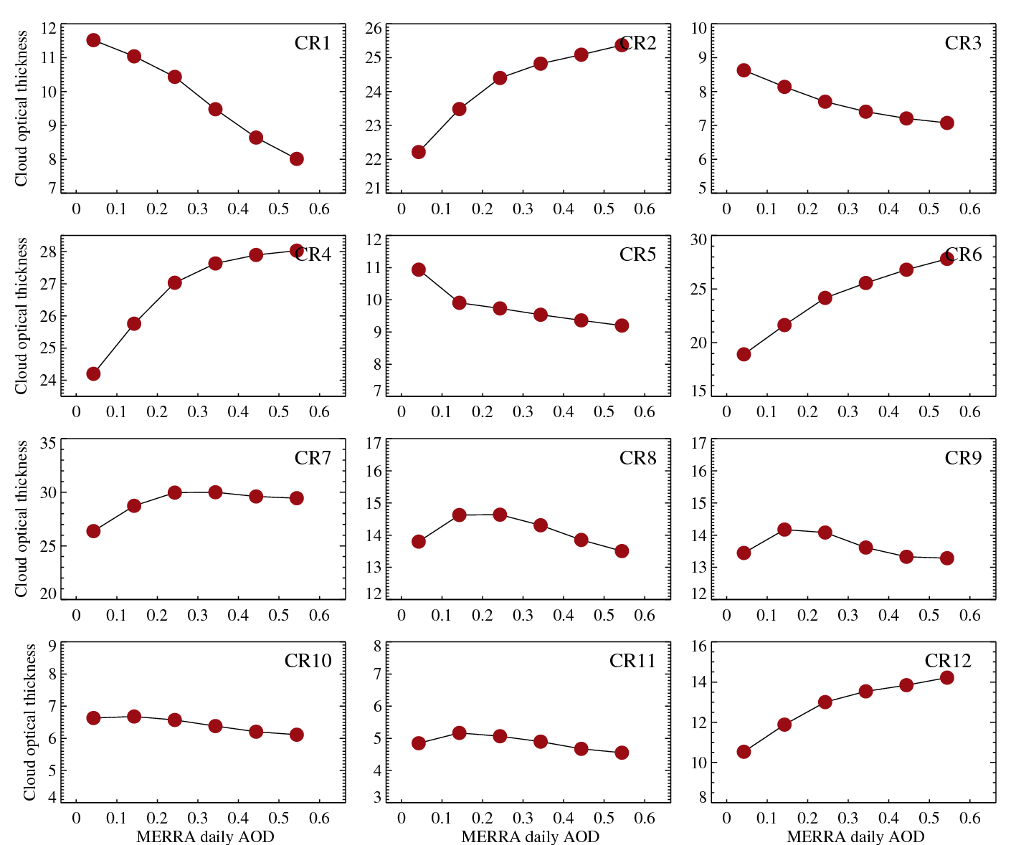
Cloud optical thickness
Ocean
Land
Cloud optical thickness as a function of AOD distribution(per grid per season). The horizontal dashed line is cloud optical thickness of each CR.
Minimum and maximum values of Y-axis are different to each CR.

Slide 67
Cloud effective radius (μm)
Ocean
Land
Cloud effective radius as a function of AOD distribution(per grid per season). The horizontal dashed line is cloud effective radius of each CR.

Slide 68


TMPA (P ≥ 0)
Ocean
Land
TMPA Precipitation (mm/h) as a function of AOD distribution(per grid per season). The horizontal dashed line is mean TMPA precipitation of each CR. The dots indicate mean AOD within their AOD distribution ranges.
Minimum and maximum values of Y-axis(for TMPA) are different to each CR, but their interval is same.

Slide 69
-Annual mean MODIS AOD
Levy et al., 2013

Slide 70
Land Ocean
Ice
Liquid
Peng et al., 2016
Region : Tropics (20S – 20N)
Aerosol from MODIS, CER from CloudSat CPR

Slide 71


Koren et al., 2012

Slide 72



SFC CRE comparison for Aqua CRs

Slide 73

LW TOA CRE comparison for Aqua CRs (three datasets)
Mean values

Slide 74
LW and SW TOA CRE comparison for Aqua CRs
CERES vs CloudSat-CALIPSO
Global contributions
more important in CERES
more important in C-C
LW
SW

