Slide 1


Uncertainties in estimates of fAPAR for photosynthesis (fAPAR_{PSN}) when approximated with fAPAR_{canopy}, NDVI and EVI
Qingyuan Zhang^{1,2}
Yujie Wang^{3,4}
Elizabeth M. Middleton²
Tian Yao^{1,2}
Alexei I. Lyapustin⁴
Karl F. Huemmrich^{2,3}
¹USRA;²NASA/GSFC, code 618;
³UMBC;⁴NASA/GSFC, code 613;
MODIS Science Team Meeting, June 6-10, 2016
Notes:
Hello everyone. My name is Qingyuan Zhang. I am PI and leading the efforts to develop the new fAPARchl products with MODIS, and to develop prototype fAPARchl products with Hyperion and AVIRIS images. fAPARchl measures fAPAR for photosynthesis. However, fAPARcanopy, NDVI and EVI have often be utilized to approximate fAPAR for photosynthesis. This talk focuses on uncertainties in estimates of fAPAR for photosynthesis when approximated with fAPARcanopy, NDVI and EVI. Support for these studies comes from the Terra and Aqua Program, the TE program, the EO1 mission and the HyspIRI mission.

Slide 2
Outline
Introduction to the retrieval algorithm:
The advanced Radiative Transfer Model: Leaf Level, Canopy Level, and Pixel Level
Retrievals: Cover fractions of vegetation, soil, snow and surface water, and fAPARs (fAPAR_{canopy}, fAPAR_{PV}, fAPAR_{NPV})
Prototype Product Development with Hyperion images
Product Development with MODIS images and uncertainties in various estimates of fAPAR for photosynthesis (fAPAR_{PSN})
Summary
Notes:
In this presentation, I will introduce the advanced radiative transfer model considering three levels: leaf, canopy and pixel. We extract fAPARchl with this advanced radiative transfer model from MODIS, Hyperion and AVIRIS images. Then I will present the progress of product development for MODIS, prototype product development for Hyperion and AVIRIS. We quantify the uncertainties in estimates of fAPAR for photosynthesis when approximated with fAPARcanopy, NDVI and EVI, compared to fAPARchl and will show how the uncertainties vary with plant functional types, temporally and spatially. If we have time, I will also show some examples of applied science of the fAPARchl, including GPP estimation, drought monitoring, disturbance and recovery monitoring, and phenology.

Slide 3
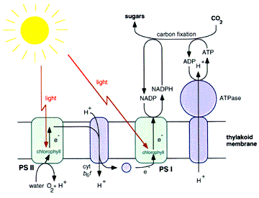
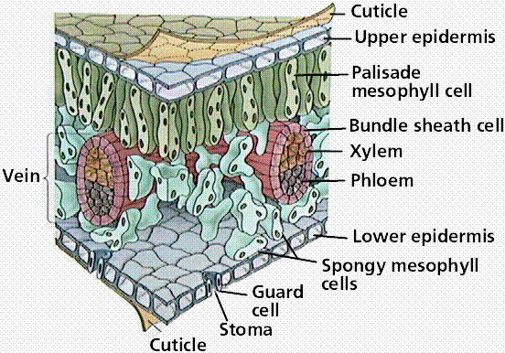
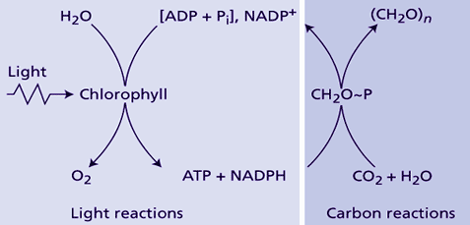
Advanced radiative transfer model
Only the PAR absorbed by chlorophyll of the canopy, not the PAR absorbed by the foliage or by the entire canopy, is potentially available for photosynthesis.
light energy
6 CO₂ + 12 H₂O ⇒ C₆H₁₂O₆ + 6 O₂ + 6 H₂O
A leaf contains PV (i.e., chl), and NPV components, including non-photosynthetic pigments, cell walls, veins, etc.
http://photoscience.la.asu.edu/photosyn/education/photointro.html
Notes:
At leaf level, even for a green leaf, it also contains non-photosynthetic vegetation component. However, only the PAR absorbed by chlorophyll of the canopy, not the PAR absorbed by the whole foliage or by the entire canopy, is potentially available for photosynthesis.

Slide 4
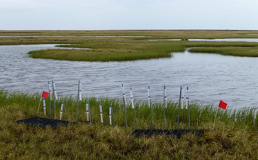
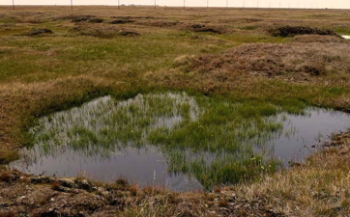
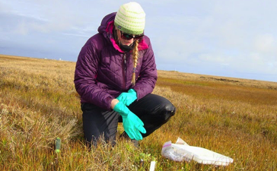
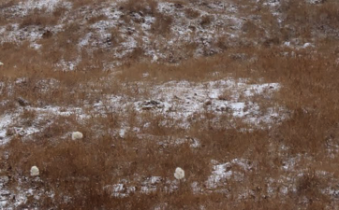
Advanced radiative transfer model
 | 2013 163 | 2013 168 | 2013 171 | 2012 172 | 2011 173 | 2008 175 | 2010 189 | 2009 201
July 12, 2013 Aug 22, 2011
Aug 30, 2014 Sept 25, 2011
http://ngee-arctic.blogspot.com/
NLCD 2001 land cover map (center: the US-Brw site)
Notes:
This slide and the next one explain motivations to develop the advanced radiative transfer model. The northernmost flux tower site of US is the Barrow site in Alaska, located at the center of the 50 km x 50 km NLCD map. The small area is 7 km x 7 km and the Barrow site is at the center. The first row of RGB true color images are 30 m Hyperion images covering the same 7 km x 7 km area from DOY 163 to 201 in year 2008 to 2013. Here is the land boundary. Here are the three small circle areas. Snow presented in the first six images. The seventh and the eighth images have very little snow. The feature of multitude of lakes or ponds is obvious. These four pictures were taken in the area during field work in July, August and September. See the lake, pond, or called small wetland. Also see the brown non-green standing grass in August. Snow starts to fall in September. In this figure we can see non-green leaves, soil, and snow.

Slide 5
Advanced RTM vs. traditional RTM for fAPAR retrieval
Traditional RTM | Our Advanced RTM
Consider only Canopy and Soil | Considers canopy, Soil, Snow, and Surface Water. Therefor, it also works for critical regions (High Latitude regions, ABoVE, HMA, coastal regions, wetlands, etc) and critical time periods (winter).
Need plant functional type/land cover type as input for retrieval | Does not need
Assume that leaf optics of each type is fixed anywhere and anytime, and pre-determined | Leaf optics is retrieved for each observation since leaf components (chlorophyll, dry matter, etc.) change seasonally and spatially even for same type
Retrieve fAPAR_{canopy} | Retrieves fAPAR_{canopy}, fAPAR_{chl} (i.e., fAPAR_{PV} or fAPAR_{PSN}) and fAPAR_{NPV}
Notes:
In the literature, traditional radiative transfer models have been developed to extract fAPARcanopy. Our advanced radiative transfer model can provide fAPARcanopy, fAPARchl or fAPARPV or fAPAR for photosynthesis, and fAPAR for non-photosynthetic vegetation component or fAPARNPV. Here this table lists the features that make our radiative transfer model is advanced. Traditional radiative transfer model considers only canopy and soil. Our model considers canopy, soil, snow and surface water. So our radiative transfer model can also work well for critical regions, for instance, High Latitude regions, ABoVE, High Mountain Asia region, coastal regions and wetlands, etc while traditional radiative transfer models have obvious limitations. Traditional radiative transfer models need plant functional type of each observation as input for retrieval while our model does not need. Traditional radiative transfer models assume that leaf optics of each type is fixed anywhere and anytime while our model retrieves leaf optics for each observation since leaf components change seasonally and spatially even for same type.

Slide 6
Advanced radiative transfer model
Notes:
With the consideration at pixel, canopy and leaf levels, We extract fAPARchl , fAPARcanopy and fAPAR for non-photosynthetic vegetation (NPV) component with the advanced radiative transfer model. Quantitatively, fAPARNPV equals to the uncertainties in estimates of fAPAR for photosynthesis when approximated with fAPARcanopy. NDVI and EVI are two traditional vegetation indices, NDSI is normalized difference snow index, also a traditional index.

Slide 7
Notes:
We run the advanced radiative transfer model with the 8 Hyperion images to produce prototype products of surface water fraction, snow cover fraction, fAPARcanopy, fAPARchl and fAPARNPV. NDVI, EVI and NDSI are also computed. They all perform well. When snow melted, snow cover fraction comes to zero and surface water fraction comes close to one. Before peak of growing season, tundra fAPARchl is less than fAPARNPV. Note that fAPARNPV equals to uncertainties in estimates of fAPARPV when approximated with fAPARcanopy. Our retrieval snow cover fraction agrees better with observations than NDSI. NDVI and EVI could be less than zero. EVI could be greater than one. For vegetated area or bare soil, NDVI is greater than fAPARcanopy and EVI is greater than fAPARchl.

Slide 8
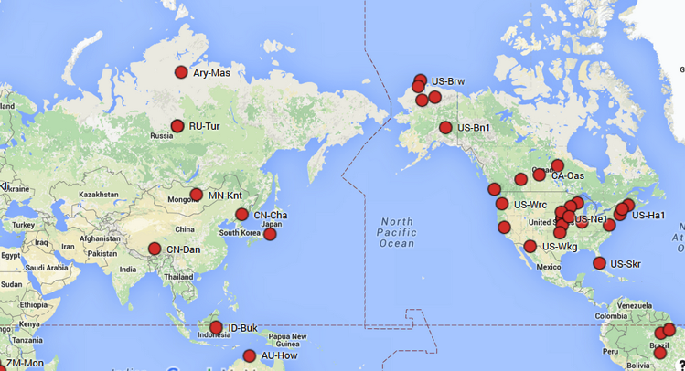
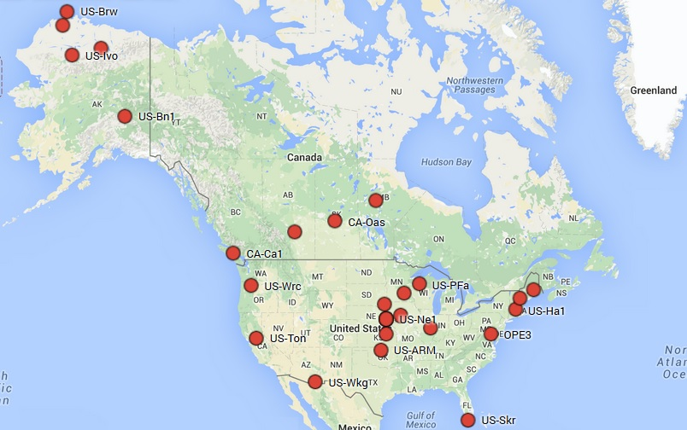
Selected Sites
Site Code
US-Ne1
US-Ha1
US-Brw
US-An3
US-Prr
US-Bn1
Ary-Mas
US-Kon
US-Ho1
US-PFa
US-Skr
US-Ton
CA-Ca1
CA-Oas
RU-Tur
US-An3
US-Ho1
Processing for each site:
define it as center of grid
subset 50 km x 50 km
retrieve fAPARs
compute NDVI, EVI
US-Kon
Go to Summary
Notes:
Move on to product development of fAPAR_canopy, fAPAR_PV and fAPAR_NPV with MODIS images. We select flux tower sites globally, including most land cover types/plant functional types: forests, crops, grassland, savanna, wetland, coastal area, tundra, shrub land. For each site, we define it as center of a 500 m grid, and subset the MODIS images for the surrounding 50 km x 50 km of each site. Then we retrieve fAPAR_canopy, fAPAR_PV and fAPAR_NPV products with the MODIS images. The traditional vegetation indices NDVI and EVI are also computed from the MODIS images. I will show results for some of the selected sites: a crop site (US-Ne1) in Nebraska, the Harvard Forest site (US-Ha1) in MA, and three flux tower sites in Alaska. If we have time, I can show more.

Slide 9
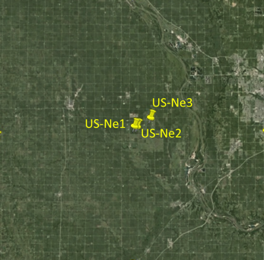
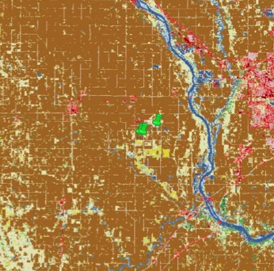
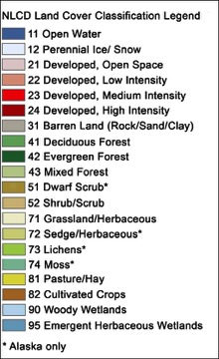
Study area: 50 km x 50 km surrounding the US-Ne1 crop flux tower site (US-Ne1) in Nebraska
50
km
NLCD 2006
50 km
2006 NLCD Class (center: Nebraska US-Ne1) | Percent(%)
71 Grassland/Herbaceous | 12.16
82 Cultivated Crops | 70.95
There are three crop flux tower sites in this study area. We pick up US-Ne1 as the center of this area
Notes:
This is the first study area selected. Within this 50 km x 50 km area, there are three crop flux tower sites. US-Ne1 is a continuous corn site, US-Ne2 and US-Ne3 are corn-soybean rotation sites. US-Ne1 and US-Ne2 are irrigated while US-Ne3 is non-irrigated. We pick up the US-Ne1 site as center of this study area. More than 70% of this area is cropland. More than 10% is grassland.

Slide 10
US-Ne1: field measurements, RTM retrievals and tower GPP from 2001 – 2004
Retrieved fAPAR_{chl} matches well with tower GPP while MOD15A2 FPAR does not.
MOD15A2 FPAR does not agree well with field fAPAR_{canopy}. It has earlier green-up and late fall-off, compared to tower GPP, fAPAR_{chl}, and field fAPAR_{canopy}. It overestimates field fAPAR_{canopy} in spring and fall, but underestimates field fAPAR_{canopy} in summer.
Notes:
This figure compares MOD15A2 FPAR, field measured fAPARcanopy, the fAPARchl and tower flux GPP: blue triangles represent MOD15A2 FPAR, red triangles represent fAPARchl, grey triangles represent field fAPARcanopy, and black dots show tower flux GPP.

Slide 11
US-Ne1: GPP estimation performance with MOD15A2 FPAR vs. fAPARchl
(MOD15A2 FPAR)*PPFD (mol m-2 d-1) fAPAR_{chl}*PPFD (mol m-2 d-1)
Positive bias (overestimation) was observed in spring and fall. Negative bias (underestimation) was observed in summer. By replacing MOD15A2 FPAR with fAPAR_{chl} , biases were reduced.
Notes:
X axis represents the product of MOD15A2 FPAR and PAR or the product of fAPARchl and PAR. Y axis represents tower flux GPP. fAPARchl performs much better, R2 is higher, RMSE and CV are lower, compared to MOD15A2 FPAR. Positive bias means overestimation and negative bias means underestimation. You see positive bias was observed in spring and in fall. Negative bias was observed in summer. By replacing MOD15A2 FPAR with fAPARchl, biases were reduced.

Slide 12

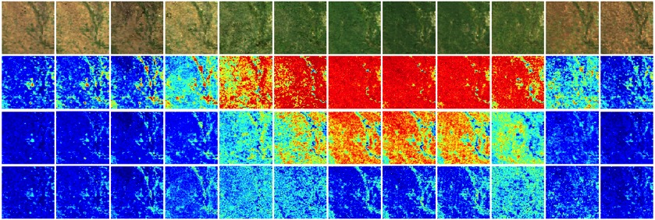
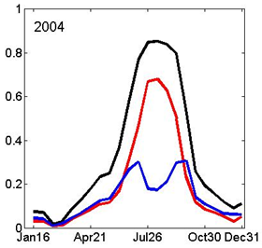
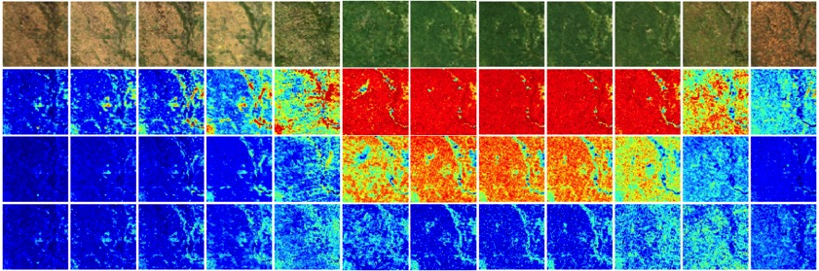
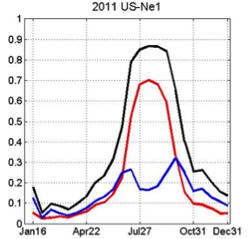
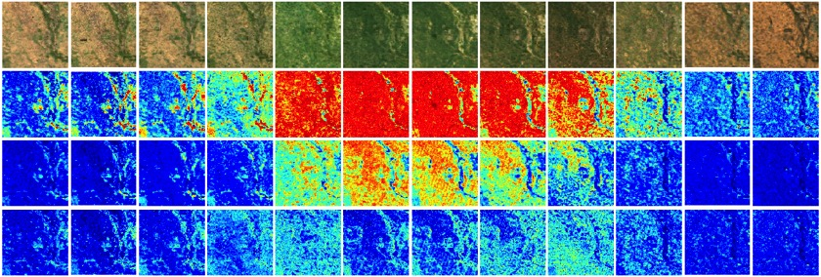
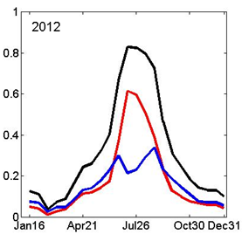

Study area: 50 km x 50 km surrounding the US-Ne1 crop flux tower site (US-Ne1) in Nebraska
DOY | 112 | 128 | 144 | 160 | 176 | 192 | 208 | 224 | 240 | 256 | 272 | 288
2004 | a)
 | b)
 | c)
 | d)
2011 | a)
 | b)
 | c) d)
2012 | a)
 | b)
 | c)
 | d)
a) RGB images , b) maps of fAPAR_{canopy}, c) maps of fAPAR_{PV}, and d) maps of fAPAR_{NPV}.
Notes:
Now move to the whole 50 km x 50 km study area. Here we shows seasonal RGB images and maps of fAPAR_canopy, fAPARchl and fAPAR_npv every 16 days in 2004, 2011 and 2012. Here are the over all seasonal profiles of the three fAPARs in the three years. fAPAR_NPV has a bi-modal shape. Young leaves were developed, then chlorophyll content increased quickly. In fall, chlorophyll content decreased also quickly. 2012 drought hit two thirds of US. 2004 and 2011 two normal years. In normal years, the high fAPAR_canopy stay for at least 5 periods, the high fAPARchl stay for at least 4 periods, and low fAPAR_npv stay for at least for 3 periods. In contrast, in drought years, the high fAPAR_canopy stay less than 5 periods, the high fAPAR_chl stay less than 4 periods, and fAPAR_npv stay for less than three periods.

Slide 13
2004 US-Ne1
(bias)
(ratios)
Bias from fAPAR_{canopy} quantitatively equals to fAPAR_{NPV}. Bias from NDVI is (NDVI-fAPAR_{PV}) and bias from EVI is (EVI-fAPAR_{PV}).
From May to October, maximum bias comes from NDVI, then fAPAR_{canopy}, then EVI.
During peak of growing season, minimum bias from fAPAR_{canopy}, NDVI and EVI were 0.17, 0.15 and 0.12, respectively.
During peak of growing season, minimum ratio of fAPAR_{NPV}/fAPAR_{canopy} is 0.2, and the ratio of fAPAR_{NPV}/fAPAR_{PV} is 0.25.

Slide 14
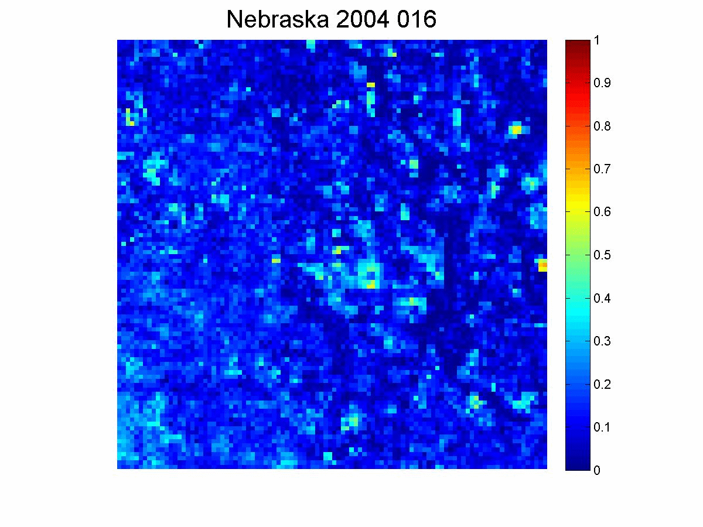
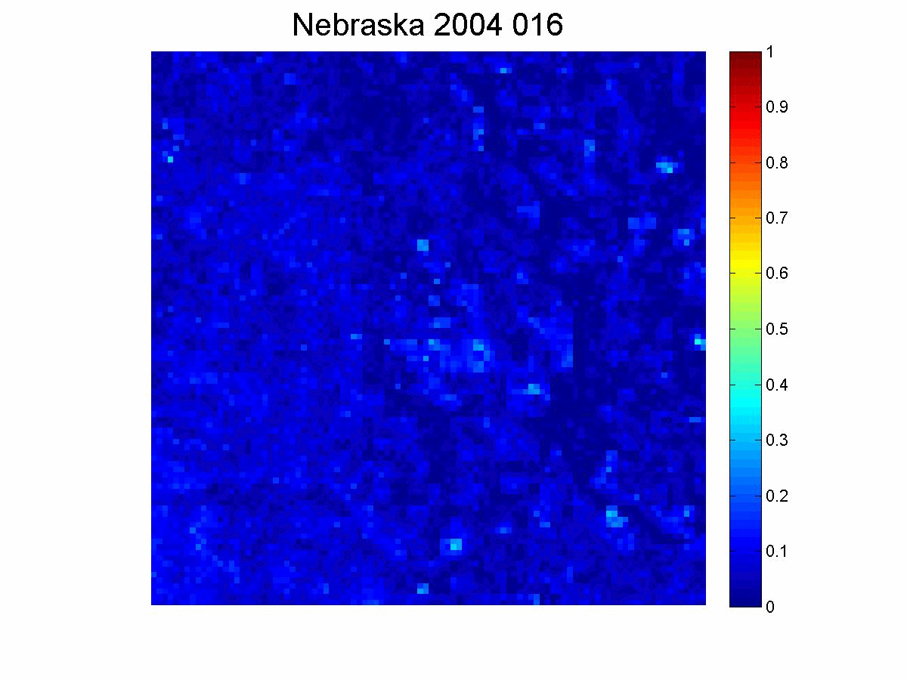
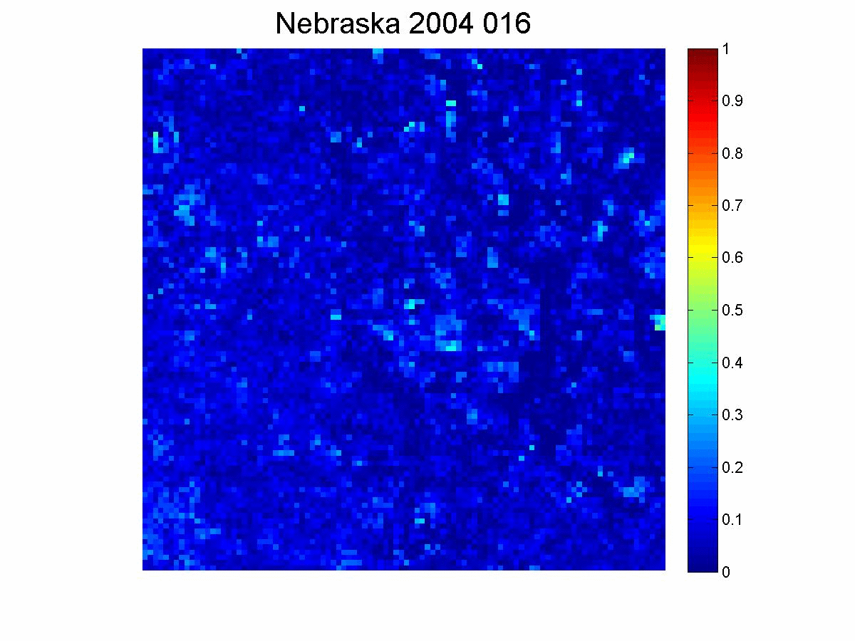

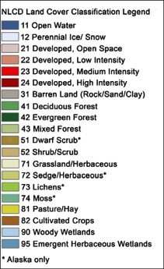
Movie 1
US-Ne1:
fAPAR_{canopy}
fAPAR_{PV}
fAPAR_{NPV}
Notes:
In spring, the grass or natural vegetation greens up first, then crops are planted and leaf out.

Slide 15
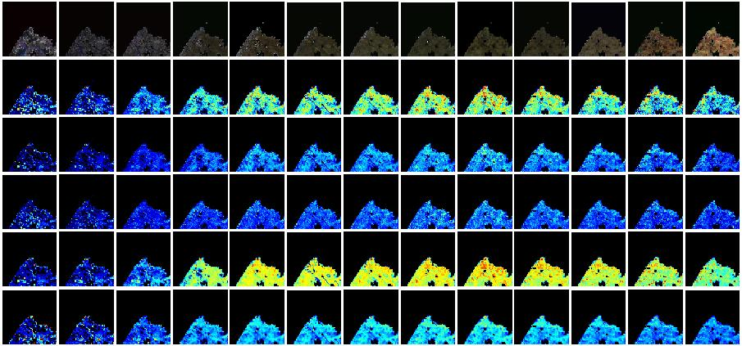
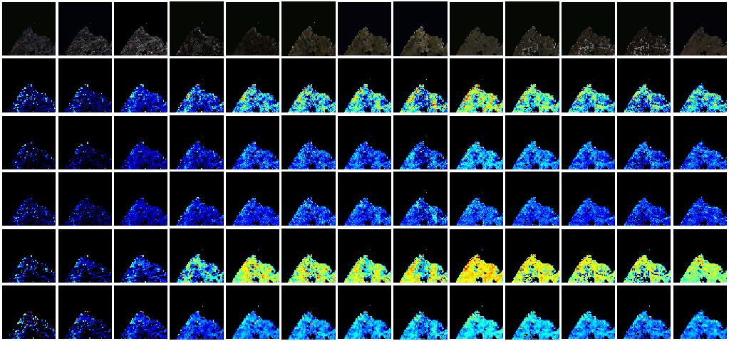
DOY | 160 | 168 | 176 | 184 | 192 | 200 | 208 | 216 | 224 | 232 | 240 | 248 | 256
US-Brw
2006 | a)
 | b)
 | c)
 | d) e) f)
2014 | a)
 | b)
 | c)
 | d) e) f)
RGB
fAPAR_{canopy}
fAPAR_{PV}
fAPAR_{NPV}
NDVI
EVI
RGB
fAPAR_{canopy}
fAPAR_{PV}
fAPAR_{NPV}
NDVI
EVI
a) RGB images, b) maps of fAPAR_{canopy}, c) maps of fAPAR_{PV}, d) maps of fAPAR_{NPV},
e) maps of NDVI, and f) maps of EVI.
Notes:
The third site I will talk is the northern most flux tower site of US – the Barrow site in Alaska.
Here we shows seasonal RGB images and maps of fAPAR_canopy, fAPARchl and fAPAR_npv, NDVI and EVI every 8 days in 2006 and 2012.

Slide 16
US-Brw
Overall seasonal profiles
2006
2014
NDVI and EVI could be negative for some MODIS pixels of this area
During peak of growing season, NDVI>fAPAR_{canopy}>EVI>fAPAR_{PV}>fAPAR_{NPV}
fAPAR_{PV} maximum value is about 0.24, NDVI 0.6, fAPAR_{canopy} 0.47, EVI 0.35, fAPAR_{NPV} 0.21
In contrast to crop site US-Ne1, during growing season, fAPAR_{NPV} increases with fAPAR_{PV} until peak of growing season and decreases with fAPAR_{PV} after.
Notes:
Here are the over all seasonal profiles of the three fAPARs, NDVI and EVI 2006 and 2014.

Slide 17
US-Brw
Biases
(a) bias in 2006
(b) bias in 2014
Bias from fAPAR_{canopy} quantitatively equals to fAPAR_{NPV}. Red lines represent bias from NDVI and blue lines represent bias from EVI
The biases change seasonally
The bias from fAPAR_{canopy} ranges from ~0.09 – 0.21, bias with NDVI can reach 0.35, bias with EVI can reach 0.1

Slide 18
US-Brw
Ratios
(a) ratios in 2006
(b) ratios in 2014
The ratio of fAPAR_{NPV}/fAPAR_{canopy}> 40% for whole growing season
The ratio of fAPAR_{NPV}/fAPAR_{PV}>80% in July and August

Slide 19
US-Brw
Long term trend:
NDVI: increasing
EVI: very slightly increasing
fAPARcanopy: flat
fAPARPV:flat
fAPARNPV:flat
IF long-term NDVI is increasing, it does not necessarily mean it becomes greener or has greater photosynthetic capacity

Slide 20
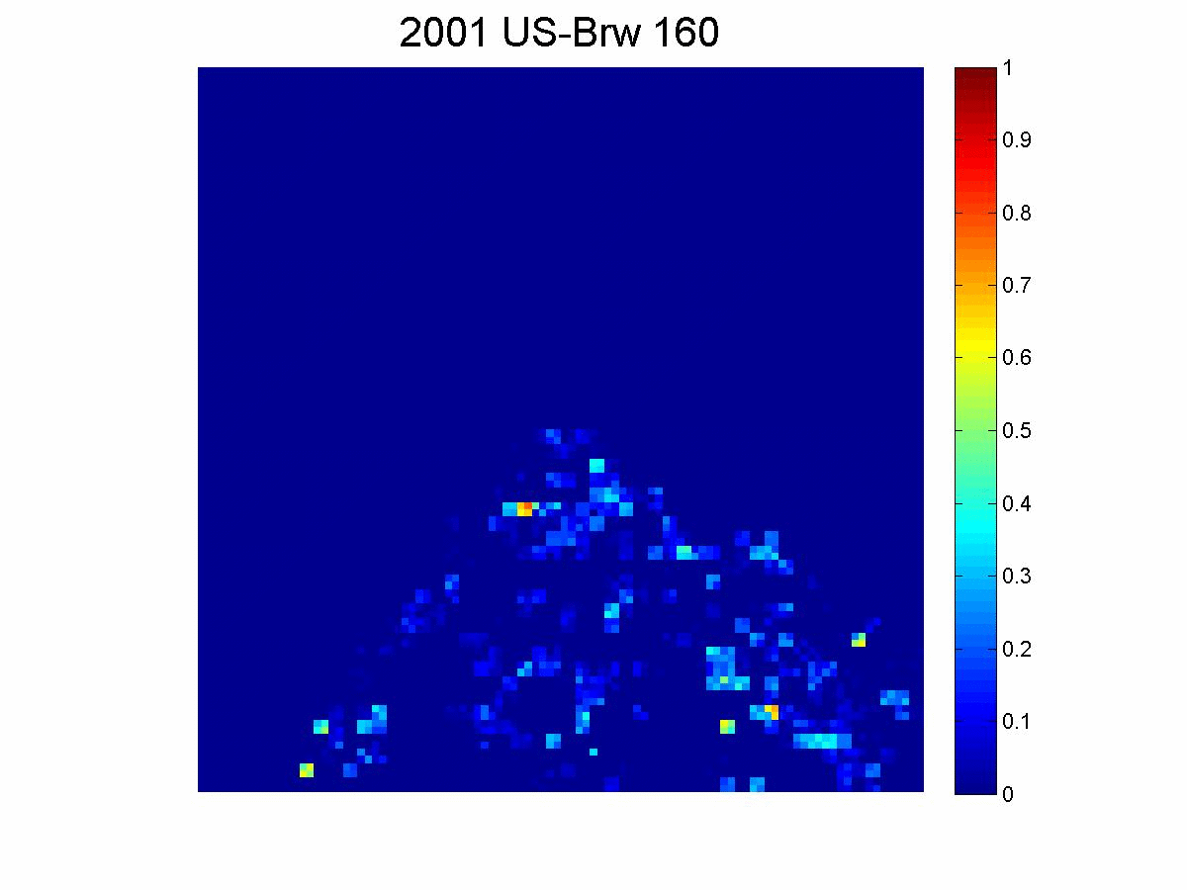
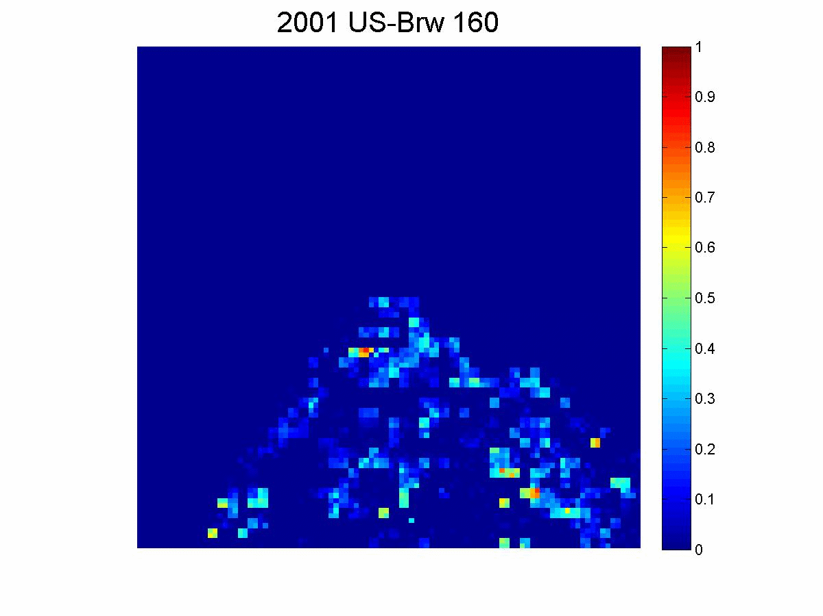
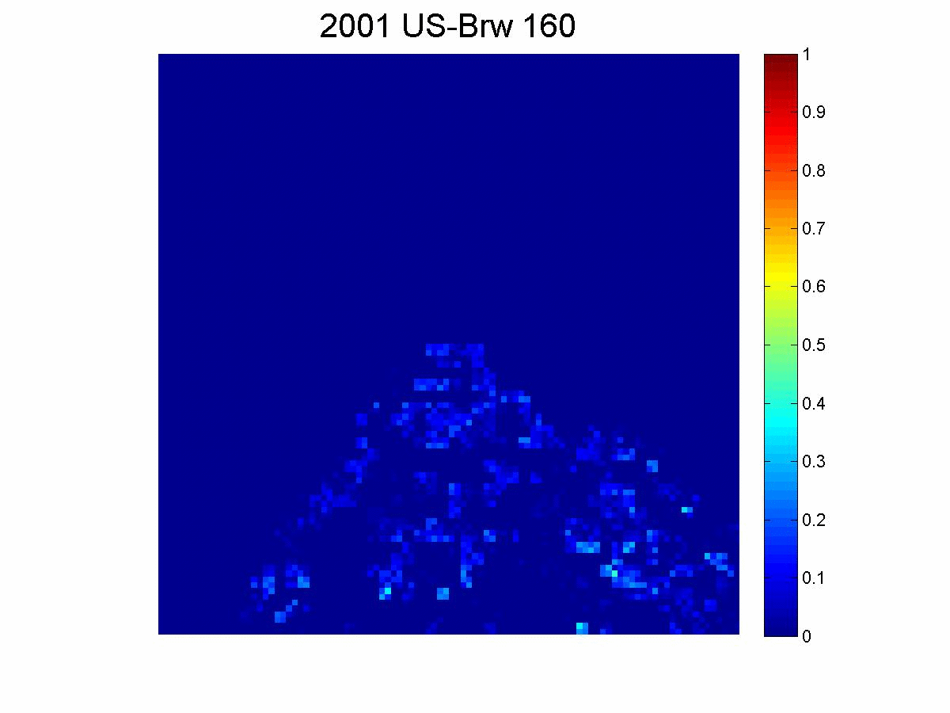
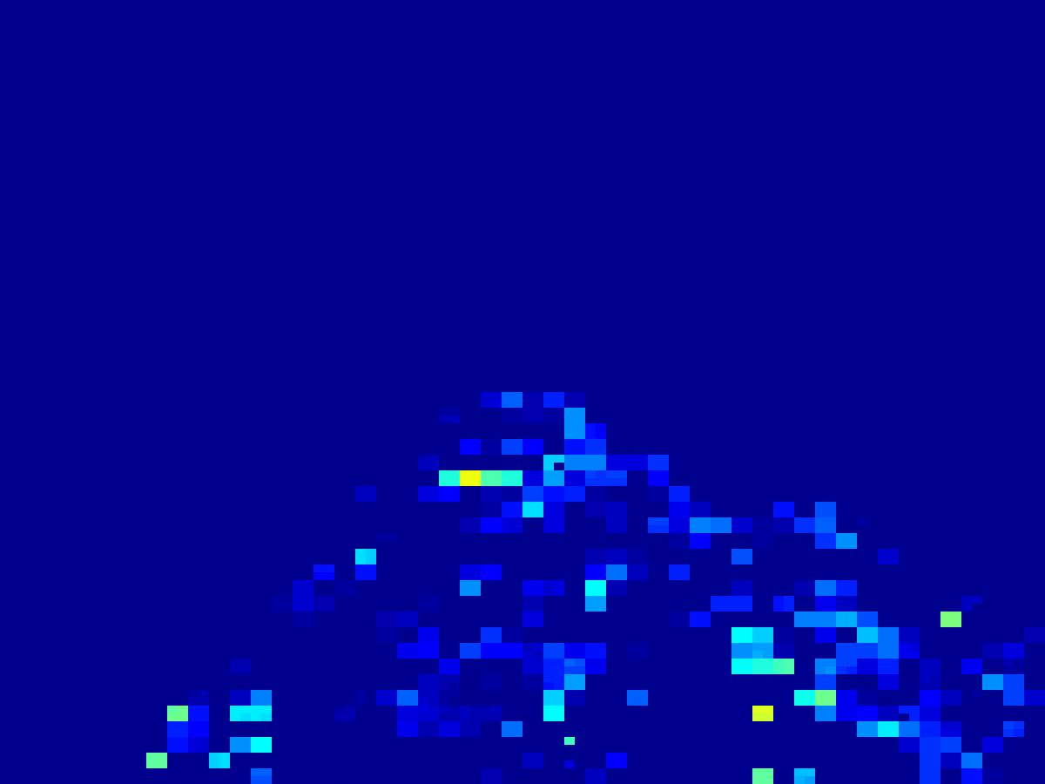
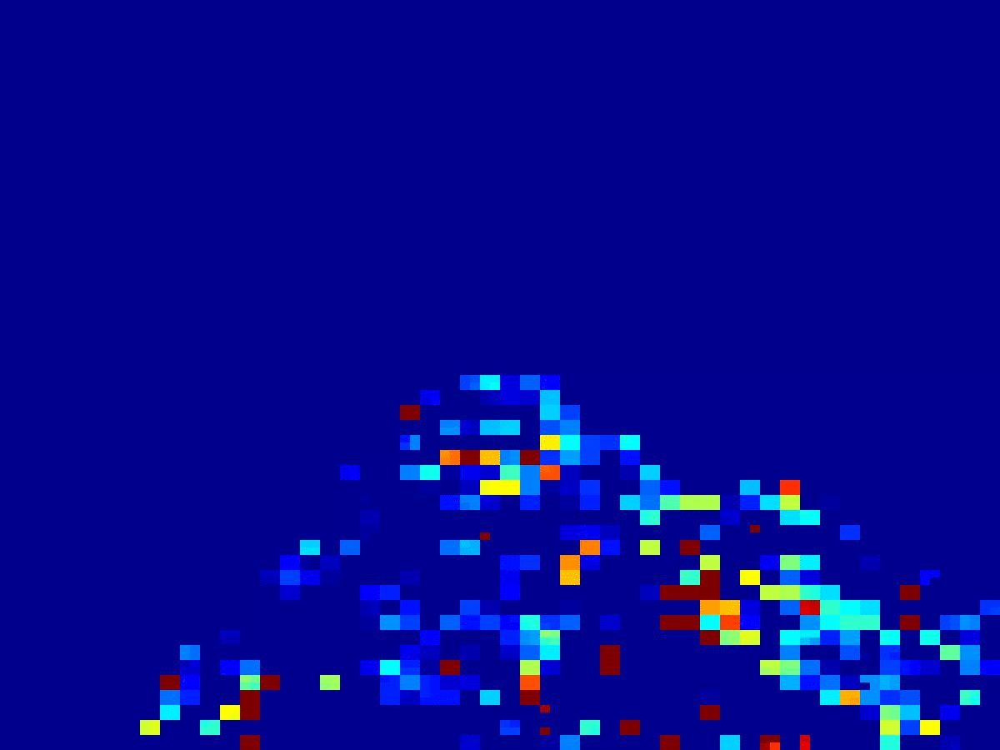
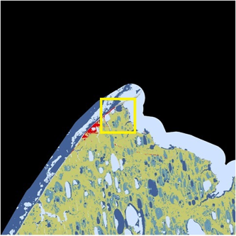
US-Brw
Movie 2
fAPARcanopy fAPAR_{PV} fAPAR_{NPV}
NDVI EVI

Slide 21
Summary
Uncertainties in estimates of fAPAR for photosynthesis are significant when approximated with fAPAR_{canopy}, NDVI and EVI
The uncertainties change with plant functional types, spatially and temporally
During peak of plant growing season, the fAPAR_{NPV} can be as much as 20% - 50% of fAPAR_{canopy}, and 25% - 100% of fAPAR_{PV}.
Shape of seasonal fAPAR_{NPV} profile changes with plant functional types (US-Ne1 has a unique bi-modal shape)
The algorithm can be modified for VIIRS to produce the fAPAR_{canopy}, fAPAR_{PV} and fAPAR_{NPV} products.
Long term trend of NDVI might be different from long term trends of fAPAR_{canopy}, fAPAR_{PV} and/or fAPAR_{NPV}. What should be used to indicate long term trends?

Slide 22
Thank you!
Notes:
In spring, the grass or natural vegetation greens up first, then crops are planted and leaf out.

