Slide 1
Testing the Dynamic Habitat Indices from MODIS for biodiversity and conservation
Volker C. Radeloff, University of Wisconsin-Madison
M. Hobi, M. Dubinin, N. Suttidate, E. Razenkova
B. Borisov, T. Brooks, M. Clayton, N. Coops, C. Graham, T. Ives, T. Kuemmerle, A. Pidgeon, C. Rondinini
NASA MODIS Science Team Meeting, 6/9/2016

Slide 2
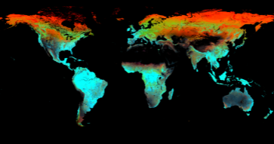
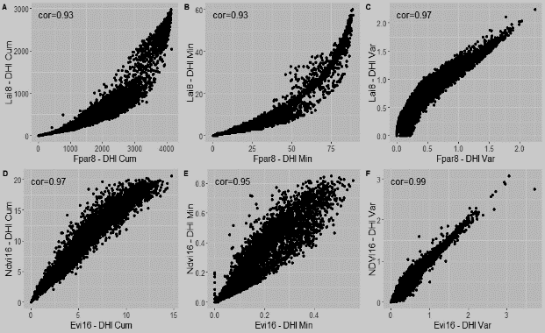
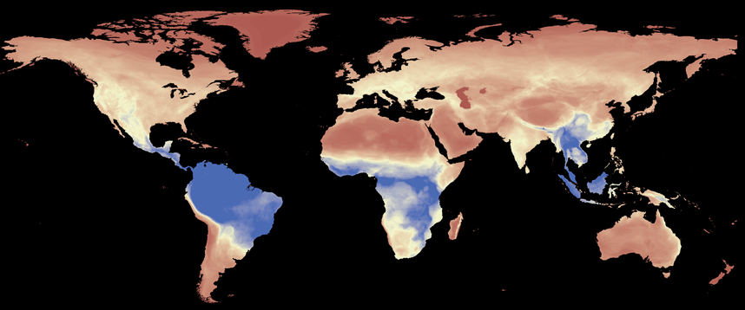
Outline
Background: the Dynamic Habitat Indices
Datasets: Composite and annual DHIs
Case studies: DHIs and biodiversity

Slide 3
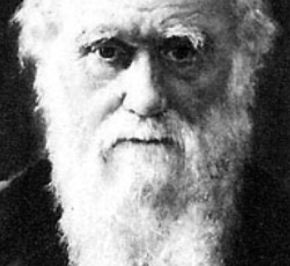
The Dynamic Habitat Indices
Understanding biodiversity patterns is a BIG scientific question

Slide 4
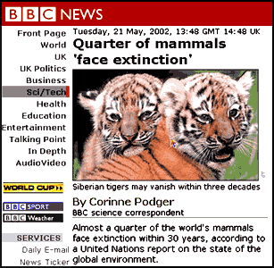
The Dynamic Habitat Indices
Understanding biodiversity patterns is a BIG scientific question
Biodiversity loss is a major challenge for society

Slide 5
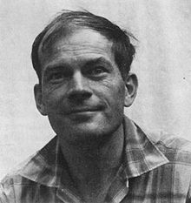
The Dynamic Habitat Indices
Biodiversity theory predicts high species richness where:
Available energy is high
Minimum energy is high
Variability in energy is low

Slide 6
SAVI
SPOT Vegetation
MODIS
LAI
EVI
AVHRR
fPAR
NPP
NDVI

Slide 7
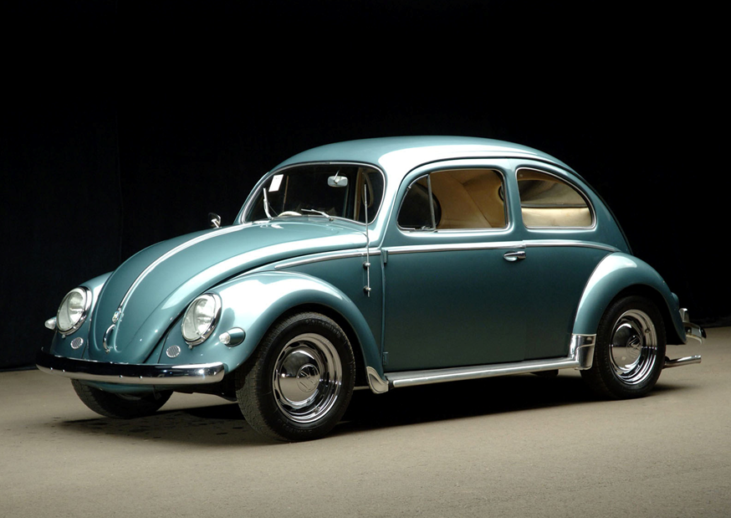

Slide 8
NDVI

Slide 9
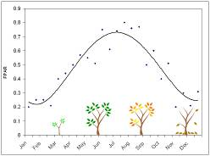
The Dynamic Habitat Indices
Plant productivity is a proxy for the energy available for biotic communities
The DHIs summarize three key attributes of annual productivity
Cumulative
Minimum
Variability (CV)

Slide 10
FPAR – Cumulative
The Dynamic Habitat Indices

Slide 11
FPAR – Minimum
The Dynamic Habitat Indices

Slide 12
FPAR – Variability
The Dynamic Habitat Indices

Slide 13
FPAR DHIs Variability, Cumulative, and Minimum in RGB
The Dynamic Habitat Indices

Slide 14
Outline
Background: the Dynamic Habitat Indices
Datasets: Composite and annual DHIs
Case studies: DHIs and biodiversity

Slide 15
Datasets
MODIS Composite DHIs for 2003-2014
Why: MODIS vegetation data have some noise and phenology varies among years
The median of all observations for a date
Only good MODIS QA flags
No-data as functional zeros
Northern Latitudes
Snow and deserts

Slide 16
FPAR July 2002
Datasets

Slide 17
FPAR January 2002
Datasets

Slide 18
Datasets
Index | Product | Platform | Temporal resolution | Spatial resolution | Composite DHI
NDVI | MOD13A2 | Terra | 16-day | 1000 m | Done
NDVI | MOD13A1 | Terra | 16-day | 500 m | In progress
EVI | MOD13A2 | Terra | 16-day | 1000 m | Done
EVI | MOD13A1 | Terra | 16-day | 500 m | In progress
FPAR | MCD15A2 | Terra/Aqua | 8-day | 1000 m | Done
FPAR | MCD15A3 | Terra/Aqua | 4-day | 1000 m | Done
LAI | MCD15A2 | Terra/Aqua | 8-day | 1000 m | Done
LAI | MCD15A3 | Terra/Aqua | 4-day | 1000 m | Done
GPP | MOD17A2 | Terra | 8-day | 1000 m | Done
 |  | MOD13A2 Terra |  | MOD15A2 Terra+Aqua |  | MOD17A2 Terra
 |  | NDVI | EVI | FPAR | LAI | GPP
16-day | 1-km | √ | √ | NA | NA | NA
8-day | 1-km | NA | NA | √ | √ | …

Slide 19
Composite EVI DHIs
Datasets

Slide 20
Composite LAI DHIs
Datasets

Slide 21
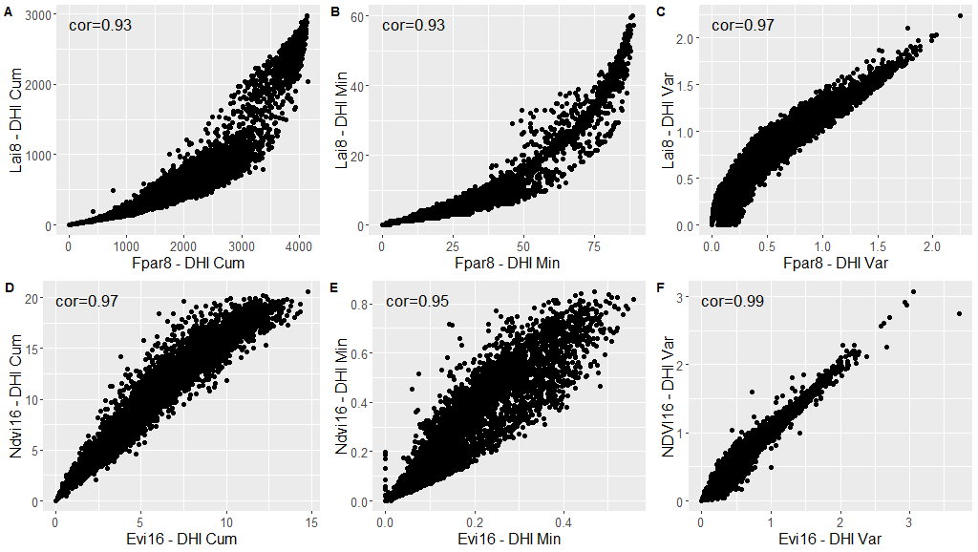
Datasets

Slide 22
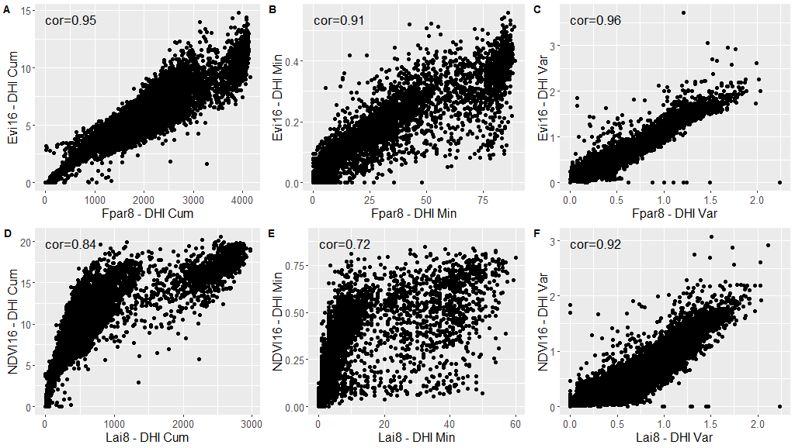
Datasets

Slide 23
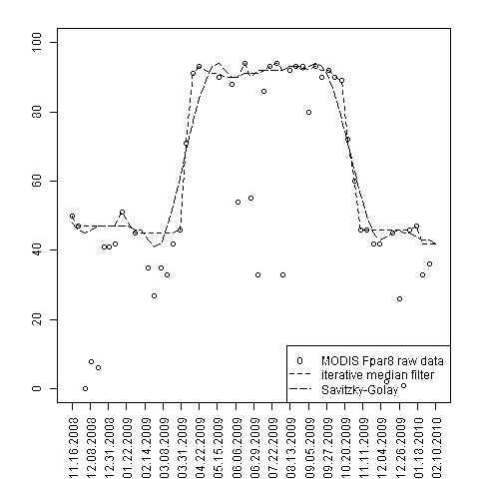
Datasets
Annual DHIs
Why: One person’s noise is another’s data
Smoothing annual phenology
Iterative median
Savitzky-Golay

Slide 24
Datasets
Index | Product | Platform | Temporal resolution | Spatial resolution | DHIs yearly | DHIs smoothed
NDVI | MOD13A2 | Terra | 16-day | 1000 m | Done | I.P.
EVI | MOD13A2 | Terra | 16-day | 1000 m | I.P. | I.P.
FPAR | MCD15A2 | Terra/Aqua | 8-day | 1000 m | Done | Done
FPAR | MCD15A3 | Terra/Aqua | 4-day | 1000 m | Done | N.A.
LAI | MCD15A2 | Terra/Aqua | 8-day | 1000 m | Done | I.P.
LAI | MCD15A3 | Terra/Aqua | 4-day | 1000 m | Done | N.A.
GPP | MOD17A2 | Terra | 8-day | 1000 m | Done | I.P.
 |  | MOD13A2 Terra |  | MOD15A2 Terra+Aqua |  | MOD17A2 Terra
 |  | NDVI | EVI | FPAR | LAI | GPP
16-day | 1-km | √ | √ | NA | NA | NA
8-day | 1-km | NA | NA | √ | √ | …

Slide 25
FPAR DHIs 2003
Datasets

Slide 26
FPAR DHIs 2012
Datasets

Slide 27
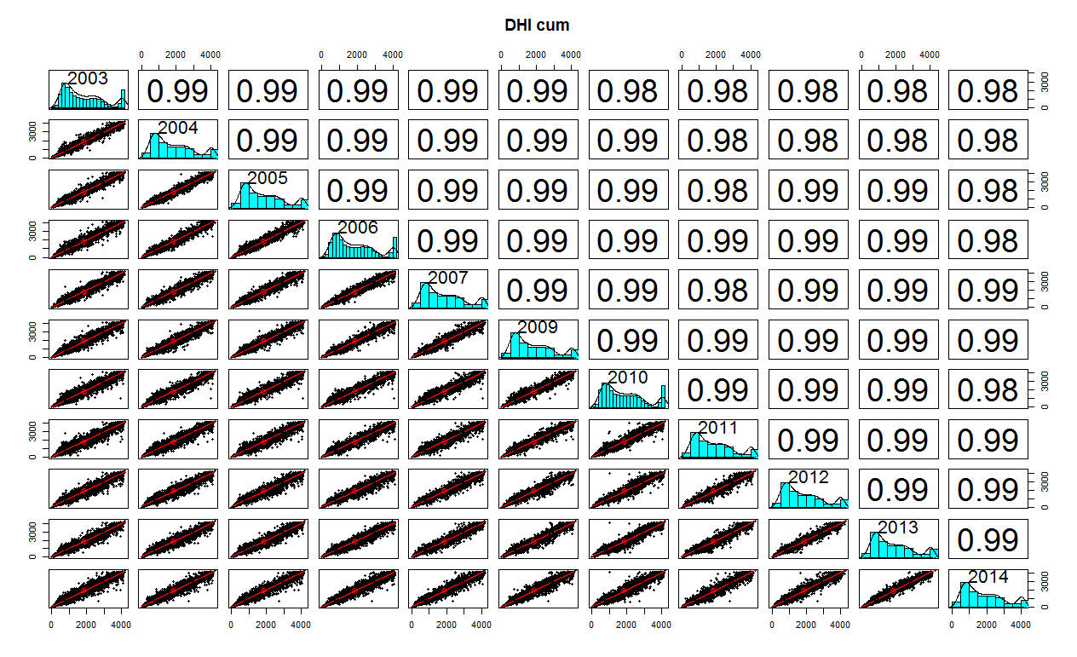
Datasets

Slide 28
Outline
Background: the Dynamic Habitat Indices
Datasets: Composite and annual DHIs
Case studies: DHIs and biodiversity

Slide 29
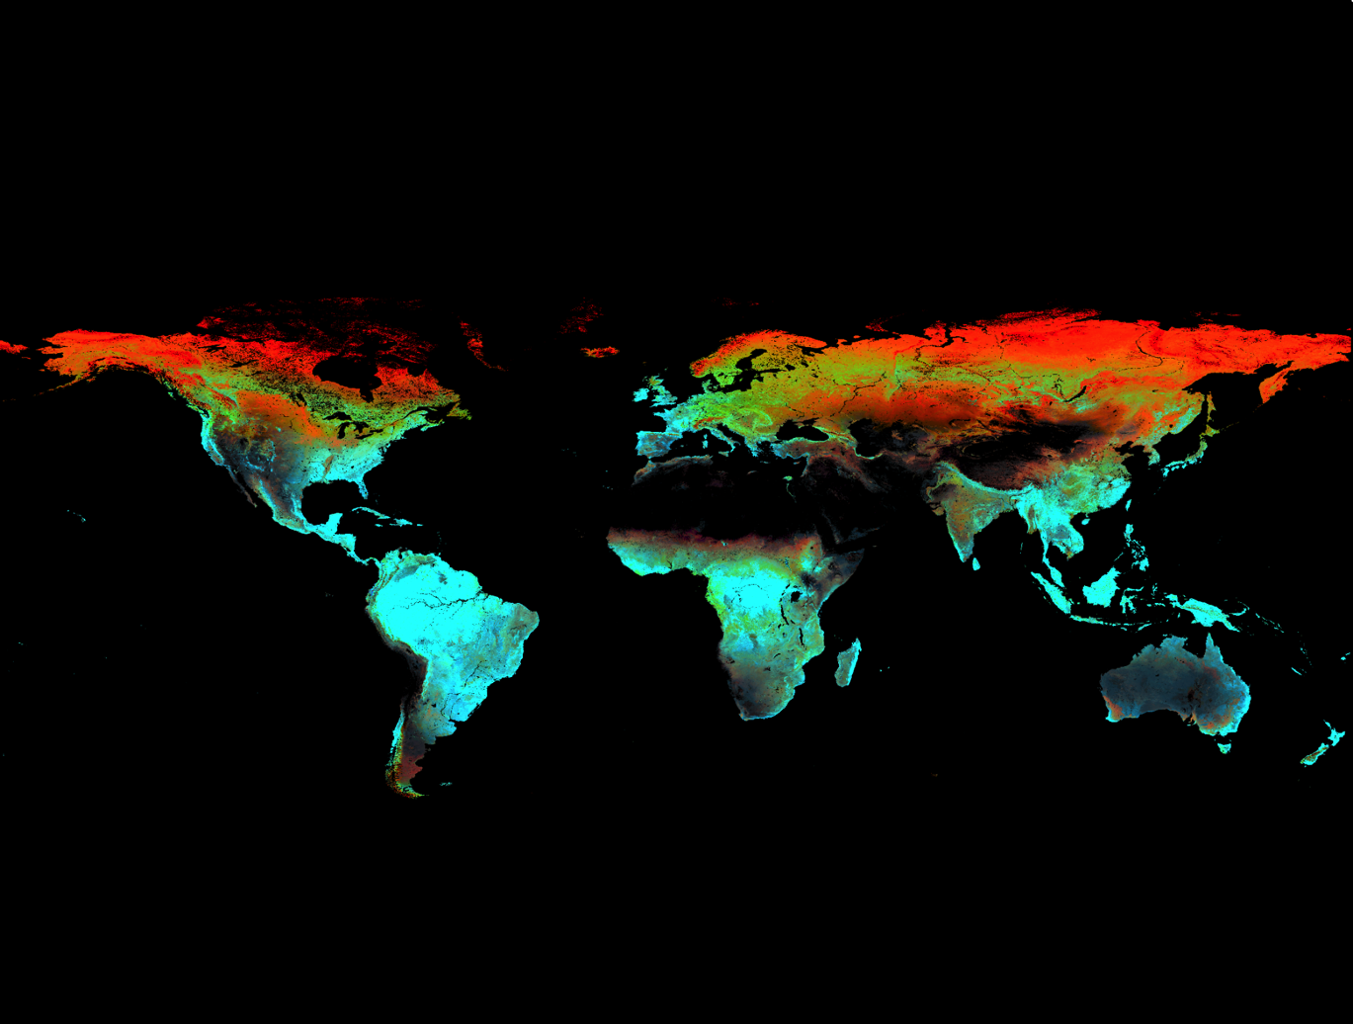
Composite FPAR DHIs
DHIs and global biodiversity

Slide 30
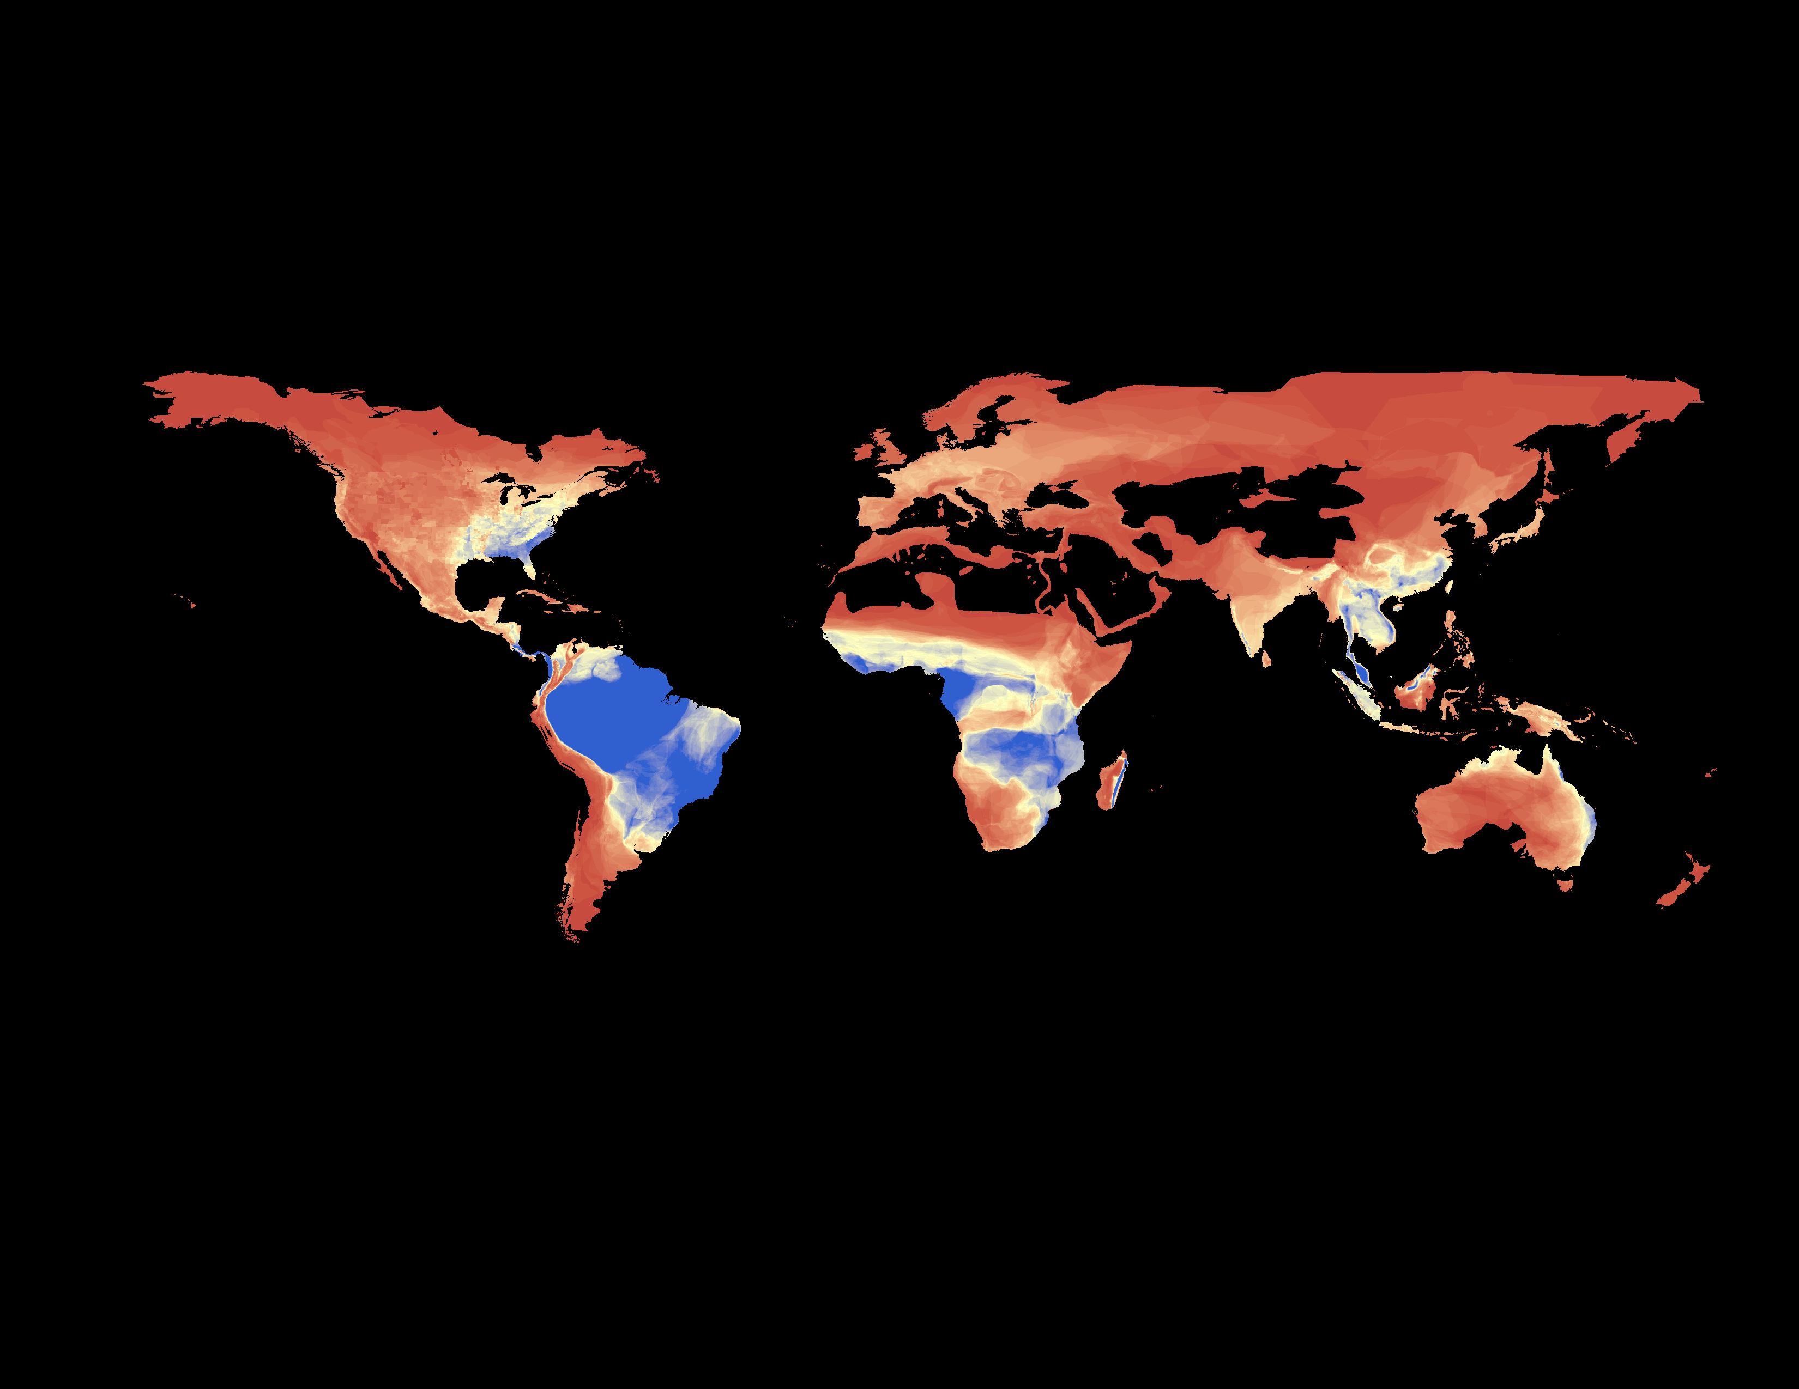
Amphibians
DHIs and global biodiversity
Amphibians

Slide 31
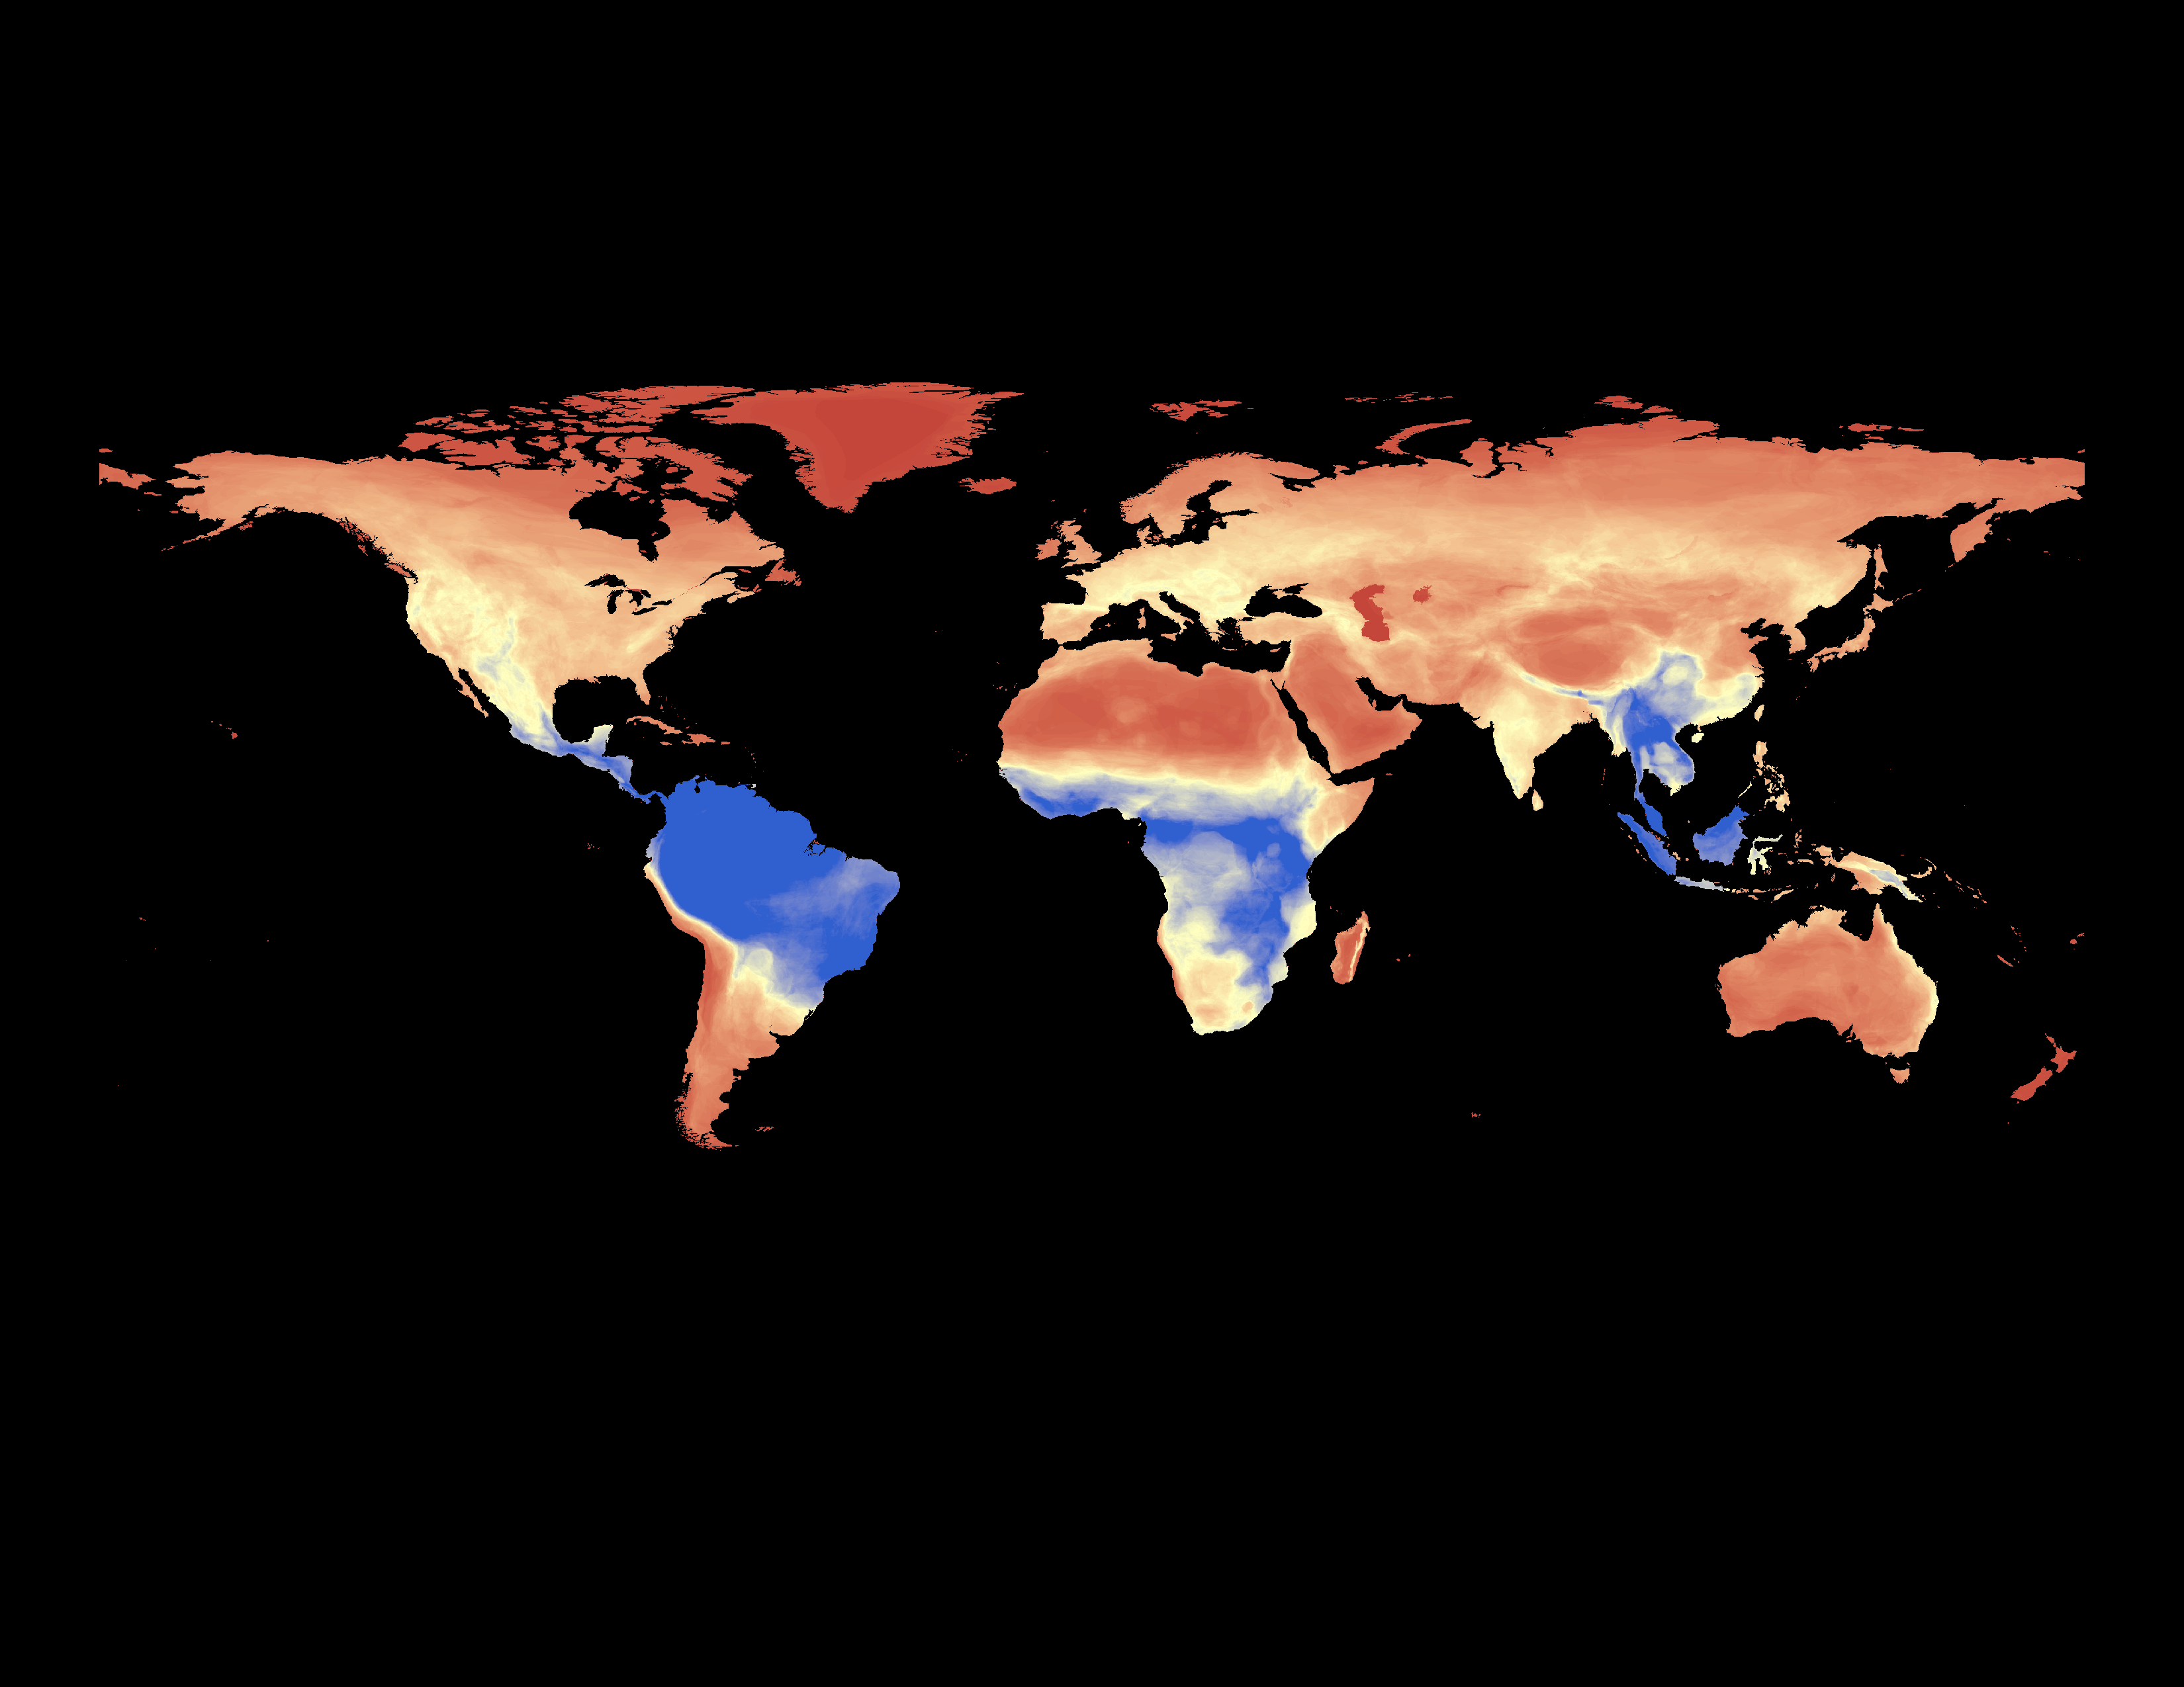
Mammals
DHIs and global biodiversity
Mammals

Slide 32
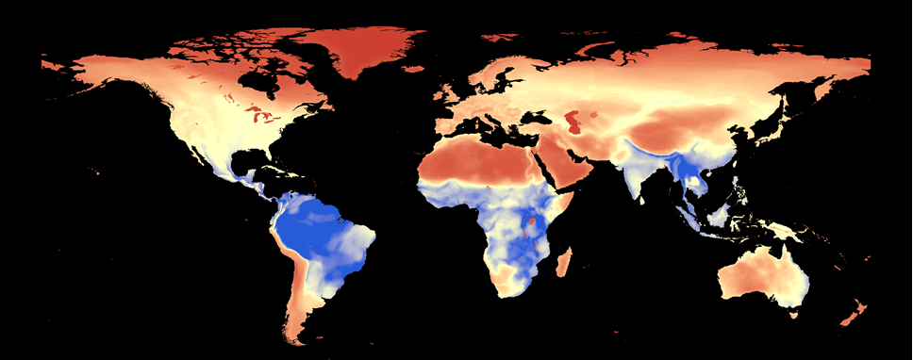
Mammals
DHIs and global biodiversity
Birds

Slide 33
DHIs and global biodiversity
 | DHI-Cumulative | DHI-Minimum | DHI-Variability
Amphibians | 0.68 | 0.70 | -0.51
Birds | 0.70 | 0.71 | -0.68
Mammals | 0.70 | 0.71 | -0.58
Pearson’s correlation coefficients (r)

Slide 34
DHIs and global biodiversity

Slide 35
Composite FPAR DHIs
DHIs and global biodiversity

Slide 36
Composite FPAR DHIs
DHIs and global biodiversity

Slide 37
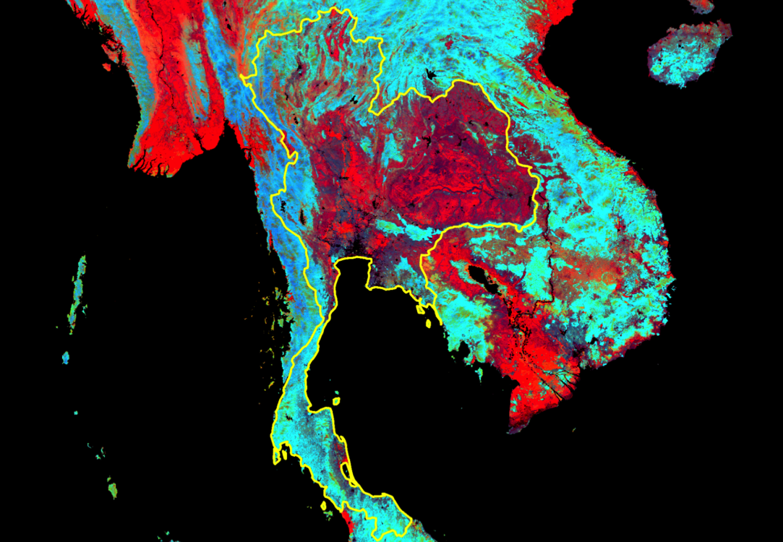
Composite FPAR DHIs

Slide 38
Composite FPAR DHIs

Slide 39
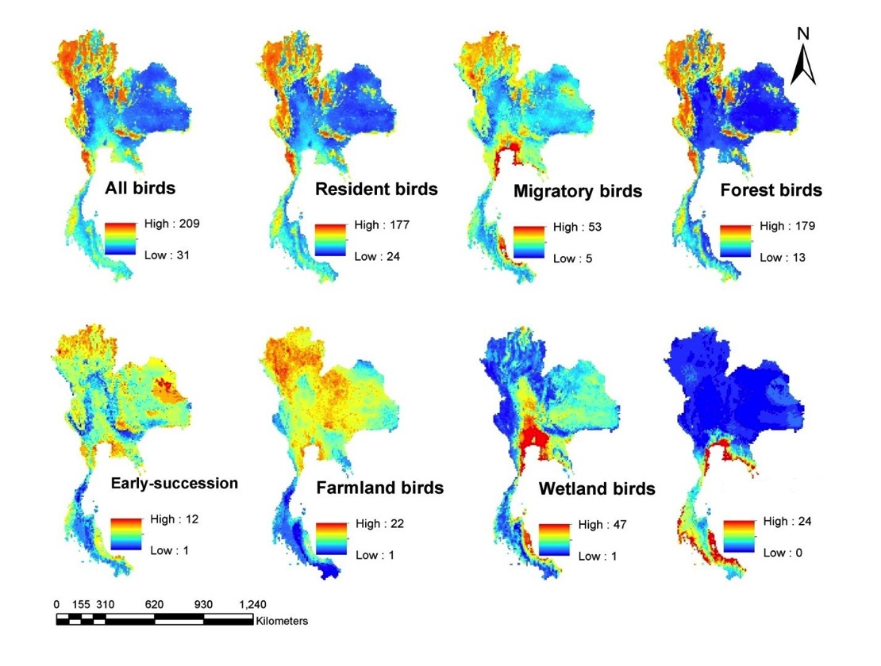
Thailand – bird species richness

Slide 40
Thailand – bird species richness
R² = 0.63

Slide 41
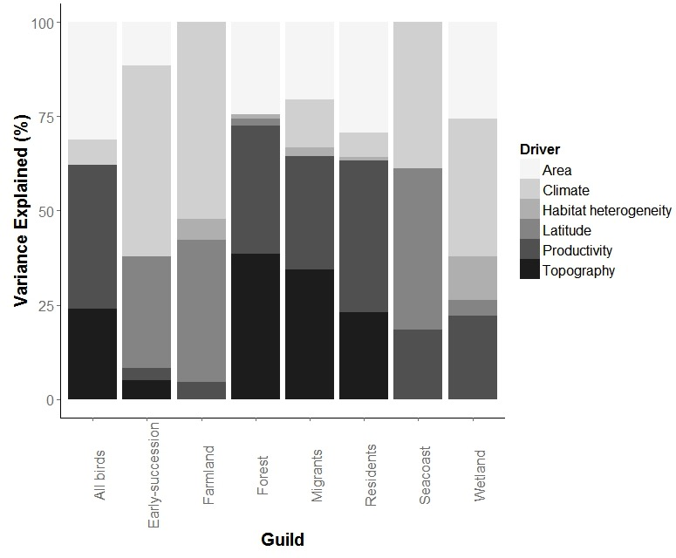
Thailand – bird species richness

Slide 42
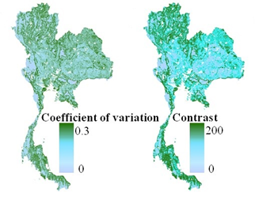
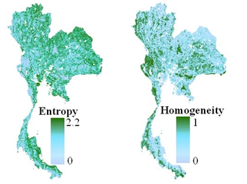
Thailand – Bird habitat
Texture of FPAR DHI-1 (cumulative)
Notes:
Composite Fpar
3x3 window

Slide 43
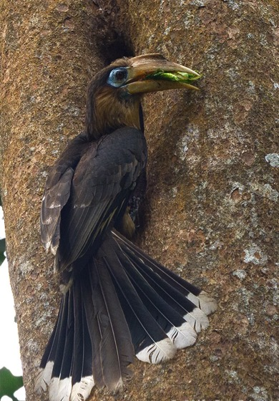
Thailand – Bird habitat
Anorrhinus tickelli
Habitat composition model
Habitat + texture model
High
High
Low
Low
Notes:
The predicted potential distributions of Tickell’s Brown Hornbills showed a broad agreement with the currently known distribution from 15 protected areas across Thailand. However, the model combined texture, fragmentation, and composition agreed better with the known range whereas the habitat composition model was over-predicted suitable habitat.

Slide 44
Outline
Background: the Dynamic Habitat Indices
Datasets: Composite and annual DHIs
Case studies: DHIs and biodiversity

Slide 45
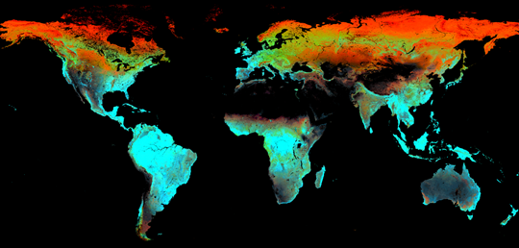
Conclusions
I. Background
The DHIs are based on biodiversity theory
Three aspects of productivity that are key for biodiversity

Slide 46
Conclusions
II. Datasets: largely completed
Composite DHIs
Annual DHIs
Next: online data viewing and downloading

Slide 47
Conclusions
III. DHIs and biodiversity
All three DHIs predict global species richness of amphibians, mammals, and birds
For birds in Thailand, cumulative DHI mattered most
Complementary to other predictors
More in progress…

Slide 48
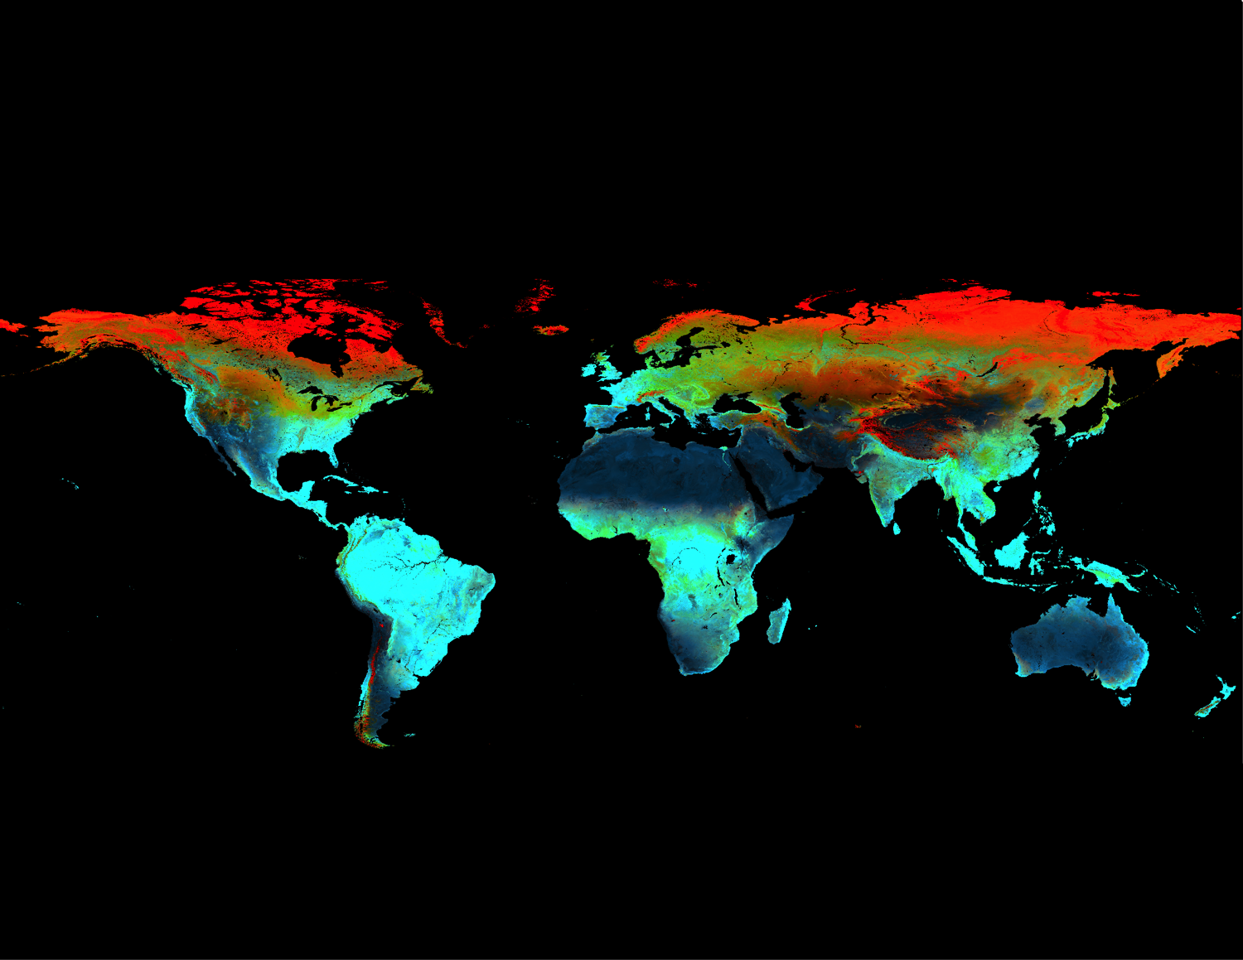
Thank you!

Slide 50
Thailand – DHI-1 texture
Lowland Evergreen
Dry Evergreen
Montane Evergreen
Mixed Deciduous
Dry Dipterocarp
Secondary-growth
Core
Edge
Perforation
Bridge
Loop
Notes:
Composite Fpar
3x3 window

Slide 51
Thailand – Bird habitat
Notes:
Composite Fpar
3x3 window

