Slide 1
MODIS/VIIRS Snow and Ice
George Riggs
NASA/GSFC Code 615/SSAI
Mark Tschudi
University of Colorado
Miguel Roman
NASA/GSFC Code 619
Dorothy K. Hall
Under Contract to the Terrestrial Information
Systems Laboratory, Code 619

Slide 2
MODIS C6 Snow Algorithm
Detection of snow cover extent for hydrologic and climatology applications or research
Snow cover detection uses the Normalized Difference Snow Index (NDSI) technique
Snow cover always has NDSI > 0.0
A surface with NDSI > 0.0 is not always snow cover
Data screens are applied to alleviate snow commission errors and flag uncertain snow cover detections
Fractional snow cover (FSC) is not calculated in C6

Slide 3
MODIS C6 Snow Algorithm
NDSI snow detection applied to all land and inland water pixels. MOD02HKM TOA reflectance input. MODIS land/water mask used.
Clouds masked with MODIS cloud mask product MOD35_L2.
Data screens applied to alleviate snow commission errors and flag uncertain snow cover detection situations.
Inland water flag
Low visible reflectance screen
Low NDSI screen
Surface temperature and height screen/flag
High SWIR screen/flag
Solar zenith flag
QA bit flags are set for snow cover detections that are changed to no snow and are set for higher uncertainty in snow cover detection, and for high solar zenith angles.
The NDSI values are output for all land and inland water pixels -- cloud mask is not applied.

Slide 4
MODIS C5 to C6 Snow Products Data Content Comparison
MOD10_L2 SDSs
C5 | C6
Snow_Cover , binary snow cover, with masked features
Fractional_Snow_Cover, 0-100% with masked features | NDSI_Snow_Cover, -- Snow cover map by NDSI in 0-100 range, with masked features.
 | NDSI_Snow_Cover_Algorithm_Flags_QA – bit flags for data screens applied in the algorithm.
Snow_Cover_Pixel_QA, basic quality value | NDSI_Snow_Cover_Basic_QA, -- basic quality value
 | NDSI – NDSI value for all land and inland water pixels in a swath
Latitude (5km resolution) | Latitude (5km resolution)
Longitude (5km resolution) | Longitude (5km resolution)
MOD10A1 SDSs
C5 | C6
Snow_Cover , binary snow cover, with masked features
Fractional_Snow_Cover, 0-100% with masked features | NDSI_Snow_Cover, -- Snow cover map by NDSI in 0-100 range, with masked features.
 | NDSI_Snow_Cover_Algorithm_Flags_QA – bit flags for data screens applied in the algorithm.
Snow_Cover_Pixel_QA, basic quality value | NDSI_Snow_Cover_Basic_QA, -- basic quality value
 | NDSI – NDSI value for all land and inland water pixels in a swath
Snow_Albedo_Daily_Tile | Snow_Albedo_Daily_Tile
 | orbit_pnt (pointer)
 | granule_pnt (pointer)

Slide 5
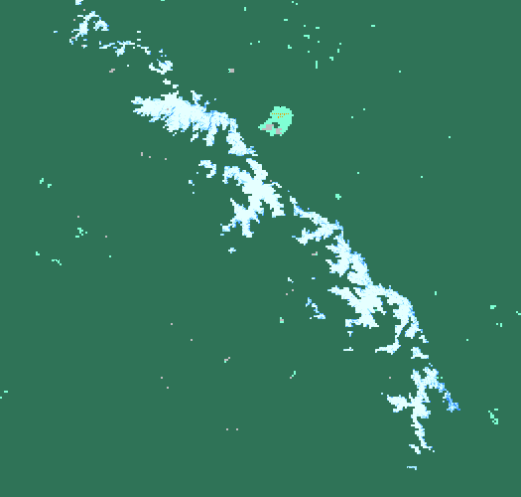
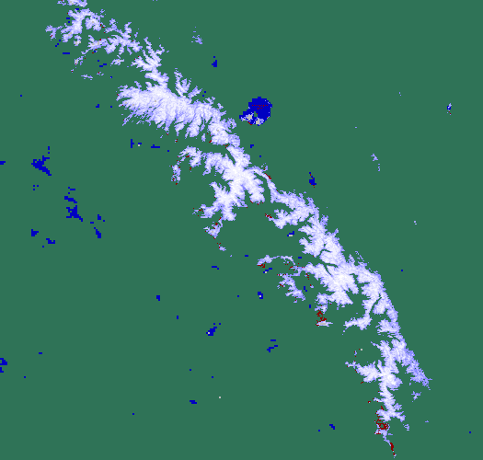
Spring – summer mountain snow cover omission error prevalent in C5 is corrected in C6
C5
C6
FRACTIONAL
SNOW COVER
NDSI
SNOW COVER
91-100%
100
81-90%
90
71-80%
80
61-70%
70
51-60%
60
41-50%
50
21-40%
40
1-20%
30
0%
20
Cloud
0
Night
Cloud
No data
Water
MOD10_L2.A2010170.1900 (19 June) Sierra Nevada region. C6 has greatly improved accuracy compared to C5. C6 snow cover extent is ~2303 km² greater than in C5 which is ~ 74% improvement. The surface temperature screen is not applied on mountains in C6.

Slide 6
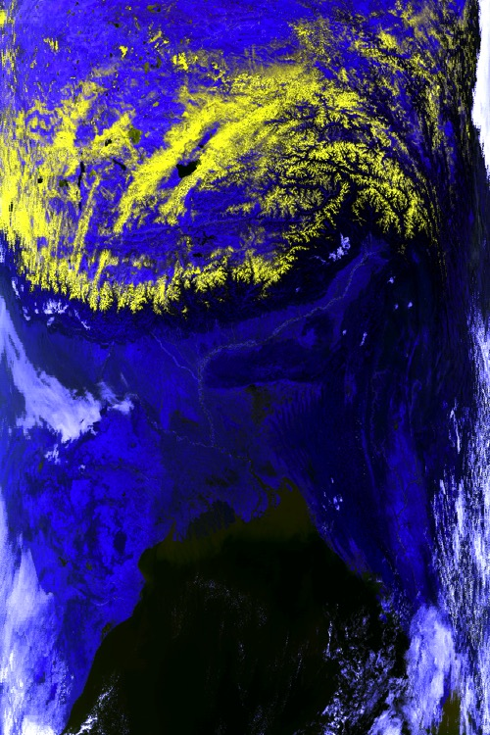
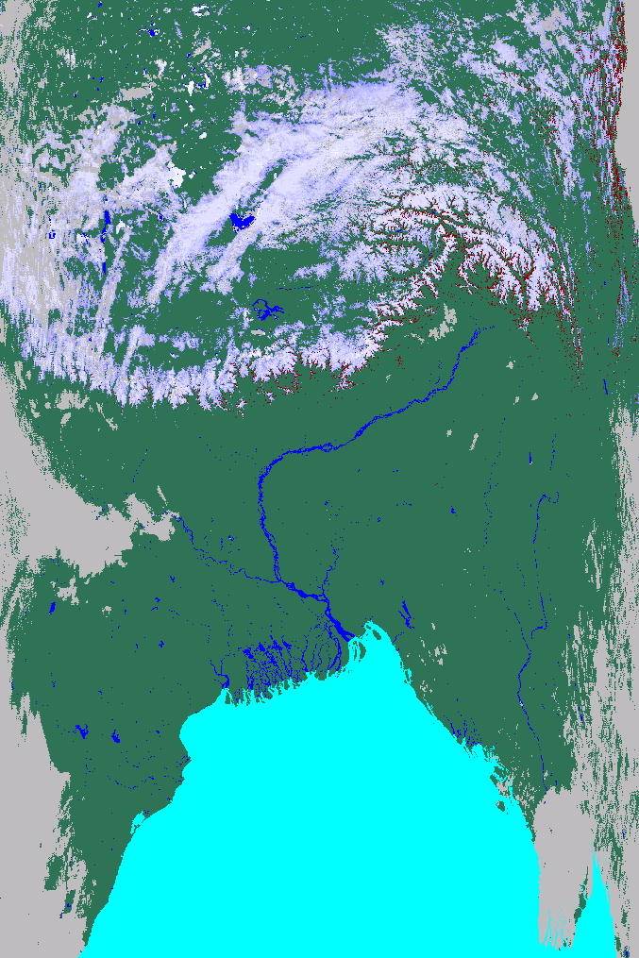
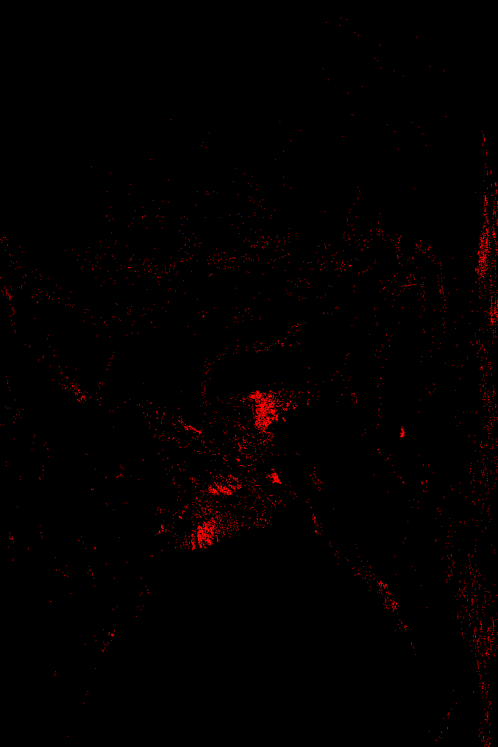
Low elevation & surface temperature screen on – not snow
MOD02HKM.A2003003.0440.006.*.hdf RGB of bands 1,4,6
MOD10_L2.A2003003.0440.006.*.hdf
NDSI_Snow_Cover
MOD10_L2.A2003003.0440.006.*.hdf
Mask of bit 3 of the QA algorithm flags
The combined surface temperature and height screen effectively blocks erroneous snow cover detections at low elevations that may not be blocked by other data screens, does not affect high elevation snow cover detection. Where that screen blocks snow commission error shown in red on right image. Himalayas in north half of swath, India and Bay of Bengal to the south.

Slide 7
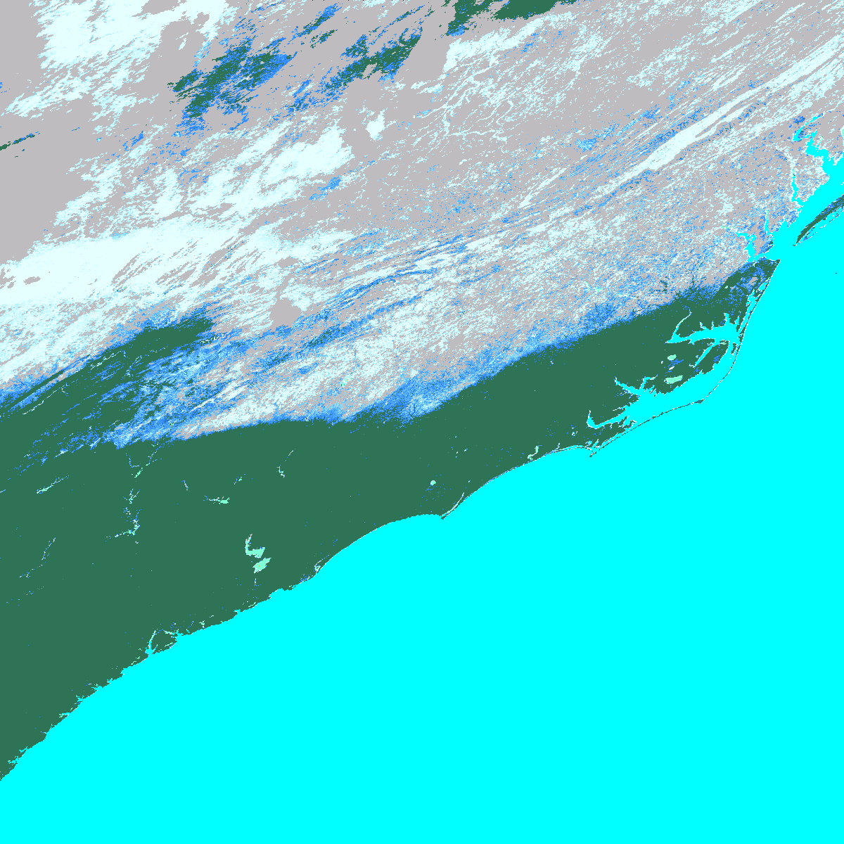
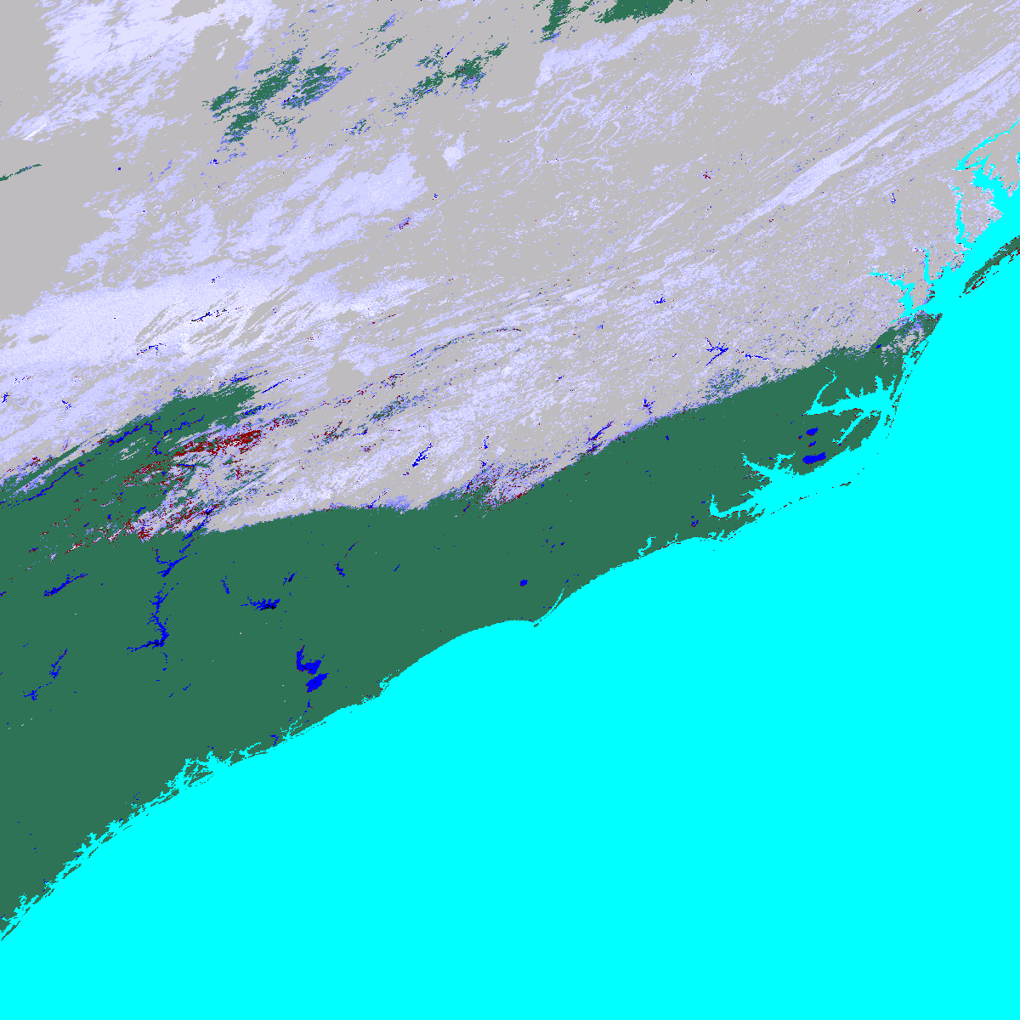
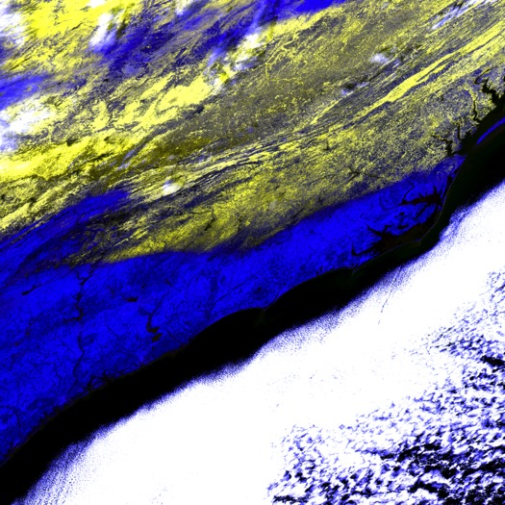
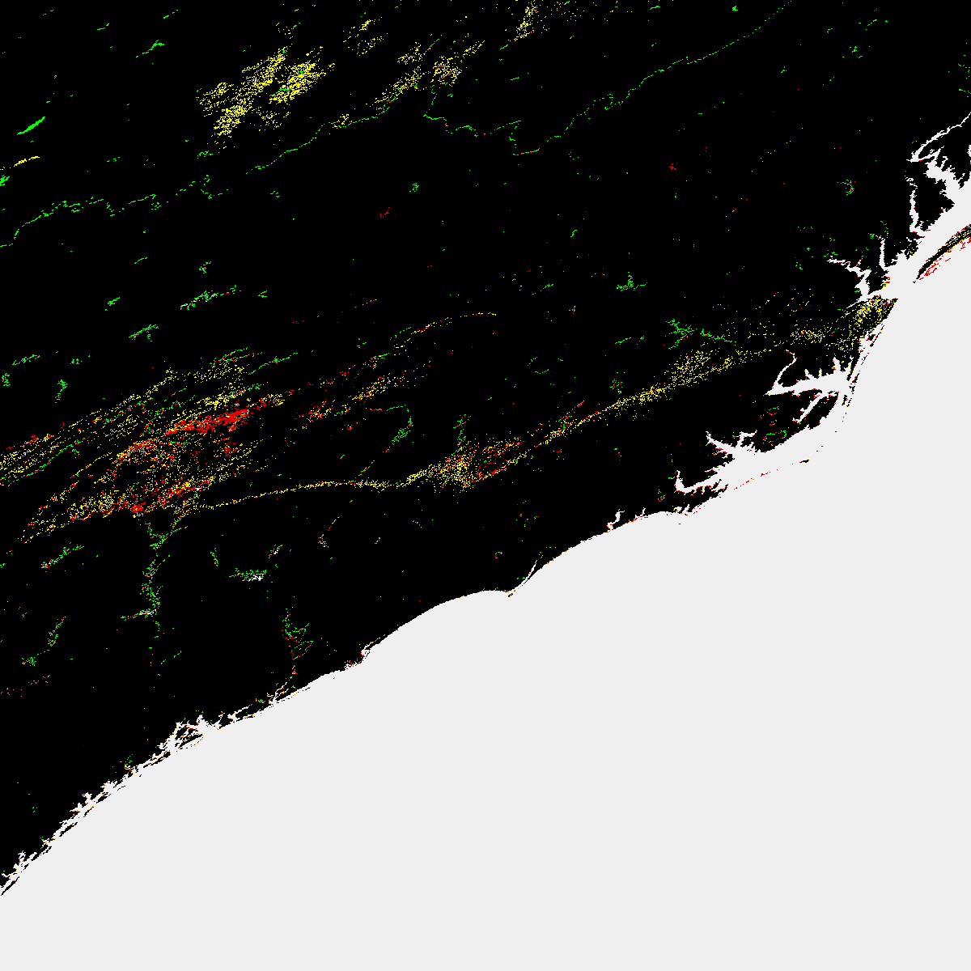
MYD10A1.A2016024.h11v05.005 fractional snowcover – band7
MYD10A1.A2016024.h11v05.006 NDSI_Snow_Cover
Aqua MYD10 uses QIR of Band 6
MOD09GA.A2016024.h11v05.006 RGB bands 1,4,6
In C6 the QIR technique is used to restore Aqua MODIS band6 data for use in the snow algorithm More accurate mapping of snow cover in C6 compared to C5 notably in difficult to detect situations along snow extent boundary as flagged by the algorithm QA bit flags.
MYD10A1.A2016024.h11v05.006 Algorithm QA bit flags for changed snow detection or uncertain snow detection Typically along boundary of snow cover.

Slide 8
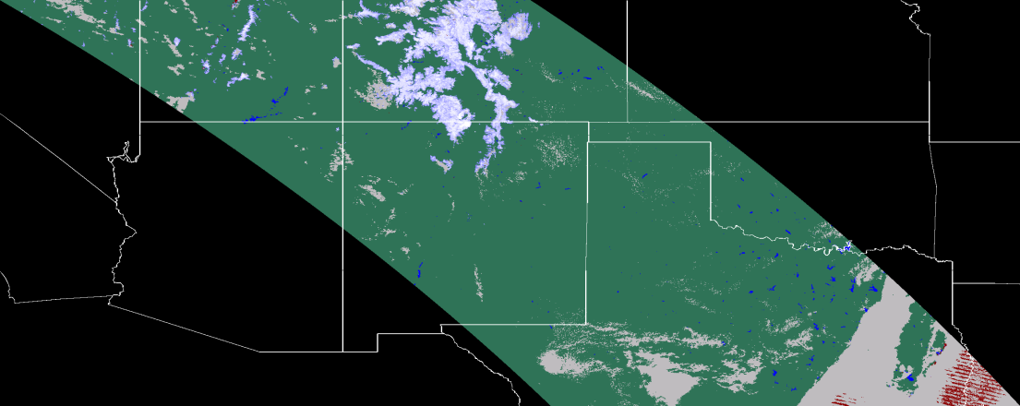
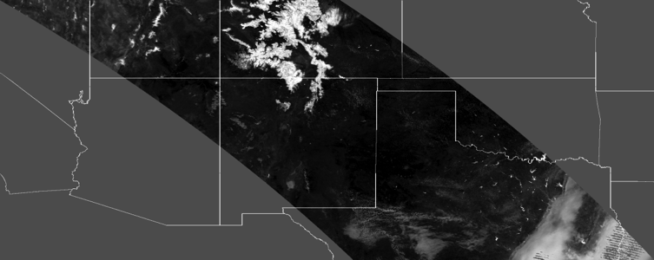
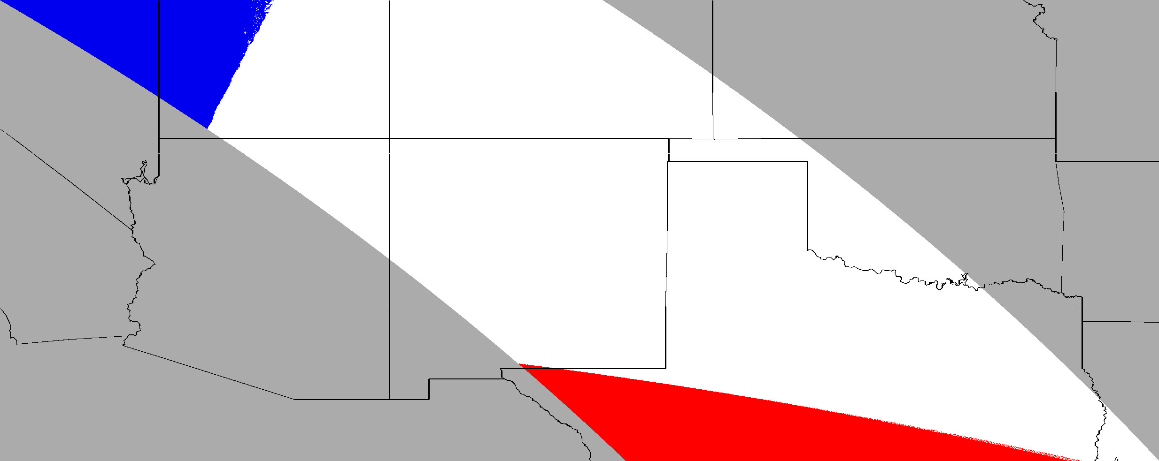
Time of observation included in C6 M*D10A1 products
NDSI
SNOW COVER
100
90
80
70
MOD10A1.A2016112.h09v05.006
60
50
40
30
20
0
Cloud
Water
NDSI
NDSI range
0.0
1.0
1920 UTC
Granule_ptr
Pointer to input MOD10_L2, use as index to get swath start time from list of product inputs in the metadata.
1740 UTC
1745 UTC

Slide 9
MODIS C6 Products Released
NSIDC released C6 products in April and May 2016
MODIS C6 user guide is available
C6 data product content is different from C5
Users familiar with the C5 binary snow cover and FSC data will have to adjust to using the new NDSI_Snow_Cover data.
Providing users with the NDSI data enables them to have flexibility in deriving snow cover area SCA maps for their purposes.
Users can use the Algorithm_flags_QA data to evaluate the snow cover data for their particular research or application. Also possible to adjust snow cover extent by combining the algorithm flags, snow cover and NDSI data.

Slide 10
NASA VIIRS VNP10 Snow Cover Algorithm I
Our process is to develop and test the science of the algorithm on our computer using IDL then to code the science into the PGE using the LSIPS computing environment.
Gain access to LSIPS computing environment.
Develop code i.e. the operational PGE in the LSIPS computing environment following the guidelines from LSIPS and using their coding environment setup.
Initial step was to adapt the MODIS C6 algorithm PGE07 to run with VIIRS data inputs.
Next we revised that algorithm into the NASA VIIRS snow cover algorithm PGE507.
Next we coded to output the product in HDF5 using the LSIPS HDF5 libraries. We have coded and tested VNP10_L2 algorithm and output as LSIPS PGE507.
Develop and test code using input data from an LSIPS Archive Set (AS).
LSIPS runs unit and global tests

Slide 11
NASA VIIRS VNP10 Snow Cover Algorithm II
Current version of PGE507 runs with LSIPS IDPS versions of VIIRS data products.
VNP10_L2 product is in HDF5
We have a version of PGE507 that runs with LSIPS NASA VNP* L1B input products. Code revised to read HDF5.
Working in the LSIPS computing environment allows for:
efficient delivery of algorithm code and download of CM baselined code
comparison of codes and test runs between the PI coding in LSIPS to unit or global test runs made by LSIPS/LDOPE focus on science and data content consistencies and are not side tracked by differences attributable to different operating systems or PGE versions between the PI’s computing environment and LSIPS.

Slide 12
NASA VIIRS VNP10 Snow Cover HDF5 Product Design
VNP10_L2 products are in HDF5. Required redesign of the products from MODIS heritage HDF4-EOS.
Specifications/requirements for the products are emerging from several sources and for differing reasons.
PI develops the science data content for datasets and attributes.
We interact with NSIDC for developing data content regarding snow cover datasets, geolocation data, and for attributes, primarily to support their data services and tools for users.
Conform to NetCDF4 Climate Forecasting Version 1.6 conventions for relevant metadata (HDF5 attributes).
LSIPS – provides attributes relevant to tracking production, PGE and Collection versions, provenance of data product, DOIs…
Draft of VNP10_L2 data product user guide has been completed.

Slide 13
NASA VIIRS VNP10 HDF5 Product Description
HDF5 “VNP10_L2*.h5" {
FILE_CONTENTS {
group /
group /GeolocationData
dataset /GeolocationData/Latitude
dataset /GeolocationData/Longitude
group /SnowData
dataset /SnowData/Algorithm_bit_flags_QA
dataset /SnowData/Basic_QA
dataset /SnowData/NDSI
dataset /SnowData/NDSI_Snow_Cover
}
}
All datasets include attributes. LSIPS generates file level (global) attributes.

Slide 14
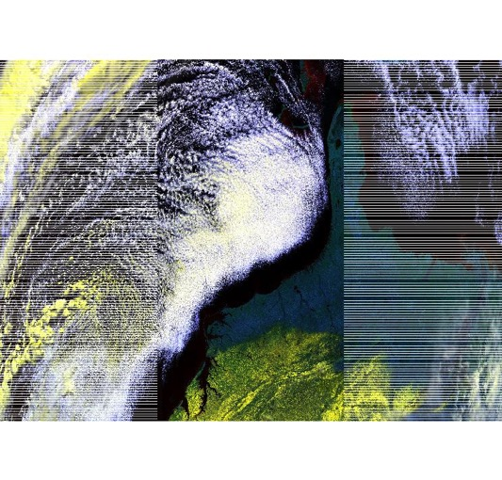
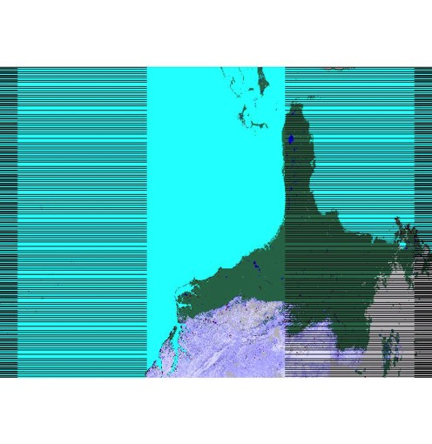
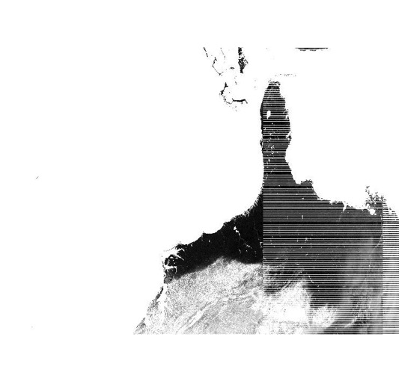
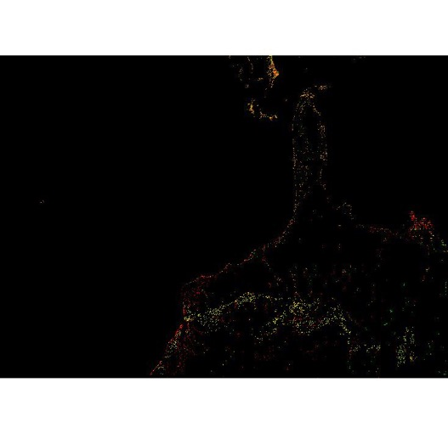
NASA VNP10_L2 Example
False color image of NPP_VIAE_L1.A2016024.1810.P1_03110.*.hdf bands I1,I2, I3, showing snow in hues of yellow.
VNP10_L2.A2016024.1810 .*.h5
NDSI
SNOW COVER
NDSI range
100
90
0.0
1.0
80
70
60
50
40
30
20
0
Cloud
Water
NDSI_Snow_Cover
NDSI
Algorithm_bit_flags_QA
Unspecified
Inland water
Low VIS screen
Low NDSI screen

Slide 15
MODIS and VIIRS Snow Cover Continuity
MOD10_L2 C6 | VNP10_L2
NDSI_Snow_Cover, -- Snow cover map by NDSI in 0-100 range, with masked features. | NDSI_Snow_Cover, -- Snow cover map by NDSI in 0-100 range, with masked features.
NDSI_Snow_Cover_Algorithm_Flags_QA – bit flags for data screens applied in the algorithm. | NDSI_Snow_Cover_Algorithm_Flags_QA – bit flags for data screens applied in the algorithm.
NDSI Snow_Cover_Basic_QA, basic quality value | NDSI_Snow_Cover_Basic_QA, -- basic quality value
NDSI – NDSI value for all land and inland water pixels in a swath | NDSI – NDSI value for all land and inland water pixels in a swath
Latitude (5 km resolution) | Latitude (375 m resolution)
Longitude (5 km resolution) | Longitude (375 m resolution)

Slide 16
MODIS and VIIRS Snow Cover Continuity
Snow cover algorithms are very similar: MODIS C6 and VIIRS VNP10
Spatial resolution different: MODIS 500 m, VIIRS 375 m
Data product content is same but the file format is different:
MODIS C6 SDSs HDF4-EOS and VIIRS VNP10 datasets, HDF5
Challenges of improving accuracy, primarily alleviating problems of cloud/snow confusion are similar in both MODIS and VIIRS associated with:
Subpixel cloud contamination
Cloud mask setting of snow/ice background flag
Spectral discrimination of snow free surfaces from snow covered surfaces

Slide 17
Suomi-npp VIIRS Ice Surface Temperature (IST)
The VIIRS Ice Surface Temperature (IST) product
provides surface temperatures retrieved at VIIRS moderate resolution (750m)
for Arctic and Antarctic sea ice
for both day and night
The baseline split window algorithm, shown below, is a statistical regression method that is based on the AVHRR heritage IST algorithm (Key and Haefliger., 1992)
IST= a_{o} + a₁T_{M15} + a₂(T_{M15}-T_{M16}) + a₃(T_{M15}-T_{M16})(sec(z)-1)
T_{M15} and T_{M16} : VIIRS TOA TB’s for the VIIRS M15 and M16 bands
z: the satellite zenith angle
a_{o,} a_{1,} a_{2,} a₃ : regression coefficients.
Threshold Measurement Uncertainty = 1K over a measurement range of 213–280 K.
Key, J., and M. Haefliger (1992), Arctic ice surface temperature retrieval from AVHRR thermal channels, J. Geophys. Res., 97(D5), 5885–5893.

Slide 18
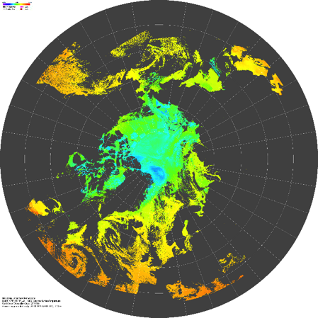
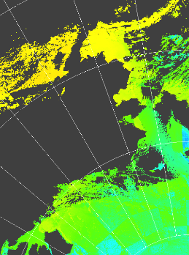
IST Needed by nasa’s operation icebridge (OIB)
IST: April 24, 2016
Produced by http://landweb.nascom.nasa.gov (NASA Goddard)
Utilized by NASA OIB Science Team during OIB Spring 2016 P-3 deployment
Needed to assess melt onset in Beaufort Sea
Performance of OIB RADARs affected when surface layer begins to melt
Will also be compared to OIB onboard IST imagers

Slide 19
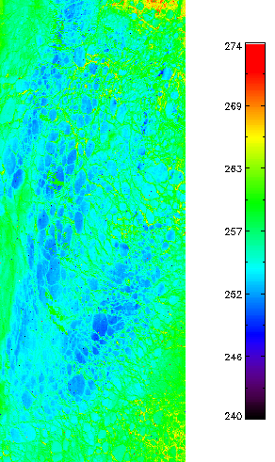
NASA VIIRS IST
Initial code generated from MODIS code by NASA’s Land Science Investigator-led Processing System (LSIPS)
Code being updated for VIIRS (calibration coefficients, etc.)
New Quality Flags to be added
Inter-comparison: MODIS, NCEP
Validation: IceBridge, buoys
First draft of ATBD delivered Jan. 2016
Left: VIIRS IST (K) from the NASA VIIRS IST product
uses new calibration coefficients from J. Key
Sept 12, 2014, 21:10 UTC
Beaufort Sea, AK

Slide 20
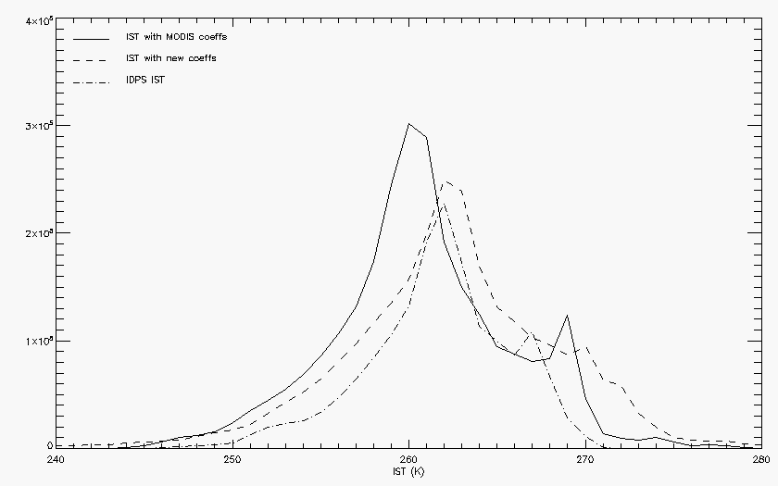
NASA IST vs. idps ist
IST for previous scene:
_____ NASA VIIRS IST algorithm with MODIS calibration coefficients
- - - - NASA VIIRS algorithm with updated calibration coefficients
_ . _ . NOAA IDPS IST
NASA IST looks comparable to the IDPS IST

Slide 21
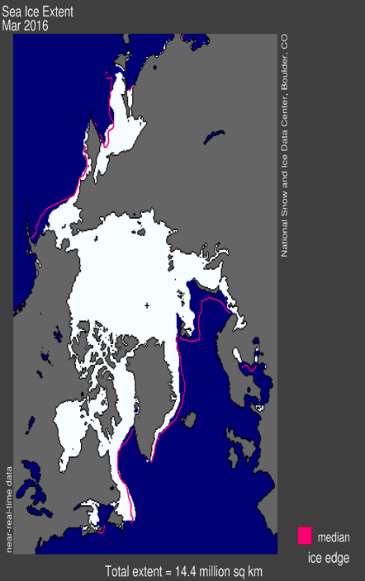
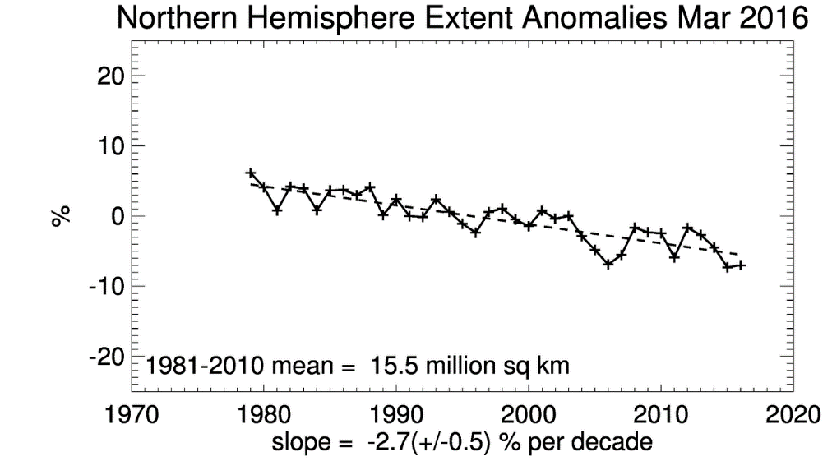
NASA viirs sea ice cover
Sea ice cover can aid in the estimation of sea ice extent using pmw data
Sea ice extent = areal coverage of sea ice over the Arctic (km²)
Sea ice extent is important for trends in ice extent, sea ice modeling, navigation, operations, …

Slide 22
Nasa viirs sea ice cover algorithm
Utilizes the Normalized Difference Snow Index (NDSI):
NDSI = [VIIRS M4 (0.555µm) – VIIRS M10 (1.61µm)] / [VIIRS M4 + VIIRS M10]
If NDSI ≥ 0.4 and VIIRS M4 > threshold, then pixel contains snow covered sea ice
Relatively thin sea ice (< 10 cm, with no snow cover) which has a lower albedo may not be detected using the NDSI. Methods to detect thin sea ice are being investigated.

Slide 23
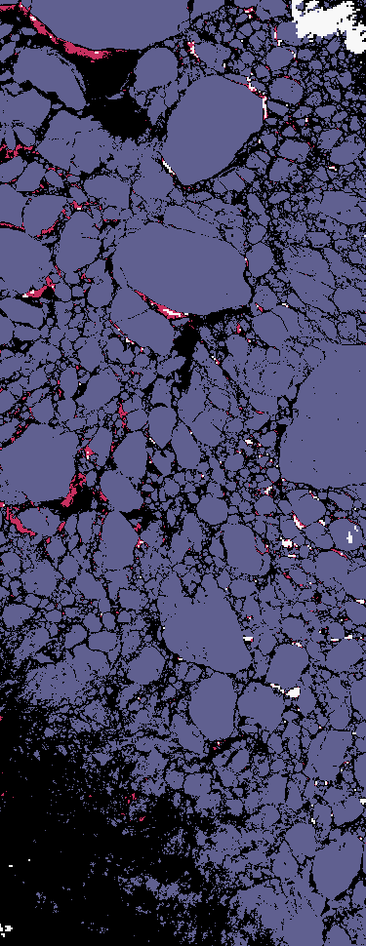
NASa viirs sea ice cover test run
Sea ice extent code using VIIRS channels
April 7, 2015
Beaufort Sea – multiyear ice floes
Can envision a follow-on sea ice concentration product

Slide 24
NASA LSIPS access summary
Have received / used NASA token
Have NASA Launchpad access
Took necessary training
Have been activated on cluster
At “press time,” working an access issue to the LSIPS

Slide 25
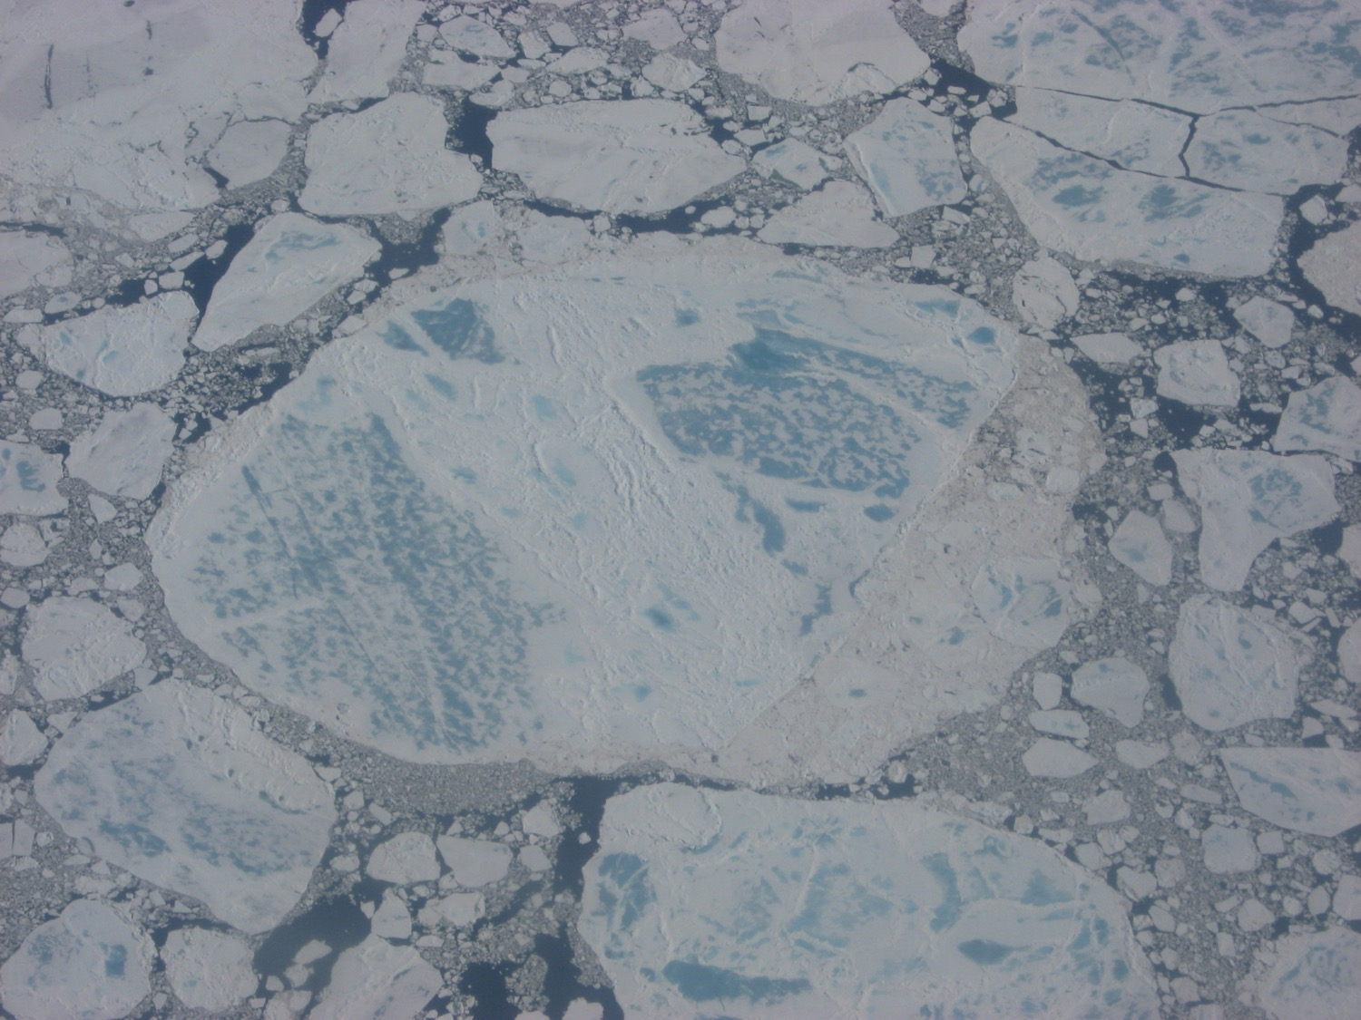
Thank you

