Slide 1
VIIRS Ocean Color Data and Global Modeling: Extending the Time Series of Ocean Biology from Space
Cecile S. Rousseaux
Watson W. Gregg
NASA Global Modeling and Assimilation Office
USRA
MODIS/VIIRS Science Team Meeting, Silver Spring, June 9th 2016

Slide 2
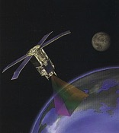
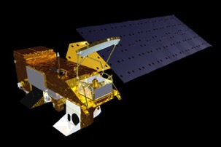
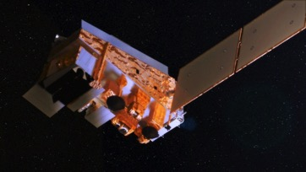
Use of Ocean Color in global numerical models
Maximize use of satellite data via data assimilation into global models
Improve the representation of past and present variability and change
Detection of trends in ocean biogeochemistry
Forecast seasonal to decadal variability
Use Ocean Color Chlorophyll Data; assimilate into the NASA Ocean Biogeochemical Model (NOBM)
1997
SeaWiFS
2010
2002
MODIS-Aqua
2011
S-NPP VIIRS

Slide 3
NASA Ocean Biogeochemical Model
Winds, ozone, relative humidity, pressure, precip, clouds, aerosols
Dust (Fe)
Sea Ice
CO₂
Winds SST
Radiative
Model
(OASIM)
E_{d}(λ)
E_{s}(λ)
E_{d}(λ)
E_{s}(λ)
IOP
Layer Depths
NOBM
Circulation Model
(Poseidon)
Temperature, Layer Depths
Advection-diffusion
Chlorophyll, Phytoplankton Groups
Primary Production
Nutrients
DOC, DIC, pCO₂, alkalinity, CDOC
Spectral Irradiance/Radiance
Outputs:
E_{d}(λ)=downwelling irradiance
E_{s}(λ)=surface irradiance
IOP=Inherent Optical Properties

Slide 4
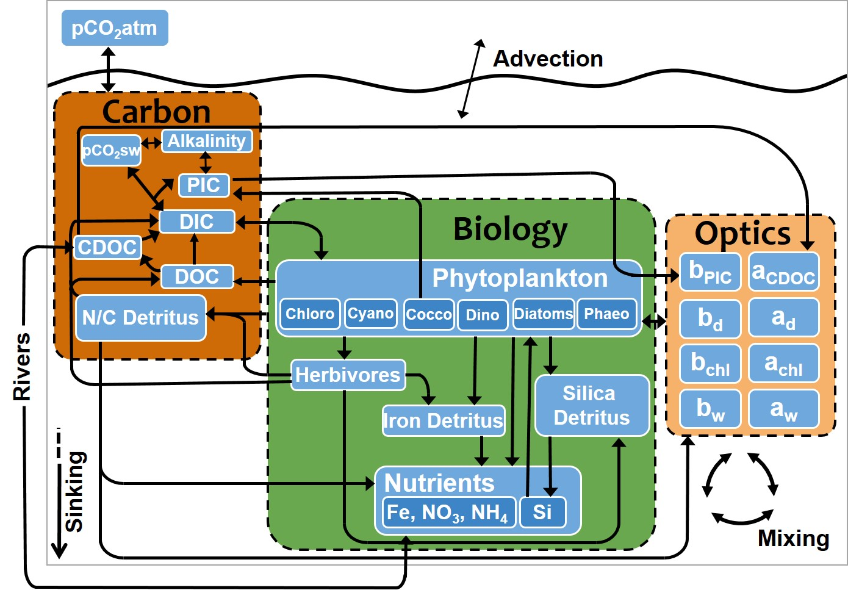
NASA Ocean Biogeochemical Model

Slide 5
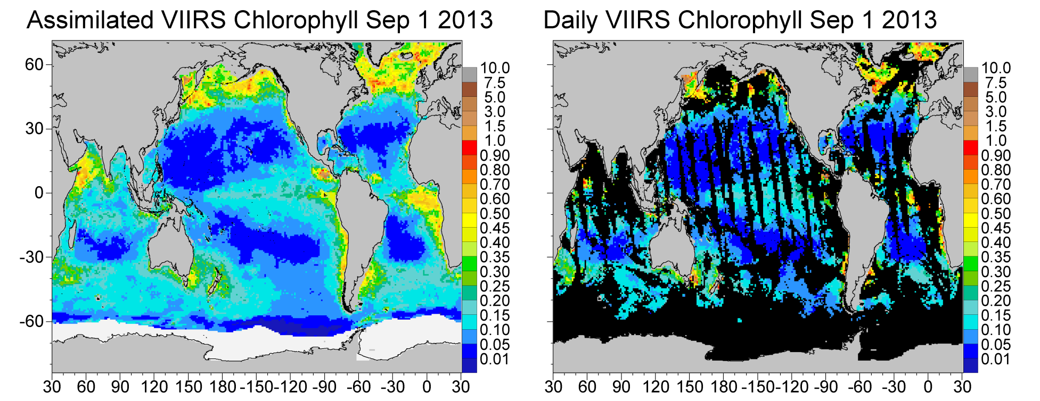
Improve the representation of past and present variability and change
It is widely known that data assimilation improves model results.
It is less widely known that data assimilation also improves data representations
Global mean chlorophyll representations are distorted by gaps in sampling. Ocean color missions typically observe only about 15% of the ocean per day
Due to:
inter-orbit gaps
insufficient light for detection at high latitudes
sun glint
clouds
aerosols
Chlorophyll mg m⁻³
Ice fields are shown in white. Missing data is shown in black.

Slide 6
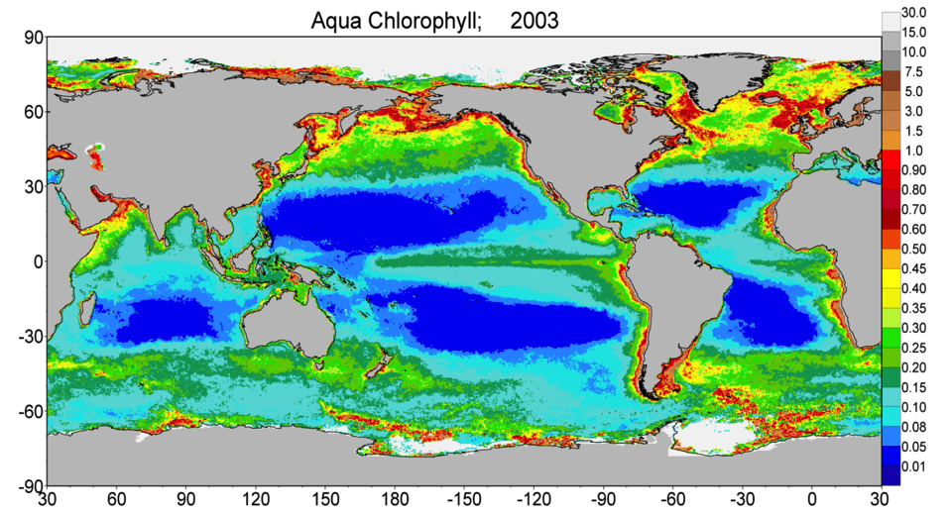
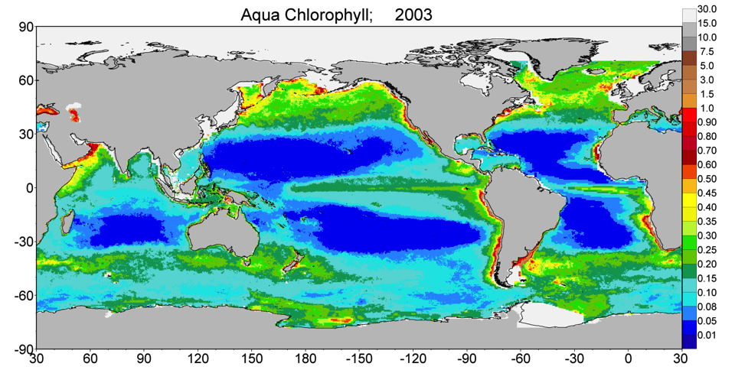
Effects of assimilation
Global Annual
Median Chlorophyll
for MODIS-Aqua
Chlorophyll mg m⁻³
Assimilated
Global Annual
Median Chlorophyll
for MODIS-Aqua
Note the plumes of high chlorophyll in the Southern Ocean that are artifacts of sampling. Missing data along some continental shelves, which is due to the underlying model domain.

Slide 7
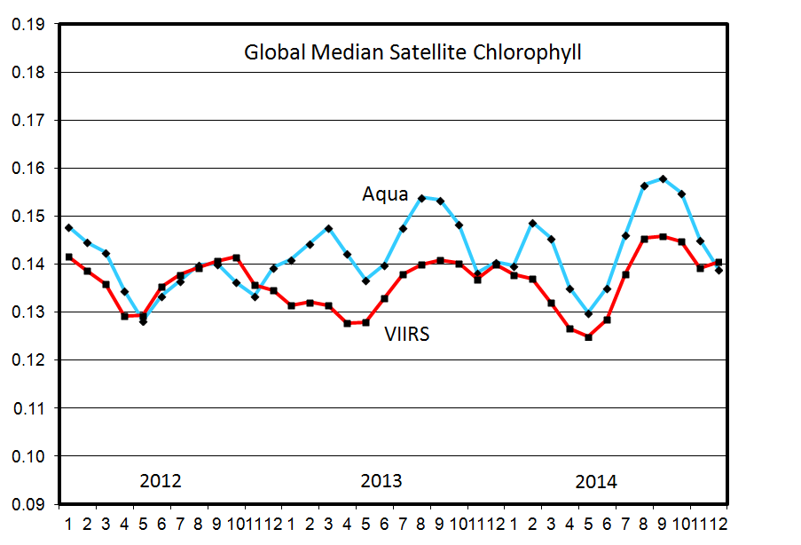
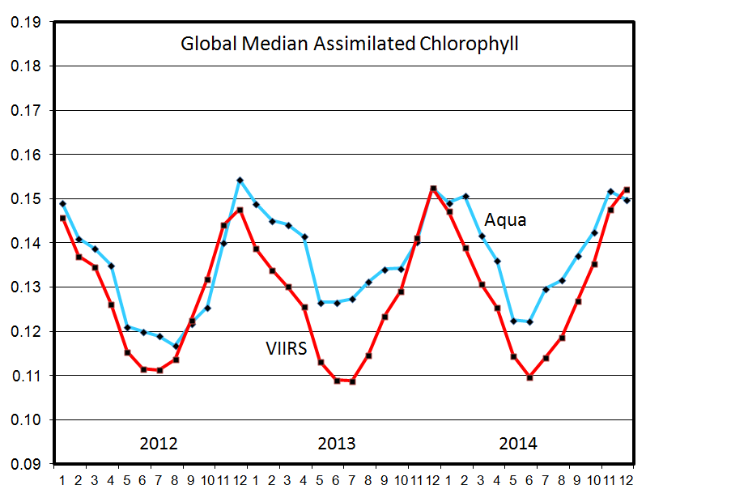
Chlorophyll mg m⁻³

Slide 8
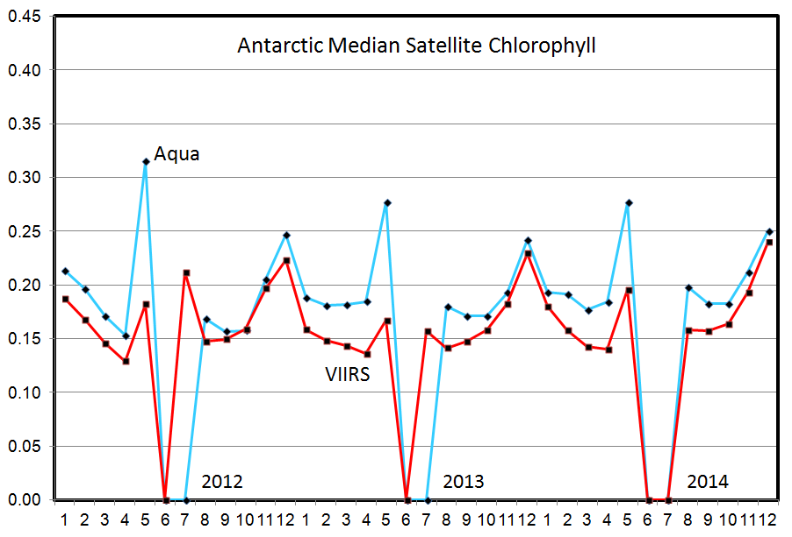
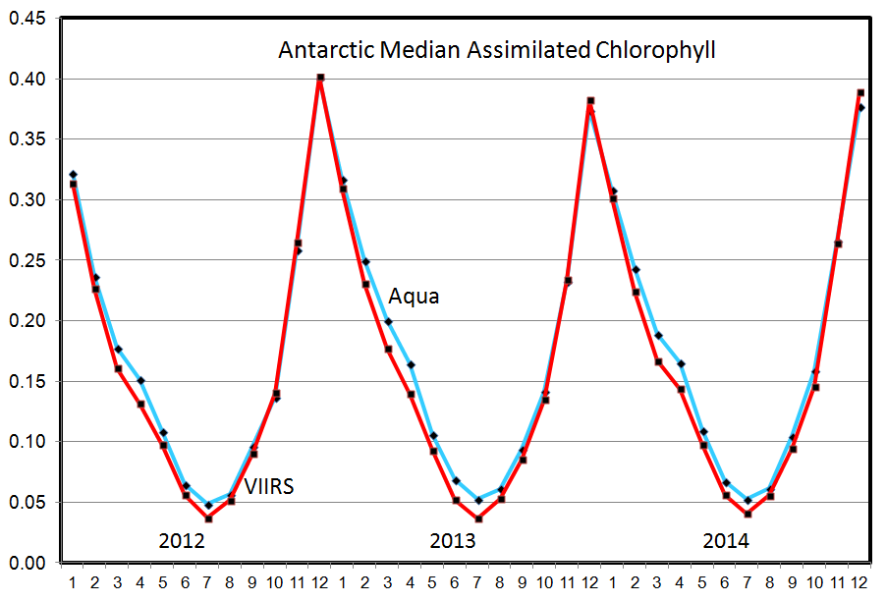
Chlorophyll mg m⁻³

Slide 9
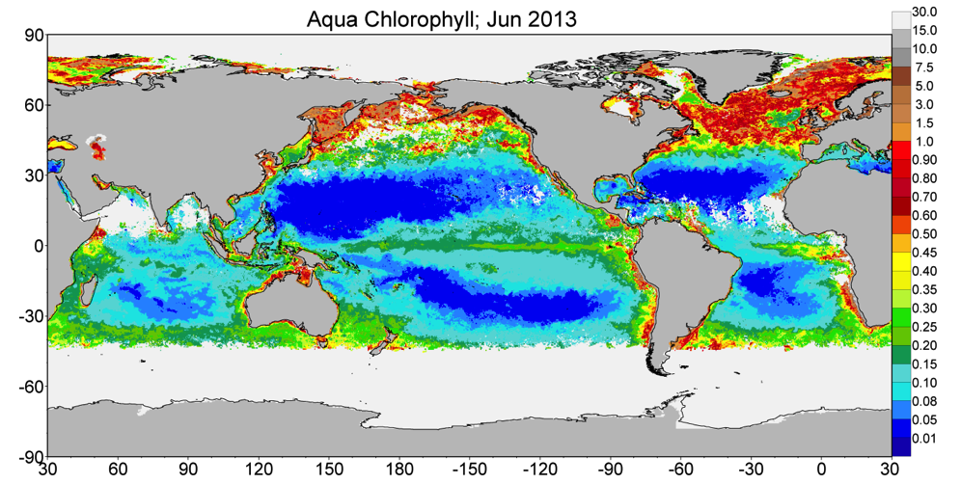
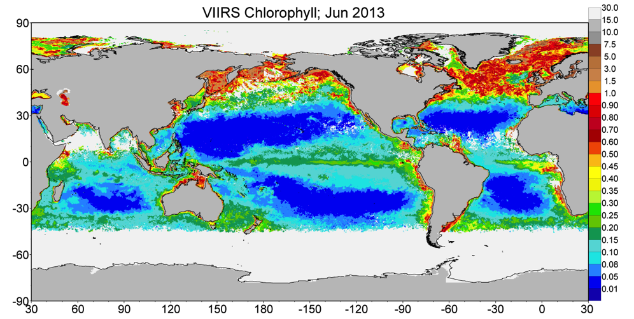
Differences in sampling between MODIS-Aqua (top) and VIIRS (bottom)
Chlorophyll mg m⁻³
North Central
Atlantic
North Indian
Antarctic

Slide 10
Detection of trends in ocean biogeochemistry
SeaWIFS: R2010.0
MODIS: R2013.1
OCX
Gregg and Rousseaux 2014; JGR Oceans

Slide 11
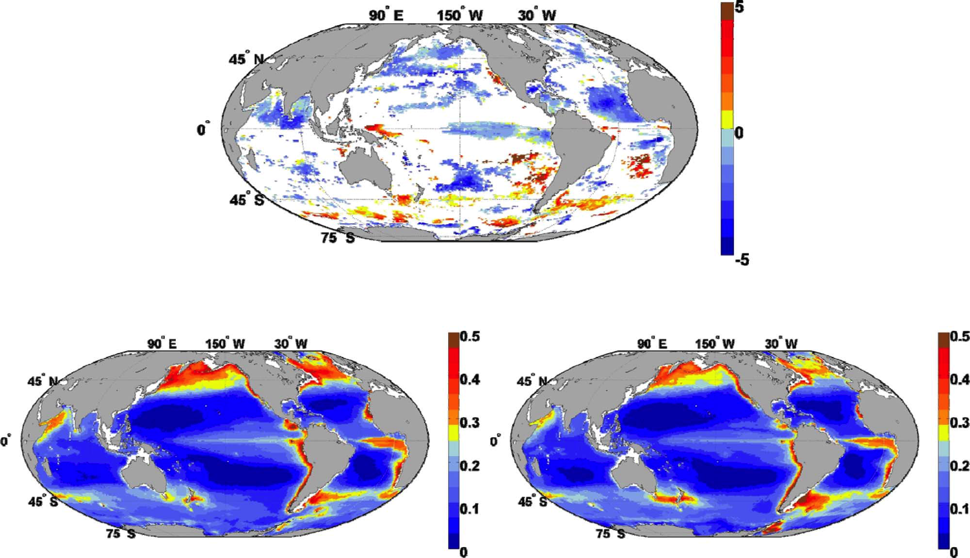
Significant Trends 1998-2012
% per year
1998
2012
Chlorophyll mg m⁻³
Gregg and Rousseaux 2014; JGR Oceans

Slide 12
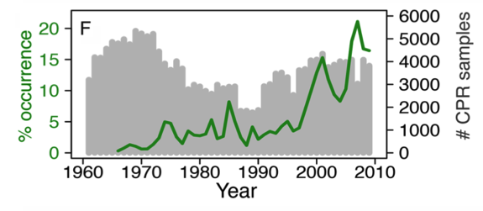
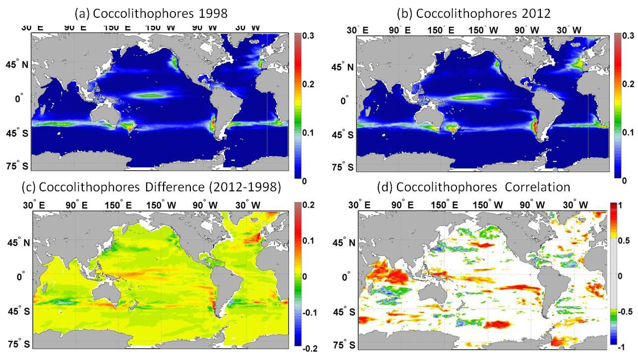
Increasing occurrence of
coccolithophores
In North Atlantic
Rivero-Calle, 2015; Science
Rousseaux and Gregg, 2015; Global Biogeochemical Cycles

Slide 13
R2014.0, OCI
Chlorophyll mg m⁻³

Slide 14
R2014.0, OCI
Chlorophyll mg m⁻³

Slide 15
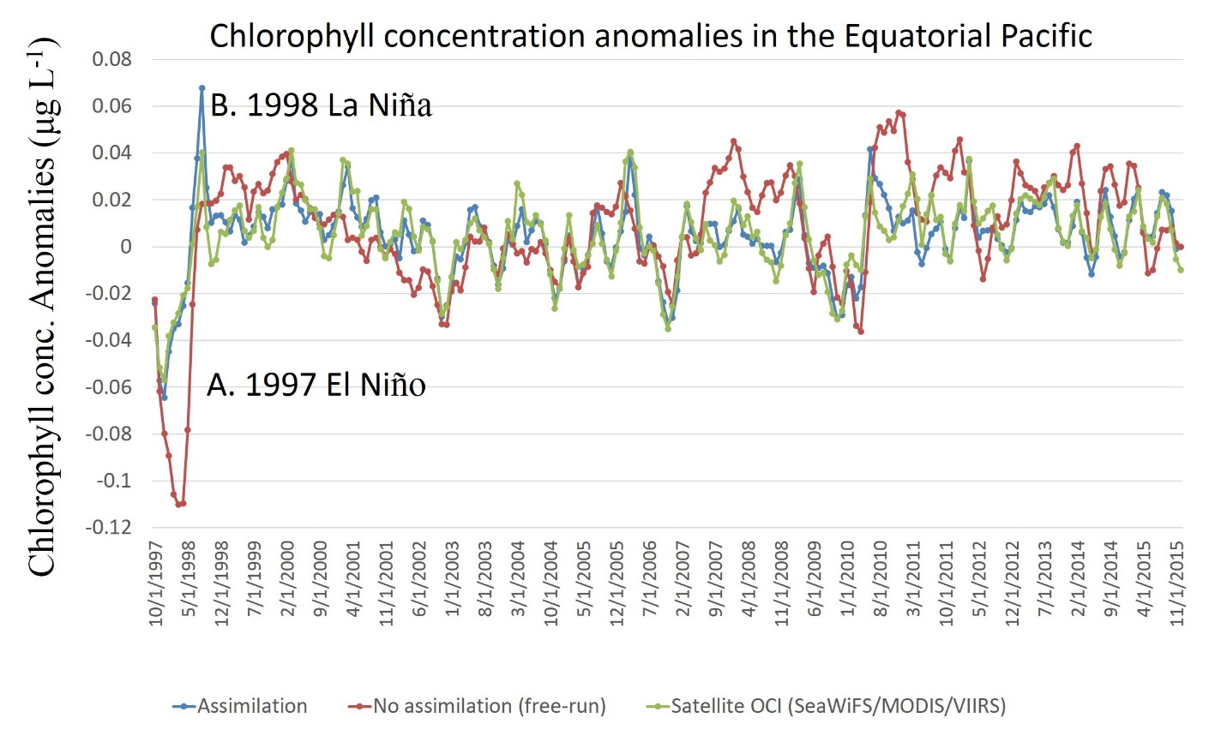
Forecast seasonal to decadal variability
Significant correlation of model versus satellite:
SeaWiFS (R=0.77), MODIS (R=0.64), VIIRS (R=0.74)

Slide 16
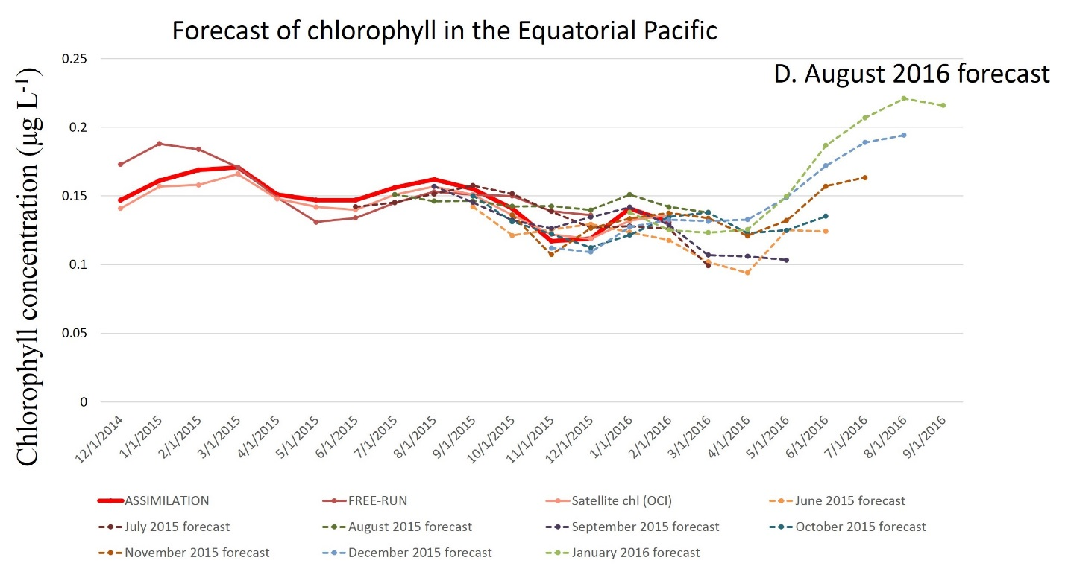
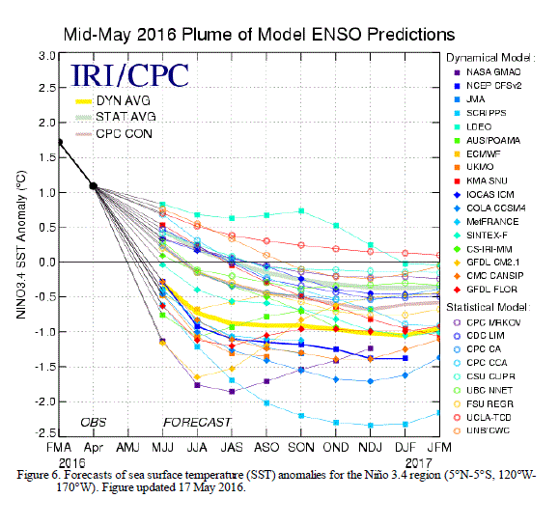
GMAO Seasonal Forecast Data (e.g. wind stress, SST, shortwave radiation)
‘Truth’
Monthly forecast
Source: NOAA Climate Prediction Center

Slide 17
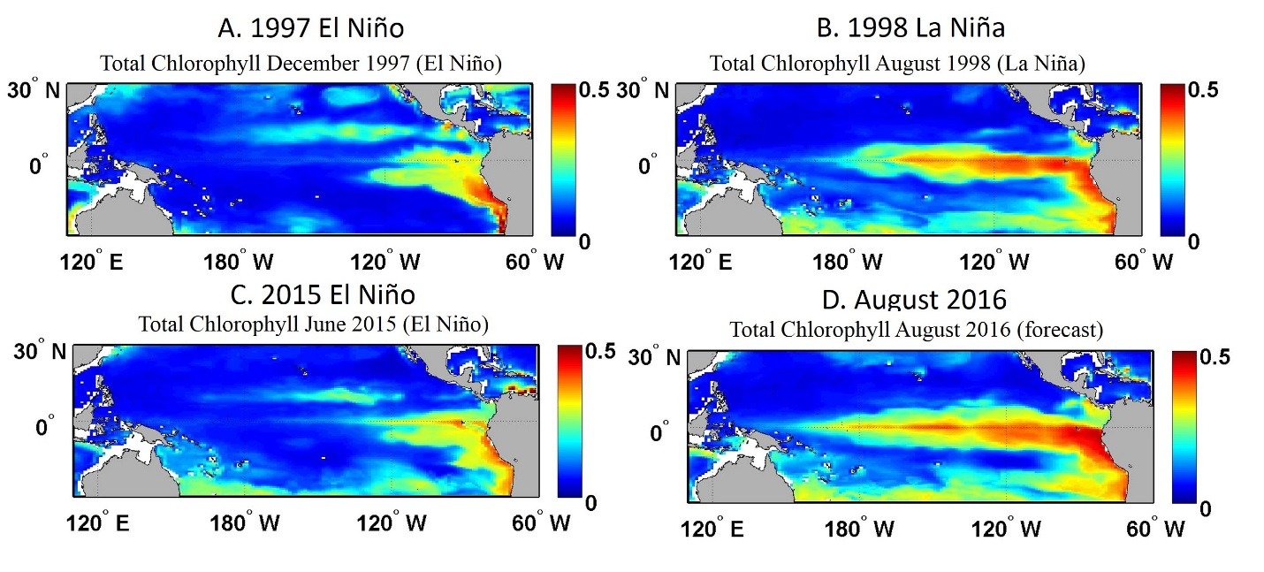
Forecasting Chlorophyll in the 2015-2016 El Niño using VIIRS
Application for ENSO but also HABs, heat content, etc

Slide 18
Summary
A rigorous integration of satellite data and models via data assimilation shows
Reduction of inconsistencies between chlorophyll observed by different satellites/sensors
Reduction of sampling biases among the sensors
Provide a global coverage and information on products that cannot (currently) be derived from ocean color
Enables trend detection over decades with multiple satellites
Next step: Use of VIIRS in improving and evaluating forecast chlorophyll in ENSO events is promising

