Slide 1
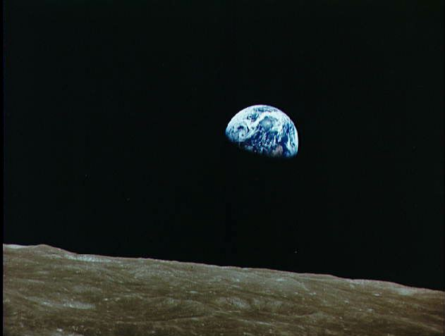
Whats new with MODIS NPP, GPP and ET
MODIS/VIIRS Science Team Meeting
June 9, 2016
Steven W. Running
Numerical Terradynamic Simulation Group
College of Forestry and Conservation
University of Montana

Slide 2
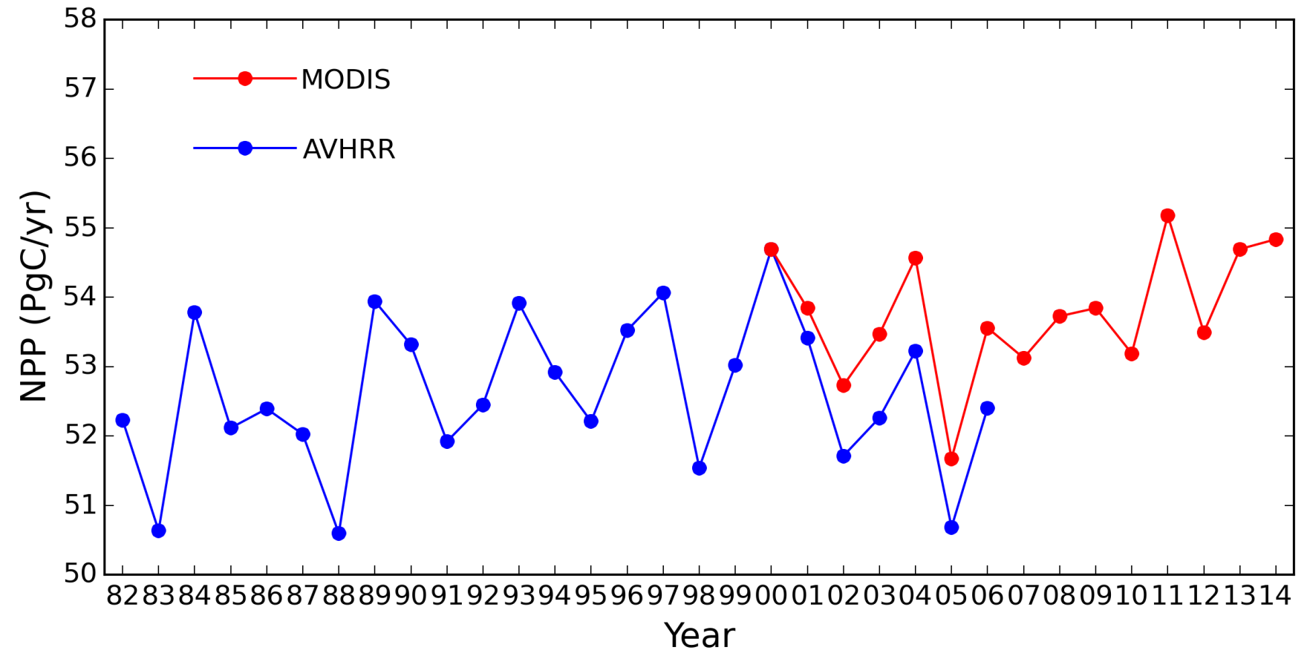
GLOBAL NPP TREND

Slide 3
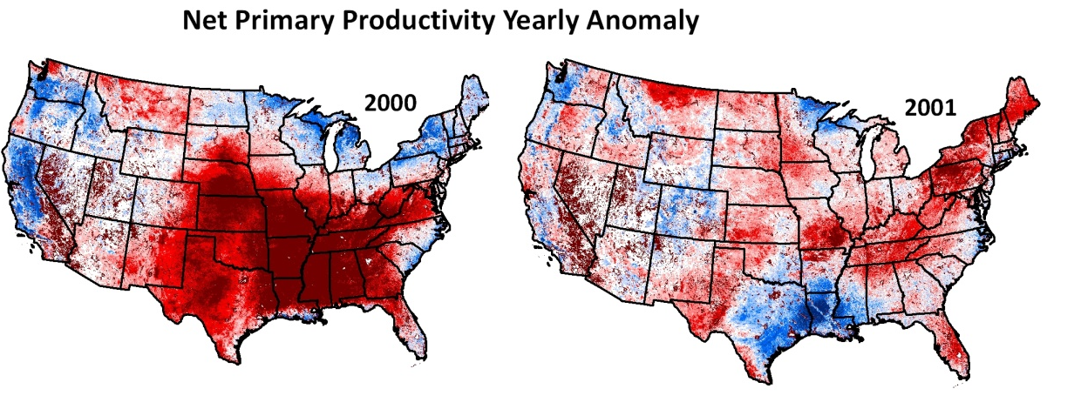
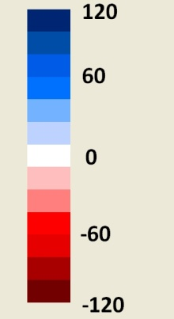
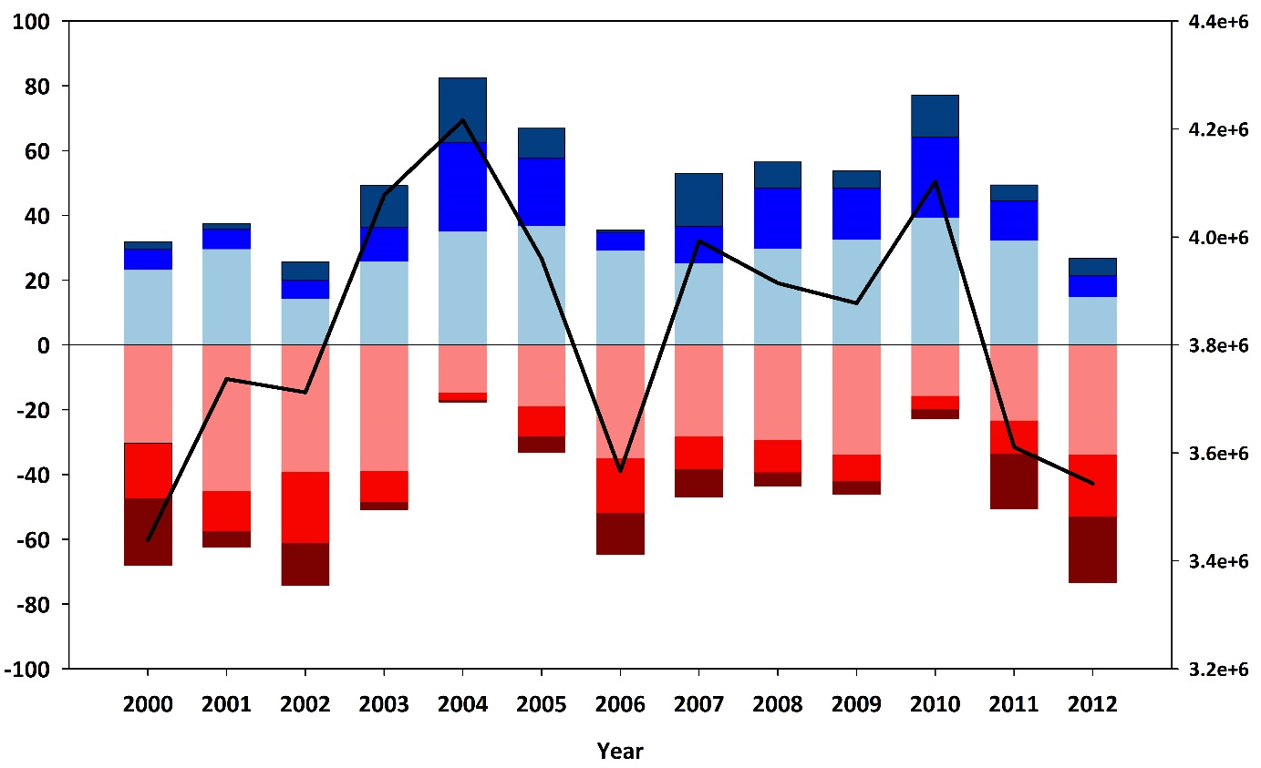

Net Primary Productivity Indicator
NPP (gC/m²)
Percentage of area above or below the 13-year NPP average
> 80 gC m² yr⁻¹
> 40 gC m² yr⁻¹
> 0 gC m² yr⁻¹
< 0 gC m² yr⁻¹
< -40 gC m² yr⁻¹
< -80 gC m² yr⁻¹

Slide 4
Smith et al 2016 Nature Climate Change, (6) p306-311
CMIP5 projections of NPP are too strong

Slide 5
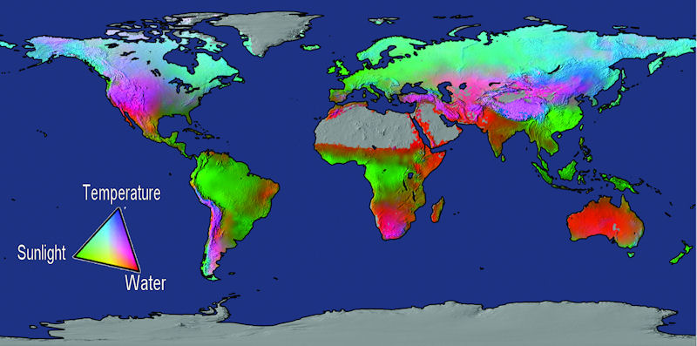
Water = 40%, Temperature = 33%, Radiation = 27%
Potential limits to vegetation net primary production based on fundamental physiological limits by solar radiation, water balance, and temperature (from Churkina & Running, 1998; Nemani et al., 2003; Running et al., 2004).

Slide 6
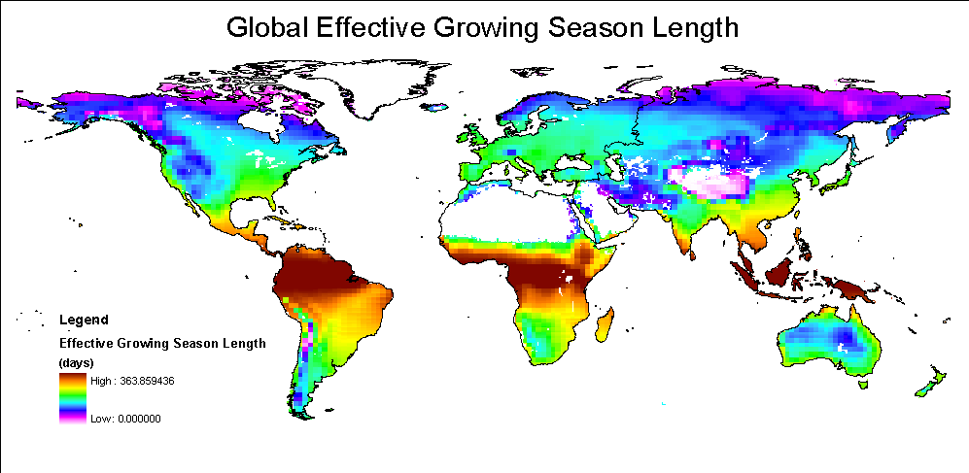
Jolly, Nemani, Running. Global Change Biology 2005

Slide 7
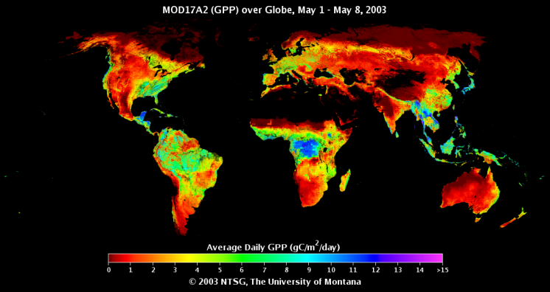
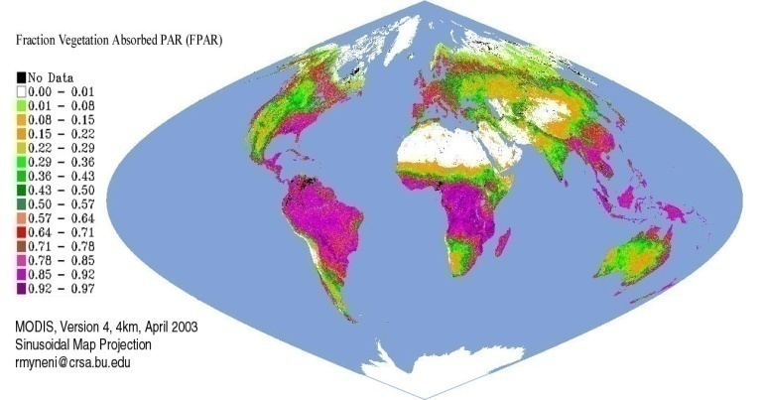
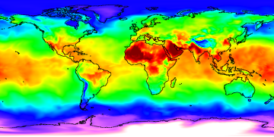
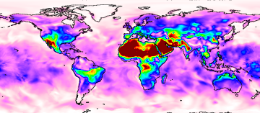
GPP = Light X Conversion Efficiency
GPP = f (PAR) x ε
Biome
Properties
Look-Up
Table (ε_{max} )
GPP
fPAR, PAR
Temperature
VPD

Slide 8
Spatial variability in LUE_{opt}
Croplands show largest LUE_{opt} variability.
MOD17 LUE_{max} < LUE_{opt} for CRO, GRA, DBF
MOD17 LUE_{max} > LUE_{opt} for CSH.
Aggregating LUE_{opt} variability within coarse plant functional type (PFT) classes leads to large model LUE and GPP error.
Spatially explicit estimation of optimal light use efficiency for improved satellite data driven ecosystem productivity modeling. Nima Madani, John S. Kimball, Steve W. Running. AGU 2014

Slide 10
Traits
Topography
Soil water
17 Tower Testing sites
Crop areas
Percent cover
Testing
Geo-statistical Generalized Additive Model
45 Tower Training sites
LUE_{opt}

Slide 11
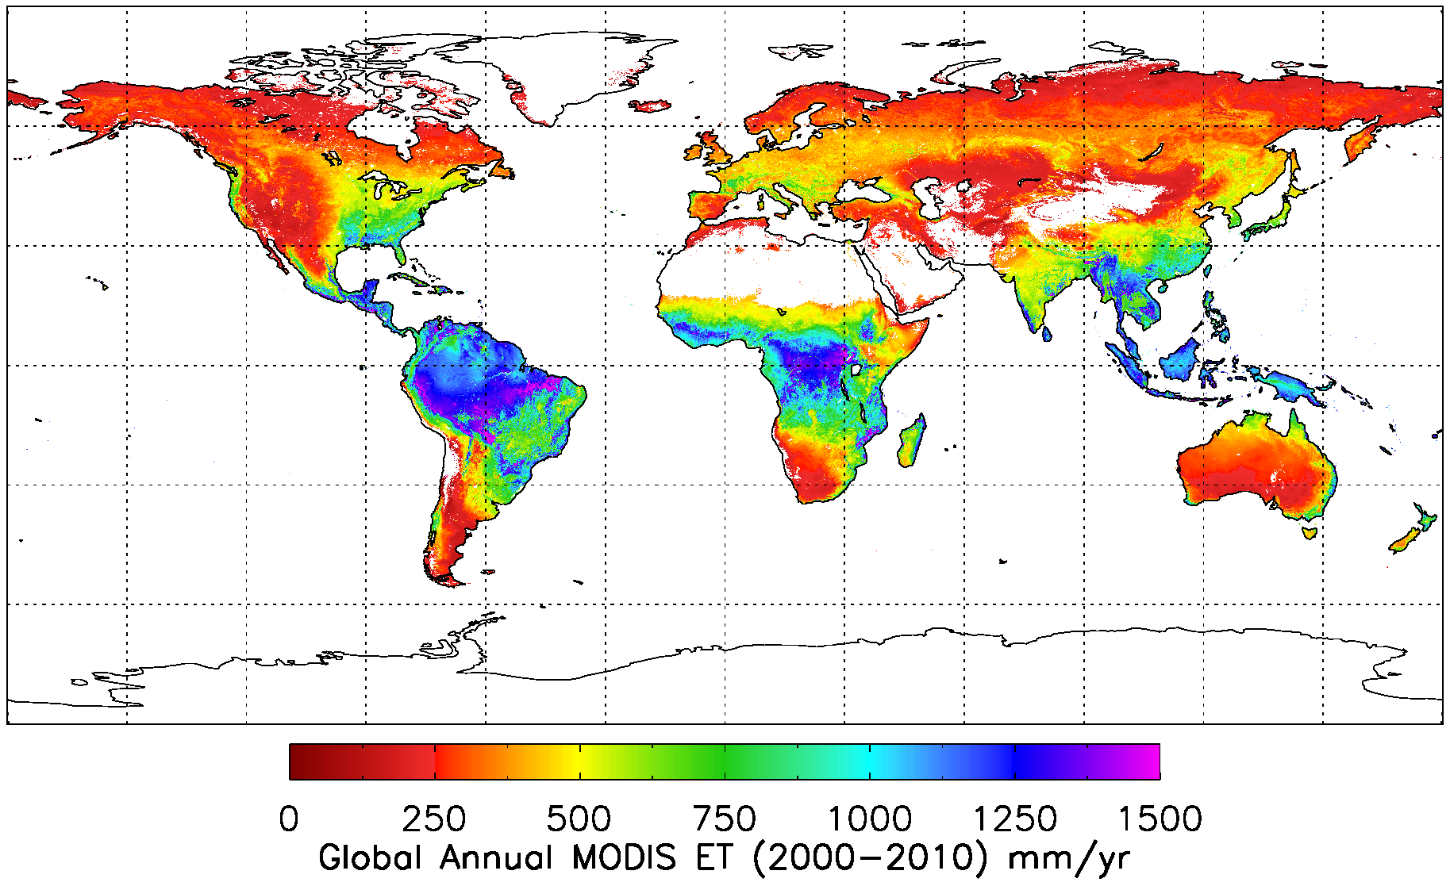
Global Annual 1-km ET over 2000-2010
Global average MODIS ET over vegetated land surface is 568.7 ± 358.2 mm yr⁻¹.

