Slide 1
MODLAND SUMMARY
SWRunning
10 June 2016

Slide 2
NEW?? PRODUCTS
WITH Collection 6
Collection 7???

Slide 3
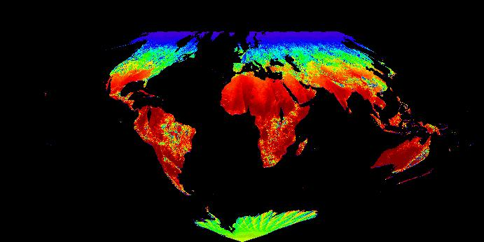
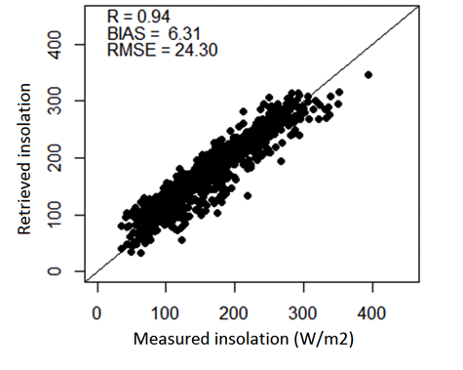
High-resolution incident shortwave radiation and PAR products over land from MODIS
New high spatial resolution insolation and PAR products
  Needed by the terrestrial modeling community (~1˚ for existing datasets)
  3-hr, daily mean.
  5km tile-based and 0.05 ˚ CMG.
Using a fast and robust LUT-based method.
  Zhang et al. RSE 2014;
  Three-year prototype products generated;
  Extensively validated and inter-compared.
Codes have been delivered and tested at MODAPS.
  PGE and ESDT have been assigned;
  Initial products will come out soon.
Example of daily DSR (MCD18C1) on Jan. 1st, 2010
Validating monthly shortwave radiation

Slide 4
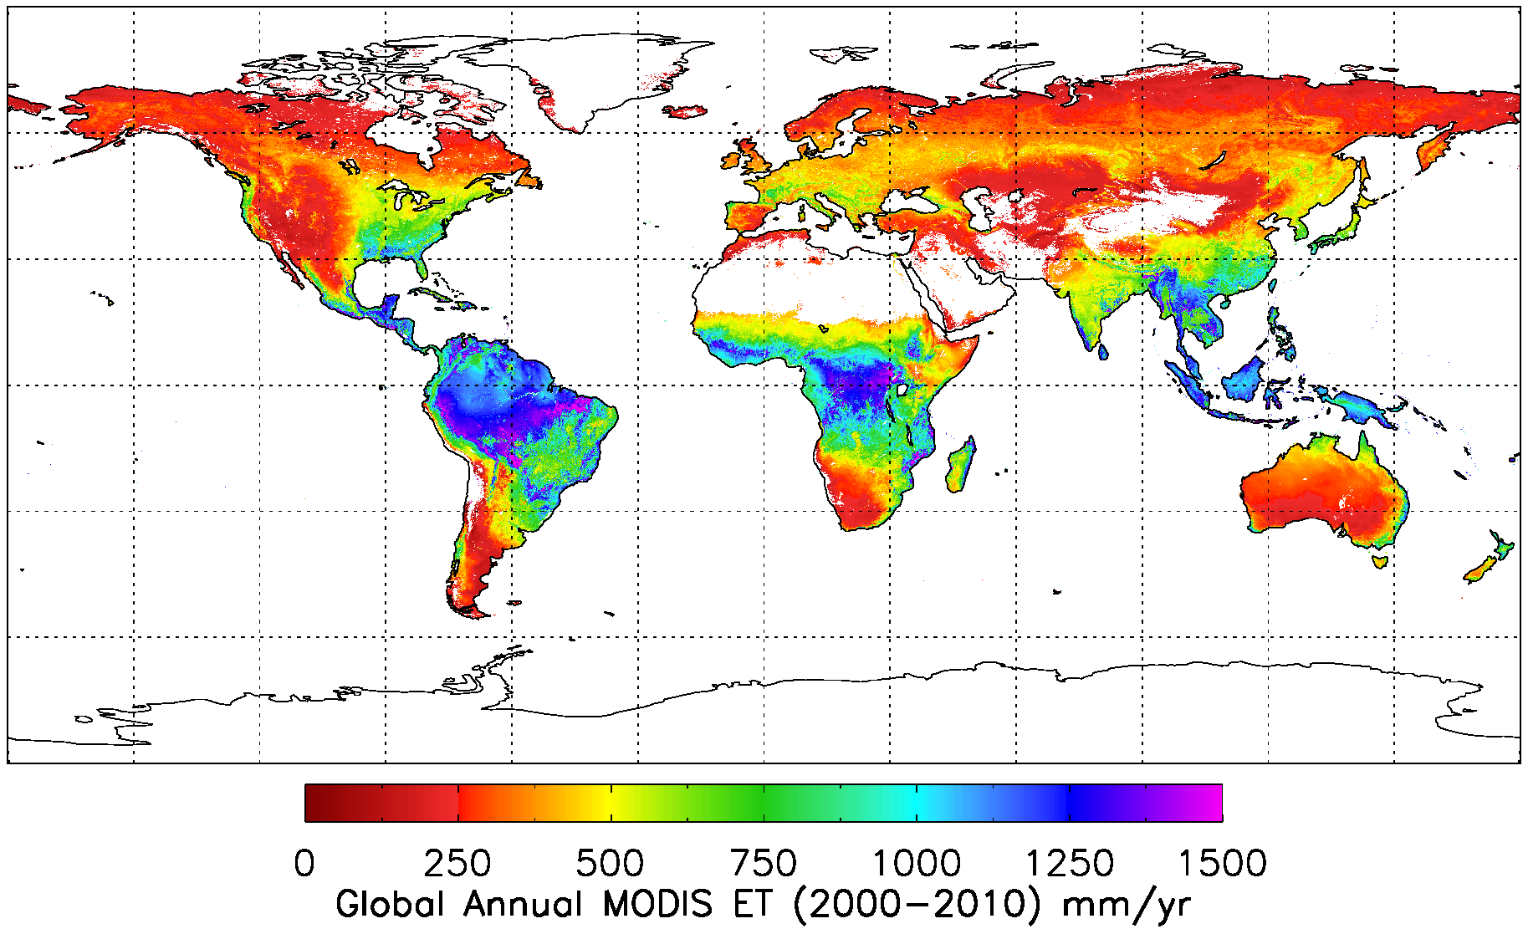
Global Annual 1-km ET over 2000-2010
Global average MODIS ET over vegetated land surface is 568.7 ± 358.2 mm yr⁻¹.

Slide 5
MODIS LST Validation Summary
MOD11 larger uncertainty over bare regions
(3-5 K)
MOD11 more stable over graybodies (higher precision)

Slide 6
TIME SERIES TREND ANALYSES
Requires huge attention to sensor and processing details

Slide 7
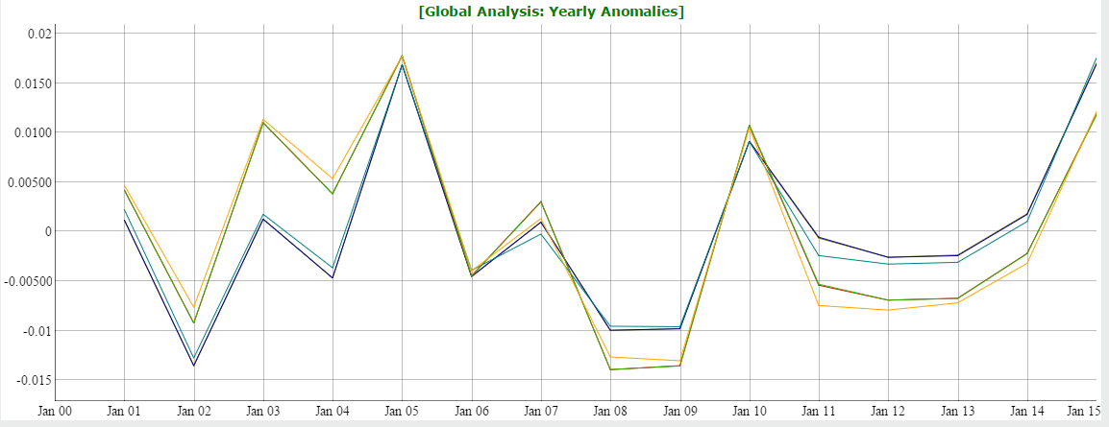
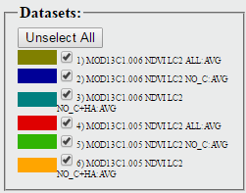
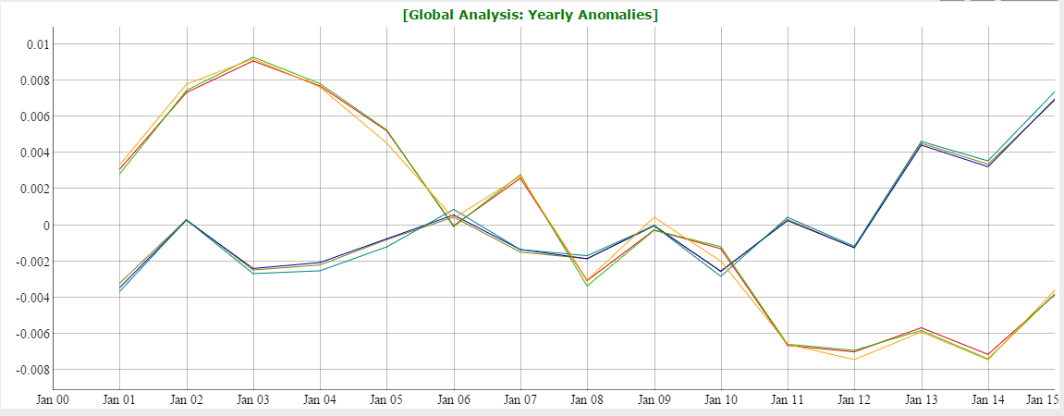
Specific Biomes Signal Anomalies/Trends
All needleleaf cover (Taiga)
C6
C5
Consistent across all data filtering approaches.
Major differences between the two collections
Taiga:
C6 ~ C5 : no clear trend
Tropics
C6 : Greening
C5 : Browning
All evergreen broadleaf cover (Tropics)
C6
C5

Slide 8
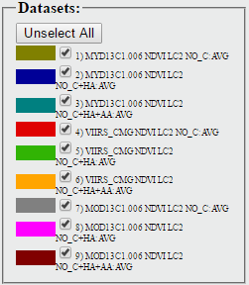
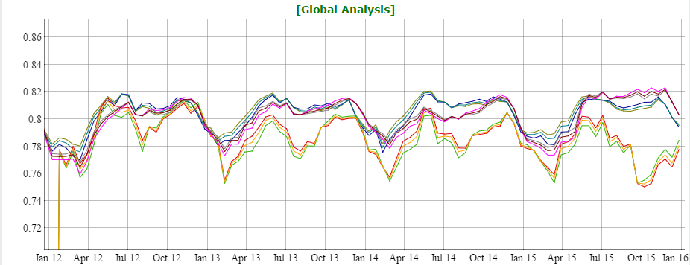
Terra-Aqua-VIIRS (Tropics)
Global Error Envelope ~0.04-0.05 VI Unit
Aqua
Terra
VIIRS

Slide 9
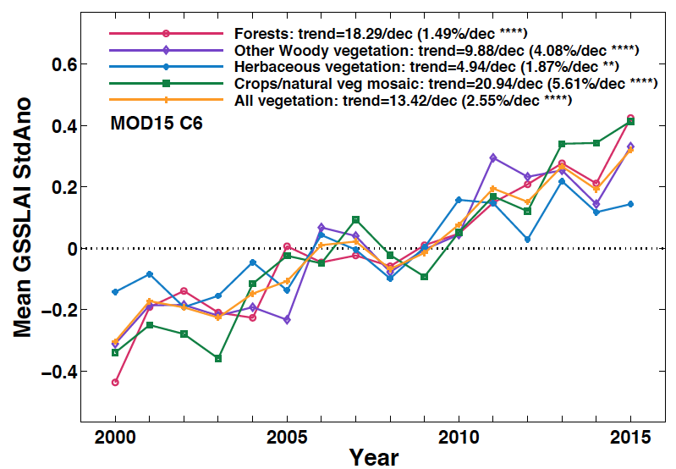
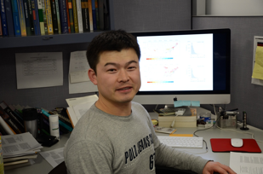

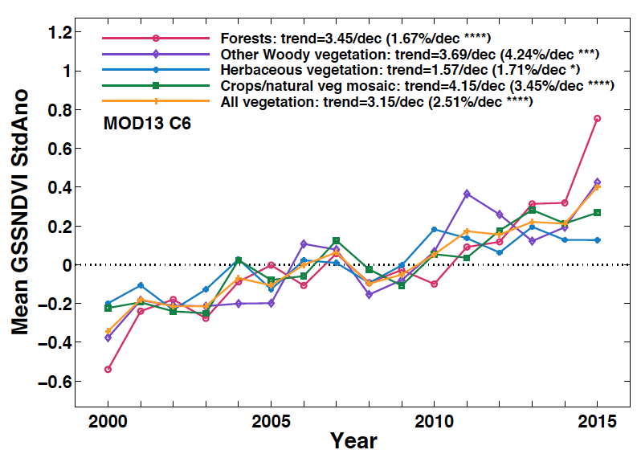

MODISLAI & FPAR – 2016 UPDATE
Does MODIS see a “greener Earth”?
Taejin Park
Kai Yan
Chi Chen

Slide 10
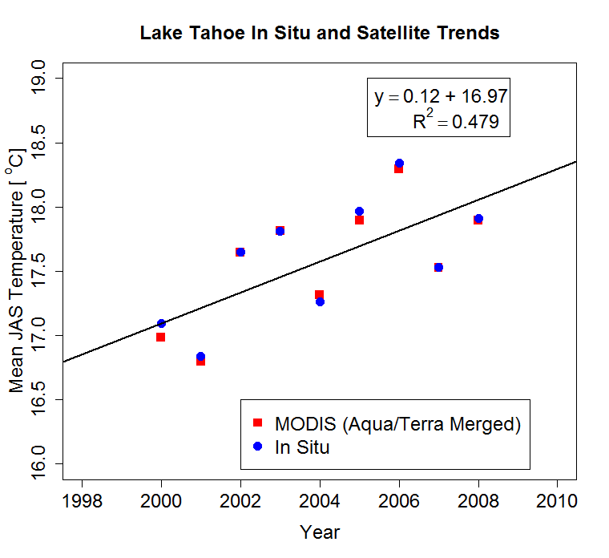
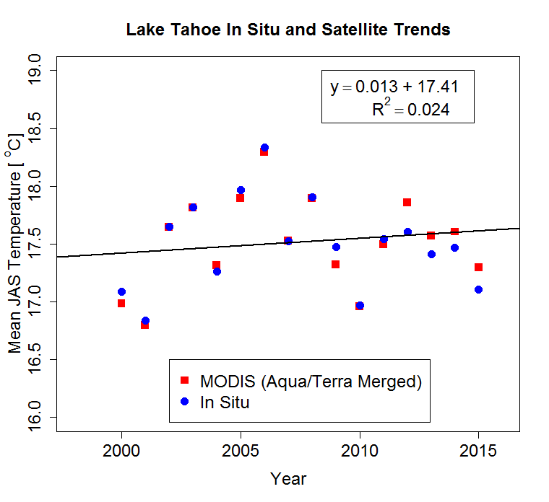
The Importance of Record Length

Slide 11
NEW SCIENCE

Slide 12
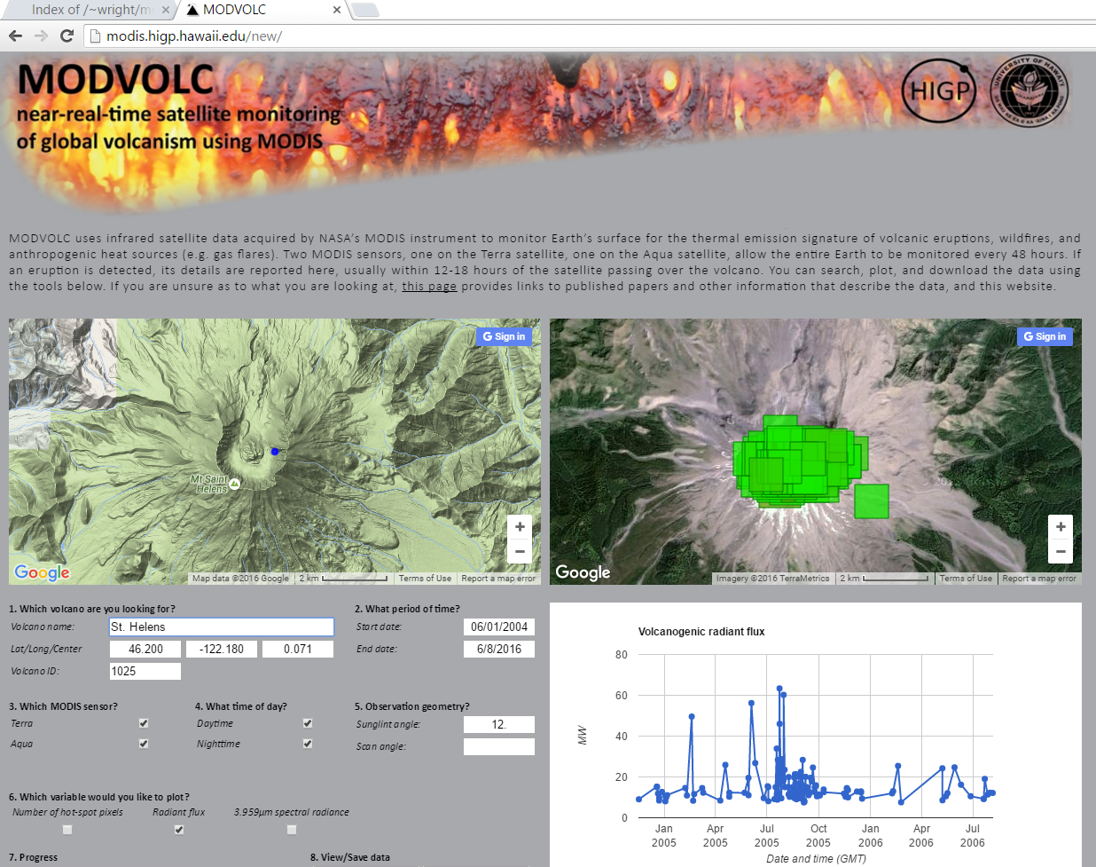

Slide 13
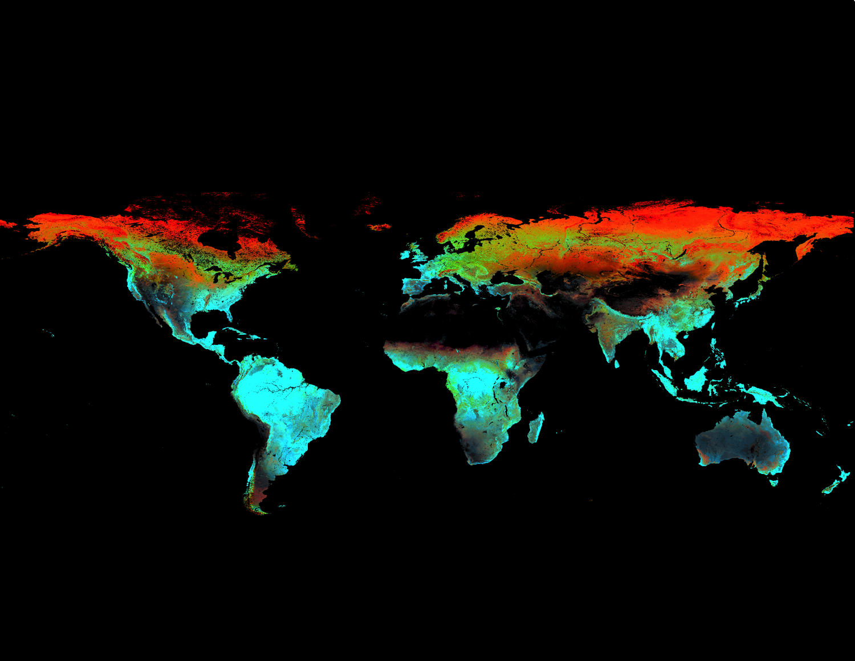
Composite FPAR DHIs
DHIs and global biodiversity

Slide 14
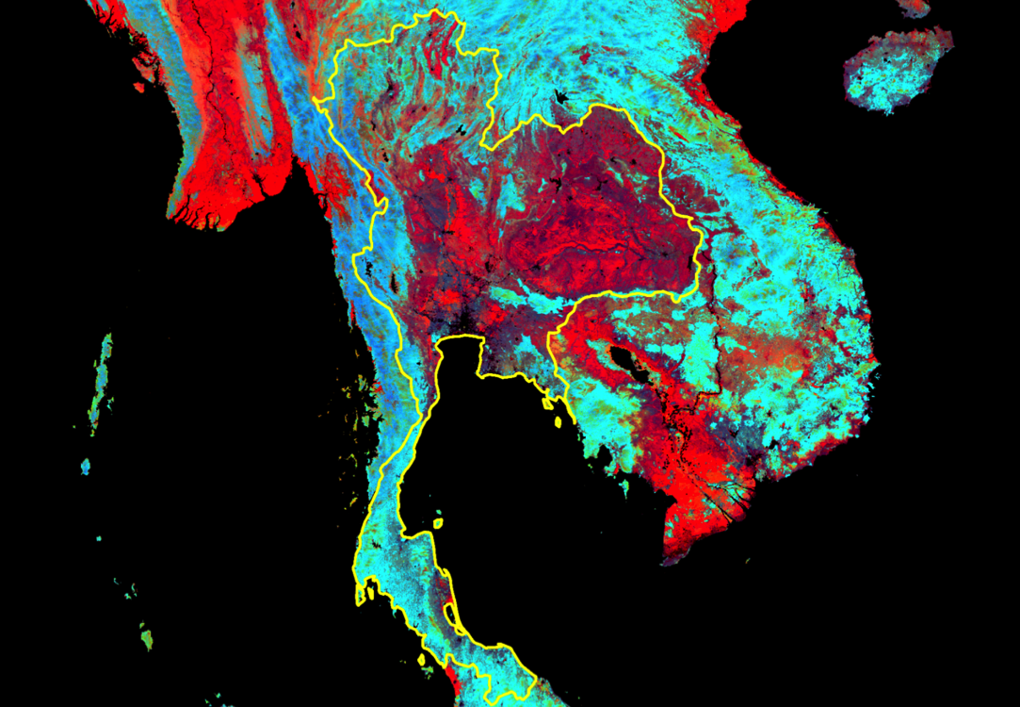
Composite FPAR DHIs

Slide 15
Evaluation of MODIS PRI Reference Bands
Ref Bands 12 10 1 3 4
Deciduous Broadleaf Forest
Table shows R² with Daily GEP
Color coded as:
  R²≥0.5 - Yellow
  R² ≥ 0.7 - Red
Evergreen Broadleaf Forest
Evergreen Needleleaf Forest
PRI(11,1) = Chlorophyll-Carotenoid Index (CCI)
Grassland
Shrub/
Savanna
Wetlands

Slide 16
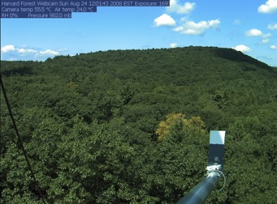


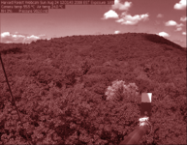
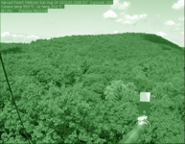
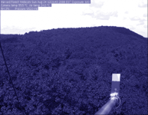

Extracting Phenology Data From Webcam Images
RGB Triplet:
RGB Color Model
Canopy “Greenness” (GCC)
Canopy “Greenness”
Richardson et al. (2013) in Schwartz (ed.)

Slide 17
POLICY RELEVANT
SCIENCE

Slide 18
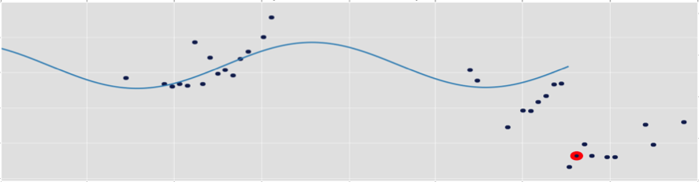
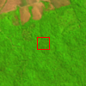
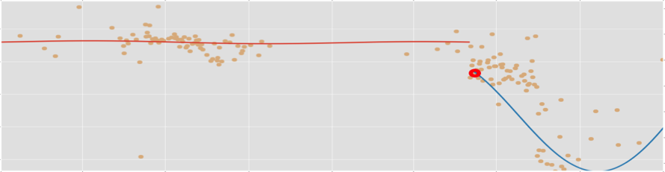
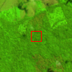
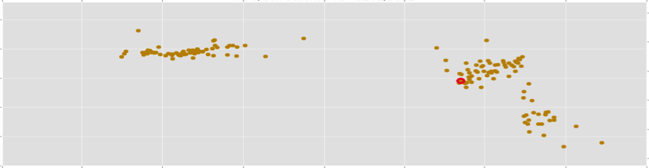
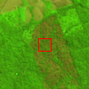
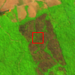
0.4
NIR
0.3
2013
228
0.2
Landsat-based (CCDC): most spatial details
0.9
NDVI
0.7
2014
135
0.5
MODIS-based: easiest to implement
0
NIR
-0.1
Residual
2014
167
-0.2
Fusion: detects change faster
2013 2014 2015
Three different time series analyses of a recent deforestation event in Pará, Brazil
2014
231
Date of change
Date of detection
Notes:
Here is a example of how the two algorithms works.
On the right we have Landsat images in 654 composite collected at different time to show the deforestation event.
On the left side we have time series plotted.
The top one is the Landsat-based approach, with less observataion.
The one in the middle is the NRT-MODIS algorithm.
And the bottom one is the Fusion approach.
The red dash line is where the model think the change happened. The blue dash line is when the model detected that change.
We can see the two MODIS approach have way more observation than the Landsat approach, and therefore detects the change way earlier.

Slide 19





















CEOS-LPV 5-Year Roadmap
<2016 2017 2018 2019 >2020
Vision
Operational Validation Framework: Land Product Characterization System (Lead Agencies: USGS/NOAA)
  All missions support validation & validation is on-going
  Uncertainty information determined through standard practices & protocols
  Algorithms are iteratively improved based on validation results
Albedo, Burned Area, & LST Protocols
Phenology, ET, & Soil Moisture Protocols (Lead Agency: NASA)
CEOS Carbon Actions 7/8 (NASA CMS Program)
Biomass Protocol (Lead Agencies: NASA/ESA)
ECV protocols and procedures for Snow ECV (Lead Agency: ESA)
WGCV Atmospheric Correction Intercomparison Exercise (Lead Agency: ESA)
Atmospheric Correction and VI Protocols (Lead Agencies: ESA/NOAA)
Field Campaigns and IOPs
New Missions
Biomass
Sustained Missions
a/b
A
/ 1b
b
Morning
c
Landsat 9
Afternoon
Terra/Aqua/S-NPP
JPSS-1
JPSS-2

Slide 20
MY FINAL THOUGHT
Datasets now long enough to look for global change trends, requiring huge attention to processing details
BUT old sensors degrading, and crosswalks to new sensors a challenge
AND bigger user community, including policy
SO OUR WORK IS GETTING HARDER, NOT EASIER!!

