Slide 1
BRDF/Albedo/NBAR: Extending MODIS to VIIRS
Crystal Schaaf, Yan Liu, Qingsong Sun, Zhan Li,
Zhuosen Wang
University of Massachusetts-Boston
NASA Goddard Space Flight Center
June 2016

Slide 2
MODIS and VIIRS Products
MODIS V006
Terra AND Aqua (morning and afternoon)
DAILY BRDF, Albedo, NBAR (Nadir BRDF Adjusted Reflectance)
NBAR-vegetation indices used in phenological research
500m Tiles, 30arc-second CMG
7 bands, 3 Broadbands
QA, uncertainty measures
VIIRS
Suomi NPP only (afternoon)
DAILY BRDF, Albedo, NBAR
500m Tiles (3 I-Bands), 1km (9 M-Bands, 3 Broadbands)
QA, uncertainty measures
LANCE NRT products delivered

Slide 3
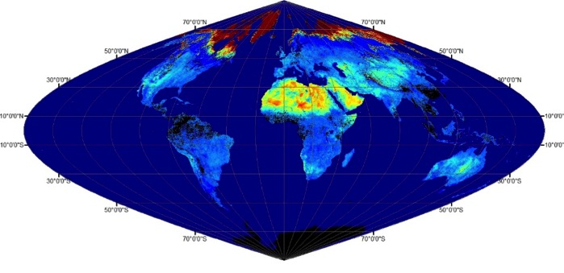
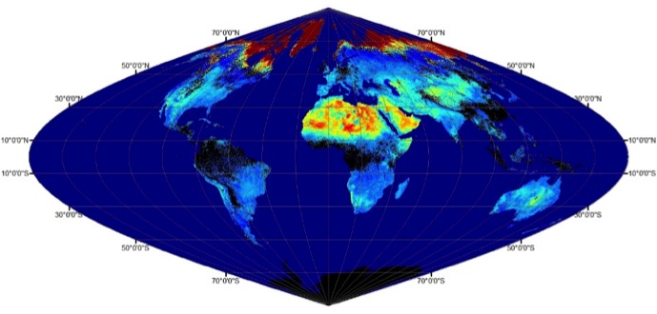
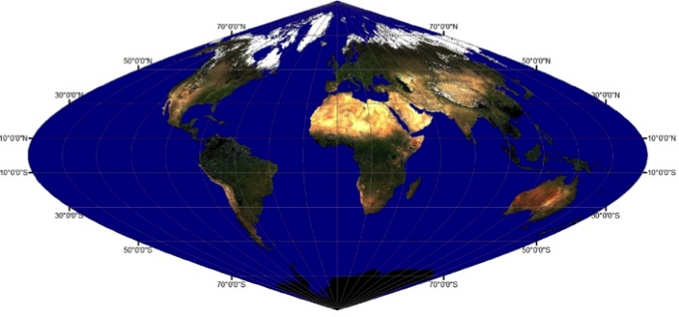
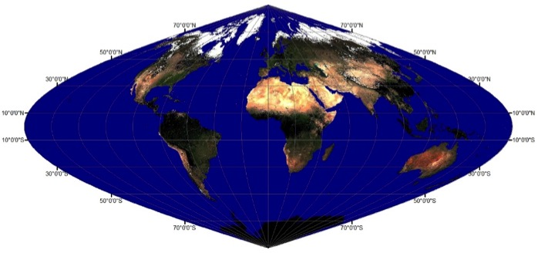
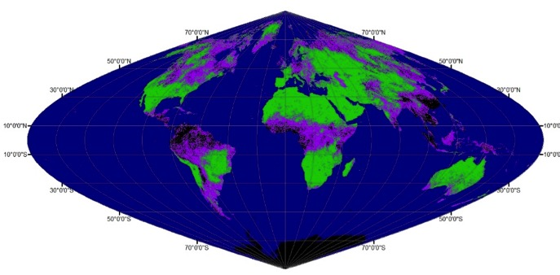
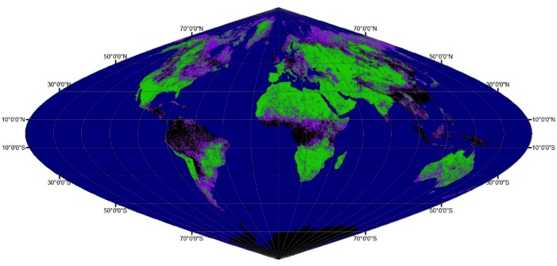
MODIS
12 May 2014 (DOY 132)
VIIRS
WSAlbedo
0 0.6
NBAR
M5-Red(0-0.3)
M4-Green (0-0.3)
M3-Blue(0-0.3)
Quality
No Data
High Quality
Poor Quality (Backup Alg)

Slide 4
Efforts Underway
Incorporation of Upstream Enhancements
VIIRS and MODIS effective spatial resolutions
Campagnolo, M. L., Sun, Q., Liu, Y., Schaaf, C. B., Wang, Z., & Román, M. O. (2016). Estimating the Effective Spatial Resolution of the Operational BRDF, Albedo, and Nadir Reflectance Products from MODIS and VIIRS. Remote Sensing of Environment, 175, 52–64.
VIIRS and MODIS Aqua combined
What happens when Terra finally ends….
VIIRS N2B
Narrow spectral to broadband albedo conversions
Land surface types and snow covered
Evaluation/validation of MODIS and VIIRS over spatially representative field sites

Slide 5
MODIS VIIRS effective resolution
Along E-W estimated resolution (m) Along N-S estimated resolution (m)

Slide 6
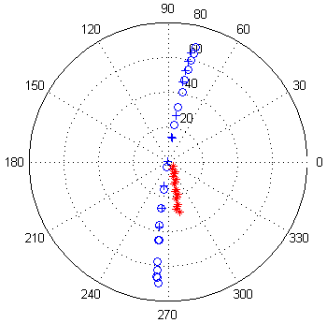
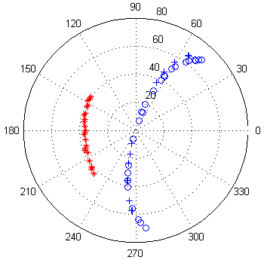
MODIS and VIIRS Combined
h19v07
h12v03
VIIRS observations
MODIS Aqua observations
Sun positions
Observations DOY 185-200, 2012

Slide 7
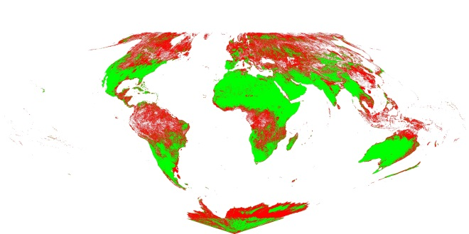
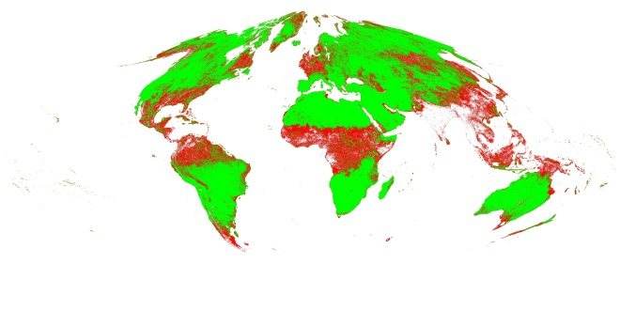
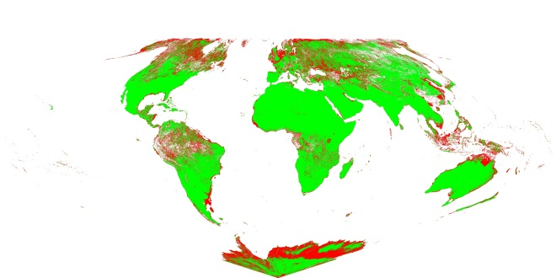
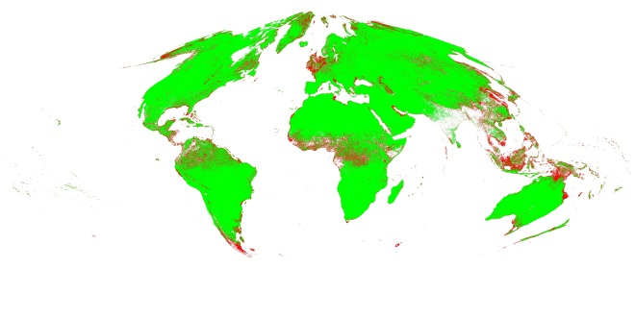
Aqua only
Green: high quality
Magenta: poorer quality
Aqua
+
VIIRS
DOY 025
DOY 185
red (vis) band

Slide 8
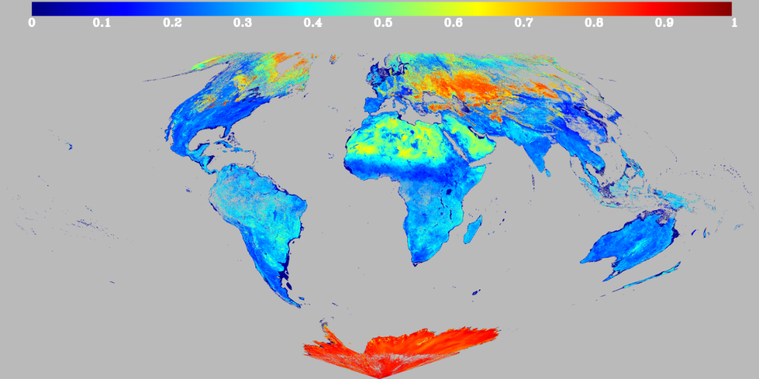
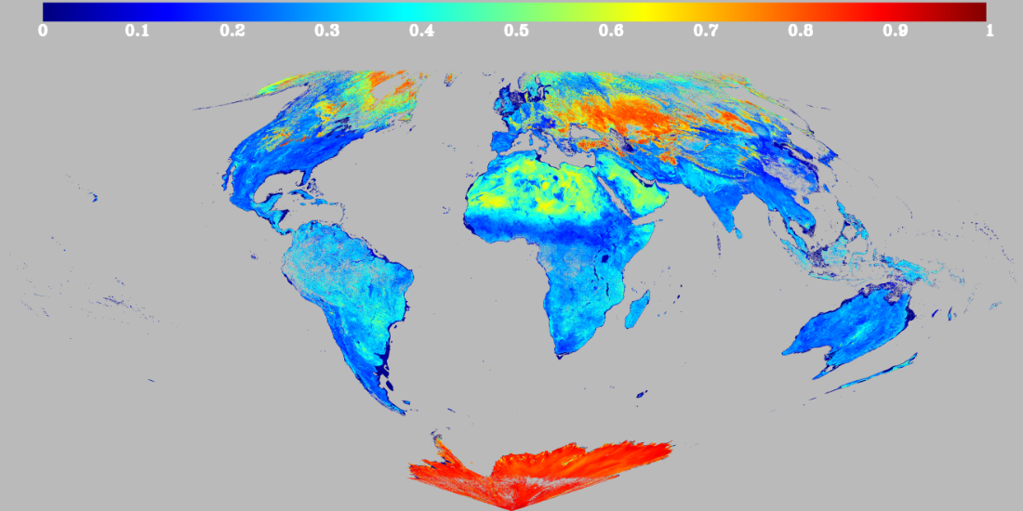
MODIS and VIIRS
WSA NIR 025, 2012
Aqua-only
Aqua + VIIRS

Slide 9
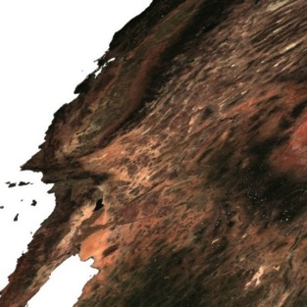
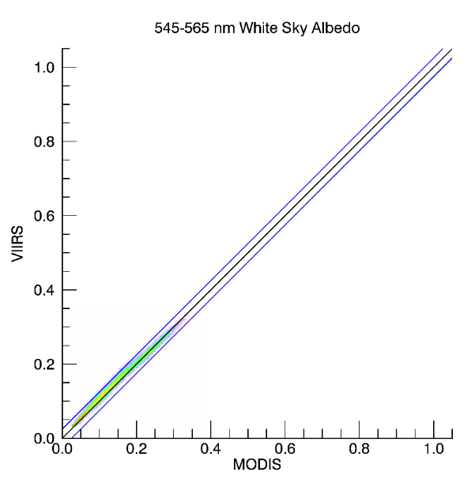
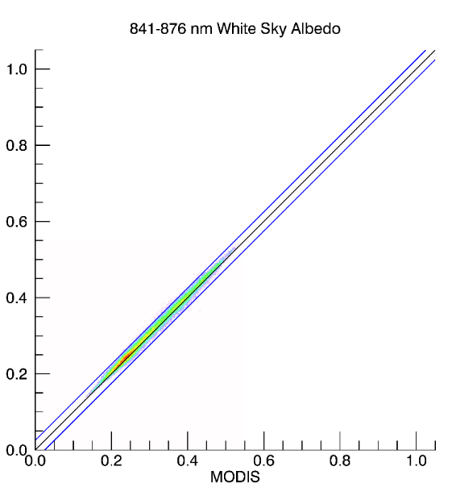
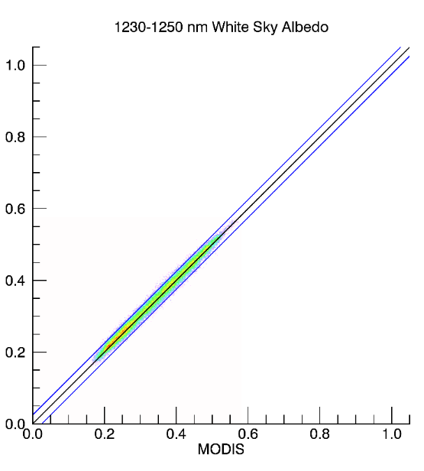
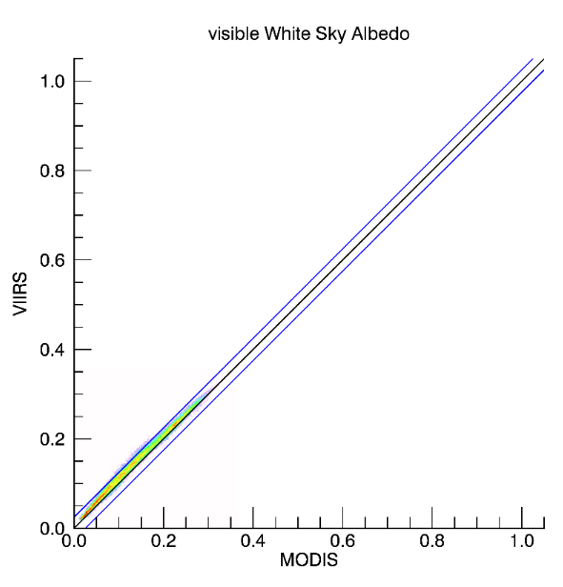
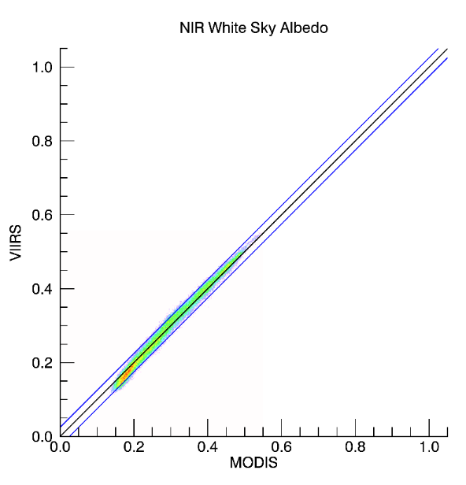
Land cover: Shrub, grass, barren or sparsely vegetated
H08v05
2014267
R,G,B:0:0.4
1:1
0.025 offset

Slide 10
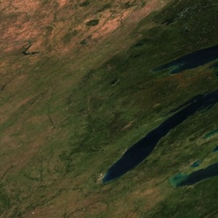
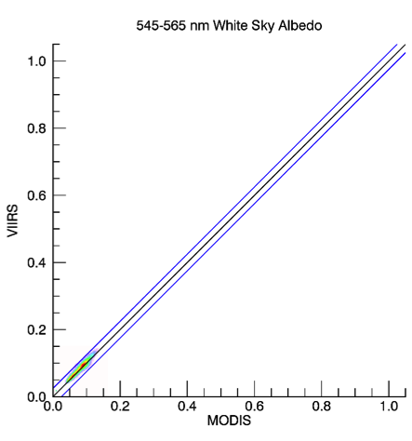
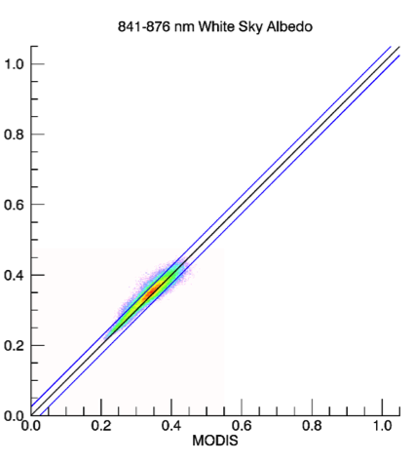
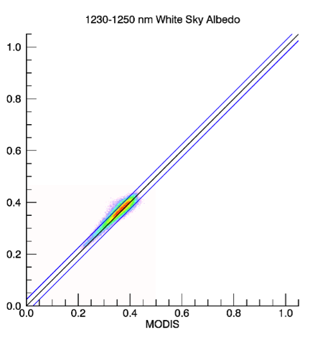
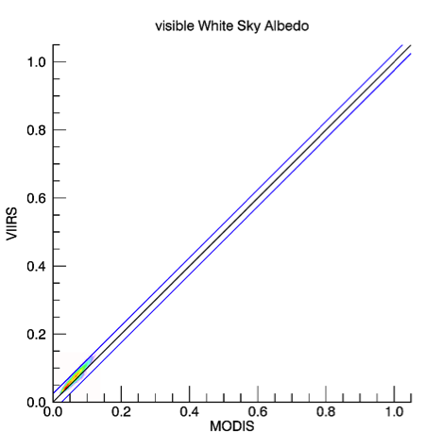
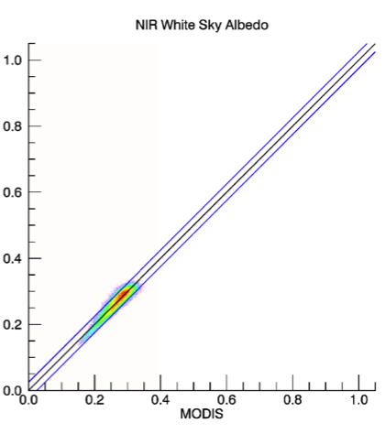
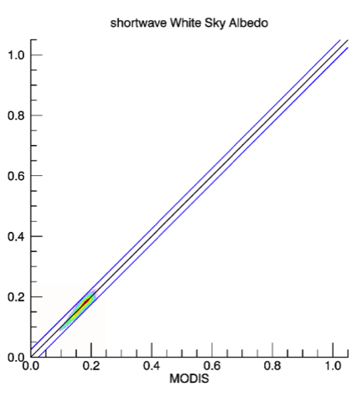
Land cover: cropland and forest
H11v04
2014267
R,G,B:0:0.2
1:1
0.025 offset

Slide 11
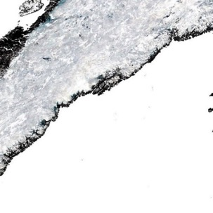
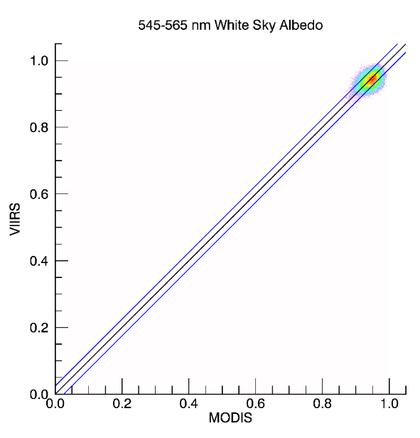
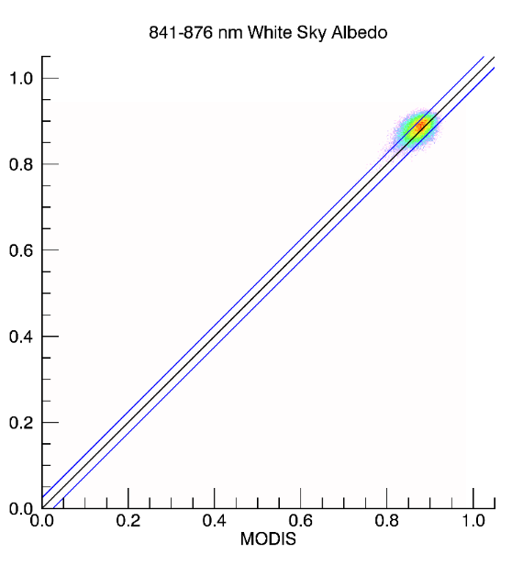
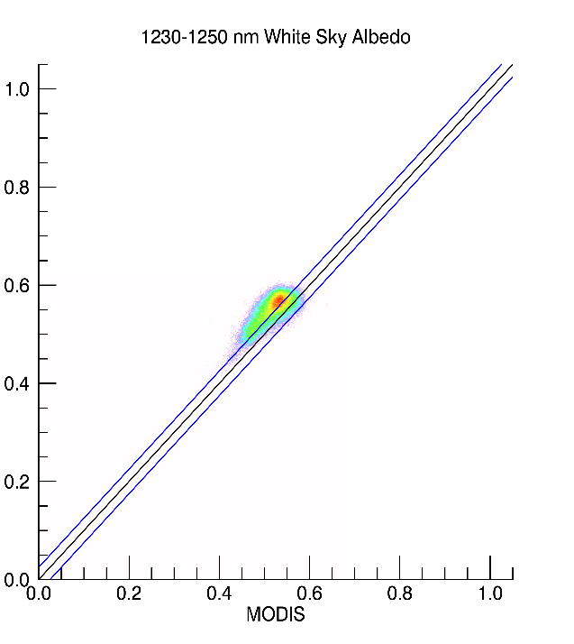
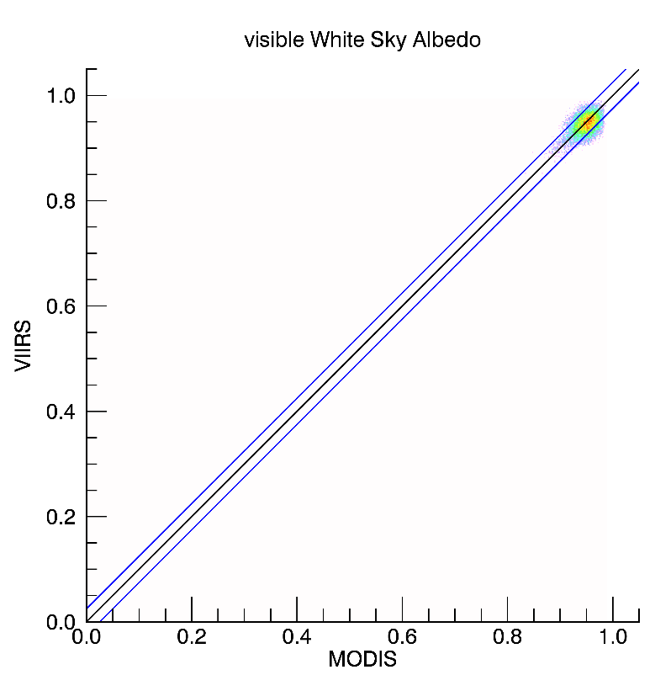
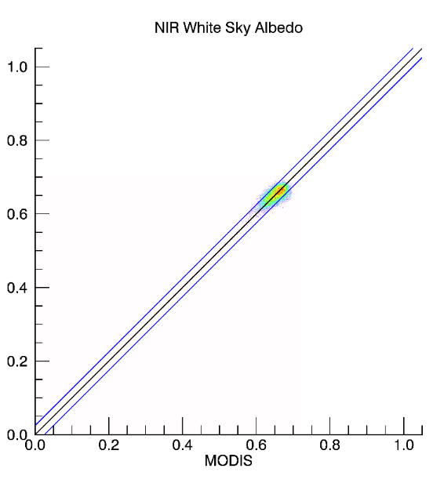
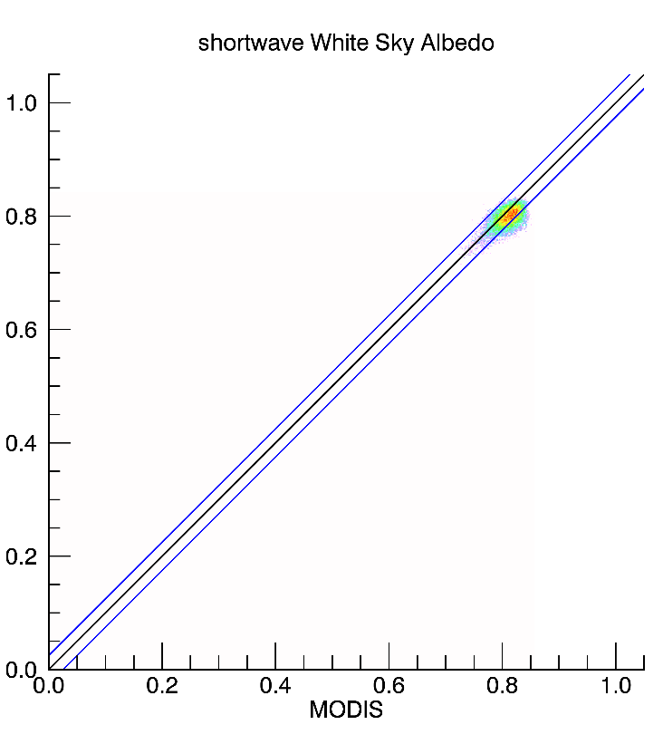
Land cover: snow and ice
H16v02
2014267
R,G,B:0.5:1.0
1:1
0.025 offset

Slide 12
Land Product Validation/Evaluation
CEOS/WGCV/Land Product Validation (LPV)
Albedo
Co-chair of LPV Radiation Subgroup
Baseline Surface Radiation Network (BSRN)
Gold Standard of Albedo Measures
SURFRAD (NOAA) US component of BSRN
Ameriflux (DOE)
NEON (NSF)
Fluxnet, TERN, Eumetsat/SAVS etc.
Use only spatially representative sites (Román et al., 2009)
BRDF
MALIBU: Multi AngLe Imaging Bidirectional Reflectance Distribution Function (BRDF) Unmanned aerial system Project
Participating in the MALIBU deployment over the Pawnee National Grasslands in Colorado in July

Slide 13
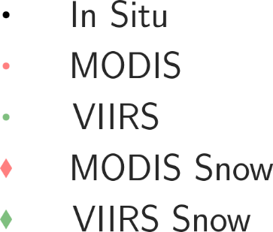
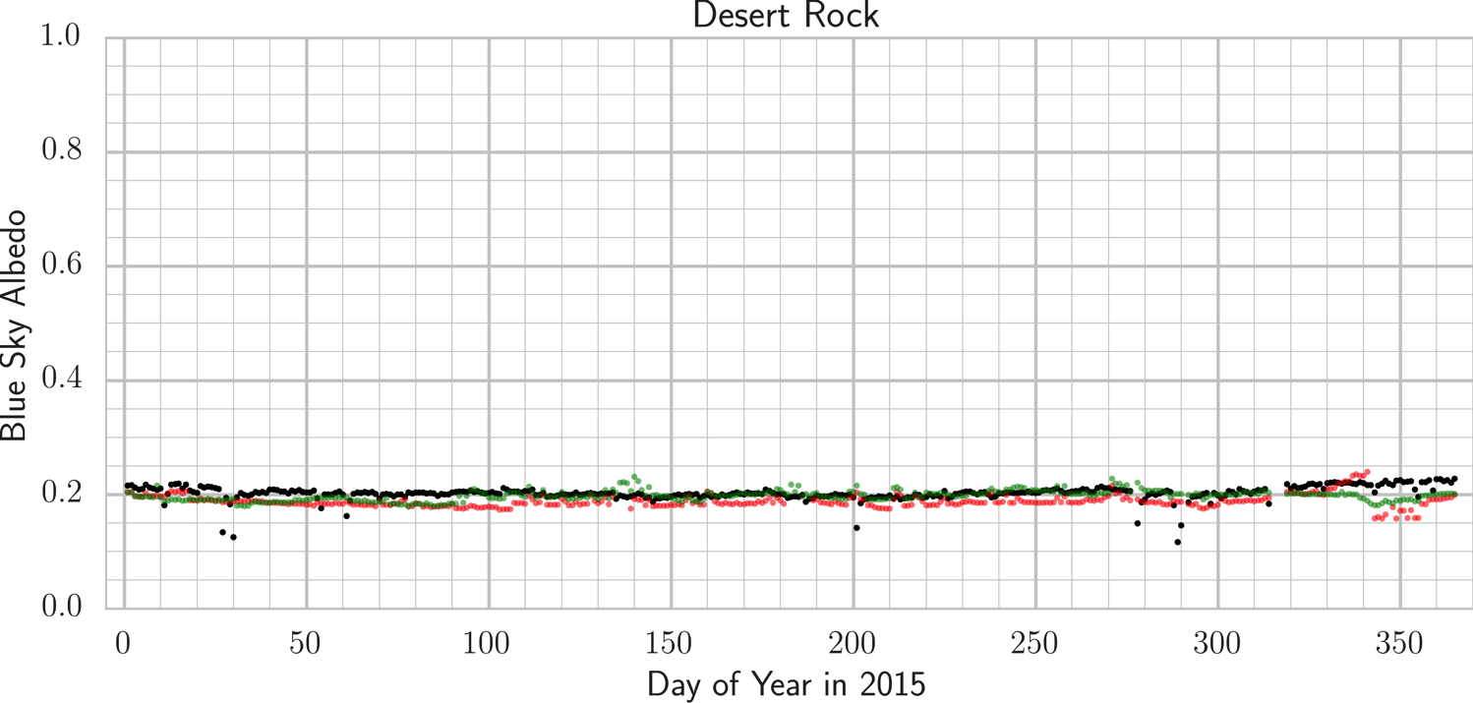
MODIS and VIIRS evaluation

Slide 14
MODIS and VIIRS evaluation

Slide 15
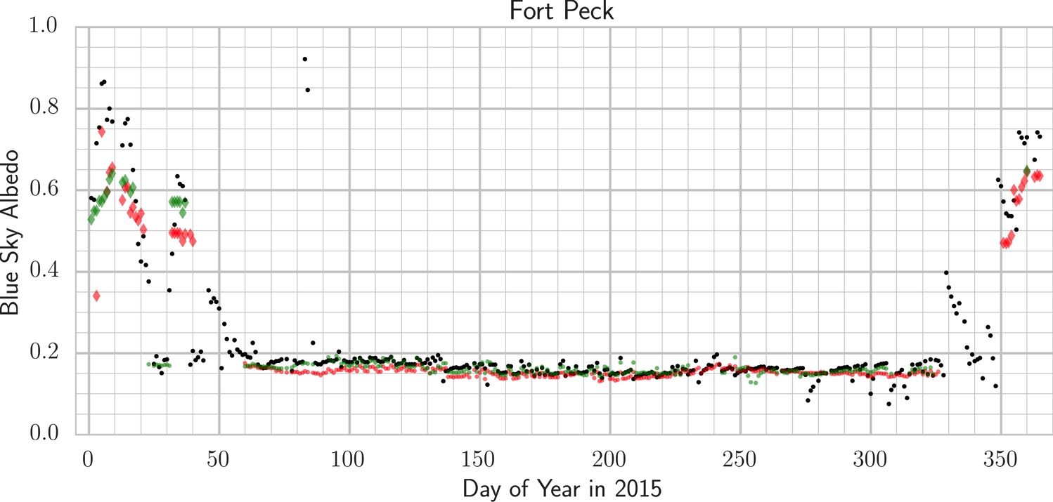
MODIS and VIIRS evaluation

Slide 16
Snow free Spatially representative sites (Desert Rock, Table Mtn, Ft Peck)
Stats. | MODIS | VIIRS
# of Obs. | 876 | 787
RMSE | 0.022 | 0.021

Slide 17
BRDF/NBAR/Albedo MODIS to VIIRS
Summary
MODIS
Collection V006 reprocessing up to DOY 56 2015
Excellent evaluations over representative tower sites
VIIRS
Just received latest VNP09 (HDF5) to evaluate
Excellent initial evaluations over representative sites
Comparable to MODIS (long term continuity)

