Slide 1
MODIS Science Team Meeting
June 6-10, 2016, Silver Spring, MD
Near real-time monitoring of forest disturbance using MODIS data: algorithms and assessment framework
X Tang, P Olofsson, EL Bullock, S Estel, CE Woodcock
Notes:
First I would like to thank my advisor Curtis and Pontus.
I also want to acknowledge my collaborator Eric Bullock and Stephan Estel who spent a lot of time of this project.
Our project focusing on trying to use MODIS data to monitor forest disturbance in near real-time.
I will talk briefly on the objectives of our project, what we are trying to achieve.
Then I’ll talk about the two different algorithms we developed.
I’ll show some preliminary results that we have so far.
And then finally I’ll talk about our plan to develop a framework for assessing near real-time change products.

Slide 2
Objectives
Develop algorithms for near real-time monitoring of forest disturbance:
Apply prediction model to daily time series of MODIS data
Fuse Landsat and MODIS data to overcome inherent variability of sequential MODIS observations
Develop framework for assessment of performance of near real-time monitoring systems
Develop prototype for operational near real-time monitoring
Notes:
We have three main objectives for our project.
The first one of course is to develop algorithms to monitor forest disturbance in near real-time.
We developed two algorithms.
One apply…
The other is based on fusion of Landsat and MODIS data...
Our second goal is to developa framework for assessment of the performance not just for our results only, but also as a guideline for assesiing any near real-time change products.
Our last objective is to develop prototype of operational near real-time change products that is updated routinely and also accessable.

Slide 3
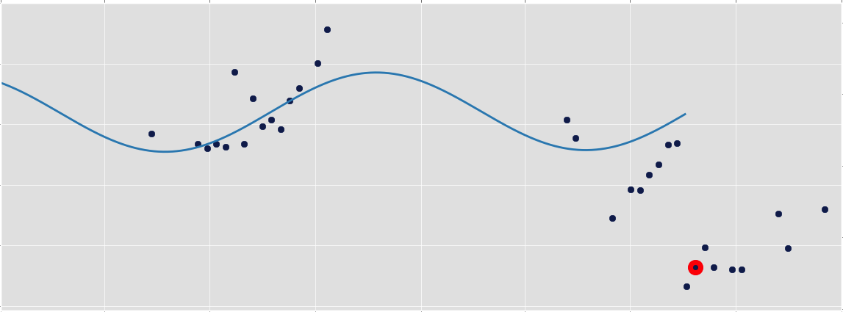
Base Algorithm: CCDC
Two term harmonic model to capture the seasonality and trends in surface reflectance
Detects change by comparing new observation to predicted value
NIR Surface Reflectance
0.4
0.3
0.2
2013 2014 2015
Change
(Zhu and Woodcock, 2014)
Notes:
Both our two algorithms are based on our work with Landsat time series.
Our group we developed this Landsat time series model we called Continuous Change Detection and Classification, or CCDC.
What it does is basically it fits a two term harmonic model to try to capture the seasonality and trend in the time series of surface reflectance.
The model updates itself as new observation comes in and it detects change by comparing new observation to the predicted value.
Down here is a example of the CCDC result on Landsat data. This is near infrared band. The dots are Landsat observations and the curve is the model fit. When the observations start to be different from model prediction, it detects the change there where the red dash line is. And it will eventually start to fit a new model after the change.

Slide 4
Algorithm 1: NRT-CCDC
CCDC modified for MODIS data
Daily surface reflectance products screened by view angle threshold (VZA lower than 35°)
Change detection based on 250 m NDVI
500 m Green and SWIR bands used for multi-temporal cloud screening
Notes:
So our first algorithm for near real-time monitoring using MODIS data is just a simple modification of the CCDC model to directly apply it on MODIS daily gridded surface reflectance data.
We call it Near Real Time CCDC
We do a simple screening of the data based on view angle.
We use only data with view zenith angle lower than 35 degree.
The change detection is based on 250m NDVI
We also use 500m green and short wave infrared bands for multi-temporal cloud screening.

Slide 5
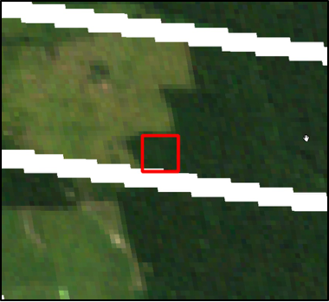
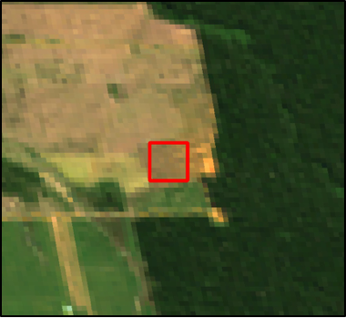
Algorithm 1: NRT-CCDC
Before change
After change
2013199
2014162
NDVI
Change
0.8
0.6
0.4
2007 2009 2011 2013 2015
Notes:
Here is a example of the result from Near Real Time CCDC.
On the top here we have two Landsat images in true color. One before the change and one after.
On the bottom here we have the time series of NDVI from MODIS.
We can see the model fit and then a change is detected here and a new model is fitted after the change.

Slide 6
Algorithm 2: Fusion approach
Use swath surface reflectance (MOD09) to identify the footprint of each MODIS observation
Use Landsat-based time series model to predict the surface reflectance of each MODIS observation
Change detected by comparing predicted and observed surface reflectance
Notes:
Our second algorithm is a little bit more complicated. It is based on fusion of Landsat and MODIS data.
Instead of gridded product, the fusion approach uses swath surface reflectance data to identify the footprint of each MODIS observation.
We use the Landsat-based CCDC time series model to predict each MODIS swath observation.
Then we compare our prediction with the observed Swath data to detect change.

Slide 7
Algorithm 2: Fusion approach
Residual Time Series
0.2
Change
0.1
Red
(Residual)
0
-0.1
-0.2
2012 2013 2014 2015 2016
Date
Notes:
Here is a example of our Fusion approach.
This is a time series of the residual which is basically the difference between our prediction and the actual observation.
We use the two 250m bands, I’m showing here is an example of the red band.
As we can see if when there’s no land cover change, the residual is almost a flat line near 0.
Here’s where the change occurred and the residual started to dance around.
So our fusion model will detect this change in residual and hence capture the change event.

Slide 8
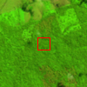
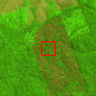
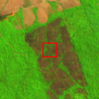
0.4
NIR
0.3
2013
228
0.2
Landsat-based (CCDC): most spatial details
0.9
NDVI
0.7
2014
135
0.5
MODIS-based: easiest to implement
0
NIR
-0.1
Residual
2014
167
-0.2
Fusion: detects change faster
2013 2014 2015
Three different time series analyses of a recent deforestation event in Pará, Brazil
2014
231
Date of change
Date of detection
Notes:
Here is a example of how the two algorithms works.
On the right we have Landsat images in 654 composite collected at different time to show the deforestation event.
On the left side we have time series plotted.
The top one is the Landsat-based approach, with less observataion.
The one in the middle is the NRT-MODIS algorithm.
And the bottom one is the Fusion approach.
The red dash line is where the model think the change happened. The blue dash line is when the model detected that change.
We can see the two MODIS approach have way more observation than the Landsat approach, and therefore detects the change way earlier.

Slide 9
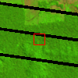
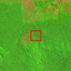
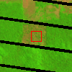
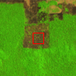
0.4
NIR
0.3
2015
213
0.2
Landsat-based (CCDC): most spatial details
1.0
NDVI
0.8
2015
229
0.6
MODIS-based: easiest to implement
0
NIR
Residual
2015
253
-0.1
-0.2
Fusion: detects change faster
2014 2015 2016
Three different time series analyses of a recent deforestation event in Rondônia, Brazil
2015
261
Date of change
Date of detection
Notes:
Here is another example of a very recent deforestation in late 2015.
This is in Rondonia, Brazil.
We can see that the Landsat approach hasn’t detected the change yet.

Slide 10
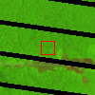
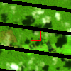
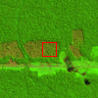
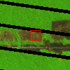
0.4
NIR
0.3
2013
295
0.2
Landsat-based (CCDC): most spatial details
1.0
NDVI
0.8
2014
138
0.6
MODIS-based: easiest to implement
NIR
0
Residual
-0.1
2014
162
-0.2
Fusion: detects change faster
2013 2014 2015
Three different time series analyses of a recent deforestation event in Rondônia, Brazil
2014
234
Date of change
Date of detection
Notes:
Here is another example of a very small deforestation event, only about the size of two MODIS pixels.
And the two MODIS approach still captures the change pretty well.

Slide 11
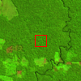
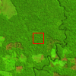
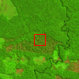
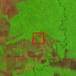
0.4
NIR
0.3
2015
165
0.2
Landsat-based (CCDC): most spatial details
1.0
NDVI
0.8
2015
181
0.6
MODIS-based: easiest to implement
0
NIR
-0.1
Residual
2015
197
-0.2
Fusion: detects change faster
2014 2015 2016
Three different time series analyses of a recent deforestation event in Rondônia, Brazil
2015
277
Date of change
Date of detection
Notes:
Here is a interesting example of a very subtle deforestation event.
In this case, The Landsat approach actually place the change earlier than the fusion approach.
But the fusion approach still finds the change earlier than the Landsat approach.
And in this case the NRT-CCDC algorithm seem to work better.

Slide 12
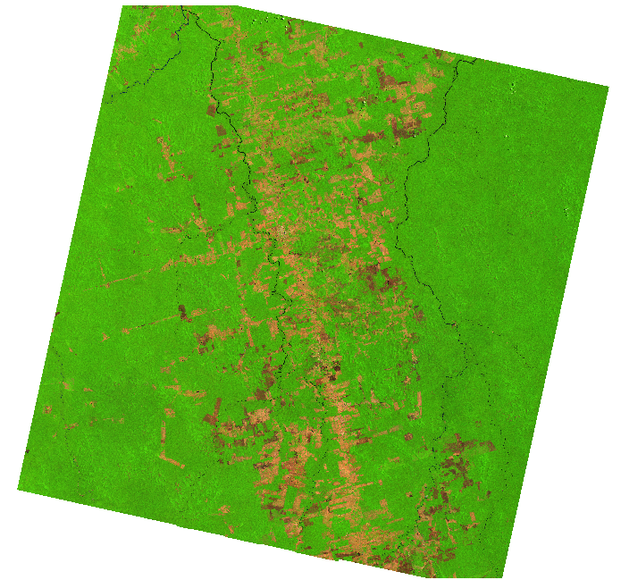
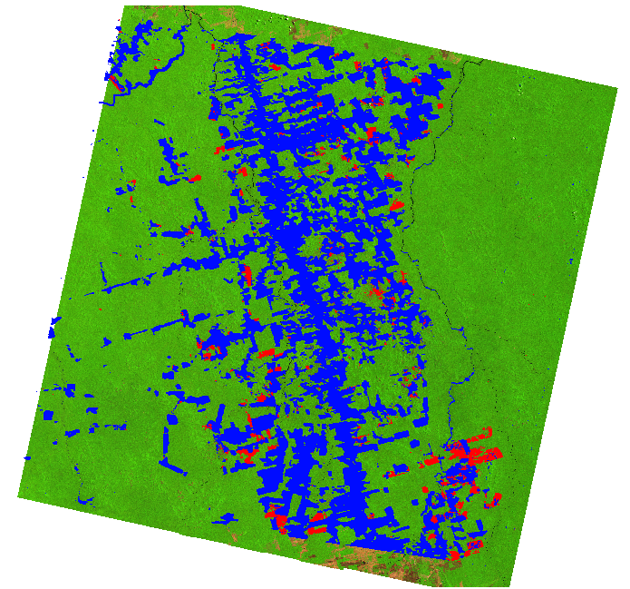
Deforestation, Para, Brazil (P227R065)
Recent Landsat 8 image
Change map from Fusion
Deforestation before 2013
Deforestation after 2013
Notes:
I’ve showed couple individual changes. To get a sense how complex they can be.
Here’s how our change map actually looks like.
On the left is a recent Landsat 8 image in 654 composite.
On the right is the change map from the fusion approach. Blue areas are non-forest or deforestation before 2013. And red areas are changes that happened between 2013 and the end of 2015
The map looks ok, but there’s really no way to tell how accurate it is until we do a actual accuracy assessment. And this is way we want to develop a framework for assessment

Slide 13
Need for assessment framework
Last 5 years, guidance on statistical inference matured but guidance focused on area estimation of REDD activities as stipulated by IPCC
Assessment protocols of near real-time studies diverge: non-existent to comparison to non-probability samples, other maps, field plots, etc.
Augment guidance for NRT: focus on disturbance events, average lag [days] of alerts and minimum disturbance patch [ha]
Notes:
In the last five years, we’ve tried to push the guidance of accuracy assessment based on statistically inference within the community.
But the guidance focuses on area estimation.
Now in this near real-time case, we are not trying to estimate the area of deforestation. But rather we trying to identify the event as soon as possible. So that maybe law enforcement agencies can take action.
So the old guidance doesn't apply in near real-time monitoring.
And we feel that there’s a need for a new guidance. So we wanted to develop this new assessment framework in the near real-time context, to focus on disturbance event.
And try to answer the question such as how good can we detect those change events? How fast can we detect change? And also what is the size and magnitude of the change that we can detect using MODIS data?

Slide 14
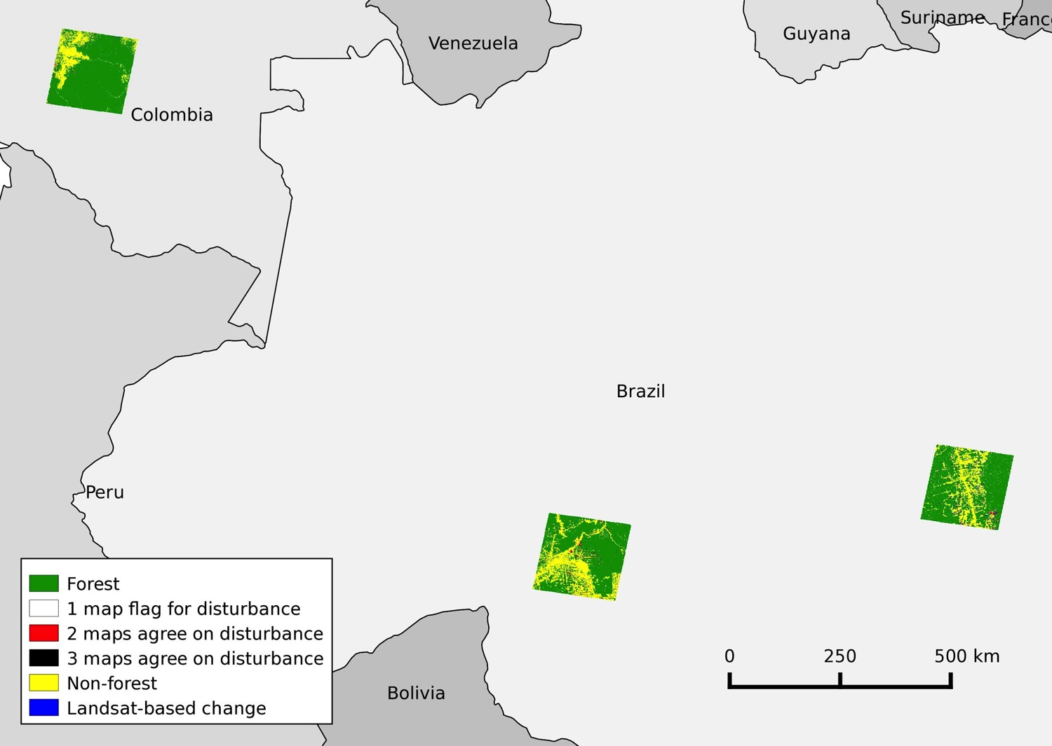
Application of assessment framework
Three products: Terra-i + aforementioned algorithms
Population: three Landsat footprints in Brazil and Colombia
Stratification: maps combined to identify level of agreement
Landsat-based information added to capture omission errors
Notes:
With those questions in mind. We developed a assessment frame work.
And we applied our framework to assess the results of our two algorithms. We also included a operational near real-time product called Terra-i.
We selected three Landsat scenes as our population of assessment. Two located in Brazil, and another one in Columbia Amazon.
We created a stratification based on the levels of agreement among the three maps.
We also added information from the Landsat-based approach to try to target errors of omission.

Slide 15
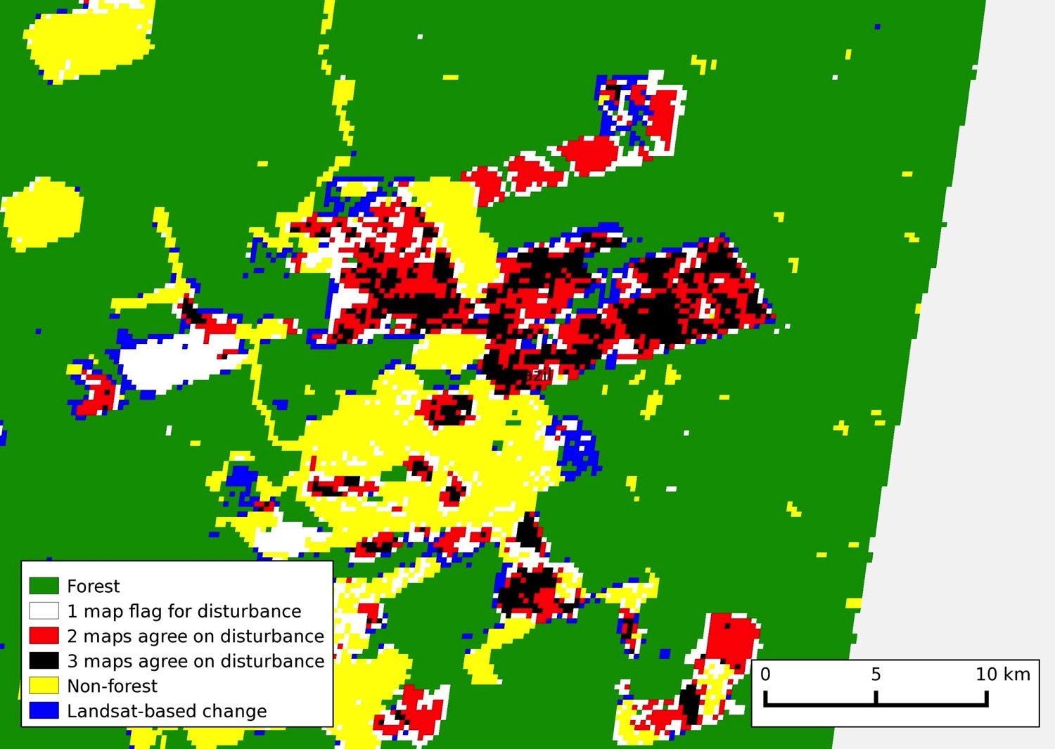
Forest
1 map flags disturbance
2 maps flag disturbance
3 maps flag disturbance
Non-forest
Landsat-based change
Notes:
Here is a zoom-in look of our stratification.
We have areas where all three maps flag change. We have areas where two maps flag change and we also have areas where only one map flags change.
Then we also have areas where the Landsat based approach thinks there’s change. We included that to try to target errors of omission.
So we selected our sample based on this stratification.

Slide 16
Sample Design
Stratified Random Sampling
Total sample size: 765
Spatial assessment unit: MODIS pixels (250 m)
Stratum | Forest | 1 Flags | 2 Flag | 3 Flag | Non-forest | Landsat | Total
Area [ha] | 7,091,271 | 146,859 | 39,503 | 14,672 | 2,346,622 | 65,847 | 9,704,772
Area [Pct] | 73% | 1.51% | 0.41% | 0.15% | 24% | 0.68% | 100%
Samples | 349 | 75 | 75 | 75 | 116 | 75 | 765
Notes:
Here is some details of our sample design. I’m just going to quickly go through this. I can come back to this later if anyone is interested in the details.
We selected a total of 765 samples.
We have finished collecting reference data for all the samples. And they are reviewed and checked carefully.
We are currently still working on trying to analyze our results.
We don’t have statistical results so far.
So I’m just going to show you one example of a change event.

Slide 17
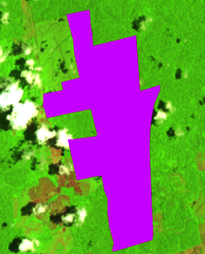
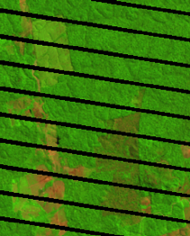
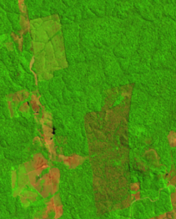
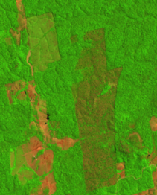
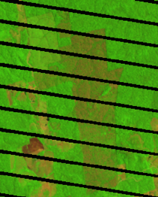
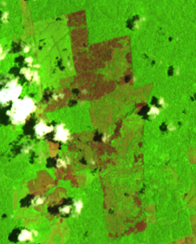
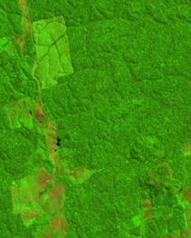
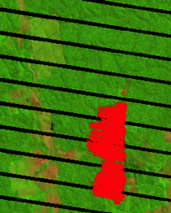
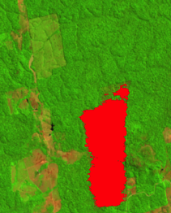
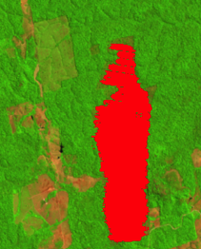
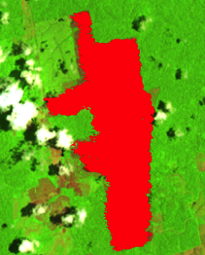
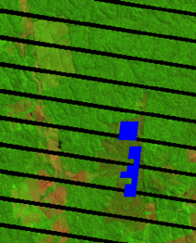
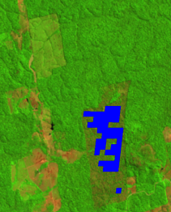
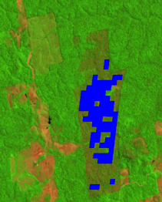
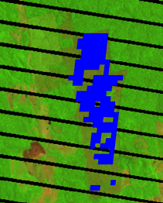
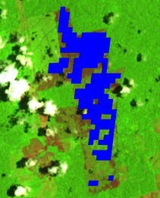
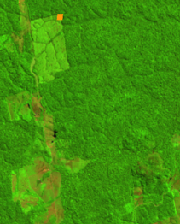
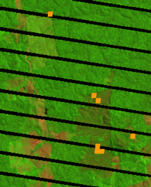
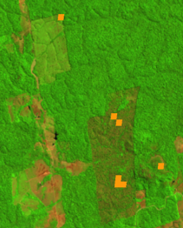
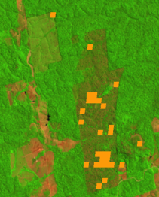
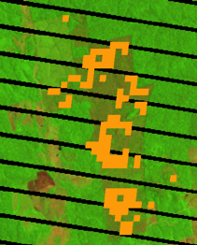
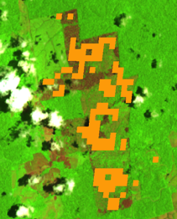
Landsat
Image
Fusion
2013188
2013212
2013220
2013236
2013260
2013284
NRT_CCDC
Terra-i
Notes:
Here what we have on the top row is Landsat images through time that shows the progression of a change event. On the left side is the change event that we identified in our reference dataset in purple.
Followed by the results of the three products that we are assessing.
In the middle we have the time of the Landsat image, year and day of year.
We can see that all products captured the event, this is a big event.
The Fusion and Near Real-time CCDC approach kind of captures the change faster than Terra-i. especially the fusion approach, captures the shape of the event pretty well.
This is just one example. We are currently in the process of analyzing the results and try to get answers statistically.

Slide 18
Three levels of operational readiness
Terra-i:
16-day MODIS NDVI product
Operational, updates every three months
NRT-CCDC:
Daily MODIS gridded surface reflectance (view angle filtering)
Easy to implement, operational-ready
Fusion:
Daily MODIS swath surface reflectance (no filtering)
Requires Landsat model in place
Have the potential to detect change faster
Notes:
The three products, Terra-i and the results from our two algorithms are really examples of three different levels of operational-readiness.
First we have terra-I that is already operational…
Then we have the Near Real-Time CCDC...
And finally we have the Fusion approach...
Which may have the potentila to detect change faster and more accurate but required more efforts.
We are trying to make Near Real-Time CCDC approach operational. Our vision on the Fusion approach is more like if we already have the Landsat based CCDC monitoring in place maybe for the LCMAP project for example, and on top of that we will have this fusion thing running and try to detect change in near real-time.

Slide 19
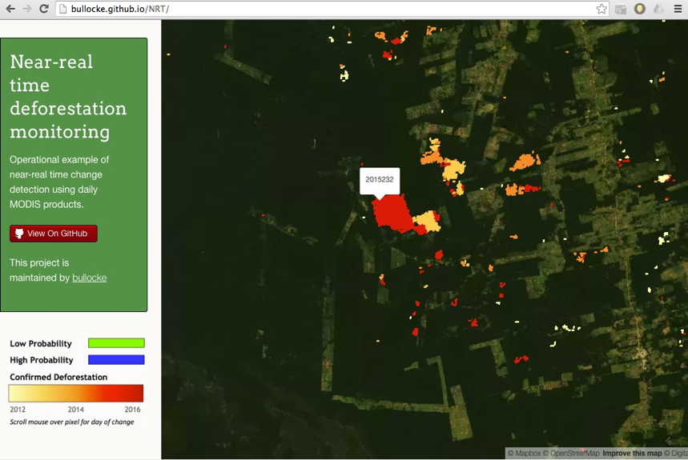
Operational-ready product
Result from NRT-CCDC is currently being tested
Open source; updated daily; view on internet
Notes:
We are currently testing the result from Near Real-time CCDC, to have it operational. We tried to host the data online using MapBox. We tried to update it daily and have it accessible.
My collaborator Eric has spent a lot of time trying to fix it. I’m not sure it will work on this browser today, but I have a screenshot here just in case.
Let’s give it a try…

Slide 20
Summary
Work completed:
Developed 2 algorithms of near real-time monitoring
Developed framework for assessment
Collected reference observation for assessment
Currently working on:
Analysing the results (What size and magnitude of change can we detect? How soon can we detect it?)
Future work:
Publish both algorithms and the framework of assessment (including comparison of the three products)
Develop operational-ready products
Notes:
Here’s a brief summary of what I just talked about.
We developed…
We are currently working on...
And in the future we plan to...

