Slide 1
MODIS/VIIRS Surface Reflectance
Eric Vermote
NASA GSFC Code 619
eric.f.vermote@nasa.gov
.

Slide 2
A Land Climate Data Record
Multi instrument/Multi sensor Science Quality Data Records used to quantify trends and changes
81
82
83
84
85
86
87
88
89
90
91
92
93
94
95
96
97
98
99
00
01
02
03
04
05
06
07
08
09
10
11 12 13 14 15 16 17
N16
N17
AVHRR
N07
N09
N11
N09
N14
METOP
N16
SPOT VEGETATION
Terra
MODIS
Aqua
AVHRR (GAC) 1982-1999 + 2003-2006
MODIS (MO(Y)D09 CMG) 2000-present
VIIRS 2011 – 2025
SPOT VEGETATION 1999-2000
Sentinel 3 2014
NPP
VIIRS
JPSS 1
Sentinel 3
Emphasis on data consistency – characterization rather than degrading/smoothing the data

Slide 3
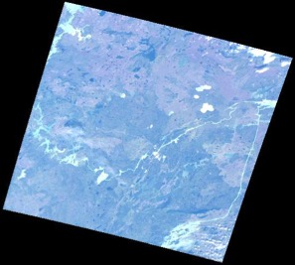
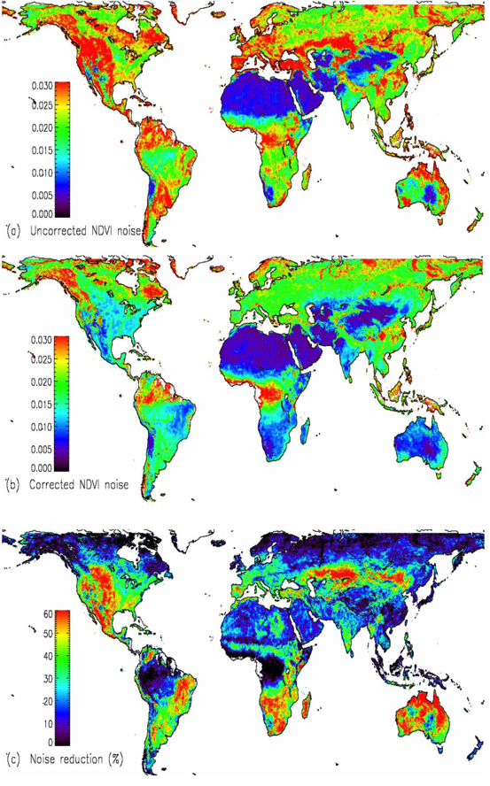
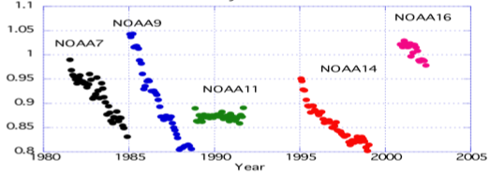
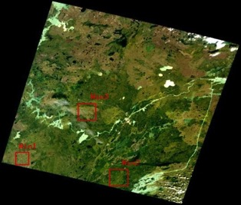
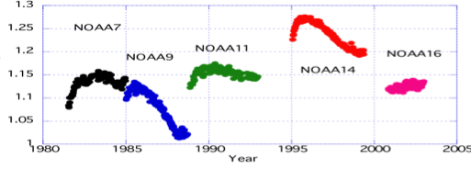
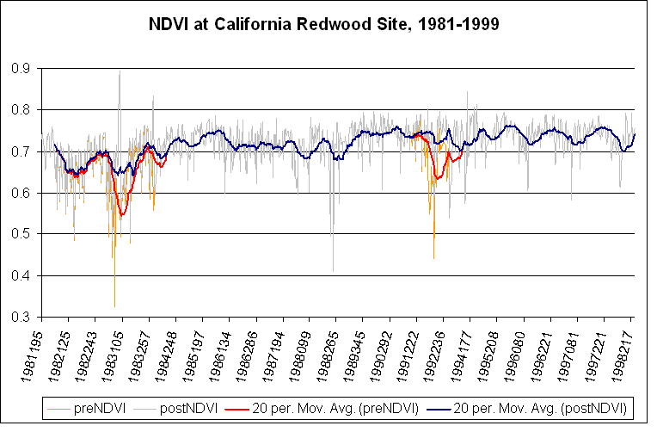
Land Climate Data Record (Approach)
Needs to address geolocation,calibration, atmospheric/BRDF correction issues
ATMOSPHERIC
CORRECTION
CALIBRATION
BRDF CORRECTION
Degradation in channel 1
(from Ocean observations)
Channel1/Channel2 ratio
(from Clouds observations)
El Chichon
Pinatubo

Slide 4
At Launch VIIRS Surface Reflectance based MODIS C5
The MODIS Collection 5 AC algorithm relies on
the use of very accurate (better than 1%) vector radiative transfer modeling of the coupled atmosphere-surface system
the inversion of key atmospheric parameters (aerosol, water vapor)
Home page: http://modis-sr.ltdri.org

Slide 5
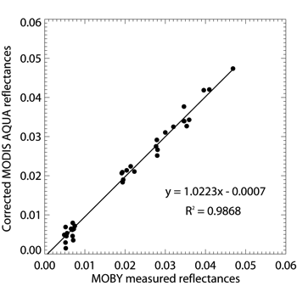
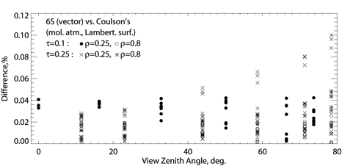
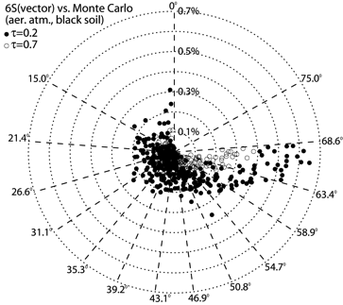
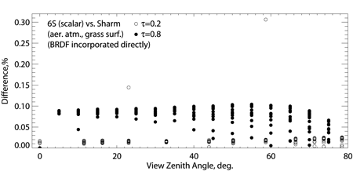
6SV Validation Effort
The complete 6SV validation effort is summarized in three manuscripts:
Kotchenova, S. Y., Vermote, E. F., Matarrese, R., & Klemm Jr, F. J. (2006). Validation of a vector version of the 6S radiative transfer code for atmospheric correction of satellite data. Part I: Path radiance. Applied Optics, 45(26), 6762-6774.
Kotchenova, S. Y., & Vermote, E. F. (2007). Validation of a vector version of the 6S radiative transfer code for atmospheric correction of satellite data. Part II. Homogeneous Lambertian and anisotropic surfaces. Applied Optics, 46(20), 4455-4464.
Kotchenova, S. Y., Vermote, E. F., Levy, R., & Lyapustin, A. (2008). Radiative transfer codes for atmospheric correction and aerosol retrieval: intercomparison study. Applied Optics, 47(13), 2215-2226.

Slide 6
Methodology for evaluating the performance of VIIRS/MODIS
To first evaluate the performance of the MODIS Collection 5 SR algorithms, we analyzed 1 year of Terra data (2003) over 127 AERONET sites (4988 cases in total).
Methodology:
Subsets of Level 1B data processed using the standard surface reflectance algorithm
comparison
Reference data set
Atmospherically corrected TOA reflectances derived from Level 1B subsets
If the difference is within ±(0.005+0.05ρ), the observation is “good”.
AERONET measurements
(τ_{aer}, H₂O, particle distribution
Refractive indices,sphericityeri)
Vector 6S
http://mod09val.ltdri.org/cgi-bin/mod09_c005_public_allsites_onecollection.cgi

Slide 7
quantitative assessment of performances (APU)

Slide 8
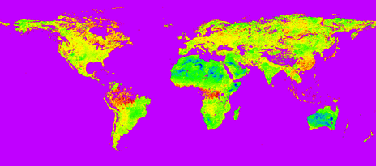
Improving the aerosol retrieval in collection 6 reflected in APU metrics
ratio band3/band1 derived using MODIS top of the atmosphere corrected with MISR aerosol optical depth

Slide 9
Aerosol retrieval also shows improvement
Scatterplot of the MOD09 AOT at 550nm versus the AERONET measured AOT at 550nm for East Coast sites selection: GSFC (top left), Stennis (top right), Walker Branch (bottom left) and Wallops (bottom right).

Slide 10
Aerosol retrieval also shows improvement
Scatterplot of the MOD09 AOT at 550nm versus the AERONET measured AOT at 550nm for the West Coast sites selection: UCLA (top left), La Jolla (top right), and Fresno (bottom left) and Table Mountain (bottom right).

Slide 11
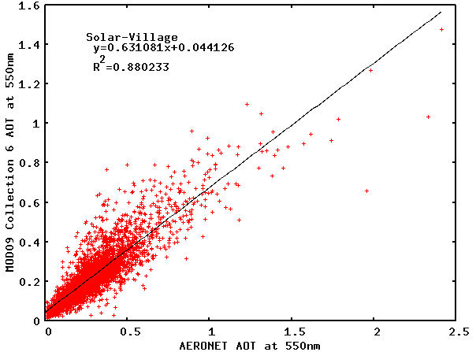
Aerosol retrieval also shows improvement
Scatterplot of the MOD09 AOT at 550nm versus the AERONET measured AOT at 550nm for for a very bright site in Saudi Arabia (Solar Village)

Slide 12
VIIRS Surface reflectance
the VIIRS SR product is directly heritage from collection 5 MODIS and that it has been validated to stage 1 (Land PEATE adjusted version)
MODIS algorithm refinements from Collection 6 will be integrated into the VIIRS algorithm and shared with the NOAA JPSS project for possible inclusion in future versions of the operational product .

Slide 13
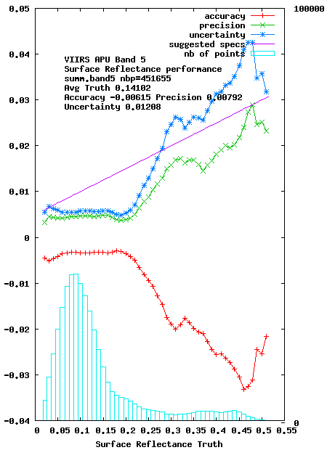
Evaluation of Algorithm Performance
VIIRS C11 reprocessing (MODIS C5 algorithm)
450000 pixels
were analyzed for each
band.
Red = Accuracy (mean bias)
Green = Precision (repeatability)
Blue = Uncertainty (quadatric sum of
A and P)
On average well below magenta
theoretical error bar
RED band

Slide 14
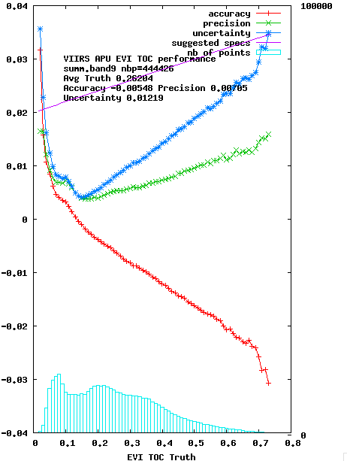
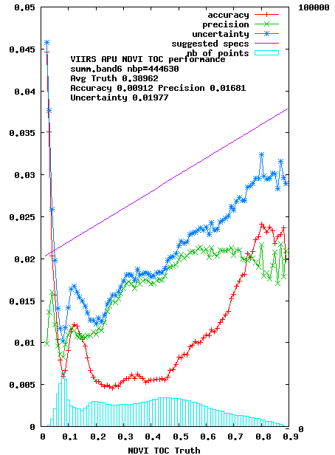
Evaluation of Algorithm Performance
VIIRS C11 reprocessing
NDVI
EVI

Slide 15
Use of BRDF correction for product cross-comparison

Slide 16
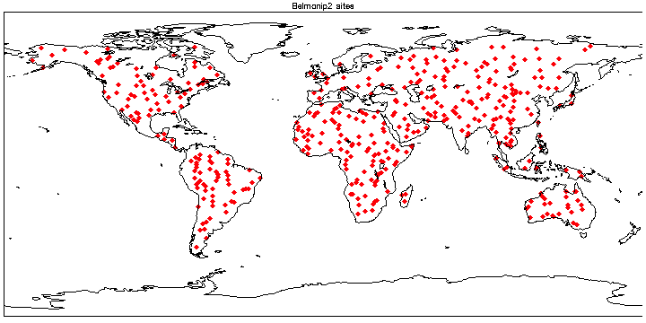
Cross comparison with MODIS over BELMANIP2
The VIIRS SR is now monitored at more than 400 sites (red losanges) through cross-comparison with MODIS.

Slide 17
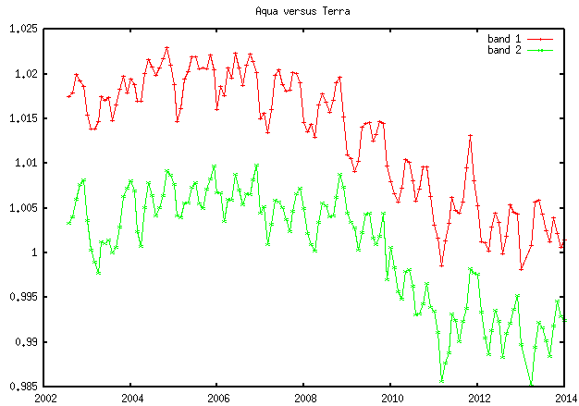
Terra/Aqua Red/NIR Collection 5

Slide 18
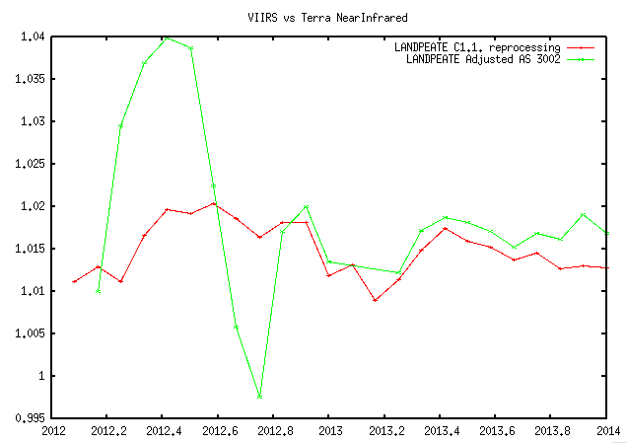
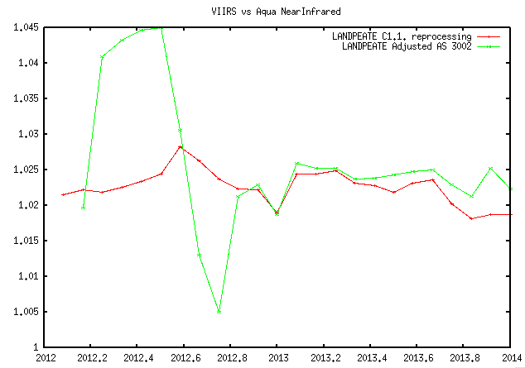
VIIRS C11 and VIIRS “operational” AS3002

Slide 19
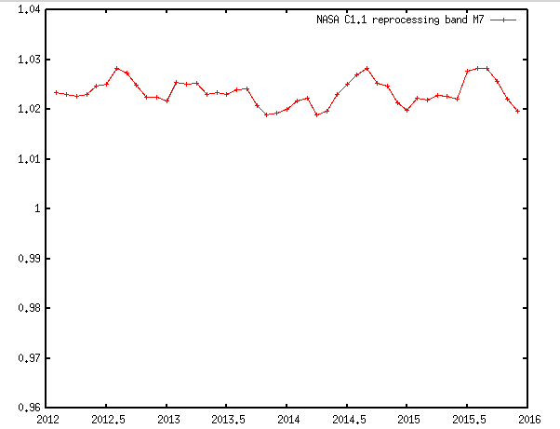
Cross comparison results of the VIIRS and MODIS-Aqua SR product on a monthly basis for the BELMANIP sites reprocessed version (C1.1) for the near infrared band (M7).

Slide 20
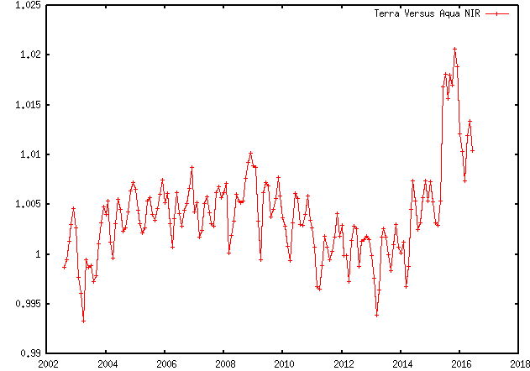
Terra/Aqua NIR Collection 6

Slide 21
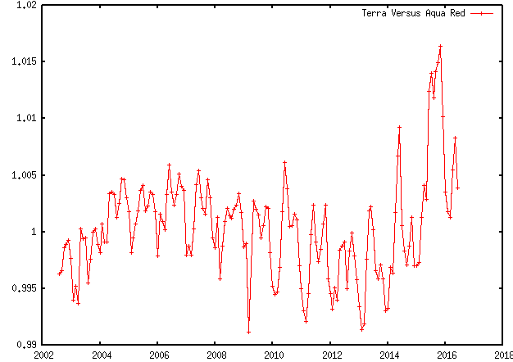
Terra/Aqua Red Collection 6

Slide 22
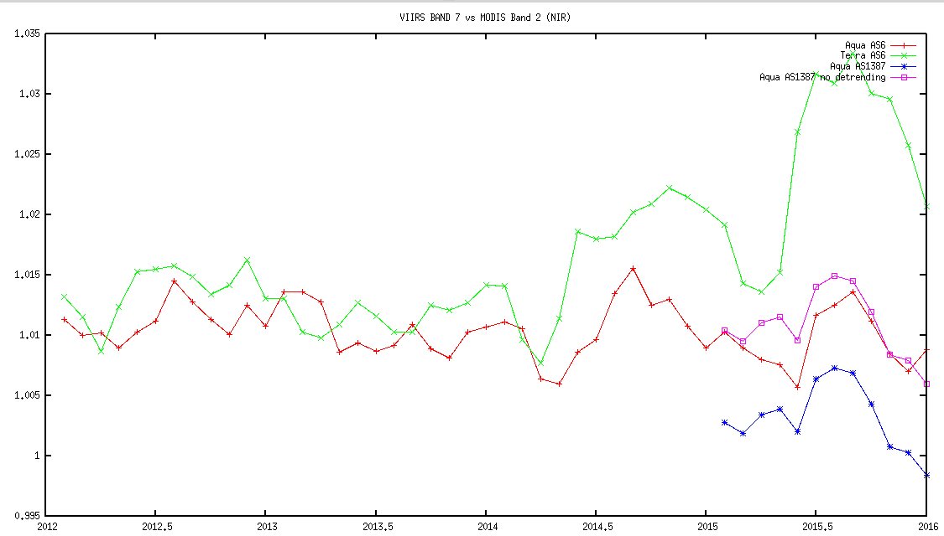
MODIS/VIIRS Results NIR

Slide 23
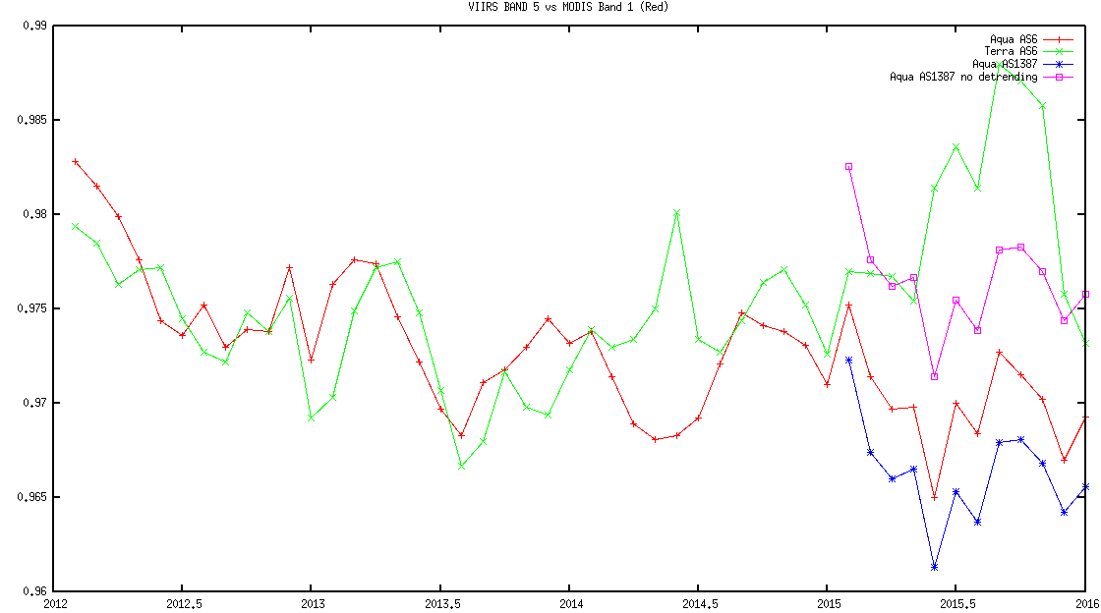
MODIS/VIIRS Results Red

Slide 24
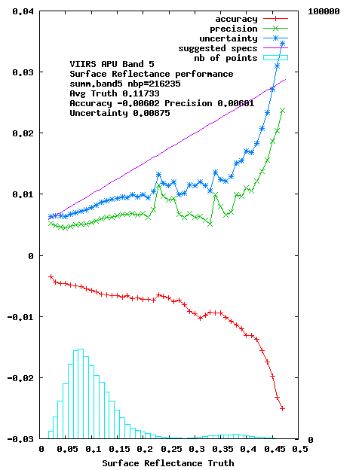
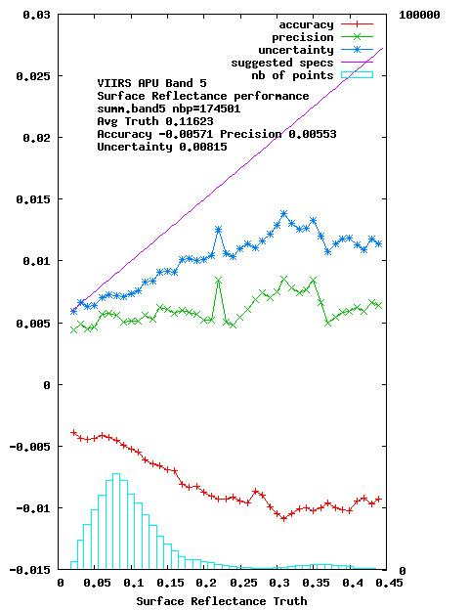
Testing of MODIS Collection 6 implementation for VIIRS (coming up in AS 5000)
Performances of the VIIRS surface reflectance in the red band derived over AERONET sites for 2012 (Left side)and 2013 (right side).

Slide 25
The need for a protocol to use of AERONET data
To correctly take into account the aerosols, we need the aerosol microphysical properties provided by the AERONET network including size-distribution (%C_{f}, %C_{c}, C_{f}, C_{c}, r_{f}, r_{c}, σ_{r}, σ_{c}), complex refractive indices and sphericity.
Over the 670 available AERONET sites, we selected 230 sites with sufficient data.
To be useful for validation, the aerosol model should be readily available anytime, which is not usually the case.
Following Dubovik et al., 2002, JAS,*² one can used regressions for each microphysical parameters using as parameter either τ₅₅₀ (aot) or τ₄₄₀ and α (Angström coeff.).
The protocol needs to be further agreed on and its uncertainties assessed

Slide 26
ACIX: CEOS-WGCV Atmospheric Correction Inter-comparison Exercise
(ESA/NASA/UMD)
The exercise aims to bring together available AC processors (actually 14 processors including SEN2COR, MACCS, L8-S2-6SAC, …) to generate the corresponding SR products.
The input data will be Landsat-8 and Sentinel-2 imagery of various test sites, i.e. coastal, agricultural, forest, snow/artic areas and deserts.
Objectives
To better understand uncertainties and issues on L8 and S2 AC products
To propose further improvements of the future AC schemes
* 1st Workshop in June 21st-22nd @ University of Maryland (by invitation): to elaborate concepts, protocols and guidelines for the inter-comparison and validation of SR products
Program (with first suggestions) will be provide April 30th (available on the web site for eventual end users feedbacks)
* 2nd workshop in January 2017 (open)
https://earth.esa.int/web/sppa/meetings-workshops/acix

Slide 27
Conclusions
Surface reflectance (SR) algorithm is mature and pathway toward validation and automated QA is clearly identified.
Algorithm is generic and tied to documented validated radiative transfer code so the accuracy is traceable enabling error budget.
The use of BRDF correction enables easy cross-comparison of different sensors (MODIS,VIIRS,AVHRR, LDCM, Landsat, Sentinel 2 ,Sentinel 3…)
AERONET is central to SR validation and a “standard” protocol for its use to be defined (CEOS CVWG initiative)

