Slide 1
Producing Incident Shortwave Radiation and Photosynthetically Active Radiation Products Over Land Surfaces from MODIS Data
Drs. Dongdong Wang, Tao He
Yi Zhang, Meredith Brown
Prof. Shunlin Liang
University of Maryland
June 8 2016

Slide 2
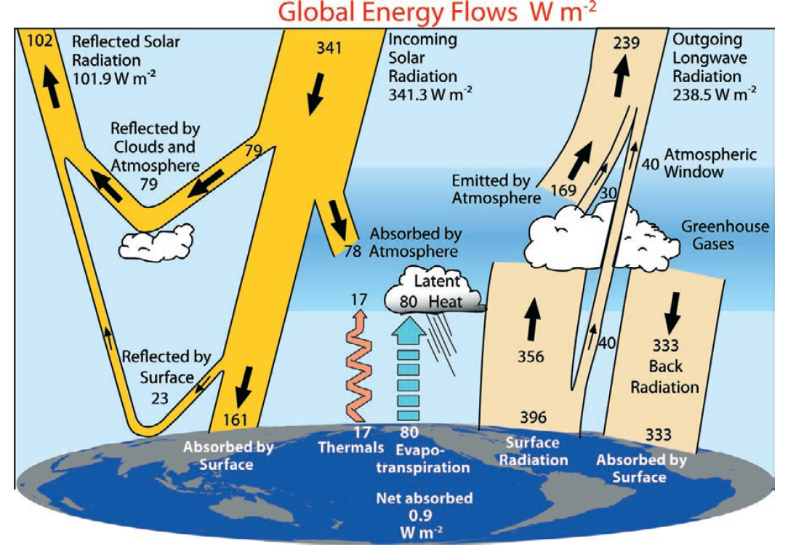
Trenberth et al. (2009)

Slide 3
Need for high spatial resolution products
Current global radiation products have coarse spatial resolution (>1°) primarily for atmospheric modeling, and do not account for many local features, such as urbanization.
Land applications require the high spatial resolution (~1km) but the reasonable temporal resolution (e.g., daily):
  Ecosystem modeling (say, MOD17 NPP product) requires high-resolution products of PAR(1km);
  Hydrological modeling (ET, MOD16) at 1km;
  Other applications (e.g., drought monitoring, clean renewable solar energy).

Slide 4
Incident shortwave radiation and PAR products
Current global incident shortwave radiation satellite products
Insolation products | Spatial resolution | Temporal resolution | Temporal range
ISCCP | 280km | 3-hour | 1983-2008
GEWEX-SRB | 1° | 3-hour | 1983-2007
CERES | 1° | 3-hour | 1997-present
WMO requirements for surface downward shortwave irradiance
 | Uncertainty goal (Wm⁻²) | Uncertainty threshold (Wm⁻²) | Horizontal resolution goal (km) | Horizontal resolution Threshold (km)
Global NWP | 1 | 20 | 10 | 100
Agricultural Meteorology | N/A | N/A | 1 | 20
Climate-AOPC | 5 | 10 | 25 | 100

Slide 5
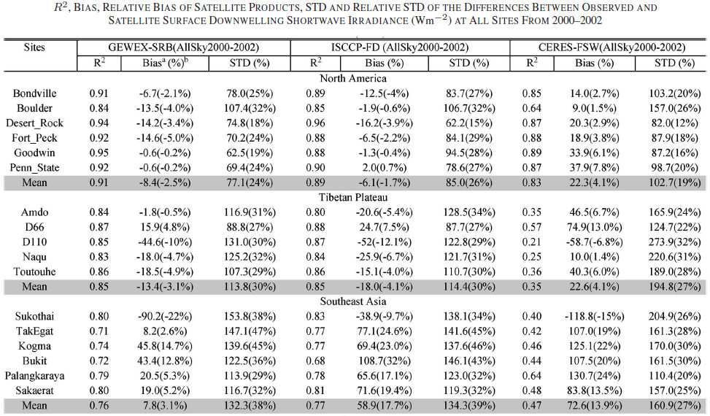
Accuracy of current data sets of incident shortwave radiation
Gui, S., S. Liang, K. Wang, and L. Li, (2010), Validation of Three Satellite-Estimated Land Surface Downward Shortwave Radiation Datasets, IEEE Geoscience and Remote Sensing Letters,7(4):776-780

Slide 6
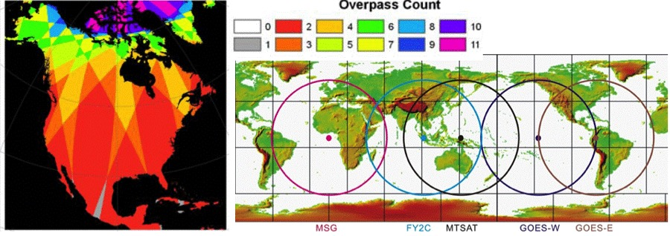
Objective and major tasks
Objective: to produce global high-resolution (5km, 3-hours) incident shortwave radiation and PAR over land surfaces from Terra/Aqua MODIS and a series of geostationary satellite data.
Figure. Daytime MODIS overpass counts from both Terra and Aqua and coverage of the current geostationary satellites.
Major tasks:
1.ATBD improvement and code delivery
2.Evaluation of sensor radiometric calibration
3.Algorithm validation
4.Product quality assessment
5.Product validation
6.Outreach and product advertisement

Slide 7
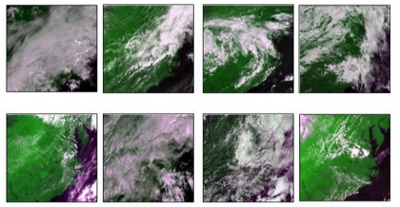
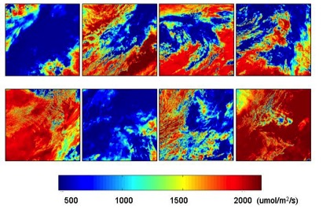
Algorithms for retrieving PAR and insolation
Fast, robust and mature LUT based approach.
The basic procedure is composed of two steps:
determination of atmospheric parameters by matching observed radiance with modeled ones from the first LUT;
calculation of incident PAR from the determined surface reflectance and TOA radiance/reflectance using the second LUT.

Slide 8
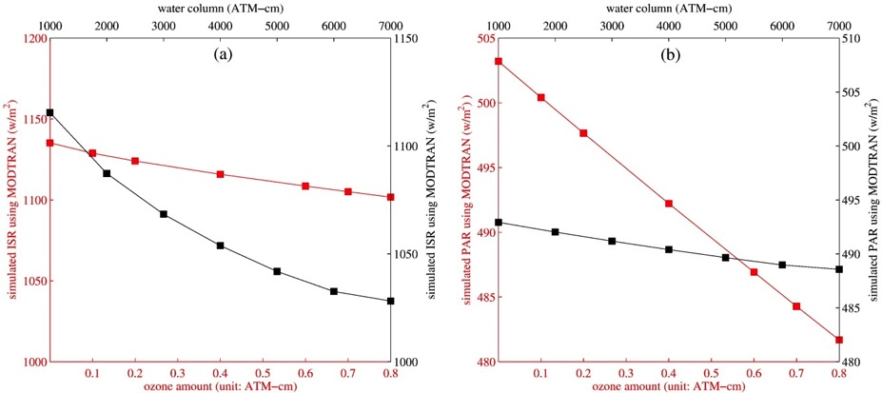
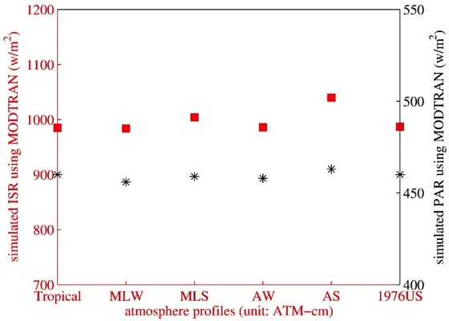
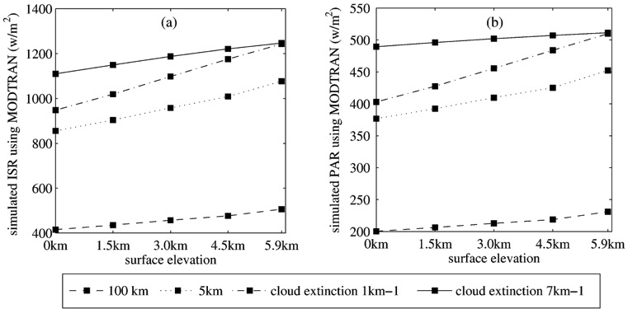
Sensitivity study of the algorithm
Water vapor and ozone concentration
Atmosphere profile
Tropical, MLW, MLS, AW, AS, and 1976US represent the tropical, mid-latitude winter, mid-latitude summer, Arctic winter, Arctic summer, and 1976 US standard atmosphere profiles, respectively.
Zhang et al., RSE, 2014
Elevation

Slide 9
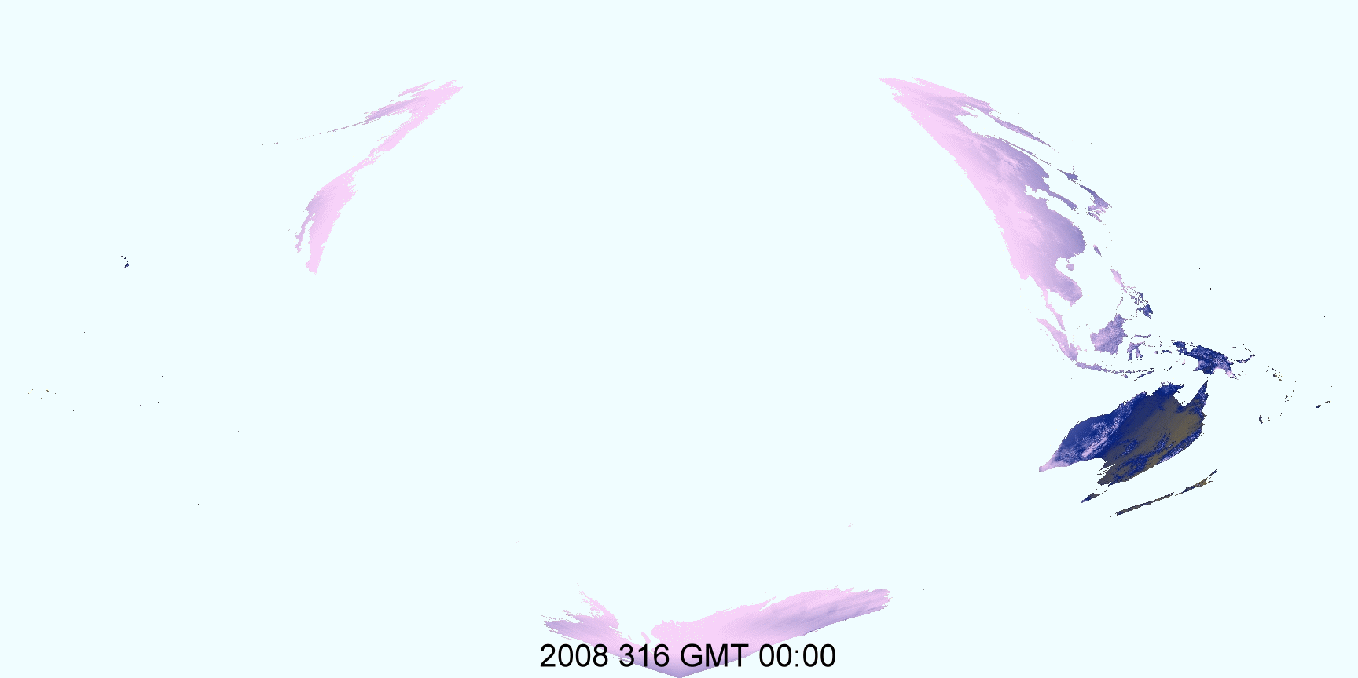
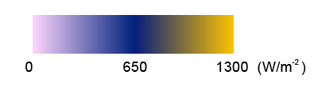
Mapping global surface radiation

Slide 10
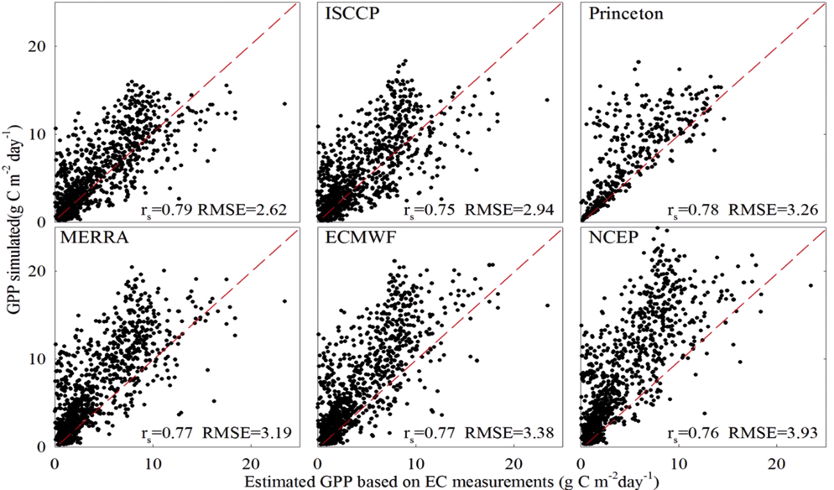
Improvement in estimating gross primary productivity (GPP) with the new PAR data
6 radiation products
Same model for calculating GPP
in-situ measurements at 12 sites in China
New PAR product produces the best GPP values
Cai, W., W. Yuan, S. Liang, et al., (2014), Improved Estimations of Gross Primary Production Using Satellite-derived Photosynthetically Active Radiation, Journal of Geophysical Research – Biogeosciences, 119, 2013JG002456

Slide 11
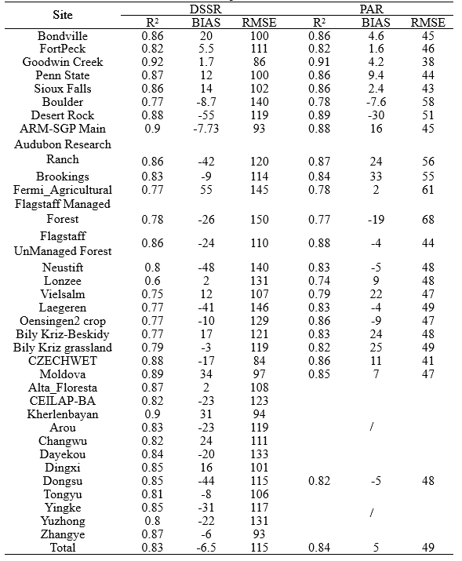
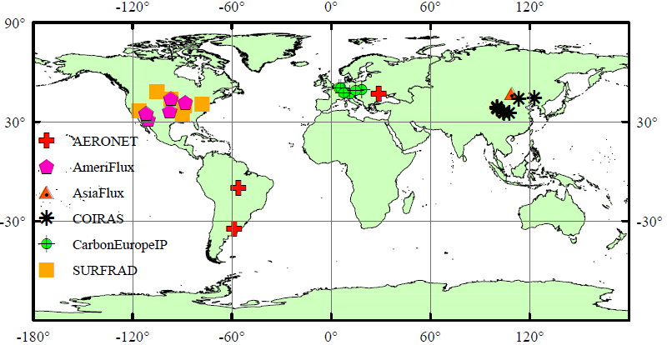
Data validation using global flux networks
Instantaneous
Daily
Monthly

Slide 12
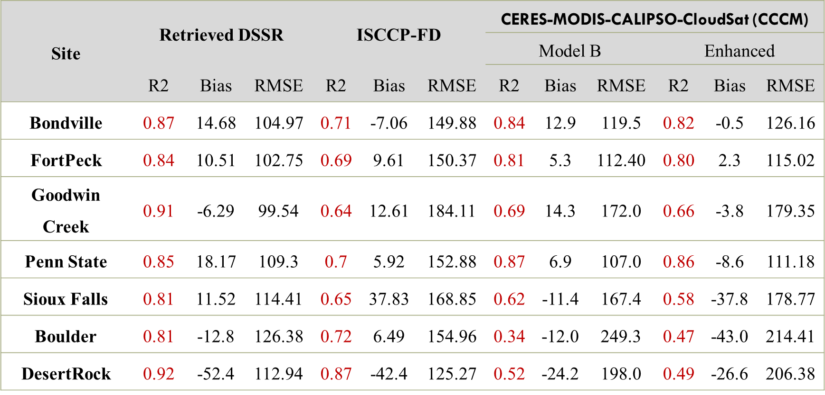
Comparison with existing products

Slide 13
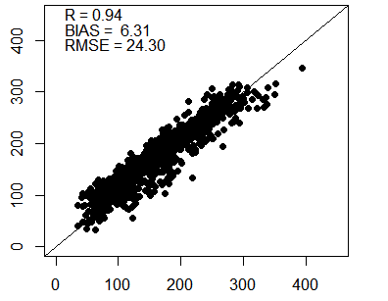
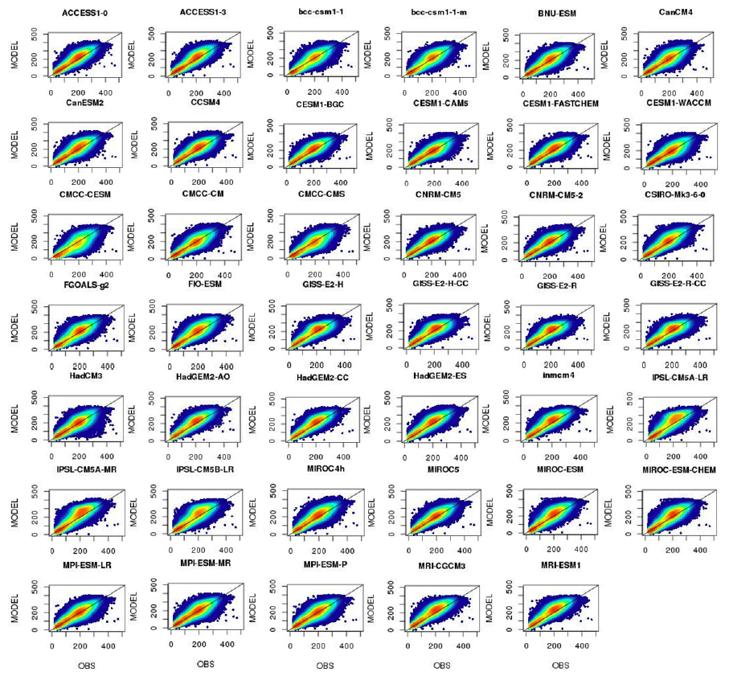
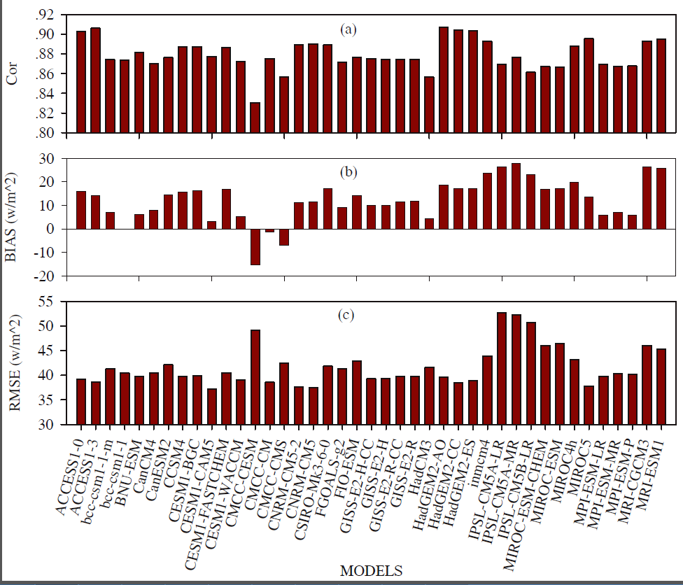
Comparison with model results
Retrieved
Measured

Slide 14
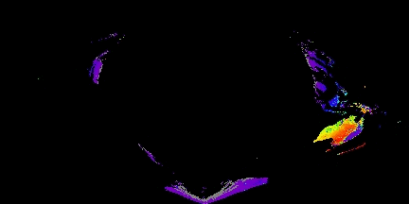
Implementation at MODAPS
Delivered and tested at MODAPS
Refined the codes to fit the tile-driven structure
Data product
  Official products:
    Tiled products MCD18A1 for 5km DSR and MCD18A2 for 5km PAR in SIN projection
    Global 0.05° products MCD18C1 for DSR and MCD18C2 for PAR in Lat/Long projection
  Temporal resolution: instantaneous, 3-hourly, and daily
3-hourly DSR (MCD18C1) on Jan. 1st, 2010

Slide 15
Major modules and I/O (1)
Pre-processing of MODIS L1B
  Extract MODIS blue band L1B, geometry, water vapor, and cloud mask
  Re-project swath into 5-km gridded data
Swath
5-min
1-km
MODIS L1B (MO/YD02)
Geometry (MO/YD03)
Water vapor (MO/YD05)
Cloud mask (MO/YD35)
Resample and re-project
Simple averaging
Combine data
Sinusoidal-Gridded
5-min, 5-km
TOA Radiance, geometry, water vapor, cloud mask

Slide 16
Major modules and I/O (2)
Instantaneous radiation estimation
  Estimate DSR and PAR from the 5-min gridded data
TOA Radiance, geometry, water vapor, cloud mask
Ancillary data
Surface reflectance database
MERRA water vapor
Radiation estimation (DSR & PAR)
DEM
Sinusoidal-Gridded
5-min, 5-km

Slide 17
Major modules and I/O (3)
Producing 3-hour and daily global maps
  Integrate and interpolate 5-min data into 3-hour and daily total values
  Generate global maps for both sinusoidal and lat/long projections at 5-km and 0.05° resolutions, respectively
Sinusoidal-Gridded
5-min, 5-km
Radiation estimation (DSR or PAR)
Diurnal interpolation & integration
Daily and 3-hourly
Sinusoidal 5-km
Lat/long 0.05°
Global radiation map (DSR or PAR)

Slide 18
Publications in 2015
Wang, D., Liang, S., He, T., & Shi, Q. (2015). Estimating clear-sky all-wave net radiation from combined visible and shortwave infrared (VSWIR) and thermal infrared (TIR) remote sensing data. Remote Sensing of Environment, 167, 31-39, doi:10.1016/j.rse.2015.03.022.
He, T., Liang, S., Wang, D., & Shi, Q. (2015). Estimation of high-resolution land surface net shortwave radiation from AVIRIS data: Algorithm development and preliminary results. Remote Sensing of Environment, 167, 20-30, doi:10.1016/j.rse.2015.03.021.
Wang, D., Liang, S., He, T., & Shi, Q. (2015). Estimation of daily surface shortwave net radiation from the combined MODIS data. IEEE Transactions on Geoscience and Remote Sensing, 53(10), 5519-5529, doi: 10.1109/tgrs.2015.2424716.
Wang, D., Liang, S., He, T., Cao, Y., & Jiang, B. (2015). Daily surface shortwave net radiation estimation from FengYun-3 MERSI data. Remote Sensing, 7, 6224-6239, doi:10.3390/rs70506224.

Slide 19
Summary
We are closely working with MODAPS team on operational data production.
  Codes using MODIS data are delivered and tested.
We have investigated several related issues and explored new methods for further improvement:
  New optimization method;
  Temporal scaling of daily SSNR;
  Improved parameterization;
  Artificial neural network.

