Slide 1
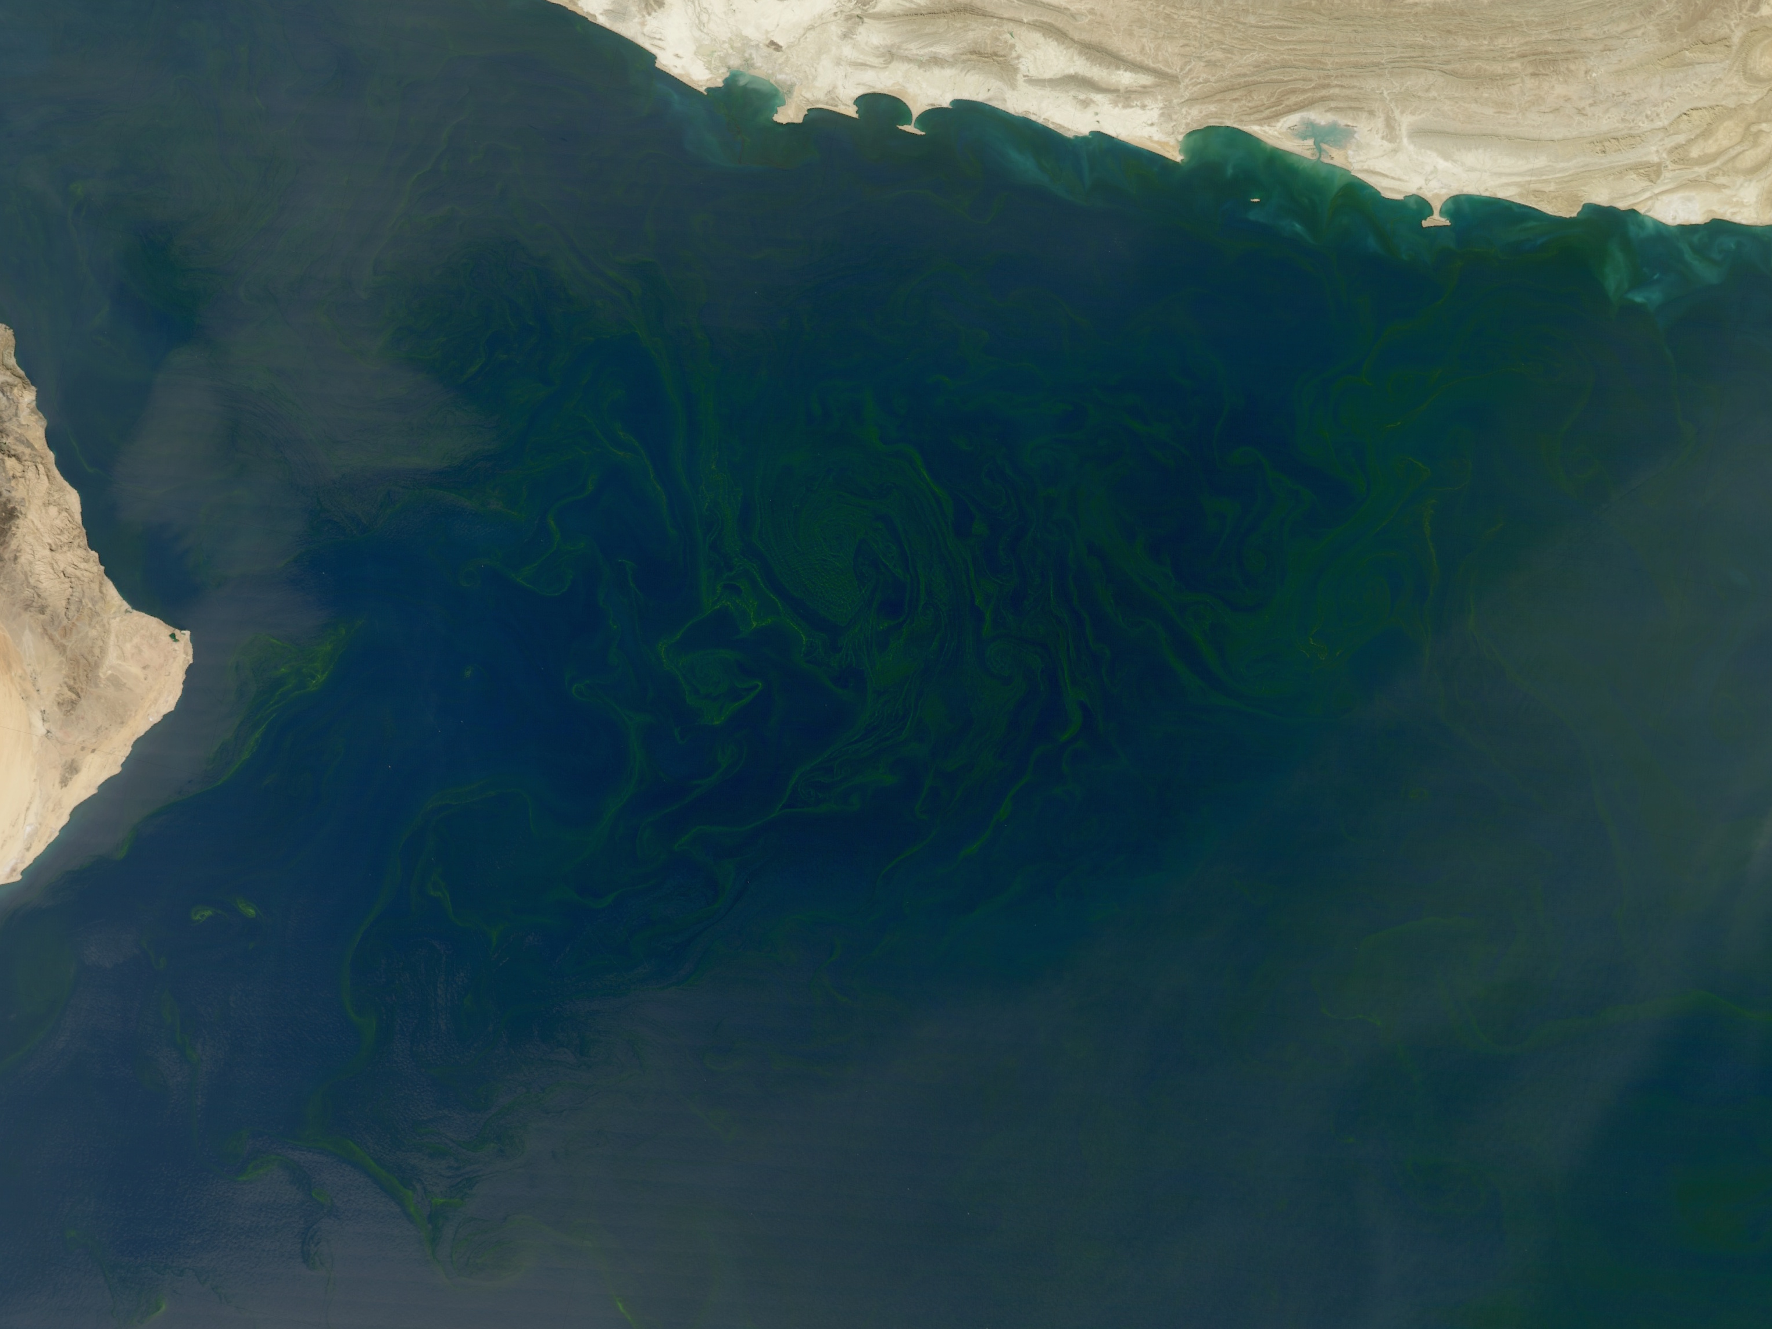
Revealing changes in phytoplankton community structure with MODIS using an ocean reflectance inversion model
Jeremy Werdell ¹, Collin Roesler ², Joaquim Goes ³
Lachlan McKinna ¹, Bryan Franz ¹
¹ NASA Goddard Space Flight Center
² Bowdoin College
³ Lamont Doherty Earth Observatory
MODIS-Aqua image credit: Norman Kuring (GSFC) & the NASA Earth Observatory

Slide 2
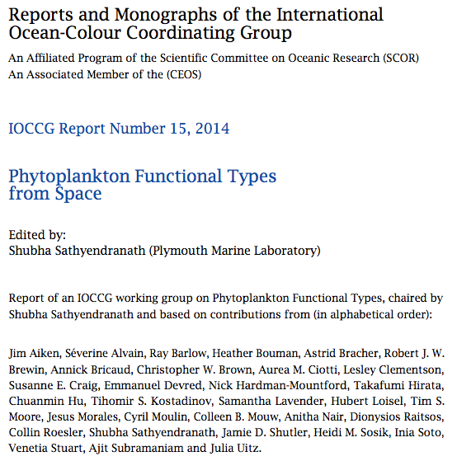
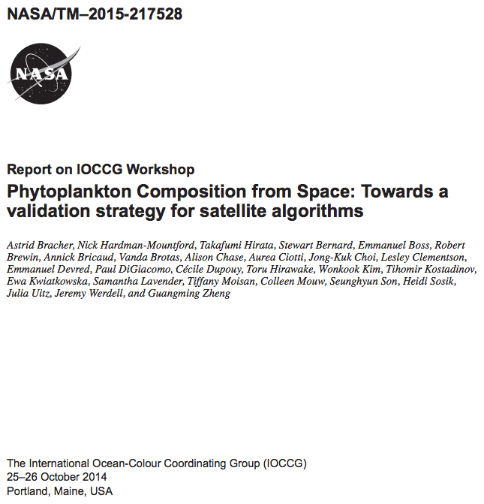
Remote-sensing of phytoplankton communities: A consumers’ market
http://www.ioccg.org/groups/PFT.html
http://ioccg.org/groups/PFT-TM_2015-217528_01-22-15.pdf

Slide 3


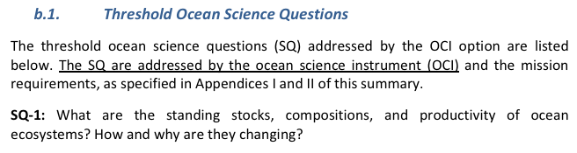
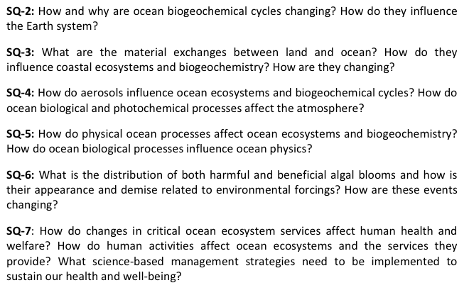
New satellite missions sold with a promise of resolving phytoplankton community structure

Slide 4
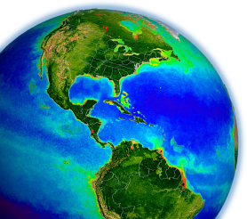
Two flavors of algorithms exist
abundance methods
spectral methods
assume a given phytoplankton biomass, defined by either Chl or absorption – covaries with the dominance of or fraction of a particular community
variations realized in the spectral shape of R_{rs}(λ) or absorption vary with community structure
unlike abundance approaches, these can detect different communities with common total biomass, provided the groups have contrasting optical signatures
diatoms
cyanos
but, often confounded by variations of spectral characteristics of the same community due to growth conditions, nutrient availability, & ambient light regimes
0.95 ≤ Chl ≤ 1.05 mg m⁻³

Slide 5
Ocean reflectance inversion algorithms (one spectral method)
forward model inverse model
what the satellite sees
what we want to estimate
terms with blue bars have pre-assigned spectral shapes associated with them (known or modeled)
find combination of M’s (red bars) such that right hand side best reconstructs left hand side

Slide 6
Quick aside: Our MODIS work
Generalized Inherent Optical Property (GIOP) framework
Standard OBPG (community supported) software for deriving spectral absorption & scattering coefficients from MODIS, VIIRS, others
Default parameterization, but alternate configurations available at runtime
Learn more: Werdell et al. (2013a), Franz and Werdell (2010)
MODIS T&A award to enhance GIOP & develop improved spectral absorption & scattering coefficients
Seawater backscattering temp & salinity dependencies (Werdell et al. 2013b)
Iterative mode per Wang et al. 2005, Brando et al. 2012 (aLMI)
Configurable expanded solution space (e.g., M_{ph}¹ … M_{ph}^{N}) (Werdell et al. 2014)
Configurable BRDF effects
Raman effects per Westberry et al. 2013, Lee et al. 2013 (McKinna et al. 2016)

Slide 7
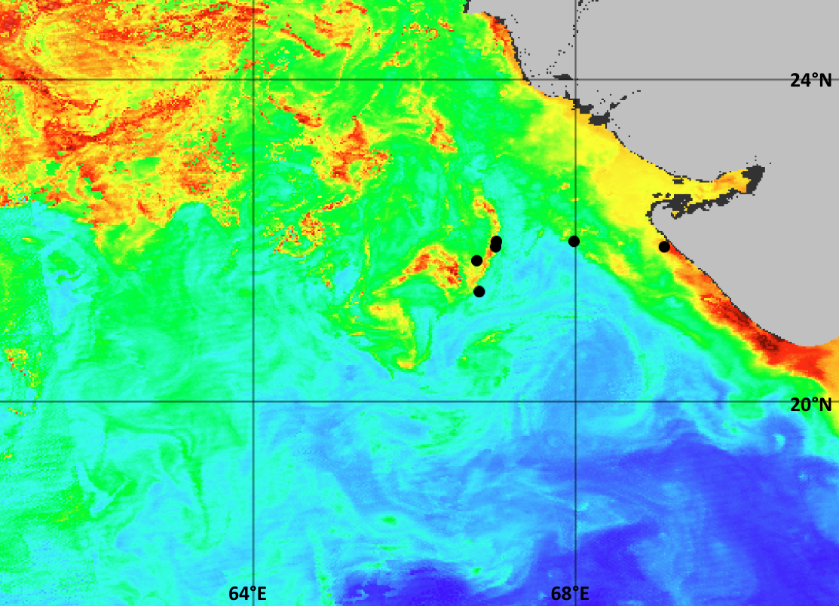
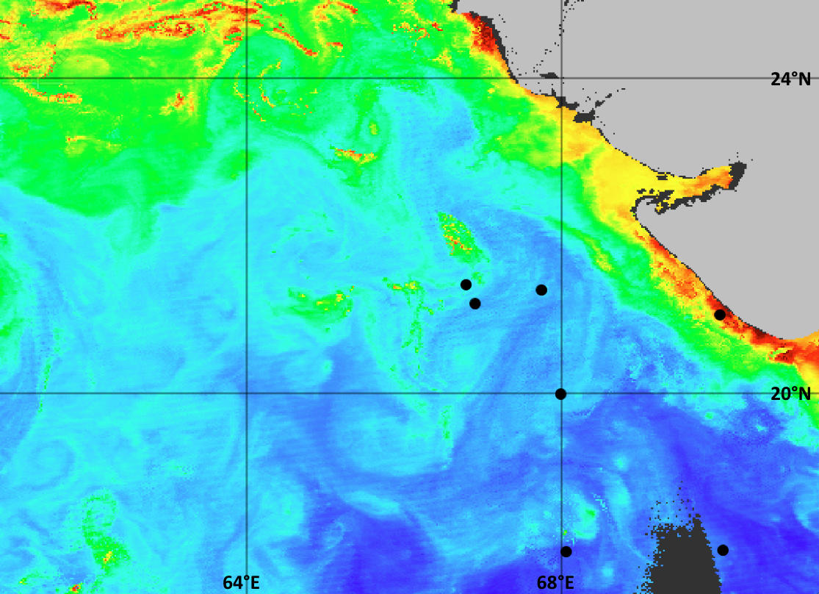
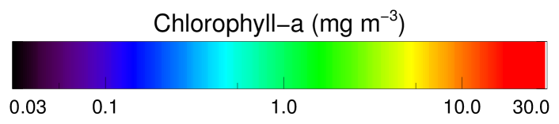
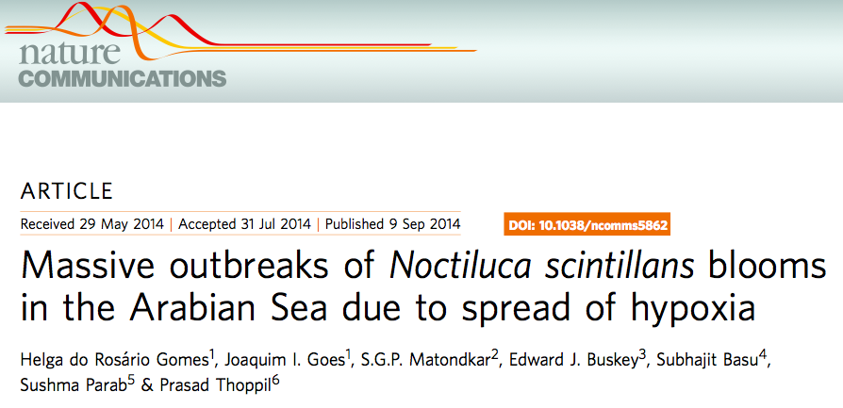
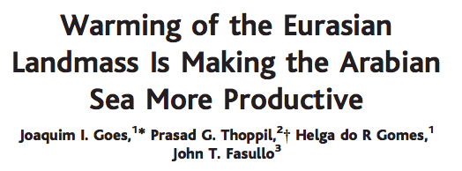
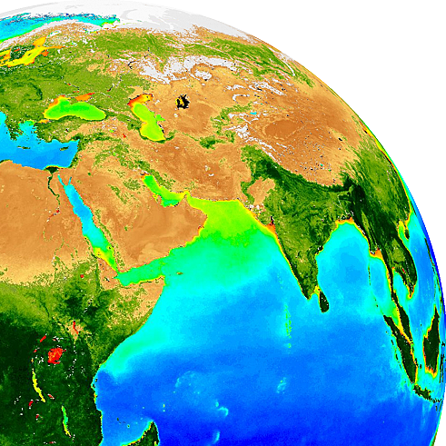
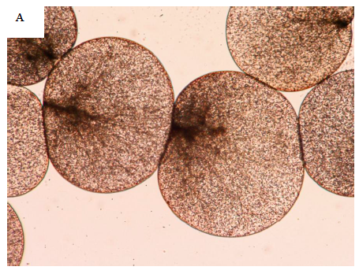
Resolving community structure using (spectral) inversion algorithms
1
4
5
6
can the temporal & spatial evolutions of Noctiluca in the northern Arabian Sea be determined using satellite ocean color?
2
9
8
3
7
10
11
7-13 March 2011
13-19 March 2011
12
A
B
13
a mixotrophic dinoflagellate
(green version)
(1) heterotrophy - feeds on bacteria, diatoms, copepod eggs, detritus, Trichodesmium (?)
(2) symbiosis – houses the photosynthetic, green flagellate Pedinomonas noctilucae

Slide 8
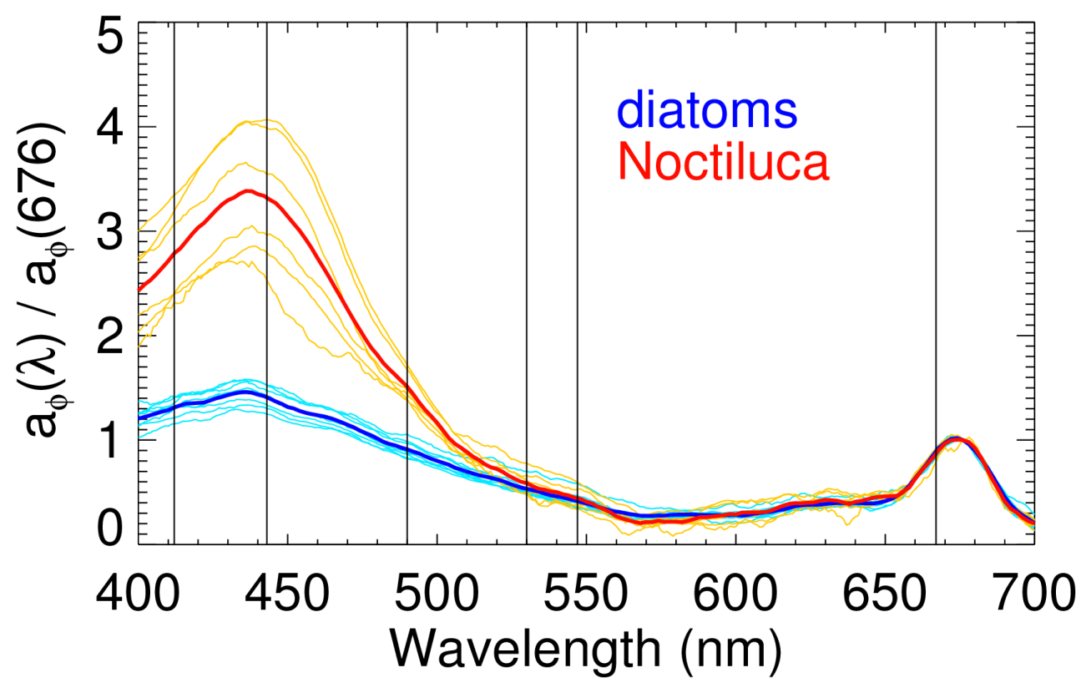
Resolving community structure using (spectral) inversion algorithms
forward model inverse model
what the satellite sees
what we want to estimate
MODIS λ
terms with blue bars have pre-assigned spectral shapes associated with them (known or modeled)
find combination of M’s (red bars) such that right hand side best reconstructs left hand side

Slide 9
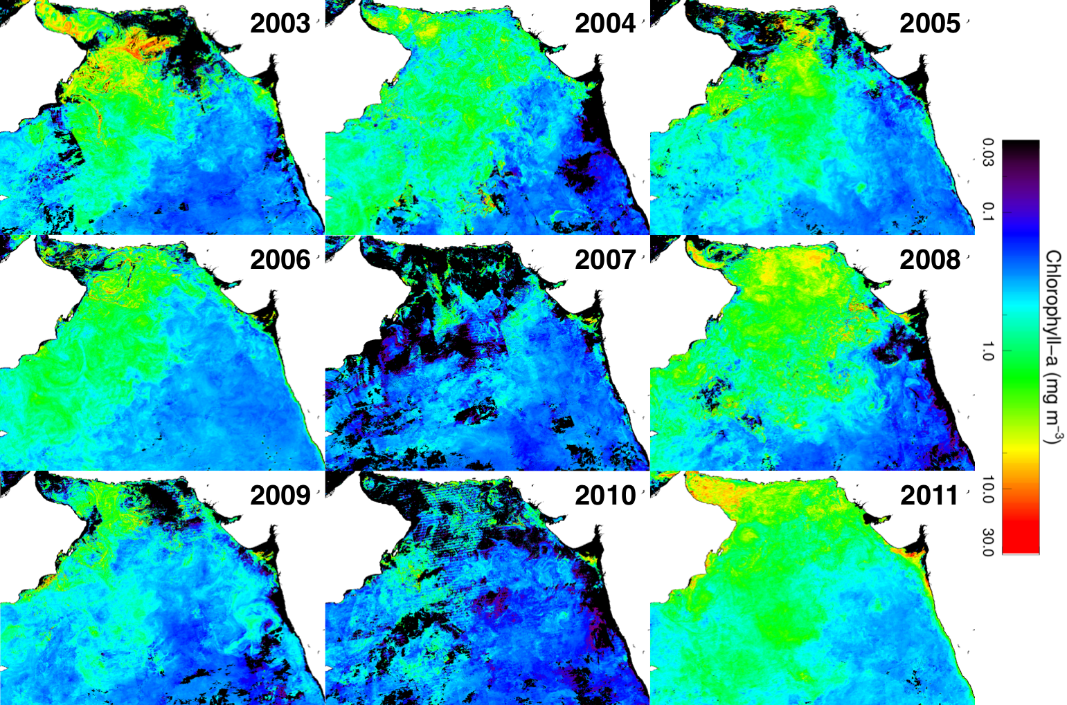
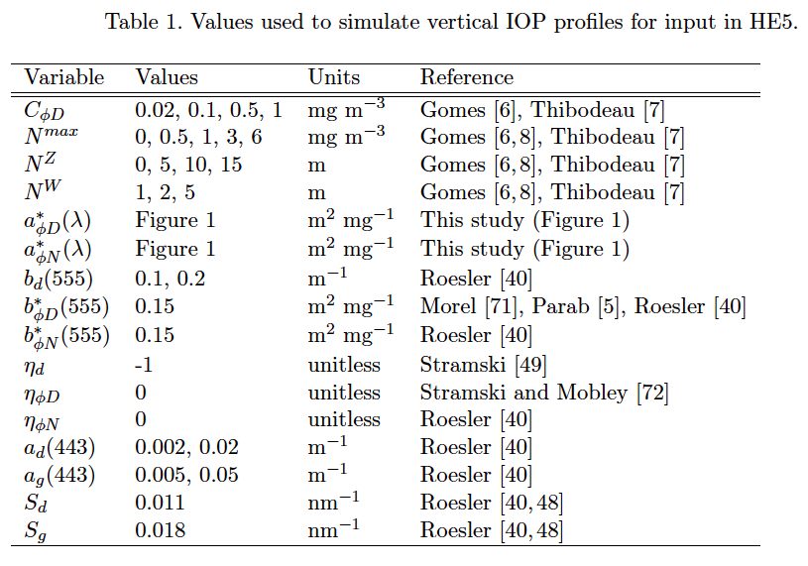

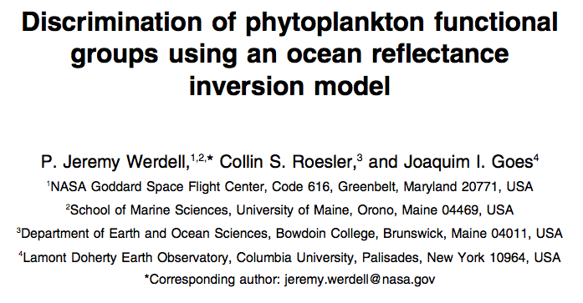

Tools & data sets
~1,500 viable simulations
~30 Hydrolight batch runs (sigh)

Slide 10
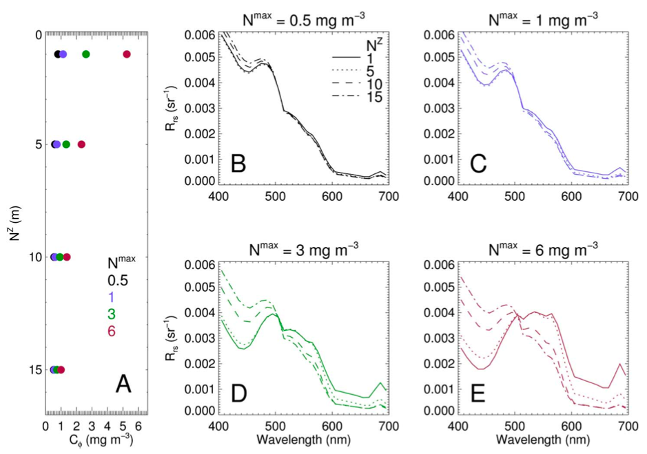
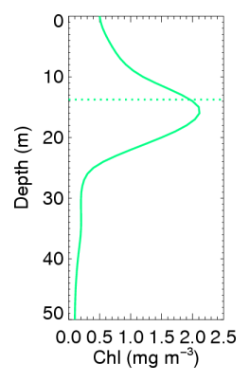
Vertical structure & mixed communities are problems
0.5 mg m⁻³
1.25 mg m⁻³
average
magnitude observed by satellite does not unequivocally inform about the vertical structure
how reliable & meaningful are the derived magnitudes in assigning community dominance?
Depth of the DCM (m)
Rrs(λ) Rrs(λ)
0.95 mg m⁻³
optically
weighted
2 mg m⁻³
DCM
Chl values the satellite sees as the bloom deepens

Slide 11
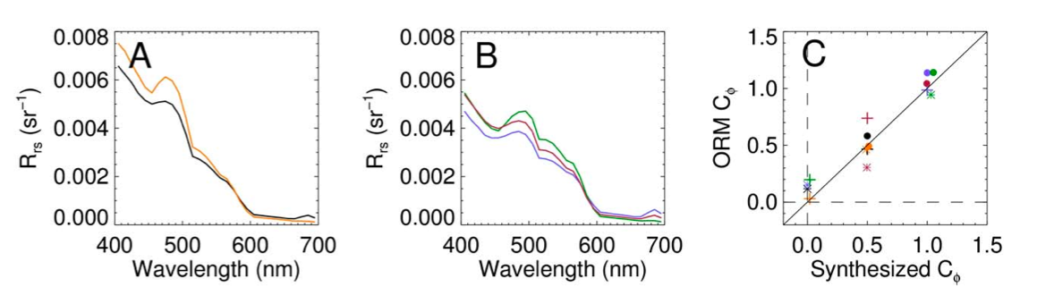
Vertical structure & mixed communities are problems
argues for more “binary” interpretation for presence or absence of Noctiluca
and, for cautious interpretation of estimated absolute magnitudes of retrievals
only diatoms ~0.5 mg m⁻³
only Noctiluca ~0.5 mg m⁻³
only diatoms ~1 mg m⁻³
only Noctiluca ~1 mg m⁻³
0.5 mg m⁻³ each (= 1 total)
some false positives for diatoms when only Noctiluca present
few false positives for Noctiluca when only diatoms present
separation of two in mixed communities less reliable

Slide 12
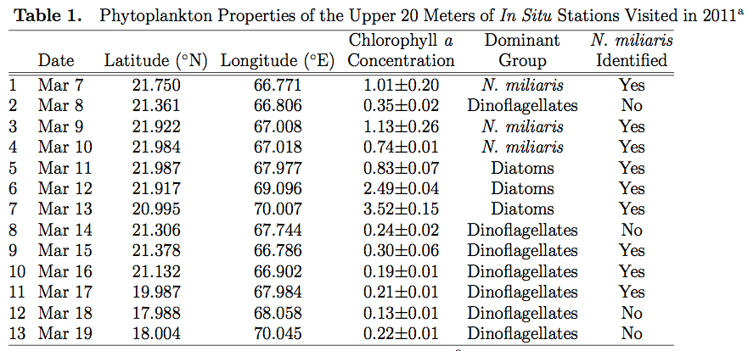
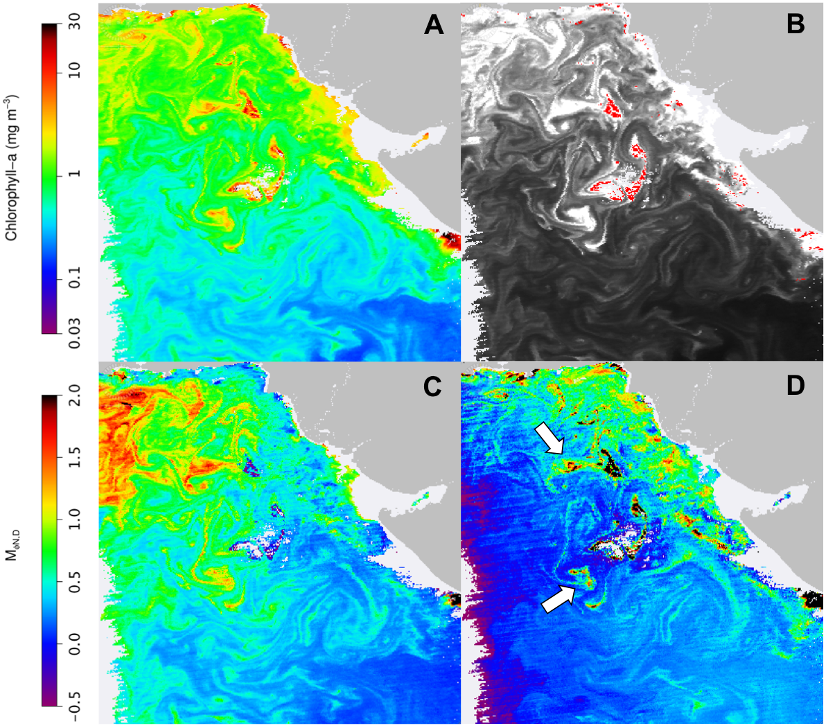
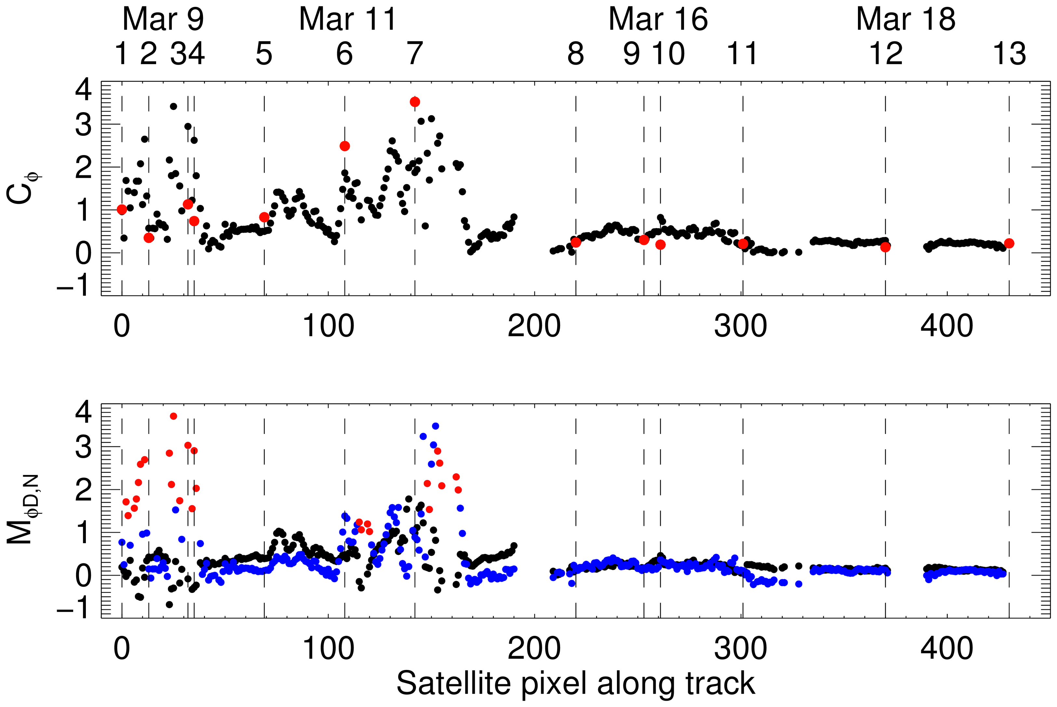
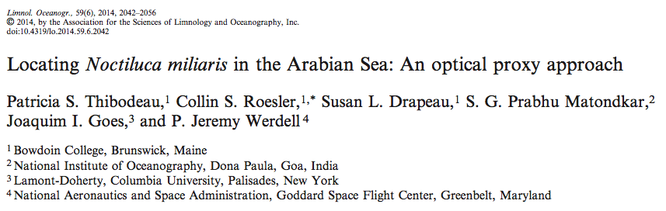
Is it there or is it not?
satellite Chl
in situ Chl
total chlorophyll
red is Noctiluca ID’ed
diatoms
Noctiluca (>1 with diatoms < 0.3)
Noctiluca (previous condition not met)
diatom component
Noctiluca component

Slide 13
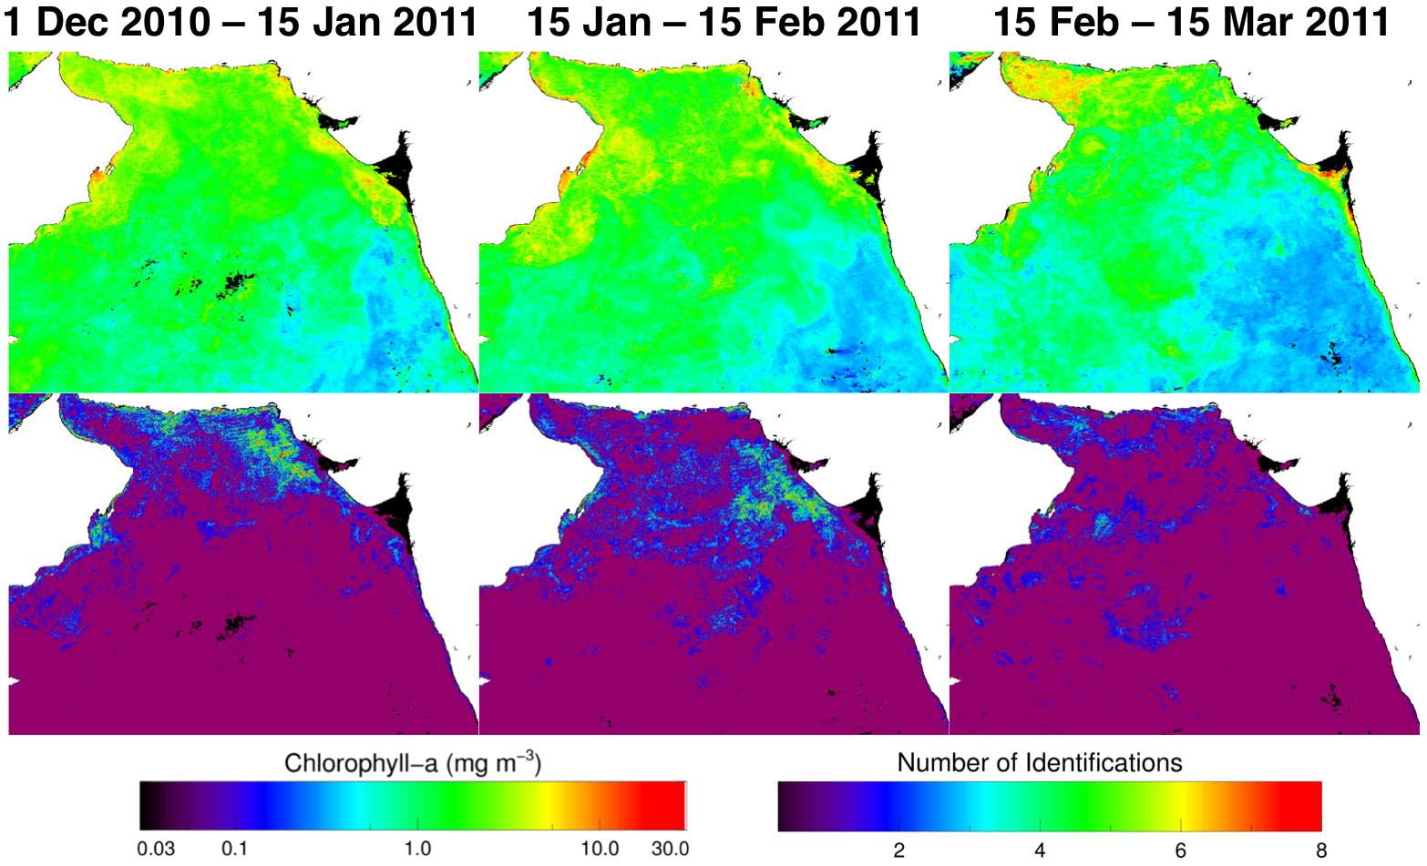
Application to MODIS-Aqua time-series
Noctiluca seen in places not previously sampled
Noctiluca distributions not correlated to total Chl
Identified Noctiluca Chlorophyll

Slide 14
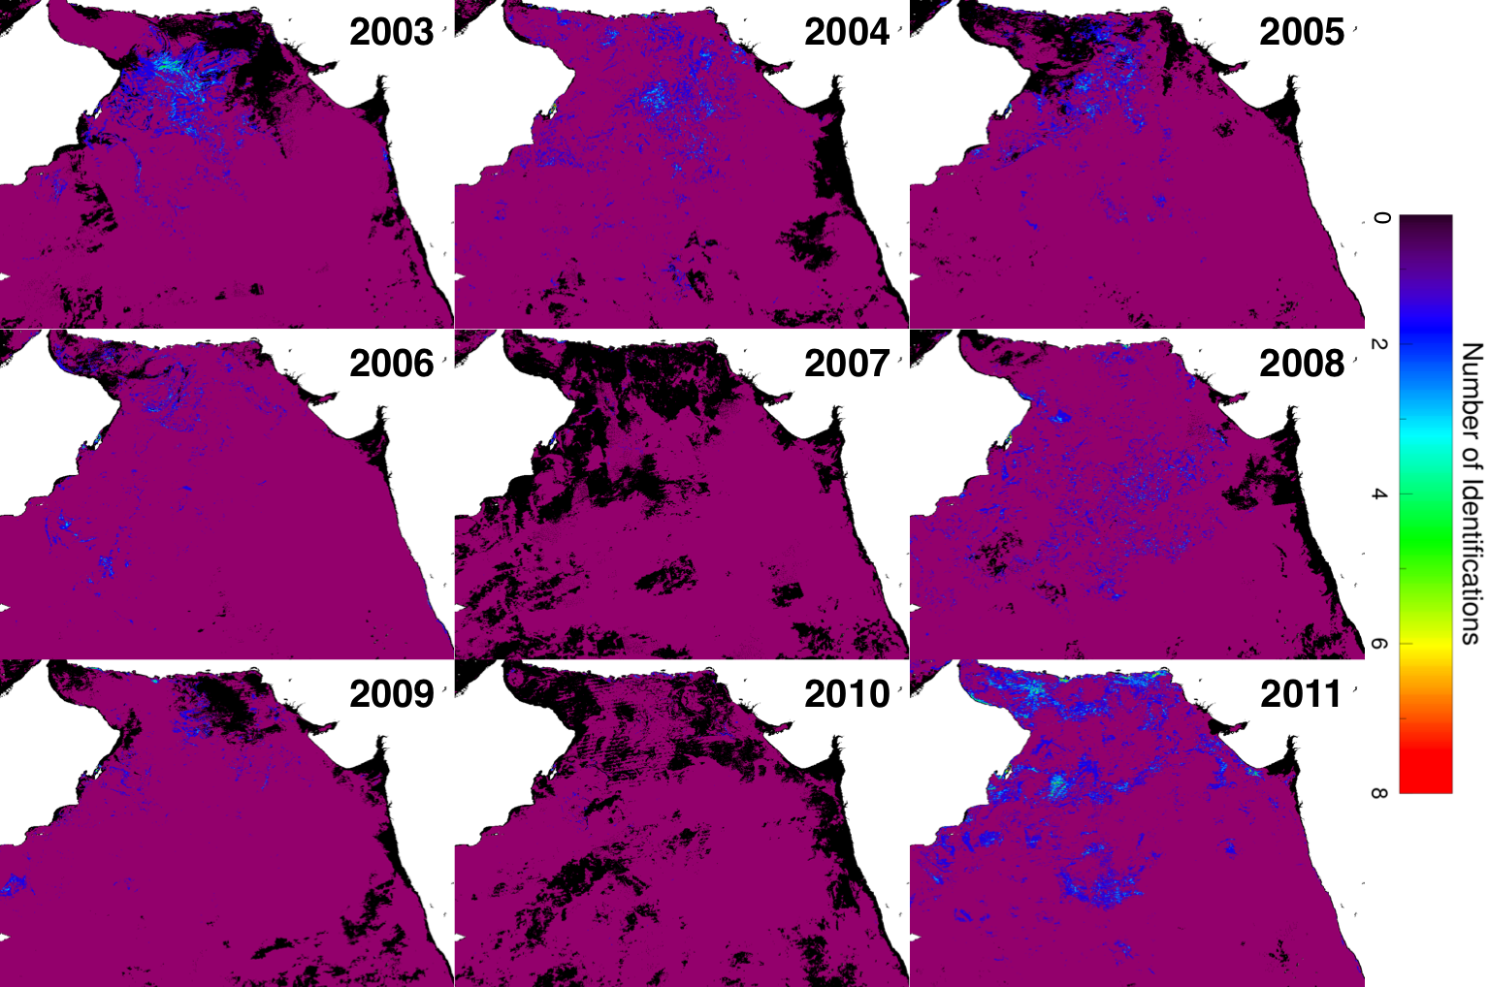
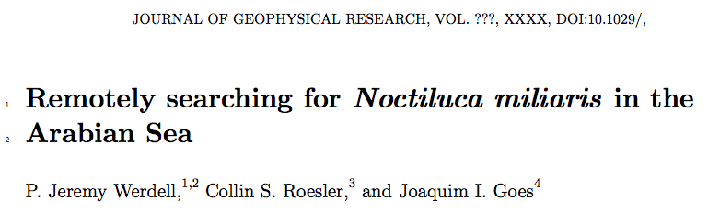
Application to MODIS-Aqua time-series

Slide 15
Lessons were learned
Ocean color inversion methods address ill-posed problems
Can successfully identify presence of a dominant species (with TLC, when assumed spectral shapes match reality)
Less successful providing information on vertical structure
Retrieved magnitudes require careful interpretation
Ocean color data records provide a highly useful tool in combination with other satellite & in situ assets
Reduces ambiguity in vertical structure & physiology
Additional spectral information provides additional insight
(Not shown) Validation remains challenging & other ocean color products (backscattering, fluorescence) can be useful
Do the right in situ data sets (and, instruments) exist?
Can these data sets be post-processed in such a way to reproduce the integrates values seen by the satellite?

Slide 16
thank you

Slide 17
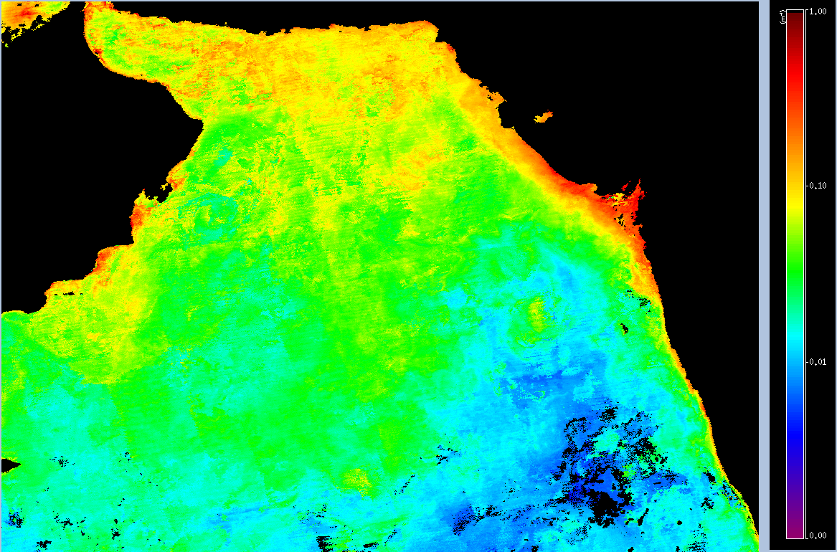
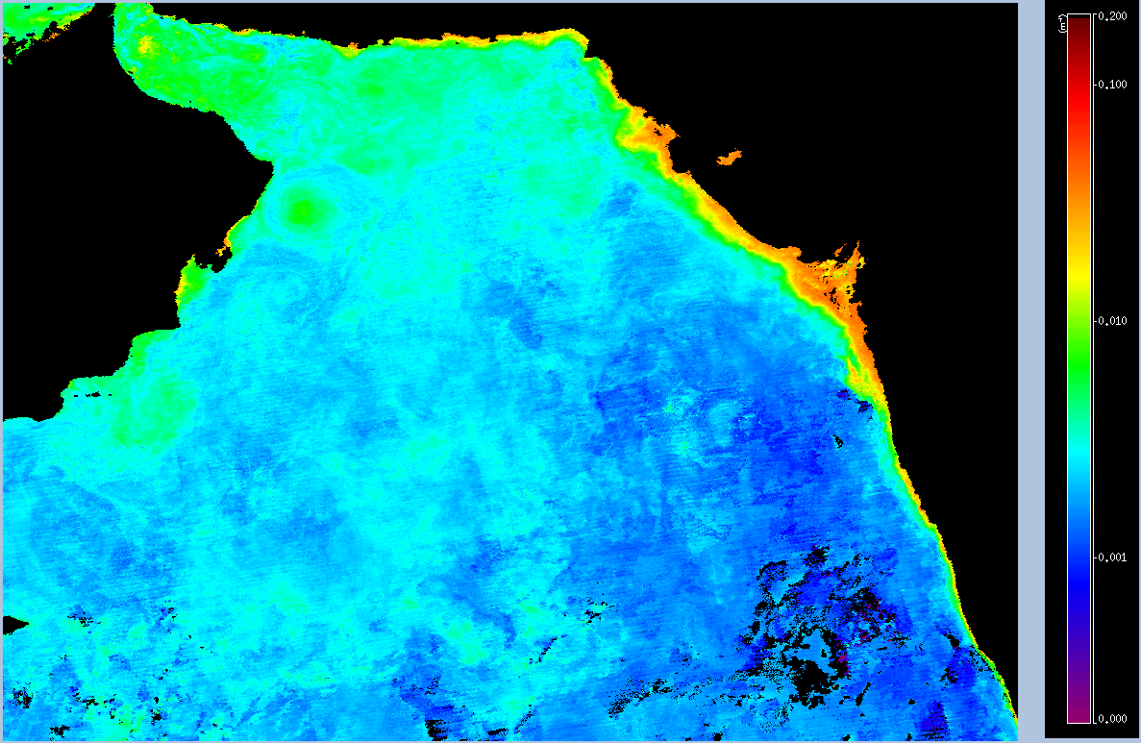
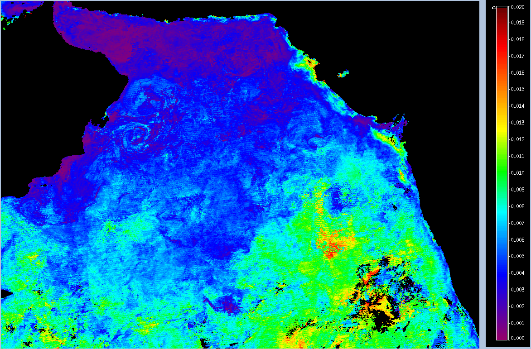
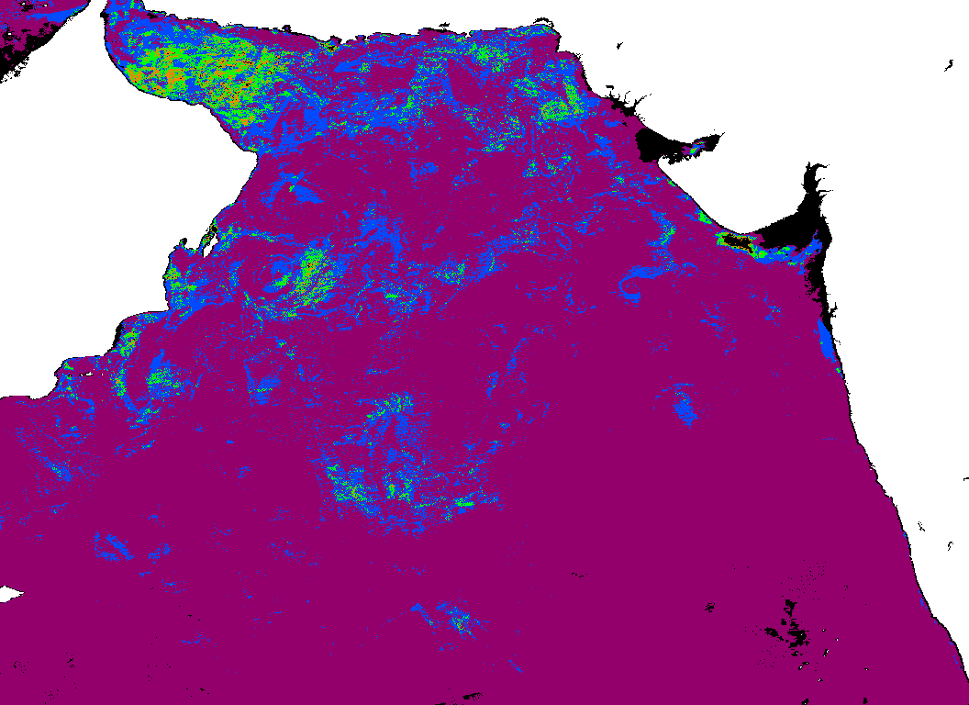
March 2011 optical properties
a_{dg}(443)
b_{bp}(443)
b_{bp}(443) / Chl
# of N. miliaris identified

Slide 18
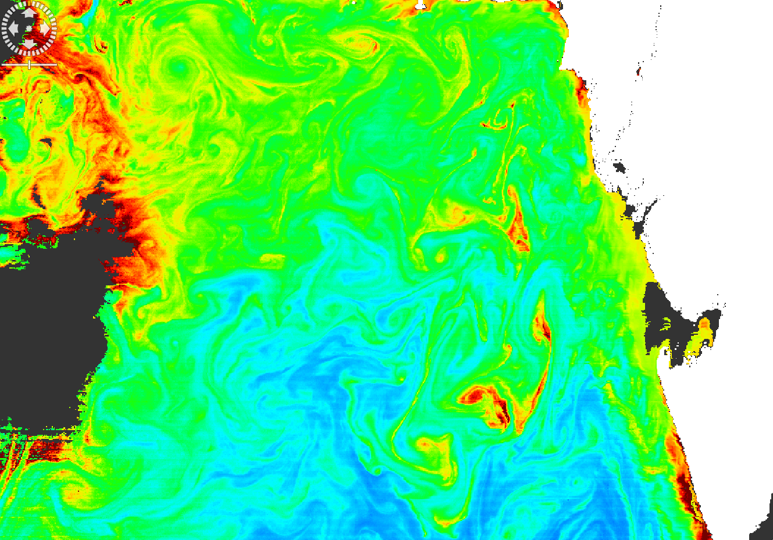
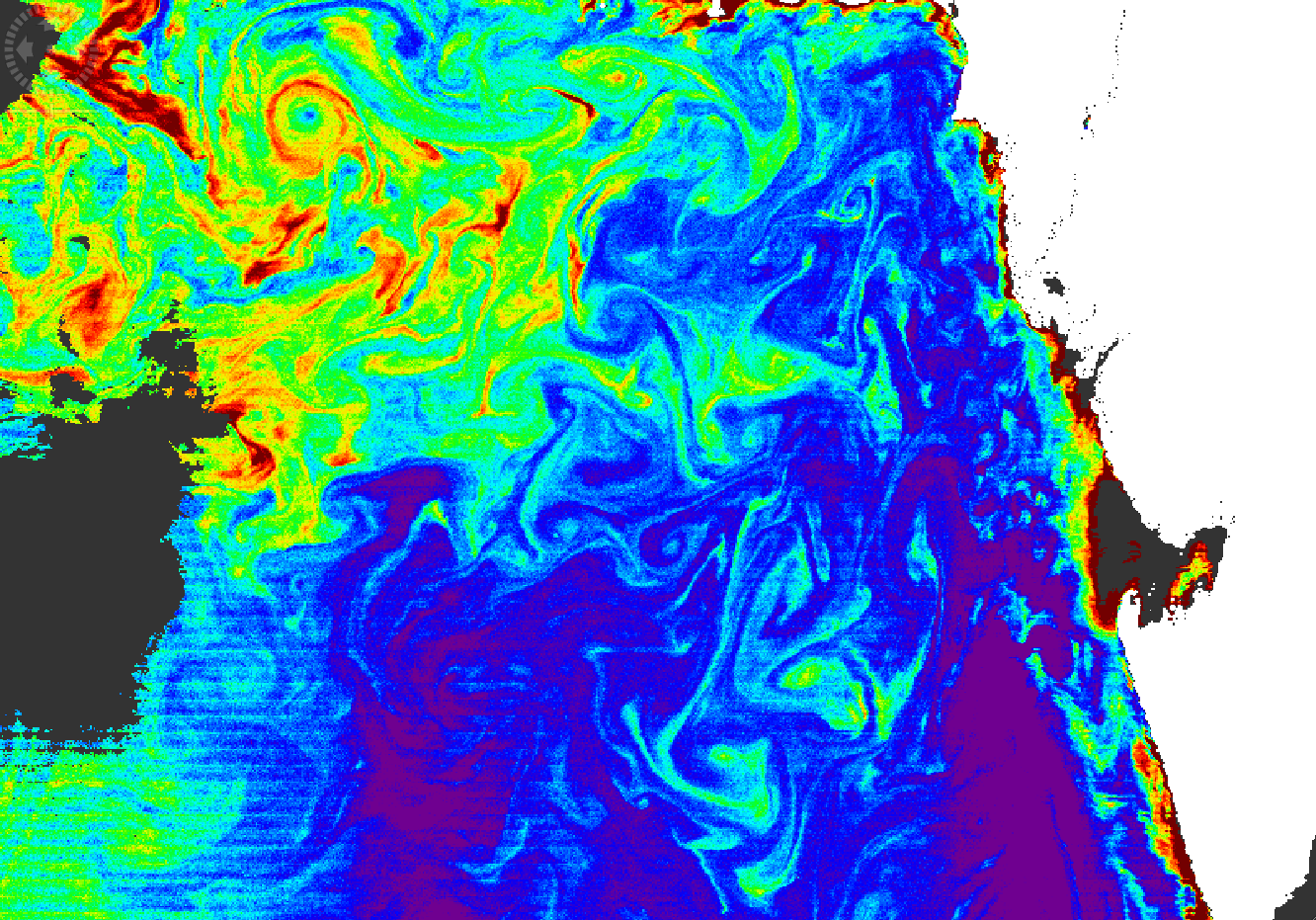
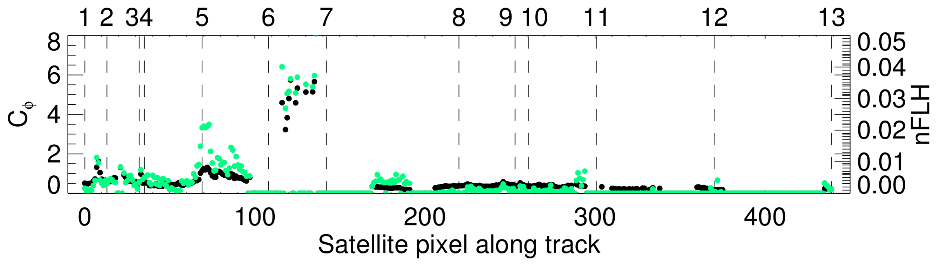
Fluorescence
OC3 0.05 to 50 mg m⁻³
nFLH 0 to 0.04 μW cm⁻² nm⁻¹ sr⁻¹

Slide 19
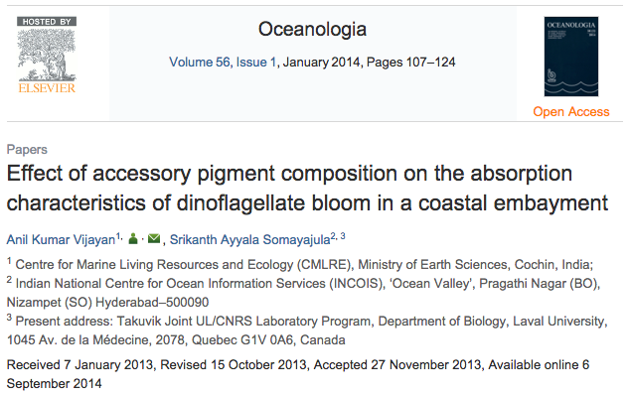
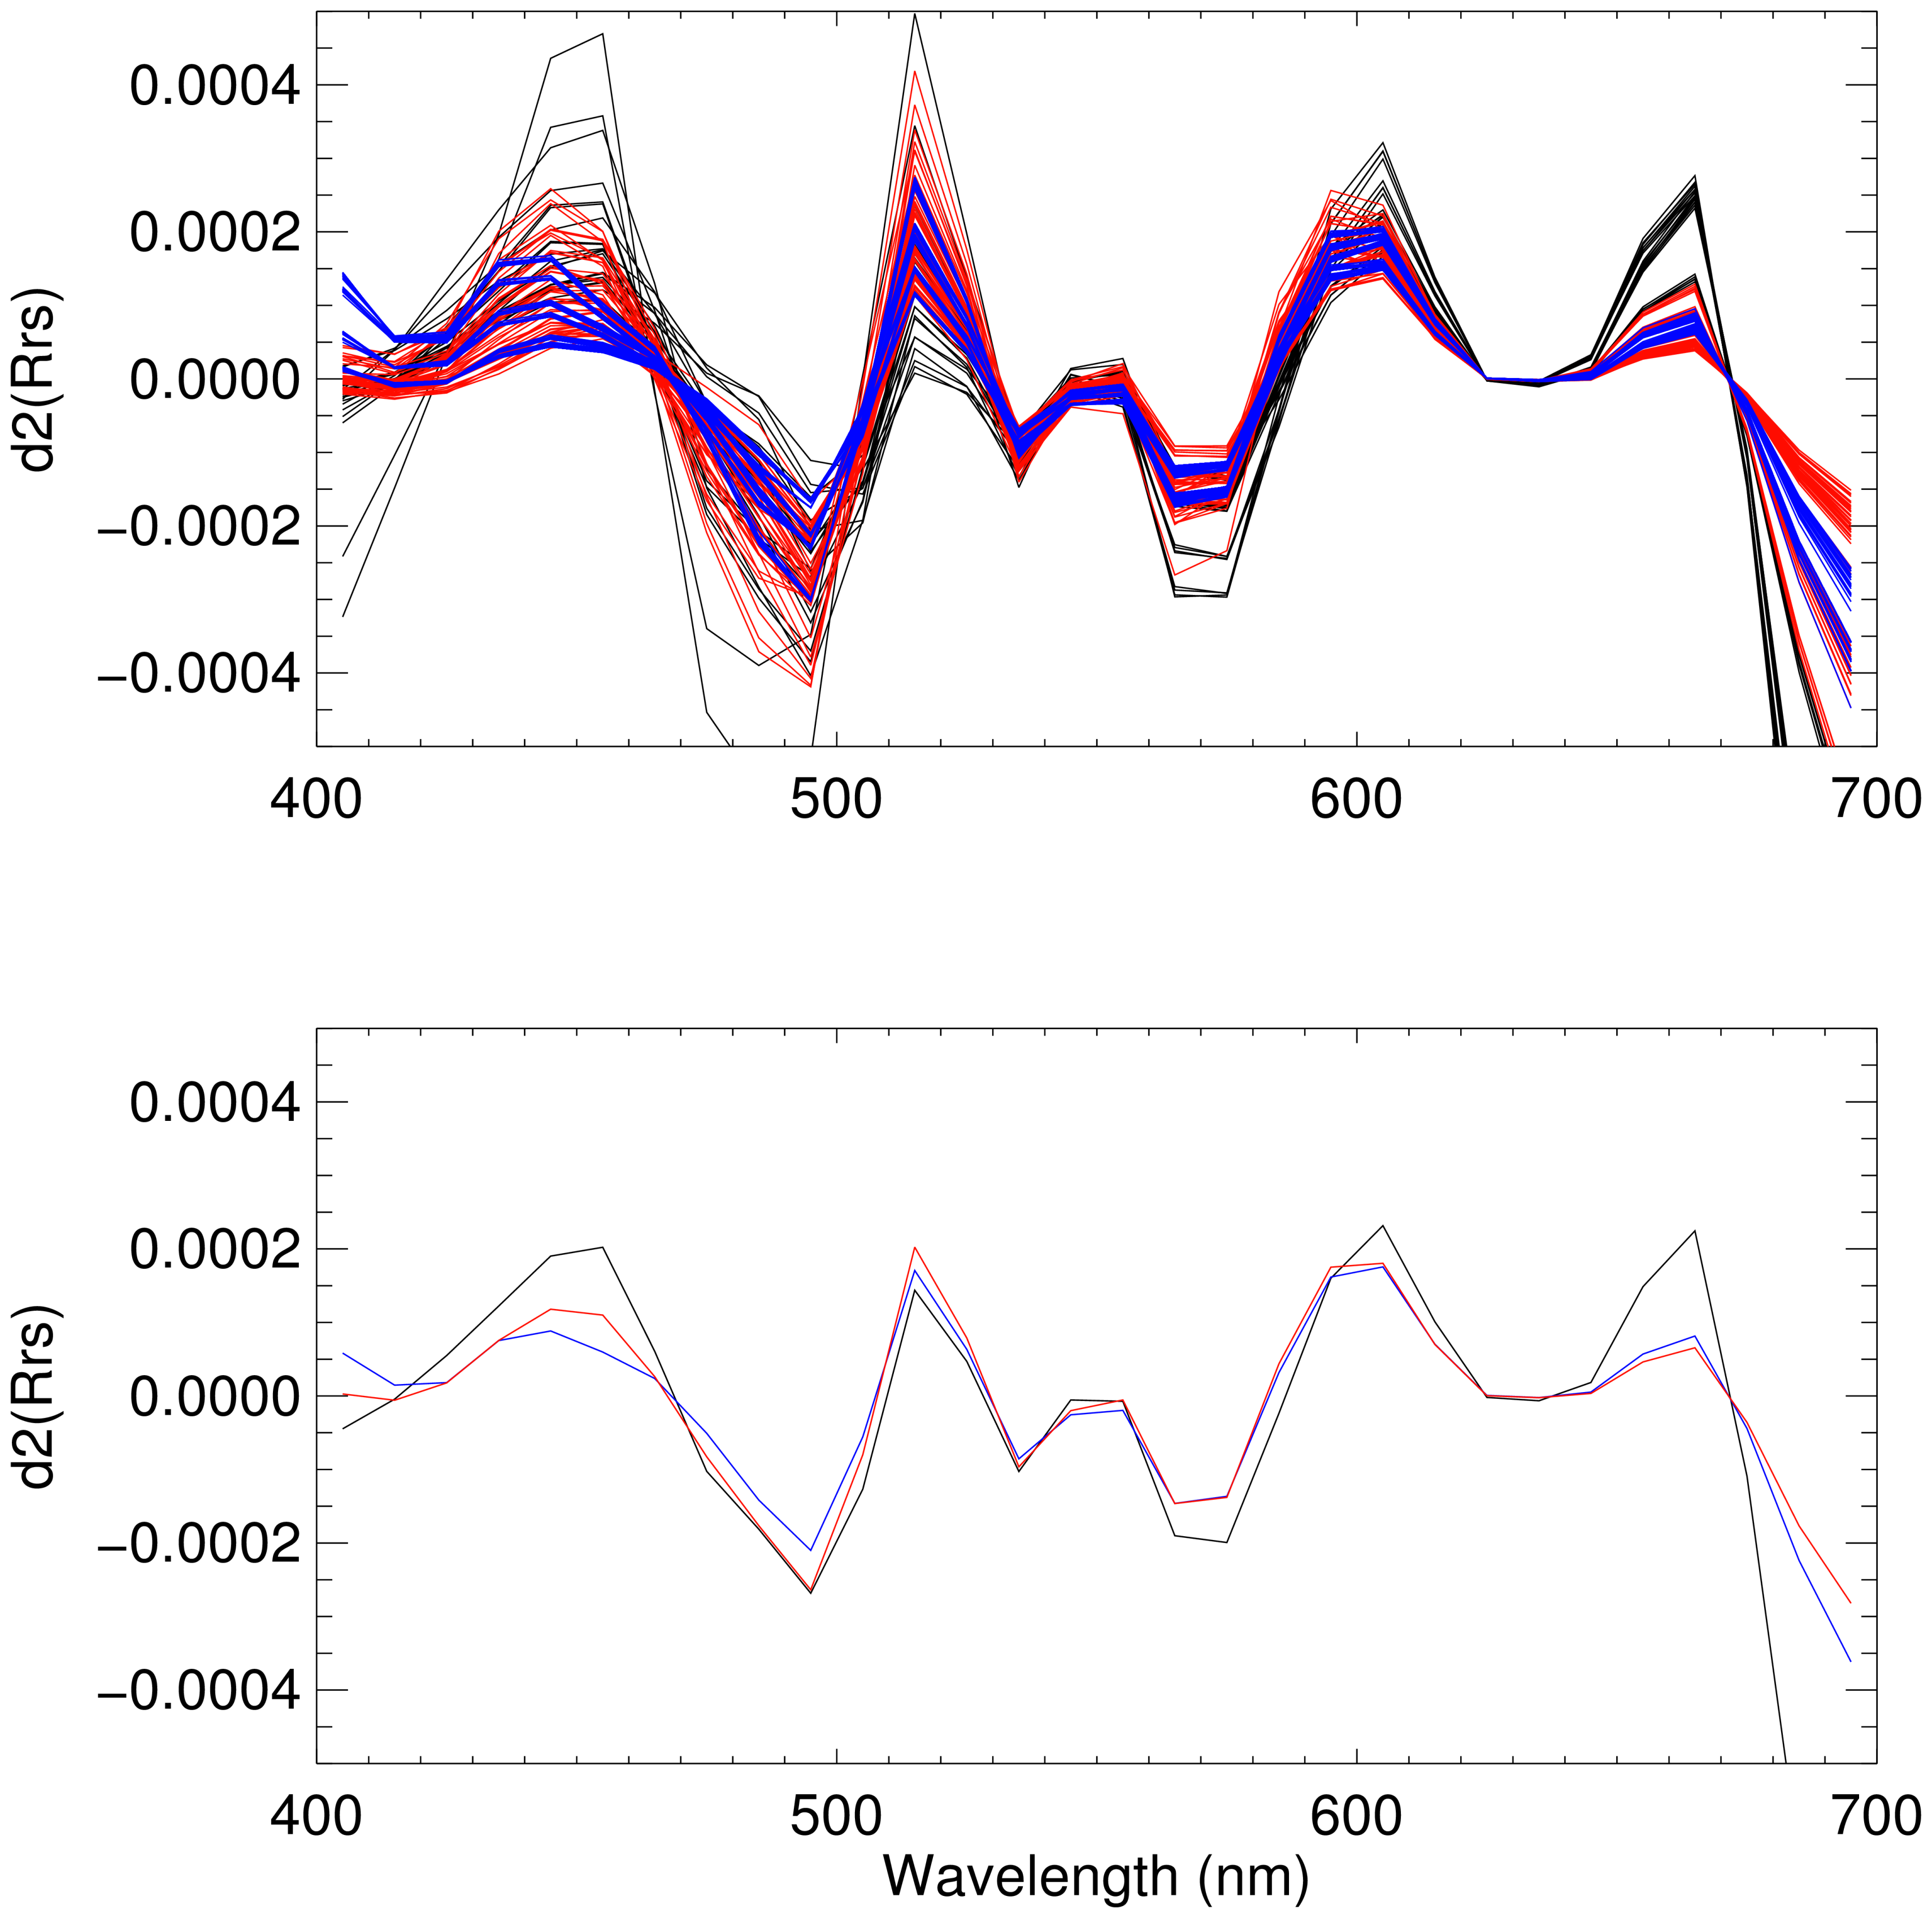
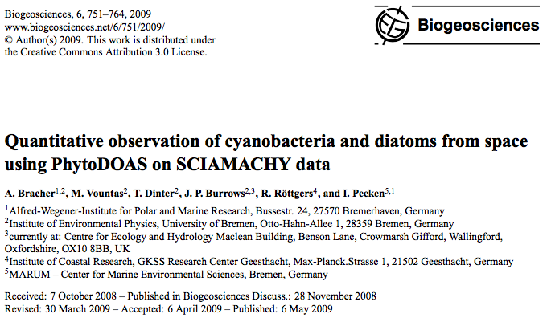
Moving towards hyperspectral information
Derivative analyses
of Rrs(λ) may reveal community composition based on differences in phytoplankton absorption
Legend:
Noctiluca only
Diatoms only
Both ~0.5 mg m⁻³
all spectra
Second derivative Rrs(λ) Second derivative Rrs(λ)
average spectra

