Slide 1
Terra Status Update including
End of Mission Orbit
Kurt Thome – Terra Project Scientist
Robert Wolfe –Terra Deputy Project Scientist for Data
NASA/GSFC
MODIS/VIIRS Science Team Meeting
June 7, 2016

Slide 2
Summary of recent events
Terra completed another successful Senior Review in October 2015
Terra is an exemplary mission that offers a tremendous long term data record capable of identifying subtle climate signals
Safe hold of the platform in February while performing an inclination maneuver
  Cause was determined and platform is healthy
  All instruments recovered without issue
Terra March Workshop in Boulder discussed impacts on science from crossing time
  Decision to move forward with request to continue operating Terra at current crossing time until 2021
  Making plans for a lunar calibration in summer 2017

Slide 3
Terra platform and sensors are healthy
Plan is to continue Terra mission for as long as sensors are providing valuable data
Mission continues to produce important science
Terra platform and instruments expected to continue operating through 2022
  Indications are that instruments and platforms will perform past 2022
  2022 is when Terra is predicted to cross its 10:15 am crossing time requirement
Remaining fuel and how to use it is the dominant platform-related factor

Slide 4
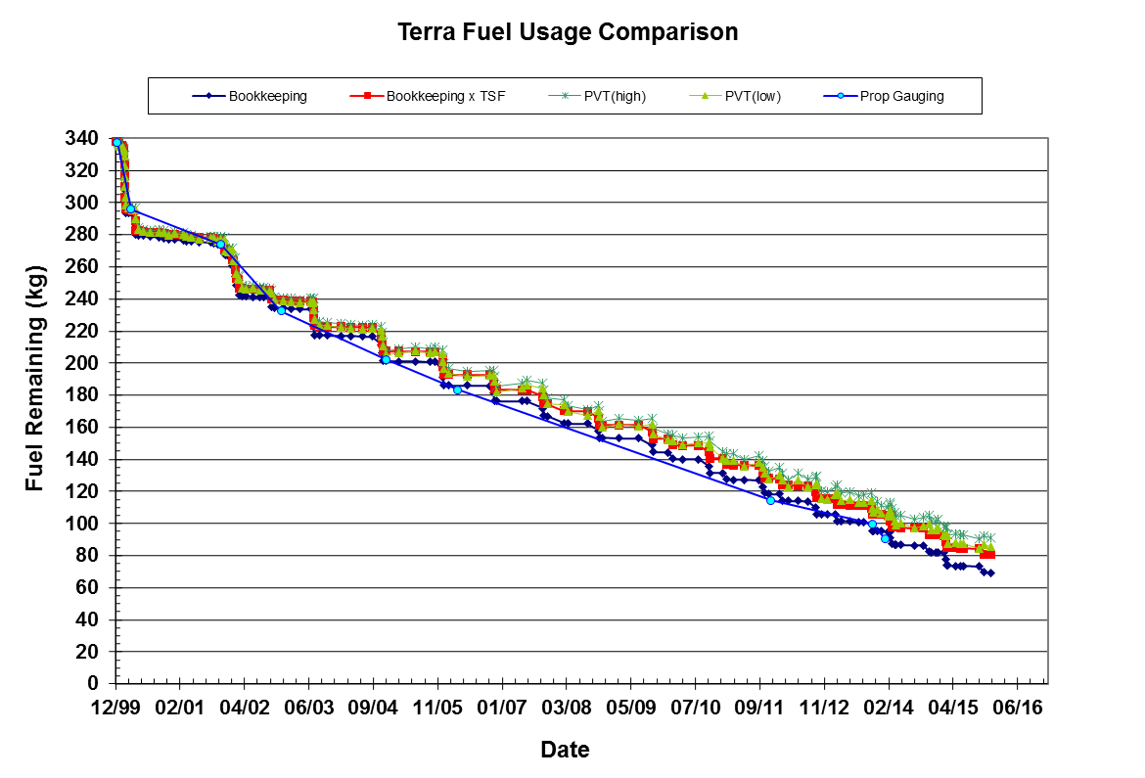
Terra’s fuel dominates future planning
Fuel Usage Approximations:
~4 kg of fuel for every inclination maneuver (IAM)
~0.15 kg of fuel for every drag make up maneuver (DMU)
Fuel needed to lower at least 19 km = 45 kg
Fuel needed to lower at least 4 km = 4 kg

Slide 5
“Nominal” mission scenario
Nominal science operations
Orbit lowering burn
Post-constellation exit science
Orbit degradation from atmospheric drag leading to reentry within 25 years
Constellation exit burn
Altitude
Science could be done during this entire time – given sufficient funding and programmatic support
Time

Slide 6
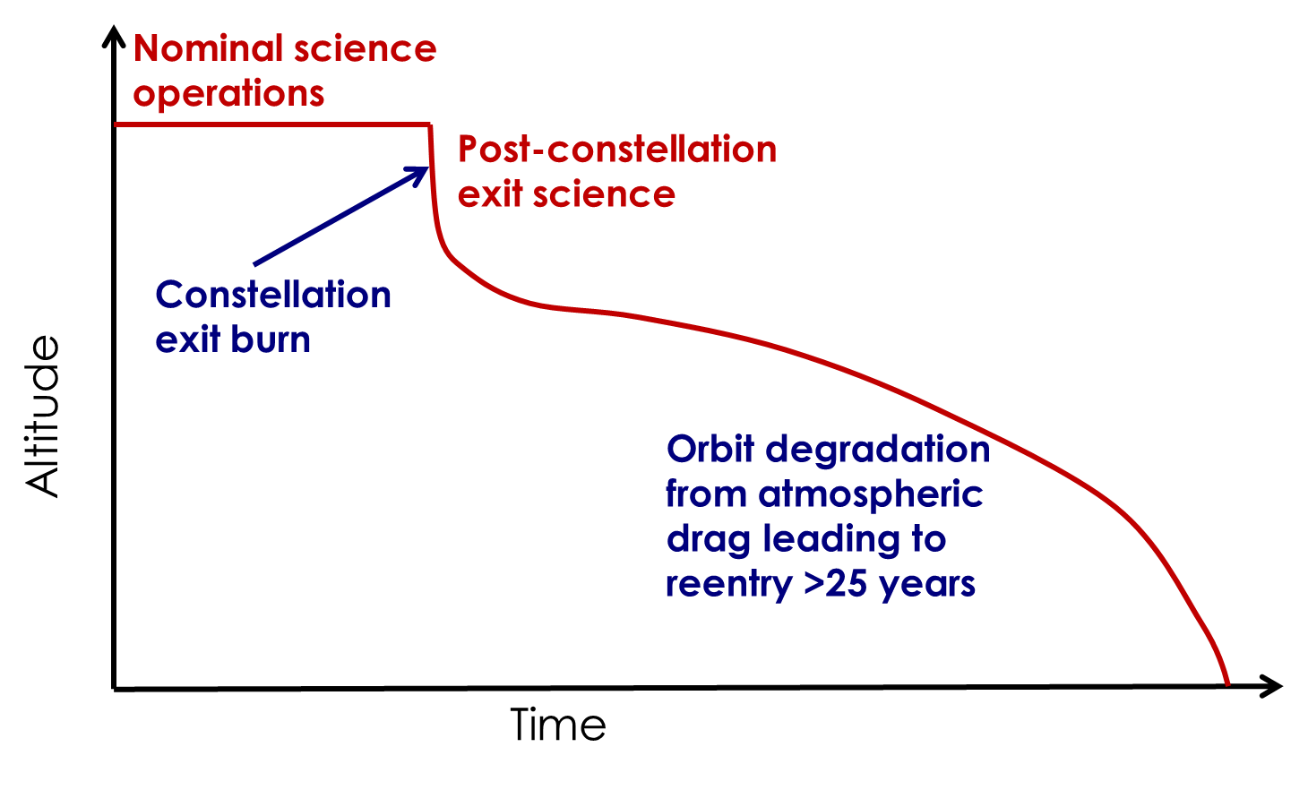
Terra’s scenario (details later)
Terra needed to perform an orbit-lowering burn in 2013 to meet 25-year requirement
Earliest predicted re-entry if Terra used all of its fuel today would be after 2045
Approach for Terra is to continue doing IAMs until the remaining fuel matches what is needed to exit
Approval of this plan is via a signed End-of-Mission Plan
Terra does not have fuel for controlled re-entry
Need sufficient fuel to exit constellation
Fuel will remain for collision avoidance maneuvers

Slide 7
Terra mission length extension
Extending length of Terra mission is
highest priority of science & instrument teams
Lack of follow-on sensors means Terra instruments will continue to be a unique resource for at least 5 years
Science can be done with Terra data regardless of altitude and crossing time
Emphasis of Terra science will shift depending upon when and how Terra exits the constellation
There is no breaking point to science due to changes in altitude or crossing time

Slide 8
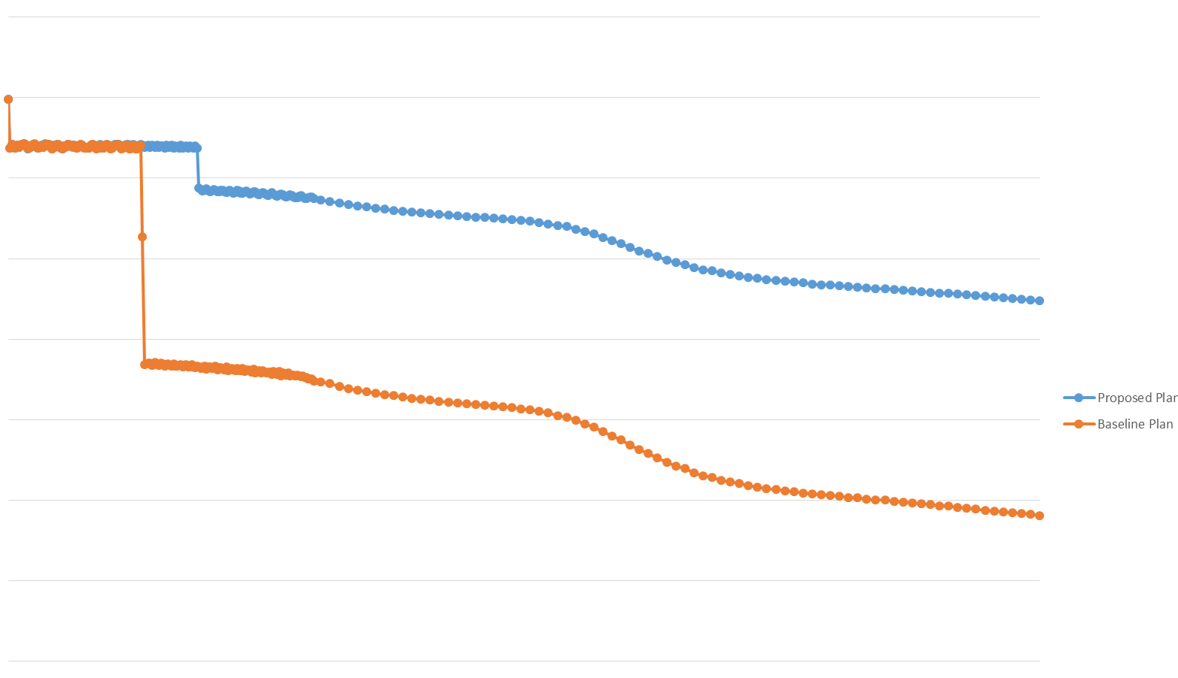
Terra altitude scenarios
720
Extra 28 months at current altitude and crossing time
Terra Operational
Orbit
4 km exit
Average Height (km)
19 km exit
Orbit Degrading
Over Time
Risk Mitigation Maneuvers
(RMM) fuel available
Science can be done during this entire period regardless of exit scenario given sufficient programmatic support
640
2015
2025
2035
2045
Year

Slide 9
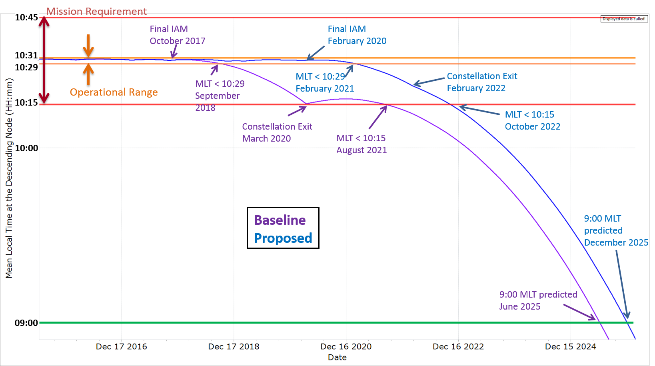
Fuel usage impacts Terra’s crossing time
4 km case
Added 28 months at current altitude and crossing time from using 41 kg of fuel for inclination maneuvers instead of orbit lowering
Crossing time for case where final burn lowers Terra >19 km

Slide 10
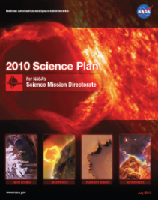
Terra science
Terra provides science community with data to study Earth as a system, discover how Earth is changing and explore human interactions with these changes
Provide answers to “How is the Earth changing and what are the consequences for life on Earth?”
Ensuring continuation of Terra’s data record makes the data more valuable by creating a record long enough to
  Gather statistics relevant to the define climate metrics
  Develop an understanding of our climate system
  Examine interannual variability
  Observe trends on the decadal scale
The 4 km exit scenario extends this science record until 2022

Slide 11
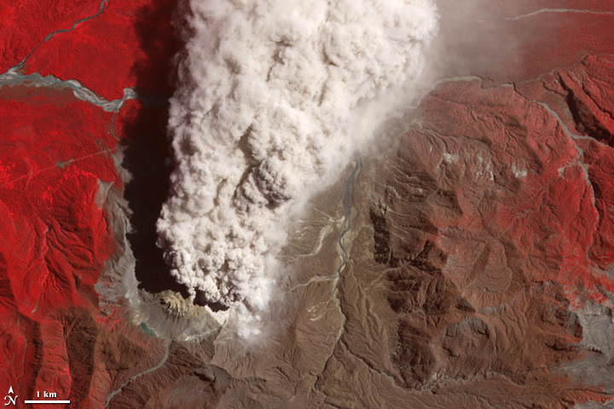
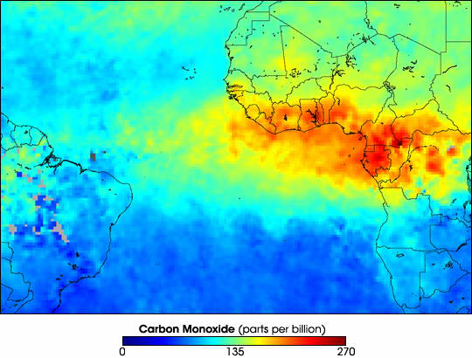
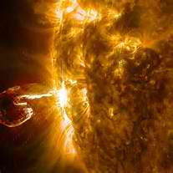
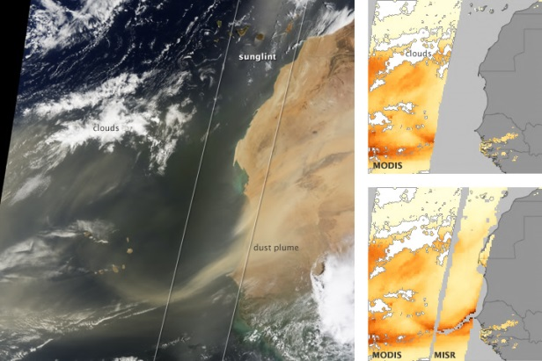
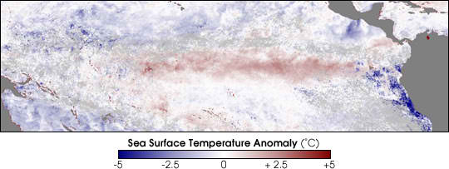
Terra’s 16+ years
>15 year record changes character of
Terra mission from process-oriented
to climate-observing
Longer record increases chance of observing climatically significant events and distinguishing natural variability from anthropogenic change
Climatic or human-caused variability in occurrences of severe wildfires, dust outbreaks, extreme air pollution, and impacts on air quality of regulatory changes or economic recovery
22-year record spans 2 complete solar cycles allowing studies of impact of solar variability

Slide 12
Current data record examples
Deseasonalized anomalies in CERES broadband (a) albedo, (b) outgoing LW radiation, and (c) net radiation. Thin line corresponds to monthly anomalies, thick line is a 12-month running mean
ForWarn has used MODIS NDVI to track forest change providing real-time forest change maps for the continental United States every eight days

Slide 13
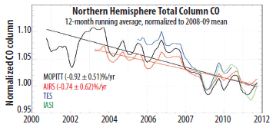
Intersensor reference
Terra data provides a standard
by which newer missions compare
Proven test bed for new science and improved processing algorithms
Several planned sensors to become operational from 2019 to 2022

Slide 14
Impacts to Terra science
Changing orbital altitude and/or crossing time has both programmatic and science impacts
Changing crossing time affects data quality
  Earlier crossing leads to lower solar elevation, lower reflected energy, poorer signal to noise
  Lower solar elevation leads to more shadowed data
  Cloud probabilities change
Changing orbital altitude changes spatial coverage
  New geometric processing algorithms may need to be developed
  Decrease spatial coverage (swath width)
  May cause gaps in spatial sampling

Slide 15
Time series impact is the real issue
The length and quality of the Terra data record makes it suitable for time series analyses
Most physical parameters have a time dependence
  Temperature changes during the day
  Cloud distributions
Goal in time series analysis is to detect change
  Change in MLT can cause changes in that parameter on the order of or larger than the change that is trying to be detected
  Corrections for crossing time can be developed but add uncertainty to the retrievals

Slide 16
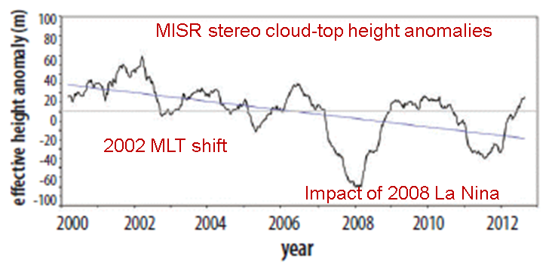
Initial crossing time change - Cloud example
10:45 to 10:30 crossing time change coincided
with noticeable changes in data records
Change in cloud climatology could be real or due to crossing time (MLT) change
Assessing impacts on time series is more difficult

Slide 17
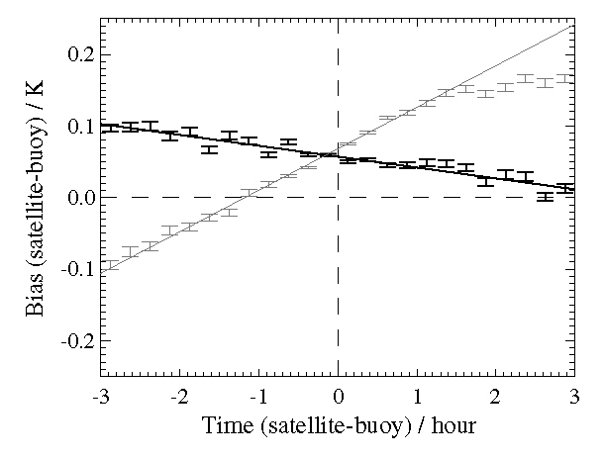
MODIS SST example
Mean difference between satellite-based sea surface temperature and buoy retrievals
Shown to change about 0.1k/hr
  Varies with location
  Caused by diurnal heating of the ocean
  Data were for an equator crossing time of 10:00 so applicable to Terra.
Drift of 15 minutes gives an average change in the global SST of 0.025K
  Order of magnitude greater than the annual stability requirement for climate records
  Corrections could be made but uncertainties would be comparable to anticipated climate change signals

Slide 18
Terra March Workshop Conclusions
Workshop summarized science impacts related to crossing time
Morning Terra record is currently unmatched in quality and duration
No planned successors in morning orbit for several instruments
Terra will provide excellent data for meeting science objectives regardless of changes in altitude or crossing time
Climate trends can be better distinguished from interannual variability as data record approaches 20 years
15 minute changes in Terra crossing time impacts science causing
  1% change in cloud fraction for boundary layer stratocumulus
  1K change in mean land surface temperature
4-km exit strategy ensures continuation of current pattern of global sampling until 2022
Maintaining current crossing time for as long as possible provides clearest climate-relevant data set

Slide 19
Terra Crossing time Panel Conclusions
Utmost importance to continue this data record while the Terra instruments are performing nearly optimally
Significant scientific value to be gained by extending the mission at the current 10:30 crossing time for as long as possible
Additional 28 months of observations at the 10:30 crossing time will be invaluable to climate trend studies
A change in the crossing time would mark the end of Terra’s “climate quality” data record for trend analysis
  Magnitude of crossing time impact would be equivalent to the magnitude of the trends expected from climate models
  Ability to separate a climate trend from the climate’s natural variability is strongly dependent on the length of the observational record
Likely be several decades until the science community can again build upon a 16+ year climate record from another continuously operating platform with similar capabilities

Slide 20
Terra recommending 4-km exit fuel use plan
Terra will continue inclination maneuvers to maintain current crossing time until Feb. 2020
Last inclination maneuver in Feb. 2020 leads to crossing time drift after that point
  Science gains 2 ½ years of constant crossing time data beyond the current Oct. 2017 end of IAMs
  Crossing time drifts to 10:15 am in Aug. 2022
Altitude lowering by at least 4 km in Aug. 2022
  Any fuel remaining would only support collision avoidance
  Orbital altitude degrades and crossing time changes after this point until platform de-orbits
  Terra does not maintain its WRS-2 ground track
Still requires approval of NASA Headquarters

Slide 21
March Workshop also discussed lunar calibration
Summer 2017 offers a favorable view of the moon similar to that from 2003
ASTER team noted the lunar phase, nutation, and libration from April 2003 nearly matches what would occur in July 2016
  Could have supported a July 2016 maneuver
  Discussion of fuel usage strategy delayed a decision for too long
Team has decided to do the deep space calibration in summer 2017 – regardless of decision on fuel burns
Planning is underway to implement the maneuver
  Flight operations is completing procedures
  Project office is gathering the paperwork needed
  Will likely be a Goddard-based review including NASA HQ

Slide 22
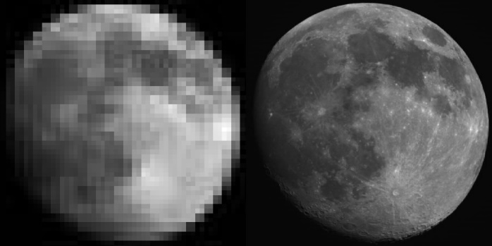
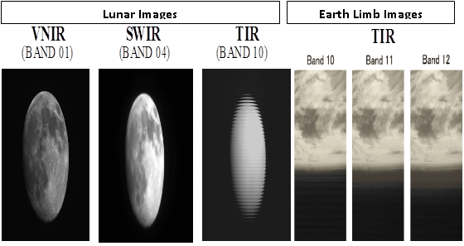
Summary
Next 18 months will be an exciting one for the Terra project
Another Senior Review process beginning in December
Decision likely on Terra’s fuel use recommendation
Planning and implementation for Terra’s flip to see the moon
MODIS ASTER
ASTER
ASTER
Note: Images are from DSC #2 (LDSC) which took place on DOY 2003/104.

Slide 23
Backup

Slide 24
Impacts to L1
Many of the L1 product generations
will require modification
Geometric corrections will require updates
  Band-to-band registration
  Camera to camera registration
  Geolocation processing
Drift from WRS will be an annoyance but not a major impact
  Straightforward modifications
Problem is that many of the original product developers have moved to other projects
Need to determine whether teams can absorb L1 processing changes in their current budgets

Slide 25
Impacts to L2 product generation
Changes to L2 product generation are not needed when crossing time changes
Shifts in crossing time affect interpretation and use of Terra data products
  Corrections needed for diurnally varying products
  Creates confusion between real change versus MLT-induced changes to data quality, data sampling, or changing position of sun glint
Sun angle changes will impact data quality near poles
There is science value (e.g., data assimilation) in collecting data at other crossing time

Slide 26
Impacts to L3 product generation
L3 products should see the highest impact from crossing time change (and WRS drift)
L3 processing should not require modification to account for MLT change
  L3 involves multi-scene combinations
  Crossing time change will not affect the approach to combining data sets
Results can see significant impacts
  See earlier cloud example
  Drift in crossing time will affect statistics of spatial scenes used in processing
  Change in crossing time will change the solar geometry of the scenes

Slide 27
How to address necessary processing changes
Cost and schedule question
Are modifications to L2 processing anticipated?
Can code modifications be absorbed within current funding profiles?
  If not, how best to address the funding issue?
  Can this be addressed through ROSES?
What is the time line for incorporating changes?
  Wait until drift is beginning or anticipate drift?
  What is the process for updating new code?

