Slide 1
Volcano monitoring using MODIS
Robert Wright
Hawaiʻi Institute of Geophysics and Planetology, Honolulu, HI

Slide 2
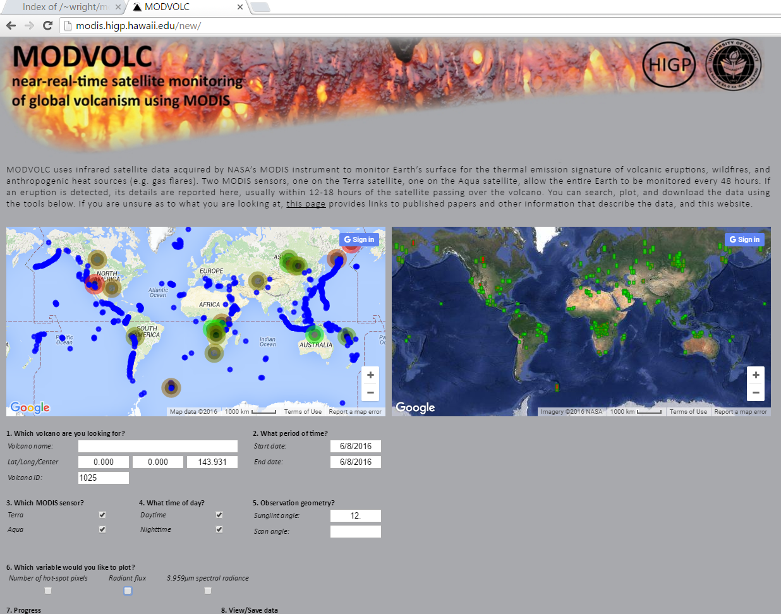
http://modis.higp.hawaii.edu

Slide 3
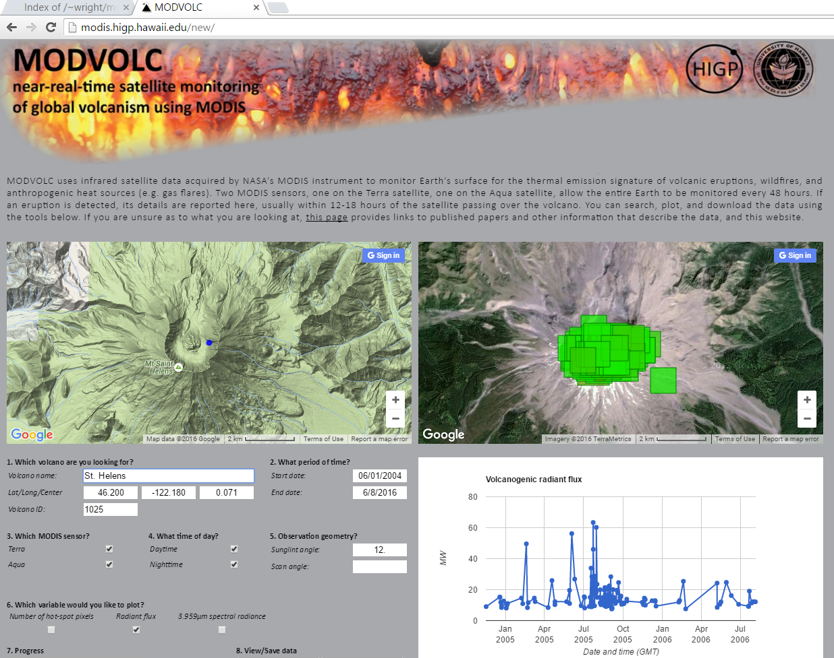

Slide 4
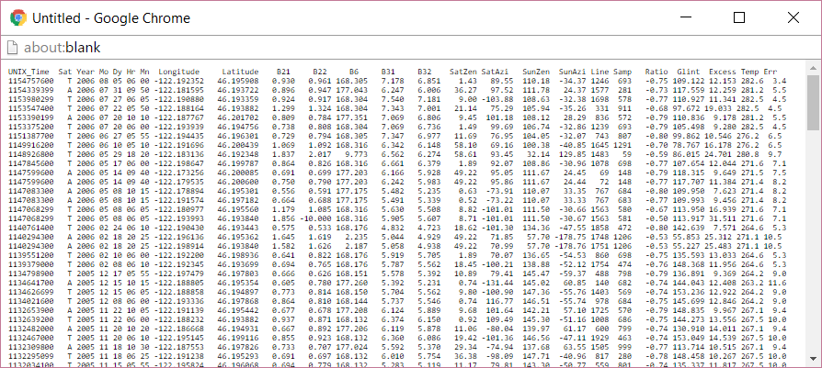

Slide 5
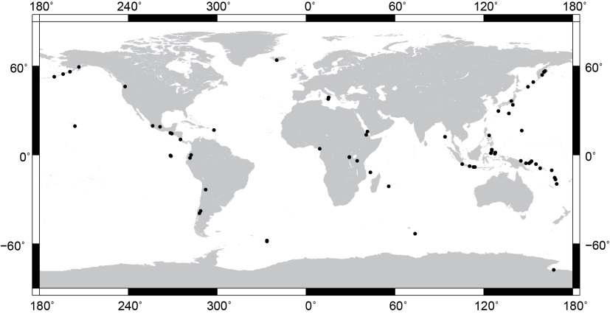
MODIS has detected volcanic thermal anomalies at over
100 volcanoes since 2000

Slide 6
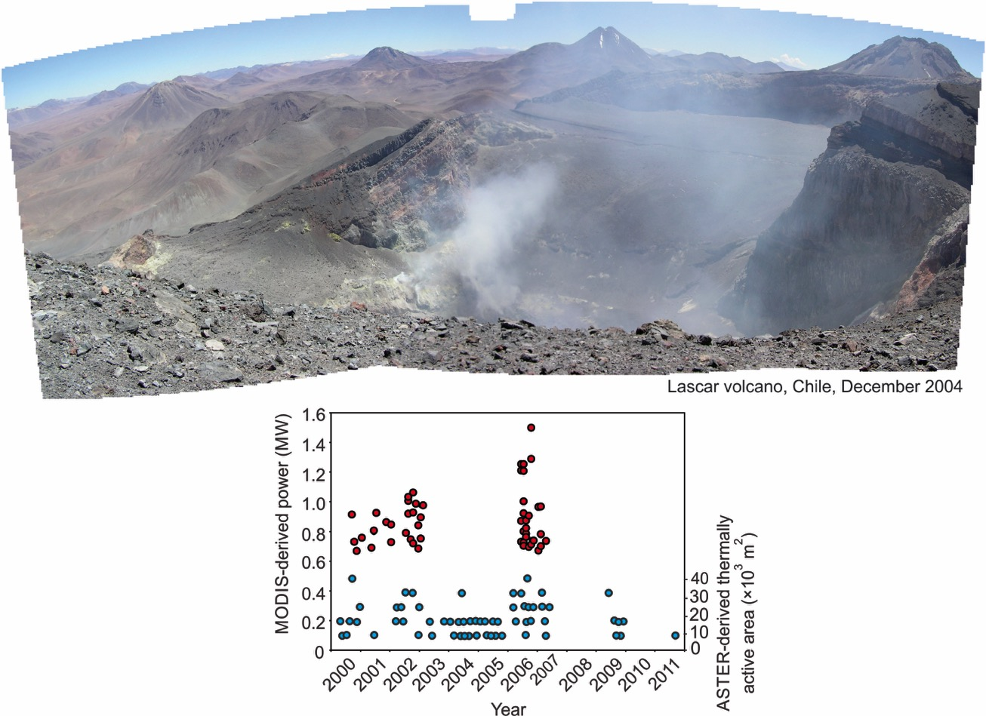
Relatively insensitive to low temperature and hydrothermal volcanic
(i.e. non-eruptive) phenomena

Slide 7
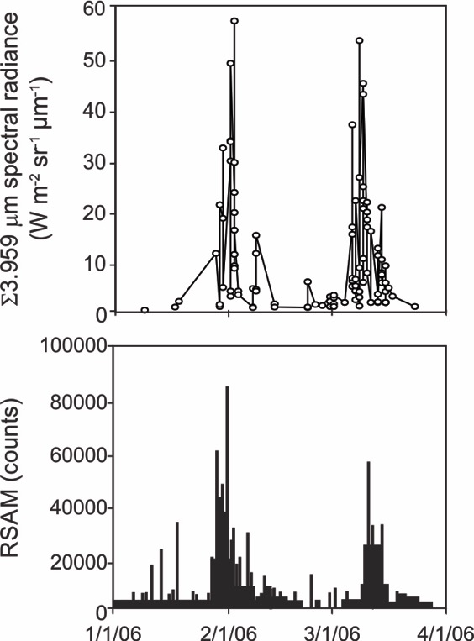
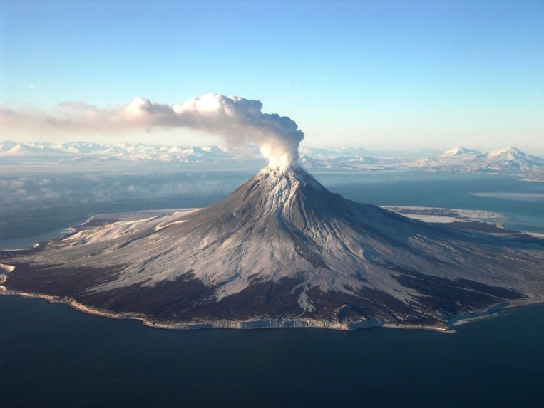
MODIS measurements of emitted spectral radiance act as an effective proxy of eruption intensity during volcanic eruptions
2006 eruption of Mount Augustine, Alaska
Power et al., (2006)
Source: USGS

Slide 8
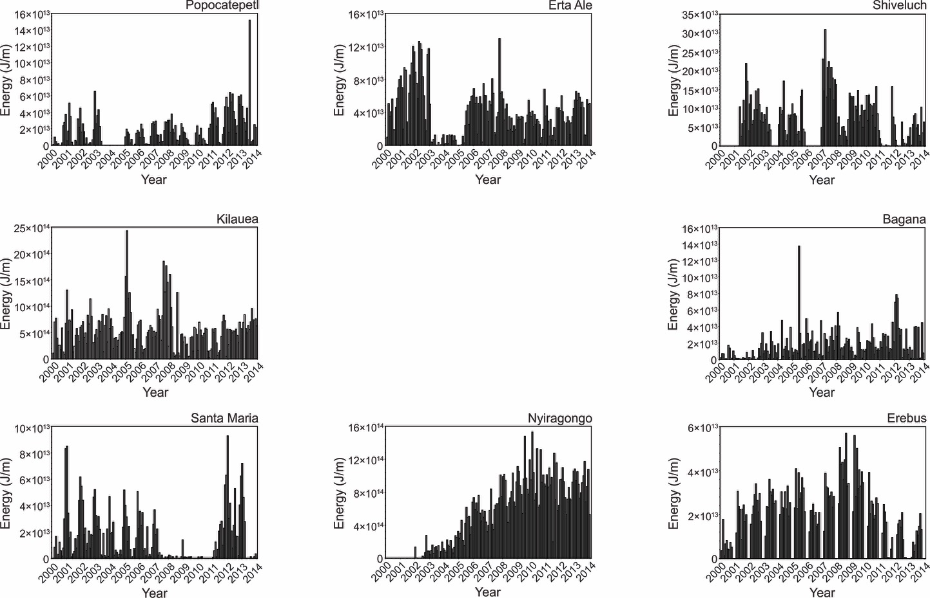
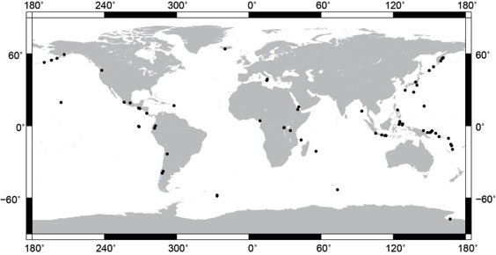
Some volcanoes have been persistently active since 2000

Slide 9
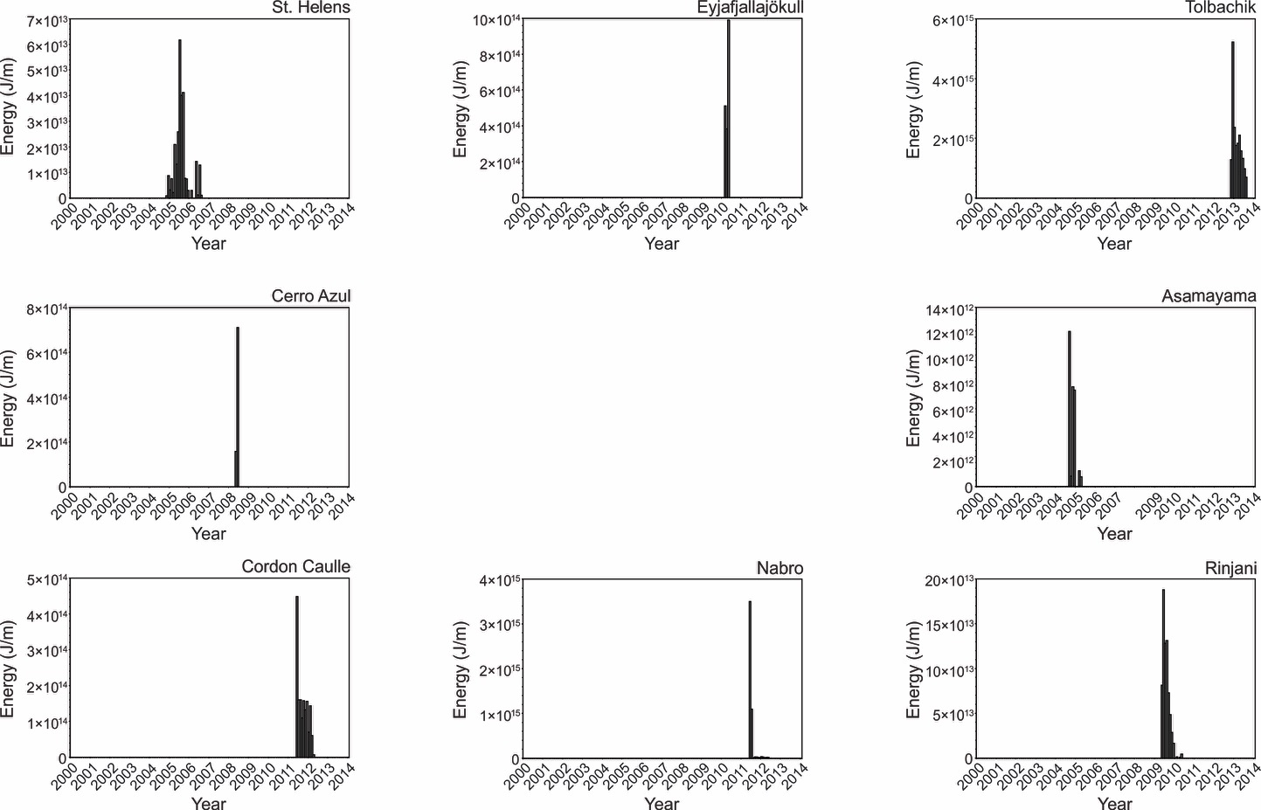
Some volcanoes have erupted only once since 2000

Slide 10
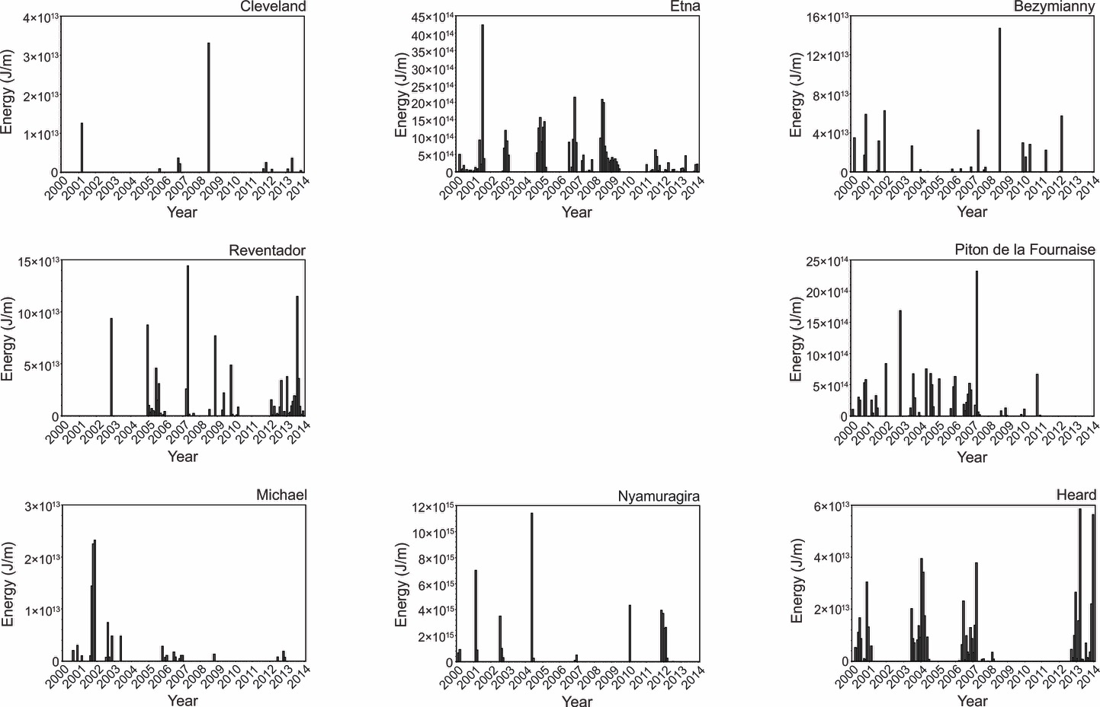
Some volcanoes have been episodically active since 2000

Slide 11
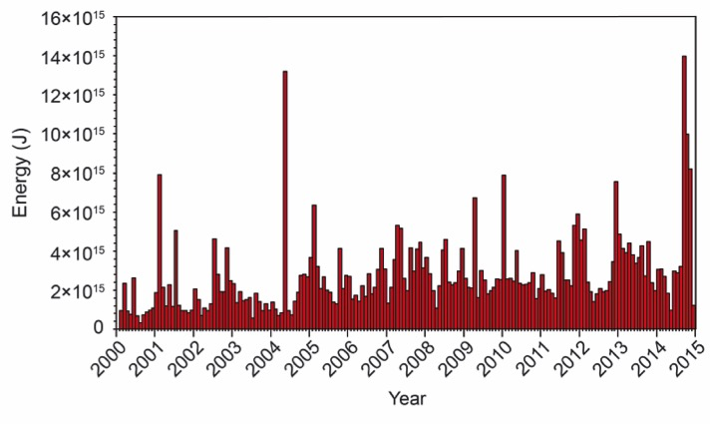
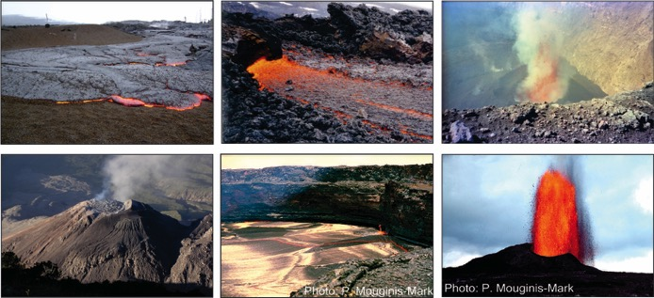
MODIS has catalogued volcanic thermal emissions at the global scale
Mafic lava flows
Mafic lava lakes
Felsic lava domes
Vent activity
Carbonatite lavas

Slide 12
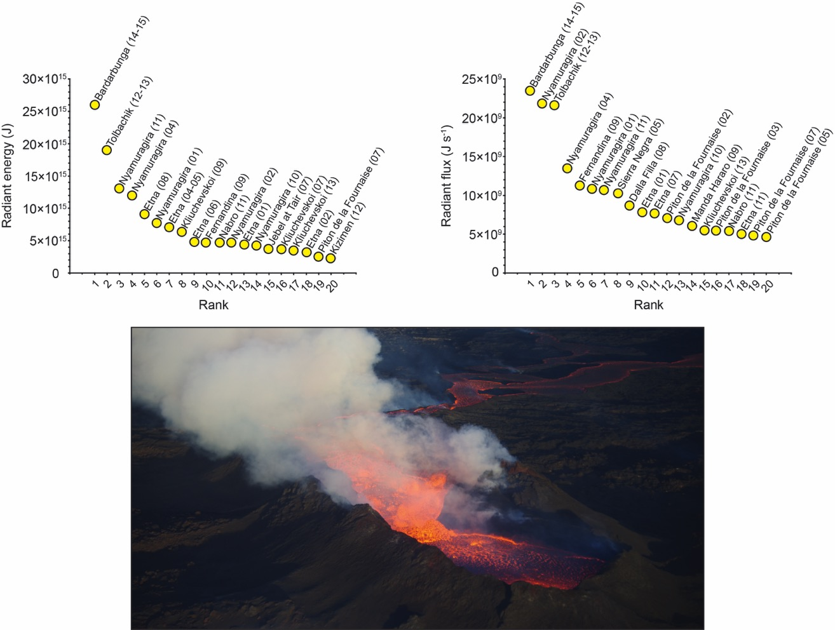
Allowing for direct quantitative comparisons of the intensities and magnitudes of terrestrial eruptions
Total energy radiated
Peak radiant flux

Slide 13
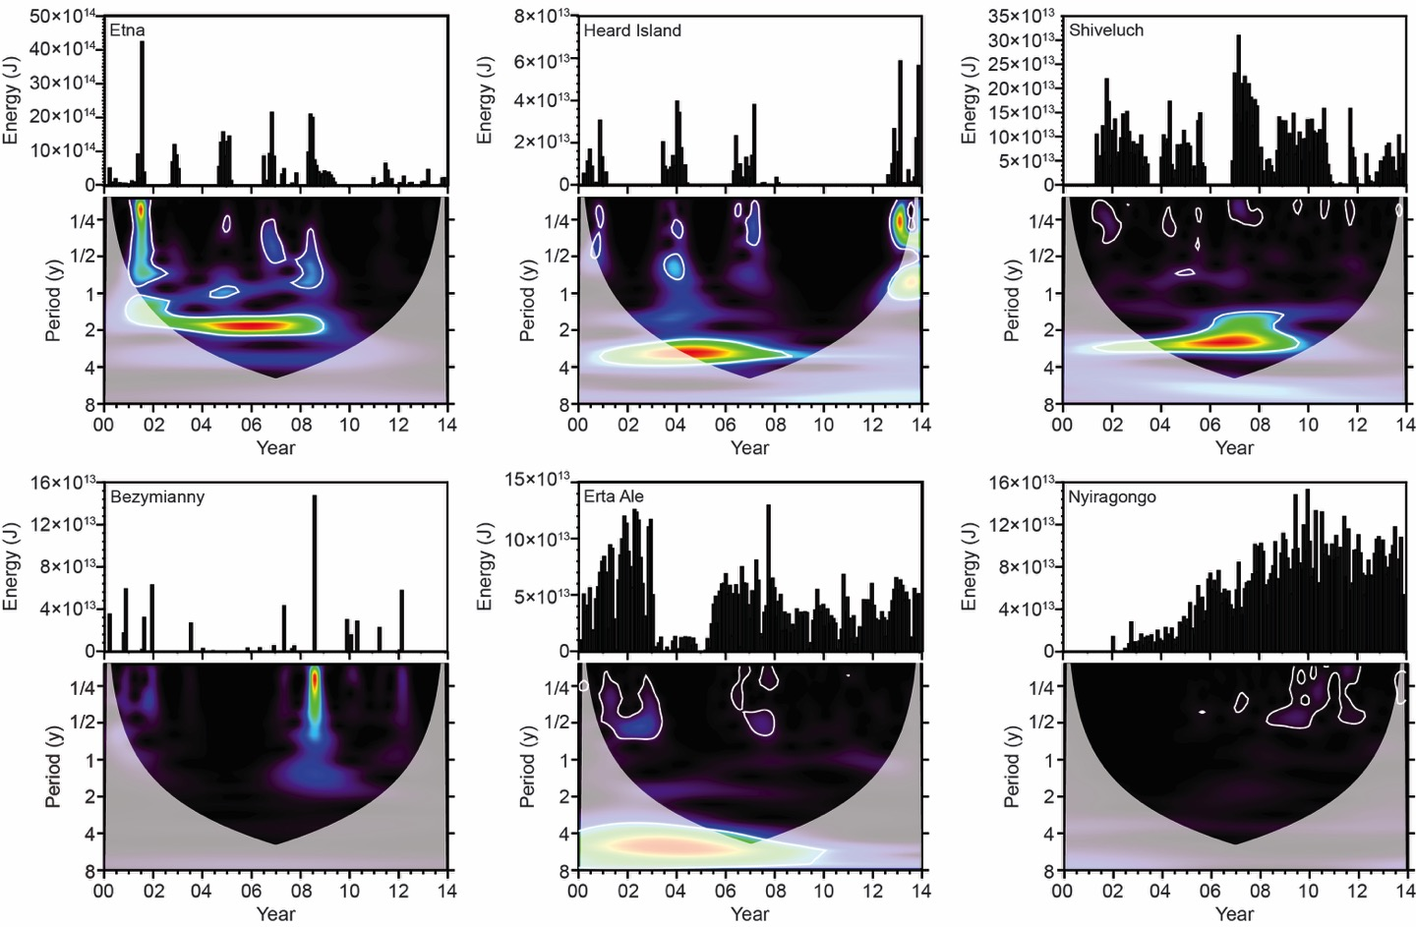
MODIS reveals evidence for periodicity in thermal output at some volcanoes, but not at others
Wright et al. 2015

Slide 14
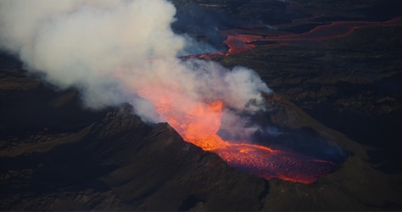
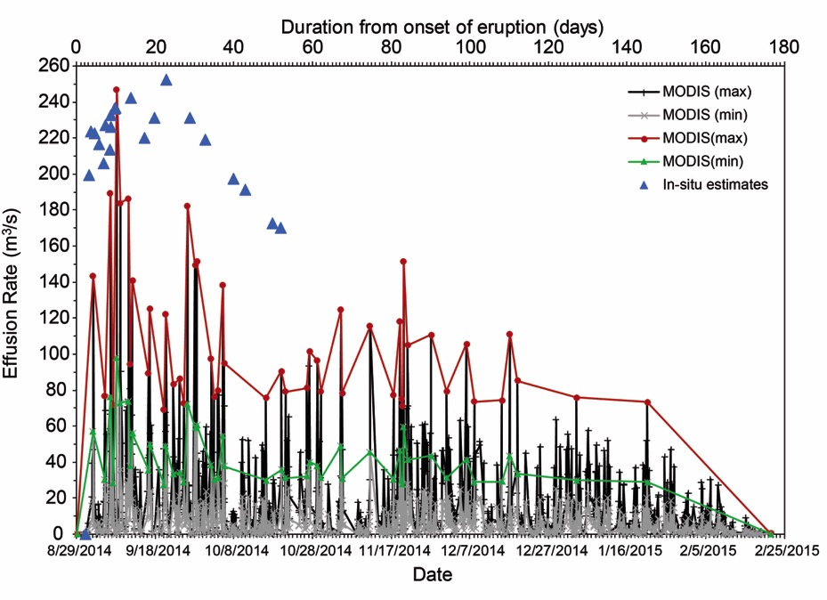
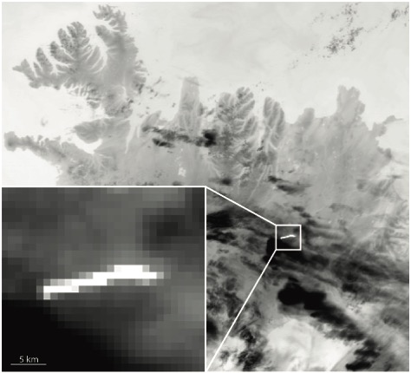
MODIS allows us to estimate the volumetric flux of lava from the vent
5 km
Bonny, Thordarsson, and Wright, in review
Integrating effusion rate over time allows the total lava output to be estimated, and MODIS-derived estimate of final volume (1.3 km³) is consistent with in-situ estimates (~1.2 km³)

Slide 15
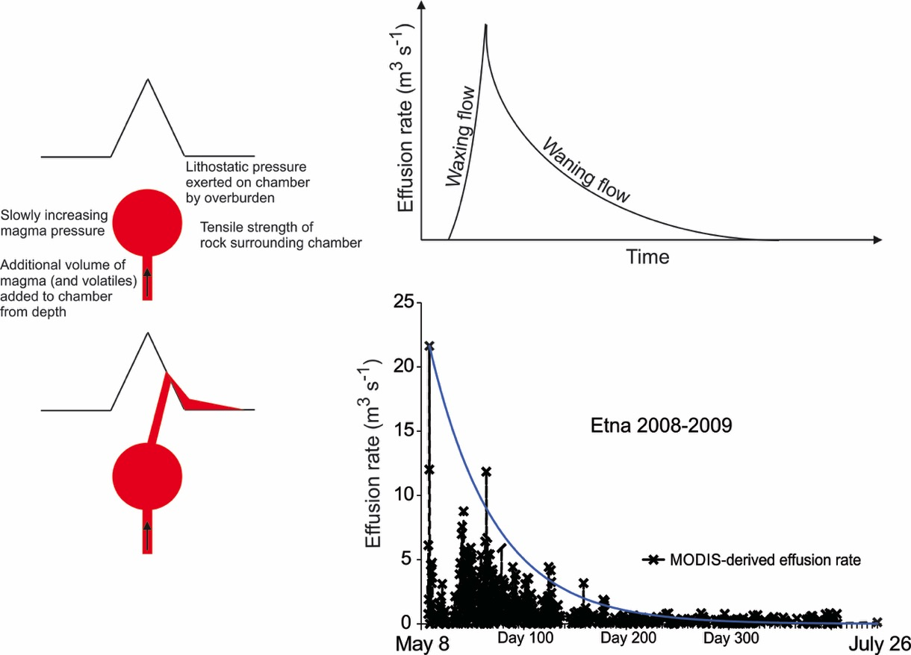
The rate at which (and total amount of) lava that is erupted constraints sub-surface magma chamber conditions

Slide 16
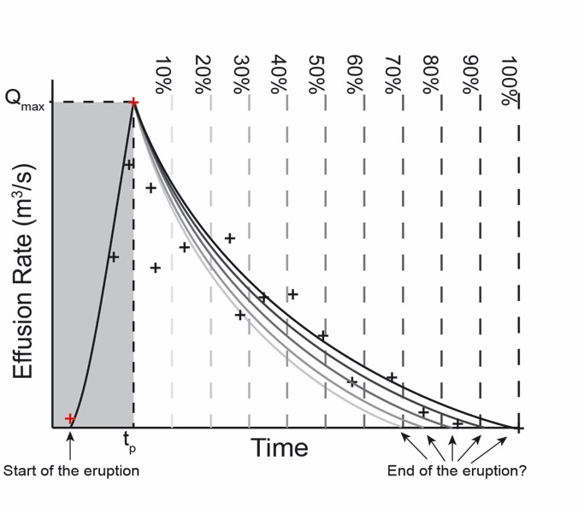
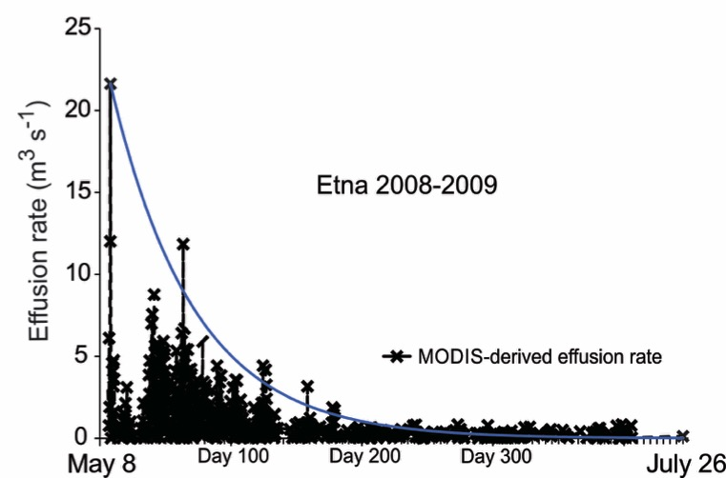
Can we use MODIS data to predict when an eruption will end?

Slide 17
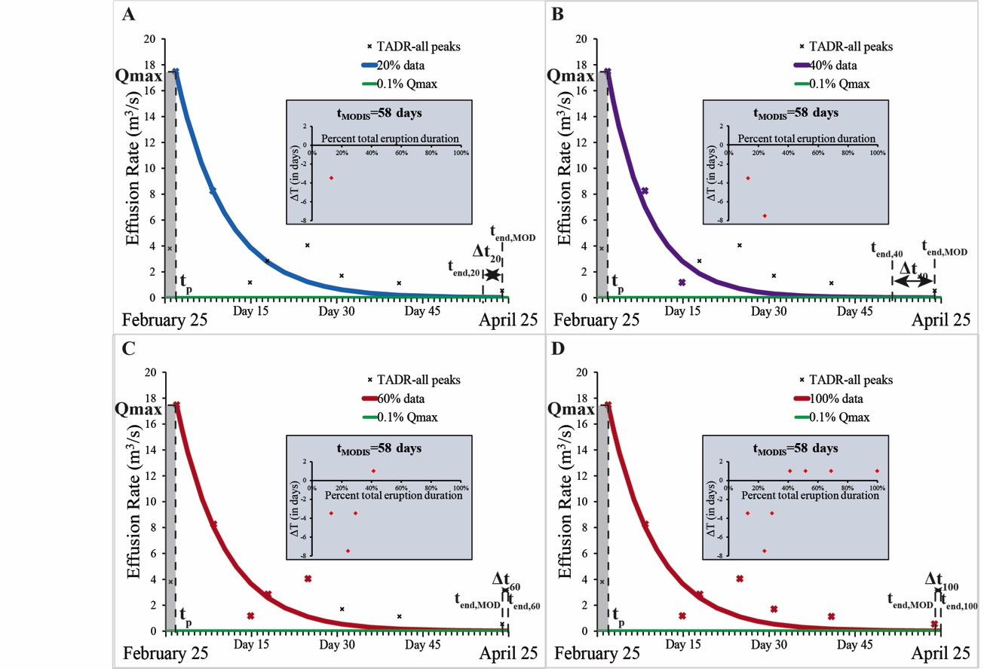
Using MODIS data to predict when an eruption will end
Nyamuragira, Democratic Republic of Congo, 2000
Bonny and Wright, in review

Slide 18
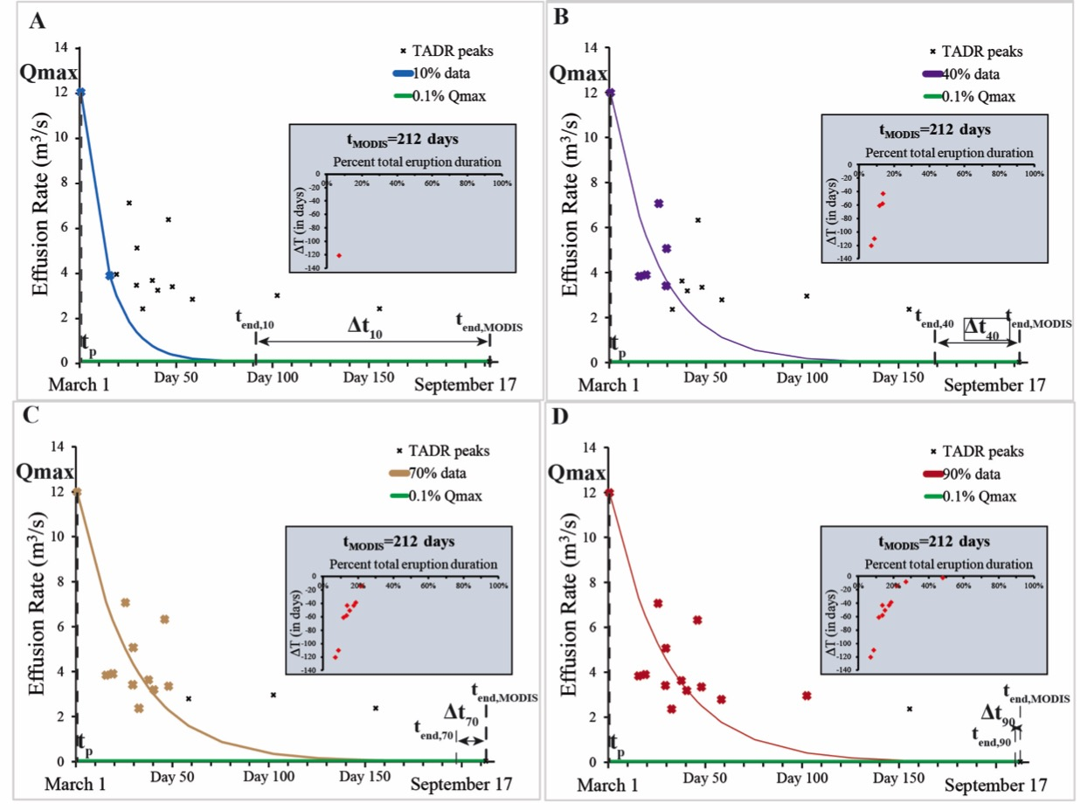
Using MODIS data to predict when an eruption will end
Kizimen, Russia, 2011

Slide 19
No reason why MODIS cannot be used to predict lava flown hazards in near-real-time
Wright et al. 2008

