Slide 1
Marine Boundary Layer Lapse-rate and Cloud-top-height Observed from MODIS and CALIPSO Over Subtropical Eastern Oceans
Feiqin Xie
Department of Physical & Environmental Sciences
Texas A&M University – Corpus Christi
Coauthors: L. Adhikari (TAMUCC), D. L. Wu (GSFC), R. Wood (UW)
Acknowledgement: NASA-NNX14AK17G (Dr. Ramesh Kakar)
MODIS Science Team Meeting, Silver Spring, MD
June 7, 2016
Notes:
1:50-2:10pm
June 7
Evaluate the MODIS Collection 6 Low cloud product

Slide 2
Liquid Water Cloud Fraction – Aqua
[King et al., 2013]
Six selected regions with prevailing boundary layer clouds.
Notes:
Figure 1: The six box areas show the high occurrence frequency of low clouds (or boundary layer clouds, generally less than 2 km above sea level) over the eastern oceans near the continents.

Slide 3
MODIS/CALIPSO Low Cloud Measurement
Cloud-top-temperature (K)
Cloud Fraction (%)
CALIPSO
MODIS Lapse-rate Method:
CALIPSO
(e.g., Zuidema et al., 2009)
Notes:
Zuidema et al., 2009
Ttop values available at 5-km resolution. As determined through the MODIS
operational algorithm, the cloudy pixels are first identified
and then subsampled (as opposed to averaged)
from the original 1-km spatial resolution at nadir to a
5-km spatial resolution. The Ttop derivation assumes an
effective emissivity of one, and corrects for infrared
absorption by the overlying water vapor based on National
Centers for Environmental Prediction (NCEP)
Global Data Assimilation System (GDAS) temperature
and humidity values (Menzel et al. 2006).

Slide 4
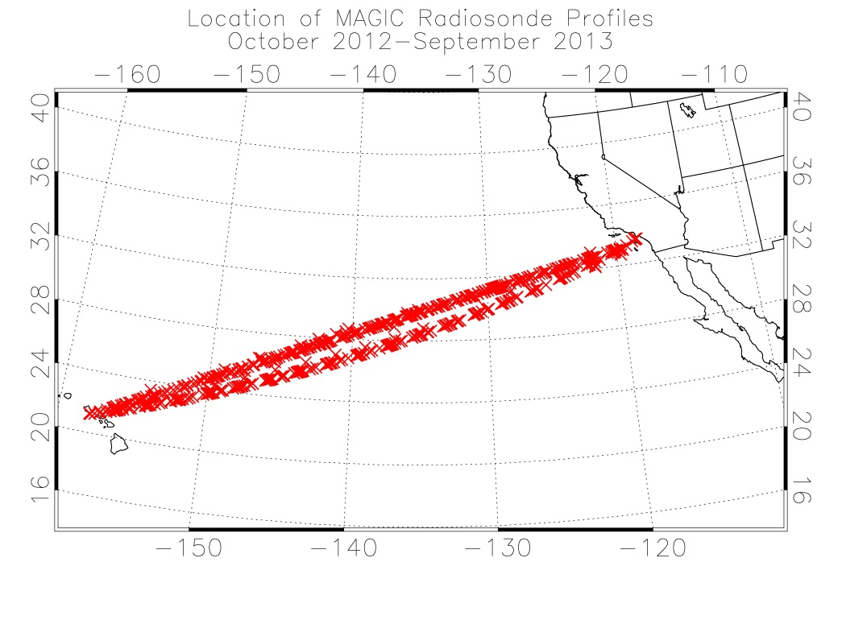
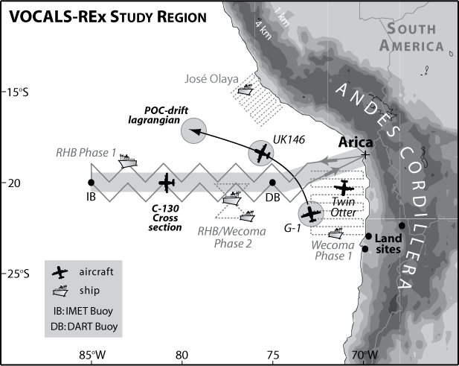
Marine Boundary Layer (Radiosonde)
Marine ARM GPCI Investigation of Clouds (MAGIC)
MAGIC
20 round trip between
Los Angeles, CA and Honolulu, HI
Over 500 radiosonde soundings
October 2012 - September 2013
q
Temp
VOCALS-REx
20º S (SE Pacific)
Over 200 radiosonde soundings
October - December 2008
VAMOS Ocean-Cloud-Atmosphere-Land Study Regional Experiment
Notes:
Marine ARM GPCI Investigation of Clouds (MAGIC) field campaign took place between Los Angeles, CA (34.0522° N, 118.2437° W) and Honolulu, HI (21.3069° N, 157.8583° W) from October 2012 through September 2013
VAMOS Ocean-Cloud-Atmosphere-Land Study Regional Experiment

Slide 5
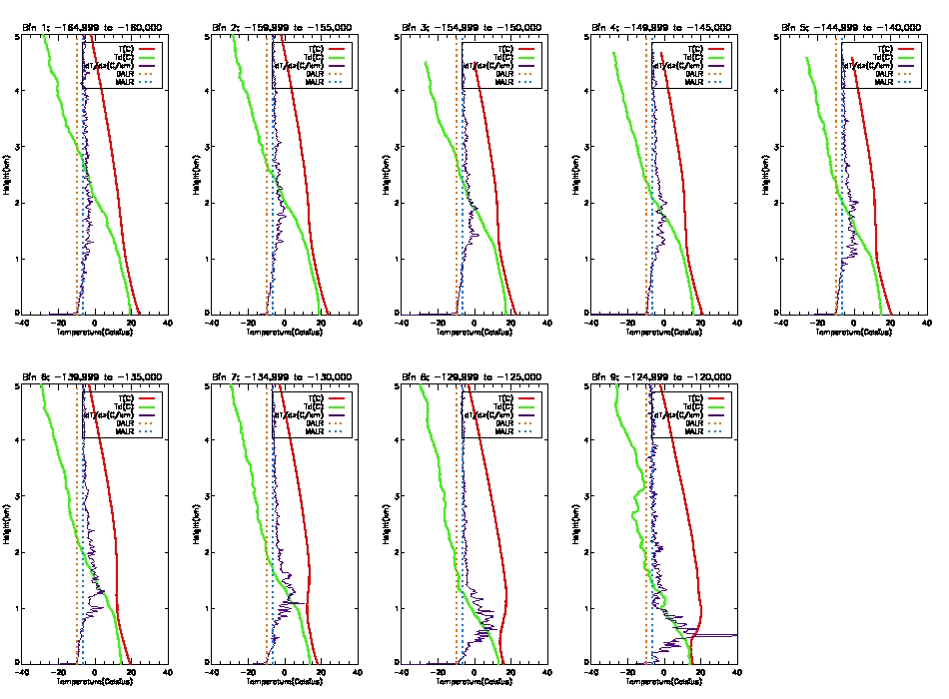
MBL Structure along the Transect – MAGIC
Height (km)
Height (km)
𝛤_{Td} =10 ∘C/km
Temperature/Dew Point (degC) / T-Gradient
Notes:
Marine ARM GPCI Investigation of Clouds (MAGIC) field campaign took place between Los Angeles, CA (34.0522° N, 118.2437° W) and Honolulu, HI (21.3069° N, 157.8583° W) from October 2012 through September 2013
5-Deg Bin (120W → 165W)

Slide 6
MBL Structure along the Transect – MAGIC
Height (km)
Height (km)
𝛤_{Td} =10 ∘C/km
Temperature/Dew Point (degC) / T-Gradient
Notes:
Marine ARM GPCI Investigation of Clouds (MAGIC) field campaign took place between Los Angeles, CA (34.0522° N, 118.2437° W) and Honolulu, HI (21.3069° N, 157.8583° W) from October 2012 through September 2013
5-Deg Bin (120W → 165W)

Slide 7
CALIPSO and MODIS-C6 Cloud Top Heights
winter
summer
CALIPSO
Dec 2012 – Feb 2013
(winter)
June – Aug 2013
(summer)
MODIS-C6
Notes:
Fig. 1. CTH from CALIPSO (Top) and MODIS (bottom) for Dec. 2012 – Feb. 2013 (winter, left) and June – July 2013 (summer, right). White line on top left panel shows the mean path of the radiosonde measurements taken during MAGIC campaign from Oct 2012 to Sep 2013.

Slide 8
CTH from Coincident MODIS and CALIPSO
MODIS C6
vs
CALIPSO CTH (single-layer, <5km)
Time:
Dec 2012 – Feb 2013 (winter, blue)
June – Aug 2013 (summer, red)
Range:
15 °N – 45 °N, 115°W – 165 °W
Notes:
Fig. 2. Comparison of MODIS Collection 6 CTH with coincident CALIPSO CTH for Dec 2012 – Feb 2013 (winter, blue) and June – Aug 2013 (summer, red) over 15 °N – 45 °N, 115 – 165 °W. (Note: only the CALIPSO observations with single-layer clouds with CTH < 5 km were analyzed.)

Slide 9
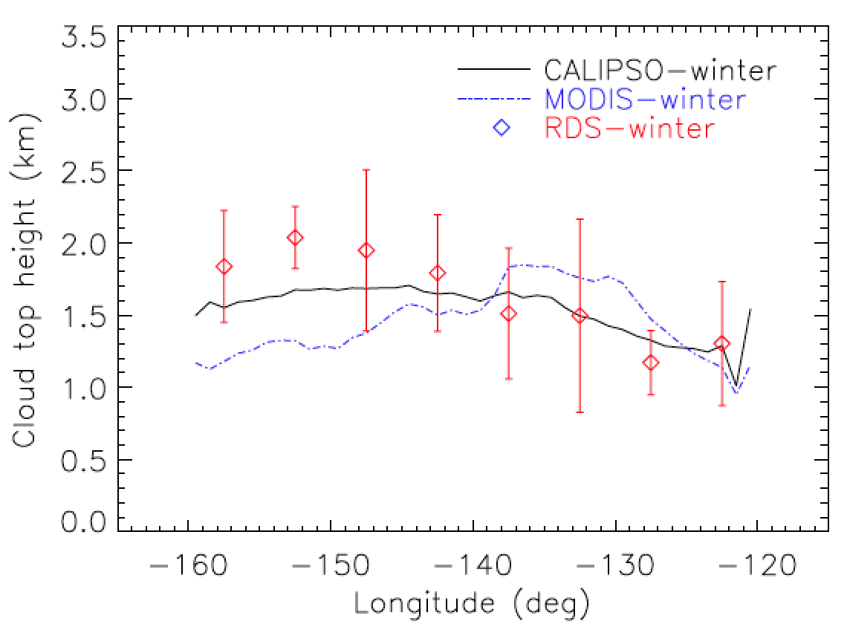
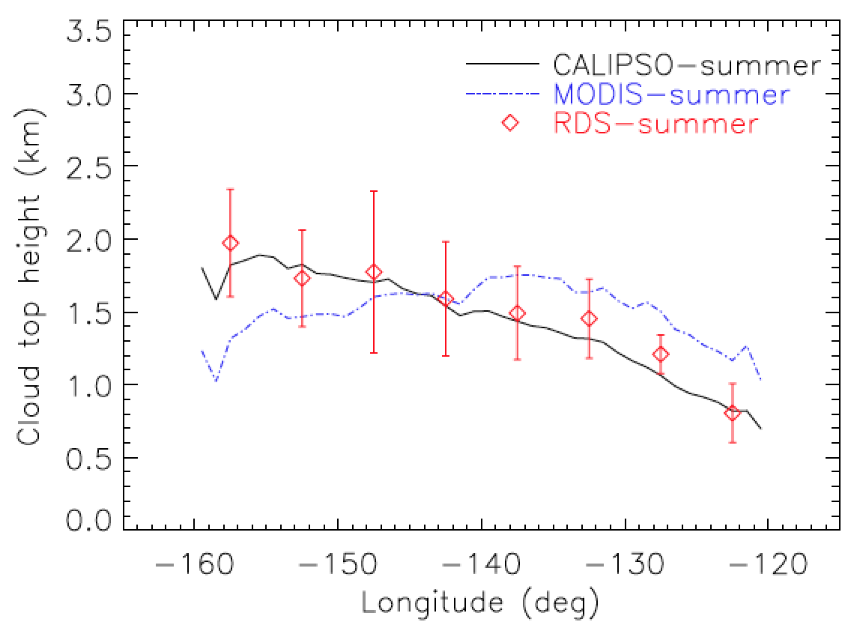
MODIS Cloud Top Height along the Transect
winter
summer

Slide 10
Low Cloud Properties
winter
summer
MODIS
Cloud Fraction
CALIPSO
Cloud Thickness
Notes:
Fig. 5. Maps of MODIS Cloud Fraction (upper) and CALIPSO Cloud Thickness (lower) for winter (left) and summer seasons.

Slide 11
MBL Lapse Rate (𝛤_{T})
winter
summer
$CTT=$ MODIS CTT
$SST =$ Sea surface temp (ERA-I)
$CTH=$CALIPSO CTH
𝛤_{T}$=−\frac{CTT−SST}{CTH}$
Notes:
Fig. 3. Maps of MODIS-CALIPSO PBL lapse rate averaged over 1° lat x 1° lon grids for winter (left) and summer (right)
Overestimate of Temp + o

Slide 12
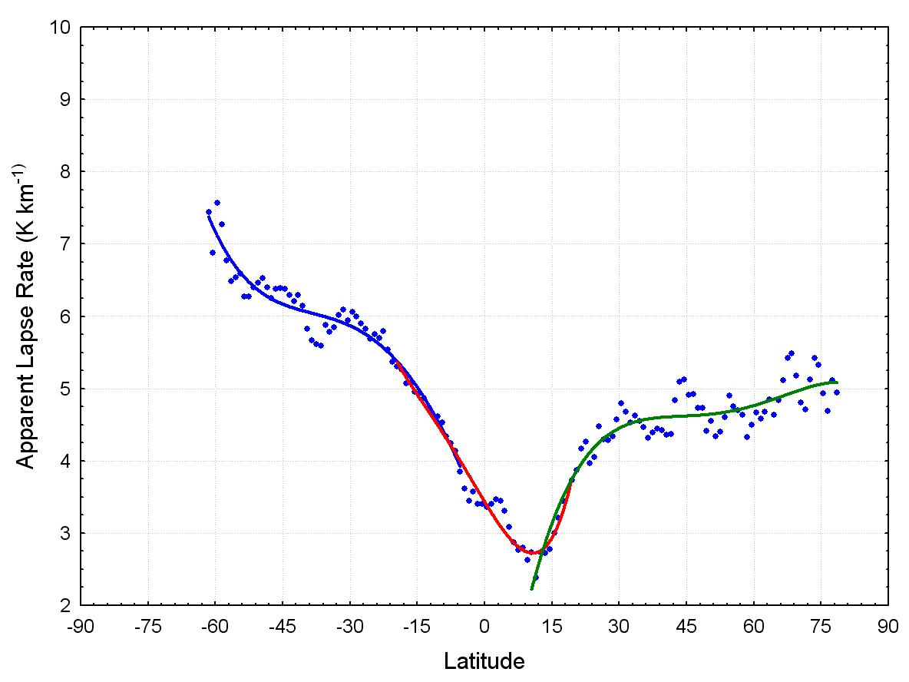
MBL Lapse Rate - Transect over NE Pacific
MODIS C6 (ATBD)
Monthly mean in Aug.
Courtesy of Richard Frey
Notes:
Fig. 4. Longitudinal variation of PBL LR for winter (blue, DJF) and summer (red, JJA) at 1° longitude bins for 15 °N – 45 °N grid.
Add: STD of LR / MAGIC LR
Figure 15: Apparent lapse rates based on 11-µm brightness temperatures as a function of latitude for the month of August. The blue points are the derived zonal mean apparent lapse rates; the blue, red and green lines are polynomial fits to the data. Three separate sets of regression coefficients are calculated: one each for southern and northern hemispheres, and one for the tropics (blue, green, and red lines, respectively). For this month, the “break points” between the three polynomial fits are at 7.8˚S and 19.5˚N latitude.

Slide 13
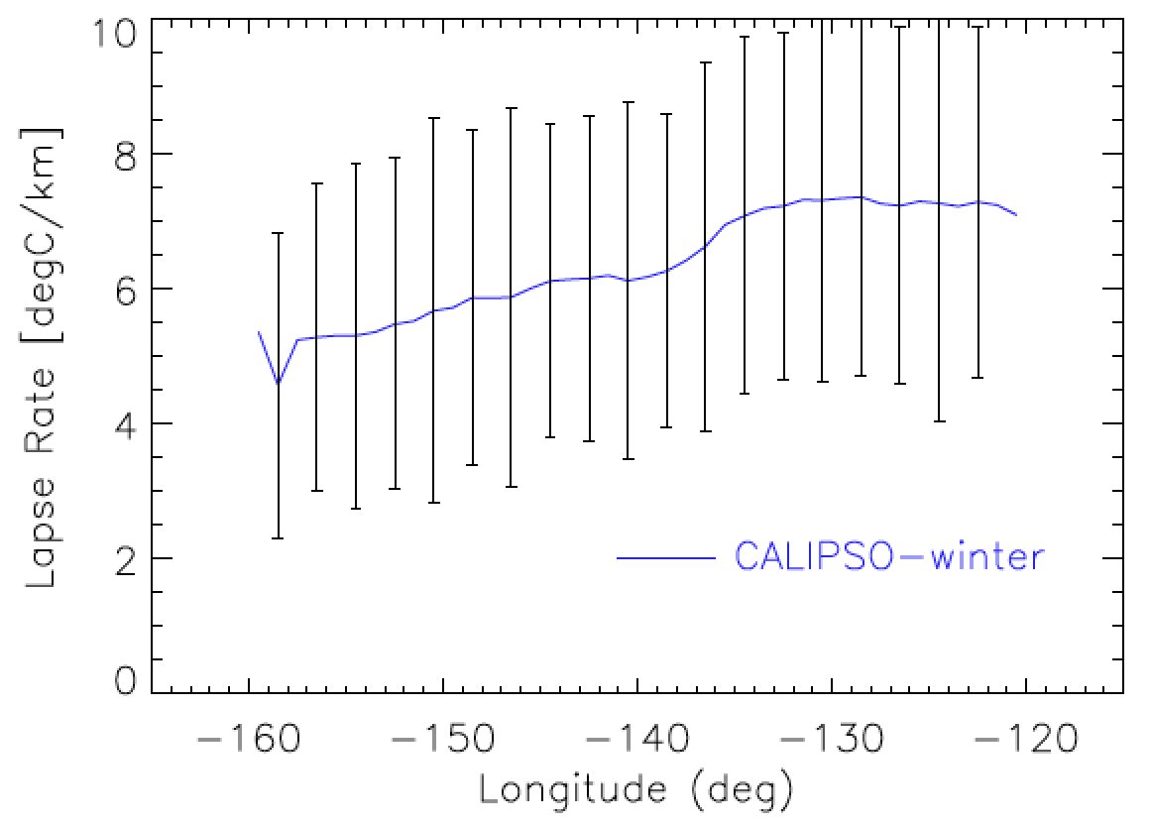
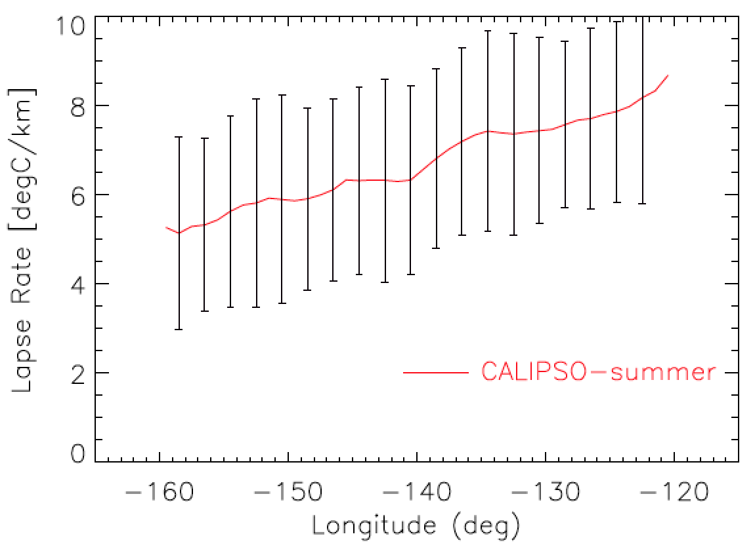
MBL Lapse Rate - Transect over NE Pacific
Notes:
Fig. 4. Longitudinal variation of PBL LR for winter (blue, DJF) and summer (red, JJA) at 1° longitude bins for 15 °N – 45 °N grid.
Add: STD of LR / MAGIC LR

Slide 14
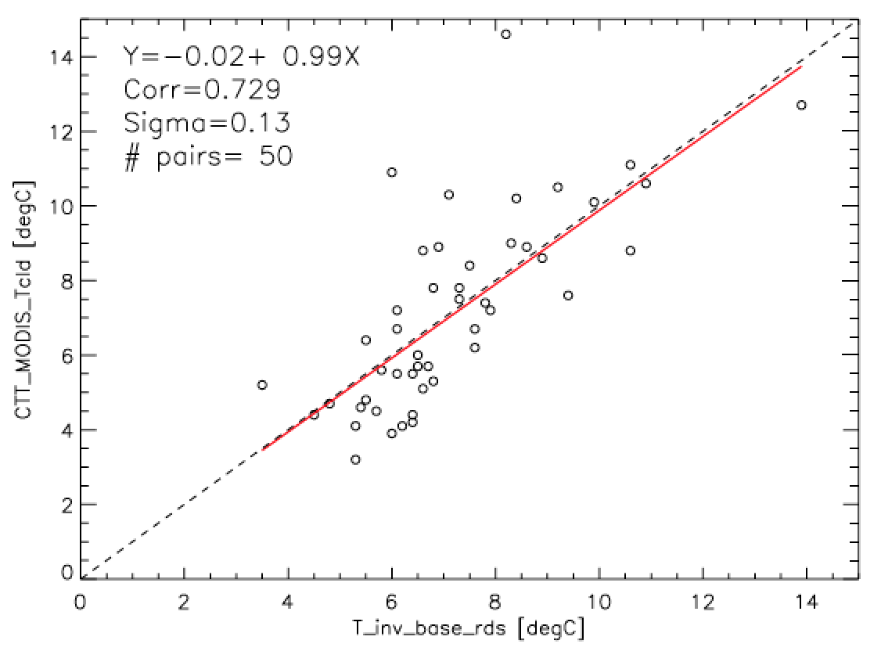
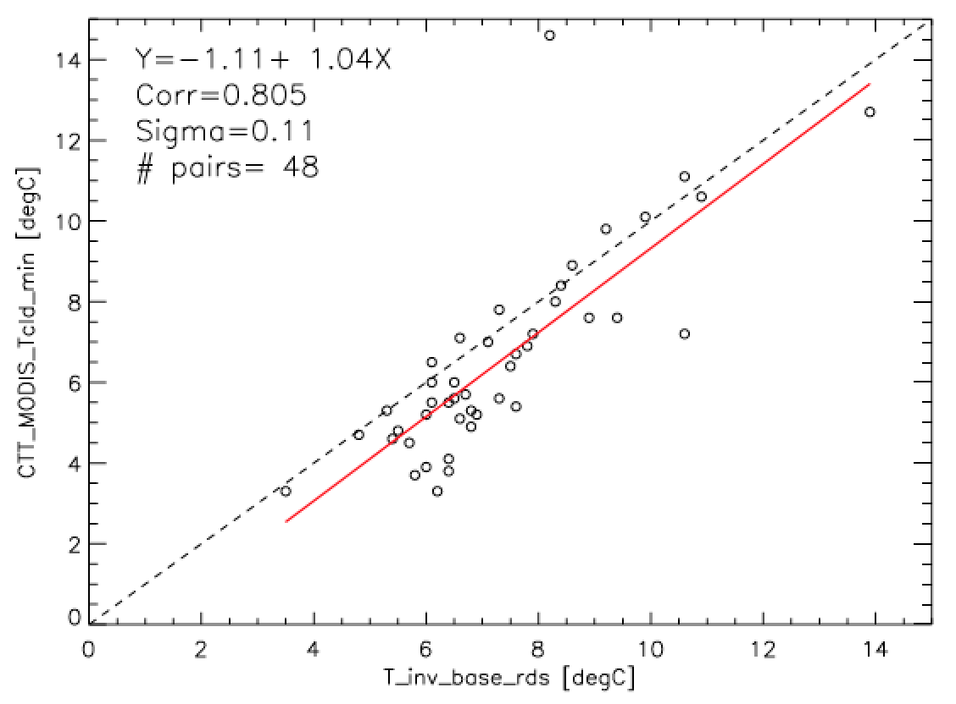
Cloud Top Temp. vs. Inversion Base Temp. (T_{IVB})
Near-Coincident MODIS vs. Radiosonde (VOCALS)
CTT – Single Footprint
CTT_{min} – 5x5 Footprint
T_{IVB} (∘C)
T_{IVB} (∘C)
CTT > 0 ∘C
CF > 90%
Near-Coincident: 300km, 3hrs
Notes:
Fig 2B: The cloud top temperatures colored based on distance from the shore (longitude)
- path for the MODIS/VOCALS near-coincident analysis results
/cloud/projects/ladhikari/TERAQ/SEP/MODIS_vocals
Output Files - MODIS_cldtop_temp_vocals_inversion_temp.txt
- header info file - readme_MODIS_VOCALS_collocated_file.txt

Slide 15
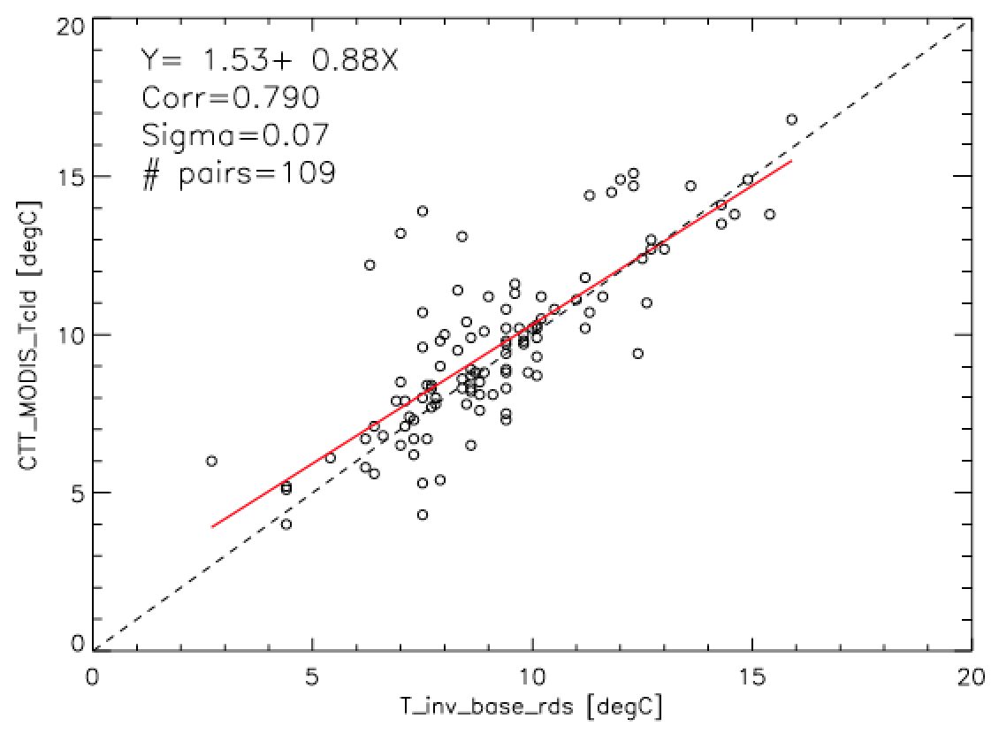
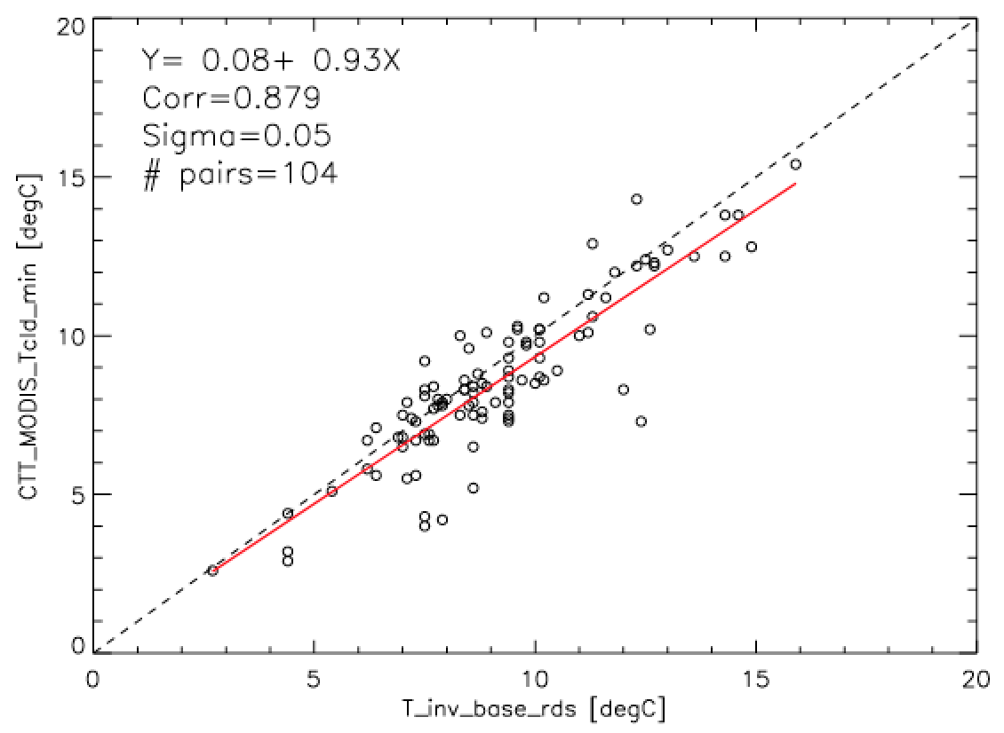
MODIS-CTT vs. MAGIC-T_{IVB}
CTT – Single Footprint
CTT > 0 ∘C
CF > 90%
Longitude [-118∘W, 140∘W]
Near-Coincident: 300 km, 3hrs
CTT_{min} – 5x5 Footprint
Notes:
Tinv_Tcld_scatter_MAGIC_cfgt0.9LonGT140

Slide 16
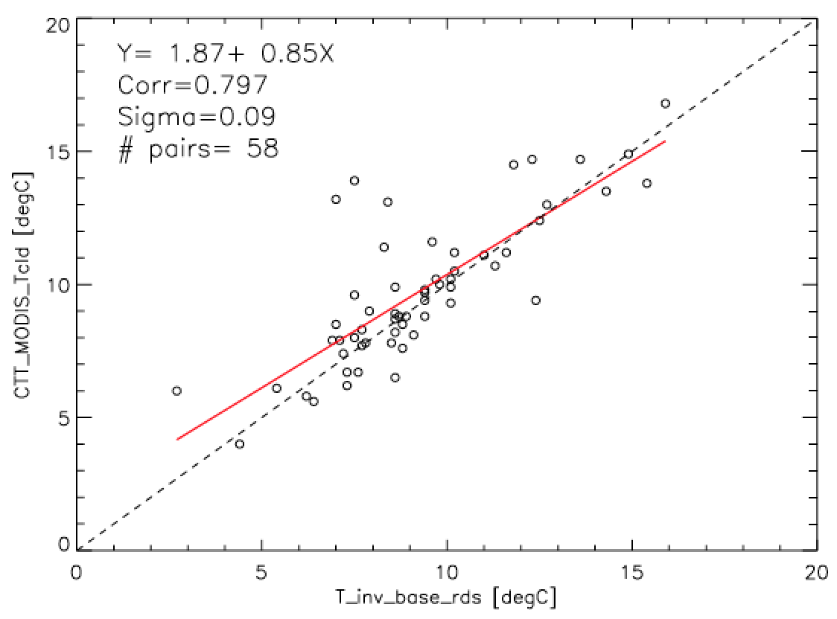
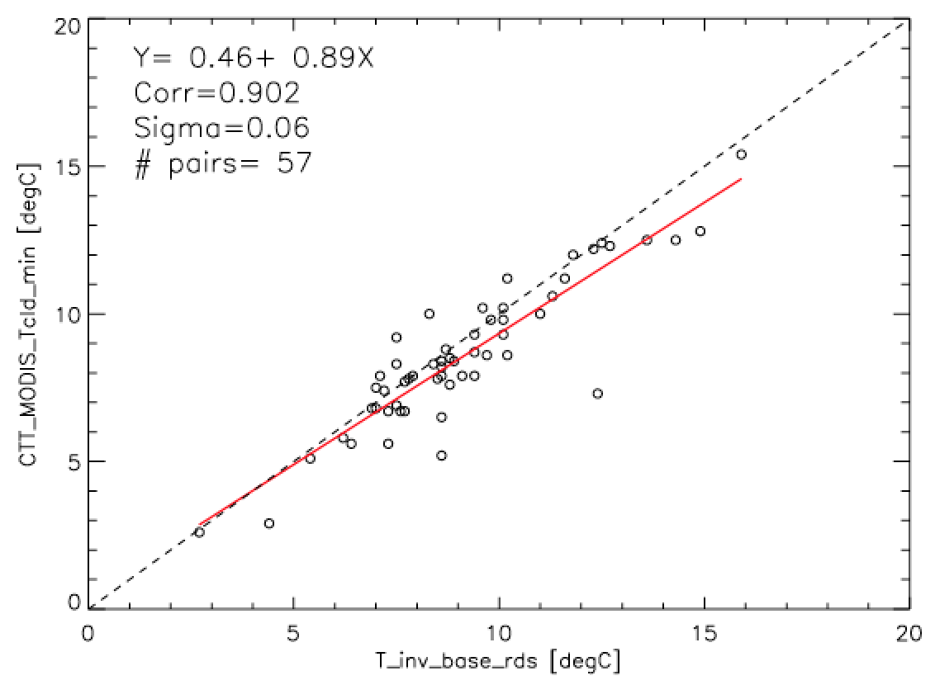
MODIS-CTT vs. MAGIC-T_{IVB}
CTT – Single Footprint
CTT > 0 ∘C
CF > 90%
Longitude [-118∘W, 140∘W]
Near-Coincident: 200 km, 2hrs
CTT_{min} – 5x5 Footprint
Notes:
Tinv_Tcld_scatter_MAGIC__cfgt0.9LonGT140dT2hrdSpace100km

Slide 17
Summary and Conclusions
MODIS Collection 6 CTH shows significant improvement over Collection 5.
CALIPSO and radiosonde observations show an increase in CTH and cloud thickness from stratocumulus near shore westward to the trade-wind regimes over the subtropical eastern Pacific.
Significant seasonal variations of LR (𝛤_{T}) and CTH are observed near shore of south California, but much less near Hawaii.
Large longitudinal variation of MBL LR from ~ 8 ∘C/km over the stratocumulus region to ~4.5∘C/km over the trade-cumulus regime. This need to be considered in the future MODIS CTH retrieval.
MODIS C6 overestimate CTH in the stratocumulus regimes likely due to the underestimated LR used in the retrieval.
MODIS C6 underestimate the CTH over higher cloud regimes such as the trade cumulus regions.
MODIS CTT measurements are highly consistent with radiosonde inversion base temperature over the overcast stratus regime but become less reliable over the broken cloud regime.
Notes:
Difference – negative value?

Slide 18
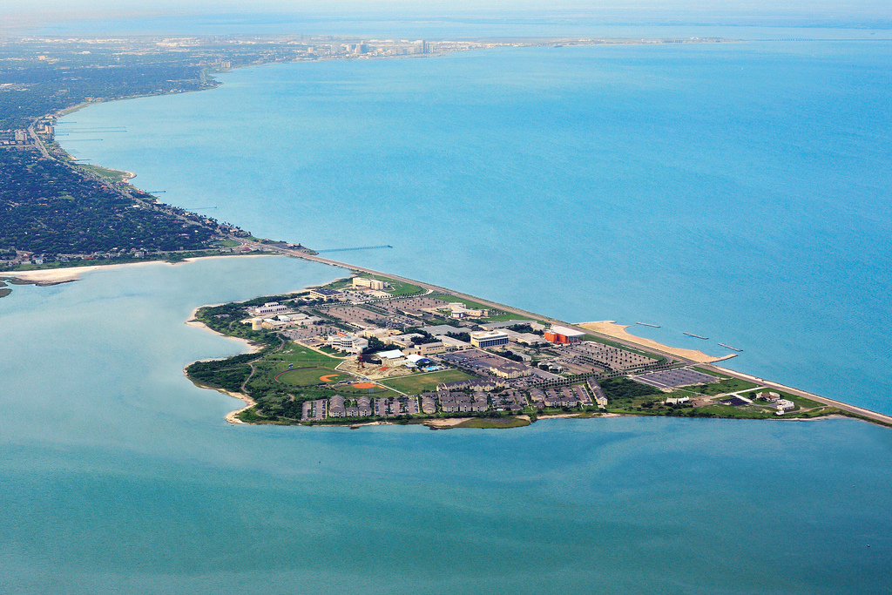
Acknowledgements
Supported by NASA-NNX14AK17G, special thanks to Dr. Ramesh Kakar.
MODIS data: L1 & Atmospheric Archive and Distribution System (LAADS) Distributed Active Archive Center (DAAC) from GSFC
CALIPSO data These data were obtained from the NASA Langley Research Center Atmospheric Science Data Center.
ECMWF/ERA-interim data
VOCALS & MAGIC (DOE-ARM) radiosonde data
Notes:
This research is funded by NASA TERAQ-NNX14AK17G. Special thanks to program manager Dr. Ramesh Kakar for the support of the project. CALIPSO data were obtained from the NASA Langley Research Center Atmospheric Science Data Center. MODIS data were obtained from the L1 & Atmospheric Archive and Distribution System (LAADS) Distributed Active Archive Center (DAAC), located in the Goddard Space Flight Center in Greenbelt, Maryland (https://ladsweb.nascom.nasa.gov/). MAGIC radiosonde data were provided by Department of Energy (DOE) ARM Data Archive.

