Slide 1



MODIS and VIIRS Instrument Status
Jack Xiong and Jim Butler
Code 618.0, NASA Goddard Space Flight Center, Greenbelt, MD 20771
MODIS and VIIRS Science Team Meeting, Silver Spring, MD (June 06-10, 2016)
1

Slide 2
Acknowledgements
Contributions:
MODIS Characterization Support Team (MCST)
MODIS Science Data Support Team (SDST)
VIIRS Characterization Support Team (VCST)
Support:
Terra and Aqua Projects, S-NPP Project Science Office (PSO), and JPSS Flight Project
MODIS/VIIRS Discipline Groups and Representatives
Terra, Aqua, S-NPP Mission/Flight Operation Teams (MOT/FOT)
MODIS and VIIRS Instrument Vendor (Raytheon)
2

Slide 3
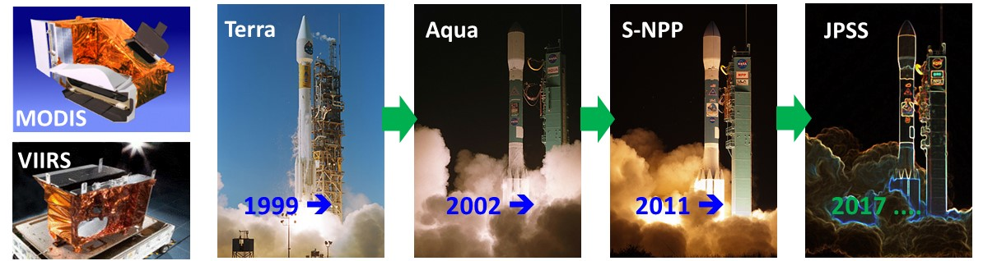
Outline
MODIS and VIIRS Highlights
MODIS and VIIRS On-orbit Performance
MODIS C5/C6 and VIIRS SDR/L1B Status (backup slides)
Future Activities
Summary
3

Slide 4
MODIS Highlights
Instrument Operations and OBC Functions – Normal
    No changes to instrument operation configuration for Terra MODIS since 2003 (currently using A-side electronics and B-side formatter)
    All B-side configuration for Aqua MODIS since launch
    Terra spacecraft (S/C) safe mode on Feb 18, 2016
      It happened on Feb 18, 2016 during a scheduled inclination maneuver when the S/C was yawed to +90° instead of the desired -90°. When attempts were made to slew it back, the edit limits were tripped and caused the S/C to enter the Safe Mode
      The S/C and all instruments were powered back on without issues after February 24, 2016 and continue to operate nominally
      Impact on MODIS: 11 (21) noisy detectors in LWIR bands before (after) safe mode; large gain changes (5-15%) in some LWIR PV bands/detectors; gain changes are relatively small (0.5-2.0%) in other spectral bands
    No new noisy detectors for Aqua MODIS since last STM
    Noticeable improvement in the control of Aqua MODIS CPFA temperatures
4

Slide 5
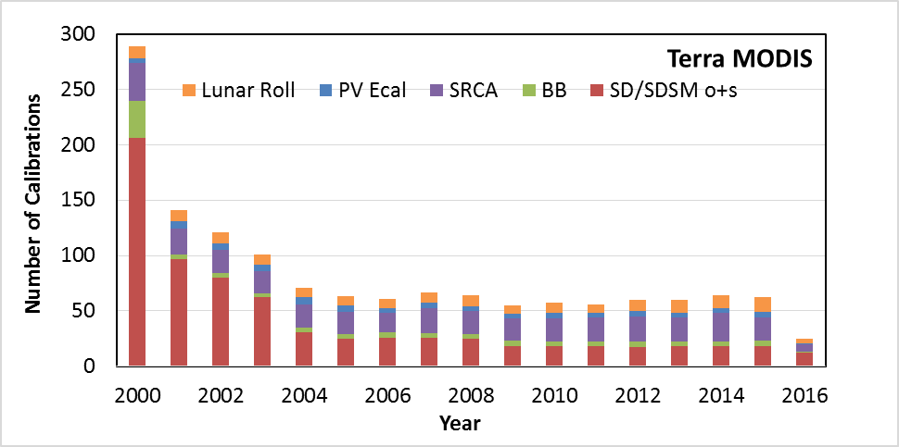
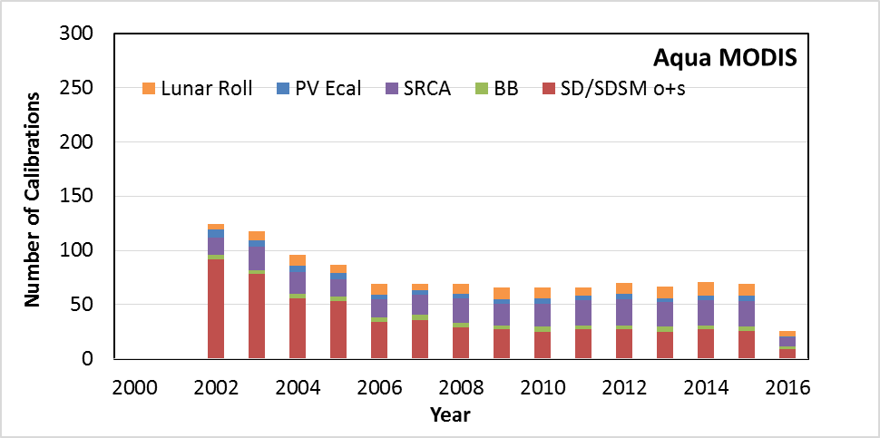
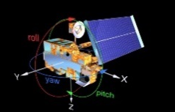
MODIS Highlights
Continuous Effort on Sensor Calibration and LUT Delivery
  Terra MODIS: C5/C6/OBPG LUT updates: 16/16/13 (19/19/18 in previous year)
  Aqua MODIS: C5/C6/OBPG LUT updates: 14/16/14 (17/16/14 in previous year)
Calibration Activities
Terra Aqua
Lunar Roll: 162 (13*) 136 (13)
PV Ecal: 92 (4) 71 (4)
SRCA: 433 (21) 315 (26)
BB: 99 (4) 61 (4)
SD/SDSM: 715 (17) 571 (35)
* (activities) since last STM
5

Slide 6
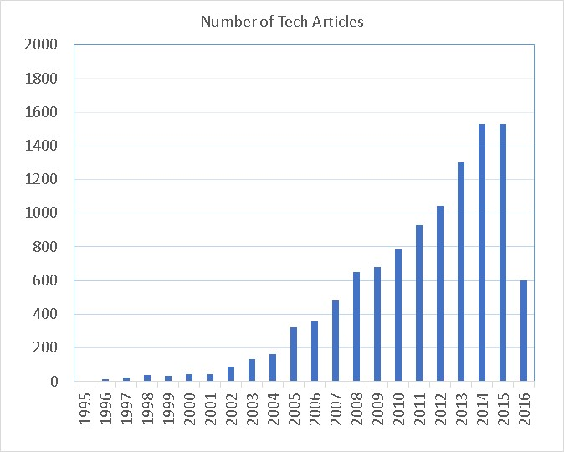
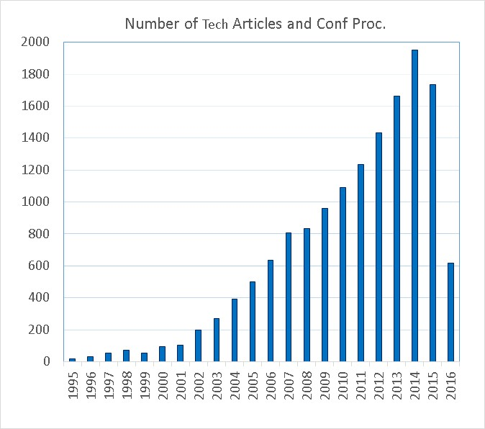
MODIS Highlights
C5/C6 Processing and Reprocessing
  Backup slides (from SDST)
MODIS Publications
  10906 tech articles and 14813 tech article and proc. combined (Web of Science)
Technical Meetings and Workshops
  MODIS and VIIRS Calibration Workshop on June 06, 2016
  Aqua MODIS CFPA Performance and Operation Review on May 04, 2016 (previous reviews in 2010, 2012, 2013, 2014, and 2015)
  Bi-weekly MsWG meetings
  Technical meetings with science groups
    Most with OBPG on LUT updates; other topics include Aqua MODIS (B1-4) RVS update strategy and Terra MODIS LWIR PV xtalk assessment
1666 since last STM
Citation: 19.1/article
2175 since last STM
Citation: 14.8/article
6

Slide 7
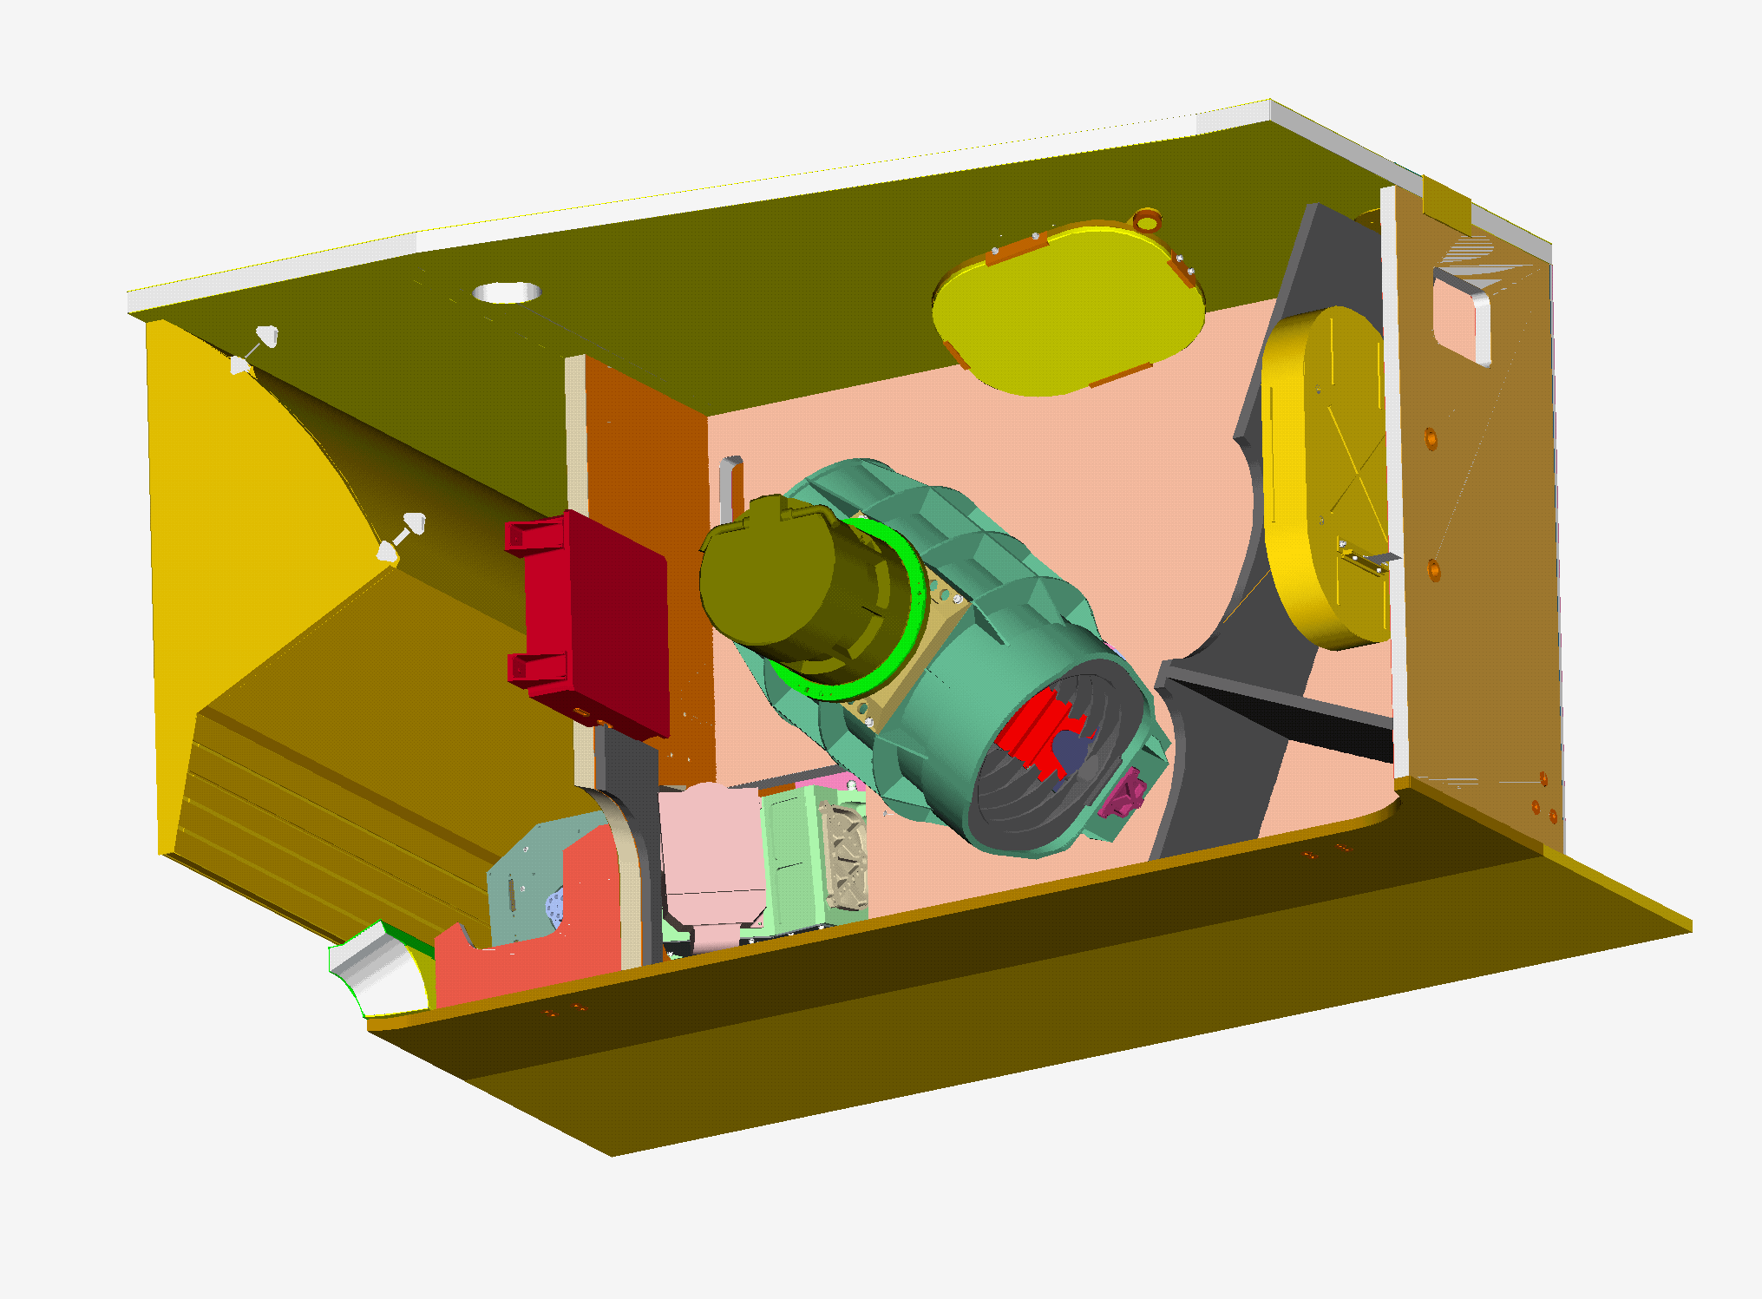
S-NPP VIIRS Highlights
Instrument Operations and OBC Functions – Normal
    Same operation configurations (B-side) since launch
    “Scan Sync Loss” between RTA and HAM: 64 since launch (2-3 min); poor geolocation accuracy
    “Petulant Mode” - the single board computer (SBC) lock-up not occurred since a FSW fix in Dec 2014 (FSW: 0x4016)
    Optical throughout degradation has nearly leveled off
On-orbit Calibration and SDR/L1B LUT Delivery
  SD calibration: each orbit; SDSM: 3 times/week
  BB WUCD: 17 since launch
  DNB: monthly VROP operation
  lunar observations: 41 since launch (not all need roll maneuvers)
  35 sets of LUTs for RSB (and DNB) delivered for Land SIPS SDR processing of C1.0 and C1.1 (Oct 2012 – present); 9 sets of LUTs delivered to Atmosphere SIPS (Nov 2014 – present)
7

Slide 8
S-NPP VIIRS Highlights
VIIRS Publications
  Total number of 264 (citation 8.4/article)
Technical Meetings and Workshops
  Regular Technical Meetings of VCST and OBPG
  VIIRS L1B Working Group Meetings
  VIIRS SDR Meetings (led by NOAA STAR)
Continues effort on L1B algorithm and LUT improvements
  POC: Fred Patt and Vincent Chiang
  Latest effort on L1 V2 SW (details in Calibration Workshop materials)
J1 and J2 VIIRS Instrument Status
  J1 VIIRS currently undergoing SC environment testing (sensor per-launch calibration performance summarized during last year’s STM and also at this year’s calibration workshop) – launch in early 2017
  J2 VIIRS recently started its ambient environment testing
8

Slide 9
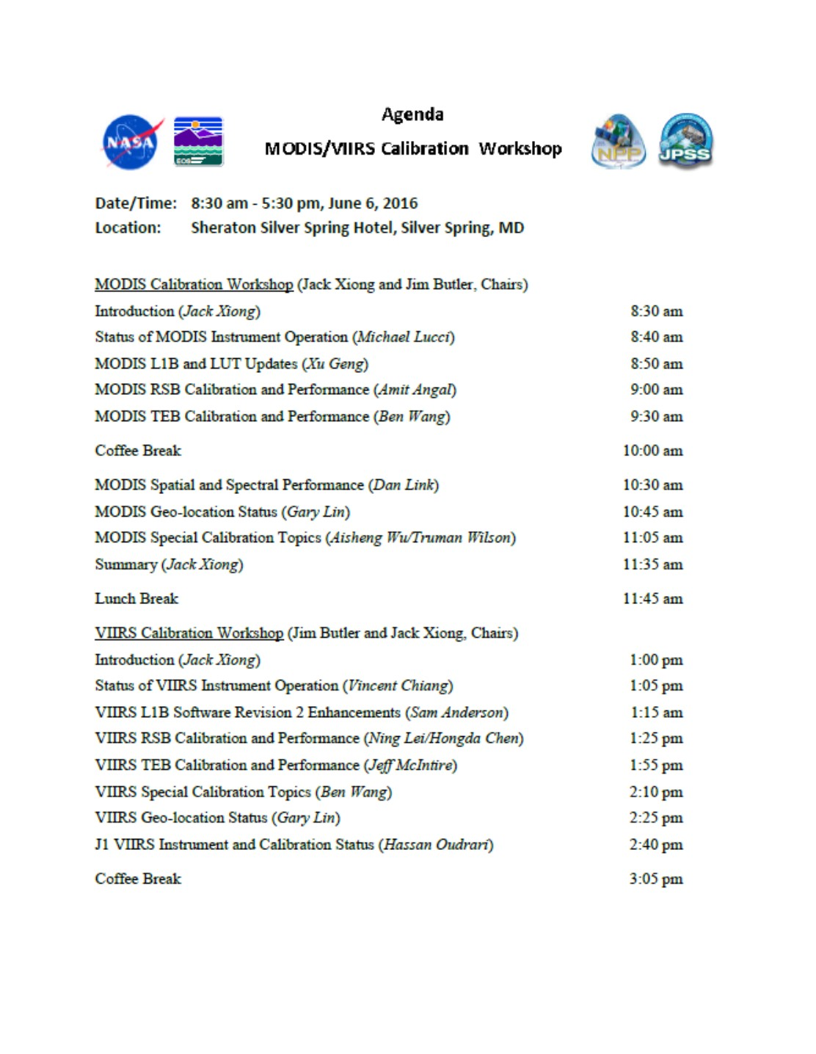
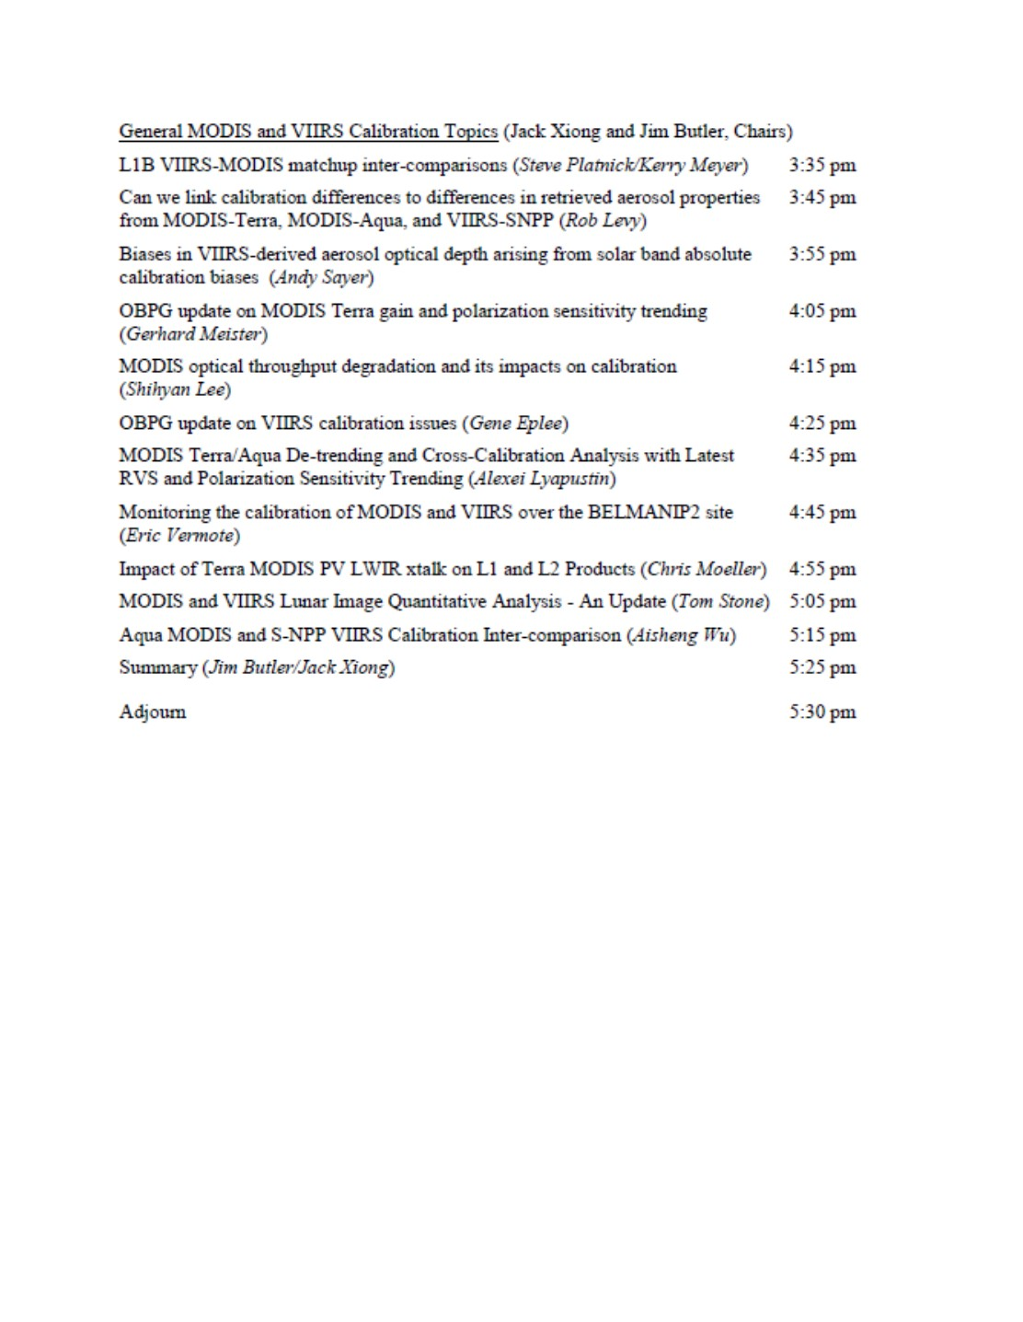
MODIS and VIIRS Calibration Workshop
24 presenters from MCST/VCST and sci. discipline representatives on a variety of topics (xtalk, polarization, calibration difference)
75±5 attendees
MCST and VCST Presentations:
ftp://mcst.ssaihq.com/pub/temp/
Available at MODIS Website after the STM
9

Slide 10
Terra and Aqua MODIS On-orbit Performance
Instrument and On-board Calibrators (OBC)
  Terra MODIS instrument, VIS/NIR FPA temperature increase: < 3.5 K; CFPA temperatures: very stable; BB temperature increase: < 30 mK: SD degradation: faster than Aqua MODIS (SD door fixed at open since 2003)
  Aqua MODIS instrument, VIS/NIR FPA temperature increase: < 2.0 K; CFPA temperatures: improved control; BB temperatures: very stable; SD degradation: slower than Terra MODIS
Radiometric
  Spectral band responses
  Detector noise characterization
Spatial and Spectral (no change since last STM)
  Band-to-band registration (BBR): continue to be stable
  Center wavelengths and bandwidths: changes are within 0.5 nm and 1.0 nm, respectively, for most VIS/NIR bands; relatively large changes for bands with broad bandwidths (bands 1, 18, 19)
Geolocation
10

Slide 11
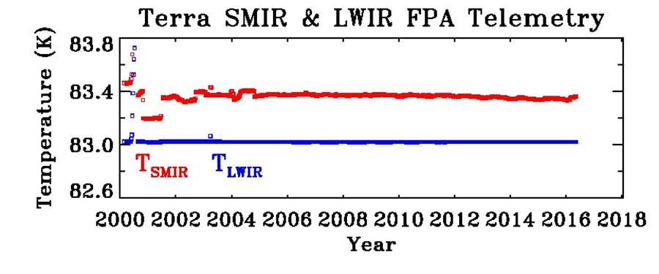
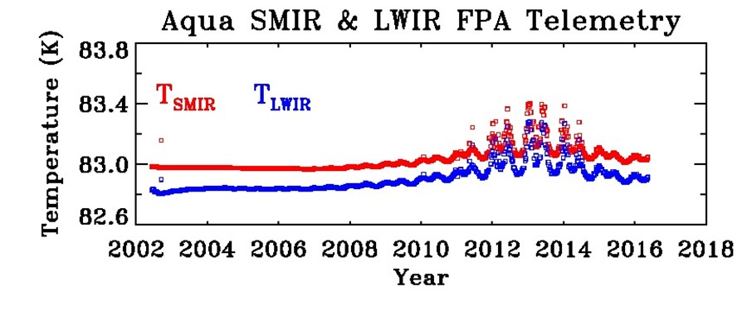
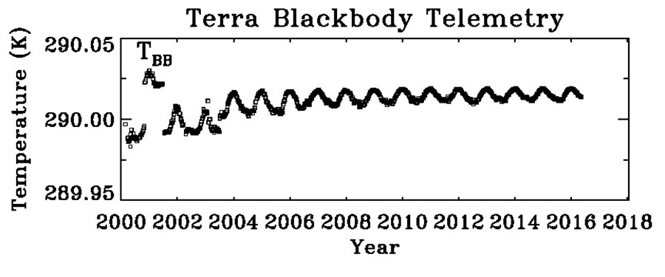
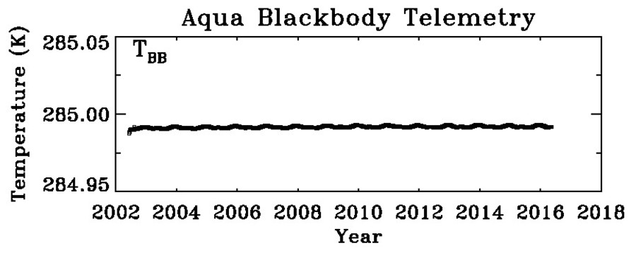
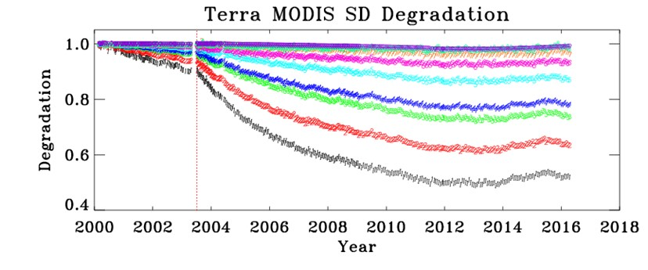
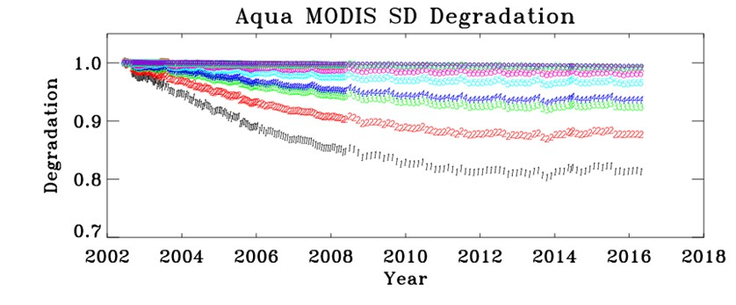
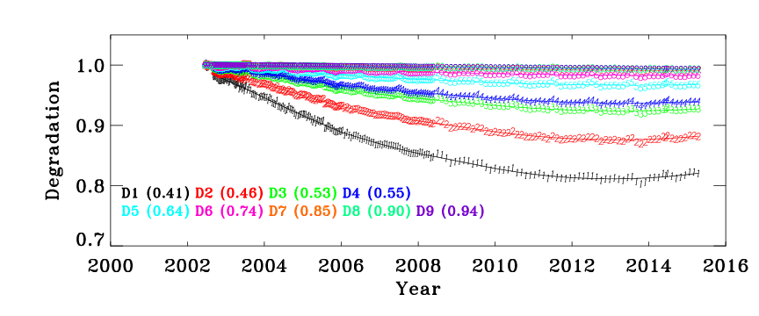
MODIS BB Temperature and SD Degradation
Excellent Stability
30 mK increase over 16 years
11

Slide 12
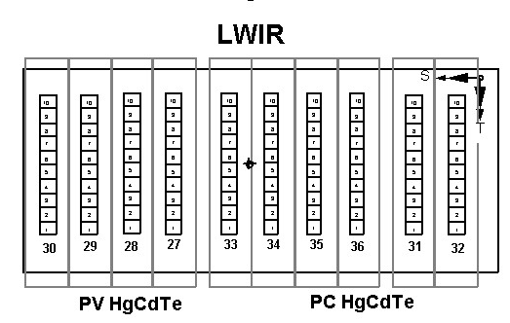
MODIS Detector Noise Characterization
MODIS: 36 spectral bands (on 4 FPAs); a total of 490 individual detectors
Terra MODIS: 53 noisy detectors (30 from pre-launch; 35 at launch) and 3 inoperable detectors (D6 in B29 D4 and D8 in B30) – 8 noisy detectors and 3 inoperable detectors since last STM
Aqua MODIS: 10 noisy detectors (2 from pre-launch; 3 at launch) and 15 inoperable detectors (13 in Band 6) – no change since last STM
Terra MODIS:
21 of the 26 noisy and inoperable detectors since launch are in LWIR PV bands
11 of the 21 occurred after the safe hold event in Feb 2016
12

Slide 13
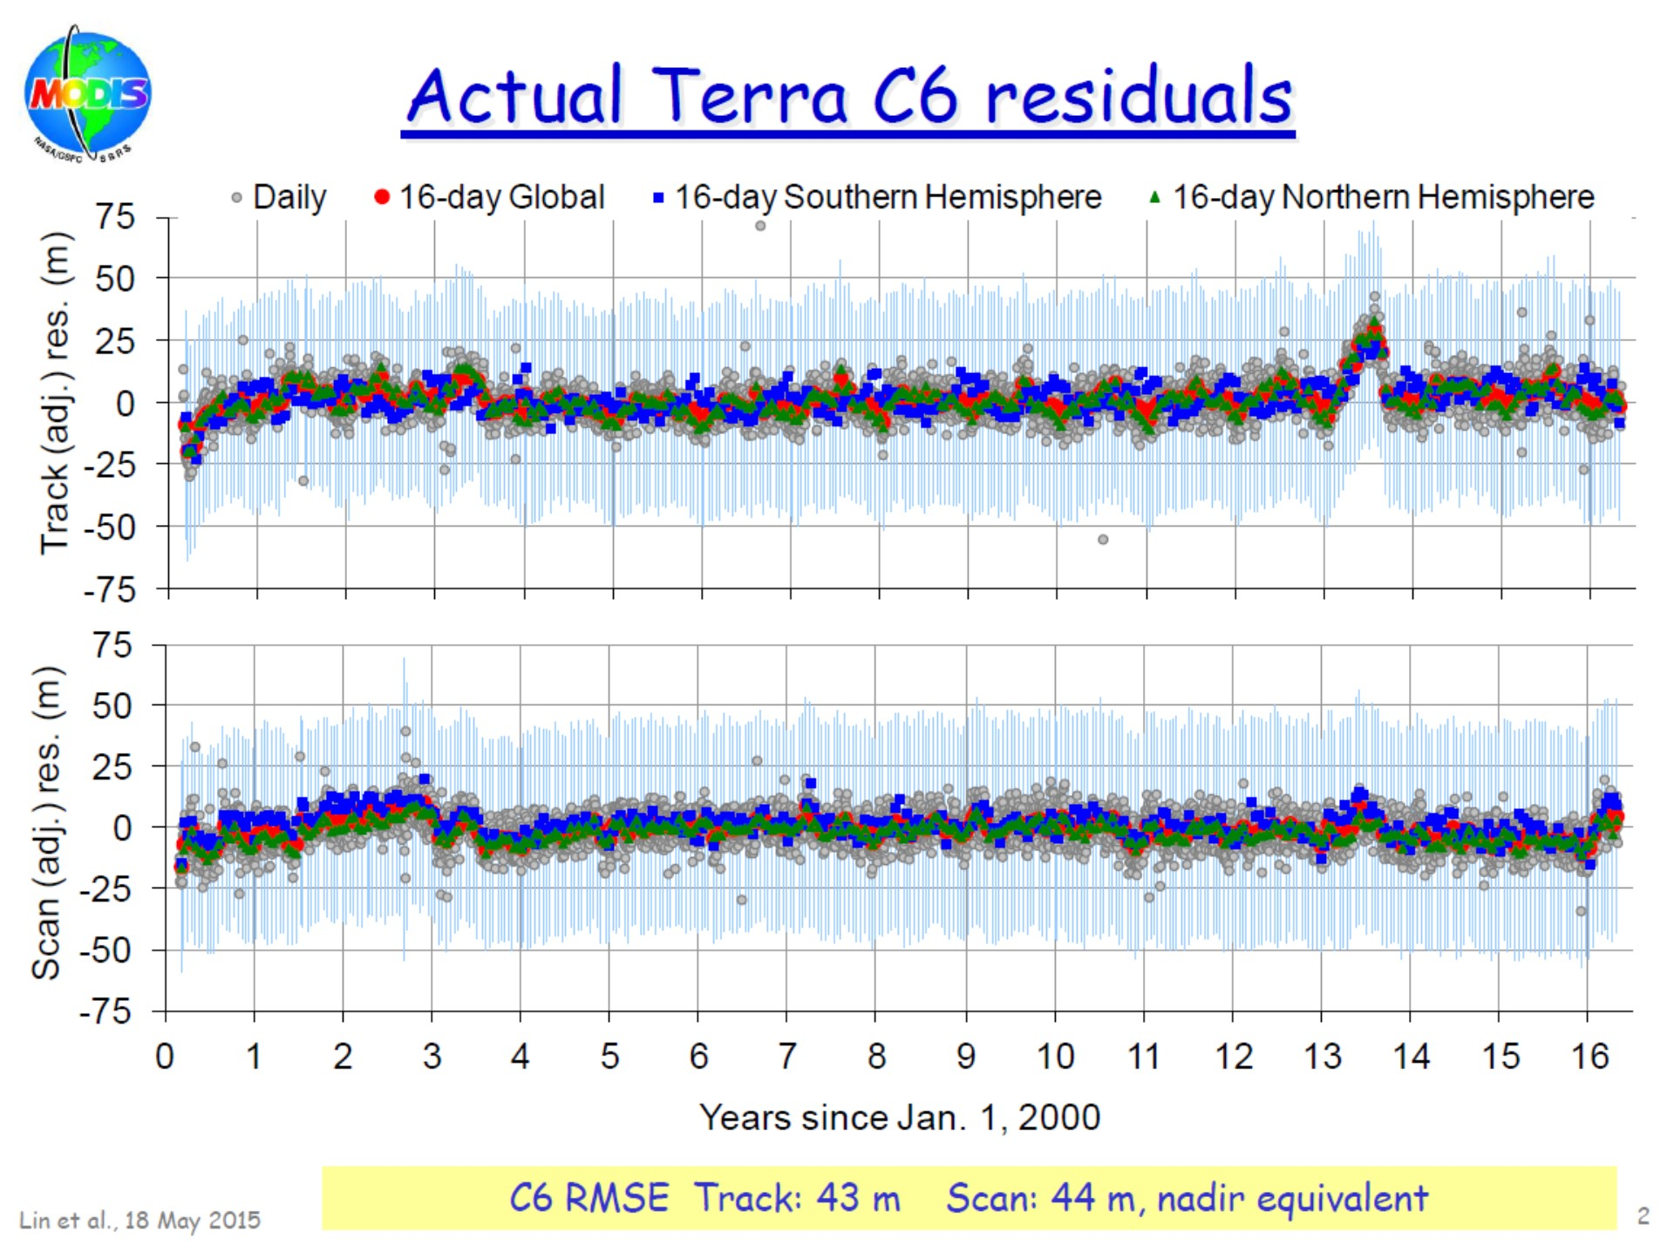
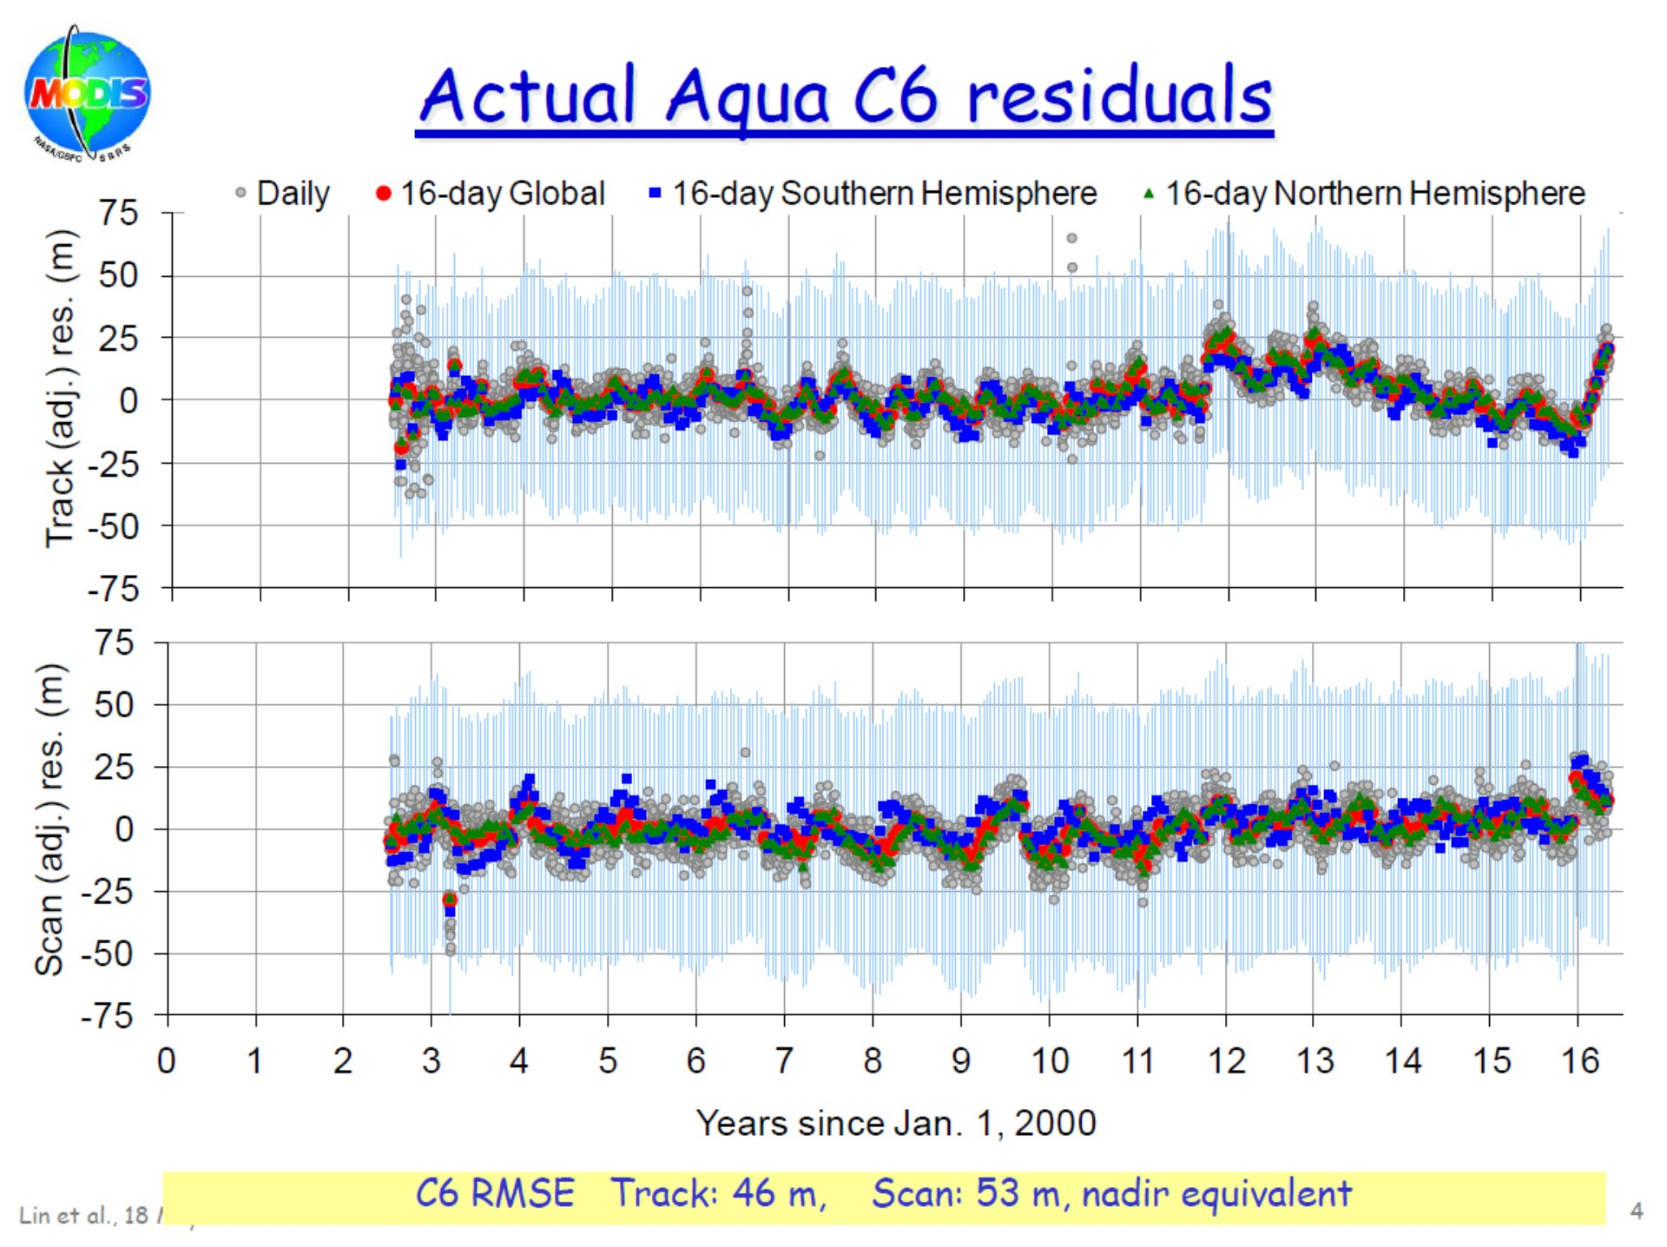
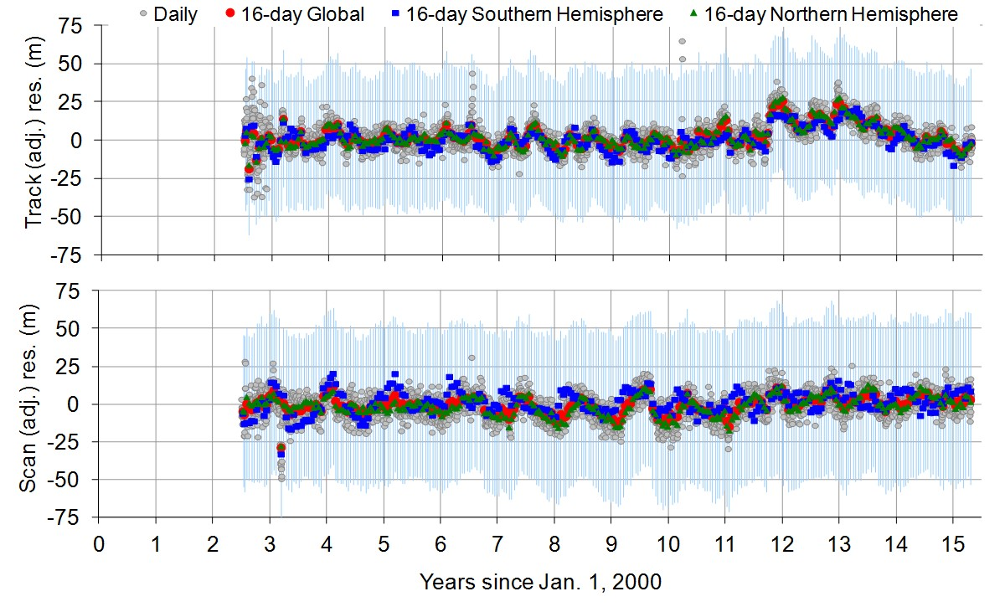
MODIS Geolocation Performance
Terra and Aqua MODIS Geolocation Performance Remains Satisfactory
(same as last year)
Terra MODIS RMSE (C6)
Track: 43 m Scan: 44 m
Aqua MODIS RMSE (C6)
Track: 46 m Scan: 53 m
Terra track direction jump - due to a delayed implementation/update of Geo LUTs (from 01/01/2013 to 08/10/2013).
Aqua track direction jump at the end of 2011 (now it’s back to “normal”) - need to model it and update the LUT.
13

Slide 14
S-NPP VIIRS On-orbit Performance
Instrument and On-board Calibrators (OBC)
  Instrument and FPA temperatures: stable
  SD degradation: relatively large (similar to Terra MODIS)
  BB stability: very stable (similar to Aqua MODIS)
Radiometric
  Spectral band responses (different from MODIS)
    Large changes in NIR and SWIR (due to mirror contamination)
    Small changes in VIS, MWIR, and LWIR
  Detector noise characterization (better performance than specification)
    Noticeable changes in NIR and SWIR are due optical throughput degradation
Spatial and Spectral
  Band-to-band registration (BBR): stable (tracked using lunar observations)
  Mirror contamination => wavelength dependent optics degradation
Geolocation
14

Slide 15
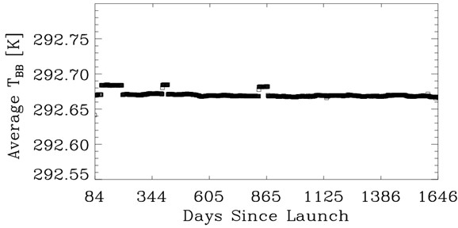
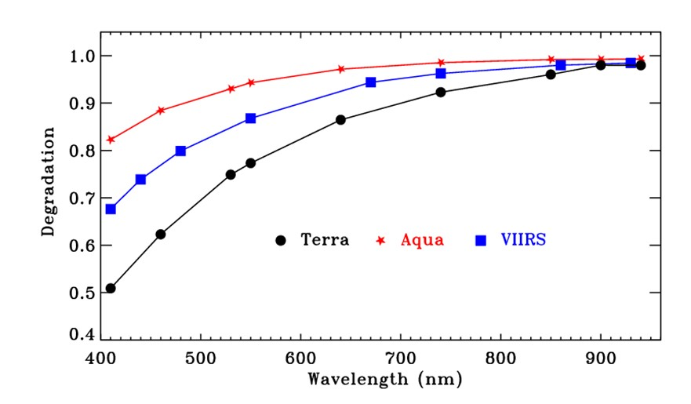
S-NPP VIIRS BB Temperature and SD Degradation
BB Temperatures
  ~15 mK offsets due to the use of two different T_{BB} settings
  Long-term stability to within a few mK
SD Degradation
Large SD degradation at short wavelength
Increased SD degradation in Terra MODIS after its SD door fixed at “Open”
VIIRS has no SD door
A-MODIS VIIRS T-MODIS
15

Slide 16
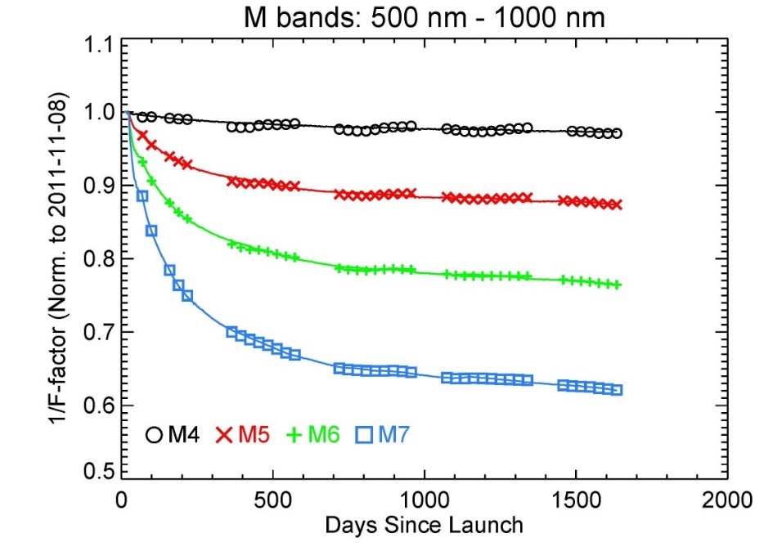
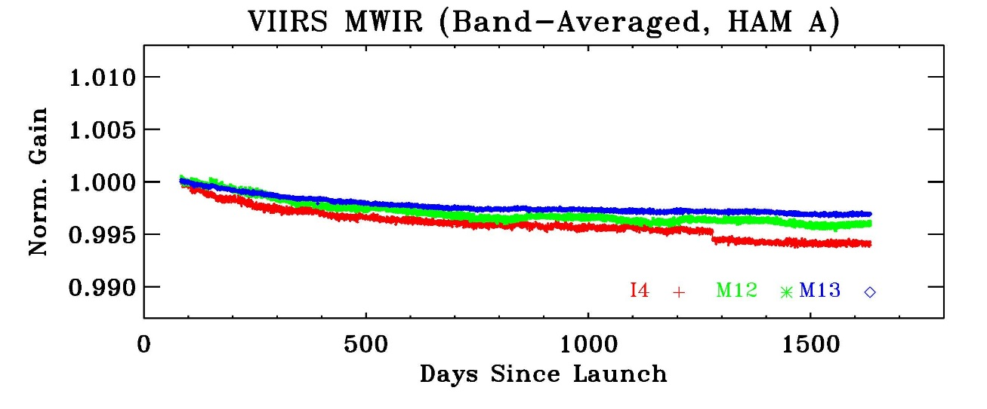
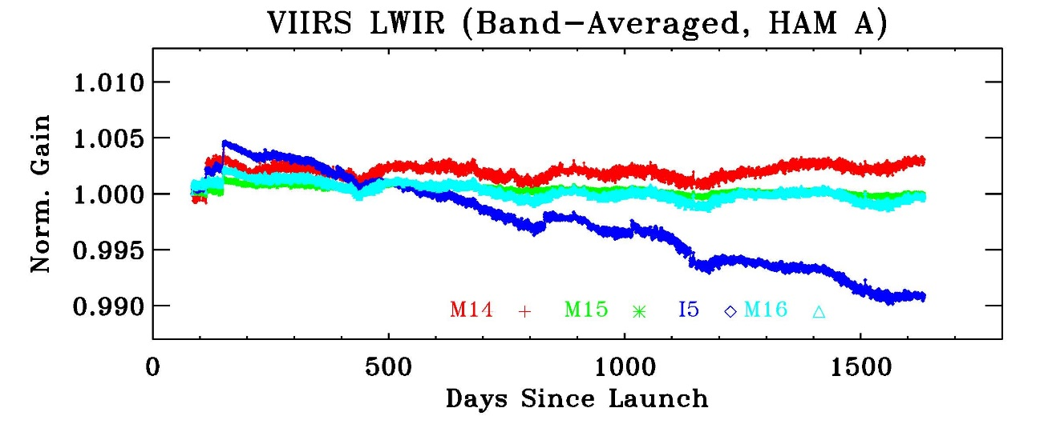
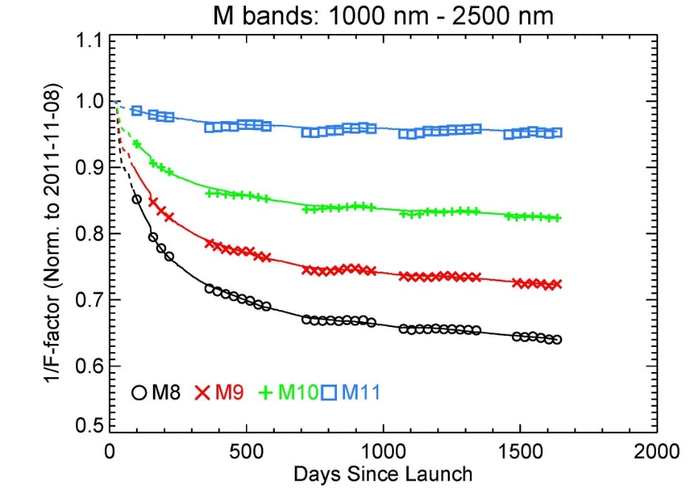
S-NPP VIIRS Spectral Band Responses (Gains)
Lunar: symbols; Solar: curves
Large changes in NIR and SWIR (due to mirror contamination)
Small changes in VIS, MWIR, and LWIR
16

Slide 17
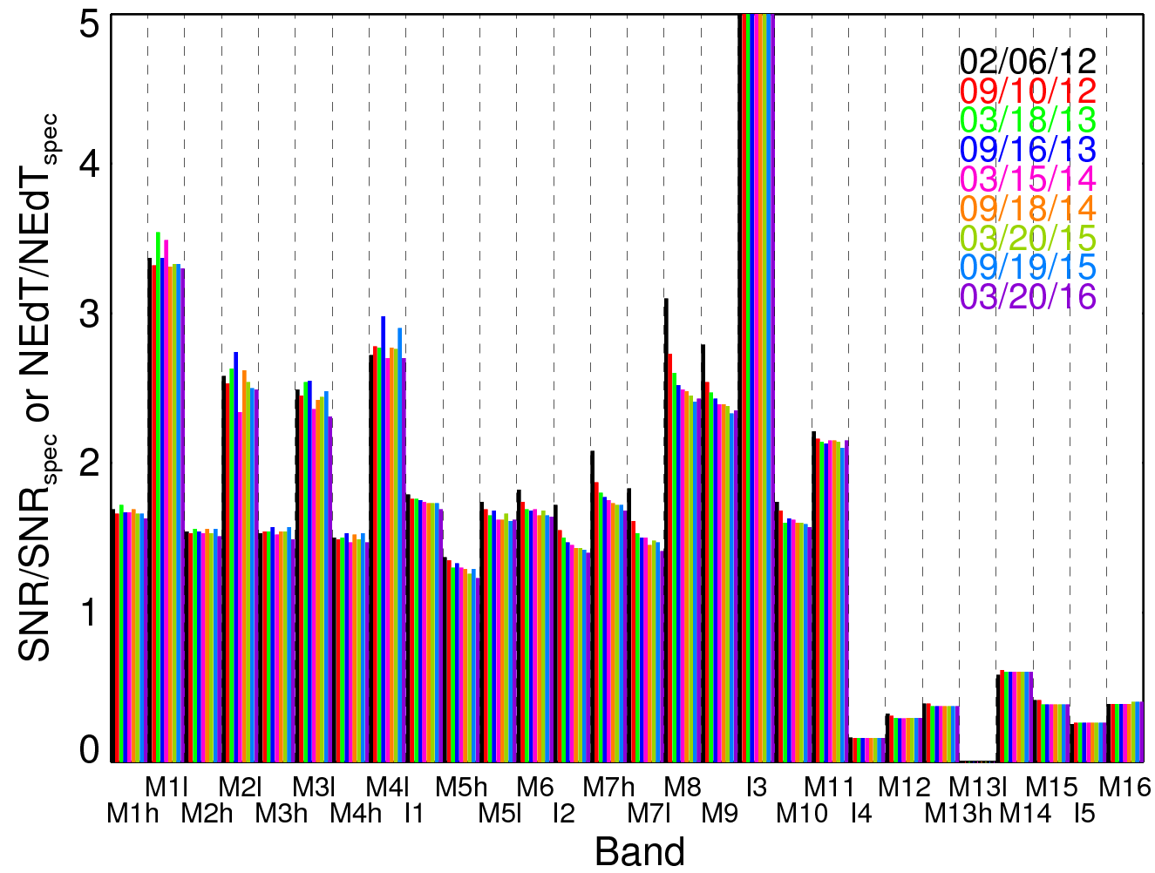
S-NPP VIIRS Detector Noise Characterization
SNR/SNR_{SPEC} > 1 or NEdT/NEdT_{SPEC} < 1: better performance
SNR for RSB
NEdT for TEB
17

Slide 18
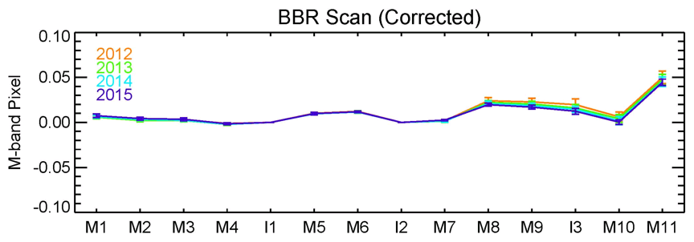
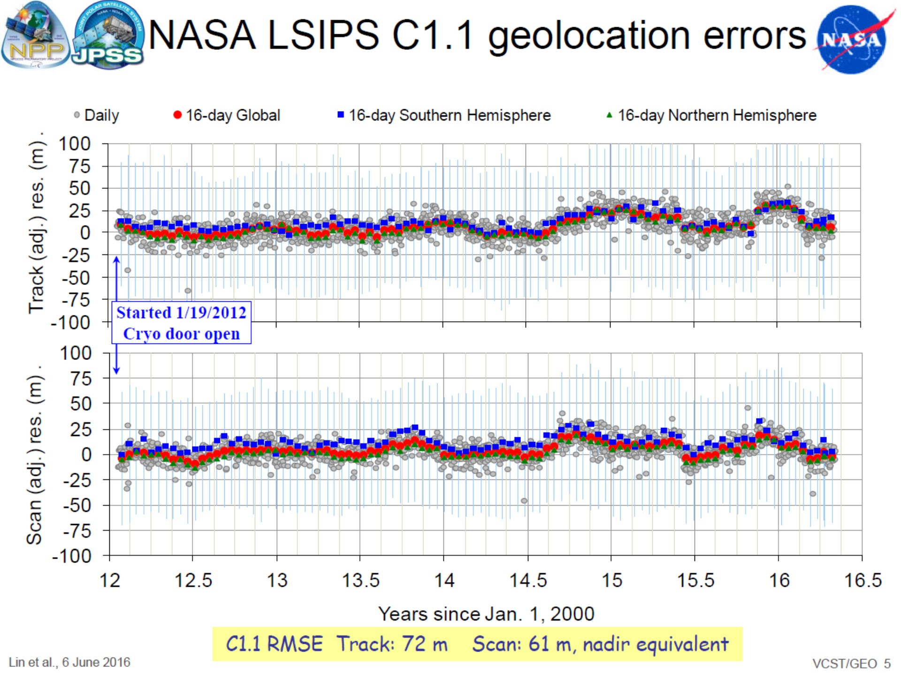
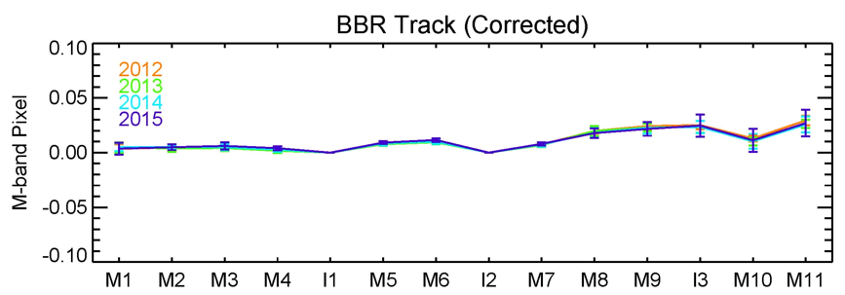
S-NPP VIIRS Spatial Characterization and Geolocation
Geolocation
S-NPP VIIRS RMSE (C1.1)
Track: 72 m Scan: 61 m
Methodology was developed for MODIS BBR characterization using lunar observations (validated using MODIS on-board SRCA)
On-orbit BBR is very stable in both scan and track directions
Terra MODIS RMSE (C6)
Track: 43 m Scan: 44 m
Aqua MODIS RMSE (C6)
Track: 46 m Scan: 53 m
18

Slide 19
Future Activities
Future work to address existing and new challenging issues in Terra and Aqua MODIS
  Changes in VIS/NIR response versus scan-angle (RVS) – continuing effort
  Changes in Terra MODIS polarization sensitivity and impact on sensor’s earth view response trending – progress has been made in recent years
  Uncertainty due to correction for large SD degradation and SD degradation correction for SWIR bands – further improvement (for more spectral bands)
  Terra LWIR PV Xtalk impact and correction – testing latest correction algorithm
  Noisy detectors and their impact on calibration – more serious in Terra MODIS LWIR PV bands
VIIRS calibration effort
  Enhanced calibration and validation effort in support of VIIRS data reprocessing and NASA L1 SW development/improvement
  Improved use of SD and lunar calibration
  Tracking potential changes in VIIRS RVS
MODIS and VIIRS calibration consistency and impact on science products
  Extensive calibration and validate effort and science support
19

Slide 20
Future Activities
J1 and J2 VIIRS calibration work
  Support to current J1 VIIRS testing in SC environment
  Support to ongoing J2 VIIRS sensor ambient environment testing
  Support to J1 launch (early 2017) and J1 VIIRS intensive calibration and validation (ICV)
Senior Review 2017
  Kick off in December, 2016
  Proposal due in March, 2017
    7th for Terra; 6th for Aqua; and 1st for S-NPP (?)
20

Slide 21
Example: Electronic Crosstalk in the LWIR PV Bands of Terra MODIS
Calibration Issues Associated with Electronic Crosstalk
  Band-to-band signal contamination during sampling among the LWIR PV bands
  False drift in the trending radiometric calibration coefficients
  Detector-to-detector differences result in image striping and overall poor quality images
  False land features observed in Bands 27-28
  False cloud detection in the Band 29 – Band 31 cloud mask due to radiometric offset
Our Approach
  Developed lunar-based and electronics based physical models and an empirical model to correct the contamination
  Derived correction coefficients for using lunar based approach for the full mission
  L1B granule testing of our coefficients show better quality images. Good removal of false features and suppression of radiometric calibration coefficient drift.
Current Issues
  Continue to monitor the impact of the safe-mode event on the crosstalk contamination
  Assess the impact of our correction on downstream science products
  Finalize our implementation and begin forward processing of the L1B granules
21

Slide 22
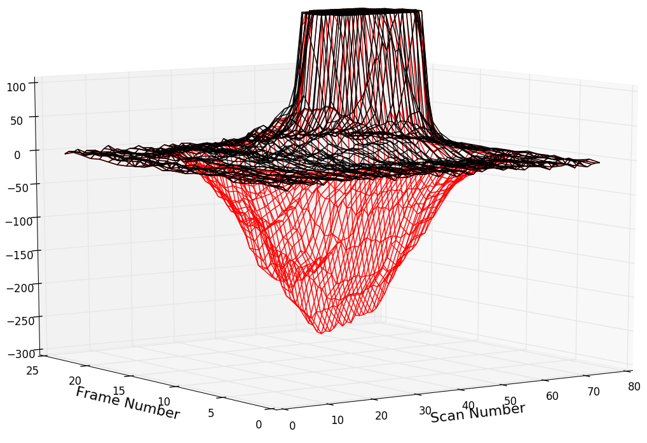
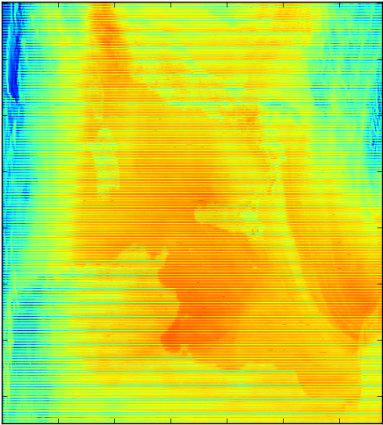
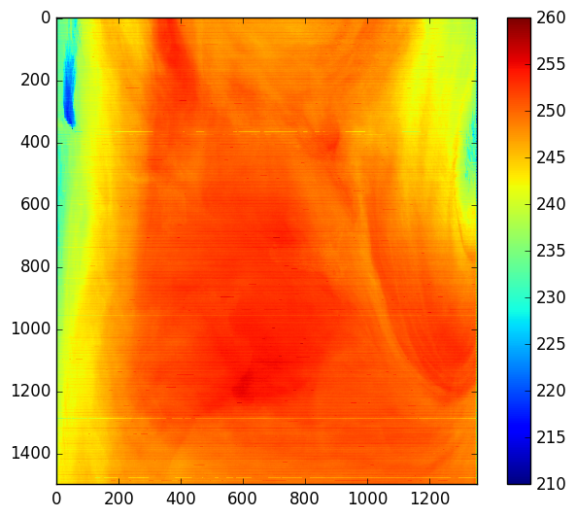
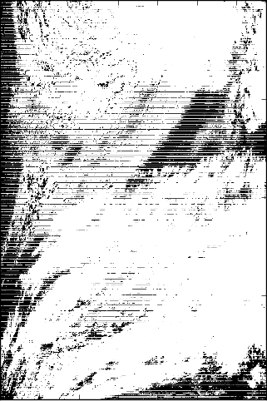
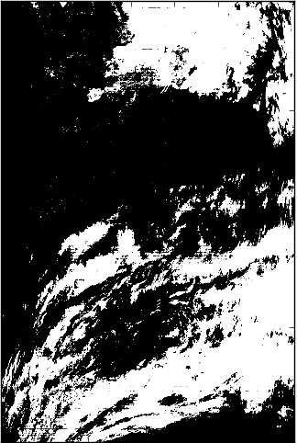
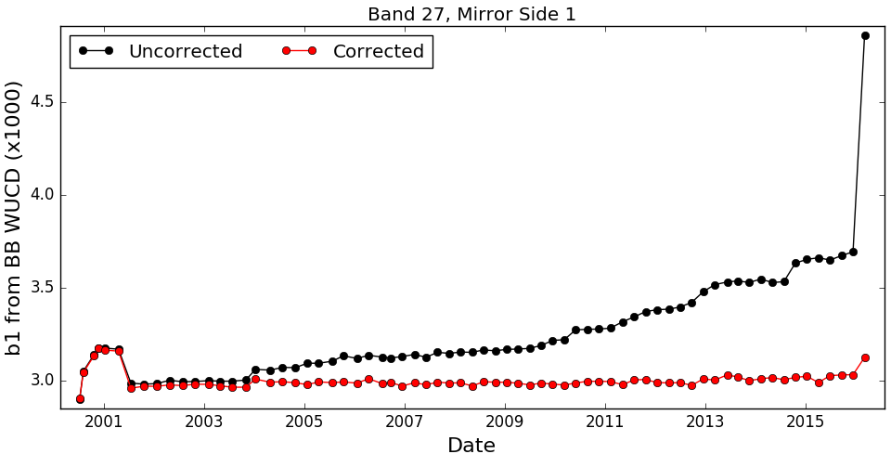
Example Corrections from the Lunar Based Algorithm
Correcting the Lunar Signal
De-striping and Land Feature Removal in Band 27
Signal limited to < 200
Band 27, Detector 1
08/04/2015
Corrected
Uncorrected
Granule 2015183.1005
BT
Removal of False Clouds from B29 – B31 Cloud Mask
Gain Coefficient Drift Correction
Terra MODIS safe-mode event, 02/18/2016
b1 averaged over all detectors
Granule 2015182.1345
22

Slide 23
Summary
Both Terra MODIS (16 years) and Aqua MODIS (14 years) and their on-board calibrators continue to operate and function normally
Dedicated effort by MCST (and SDST) and support from science algorithm developers remain critical to MODIS instrument calibration/data product quality
Challenging issues identified for both MODIS instrument calibration will be investigated and addressed for future improvements of data processing/reprocessing
SNPP VIIRS on-orbit performance (4.5 years) has become very stable
Effort from VCST is vital in support of SIPS for producing the improved and consistent VIIRS data products
Multiple and major instrument calibration activities in the coming year will be more challenging for both MCST and VCST
23

Slide 24
Backup Slides
24

Slide 25
MODIS C5 Forward Processing Status
Forward processing (C5 Land, and C51 Atmosphere) is typically 1-2 days behind real time.
The C4.1 LST (C4 code with C5 L1 input) is processed and archived at LAADS.
C5/C5.1/C4.1 processing to be continued for a year after completion of the C6 land and atmosphere reprocessing.
Products from the C5 processing are expected to be available from DAAC for a year after completion of the C6 land reprocessing. C5 processing could be discontinued in late 2016 or Spring 2017.
NRT processing (C5 Land, C51 Atmosphere and C6 Land and Atmosphere) is completed typically 2 – 2.5 hours after acquisition of data.
25

Slide 26
MODIS C6 Reprocessing Status
L1, Geolocation, and L1B
  C6 reprocessing of Terra and Aqua completed in 2012.
  Forward processing of Terra and Aqua L1B started in 2012 and is currently at leading edge.
  Terra L1B “reprocessed” in August 2014 to address trending in Band 5.
  C6 L1 Products have been available to public since late 2012 from LAADS.
26

Slide 27
MODIS C6 Reprocessing Status
Atmosphere Products
  Reprocessing of L2 products from Aqua MODIS started in Dec 2013 and completed in April 2014.
  Reprocessing of L2 products from Terra MODIS started in Oct 2014 and completed in March 2015.
  Reprocessing of L3 product from Aqua MODIS completed in April 2015, and Terra MODIS in Sept 2015.
  C6 Products have been available to public from LAADS: L2 Aqua MODIS since Jan 2014 and Terra MODIS since Dec 2014; L3 Aqua MODIS since May 2015 and Terra MODIS since Oct 2015.
Details in Reports at the Atmosphere break out session
27

Slide 28
MODIS C6 Reprocessing Status
Land Products
  Reprocessing of Tier1 block of products, including Land Surface Reflectance, Vegetation Index, LAI/FPAR, GPP, Sea-Ice, and Active Fire started in Feb 2015 and completed in Jan 2016. Forward processing of these products started in Jan 2016. These data have been released to public.
  Reprocessing of Teir1 block products BRDF-Albedo and Land Surface Temperature products and Tier 2 Snow product expected to complete in August 2016.
  C6 Algorithm changes for Teir2 block products, including MAIAC, LST from JPL, Burned Area, Land Cover and Land Cover Dynamics, VCF, Evapotranspiration, Daily Radiation and PAR, are currently under development and science testing. Reprocessing of these products will start following approval of the C6 algorithms by the product PIs.
Details in Reports at the Land Break out session
28

Slide 29
S-NPP VIIRS Land SIPS
Forward processing
  Generates the VIIRS Land L1B SDRs, L2 swath products (IPs and EDRs) using mix of IDPS OPS PGEs and Land SIPS variation of IDPS PGEs, and the L3 gridded products using the Land SIPS DDR algorithms.
  L1B SDRs are generated from processing of NASA L1A using IDPS SDR calibration algorithms.
  Products are generated in HDF4/HDF4-EOS format and are available to public from AS 3002 of LAADS. Most L2 and L3 daily products have retention period of 30 days. Some L3 daily and n-day products may be available for longer mission period.
  Products were generated using the incremental build versions from IDPS, with build version Mx8.11 in use since March 4, 2016. Land SIPS will not install any future IDPS algorithm revisions.
  Processing of data prior to April 1, 2016 used IDPS RDRs aggregated to ~5min granules. Since then Land SIPS processing has been using the 5min granules of NASA L1A generated from the NASA L0 data.
Details in Reports at the Land Break out session
29

Slide 30
S-NPP VIIRS Land SIPS
C1.1 reprocessing
  Generated VIIRS land data products from beginning of the NPP mission (Feb 19, 2012) through Jan 31, 2016.
  Included L1B SDRs, L1/L2 swath products (IPs and EDRs) generated using the Mx7.2 based IDPS OPS algorithms and Land SIPS variation of the IDPS algorithms, and L3 daily and n-day tiled products generated using the DDR algorithms based on the C5/C6 MODIS L2G/L3 algorithms.
  L1B SDRs are generated using the calibration LUTs provided by the NASA VCST.
  Products are in HDF4/HDF4-EOS format and is available to public from AS 3110 of LAADS.
Details in Reports at the Land Break out session
30

Slide 31
S-NPP VIIRS Land SIPS
V1 Processing
  Will generate the MODIS heritage VIIRS products proposed by the NASA VIIRS science team.
  L1B is generated by processing the NASA L1A using the NASA calibration algorithm and L1B LUTs provided by the NASA VCST.
  L2 and L3 products are generated using the NASA science team delivered algorithms. Science team delivered algorithms are used in the V1 forward processing and reprocessing when they are approved by the science teams.
  Algorithms for Land Surface Reflectance, Fire and Snow product are currently in science testing. Processing of Land Surface Reflectance Product suite is expected start in June 2016.
  L1/L2 products are in HDF5/netcdf4 and L3/L4 products are in HDF5-EOS format.
  Products are available to public from LP-DAAC and from LAADS.
  NRT processing of VIIRS LSR and Fire products with Session-based L0 data is completed typically about 3.5 hrs after acquisition of data.
Details in Reports at the Land Break out session
31

Slide 32
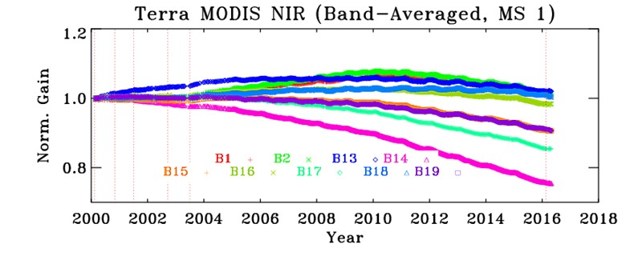
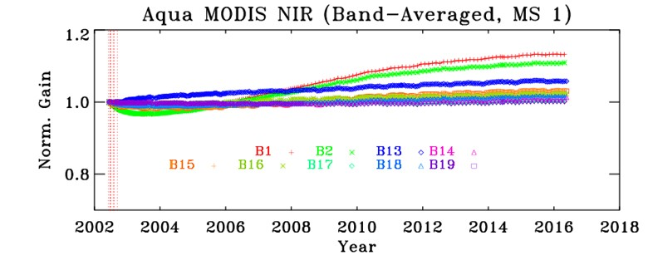
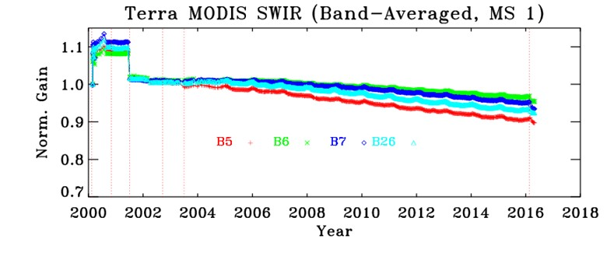
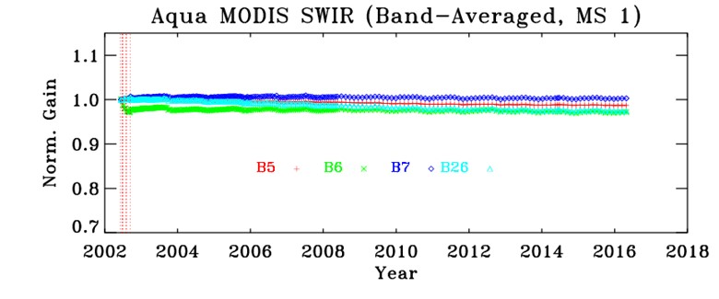
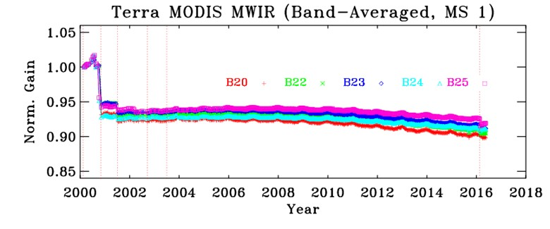
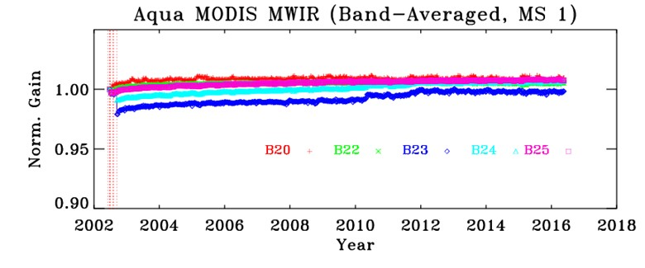
MODIS Spectral Band Responses (Gains)
32

Slide 33
MODIS Instrument Operation
☺ No Changes to both Instrument Operation Configurations and OBC fucntions since Last Science Team Meeting (details on MCST website)
Terra MODIS
Launch: Dec 18, 1999
First light: Feb 24, 2000
A-side: launch - Oct 30, 2000
B-side: Oct 30, 2000 - June 15, 2001
A-side: July 02, 2001 - Sept 17, 2002
A-side electronics & B-side formatter: since Sept 17, 2002
BB nominally set at 290 K
SD door fixed at “open” since July 02, 2003
SRCA operated with 2 10-W lamps since 2006
CFPA controlled at 83 K (briefly at 85 K: 3-5 Aug 2000)
Aqua MODIS
Launch: May 04, 2002
First light: June 24, 2002
B-side: launch - present
BB nominally operated at 285 K
SD calibration: gradually reduced frequency
SRCA operated with 2 10-W lamps since 2005
CFPA controlled at 83 K (small increase of CFPA temperatures since 2007)
33

Slide 34
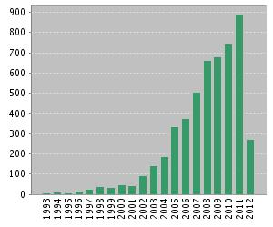
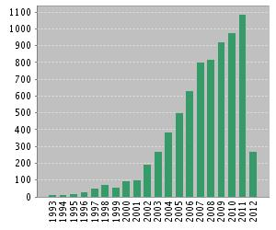
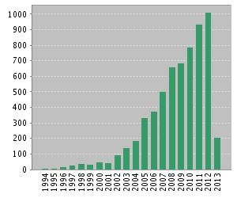
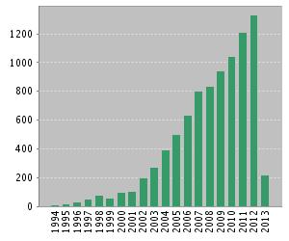
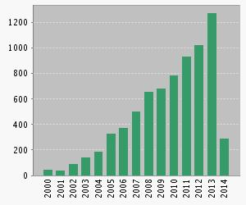
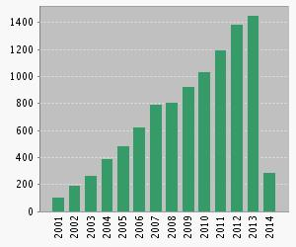
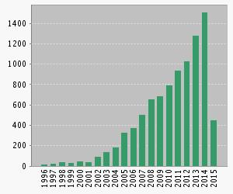
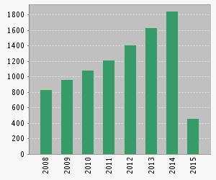
Technical Articles: 5119
Avg. Citation: 14.4/article
Tech & Proc. Articles: 7365
Avg. Citation: 10.6/article
Goggle Scholar
(05/12/2015)
NASA Hubble:
114,000
NASA MODIS:
76,500
NASA Landsat:
54,800
Technical Articles: 6176
Avg. Citation: 15.2/article
Tech & Proc. Articles: 8865
Avg. Citation: 11.2/article
MODIS Publication Metrics
Goggle Scholar
(05/31/2016)
NASA Hubble:
149,000
NASA MODIS:
101,000
NASA Landsat:
68,100
Technical Articles: 7406
Avg. Citation: 14.7/article
Tech & Proc. Articles: 10,054
Avg. Citation: 10.8/article
Technical Articles: 9240
Avg. Citation: 17.72/article
Tech & Proc. Articles: 12,738
34

Slide 35
VIIRS and MODIS Spectral Bands
1 DNB
14 RSB
(0.4-2.3 μm)
16 Moderate (radiometric) bands, 5 Imaging bands, 1 DNB
Dual Gain Bands:
M1-M5, M7, M13
7 TEB
35

