Slide 1
Nightlights-Based Assessment of Global Electricity Infrastructure and Future Emissions to Meet Growing Demand
Eleanor Stokes, Srija Chakraborty, Olivia Alexander
USRA
Yuyu Zhou, Wenru Xu
Iowa State University
Collaborators:
Jennifer Layke (World Resources Institute);
Bob Chen (CIESEN, Columbia University)

Slide 2
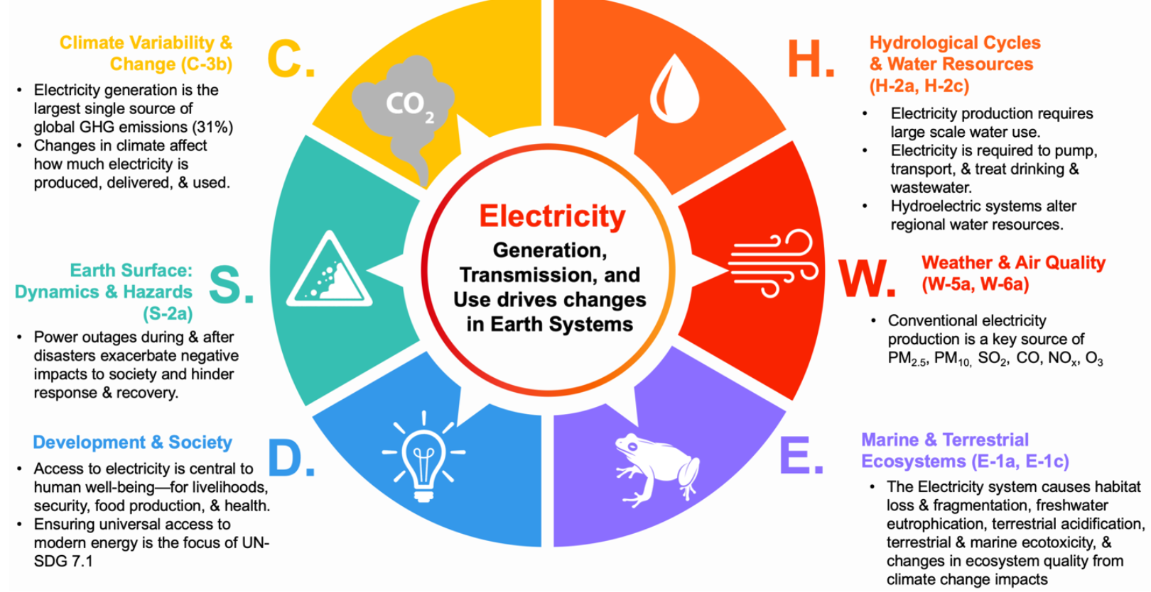
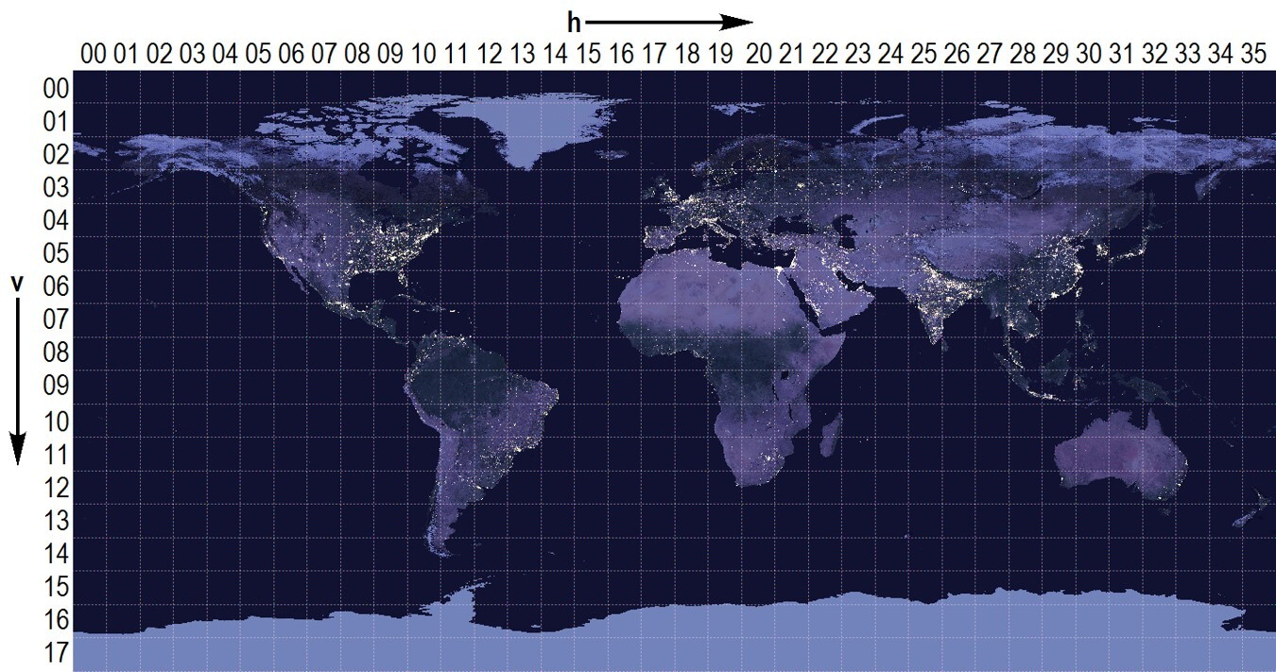
Nightlights-Based Assessment of Global Electricity Infrastructure and Future Emissions to Meet Growing Demand
Impact of electricity infrastructure development and use across different earth system components
Proposed Research
Black Marble Nighttime Lights, M. O. Román
Objective:
Assess electricity access and reliability
Assess unmet demand in low access areas
Assess how future demand over these areas will evolve under different socioeconomic and climate futures
U.S. Decadal Survey for Earth Science and Applications from Space (ESAS), E Stokes
Assess the spatial distribution and degree of electricity access deficits and explore how future electricity supply— to close those deficits and meet growing demand— will impact emissions.

Slide 3
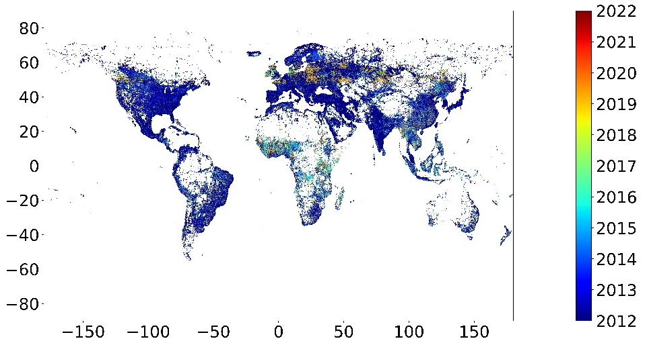
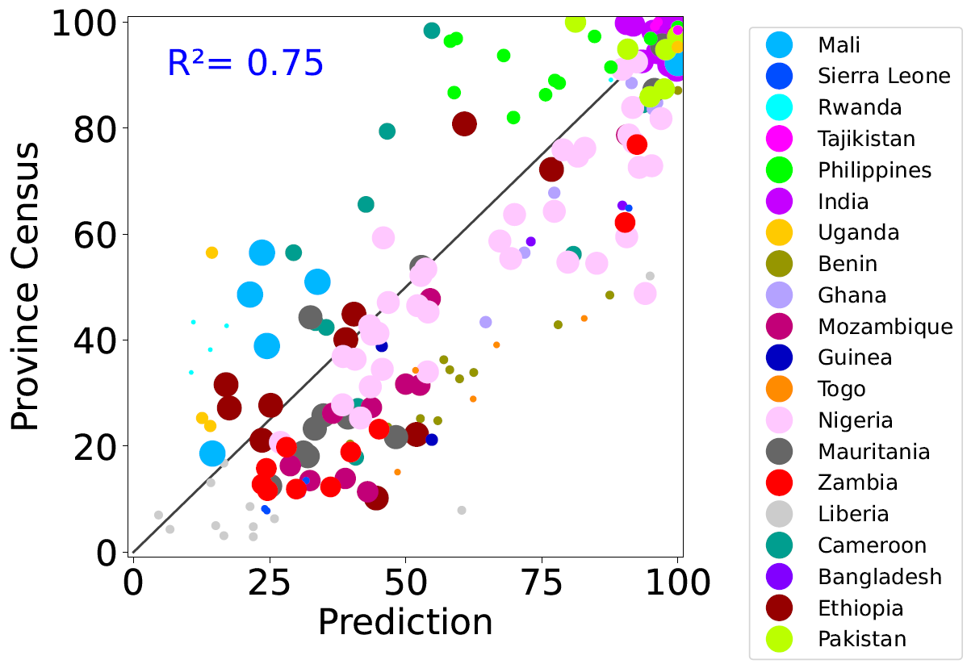
Global Electrification Estimates from Black Marble Nighttime Lights
WSF, QA Masking
NTL > $τ$ for 20% of data in 30-day windows
Black Marble NTL
Pixel-level tests of electrification
Comparison of % of population (LandScan) with electricity access to Census Estimates (USAID/DHS Program STAT-compiler)
O. Alexander
O. Alexander

Slide 4
Towards Global Electrification reliability from Black Marble Nighttime Lights and Machine learning
Training temporal dependence in NTL
$$1$$
$$2$$
….…
$$k$$
NTL of a pixel $t$
$X_{t}$:
Training over sliding windows
Similarity between NTL prediction and observation
High similarity:
no change/ reliable
Low similarity:
Likely change point/ unreliable
$$X_{w_{i}}$$
$$X_{w_{o}}$$
Trained forecasting model
$$f$$
$X_{w_{o}}$: output window
$X_{w_{i}}$: input window
Next Steps/ Outcome:
Global per-pixel estimates of electricity reliability,
power access frequency and consistency

Slide 5
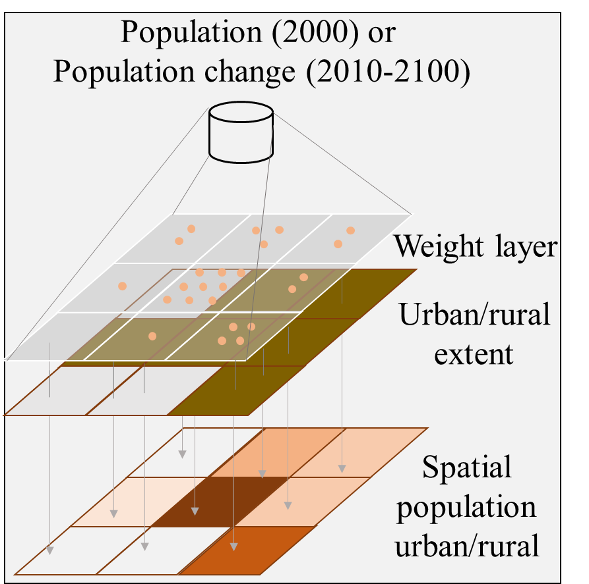
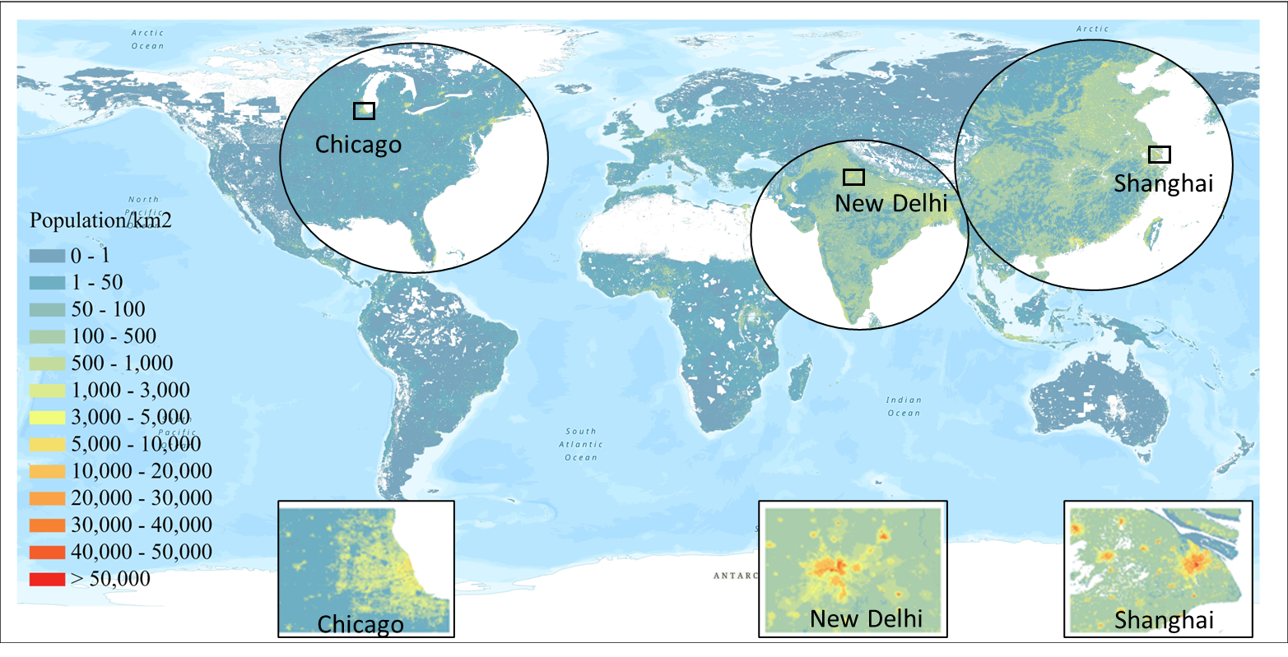
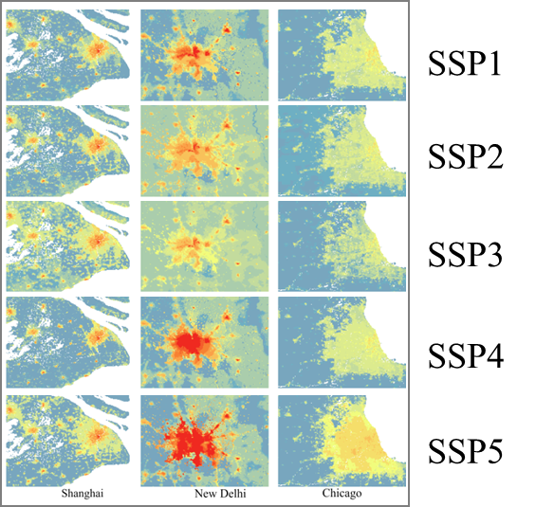
Building Energy Modeling- Global Population distribution from 2000 to 2100
Urbanization
Urban heat island
（2）Population-weighted HDD/CDD
Building energy use
Climate change
（1）Population distribution
Per capita building floorspace
Population distribution
Population distribution
2000
2010-2100
Random forest based dasymetric model
Gravity based population redistribution model
Dynamic
urban
boundary
2000
Next Steps:
Quantify annual electricity demand that was consumed, considering intermittency from NTL Reliability.
How electricity demand for low and no access areas evolve, given different socioeconomic and climate futures?
Base year
Y. Zhou, W. Xu

