Slide 1
Continuity of Terra MODIS Observation
SIPS Status
Sadashiva Devadiga
NASA GSFC
Contributions from:
SCF: Eric Vermote (PI), Jim Ray
MODAPS/STIG: Sudipta Sarkar, Carol Davidson, Rui Zhang, & Maosheng Zhao

Slide 2
Sentinel 3A and 3B: OLCI and SLSTR
Earth observation satellite developed by ESA as part of Copernicus program.
Currently consists of two satellites in operation - Sentinel-3A launched in Feb 2016 and Sentinel-3B launched in Apr 2018
Sentinel-3C and Sentinel-3D expected to follow in 2024 and 2028 respectively
Sun-synchronous polar orbiting satellites operating at an altitude of 815km at inclination of 98.6 deg
Equator crossing time is 10:00 am
Ocean and Land Color Instrument (OLCI): 68.5° field of view, nadir pointing, covers a swath width of 1 270 km, full spatial resolution is approximately 300 m.
Sea and Land Surface Temperature Radiometer (SLSTR): swath width of 1400 km at a resolution of 1km.

Slide 3
Sentinel Pilot Study – SIPS Status
L1 Status
Currently ingesting NRT and Standard NTC L1 calibrated radiance products from ESA
Standard L1 data is in LAADS archive
NRT data accessible from nrt3 and nrt4. Currently only 3-days of global data is hosted. Will size up when ready for operational processing.
Most granules are 3-min size. Granules are truncated at end of orbit, so could be much shorter.
Code Delivery Status
Science processing code for Corrected Reflectance from L1 SLSTR and OLCI delivered
Testing Integration Status
OLCI CR successfully integrated and tested using standard and NRT samples. Production ready code (PGE) is now in science testing
SLSTR CR code in integration testing, science code currently being updated to production PGE
Production Status
Daily ingest of NRT L1 in progress
Operational processing of OLCI & SLSTR CR – expected late May 2023

Slide 4
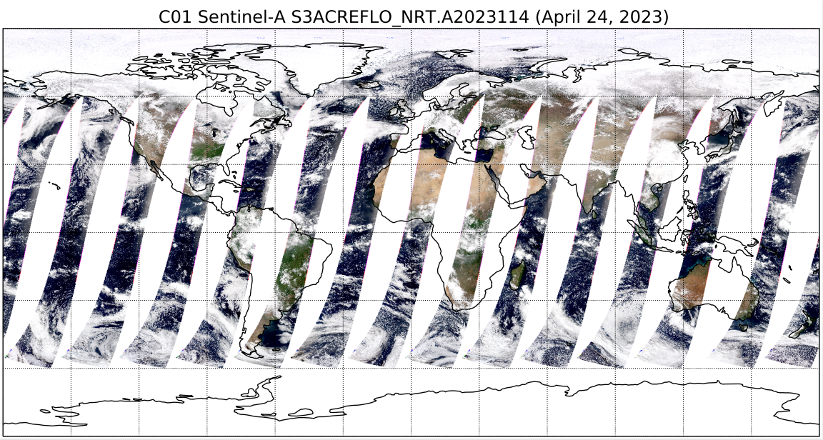
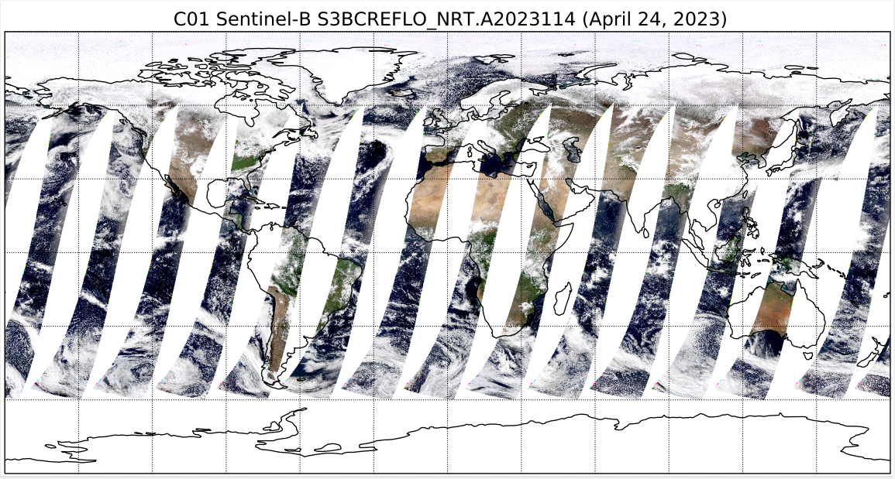
Corrected Reflectance: OLCI S3A & S3B
R: O8 0.660 – 0.670
G: O6 0.555 - 0.565
B: O4 0.485 – 0.495
R: O8 0.660 – 0.670
G: O6 0.555 - 0.565
B: O4 0.485 – 0.495

Slide 5
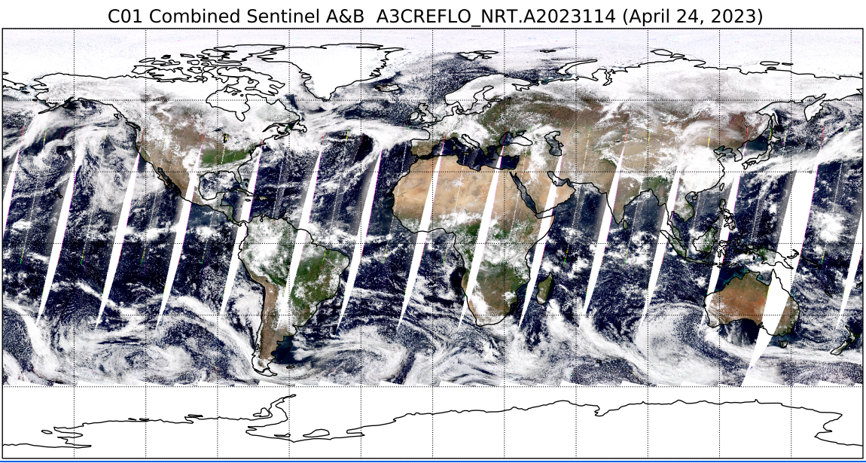
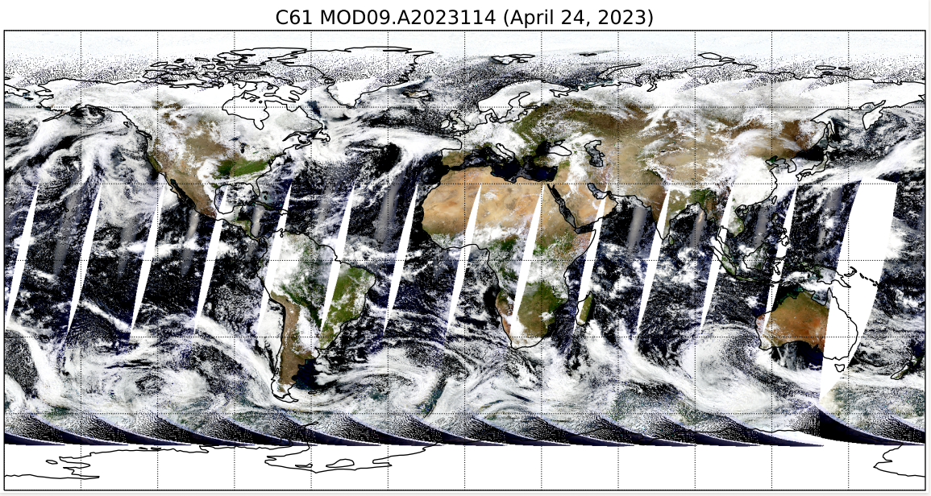
Corrected Reflectance: S3 OLCI vs T MODIS
R: O8 0.660 – 0.670
G: O6 0.555 - 0.565
B: O4 0.485 – 0.495
R: b1 0.620 – 0.670
G: b4 0.545 - 0.565
B: b3 0.459 – 0.479

Slide 6
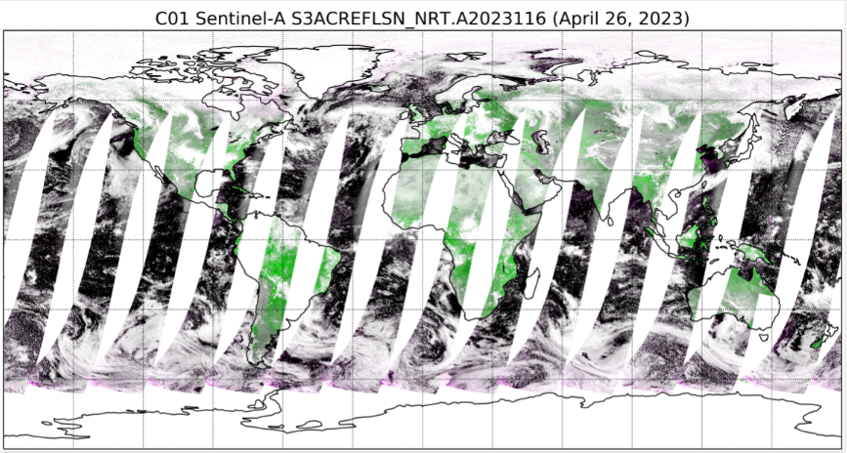
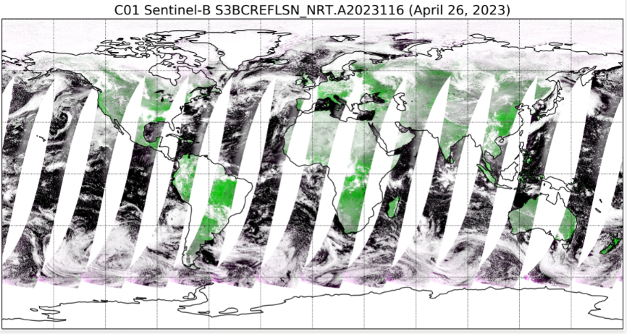
Corrected Reflectance: SLSTR S3A & S3B
R: S2 0.650 – 0.670
G: S3 0.858 - 0.878
B: S2 0.650 – 0.670
R: S2 0.650 – 0.670
G: S3 0.858 - 0.878
B: S2 0.650 – 0.670

Slide 7
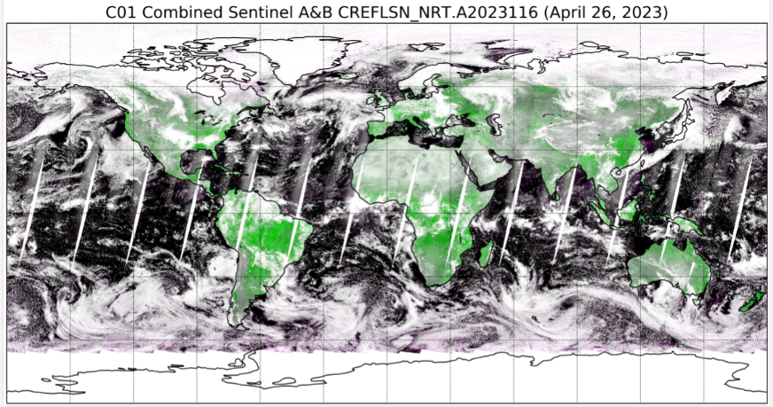
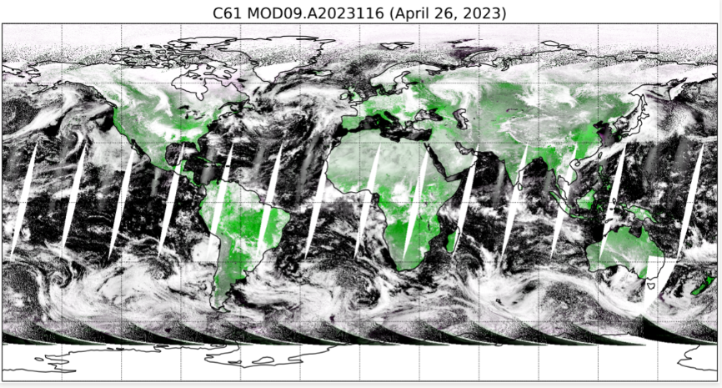
Corrected Reflectance: S3 SLSTR vs T MODIS
R: S2 0.650 – 0.670
G: S3 0.858 - 0.878
B: S2 0.650 – 0.670
R: B1 0.620 – 0.670
G: B2 0.841 - 0.876
B: B1 0.620 – 0.670

