Slide 1
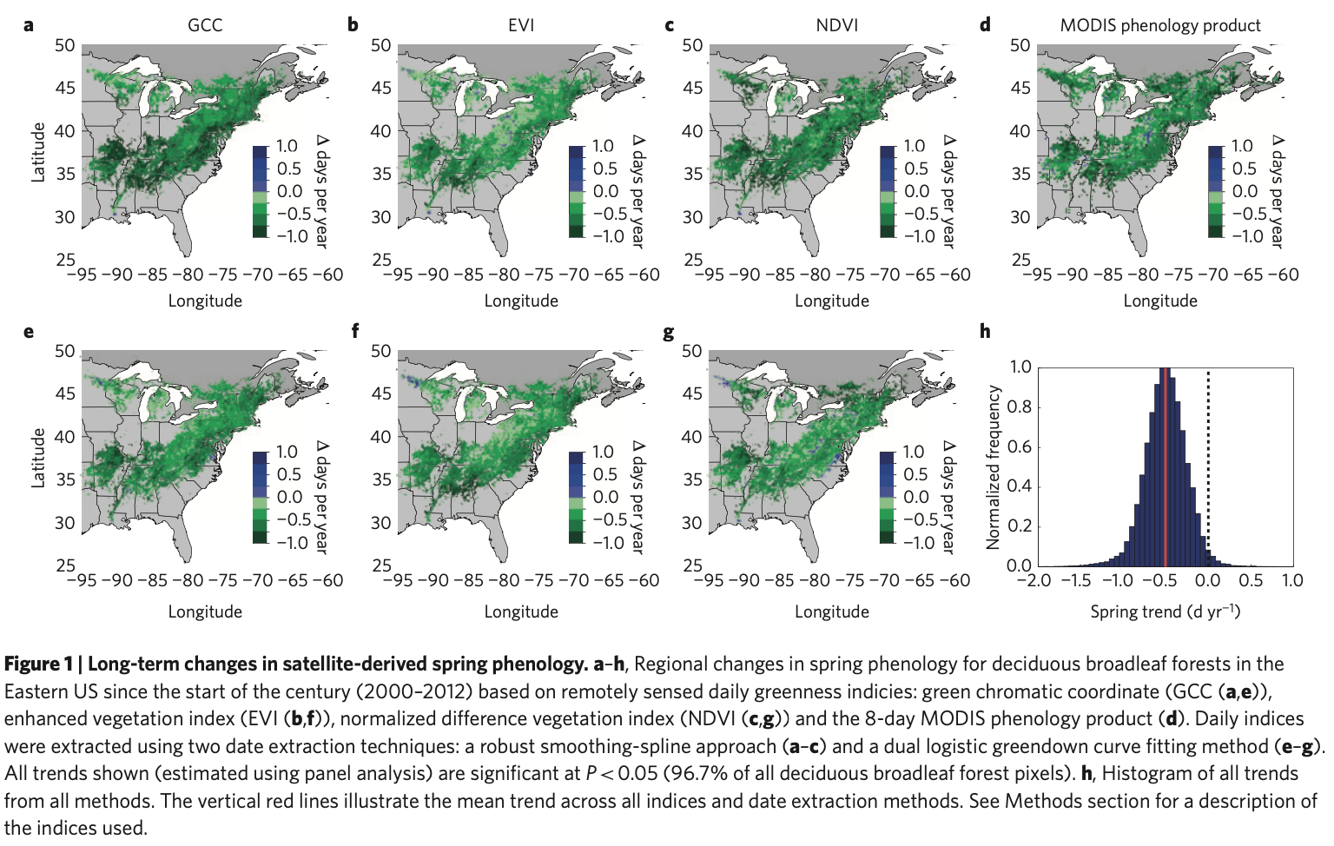
Long-Term Changes and Variability in Global Ecosystem Phenology From MODIS
Mark Friedl (BU) , Joshua Gray (NCSU) Andrew Richardson (NAU),
Minkyu Moon (BU), Tristan Green (BU), Grace Choi (NCSU), Xiaojie Gao (NCSU)
Project Description
How has the timing and length of growing seasons changed over the MODIS era?
How do LSP anomalies and trends impact sub-seasonal and seasonal scale carbon fluxes?
How can joint information from MODIS land surface temperature and land surface phenology be used to characterize the impact of droughts on ecosystems?
Keenan et al, Nature Climate Change, 2014

Slide 2
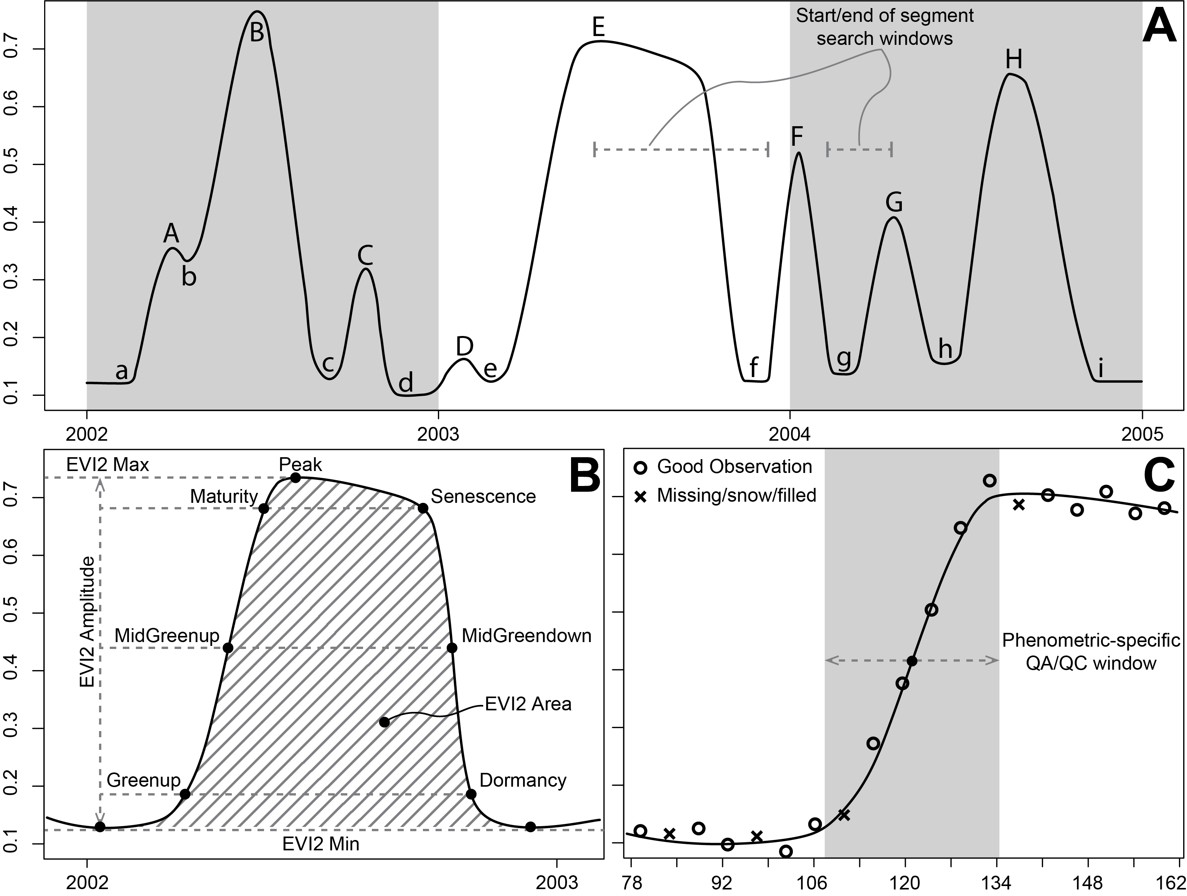
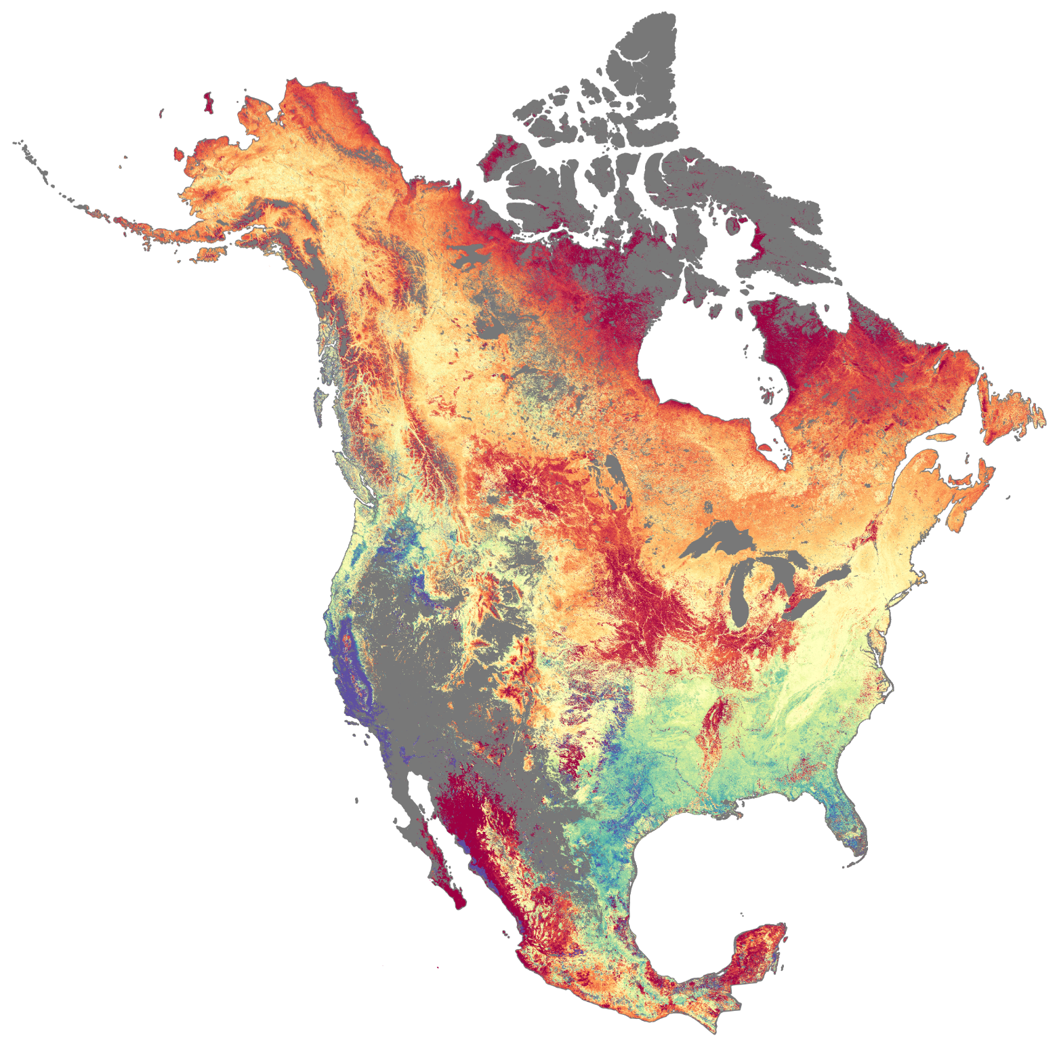
MCD12Q2: 22 Years (and counting) of Global Land Surface Phenology
Algorithm
Product
MidGreenup

Slide 3
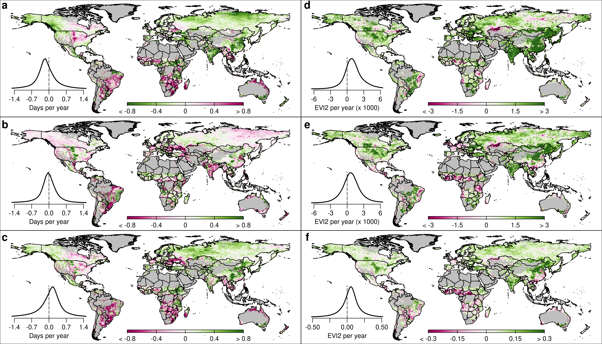
Progress and Results: Trends in GSL Timing & Length
MGU
EVImax
MGD
EVIamp
GSL
EVIarea
Notes:
Trend from AR regression
A: mid-greenup; B: mid-greendown; C: Growing season length; D: EVImax; E: EVIamp; F: EVIarea

Slide 4
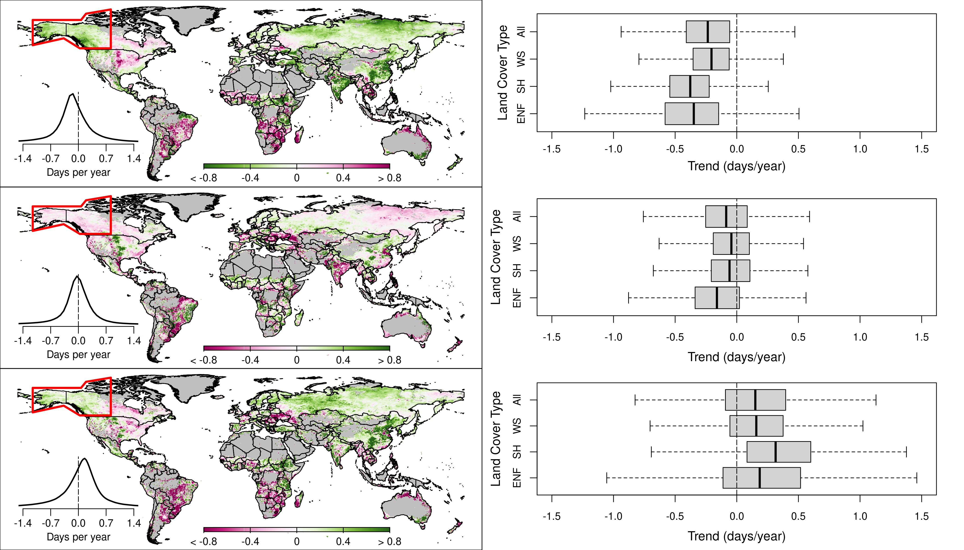
Progress and Results: Trends in GSL Timing & Length
MGU
*
*
55%
*
16%
*
11%
IPCC Climate
Reference Regions
Northwestern
North America
MGD
*
*
*
*
GSL
*
*
* Indicates p < 0.05
based on Ives et al, RSE, 2021
*
*

Slide 5
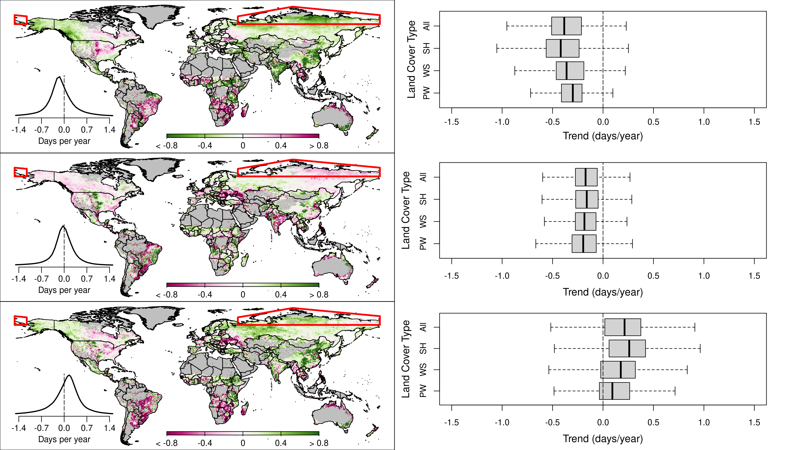
Progress and Results: Trends in GSL Timing & Length
MGU
*
*
56%
*
35%
*
3%
IPCC Climate
Reference Regions
Russian
Arctic
MGD
*
*
GSL
*
*
* Indicates p < 0.05
based on Ives et al, RSE, 2021
*
*

Slide 6
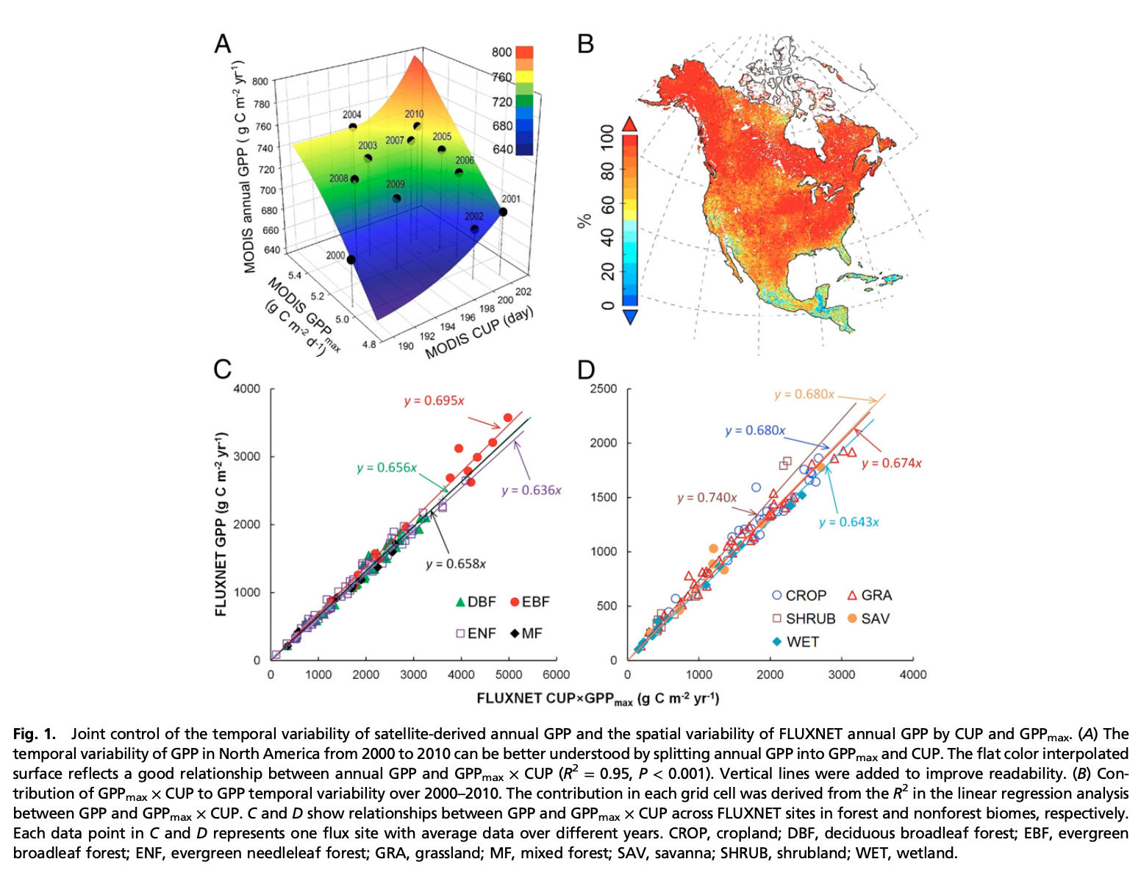
Progress and Results: Sub-Seasonal & Seasonal Scale Carbon
GPP = 𝛼 . CUP . GPP_{max}
MODIS GSL and Max EVI do not reproduce results based on tower-based GSL and carbon uptake period
Challenge: MODIS does not capture site-specific variance, esp WRT GPP_{max} vs EVI_{max}
Xia et al, PNAS, 2015
Gao et al., Global Biogeochemical Cycles, 2023

Slide 7
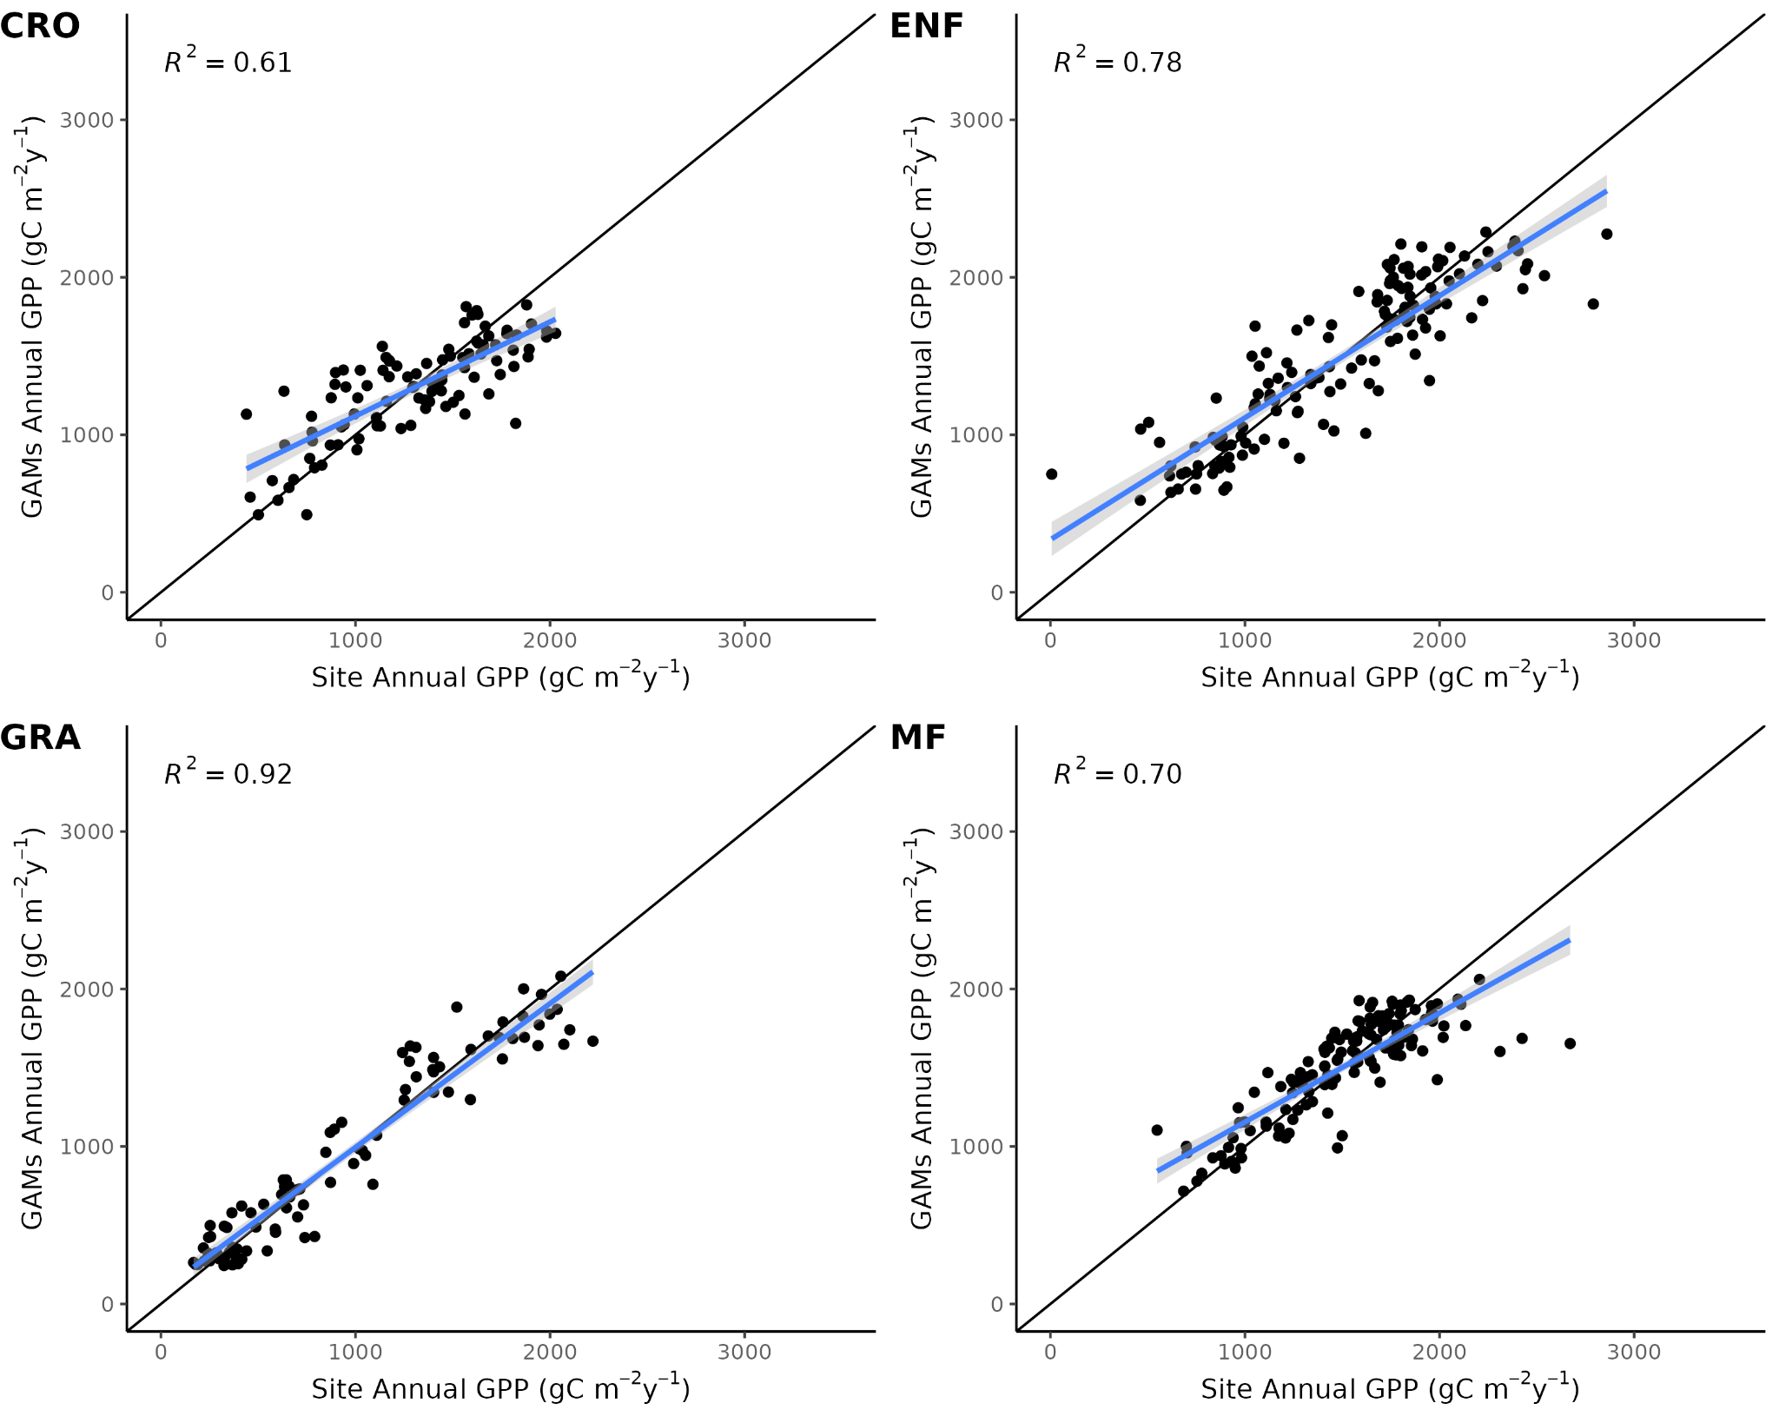
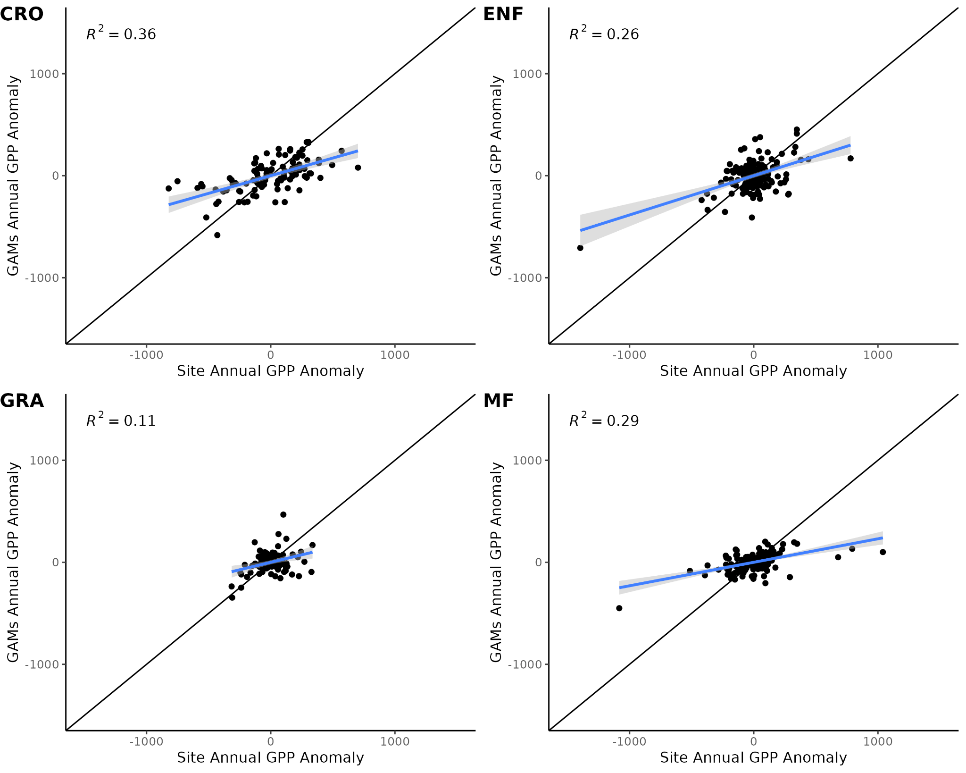
Progress and Results: Sub-Seasonal & Seasonal Scale Carbon
Generalized additive models (GAMs) estimated using gridded met data to capture site-specific
variance at 73 AmeriFlux sites with 453 site-years of data spanning 4 cover types
Observed vs Modeled GPP
Observed vs Modeled GPP Anomalies

Slide 8
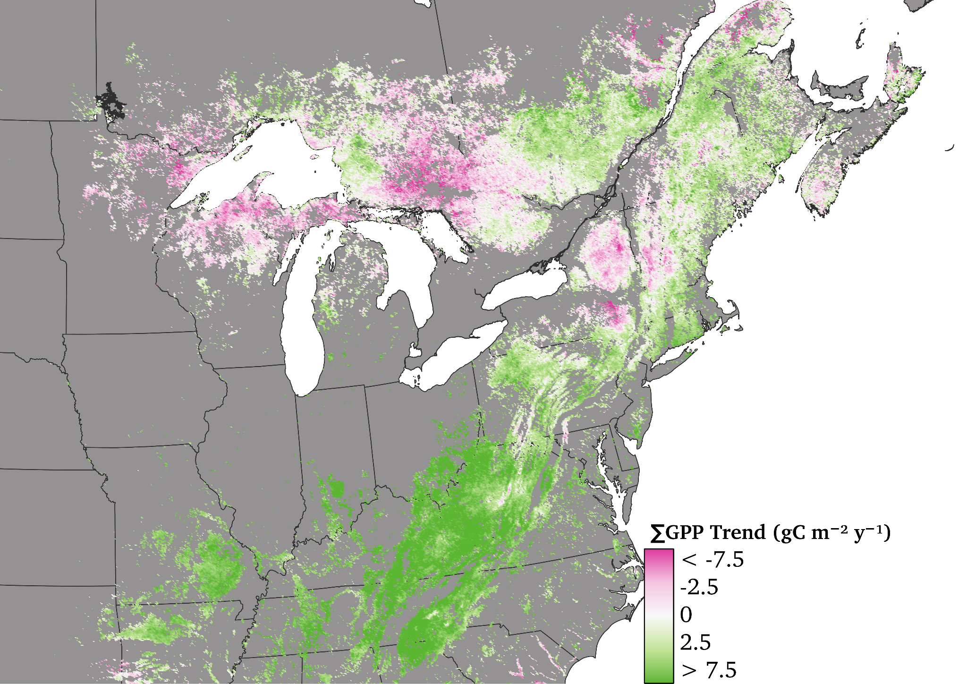
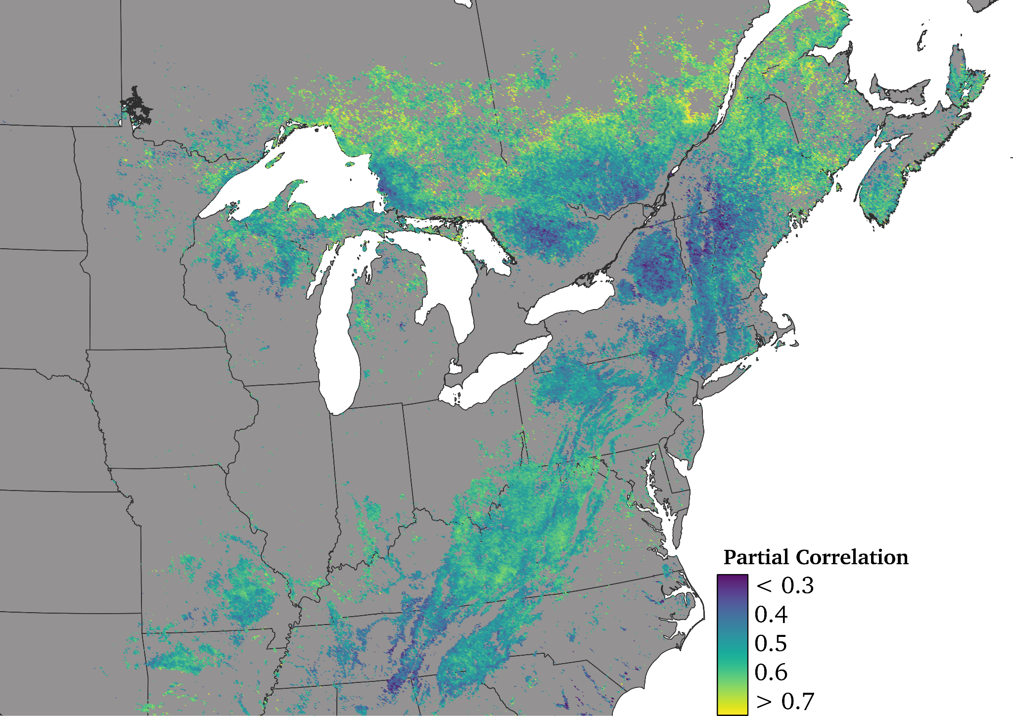
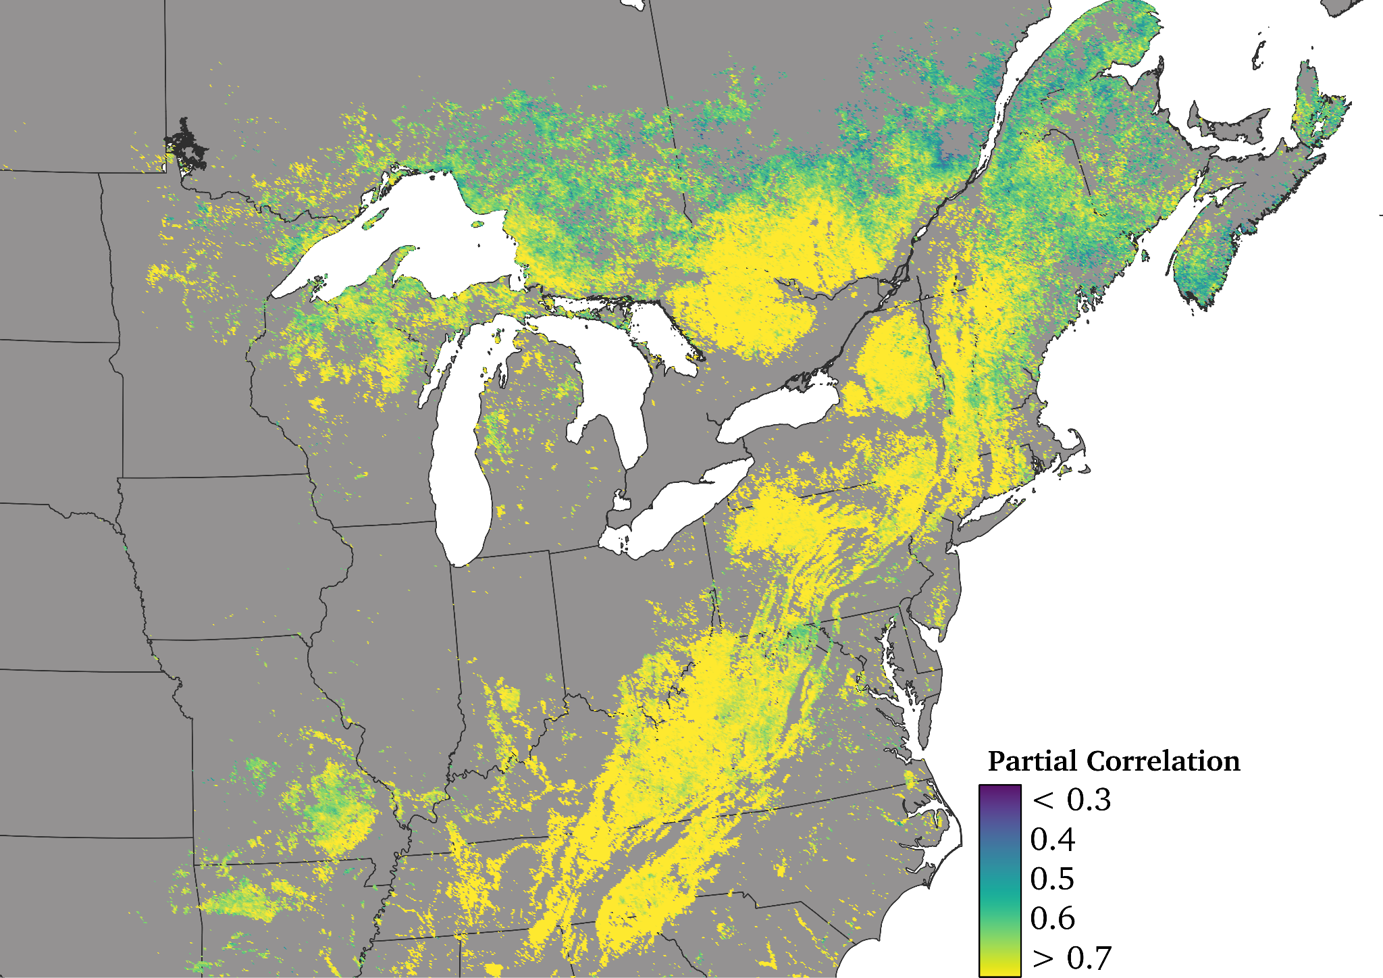
Progress and Results: Sub-Seasonal & Seasonal Scale Carbon
Upscaling tower-based results to biome scale in Eastern Temperate Forests
Biogeographic variation in drivers GPP trends
GPP Trend
GPP GSL
GPP Max

Slide 9
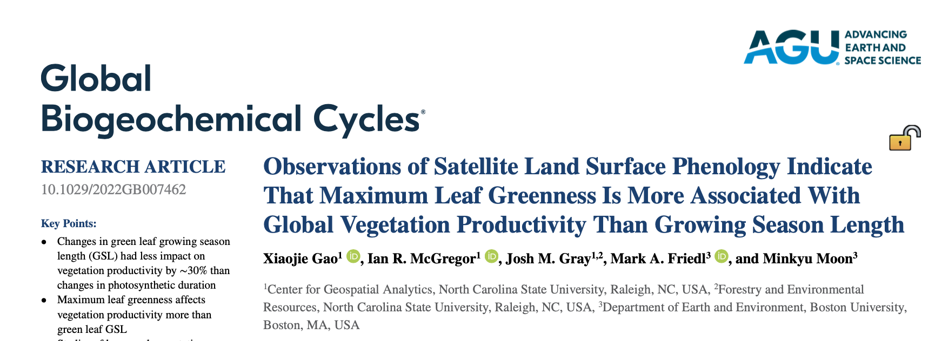
Next Steps
Synthesize LSP trend results (Moon et al., in prep)
Continue and extend GPP analysis (Green et al., in prep)
Analysis of trends and drivers of in arid/semi-arid systems (Choi et al)
Start looking at LSP-Carbon-Drought signatures
Publications:

