Slide 1

MODIS/VIIRS Global Water Reservoir (GWR) Product
PI: Huilin Gao¹
Acknowledgement:
Shuai Zhang¹, Deep Shah¹, Gang Zhao²,
Sudipta Sarkar³, Carol C Davidson³, Rui Zhang⁴, Maosheng Zhao^{3,5}, and Sadashiva Devadiga⁵
^{1.} Texas A&M University, ^{2.} Carnegie Institution for Science, ^{3.} Science Systems and Applications Inc, ^{4.} Global Science & Technology Inc, ^{5.}NASA GSFC
MODIS/VIIRS Science Team Meeting
May 3, 2023

Slide 2
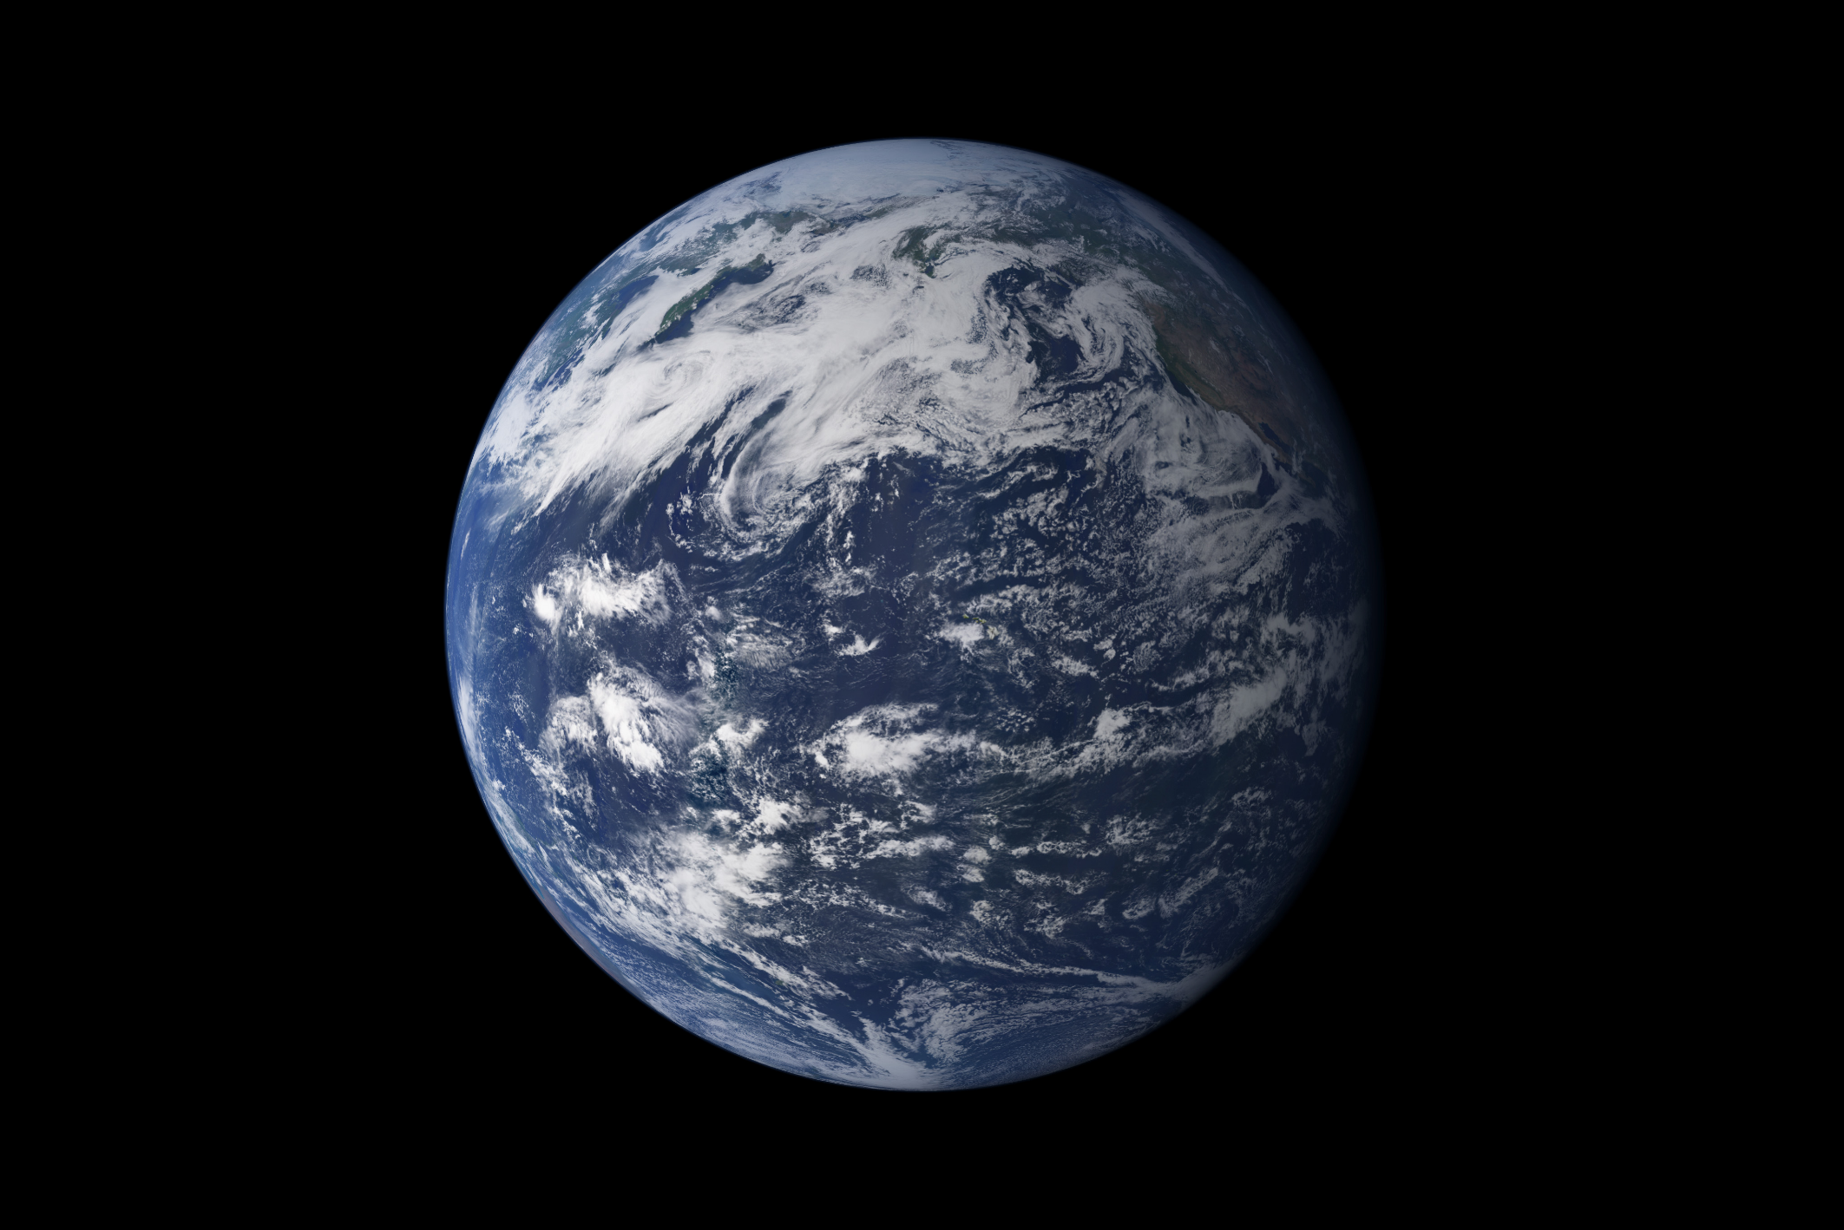
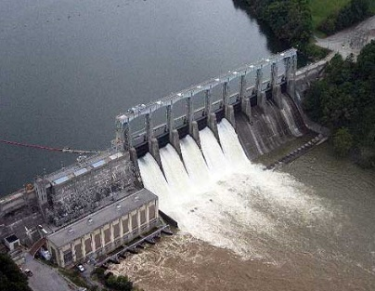
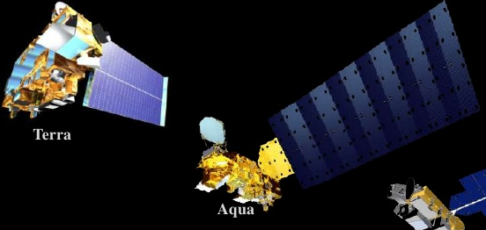
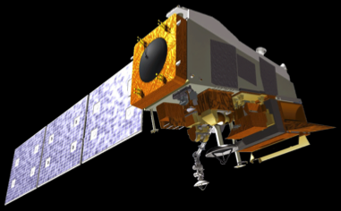
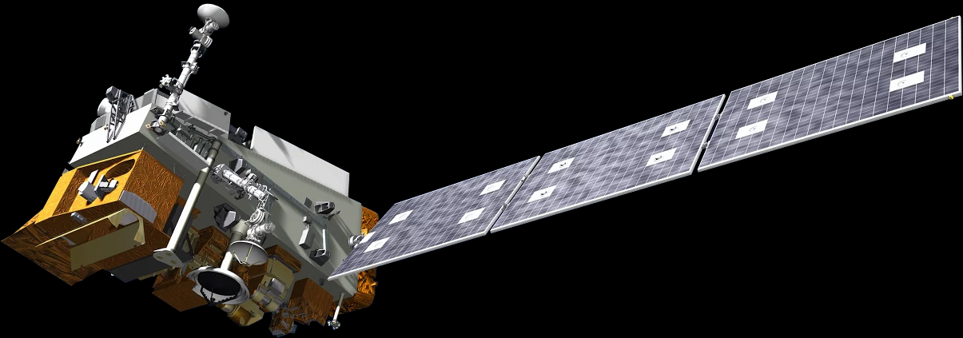

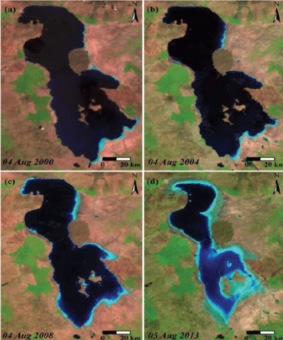

Why MODIS/VIIRS Global Water Reservoir (GWR) Product?
Chao, 2008
Terra
2000-
Aqua
2002-
Soumi NPP
2011-
JPSS-1/NOAA20
2017-
Hydropower
Flood control
Irrigation
Water supply
JPSS-2 2022-
JPSS-3 2027-
JPSS-4 2032-
Reservoir storage can be inferred using surface reflectance classifications (Gao et al., 2012)
Reservoir evaporation can be better estimated using LST (Zhao et al., 2020)
Simultaneous storage & evaporation observations can provide comprehensive monitoring capability
MODIS images of Urmia Lake
2000
2004
2008
2013
Figure from Mohebzadeh, 2018

Slide 3
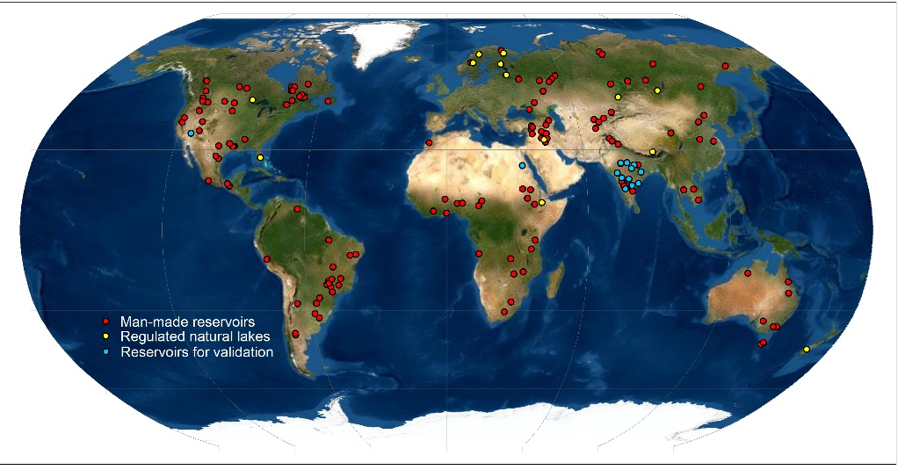
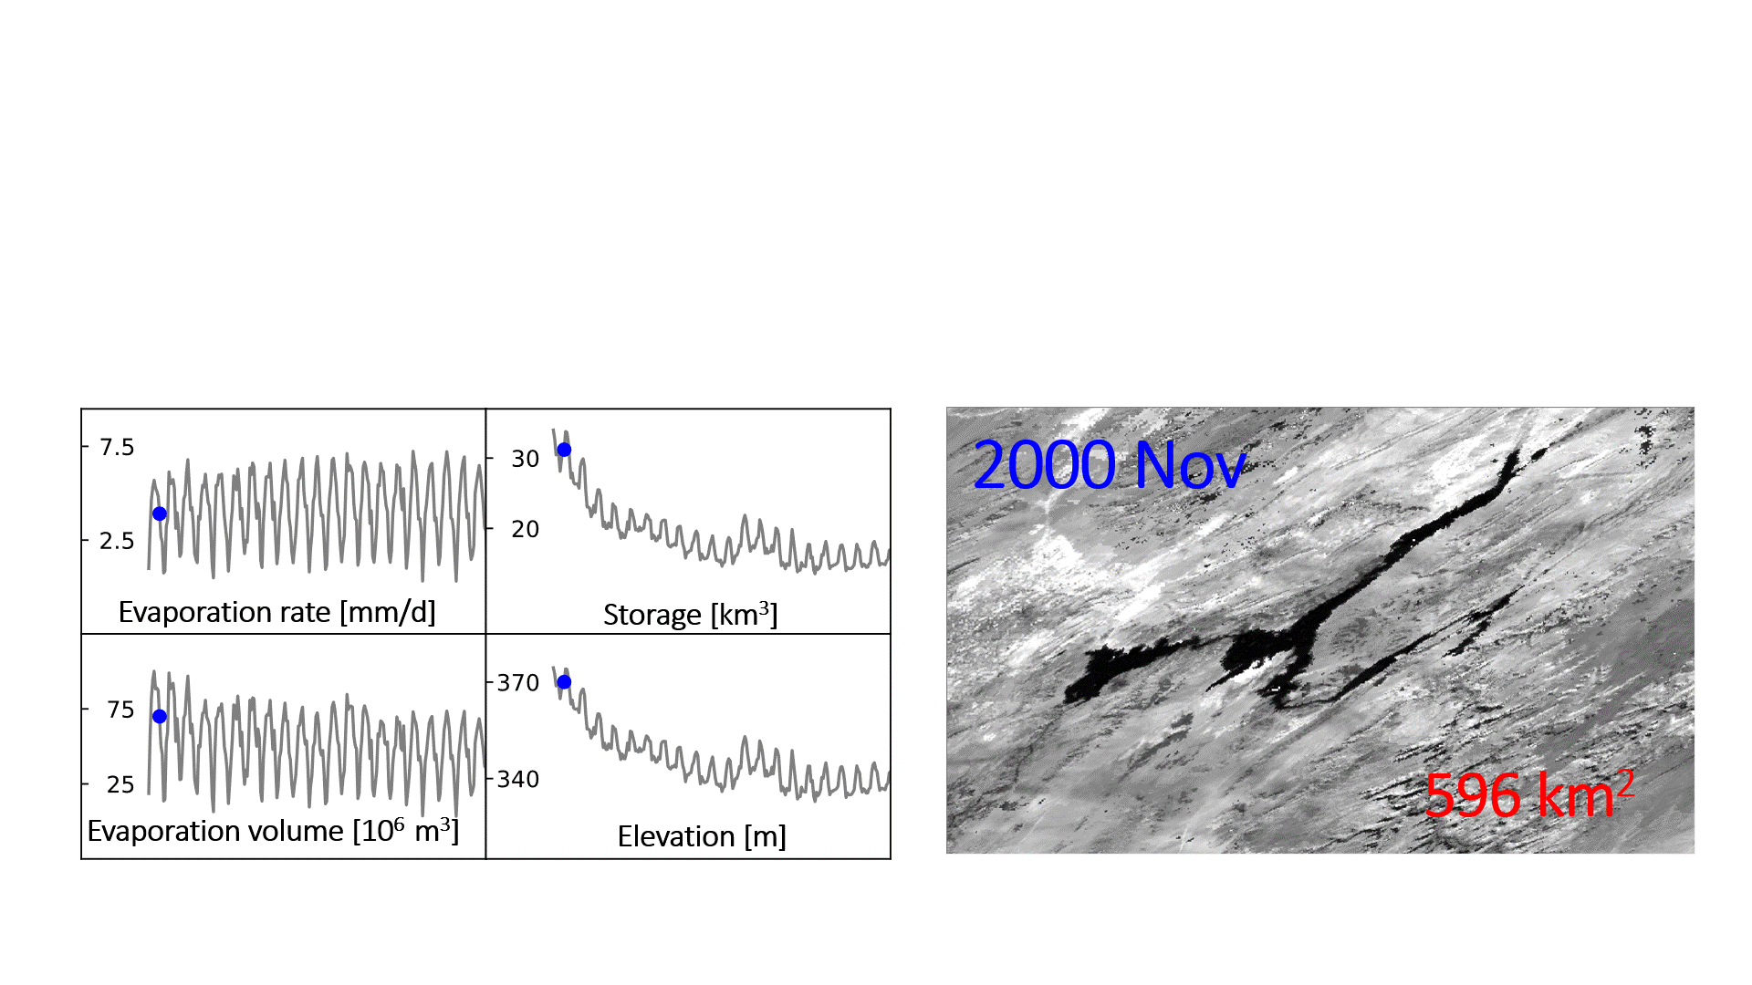
MODIS/VIIRS GWR Product Overview
Lake Mead (ID: 61)
Locations of the 164 reservoirs (46% global capacity)
Key inputs:
8-day reflectance, Monthly LST
Temporal Resolution | Variables
8-day | Area, elevation, storage
Monthly | Area, elevation, storage, evaporation rate and volume
Product name | Period
MxD28¹ (C6.1) | 2000-2023
VNP28² (C2) | 2012-2023
VJ128² (C2) | 2018-2023
¹ Released in 2021
² To be released in 2023
Zhao et al., 2020; Li et al., 2021

Slide 4

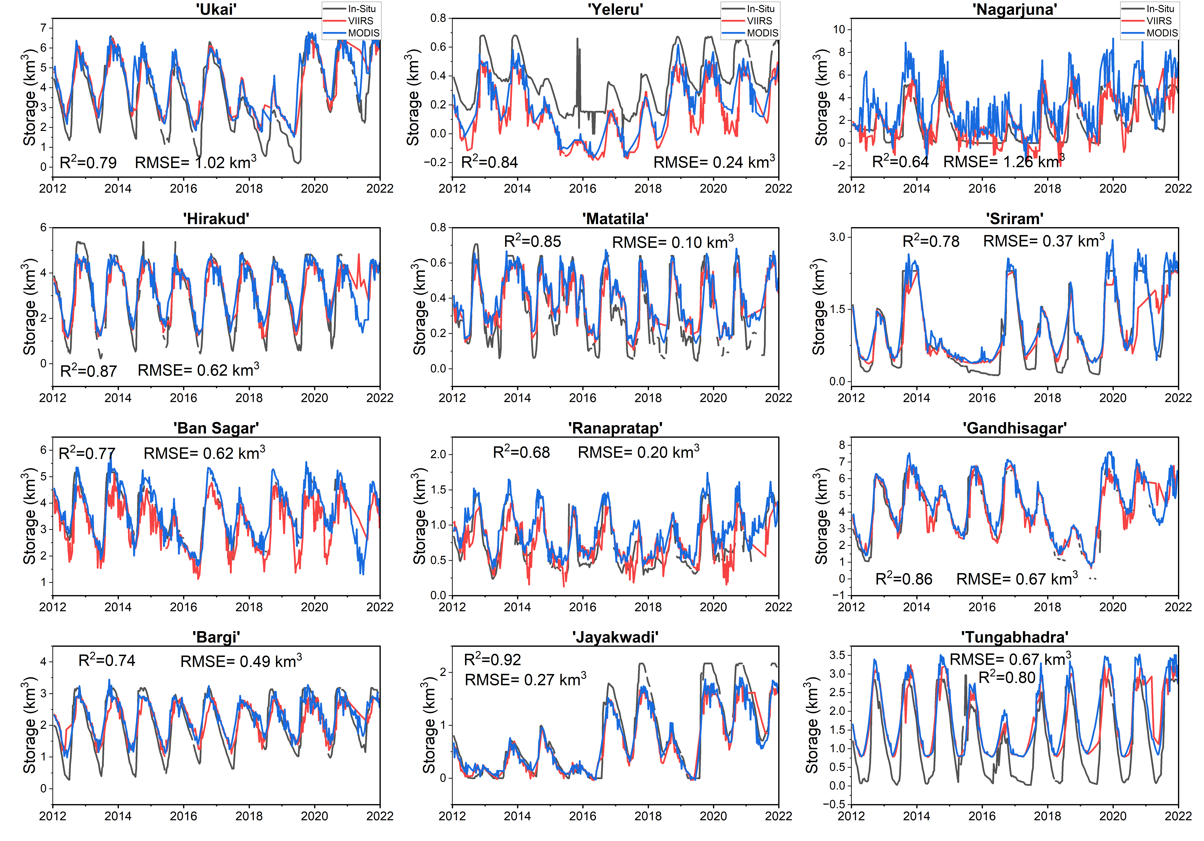
MODIS/VIIRS GWR Product Validation and Continuity
Validation of the 8-day storage data from VIIRS (SNPP) and
MODIS (Terra) using in situ observations
Continuity of the monthly storage and evaporation rate
VJ1 v.s. MYD VNP v.s. MYD
More results are provided in the poster “On the Continuity of MODIS and VIIRS Based Global Reservoir Products” by Gao et al.

Slide 5
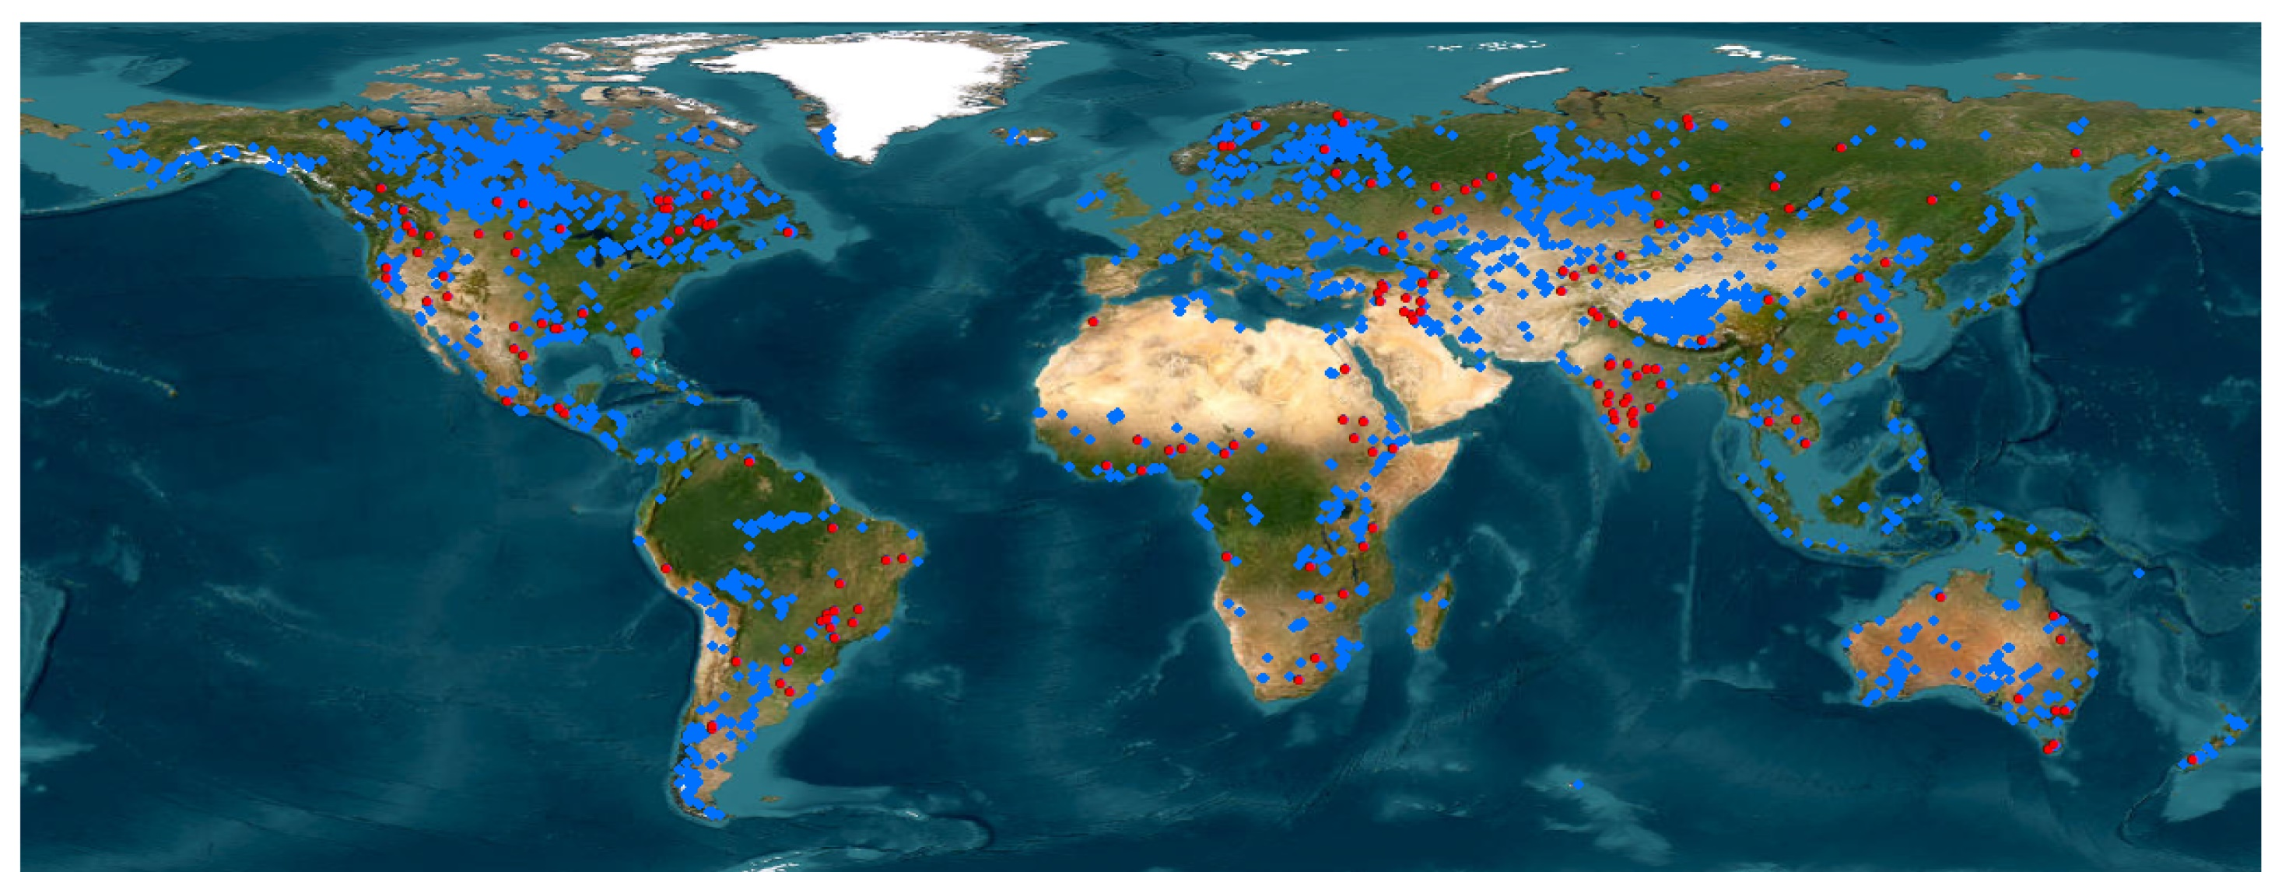
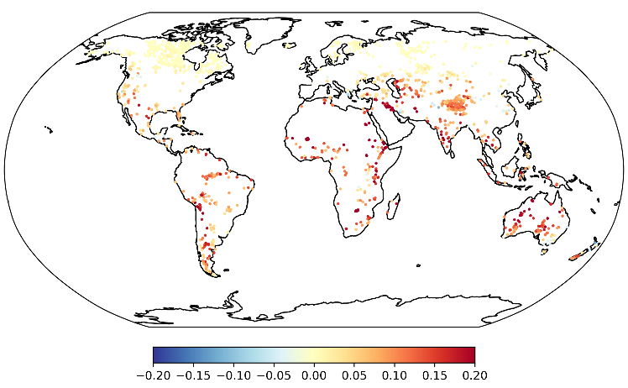
Understanding the Long-term Dynamics of Global Lake/Reservoir Storage and Evaporation
Trend of global evaporation rate
Extended lake/reservoir dataset (2000-2022)
2338 natural lakes and 397 reservoirs
Accounting for 71% of the total lake surface area, and 98% of the global reservoir capacity
GWR product
164 reservoirs
Accounting for 46% of the global reservoir capacity

