Slide 1
Terra/Aqua MODIS Fire Product Continuity Sentinel-3 Pilot Study Update
L. Giglio, E. Ellicott, F. Argueta
University of Maryland

Slide 2
Sentinel-3A/3B SLSTR
ESA Sentinel-3A (Feb. 2016 launch) + Sentinel-3B (Apr. 2018 launch)
10:00 local crossing time (sun-synchronous orbit)
Sea and Land Surface Temperature Radiometer (SLSTR)
1420-km swath (versus 2300-km MODIS swath)
Oblique + nadir asymmetric conical scans
1-km fire bands
Quirks w/ respect to saturation and band-to-band co-registration
Near-real time (NRT) and science-quality SLSTR active fire products available from EUMETSAT and ESA, respectively
Our focus is on SLSTR NRT active fire product for FIRMS

Slide 3
Summary of SLSTR Active-Fire Product Findings (1/2)
Sentinel-3 NRT & standard fire products are two distinctive processing branches due to the different European Commission mandates
No requirement for NRT and standard products to be aligned
NRT product actually contains four different active-fire products made with four different detection algorithms
Each SLSTR reports ∼3× as many fire pixels as Terra MODIS
Higher sensitivity, especially at night
Constrained pixel growth + wavelength
Higher false alarm rate, especially along cloud edges
MWIR/LWIR misregistration + wavelength
Significant differences in distribution of fire radiative power (FRP)

Slide 4
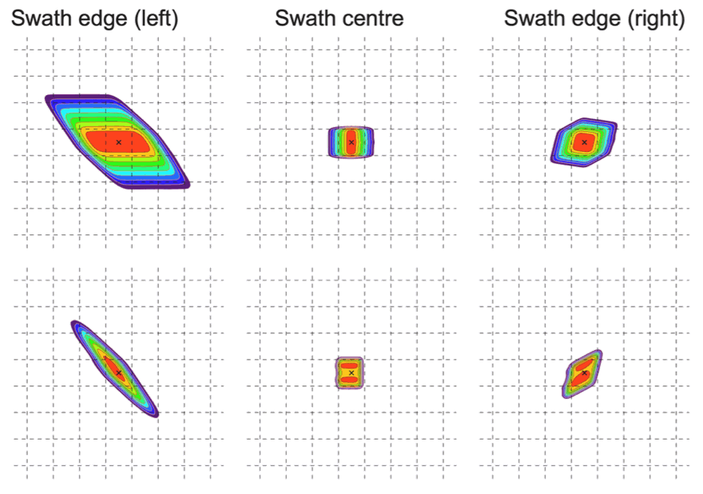
SLSTR Pixel Footprint
S7
1-km grid
F1
Xu et al. (2021, RSE)

Slide 5
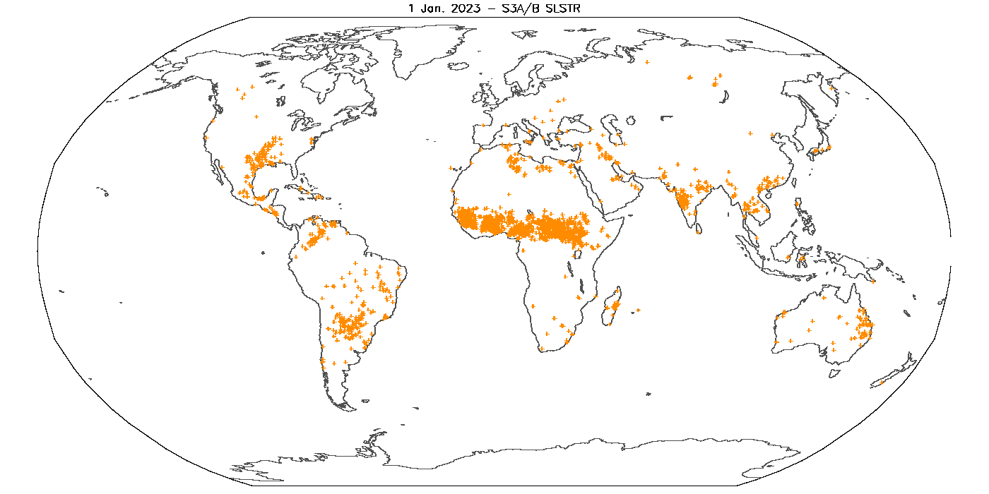
1 Jan. 2023 S3A+S3B SLSTR ESA Algorithm #1 (Science Product)
16,061 fire pixels

Slide 6
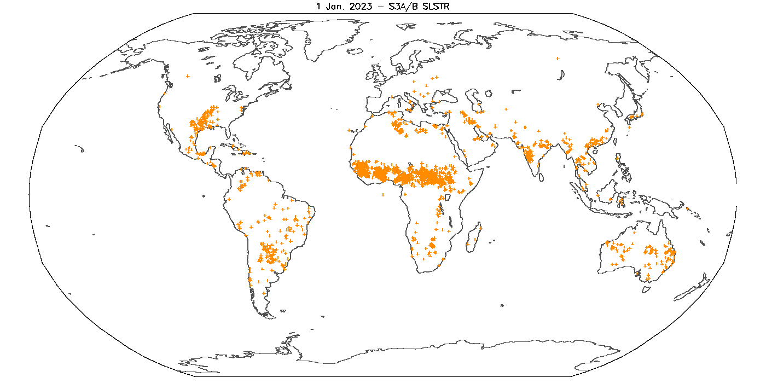
1 Jan. 2023 S3A+S3B SLSTR EUMETSAT NRT Algorithm #2
12,242 fire pixels
Notes:
EUMETSAT refers to this as the “alternative algorithm”.

Slide 7
1 Jan. 2023 S3A+S3B SLSTR EUMETSAT NRT Algorithm #3
7,098 fire pixels

Slide 8
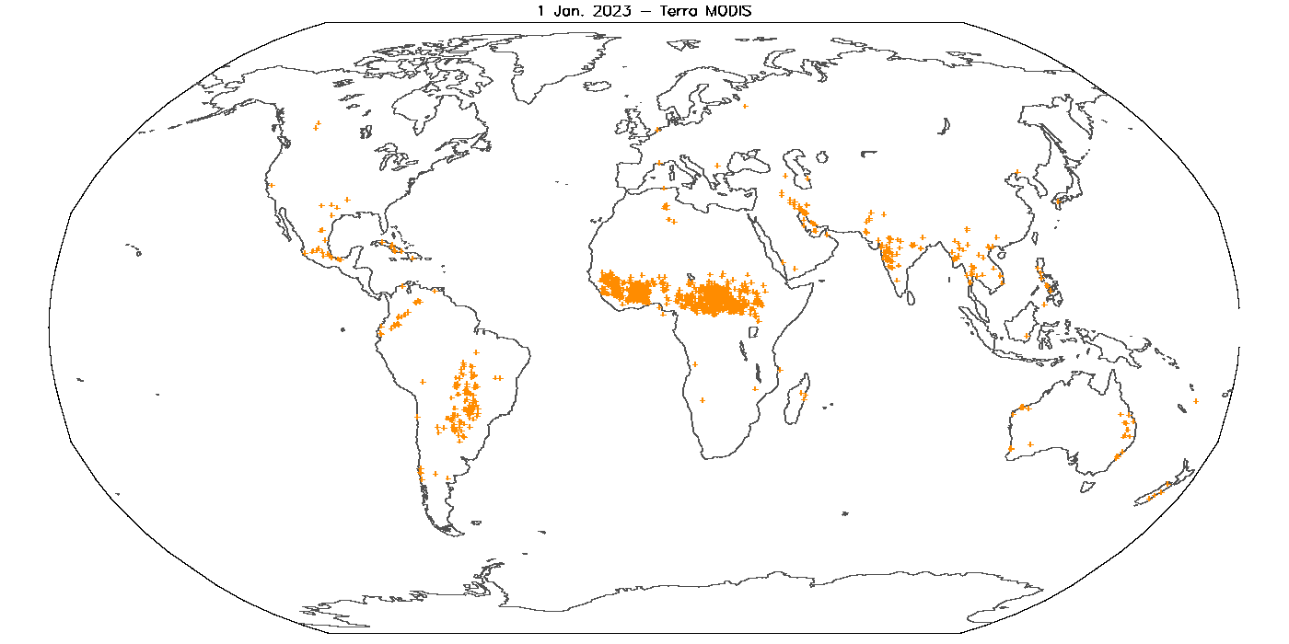
1 Jan. 2023 Terra MODIS
3,134 fire pixels

Slide 9
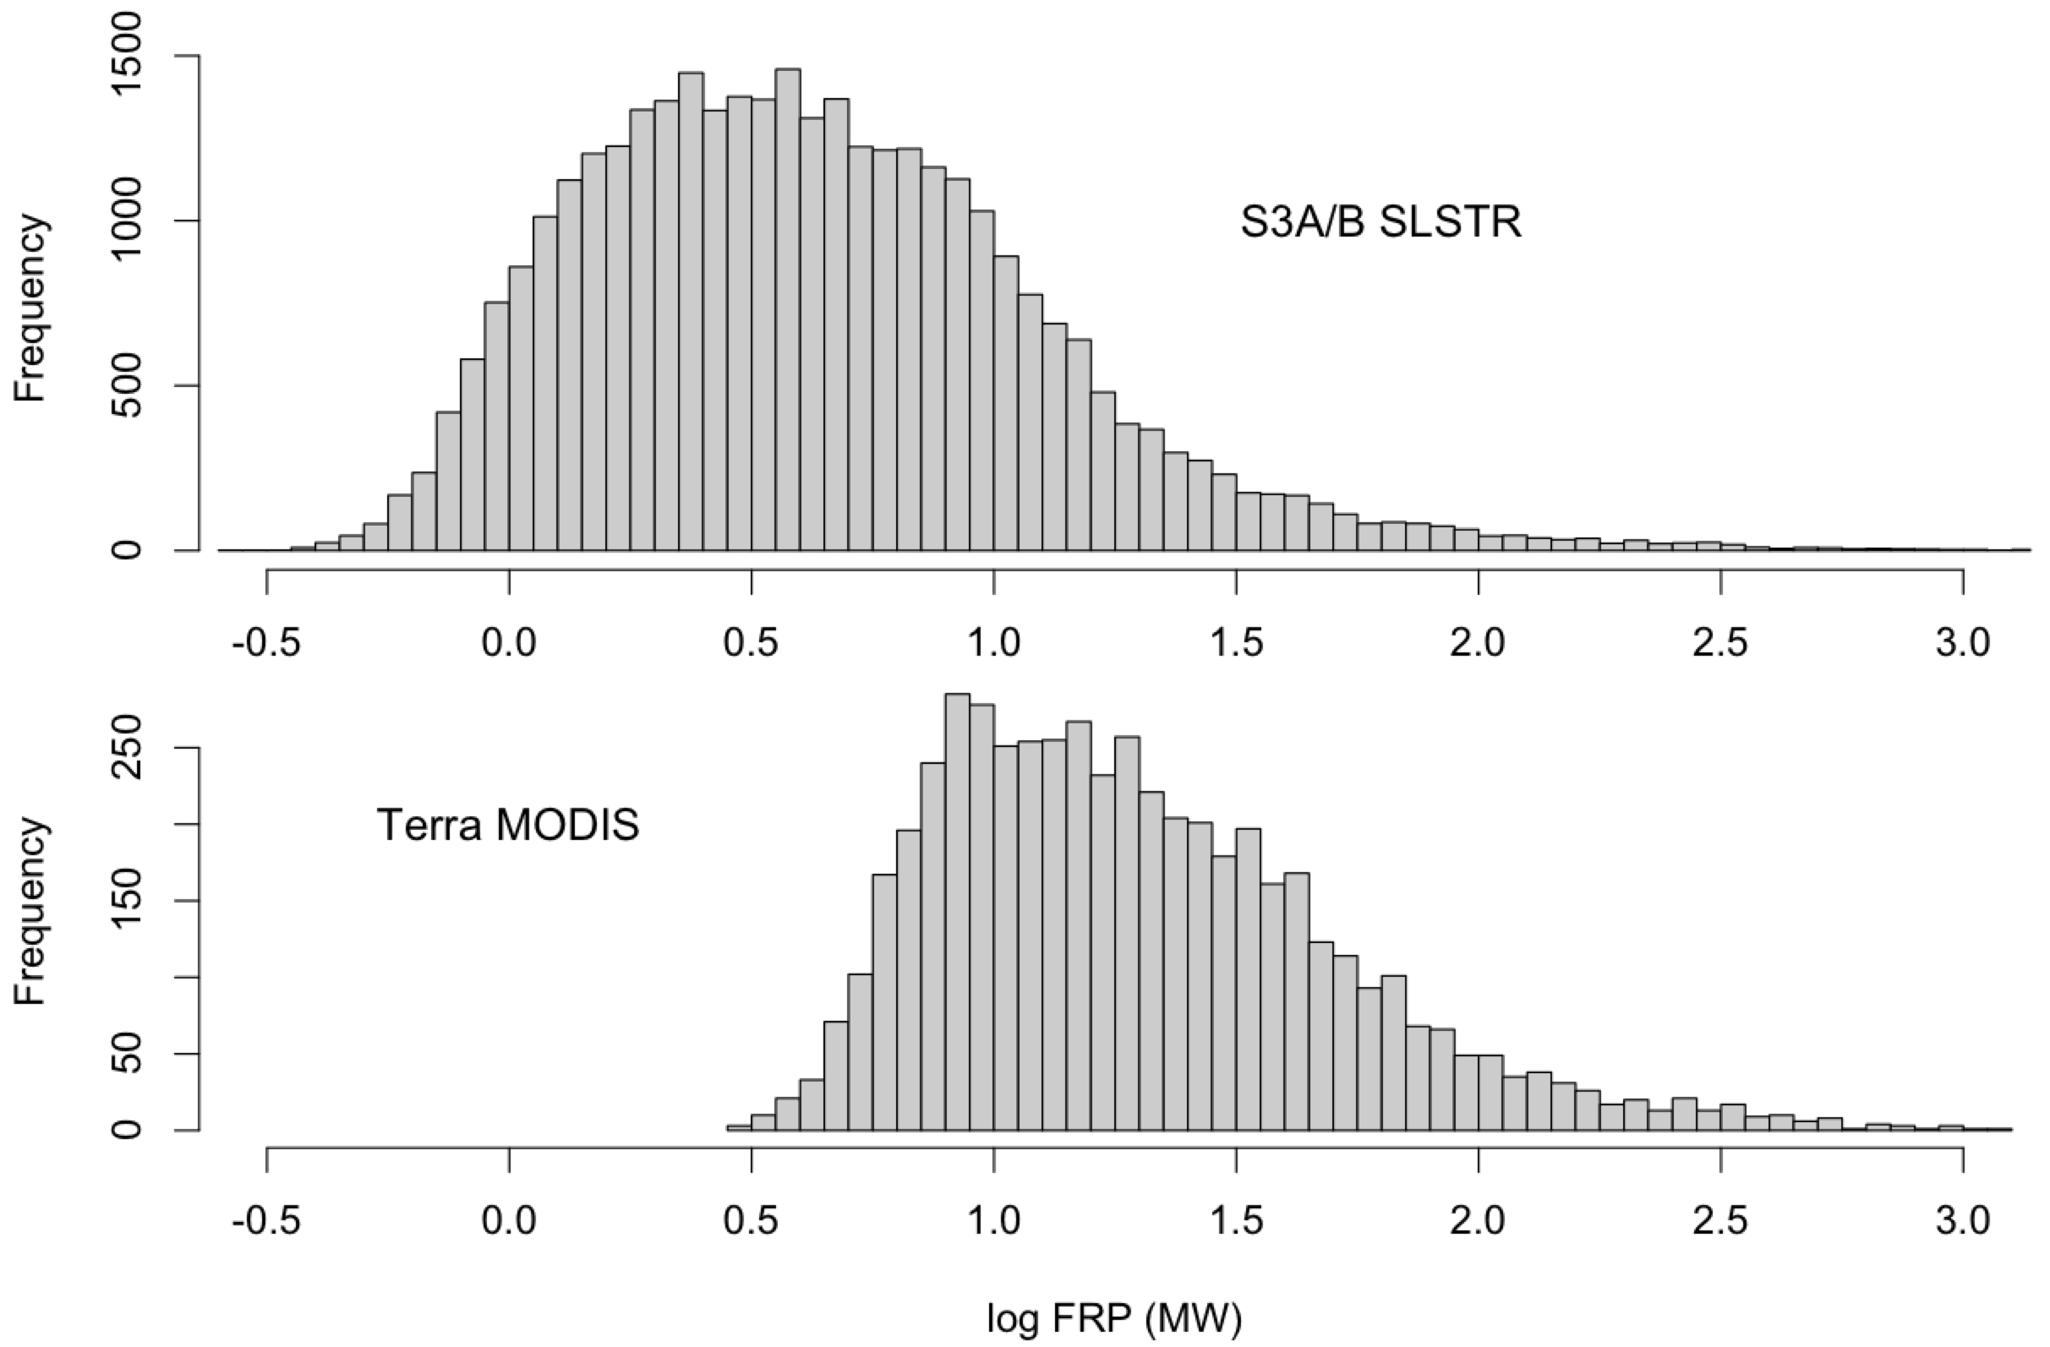

Slide 10
Summary of SLSTR Active-Fire Product Findings (2/2)
Assorted practical (but mostly manageable) product issues
Cumbersome product format (zip files)
Product size is many times larger than MODIS swath product
Significant differences in contents of standard vs. NRT products
Most/all production software is proprietary
NRT fire product is not yet widely used but is actively being updated by EUMETSAT
Numerous recommendations from our team
Continuing false-alarm assessment with eye toward filtering in FIRMS

