Slide 1
Status Update on Deep Blue Aerosol Products from MODIS, VIIRS, and GEO sensors
Deep Blue Aerosol Project team:
N. Christina Hsu¹ (PI), Jaehwa Lee^{2,1}, W. Vincent Kim^{2,1}, Seoyoung Lee^{3,1}, and Andrew M. Sayer^{3,1}
¹NASA Goddard Space Flight Center
²University of Maryland College Park
³University of Maryland Baltimore County

Slide 2
Status of Deep Blue Aerosol Products
Deep Blue aerosol project aims to create multi-sensor aerosol climate data record using consistent algorithm suite applied to SeaWiFS, MODIS, and VIIRS, as well as new generation GEO sensors
Major updates were made to the VIIRS Version 2.0 algorithm
Standard and NRT data sets from SNPP and NOAA-20 VIIRS are now online and available at LAADS
Consistent algorithms are being applied to MODIS for the C7 reprocessing and GEO sensors
Algorithm changes include:
Improved aerosol retrievals over high elevation regions by better accounting for changing surface pressure and Rayleigh-aerosol interactions
Improved surface reflectance determination particularly over bright surfaces
More realistic aerosol optical models for fine-mode aerosols and revised regional aerosol model assignment
Accounting for changing surface pressure over water surfaces

Slide 3
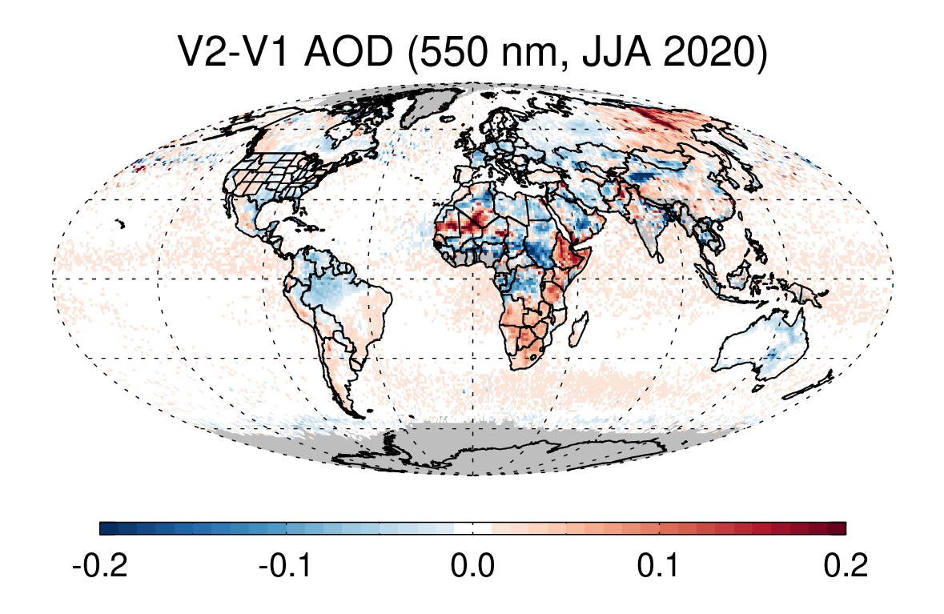
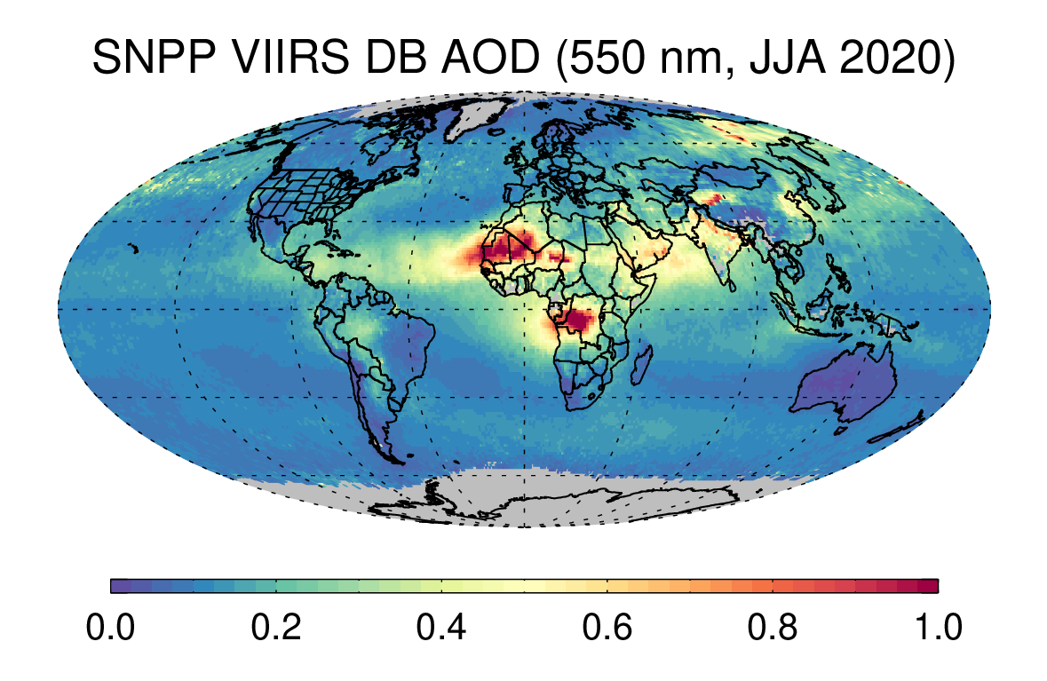
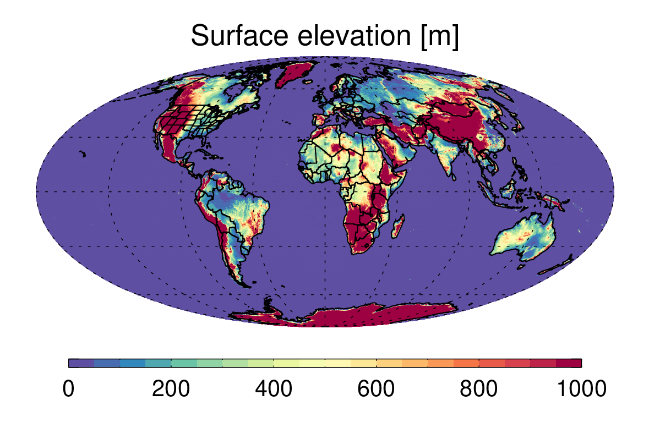
SNPP VIIRS Version 2 vs. Version 1 AOD
High elevation regions: mitigated negative biases by better accounting for effects of changing surface pressure
Bright surfaces: mitigated positive biases by improved surface reflectance
Aerosol optical model: New fine-mode aerosol model + regional aerosol model adjustments
Over water: Generally, slight increase in AOD for pressure < 1 atm

Slide 4
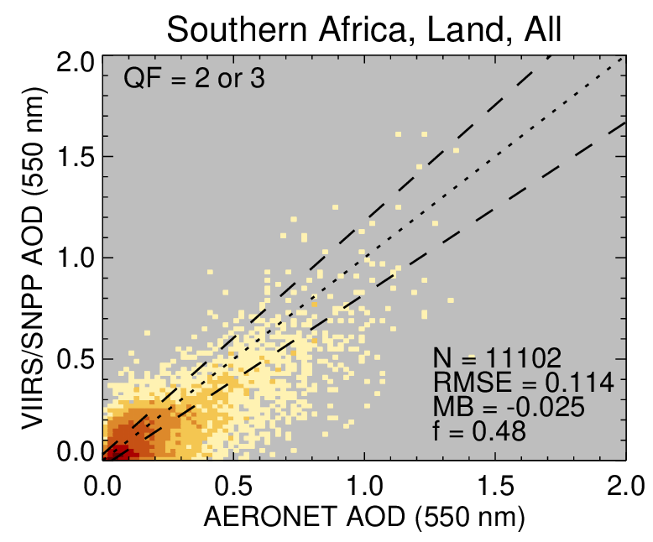
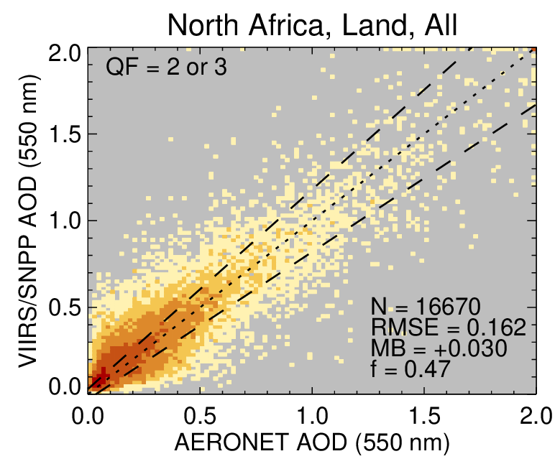
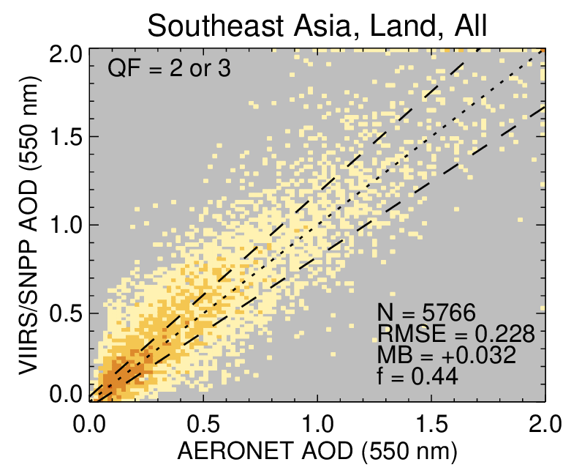
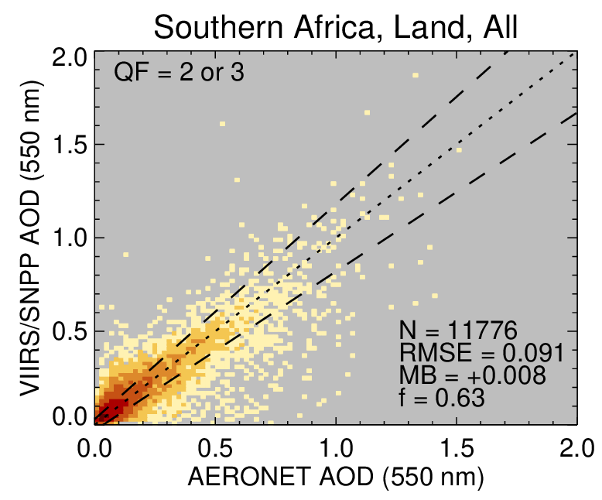
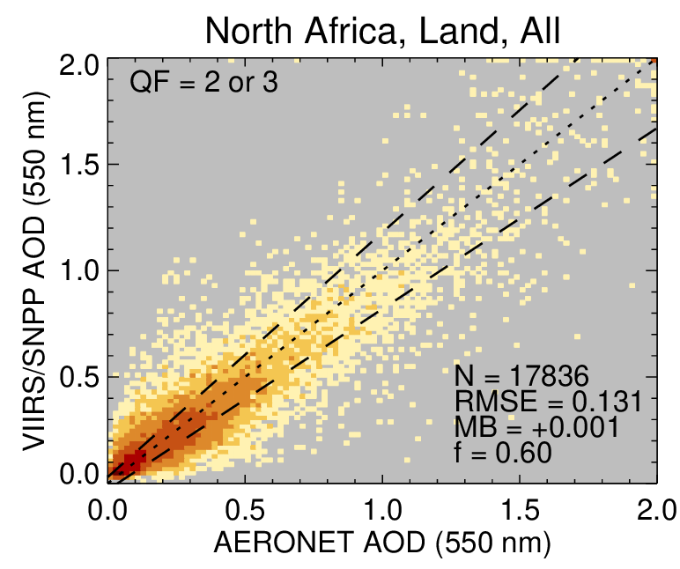
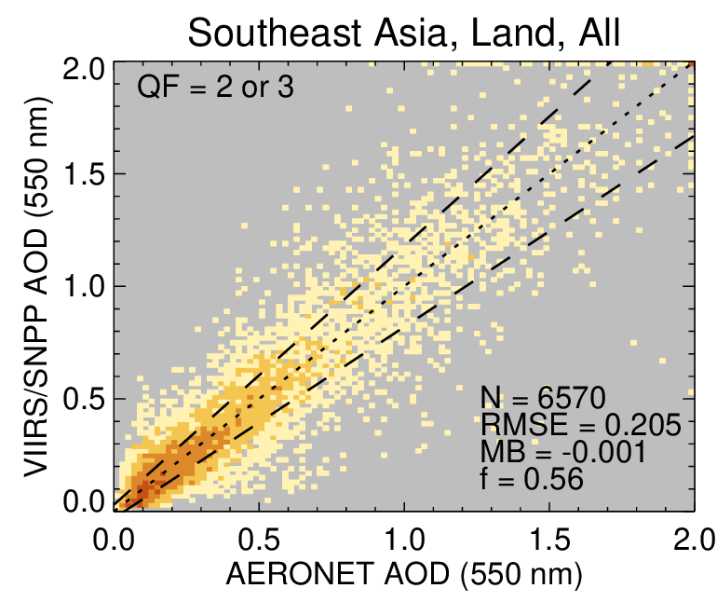
SNPP VIIRS AOD against AERONET (Version 2 vs. Version 1) (2012-2020)
High elevation region
Bright surfaces
Aerosol model
Version 1
Version 2
Estimated error (EE) = ±(0.03+15%) over land
*previously EE = ±(0.05+20%)

Slide 5
SNPP VIIRS Version 2 vs. Version 1 AOD (2012-2020)
Over land, VIIRS V2 AOD is generally much improved compared to V1.
Over ocean, validation statistics are slightly degraded compared to V1 with increased spatial coverage.
Consistent algorithms are being applied to MODIS for the C7 reprocessing as well as GEO sensors to ensure data continuity.
EE = 0.03+15%
EE = 0.03+15%
Land
Ocean
Land (419 sites): 5% 57% 38%
Ocean (118 sites): 19% 81% 0%

Slide 6
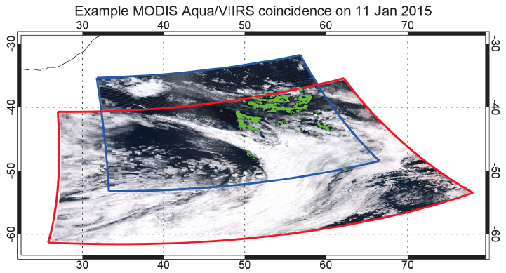
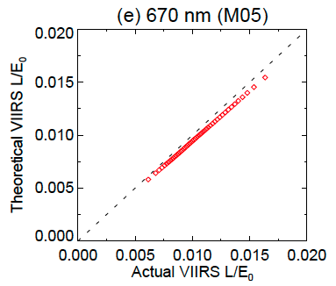
Data Consistency: Calibration Adjustments for SNPP and NOAA-20 VIIRS
Sayer et al. (2017)
Calibration gain factor for N20 | 412 nm | 443 nm | 490 nm | 550 nm | 670 nm | 870 nm | 1240 nm | 1610 nm | 2250 nm
Dome-C | 1.059 | 1.070 | 1.052 | 1.069 | 1.054 | 1.052 | 1.026 | 1.036 | 1.008
Meyer et al. (2020) over clouds |  |  |  |  | 1.053 | 1.041 | 1.030 | 1.041 | 1.021
Cross-calibration of SNPP VIIRS against Aqua MODIS is base upon VIIRS/MODIS matchup files generated by A-SIPS using the approach of Sayer et al. (2017)
We also normalize N20 VIIRS to SNPP using the matchup data over Dome-C cal/val site (Aqua MODIS serves as bridge between SNPP and N20).
For more details, see our poster “Improved Deep Blue aerosol data records from SNPP/NOAA-20 VIIRS and beyond” by Lee et al.

Slide 7
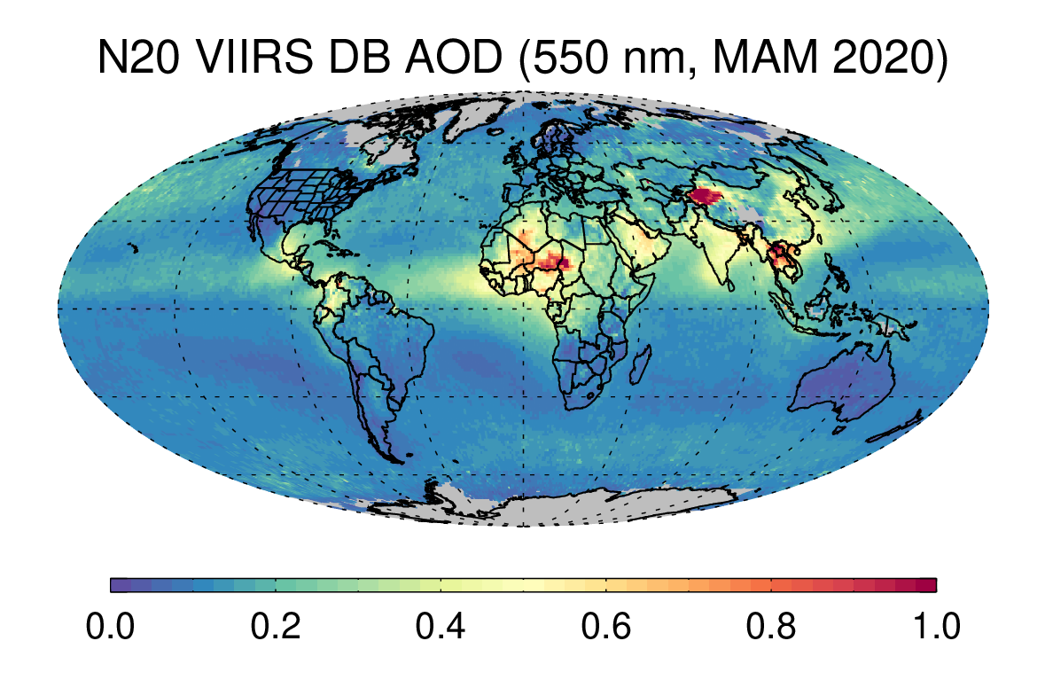
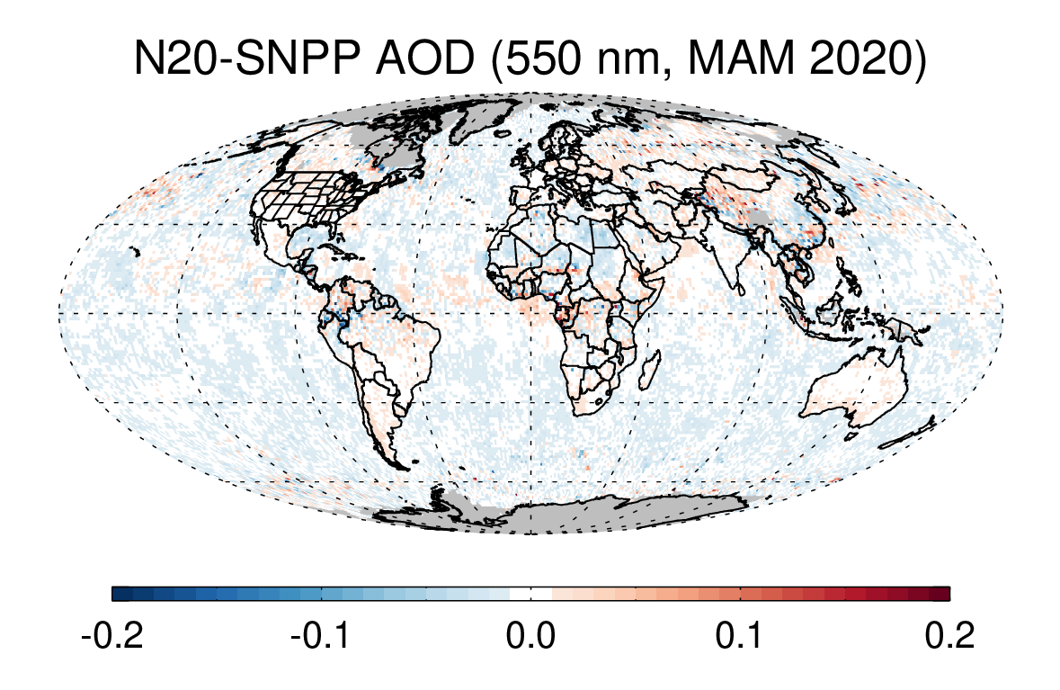
SNPP vs. NOAA-20 VIIRS AOD
The cross-calibration makes the AOD retrievals comparable between SNPP and NOAA-20 VIIRS.
Mean offset = 0.001 – 0.005 over land, (-0.006) – (-0.009) over ocean, and (-0.004) – (-0.006) overall, depending on season

Slide 8
SNPP vs NOAA-20 VIIRS AOD (2018-2020)
Over land, N20 and SNPP AOD are generally comparable.
Over ocean, N20 VIIRS AOD is generally comparable or better due to smaller positive bias of N20 VIIRS.
Cross-calibration enables the creation of consistent aerosol records using the series of VIIRS.
Further discussions on cross-calibration will be made for better consistencies between different sensors (e.g., GSICS, CLARREO).
Land
Ocean
EE = 0.03+15%
Land (312 sites): 8% 85% 7%
Ocean (85 sites): 2% 44% 54%
For more details, see our poster “Improved Deep Blue aerosol data records from SNPP/NOAA-20 VIIRS and beyond” by Lee et al.

Slide 9
Extending the LEO Deep Blue aerosol products to GEO sensors from GOES16/17 and Himawari-8

Slide 10
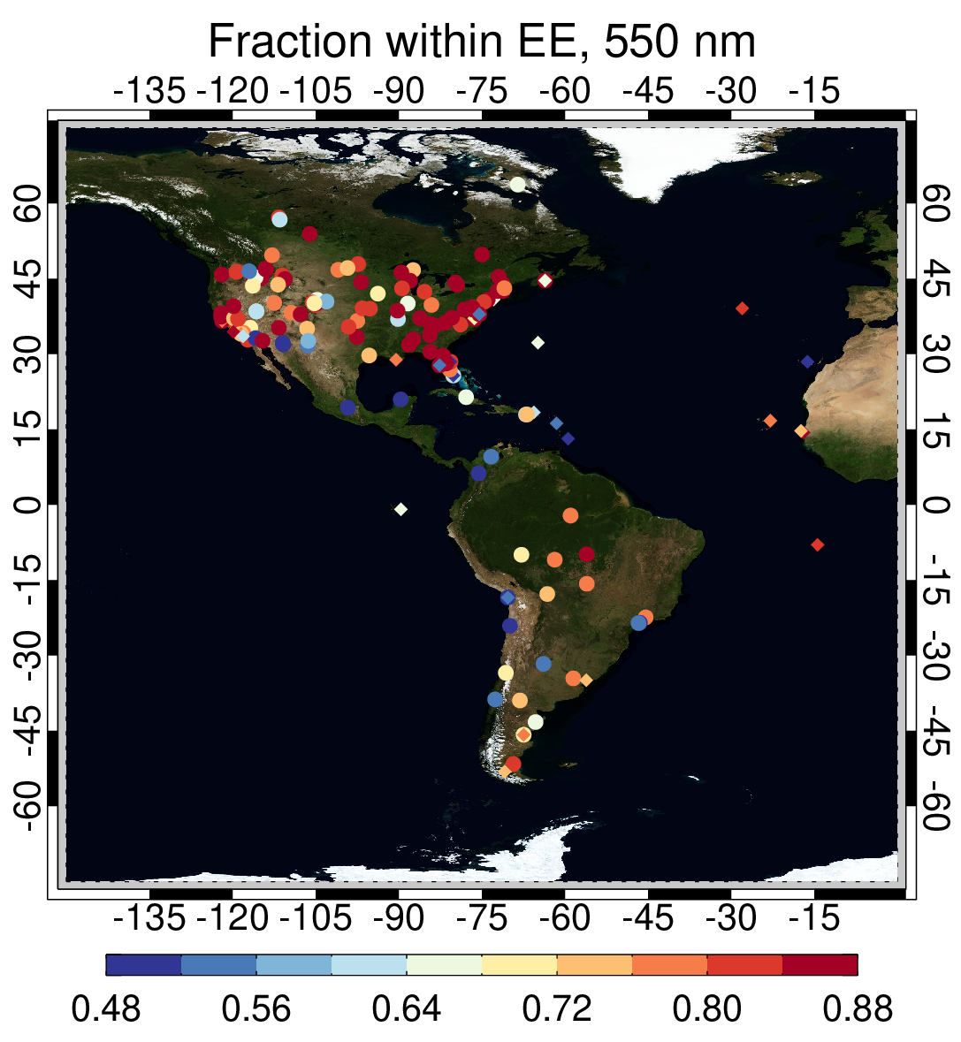
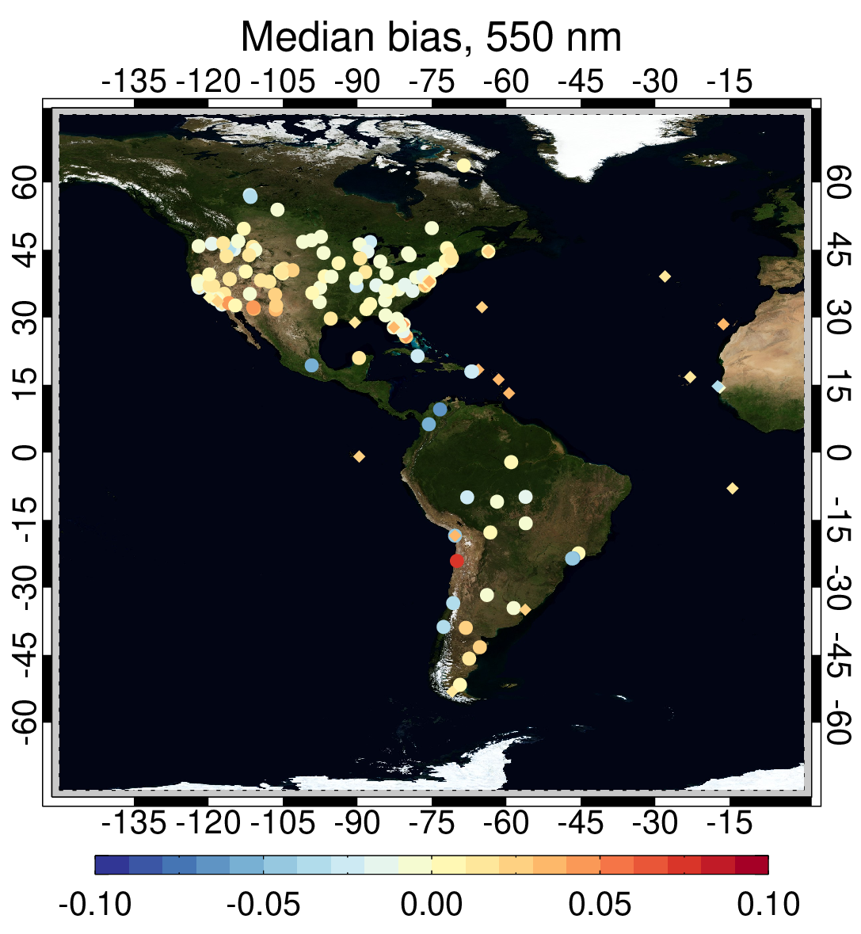
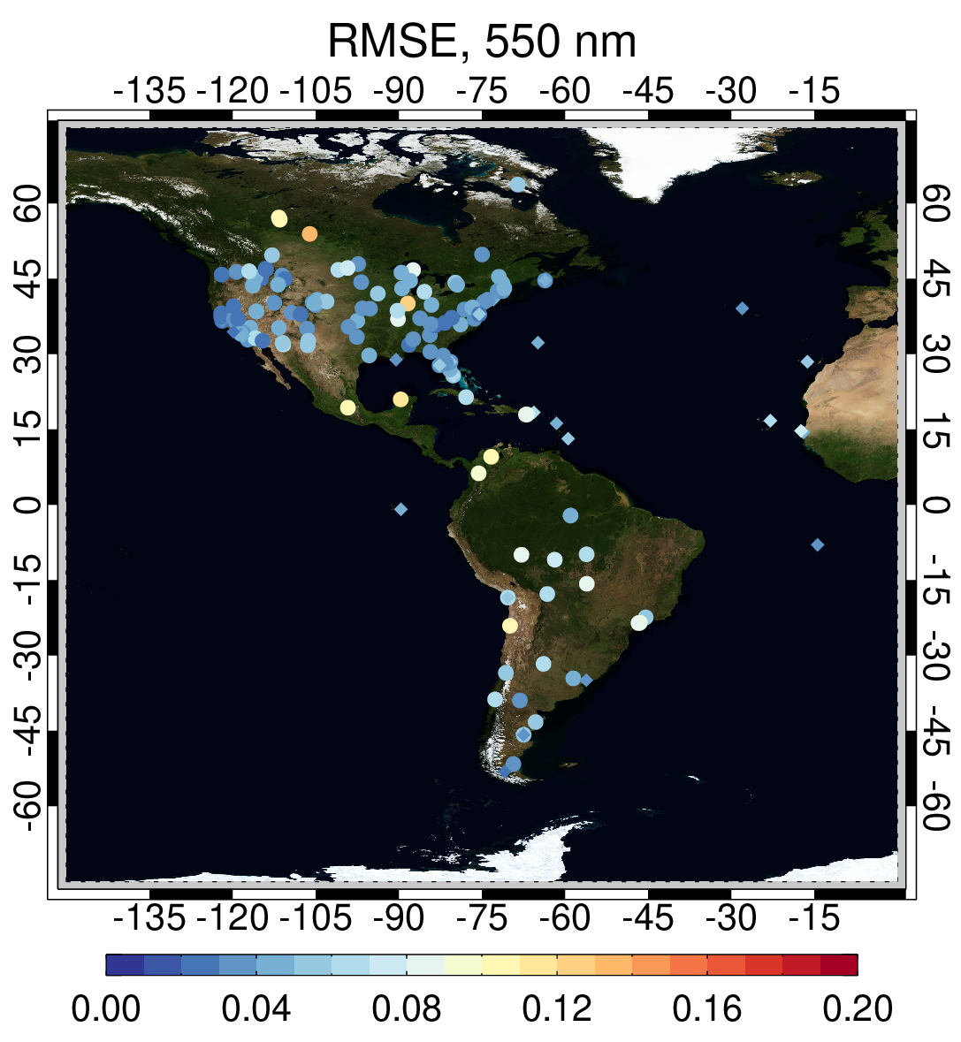
Comparisons of GEO DB AOD against AERONET (ABI/GOES-16)
EE = 0.03+15%
Modified VIIRS V2 algorithm has been applied to GEO sensors (G16/17 ABI and H8 AHI)
Validation statistics of GEO AOD are comparable with VIIRS V2 AOD except for extreme observation angles
One year of GEO demonstration data sets (May 2019 – April 2020) will be released in mid-2023

Slide 11
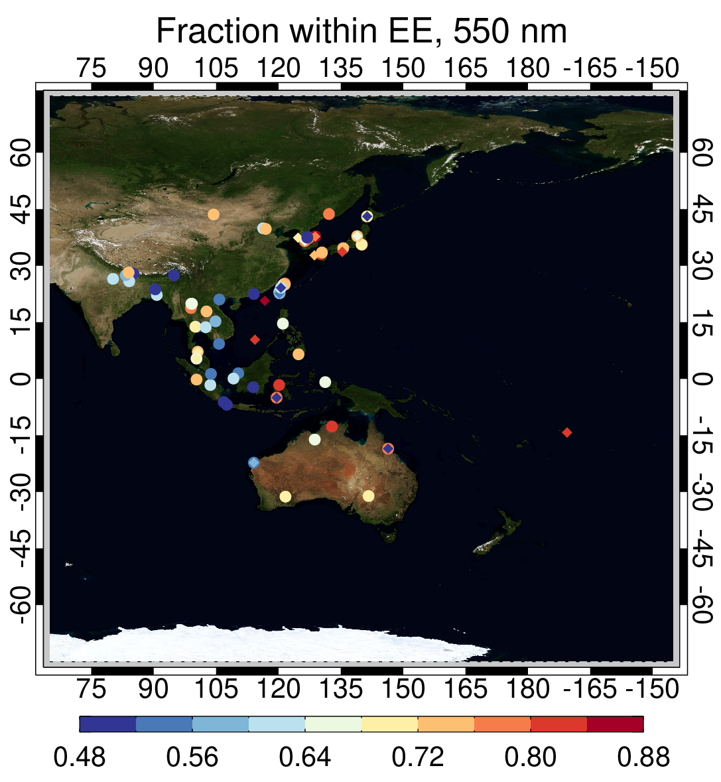
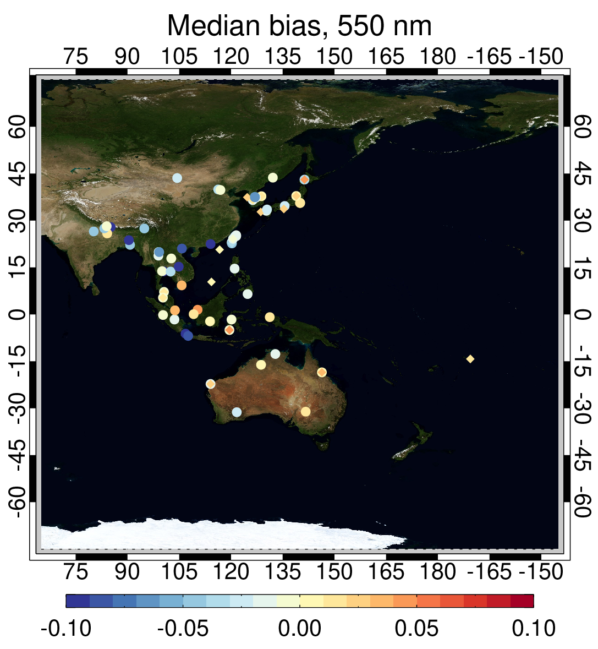
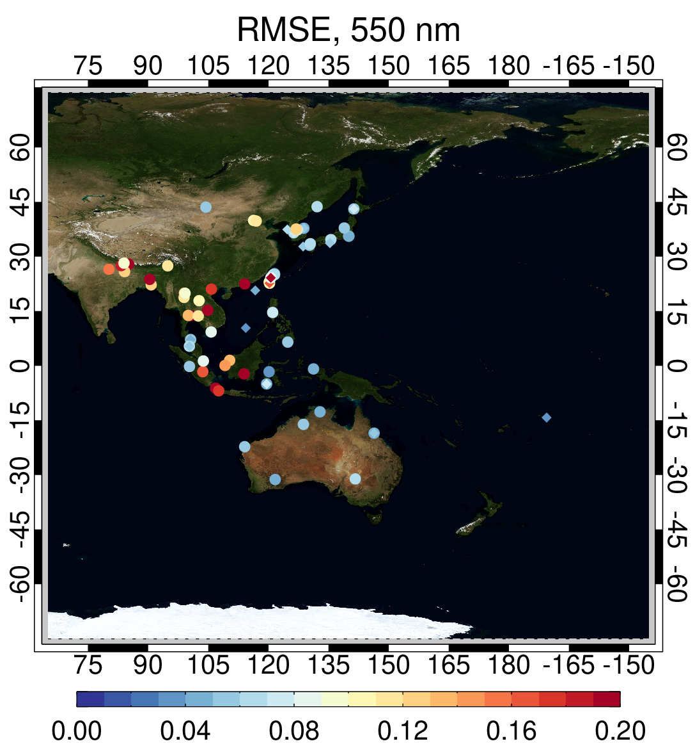
Comparisons of GEO DB AOD against AERONET (AHI/Himawari-8)
EE = 0.03+15%
Modified VIIRS V2 algorithm has been applied to GEO sensors (G16/17 ABI and H8 AHI)
Validation statistics of GEO AOD are comparable with VIIRS V2 AOD except for extreme observation angles
One year of GEO demonstration data sets (May 2019 – April 2020) will be released in mid-2023

Slide 12
Data Consistency: Comparisons of daily LEO/GEO AOD vs AERONET (May 2019-May 2020) .
Alta Floresta (S. America, Biomass Burning)
2019
Appalachian State (eastern US Mountain)
2020
Beijing (eastern China, Urban Pollution+ Transported Dust)
Cape Verde (Ocean site, Transported Saharan Dust)
2019
2020
For more, see our poster: “Geostationary Deep Blue AOD and Multi Sensor L2G/L3 Product” by Kim et al.

Slide 13
Global Merged AOD at 30 min interval from LEO (Terra/Aqua MODIS, SNPP/NOAA20 VIIRS) + GEO (GOES16/17 ABI, Himawari-8 AHI)
Time period: Jan 1-8, 2020, every 30 min.
Heavy smoke plumes generated from the fires over Australia were seen to travel across the entire Southern Hemisphere.
The long-range transport of the Saharan dust clouds were also well captured by the LEO/GEO sensors.

Slide 14
Summary
VIIRS Version 2.0 Deep Blue aerosol products for SNPP and NOAA20 are operational and available at LAADS DAAC and Earthdata (https://earthdata.nasa.gov). Big thanks to A-SIPS and LAADS!!!
Much improved AOD retrieval over high elevation regions and bright surfaces, and for fine-mode aerosols.
The cross-calibration enables the creation of consistent aerosol records using the series of VIIRS as well as the twin MODIS.
Consistent algorithm will be used for MODIS Collection 7 reprocessing and GEO data records.
For more details, see our posters:
“Improved Deep Blue aerosol data records from SNPP/NOAA-20 VIIRS and beyond” by Lee et al.
“Geostationary Deep Blue AOD and Multi Sensor L2G/L3 Product” by Kim et al.

