Slide 1

Review of OBPG
crosscalibration approach
Gerhard Meister
OBPG (Ocean Biology Processing Group)
5/2/2023
MODIS/VIIRS Science Team Meeting, May 2023, College Park, MD
1
1
Notes:
1
1
1
1
monitoring harmful blooms from space gives coastal communities ability to take precautionary measures
fishing bans
beach closures
image shows true color (top) and chlorophyll (bottom) views of bloom in mouth of Mississippi
similar information was used to monitor a red tide bloom off coast of Texas last fall

Slide 2
Background:
OBPG derives large corrections to RVS and polarization for MODIST with a crosscalibration approach, using MODISA as truth
OBPG uses the crosscalibration for MODISA to itself to correct RVS residuals
In the ratio to MOBY in-situ measurements, significant seasonal oscillations are seen for MODISA, but less strong for MODIST
Conundrum: how can the adjusted data (MODIST) be better than the source data (MODISA)?
2
2
Notes:
2
2
2
2

Slide 3
Crosscalibration:
How do we get MODIST ‘true’ TOA radiance L_{t}?
air
aerosol
whitecap
glint
water
gas
L_{t} (λ) = [ L_{r}(λ) + Lª(λ) + tL_{f}(λ) + TL_{g}(λ) + t_{d}(λ) * L^{w}(λ) ] * t_{g}(λ)
from MODISA L3 data (7-day mean)
from MODIST NIR (same pixel);
assumes MCST NIR band characterization
Note: usually, this equation is used to derive the water leaving
radiance L^{w}(λ) from the measured TOA radiance L_{t})

Slide 4
Crosscalibration coefficients:
L_{m}/M₁₁ = L_{t} + m₁₂*Q + m₁₃*U
L_{m}: measured TOA radiance (MODIST)
L_{t}: true TOA radiance (from MODISA)
Q, U : linear Stokes vector components, modeled from Rayleigh and glint
M₁₁, m₁₂, m₁₃ : fitted instrument characterization parameters (depends on band, MS, detector; function of scan angle (4th order polynomial for M₁₁, 2nd order for m₁₂ and m₁₃)
4
Notes:
4
4
4

Slide 5
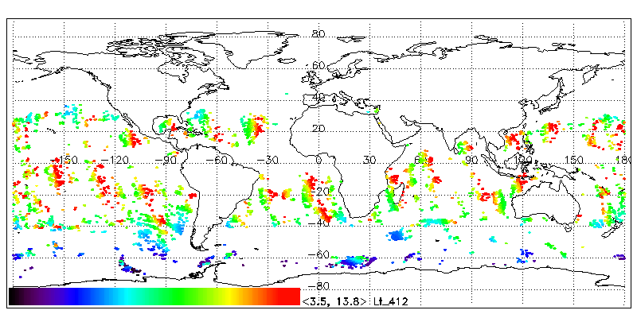
Xcal approach (step 1): select MODIST L_{m} from 1 day
Strict selection criteria (deep water, low chlorophyl,
low AOT, low glint)
5
Notes:
5
5
5

Slide 6
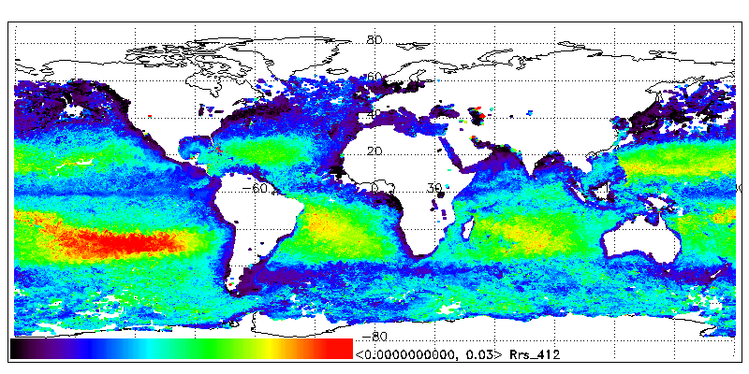
Xcal approach (step 2): use MODISA L3 (7 days) Rrs
Rrs: remote sensing reflectance (BOA, water-leaving reflectance)
6
Notes:
6
6
6

Slide 7

Xcal approach (step 3): Lt (vicarious Lt from L3)
Lt calculated with (see slide 3, L^{w}, from Rrs):
L_{t}(λ) = [ L_{r}(λ) + Lª(λ) + tL_{f}(λ) + TL_{g}(λ) + t_{d}(λ) * L^{w}(λ) ] * t_{g}(λ)
7
Notes:
7
7
7

Slide 8
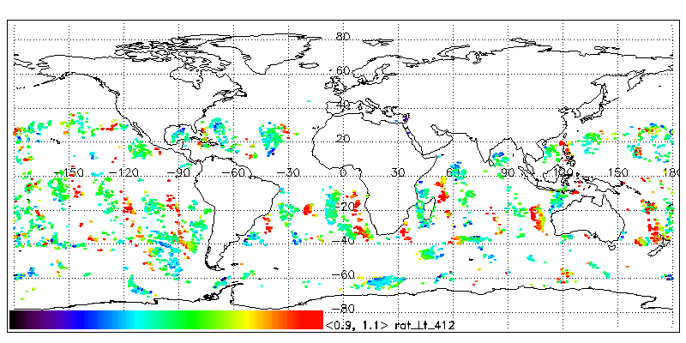
Xcal approach (step 4): Derive M₁₁, m₁₂, m₁₃
M₁₁, m₁₂, m₁₃ calculated with (see slide 4):
L_{m}/M₁₁ = L_{t} + m₁₂*Q + m₁₃*U
8
Notes:
8
8
8

Slide 9
Xcal results: MODISA to SeaWiFS, 412nm
Solid/dashed: mirror side 1/2; colors: detectors 1-10
Eval version 61b, 3-month smoothing
Seasonal oscillations in all 3 parameters (6% for m₁₃,
BOS) , but no trend
9
Notes:
9
9
9

Slide 10
Xcal results: MODISA to SeaWiFS, 547nm
Eval version 61b, 3-month smoothing
Seasonal oscillations in all 3 parameters, but no trend.
MODISA uses prelaunch for operational processing.
10
Notes:
10
10
10

Slide 11
Xcal results: MODIST to MODISA, 412nm
Operational v2.4b, 3-month smoothing
Seasonal oscillations in all 3 parameters,
strong trend in m₁₂
11
Notes:
11
11
11

Slide 12
Xcal results: MODIST to MODISA, 547nm
Operational v2.4b, 3-month smoothing
Seasonal oscillations in all 3 parameters,
obvious trends, but not large.
12
Notes:
12
12
12

Slide 13
Xcal results: MODISA to itself, 412nm
Operational v2.8d, 1-year smoothing
13
Notes:
13
13
13

Slide 14
Xcal results: MODISA to itself, 547nm
Operational v2.8d, 1-year smoothing
14
Notes:
14
14
14

Slide 15
Xcal: MODISA to itself, 412nm, no detrending
Eval v2.7e, M₁₁ with 1-year smoothing; m₁₂ and m₁₃
from xcal to SeaWiFS, mission average
Similar polarization sensitivity (m₁₂) at beginning and
end of scan. Prelaunch: increase with HAM AOI
15
Notes:
15
15
15

Slide 16
Xcal: MODISA to itself, 547nm, no detrending
Eval v2.7e, M₁₁ with 1-year smoothing; m₁₂ and m₁₃
from xcal to SeaWiFS, mission average
16
Notes:
16
16
16

Slide 17
Xcal results: MODISA to SeaWiFS, 412nm
Eval version 61e: mission average M₁₁, m₁₂ and m₁₃
Similar polarization sensitivity (m₁₂) at beginning and
end of scan. Prelaunch: increase with HAM AOI
17
Notes:
17
17
17

Slide 18
Xcal results: MODISA to SeaWiFS, 547nm
Eval version 61e: mission average M₁₁, m₁₂ and m₁₃
18
Notes:
18
18
18

Slide 19
Xcal results: MODIST to SeaWiFS, 412nm
Eval version 26b, 3-month smoothing
Seasonal oscillations in all 3 parameters
19
Notes:
19
19
19

Slide 20
Xcal results: MODIST to SeaWiFS, 547nm
Eval version 26b, 3-month smoothing
Seasonal oscillations in all 3 parameters
20
Notes:
20
20
20

Slide 21
MODIST and MODISA to SeaWiFS, 412nm
Seasonal oscillation opposite in phase for m₁₃, end of scan;
Larger variation in MODISA, BOS, m₁₂ and m₁₃, than MODIST.
MODISA M₁₁ oscillation EOS should improve MOBY ratio.
21
Solid line: MODIST; dashed line: MODISA; only mirror side 1
Notes:
21
21
21

Slide 22
MODIST and MODISA to SeaWiFS, 547nm
Similar variation for m₁₃, end of scan (not opposite in phase).
Larger variation in MODISA, BOS, m₁₂ and m₁₃, than MODIST.
MODISA M₁₁ oscillation EOS should improve MOBY ratio.
22
Solid line: MODIST; dashed line: MODISA; only mirror side 1
Notes:
22
22
22

Slide 23
Summary:
Xcal of MODISA to SeaWiFS shows no large polarization sensitivity trend over time (until 2011).
Xcal of MODIST to MODISA shows very large polarization sensitivity trends over time for MODIST in the blue bands. Correcting for these changes improves the agreement of MODIST ocean color products with MODISA and SeaWiFS, so these long term trends are likely real changes of the MODIST instrument polarization sensitivity.
Both xcals (and xcal of MODIST to SeaWiFS) show large seasonal oscillations in polarization sensitivity (with opposite phase for 412nm end of scan) that are very unlikely to be actual changes of the instrument polarization sensitivity.
Xcal of MODISA to SeaWiFS shows seasonal oscillations in M₁₁, on the order of 1% at 412nm. Although there are potential mechanisms for such an oscillation (e.g. temperature sensitivity, linearity), these are unlikely to be the reasons for the oscillation.
Xcal of MODIST to SeaWiFS has smaller oscillations than MODISA to SeaWiFS (until 2005).
Good!
???
23
23
Notes:
23
23
23
23

Slide 24
Backup
24
Notes:
24
24
24

Slide 25
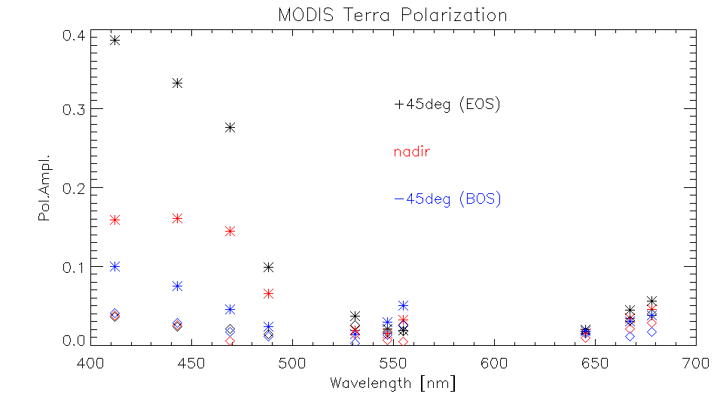
Xcal results: Max. Polarization Amplitude
Stars: mission max. (as of 2014)
Diamonds: beginning of mission
25
Notes:
25
25
25

